Slide 1
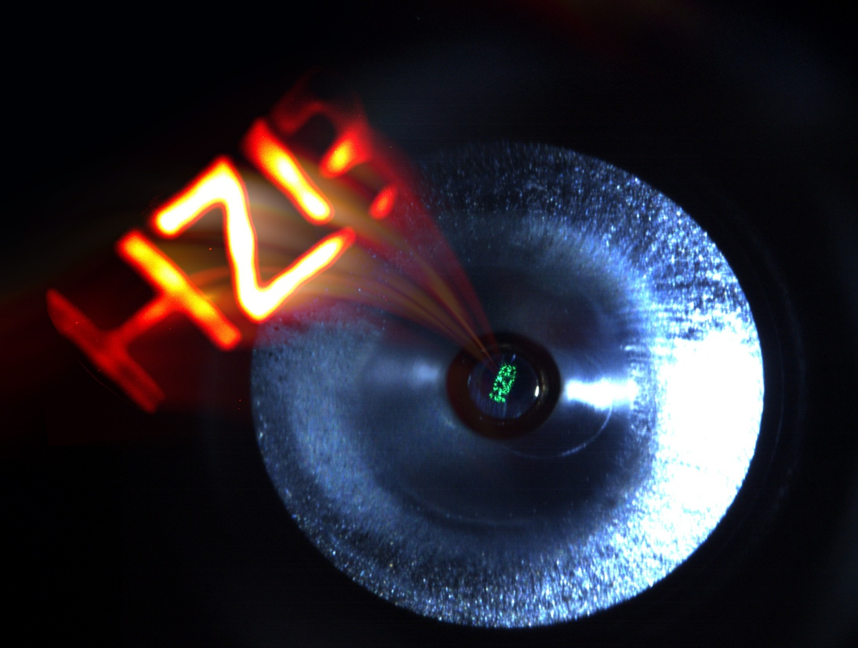
Na-K-Sb photocathode operation in an SRF photoinjector
Results, lessons learned & outlook
Photocathode for Accelerator Science in Europe 2026
September 21, 2026, Orsay, IJCLAB, France
Jonas Dube
P3 Workshop
2025

Slide 2
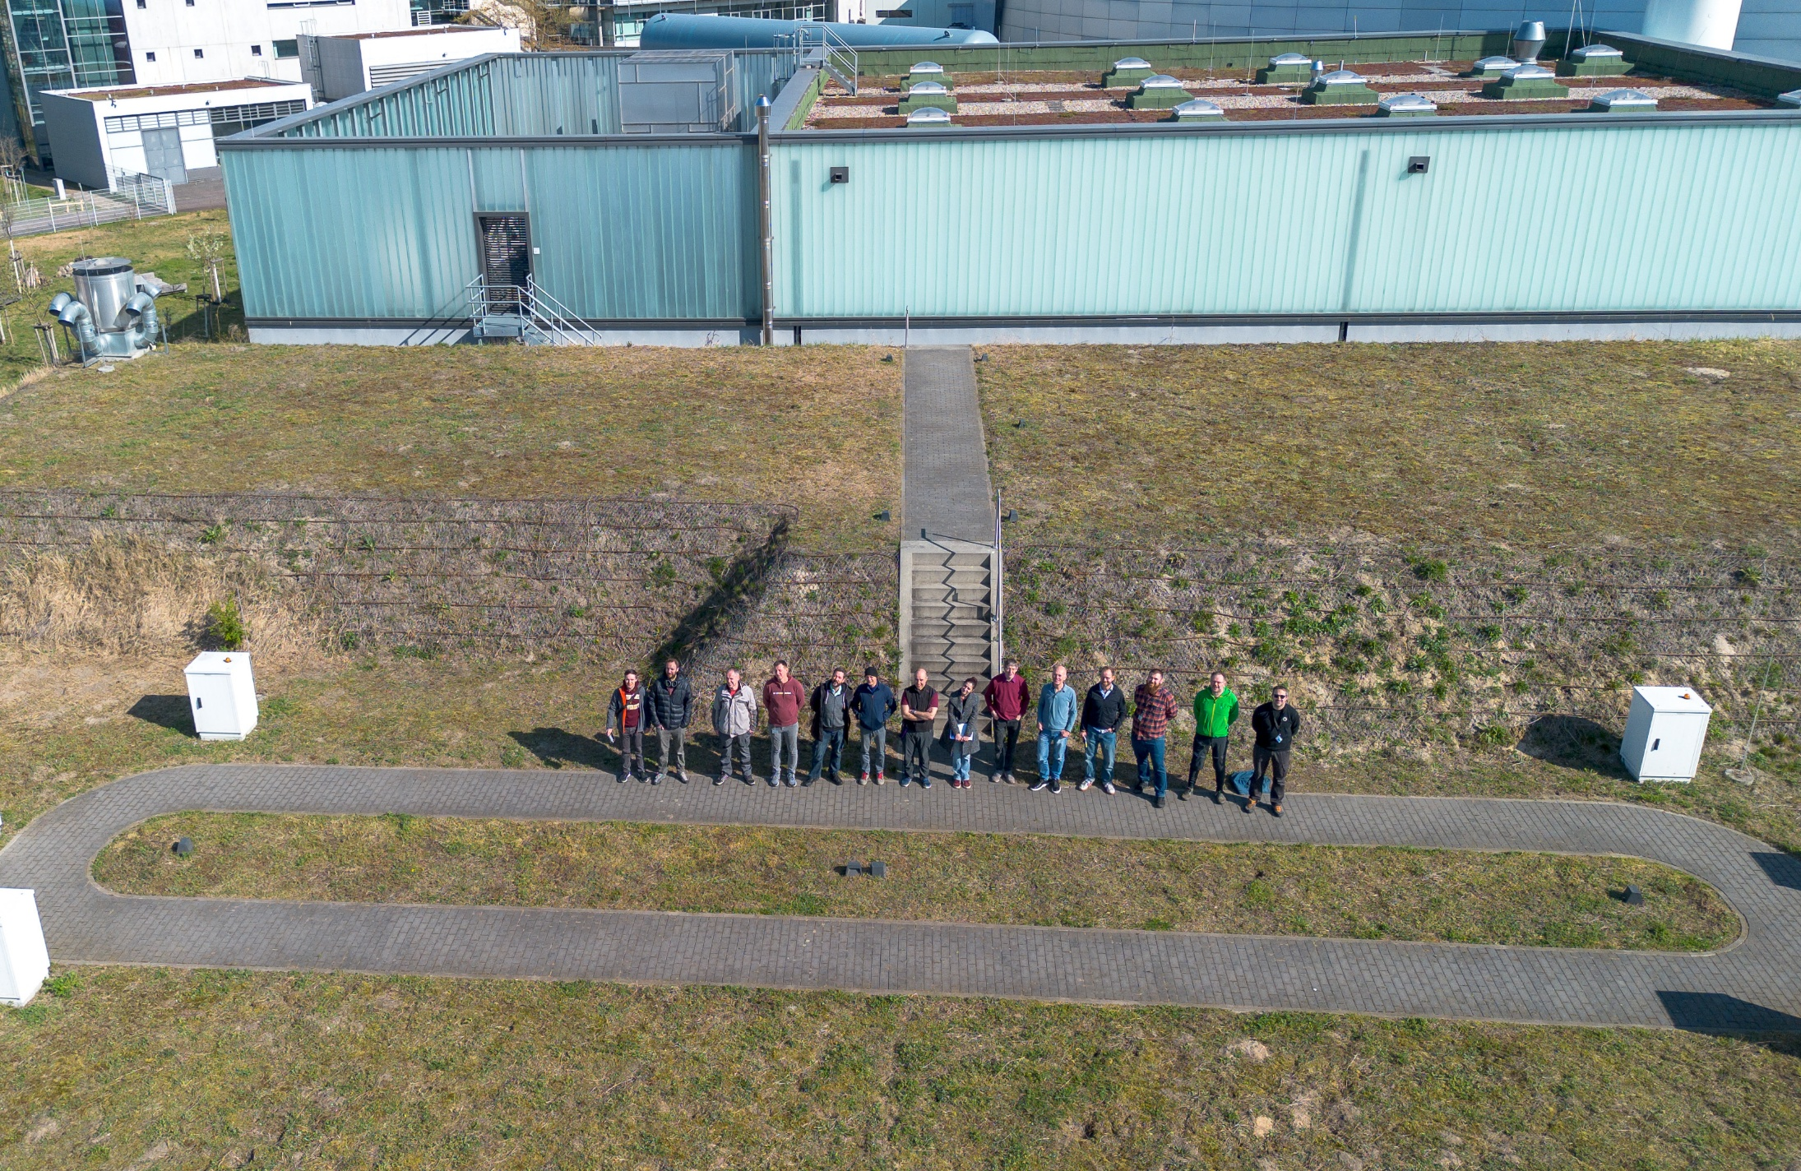
Thank you for your support!
Thanks to the support of the photocathode community we got the possibility for a final SEALab run in Q2 2026

Slide 3
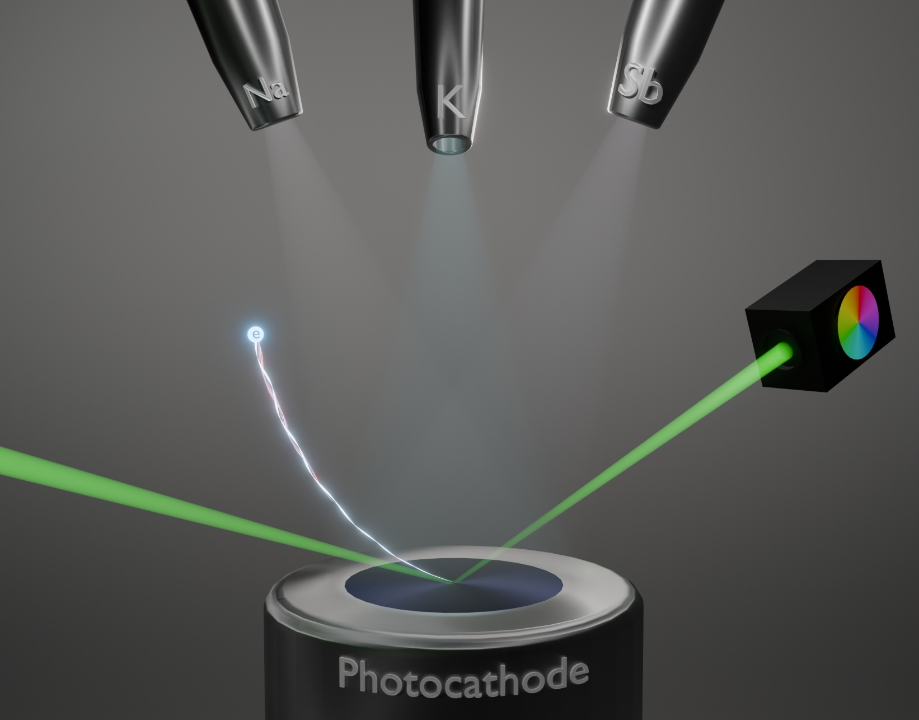
Na-K-Sb photocathodes for SEALab
Na-K-Sb photocathodes promising candidate for high-brightness applications
High QE, low intrinsic emittance, improved thermal stability and lifetime compared to Cs-K-Sb
Improved SRF compatibility expected due to lack of Cs
Triple evaporation growth for more homogeneous and reproducible photocathodes [1]
Fig 1: Triple evaporation growth procedure
[1] Wang, C., et al. "Triple evaporation growth of sodium–potassium–antimonide thin films as photoemission source for electron accelerators." Journal of Physics D: Applied Physics 59.7 (2026): 075102.

Slide 4
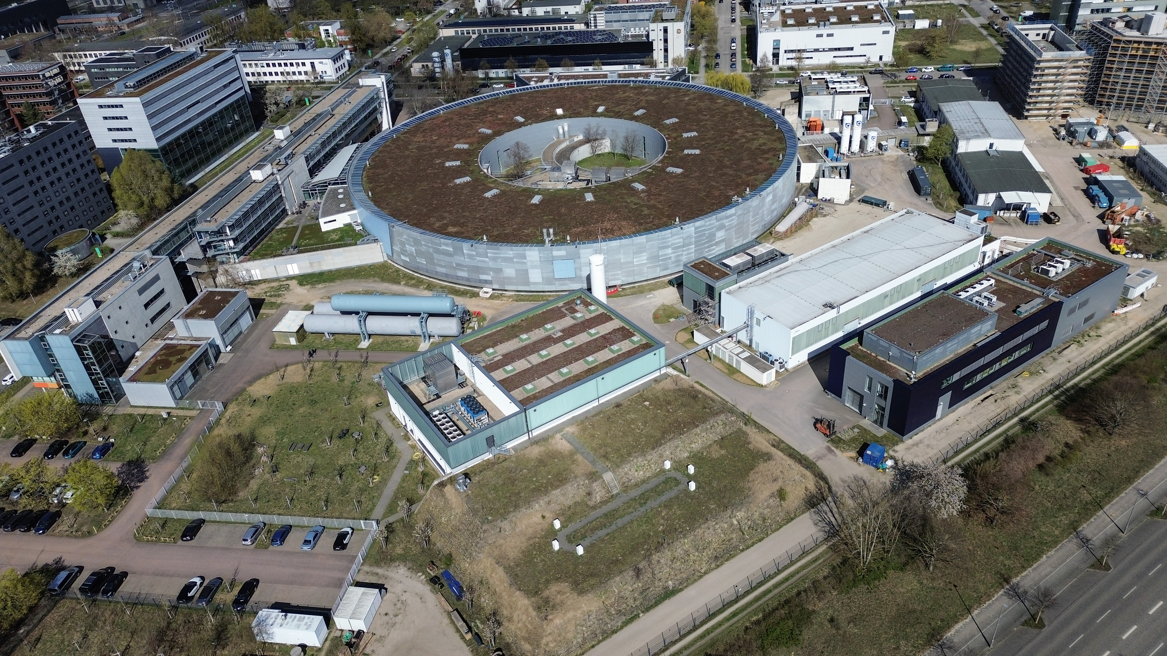
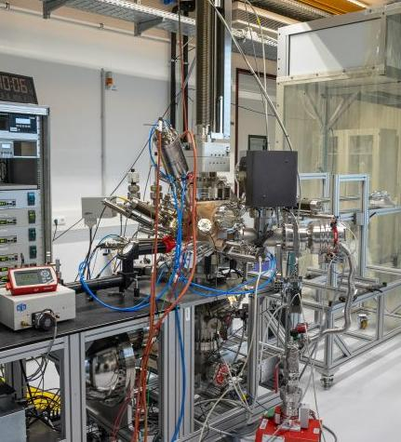
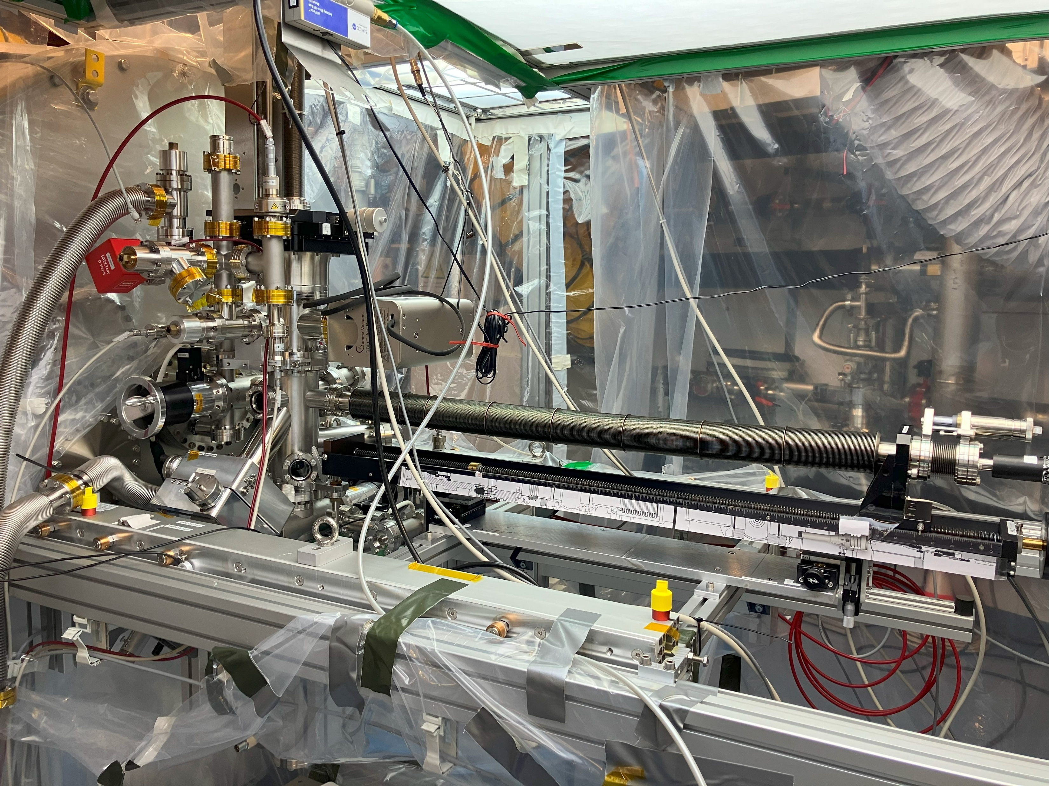
Photocathode Lab (QE #1)
Transfer system + Gun (QE #2 & #3)

Slide 5
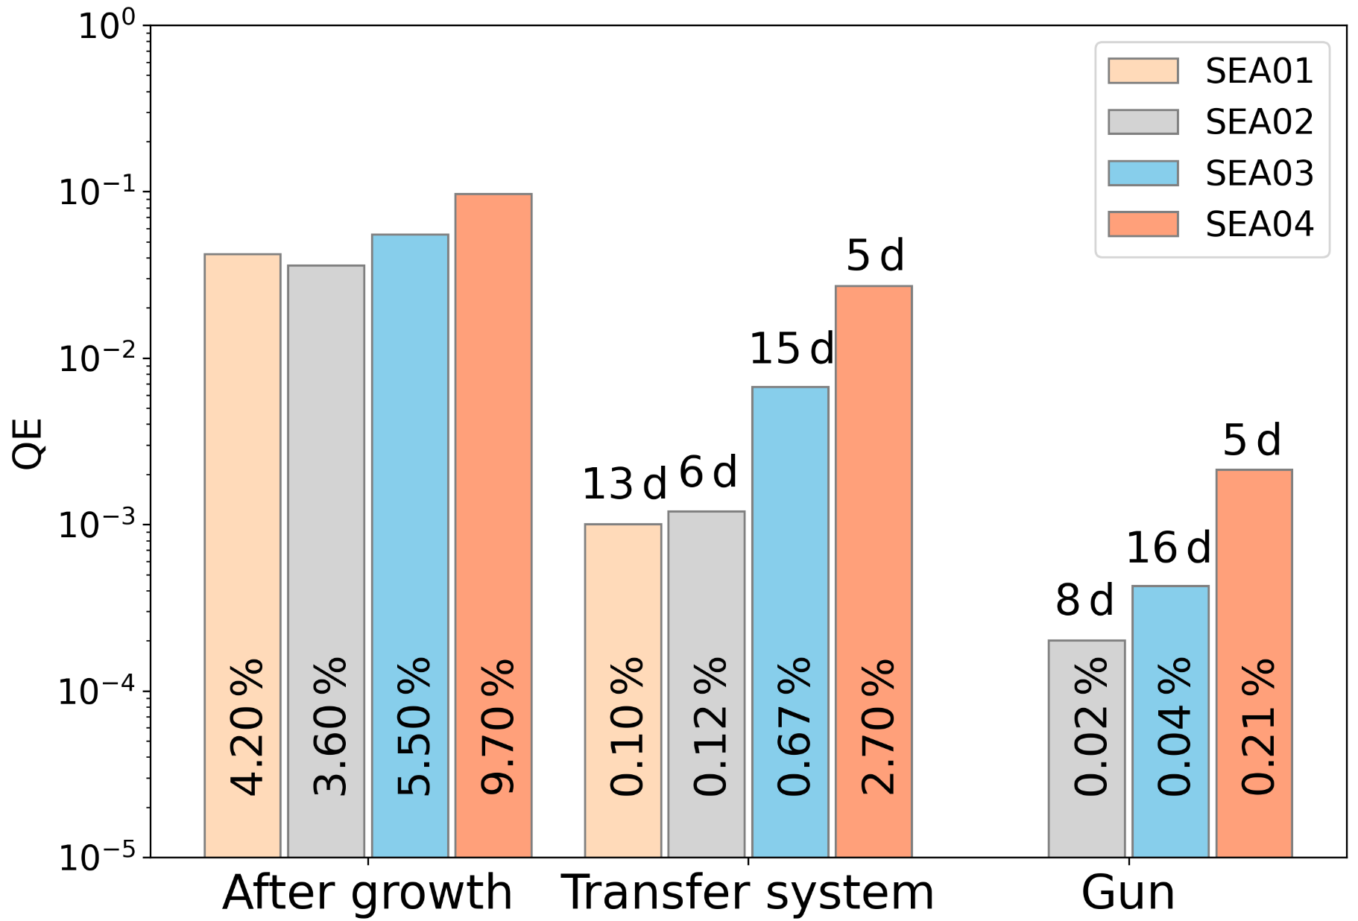
Na-K-Sb photocathodes for SEALab
> 5 % regularly achieved, highest QE close to 10 %
(at 520 nm)
Strong degradation between preparation and operation
Improved by one order of magnitude due to recipe optimization and vacuum improvement
QE #1
QE #2
QE #3
Fig 2: Overview of the 4 photocathodes prepared for SEALab

Slide 6
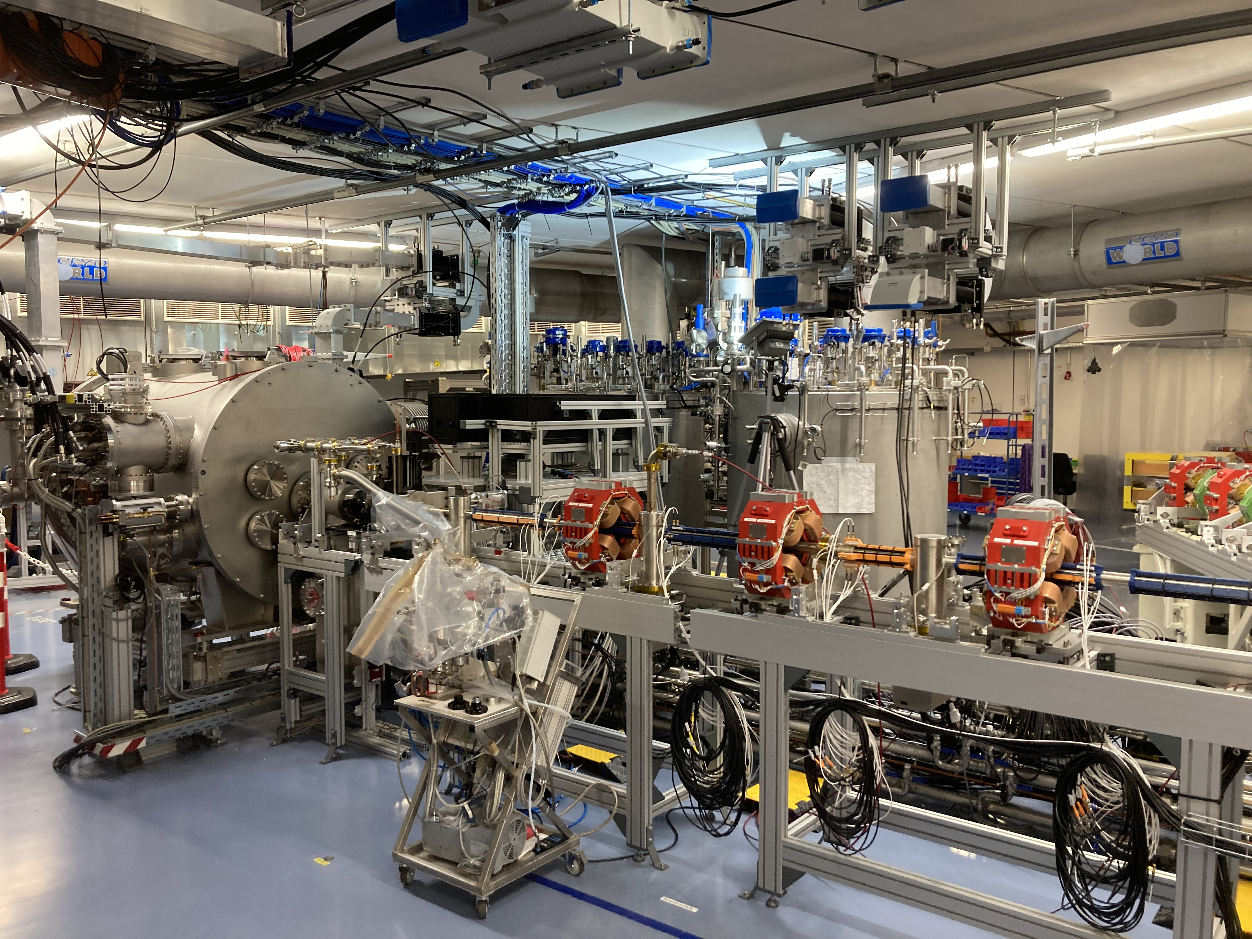
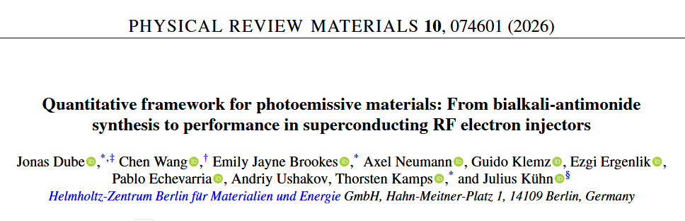
Na-K-Sb photocathodes for SEALab
Fig 3: The SEALab photoinjector
First operation of Na-K-Sb photocathodes in an SRF photoinjector in 2025
Low field emission
No multipacting (at 3 kV DC bias at cathode insert)
Results of the first two runs published [2]

Slide 7
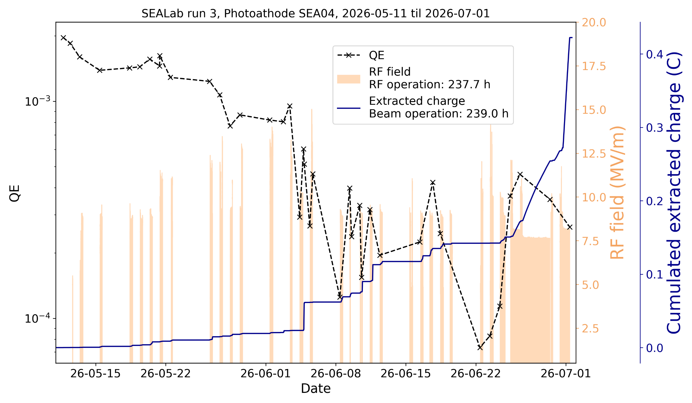
The final SEALab run (May – July 2026)
About 240 h of RF and beam operation
~0.42 C total extracted charge
Photocathode QE can recover → already observed during first run, this time detailed investigations
Investigation of photocathode parameters (QE, MTE, threshold energy)
Fig 4: Overview of the final SEALab run with the photocathode SEA04. The QE, RF operation and extracted charge is shown.

Slide 8
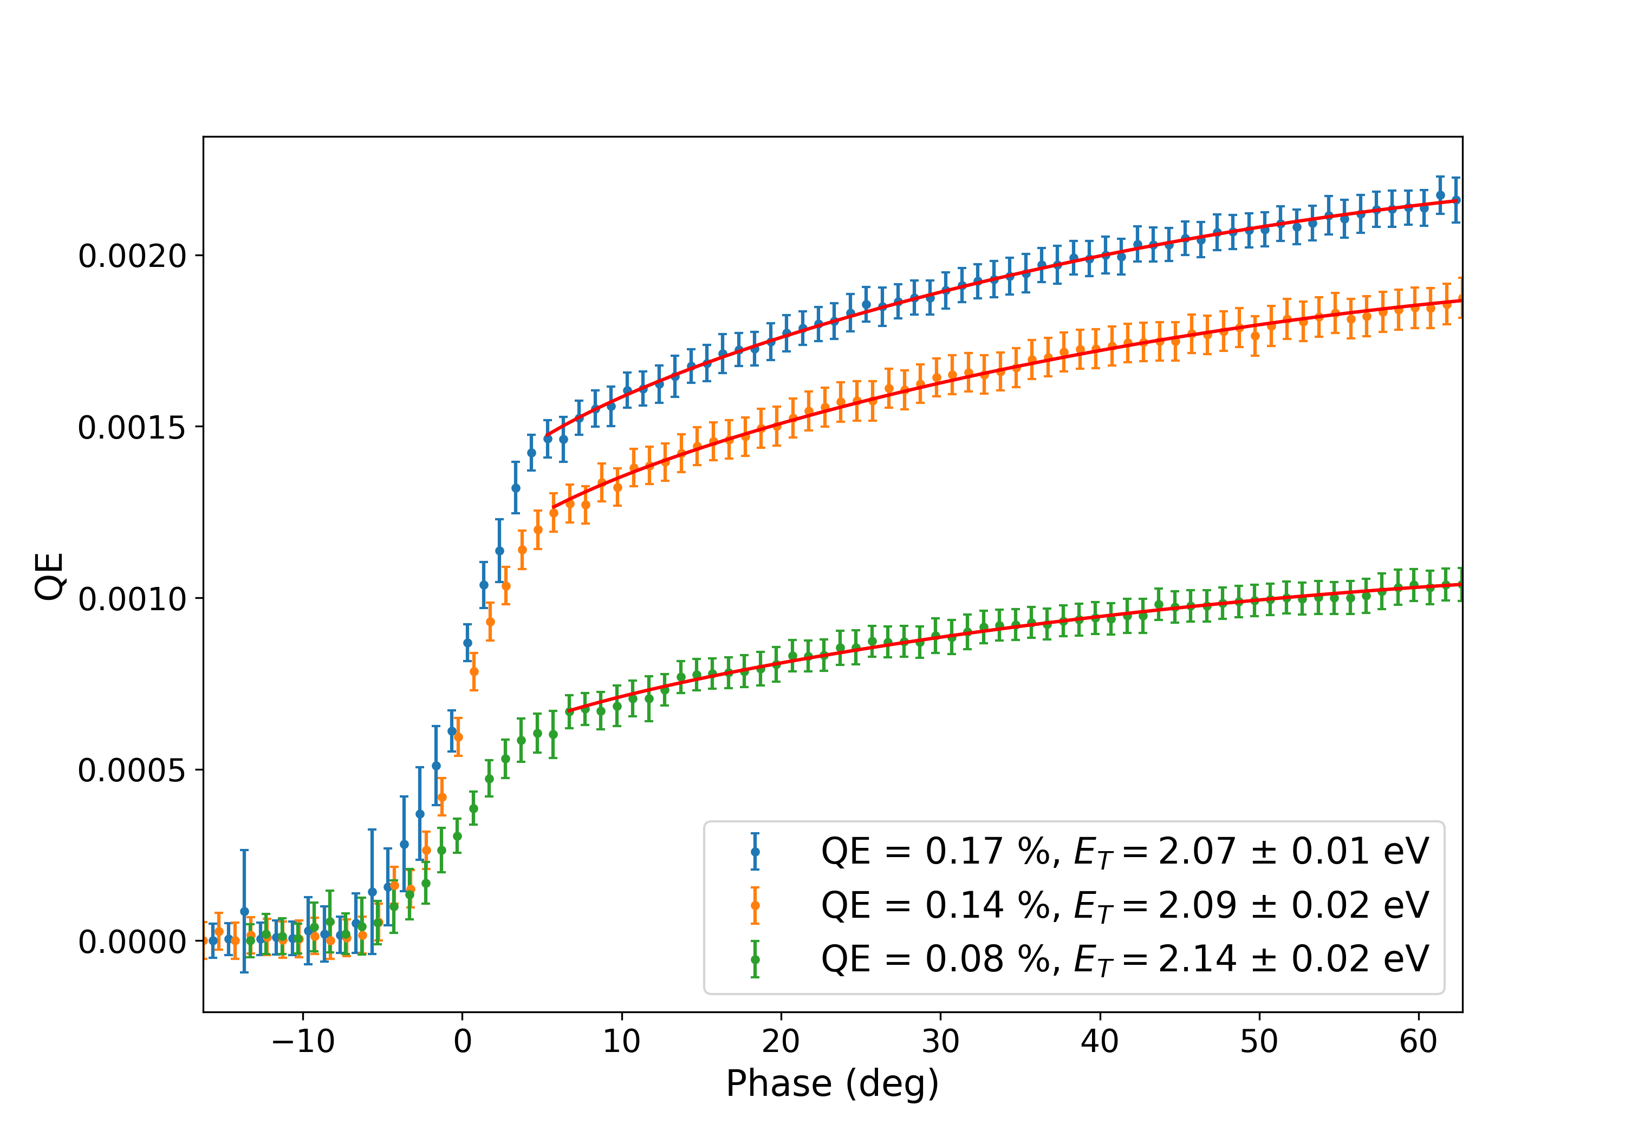
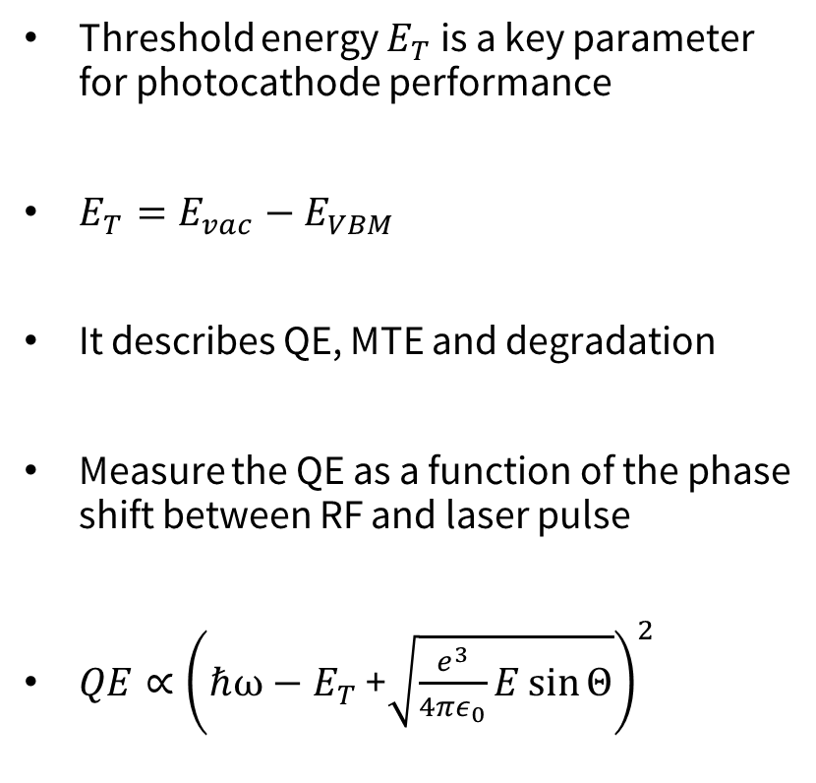
Threshold energy - Schottky scans
Threshold energy $E_{T}$ is a key parameter for photocathode performance
$E_{T}=E_{vac}−E_{VBM}$
It describes QE, MTE and degradation
Measure the QE as a function of the phase shift between RF and laser pulse
$QE∝{\left(\text{ℏ}ω−E_{T}\text{ +}\sqrt{\frac{e^{3}}{4πε_{0}}E\sin{Θ}}\right)}^{2}$
Fig 5: Schottky scans (RF-laser phase scans) are used to determine the threshold energy in the photoinjector. A clear correlation between threshold energy and QE can be seen.
Known
Fit
Vary

Slide 9
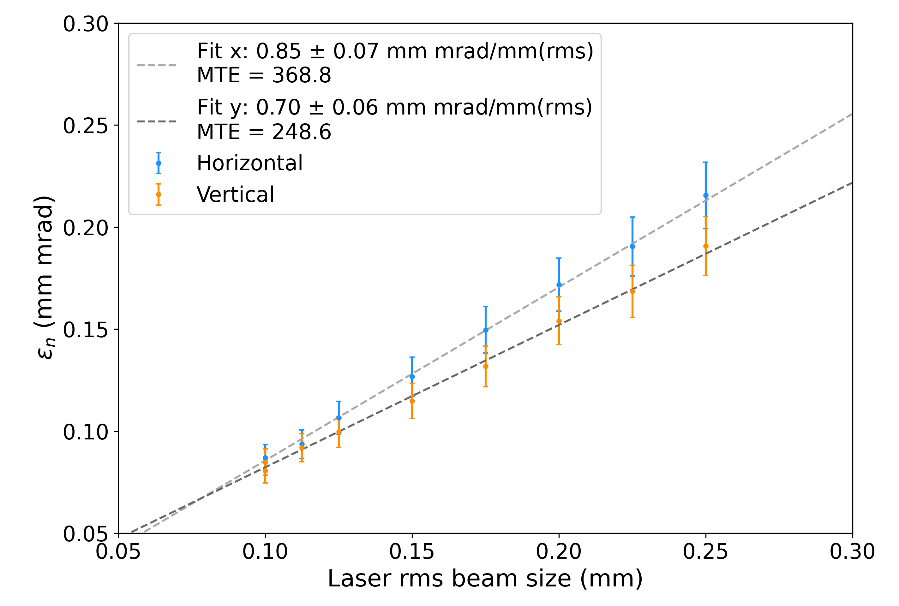
Intrinsic emittance
Normalized emittance measured by solenoid scans for different laser spot sizes
Very good linearity with MTE = 368.8 meV (horizontal) and 248.6 meV (vertical)
Emittance growth by a factor of 2-3 compared to expected value from threshold energy,
→ Contributions from aberrations from RF, and solenoid
Fig 6: The thermal emittance/MTE of the photocathode SEA04 was measured by solenoid scans in the photoinjector of SEALab

Slide 10
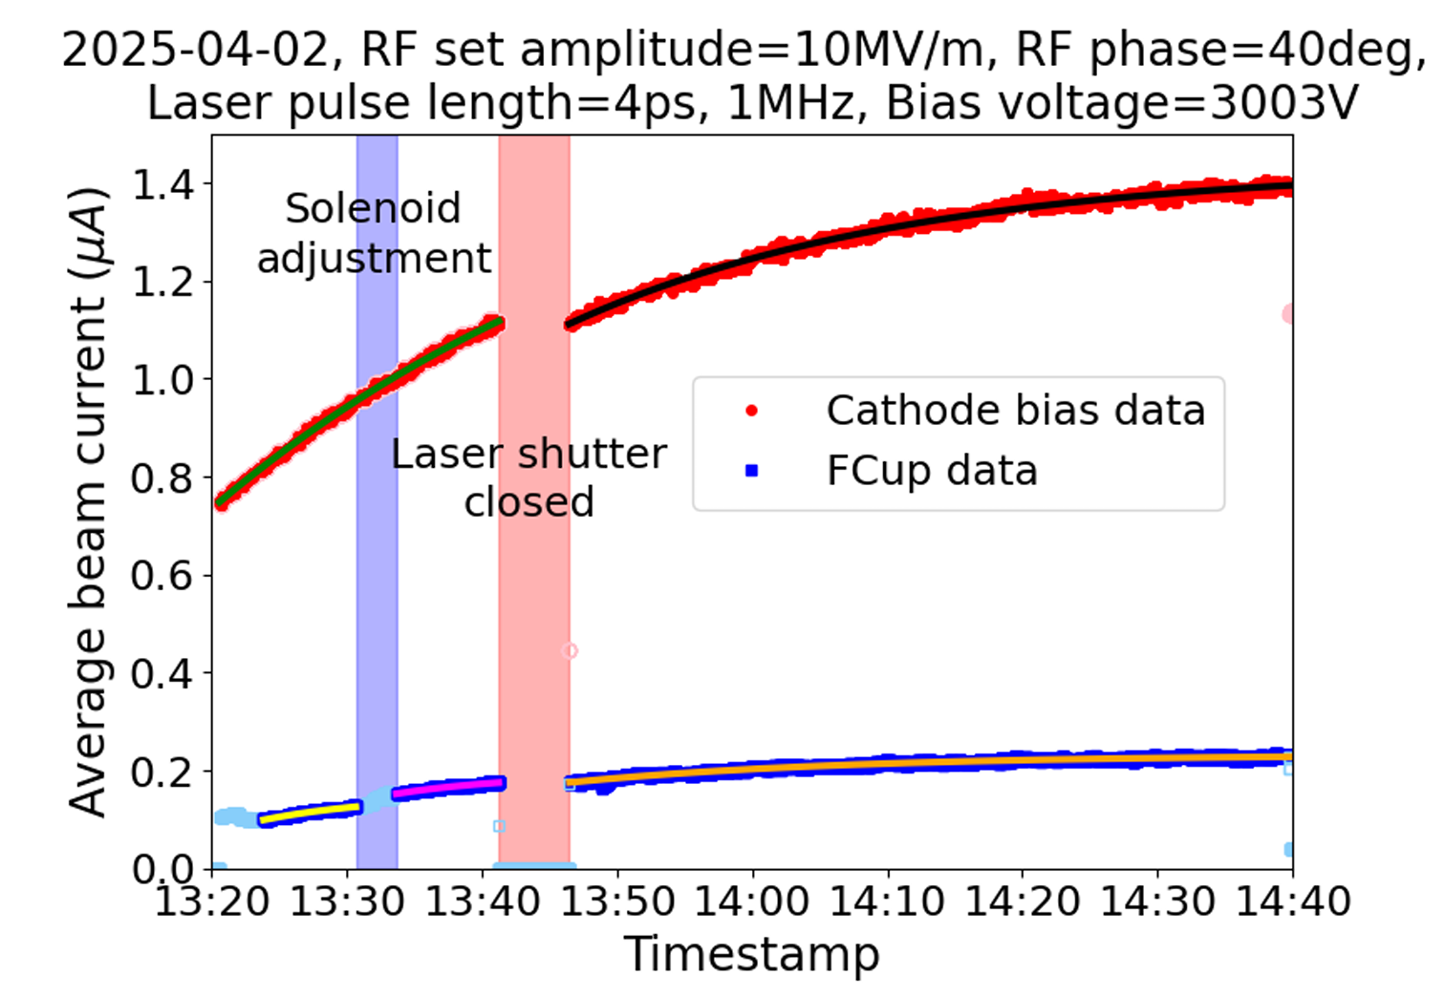
Photocathode Recovery
First observed during first SEALab run [3]
QE increases over time during beam operation
It was not increasing with the laser shutter closed
Detailed investigations during the last run
Fig 7: First evidence of QE recovery of the photocathode SEA02 during the first run of SEALab. The effect only occurs with laser shutter open.
[3] Kamps et al. "First beam commissioning of the HZB SRF photoelectron gun." Proc. IPAC’25. 2025.

Slide 11
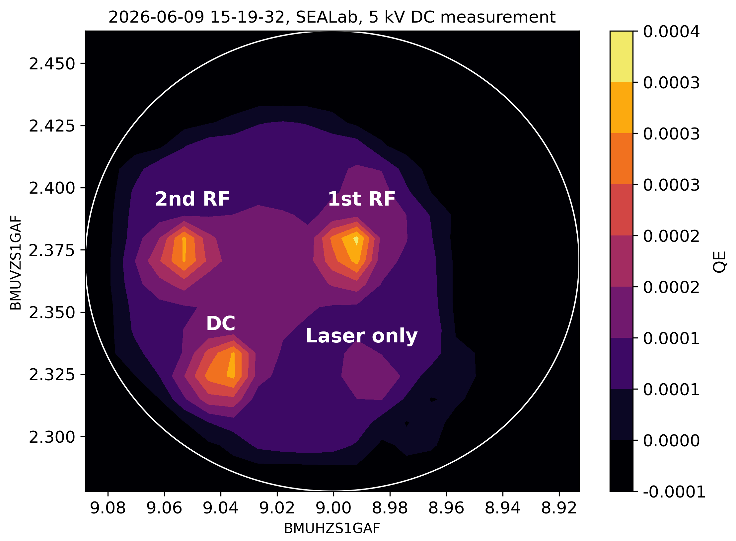
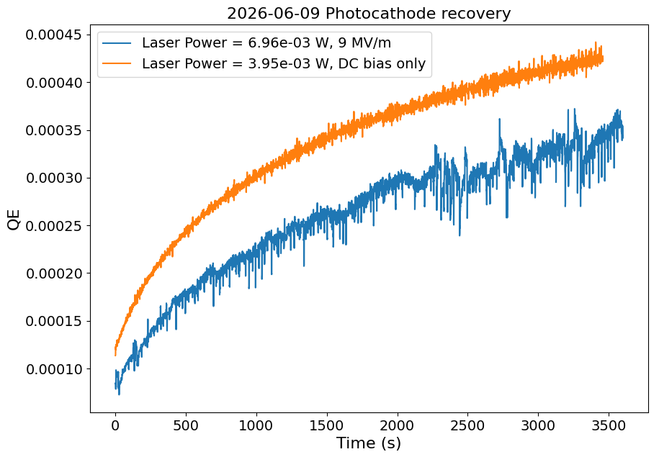
Photocathode Recovery
With RF + laser → beam operation: Strong recovery
With DC + laser → electron extraction: Strong recovery
With laser only → no electron extraction: No recovery
(Very little recovery in map probably just from the measurement itself)
Photocathode QE increasing during operation
The effect is very local at the emission point
No recovery with laser only
→ We can exclude thermal effects
Fig 8: (top) QE map after recovery studies; (bottom) QE recovery curves for DC and RF operation

Slide 12
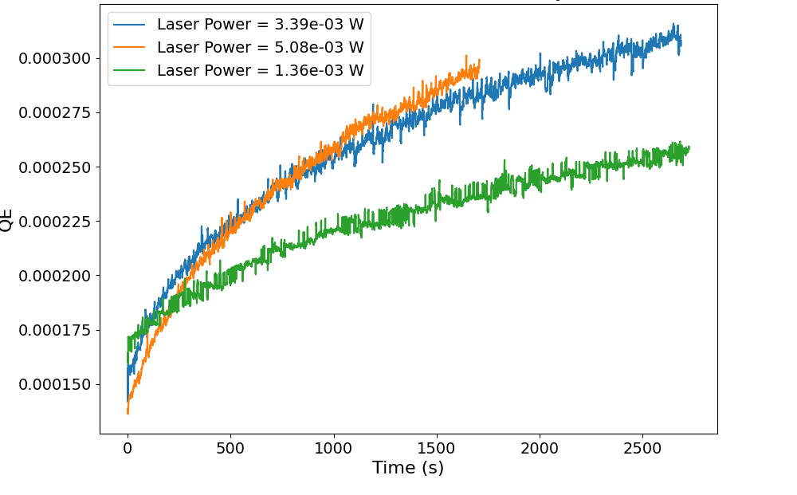
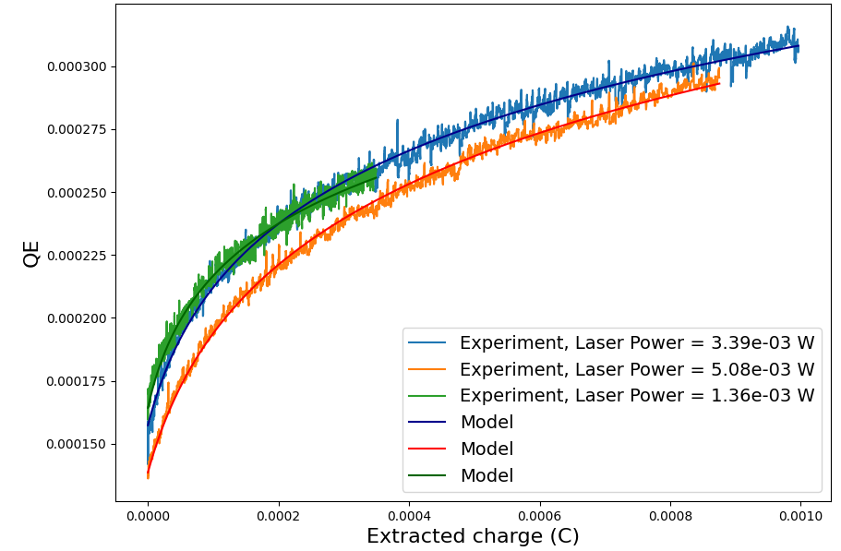
Photocathode Recovery
Variation of the laser power showed that recovery is a function of charge, not of time
Based on the observations a theoretical model was developed
Fig 9: (left) QE recovery curves with different laser powers plotted against time; (right) same data plotted against cumulated extracted charge. A model was developed and is in good agreement with the experimental data

Slide 13
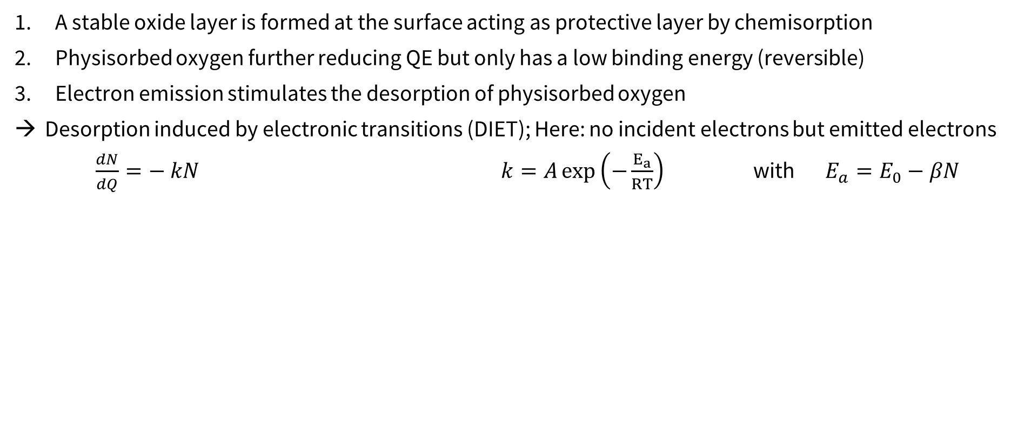
Photocathode Recovery
A stable oxide layer is formed at the surface acting as protective layer by chemisorption
Physisorbed oxygen further reducing QE but only has a low binding energy (reversible)
Electron emission stimulates the desorption of physisorbed oxygen
Desorption induced by electronic transitions (DIET); Here: no incident electrons but emitted electrons
$\frac{dN}{dQ}=− kN$ $k=A\exp\left(−\frac{E_{a}}{RT}\right)$ with $E_{a}=E_{0}−βN$
Exp. decay
Arrhenius eq.
O
O
e
O
O
O
O
O
O
O
O
O
O
O
O
e
e
O
O
O
O
O
O
O
O
O
O
O
O
“Mixed-Oxide”
“Mixed-Oxide”
“Mixed-Oxide”
Photocathode
Photocathode
Photocathode
Photocathode
Fresh Photocathode
Chemisorption
Strong degradation,
High binding energy
Physisorption
Low binding energy, reversible
Desorption
Stimulated by electronic transitions

Slide 14
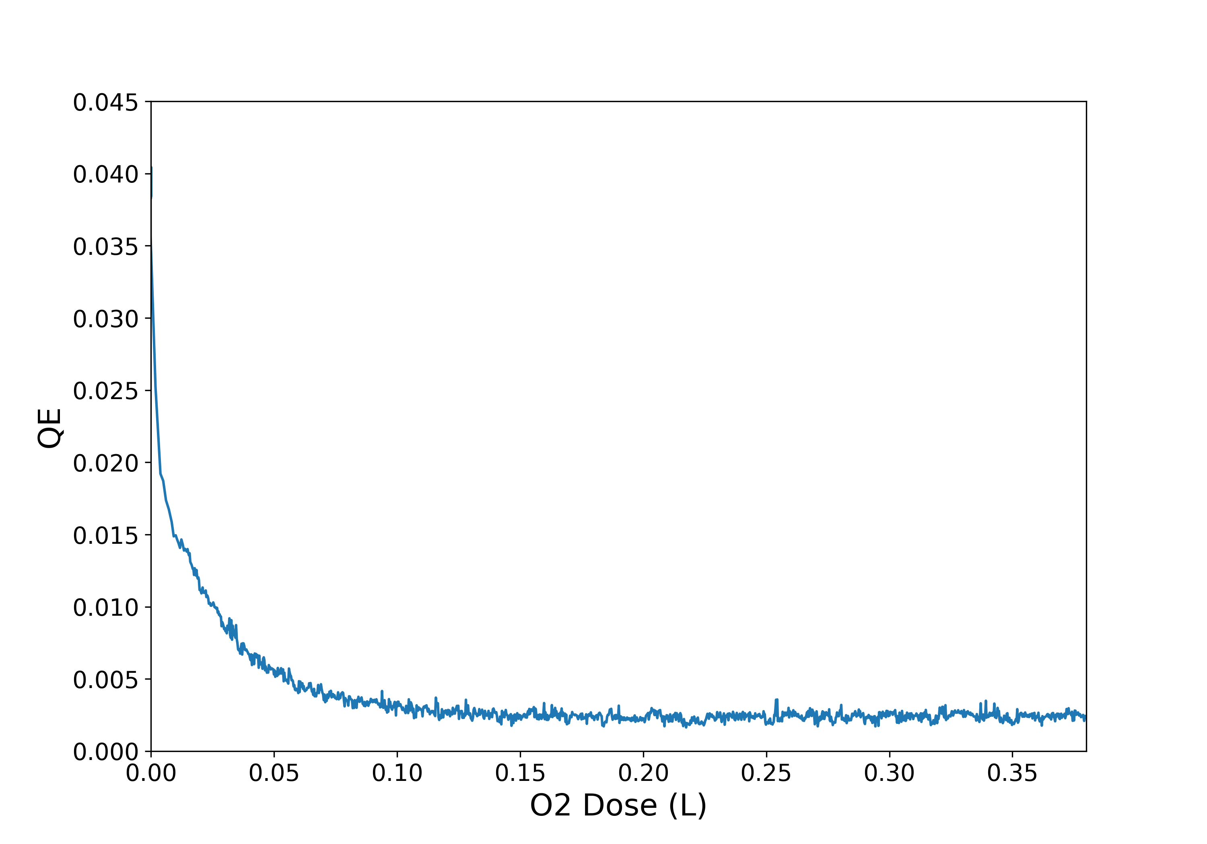
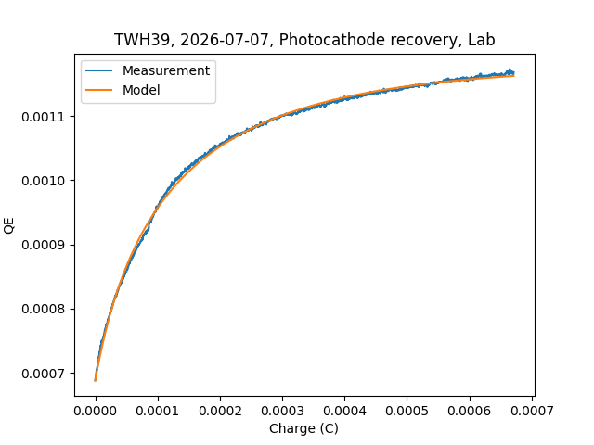
Photocathode Recovery
The effect was reproduced under clean lab conditions with an O2 poisoned photocathode
Clean degradation mechanism, photocathode did not experienced other effects like transfer, EBB, high fields, cool down, …
Fig 10: (left) A photocathode was degraded by pure O2 poisoning; (right) the QE was recovered by electron extraction. The curve again follows the theoretical model.

Slide 15
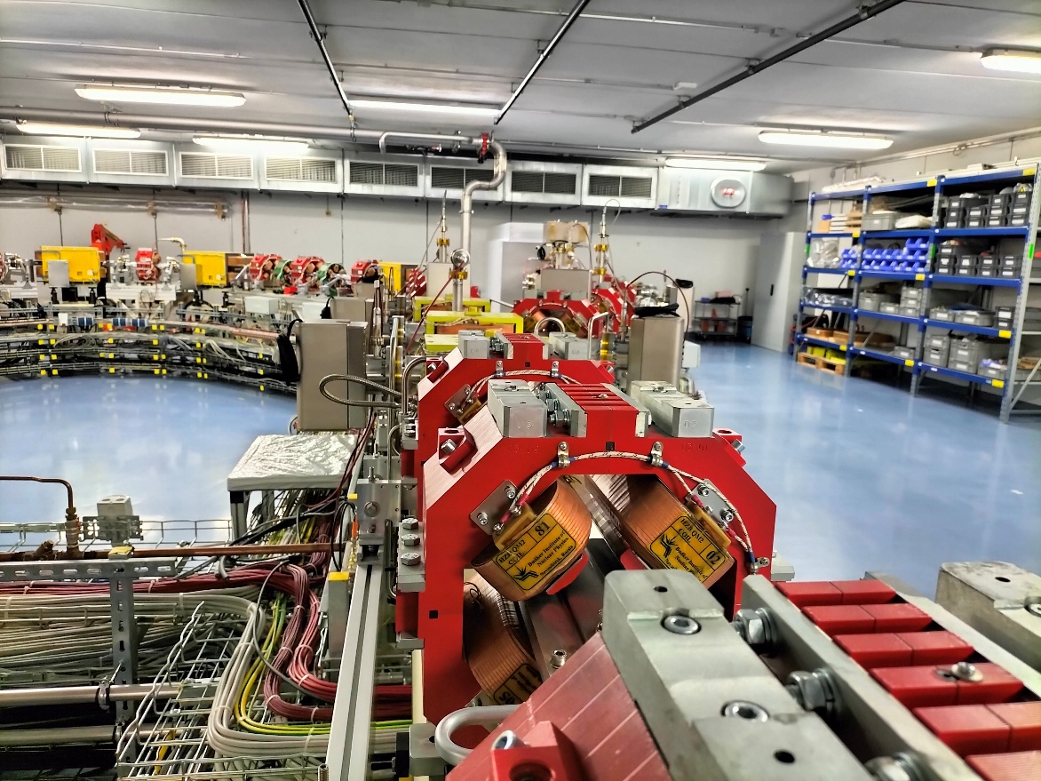



Photocathodes for DALI
SEALab project ended July 2026
Now collaboration with Rong Xiang et al. (HZDR) to develop Na-K-Sb photocathodes for DALI

Slide 16
Conclusions & Outlook
Na-K-Sb shows good compatibility with SRF environment, low field emission, no multipacting
Na-K-Sb photocathodes can recover by stimulated desorption of contaminants
Further Research:
Growth optimization & automation for increased reproducibility
Poisoning studies to understand the degradation mechanisms
Electronic structure and in-depth analysis of chemical composition at beamline
  → Talk by Alice Galdi in the session “semiconductor photocathodes“
  → Poster from Lucia Santen

Slide 17
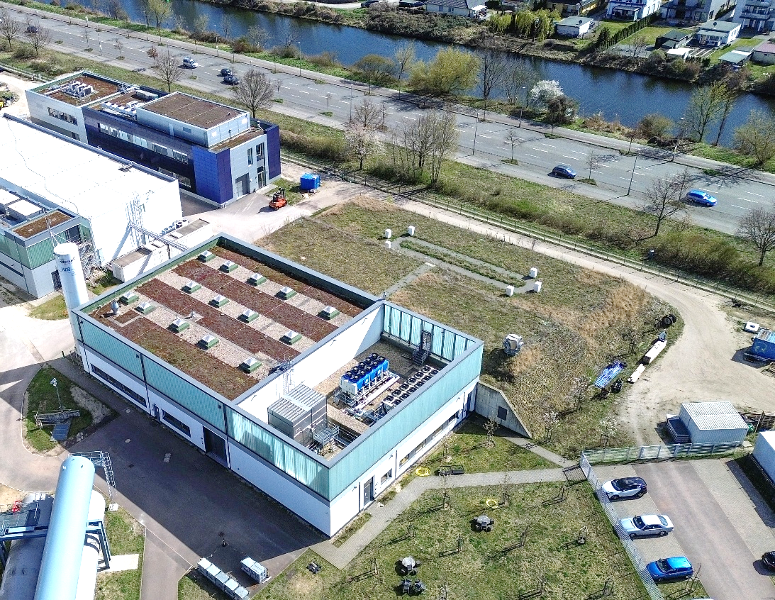
Visual Tour of SEALab on YouTube https://www.youtube.com/watch?v=N0cUq7n-nkM
Acknowledgments
High Brightness Team at HZB:
Julius Kühn, Chen Wang, Guido Klemz, Thorsten Kamps, Ezgi Ergenlik, Emily Brookes, Alice Galdi (Università degli Studi di Salerno, Italy)
SRF Team at HZB:
Axel Neumann, Michael Schuster, Andre Frahm, Jan Ullrich, Pablo Echevarria Fernandez, Andriy Ushakov, Stefan Rotterdam, Jens Knobloch
Thank you for your attention!

