Slide 1
The CLARA Photocathode and Rb-Te R&D at Daresbury Laboratory
Hugh Churn
Accelerator Science and Technology Centre, STFC
hugh.churn@stfc.ac.uk
21/09/2026
Photocathodes for Accelerator Science in Europe, Orsay, 2026

Slide 2
Outline
The CLARA Photocathode
  Cathode manufacture
  RF conditioning in CLARA
  Current performance
Rubidium Telluride R&D
  Motivation
  Deposition process
  QE and QE degradation comparison with Cs-Te
  MTE and MTE degradation comparison with Cs-Te

Slide 3
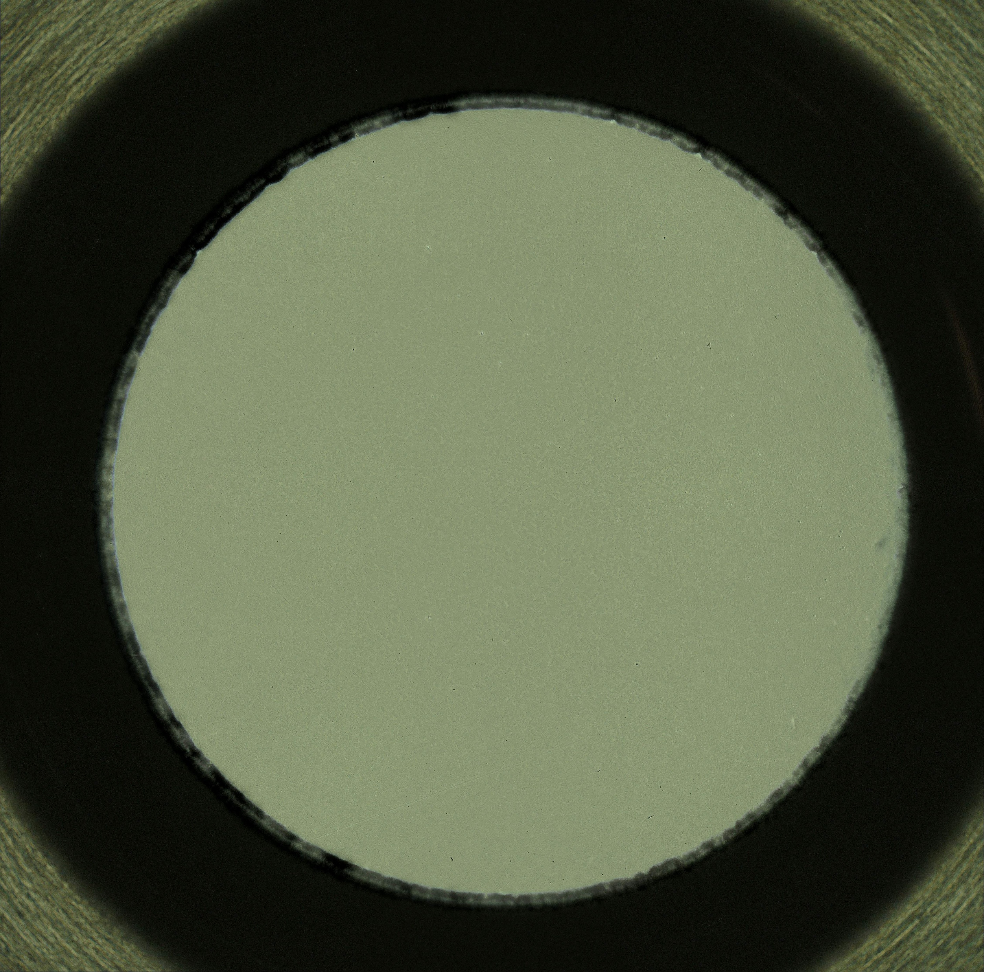
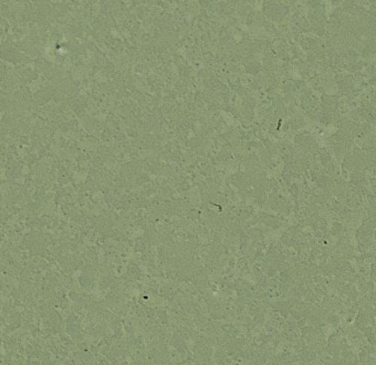
CLARA Caesium Telluride Cathode Production
CLARA: 250 MeV 250 pC 100 Hz high brightness linear electron accelerator.
Full details of the process presented at IPAC ‘26
  H. Churn et al., DOI: 10.18429/JACoW-IPAC2026-THP2143
Manufacture & Polishing
  High purity, sintered molybdenum stock, INFN style plug.
  Polished by DESY, Hamburg. EuXFEL polishing procedure.
  Reasonable roughness but pitting present on surface.
White light interferometry roughness measurements post polishing
High resolution images showing microscopic pits on the surface: Cathode 034
Photo-cathode | S_{q} [nm] |  | S_{a} [nm]
 | Av. | Std. Dev. | Av. | Std. Dev.
033 | 30.5 | 8.2 | 23.8 | 6.1
034 | 31.2 | 18.5 | 22.3 | 12.5
036 | 26.5 | 11.0 | 21.0 | 9.0

Slide 4
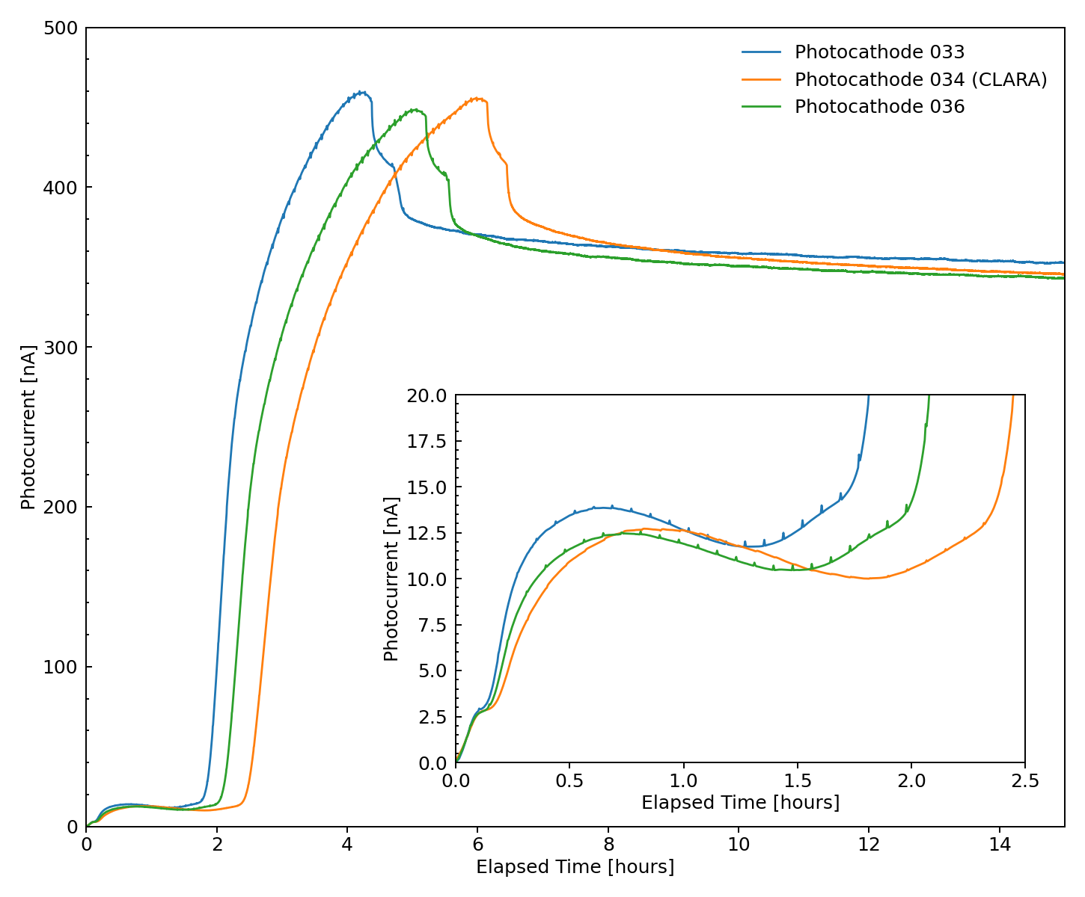
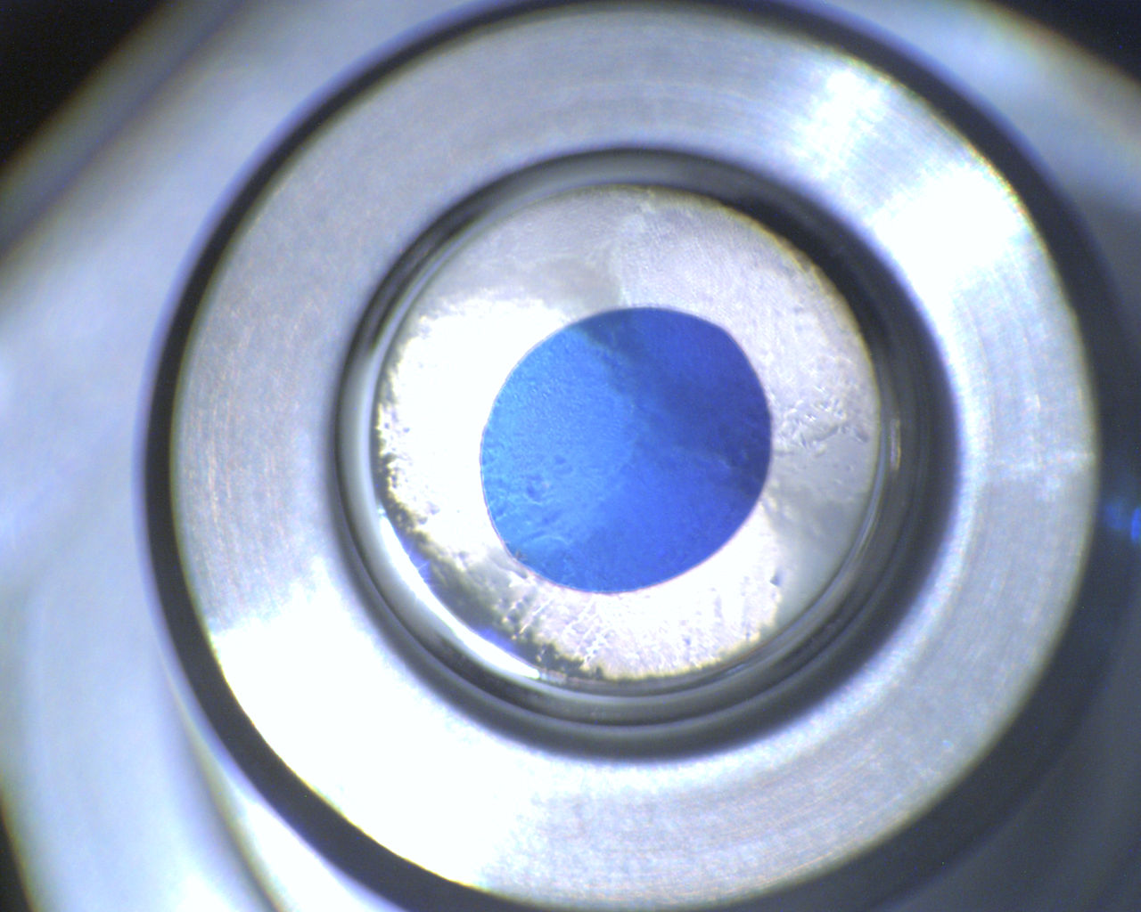
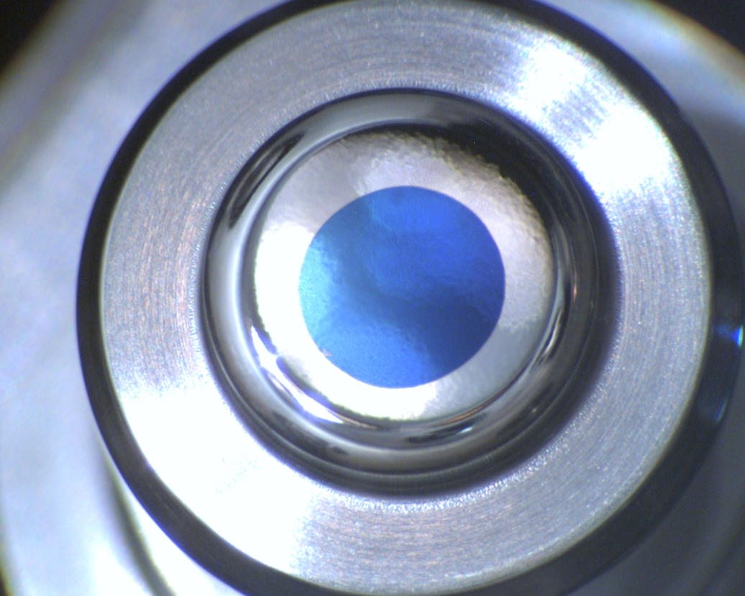
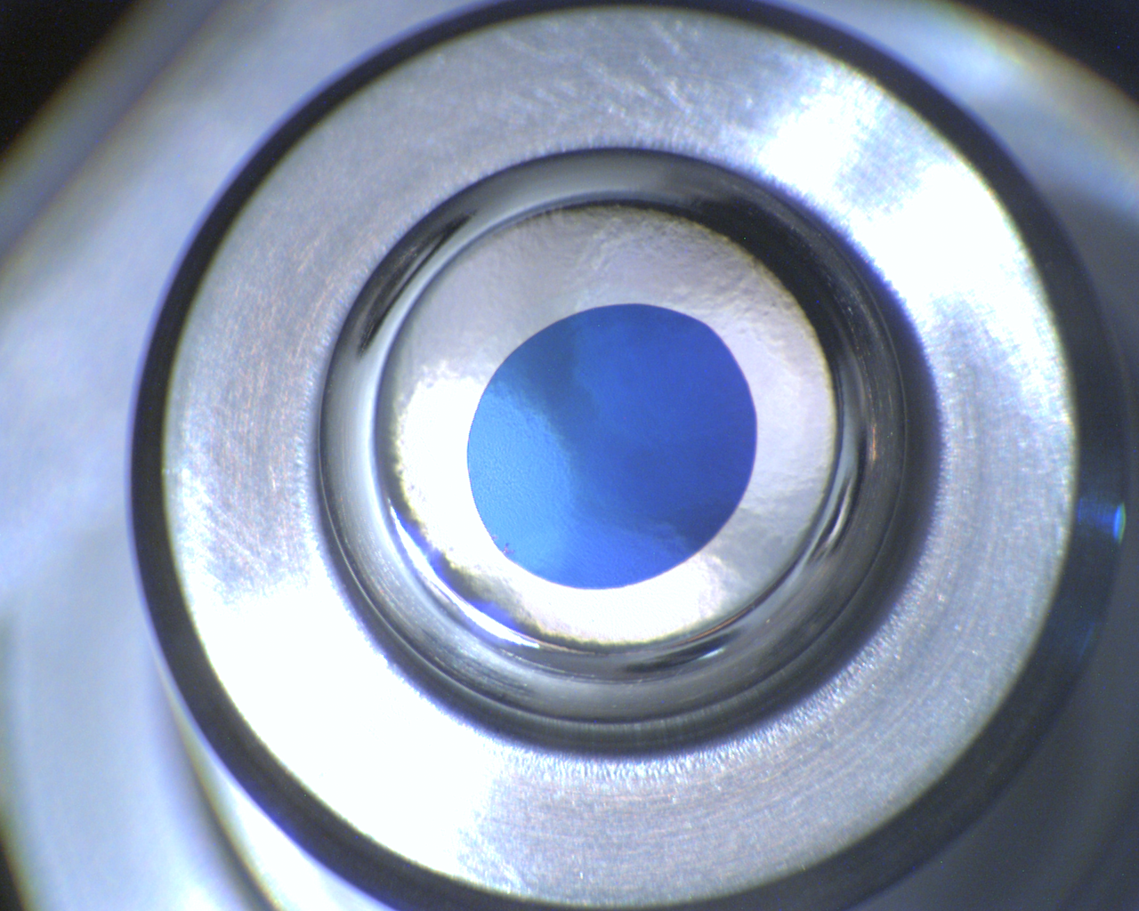
CLARA Caesium Telluride Cathode Production
Room temperature deposition.
10 nm 20 nm* Te deposited according to QCM.
Cs deposited from SAES Alkamax pills until photocurrent peaked.
Immediate post deposition QE NOT precisely measured but estimated at ~25 %.
Photocurrent during Cs deposition
Cathode #033
Cathode #034
Cathode #036
Images taken post deposition
* Since IPAC we have discovered a fault in how our QCM was reporting data. Rates were x2 higher than originally thought.

Slide 5
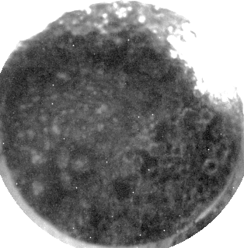
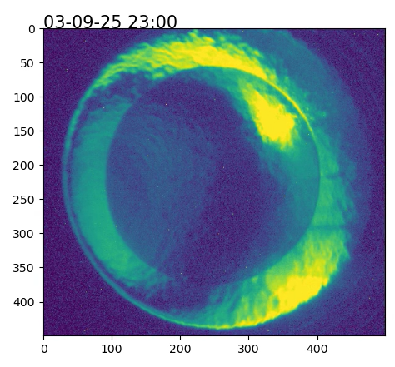
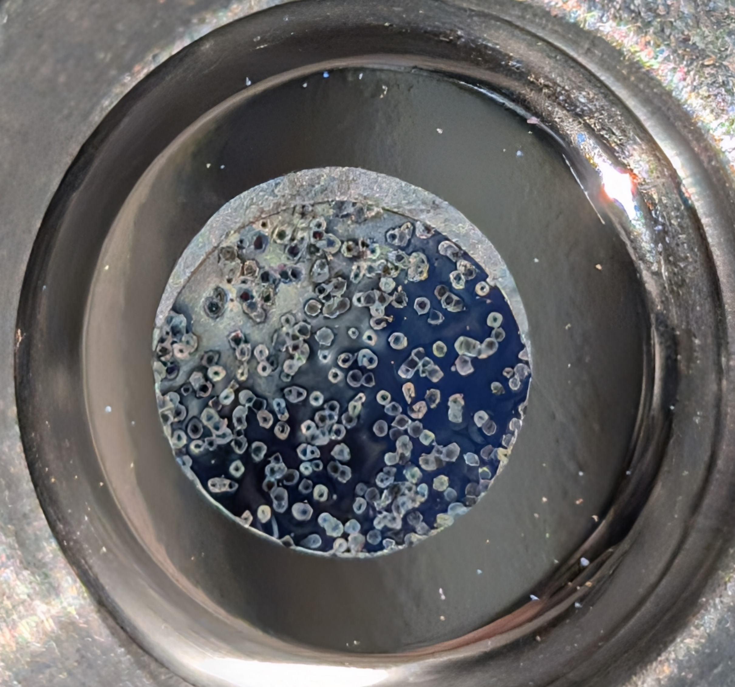
RF Conditioning the photocathode in CLARA
Details presented at IPAC 2026 and P3 2025
  L. Jones, CLARA Photocathodes: A Tale of Two Three Cathodes, P3 2025
  A. Pollard et al., DOI: 10.18429/JACoW-IPAC2026-TUP3075
‘Features’ appear during RF conditioning.
Quantitatively linked to RF breakdown events.
Hypotheses: Caused by…
  …the micro-pits seen on the molybdenum substrate?
  …by dust on the cathode during loading?
  …embedded polishing particulate?
Questions: are they physical, chemical, both?
Tellurium has changed?
Features about 0.25 mm across.
Cathode 036 after a failed attempt at RF conditioning in CLARA
Cathode 034 during RF conditioning in CLARA

Slide 6
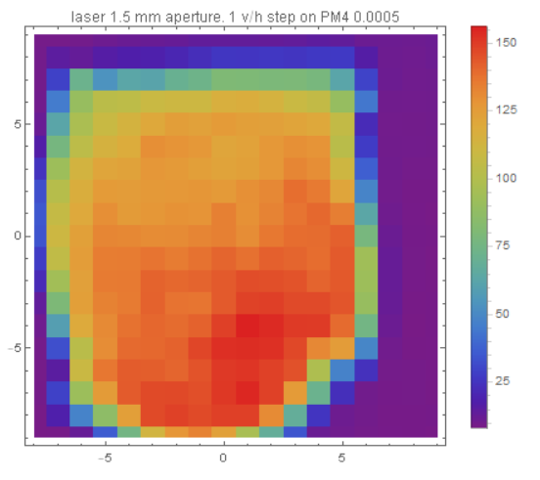
Cathode performance during CLARA Operation
CLARA’s highly successful friendly user run presented at IPAC 2026
  M. Johnson et al., DOI: 10.18429/JACoW-IPAC2026-TUO2M05 & Talk!
0.7 µm rad normalised emittance with a 250 pC 35 MeV/c beam.
Acceptable dark current; ~100 pC with a 1.25 µs RF pulse and an 87 MV/m field.
No evidence of ‘features’ in QE map…
…but laser spot size is 0.6 mm
…and features are ~0.25 mm
Bunch Charge (pC)
Charge map of Cathode 034 in CLARA shortly after RF conditioning: September 2025

Slide 7
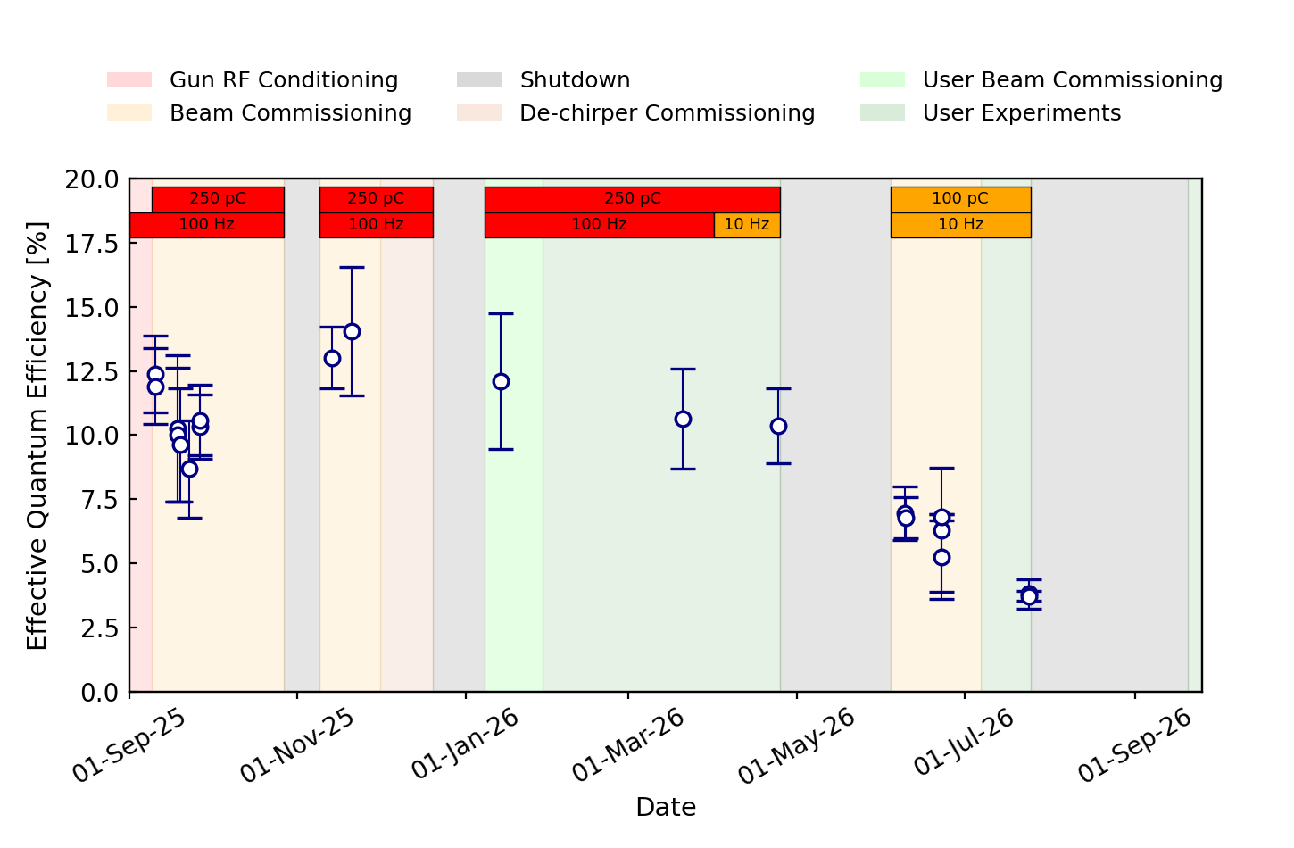
Cathode performance during CLARA Operation
Before May shutdown:
QE looked like it was stable/very slowly decreasing at 11 %.
After May shutdown:
Rate of QE decay appears to increase. But why?
Currently investigating the corresponding vacuum and RF data.
The QE post summer shutdown is…

Slide 8
Rubidium Telluride
With comparisons to caesium telluride
Preliminary results!

Slide 9
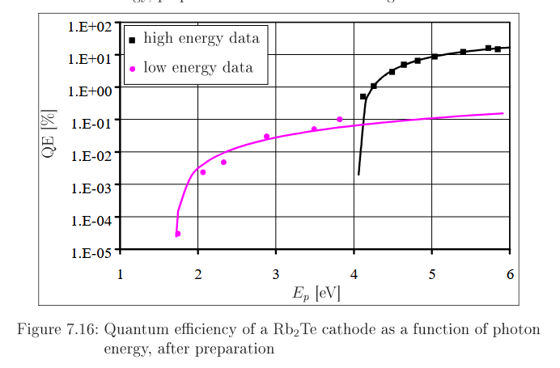
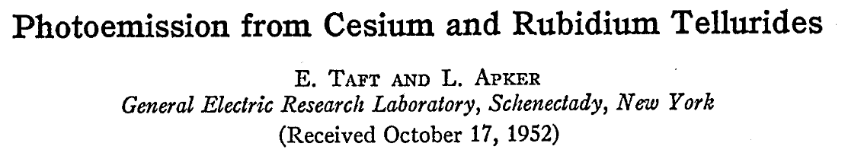
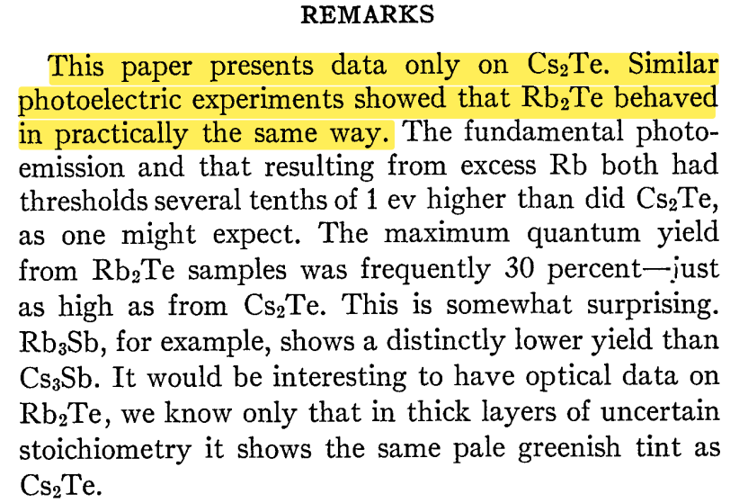
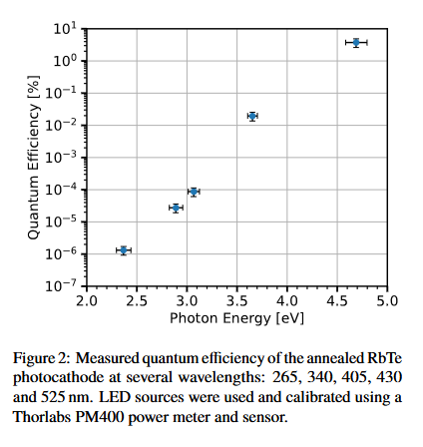
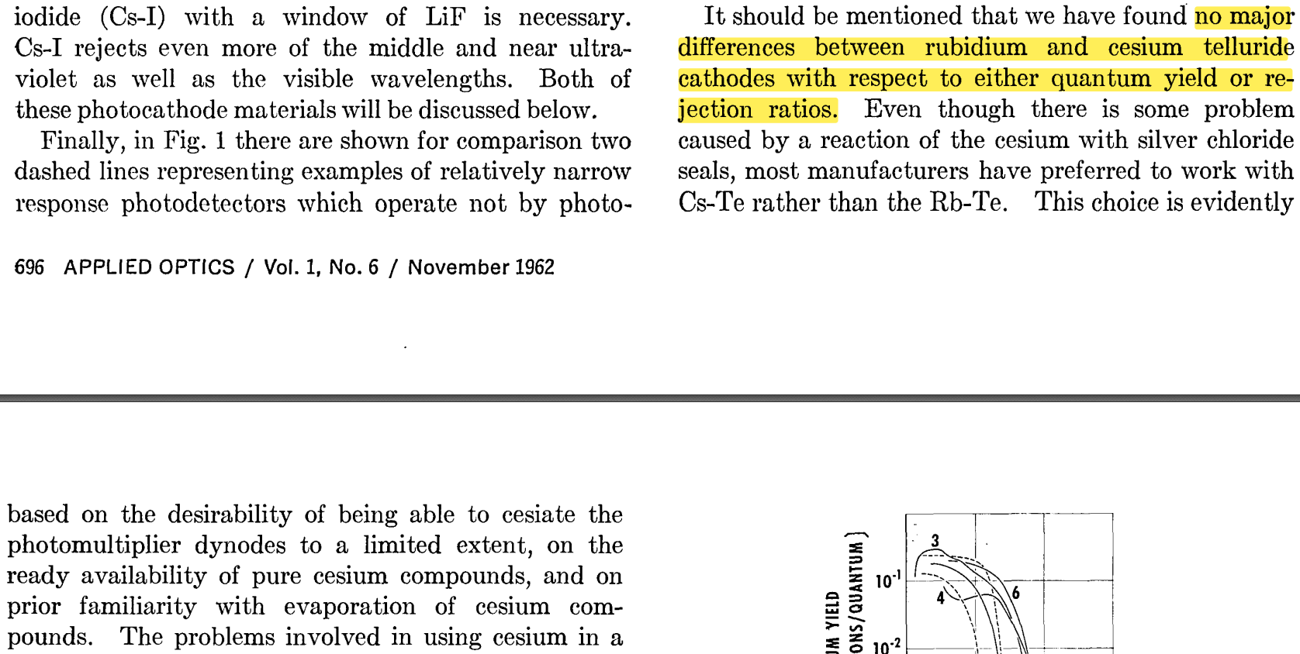
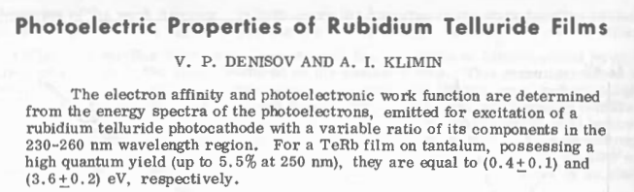
Rb-Te Motivation
Limited literature.
Some suggest no change in QE vs Cs-Te, others expect slightly lower QE.
But in an accelerator:
  Charge extracted more linked to field on the cathode.
  QE needs to be high enough to:
    Emit enough electrons for the given laser power, after any pulse shaping techniques.
    Allow for degradation before needing to be changed.
Full list of Rb-Te references in additional slides
Could Rb-Te provide increased robustness and lower MTE in exchange for a moderate hit to QE?

Slide 10
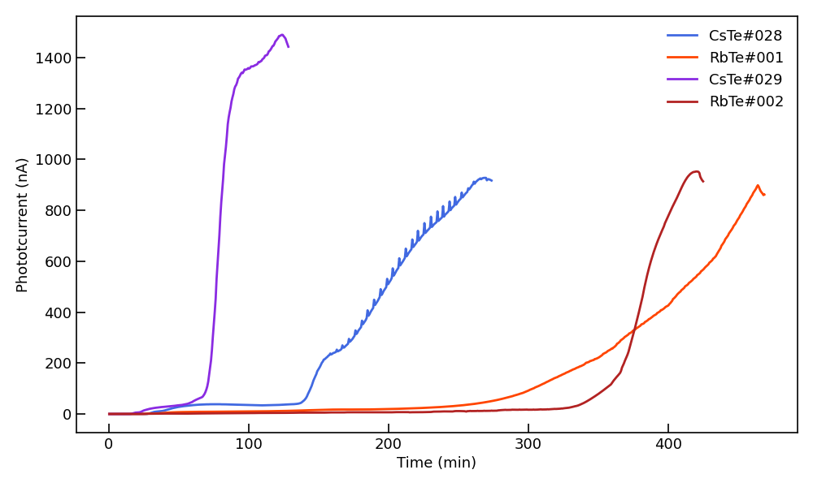
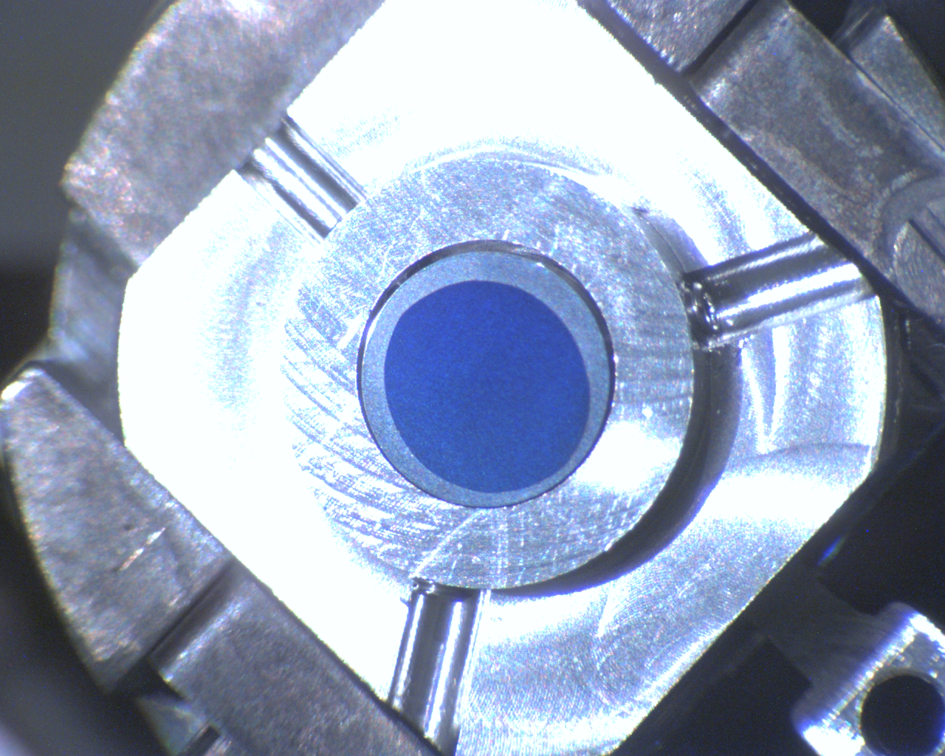
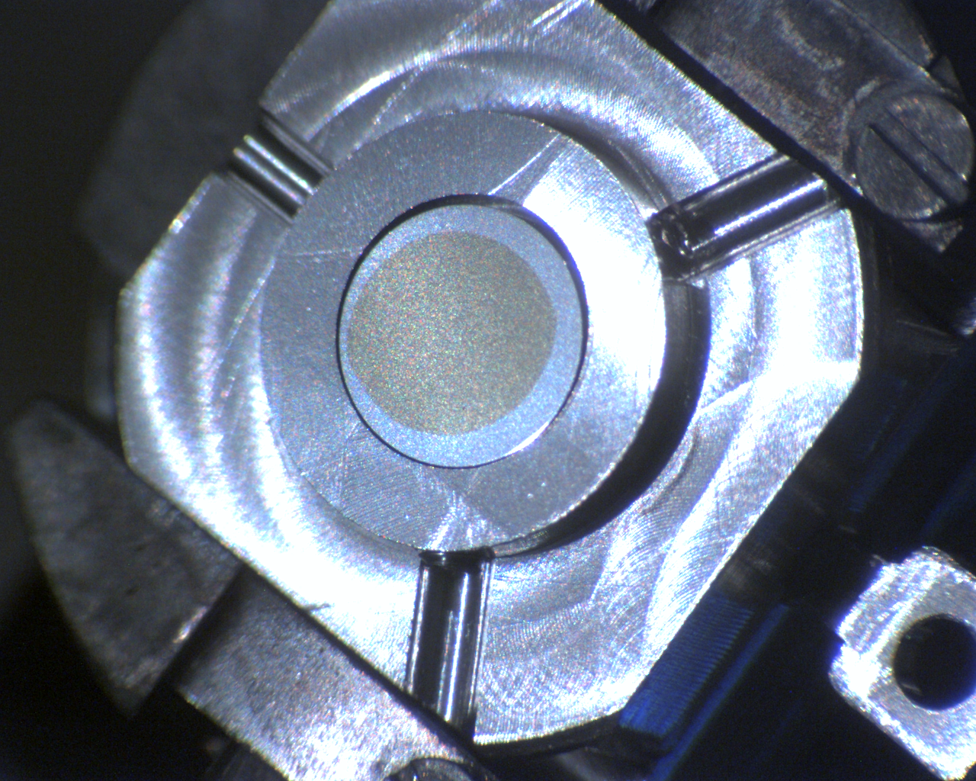
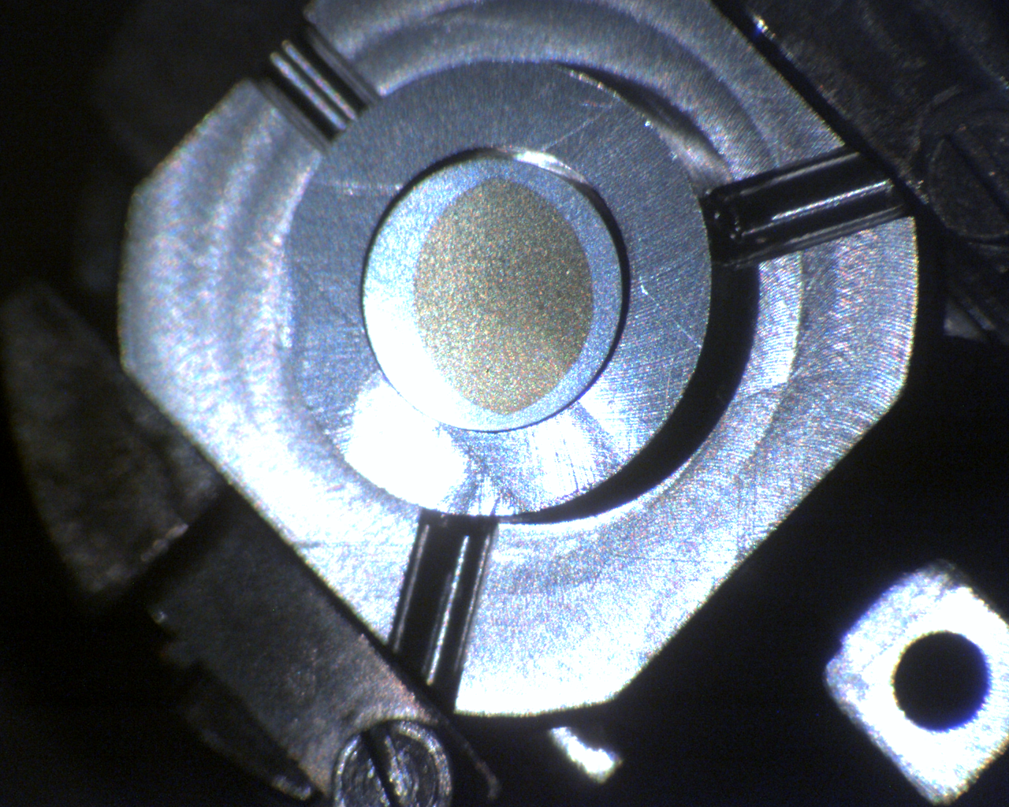
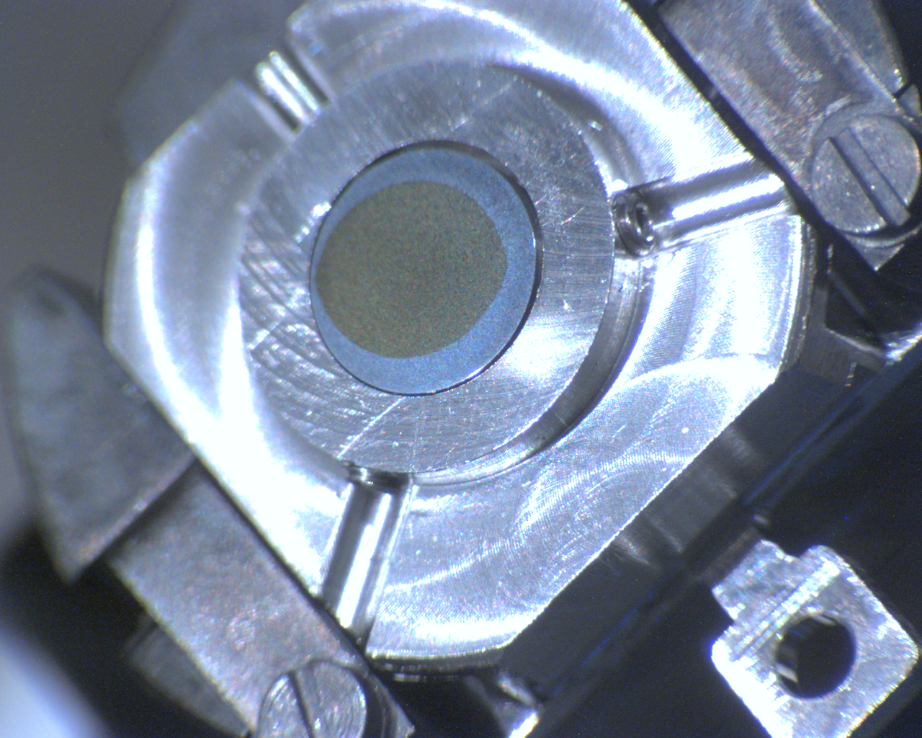
Rb-Te (& Cs-Te) Depositions
Order of deposition
4 samples in 2 runs.
Colour: Thickness seems more important than composition.
RbTe#001: Deposition stopped before photocurrent decreased.
Run #1
Run #2
Parameter | CsTe#028 | RbTe#001 | CsTe#029 | RbTe#002
Substrate Temperature | RT | RT | RT | RT
Tellurium thickness | 20nm | 10nm | 10nm | 10nm
Final photocurrent* | 1007 nA | 790 nA | 1238 nA | 797 nA
Final colour
* Final photocurrent values are only comparable between runs – LED changes.
Photocurrent during alkali metal deposition

Slide 11
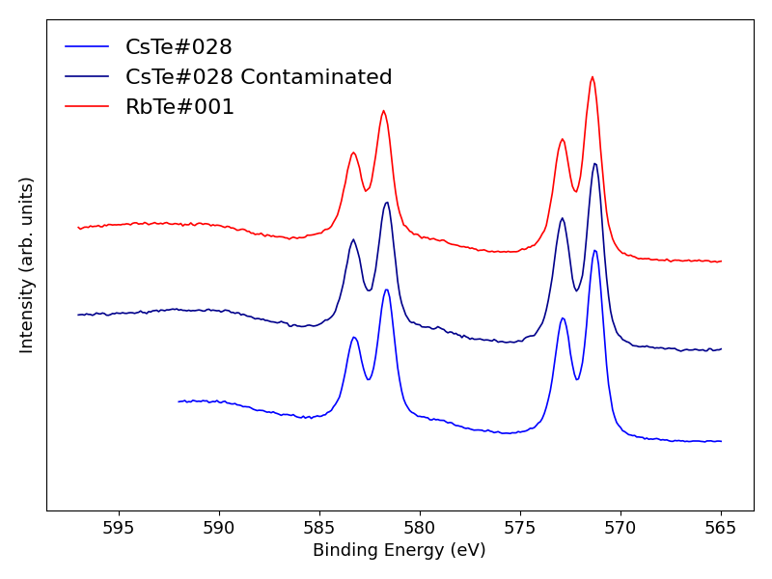
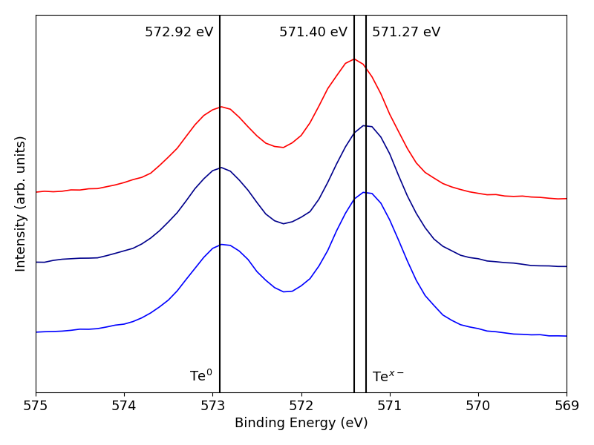
CsTe#028 and RbTe#001: QE and XPS
Tellurium core region scan
CsTe#028 QE = 19.6%.
  Fluorine contamination reduced it to 13.5% prior to additional measurements.
RbTe#001 QE = 14.6%.
Element | Sample
 | CsTe#028 Post Dep | CsTe#028 Contaminated | RbTe#001 Post Dep
Tellurium (Te⁰) | 14.8 % | 14.6 % | 17.1 %
Telluride (Te^{x-}) | 23.5 % | 20.5 % | 26.9 %
Caesium/Rubidium | 59.6 % | 57.5 % | 56.0 %
Oxygen | 2.1 % | 3.5 % | -
Fluorine | - | 3.9 % | -
Alkali : Te^{x-} Ratio | ~ 2.54 : 1 | ~ 2.80 : 1 | ~ 2.08 : 1
Alkali* : Te^{x-} Ratio | ~ 2.35 : 1 | ~ 2.27 : 1 | ~ 2.08 : 1
Te⁰ : Te^{x-} Ratio | ~ 1 : 1.58 | ~ 1 : 1.41 | ~ 1 : 1.57
~ 0.13 eV greater shift of the telluride relative to the tellurium in Cs-Te vs Rb-Te.
*Subtracting estimated (Cs/Rb)F and (Cs/Rb)₂O contributions.

Slide 12
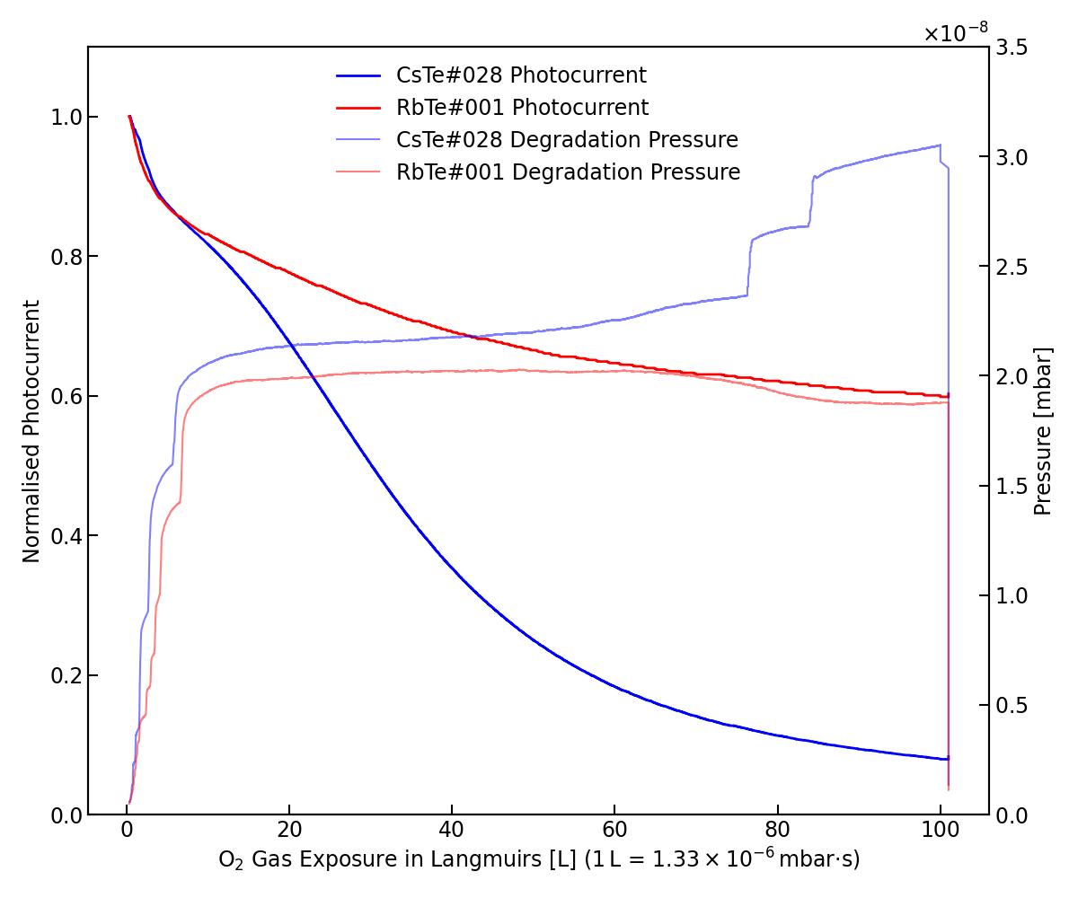
CsTe#028 and RbTe#001: Degradation
Degradation over 100 Langmuirs of oxygen exposure
Base pressure ~ 3x10⁻¹⁰ mbar.
100 Langmuir oxygen exposure.
RbTe#001: 40% drop in photocurrent.
  14.3% → 8.5%
CsTe#028: 92% drop in photocurrent*.
  13.5% → 1.1%
Some QE was recoverable upon heating for both samples.
*Degradation was less severe on the un-illuminated parts of cathode (5% vs 1%). Some kind of catalytic UV effect?

Slide 13
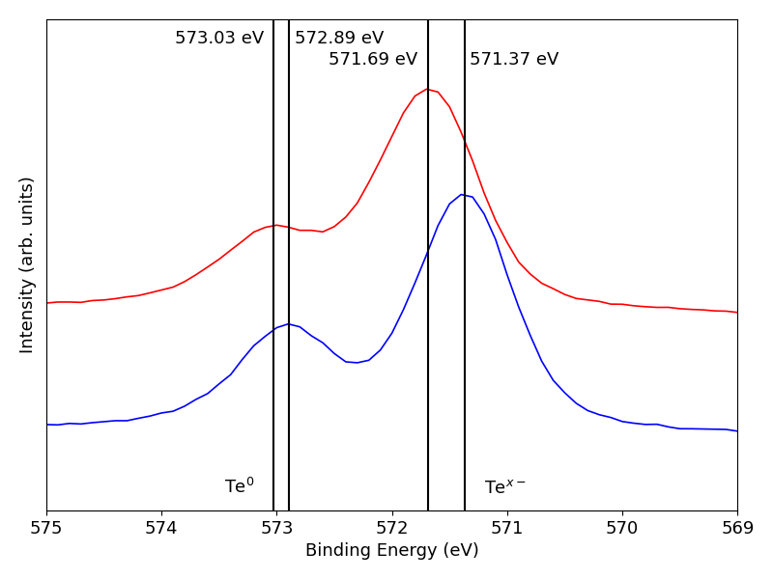
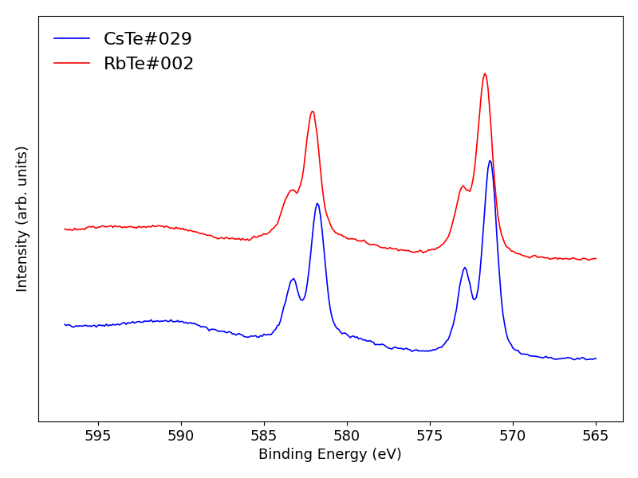
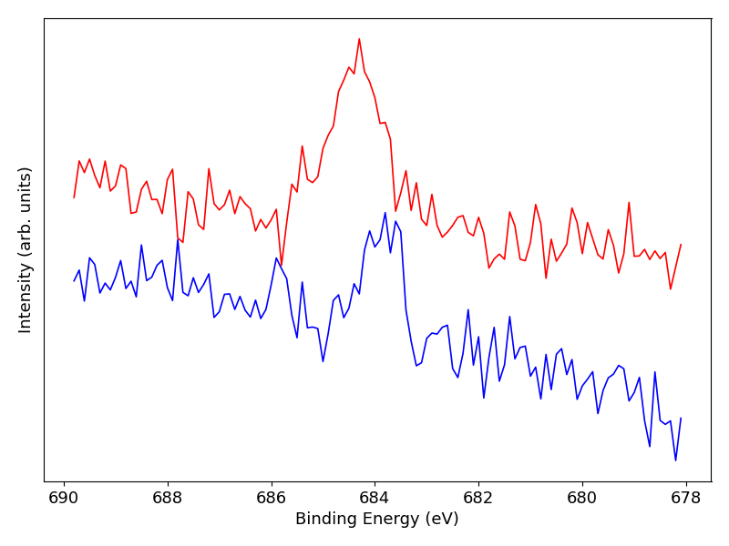
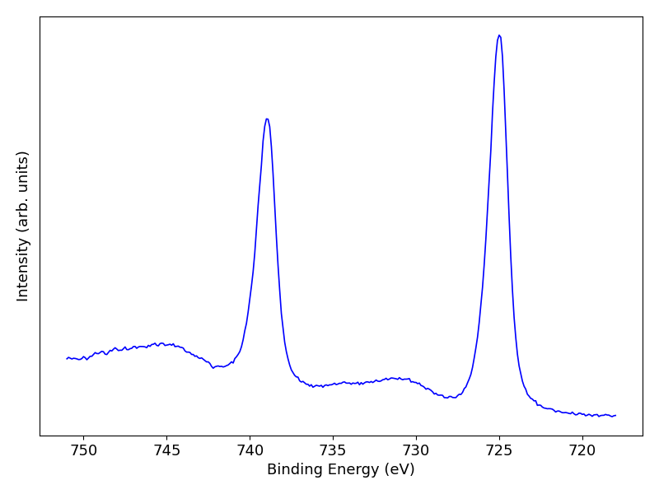
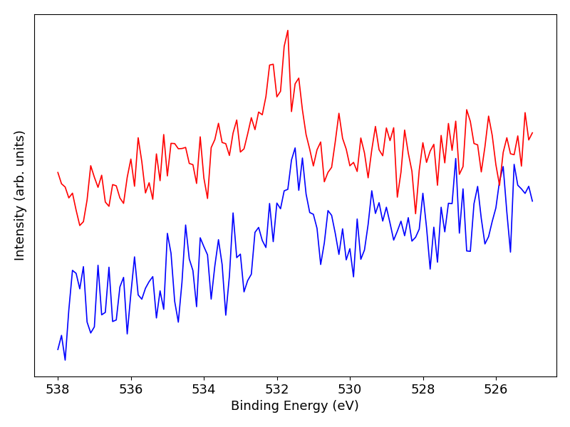
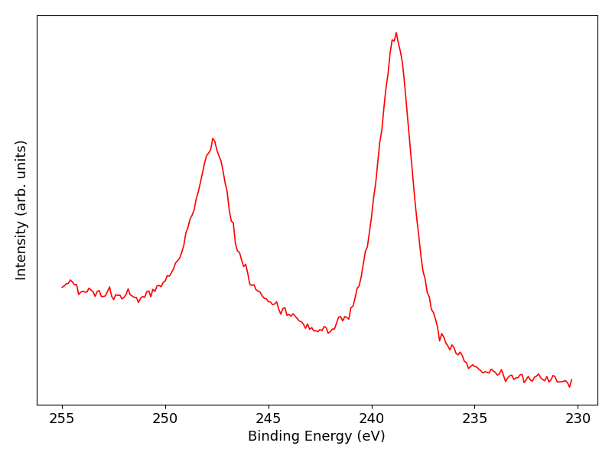
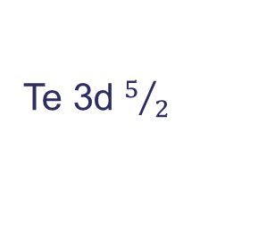
CsTe#029 and RbTe#002: QE and XPS
Te 3d $5/2$
Te 3d
CsTe#029 QE = 24.7%
RbTe#002 QE = 16.7%
Element | Sample
 | CsTe#029 Post Dep | RbTe#002 Post Dep
Tellurium (Te⁰) | 10.9 % | 9.7 %
Telluride (Te^{x-}) | 26.8 % | 28.3 %
Caesium/Rubidium | 60.2 % | 57.3 %
Oxygen | 1.1 % | 1.8 %
Fluorine | 1.0 % | 3.0 %
Alkali : Te^{x-} Ratio | ~ 2.25 : 1 | ~ 2.03 : 1
Alkali* : Te^{x-} Ratio | ~ 2.13 : 1 | ~ 1.79 : 1
Te⁰ : Te^{x-} Ratio | ~ 1 : 2.46 | ~ 1 : 2.92
F 1s
Cs 3d
O 1s
Rb 3p
*Subtracting estimated (Cs/Rb)F and (Cs/Rb)₂O contributions

Slide 14
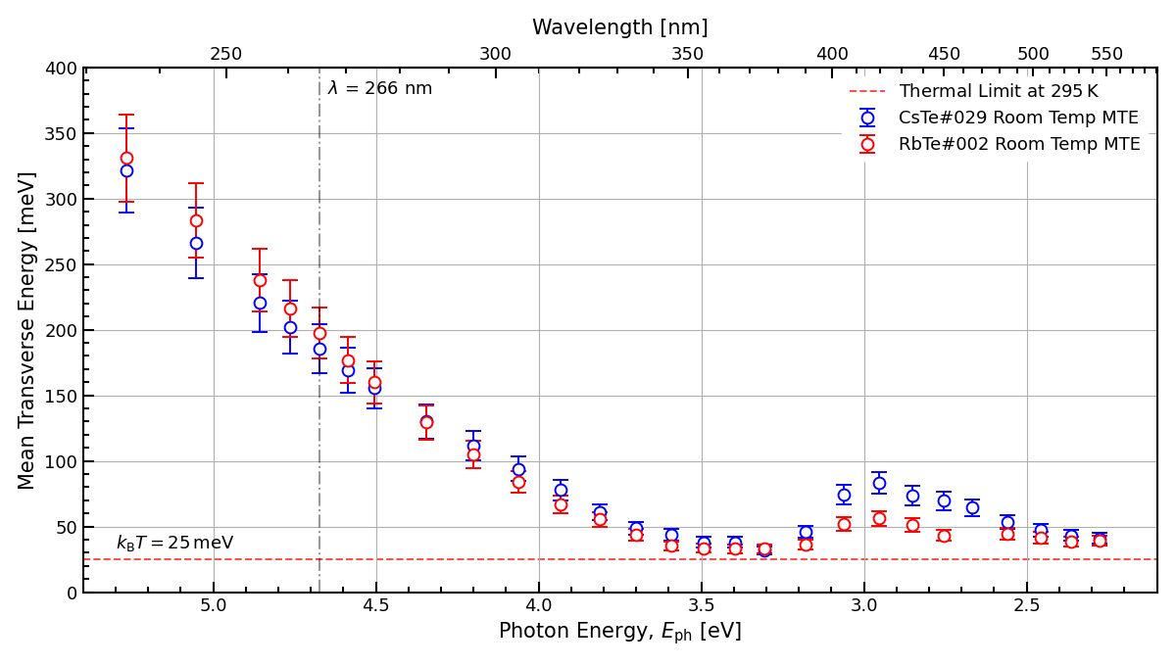
CsTe#029 and RbTe#002: MTE
MTE analysed in the TESS.
  Jones et al. DOI: 10.1063/5.0109053
No noteworthy difference between the MTE of Rb-Te and Cs-Te.
UV differences within error, slight divergence in the visible.

Slide 15
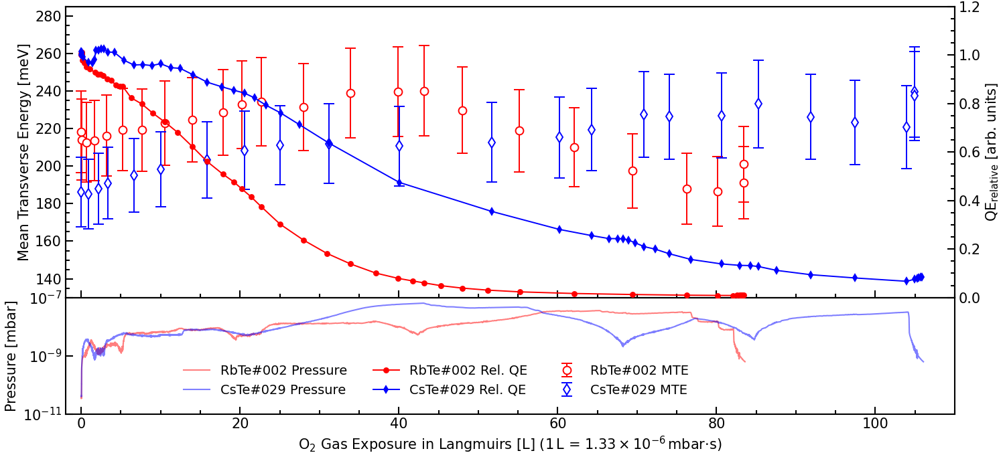
CsTe#029 and RbTe#002: MTE and Rel. QE Degradation at 266 nm
Base pressure ~ 3x10⁻¹¹ mbar.

Slide 16
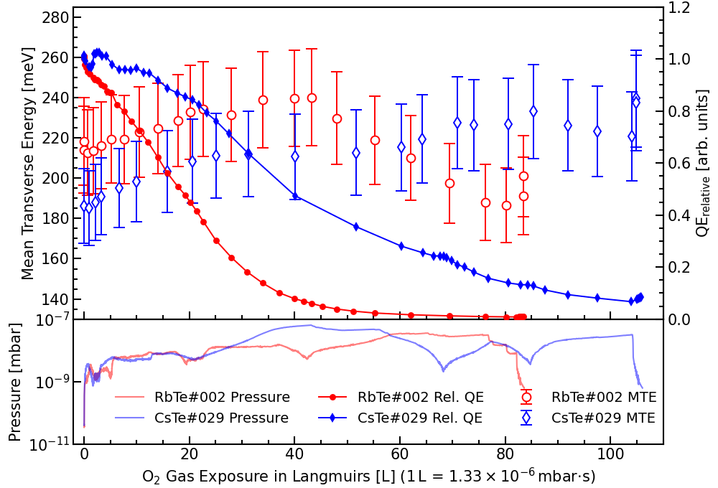
CsTe#029 and RbTe#002: MTE and Rel. QE Degradation at 266 nm
RbTe#002 degraded ~2x faster than CsTe#029.
  Contradictory to direct QE data.
  Cs-Te dropping ~90 % over 100 L is consistent.
Starting RbTe#002 MTE higher than original 266 nm data.
  Needs investigating.
Consistent upward trend of the CsTe#029 MTE.
  This matches previous data I have taken.
RbTe#002 MTE trends upwards until QE nearly gone, then trends down.
  Would CsTe#029 do the same if exposed to 200 L of oxygen?
All changes modest when compared to error.

Slide 17
Conclusions and Caveats
Conclusions
Caveats
QE of Rb-Te approximately 0.1 lower than Cs-Te (25 % vs 15 %) but still high!
Rb-Te more resistant to O₂ degradation!?
Modest QE recovery possible with heating.
MTE of Rb-Te and Cs-Te is the same within error at UV.
MTE evolution under O₂ degradation differs between Cs-Te and Rb-Te.
Only two Rb-Te samples!!!
RbTe#001 was stopped pre photocurrent peak.
Mild fluorine contamination might be influencing results.
Simple room temperature sequential deposition recipe used. Results may vary with:
  Optimised substrate temperatures
  Different thicknesses
  Multilayer or co-depositions
  Epitaxy
Inferred QE degradation (TESS) and direct QE degradation measurements disagree.
More research required!

Slide 18
Summary
Caesium telluride successfully running in CLARA.
Features appear on the caesium telluride during RF conditioning.
QE is trending downwards but remains sufficiently high.
Rb-Te has a high QE, but less than Cs-Te.
Yet may be more robust to O₂ degradation.
Preliminary MTE measurements show no discernible difference.
Photocathode Team:
Hugh Churn, Saransh Malhotra, Tim Noakes & Lee Jones
Recent Past Members:
Chris Benjamin, Dominic Sterland & Felix Mildner
+ the wider CLARA team
hugh.churn@stfc.ac.uk
Questions?

Slide 19
Extra Slides

Slide 20
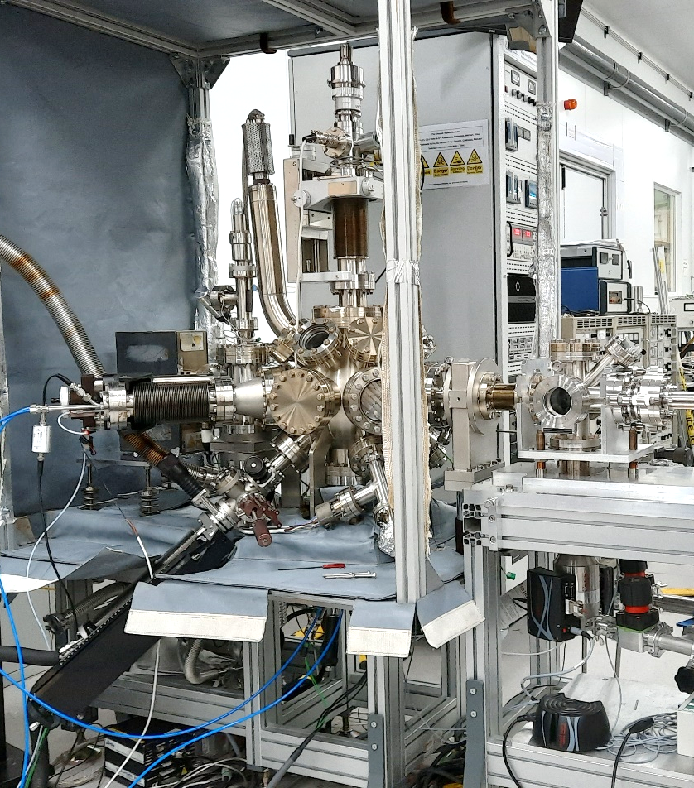
Alkali-metal Photocathode Preparation Facility (APPF)
Can be swapped between Omicron flag samples and CLARA INFN plug cathodes.
Low x 10⁻¹⁰ mbar base pressure.
Tellurium deposition via thermal sublimation with optional cracker stage.
Caesium deposited via Saes Alkamax pills. Thermal decomposition of caesium molybdate.
Quartz crystal microbalance to measure deposition rate.
Photocurrent monitored via 265 nm LED.
Camera and internal halogen lighting takes images every 5 minutes.

Slide 21
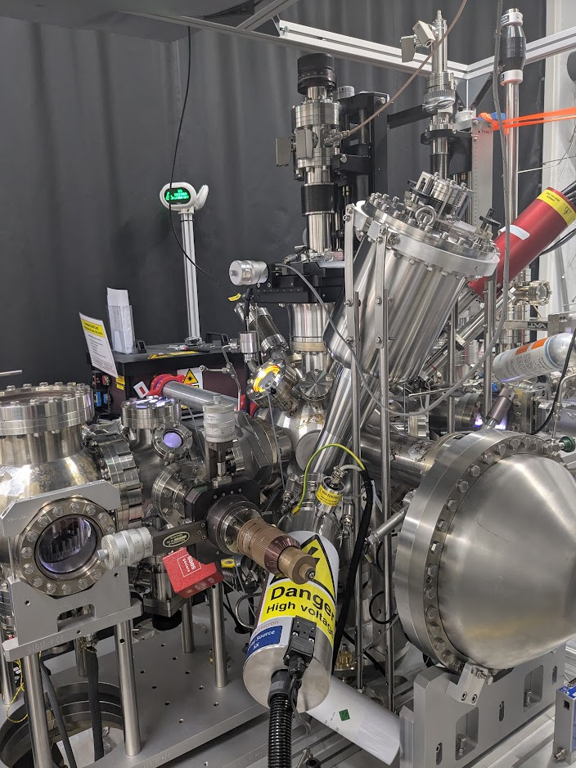
Multiprobe
Surface analysis R&D on Omicron flag samples.
Surface composition via X-ray Photoelectron Spectroscopy.
  Monochromated aluminium X-Ray source.
  Dual anode (Mg and Al) Un-monochromated X-Ray source.
  Refurbished Thermo Alpha 110 hemispherical analyser.
High precision QE measurement.
  Pulsed 266 nm laser, high voltage anode and lock-in amplifier.
Surface Topography.
  Atomic Force Microscopy.
  Scanning Tunnelling Microscopy.
Modifiable to include ultraviolet photoelectron spectroscopy and low energy electron diffraction.
Dedicated deposition chamber for further R&D.

Slide 22
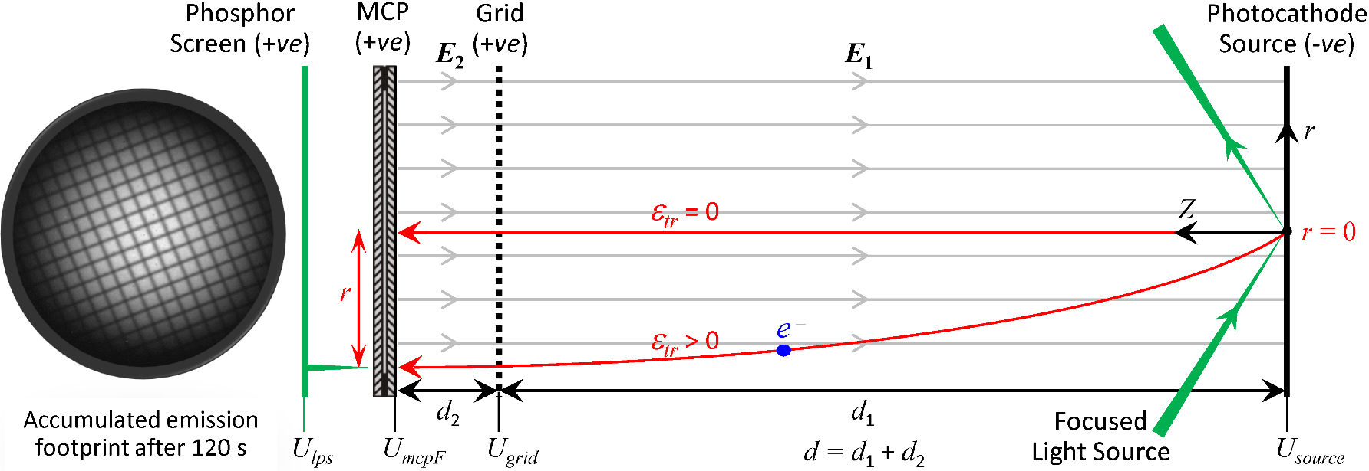
Transverse Energy Spread Spectrometer (TESS)
Laser-driven plasma broadband light source and monochromator provides incident light from deep UV to near infrared.
Electrons are emitted from a tightly focussed spot on the cathode at very low currents to avoid space charge.
Electrons are accelerated through a known distance and potential.
Multichannel plate amplifies the signal then we image the fluorescence of a phosphor screen.
~100s exposure records all possible transverse energy components.
Extremely low base pressure (3 x 10⁻¹¹ mbar) and a piezoelectric leak valve allow for fine control of gas composition during experiments.
L. Jones et al.; Rev. Sci. Instrum. 93, 113314 (2022)

Slide 23
List of Rb-Te Sources
V. Denisov and I. Klimin, “Photoelectric properties of rubidium telluride films”, Radio Engineering and Electronic Physics, vol. 23, Feb. 1978, p. 114-116. (1978)
L. Dunkelman et al., “Spectrally Selective Photodetectors for the Middle and Vacuum Ultraviolet”, Appl. Opt. 1, 695-700 (1962)
H. Trautner, “Spectral Response of Cesium Telluride and Rubidium Telluride Photocathodes for the Production of Highly Charged Electron Bunches”, PhD Thesis (2000)
E. Taft and L. Apker, “Photoemission from Cesium and Rubidium Tellurides”, Journal of the Optical Society of America Vol. 43, Issue 2, pp. 81-83 (1953)
M. Polyakova and D. Zernov, “The photoelectric and optical properties of the tellurium–rubidium photocathode”, Radio Engineering and Electronic Physics, 11, No. 6 (1966)
C. Benjamin et al., “Rubidium telluride photocathodes for high quantum efficiency and low mean transverse energy accelerator applications”, JACoW IPAC2024 (2024), WEPC71 (2024)
X. Zhang et al., “Spectral response characteristics of transmission-mode alkali telluride photocathodes working from vacuum-ultraviolet to ultraviolet band”, J. Vac. Sci. Technol. B 35, 061202 (2017)
Not Rb-Te, but interesting:
L. Cultrera et al., “Rb based alkali antimonide high quantum efficiency photocathodes for bright electron beam sources and photon detection applications”, J. Appl. Phys. 121, 055306 (2017)
D. Bisero et al., “K₂Te photocathode growth: A photoemission study”, J. Appl. Phys. 87, 543–548 (2000)

Slide 24
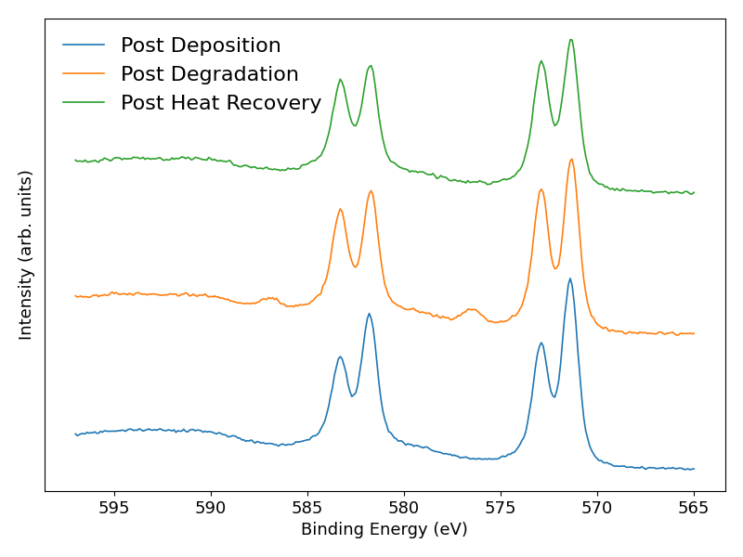
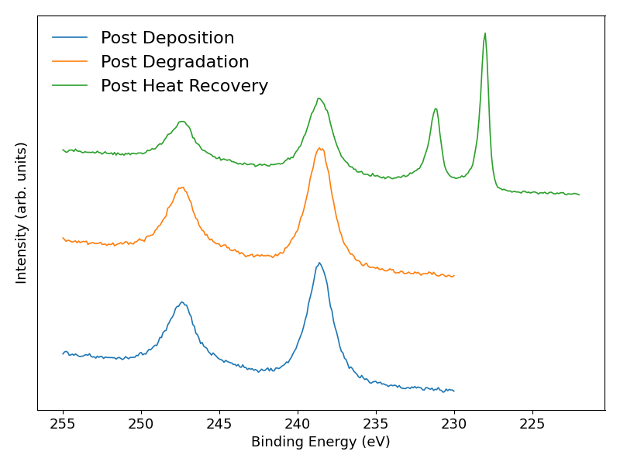
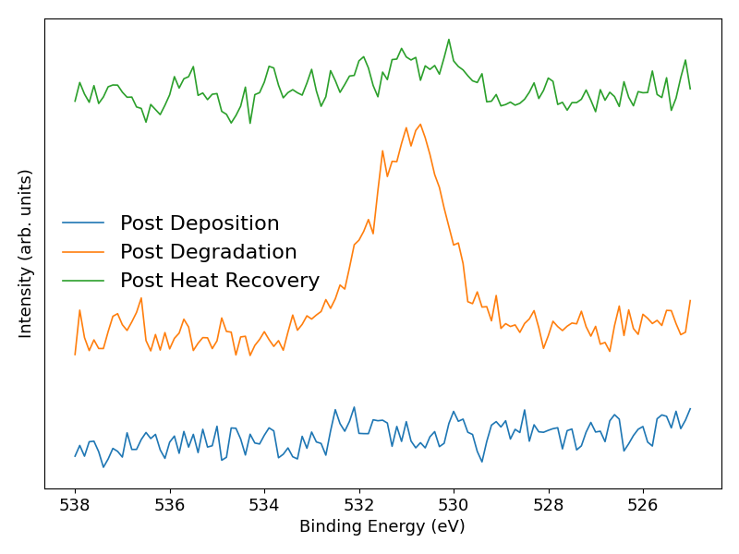
RbTe#001 Degradation XPS
Te 3d
Rb 3p (& Mo 3d)
O 1s
Heat Recovery: Progressively increased heating to ~12 W over ~2.5 hrs until photocurrent started to decrease.
QE: 14.6 % → 8.5 % → 11.7 %
Degradation increases tellurium, decreases telluride, small amount of tellurium oxide appears.
  Oxygen pulls rubidium out of rubidium telluride into rubidium oxide?
Sample thinner after heating, Mo 3d appears.
Oxygen almost entirely removed by heating.

Slide 25
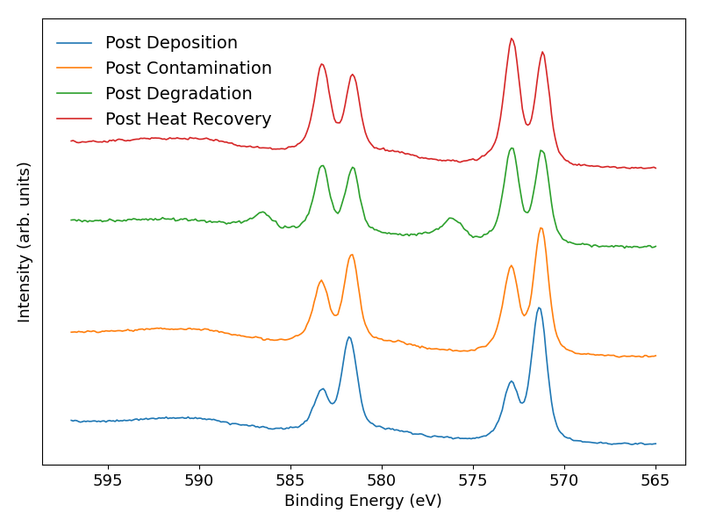
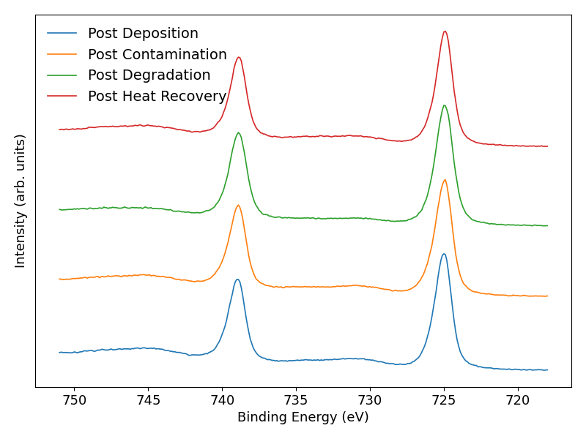
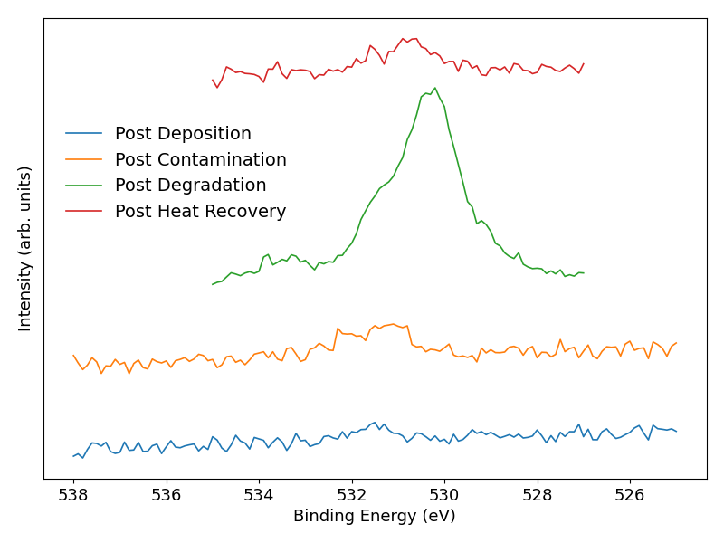
CsTe#028 Degradation XPS
Te 3d
Cs 3d
O 1s
Heat Recovery: Progressively increased heating to ~8.5 W over ~3.5 hrs until photocurrent started to decrease.
QE: 19.6 % → 13.5 % → 1.1 % → 2.9 %.
  But no noticeable change after heat recovery on the lesser degraded spot at 5 % QE.
Degradation increases tellurium, decreases telluride, small amount of tellurium oxide appears.
  Oxygen pulls caesium out of caesium telluride into caesium oxide?
No Mo 3d (or 3p) on survey to indicate thinning, but sample did start off thicker (20 nm of tellurium).
Oxygen levels substantially lowered by heating.

