Slide 1

Robust photocathodes for CW XFEL
Xudong Li
Shanghai Advanced Research Institute, CAS
Photocathodes for Accelerator Science in Europe
(PhASE 2026), September 21-23, 2026 Orsay-IJCLAB-France
http://www.sari.cas.cn

Slide 2
Groups
Shanghai Advanced Research Institute,Chinese Academy of Sciences(SARI,CAS):
  Xudong Li, Zenggong Jiang, Hao Meng, Qiang Gu
Zhangjiang Laboratory(ZJLAB):
  Qin Zhou, Chen Wang，Zipeng Liu, Guan Shu, Houjun Qian
Graduate Students, University of Chinese Academy of Sciences (UCAS):
  Tao Hou, Zehao Tong

Slide 3
Outline
Background
  Photocathodes in CW XFEL
Photocathode Preparation, Characterization, and Operation Apparatus
Photocathode Preparation Study
Photocathode Testing and Commissioning
Summary and Plans

Slide 4
Photocathode Characterizations in CW XFEL
Optimization Metrics
⭐⭐⭐
Ultrafast Response Time
Thermal Conductivity and Laser‑damage Threshold: strongly dependent on cathode substrate (Mo, Cu, etc.)
Key Performance
⭐⭐⭐⭐
Low Dark Current
Mandatory Requirements
⭐⭐⭐⭐⭐
Low MTE(Low Thermal Emittance): Determines the Upper Limit of FEL Brightness
Lifetime, Vacuum Robustness, Ion Back Bombardment Resistance: Keys to CW Operation
Sufficiently High QE: Matching CW Drive‑laser Power
Spatial Uniformity of QE and MTE: Directly Limits Achievable Beam Brightness
High Electric Field Tolerance(RF, DC)
Preparation Repeatability and In‑situ Regeneration: critical for large‑facility operation
Spin polarization (required only for polarized‑electron applications)
Electric Field Tolerance and Material Migration
Photoemission Uniformity
Preparation Reproducibility & In-Situ Regeneration
Operating Wavelength and Spectral Response
Response Time
Dark Current
Lifetime and Stability
Thermal Emittance/Mean Transverse Energy (MTE)
Quantum Efficiency(QE)

Slide 5
Typical Candidate Photocathodes for CW XFEL
Materials | Parameters | Advantages | Disadvantages | CW‑FEL Suitability
Alkali‑metal antimonides K₂CsSb/Na₂KSb | MTE：0.10–0.25 eV Drive laser:515 nm Green QE：5%-15% | Low MTE, high QE at green light | Moderate lifetime, alkali‑metal migration risk, vacuum‑sensitive | ⭐⭐⭐⭐ Popular candidate
Alkali‑metal tellurides Cs₂Te | MTE：0.15–0.30 eV Drive laser:266 nm UV QE：~10% | Good robustness, long lifetime | Elevated MTE, UV‑laser required | ⭐⭐⭐ Suitable for Non-Extreme Brightness
Metals Cu/Mg | MTE：0.40–0.70 eV Drive laser:266 nm UV QE：~10⁻⁵–10⁻³ | Excellent lifetime, high stability | Very low QE, UV‑laser required, large MTE | ⭐ Low-Brightness CW Only
III-V semiconductors NEA‑GaAs | MTE：0.10–0.20 eV Drive laser:532 nm Green QE：~10% | Low MTE, spin‑polarized emission | Extremely residual‑gas‑sensitive, short lifetime | ⭐ Short-Time Polarized Experiments Only

Slide 6
Photocathode Research Journey
Evolution of Photocathode Facilities and Related Research in the Project Team
2009-2012
SINAP Photocathode Apparatus Design
2015-2017
K-Cs-Sb Photocathode Preparation Exploration
2018
2012-2015
Photocathode Apparatus Assembly & Commissioning
Cs-Te Photocathode Preparation Exploration
2018-2021
SARI Photocathode Facility: Photocathode Preparation Apparatus, Photocathode Emittance Measurement Apparatus, Photocathode Transfer Apparatus
2022-2024
ZJLAB Photocathode Facility: Photocathode Preparation Apparatus, Photocathode Transfer Apparatus
2022-2025
2026-now
ZJLAB MBE Photocathode System
In‑situ Photocathode Research Apparatus
Photocathode Preparation Apparatus
Photocathode Suitcase
Photocathode Transfer Apparatus
Electron Gun
Photocathode Preparation
Photocathode Transport
Photocathode Operation
Functions：

Slide 7
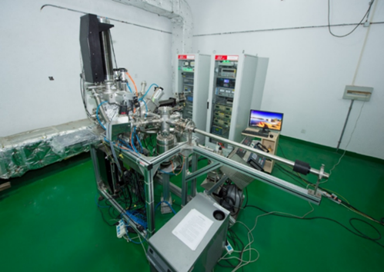
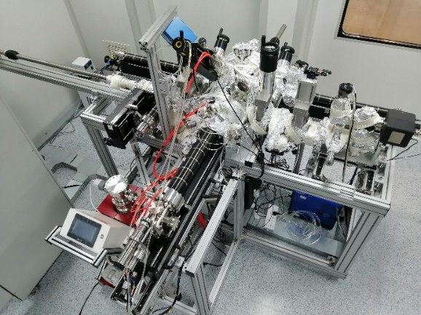
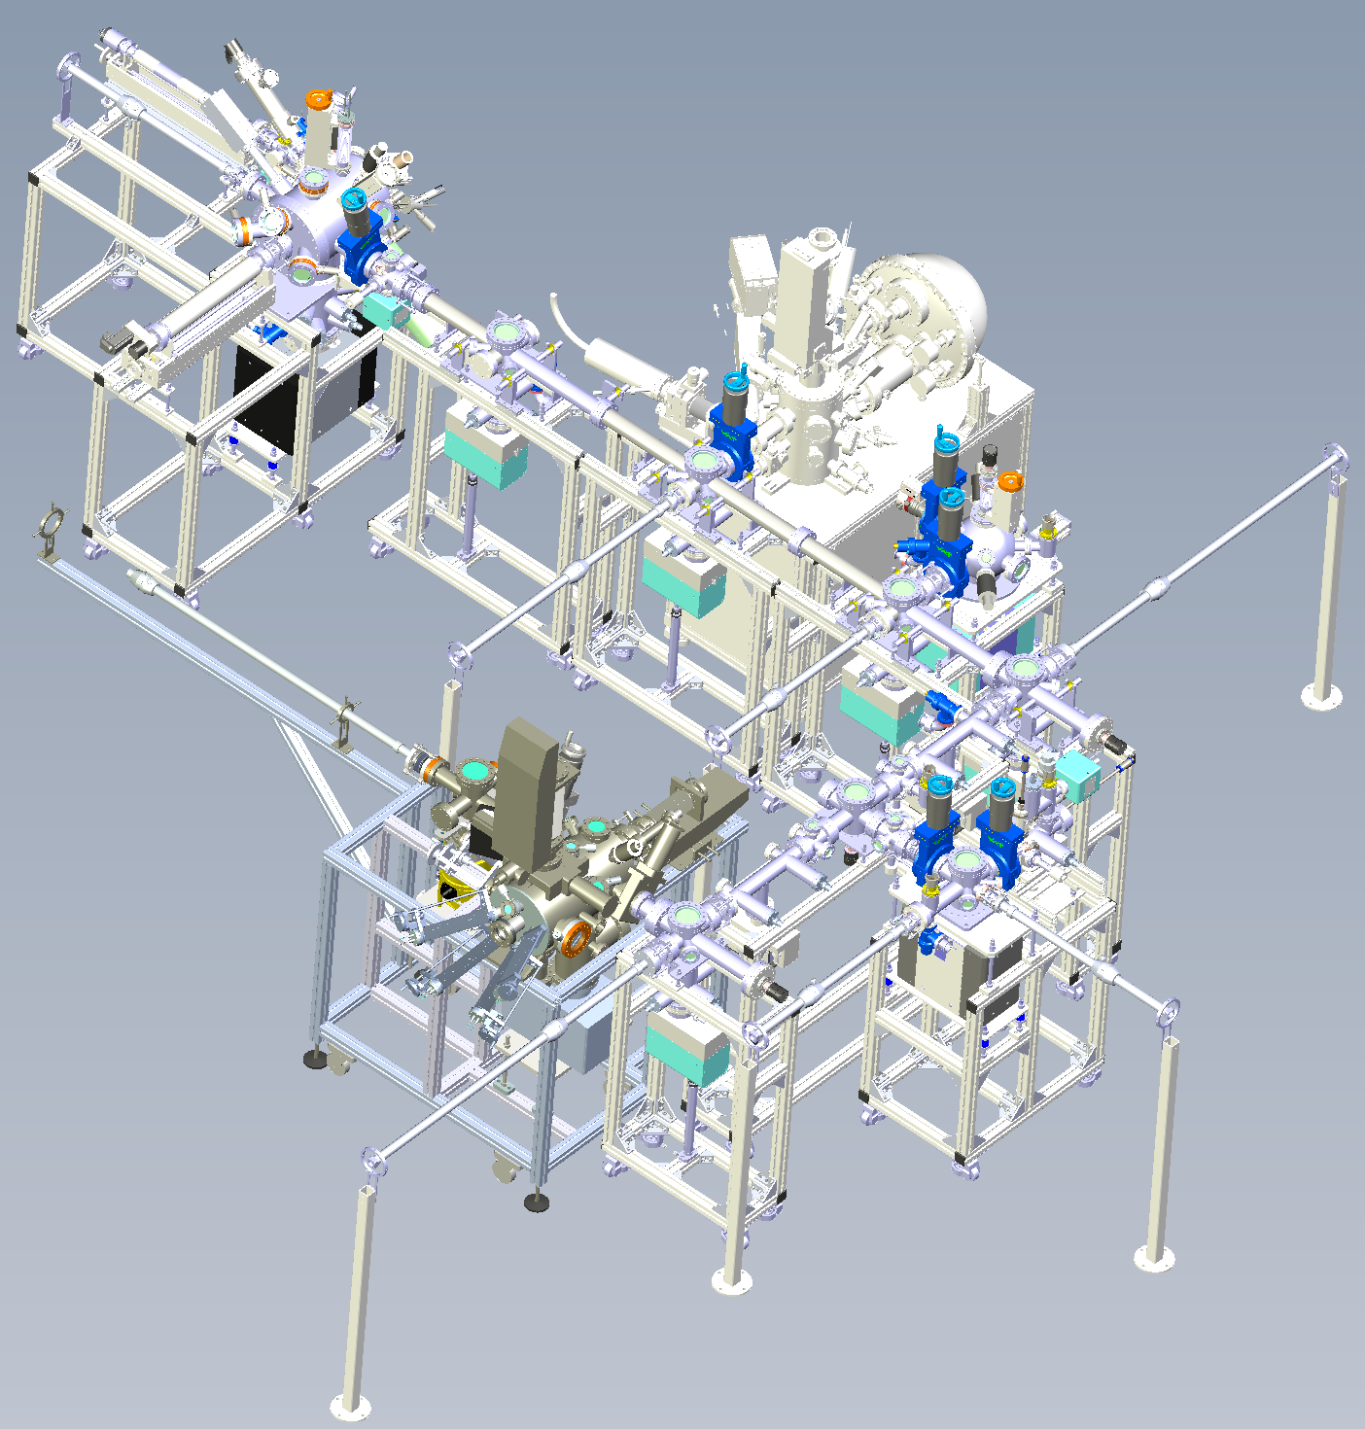
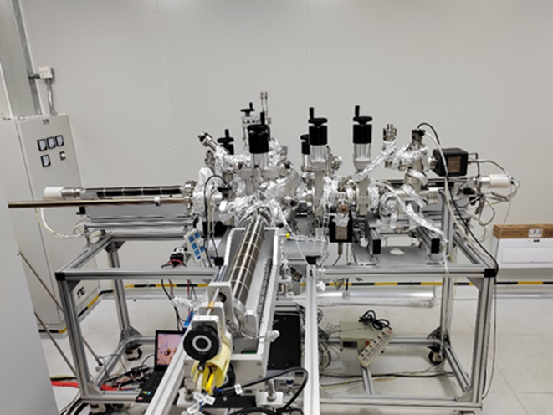
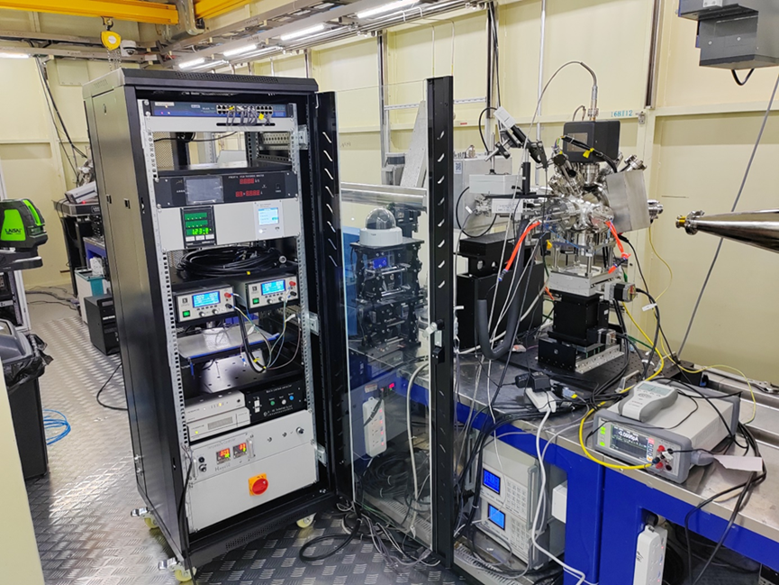
Photocathode Apparatus
Photocathode Preparation Apparatus
MBE Photocathode Preparation Apparatus
XPS
Substrate Processing Chamber
SINAP photocathode preparation apparatus
SARI photocathode preparation apparatus
Photocathode Suitcase
SINAP Photocathode Preparation Apparatus
ZJLAB photocathode preparation apparatus
SARI in-situ photocathode research apparatus
ZJLAB MBE Photocathode System

Slide 8
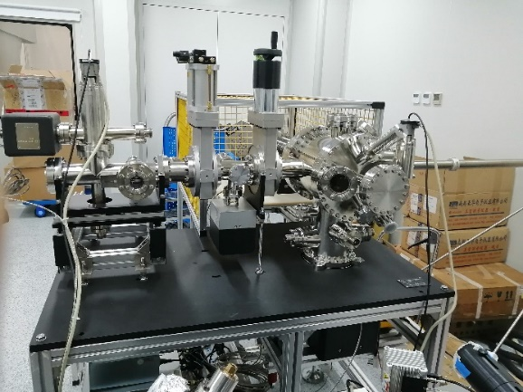
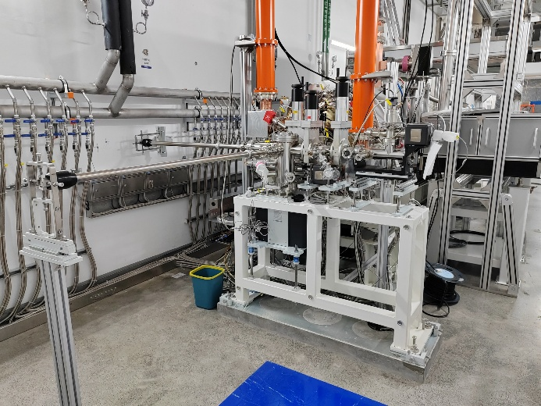
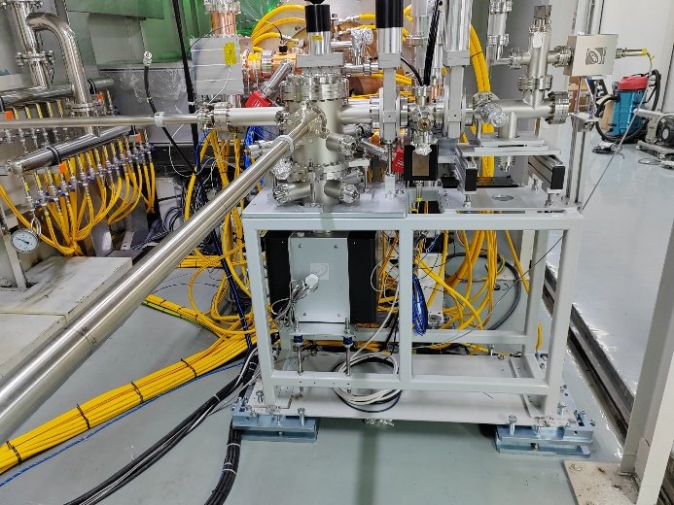
Photocathode Apparatus
SARI Photocathode Emittance Measurement Apparatus
Photocathode Transfer Apparatus
  SHINE photocathode transfer apparatus
  ZJLAB/SARI photocathode transfer apparatus
SARI photocathode emittance measurement apparatus
SHINE photocathode transfer apparatus
ZJLAB/SARI photocathode transfer apparatus

Slide 9
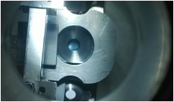
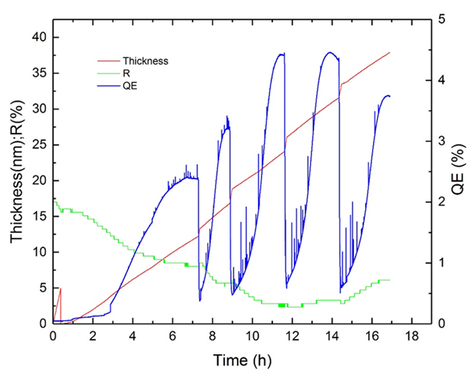
K₂CsSb Photocathode Preparation
K₂CsSb photocathode preparation
  Sequential Sb, K, Cs Deposition
  Sb, K/Cs Deposition
  Intermittent Sb, Continuous K/Cs Deposition
    Upon resolving evaporation‑source crosstalk, perform Sb, K, Cs co‑evaporation preparation
K₂CsSb
Sb, K/Cs Deposition
Intermittent Sb, Continuous K/Cs Deposition
Sequential Sb, K, Cs Deposition

Slide 10
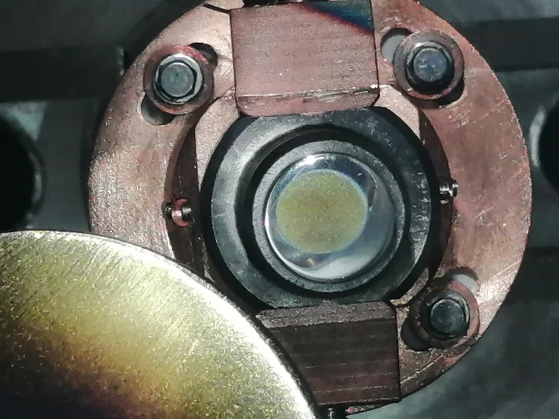
Cs₂Te Photocathode Preparation
Cs₂Te Photocathode Preparation
  Methods: Sequential Te, Cs Deposition; Intermittent Te, Continuous Cs Deposition; Te, Cs Co‑evaporation
  Substrate temperature, source deposition rate and preparation method have no effect on final Cs₂Te QE
Sequential Te, Cs Deposition
Intermittent Te, Continuous Cs Deposition
Te,Cs Co‑evaporation

Slide 11
Cs₂Te Photocathode Preparation
Cs₂Te photocathode preparation by intermittent Te and continuous Cs deposition on different apparatus
SARI photocathode preparation apparatus
SARI in-situ photocathode research apparatus
ZJLAB photocathode preparation apparatus

Slide 12
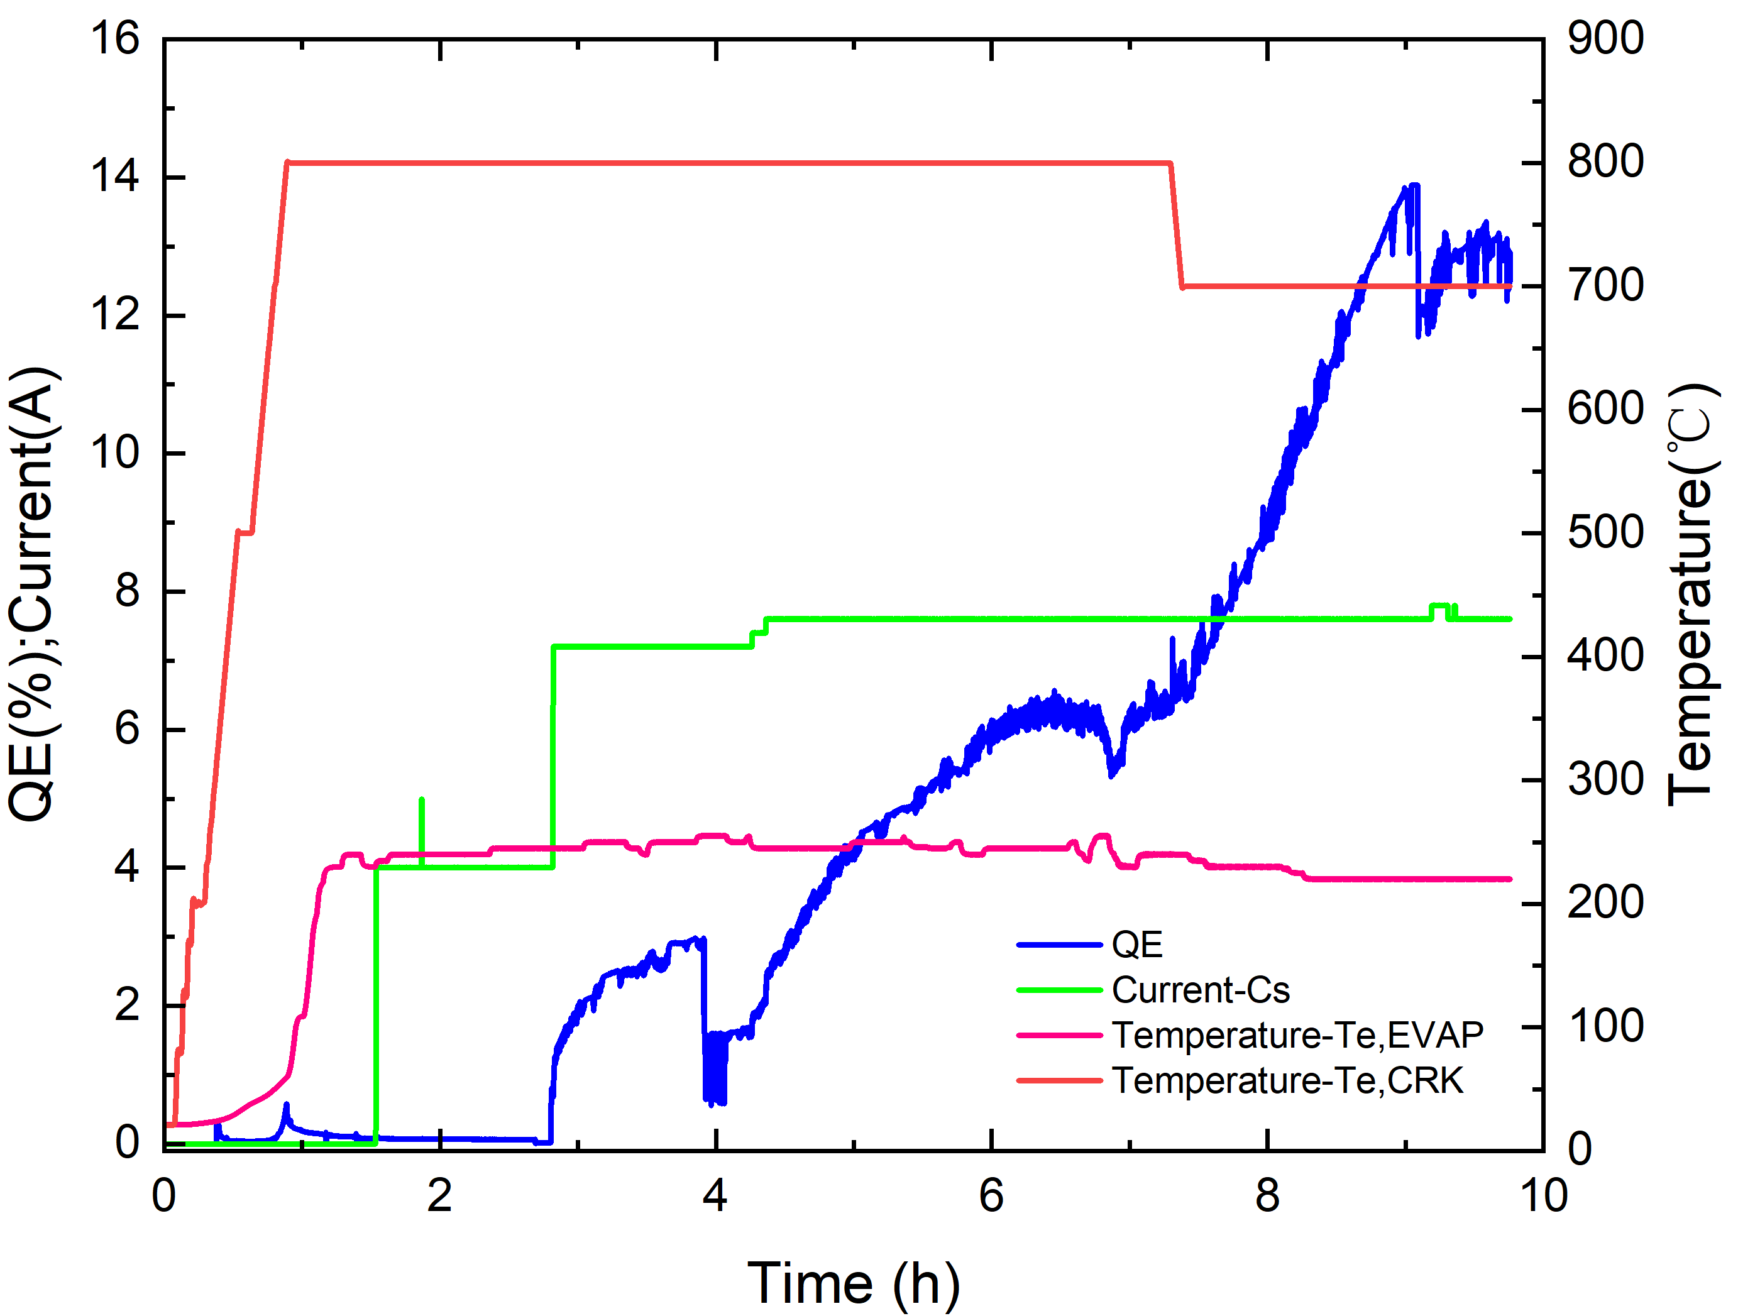
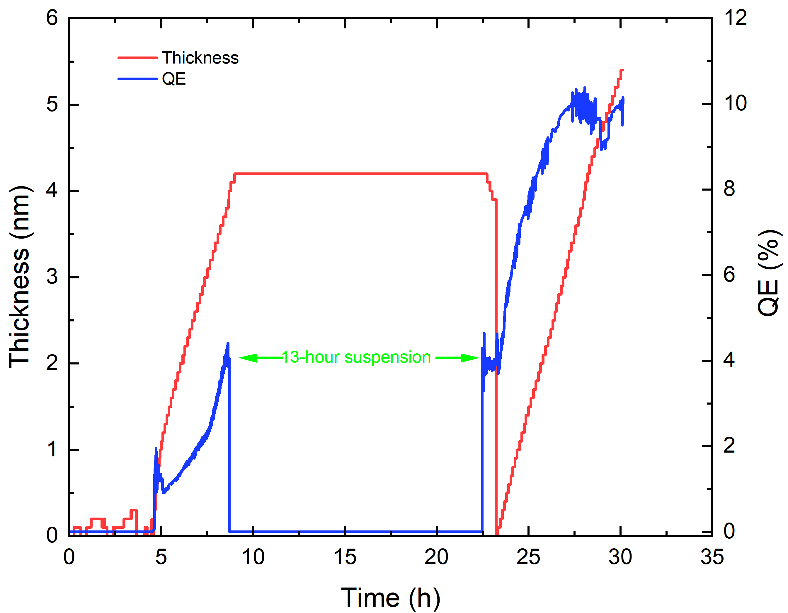
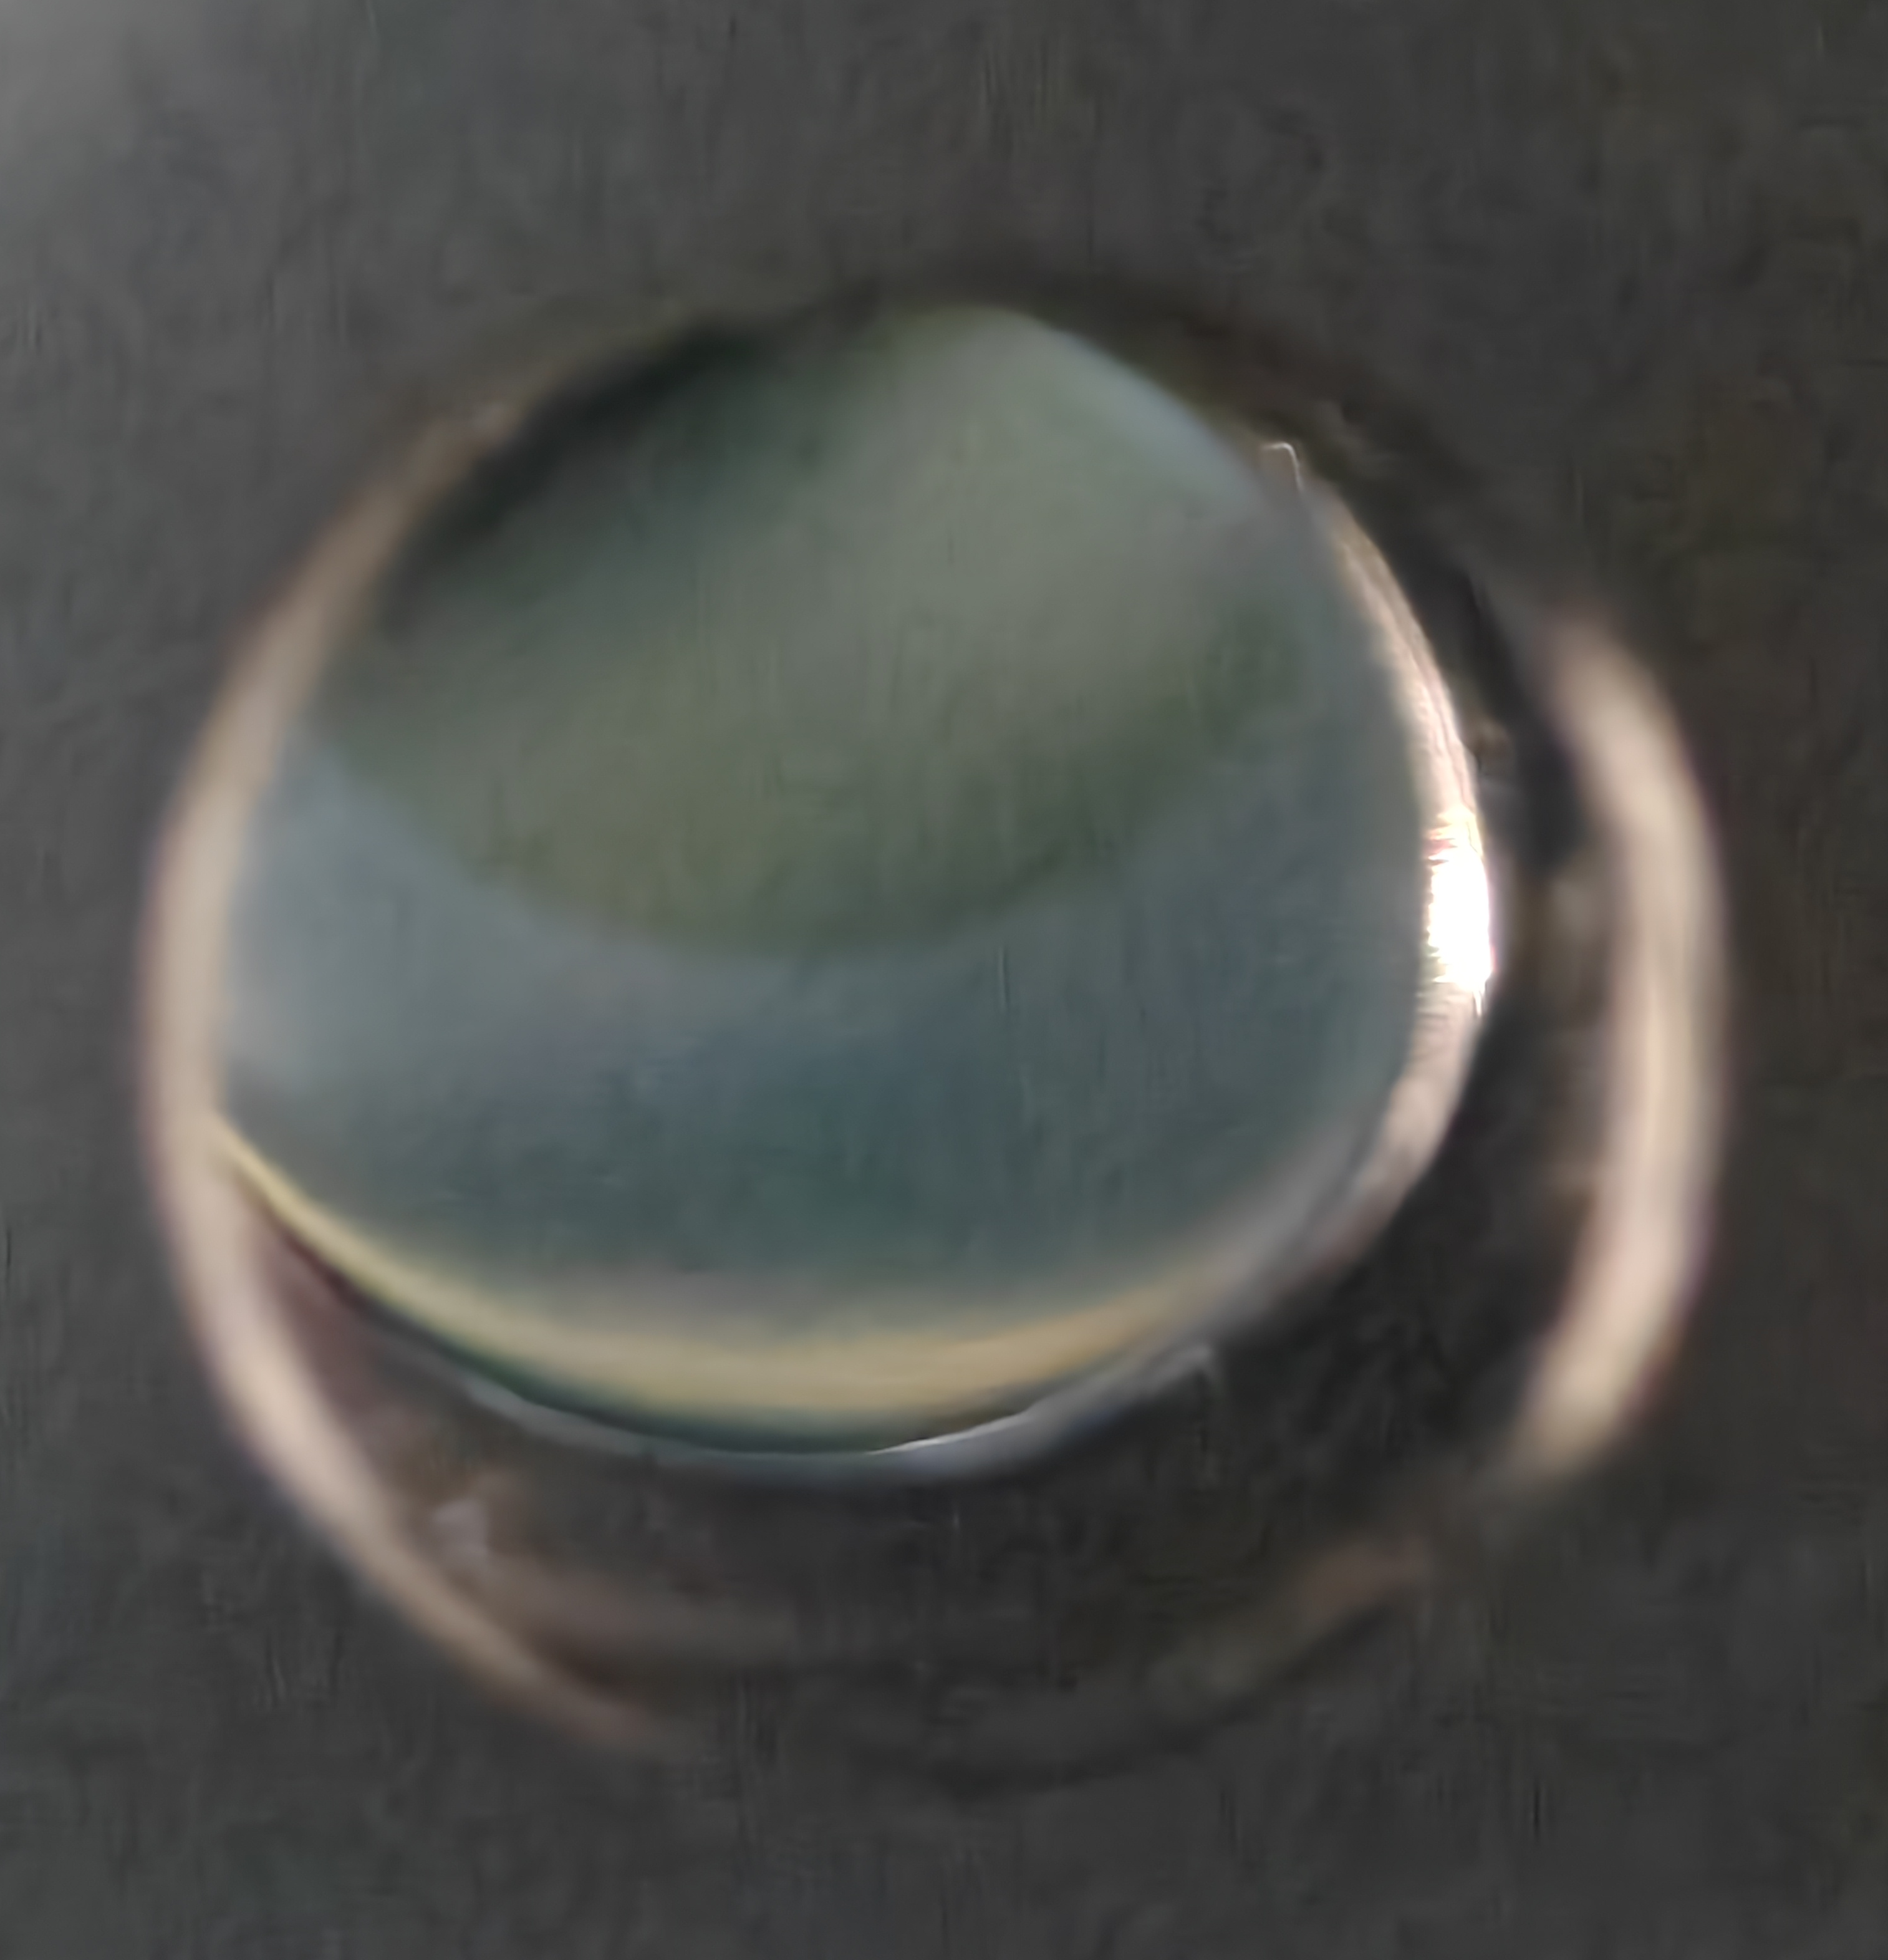
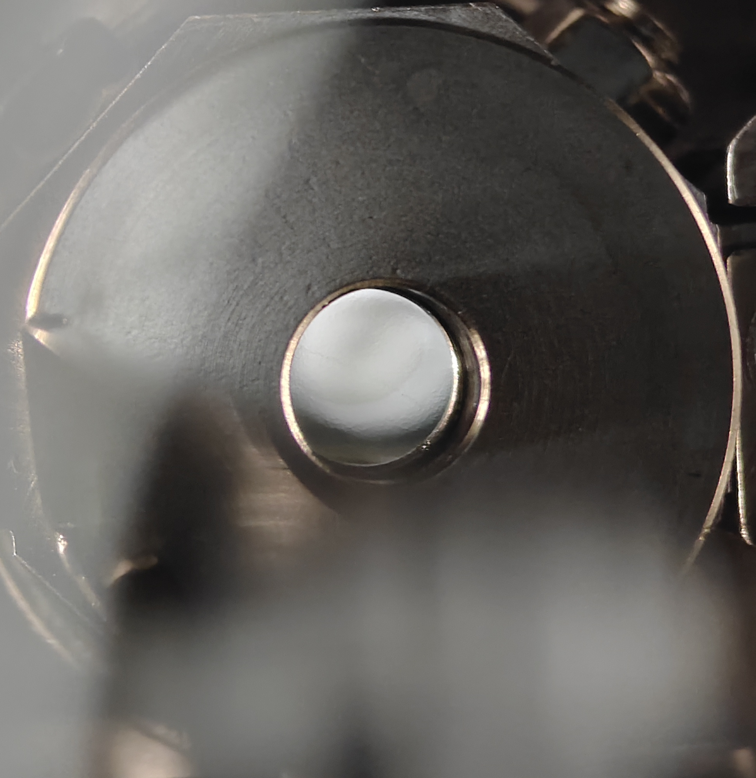
Cs₂Te photocathode co-evaporation
Problem:
  Strip‑shaped Te and Cs evaporators on one shared support exhibit severe thermal crosstalk, inhibiting Cs‑Te co‑evaporation
Solution:
  Te is placed in an independent cracker source to enable Te,Cs co‑evaporation; Te evaporation temperature and Cs heater power must be tuned appropriately
Following a period of interruption(about 13 hours), the unfinished photocathode was subsequently prepared
Cs₂Te
Cs₂Te

Slide 13
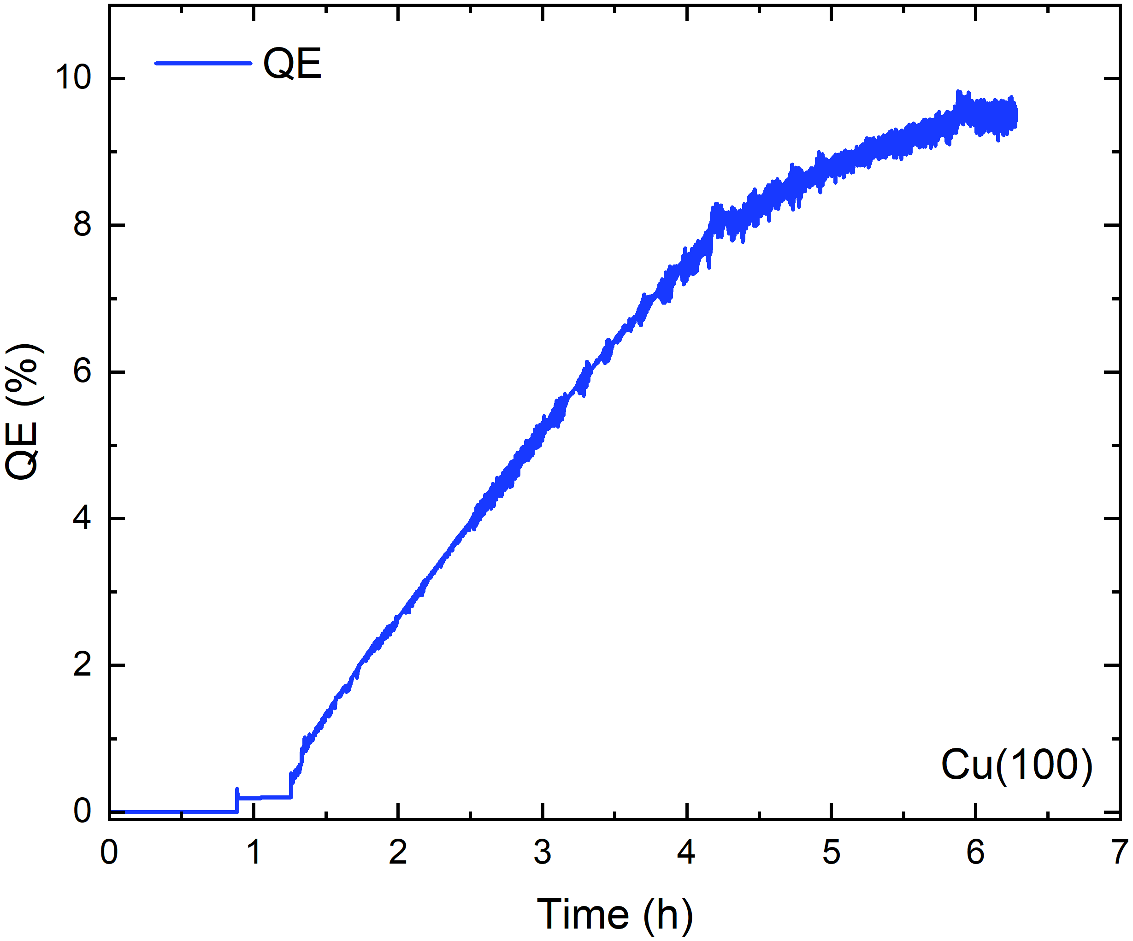
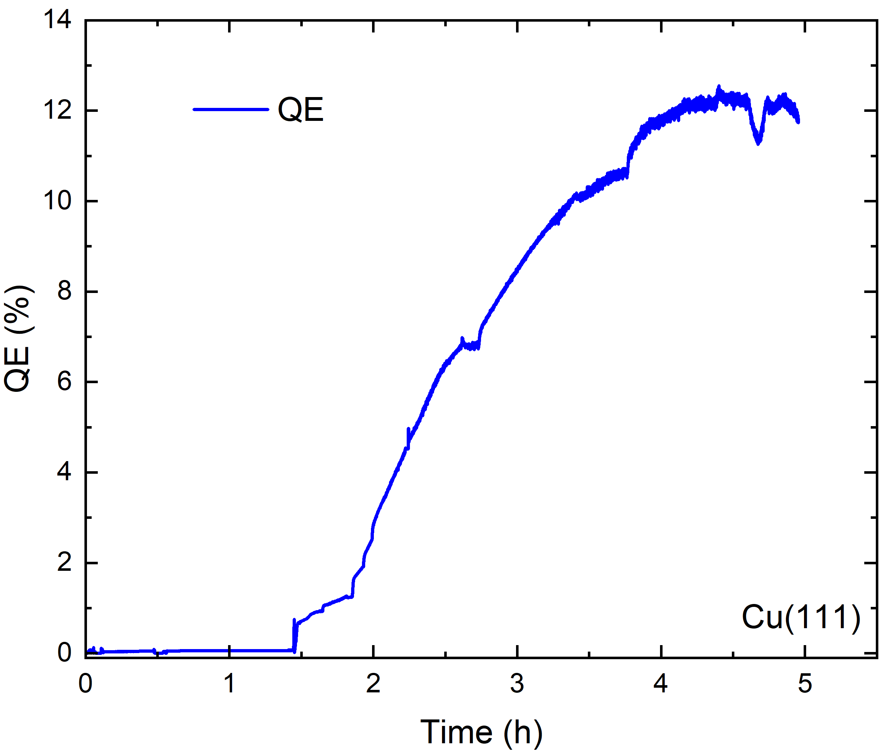
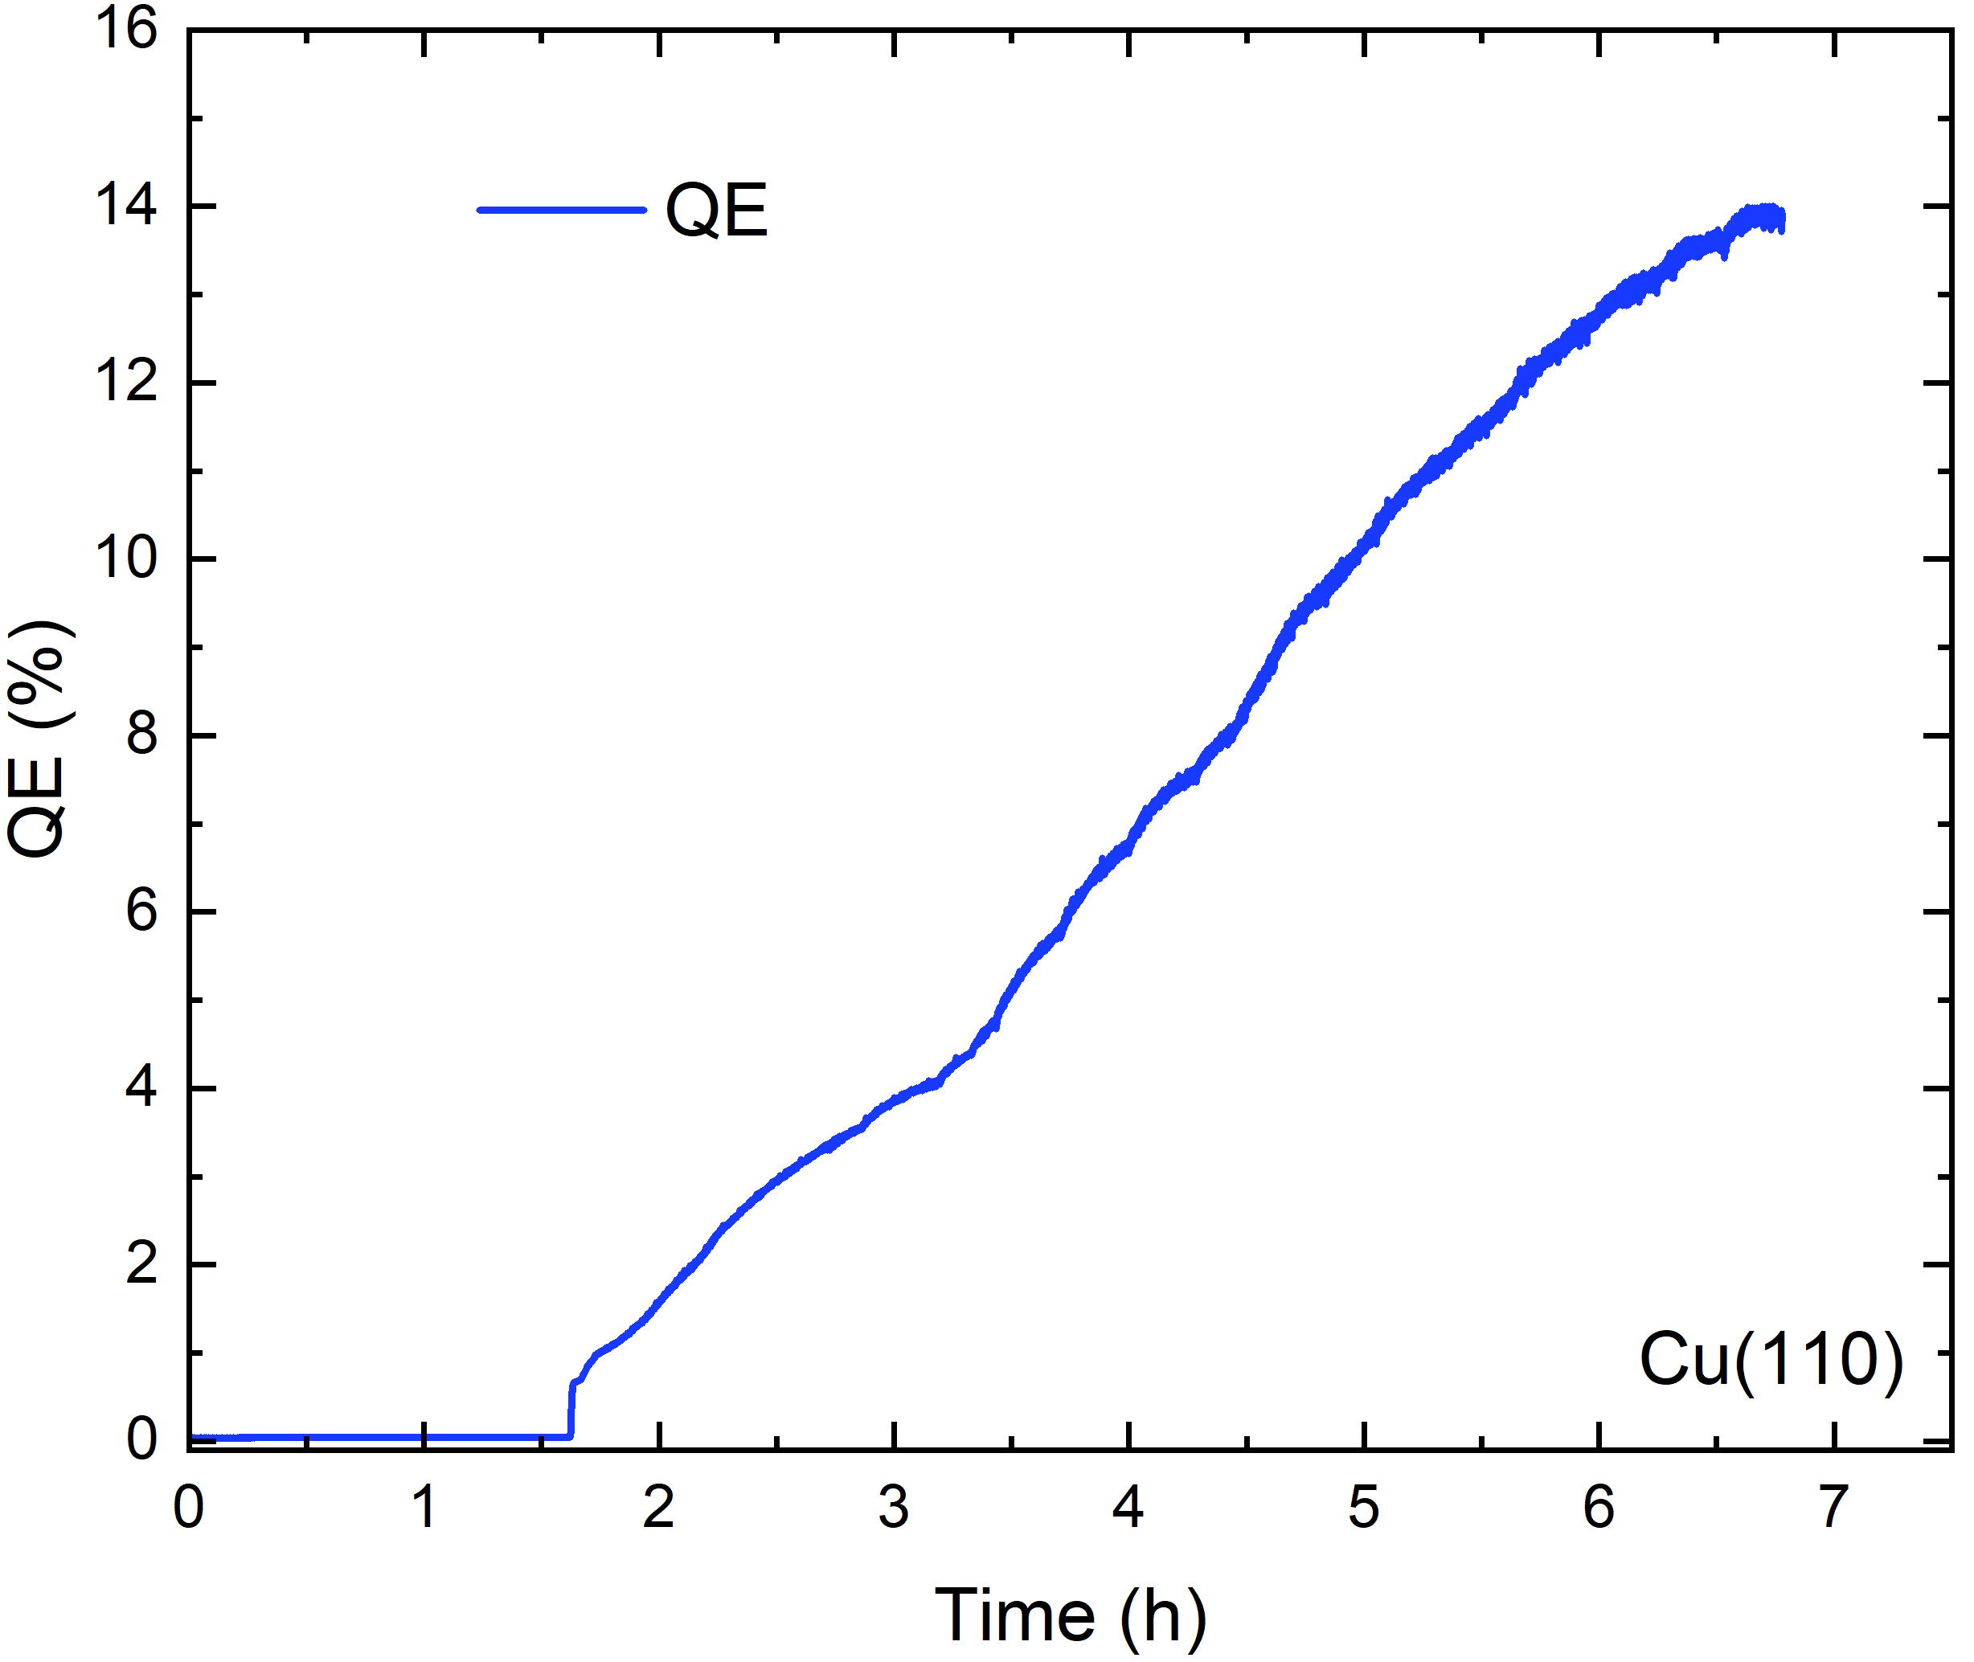
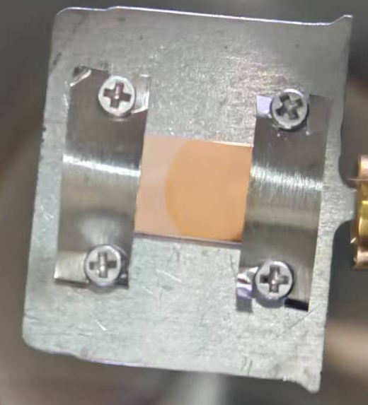
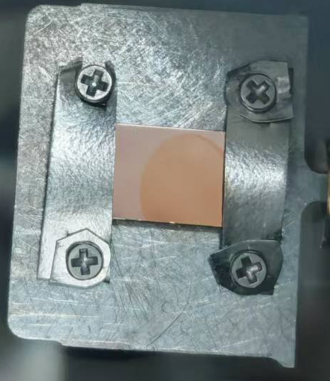
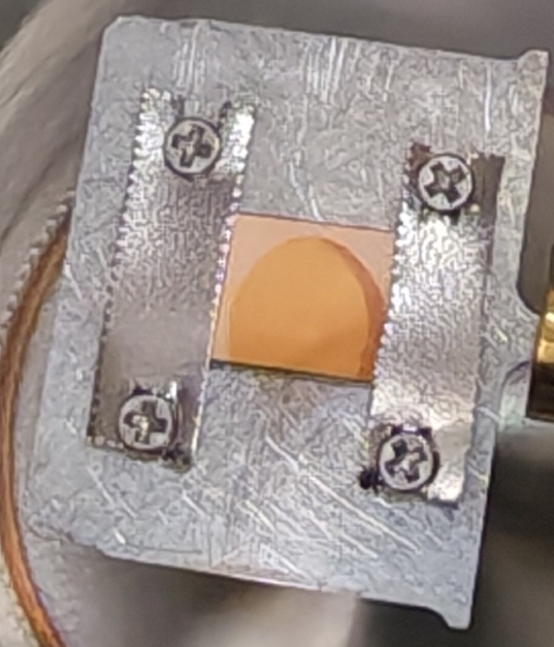
Cs₂Te photocathode preparation on single‑crystal Cu substrates
Single-crystal Cu substrates: Te (cracker) + Cs co-evaporation → Cs₂Te photocathode, QE ~10% @257 nm.
Cs₂Te photocathodes grown on Cu(100)/(111)/(110)
  Ex‑situ RHEED: substrate single‑crystal, Cs₂Te not single‑crystal
  STM: not flat surface (roughness <2 nm); single‑crystal Cu exhibits step‑terrace structure
Cu(100)/Cs₂Te
Cu(111)/Cs₂Te
Cu(110)/Cs₂Te

Slide 14
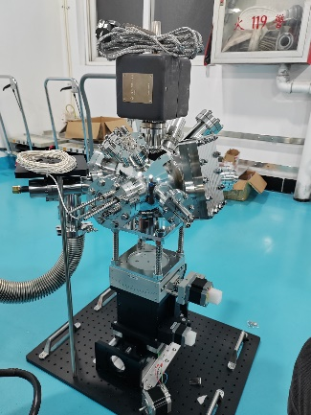
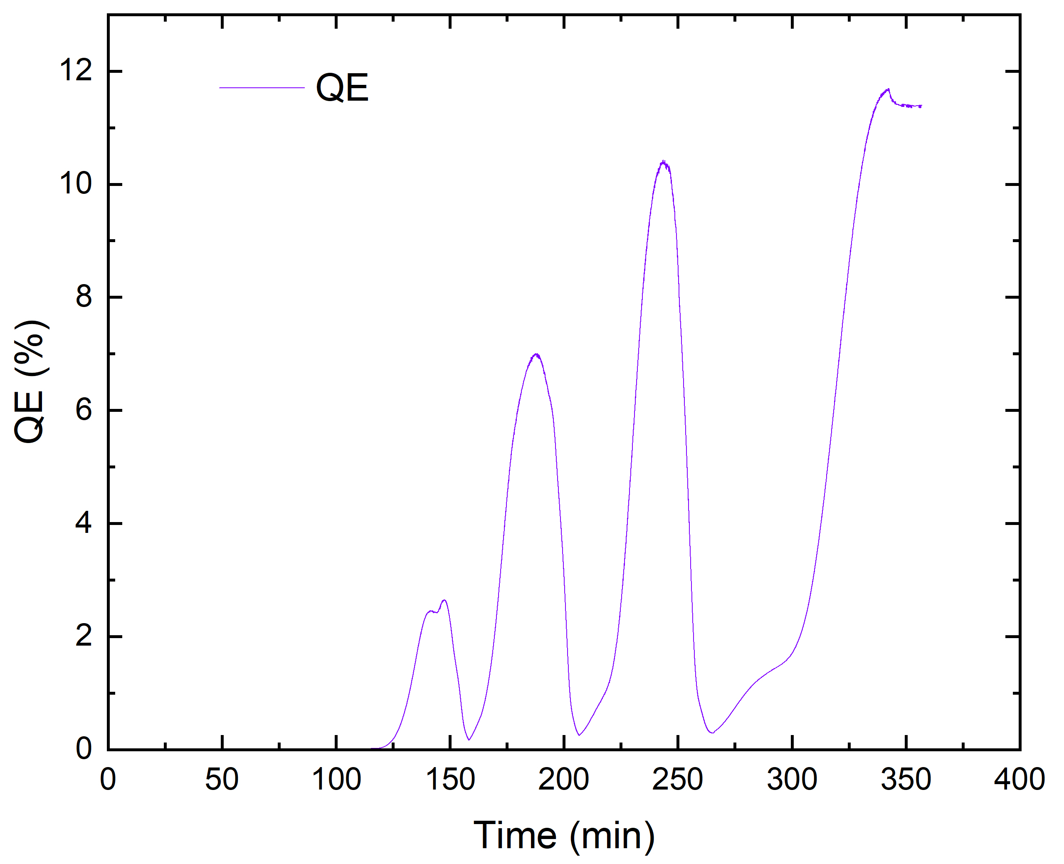
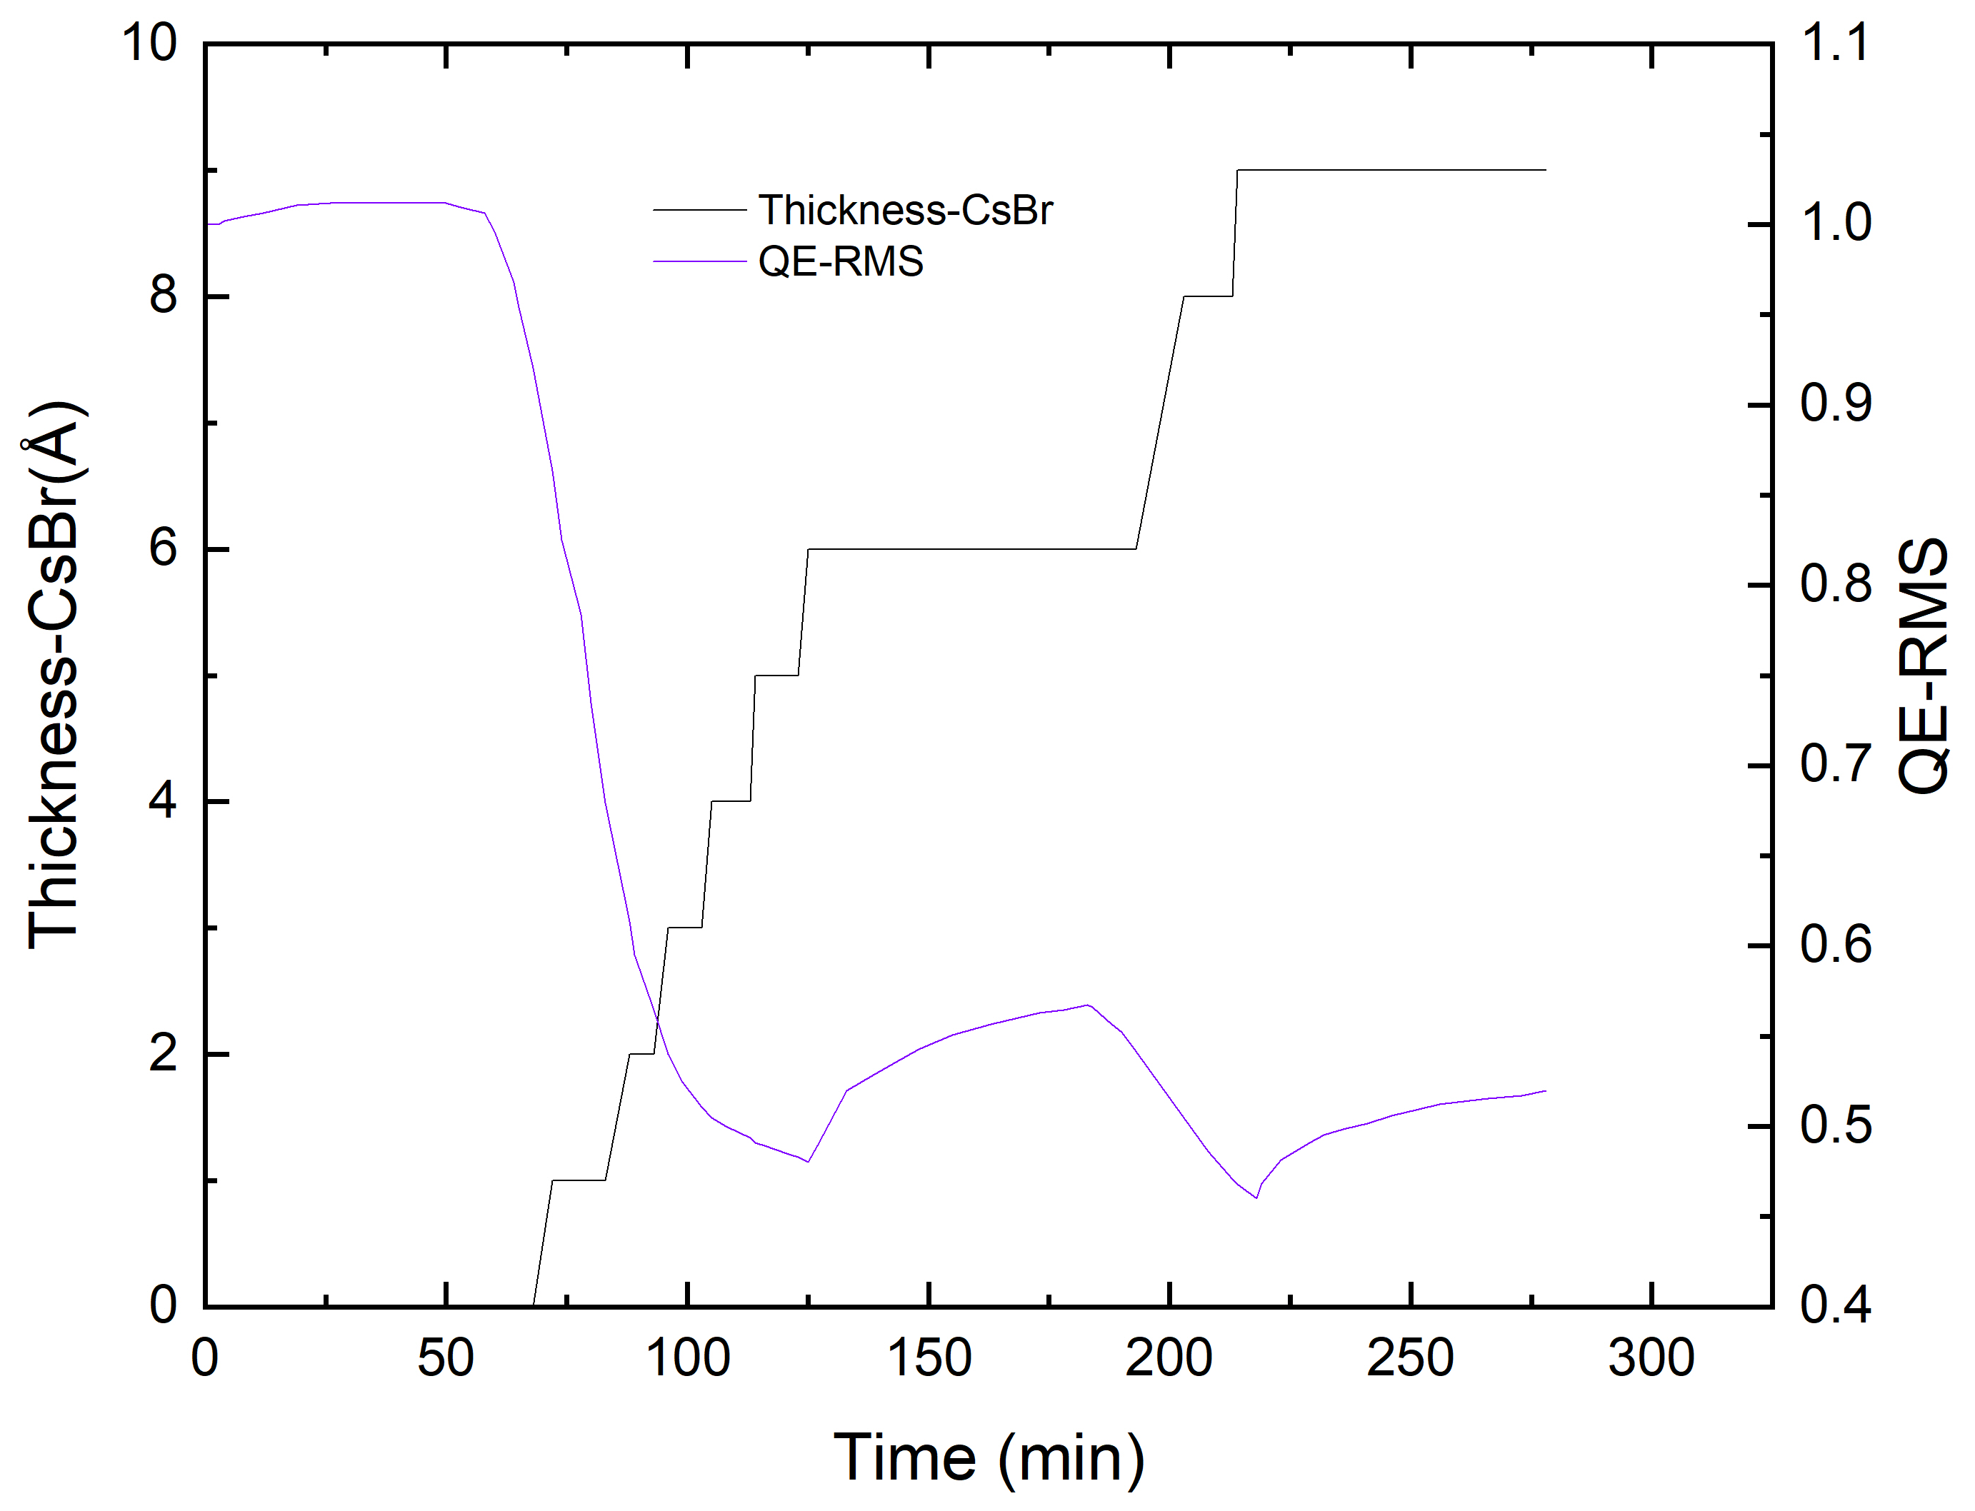
CsBr-coated Photocathode
Cs₂Te@SARI in-situ photocathode research apparatus
  Cs₂Te photocathode deposition
  Deposition of CsBr protective layer on Cs₂Te photocathode
  The temperature-dependent QE of Cs₂Te+CsBr photocathode
Cs₂Te preparation
CsBr Protective Layer Deposition
QE of Cs₂Te + CsBr Photocathode at Different Temperatures
Li X D, et al. THP3620, IPAC2026

Slide 15
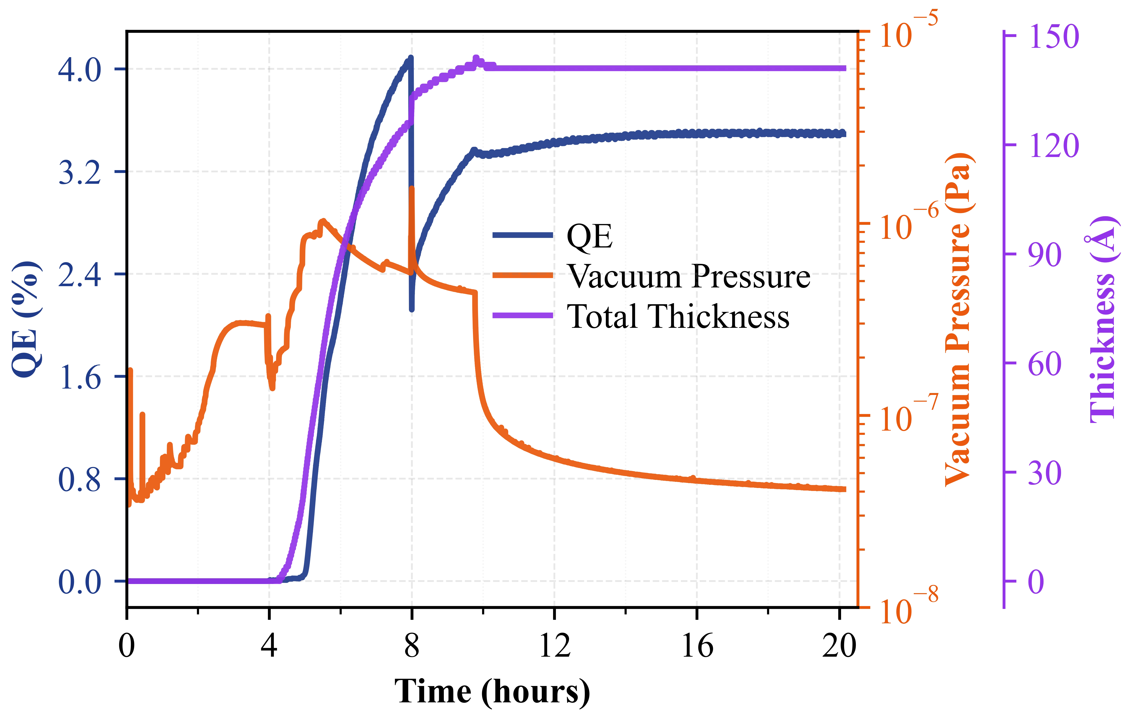
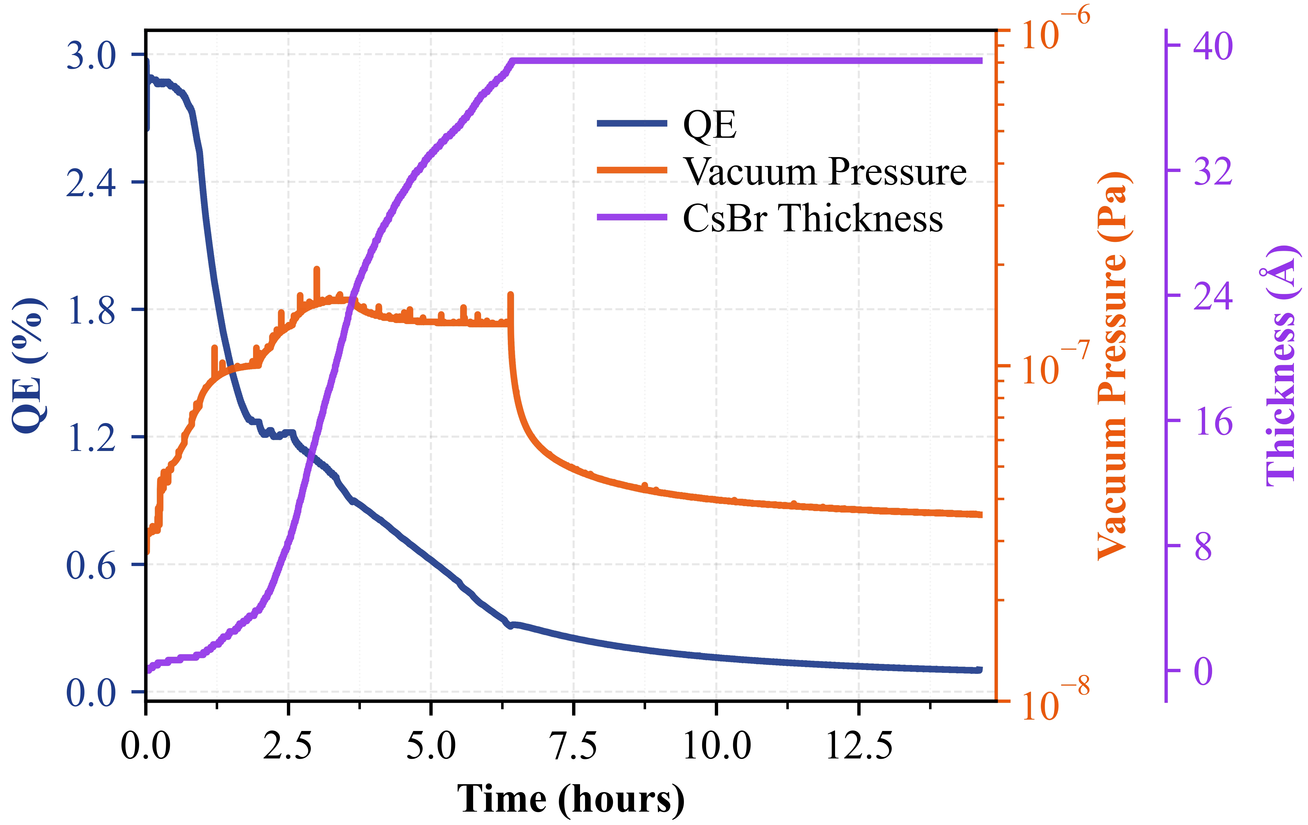
CsBr-coated Photocathode
Cs₃Sb@SARI in-situ photocathode research apparatus
  Cs₃Sb prepared by sequential deposition Sb and Cs
  Deposition of CsBr protective layer on Cs₃Sb
  QE as a function of pressure for uncoated and CsBr coated Cs₃Sb photocathode
Cs₃Sb preparation
CsBr Protective Layer Deposition
QE vs pressure for uncoated and CsBr
coated Cs₃Sb photocathodes.
Hou T, et al. TUP2668, IPAC2026

Slide 16
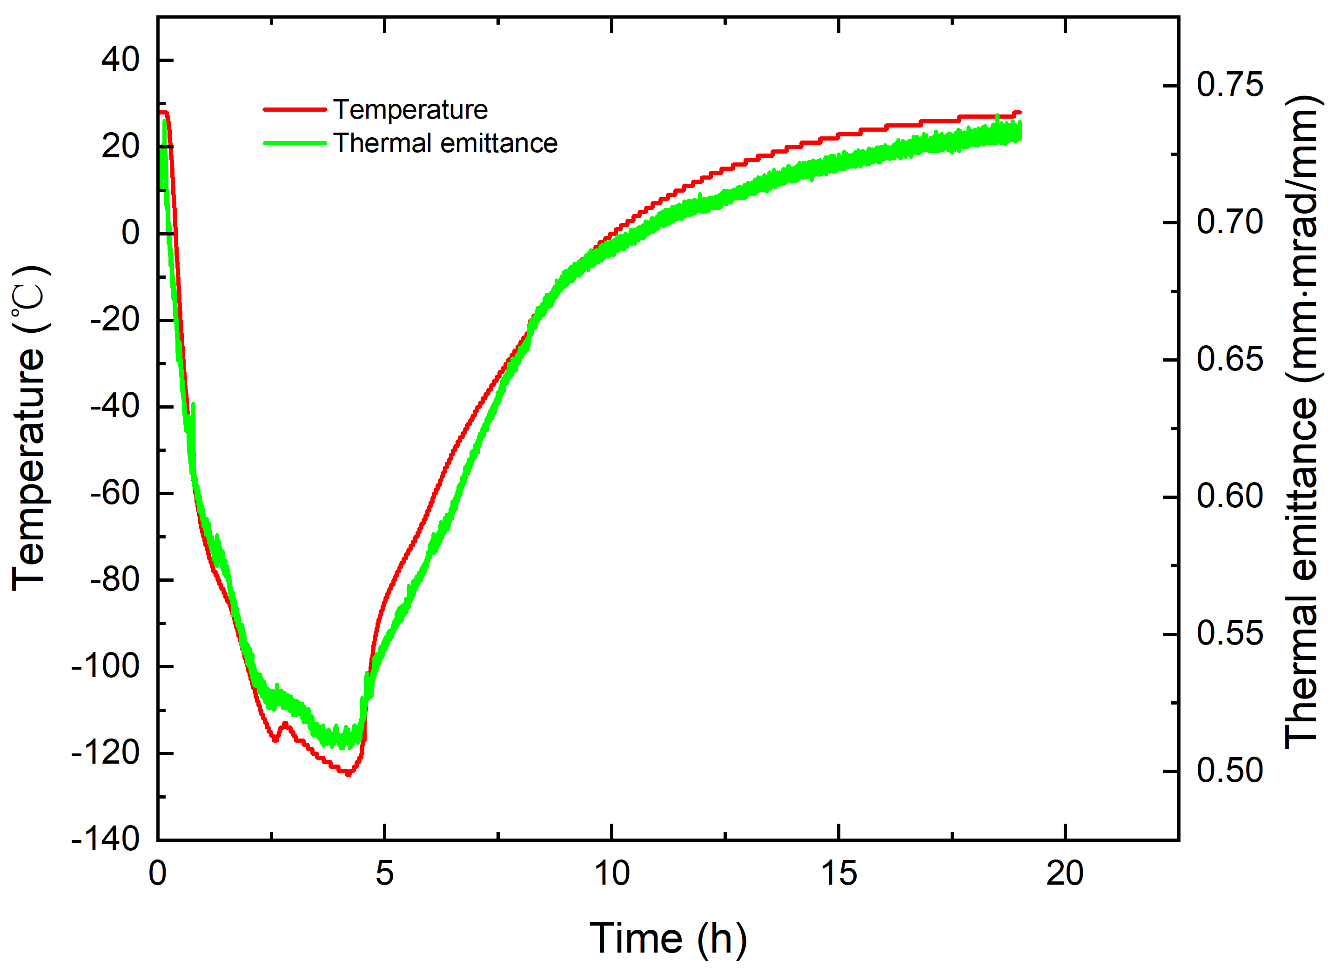
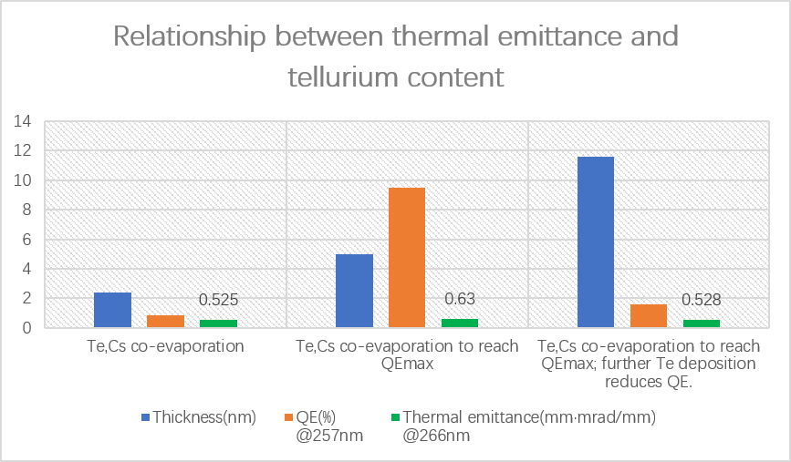
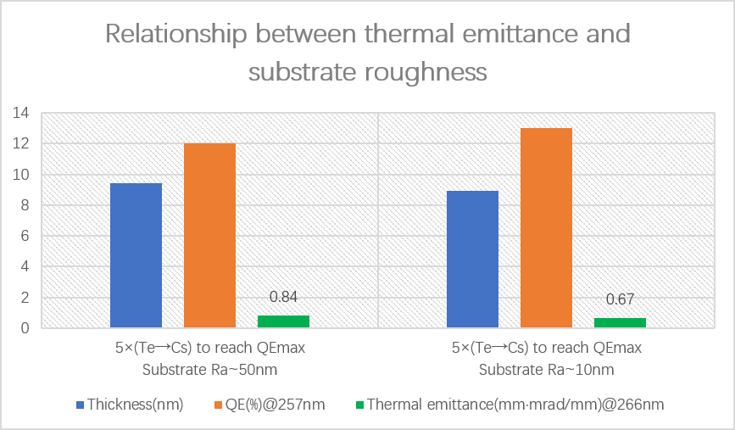
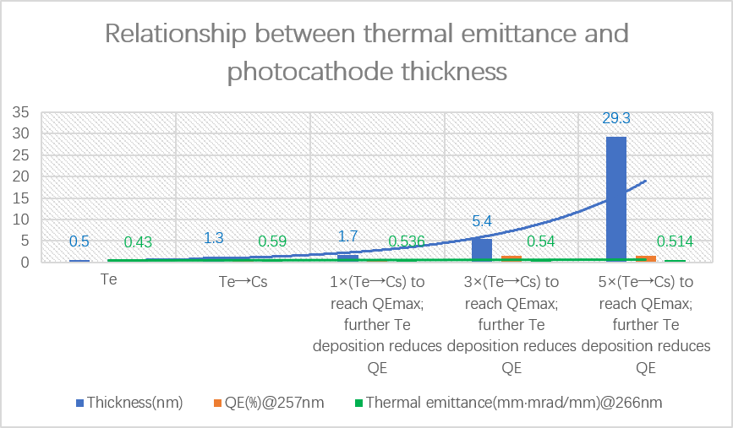
Low‑Thermal‑Emittance Cs₂Te Photocathode Development
Low‑temperature operation greatly lowers Cs₂Te photocathode thermal emittance at the cost of QE.
Operating near the photoemission threshold: lowers thermal emittance but also reduces QE
  Excess Te (Te-rich phase): higher Cs₂Te work function, lower thermal emittance
Substrate roughness significantly affects thermal emittance: smoother substrates produce lower thermal emittance
No direct correlation between thermal emittance and film thickness

Slide 17
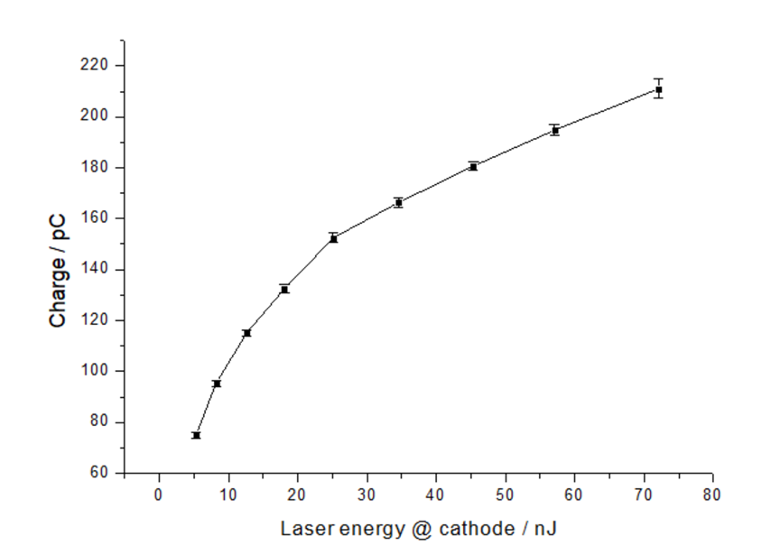
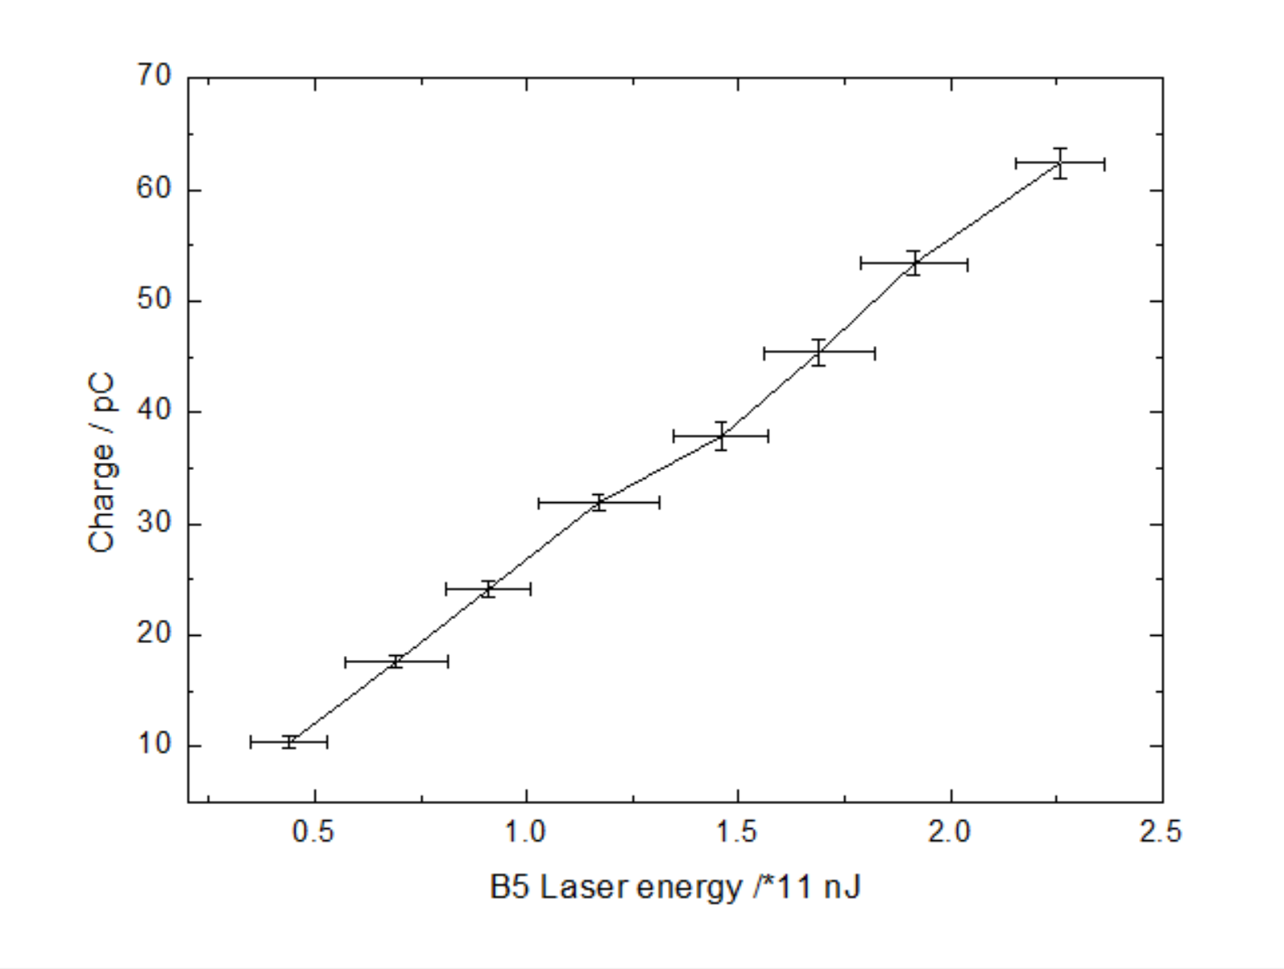
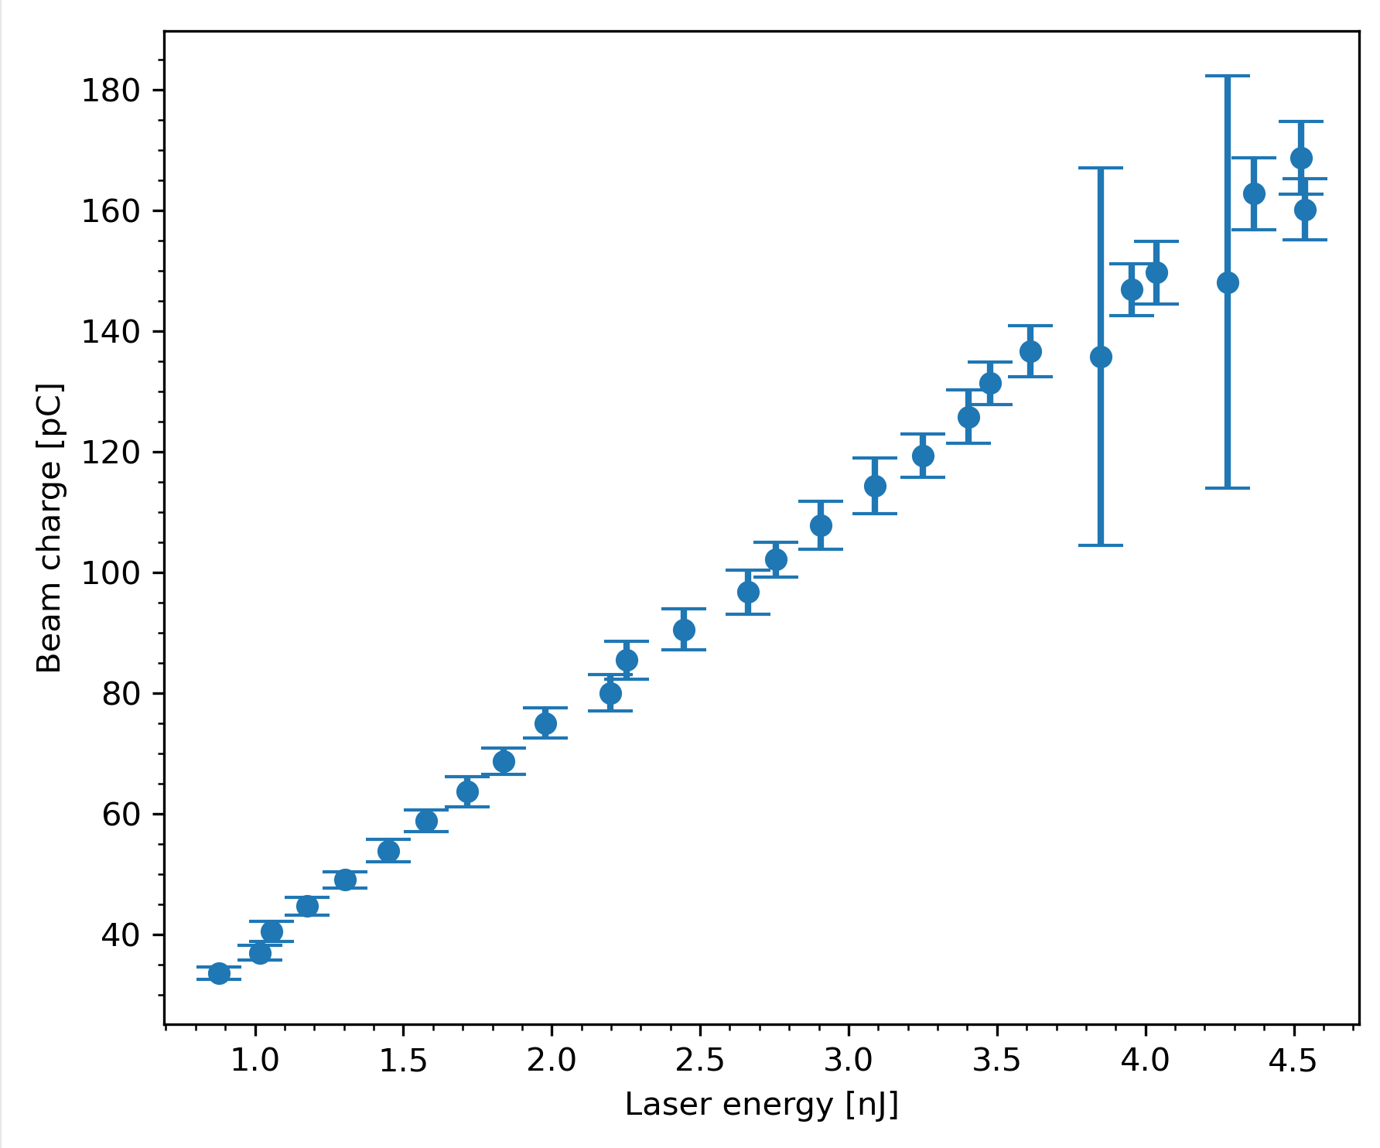
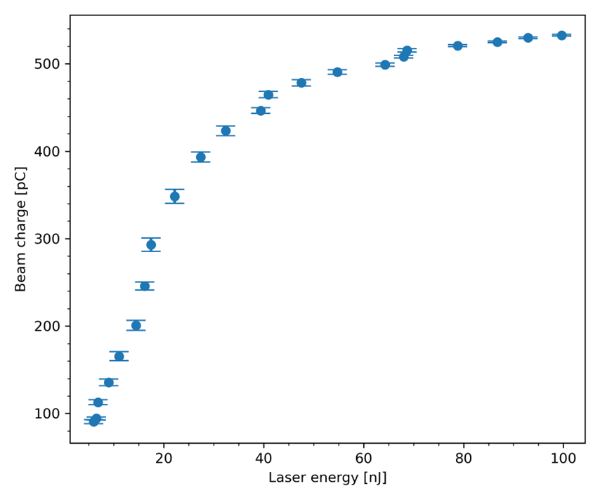
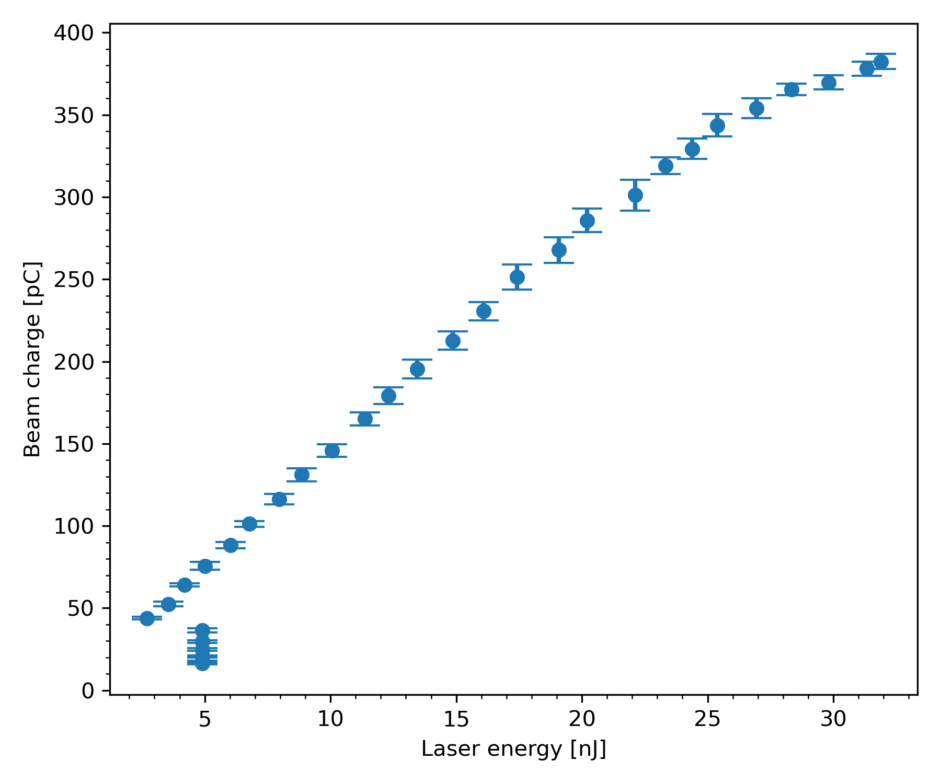
Cs₂Te Photocathode Operation @ SHINE gun
Cs₂Te photocathode operation @SHINE photocathode VHF electron gun
  Support commissioning of SHINE electron gun, injector, Linac and undulator
1 Dec 2023
Mo plug(Ra~50mm)：36.5nm(Not over-inserted)
14 Jan 2024
Mo plug(no polishing)：36.5mm(Not over‑inserted)
25 Sep 2024
SS plug(Ra~10nm)：37mm(0.5mm over-inserted)
Objective：
Objective:
25 Nov 2024
Mo plug(Ra~15nm)：37mm(0.5mm inserted)
Objective：
QE=11%@255nm(Preparation chamber）
QE=10%@255nm(Preparation chamber）
QE=7.5%@255nm(Preparation chamber）
QE=18%@255nm(Preparation chamber）
Objective：
Cs₂Te Photocathode Dark Lifetime (SHINE VHF Gun)
Dark current: up to 5 μA
SHINE Injector Commissioning
Gun dark current: abrupt rise 20 nA → 400 nA (during commissioning)
SHINE Injector Commissioning
Gun dark current: < 2 nA
25 Jun 2025
Mo plug(Ra~15nm)：37mm(0.5mm over-inserted)
Objective：
QE=5%@255nm(Preparation chamber）
Linac and undulator commissioning
QE=18%@257.5nm(Electron gun）
QE=10%@257.5nm(Electron gun)
QE=12.5%@257.5nm(Electron gun）
QE=7.5%@257.5nm(Electron gun）
QE=7.5%@257.5nm(Electron gun）
SHINE VHF Gun Commissioning
dark current: < 2 nA (25 Jun 2025) → < 3 nA (26 Jun 2026)

Slide 18
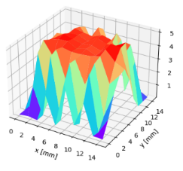
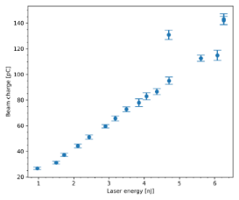
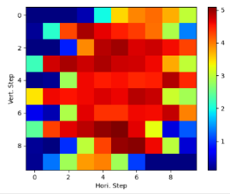
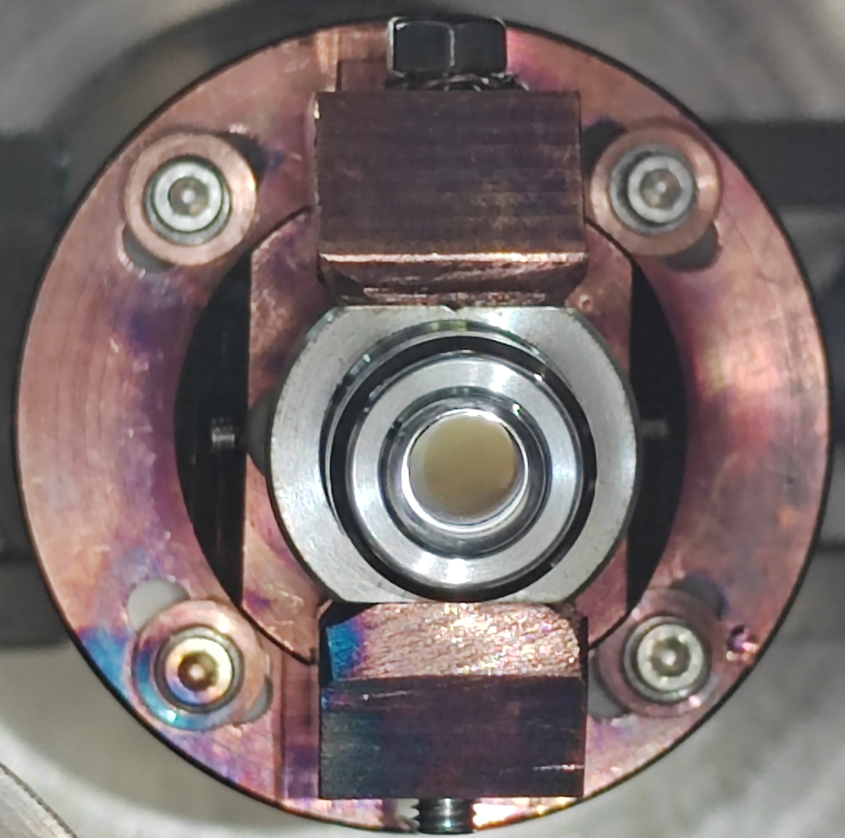
Cs₂Te Photocathode Operation @SHINE gun
Cs₂Te operation @SHINE VHF electron gun（Prepared on 4 Nov 2024）
  Injector Commissioning and Acceptance, 22‑23 Dec 2024
QE map
Photoemission Curve：QE>10%
50pC/4ps/12.5A | 1 | 2 | 3 | Average | unit
Proj. Emittance @x | 0.40 | 0.40 | 0.44 | 0.413±0.026 | mm mrad
Proj. Emittance @y | 0.50 | 0.51 | 0.52 | 0.51±0.0096 | mm mrad
Slice Emittance @y | 0.328 | 0.268 | 0.384 | 0.327±0.094 | mm mrad
100pC/10ps/10A
Proj. Emittance @x | 0.62 | 0.53 | 0.57 | 0.573±0.037 | mm mrad
Proj. Emittance @y | 0.55 | 0.56 | 0.55 | 0.55±0.0047 | mm mrad
Slice Emittance @y | 0.413 | 0.522 | 0.433 | 0.456±0.047 | mm mrad
Emittance

Slide 19
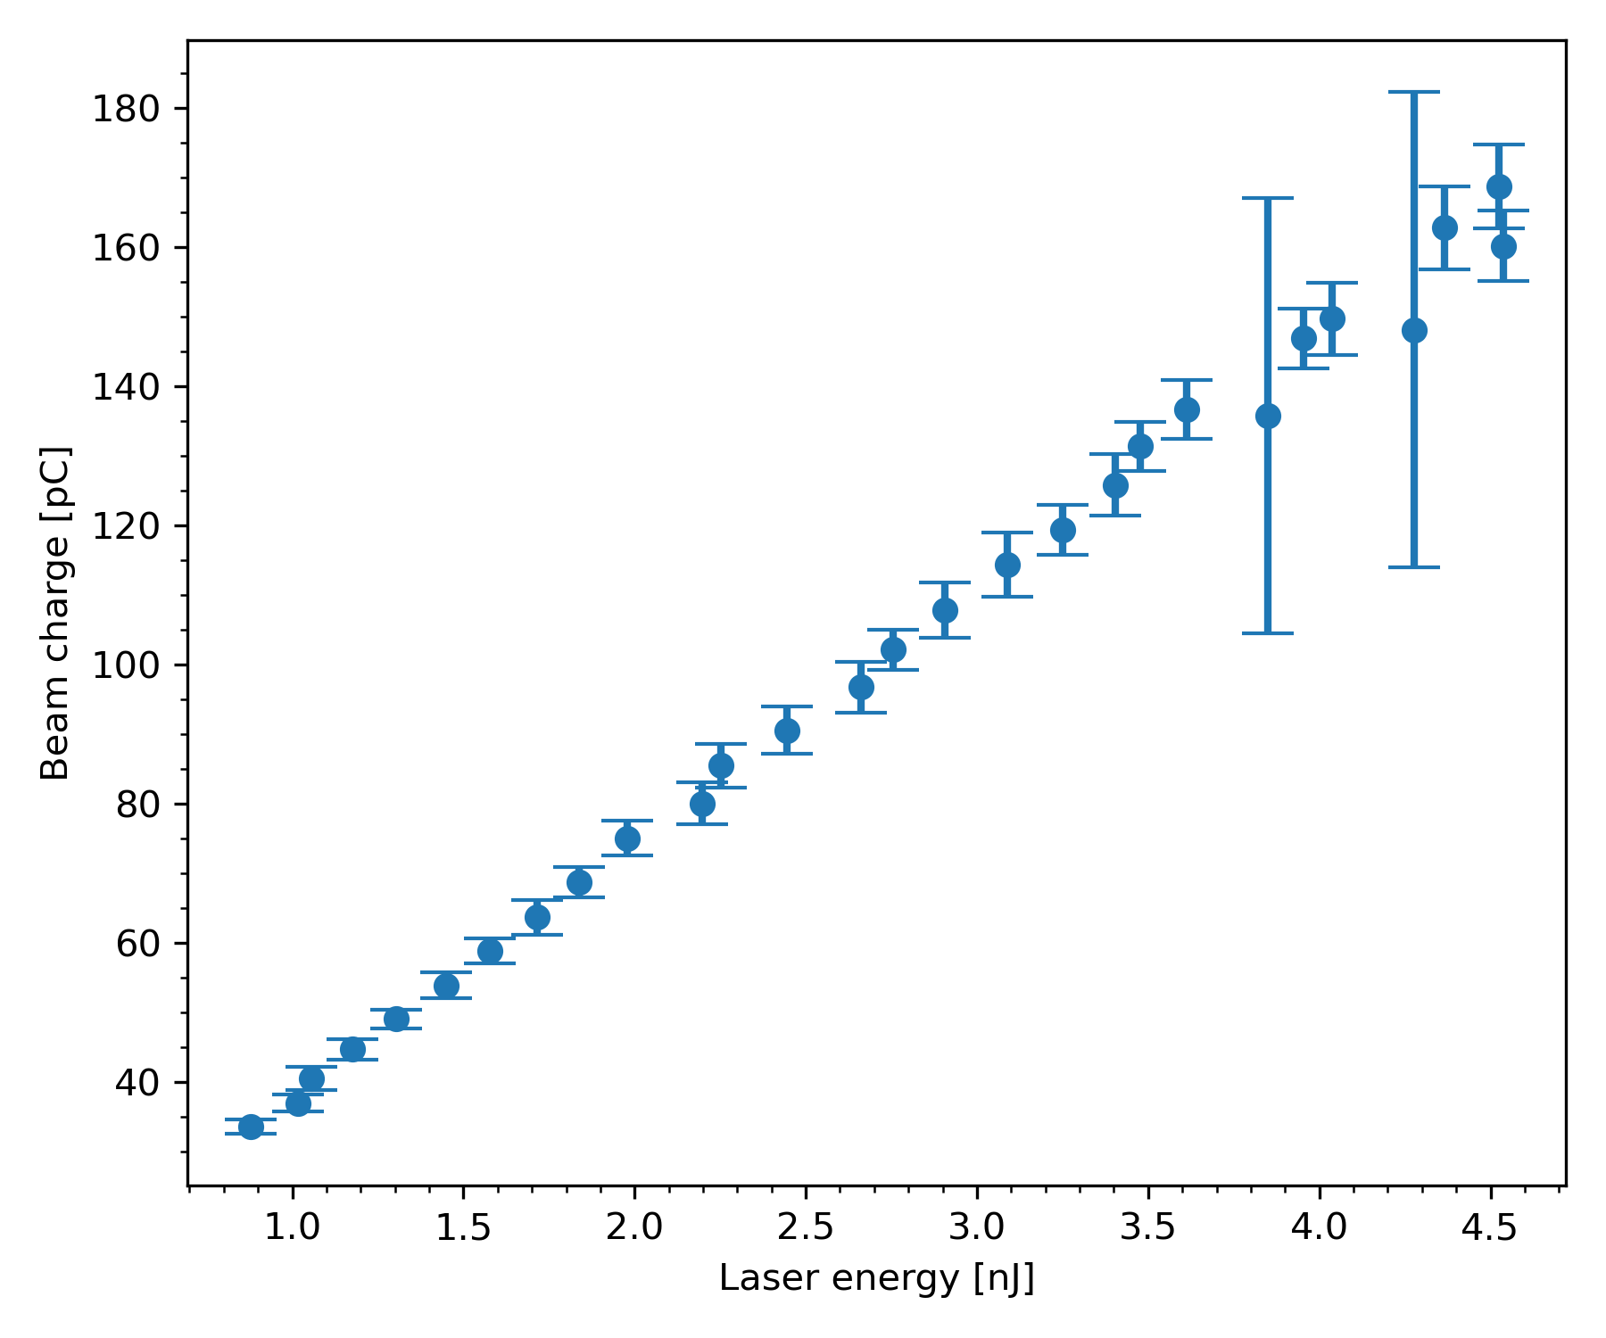
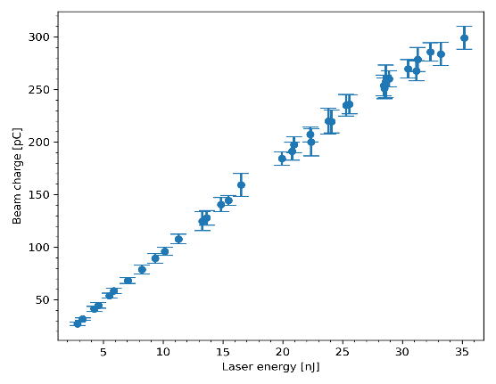
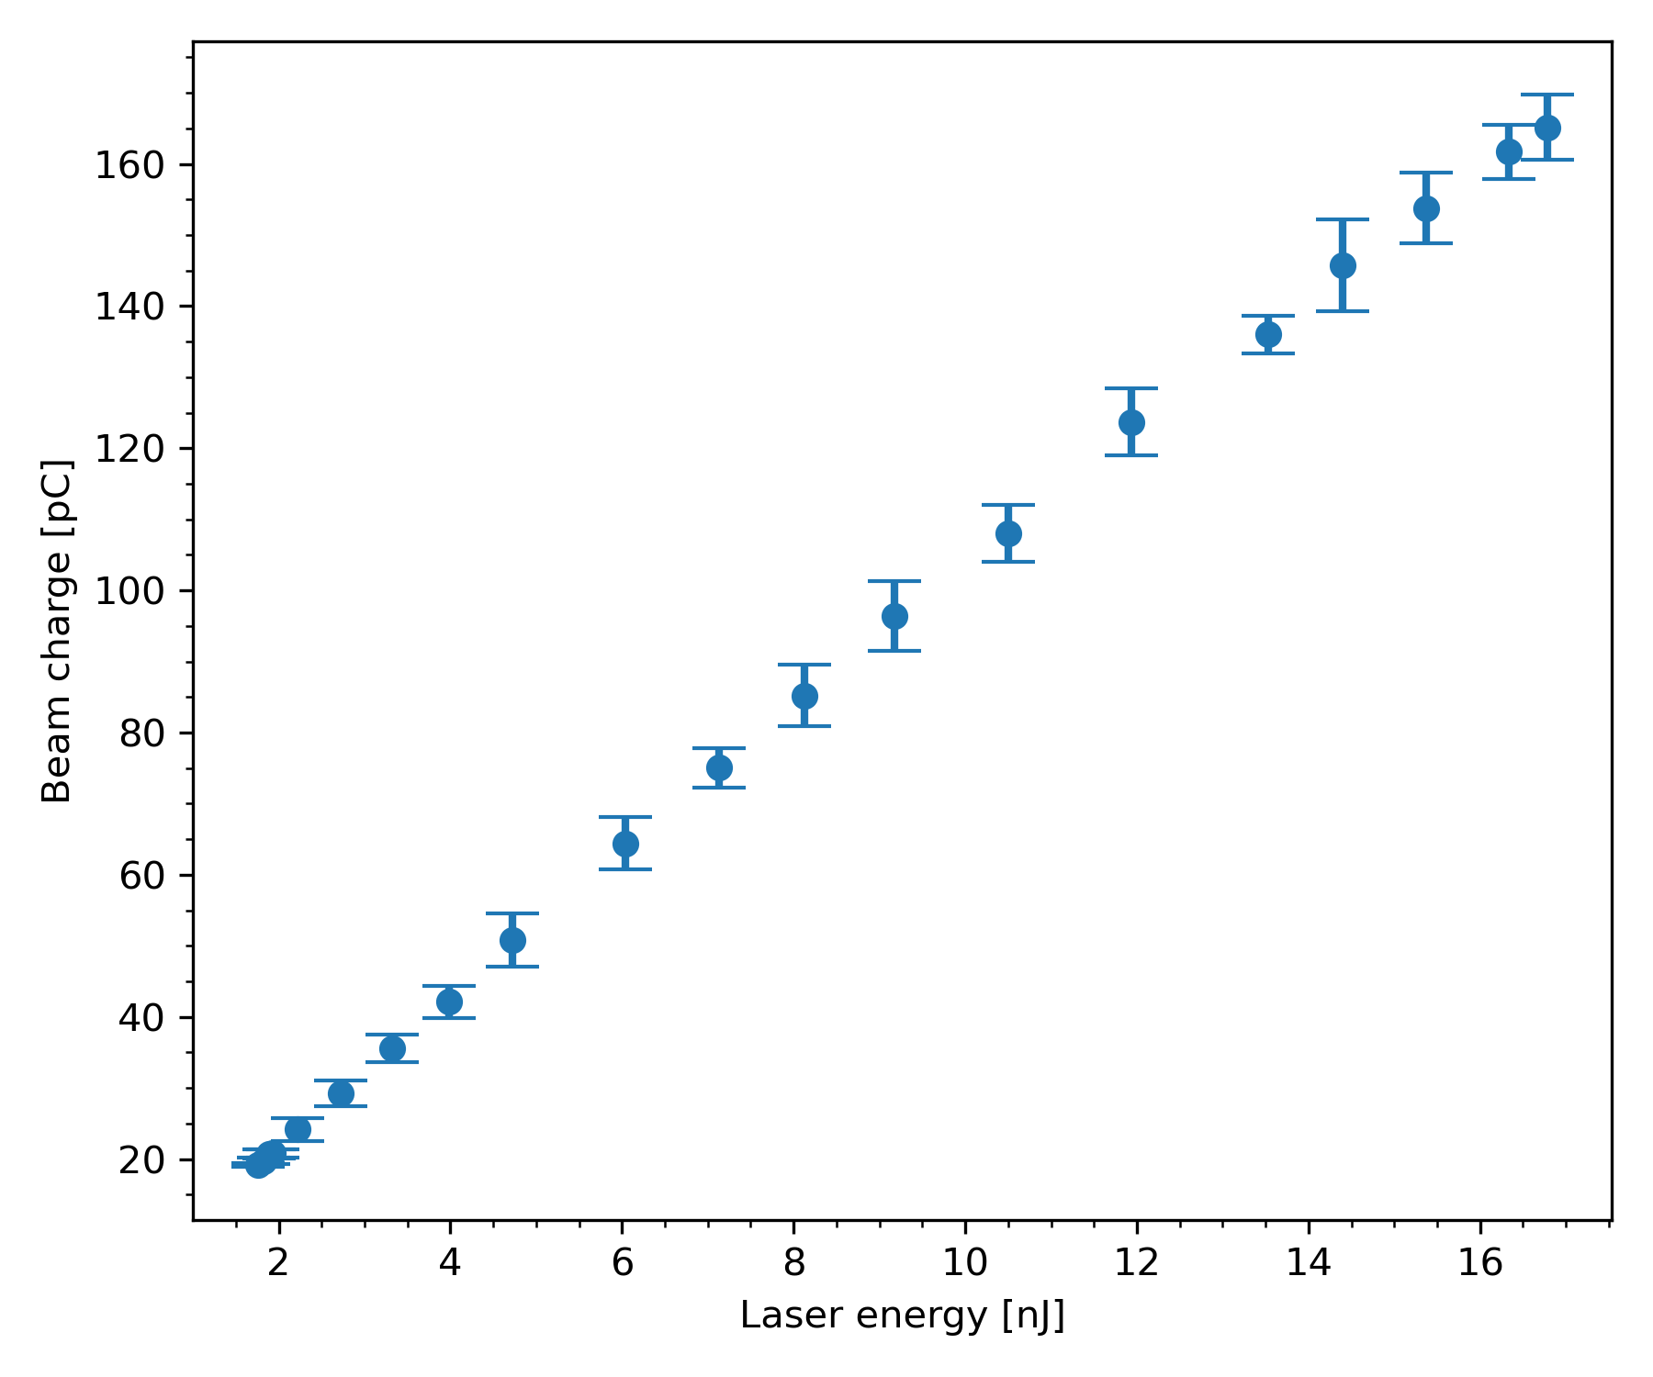
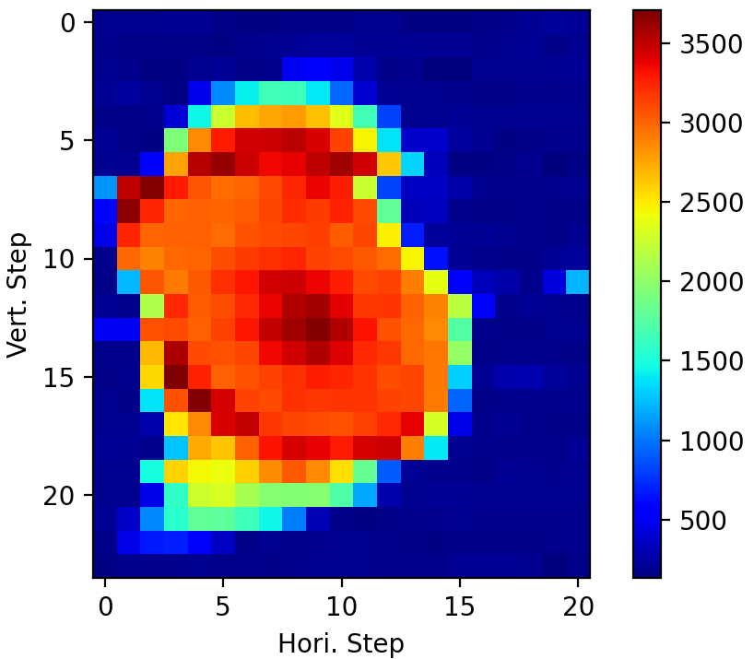
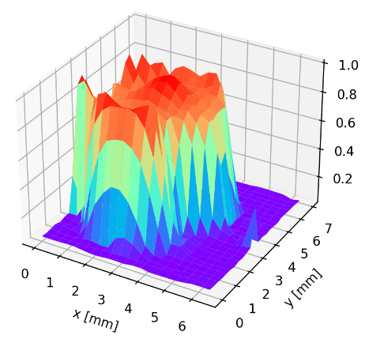
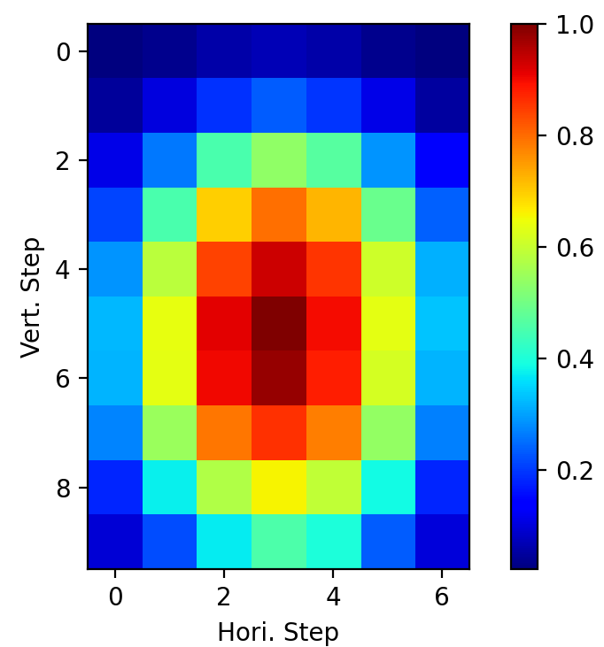
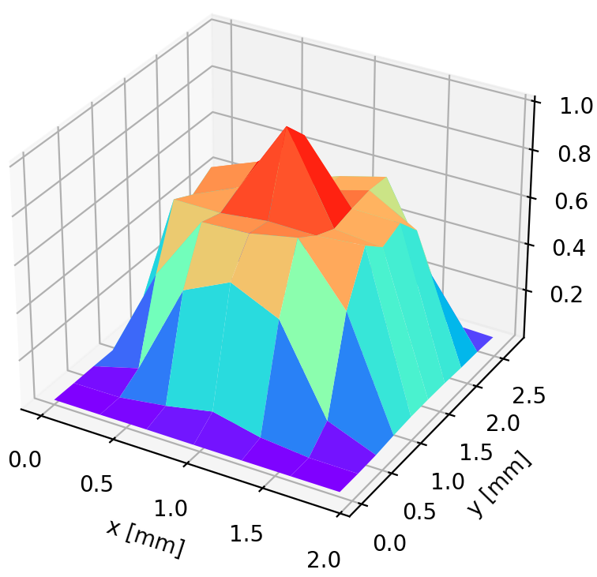
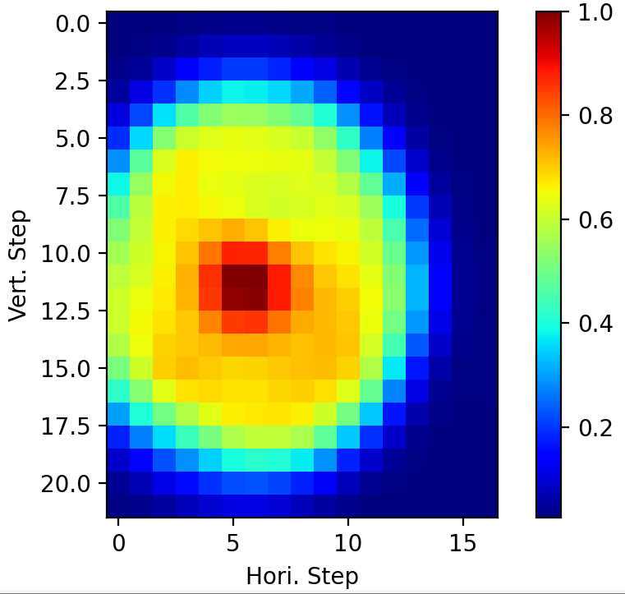
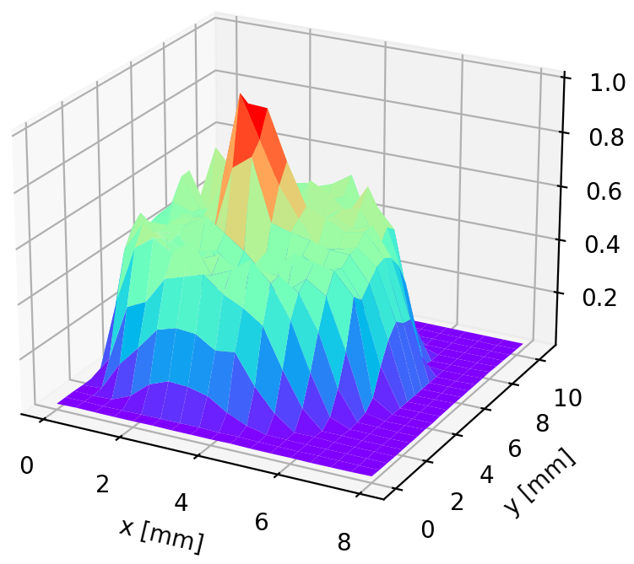
Cs₂Te Photocathode Operation @ SHINE gun
  Cs₂Te operation @SHINE VHF electron gun （Prepared on 11 Apr 2025）
    Linac and undulator commissioning (L1/BC1 Test and Acceptance, 2‑3 Nov 2024)
QE=19.3%
QE=4.82%
QE=4.8%
25 Jun 2025
26 Jun 2026
14 Aug 2026

Slide 20
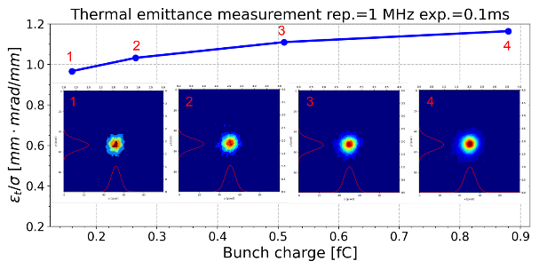
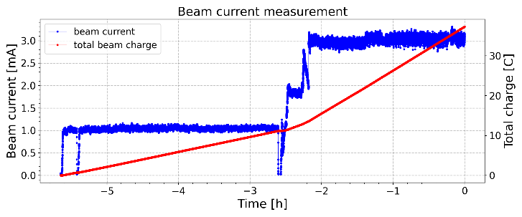




Cs₂Te Photocathode Operation @ ZJLAB/SARI gun
Cs₂Te photocathode operation @ZJLAB/SARI photocathode VHF electron gun
  Beam‑on tests at 0.5 mA, 1 mA, 3 mA;7×24 h continuous operation at 0.1 mA;
  7×24 h continuous operation at 1 mA;
  10‑day continuous operation at 0.45 mA;
  30‑day continuous operation: 0.5 mA (20 d) & 1 mA (10 d)
Time | Current | QE@257nm
2024.12.27-2025.01.06 | 0.1mA | 16%→5%
2025.03.22-2025.03.29 | 1mA | 18%→8%
2025.12.09-2025.12.18 | 0.45mA | 5.8%→1.34%
2026.03.21-2026.04.21 | 0.5mA/1mA | 13.1%→10.7%
Before operation
QE=18%
Dark current<1nA
Thermal emittance:
0.97 mm mrad
After operation
QE=8%
Dark current<1nA
Thermal emittance:
0.95 mm mrad

Slide 21




Cs₂Te Photocathode Operation @ ZJLAB/SARI gun
Cs₂Te photocathode operation @ZJLAB/SARI photocathode VHF electron gun
  30‑day continuous operation: 0.5 mA (20 d) & 1 mA (10 d)
    03.21‑04.13: Beam‑on at 0.5 mA (55 pC & 9 MHz)
    04.13‑04.21: Beam‑on at 1 mA (110 pC & 9 MHz)
  Slight QE drop, no dark current increase
Gun voltage 590kV
Laser power ~43mW
Laser power
Laser power ~20mW
Charge 55-110pC
Vacuum Pressure:3E-8Pa
Time | Current | QE@257nm
2024.12.27-2025.01.06 | 0.1mA | 16%→5%
2025.03.22-2025.03.29 | 1mA | 18%→8%
2025.12.09-2025.12.18 | 0.45mA | 5.8%→1.34%
2026.03.21-2026.04.21 | 0.5mA/1mA | 13.1%→10.7%
Cs₂Te photocathode after 1-month beam extraction
20 Mar 2026: Coarse charge scan on two axes using 1.2 mm‑diameter laser
21 Apr 2026: QE map

Slide 22
Summary and Future Plans
Conclusions
  Designed, assembled, and commissioned photocathode apparatus.
  Developed photocathode preparation processes.
    High QE photocathodes preparation process.
    Low emittance Cs₂Te photocathode preparation process.
  Cs₂Te photocathode performance characterization.
  Cs₂Te photocathode operational tests.
Plans
  Study on Cs₂Te, K₂CsSb, Na₂KSb photocathodes in CW electron guns (QE, thermal emittance, lifetime, etc.)
  Research Directions
    K₂CsSb/Cs₃Sb: QE enhancement
    K₂CsSb/Cs₃Sb + protective layers: Lifetime extension
    Na₂KSb: Apparatus modification & preparation process development
    K‑Te/K‑Cs‑Te: Preparation process development
    Cs₂Te: Epitaxial growth on single‑crystal substrates

Slide 23
Thank You for Your Attention
  Xudong Li
  Shanghai Advanced Research Institute, CAS
  Email: lixudong@sari.ac.cn

