Slide 1

Cesium Telluride Photocathodes for the
Eu-XFEL and FLASH
Anna Winiarska-Bialk, Lutz Lilje, Nils Plambeck, Hamed Achour, Mario Lengkeit
Orsay, 21/09/2026

Slide 2
Agenda
01 Introduction
DESY accelerators
Deposition setup for photocathodes
02 Cs₂Te photocathode
Plugs
Deposition parameters
Coating thickness deviations
03 Overview of past coatings
Thick coating
Performance and lifetime in the machines
04 QE measurements
Degradation and recovery FLASH
Degradation and recovery XFEL
05 Conclusions
06 Appendix

Slide 3
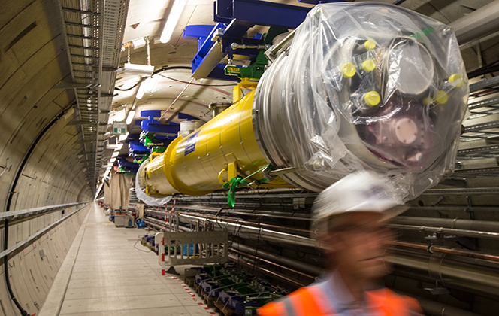
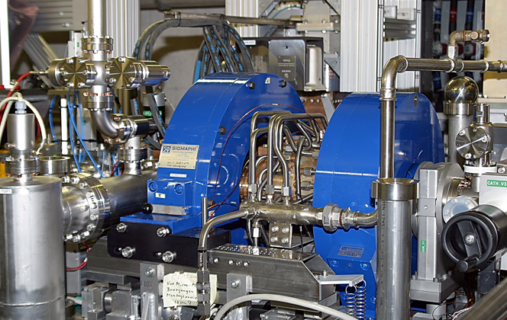
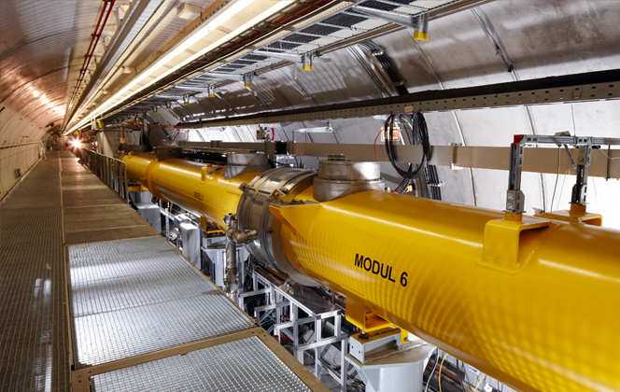
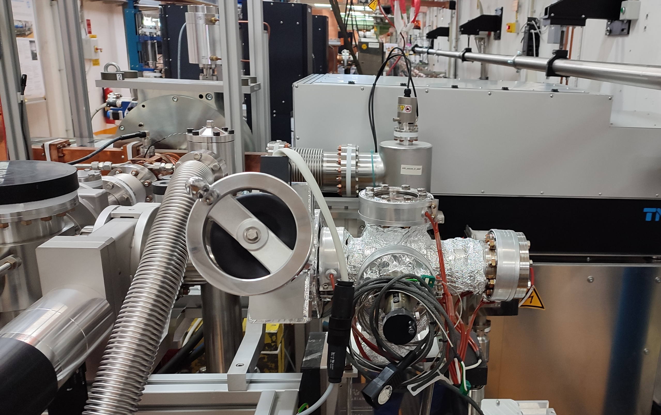
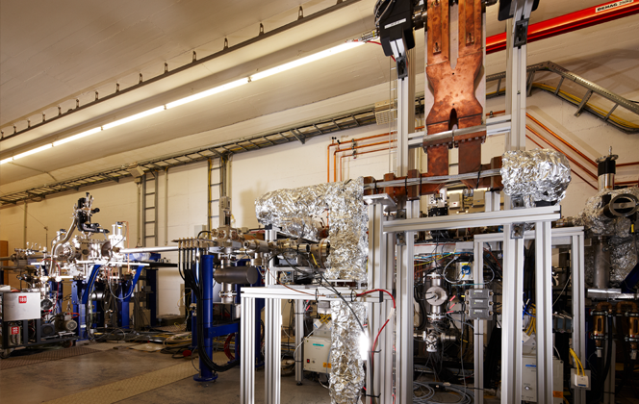
Introduction
DESY accelerators
Accelerator & Projects at DESY
European XFEL
PETRA III
FLASH
REGAE
DESY II
PITZ
ARES
PETRA IV (future project)
European XFEL
PITZ
FLASH
ARES
REGAE

Slide 4
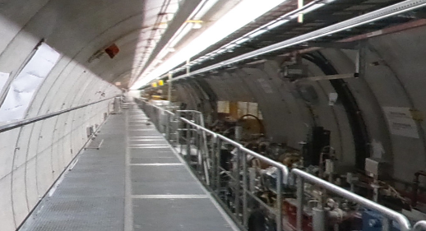
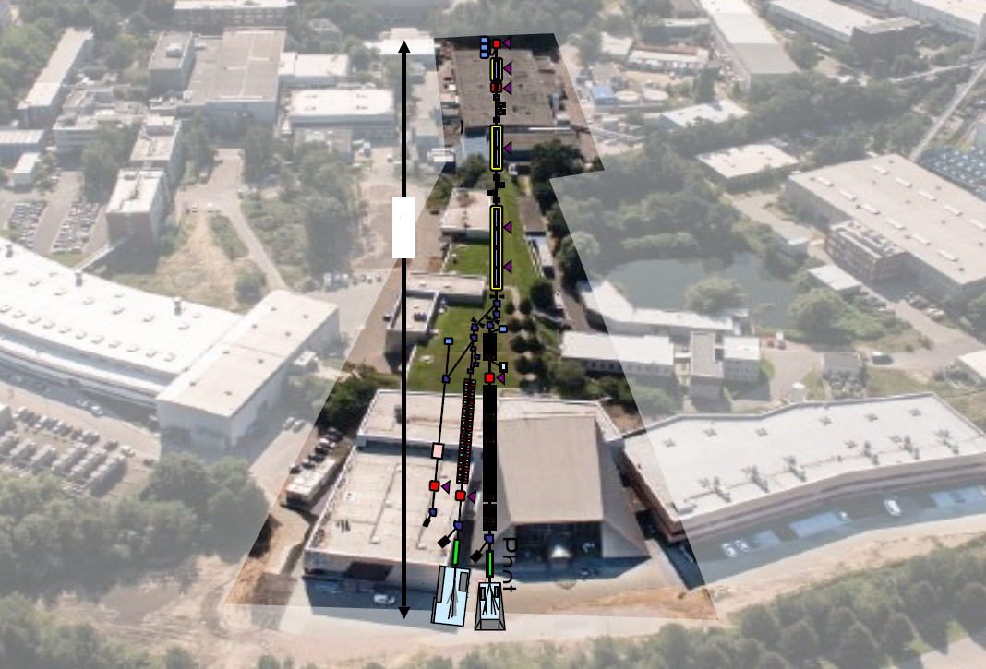
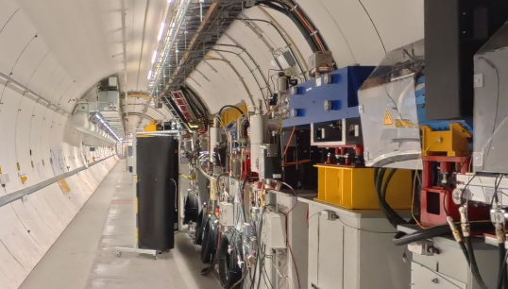
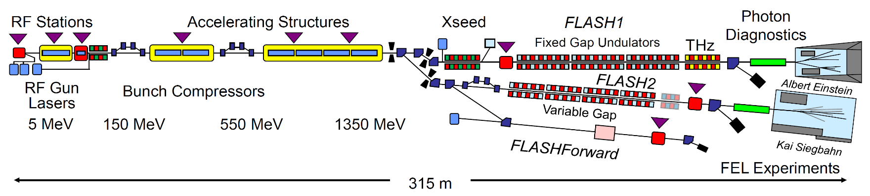
old
Introduction
DESY accelerators
new
FLASH → FLASH2020+
Extensive refurbishment of FLASH and
the accelerator tunnel until August 2025
First soft X-ray FEL user facility that operates
two undulator beamlines simultaneously
Improved photon- and electron beam parameters
parameter | unit | value
facility length | m | 315
energy | GeV | 1.35
bunches per second | Hz | 5000
emittance | µm rad | 0.4
bunch charge | nC | 0.01... 1.2
photon wavelength | nm | 51... 3.4
ph. pulse duration | fs | 30... 200

Slide 5
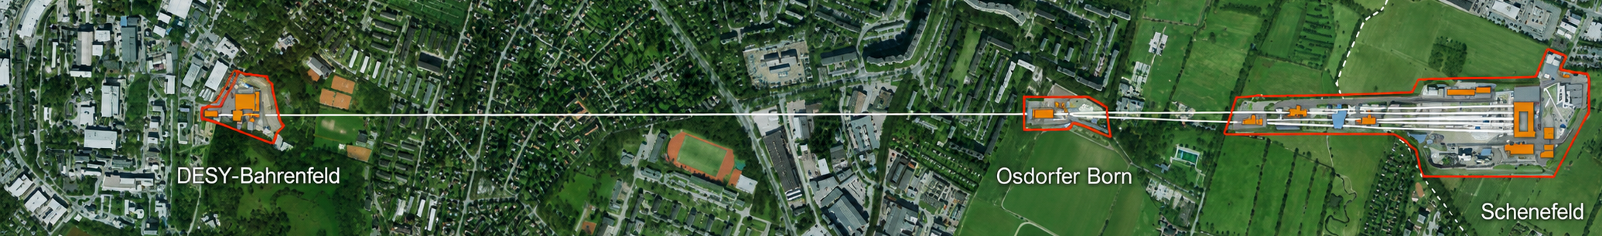
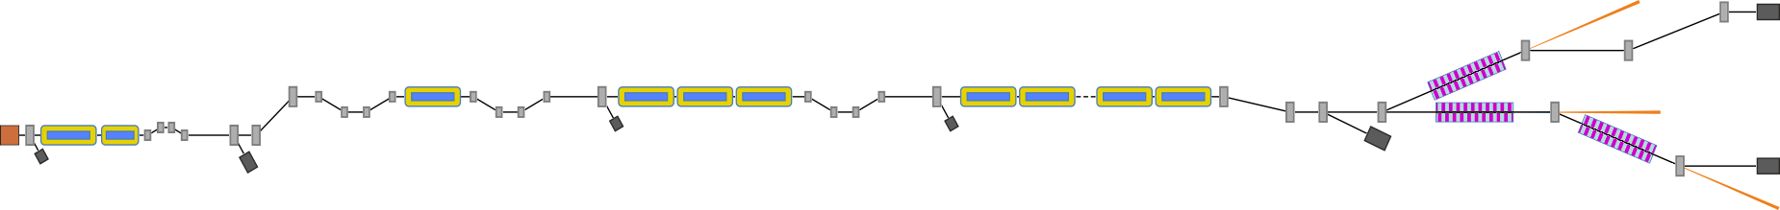
Introduction
DESY accelerators
European XFEL
Laser driven RF-gun
3 bunch compressors
96+2 1.3 GHz
superconducting accelerator modules
Up to 600 kW beam power
Three variable gap undulators
  SASE1 and SASE2
    175 m magnetic length
    0.05 – 0.4 nm wavelength (25 keV – 3 keV)
  SASE3
    105 m magnetic length
    0.4 – 4.7 nm wavelength (3 keV – 0.26 keV)
main linac
SASE2
RF gun
injector
bunch compression
collimation
SASE1
SASE3
5 MeV
150 MeV
600 MeV
2 GeV
17.5 GeV
0.05...0.4 nm
0.4...4.7 nm
parameter | unit | value
facility length | m | 3.4
energy | GeV | 17.5
bunches per second | Hz | 27000
emittance | µm rad | 0.8
bunch charge | nC | 0.02... 1.0
photon wavelength | nm | 4.7... 0.05
ph. pulse duration | fs | <100

Slide 6
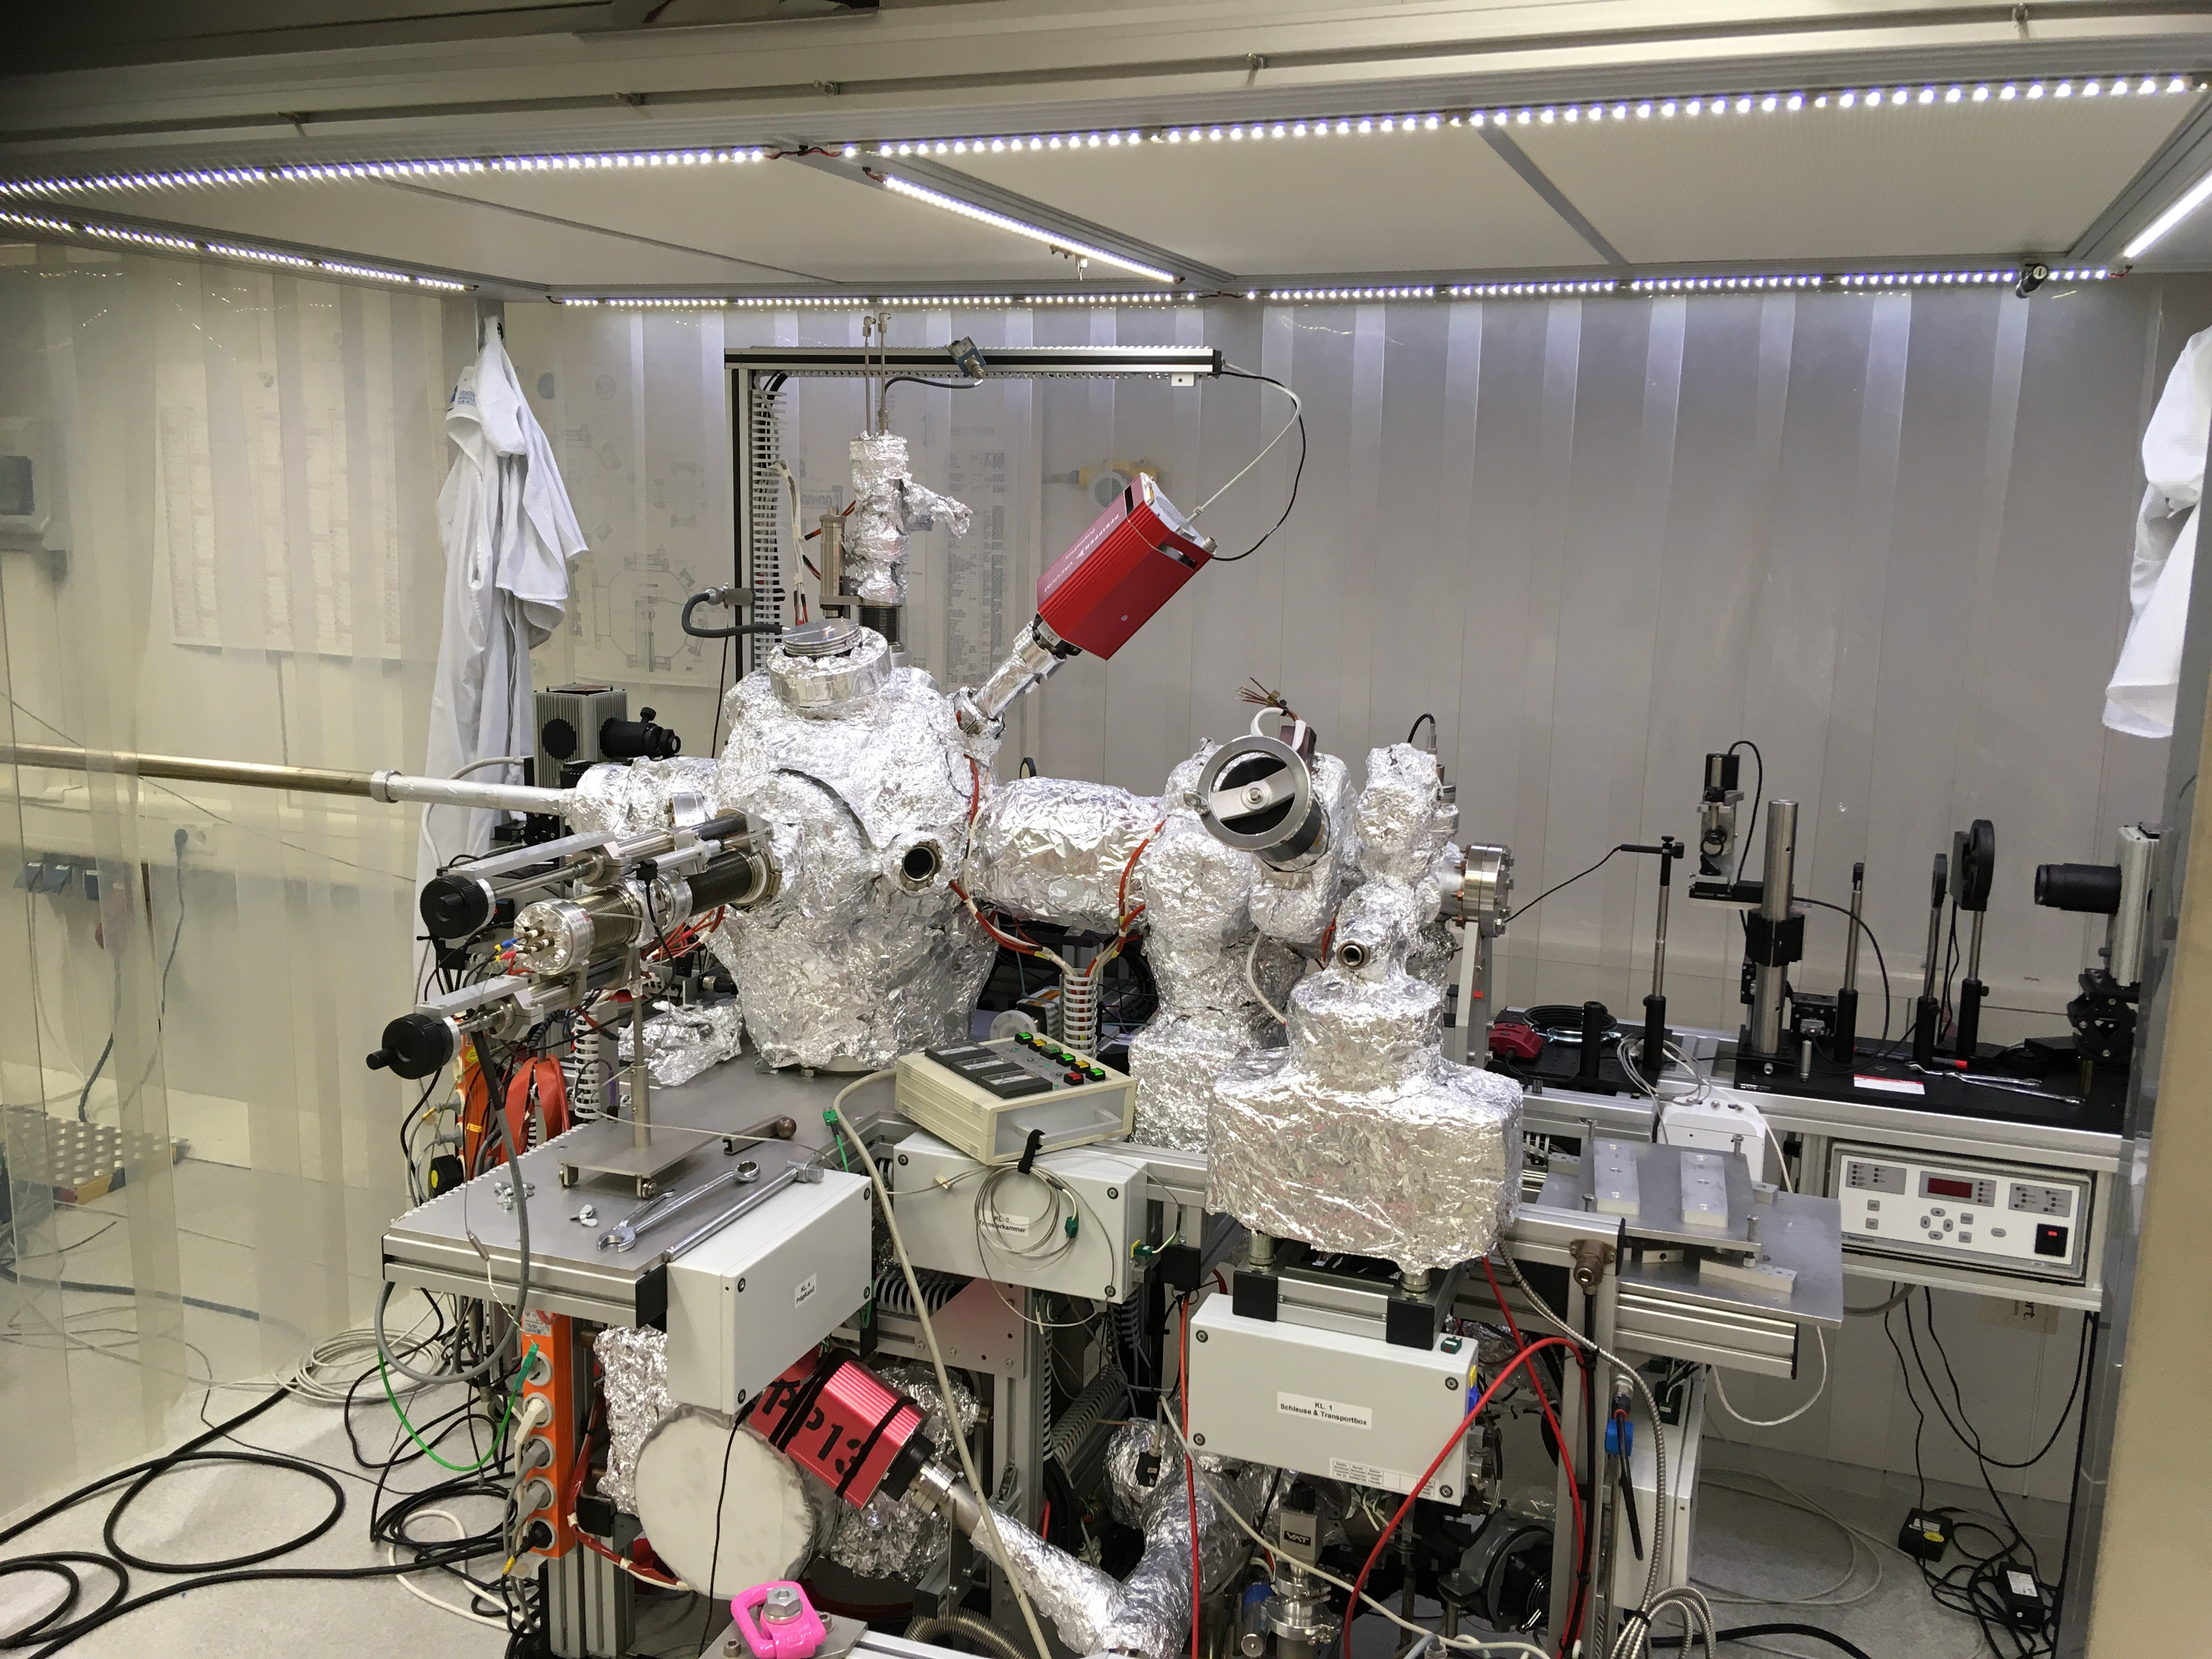
Introduction
Deposition setup for photocathodes
INFN LASA deposition system design
Assembled by LASA in close collaboration with DESY
All components are 100 % compatible with the Milano system

Slide 7
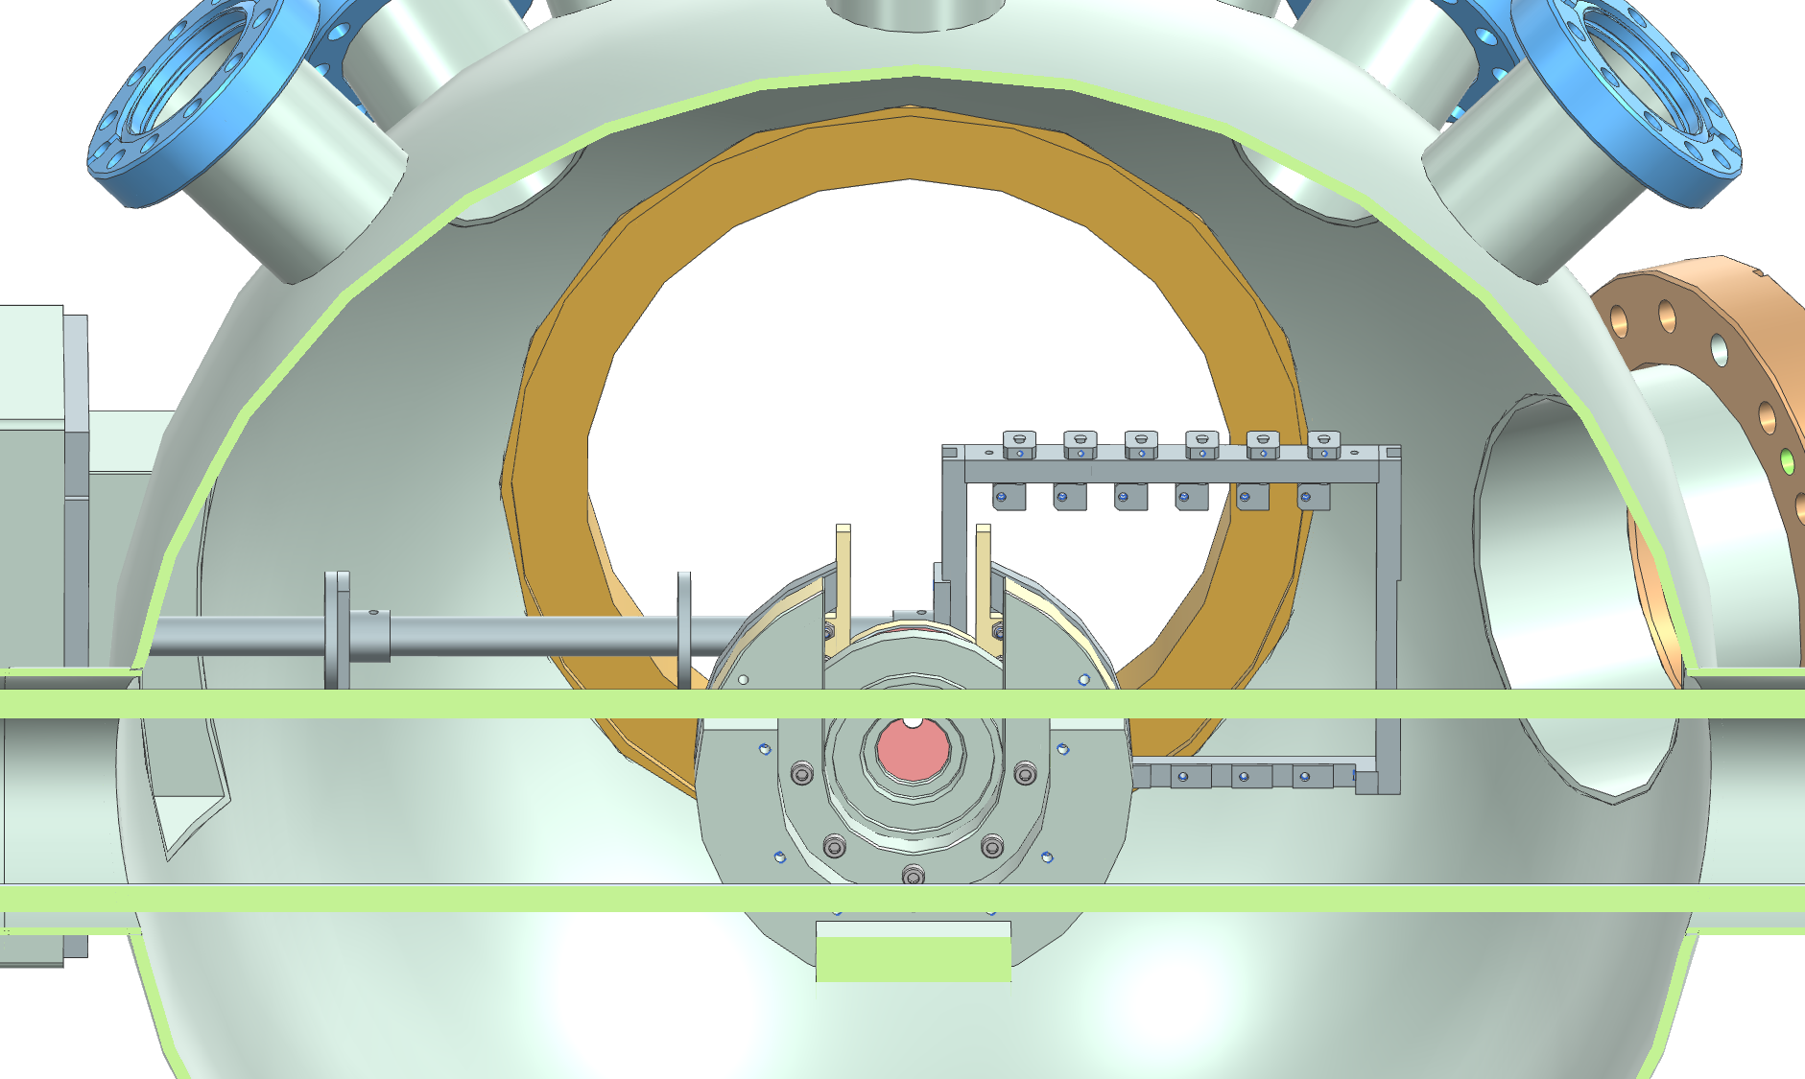
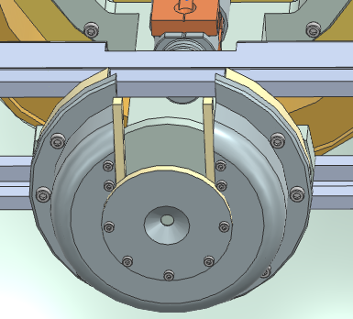
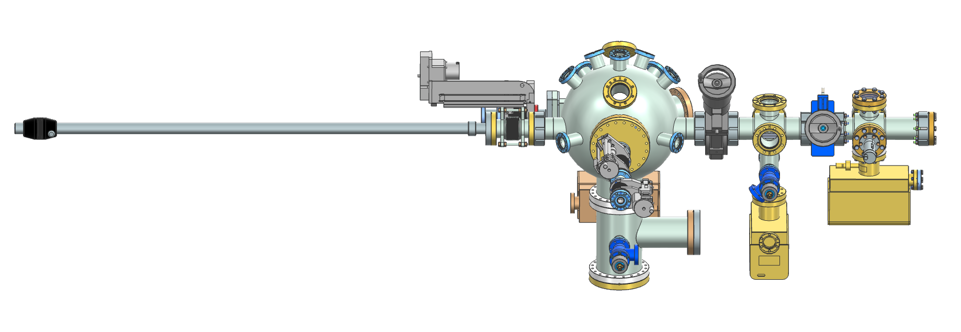
Introduction
Deposition setup for photocathodes
Deposition system improvements
Reduced system length
Rectangular flange geometry
Cutout in the rail for better view
Improved temperature monitoring
Optimized antenna positioning
Omitted metal sheet between orifice
and cathode plug

Slide 8
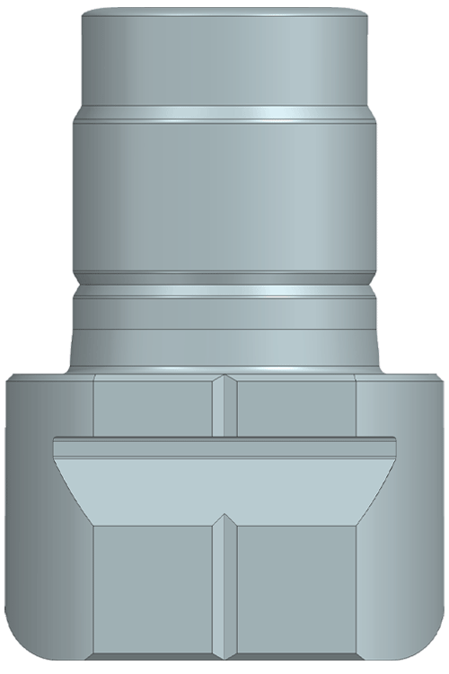
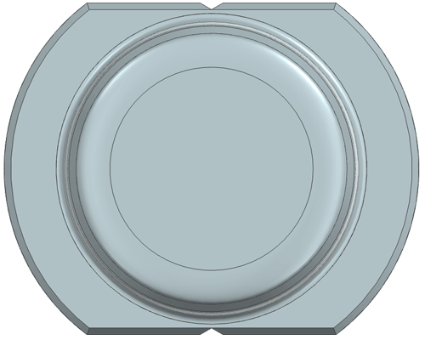
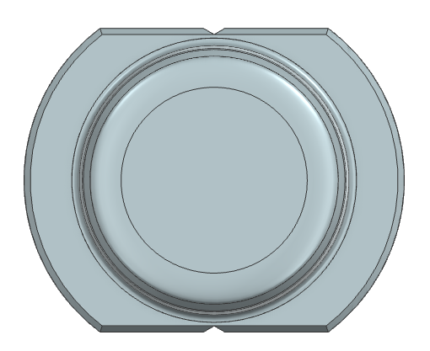
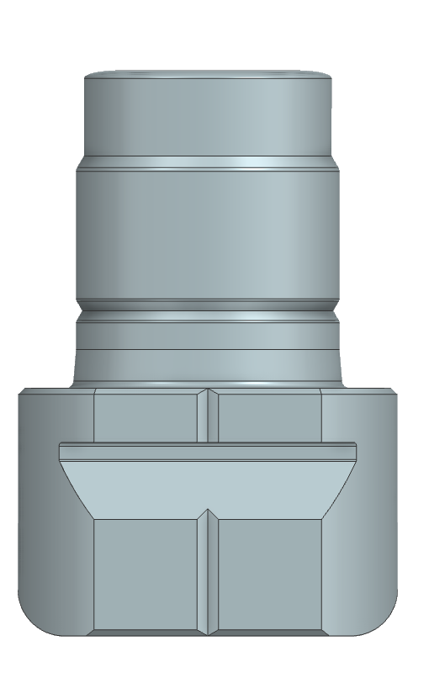
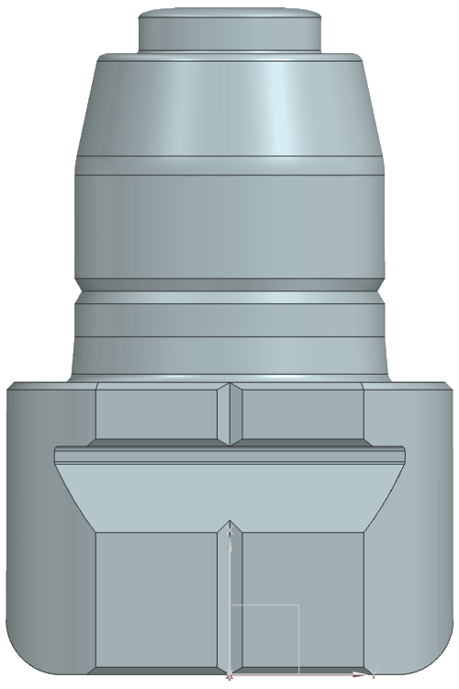
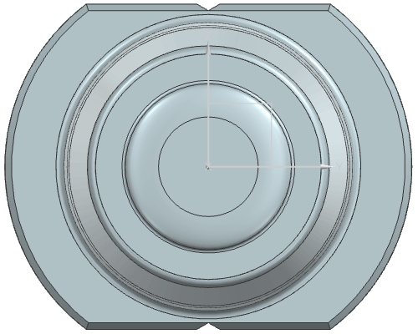
Cs₂Te photocathode
Plugs
Material and design
Molybdenum plugs
FEL
    elliptical (before circular)
PITZ/XFEL
UED FPR
    elliptical (before circular)
FEL
UED FPR
PITZ/XFEL

Slide 9
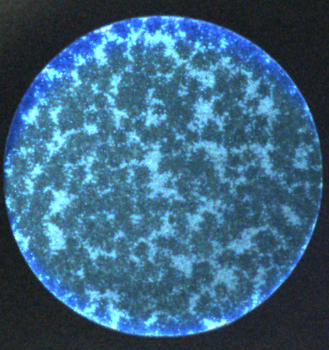
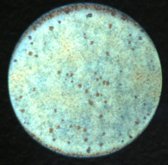
Cs₂Te photocathode
13.07.2022 0727.2
QE 12,96%
I(Te) 3,24 A 10nm I(Cs) 4,7 A 50nm
Deposition parameters
Standard parameters - recipe from INFN Milano
Plug is heated to 450 °C then kept at 120 °C
Temperature during deposition: 100-110 °C
Duration of the whole process: ~2 h
Spot size ca. 5 mm
Thickness:
  Te: 10 nm - 1st layer
  Cs: ~50 nm - 2nd layer
14.07.2022 0748.1
QE 9,8%
I(Te) 3,24 A 10nm I(Cs) 4,85 A 50nm

Slide 10
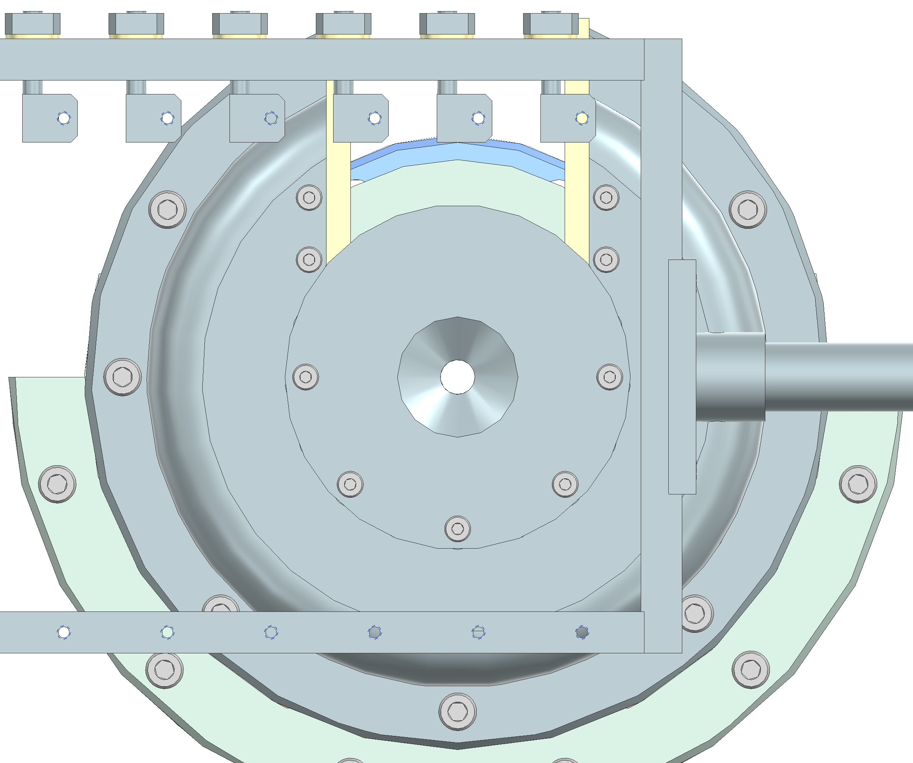

Cs₂Te photocathode
QCM out (during deposition)
Coating thickness deviations
QCM in (for calibration)
Problems with thickness monitor...
Measurement range of thickness monitor
(Inficon SQM-160) set too high for direct readout
Area factor of quartz crystal microbalance (QCM) not always or falsely considered in LabVIEW programs
The problem was indicated by changing dispenser currents (3.0→3.2 A) and lifetimes (5→10+ coatings)
  Same Te dispenser used since beginning!
  Te dispenser current dropped in 2020 and 2023 while the Cs lifetime increased significantly (usually 4-5 coatings)
Most coatings in the past were much thicker than indicated by the programs!
(rate increased by area factor)
orifice
(cathode)
dispenser

Slide 11
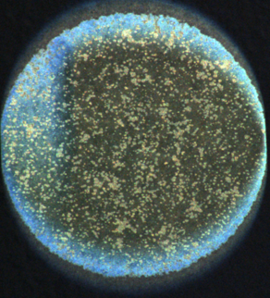
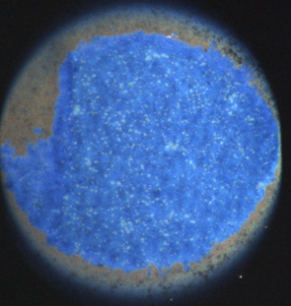
Overview of past coatings
05.05.2026 1117.3
QE 17.1% QE(map)18% I(Te) 3,38 A 27nm I(Cs) 5,20 A 147nm Temp. 103°C
Thick coating
Improved coating thickness control
A new coating thickness determination method was introduced after identifying issues with the area factor
The new approach provides more accurate and consistent thickness measurements
It enables better monitoring and comparison of coating variations between photocathodes
15.06.2026 734.2
QE 13,5% QE(map) 16,8%
I(Te) 3,28 A 15nm
I(Cs) 4,96 A 96nm Temp. 91,5°C

Slide 12
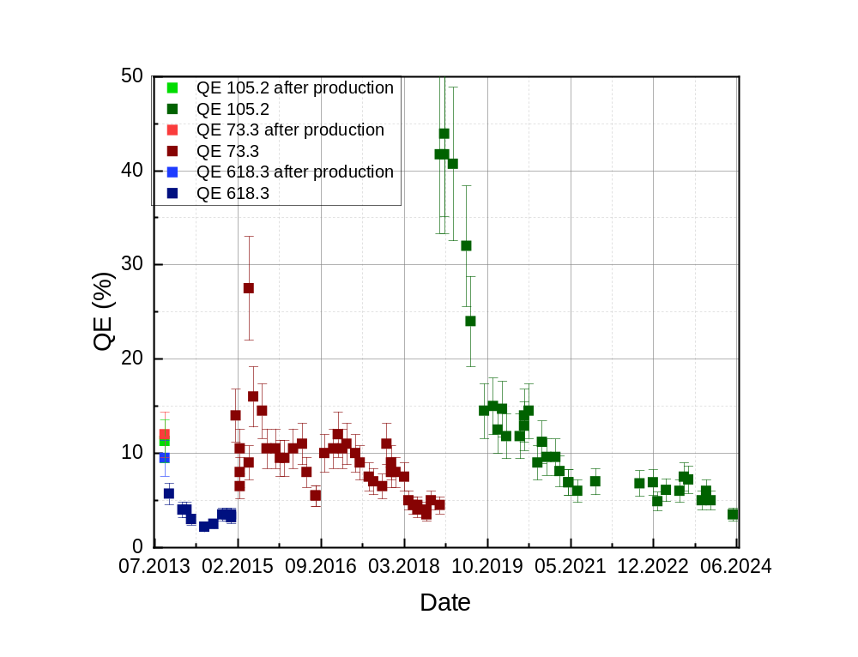
Overview of past coatings
Performance and lifetime in the machines
FLASH:
#76.3 around 150 days in operation
#91.2 around 130 days in operation
#77.2 around 175 days in operation
#98.2 around 70 days in operation
#90.3 around 55 days in operation
#114.2 around 100 days in operation
#618.3 since December 2013 until February 2015- 439 days in operation
#73.3(Milano) since February 2015 until December 2018 - 1413 days in operation
#105.2(Milano) since December 2018 until now
2009-2012

Slide 13
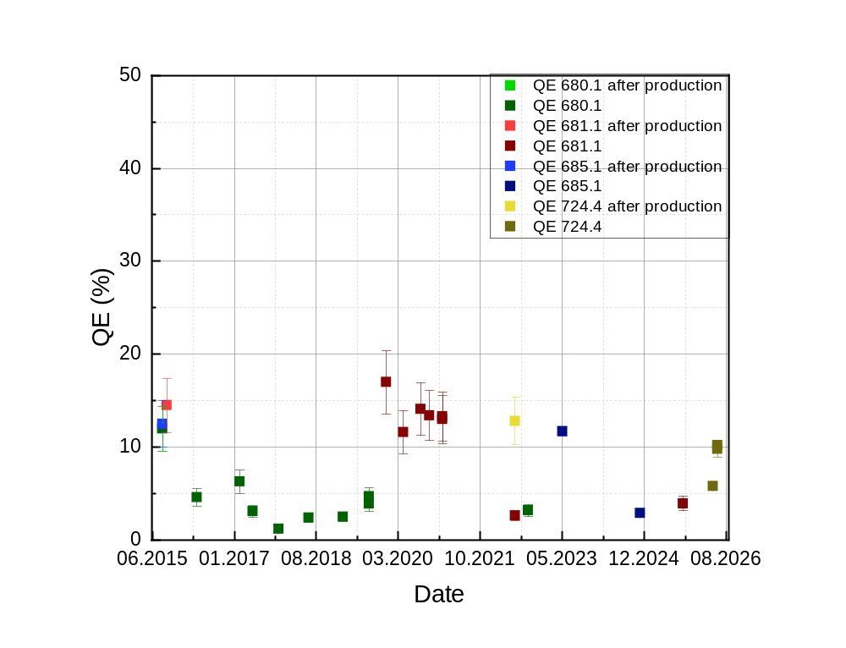
Overview of past coatings
Performance and lifetime in the machines
XFEL:
#680.1 since December 2015 until July 2018 -1452 days in operation
#681.1 since January 2020 until June 2022
#681.1 since July 2022 until October 2022
(180 deg rotated in comparison the last time)
#685.1 since October 2022 until July 2025
#724.4 since November 2025 until July 2026
#1117.3 since July 2026 until now

Slide 14
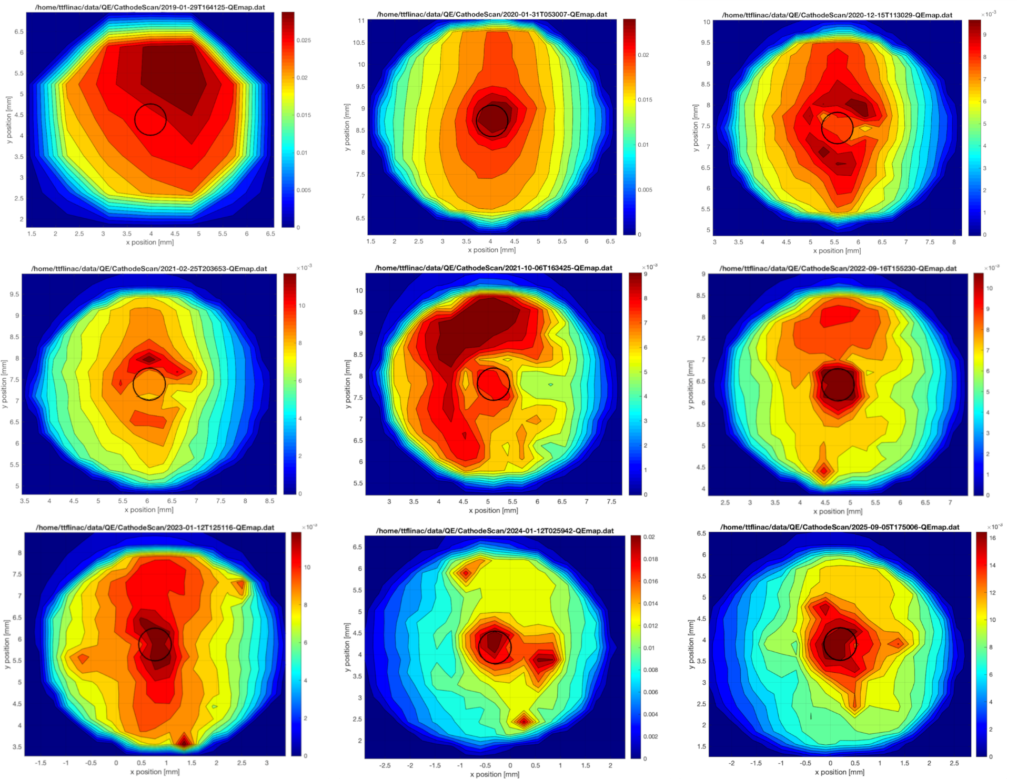
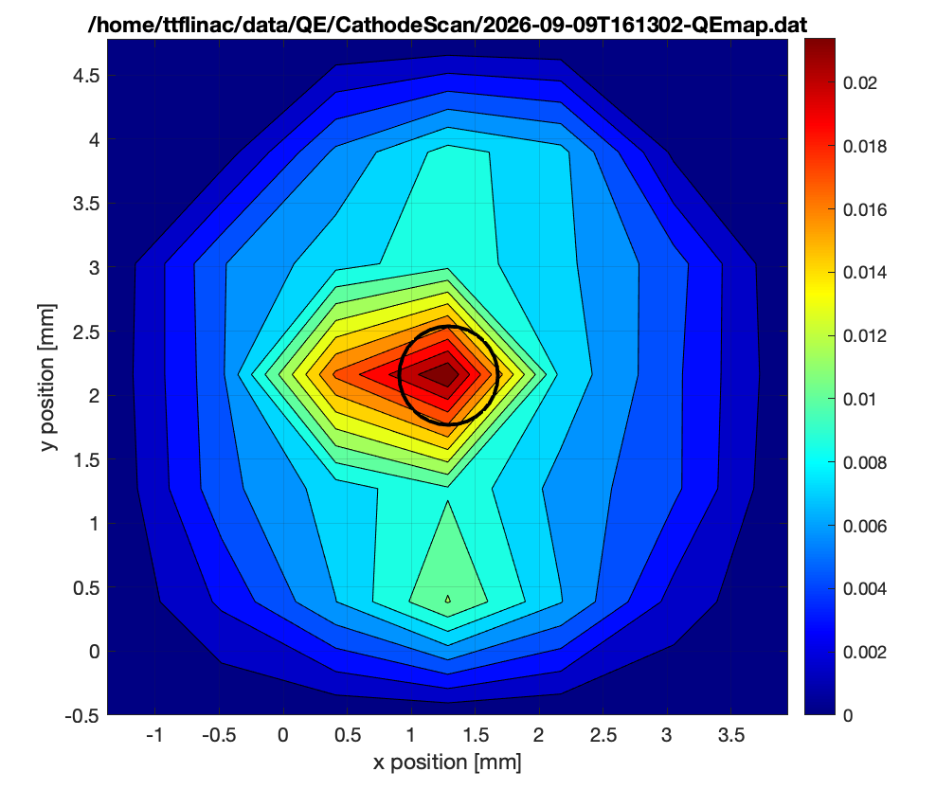
QE measurements
Jan. 2019
Mar. 2020
Dec. 2020
Degradation and recovery FLASH
Sep. 2026
Feb. 2021
Oct. 2021
Sep. 2022
Jan. 2023
Jan. 2024
Sep. 2025

Slide 15
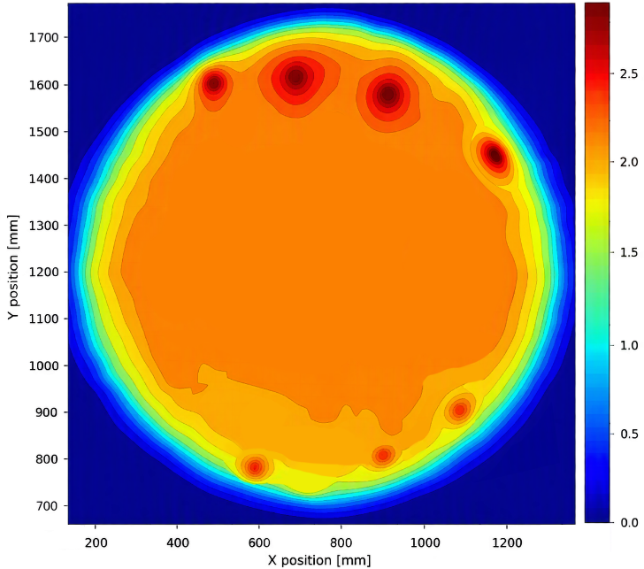
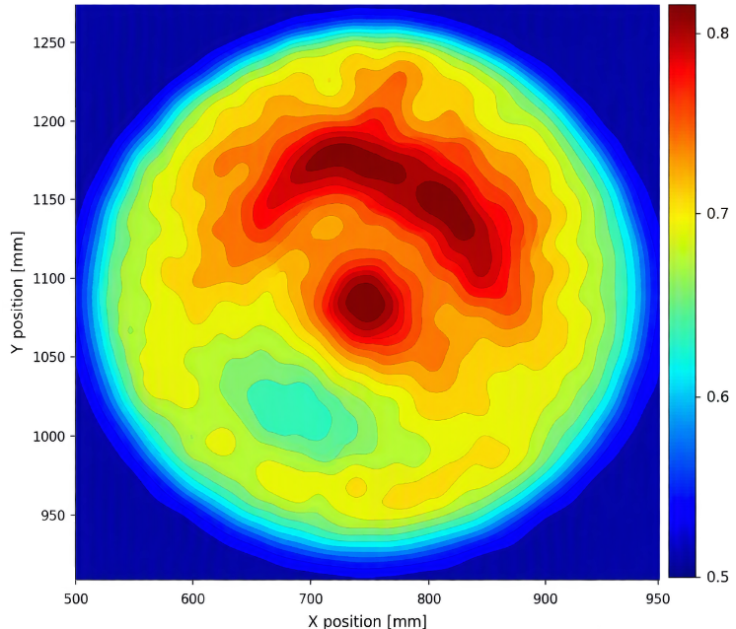
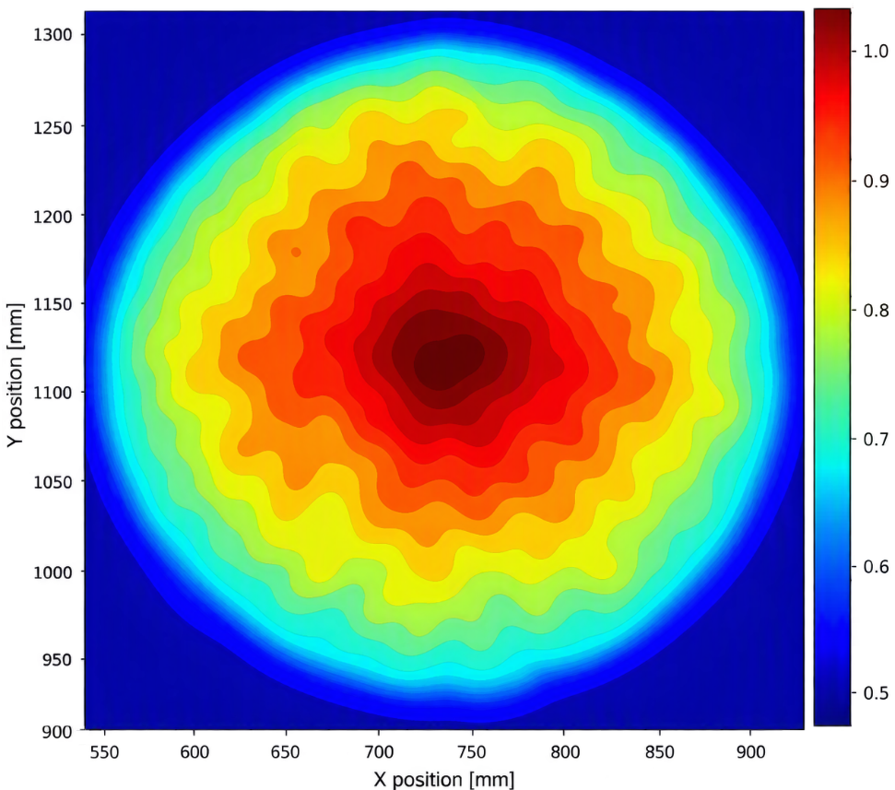
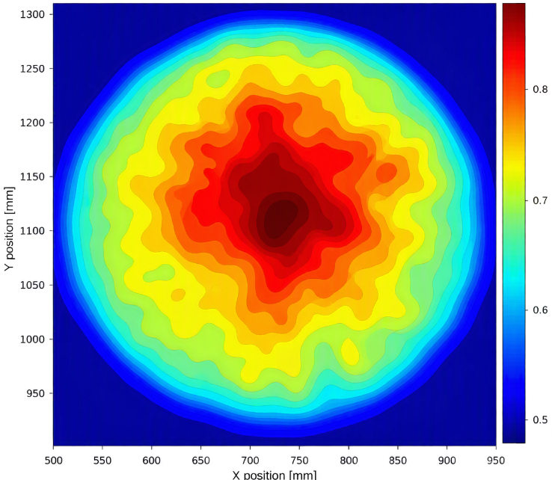
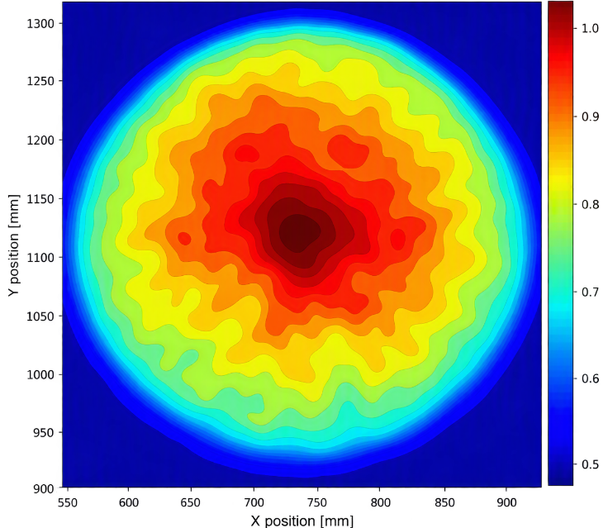
QE measurements
10 Jan. 2026
7 May 2026
Degradation and recovery XFEL
2 Jun. 2026
18 May 2026
26 May 2026

Slide 16
Conclusions
Deposition system: new design with improved functionality and usability
Plugs: continuous development driven by evolving RF gun requirements
Coating thickness: improved monitoring enables systematic investigation of thickness–performance correlations
Cs₂Te: high QE + long lifetime → well suited for FLASH & European XFEL

Slide 17
Thank you
Grateful acknowledgment is made to Juliane Rönsch-Schulenburg and Frank Brinker for their vital support in performing the measurements and providing the data.
Anna Winiarska-Bialk
MVS
anna.winiarska@desy.de
+49 40 8998 (9)3442

Slide 18
Appendix

Slide 19
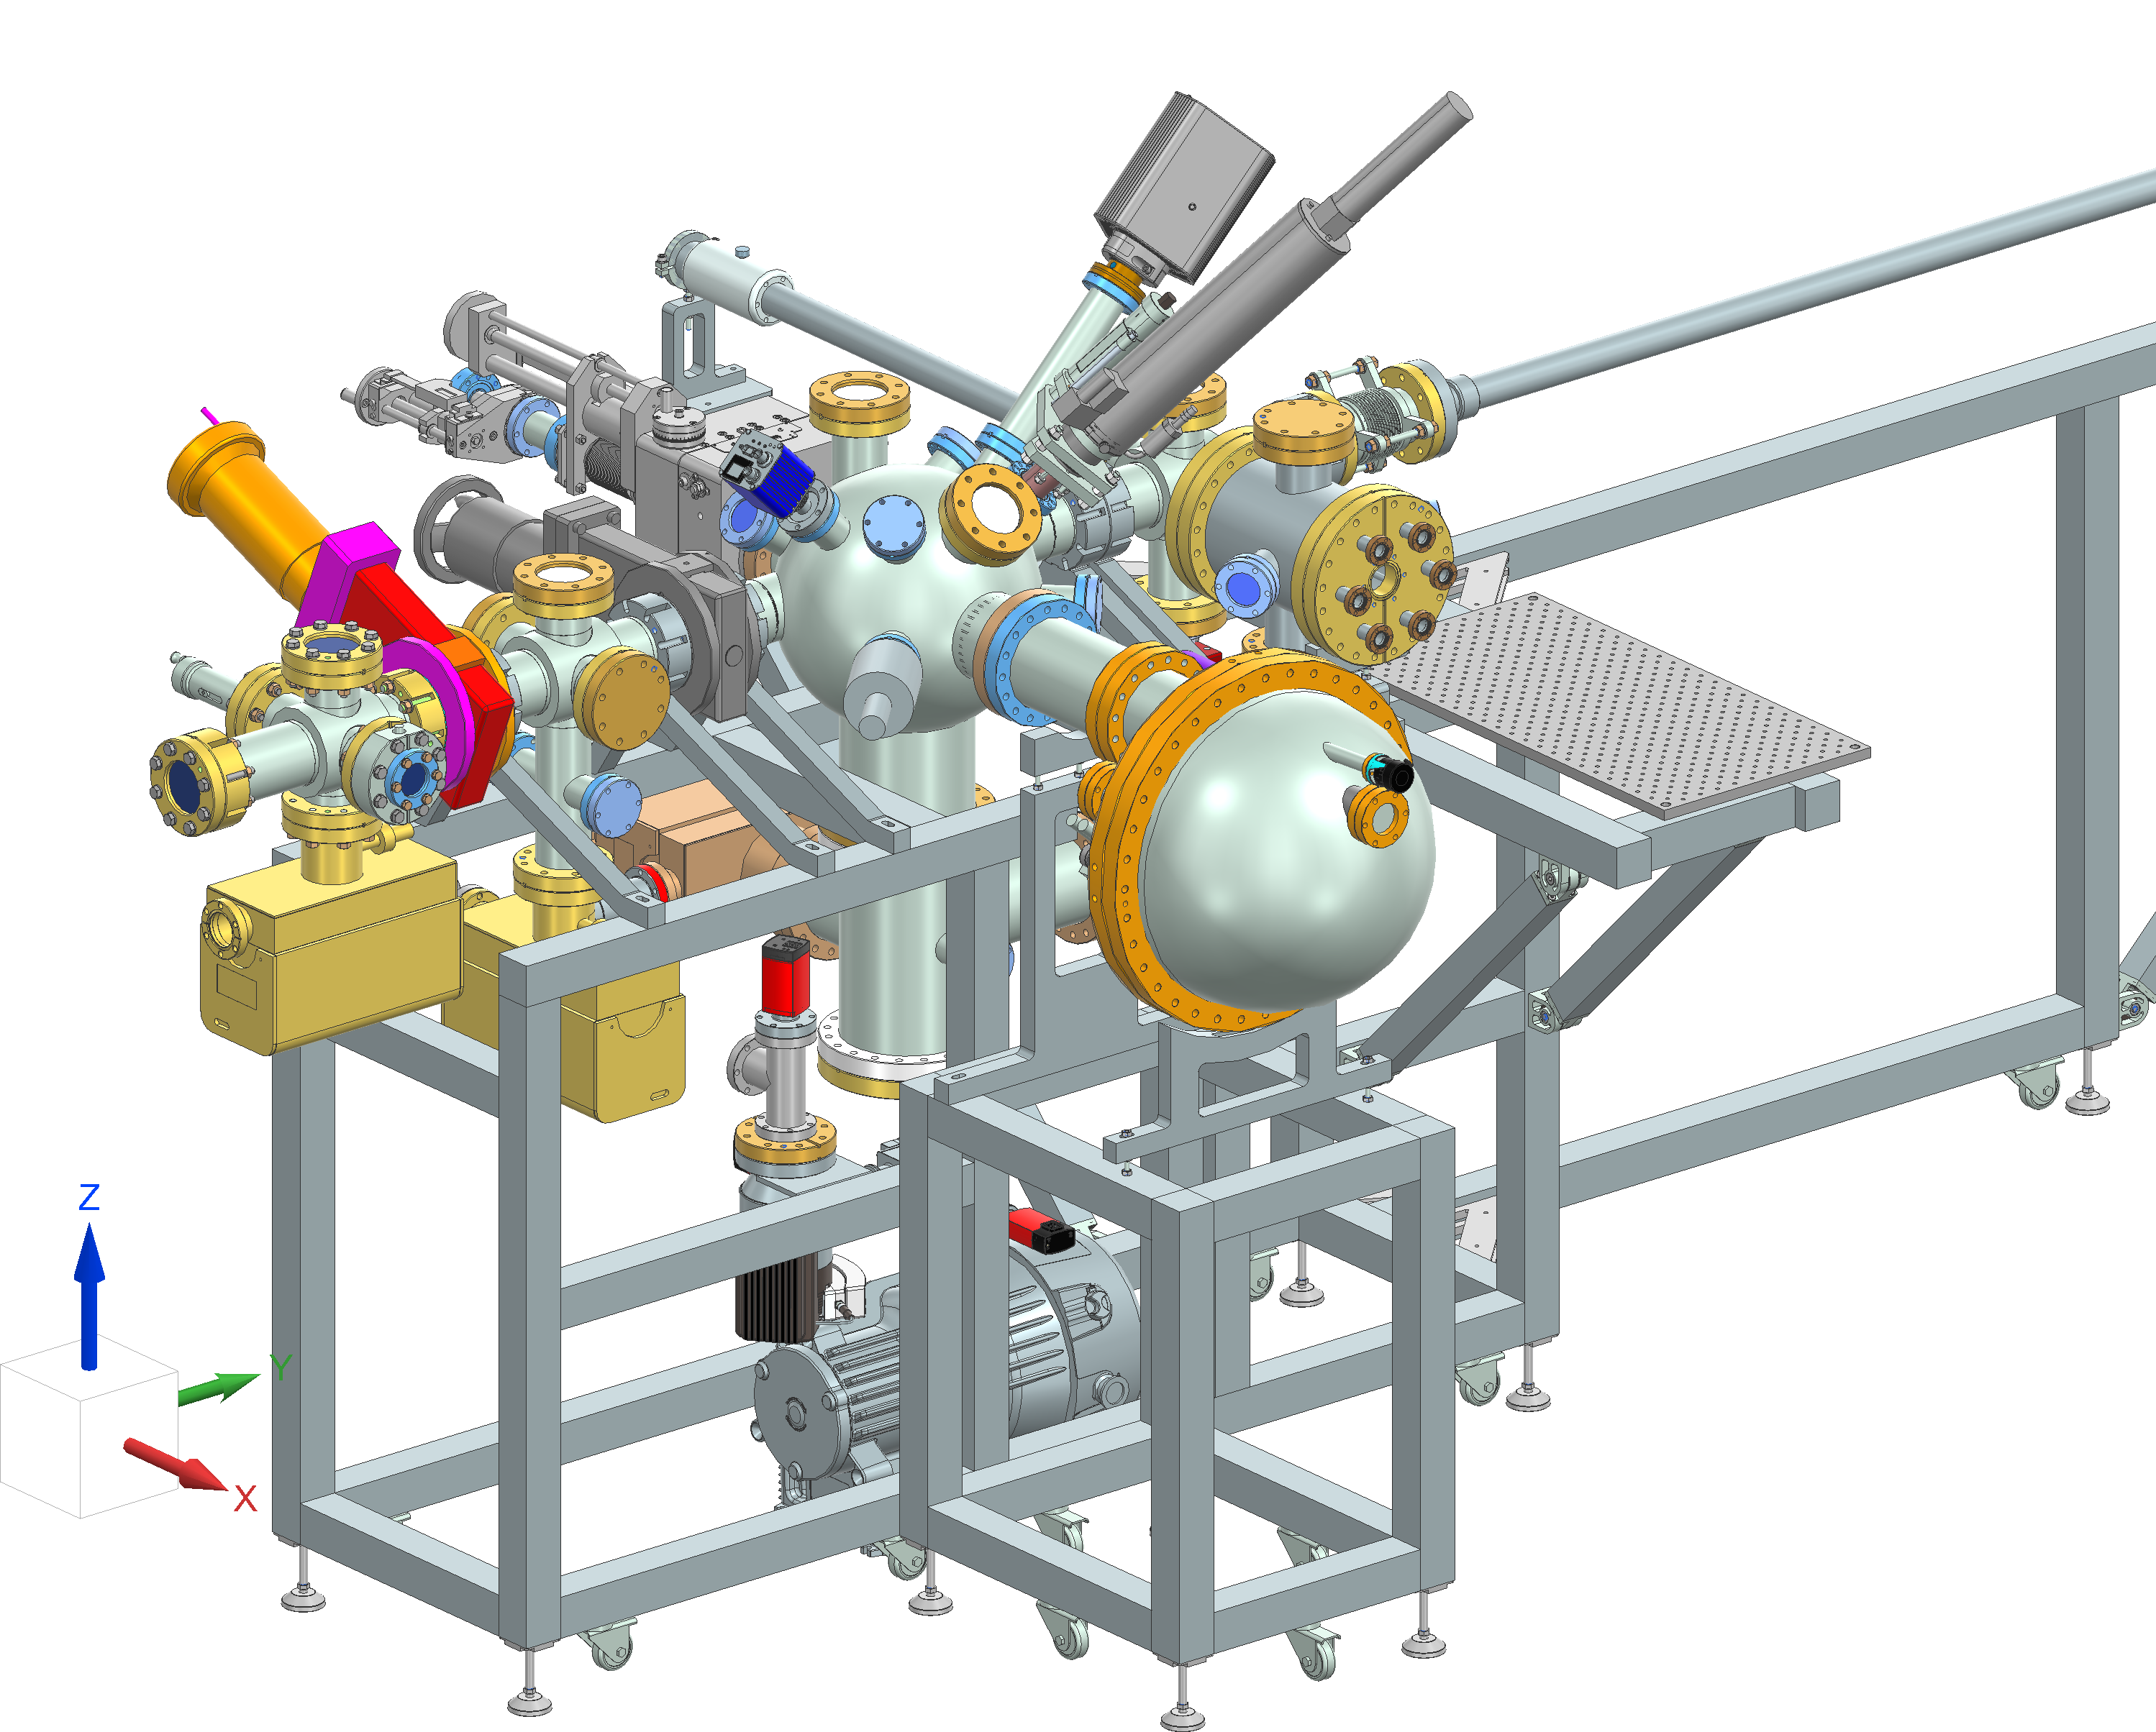
Appendix
Complementary XPS and AES measurements
Load Lock
ELAS (ELectron Analysis System)
Compatible with our cathode transport boxes
Main chamber equipped with
  PHOIBOS 100 (SPECS)
  EGG-3101 (Kimball Physics Inc.)
  RS 40B1 (PREVAC)
  X-ray Photoelectron Spectroscopy (XPS)
  Auger-Electron Spectroscopy (AES)
Mean Transverse Energy (MTE) measurement
via attached TEMA setup

Slide 20
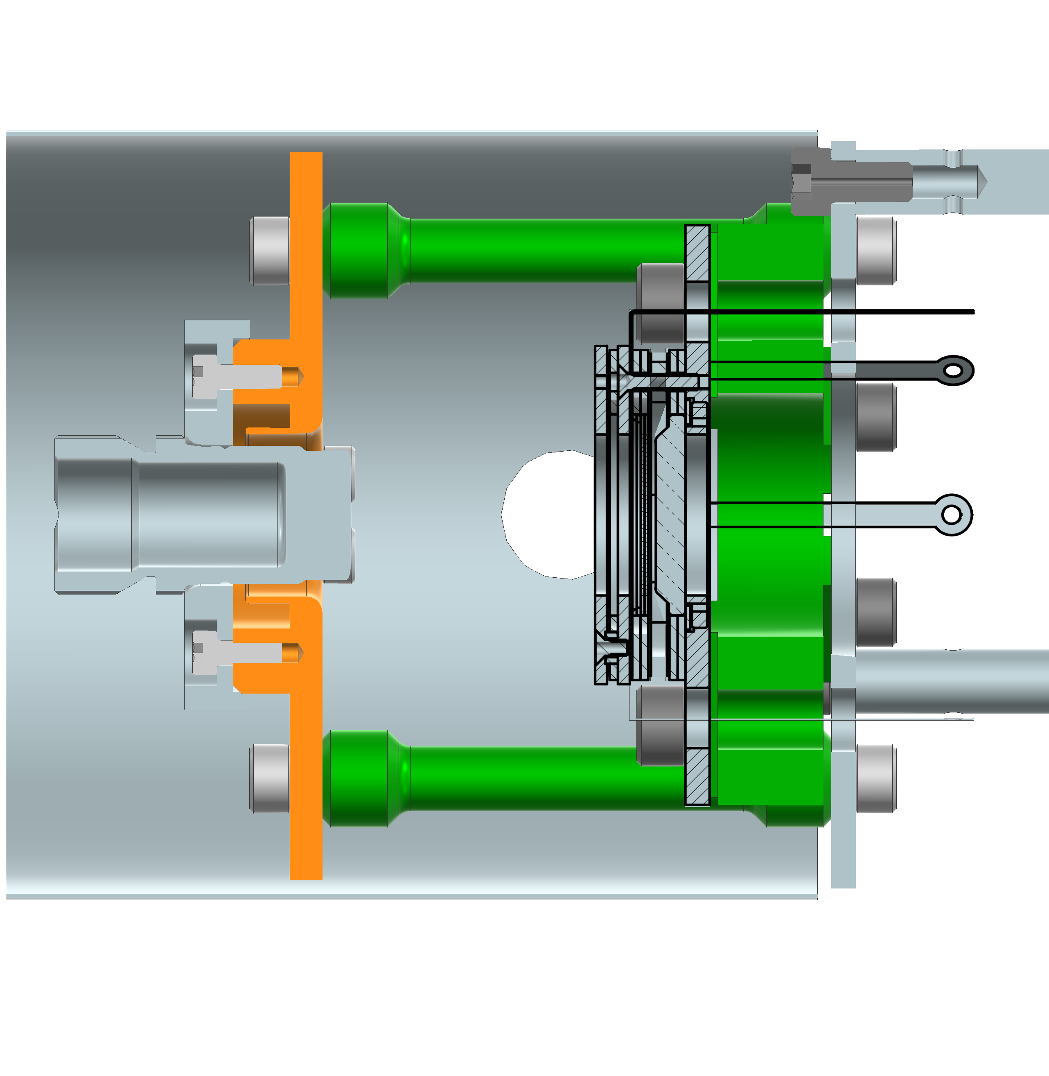
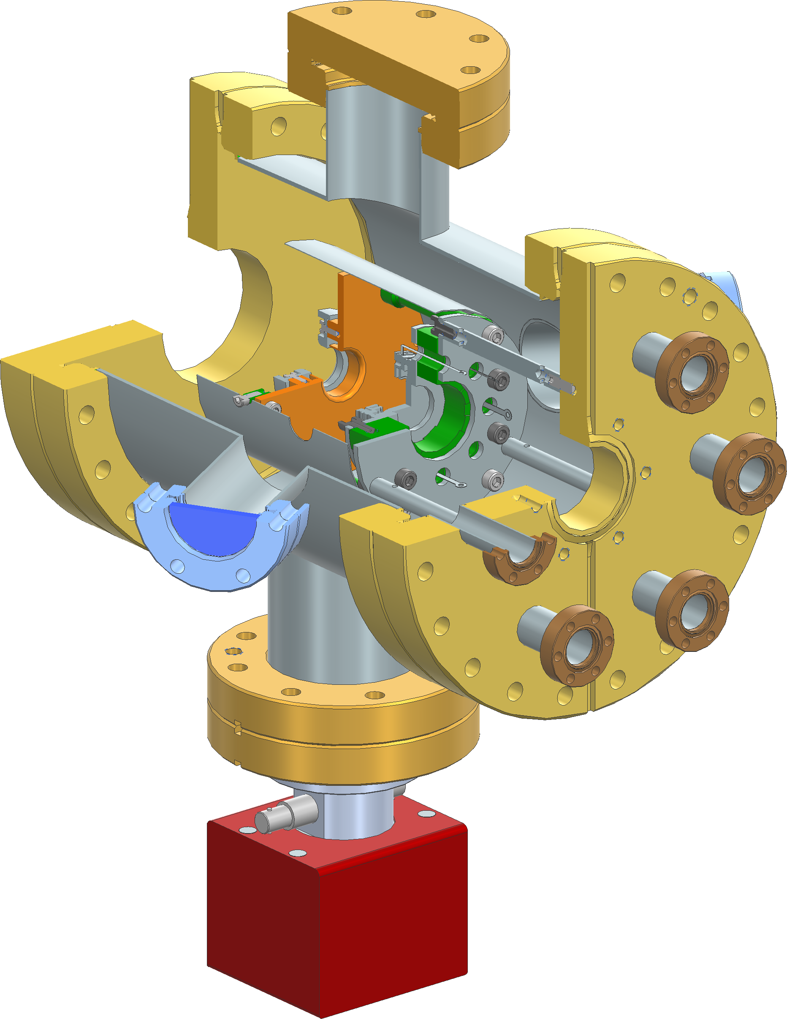

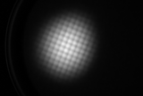
Appendix
Complementary XPS and AES measurements
TEMA (Transverse Energy Momentum Analyser)
Adapted to TESS design
  Developed at ASTeC STFC Daresbury
  see also: DOI 10.1063/5.0109053
U_{A} : | Acceleration voltage applied across the gap
d : | Cathode to detector acceleration gap distance
σ_{det} : | RMS radius of electron spot measured on the detector screen
σ₀ : | RMS radius of the focused laser spot on the cathode surface
Detector
camera
Photocathode
Lens
grid
screen
multiplier

Slide 21
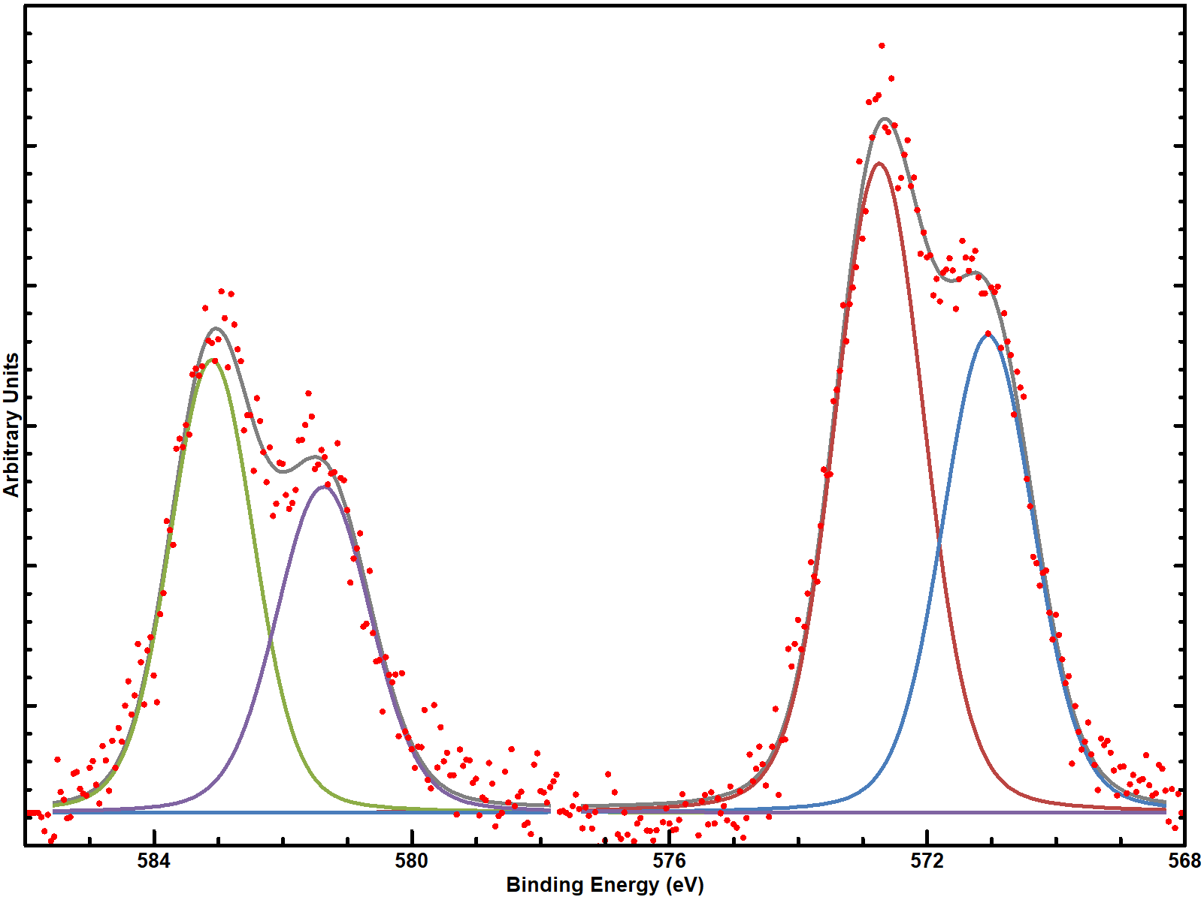
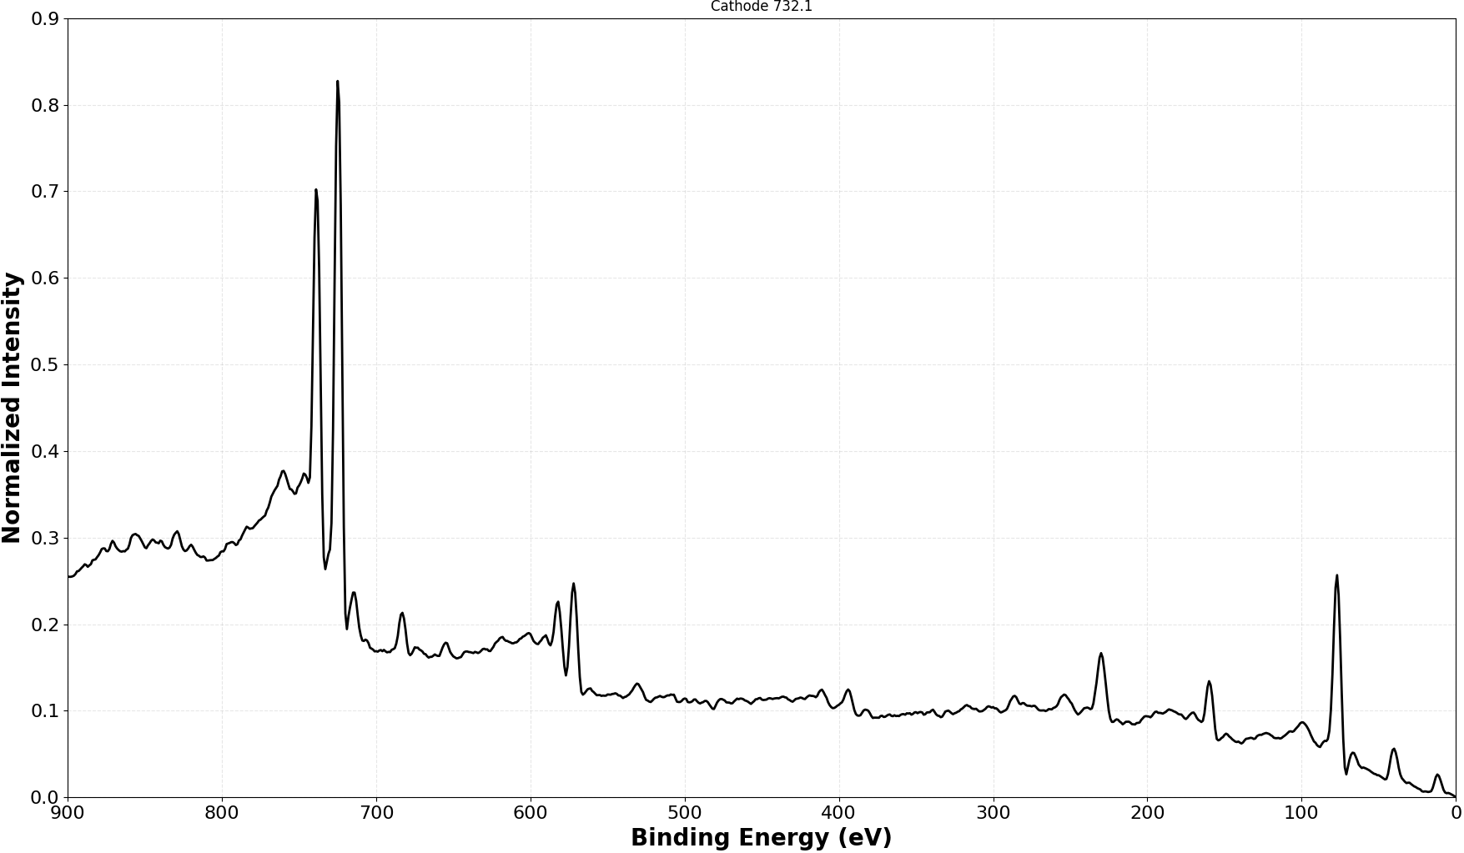
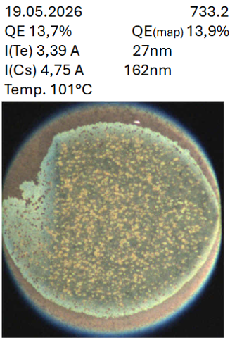
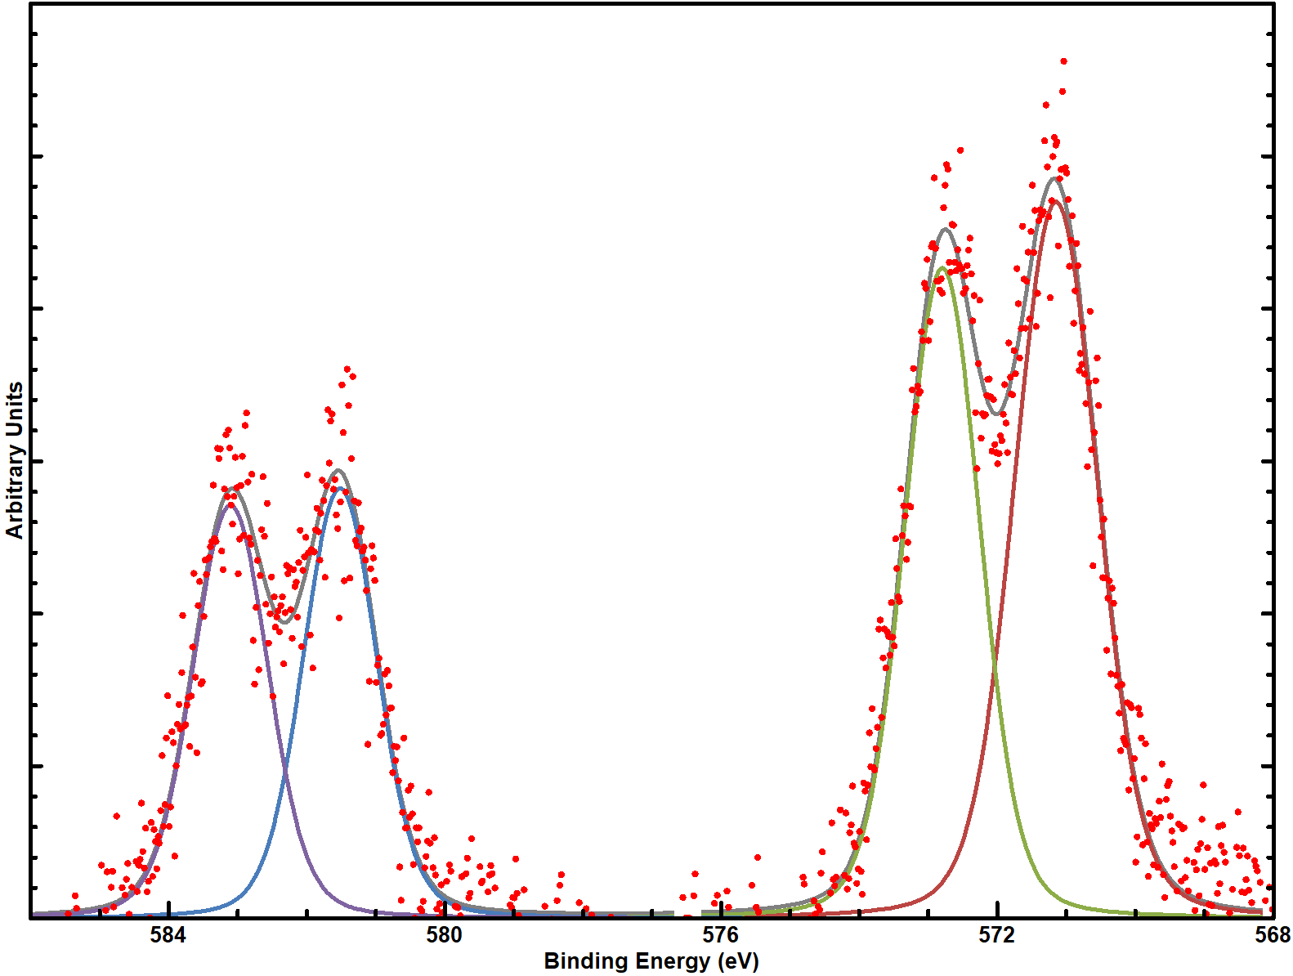
Appendix
High resolution (Te 3d) < 0.5 mm spot size:
Te 3d5/2 ²⁻
Complementary XPS measurements
Te 3d5/2 ⁰
Te 3d3/2 ²⁻ (Cs₂Te)
ELAS (XPS Cs₂Te):
Surveys:
Te 3d3/2 ⁰
(Metallic)
Cs
Larger spot size, 1-2 mm:
Te
O
C
Mo
Te 3d5/2 ⁰
Te 3d5/2 ²⁻
Te 3d3/2 ²⁻ (Cs₂Te)
Te 3d3/2 ⁰
(Metallic)

Slide 22
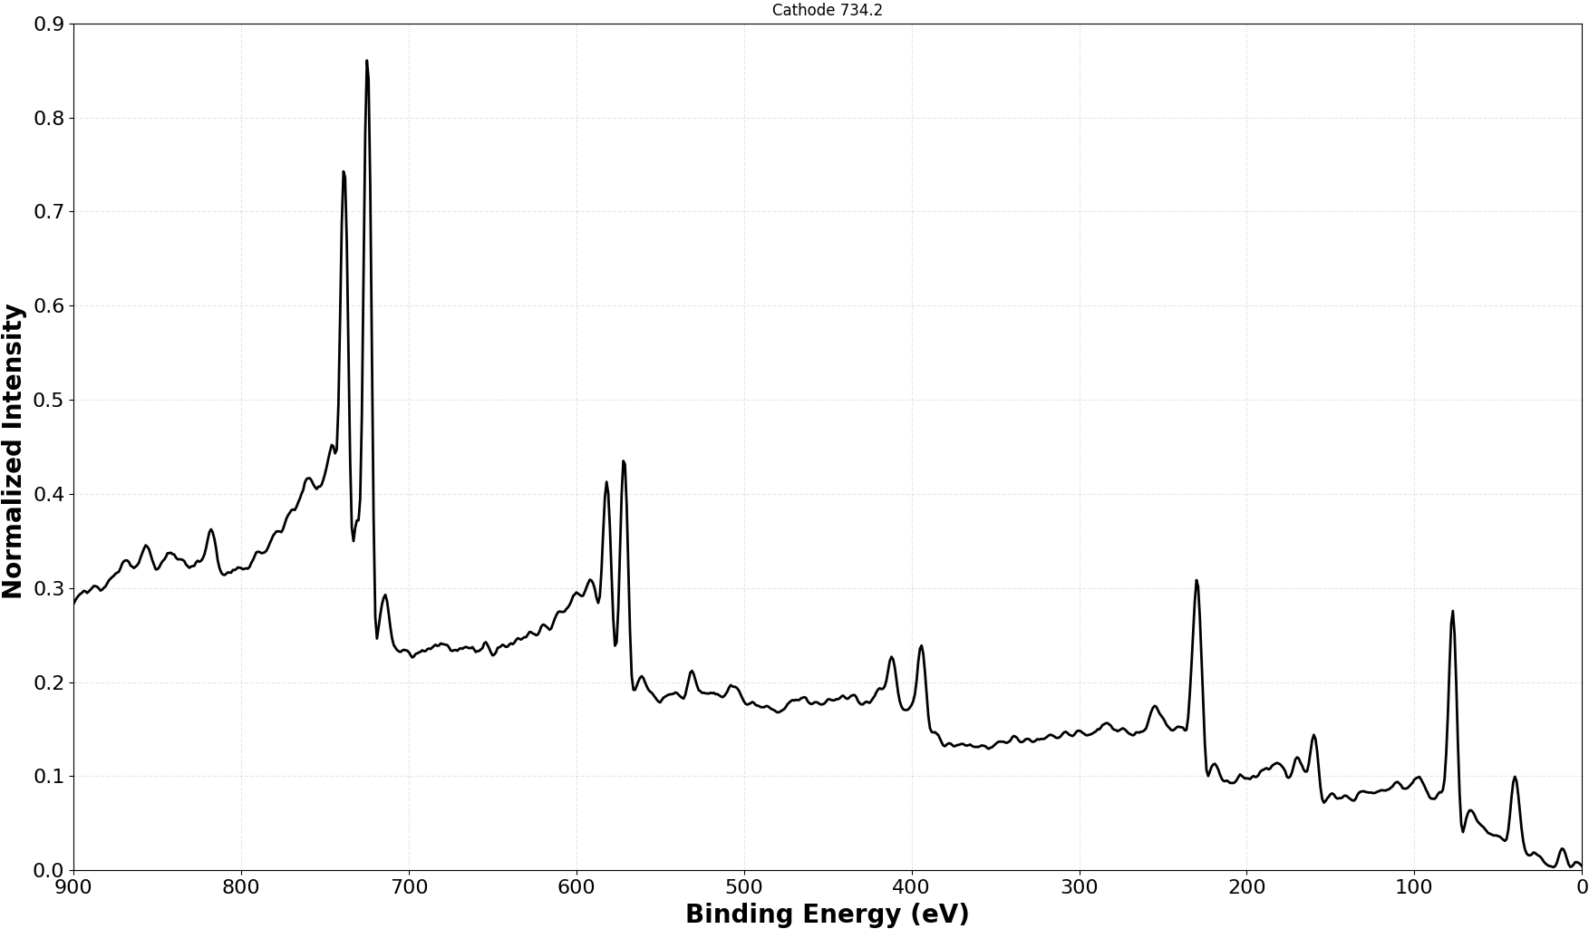
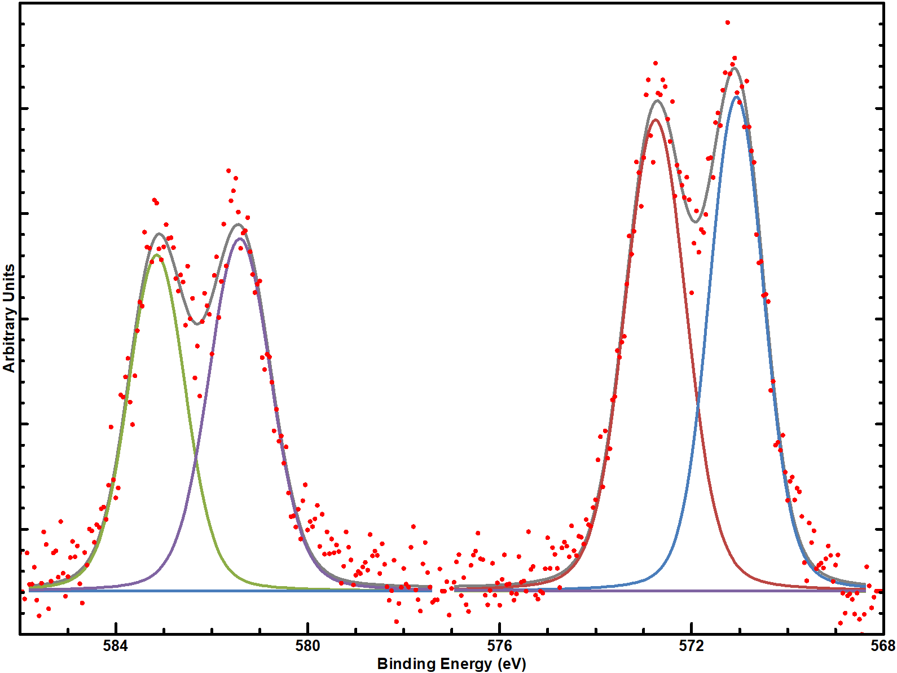
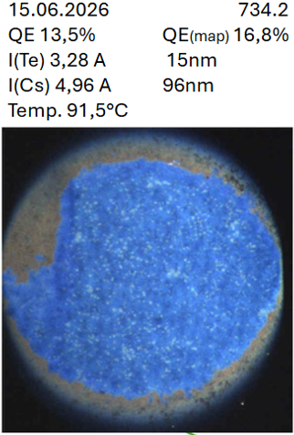
Appendix
Complementary XPS measurements
ELAS (XPS Cs₂Te):
Surveys:
Cs
Te 3d5/2 ⁰
Te 3d5/2 ²⁻
Te 3d3/2 ²⁻
Te
Te 3d3/2 ⁰
O
Mo
C

Slide 23
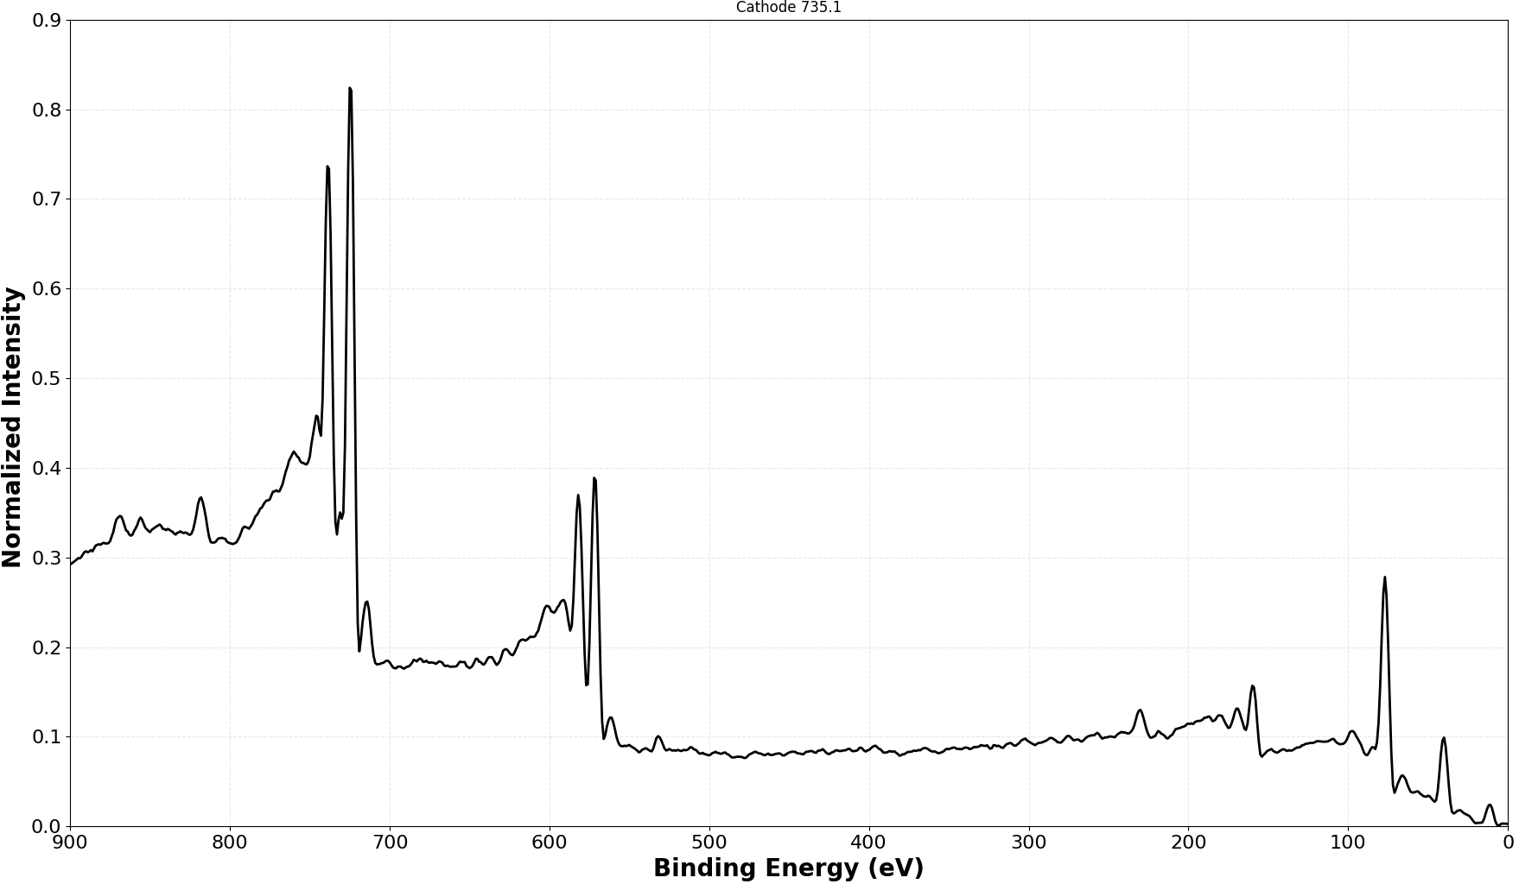
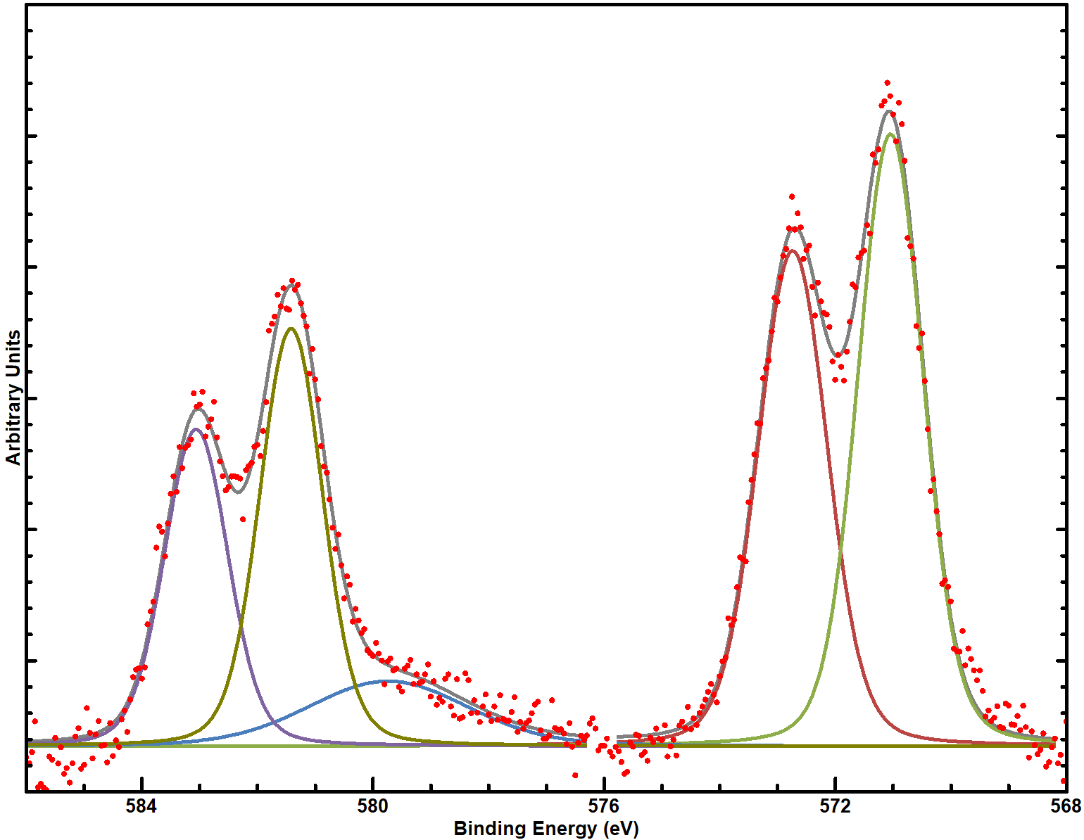
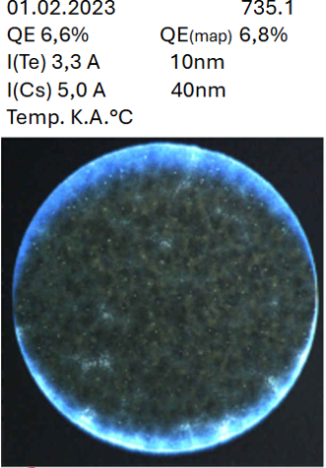
Appendix
Complementary XPS measurements
ELAS (XPS Cs₂Te):
Surveys:
Te 3d5/2 ⁰
Cs
Te 3d5/2 ²⁻
Te 3d3/2 ²⁻
Te 3d3/2 ⁰
Te
O
Mo

