Slide 1
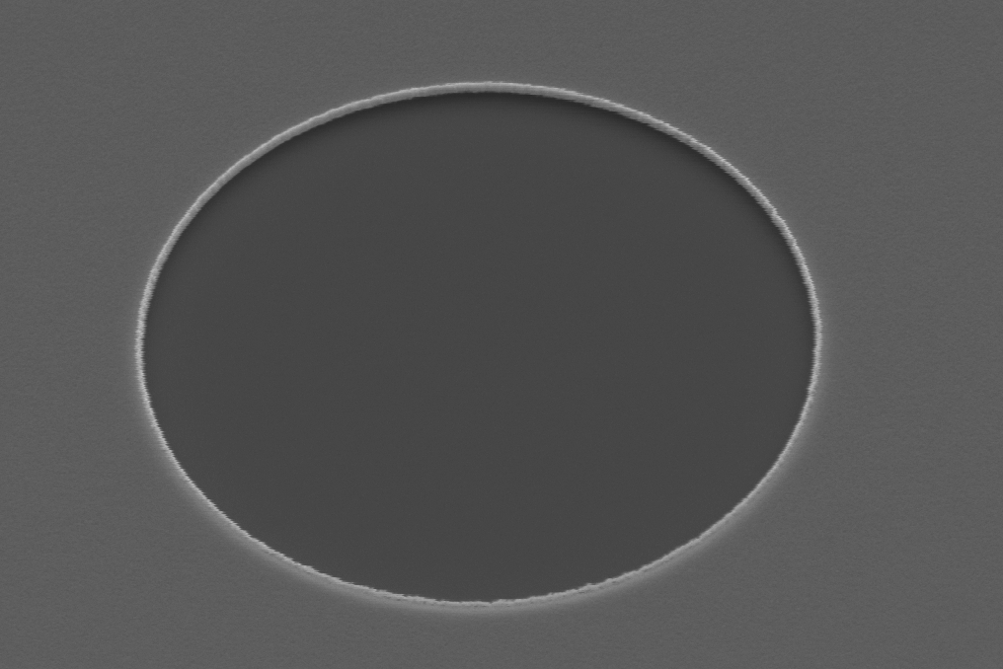
Nano-emitter Electron Sources for Ultrafast Applications
Presented by: Charles Zhang
Cornell University
Image credit: Adam Bartnik (Cornell)

Slide 2


Acknowledgements
Cornell University
Adam Bartnik
Matt Gordon
Michael Kaemingk
Samuel Levenson
Jared Maxson (PI)
Arizona State University
Anagha Ullattuparambil
Mansoure Moeini Rizi
Peter Owusu
Siddarth Karkare (PI)

Slide 3
How do you increase the brightness of an electron beam without losing charge/current?

Slide 4
$$\text{Beam Brightness} =\frac{\text{Total Charge}}{\text{Phase Space Volume}}=\frac{\text{Total Charge}}{σ_{x}σ_{y}σ_{t}{σ_{px}σ}_{py}σ_{E}}$$

Slide 5

For applications like ultrafast electron diffraction,
${10}^{3} \text{to }{10}^{5}$ electrons
$$\text{Beam Brightness} =\frac{\text{Total Charge}}{\text{Phase Space Volume}}=\frac{\text{Total Charge}}{σ_{x}σ_{y}σ_{t}{σ_{px}σ}_{py}σ_{E}}$$

Slide 6
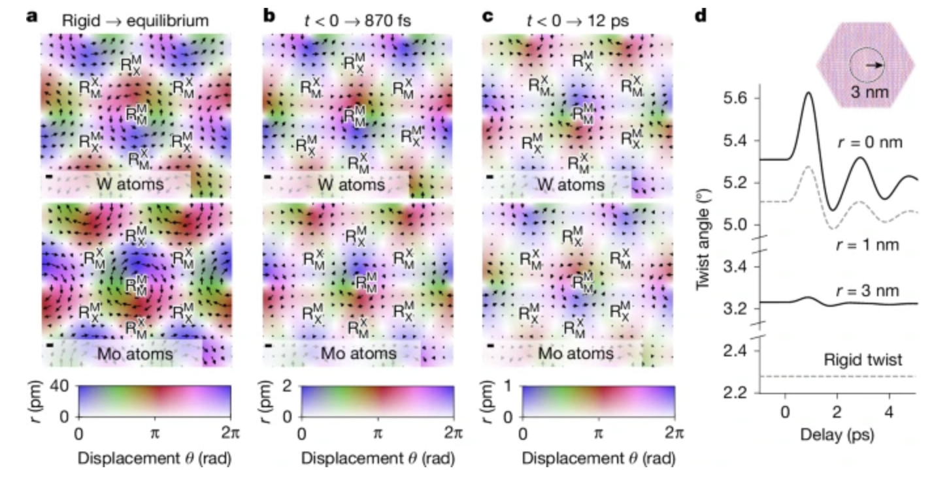
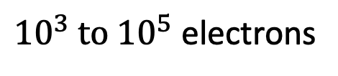
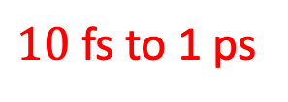
For applications like ultrafast electron diffraction,
${10}^{3} \text{to }{10}^{5}$ electrons
$$\text{Beam Brightness} =\frac{\text{Total Charge}}{\text{Phase Space Volume}}=\frac{\text{Total Charge}}{σ_{x}σ_{y}σ_{t}{σ_{px}σ}_{py}σ_{E}}$$
$10$ fs to 1 ps
Image credit: Duncan et al., Nature 647, (2025)

Slide 7
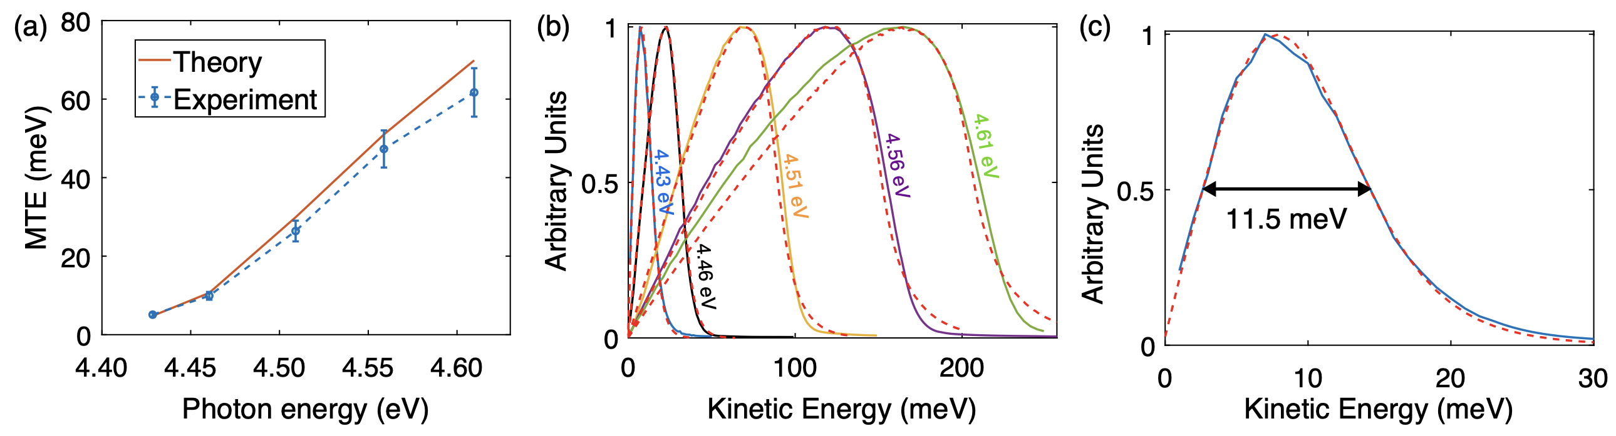
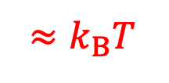
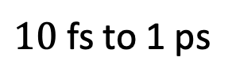
For applications like ultrafast electron diffraction,
${10}^{3} \text{to }{10}^{5}$ electrons
$$\text{Beam Brightness} =\frac{\text{Total Charge}}{\text{Phase Space Volume}}=\frac{\text{Total Charge}}{σ_{x}σ_{y}σ_{t}{σ_{px}σ}_{py}σ_{E}}$$
Cold copper photoemission
$10$ fs to 1 ps
$$≈k_{B}T$$
Image credit: Karkare et al., Phys. Rev. Lett. 125, (2020)

Slide 8
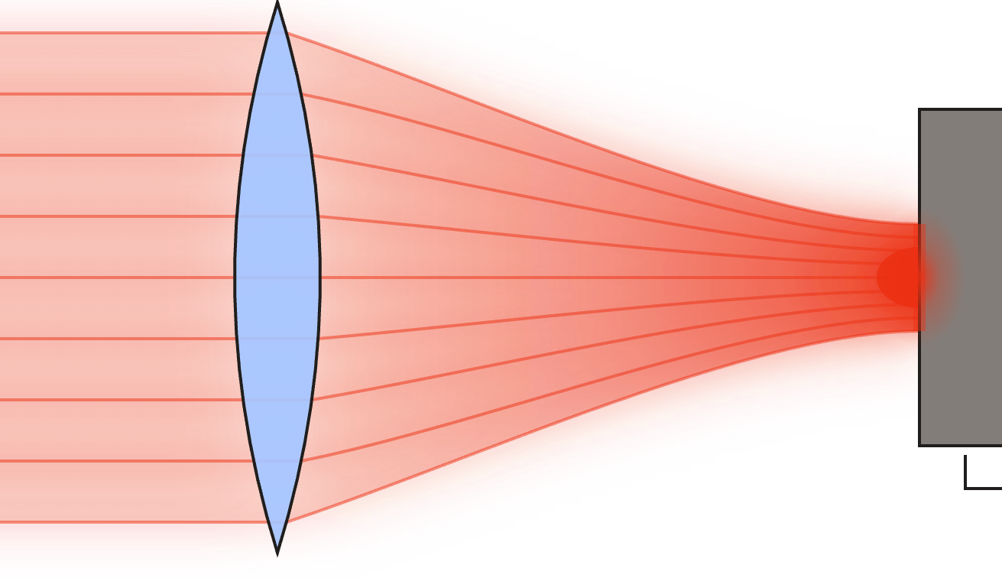

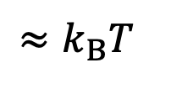
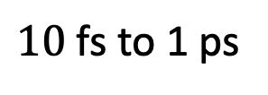
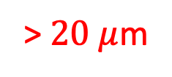

For applications like ultrafast electron diffraction,
${10}^{3} \text{to }{10}^{5}$ electrons
$$\text{Beam Brightness} =\frac{\text{Total Charge}}{\text{Phase Space Volume}}=\frac{\text{Total Charge}}{σ_{x}σ_{y}σ_{t}{σ_{px}σ}_{py}σ_{E}}$$
> $20 μ$m
$10$ fs to 1 ps
$$≈k_{B}T$$
Diffraction-limited $σ_{x}$
~ mm
Photocathode
$f≈100$ mm

Slide 9
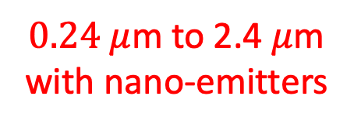
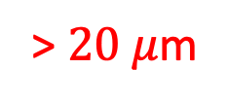
For applications like ultrafast electron diffraction,
${10}^{3} \text{to }{10}^{5}$ electrons
$$\text{Beam Brightness} =\frac{\text{Total Charge}}{\text{Phase Space Volume}}=\frac{\text{Total Charge}}{σ_{x}σ_{y}σ_{t}{σ_{px}σ}_{py}σ_{E}}$$
> $20 μ$m
$10$ fs to 1 ps
$$≈k_{B}T$$
$0.24 μ$m to 2.4 $μ$m
with nano-emitters

Slide 10
For applications like ultrafast electron diffraction,
${10}^{3} \text{to }{10}^{5}$ electrons
$$\text{Beam Brightness} =\frac{\text{Total Charge}}{\text{Phase Space Volume}}=\frac{\text{Total Charge}}{σ_{x}σ_{y}σ_{t}{σ_{px}σ}_{py}σ_{E}}$$
> $20 μ$m
$10$ fs to 1 ps
$$≈k_{B}T$$
$0.24 μ$m to 2.4 $μ$m
with nano-emitters
Besides being small, other benefits of nano-emitters also include:
Easier to make hard edge emission boundaries
Precise control of position and number of emitted electrons

Slide 11
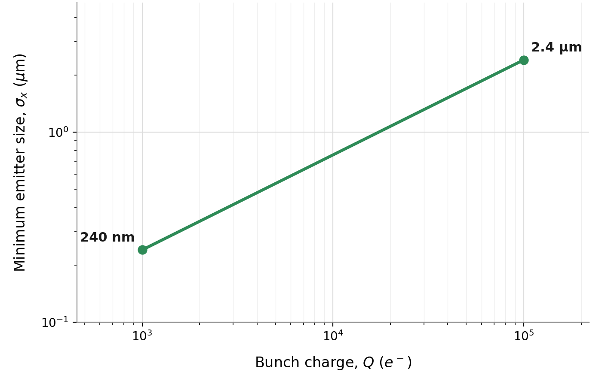

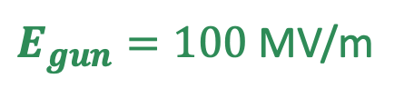
Why limit the emission size to $0.24 μ$m to 2.4 $μ$m?
“Space charge limit”: $σ_{x}=\sqrt{\frac{Q}{ε_{0}πE_{gun}}}$
$E_{gun}=100$ MV/m

Slide 12
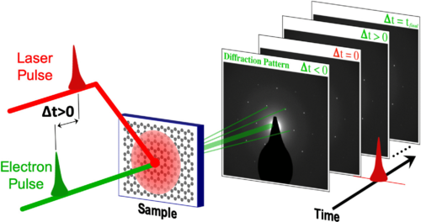
Implications for ultrafast electron diffraction
Image credit: Filippetto et al., Rev. Mod. Phys. 94, (2022)
Notes:
Typical resolving power for TEM is >10^2 and >10 for UED

Slide 13
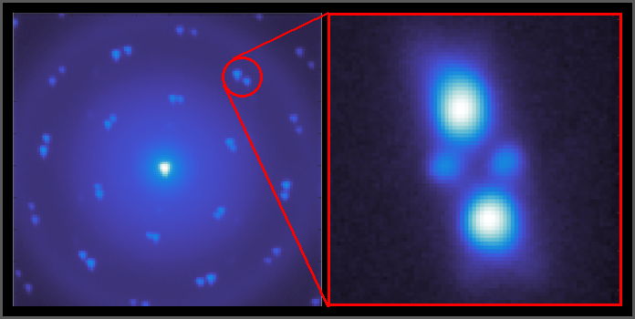
Increasing e-beam brightness -> Higher diffraction spot resolution
Image credit: Adam Bartnik, Matt Gordon, Cameron Duncan (Cornell)
Notes:
Emittance used here is sub nm, ~0.7 nm-rad, with total bunch charge of around 1000-2000 electrons
Typical resolving power for TEM is >10^2 and >10 for UED

Slide 14
How do we make nano-emitters?

Slide 15
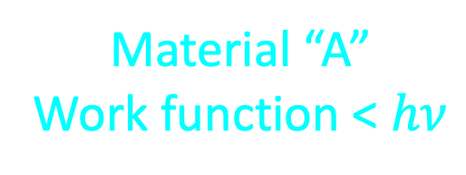

Photoemission Contrast
Material “B”
Work function > $hν$
Material “A”
Work function < $hν$
Lithographically-defined emission region

Slide 16
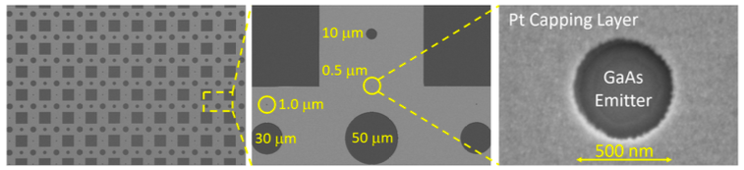


GaAs emitters
$φ=1.4$ eV
$φ=5.6$ eV
Image credit: Adam Bartnik (Cornell)

Slide 17
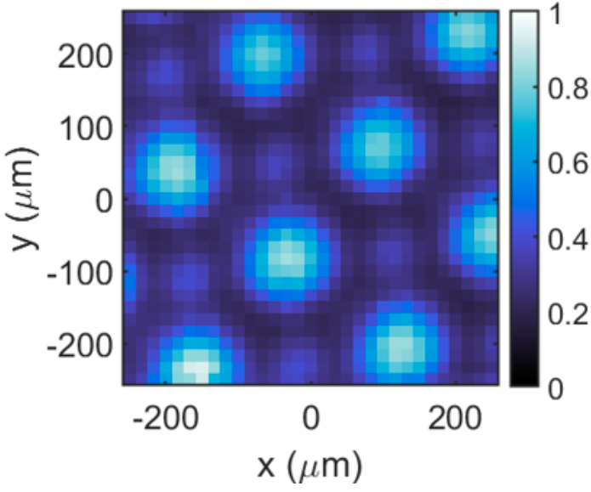
GaAs emitters post-Cs/O activation
Quantum efficiency ($hν=$2.3 eV) spatially mapped here with a laser position scan ($σ_{x}≈25 μ$m)
QE of GaAs is over 40 times larger than QE of Pt.
Image credit: Adam Bartnik, Michael Kaemingk, Samuel Levenson (Cornell)
Notes:
1% average QE at 780 nm

Slide 18
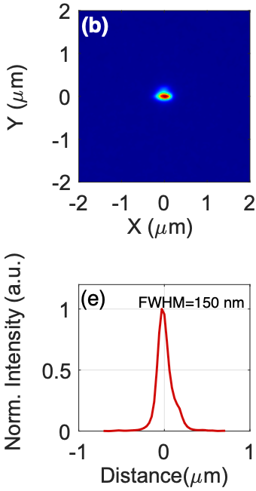
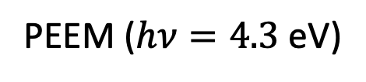
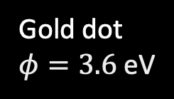
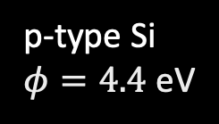
PhotoEmission Electron Microscopy allows for much higher resolution
PEEM ($hν=4.3$ eV)
p-type Si
$φ=4.4$ eV
Gold dot
$φ=3.6$ eV
Measured emittance comparable to electron microscope tips!
Image credit: Anagha Ullattuparambil, Mansoure Moeini Rizi, Peter Owusu (ASU)

Slide 19
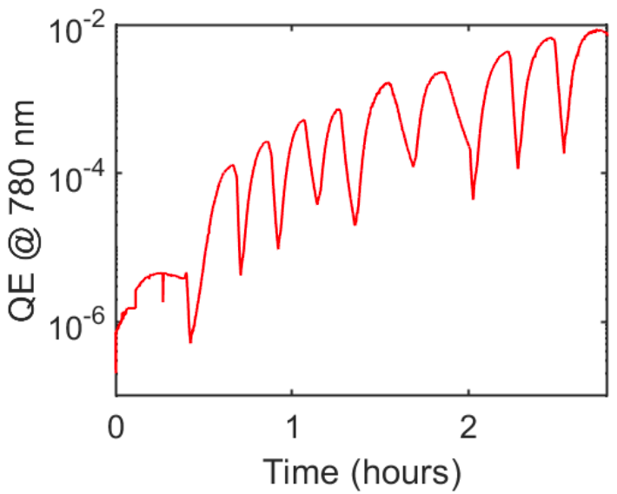
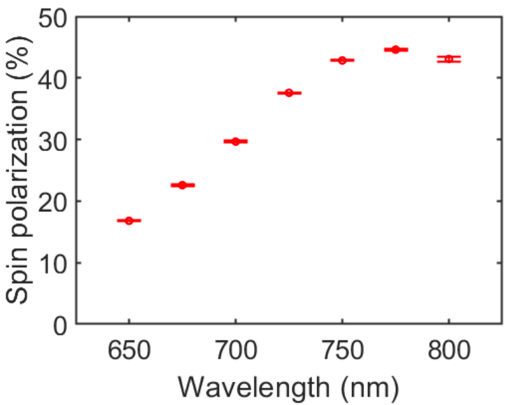
High charge + Ultrafast Operation?
QE and spin polarization of GaAs emitters remain good after photolithography.
45%
Image credit: Samuel Levenson (Cornell)
Notes:
so what is our plan going forward?

Slide 20
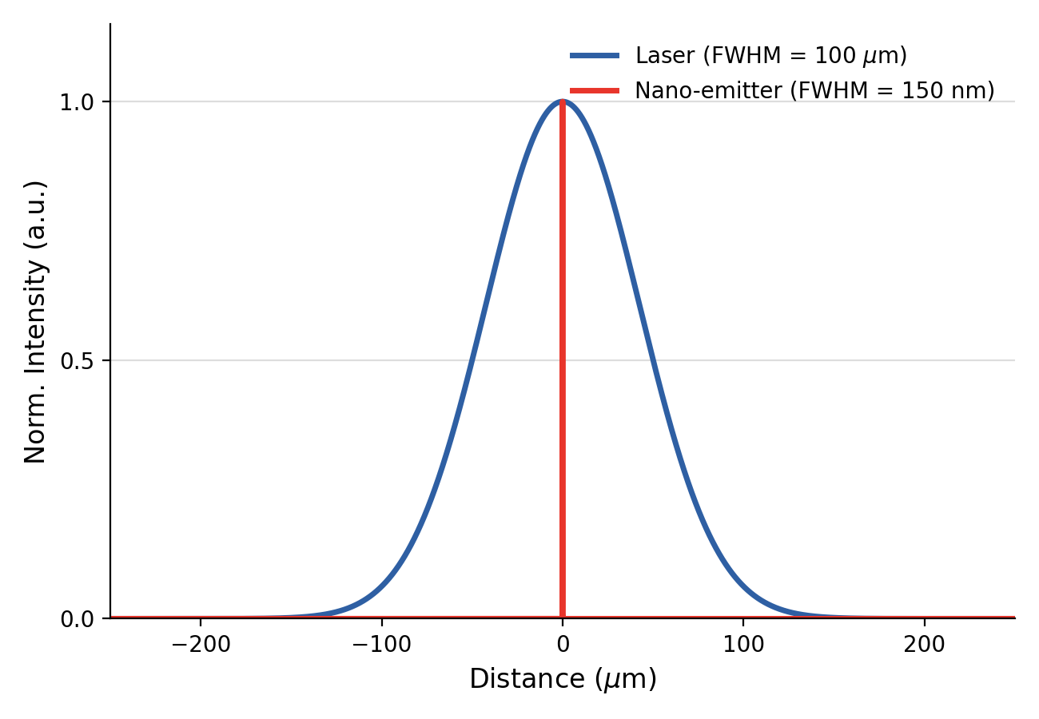
High charge + Ultrafast Operation?
Only 0.15% of the laser’s energy is being used to generate beam ☹

Slide 21
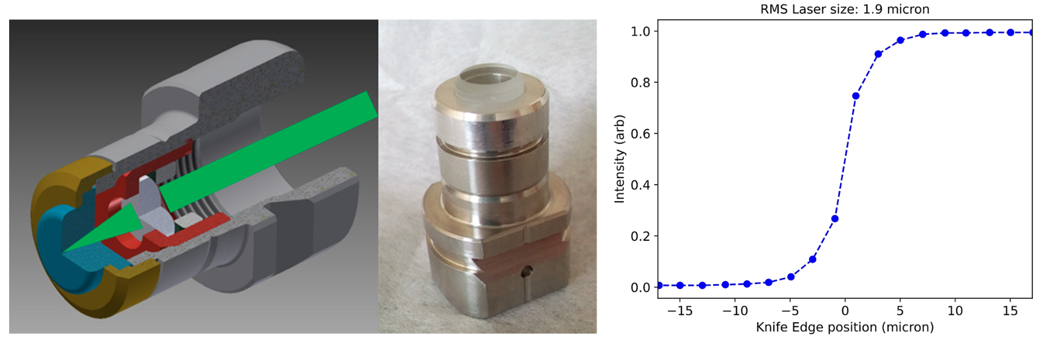
High charge + Ultrafast Operation?
Transmission-mode operation with a lens built into the gun allows for sub-micron laser waists.
Modified INFN/DESY plug
Image credit: Yang et al., Photonics 11, (2024)

Slide 22
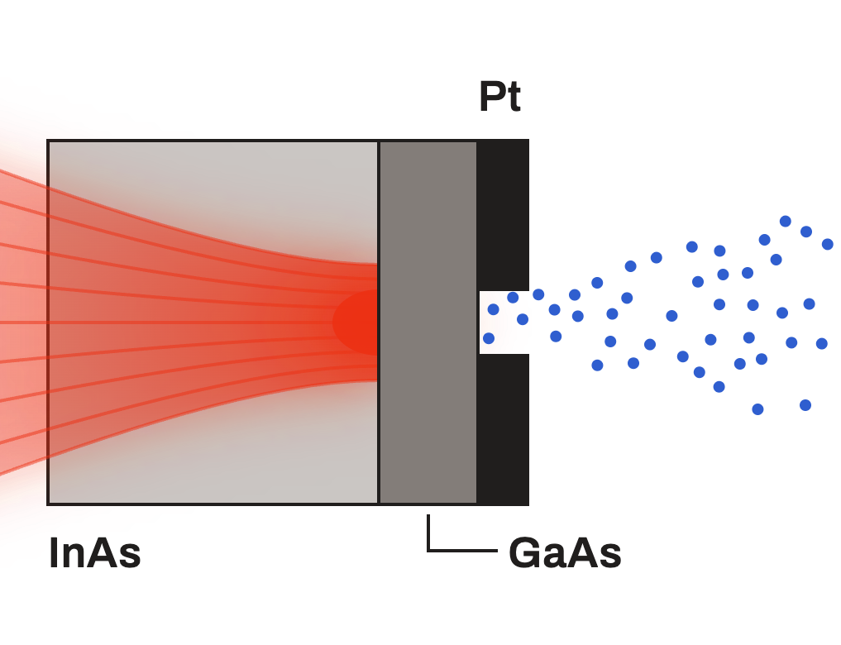

High charge + Ultrafast Operation?
Thin GaAs grown on a transparent substrate like AlGaAs or InGaP would reduce the response time, resulting in shorter bunch lengths for ultrafast operation.
$λ=800$nm
AlGaAs or InGaP

Slide 23
What if we reduced the emitter size below the space charge limit?

Slide 24
We can imagine tuning the emitter size D to set a maximum bunch charge of single to few electrons at the space charge limit.
Background field = E₀
Pt
H
Pt
D
V = 0
V = 0
GaAs
V = φ₀

Slide 25

We can imagine tuning the emitter size D to set a maximum bunch charge of single to few electrons at the space charge “Coulomb blockade” limit.
Background field = E₀
$$E_{tot,z}≤0$$
-
Pt
Pt
-
GaAs
+

Slide 26
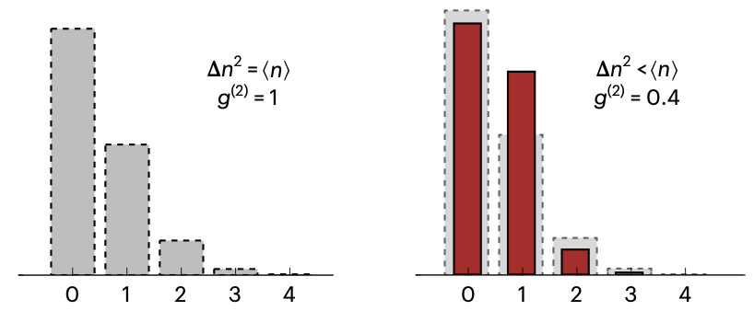
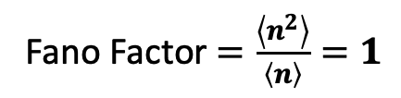
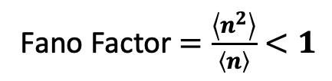
In the Coulomb blockade emission of few electrons, we can achieve sub-Poissonian statistics.
Poisson Distribution
Sub-Poissonian Distribution
Fano Factor $=\frac{\left\langle n^{2}\right\rangle }{\left\langle n\right\rangle }=1$
Fano Factor $=\frac{\left\langle n^{2}\right\rangle }{\left\langle n\right\rangle }<1$
# of emitted electrons per pulse
# of emitted electrons per pulse
For example, with an average emission of 0.5 electrons, sub-Poissonian emission significantly improves the chances of emitting only 1 electron per pulse.
Image credit: Meier et al., Nature Physics 19, (2023)

Slide 27
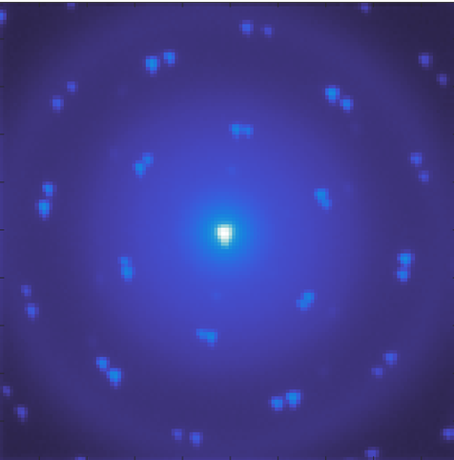
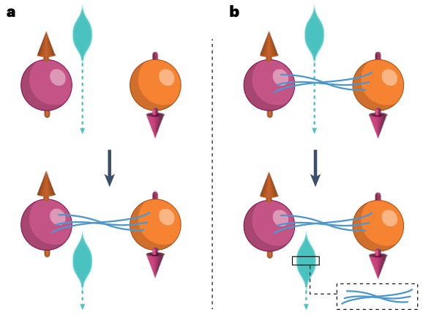
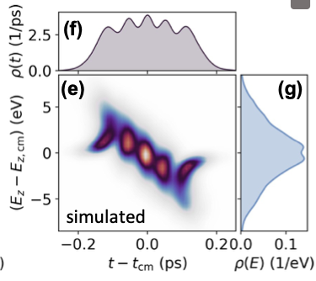
On-demand single electron emission can improve current imaging methods and potentially unlock new ones.
Sub-shot noise UED
Free electron quantum optics
Highly-ordered Electron Beams
Di Giulio et al., CLEO, (2026)
Ruimy et al., Nature Physics 21, (2025)

Slide 28
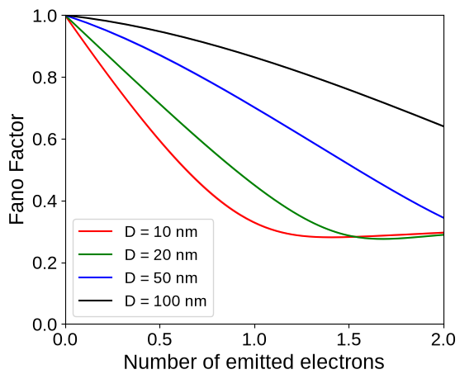
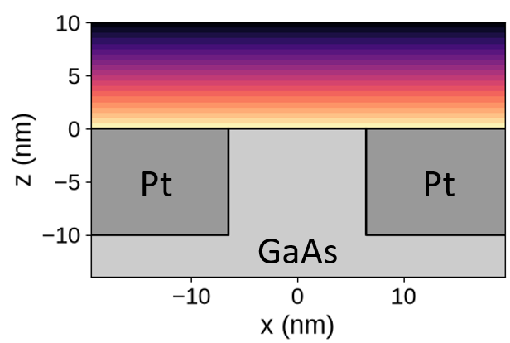
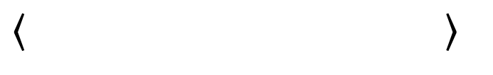
Flat geometry
D

Slide 29
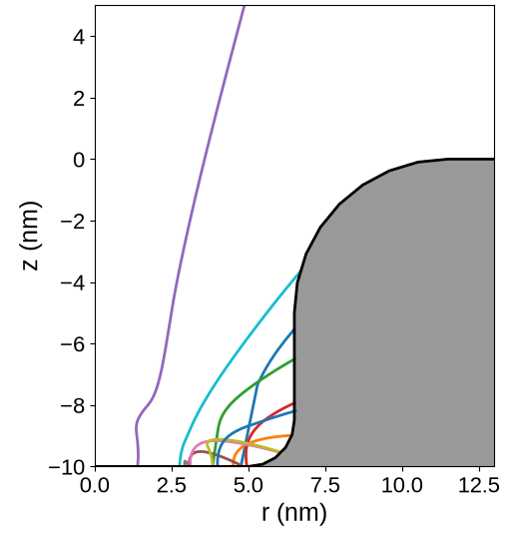
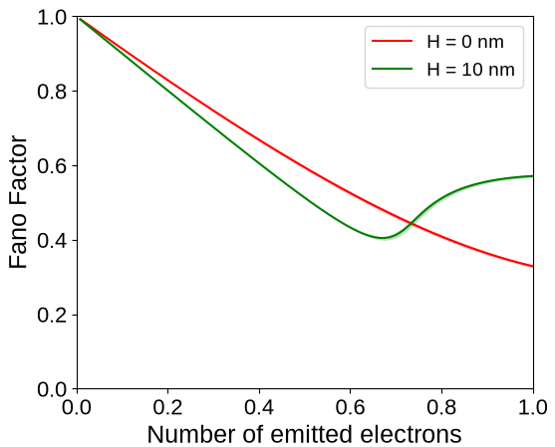
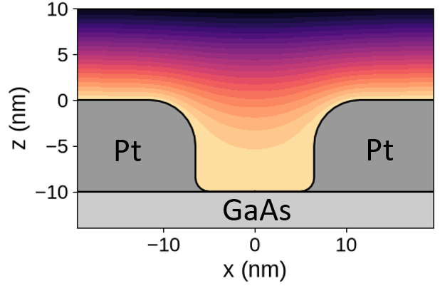
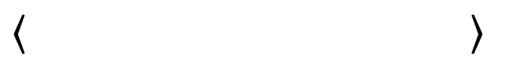
emitter wall height
H
Pt
0 e⁻: 39%
1 e⁻: 60%
2 e⁻: 1%
H
D=10 nm
Image credit: Adam Bartnik, Michael Kaemingk, Matt Gordon (Cornell)
Notes:
Green line geos back up since larger avg number of electrons emitted requires greater number of excited electrons, so chances of emitting more electrons is greater. The walls also attract electrons due to image charge, which also contributes to the increase in Fano factor.
Basically I think of it as, by having walls, there’s more ways to change the number of electrons that ultimately escapes, which introduces more uncertainty to the number of electrons.

Slide 30
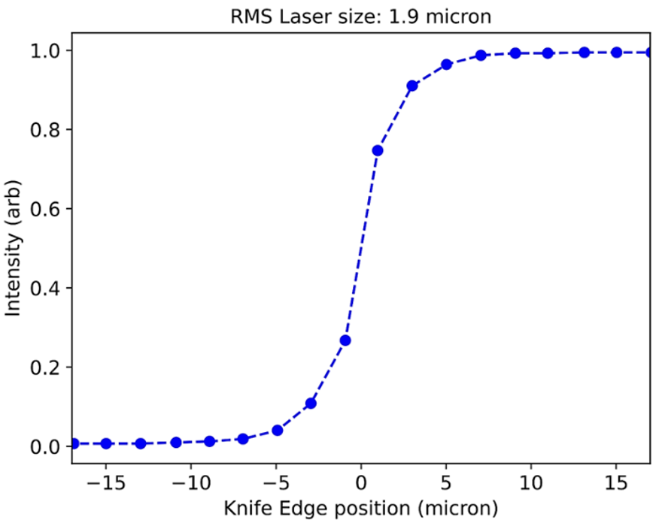
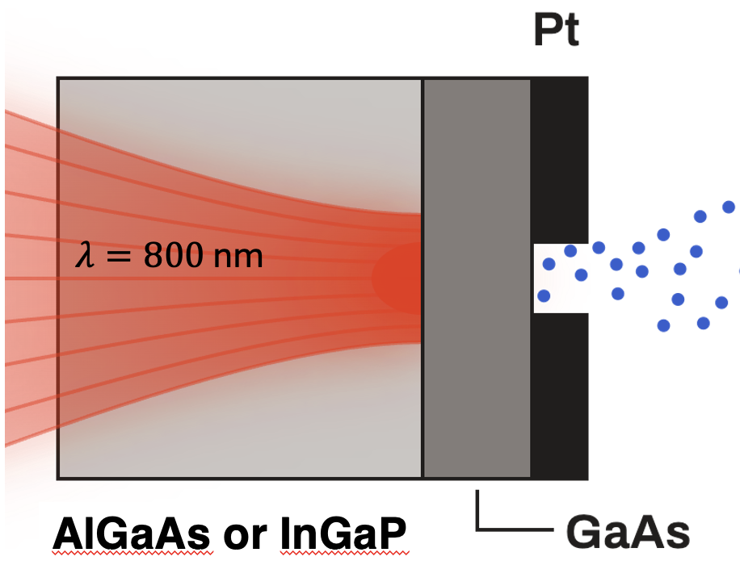
Takeaways
Demonstrated sub-micron electron emission using photoemission contrast.
Proposed approach for achieving high charge and small response times with GaAs nanoemitters for ultrafast applications, e.g UED.

Slide 31
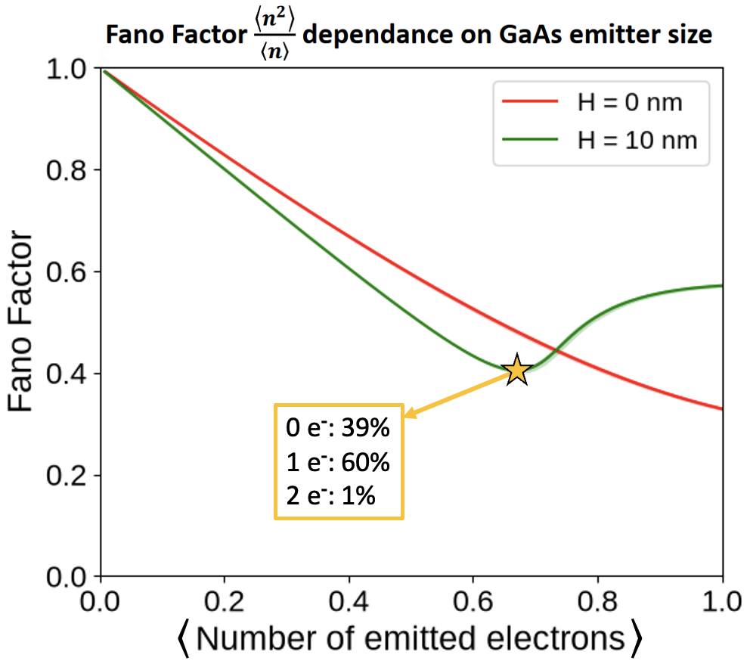
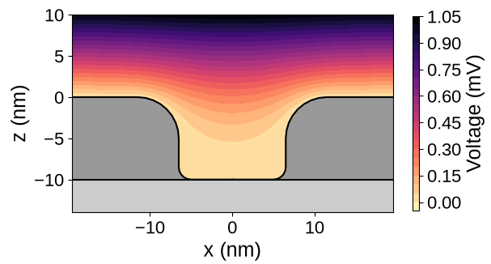
Takeaways
Analytic Potential in Gun Field
Pt
Pt
GaAs
Developed model for electron dynamics near nanoemitters.
Simulated sub-Poissonian emission for varying emitter geometries, yielding a Fano factor as low as 0.4.

Slide 32
FIN

Slide 33
Backup/abandoned slides

Slide 34
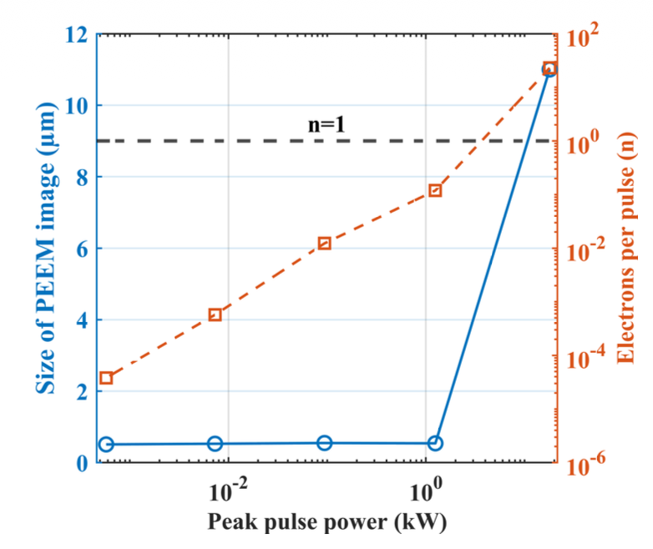
Space charge becomes more effective with increasing the bunch charge and results in broadening of the measured PEEM spot

Slide 35
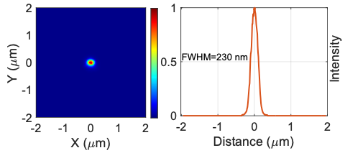
Photoemission electron microscope measurements of nano-emitters at ASU
Cs-Si
Cs-Sb

