Slide 1




Accelerator: Science, Technology & Applications
Aim: A premier Open-Access journal for dissemination of high-impact research across the full spectrum of particle accelerator science, technology, and its transformative applications. APC is free before 2030.
Accelerator Physics & Concepts
Advanced Accelerator Technologies
Accelerator Facilities & Applications
Medical & Industrial Applications
Cross-Disciplinary Integration
Research Article, Review, Letter, Perspective, Dataset, Editorial, Erratum
Expected IF: ~5.0
Editor-In-Chief: Prof. Zhentang Zhao
Executive Editor-In-Chief: Prof. Haixiao Deng
Welcome to submit your contributions!

Slide 2
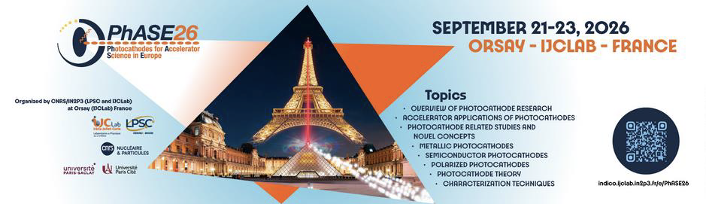


UED sources and photocathode R&D at Tsinghua University
Renkai Li
Tsinghua University
September 22, 2026

Slide 3
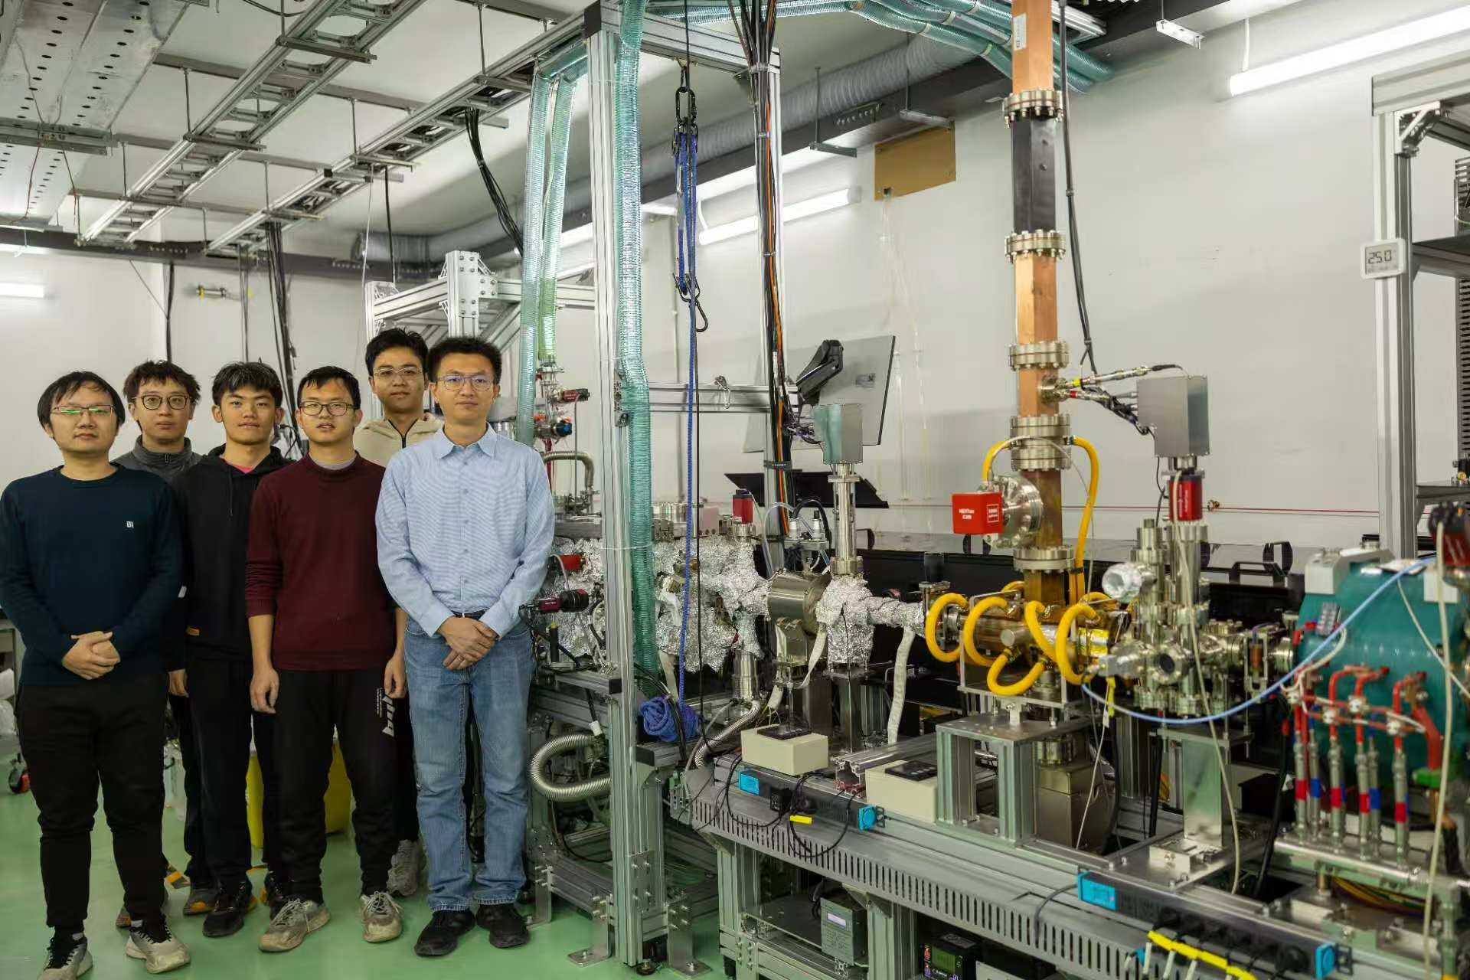
Acknowledgement
Collaboration and discussions with many colleagues, especially at Cornell, UCLA, and SLAC
Colleagues at Tsinghua & team members: C. X. Tang, W. H. Huang, Y. C. Du, L. M. Zheng, L. M. Zheng, P. W. Huang, Y. N. Yang, P. Lv, Z. Y. Wang, B. T. Song, Z. X. Liu etc.
Funding agencies

Slide 4
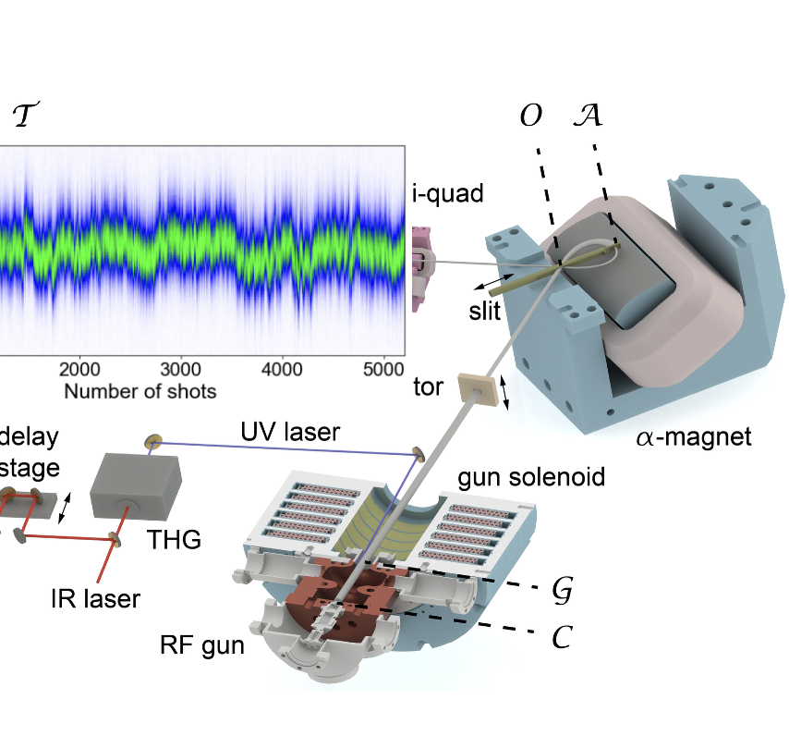
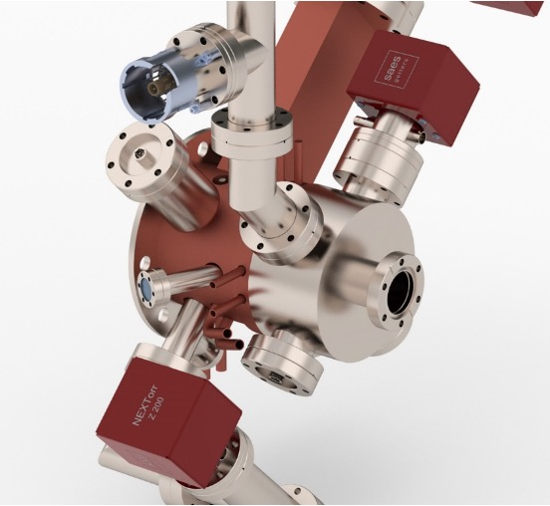
Outline
Introduction
FORTRESS beamline
few-fs e-beam control
Ultrahigh-vacuum S-band gun
Alkali-antimonide at high-field

Slide 5

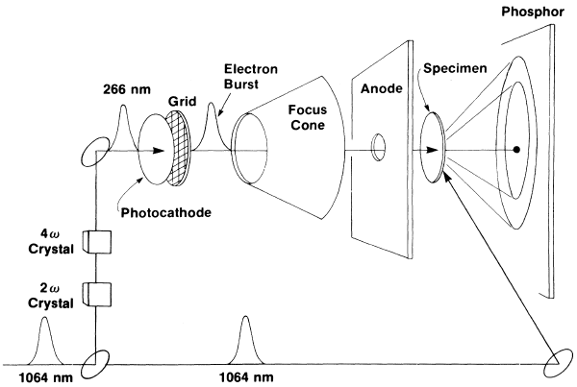
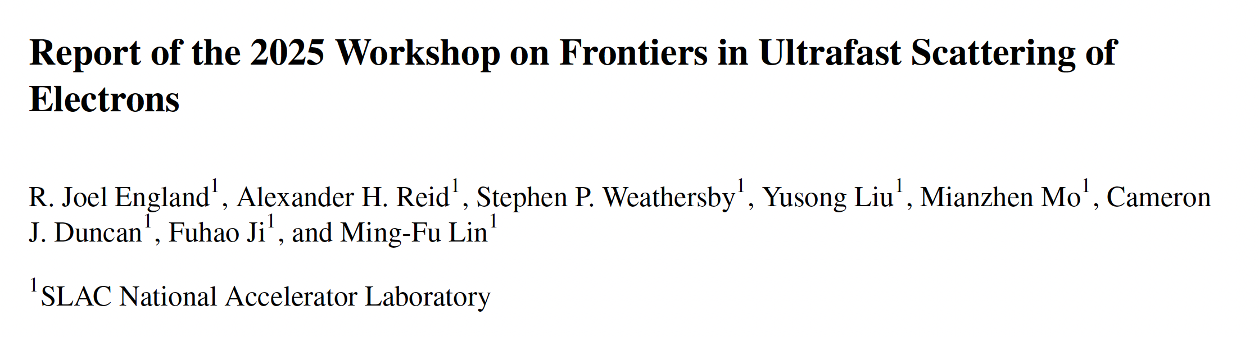
Ultrafast electron diffraction
G. Mourou and S. Williamson, APL 41, 44 (1982)
S. Williamson, G. Mourou and J. C. M. Li, PRL 52, 2364 (1984)
https://lcls.slac.stanford.edu/instruments/slac-mev-ued/mev-ued-publications
Full potential of (MeV) UED are being explored: science and instrument
Sensitive to Coulomb fields, large cross sections, large q-range, low radaition damage…

Slide 6
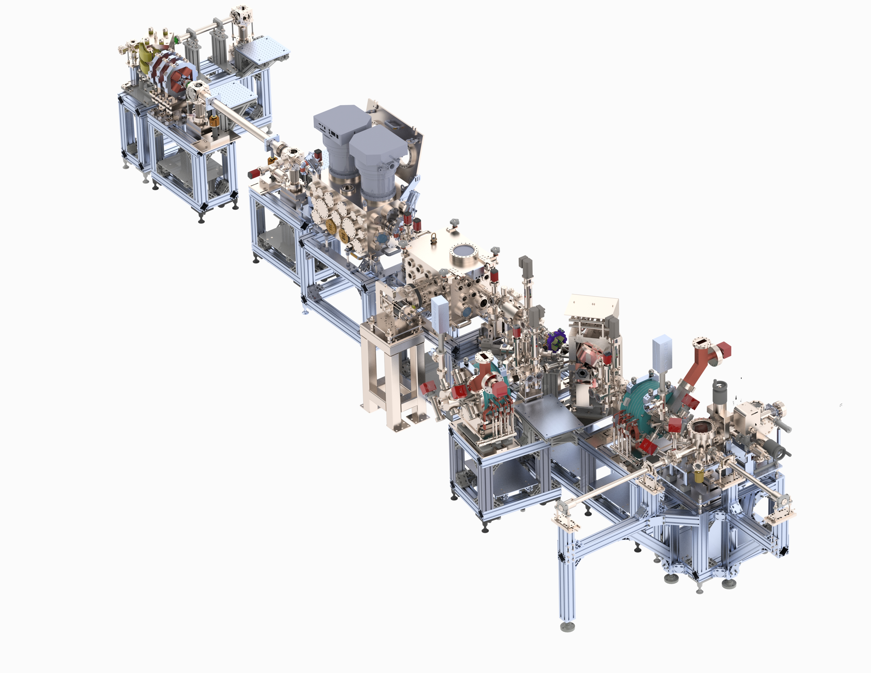
An R&D facility for bright beams research
High resolution spectrometer
FORTRESS
Facility fOr Relativistic Time-Resolved Electron Sources and Scattering
Beam study
Sources and cathodes
Low emittance
fs bunch and timing
Advanced diagnostics
UED/UEM
Training students
Liquid/gas phase chamber
Solid state chamber
Gun
Gun and load-lock

Slide 7
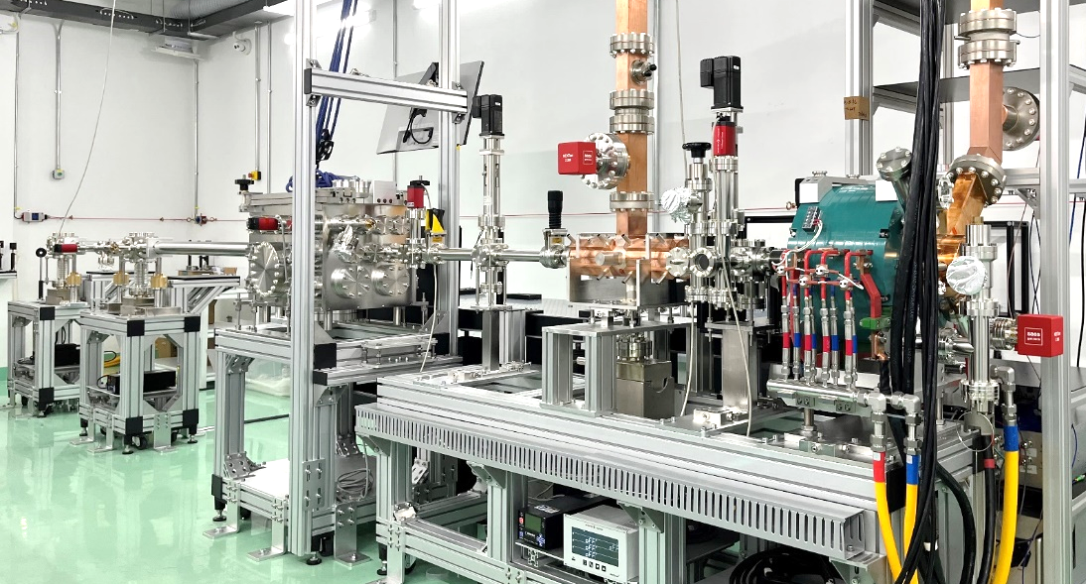
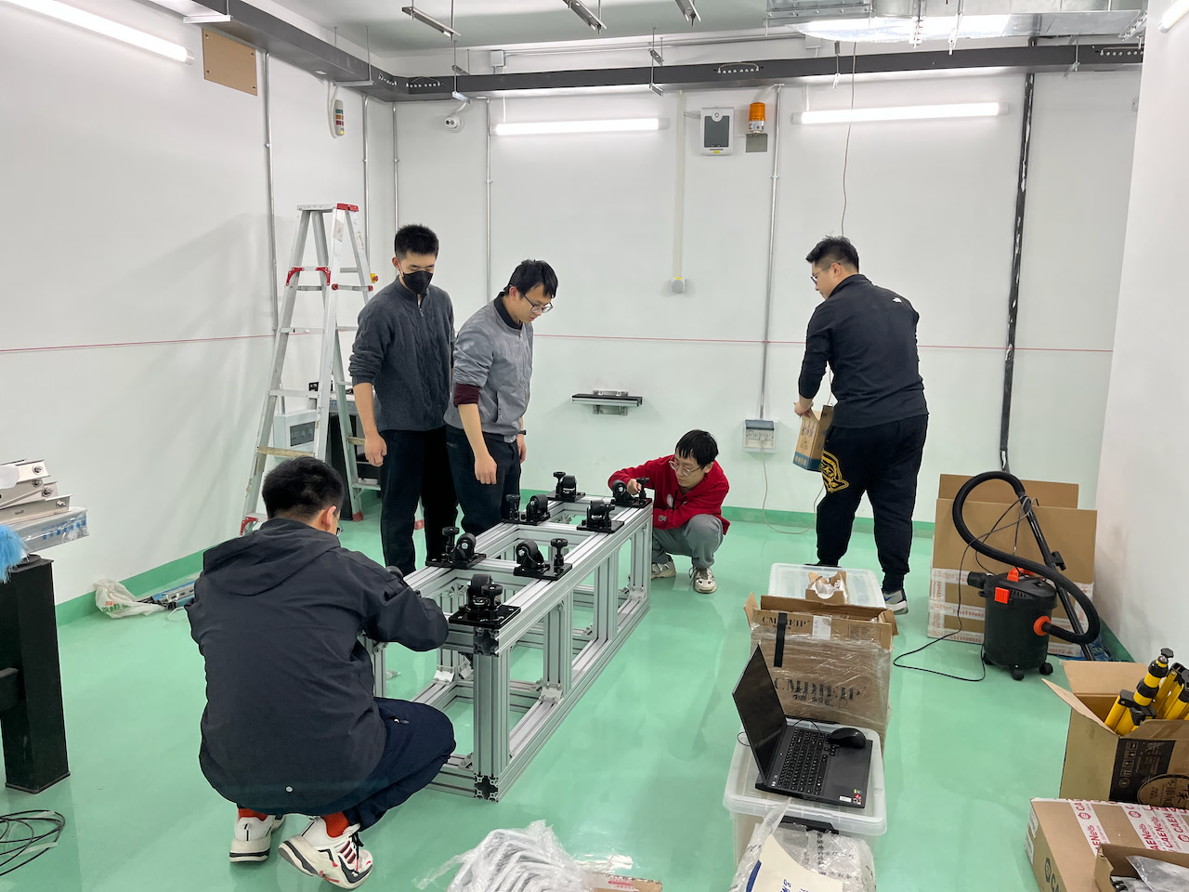
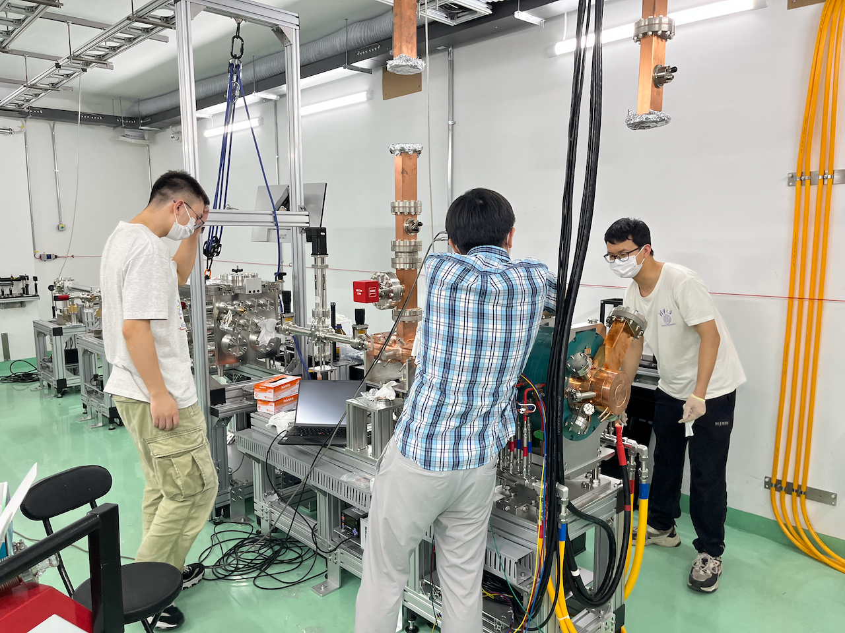
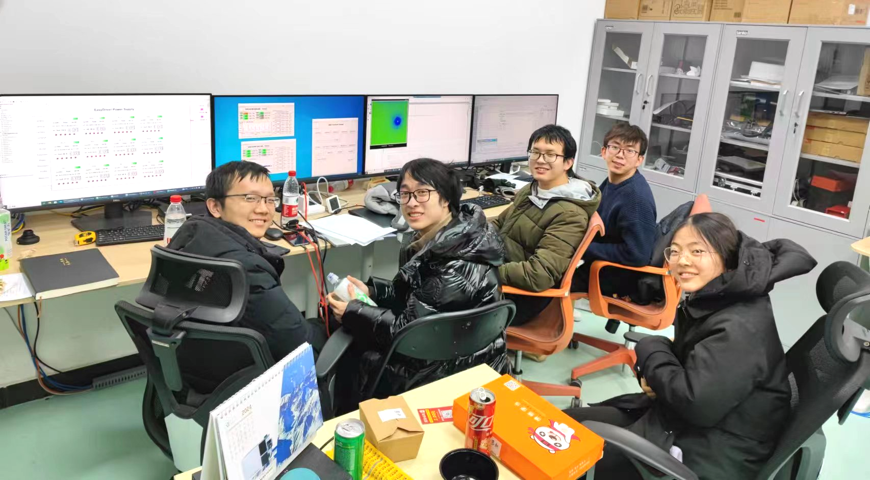
Construction of FORTRESS
Zhiyuan Wang
1st yr grad.
Peng Lv
2nd yr grad.

Slide 8
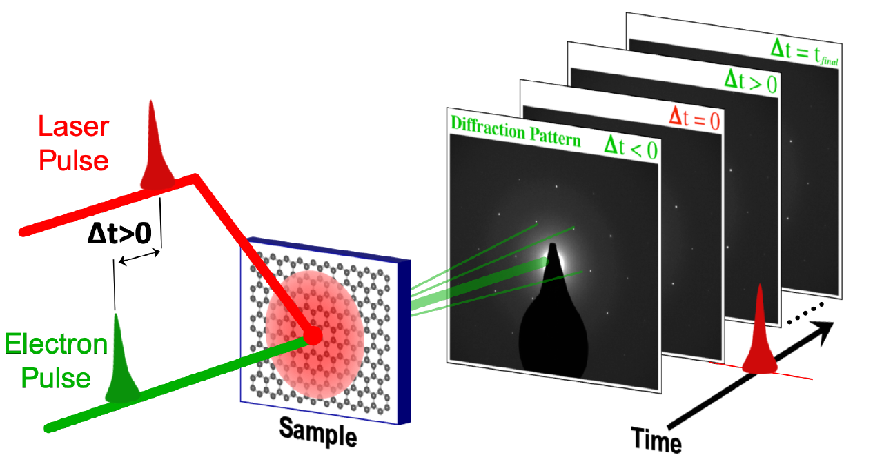
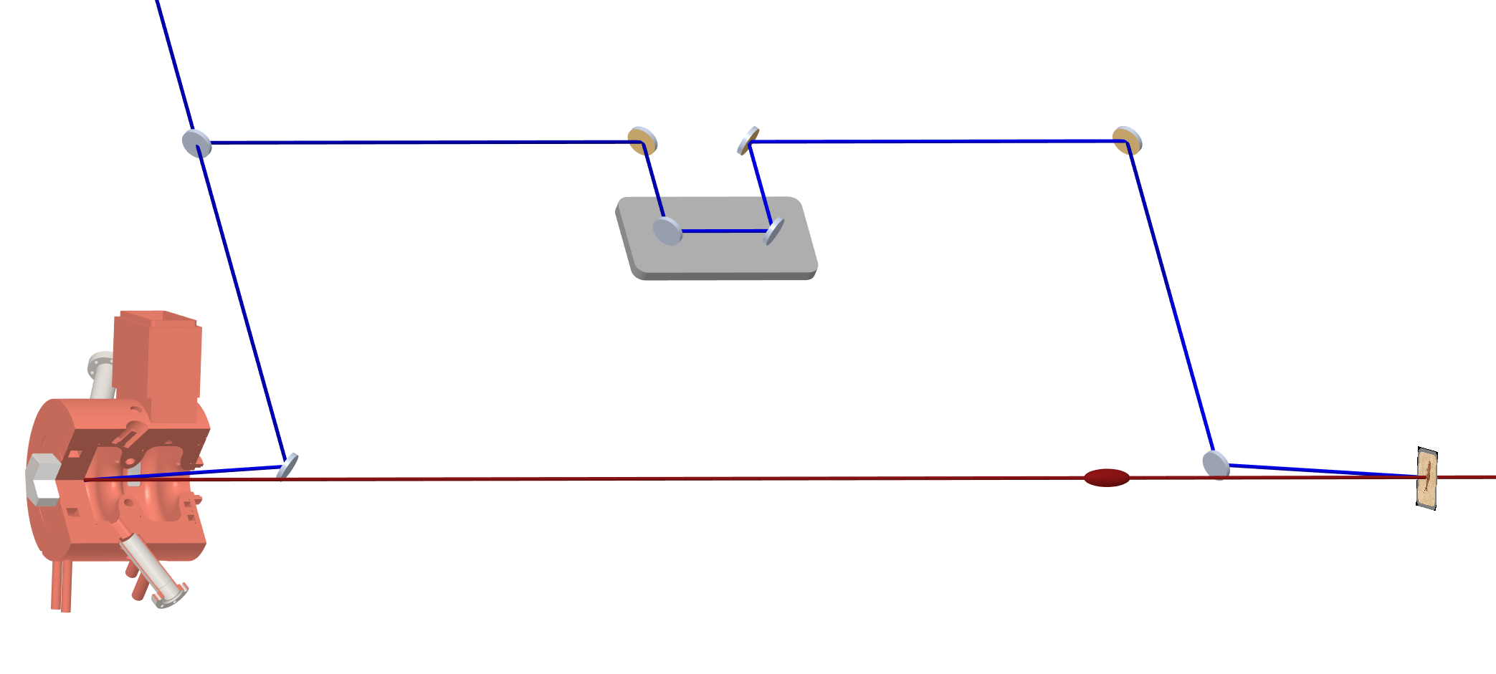

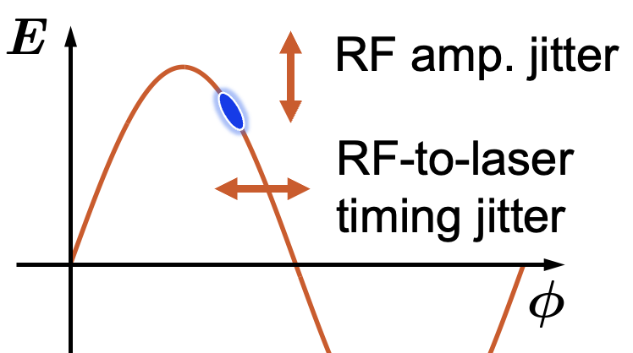
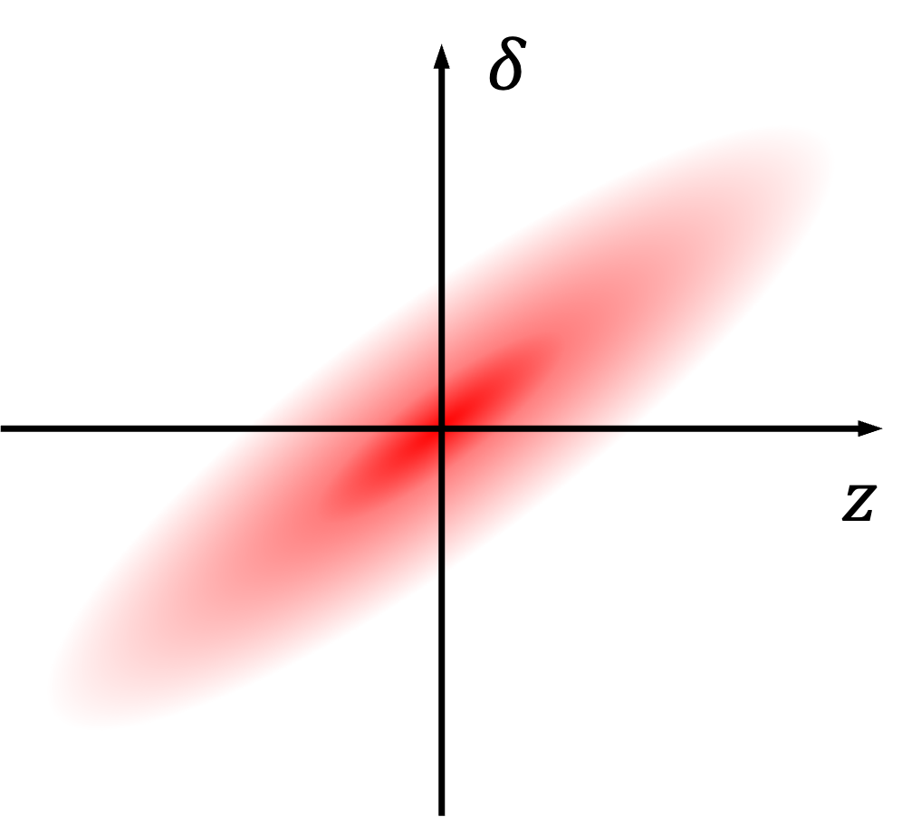
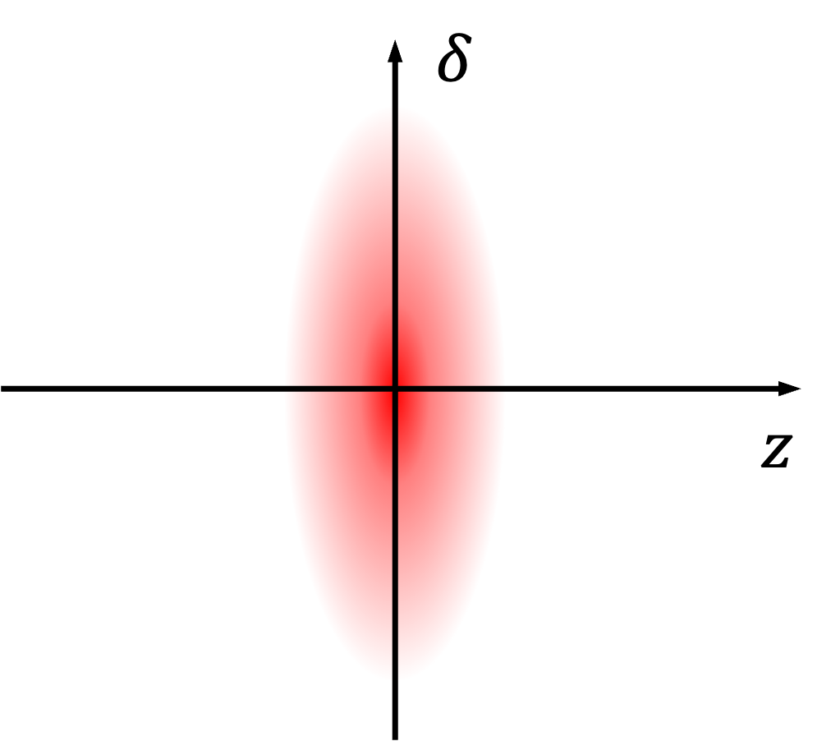
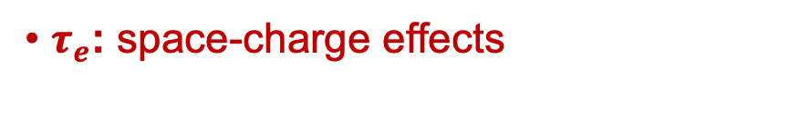
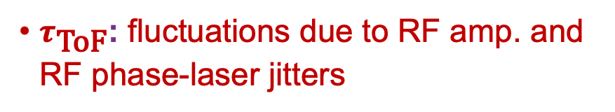
Temporal resolution and challenges
cathode laser
pump laser
e- bunch
Filippetto, Musumeci, Li et. al., RMP 94, 045004 (2022)
Long bunch
Short bunch
$τ_{e}$: space-charge effects
$τ_{\text{ToF}}$: fluctuations due to RF amp. and RF phase-laser jitters

Slide 9
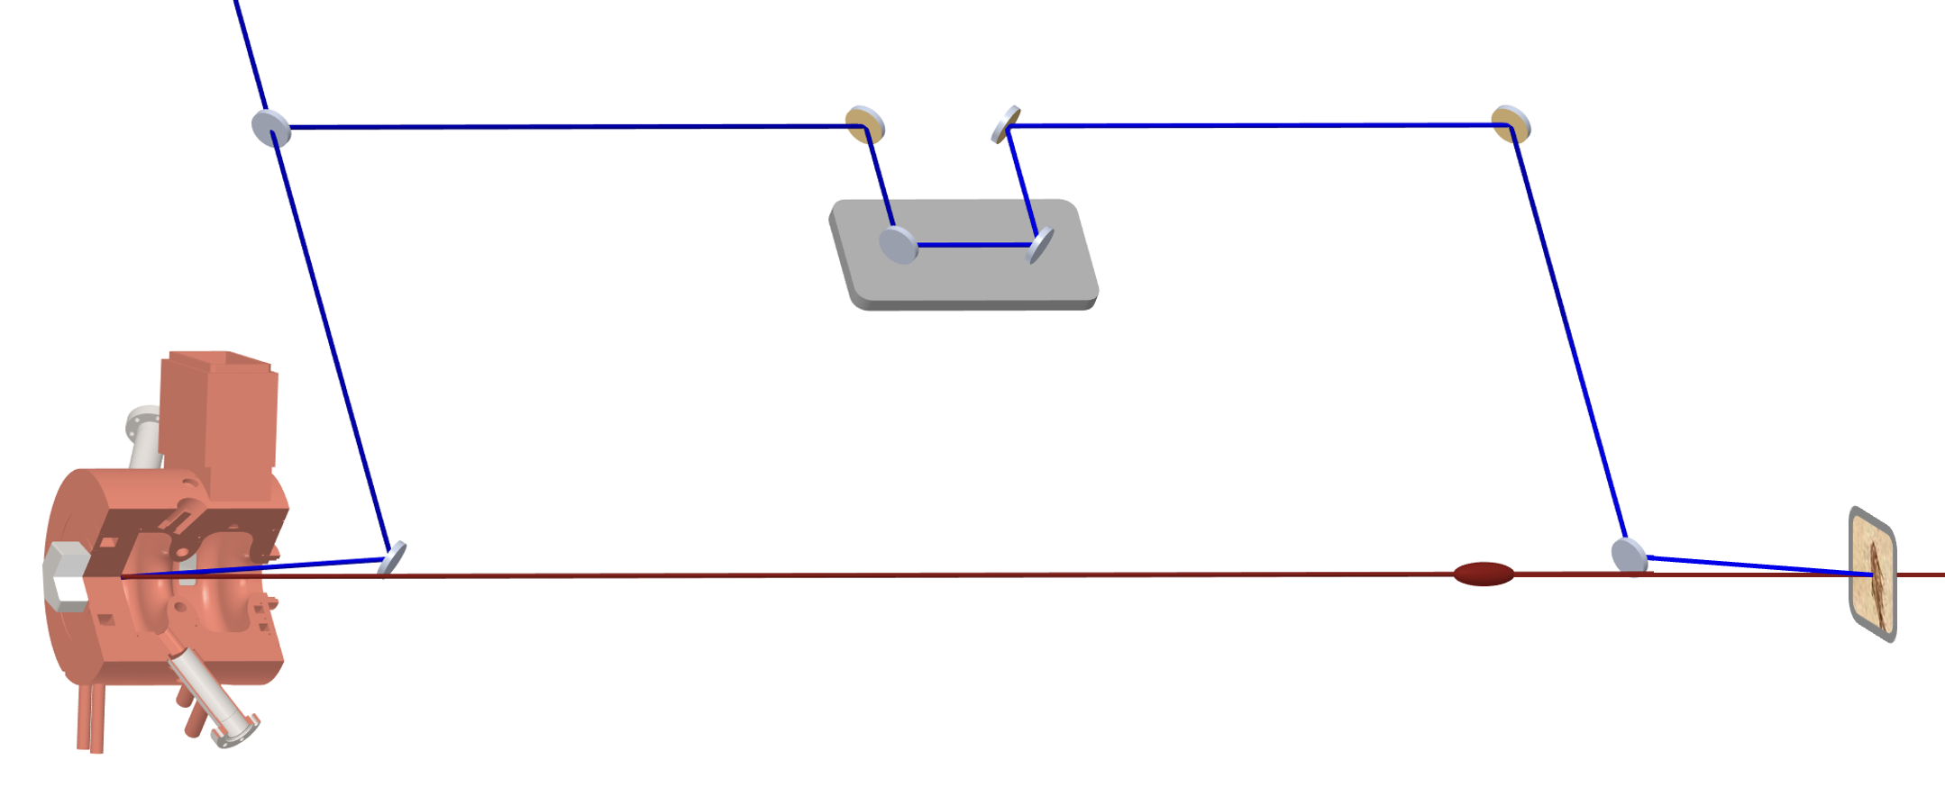
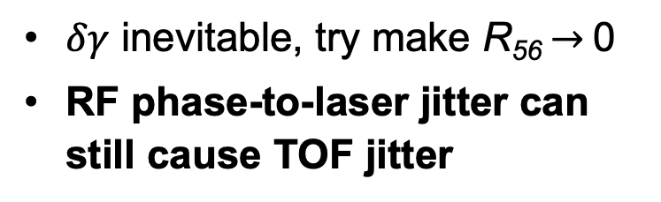
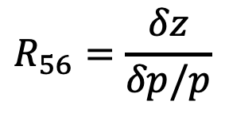
Criteria for temporal control
cathode laser
pump laser
Simultaneous sync. & comp.
Preserve beam brightness Simple, reliable, clear
e- bunch
$$R_{56}=\frac{δz}{δp/p}$$
Fix cathode-target TOF
Compress bunch duration
$δγ$ inevitable, try make R₅₆$→$0
RF phase-to-laser jitter can still cause TOF jitter
Rotate LPS w/o affecting centroid TOF (no ‘active’ EM fields)

Slide 10
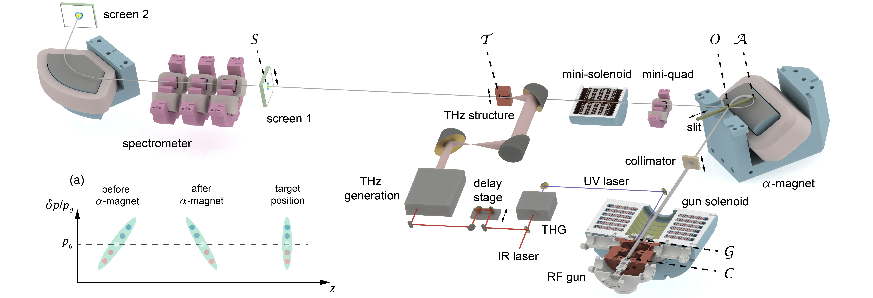
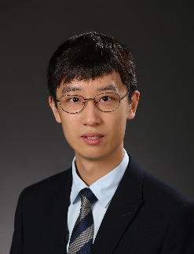

a new method for few-fs control
Low-jitter photoinjector
High-gradient $α$-magnet
Yining Yang
Now postdoc @ UCLA

Slide 11
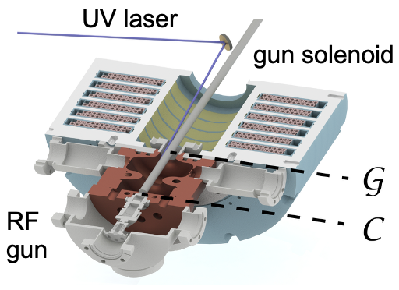
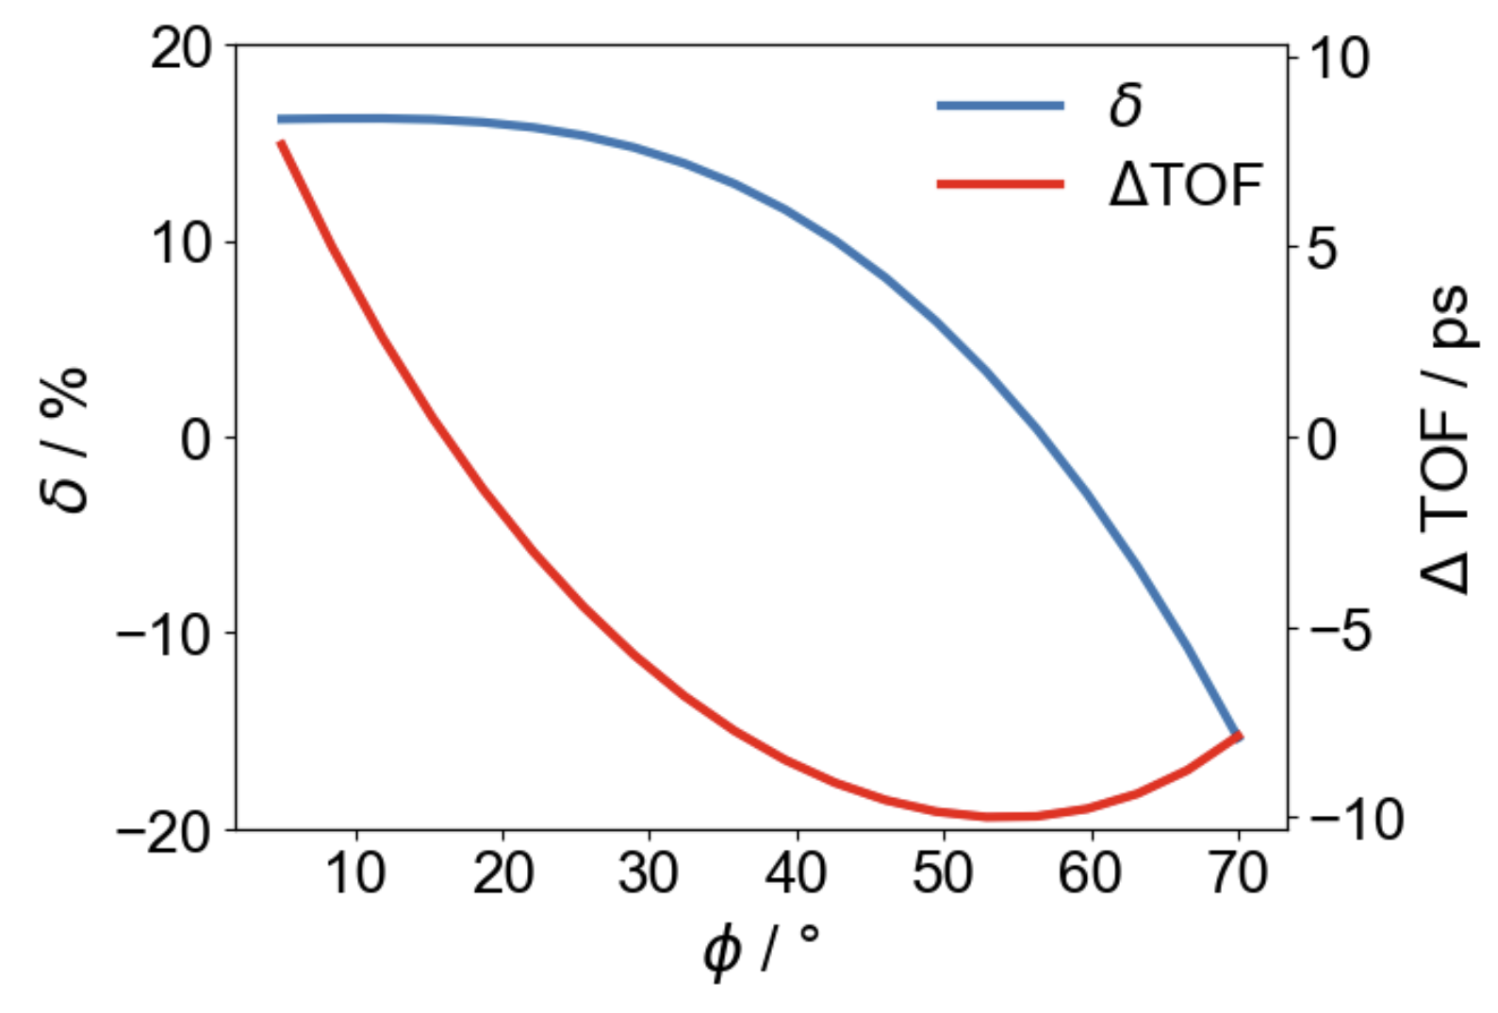
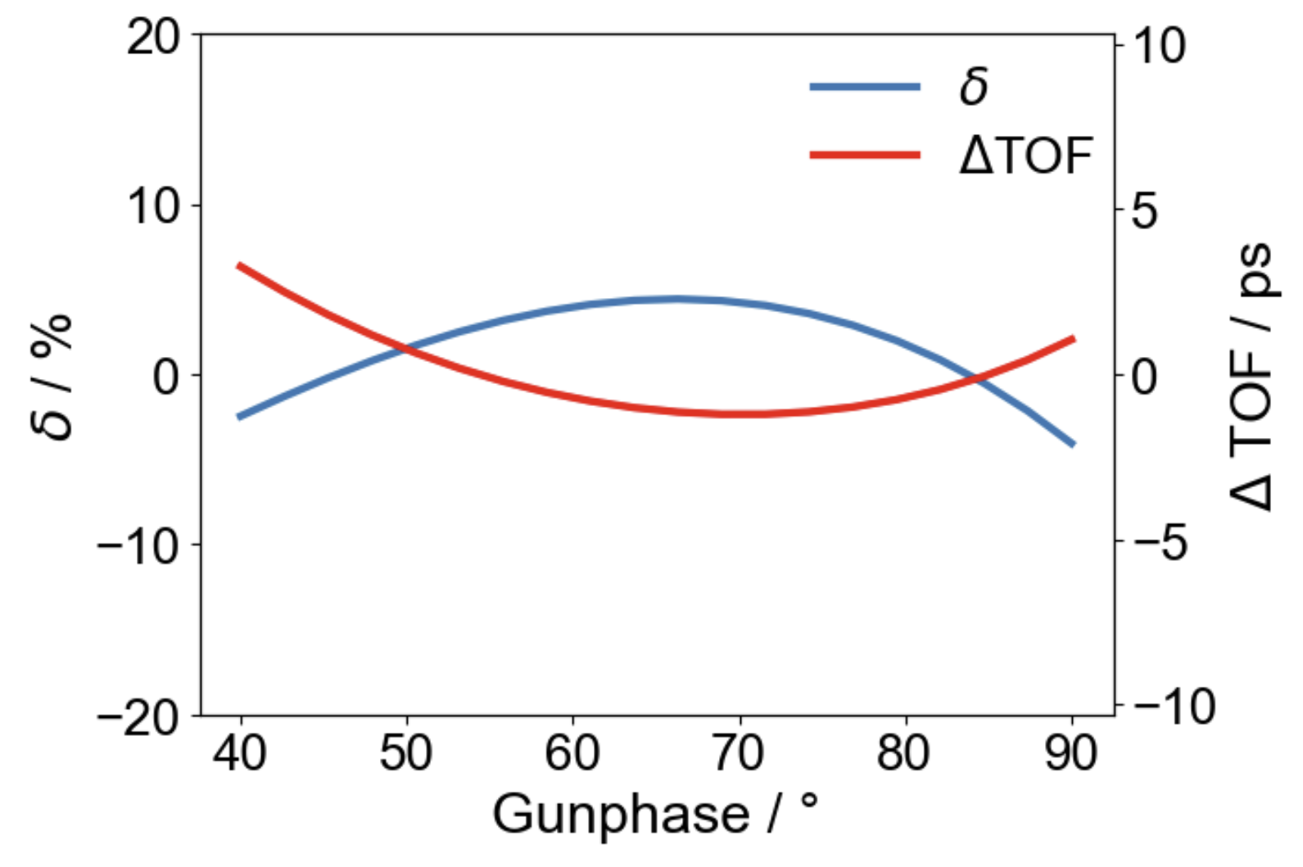
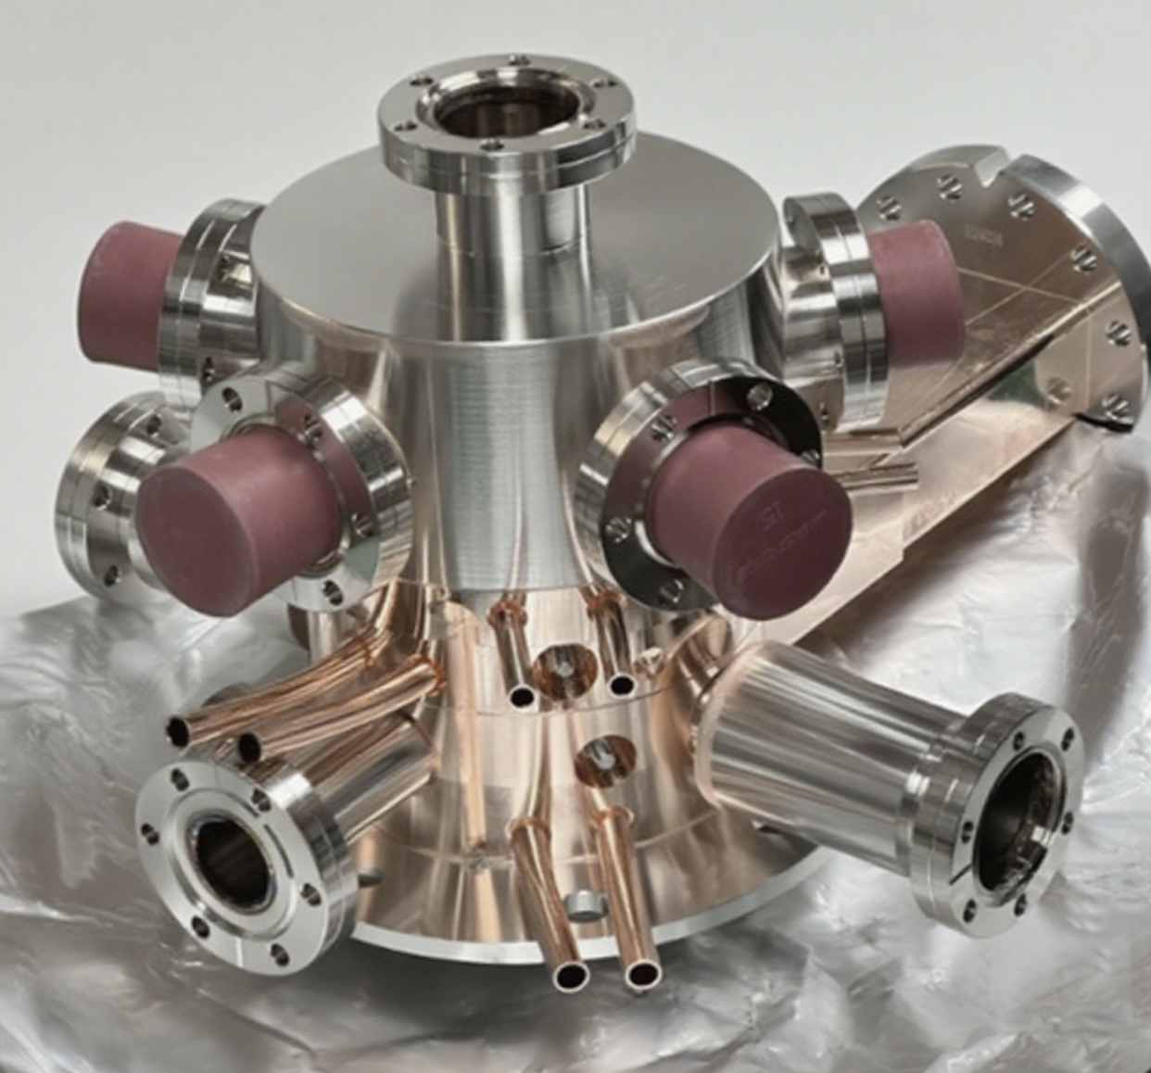



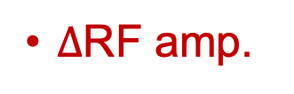
Low-jitter photoinjector
Conventional gun (1.6 cell)
New geometry (1.4 cell)
Much less impact from $∆φ$
Large ToF jitter
Large energy jitter
$∆$momentum
$∆$RF amp.
R₅₆
$∆$ToF

Slide 12
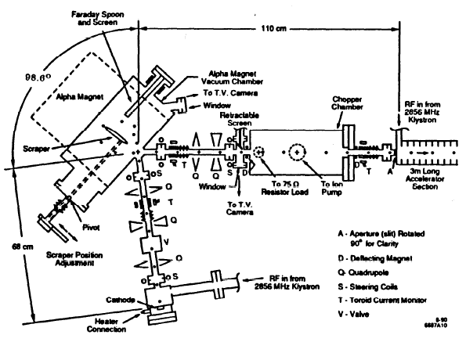
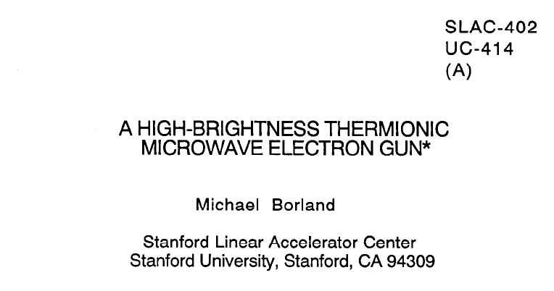
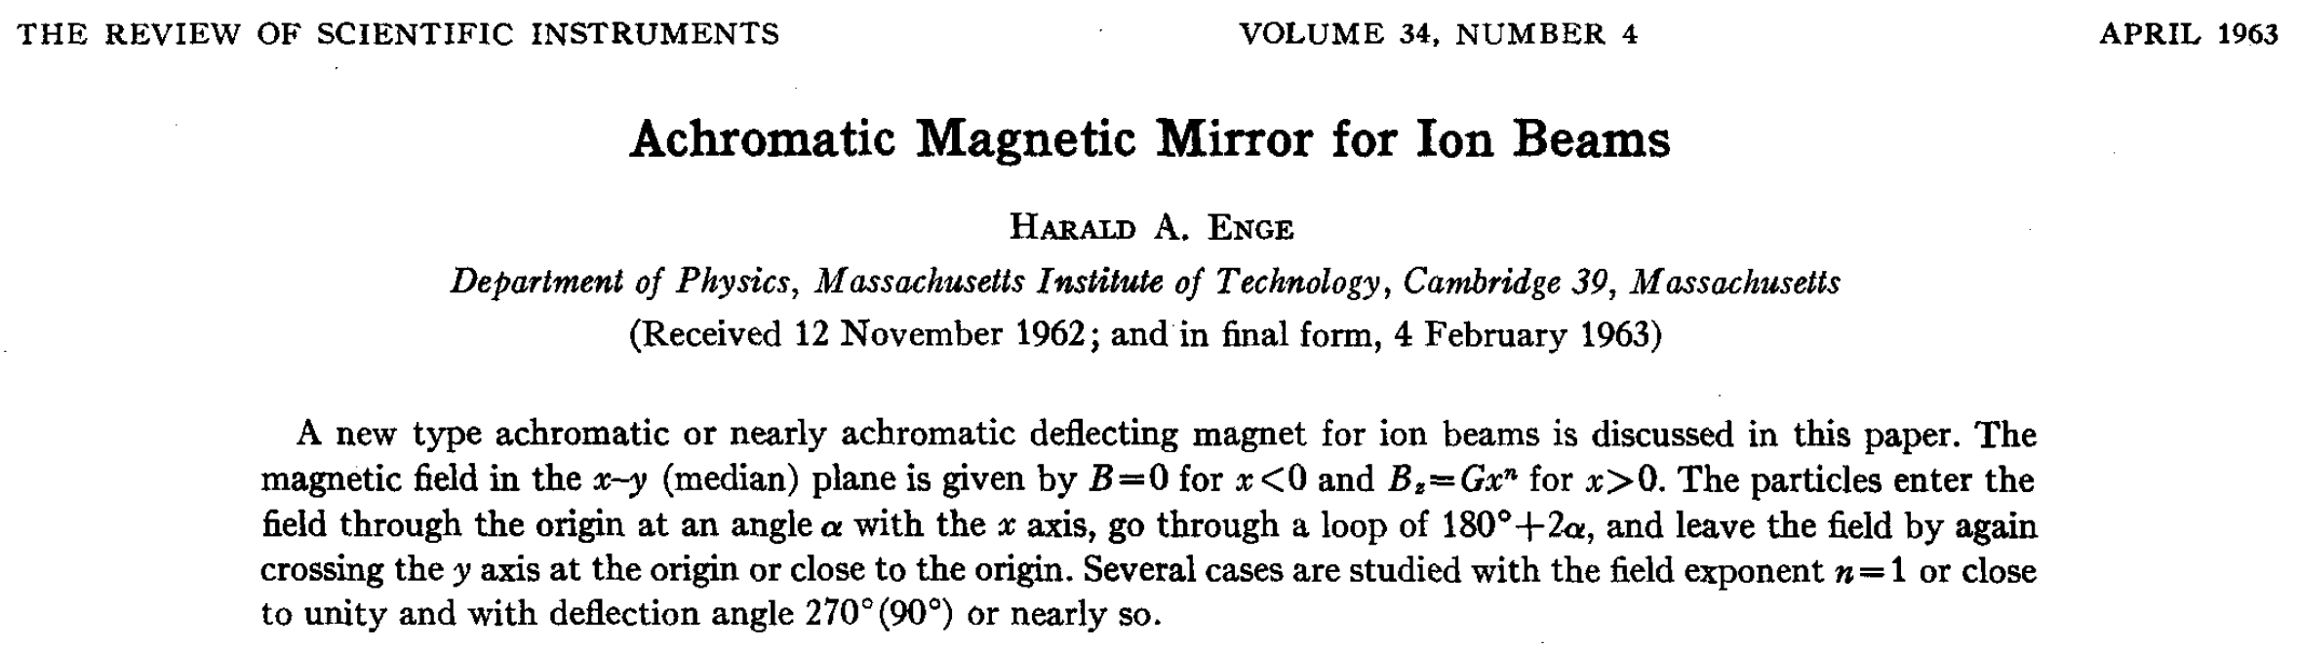
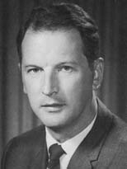
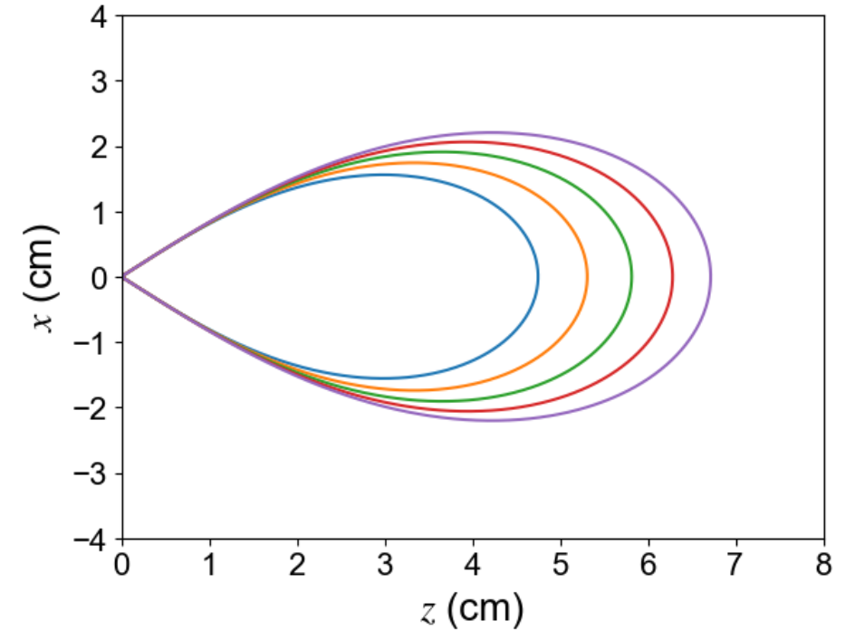
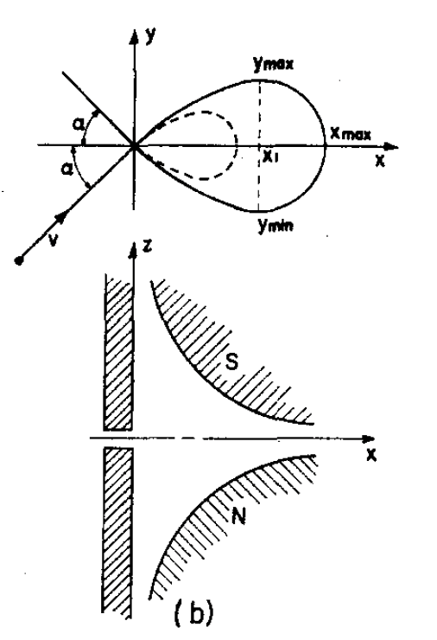
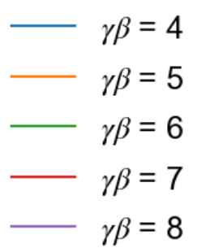

What is an $α$-magnet?
Harald Enge, proposed in 1963
Michael Borland’s
PhD Thesis, 1991
SSRL injector
GPT tracking results
Top view
Side view
$$α=40.71°$$

Slide 13
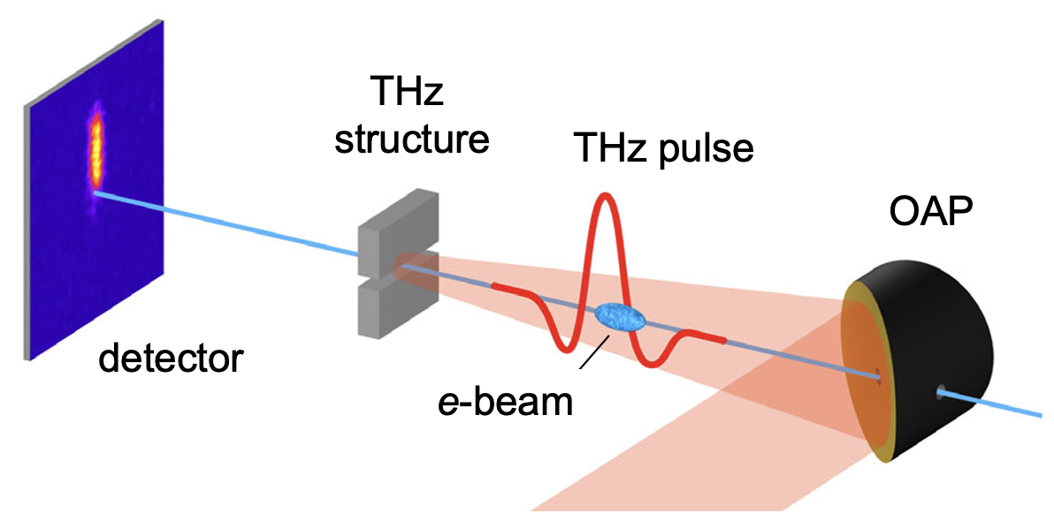
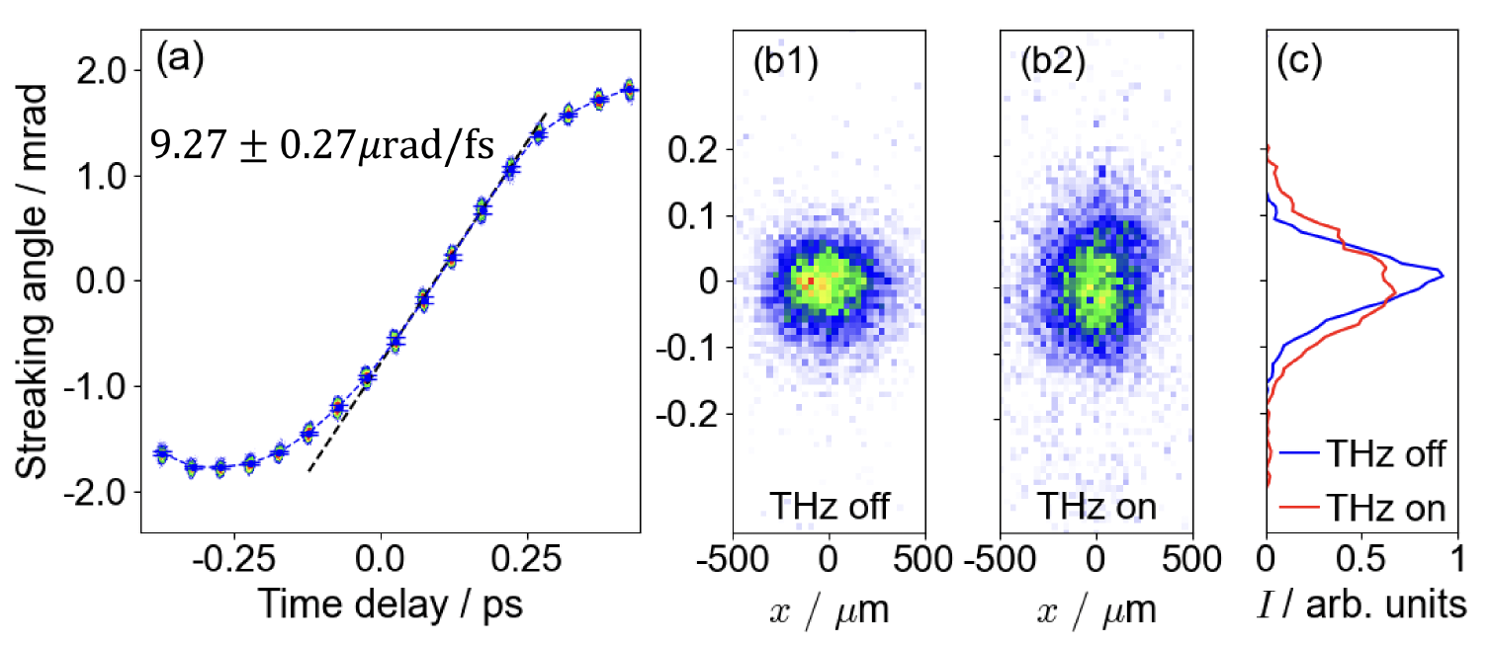
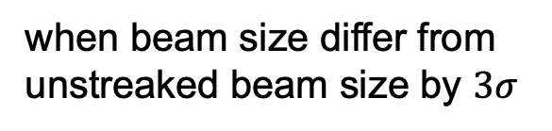
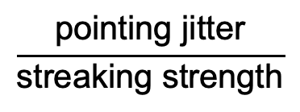
THz streaking
Laser-generated THz pulse
R. K. Li et al., PRAB 22, 012803 (2019)
Strong linearly polarized THz generated by and intrinsically synchronized with ultrafast lasers
Map temporal distribution into transverse profile
Measure bunch duration and relative-to-laser timing jitter
ToF resolution
Bunch duration resolution
$$\frac{\text{pointing jitter}}{\text{streaking strength}}$$
when beam size differ from unstreaked beam size by $3σ$
0.51 fs rms
2.55 fs rms

Slide 14
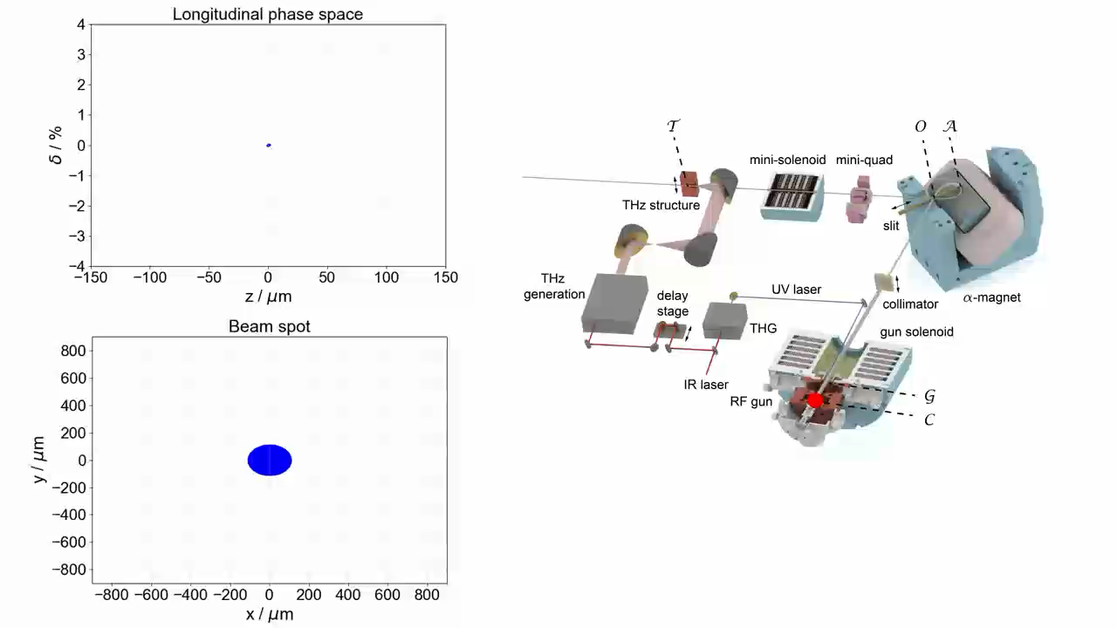
Phase space evolution
Courtesy of Yining Yang

Slide 15
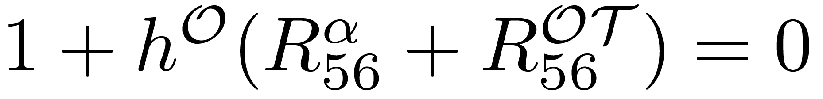
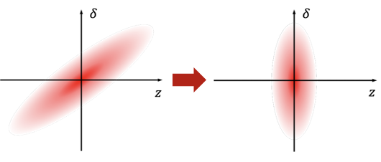
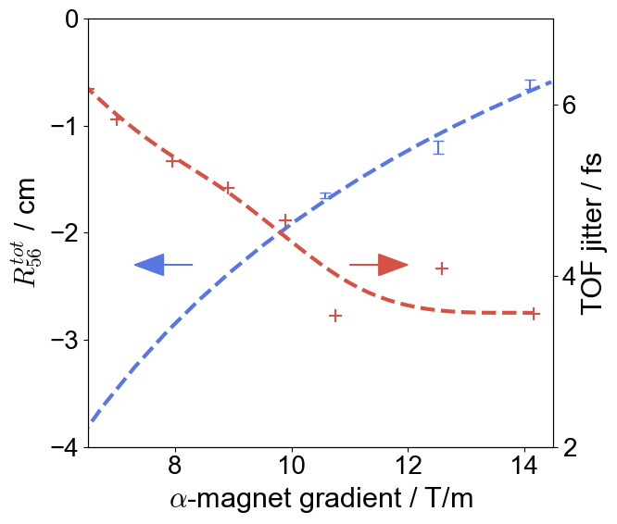
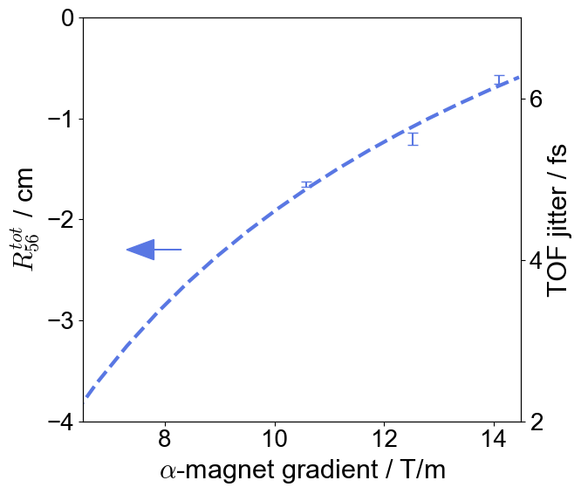
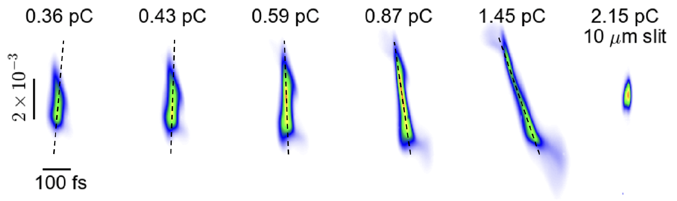

ToF tuning and compression
ToF control
Compression
ToF
$$R_{56}^{tot}$$
Phase-space selection
slit

Slide 16
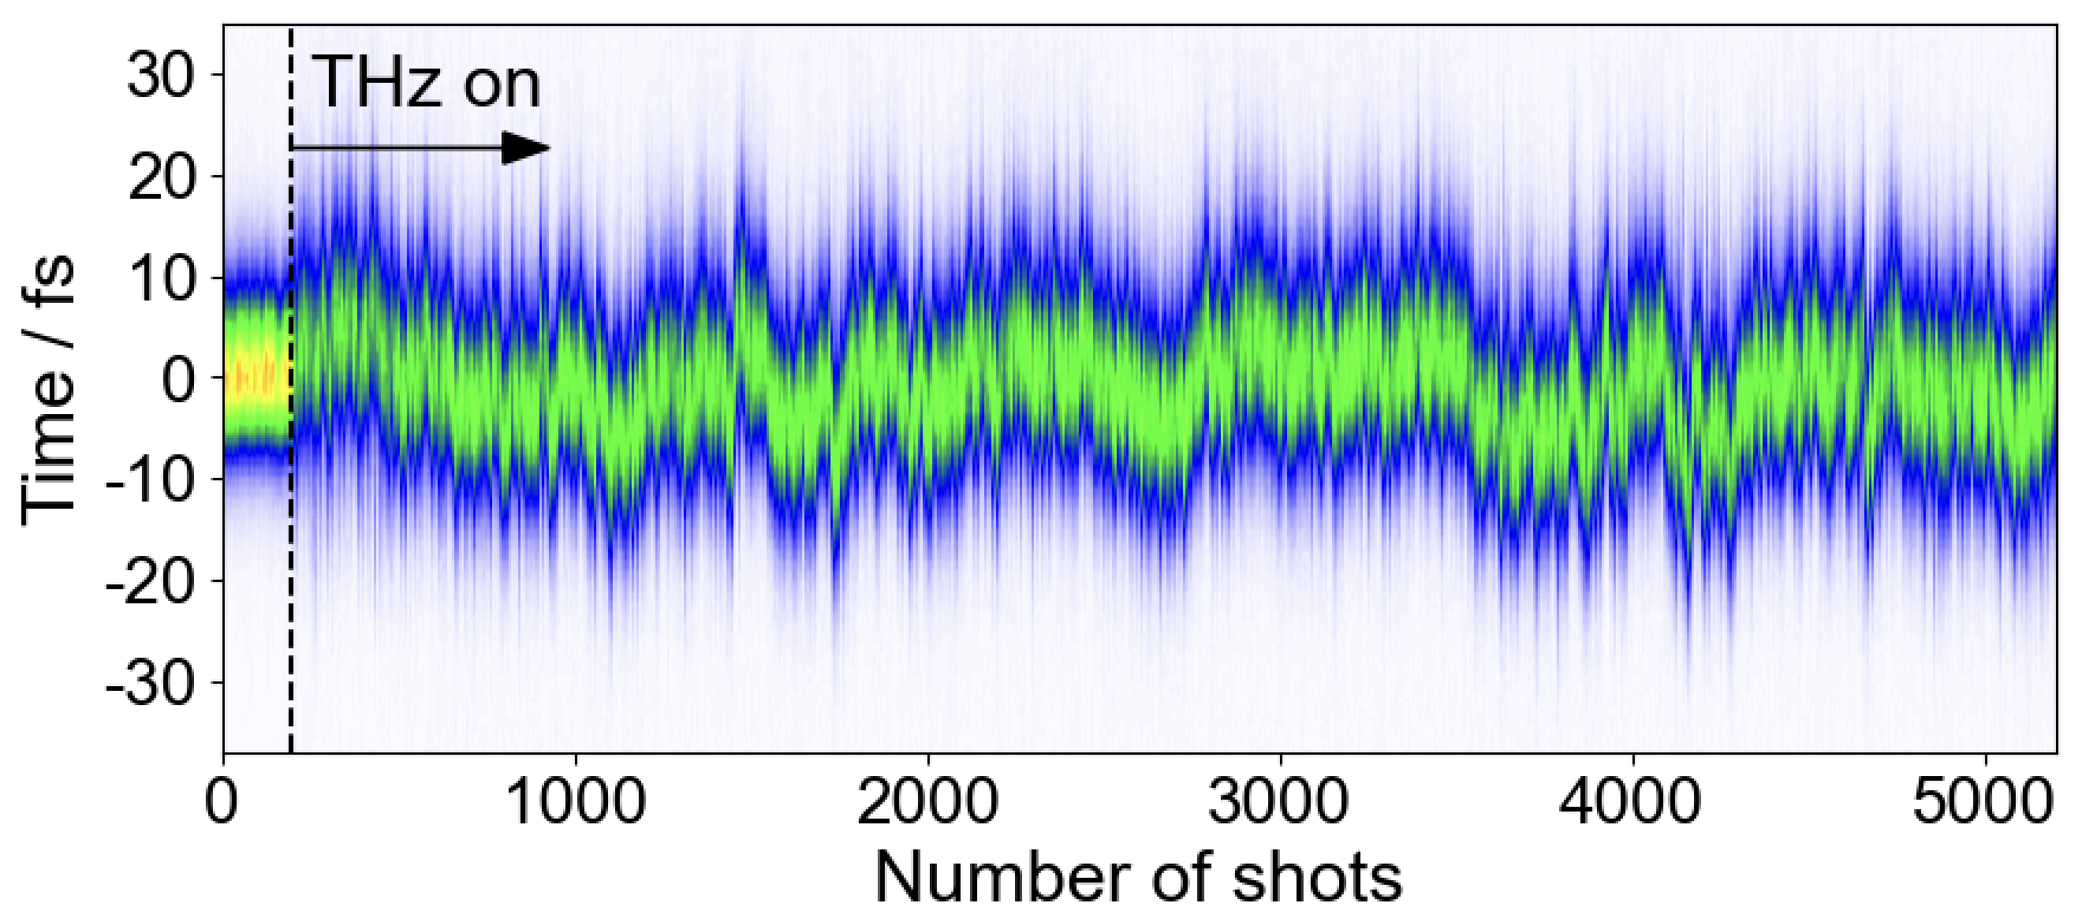

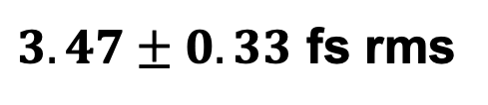

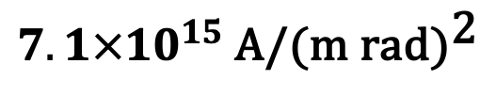
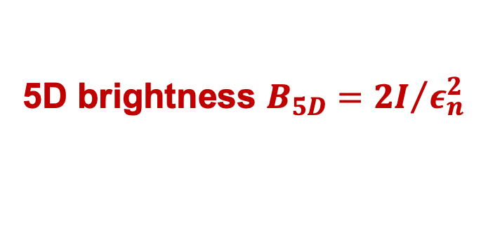
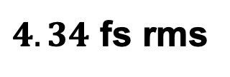
Robust, sub-5 fs control
Bunch duraiton
Simple, clear, compact, reliable
Minimal number of elements
Emittance preserved for high brightness
$3.47±0.33$ fs rms
TOF-to-laser jitter
$4.34$ fs rms
Bunch charge
1.6 fC (~10⁴ e-)
5D brightness ${B_{5D}=2I}/{ε_{n}^{2}}$
$$7.1×{10}^{15} \text{A/}{\text{(m rad)}}^{\text{2}}$$
20 minutes data
Energy spread
$$(5.7±0.37)×{10}^{−4}$$
Momentum jitter
Y. Yang et al., arXiv:2508.03946
$$2.6×{10}^{−5}$$

Slide 17


UED measurements
Single image (500 bunches)

Slide 18








Dependence on photocathodes
$$Q:−20\%$$
$$Q:+20\%$$
Currently operating with Cu
$$τ_{ini}=100 \text{fs}$$
$$τ_{ini}=300 \text{fs}$$
Compression depends on bunch charge
Initial bunch duration also affect LPS evolution

Slide 19
Outline
Introduction
FORTRESS beamline
few-fs e-beam control
Ultrahigh-vacuum S-band gun
Alkali-antimonide at high-field

Slide 20



Ultrahigh vacuum & high gradient
>10 times better vacuum at cathode
New gun
Earlier version
Pengwei Huang
Now Assoc. Prof. @ Sichuan University
P. W. Huang et al., NIMA 1051, 168251 (2023)

Slide 21




Some details of the design
Shaping the edge of the cathode plug to optimize field enhancement

Slide 22


New gun installed
to load-lock
full cell
half cell
vacuum cell

Slide 23



Vacuum test and rf conditioning
rf conditioning after 24 hrs
Base/operation pressure
7.7e-9 Pa
(w/o loadlock)
1.3e-8 Pa
(w/ loadlock)
1.7e-8 Pa
(～2.2e-8 Pa at cathode)
Faraday cup
<2.1e-9 Pa
2.2e-8 Pa
rf reflec.
rf forward
Dark current 0.5 nC @ E_{z}～105 MV/m
QE 4~5% over 6 months
<2.1e-9 Pa
1.4e-8 Pa
<2.1e-9 Pa
<2.1e-9 Pa
Cs₂Te

Slide 24




Fabrication of Alkali Antimonide etc.
A newly commissioned deposition system for Alkali Antimony cathodes (Cs-Sb, K-Cs-Sb, etc.)
Baseline vacuum 5.9e-9 Pa
Study of QE, MTE versus deposition recipes
Started fabrication of K₂CsSb cathodes
K₂CsSb QE 4-6%@532 nm
Evaporation sources

Slide 25


Load-lock system w/ green cathodes
Loaded 4 K₂CsSb cathodes
Load-lock chamber
No. | QE@532 nm
#1 | 5.6%
#2 | 4.5%*
#3 | 5.7%
#4 | 4.1%**
Cathode suitcase
* swapped Cs source, outgassing
** run out of Cs
Ultrahigh vacuum gun

Slide 26


K₂CsSb at high field
K₂CsSb in ultrahigh-vacuum S-band gun @ 100 MV/m
>1% for 2 weeks
K₂CsSb survived and characterized at ~100 MV/m
Measured QE and MTE at different laser wavelength, P. Huang et al., to be submitted
Potential benefits for FEL and others, P. Huang, NIMA 1051, 168251 (2023)

Slide 27




MTE measurement
Field-dependence of MTE
P. Huang et al., to be submitted
～ 2 nm

Slide 28




VHF gun
VHF gun, design pioneered at APEX and motivated by CW XFEL application
5 guns fabricated, commissioned, improved since 2019 (Profs. Chuanxiang Tang, Yingchao Du, Lianmin Zheng, etc.)
Test beamline repurposed for UES and photocathode R&D
Prof. Lianmin Zheng
Prof. Yingchao Du
Key parameters | Values
Gun gradient | 29.9 MV/m @ 82 kW
Gun voltage | 856 kV
rf amp. stability | 3.3×10⁻⁵
rf phase stability | 0.0033 deg
Dark current | 6.8 nA
Vacuum | 4e-9 (RF off)/2.2e-8 (RF on) Pa
Installed at SHINE

Slide 29



Photocathode R&D infrastructure
Photocathode preparation system
200 keV DC gun, 7.5 MV/m
Ultrahigh vacuum S-band gun up to 100 MV/m
VHF gun, CW, ~30 MV/m

Slide 30



Summary and outlook
Flexible test facility for photocathodes and beams R&D, and UED experiments
High-field testing of alkali-antimonide photocathodes
New photocathodes will support improved shaping and brighter beams
Few-fs beam control, depends on high-performance cathode
K₂CsSb at high-field
Stable, versatile test facility
Source & beam shaping R&D
Testing in high-field, high-vacuum real guns
Thank you!

