Slide 1

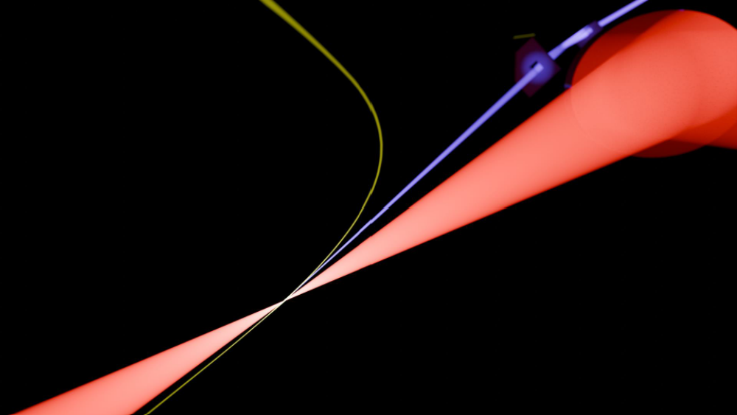


Compact all optical terahertz (THz)-driven electron source
Nicholas Matlis
Arizona State University
Physics Department &
CXFEL Labs
Photocathodes for Accelerator Science in Europe (PhASE 2026)
Workshop, Sept 22nd 2026

Slide 2
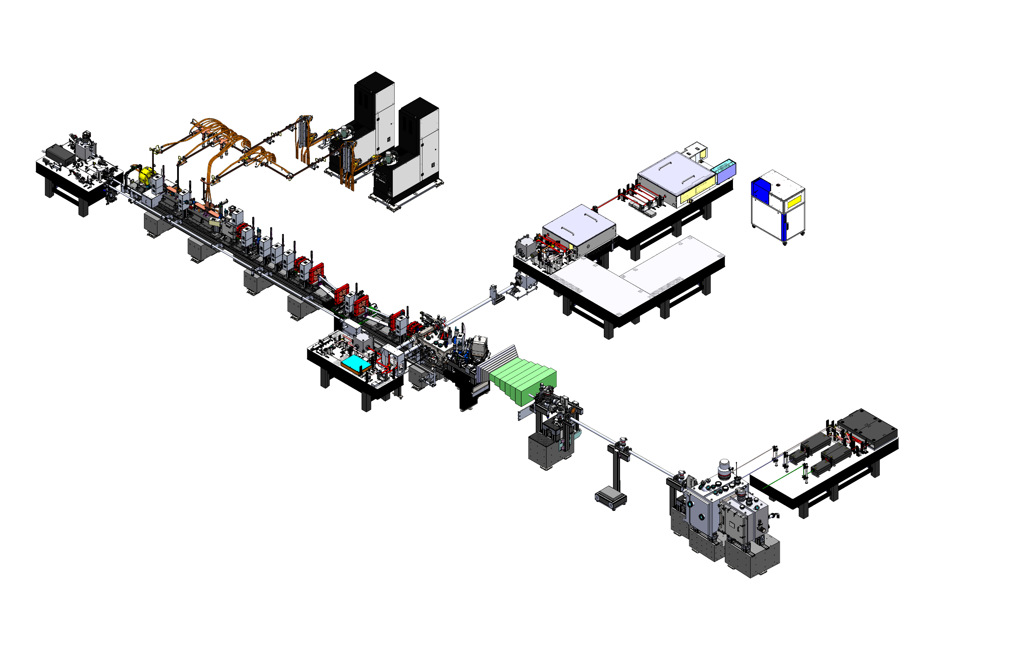


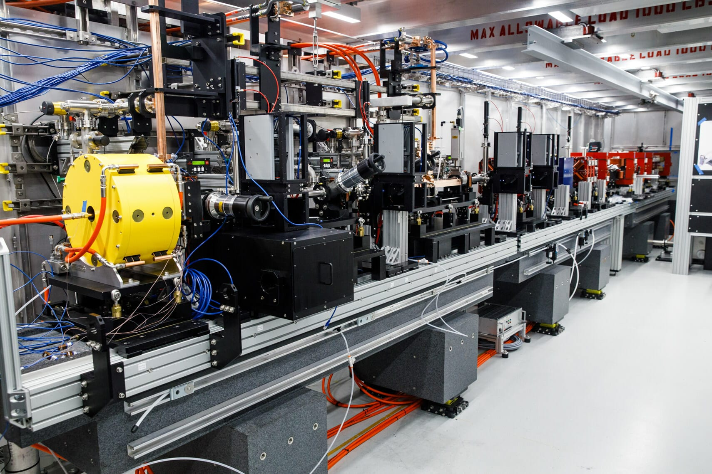
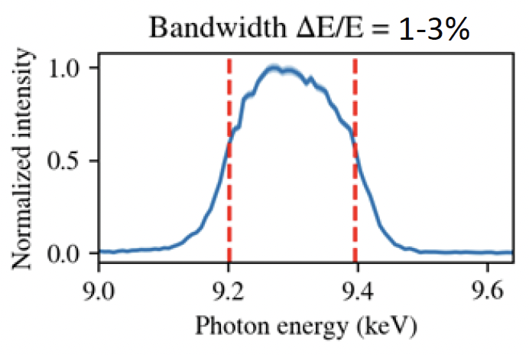
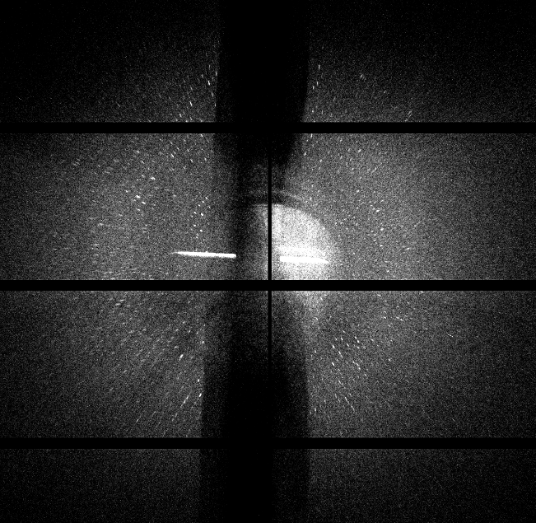
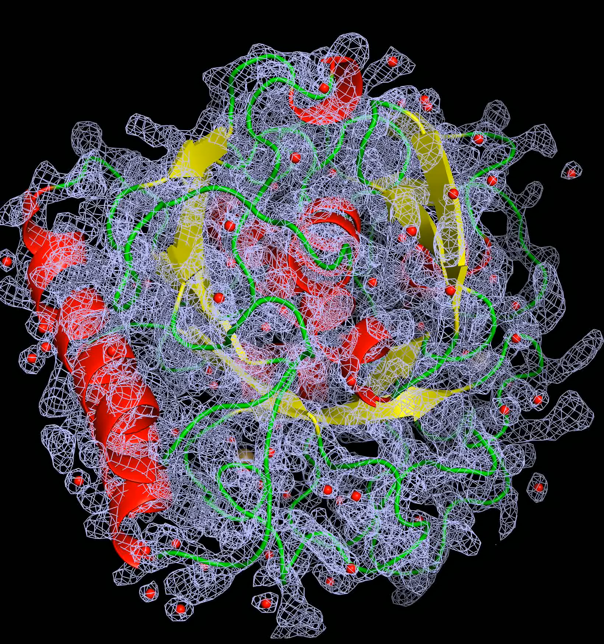
CXLS & CXFEL Advanced X-ray Sources at ASU
Personnel
Arvinder Sandhu (Director & plasma/X-rays)
Sami Tantawi (Accelerator R&D)
Bill Graves (Accelerator R&D)
Mark Holl (Chief Engineer)
Petra Fromme (Bio-sciences)
Robert Kaindl (THz & Ultrafast Science)
Nicholas Matlis (Adv. Accel & THz Tech)
Sabine Botha (Bio & X-ray Science)
Aaron LaForge (AMO & X-ray Science)
Hao Hu, Adil Ansari
Postdocs, students
And many others…
CXLS Instrument
Scandinova Solid-State
Modulators &
Stellant Klystrons
9.3 GHz
6 MW for 1 µs at 1 kHz
<100 ppm stability
Trumpf IR Laser
200 mJ, 1 ps, 1 kHz
Diagnostics & matching quads
DIRA Laser
ASU-TibaRay
Photoinjector
9.3 GHz
1 kHz
120 MV/m
4.5 cell
4 MeV Energy
Chicane
Compressor
TibaRay LINAC
9.3 GHz
Standing Wave
1 kHz
25-30 MV/m
Biodesign C
CXLS X-band Accelerator
1st protein diffraction images
Hi-quality reconstructions

Slide 3
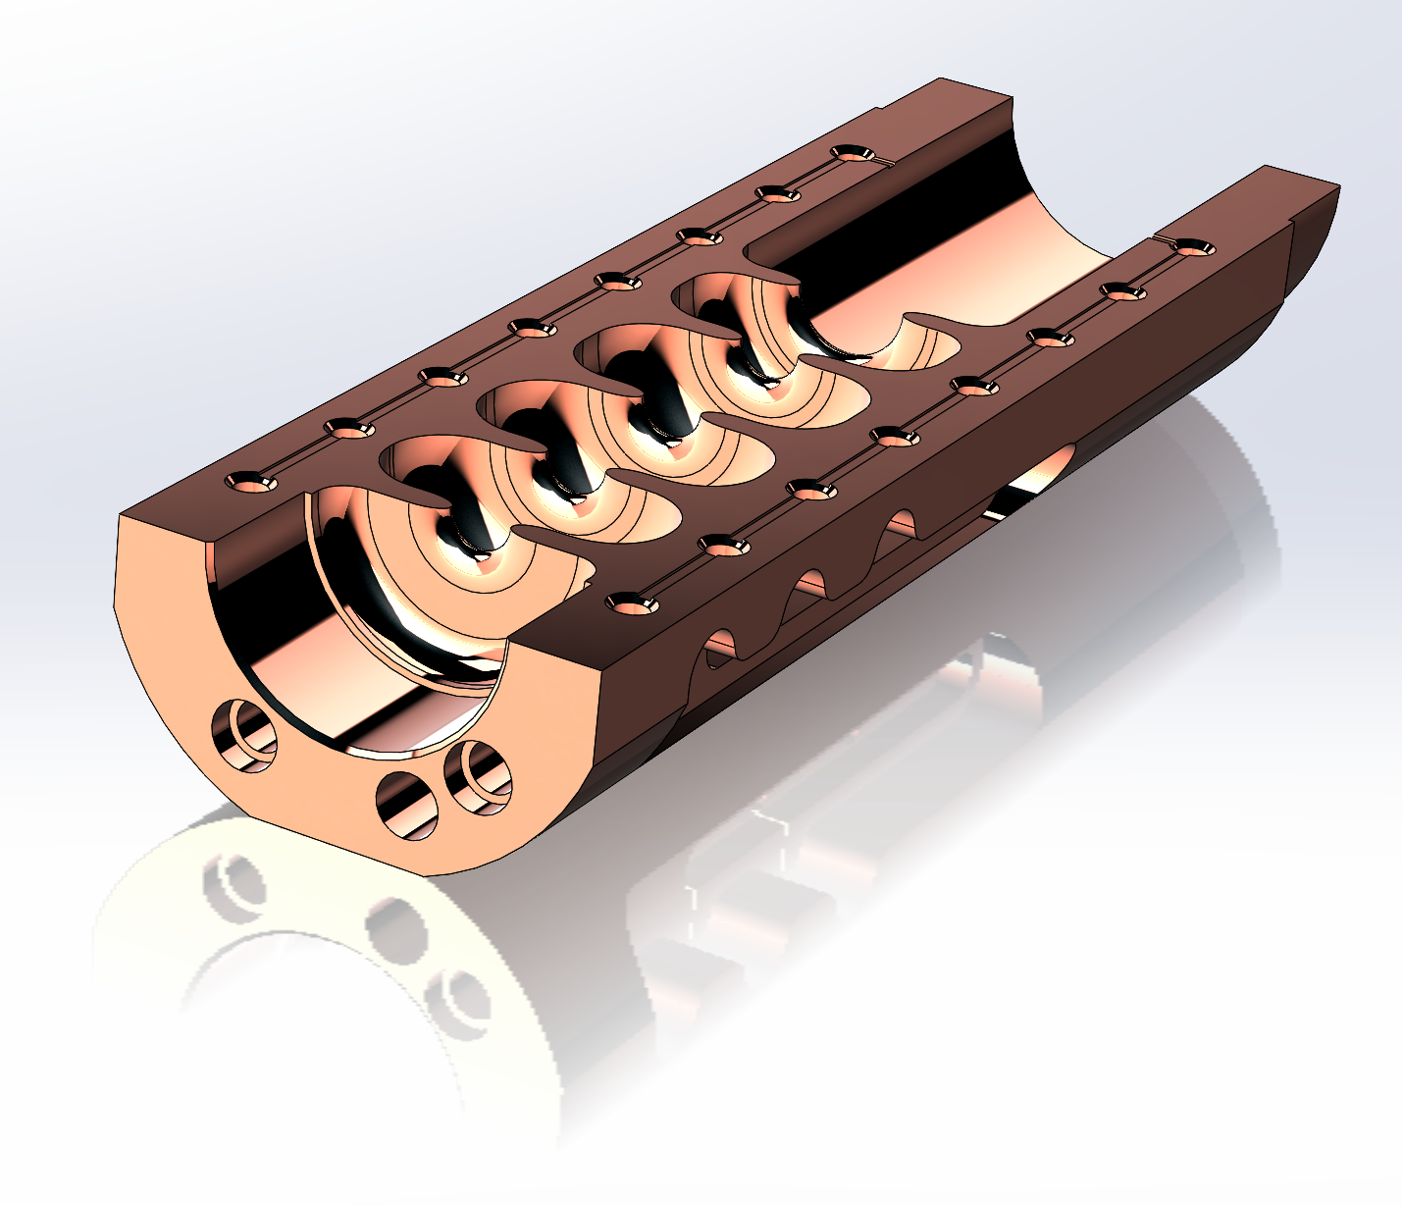
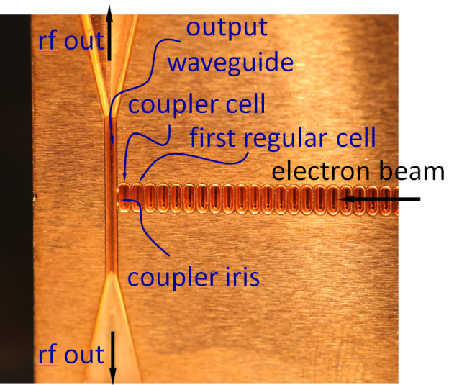
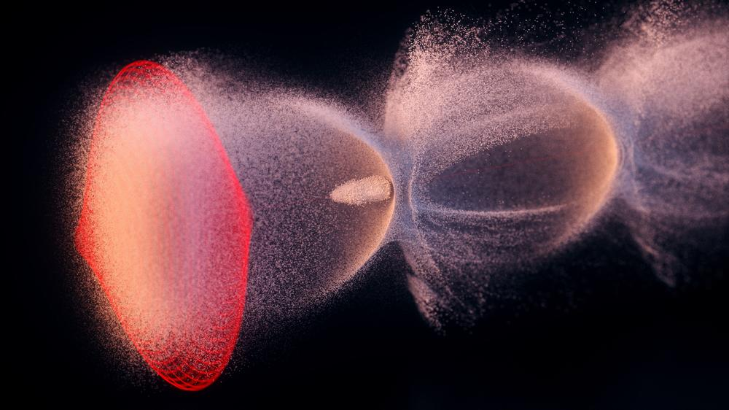





Options for reaching higher gradients: smaller scales & higher fields
X-band
Potential benefits of shorter waves:
mm-wave
Higher breakdown fields
Lower pulse energy
THz
Reduced pulse heating
More compact
$$λ≈3 cm$$
Less $$$
LPA
$$λ≈3 mm$$
Potential issues:
Laser-Dielectric
$$λ≈0.3 mm$$
Lower technical readiness level
Complexities in manufacturing
$$λ≈30 μm$$
Less space for the electrons
$$λ≈3 μm$$

Slide 4
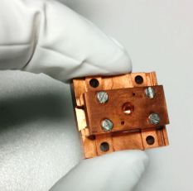
THz provides a possibility to dramatically shrink X-ray light sources
Conventional microwave-driven light-source (European XFEL at DESY)
Gun
LINAC ~ 2 km
Undulator
THz-driven light-source
L_{interaction} ~ 𝜇m
D. Zhang et al., Nature Photonics (2018)
E. Nanni et al., Nat. Comm. 6, 8486 (2015)
electrons
IR Laser
X-rays
Gun
LINAC
Undulator

Slide 5

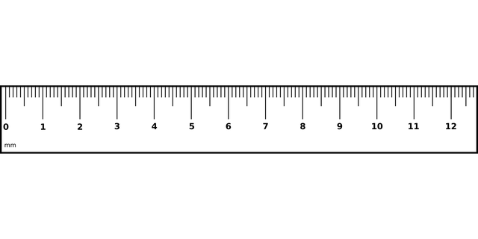
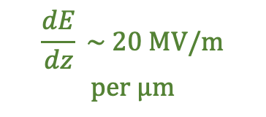



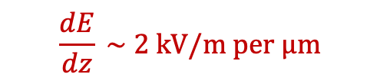



The case for THz accelerators
THz accelerators
$$E_{0} ≈3 \text{GV/m}$$
RF accelerators
$$e^{−} \text{source}$$
$$λ_{p} ≈1 \text{mm}$$
UV
$$E_{0} \sim 30 \text{MV/m}$$
$$e^{−} \text{bunch}$$
$$λ_{RF} ≈10 \text{cm}$$
$$\vec{E}$$
$$+\vec{F}$$
$$−\vec{F}$$
$\vec{E}$ extraction and acceleration
$$\sim 1 \text{fs}, 1μ\text{m}$$
*${\left|\overset{⃑}{E}\right|}_{breakdown}∼\frac{1}{τ^{1/6}}$
THz wave
$${+100 E}_{0}$$
4D Brightness
Instrument response function
$$B_{4D}∝\frac{{\left|E_{0}\right|}^{n}}{MTE}$$
$$τ≡\sqrt{τ_{e}^{2}+τ_{p}^{2}+τ_{TOA}^{2}+τ_{VM}^{2}}$$
$$\frac{dE}{dz} \sim \text{ 20 MV/m}$$
$$\text{per }μ\text{m}$$
$${+E}_{0}$$
RF wave
$$\frac{dE}{dz} \sim \text{ 2 kV/m per }μ\text{m}$$
$${−E}_{0}$$
0
mm
1
2
3
4
5
6
7
8
9
10
11
12
*
[1] Kilpatrick RSI 28, 824 (1957)
[2] Dolgashev APL 97, 171501 2010
[3] Forno, et al. PRAB. 19, 011301 (2016)
$${−100 E}_{0}$$

Slide 6
THz-powered electron and X-ray light source: AXSIS
THz LINAC
(2x 20 mJ THz)
THz Gun
PPLN
(2x 1 mJ THz)
X-ray Beamline
(H. Chapman & P. Fromme)
LiNbO3
multi-cycle
THz
Optical Undulator
UV
generation
1-cycle THz
X-ray
Diffraction
1 MeV
electrons
20 MeV
electrons
THz
ICS
THz LINAC
UV
Gun
IR
5 keV
X-rays
Sample
1-cycle THz
multi-cycle
THz
X-ray
Spectrum
LiNbO3
PPLN
Gun
Laser
LINAC
Laser
ICS
Laser
E. Nanni et al., Nature Comm. 6, 8486 (2015)
D. Zhang et al., Nature Photon. 12, 336 (2018)
D. Zhang et al., Optica 6, 872 (2019)
D. Zhang et al., Phys. Rev. X 10, 011067 (2020)
F.X. Kärtner et al., NIMPRA 829, 24 (2016)
Notes:
This work is part of a project called AXSIS at DESY which is pioneering the development of THz-powered electron acceleration and its applications towards realization of a fully THz-powered X-ray light source.
**CLICK**
As major motivation for the development of THz acceleration is the drive to create compact electron and x-ray sources that are more widely accessible and enable development of new applications that can be integrated on the optical table.
However, as you can imagine, miniaturization of any technology brings with it many complexities which must be fully explored.
In this talk I will concentrate on studying the dynamics of the multicycle-THz driven LINAC. In particular, I will focus on some of the challenges associated with using dielectrically loaded waveguides as LINACs for non-relativistic electrons.

Slide 7
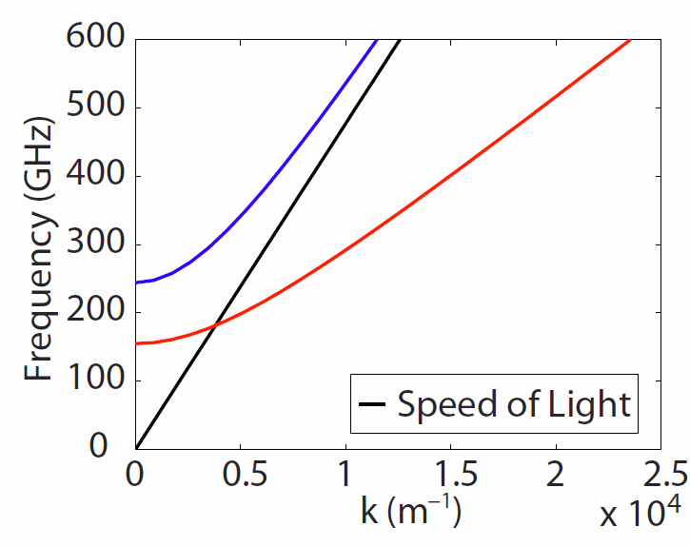
THz accelerator anatomy
A. Fallahi, et al. PRSTAB 19, 081302 (2016)
D. Zhang et al., Nature Photonics (2018)
D. Zhang et al., Optica (2019)
L.J. Wong et al., Opt. Exp. 21, 9792 (2013)
DLW Dispersion Relation
Segmented
THz
Electron
Accelerator &
Manipulator
UV pulse
1 MeV
electrons
20 MeV
electrons
THz
w/o dielectric
THz LINAC
v = c
w/ dielectric
Gun
v/c = 0.941
v/c = 0.9997
Transverse
Interaction
$$\overset{⃑}{B}$$
THz
THz
$$\overset{⃑}{B}$$
Longitudinal
Interaction
STEAM Device
$$\overset{⃑}{E}$$
$$\overset{⃑}{E}$$
dielectric-lined waveguide
B-fields Cancel
e⁻
E-fields Cancel
$$\overset{⃑}{B}$$
$$\overset{⃑}{B}$$
$$\overset{⃑}{B}$$
vacuum
$$\overset{⃑}{E}$$
$$\overset{⃑}{E}$$
$$\overset{⃑}{E}$$
copper waveguide
$$\overset{⃑}{E}$$
$$\overset{⃑}{B}$$
Acceleration
Compression
$$\overset{⃑}{E}$$
Deflection
Streaking
dielectric lining
Tuning: dielectric I.D. & O.D.
F.X. Kärtner et al., NIMPRA 829, 24 (2016)
Notes:
The THz accelerator has the same basic architecture as a conventional one, in that there is a Gun (or injector) which pre-accelerates electrons to relativistic speeds, and a LINAC which provides the bulk of the energy gain.
A major reason for this split comes from the relativistic nature of the electron acceleration and the resultant dynamics of phase matching between the electrons and the THz field in the LINAC.
**CLICK**
The design energy for our LINAC is 20 MeV. At this energy, the electrons are travelling within 0.03% of the speed of light
**CLICK**
Notice, however, this small bit of velocity change at the beginning of the acceleration. This is the dynamics I was talking about. LINACs generally don’t handle velocity change well. Although in this sketch, the THz is coupled into the LINAC transversely, the interaction between the electrons and the field within the waveguide is longitudinal, meaning the electrons and THz co-propagate. For the LINAC to remain phase-matched over long interaction lengths and large energy gains, the electrons and the THz wave crests must both be travelling at close to the same speed. So, for the highest efficiency of the LINAC, this little bend at the beginning should be minimized as much as possible.
The job of the gun is therefore to accelerate electrons from rest to nearly the speed of light so that the electrons can “catch the wave” in the LINAC.
**CLICK**
The gun is specifically designed to maintain phase matching over this large range of electron speeds. As discussed in the previous talk, for a THz gun, this ability comes from a design which employs a transverse interaction geometry as well as a segmentation of the interaction into sub units which are individually rephased.

Slide 8
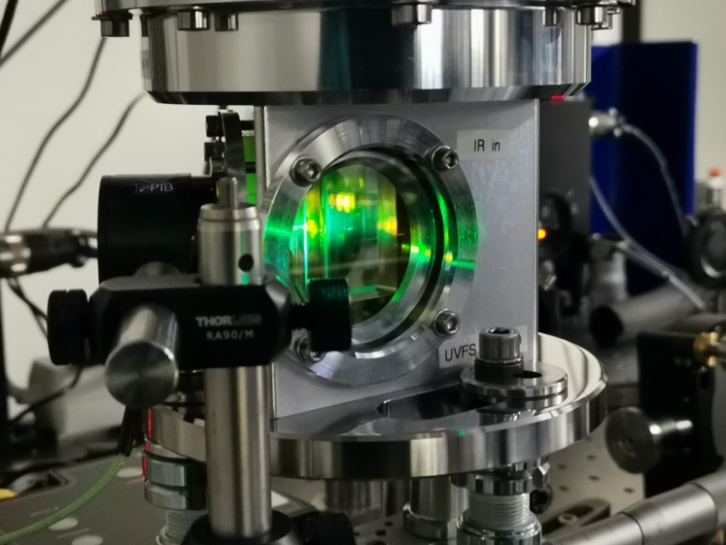
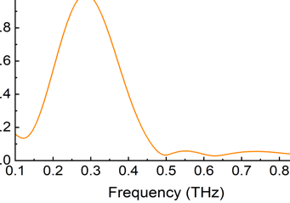
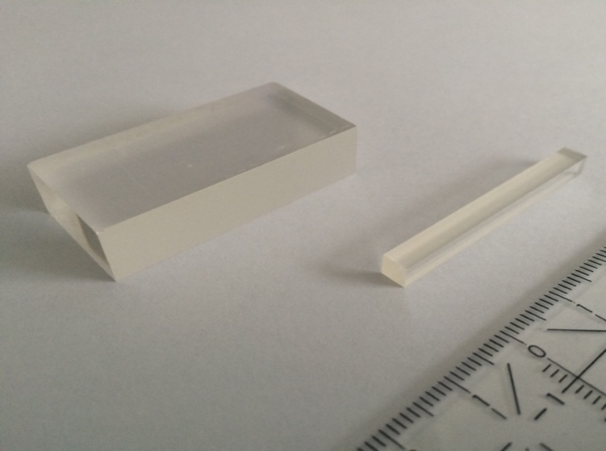
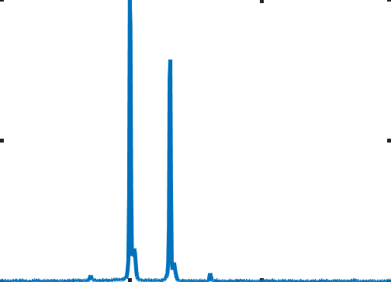
THz sources available with multiple x 100 𝜇J
THz Generation
tilted pulse front method
Single-cycle THz Gen.
200 mJ Magma → 300 – 600 𝜇J
300 GHz, 1-cycle
> 200 GHz bandwidth
> 0.3% conversion eff.
IR
LiNbO₃
grating
λ/2
THz
T. Kroh et al., in preparation
Large LiNbO3 prisms
Chirp & Delay
Record Narrowband THz Gen.
1J Ti:S → 600 𝜇J
360 GHz
<1% bandwidth
0.24% conversion eff.
PPLN
-300
-200
-100
0
100
200
time [ps]
S. Jolly et al., Nature Commun. 10, 2591 (2019)
Large PPLN
0
0.1
0.2
0.3
0.4
0.5
0.6
0.7
0.8
0.9
1
frequency [THz]
Custom 2-Line Laser
Record Narrowband THz Eff.
10 mJ Yb:YAG → 45 𝜇J
540 GHz
<1% bandwidth
0.9% conversion eff.
provided by T. Taira & H. Ishizuki
IMS Japan
PPLN
1025
1030
1035
1040
Wavelength (nm)
H. T. Olgun et al., Opt. Lett. accepted for publication

Slide 9


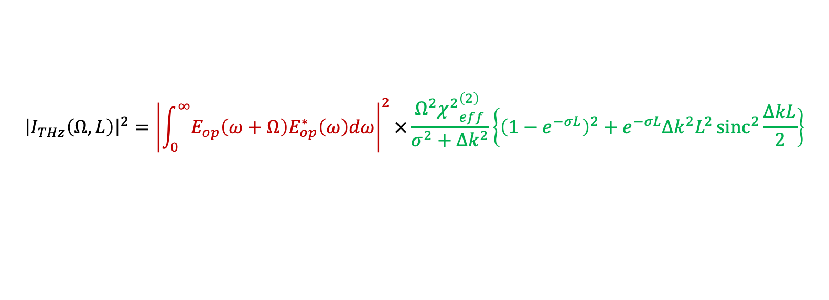






Quasi Phase-Matching Enables Efficient Multicycle THz Generation
Periodically poled nonlinear medium
$$Ω_{THz}=ω_{1}−ω_{2}$$
$$Χ^{2}$$
$$Χ^{2}$$
$$Χ^{2}$$
$$Χ^{2}$$
$$ω_{1} \& ω_{2}$$
-$Χ^{2}$
-$Χ^{2}$
-$Χ^{2}$
-$Χ^{2}$
$${\left|I_{THz}\left(Ω, L\right)\right|}^{2}={\left|\int_{0}^{∞}{E_{op}\left(ω+Ω\right)E_{op}^{∗}\left(ω\right)dω}\right|}^{2}×\frac{Ω^{2}{χ^{2}}_{eff}^{\left(2\right)}}{σ^{2}+Δk^{2}}\left\{{\left(1−e^{−σL}\right)}^{2}+e^{−σL}Δk^{2}L^{2}{sinc}^{2}{\frac{ΔkL}{2}}\right\}$$
THz Spectrum
Laser pulse properties
Crystal properties
Recent results from our group in THz generation with QPM
Record Result | Energy | Material | Conv. Eff. | Article
Energy | 1 𝜇J | LiNbO3 | 0.12% | Carbajo et al., Opt. Lett. 40, 5762 (2015)
Energy | 40 𝜇J | LiNbO3 | 0.13% | Ahr et al., Opt. Lett. 42, 2118 (2017)
Energy | 600 𝜇J | LiNbO3 | 0.24% | Jolly et al., Nat. Commun. 10, 2591 (2019)
Energy | 1,300 𝜇J | LiNbO3 | 0.14% | Lemery, Commun Phys 3, 150 (2020)
Material | 0.7 𝜇J | KTP | 0.16% | W. Tian et al., Opt. Lett. 46, 741 (2021)
Efficiency | 45 𝜇J | LiNbO3 | 0.89% | H. T. Olgun et al., Opt. Lett. 47, 2374 (2022)

Slide 10
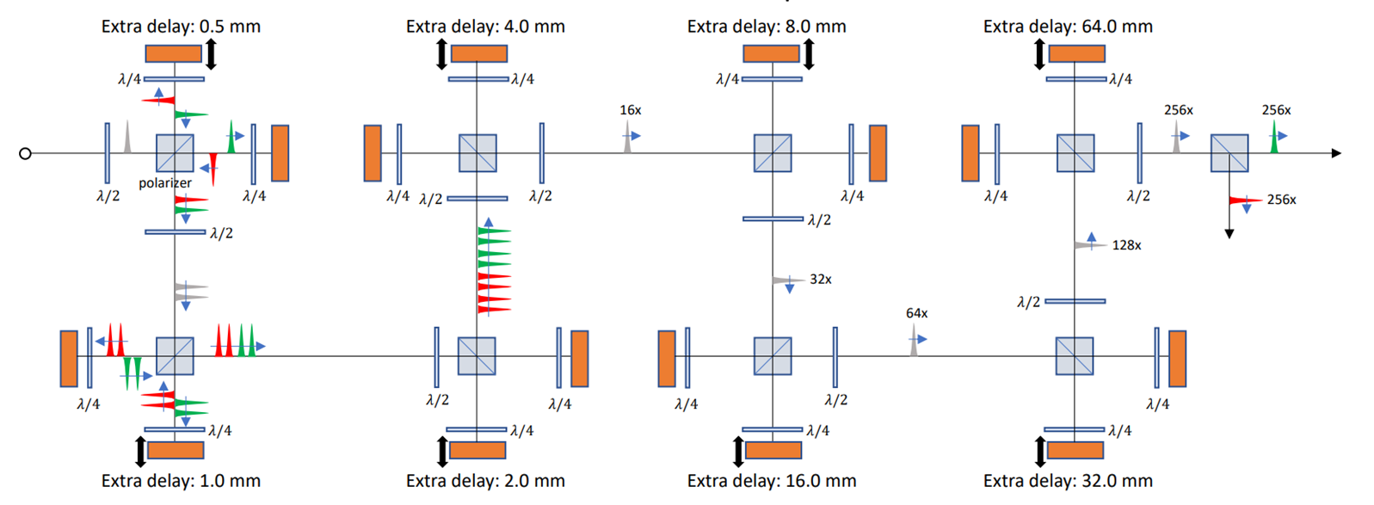
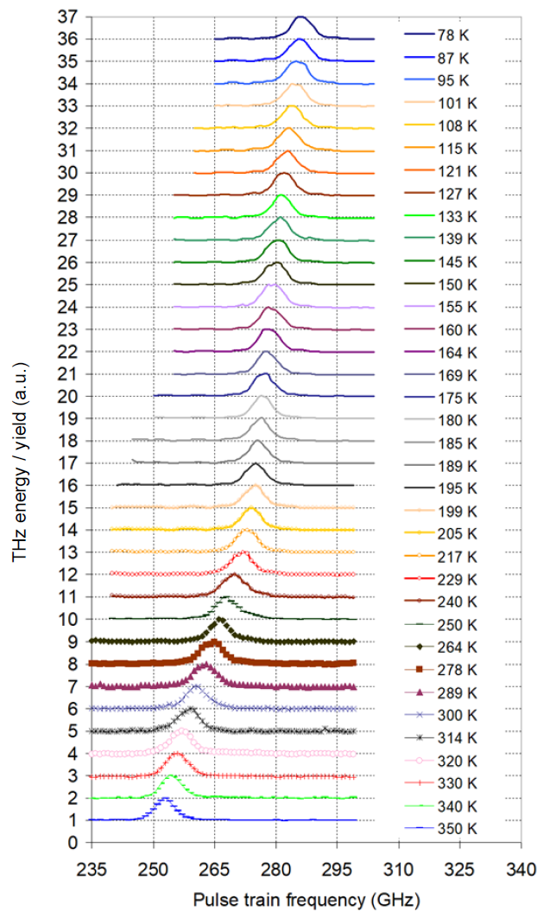
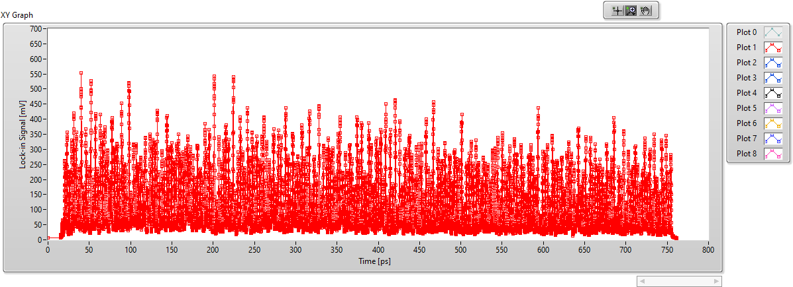
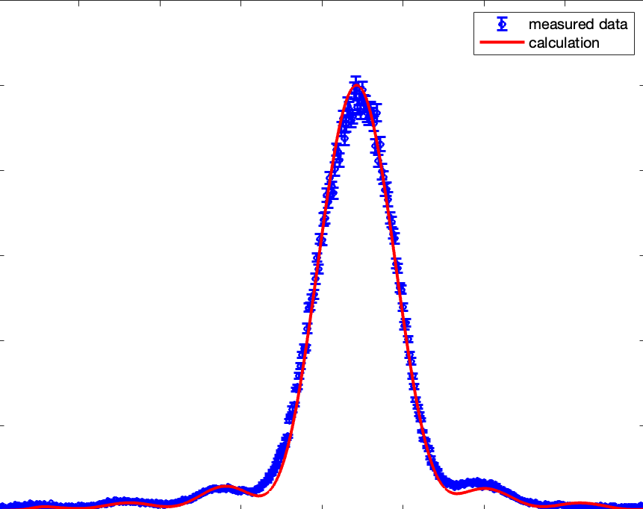
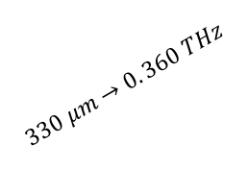
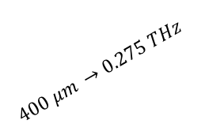
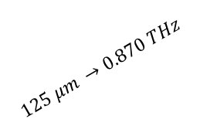
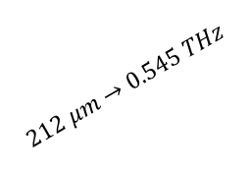
Pulse-Divider Pump Enables Frequency Fine Tuning
Scan Temperature
Pulse Train
$$400 μm →0.275 THz$$
$$330 μm→0. 360 THz$$
Tuning Curve
pulse-train measurement
$$212 μm→0.545 THz$$
1
1
Intensity (norm.)
Intensity (norm.)
$$125 μm →0.870 THz$$
0
0
330
340
350
360
0
200
400
600
800
Frequency (GHz)
Scan PPLN Period
Time (ps)
Notes:
will take a long time
Herman ?? -> aim for 1 slide per 2 min and discuss
Don’t have to explain how it was done
Don’t have to show Regen and 4-pass
Can use this as backup slide

Slide 11
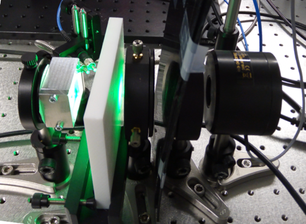
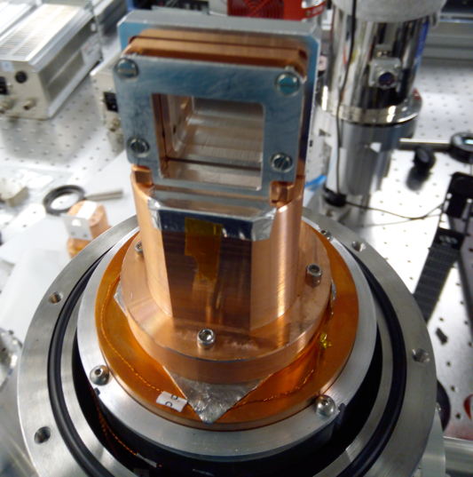
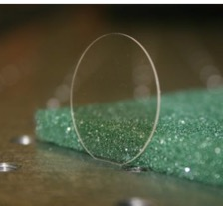
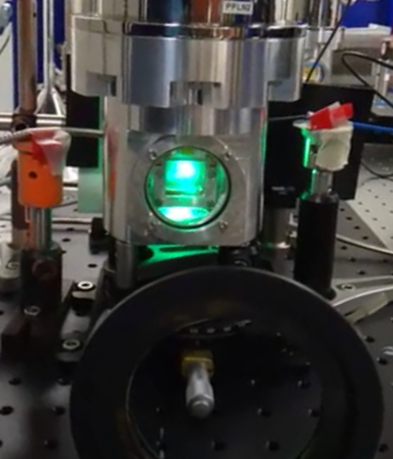
Development of Large-Aperture Crystals
Manually
assembled
wafers
200 mJ
500 fs
50 Hz
Laser
THz
Wave
Incident beam:
6.3 x 5.7 mm² (1/e² radius)
Teflon
Beam
Separator
Power Meter
Wafer Stack

Slide 12
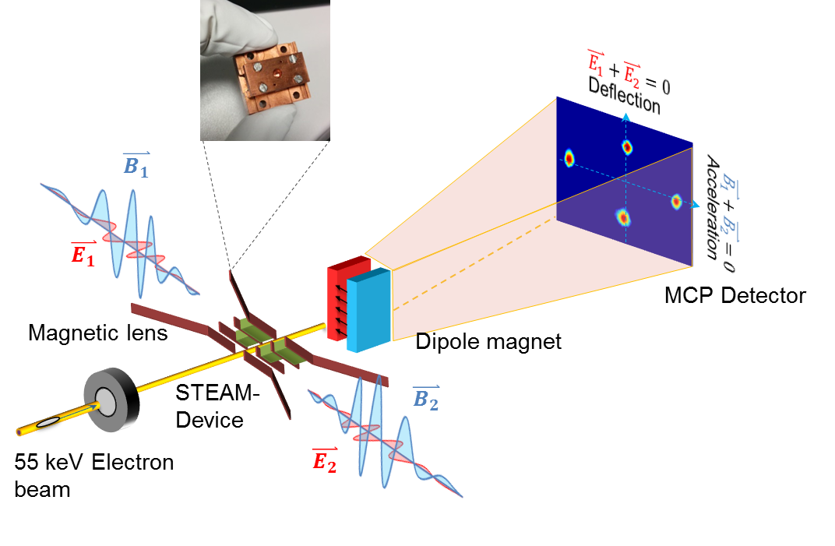
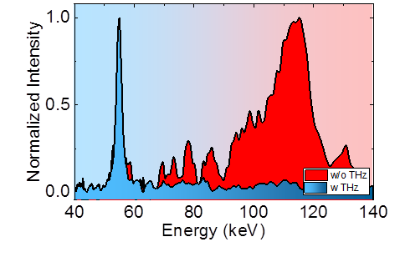
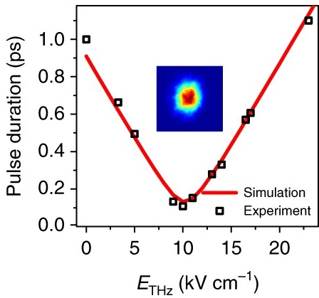
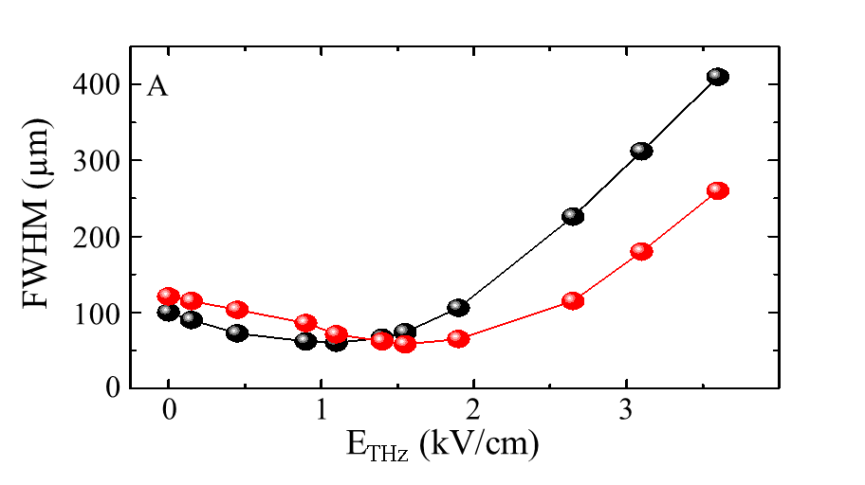
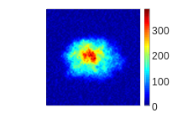

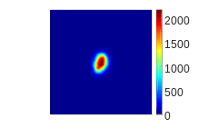
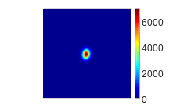
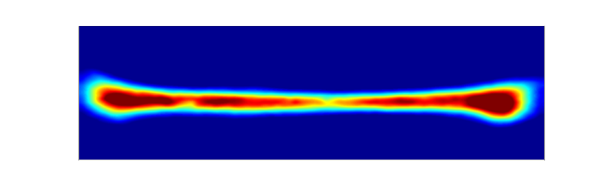


STEAM device yields practical beam acceleration & manipulation
D. Zhang et al., Nature Photon. 12, 336 (2018)
Segmented
THz
Electron
Accelerator &
Manipulator
D. Zhang et al., Optica 6, 872 (2019)
acceleration: 65 keV
compression: $τ≈100 \text{fs}$
focusing: $\left(\frac{∂B_{φ}}{∂r}=2 k\text{T/m}\right)$
streaking: 140 µrad/fs
Unstreaked
beam
Streaked beam
Resolution: sub-10 fs

Slide 13
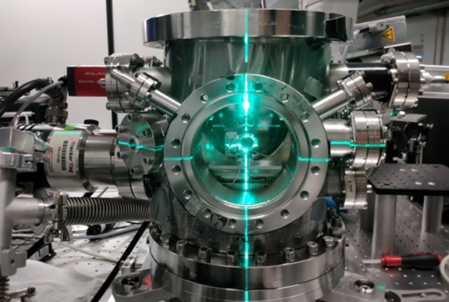
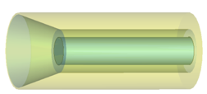
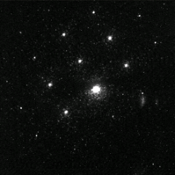
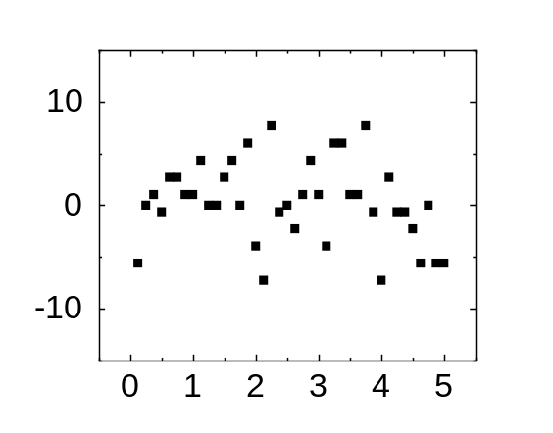
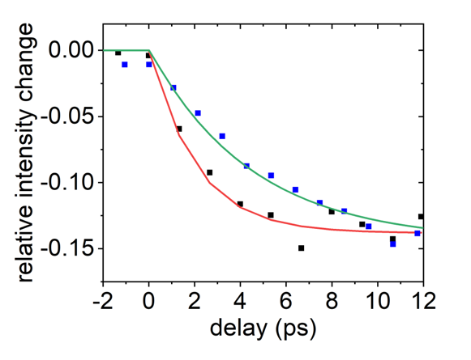
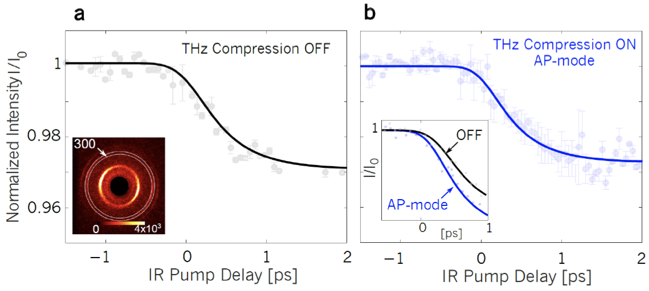
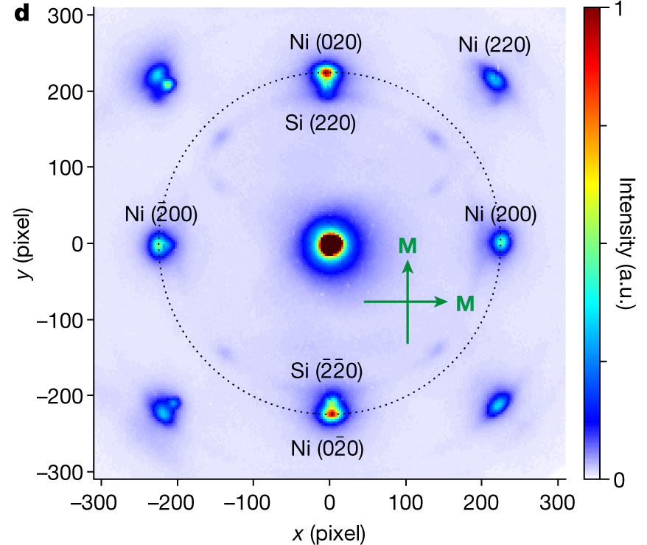
THz-compression enhances UED temporal resolution
D. Zhang et al., Ultrafast Science, Issue 1, 2021, see also DESY News
PPLN
Multicycle THz
Electron diffraction
Segmented
waveplate
Excitation pulse
DC Gun
DLW
53 keV e⁻ beam
Debye-Waller dynamics in Si
Solenoid
OAP
Compressed beam
Sample
Stability
Si lattice dynamics
electron-phonon coupling in Bi
ultrafast demagnetization in Ni
Jitter (fs)
Std=3.8 fs
Othman et al., arXiv:2104.05691 (2021)
Tauchert et al., Nature 602, 73 (2022)
Time (minutes)

Slide 14
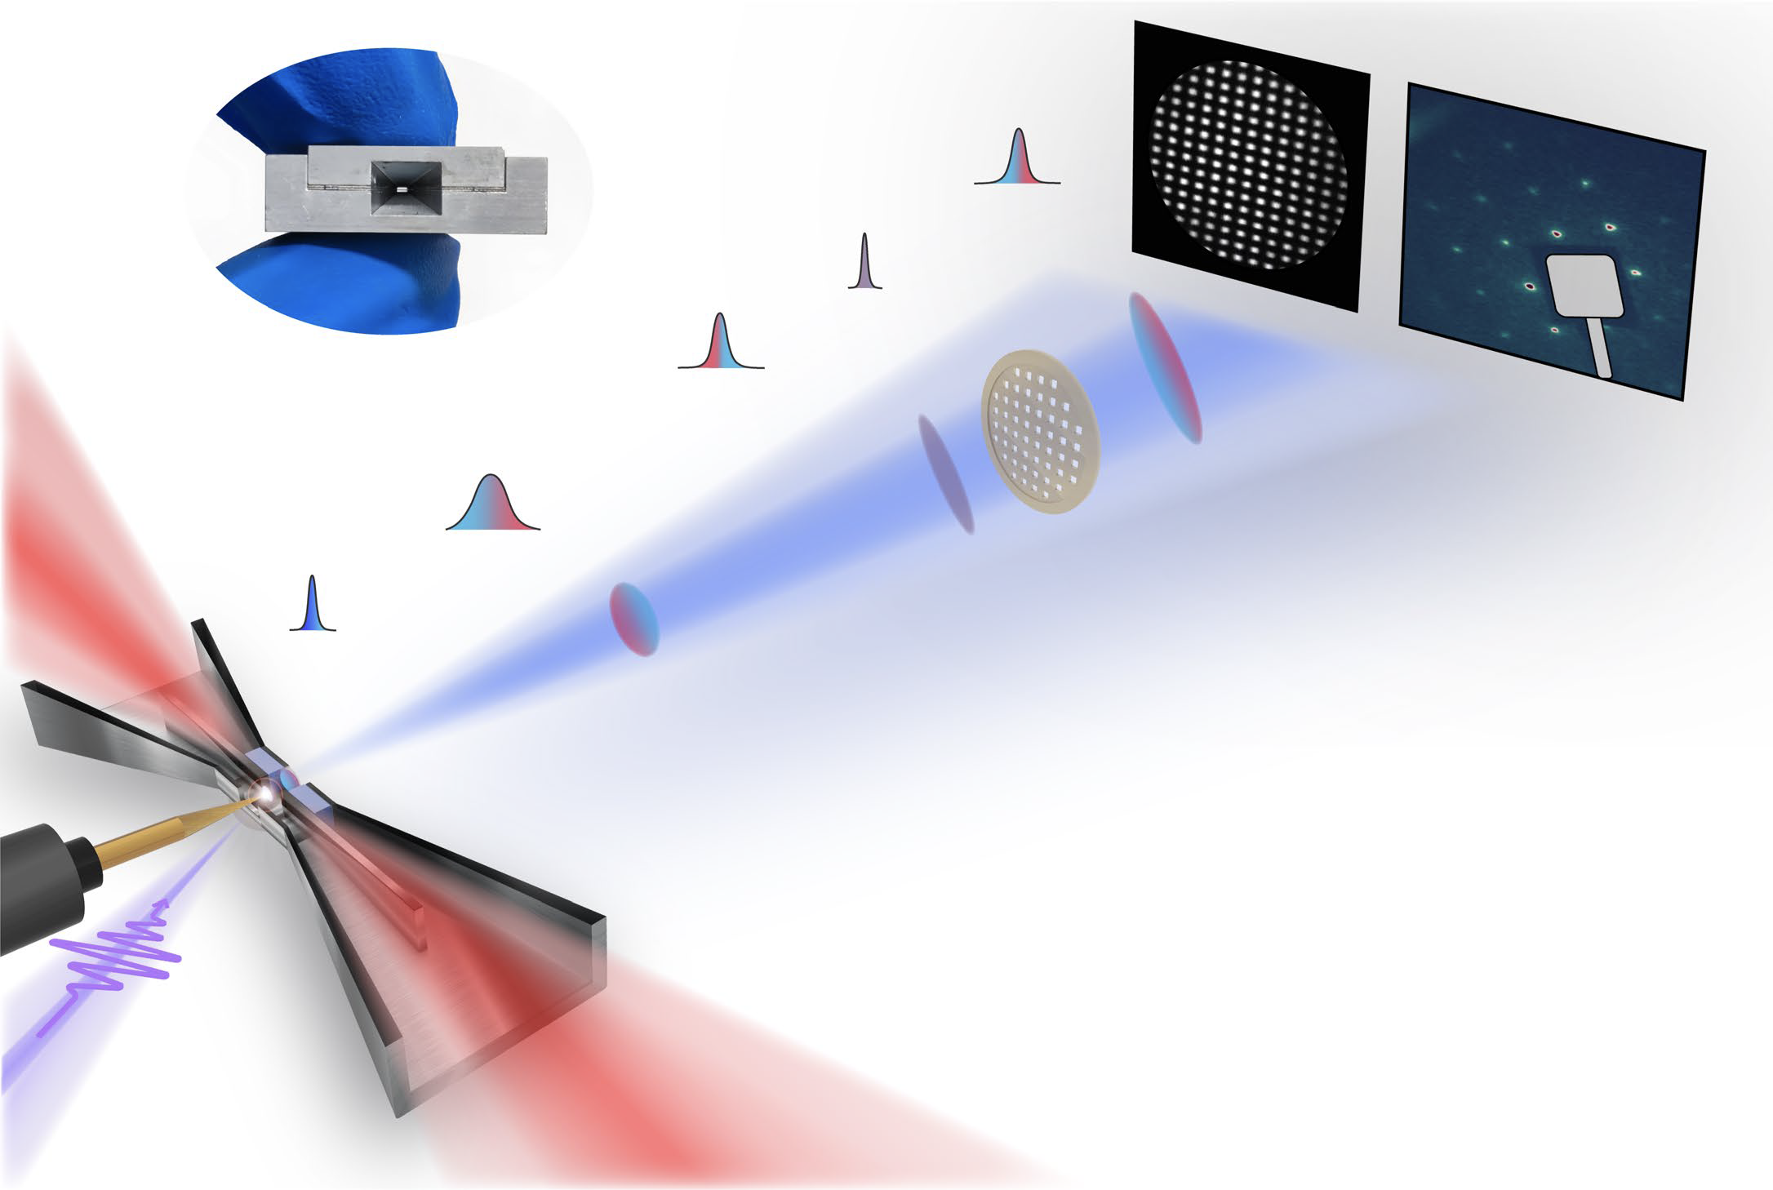
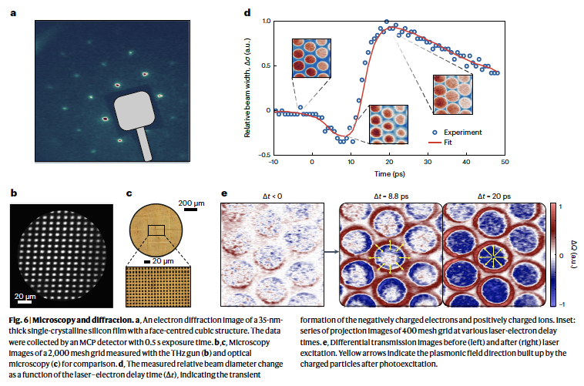
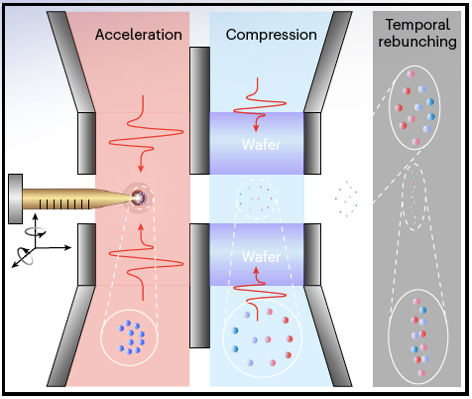
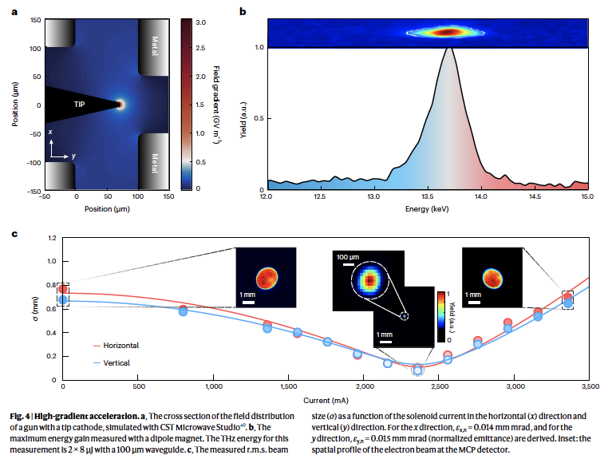

High gradient terahertz-driven ultrafast photogun
J. Ying et al., Nature Photonics s41566 (2024)
Practical gun with new features:
tip for controlling injection
integrated compressor
Hi-quality diffraction pattern
35 nm Silicon, 1-crystal
Spatially-resolved plasmon dynamics
THz gun energy record
Mesh
1.0
THz Gun Performance:
$\left|{\vec{E}}_{THz}\right|≈3 GV/m$
$E_{gun}≈14 keV$
$∆E/E≈1\%$
$∆t ≈167 fs$
$Q≈10 fC$
$ε ≈0.015 mm mrad$
0.5
Relative beam width
yield (a.u.)
0
-0.5
12
12.5
13
13.5
14
14.5
15
-10
0
10
20
30
40
50
Energy (keV)
Time (ps)

Slide 15













THz-Driven Accelerator Technology is Taking Off
MeV compression and streaking
MeV Acceleration
MeV compression and streaking
L. Zhao et al., Phys. Rev. Accel. Beams 21, 082801 (2018)
E. Curry et al., PRL 120, 094801 (2018)
MeV compression and streaking
E. C. Snively et al., PRL 124, 054802 (2020)
MeV Acceleration
MeV Acceleration
L. Zhao et al., PRL 124, 054802 (2020)
M. T. Hibberd et al., Nature Photonics 14, 755 (2020)
H. Tang et al., PRL 127, 074801 (2021)
MeV Acceleration
MeV Acceleration
MeV compression and streaking
H. Xu et al., Nature Photonics 15, 426 (2021)
M. Lenz et al., arXiv: 2605.00125v2 (2026)
X.-Q. Yu et al., Nature Photonics 17, 957 (2023)

Slide 16
















Nicholas Matlis Group: Research Opportunities
DOE’s Basic Energy Sciences Advisory Committee (BESAC)
5 grand challenges
5 transformative opportunities
Collective Modes
Phonons (lattice waves)
Unexplored Territory
optical pump
structure
electronic state
High Energy (mJ)
THz pulses
L₃
Fe
Polarons
0.4
B↑
Excitons
L₂
B↓
0.2
XMCD
Controlling Matter
XAS & XMCD (a.u.)
Observing Matter
Spectrum Control
$\overset{⃑}{B}$ vs $\overset{⃑}{E}$ Control
0
-0.2
700
710
720
730
Photon energy (eV)
light & electron sources
Low Repetition
Rates
Single-Shot
Detection
Magnons (spin waves)
SLAC-R-1053
Charge Density Waves
Novel THz Sources
CXLS
SLAC-R-1053:
“the relevant collective modes appear at 1 to 100 meV”
biodesign.asu.edu/cxfel/

Slide 17








Tunable narrowband THz source using pulse train
Pulse train + Broadband phase-matching
THz Parameter Tuning
Matlis et al., Opt. Express 31, 44424 (2023)
pulse-train energy
THz field strength
Temporal Shaping
16x
256x
256x
256x
128x
64x
pulse-train frequency
THz frequency
pulse-train number
THz bandwidth (# of cycles)
4x
8x
Kroh et al., Opt. Express 30, 24186 (2022)
Controls:
Field strength (pulse energy)
Frequency (pulse train spacing)
Bandwidth (# of pulses in train)
Field content (coherent combining)
Linear/Circular polarization (coherent combining)
E-fields Cancel
B-fields
$$\overset{⃑}{B}$$
Cancel
$$\overset{⃑}{B}$$
$$\overset{⃑}{E}$$
$$\overset{⃑}{B}$$
Field Type:
$$\overset{⃑}{E}$$
$$\overset{⃑}{E}$$
$$\overset{⃑}{B}$$
$$\overset{⃑}{E}$$

Slide 18


Broadband THz pulses excite modes indiscriminately
THz $E_{THz} \& B_{THz}$Driven Magno-phononics in FePS₃
FePS₃
(out of bandwidth) Nonlinearly excited
Multiple processes possible:
2-photon
Photon + Magnon
Photon + Phonon
1-cycle pulse
T. Luo et al., Nature Commun. 16,6863 (2025)

Slide 19




Methodology Behind Quantum Pathway Engineering
High-Energy Laser System (200 mJ, 0.5 ps, 1 kHz, 1 um)
Flexible Pulse Divider
Flexible Pulse Divider
${\overset{⃑}{B}}_{y}$ @ $f_{1}$
${\overset{⃑}{E}}_{x}$ @ $f_{2}$
Sample

Slide 20
Conclusions
Progress in THz generation yields mJ-scale pulses
THz-driven acceleration is gaining STEAM with demonstrations at keV and MeV level
THz accelerator technology increasingly used across LPA and conventional platforms
THz sources for accelerators offer new possibilities for driving quantum material science

Slide 21


































































AXSIS Team and Collaboration
SYNERGY Grant
Ultrafast Optics and X-rays Group
Alumni
Coherent Diffractive Imaging Group
Bio-Physical-Chemistry Group
Detector Group
UHH (LUX)
Accelerator Division: DESY
Notes:
This work is part of a project called AXSIS at DESY which is pioneering the development of THz-powered electron acceleration and its applications towards realization of a fully THz-powered X-ray light source.
**CLICK**
As major motivation for the development of THz acceleration is the drive to create compact electron and x-ray sources that are more widely accessible and enable development of new applications that can be integrated on the optical table.
However, as you can imagine, miniaturization of any technology brings with it many complexities which must be fully explored.
In this talk I will concentrate on studying the dynamics of the multicycle-THz driven LINAC. In particular, I will focus on some of the challenges associated with using dielectrically loaded waveguides as LINACs for non-relativistic electrons.

Slide 22
END

