Slide 1
Field emission and plasmon-assisted photocathodes: from emitter arrays to graphene-edge cathodes
Soichiro Tsujino*
Photocathodes for Accelerator Science in Europe (PhASE 2026)
Sep 22, 2026: Auditorium Joliot Curie (IJCLab), Orsay France
* also at Shizuoka University, Hamamatsu, Japan.

Slide 2
Outline
Double-gate field emitter array (FEA) as a low-emittance cathode
Surface-plasmon-polariton (SPP) asssited FEA photocathode
Spatial coherence of field emitters: field-emission wave packet
Recent developments: 2D material-edge field-emitter
Summary

Slide 3
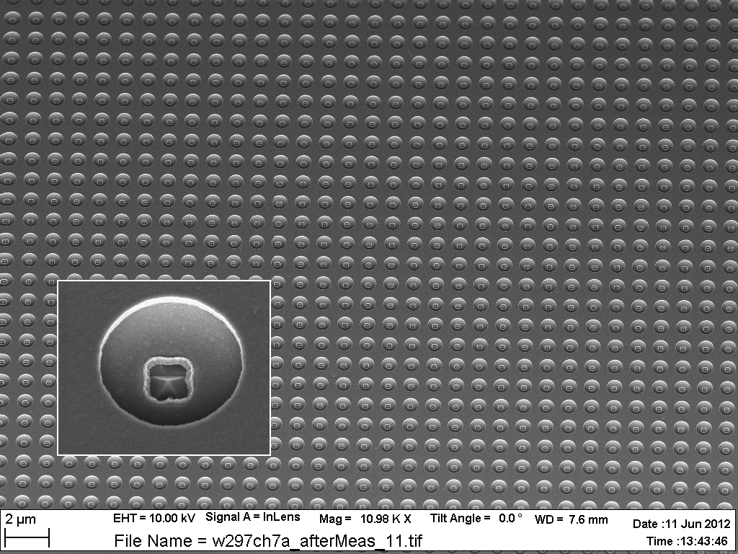
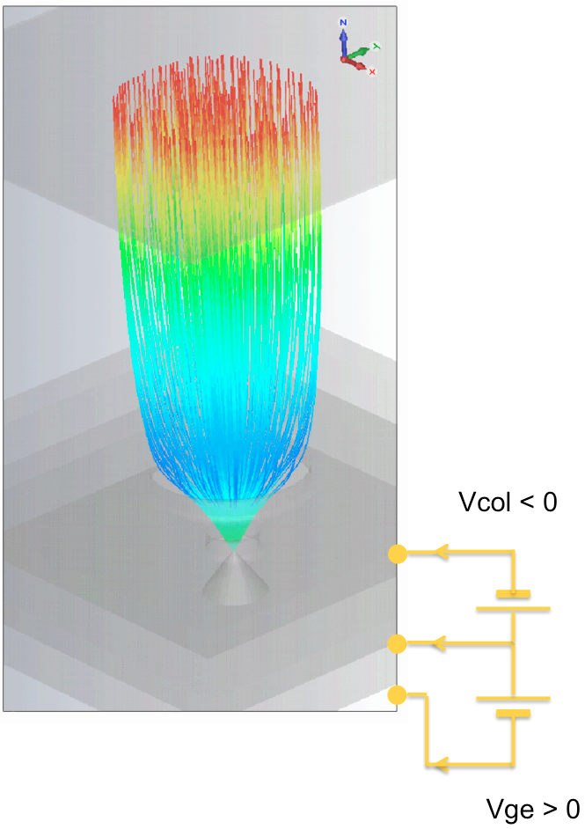
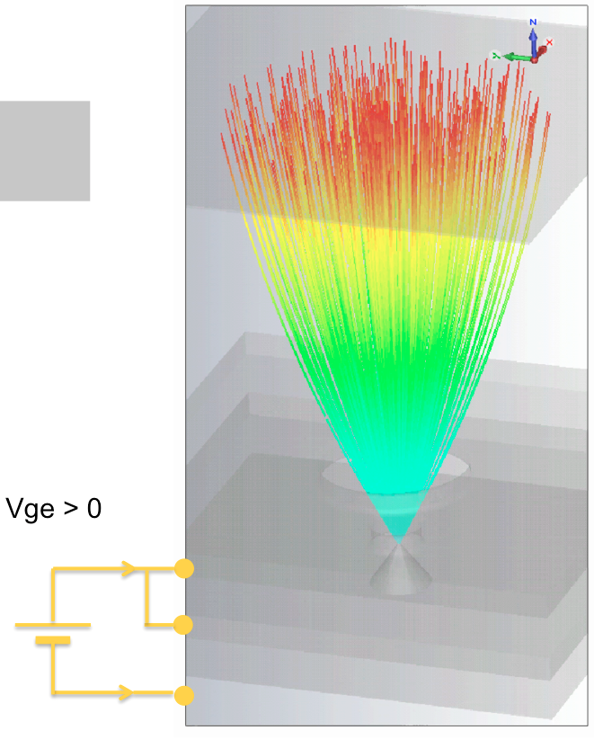
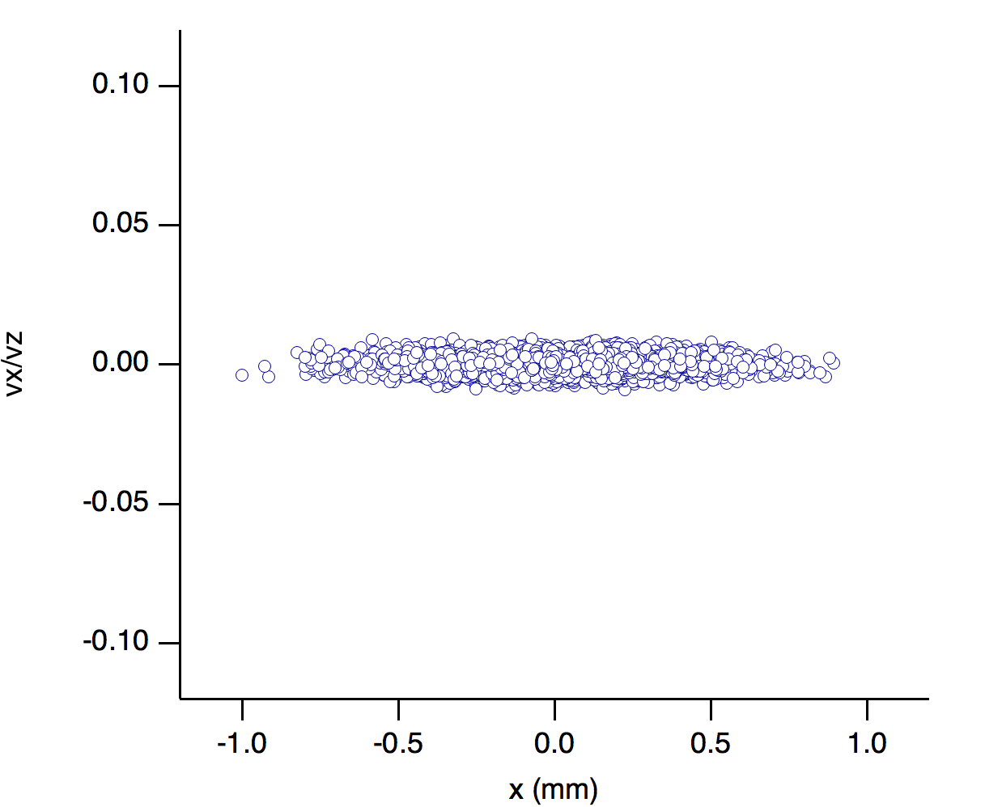
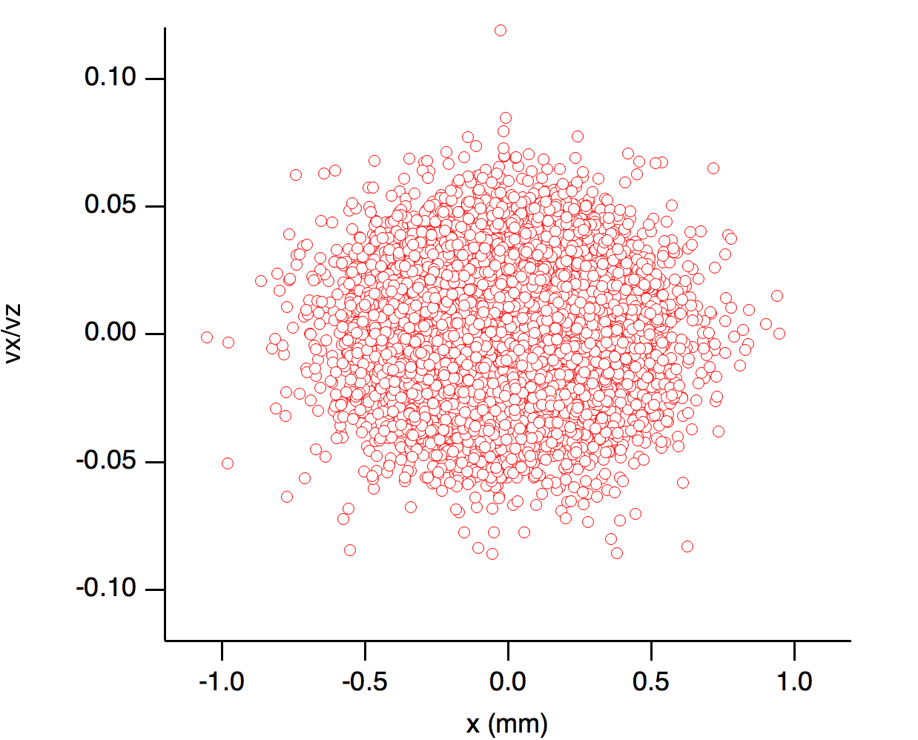
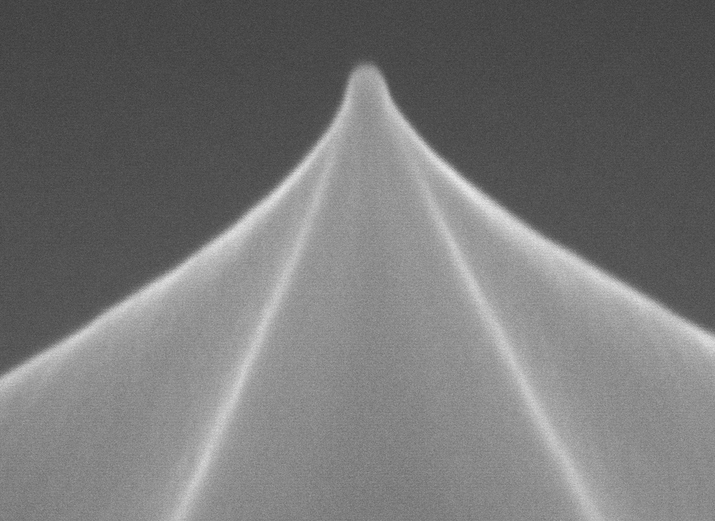
Double-gate field emitter array (FEA) as high-current, low-emittance cathode
Collimagion gate
Collimated beam
Diverging
Extraction gate
V_{ge} > 0
k_{col} = V_{col}/V_{ge} = 0
Case: ΔE_{t} = 0.12 eV
Case: ΔE_{t} = 11 eV
5 nm
Transverse moment p_{x}/p_{z}
Transverse moment p_{x}/p_{z}
Field emission Mo nanotip
V_{ge} > 0
S. Tsujino et al. Nat Comm (2016).

Slide 4
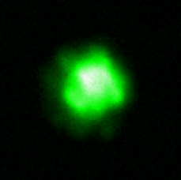
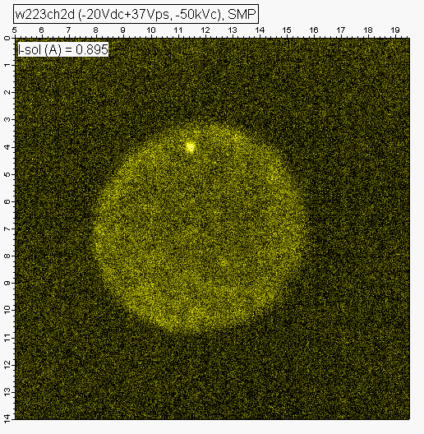
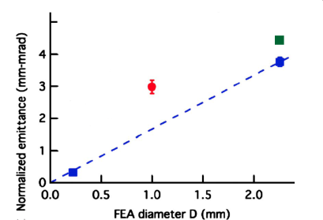
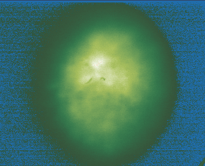
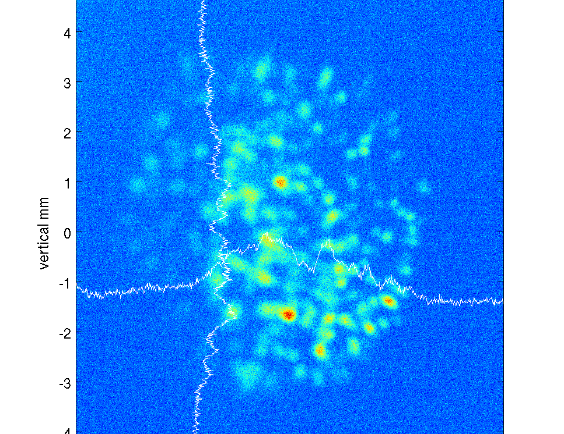
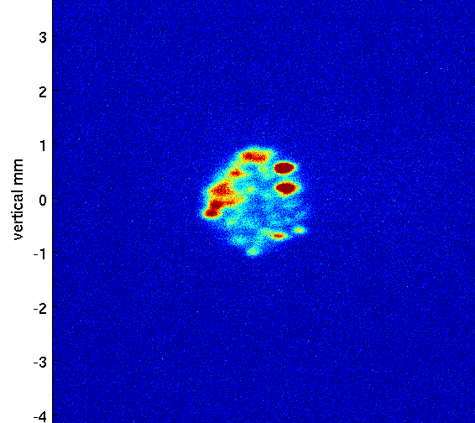
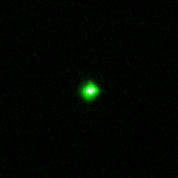
Double-gate FEA: emittance reduction
Uncollimated
Beam (k=0)
ɛ = 1.2 μm
FEA3: Ne-conditioned
Spindt-FEA
E_{t} = 11.8 eV (k = 0)
FEA1: as-fabricated
FEA2: as-fabricated
Collimated beam (k=1)
ɛ = 0.13 μm
E_{t} = 0.13±0.06 eV (k = 1)

Slide 5
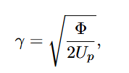
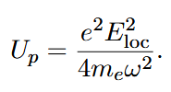


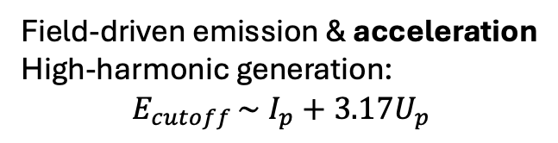


Enhanced local electric field via plasmon resonance and electron energy
Barrier height 𝛷 /ionization potential (I_{p})
Keldysh parameter:
Ponderomotive energy
Field-driven emission & acceleration
High-harmonic generation:
$$E_{cutoff }\sim I_{p}+3.17U_{p}$$
$$γ \sim 1$$
$$\left(U_{p} \sim 1eV or larger\right)$$
Photoemission (perturbative)
Plasmonics modulate E_{loc},
hot-electron
$$γ≫1$$
$$\left(U_{p}≪1eV\right)$$

Slide 6
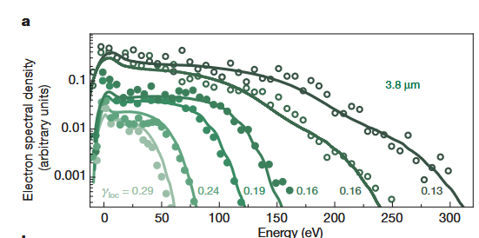
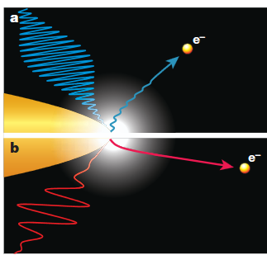
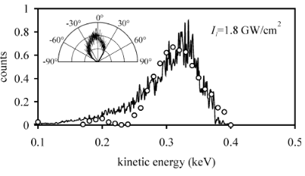
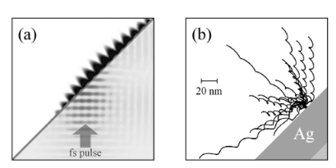

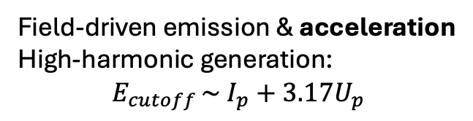
Example: strong-field electron dynamics at nanotip & SPP
[3] Herink et al. (2012): gold nanotips, 0.8-8 um pulses
$$γ \sim 1$$
$$γ \sim 1$$
$$\left(U_{p} \sim 1eV or larger\right)$$
Field-driven emission & acceleration
High-harmonic generation:
$$E_{cutoff }\sim I_{p}+3.17U_{p}$$
[5] Irvine et al. (2004): SPP on Au via grating

Slide 7
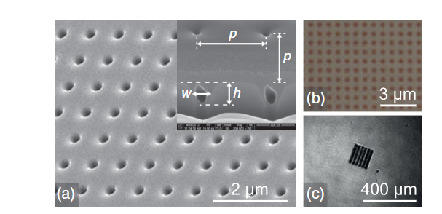
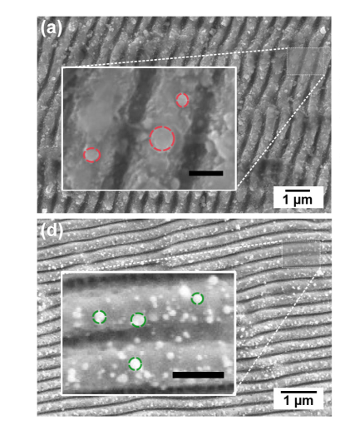
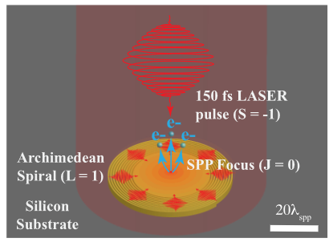
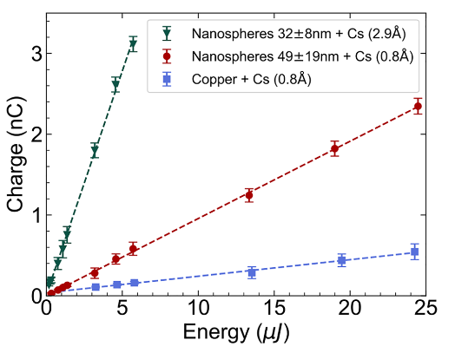
SPP for enhancing QE at moderate excitation: $γ≫1$
[7] Li et al. (2013): SPP Cu
[11] Martinez-Calderon et al. (2023):
localized plasmon exc. & hot-carrier
γ_{sp} > 10
γ ~ 1E4
UV (266 nm)
ε_{in} = 1.4 mm mrad/mm rms (~1eV)
[9] Kachwala et al. (2024): SPP focusing/interference for Cu
γ_{sp} >> 1
(E_{loc} ~0.5 GV/m)
ε_{in} = 0.8-1.0 mm mrad/mm rms (0.33-0.51 eV)

Slide 8
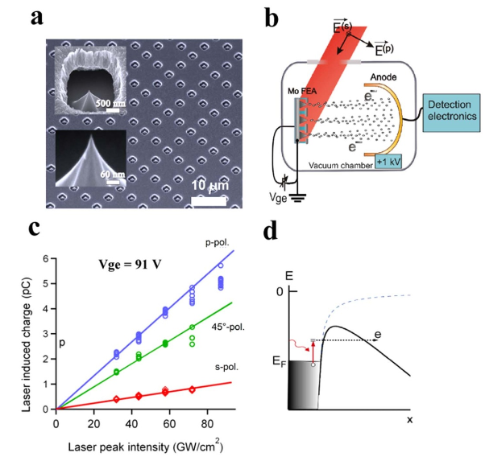
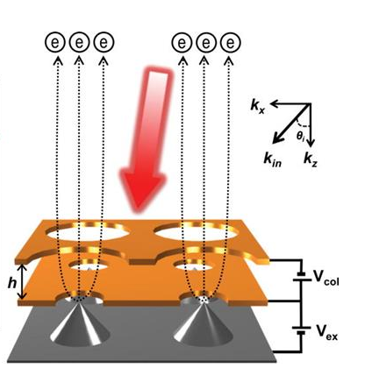
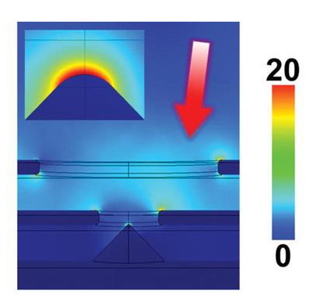
SPP-assisted FEA photocathode ($γ≫1)$
EOT through sub- λ apertures
+
Photo-field emission
10^6 tips, 1 µm-pitch, NIR (800 nm)
Copper double-gate struc. QE ~ 10⁻⁵
~25 µJ for 200 pC.
cf. Cu QE (flat cathode)~ 6×10⁻⁵
by UV pump
(less stability, uniformity, efficiency)
(APL 2008/2009/2011-2, SciRep 2012, APEX 2013, JVST2015)

Slide 9
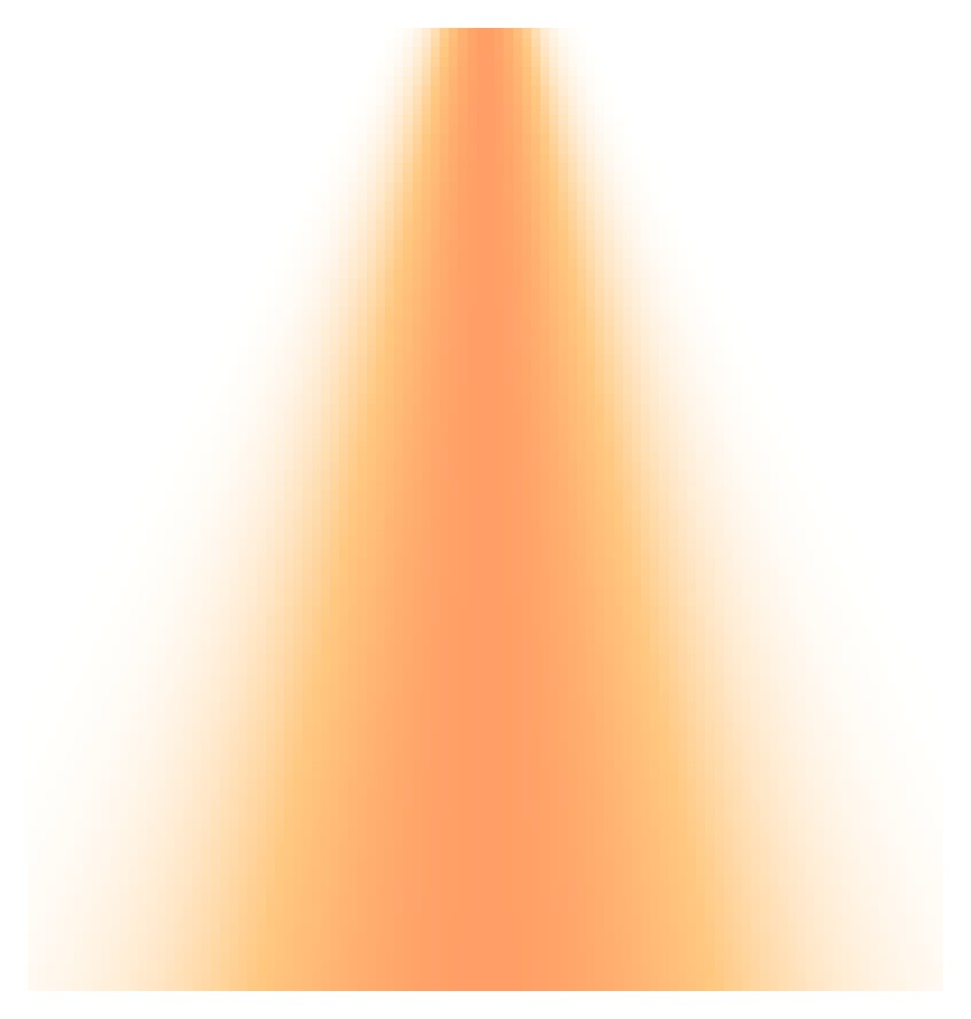
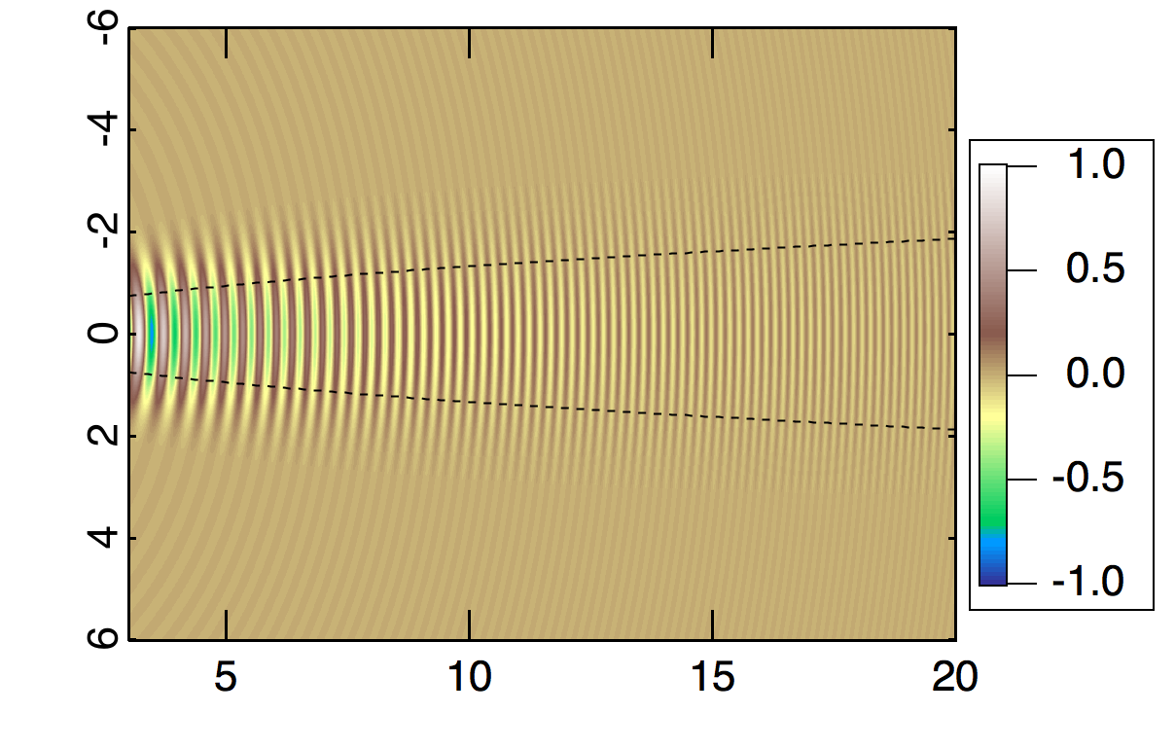
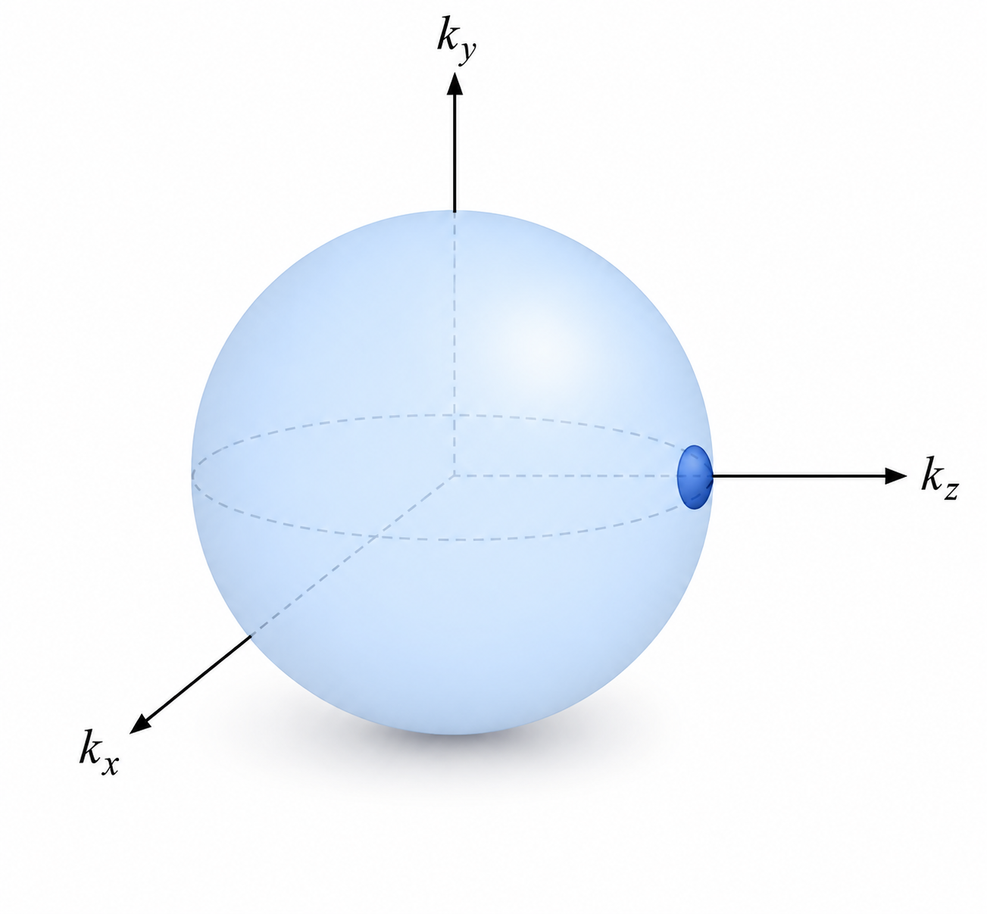
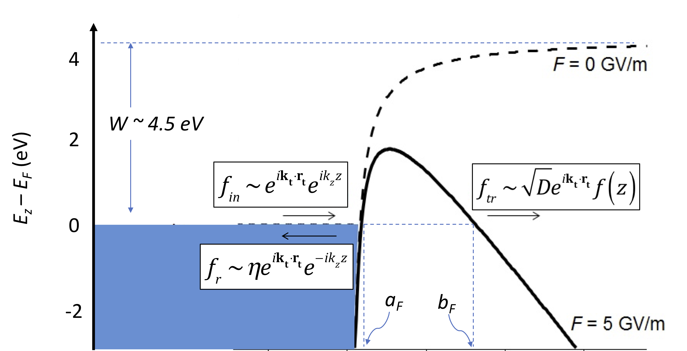
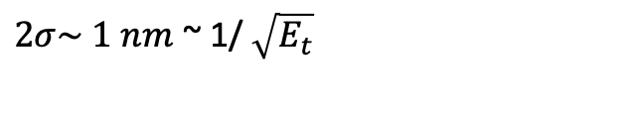
Field emission wave packet
Planar point-emitter case
-conservation of crystal momentum
-summation over available states
r
wave packet expansion
~ free space
$2σ\sim 1 nm$ ~ 1/ $\sqrt{E_{t}}$
z
k_{x}
r (nm)
Tunnelling allowed for states with k_{z} ~ k_{F}
k_{z}
k_{y}
z (nm)

Slide 10
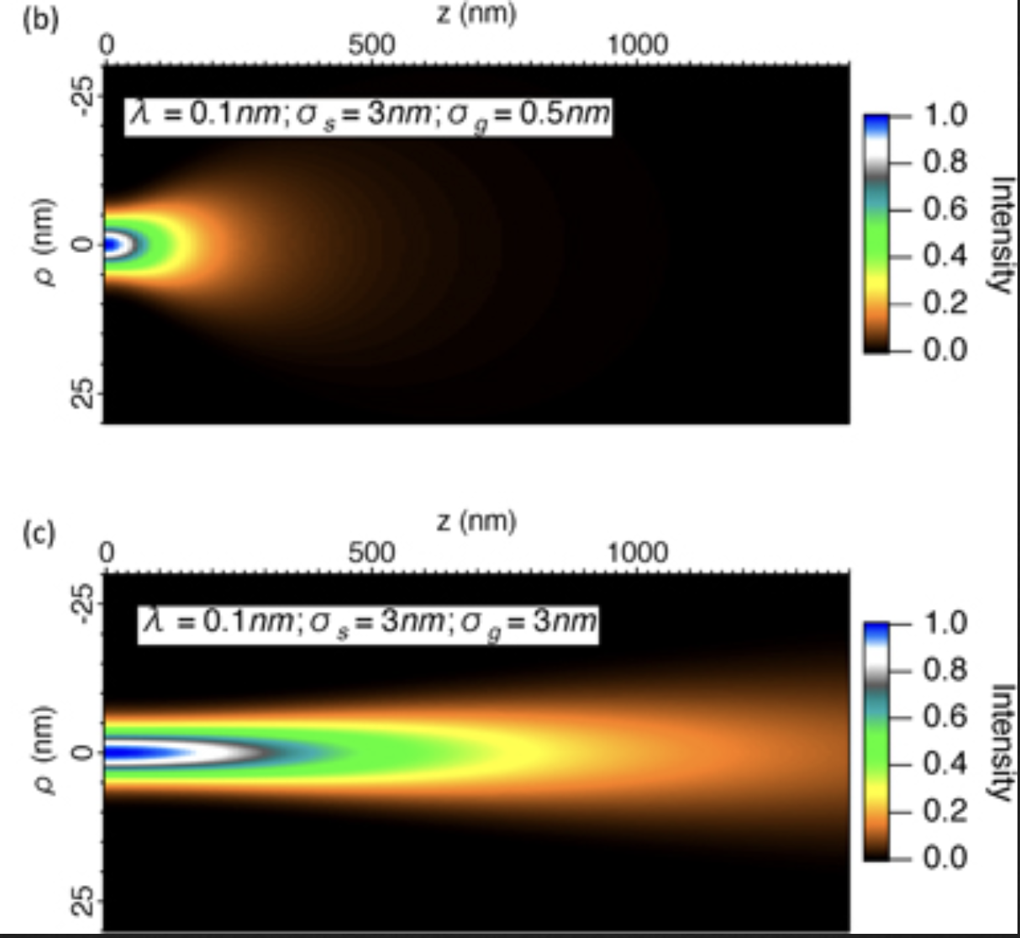
Field emission wave packet: fully coherent case
‘Point’-emitter
Finite-initial beam size 𝜎₀
( ~ 1/momentum spread)
Angular spread ~ 𝜃₀
Fully-spatially coherent-emitter (size r):
Angular spread ~ 𝜃₀ x (𝜎₀ / r)
JAP (2018); JVSTB(2022); JAP (2026)

Slide 11
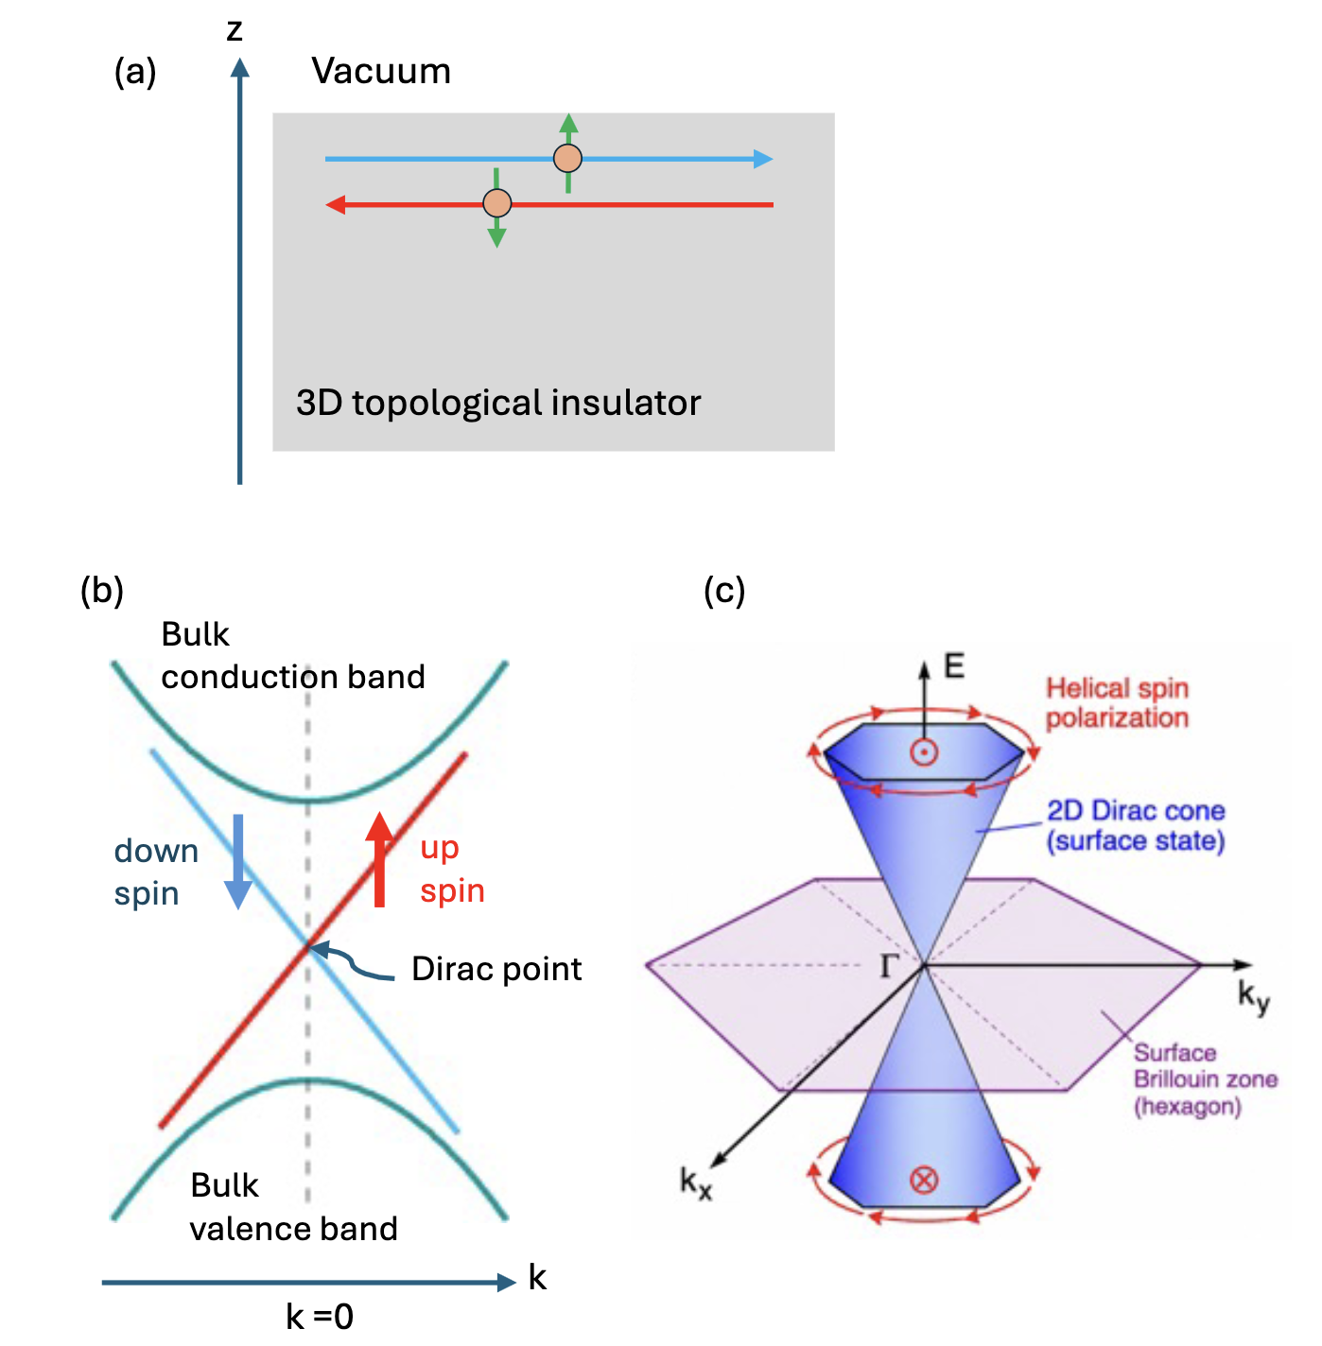
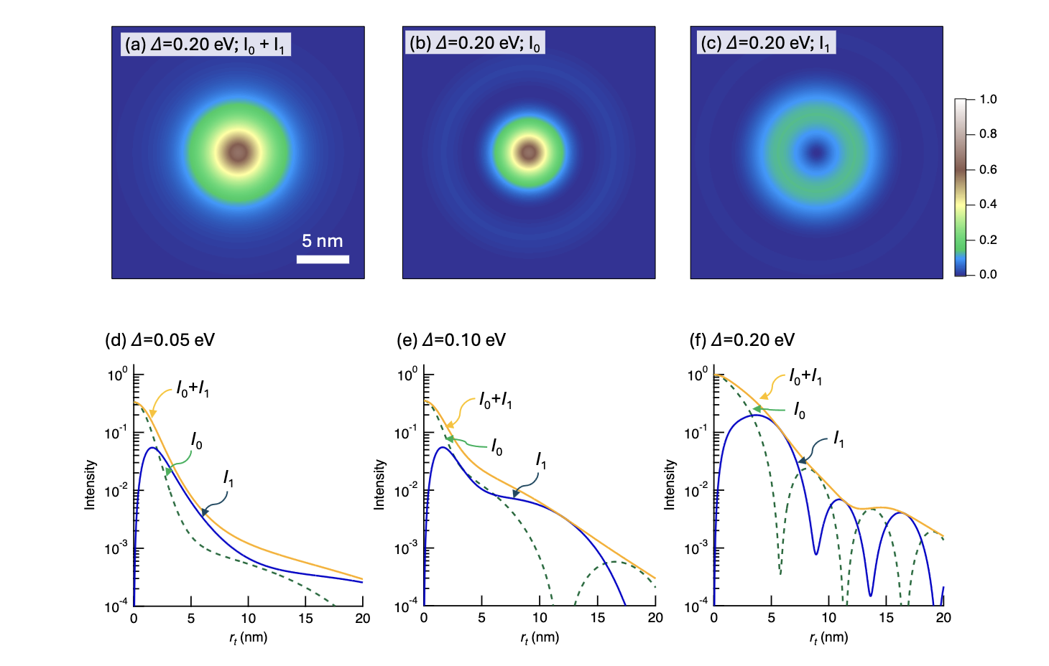
Field emission wave packet from Surface State of Topological Insulator
𝓁=0 component
Total beam intensity
𝓁=0 + 𝓁=1
𝓁 =1 component:
vortex beam
Tsujino, Mussler, Hajibaba (2026): submitted

Slide 12
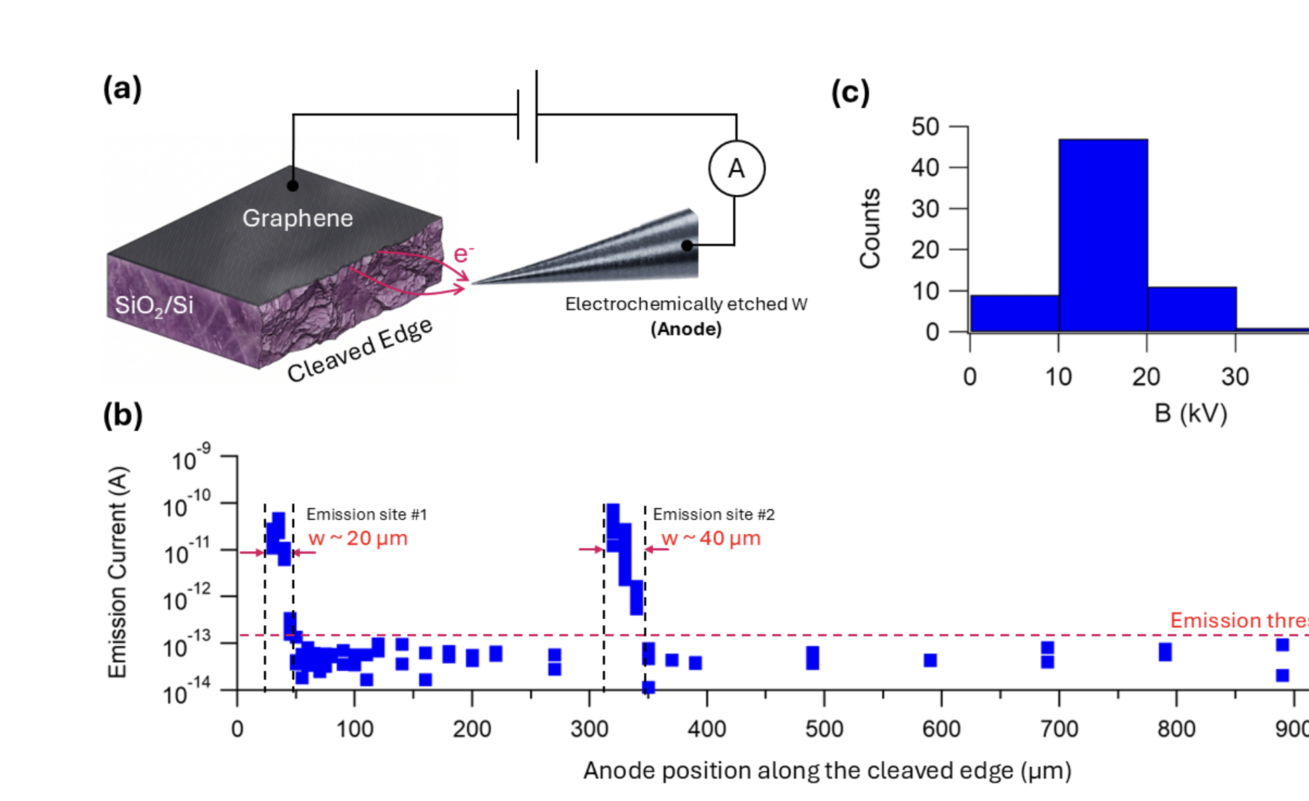
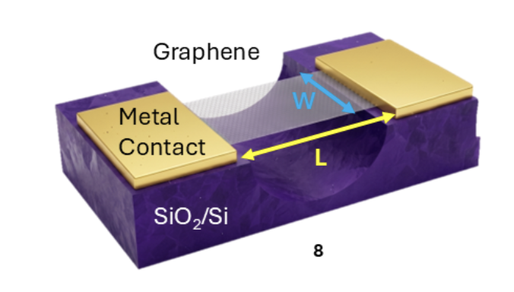
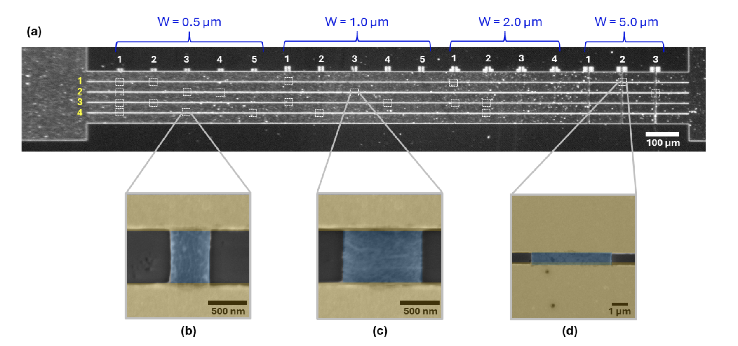
Suspended Graphene-Edge Field-Emitter

Slide 13
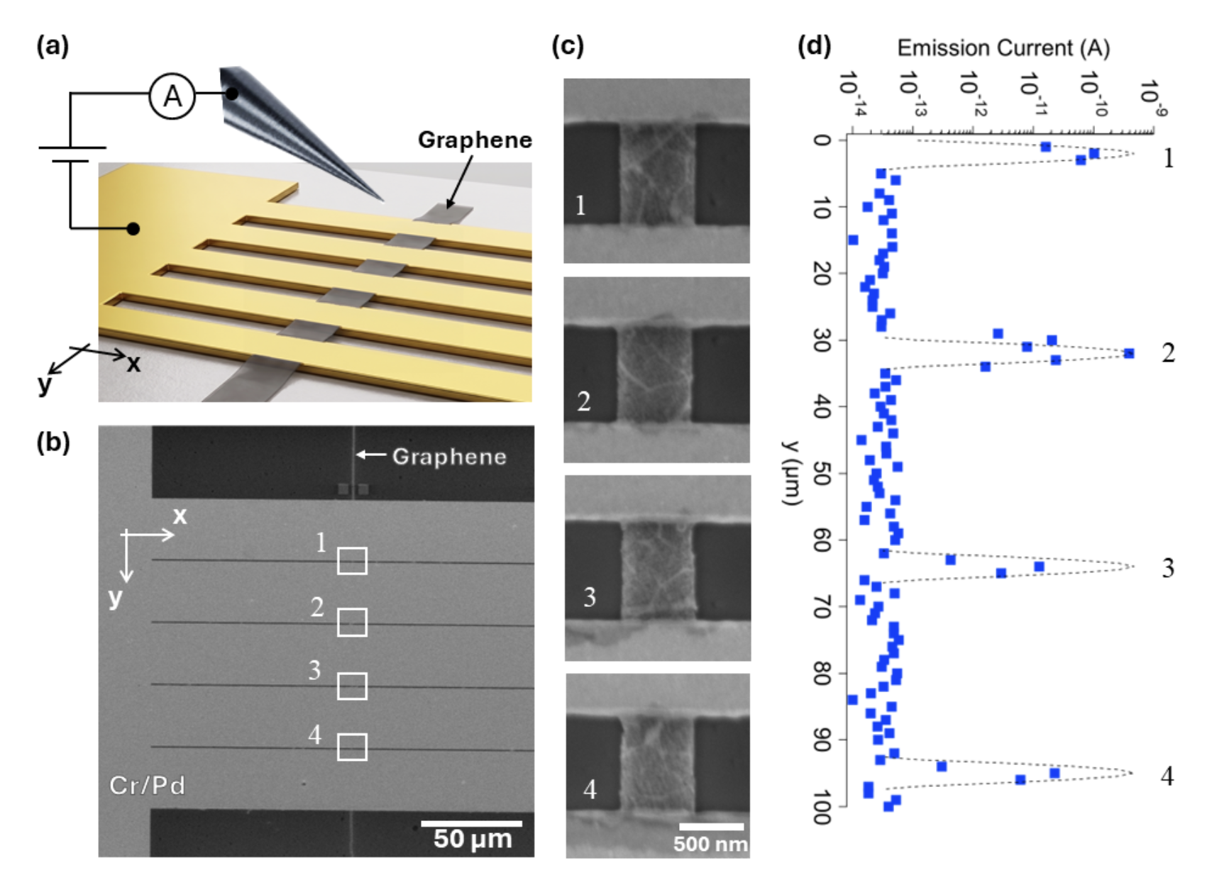
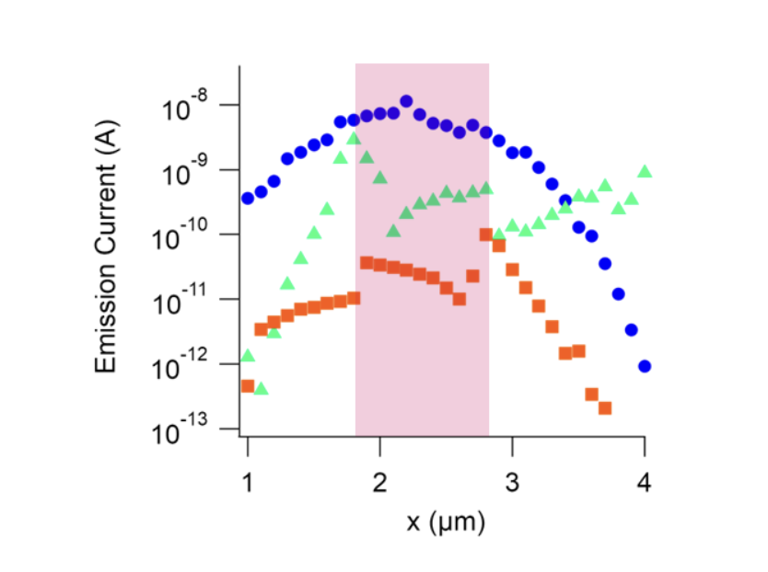
Suspended Graphene-Edge Field-Emitter

Slide 14
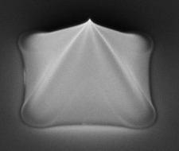
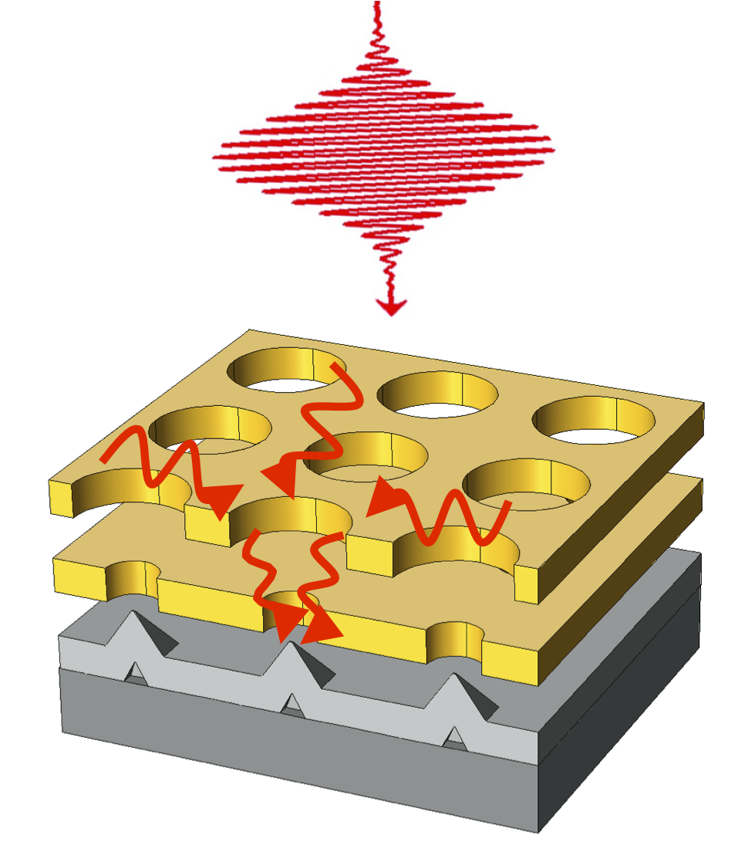
Summary
SPP-assisted FEA photothode:
  low-emittance, ultrafast cathode?
Field emission wave packet:
  window of solid state into vacuum?
2D Film-edge emitter

Slide 15
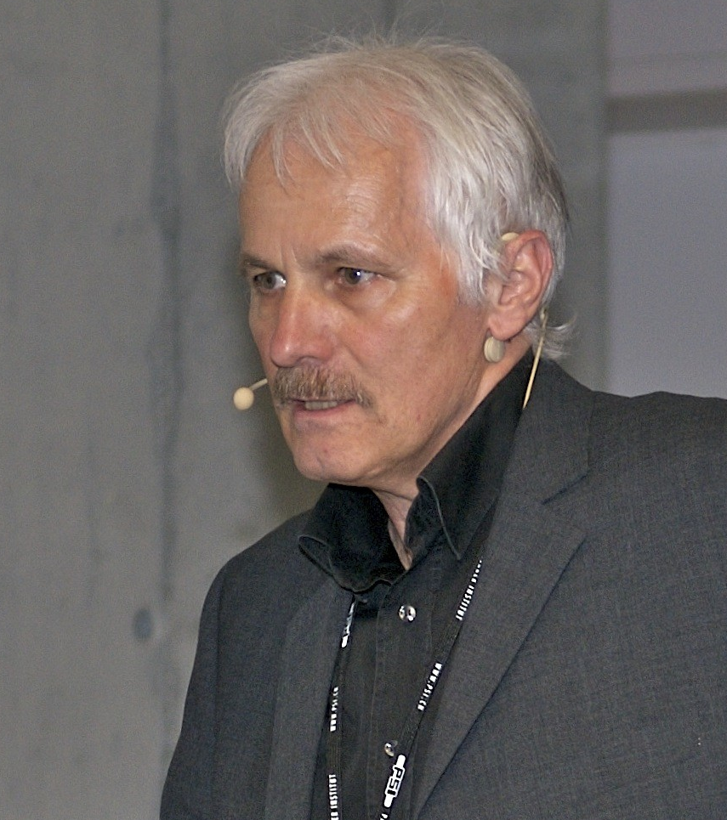

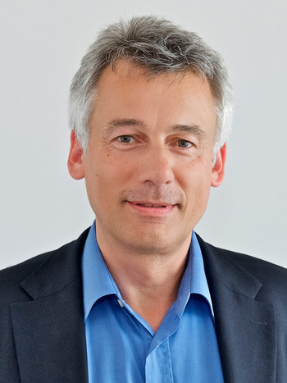

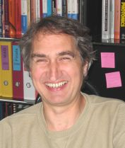
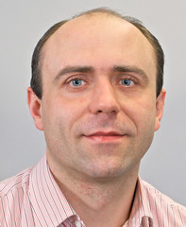
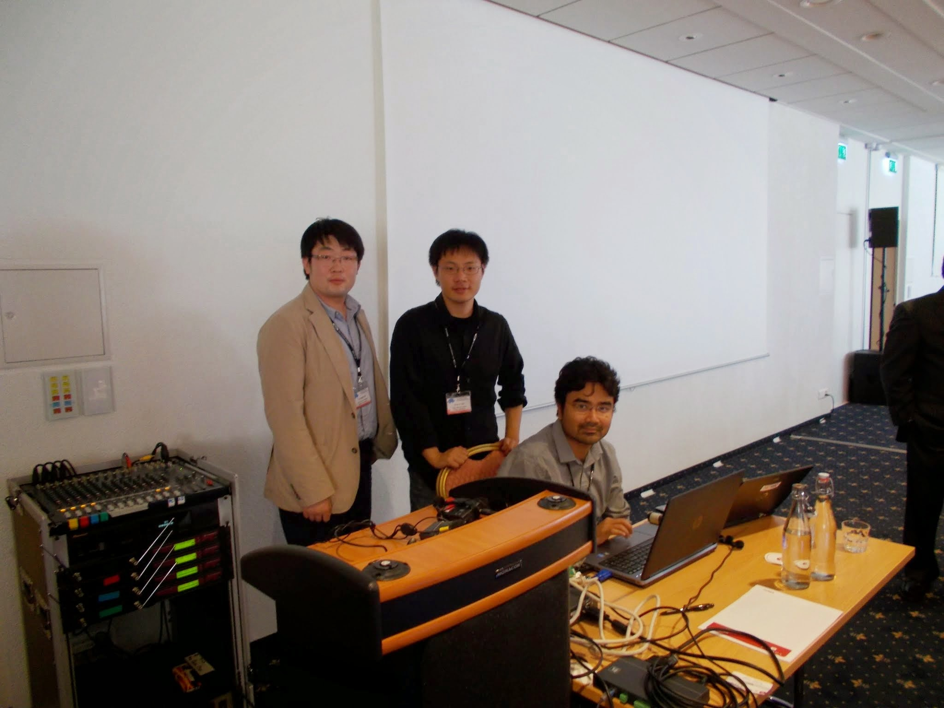
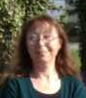
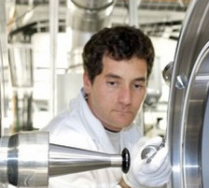












V. Guzenko
Albin Wrulich
Jens Gobrecht
Hans-H Broun
Y. Oh
P. Helfenstein
A. Mustonen
Thomas Feurer
M. Monshipouri
P. Beaud
H.-W. Fink
S. Leemann
E. Kirk
M. Paraliev
P. Das Kanungo
Chiwon Lee
D. R. J. Miller
Funding
SwissFEL/PSI-XFEL project, PSI
Swiss National Science Foundation
Max Planck Institute for structure and material dynamics
Swiss Nanoscience Institute, Uni. Basel
Pooja Thakkar
Penghan Lu (FZJ)
Seite 15
Soheil Hajibaba
Rafal Dunin-Borowski (FZJ)

Slide 16

FEA emittance measurement
Focused beam (by solenoid)
[un-collimated, kcol = 0]
Double-Gate FEA
10 µm-pitch, 10⁴ tips
1 mm-dia
L = 0
L
Anode (ground)
Solenoid lens
phosphor screen
Uncollimated
Beam (k=0)
ɛ = 1.2 μm
E_{t} = 11.8 eV (k = 0)
camera
Focused beam
[collimated, kcol = 1]
Collimated beam (k=1)
ɛ = 0.13 μm
Faraday cup
FEA at – 20kV
E_{t} = 0.13±0.06 eV (k = 1)
S. Tsujino et al. Nat Comm (2016).

Slide 17



Is FEA beam coherent?...test with diffraction
Single-nanotip double-gate
field emitter
V₀=0.8 kV
MCP
Phosphor
Screen
Direct beam
s₀ = 59 µm-rms
e⁻
$$\frac{s_{0}}{L}=12 mrad≈\sqrt{\frac{E_{t}}{V_{0}}}$$
50 mm
L = 5 mm
Suspended 1 ML graphene (on TEM grid)
- Beam potential set by sample voltage
- No additional optics ~ relying on the small velocity spread
of collimated double-gate field emitter beam
Lee, Appl Phys Lett (2018).
Lee, Appl Phys Lett (2018).

Slide 18

Relationship between the spot size, crystal size, & transverse coherence length
When crystal is larger than wave function (transverse coherence length L_{c})
1.1 L_{c} covers a few lattice: large spot size
L_{c}
σ_{c} = 4 nm
L_{c}
2 nm
0.4 nm
0.2 nm
Bragg spot absout same size as the direct beam spot
1.2 L_{c} >> lattice size : small spot size
L_{c}

Slide 19
Relationship between the spot size, crystal size, & transverse coherence length
When crystal is larger than wave function (transverse coherence length L_{c})
d_{B} ⬄ L_{c} ≳ 2 nm
~ beam size (60 µm)
d_{B} ⬄ L_{c} ≳ 2 nm
1.1 L_{c} covers a few lattice: large spot size
σ_{c} = 4 nm
L_{c}
2 nm
0.4 nm
0.2 nm
1.2 L_{c} >> lattice size : small spot size
L_{c}
d_{sat} ≲ d_{main}/10
L_{c} ≳ 20 nm
~ 6 µm domain
⬄ L_{c} ≳ 20 nm
=> 6 µm > L_{c} ≳ 20 nm

