Slide 1

Electron emission at metallic needle tips and nanophotonic electron accelerators
M. Konrad¹, F. López Hoffmann¹, J. Pölloth¹, S. Kraus¹, J. Litzel¹, Z. Zhao¹, A. Rasputnyi^{1,2}, T. Wirth¹,
T. Volk¹, J. Illmer¹, M. Knipfer¹, J. Heimerl¹, S. Meier¹, D. Lesko¹, L. Brückner¹, R. Shiloh³, T. Chlouba⁴, T. Weitz¹,
M. Chekhova^{1,2}, P. Hommelhoff^{1,2,5}
¹ Department of Physics, Friedrich-Alexander-Universität Erlangen-Nürnberg (FAU), Erlangen, Germany
² Max Planck Institute for the Science of Light (MPL), Erlangen, Germany
³ Institute of Applied Physics, Hebrew University of Jerusalem (HUJI), Jerusalem, Israel
⁴ Center for Nanophotonics, NWO-Institute AMOLF, 1098 XG Amsterdam
⁵ Faculty of Physics, Ludwig-Maximilians-Universität München (LMU), Munich, Germany
manuel.l.konrad@fau.de

Slide 2
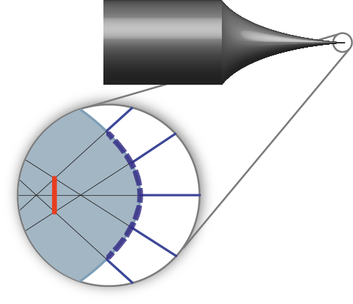
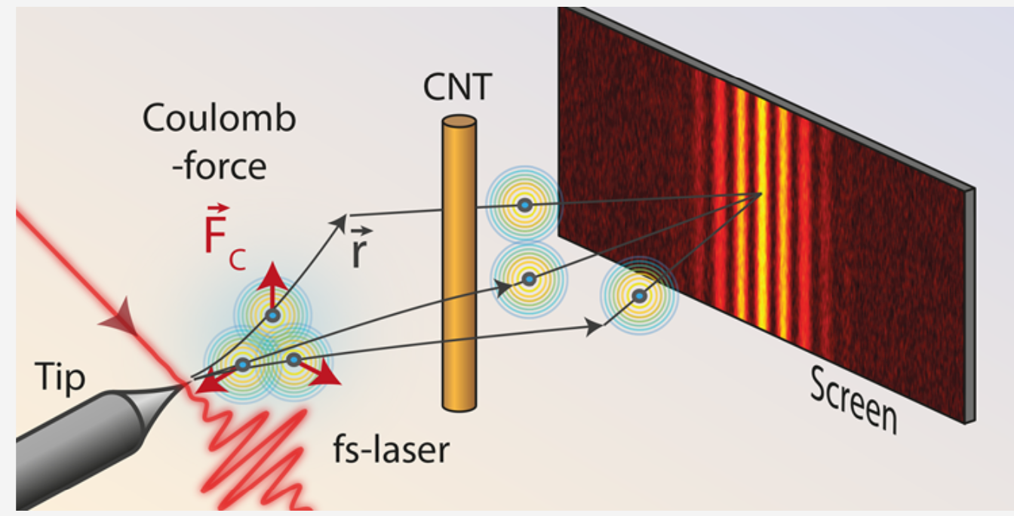
From flat photocathode to metallic needle tip
Flat photocathodes:
  Emittance: ~µm rad
  Diameters: Laser spot size (>µm)
  ~10⁹ electrons/pulse
-> Compromise between beam quality and current
Metallic needle tips:
  Norm. emittance: ~pm rad to nm rad
  Effective source size: ~ 1 nm (for tip radius ~10 nm)
  Few electrons per pulse
-> High quality, low current (e.g. used in SEMs)
S. Meier et. al, Appl. Phys. Lett. 113 (14) 143101 (2018)
S. Meier, P. Hommelhoff, ACS Photonics 9 (9): 3083–3088 (2022)

Slide 3
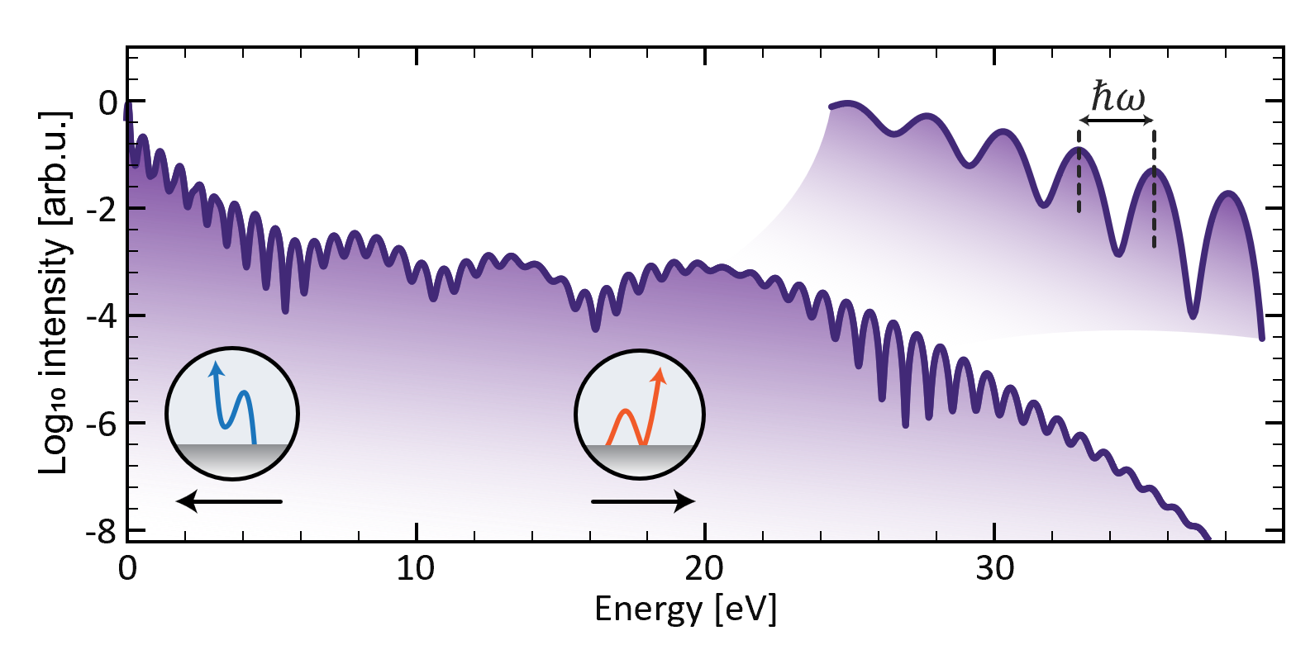

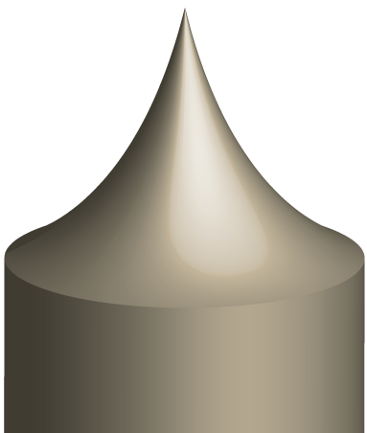





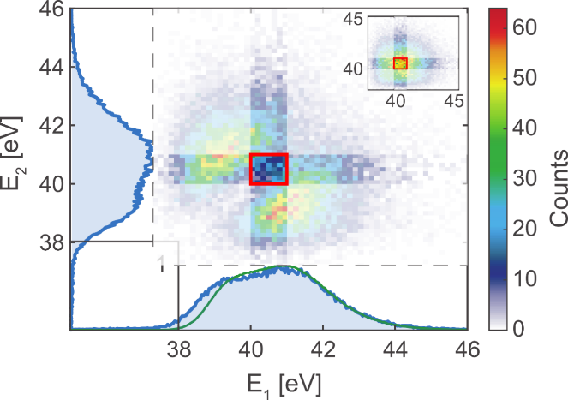




Strong field effects
Field enhancement around tip apex
Emission into small space- and time-volume
~nm
Heimerl et.al. (2023) Nat. Phys. 12, 1–6
Electron (energy) correlations
~10 fs
$Δ$E
tip
$$U_{tip}$$
Meier et al. (2023) Nat. Phys. 19, 1402–1409

Slide 4
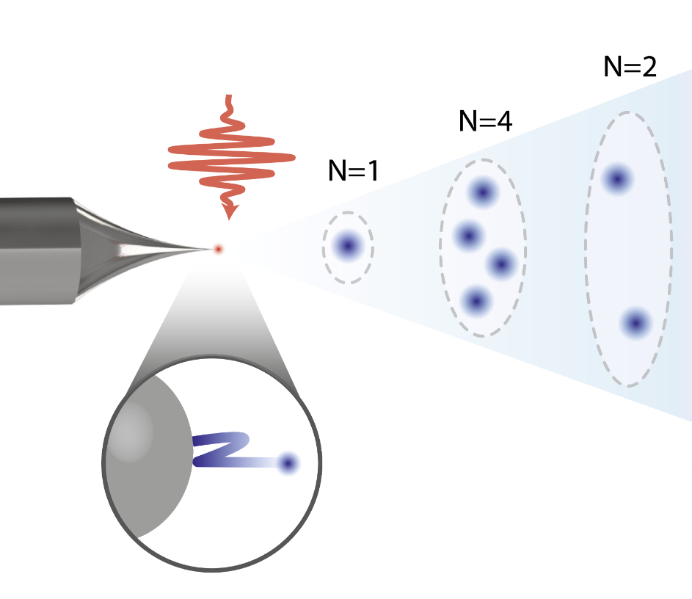
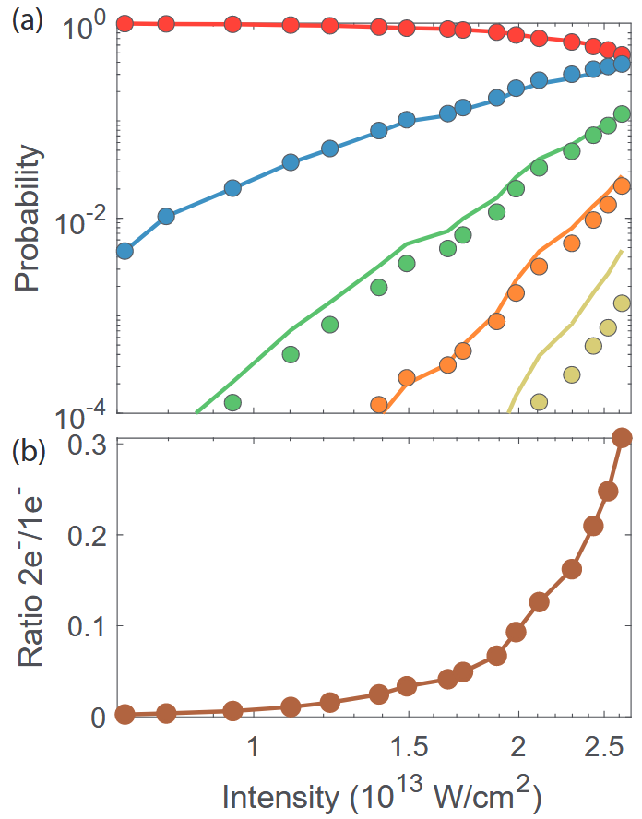
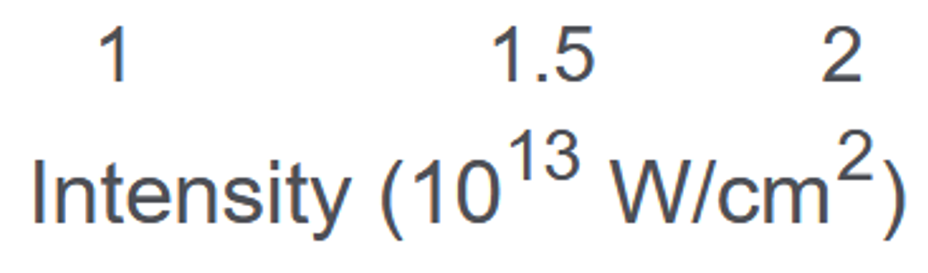
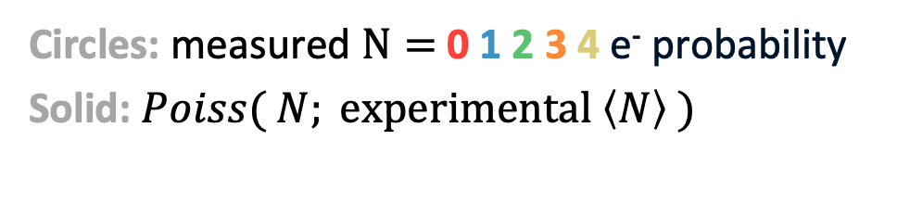
Scaling of electron number statistics
Jonas Heimerl, Stefan Meier et. al., Nonlinear scaling of strong field-driven multielectron emission. J. Vac. Sci. Technol. B 1 43 (5): 054201 (2025)
Many uncorrelated
stochastic emitters
→ Poisson statistics
Circles: measured $N=$ 0 1 2 3 4 e⁻ probability
Solid: $Poiss( N; \text{experimental} \left\langle N\right\rangle )$
→ Emission seems uncorrelated even for substantial fraction of 2 e⁻ events

Slide 5


$Δ$E
Energy correlations in multi-electron
emission events
tip
$$U_{tip}$$

Slide 6
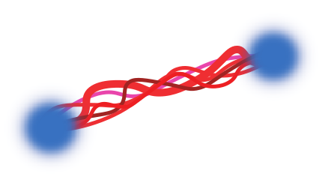

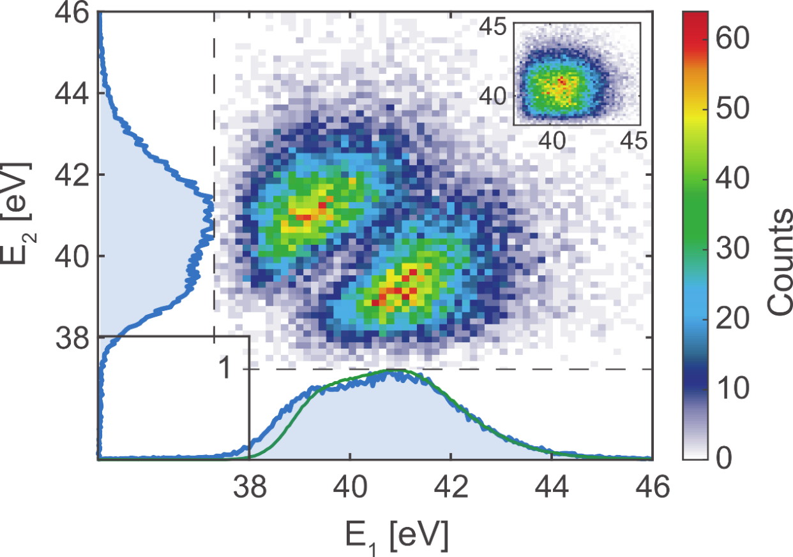
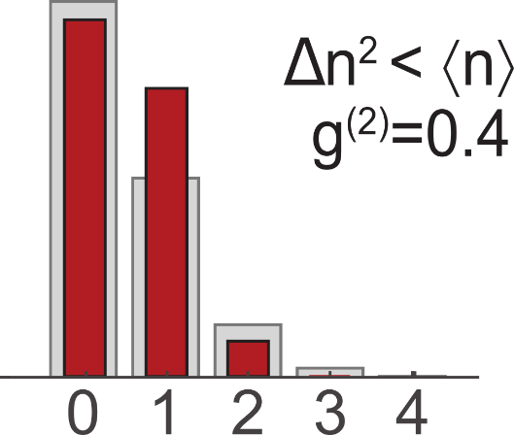
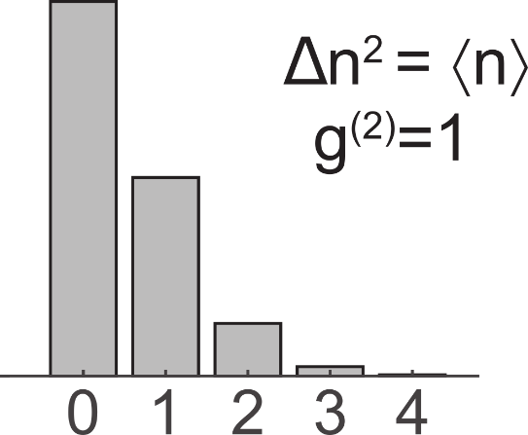
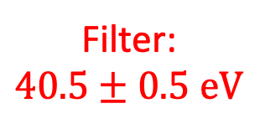
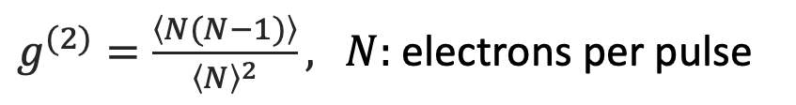
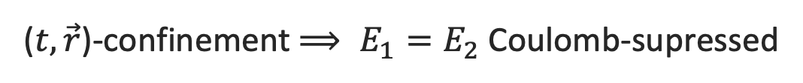
Bivariate energies and filtering
Post-select 2e⁻ events
E₂
Tune number distribution via filter
E₁
$g^{(2)}=\frac{\left\langle N(N−1)\right\rangle }{{\left\langle N\right\rangle }^{2}},$ $N:$ electrons per pulse
Filter:
$$40.5±0.5 \text{eV}$$
Number of electrons
→ Sub-Poissonian
→ Shot noise reduction
($t,\vec{r}$)-confinement $⟹ E_{1}=E_{2}$ Coulomb-supressed
Meier et al. (2023) Nat. Phys. 19, 1402–1409
Related work: Haindl et al. Nat. Phys. 19.10 (2023): 1410-1417
5

Slide 7
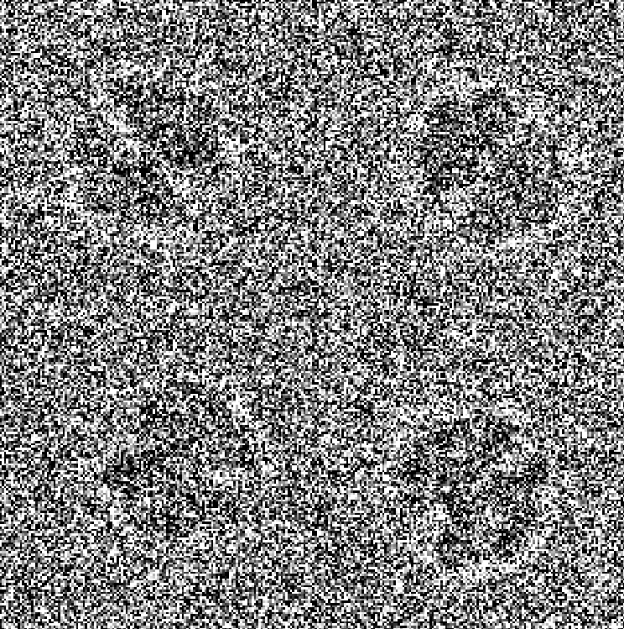
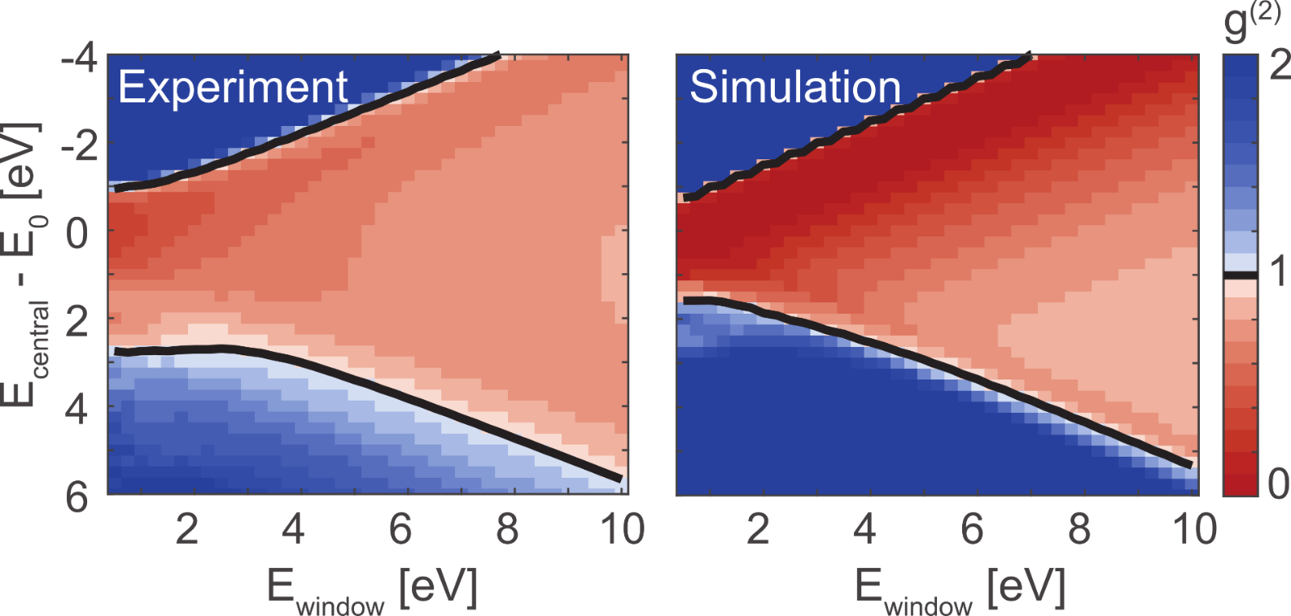
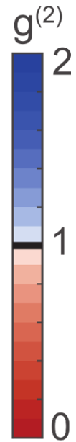
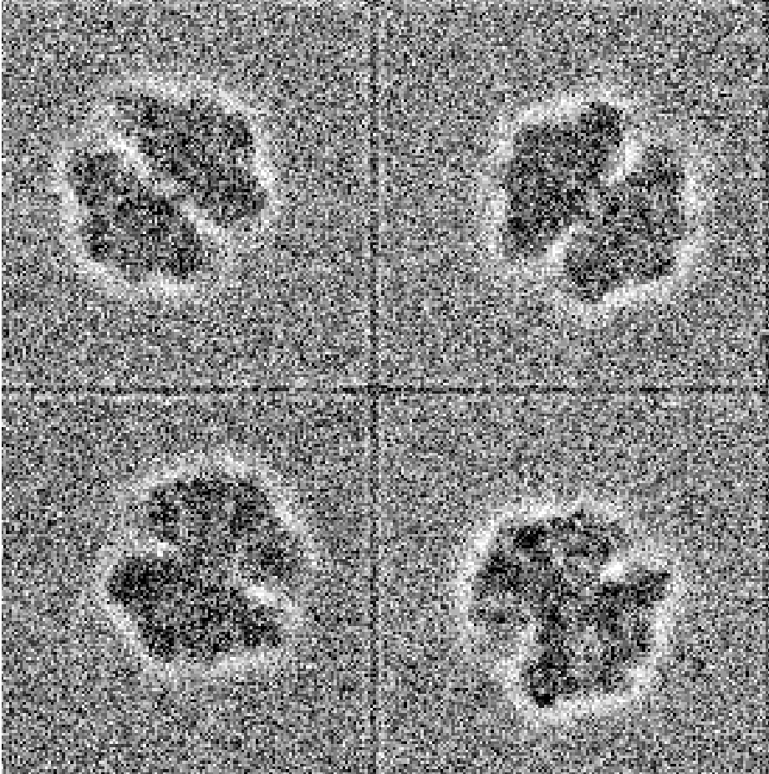
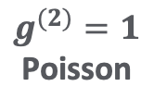

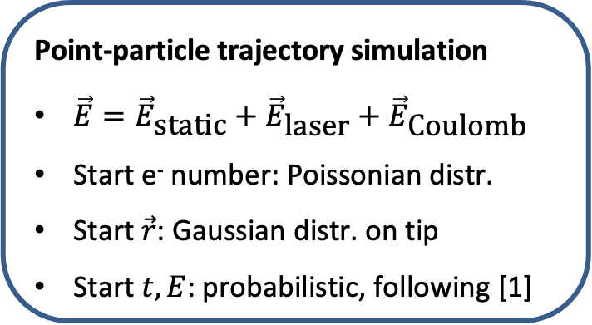
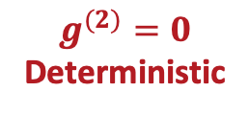
Filter-tuned g⁽²⁾: Experiment and simulation
E_{window}
Point-particle trajectory simulation
$\vec{E}={\vec{E}}_{\text{static}}+{\vec{E}}_{\text{laser}}+{\vec{E}}_{\text{Coulomb}}$
Start e⁻ number: Poissonian distr.
Start $\vec{r}$: Gaussian distr. on tip
Start $t,E$: probabilistic, following [1]
$$g^{(2)}=1$$
Poisson
E_{central}
$$g^{(2)}=0$$
Deterministic
20 pulses per pixel at $\left\langle N\right\rangle =1$ per pulse
Original image: R. Burton-Smith, bioRxiv: 2023.06.09.544325 (2023)
Meier et al (2023) Nat. Phys. 19, 1402–1409
[1] Yudin, Ivanov (2001) Phys. Rev. A 64, 013409

Slide 8
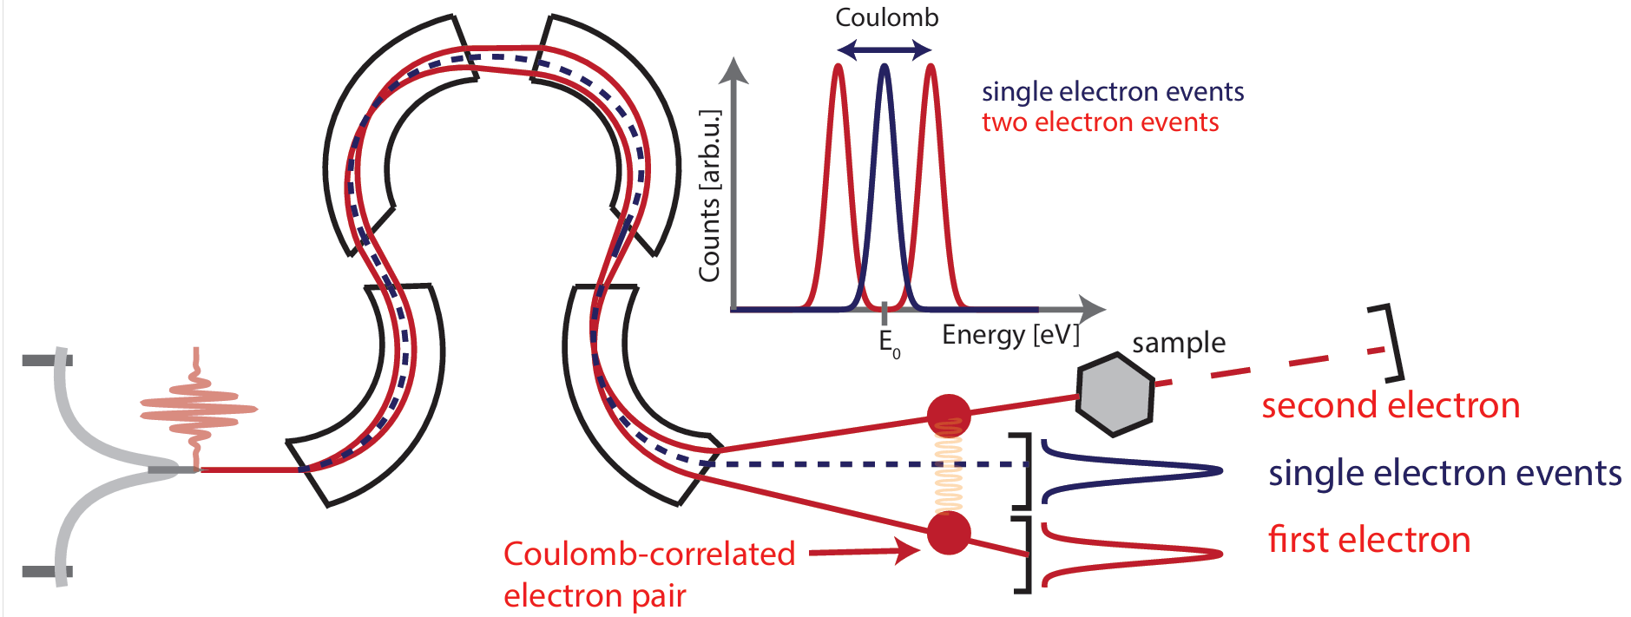
Heralded measurement scheme

Slide 9
Electron Emission Statistics using non-classical light

Slide 10
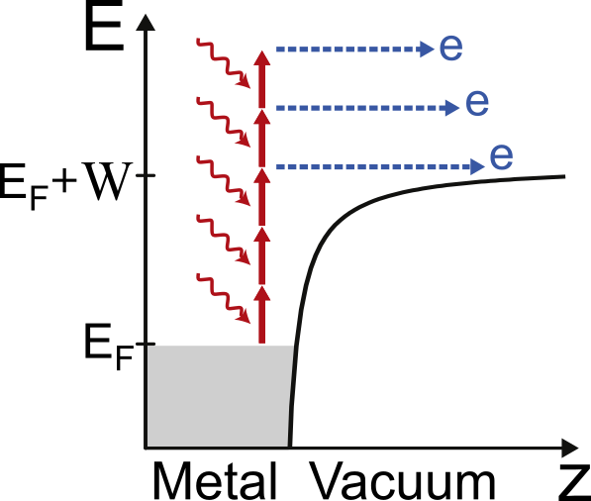
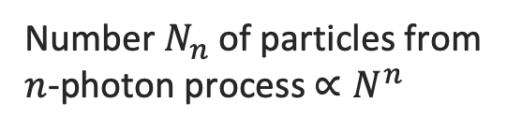
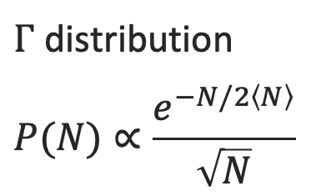
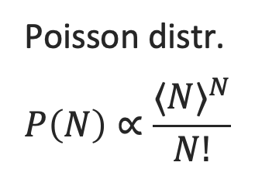

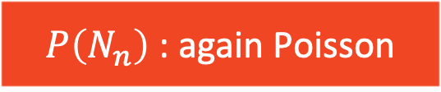
Photon number distributions
Coherent
Poisson distr.
$$P\left(N\right)∝\frac{{⟨N⟩}^{N}}{N!}$$
Number $N_{n}$ of particles from
$n$-photon process $∝N^{n}$
$P\left(N_{n}\right)$ : again Poisson
Bright Squeezed Vacuum
$P\left(N_{n}\right)$ : $n$^{th} order $Γ$
$Γ$ distribution
$$P(N)∝\frac{e^{−N/2\left\langle N\right\rangle }}{\sqrt{N}}$$
e.g. in HHG
Manceau et al. (2019)
Phys. Rev. Lett. 123 123606
Gorlach et al. (2023)
Nat. Phys. 19 1689–1696
Adapted from Rasputnyi et al. Nat. Phys. 20.12 (2024): 1960-1965
Heimerl et al. Nat. Phys. 20.6 (2024): 945-950

Slide 11
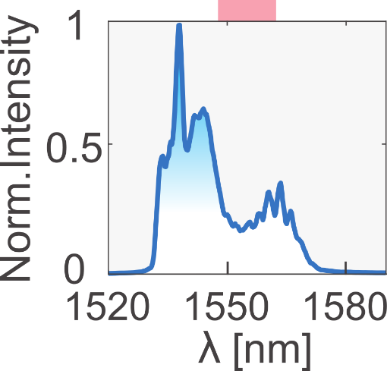
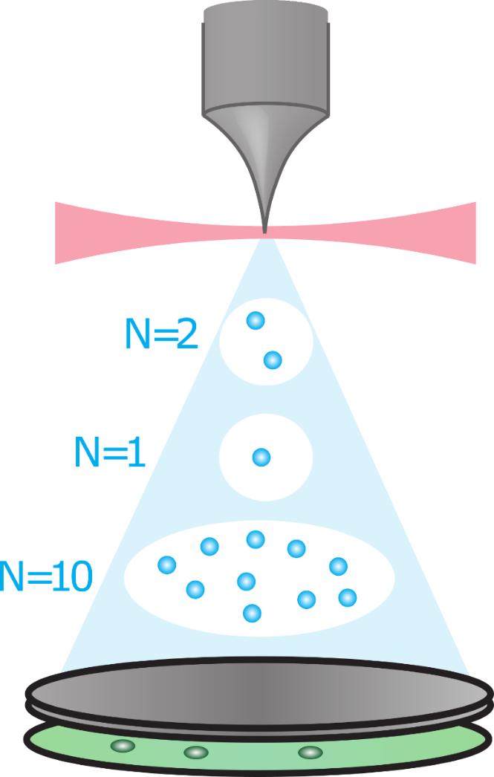
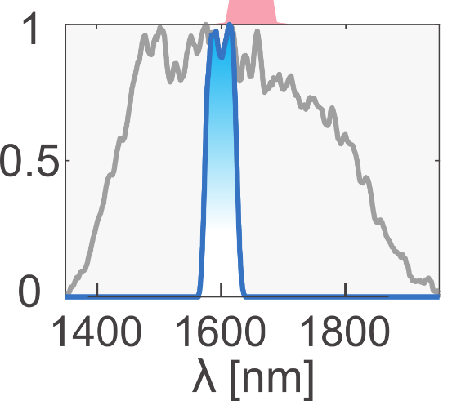
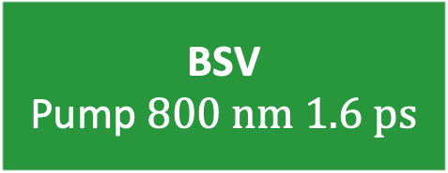
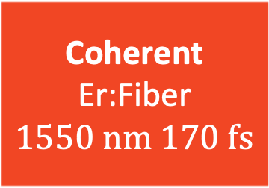
Experimental setup and light sources
Coherent
Er:Fiber
$$1550 \text{nm} 170 \text{fs}$$
BSV
Pump $800 \text{nm} 1.6 \text{ps}$
MCP
phosphor screen
CCD + image
recognition
Heimerl et al. Nat. Phys. 20.6 (2024): 945-950

Slide 12
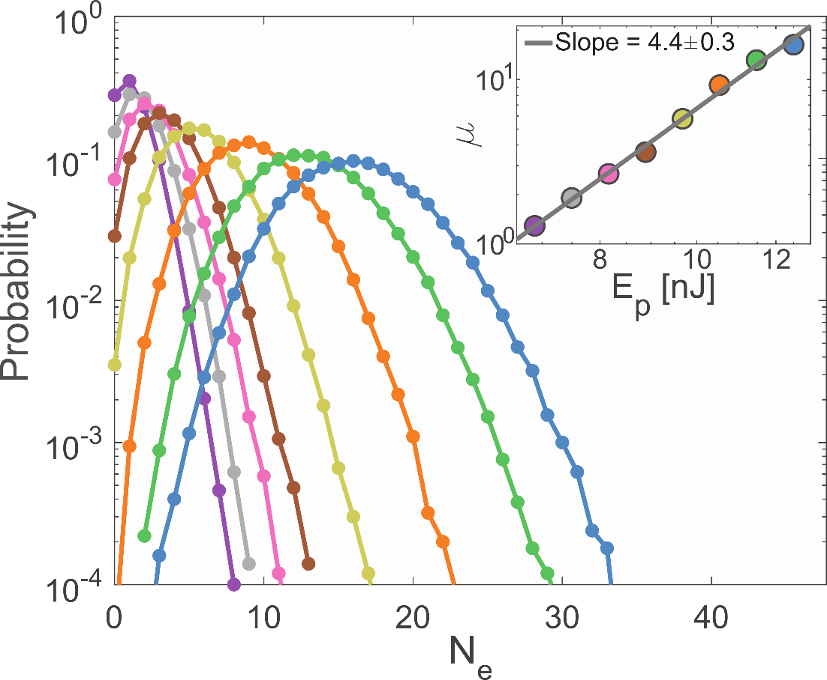
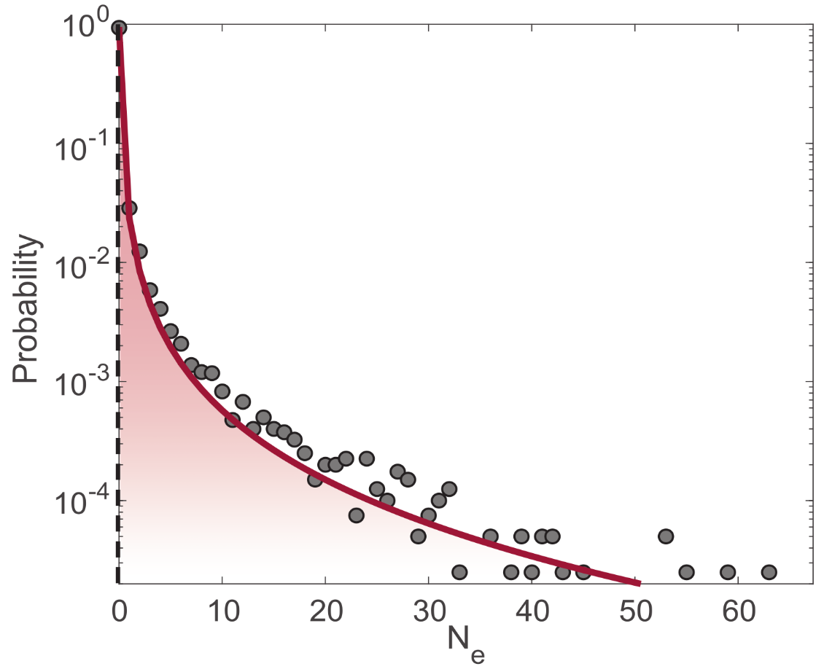
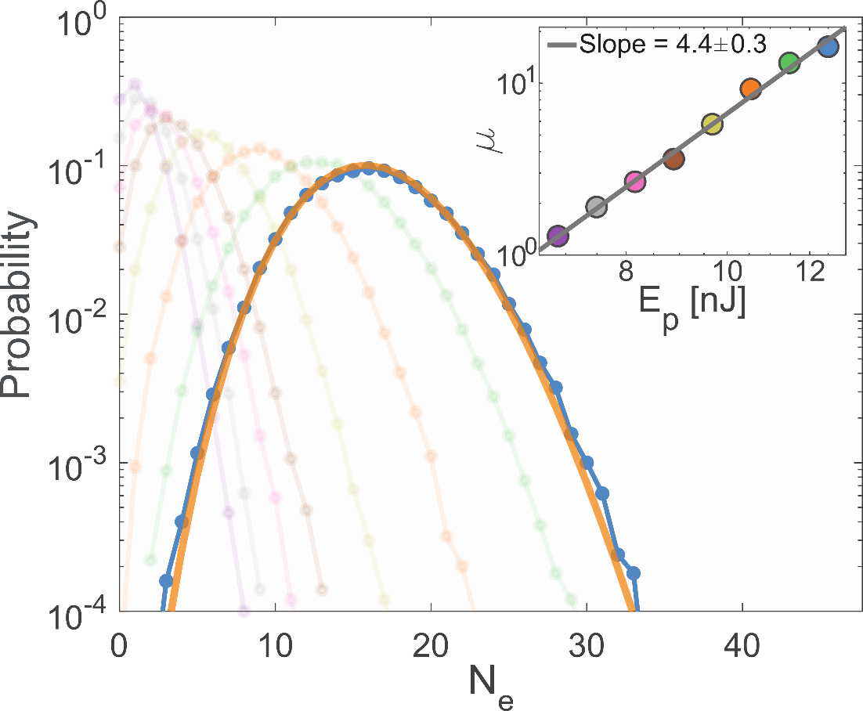
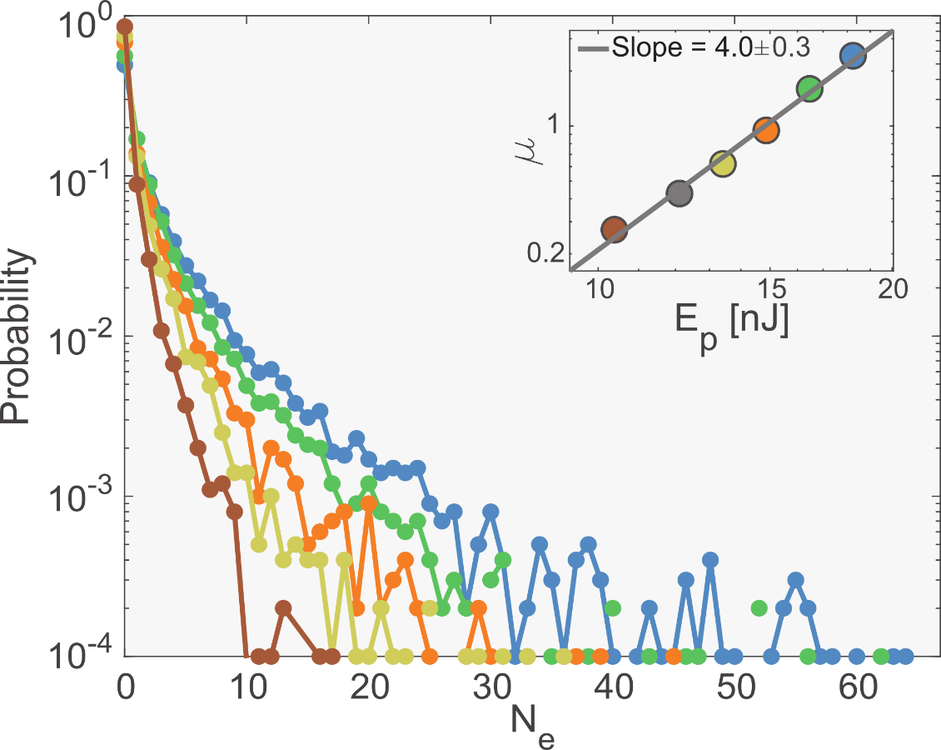
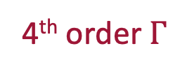
Measured electrons per pulse number statistics
Coherent
BSV
Poisson
4th order $Γ$
Similar non-linearity, different distribution
Heimerl et al. Nat. Phys. 20.6 (2024): 945-950

Slide 13
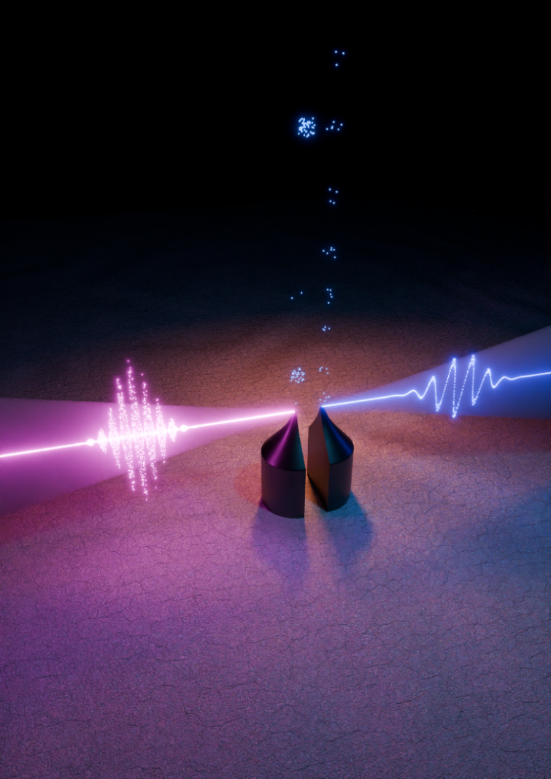



Slide 14
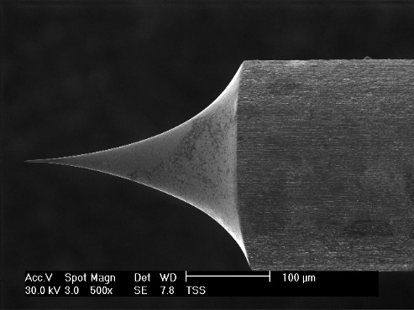
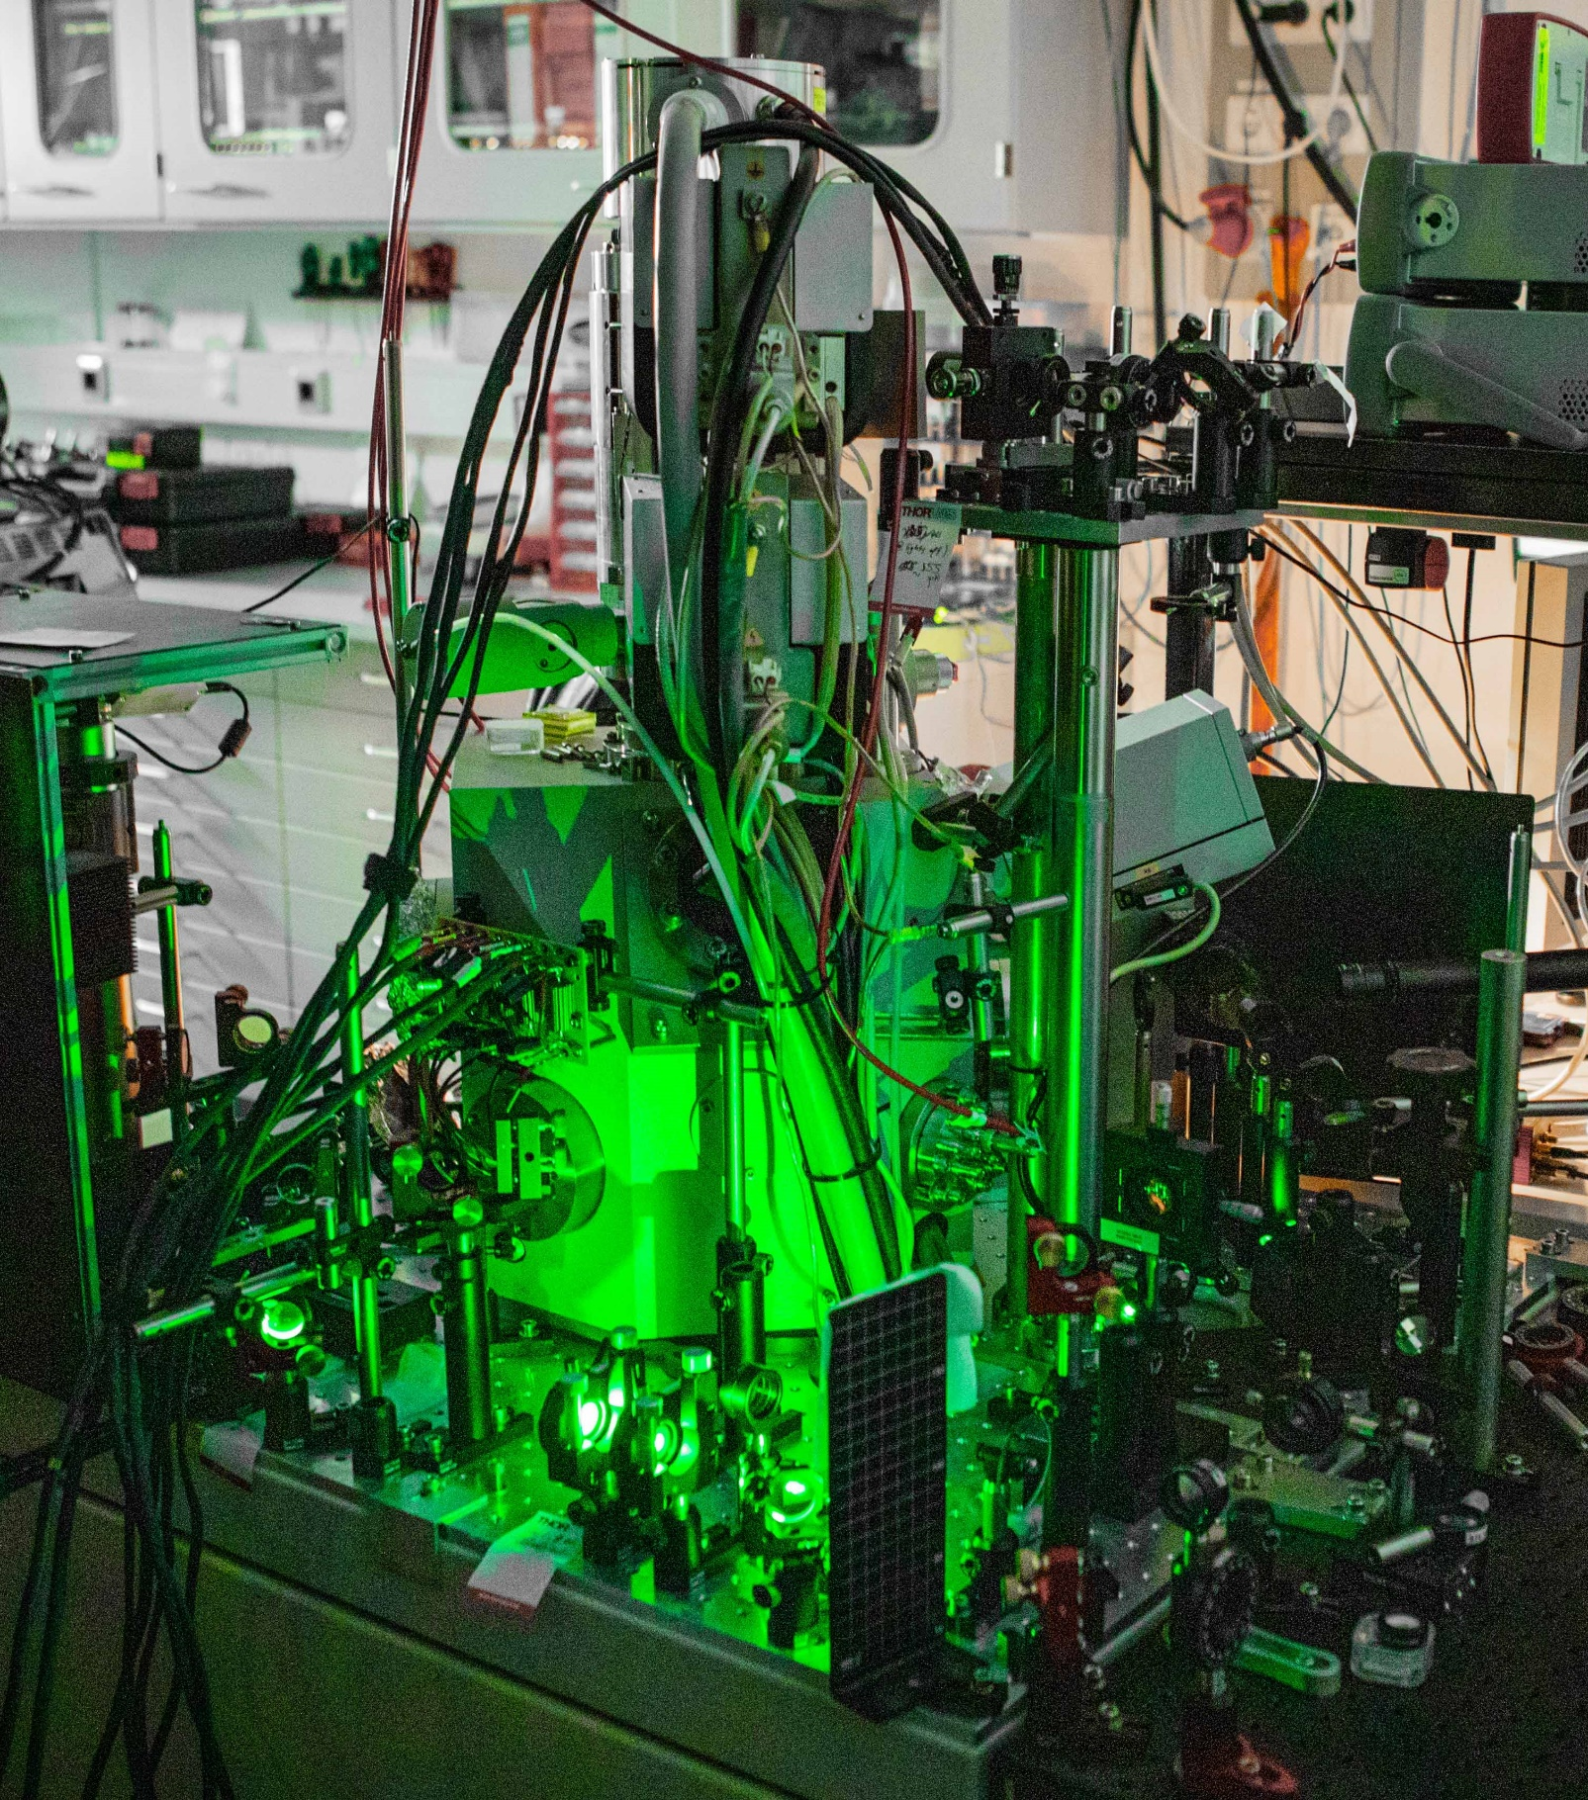
Nanophotonic electron accelerators
XL30
Electron source

Slide 15
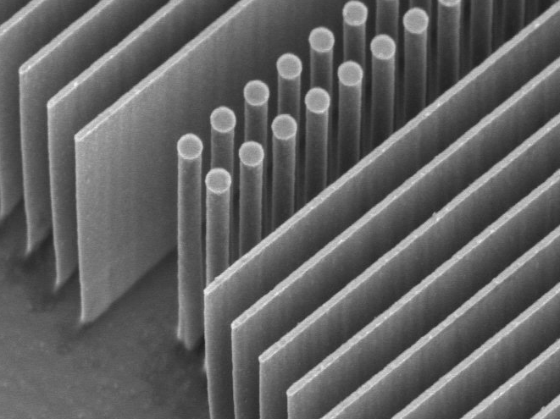
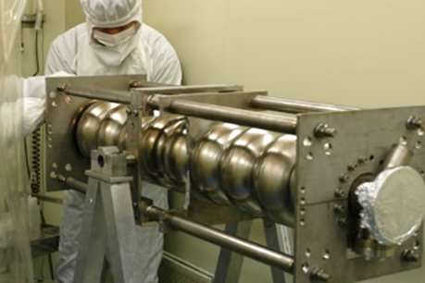
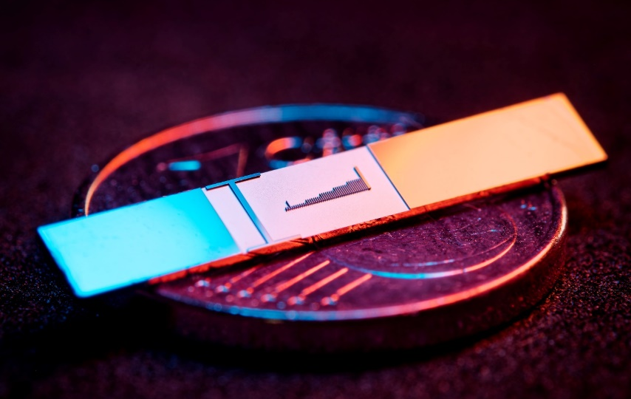

Why dielectric-based laser accelerators?
$$\text{1 μm}$$
Fermilab
Dielectric materials and optical frequencies
Higher damage threshold than metallic cavities
Higher gradients and smaller, minituarized structures
Much stricter requirements on beam properties
Lower current
per channel
DLA
f=150 THz (λ=2 μm)
τ=6.6 fs
RR ~ kHz-MHz
>3 GV/m fields
Gradient >1 GeV/m
Physical aperture: ~200 nm
Emittance <100 pm rad (norm)
fA-pA
(in single channel, many are possible soon)
RF
f=3 GHz
τ=333 ps
RR ~ Hz-kHz
<200 MV/m
25-50 MeV/m
~1cm
1 μm ~ 1 mm rad
nA-μA and larger

Slide 16
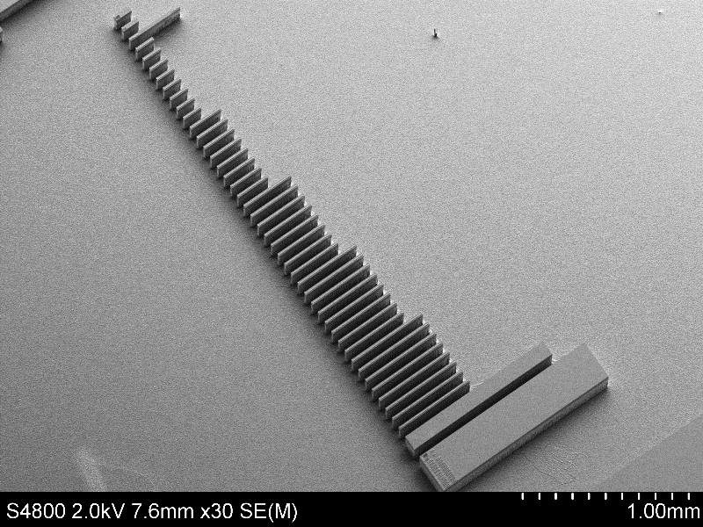
1mm

Slide 17
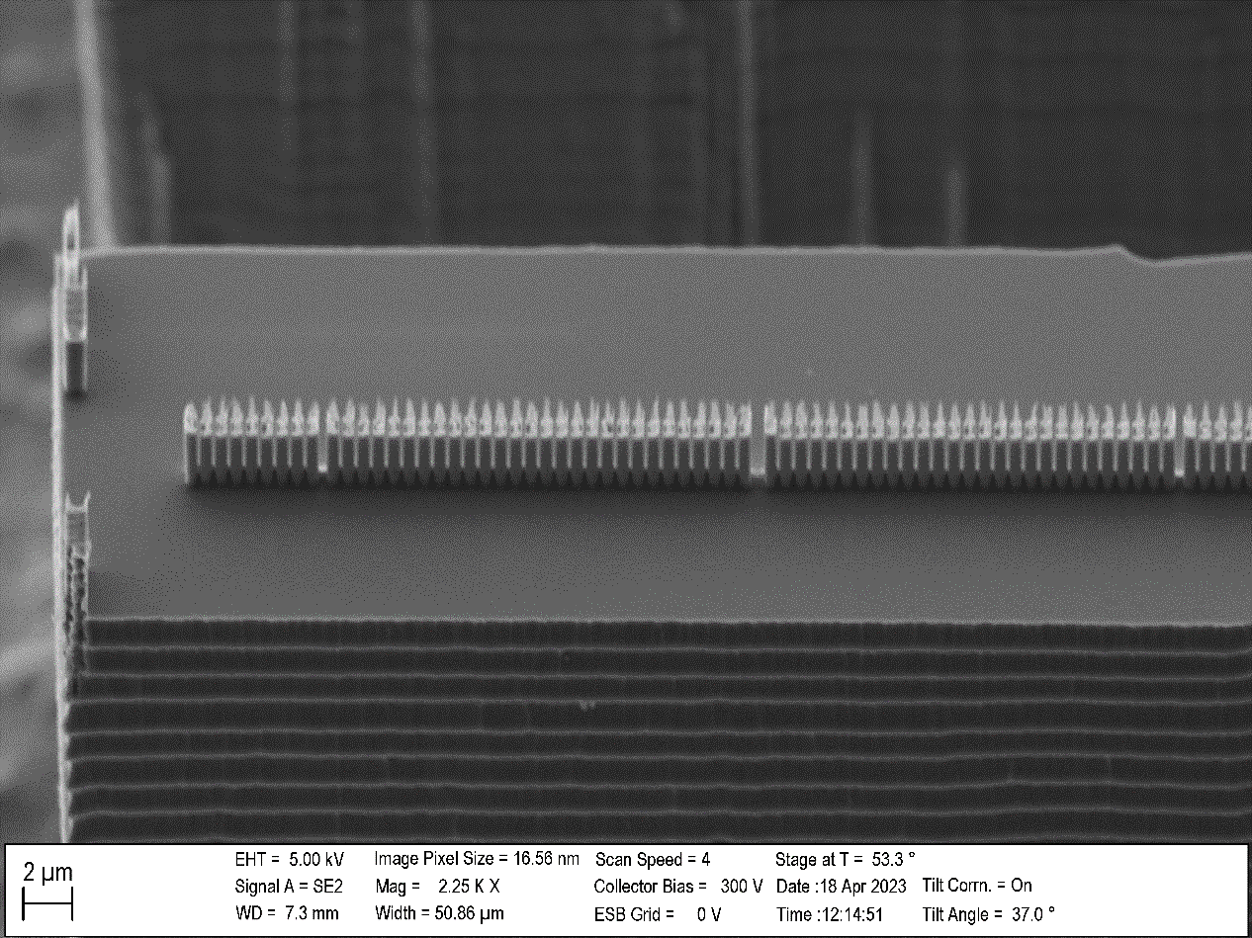




Laser
e-
2µm
200 $μm$
300 $μm$
400 $μm$
E_{Peak} = 600MV/m - 700MV/m
Design gradient: 22.7MeV/m
500 $μm$
1mm
16

Slide 18
Laser
e-
2µm
200 $μm$
300 $μm$
400 $μm$
E_{Peak} = 600MV/m - 700MV/m
Design gradient: 22.7MeV/m
500 $μm$
1mm
17

Slide 19
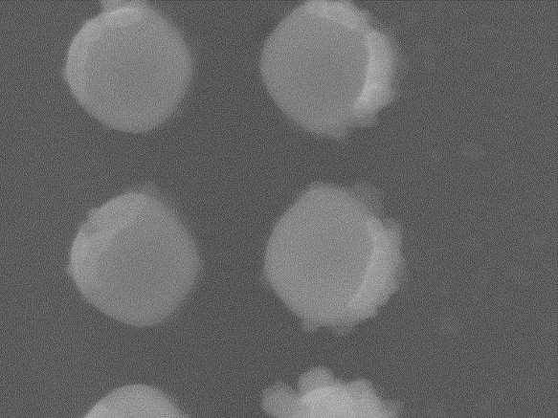



Acceleration structures
Top view
225nm
139 – 237nm
500 µm long, made of 733 pillar pairs
Tapered periodicity: from 619 nm to 717 nm
Pillar radii: 240nm x 225nm, 225nm wide channel
Macro-cells: from 5 µm to 22.5 µm (total of 26 segments)
Average design gradient: 22.7 MeV/m
Peak electric optical field: 600 MV/m (2.2 µJ pulse energy and 360 mW average power)
Laser pulse front tilting required in experiment
480nm
450nm
$$\text{20}\text{0}\text{n}\text{m}$$
2$μm$ pillar height
$$\text{50 μm}$$

Slide 20
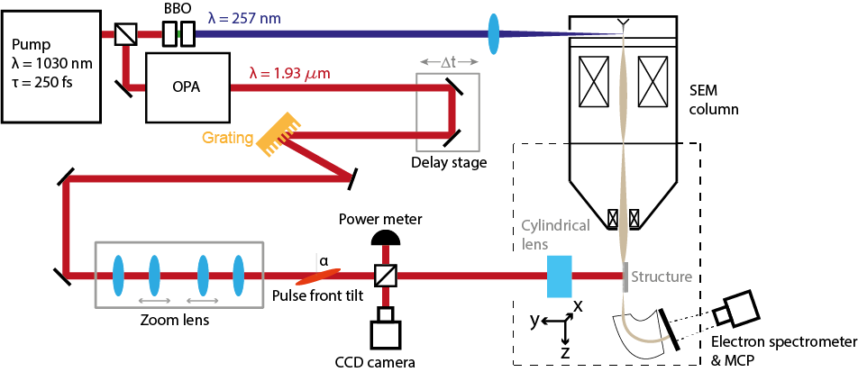
Experimental setup at FAU
Electron sources
XL30

Slide 21
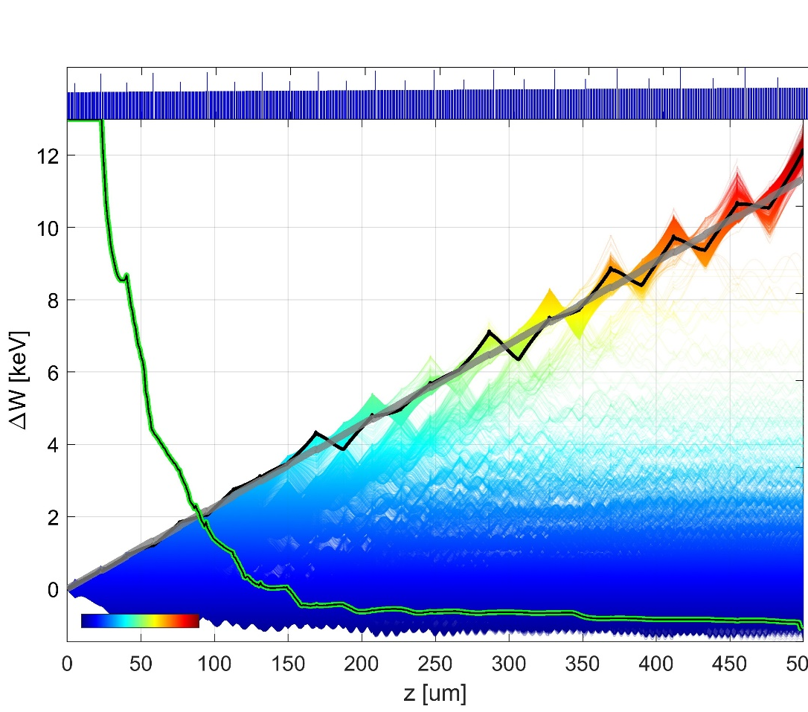






Simulation
Pillar distance
200$μ$m
1
11.9 keV
8.8 keV
Energy gain (keV)
6.6 keV
% of survived particles
0.5
300$μ$m
4.5 keV
Laser on
Laser off
Simulation
Energy
0
400$μ$m
Maximum energy gain 12.3 keV
Total energy of 40.7 keV
43% energy gain
500$μ$m
Similar results from Stanford/Darmstadt team:
Broaddus, Egenolf, …, Byer, Leedle, Solgaard, Phys. Rev. Lett. 132, 085001 (2024)
T. Chlouba*, R. Shiloh*, S. Kraus*, L. Brückner*, J. Litzel, P. Hommelhoff, Nature, 622, 476 (2023)

Slide 22











Collaboration partners:
iQCE collaboration
ACHIP collaboration
M. Chekhova, MPL
Y. Morimoto, RIKEN
I. Kaminer, Technion
O. Neufeld, Technion
J. von Zanthier, Erlangen
J. Rosenzweig, UCLA
I. Franco, Rochester
F. Tani, Ph. Russell, MPL
Th. Fennel, Rostock
C. Lemell, J. Burgdörfer, TU Vienna
A. Leitenstorfer, Konstanz
FAU Applied Physics: H. Weber
M. Kling, LMU/MPQ
R. L. Byer + coll., Stanford / SLAC
M. Stockman^{Ϯ}, Georgia State
G. G. Paulus, Jena
Fabian Bammes
Adrian Borries
Julian Freier
Tom Herrmann
Dominik Illauer
Johannes Illmer
Kai Köbnick
Manuel Konrad
Stefanie Kraus
Weizhe Li
Julian Litzel
Felix López Hoffmann
Matthias Meier
Florian Mossner
Selina Nöcker
Jonathan Pölloth
Tamara Pröbster
Franz Schmidt-Kaler
Fabian Sochor
Gilbertas Umbrazunas
Frederic Voggel
Tobias Volk
Timo Wirth
Zhexin Zhao
Group outing: hike and canoeing on river Wiesent, Muggendorf, Franconian Switzerland
Recent alumni:
PhDs: L. Brückner J. Heimerl S. Meier T. Weitz Ph. Dienstbier J. Illmer C. Gerner C. Heide Ang Li M. Seidling T. Paschen A. Tafel N. Schönenberger R. Zimmermann (M. Sirotin)
Postdocs: Y. Fang D. Lesko T. Chlouba M. Knipfer V. Korolev F. Mooshammer Y. Morimoto R. Shiloh T. Shibuya
Master students: C. Hüttner N. Bode P. Käferlein S. Hillmann M. Knauft B. Löhrl A. Michalak I. Probst M. Reh S. Wittigschlager (Maria Würth†)
Recent alumni:
PhDs: L. Brückner J. Heimerl S. Meier Ph. Dienstbier J. Illmer C. Gerner C. Heide Ang Li M. Seidling T. Paschen A. Tafel N. Schönenberger R. Zimmermann (M. Sirotin)
Postdocs: T. Chlouba M. Knipfer F. Mooshammer Y. Morimoto R. Shiloh T. Shibuya
Master students: N. Bode P. Käferlein S. Hillmann M. Knauft B. Löhrl A. Michalak I. Probst M. Reh S. Wittigschlager (Maria Würth†)

Slide 23




Electron (energy) correlations
$Δ$E
tip
$$U_{tip}$$
Questions?

Slide 24












Operation principle
Synchronicity condition:
$$β=Λ_{p}/λm$$
Depending on particles position:
Acceleration
Deceleration
Deflection
1
2
3
4
1
2
$$Λ_{p}$$
3
4
$$\hat{y}$$
TM-polarized
$$\hat{x}$$
$$\hat{y}$$
Goal: generate a mode that allows momentum transfer from laser field to electrons
Use first order effect, so m=1 (efficient!)
Second order effects too already too inefficient
$$\hat{z}$$
$$\hat{x}$$
4
~620nm
$$\hat{z}$$
1
2
3
$$Λ_{p}$$
First spatial harmonic
$$λ$$
Proof of concept:
0
$β=0.3:$ 25 MeV/m: J. Breuer, P. Hommelhoff, PRL 111, 134803 (2013)
$β=0.7$: 250MeV/m: Peralta, E. A., Soong, K., England, R. J., Colby, E. R., Wu, Z., Montazeri, B., ... & Byer, R. L. (2013). Nature, 503(7474), 91-94.
Deceleration
Acceleration

Slide 25



2015
Silicon pillar structures
2021
2013
Top illumination
Bonded silica gratings
Leedle, et al. CLEO, pp. FM3M-7 (2018)
Leedle, et al. Opt. Lett. 40, 4344-4347 (2018)
Yousefi et al., Opt. Lett. 44, 1520-1523 (2019)
Fishman et al., Nature Comm 14, 3687 (2023)
Black et al., PRAB 23, 114001 (2020)
Peralta et al. Nature 503, 91–94 (2013)
Koyama, K., et al. IPAC (2014)
Wei et al., Appl. Optics 56(29) (2017)
Wie et al., Physics of Plasmas 24.7 (2017)
Cesar et al., NIMA 909, 252-256 (2018)
Cesar et al., Optics Expr., 26(22), (2018)
Crisp et al., arXiv:2310.12384 (2023)
Chen et al., Proposal (1989)
Shiloh, et al., Opt. Express 29, 14403-14411 (2021)

Slide 26

2015
Silicon pillar structures
2021
2013
Top illumination
Bonded silica gratings
Leedle, et al. CLEO, pp. FM3M-7 (2018)
Leedle, et al. Opt. Lett. 40, 4344-4347 (2018)
Yousefi et al., Opt. Lett. 44, 1520-1523 (2019)
Fishman et al., Nature Comm 14, 3687 (2023)
Black et al., PRAB 23, 114001 (2020)
Peralta et al. Nature 503, 91–94 (2013)
Koyama, K., et al. IPAC (2014)
Wei et al., Appl. Optics 56(29) (2017)
Wie et al., Physics of Plasmas 24.7 (2017)
Cesar et al., NIMA 909, 252-256 (2018)
Cesar et al., Optics Expr., 26(22), (2018)
Crisp et al., arXiv:2310.12384 (2023)
Chen et al., Proposal (1989)
Shiloh, et al., Opt. Express 29, 14403-14411 (2021)

Slide 27



Red (accelerating) and blue (decelerating)
2015
e⁻
E_{z}
x
Silicon pillar structures
2021
2013
Top illumination
y
z
Bonded silica gratings
Laser
Laser
Laser
Laser
Side illumination
Leedle, et al. CLEO, pp. FM3M-7 (2018)
Leedle, et al. Opt. Lett. 40, 4344-4347 (2018)
Yousefi et al., Opt. Lett. 44, 1520-1523 (2019)
Fishman et al., Nature Comm 14, 3687 (2023)
Black et al., PRAB 23, 114001 (2020)
Peralta et al. Nature 503, 91–94 (2013)
Koyama, K., et al. IPAC (2014)
Wei et al., Appl. Optics 56(29) (2017)
Wie et al., Physics of Plasmas 24.7 (2017)
Cesar et al., NIMA 909, 252-256 (2018)
Cesar et al., Optics Expr., 26(22), (2018)
Crisp et al., arXiv:2310.12384 (2023)

