Slide 1

Semiconductor photocathodes at CERN: production experience and developments towards FCC-ee
Giulia Tenasini
22/09/2026, PhASE2026, Orsay
Notes:
Semiconductor photocathodes at CERN: feedback from production and operation towards FCC-ee
Semiconductor photocathodes at CERN: production experience and developments towards FCC-ee

Slide 2
Outline
High-brightness electron sources at CERN
  CLEAR and AWAKE
  FCC-ee photoinjector: baseline operational requirements
Photocathode production and operational experience
  The Photoemission laboratory
  Production reproducibility challenges: statistical analysis of Cs₂Te data
  Charge production tests in RF guns
Roadmap and open questions towards FCC-ee

Slide 3
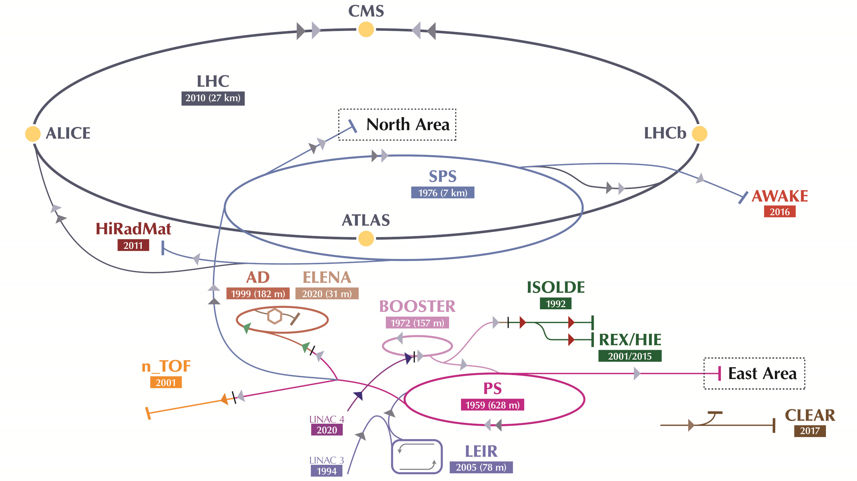
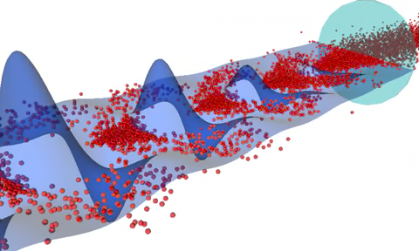
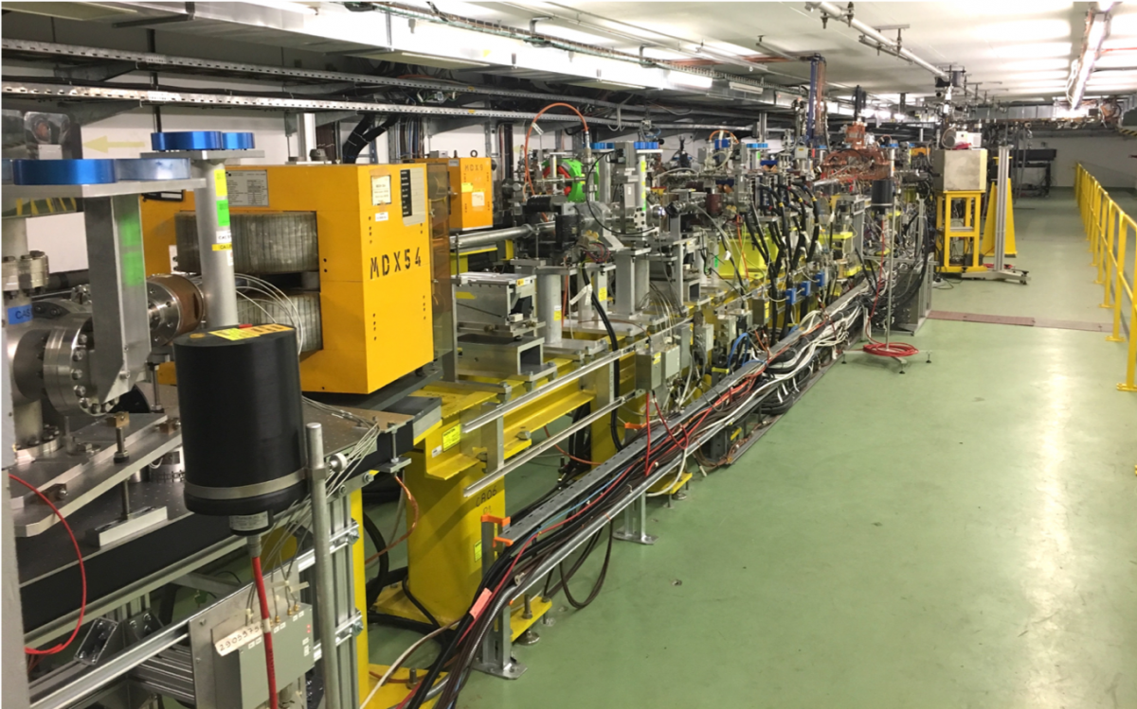
Electron sources at CERN
Advanced Proton Driven Plasma Wakefield Acceleration Experiments (AWAKE):
First proton-driven plasma wakefield accelerator.
Uses SPS proton beam to generate strong plasma waves in a 10 m plasma cell.
Successfully accelerated electrons from ~20 MeV → ~2 GeV in one step.
Aims to develop compact, scalable high-energy accelerators.
CERN Linear Electron Accelerator for Research (CLEAR):
Flexible 220 MeV electron-beam test facility supporting diverse research on:
Medical applications of e-beams (e.g., FLASH therapy);
Novel components and concepts for existing and future accelerators;
Radiation hardness of electronics for aerospace or high energy physics.
Notes:
Where do we need high brighness e source at CERN?

Slide 4
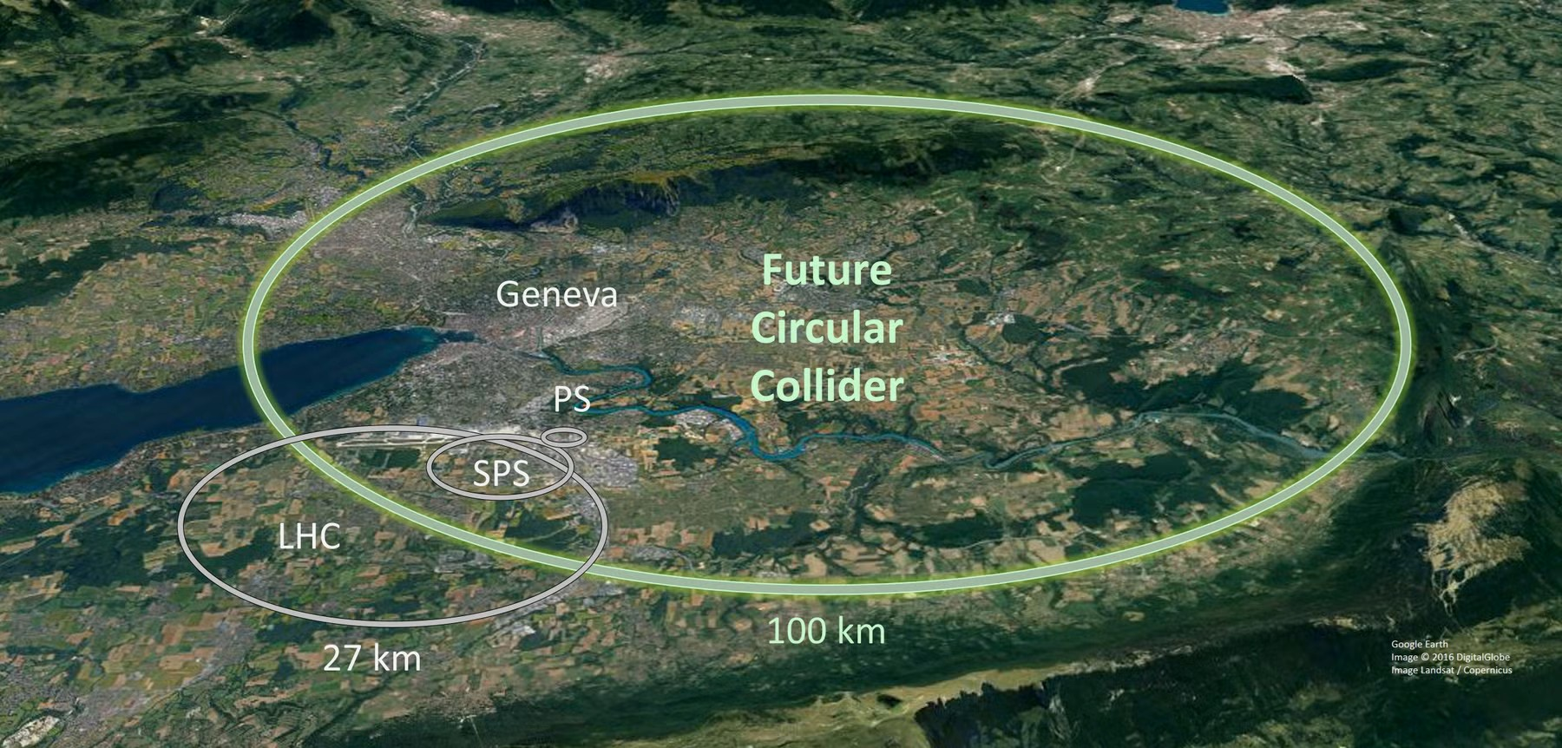
Electron sources at CERN
.
FCC-ee photoinjector: electron source for the world largest accelerator complex
Notes:
Beside AWAKE and CLEAR, which demonstrate CERN experience and capabilities,
future photoinjectors one are now becoming the focus of studies, with FCC-ee photoinjector being the electron source for the world largest accelerator complex
CERN photoinjector experience for ensuring FCC-ee operational parameter

Slide 5



FCC-ee electron sources
Injection / dynamics
“baseline”
Photoinjector
To LINAC and rings
“Colliding bunches”
PSI + SY-RF + SY-STI
BE-ABP + SY-RF + PSI + IJCLab
“other sources under consideration”
Thermionic source
Buncher system
SY-RF
“baseline”
“Pilot bunches”
Polarized source
  Provide technical input to the
  FCC-ee Reference Design Report (RDR), due by the end of 2027.
+ international collab.
SY-STI
Courtesy of E. Granados
Notes:
The baseline layout of the electron linac will have two complementary electron sources:
-main e source for colliding bunches:
-polarized e source which provide pilot bunches for precise energy calibration by resonant depolarization.

Slide 6






FCC-ee electron sources: R&D and testing
“Colliding bunches”
R&D
Testing
“baseline”
Photoinjector
Photoinjector design and layout
Photocathode production: reliability
Laser architecture and modulation
Alternative photocathode study
Start-to-end photoemission simulation
ITF photoinjector (with SY-RF)
CLEAR photoinjector
DC gun test stand
Experiments: PSI, SLAC, …
SY-STI + SY-RF + PSI
“Pilot bunches”
R&D
Testing
“baseline”
Polarized source
Photoinjector design and layout
Photocathode substrate fabrication
Photocathode activation
Vacuum systems (with TE-VSC)
Laser requirements and systems
Diagnostics and control systems
ITF / CTF2 (with SY-RF)
Install ALICE DC gun
Experiments: BNL, Jlab, ELSA
+ international collab.
SY-STI + TE-VSC
Notes:
Our group at CERN needs to provide technical input for the photoinjectors. For this R&D studies followed by a testing phase are needed. Focusing on the photocathodes requirements: we need to provide a choice of photocathode technology and ensure production reliability. Similarly for the polarized, in this case also building expertise, established collaborations.
Let’s now focus on the colliding bunches for the main RF photoinjectors

Slide 7
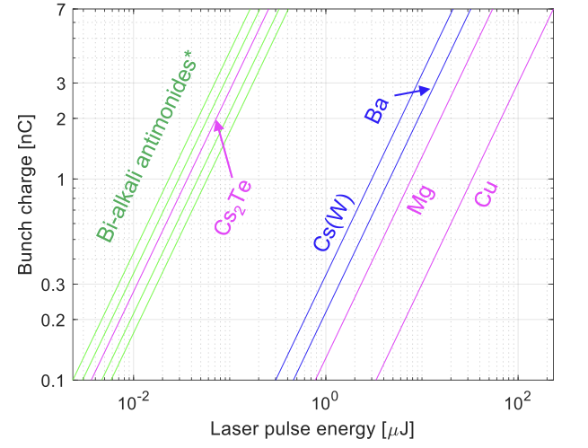
Colliding bunches: operational requirements
Baseline operational parameters for electron production
Required laser pulse energy on cathode
Parameter | Requirements
Bunch charge | 5 – 7 nC
Bunch duration | ~3 ps (rms)
Bunch spacing | 25 ns
Bunch number (Nb) | 2 – 4 (depending on operating mode)
Repetition rate | Up to 200 Hz
Transverse emittance | ~ 7 mm mrad (gun), ~ 4 mm mrad (200 MeV)
To be reviewed with new damping ring
257 – 266 nm
343 – 355 nm
515 – 532 nm
Minimum laser requirements for Cs₂Te and Copper
Parameter | QE 1% (Cs₂Te) | QE ~10⁻⁴ - 10⁻⁵ (Cu)
Pulse energy | > 3 µJ | > 200 µJ (> 1 mJ)
Pulse duration (tunable) | 1 – 5 ps rms | 0.1 – 5 ps rms
Wavelength | 257 – 266 nm | 257 – 266 nm
Cs₂Te provides the high-efficiency baseline, but Copper remains a robust alternative if sufficient laser pulse energy is available.
* While bi-alkali antimonide photocathodes have high QE and operate with green excitation wavelength, their development and usage in photoinjectors is still under study
Notes:
The baseline operational requirements requires a bunch charge
Assuming a Cs2Te cathodes of QE=1% this implies a minimum laser power of..

Slide 8
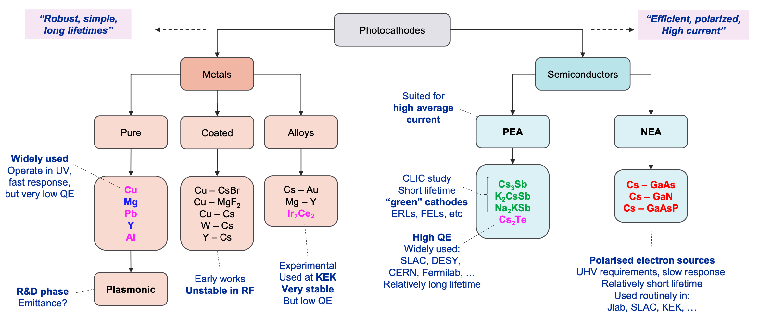
Photocathodes landscape
Courtesy of E. Granados
Notes:
Focus attention on the main topic of this talk: photocathodes. Do not need to go here in details but photocathode landscape quite broad..
Semiconductors cathode are the focus of this talk

Slide 9
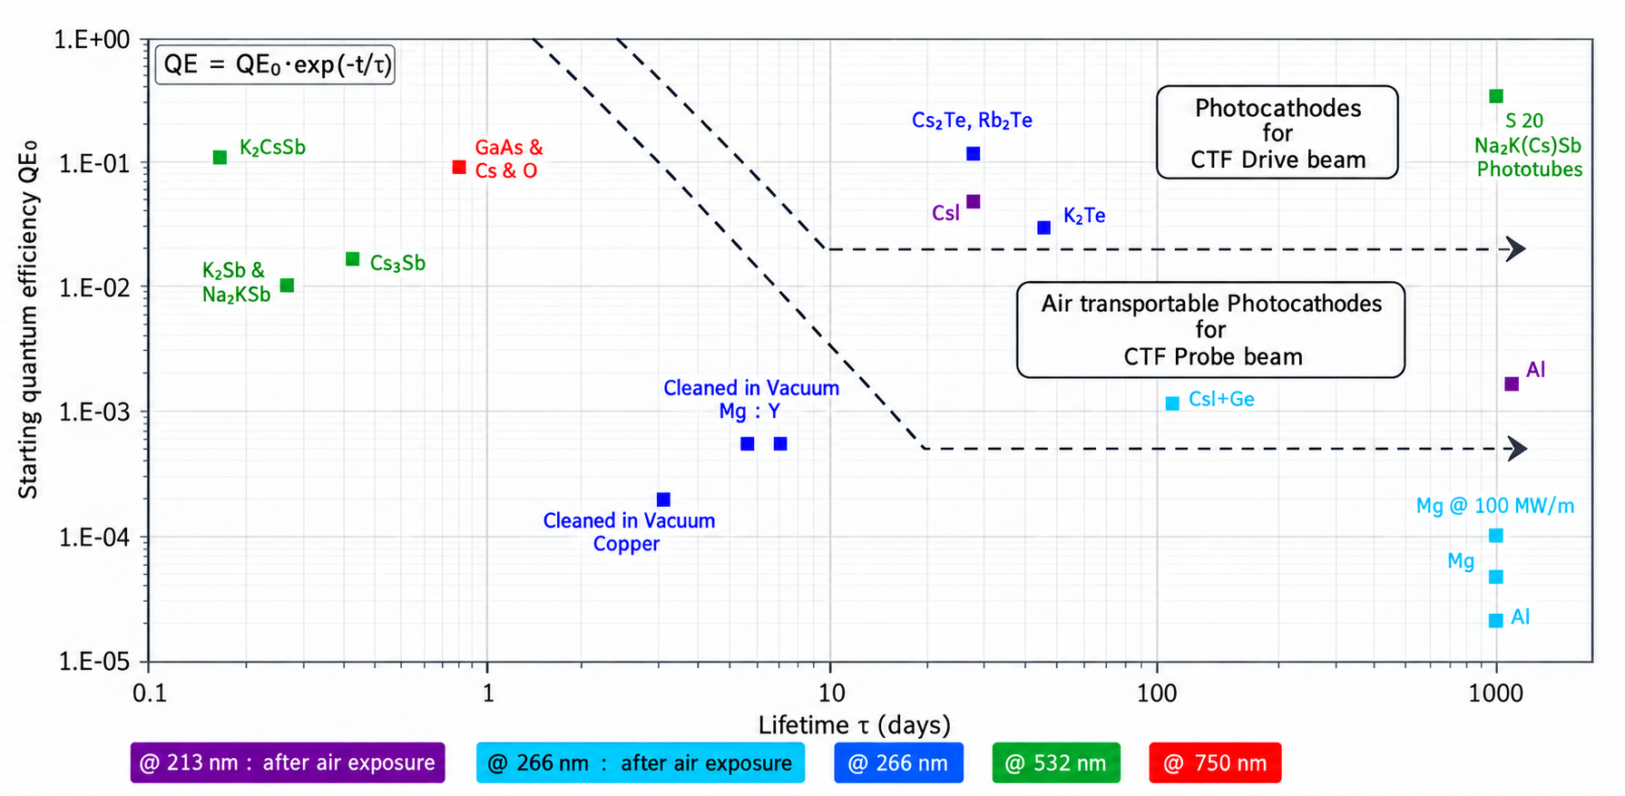
Experience at CERN Photoemission laboratory (CLIC)
Experience in alkali and bialkali photocathodes, with Cs₂Te current workhorse for CLEAR and AWAKE, and now baseline for FCC-ee photoinjector.
Notes:
CERN has built in experience in the production of many of them

Slide 10
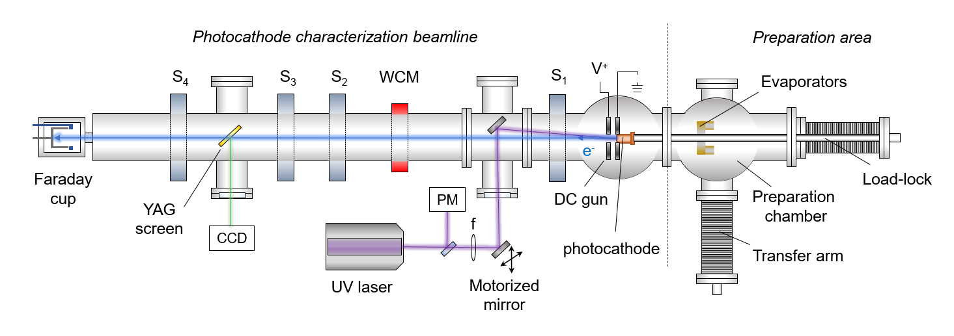
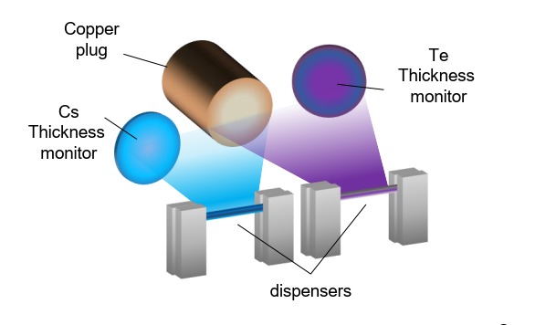
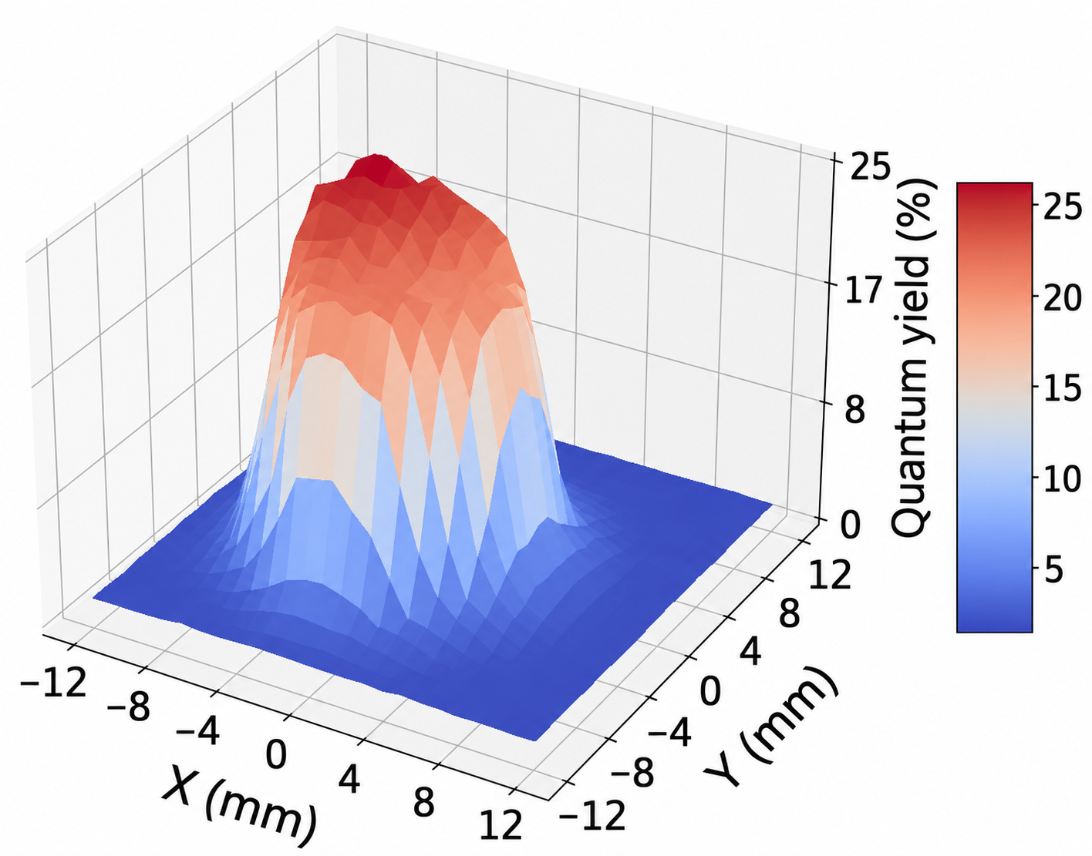
The photoemission laboratory
A setup for semiconductors photocathode production and full characterization.
p ~10⁻¹¹ mbar
Co-deposition
Phys. Rev. Accel. Beams 27, 023401 (2024)
266 nm
Characterization beamline:
65 kV DC gun with diagnostics and focusing solenoids;
Motorized stage for QE maps;
Preparation chamber:
Cs and Te deposited on a polished copper plug (Ra < 20nm) via Physical Vapor Deposition;
Possibility to monitor QE during growth (1KV extraction voltage): evaporator power adjusted to reach max QE;
Co-deposition: Cs and Te evaporated simultaneously. Elements can mix together in the vapor phase.
Notes:
CERN has a dedicated lab for photocathodes production and testing, also CLIC heritage

Slide 11
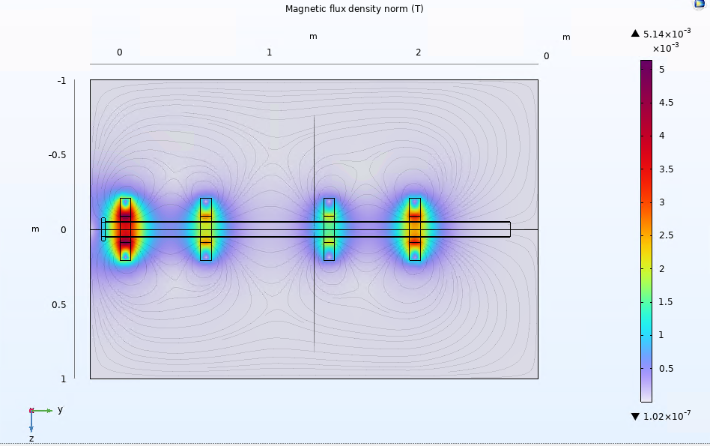
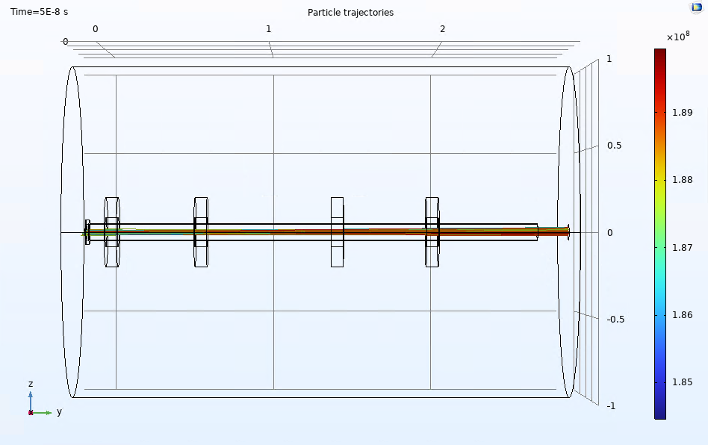
DC gun digital twin
Optimal parameters (HV, solenoids settings) for focused electron beam.
Allows future developments, such as the insertion of new diagnostics (e.g., transverse energy spread spectrometer TESS for transverse emittance measurements).
Energy = 65 keV
Notes:
With the idea of optimizing electron beam parameters, understand the working conditions and insert new diagnostic in the line, like TESS, we are now developing a digital twin

Slide 12
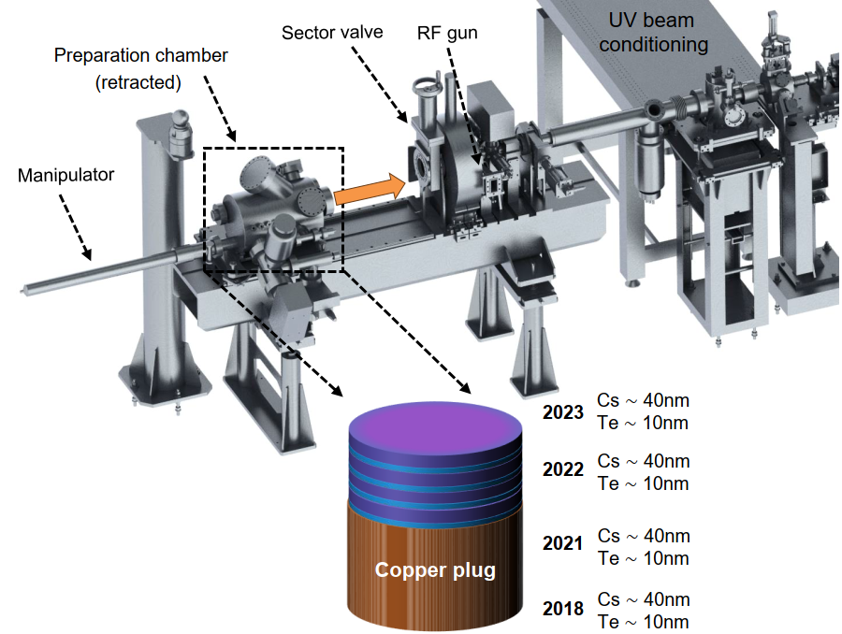
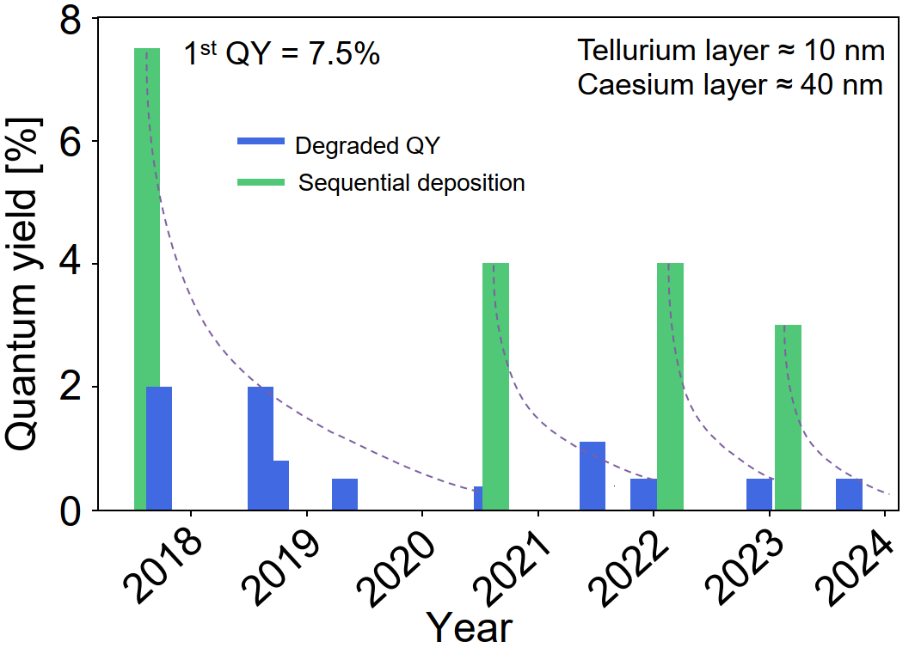
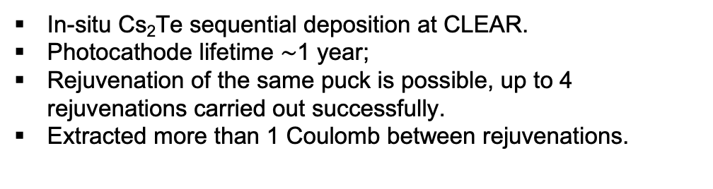
Cs₂Te photocathode rejuvenation at CLEAR
Phys. Rev. Accel. Beams 27, 023401 (2024)
In-situ Cs₂Te sequential deposition at CLEAR.
Photocathode lifetime $\sim$1 year;
Rejuvenation of the same puck is possible, up to 4 rejuvenations carried out successfully.
Extracted more than 1 Coulomb between rejuvenations.
Notes:
Cs2Te photocathodes are also produced in-situ at CLEAR, compact evaporator

Slide 13
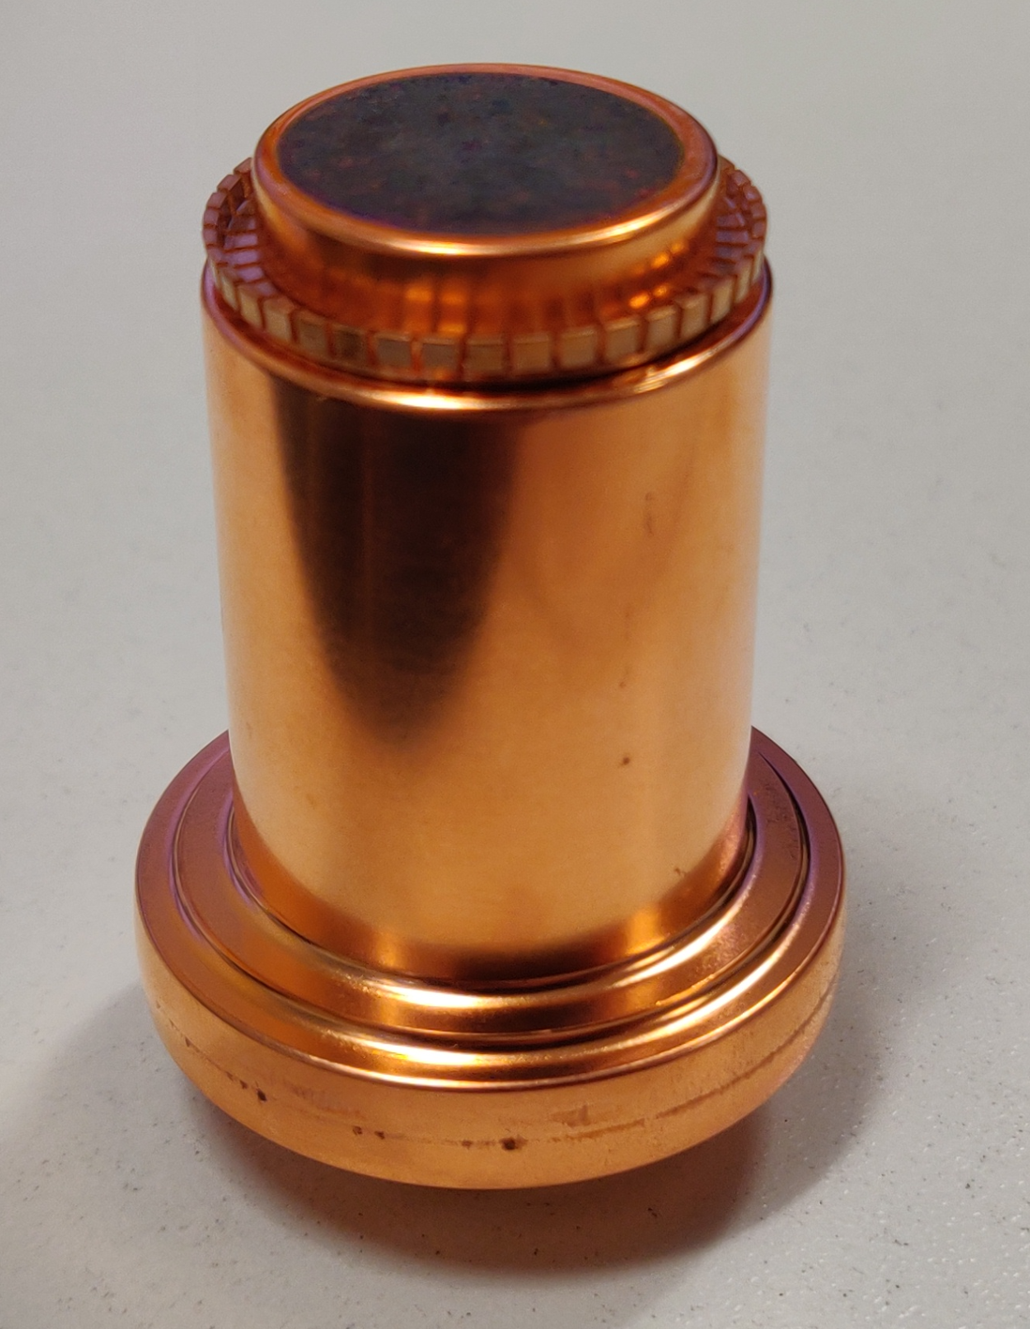
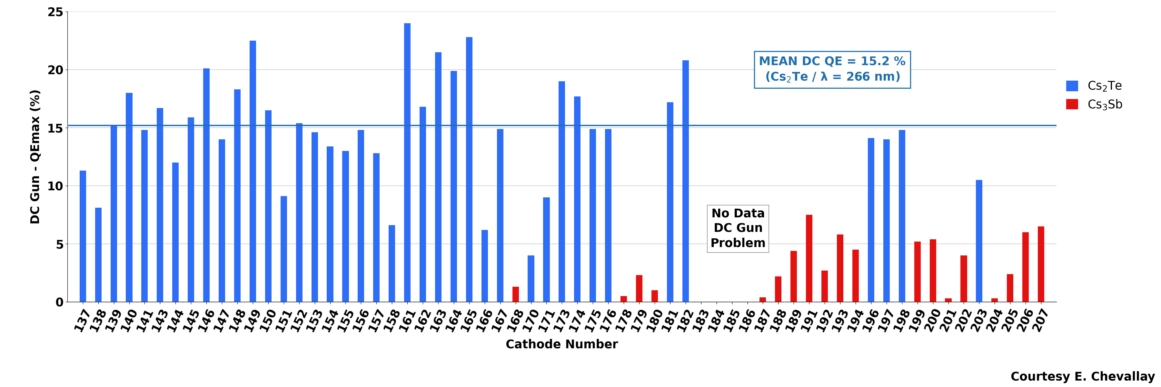
Photocathode production: reproducibility challenge
  Tested productions of different photocathodes:
    Semiconductors: Cs₂Te, Cs₃Sb, KCsSb;
    Metallic: copper, molybdenum, nanostructured plasmonic;
  Record values of initial QE (>20%) for Cs₂Te cathodes produced with co-deposition technique;
  5-20% initial QE variability after co-deposition: process automation needed to improve reproducibility.
  More than 200 photocathodes produced over 30 years:
  precious resource to improve process reliability!
Notes:
In the last 30 years CERN has..
Focusing on semiconductors..
CERN has more than 30 years of photocathode-production experience, with over 200 photocathodes produced and several semiconductor and metallic materials tested. Cs₂Te remains our main reference because of its high quantum efficiency and demonstrated operational performance. However, even for productions following comparable recipes, the initial QE can vary approximately between 5 and 20%. For FCC-ee, producing an excellent cathode once is not sufficient—the performance must be predictable and reproducible. The challenge is therefore to transform this large production history into production feedback and identify which growth parameters control the final performance.

Slide 14
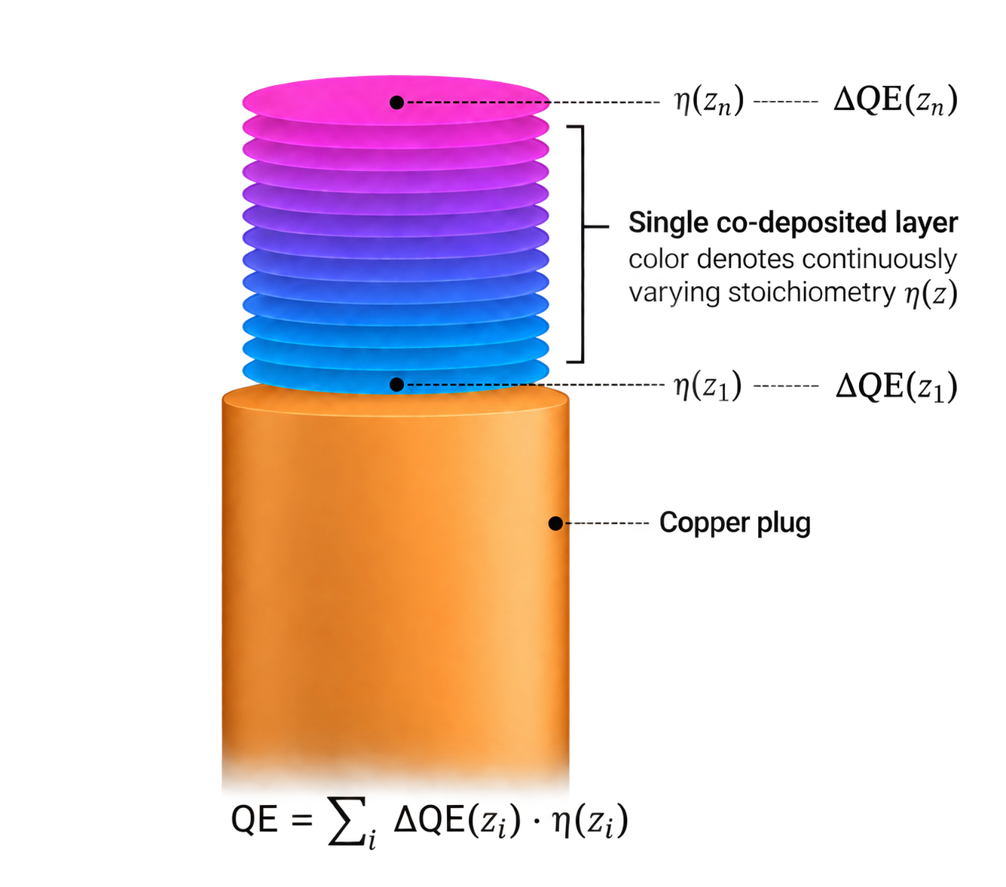
Cs₂Te photocathodes analysis
Reveals a strong correlation between quantum efficiency and compound stoichiometry ratio
The photocathode active layer can be seen as a sum of sub-layers with a relative stoichiometry ratio;
Each layer contributes with a differential QE depending on the relative layer stoichiometry;
The total QE is given by the sum of the differential QE in all the different layers.
Notes:
To investigate this variability we used the production data to reconstruct the evolution of the Cs-to-Te ratio during growth.

Slide 15
Cs₂Te photocathodes analysis
  Analysis of the thickness at different “windows” of stoichiometric deposition ratio;
  Clear trend when the “window” is narrowed to a range of 1.9 – 2.2. When the percentage of the total thickness at this “window” is higher, the measured QE also increases.
The larger the fraction of total thickness with the right stoichiometry ratio, the higher the measured QE.
What’s next?
Finalize the analysis and extract optimal growth parameters (e.g., deposition time, layer thickness): improve process reliability and reproducibility
Extend the analysis to Cs₃Sb (more sensitive to growth parameters)
Notes:
To dig deeper into this analysis, we analyzed the thickness at different “windows” of the stoichiometric deposition ratio .
We find a figure of merit of the cathode.

Slide 16
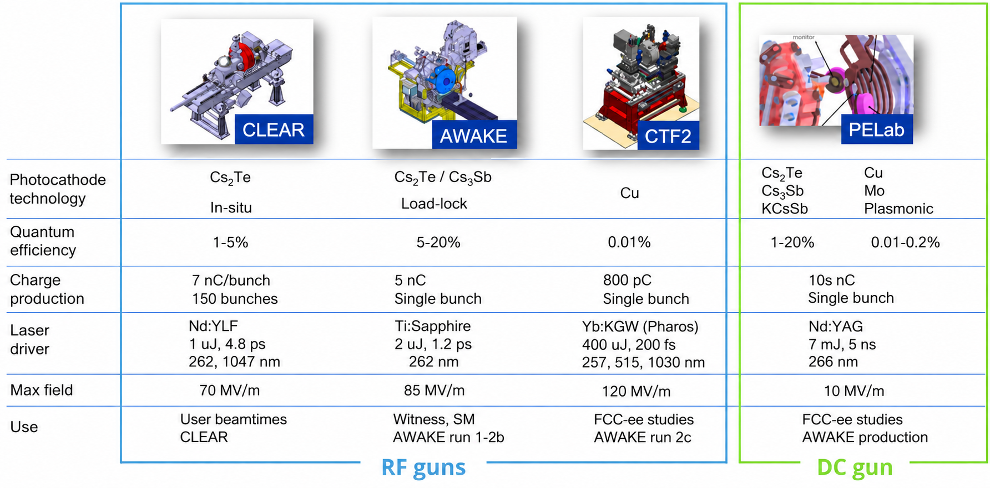
Testing Photocathode performances: e-guns at CERN
Notes:
Now, regarding photocathodes performance testing,
Beside the DC gun in the PE lab, Cs2Te cathode are tested in RF guns at CLEAR and AWAKE

Slide 17
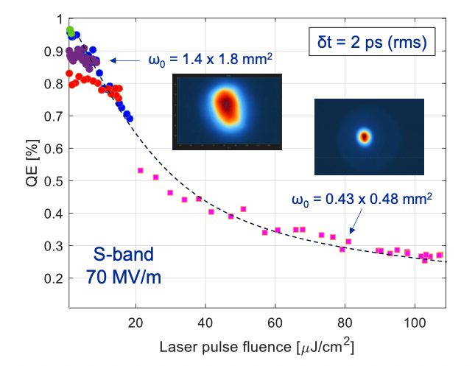
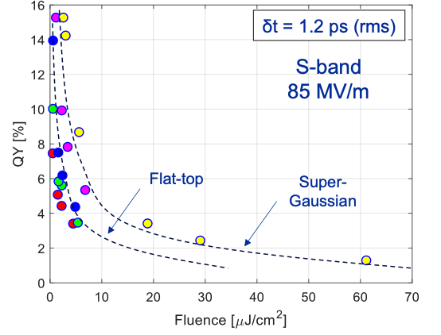
Cs₂Te cathodes: charge production tests in RF guns
AWAKE
CLEAR
Up to 5 nC/bunch, 1-2 mm mrad
Up to 7 nC/bunch, 20-30 mm mrad
Notes:
Mention charge production tests already (CTF2, AWAKE, CLEAR)
Variable spot size achieved using a motorized telescope + variable attenuator

Slide 18
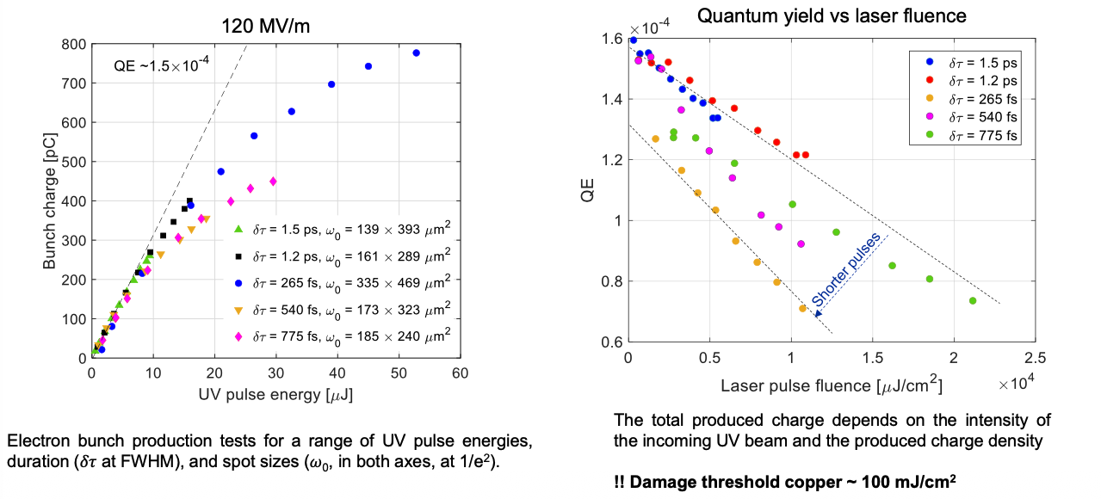
Copper cathodes: charge production tests at CTF2
CTF2
Notes:
CTF2

Slide 19
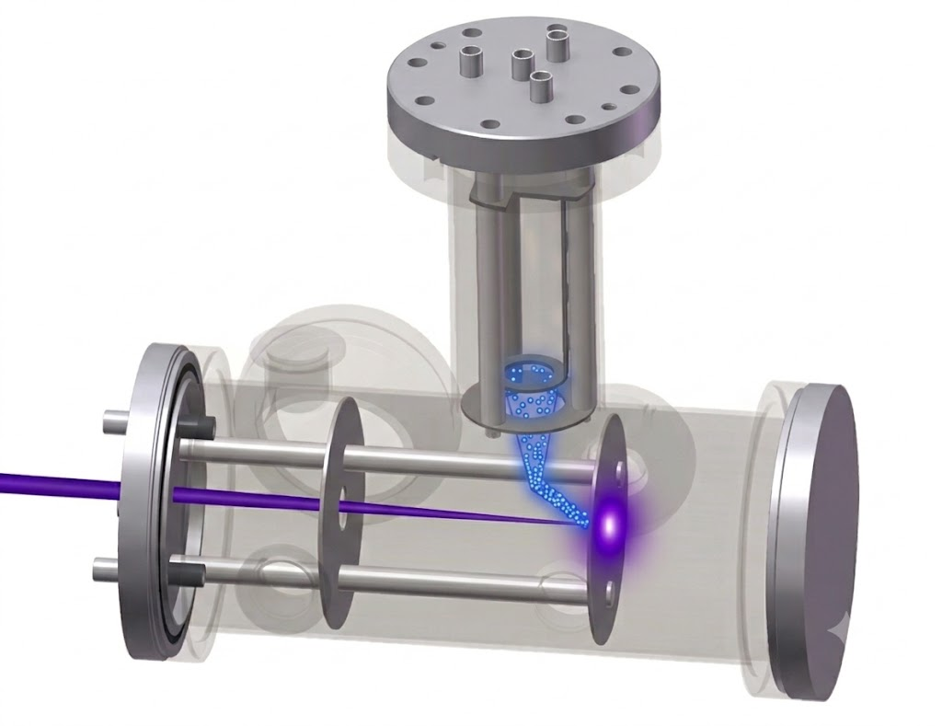
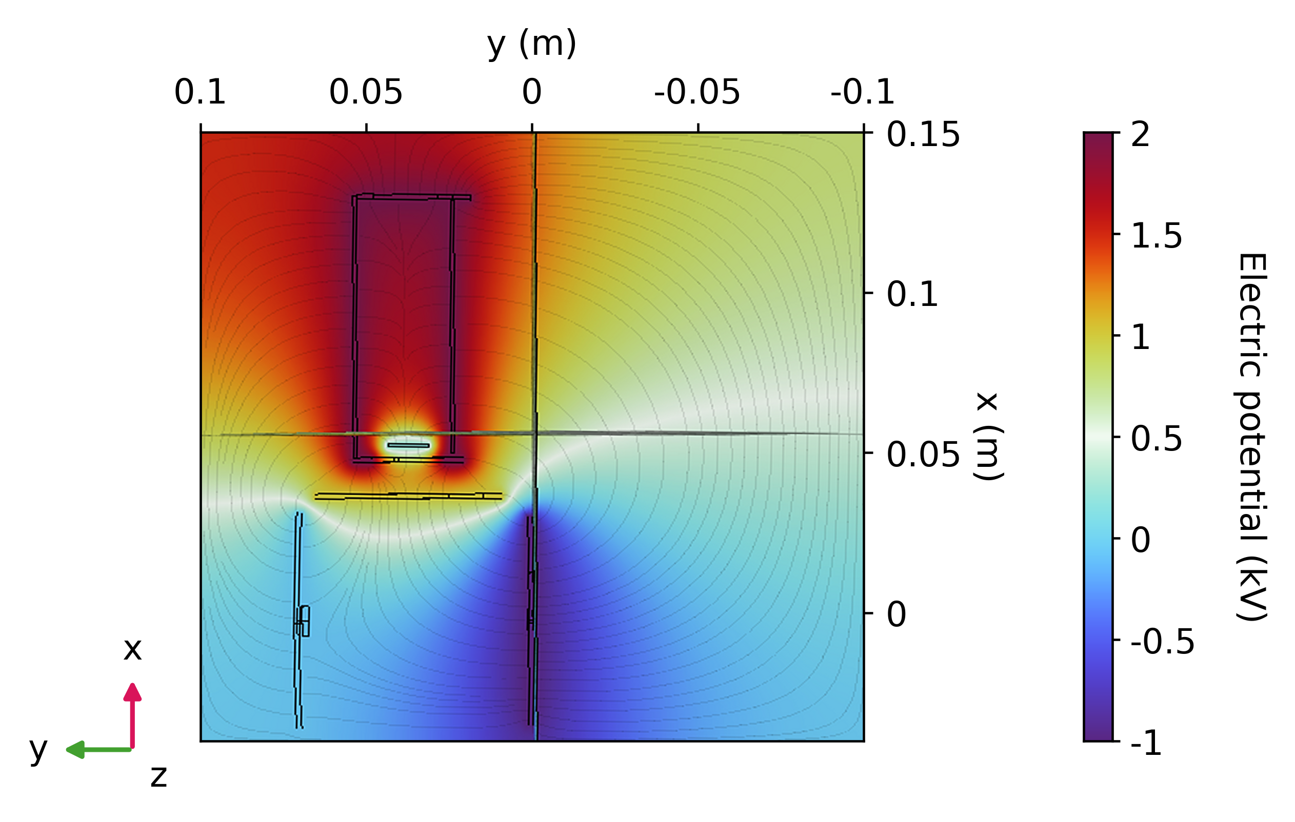
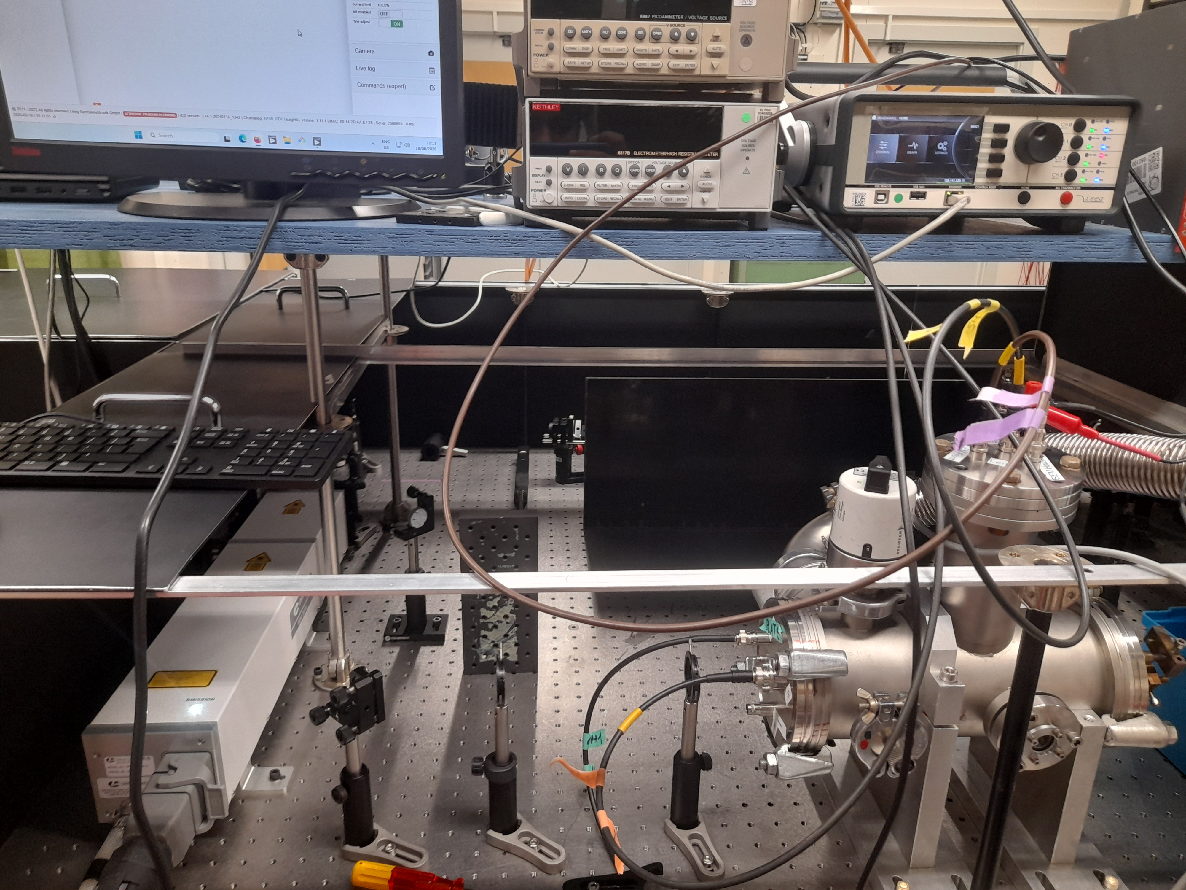
Alternative photocathode studies: a photoemission test chamber
Compact chamber for research on robust novel materials: Ir₇Ce₂, quantum materials with engineered properties (2D materials), nanostructured metallic photocathodes
Notes:
Slowly coming back to FCC-ee requirements, we have seen that Cs2Te represents the baseline with high efficiency, copper a solid robust alternative. We are not excluding other alternative photocathode and for this we are starting to develop..

Slide 20
Towards FCC-ee: roadmap and open questions
Consolidate Cs₂Te cathode production
    Refine data analysis of 30 years of photocathode production to identify optimal growth parameters and improve process reproducibility;
    Sequential vs Co-deposition: extracted charge, lifetime studies, rejuvenation.
Explore alternative materials for robust photocathodes
  Charge production tests on Copper cathodes
  Development of a compact photoemission test chamber for novel materials
Develop know-how and foster collaborations for polarized electron source production:
  Identify best material candidates (eg, GaAs/GaAsP superlattice, GaNi);
  Understand basic requirements and needs to produce polarized electron sources at CERN.
Notes:
To summarize our photocathode developments strategy for FCC-ee will focus on 3 research lines:

Slide 21
Conclusions
CERN has a demonstrated experience in production, characterization and operation of semiconductors photocathodes, in particular Cs₂Te:
  Co-deposition of Cs₂Te photocathode with QE > 20%;
  Charge production FCC-ee baseline specifications (5 nC) already achieved with Cs₂Te and Copper photocathodes in RF guns;
FCC-ee raises the requirements for reproducibility, lifetime and charge control.
  Large production database of Cs₂Te photocathodes is a unique resource to understand and optimize key growth parameters and improve process reliability;
  Alternative robust photocathodes are investigated.

Slide 22
Thank you for your attention.
Special thanks to
Eduardo GRANADOS, Ralf Erik ROSSEL, Miguel MARTINEZ CALDERON, Nikhil SINGH, Gunn KHATRI, Eric CHEVALLAY.

Slide 23
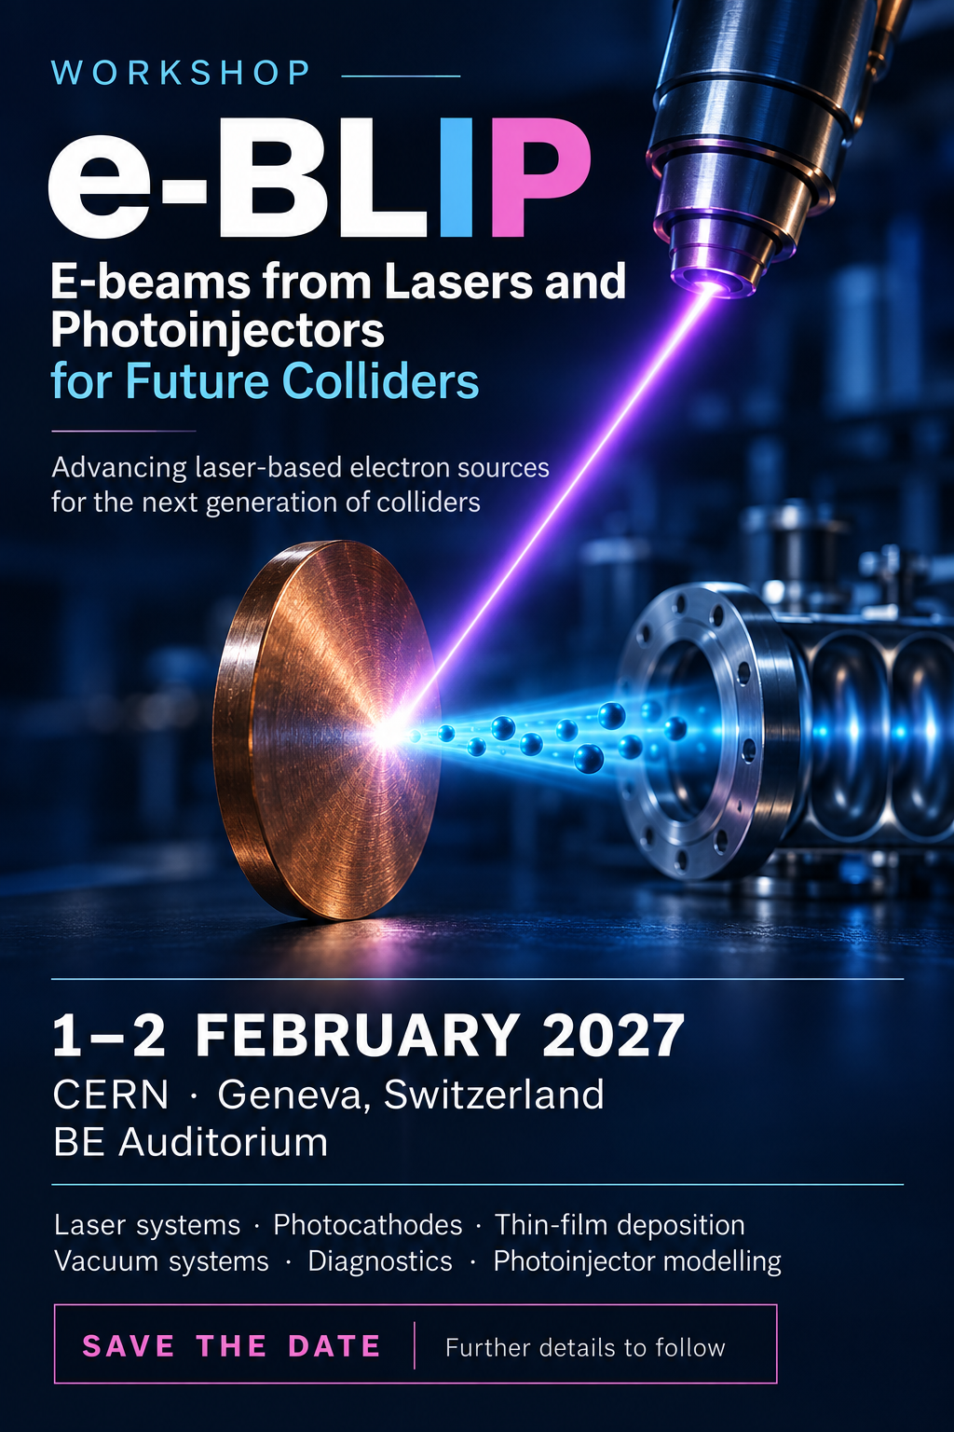
eBLIP!
e-BLIP Workshop 2027
Electron beams from Lasers and Photoinjectors for Future Colliders
1–2 February 2027 · CERN, Geneva
Join the community advancing laser-based electron sources for the next generation of colliders!
Topics include laser systems, photocathodes, thin-film deposition, vacuum systems, diagnostics and photoinjector modelling.
Save the date. Further details to follow.
https://indico.cern.ch/event/1728740/

Slide 24
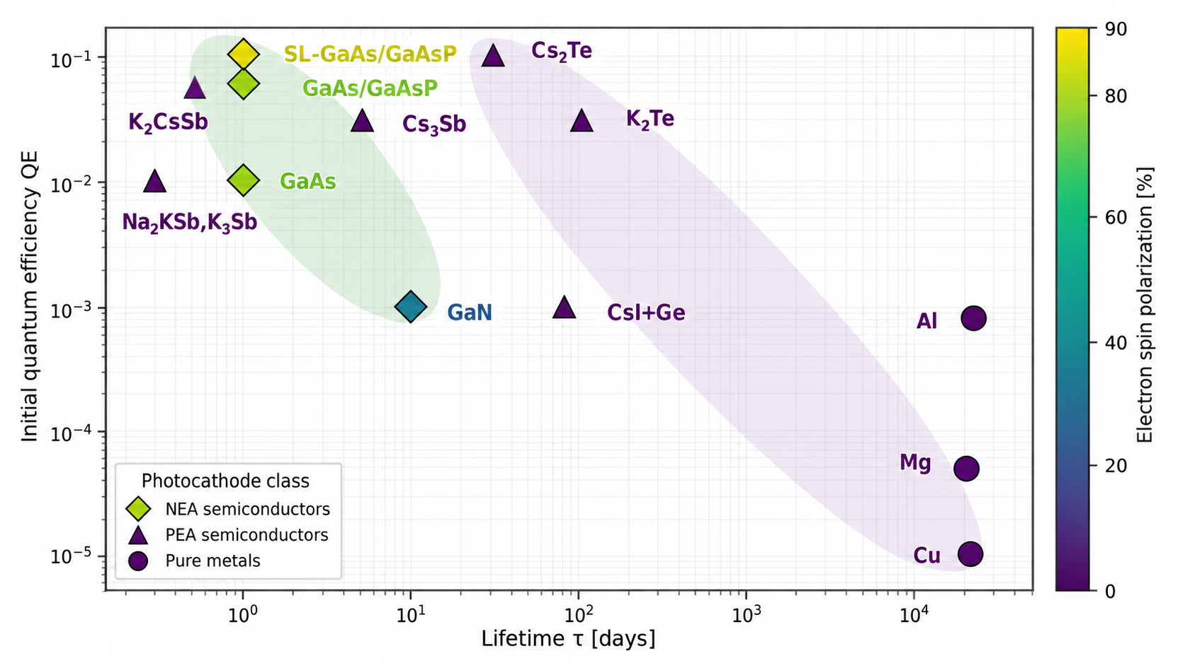
Photocathodes trade-off: QE vs lifetime
Courtesy of E. Granados

Slide 25
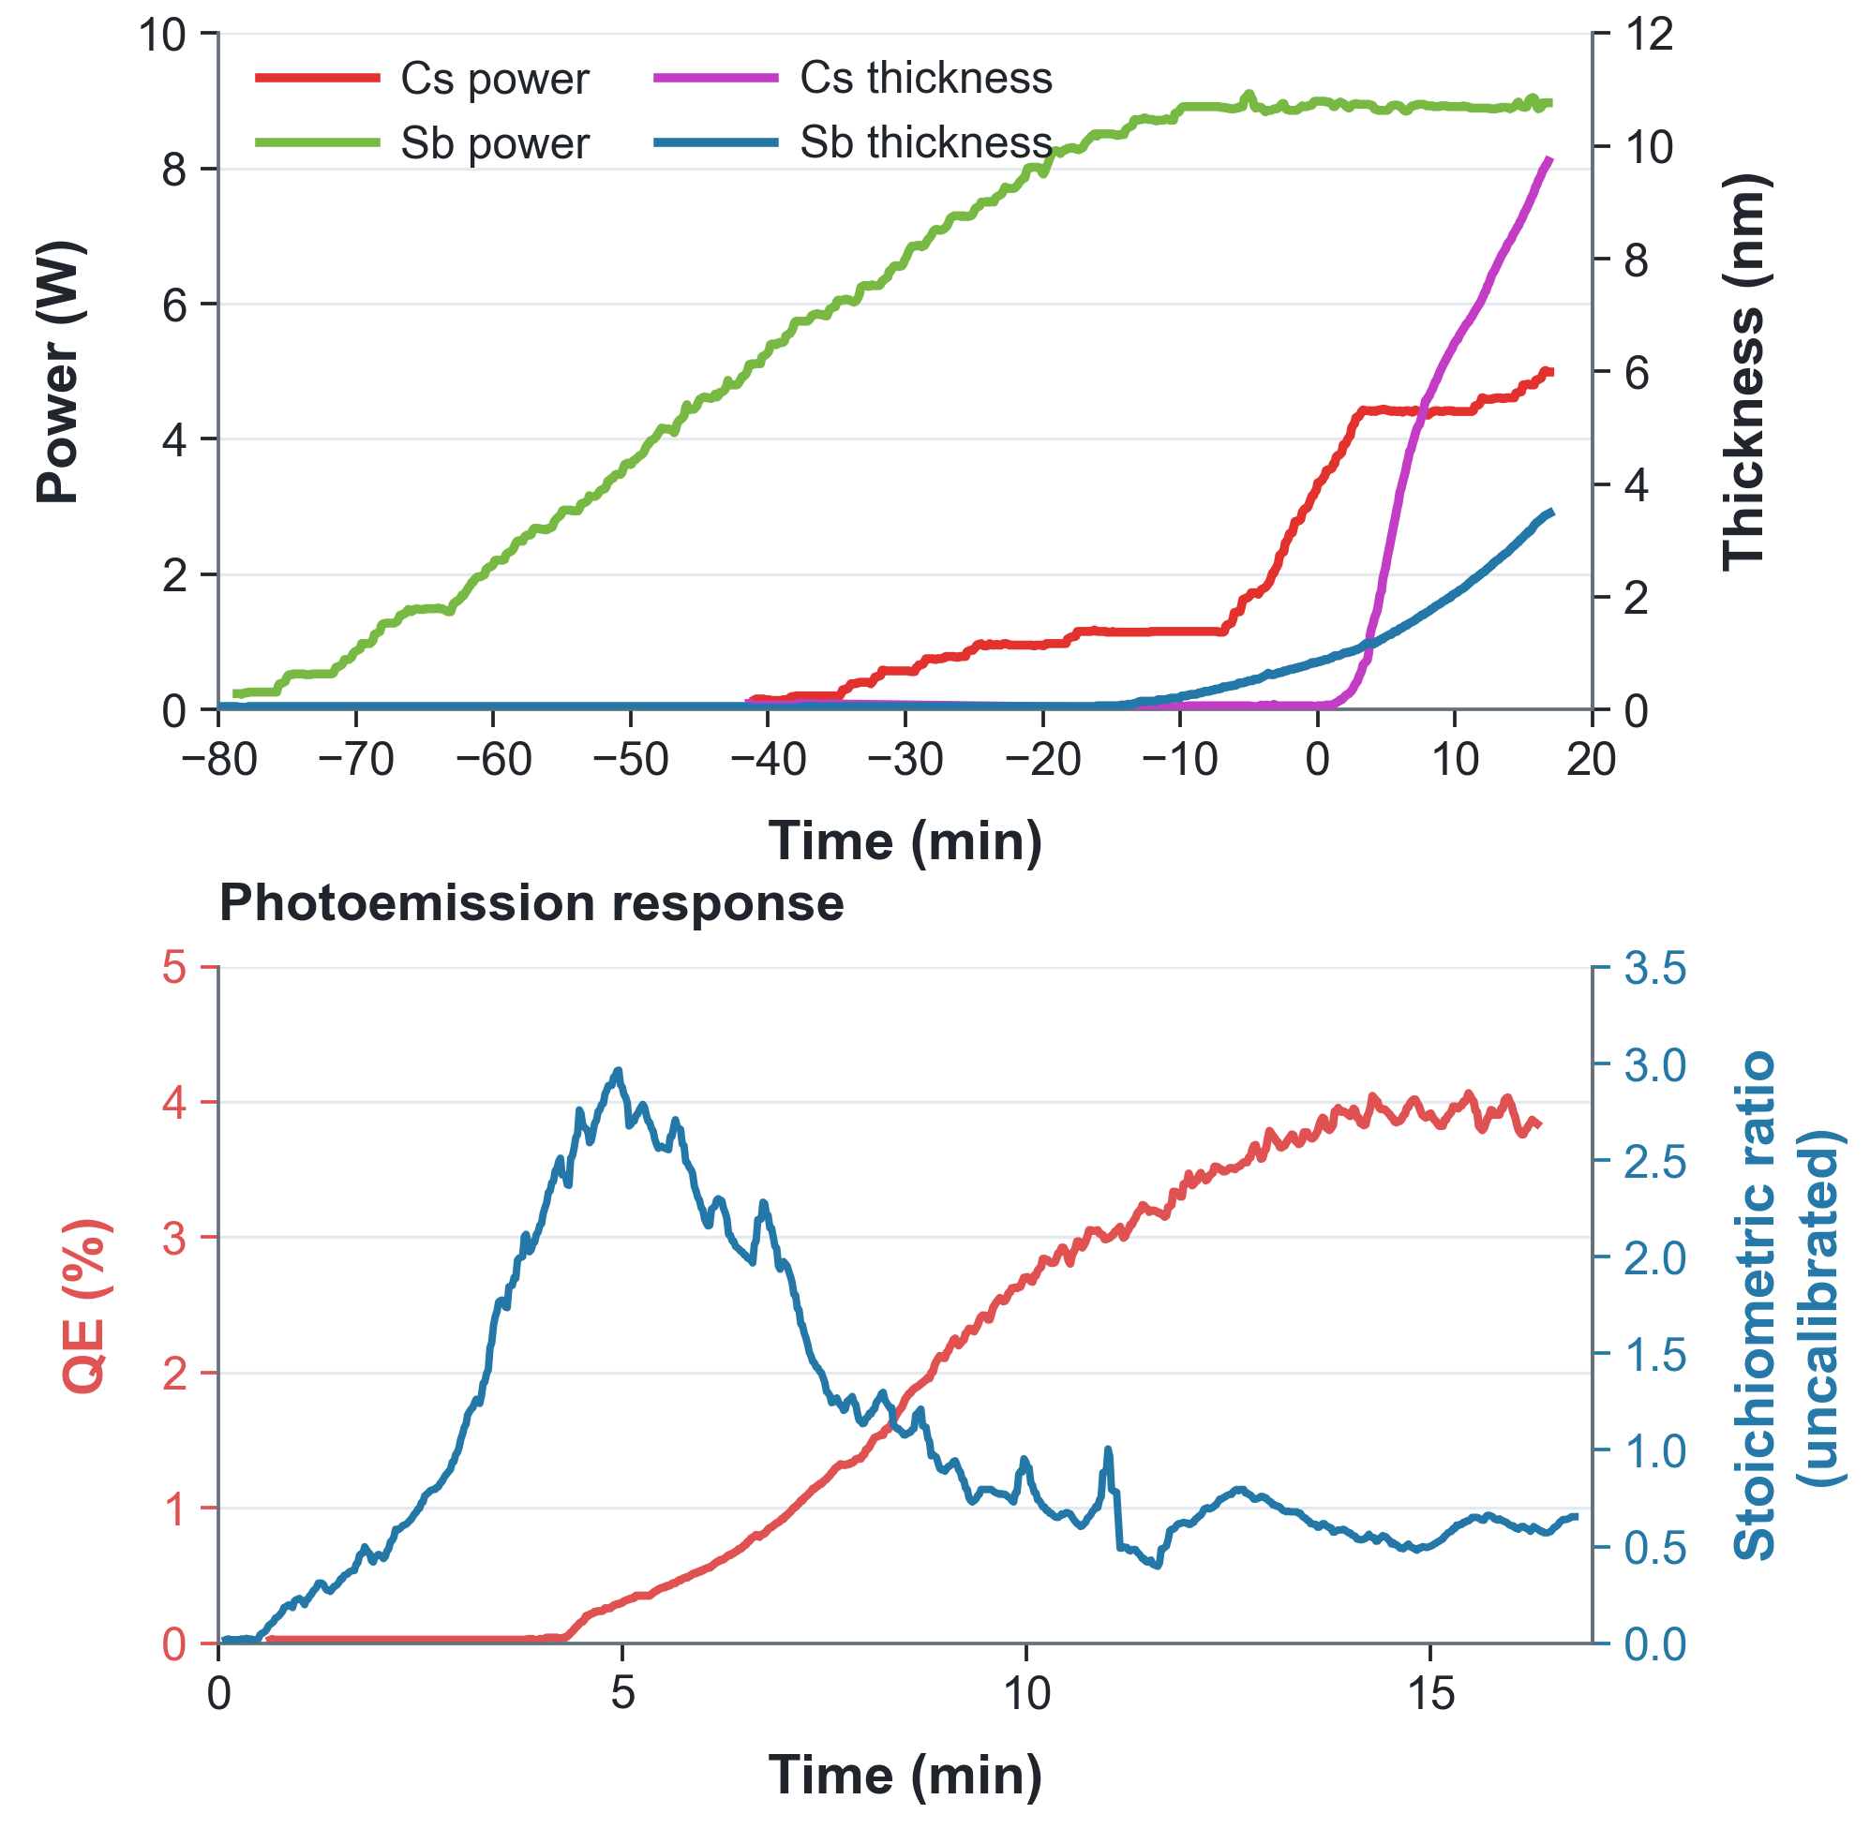
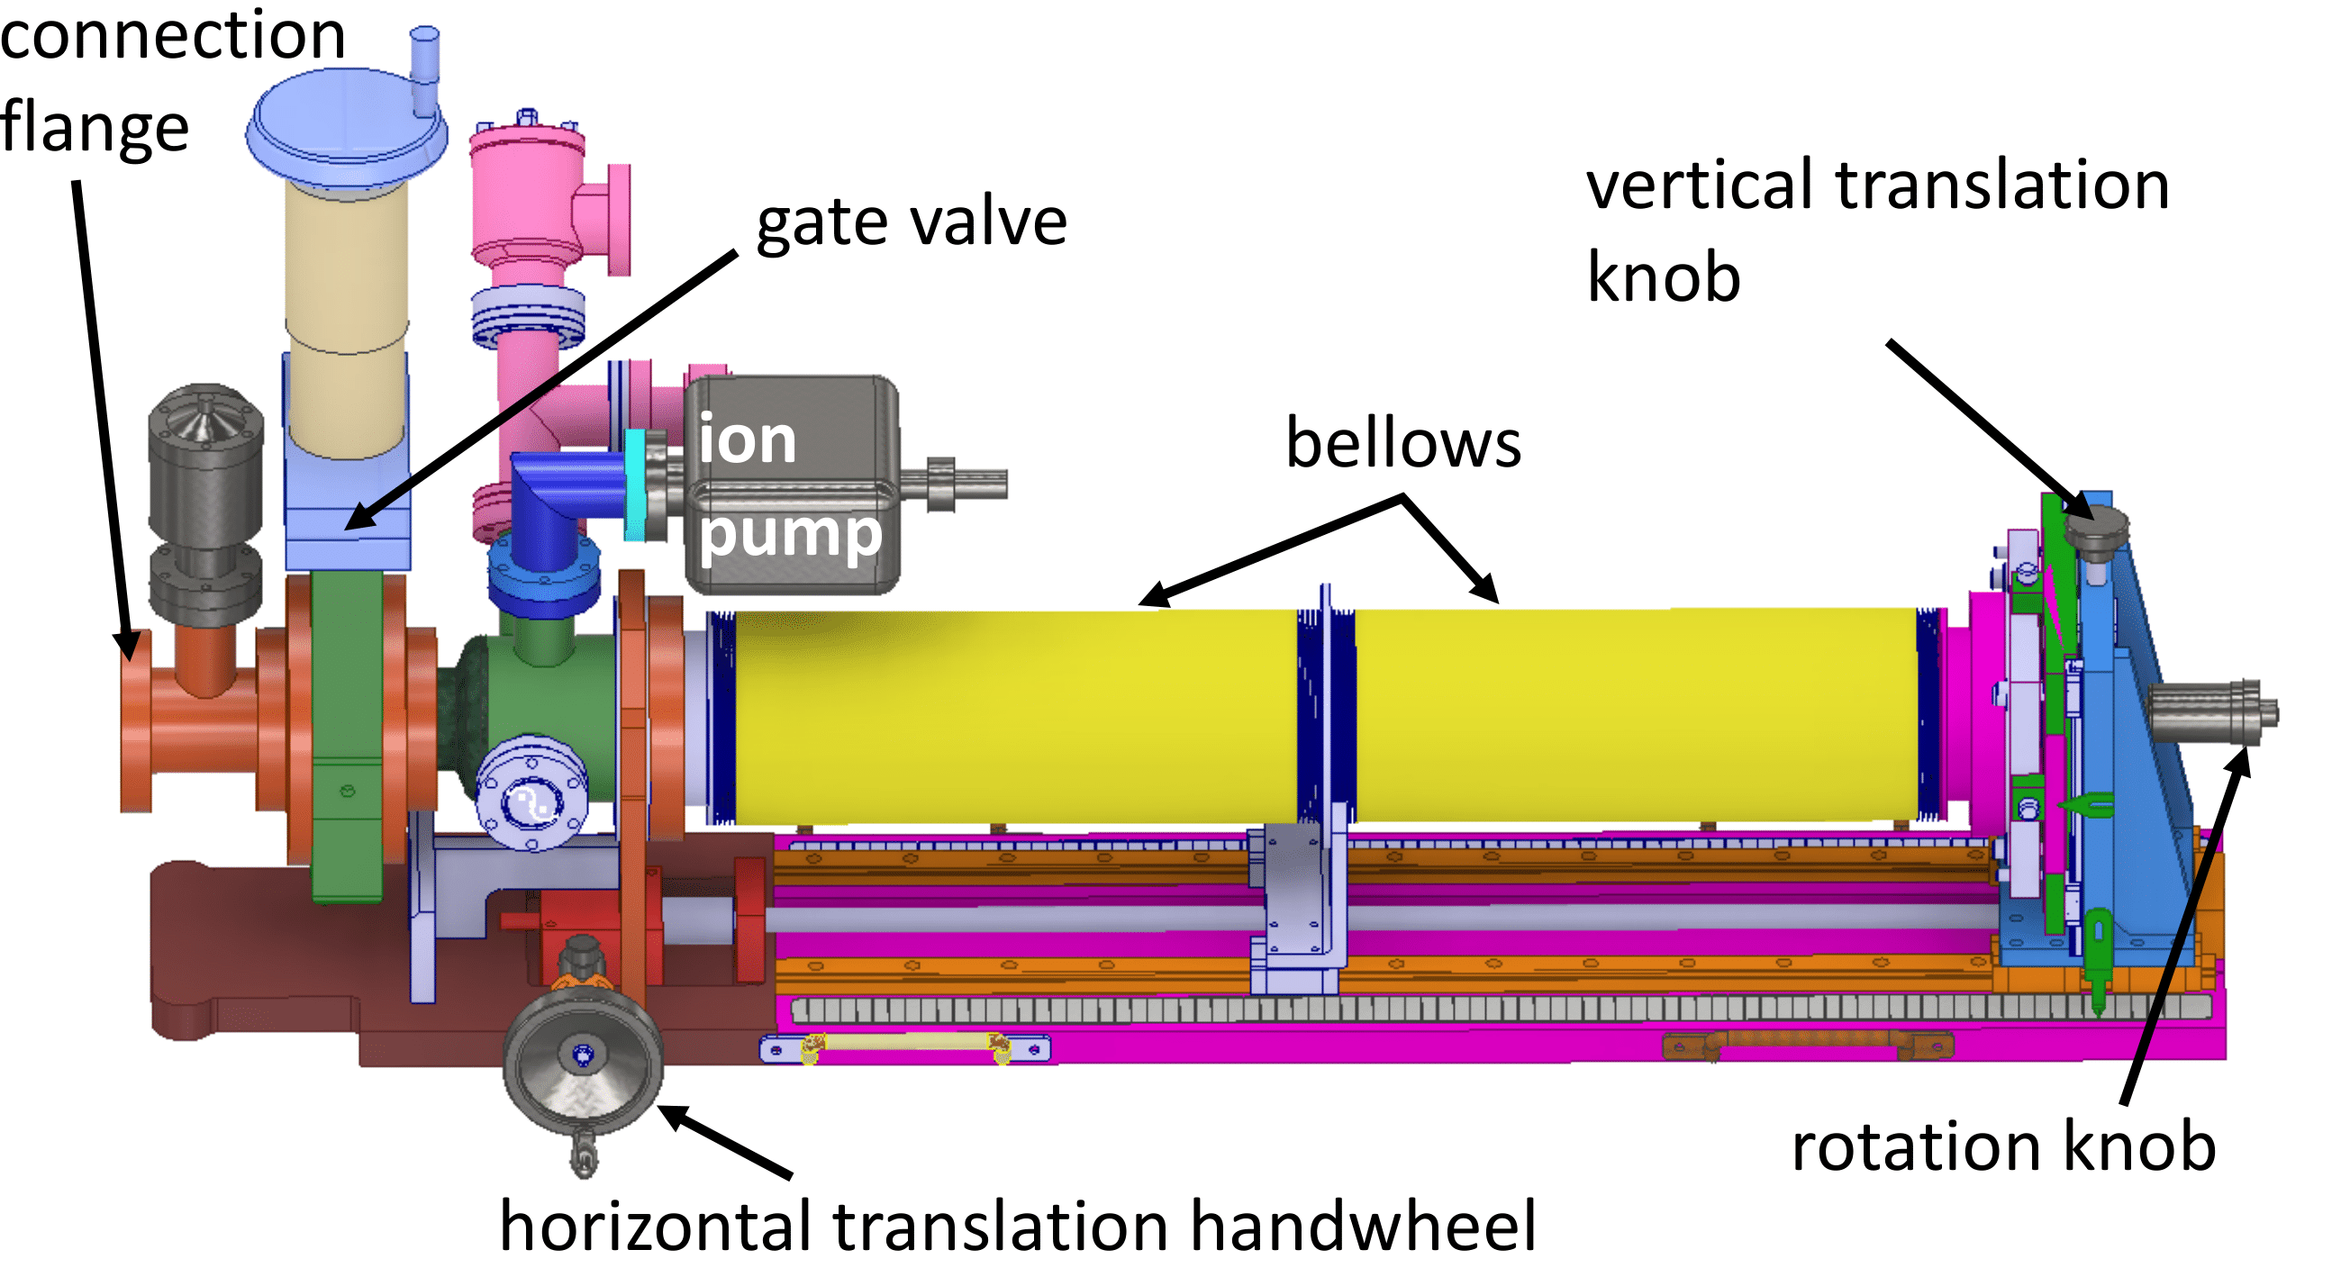
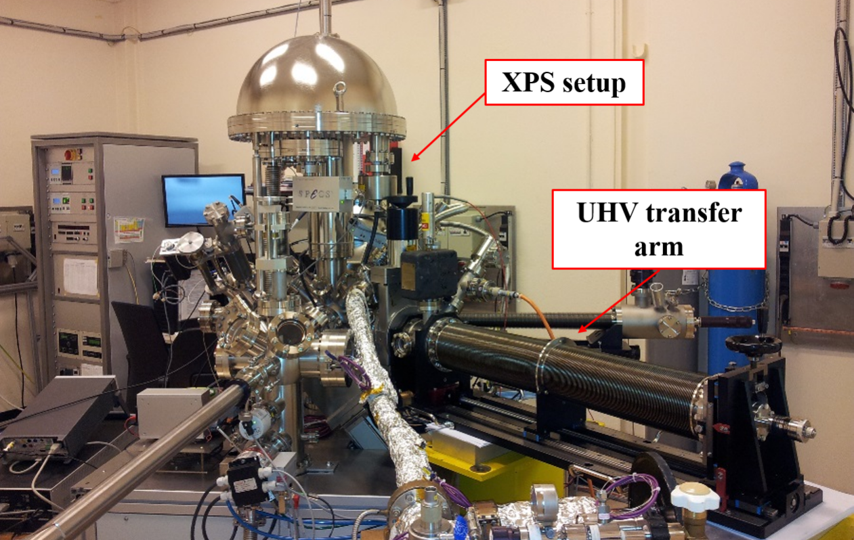
Cs₂Te cathodes co-deposition and characterization
Evaporators power adjusted during growth to reach maximum QE;
Average pressure during the process is 1e-⁻⁸ mbar.
Full characterization in the DC line: QE map gives info on spatial homogeneity.
Lifetime studies can be performed with higher repetition rate laser.
Surface characterization (XPS, UPS) is available next door.
Production process
UHV transfer arm

Slide 26
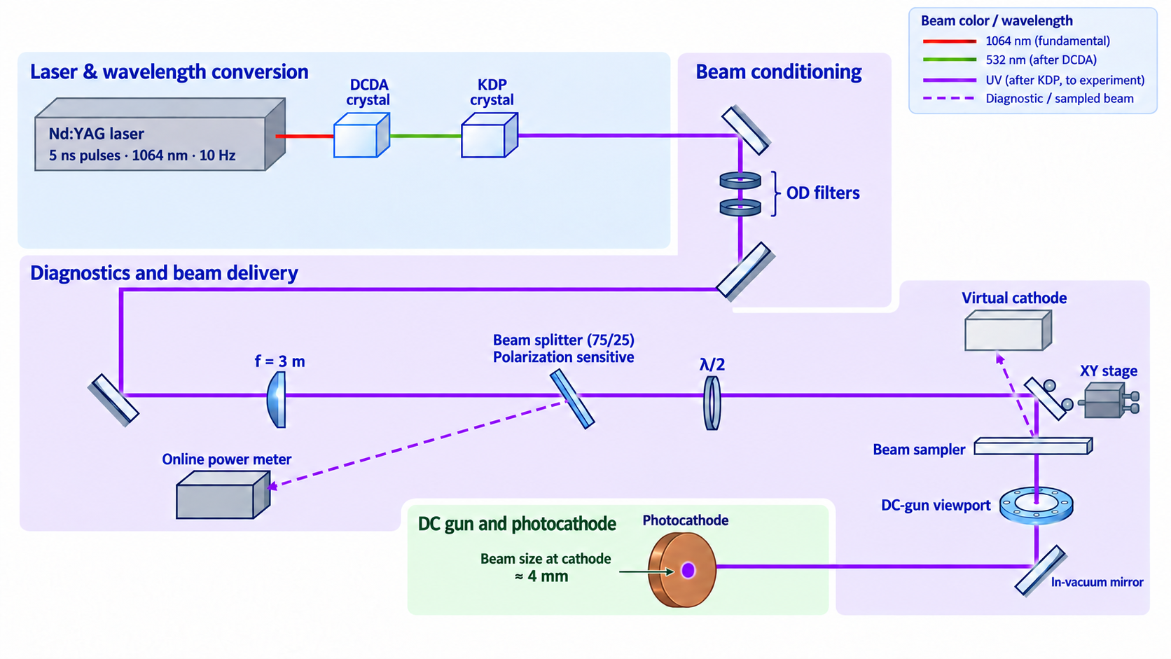
Laser layout PE lab

Slide 27
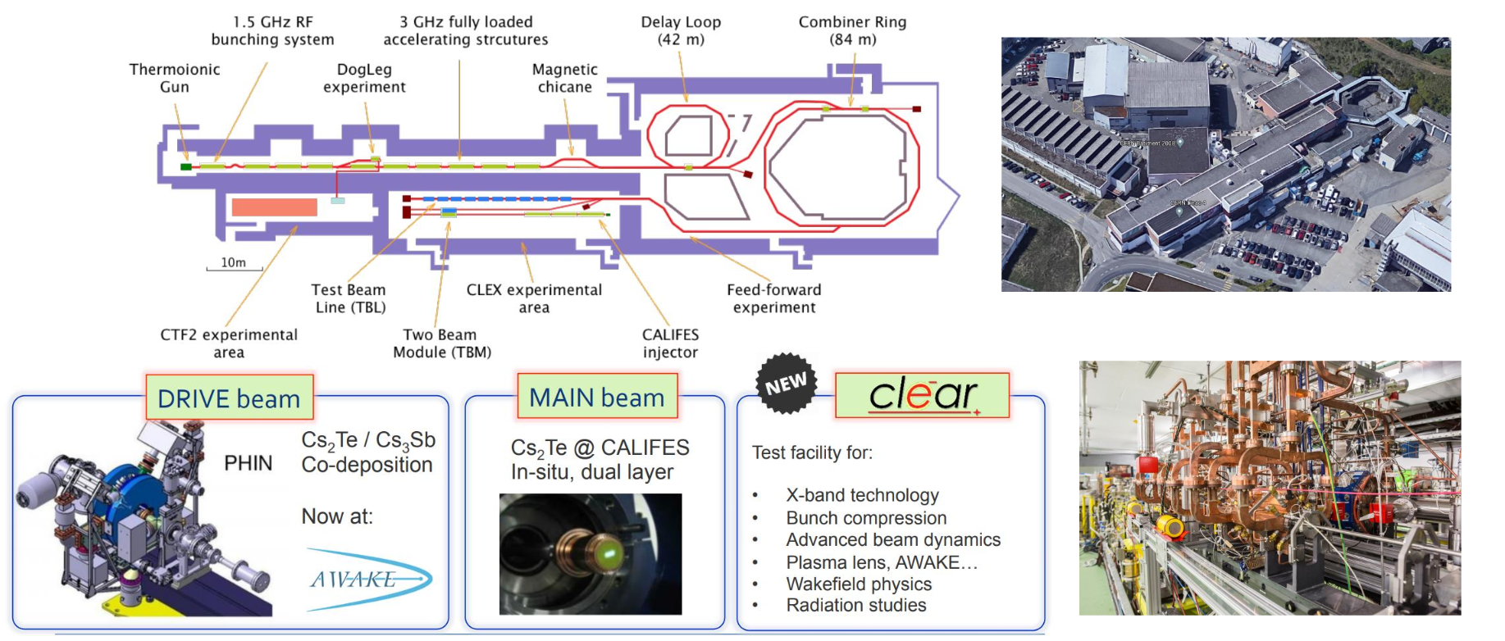
CLIC Test Facility (CTF3) heritage

Slide 28

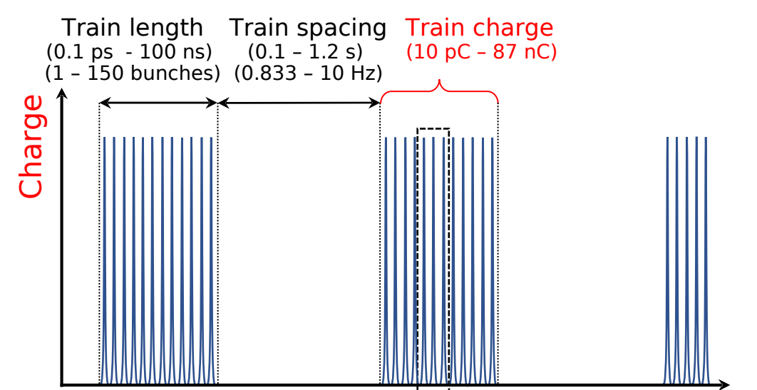
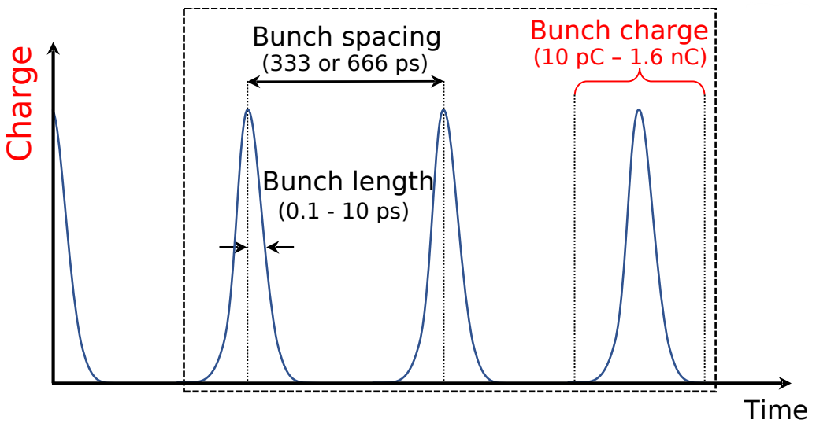

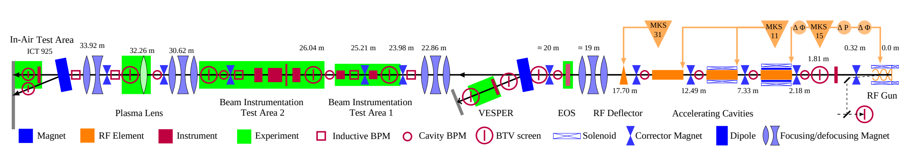


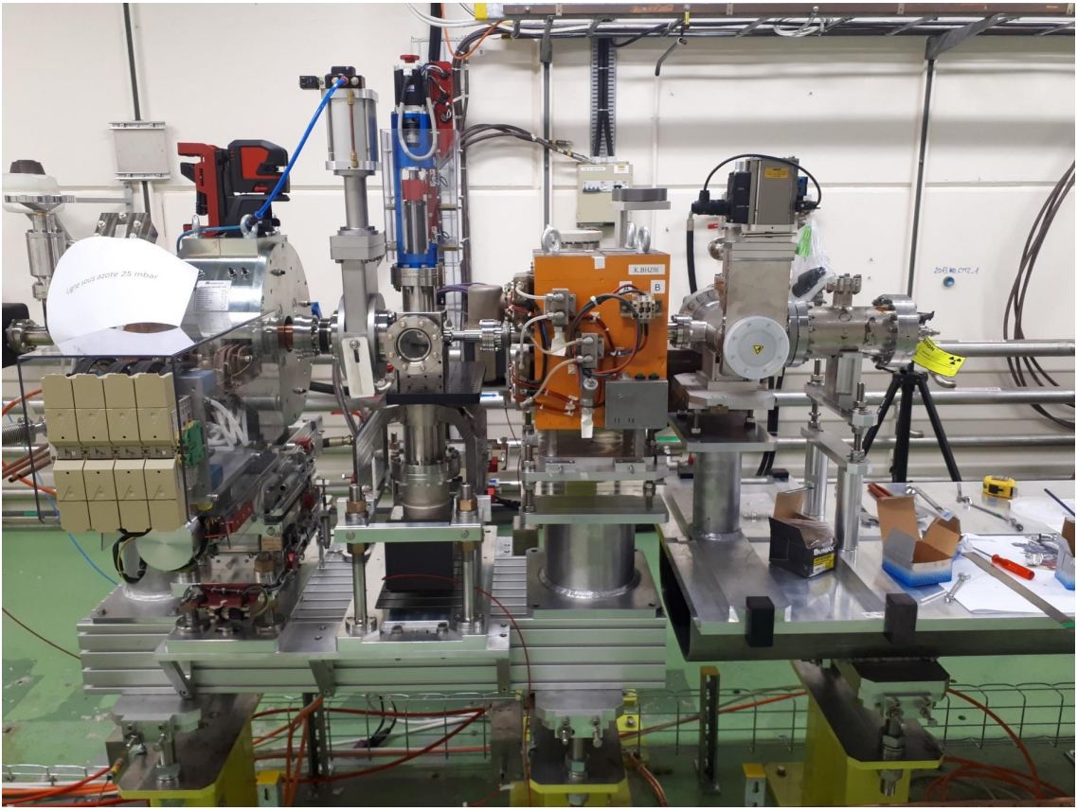
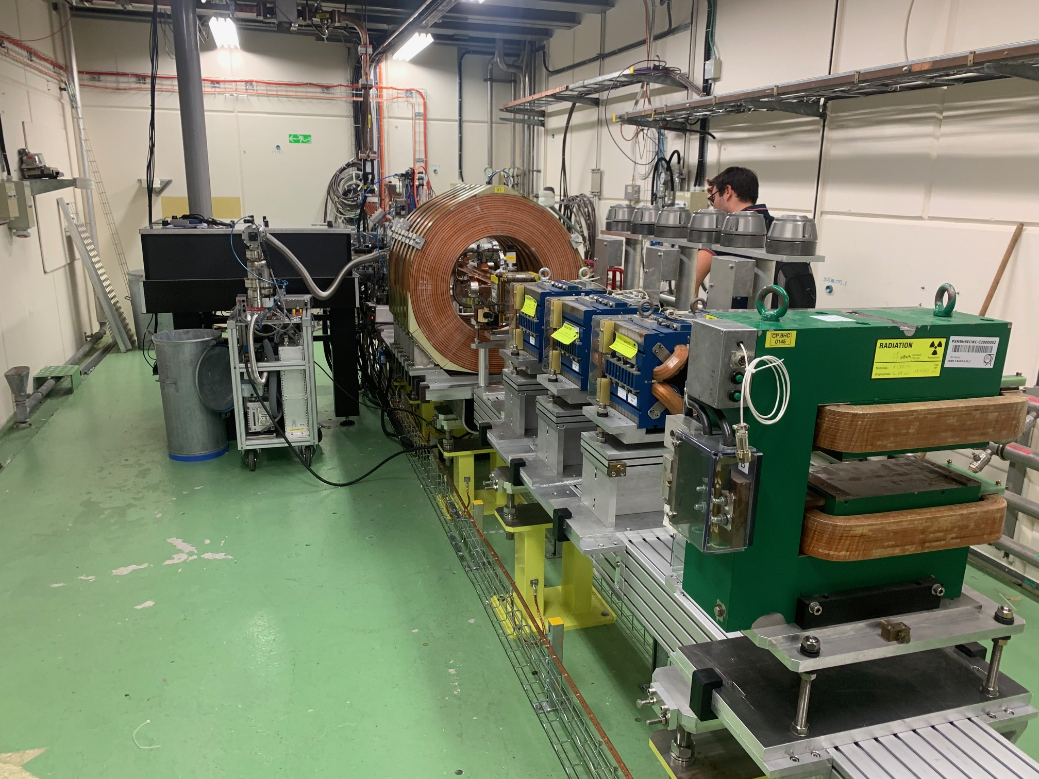
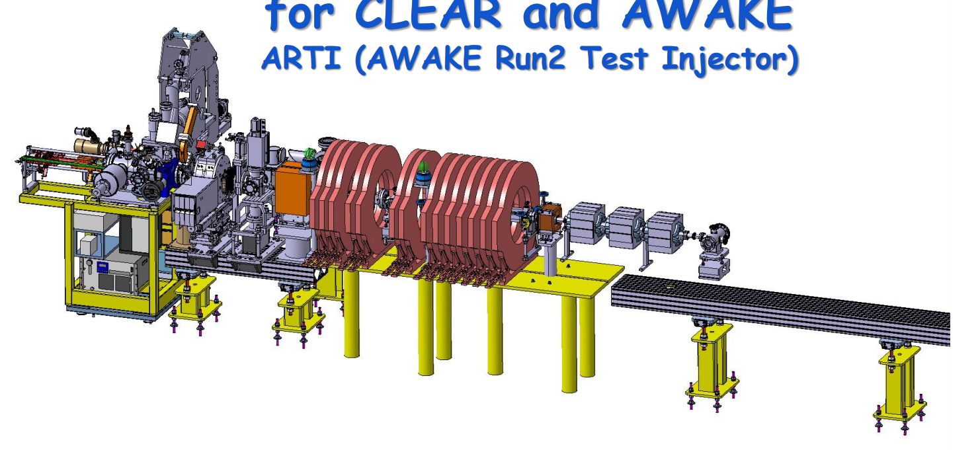
Electron sources available at CERN (not including AWAKE)
2017-2030
CLEAR
30 - 220 MeV
7 nC/bunch
1 - 150 bunches
1 - 10 Hz
1.5 – 3 GHz
CTF-2
2023-?
CTF2 / CLIC
6 - 150 MeV
1 nC/bunch
1 bunch
1 - 10 Hz
Under development
E. Granados | High-Brightness Sources and Light-Driven Interactions Congress ETu3A.3 | 12.03.24

