Slide 1

Photocathodes for Accelerator Science in Europe (PhASE26) Workshop
IJC Lab, Orsay, France, September 21-23, 2026.
UIC
Semiconductor Photocathodes:
Modeling of Electron Emission Processes
W. Andreas Schroeder
Louis A. Angeloni and Ir-Jene Shan
Physics Department, University of Illinois Chicago
Lee B. Jones
ASTeC, STFC Daresbury Laboratory, United Kingdom
Department of Energy
DE-SC0020387
Theodore Vecchione
SLAC

Slide 2
Outline
Two photoemission processes
(i) ‘Normal’ one-step direct band photoemission
− Energy (E) and transverse momentum (p_{T}) conserving
(ii) Optical phonon mediated Franck-Condon (FC) electron emission
− Energy (E) and momentum (p) resonant
… Photoemission by inelastic phonon scattering
Polar semiconductor photocathodes
− MTE and QE measurements vs. FC emission theory:
Cs:GaAs at 808 nm (long transport regime); T_{e} → T_{lattice}
GaN for ħω > E_{g} (short transport regime); k_{B}T_{e} = f(ħω − E_{g})
Fe:Ga₂O₃(010) photocathode
− Ultracold photoemission: MTE ≈ 6 meV at 300 K
− Evidence for T_{e} increase due to polaron formation

Slide 3
Prior work: H-terminated diamond(001)
− ARPES measurement; ħω = 6.01 eV (208 nm) ⇒ α ≈ 4000 cm⁻¹ (absorption depth ≈ 2.5 μm)
Emitted electrons from NEA CBM
χ_{eff} = E_{vac} – (E_{CBM} − għΩ) ≈ −0.96 eV
… għΩ is real part of the electron-
polaron self energy and the
dimensionless Fröhlich coupling
constant for diamond g = 1.1
Emission ‘bands’ are replicas of electron distribution in CB separated by ħΩ = 165 meV optical phonon energy
I(n) = e^{-g}g^{n}/n! Poisson statistics govern emission strength for n^{th} phonon band
(n = 0, 1, 2, …)
n = 0
n = 1
n = 2
n = 3
.
.
J.D. Rameau, J. Smedley, E.M. Muller, T.E. Kidd, and P.D. Johnson, Phys. Rev. Lett. 106, 137602 (2011)

Slide 4
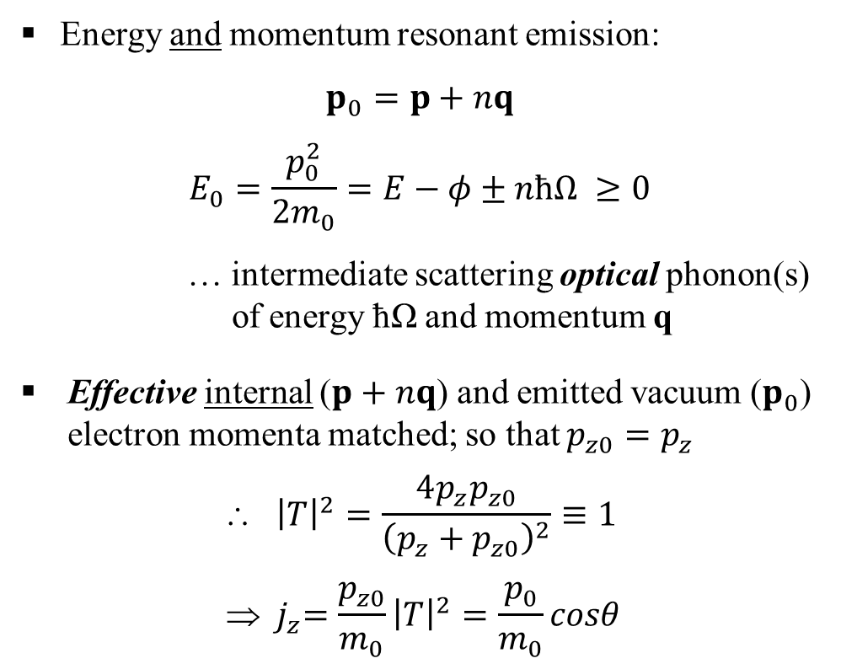
Franck-Condon mechanism in photoemission
− Phonon scattering based electron emission from semiconductor photocathodes
Energy and momentum resonant emission:
$$p_{0}=p+nq$$
$$E_{0}=\frac{p_{0}^{2}}{2m_{0}}=E−φ±nħΩ ≥0$$
… intermediate scattering optical phonon(s)
of energy ħΩ and momentum q
Effective internal ($p+nq$) and emitted vacuum ($p_{0}$) electron momenta matched; so that $p_{z0}=p_{z}$
$${ \left|T\right|}^{2}=\frac{4p_{z}p_{z0}}{{\left(p_{z}+p_{z0}\right)}^{2}}≡1$$
$${  j}_{z}=\frac{p_{z0}}{m_{0}}{\left|T\right|}^{2}=\frac{p_{0}}{m_{0}}cosθ$$
x,y
n = 1
q
p
p₀
θ
z
Photocathode
Vacuum

Slide 5
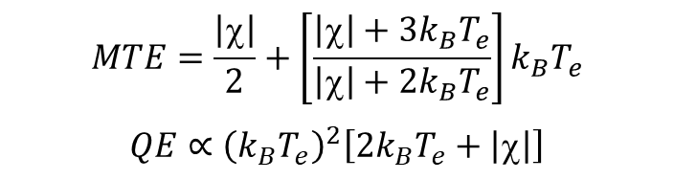
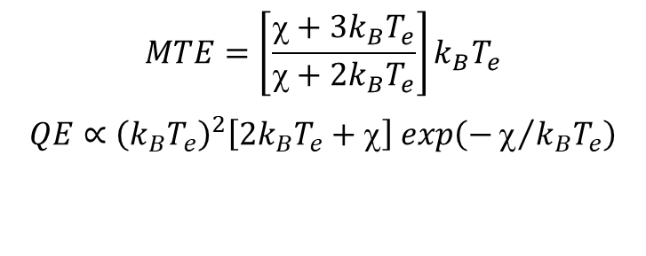
Franck-Condon emission theory
− Analytical evaluation in parabolic band approximation with thermalized electron distribution at T_{e}; ħΩ → 0
PEA
(χ > 0)
NEA
(χ < 0)
E
E
E
E
p₀ = p + nq
p₀ = p + nq
χ
p
χ
p₀
p
p₀
bulk
vacuum
bulk
vacuum
$$MTE=\left[\frac{χ+3k_{B}T_{e}}{χ+2k_{B}T_{e}}\right]k_{B}T_{e}$$
$$QE∝{\left(k_{B}T_{e}\right)}^{2}\left[2k_{B}T_{e}+χ\right] exp\left(−χ/{k_{B}T_{e}}\right)$$
$$MTE=\frac{\left|χ\right|}{2}+\left[\frac{\left|χ\right|+3k_{B}T_{e}}{\left|χ\right|+2k_{B}T_{e}}\right]k_{B}T_{e}$$
$$QE∝{\left(k_{B}T_{e}\right)}^{2}\left[2k_{B}T_{e}+\left|χ\right|\right]$$
W.A. Schroeder, L.A. Angeloni, I-J. Shan, and L.B. Jones, Phys. Rev. Applied 23, 054065 (2023)

Slide 6
Cesiated p-GaAs photocathode
− Measurements performed using TESS (Daresbury Laboratory, U.K.); λ = 808 nm, T = 300 K
Absorption depth ~1 μm at 808 nm
⇒ Long transport limit with low excess photo-
excitation energy in CB (ΔE_{CB} < 100 meV)
∴ Expect k_{B}T_{e} ≈ 25 meV due to rapid carrier
cooling during drift to emission face
Surface depletion region w_{d} ≈ 10 nm traversed in less than ~200 fs optical phonon emission time by 25 meV electrons (m* = 0.067m₀)
Controlled oxygen ‘poisoning’ of cesiation used to vary electron affinity χ from −0.1 eV to +0.2 eV
BOTH QE and MTE measured as a function of χ
CB
χ
ħω
E_{vac.}
[Zn] = 10¹⁹ cm⁻³
VB
w_{d}
L.B. Jones, H.E. Scheibler, et al., J. Phys. D: Appl. Phys. 54, 205301 (2021)

Slide 7
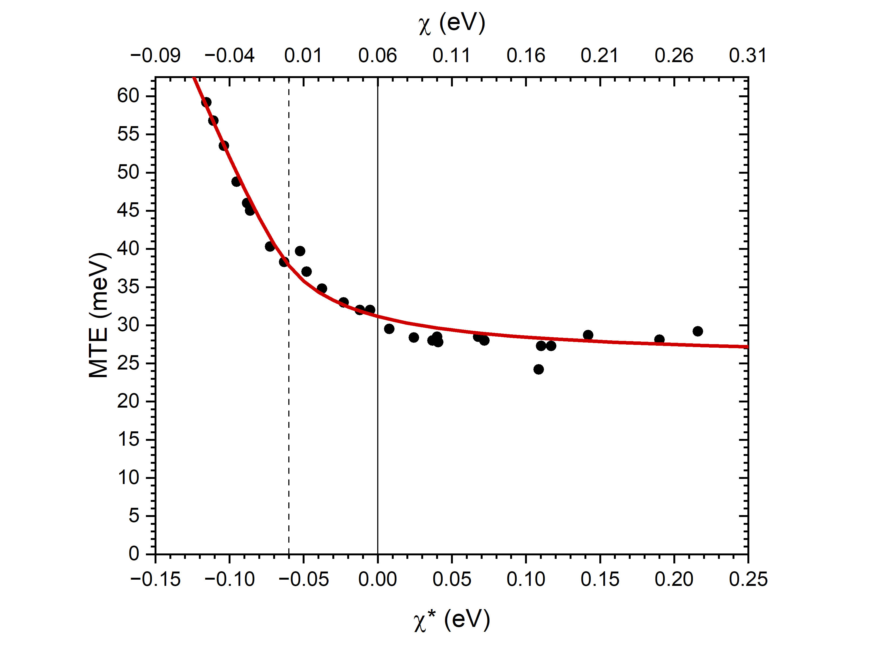
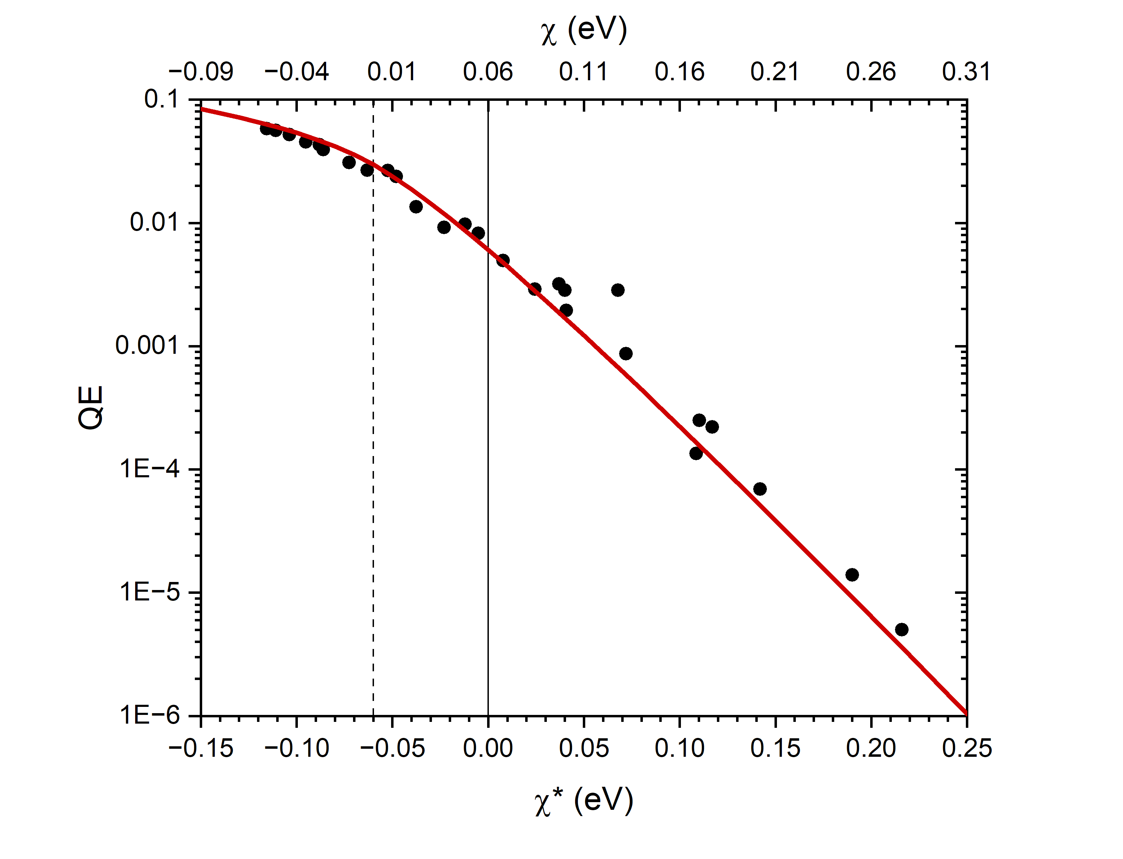
Cesiated p-GaAs: Theory vs. Experiment
− Fits to experimental data use k_{B}T_{e} = 27 meV (> 25 meV) due to drift transport in E ≈ 3 kV/cm acceleration field
MTE → k_{B}T_{e}
for large PEA
QE ∼ exp[−χ/k_{B}T_{e}] for large PEA
NEA
PEA
NEA
PEA
χ = χ* + 60meV
NOTE: χ = χ* + 60 meV shift due to error in assumption of instrument resolution
L.B. Jones, H.E. Scheibler, et al., J. Phys. D: Appl. Phys. 54, 205301 (2021)

Slide 8
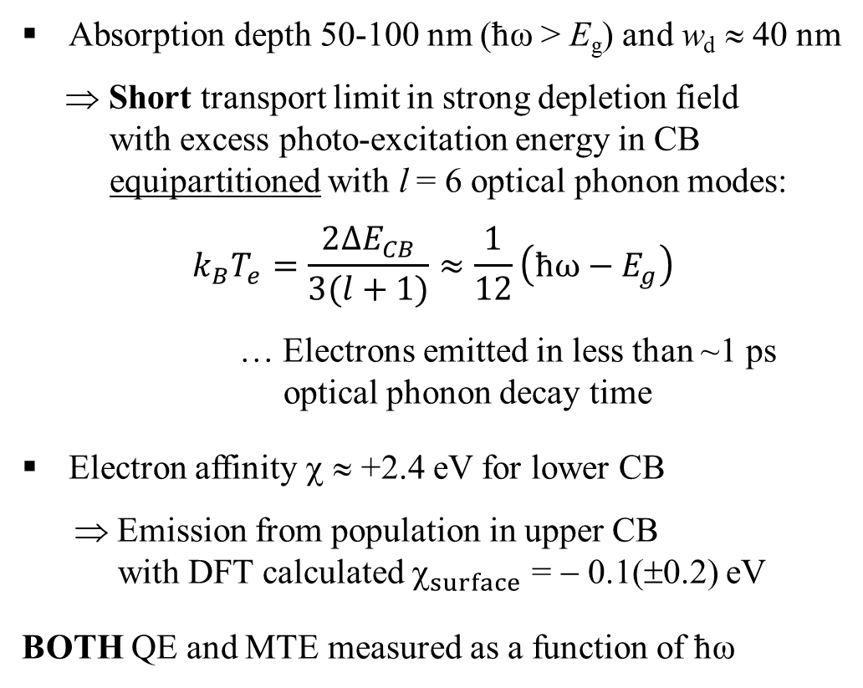
Mg-doped p-GaN(0001) photocathode
− Spectral measurements performed at UIC; λ = 230-410 nm, T = 300 K
Absorption depth 50-100 nm (ħω > E_{g}) and w_{d} ≈ 40 nm
⇒ Short transport limit in strong depletion field
with excess photo-excitation energy in CB
equipartitioned with l = 6 optical phonon modes:
$$k_{B}T_{e}=\frac{2∆E_{CB}}{3(l+1)}≈\frac{1}{12}\left(ħω−E_{g}\right)$$
… Electrons emitted in less than ~1 ps
optical phonon decay time
Electron affinity χ ≈ +2.4 eV for lower CB
⇒ Emission from population in upper CB
with DFT calculated $_{surface}$ = − 0.1(±0.2) eV
BOTH QE and MTE measured as a function of ħω
Upper CB
2.5 eV
χ
CB
E_{vac.}
ħω
[Mg] = 5x10¹⁷ cm⁻³
VB
w_{d}
W.A. Schroeder, L.A. Angeloni, I-J. Shan, and L.B. Jones, Phys. Rev. Applied 23, 054065 (2023)

Slide 9
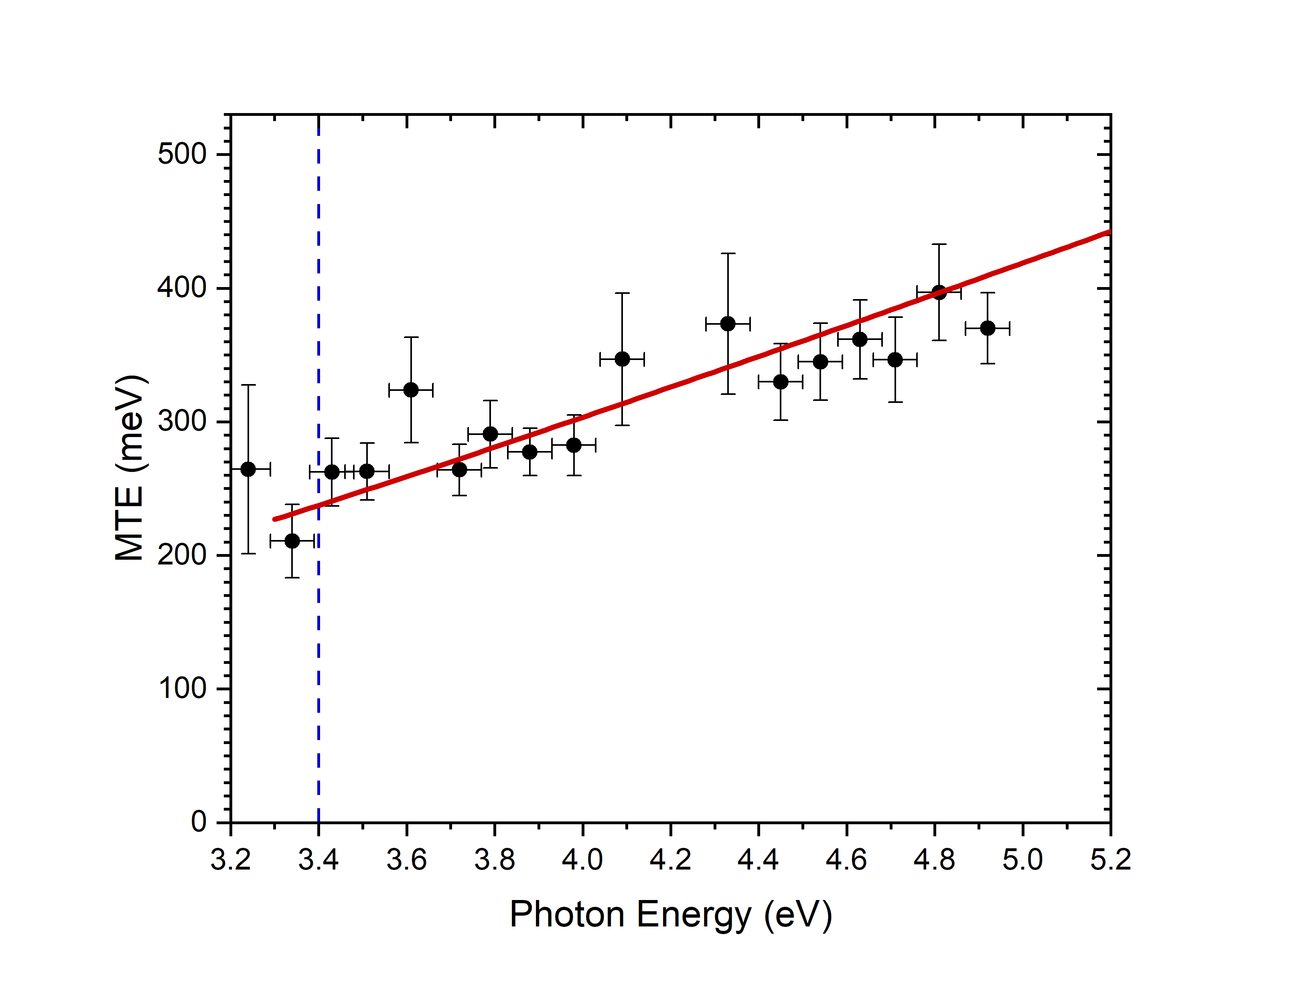
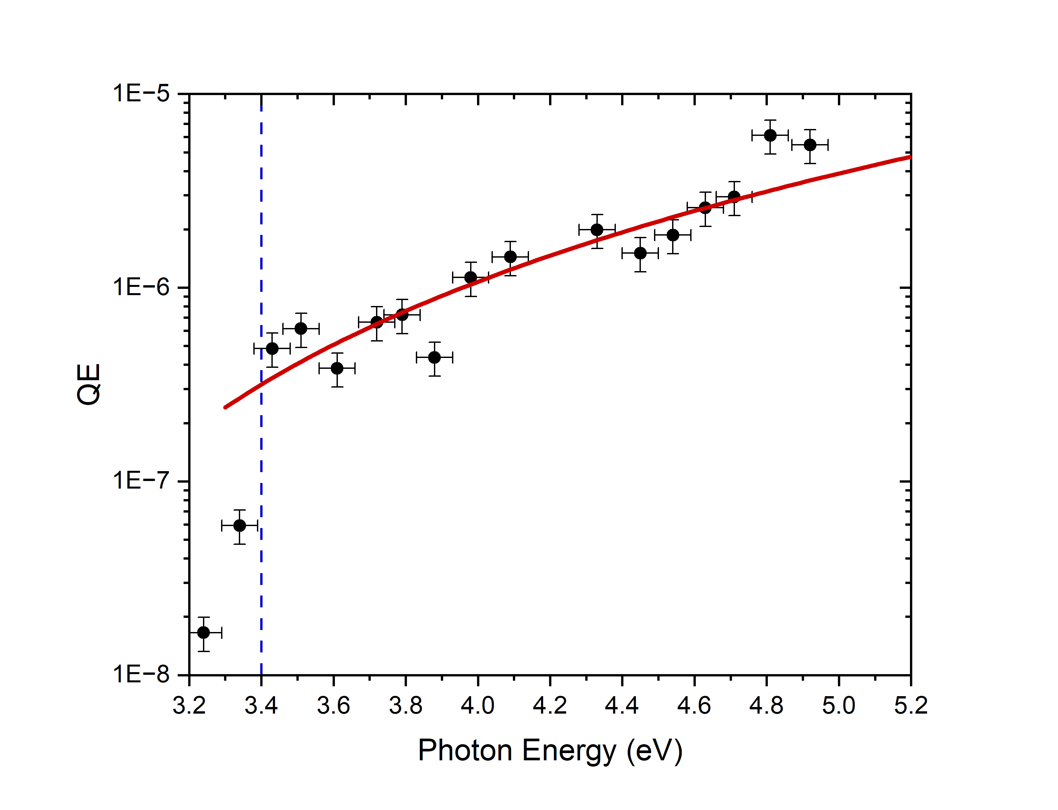
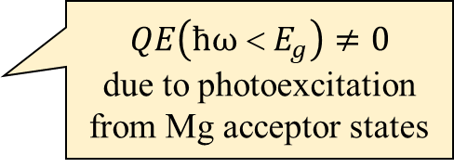
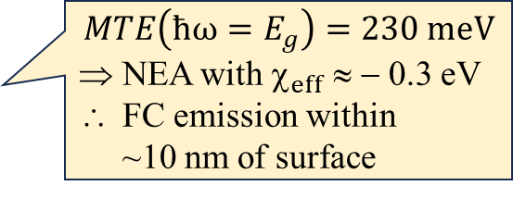
GaN(0001): MTE
− Fits to experimental data use $k_{B}T_{e}=għΩ+\frac{1}{12}\left(ħω−E_{g}\right)$; polaron formation energy għΩ ≈ 75 meV
E_{g} = 3.4 eV
E_{g} = 3.4 eV
$$MTE\left(ħω=E_{g}\right)=230 meV$$
NEA with $_{eff}$ ≈ − 0.3 eV
FC emission within
~10 nm of surface
$QE\left(ħω < E_{g}\right)≠0$
due to photoexcitation from Mg acceptor states
NOTE: Untreated epi-polished GaN wafer (Ra < 1 nm) ⇒ Surface roughness effects negligible
W.A. Schroeder, L.A. Angeloni, I-J. Shan, and L.B. Jones, Phys. Rev. Applied 23, 054065 (2023)

Slide 10
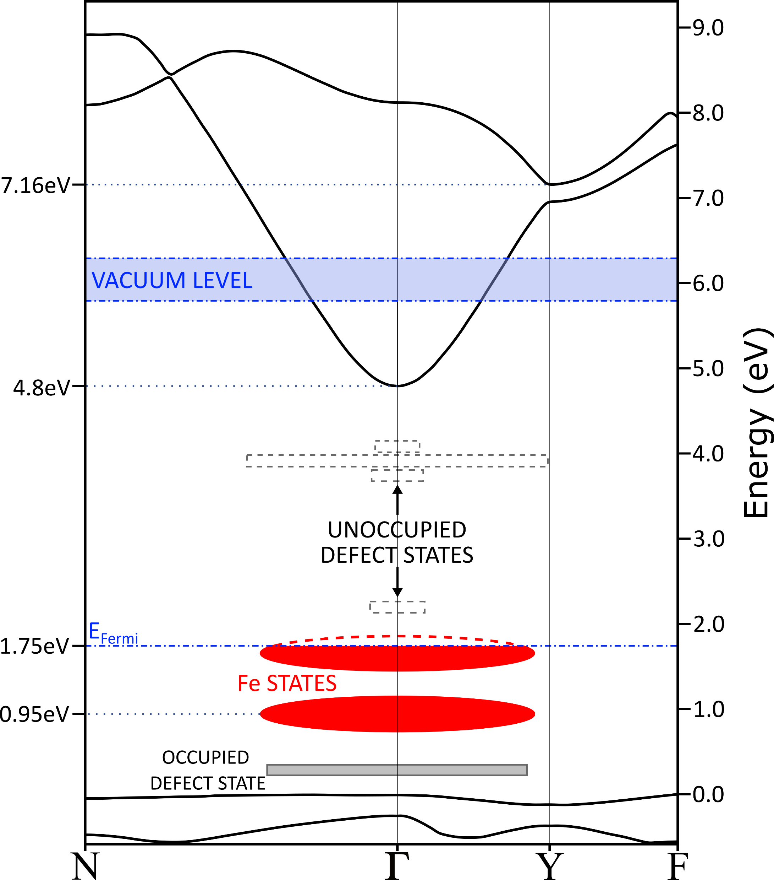
Fe-doped Ga₂O₃(010): Band structure
− Amsterdam Suite with rSCAN functionals
Thin-slab calculations give E_{vac.} = 6.0(±0.2) eV above valence band Γ point
⇒ Lower CB χ ≈ +1.2 eV
AND first ‘closed’ upper CB χ ≈ −1.1 eV
Photoexcitation into lower CB primarily from
(i) Two Fe dopant states (ħω < E_{g})
([Fe] ≈ 10¹⁸ cm⁻³ for semi-insulating behavior)
(ii) Valance band (ħω > E_{g})
UCB
LCB

Slide 11
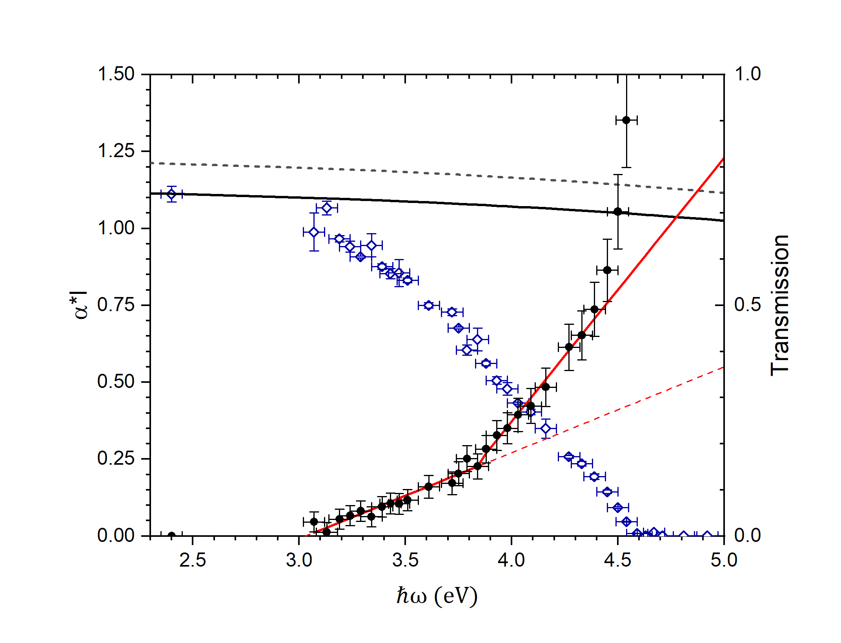
Fe-doped Ga₂O₃(010): Absorption α(ħω)
− Sample thickness: 450(±50) μm
BOTH electron transport regimes expected in one photocathode:
‘Long’ transport for ħω < 4.5 eV
− Absorption depth > 400 μm;
Fe dopant state to CB transitions
‘Short’ transport for ħω > 4.5 eV
− Absorption depth < 100 nm;
band-to-band transitions
NOTE:
Strong E_{g}(T) variation, Urbach absorption
tail, and anisotropic valence band
contribute to E_{g,eff.} ≈ 4.5 eV at 300 K
αl
‘long’ transport
‘short’ transport
L.A. Angeloni, I-J. Shan, J.H. Leach, and W.A. Schroeder, Appl. Phys. Lett. 124, 252104 (2024)

Slide 12
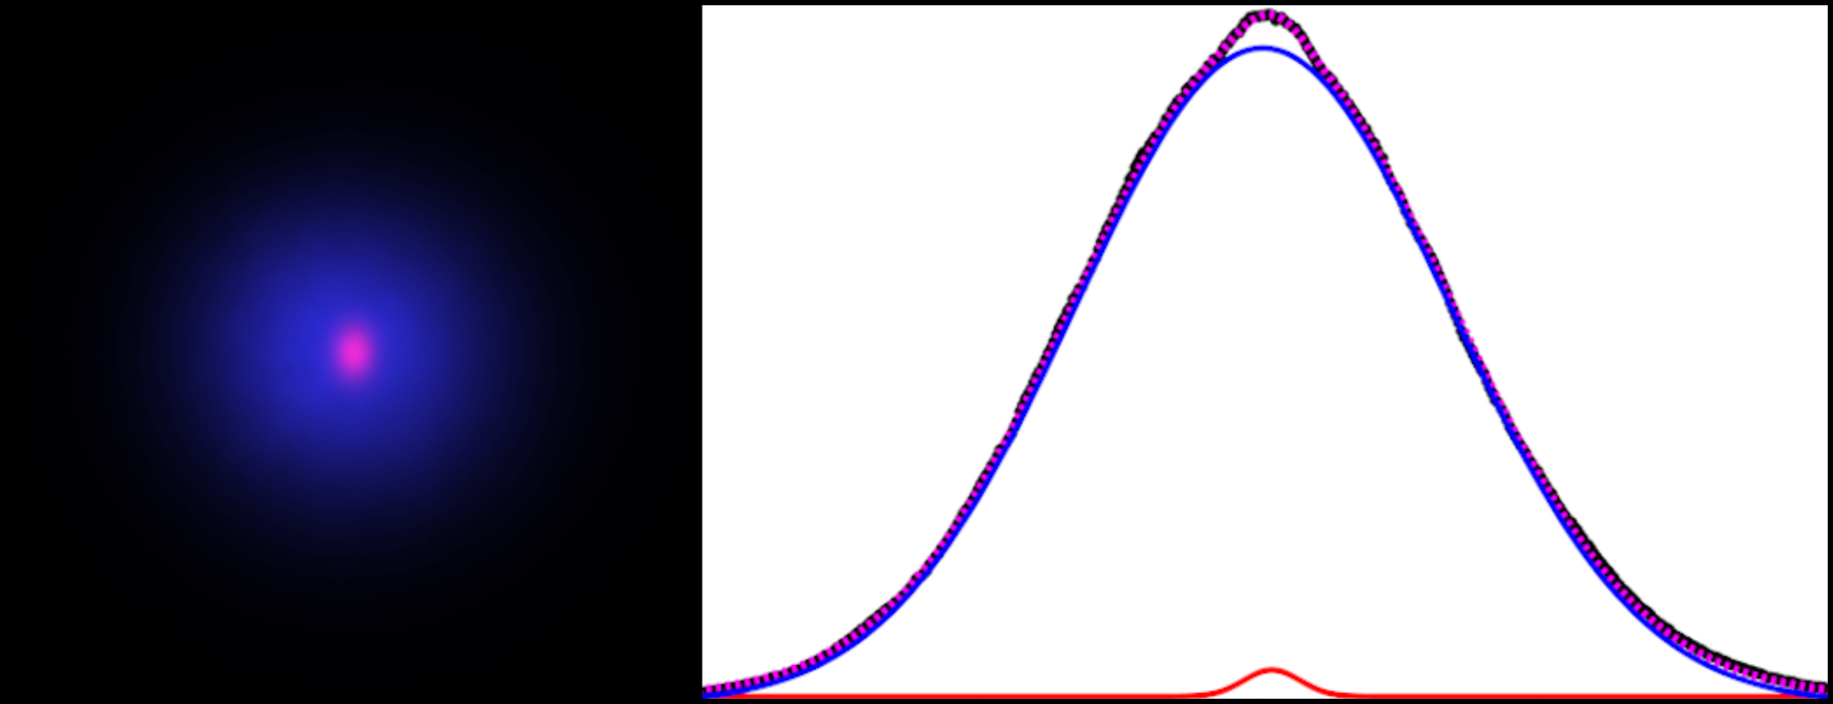
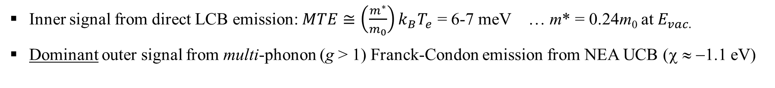
Fe-doped Ga₂O₃(010): Two emission signals
− Two Gaussian decomposition reveals sub-thermal emission signal !!
ħω = 4.33 eV
Outer signal
MTE ≈ 280 meV
300 K
Long transport regime
(ħω < E_{g} ≈ 4.5 eV)
⇒ T_{e} → T_{lattice}
Transport analysis in
internal drift field gives
k_{B}T_{e} ≈ 27 meV
Inner signal
MTE ≈ 6 meV
p_{T}
Inner signal from direct LCB emission: $MTE≅\left(\frac{m^{∗}}{m_{0}}\right)k_{B}T_{e}$ = 6-7 meV … m* = 0.24m₀ at $E_{vac.}$
Dominant outer signal from multi-phonon (g > 1) Franck-Condon emission from NEA UCB (χ ≈ −1.1 eV)
L.A. Angeloni, I-J. Shan, J.H. Leach, and W.A. Schroeder, J. Appl. Phys. 139, 095706 (2026)

Slide 13
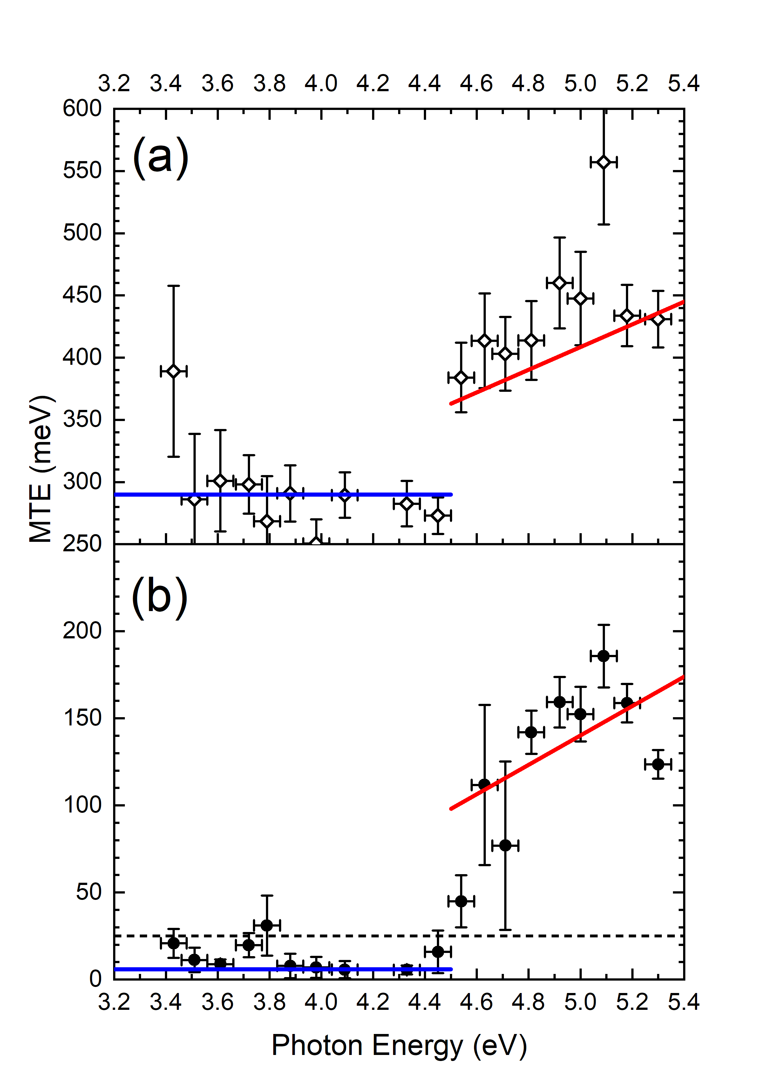
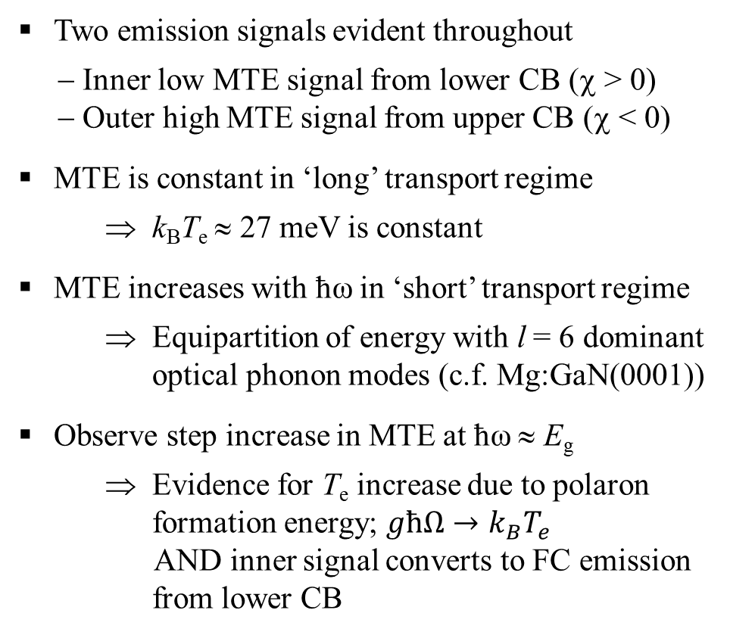
Fe-doped Ga₂O₃(010): MTE
Two emission signals evident throughout
− Inner low MTE signal from lower CB (χ > 0)
− Outer high MTE signal from upper CB (χ < 0)
MTE is constant in ‘long’ transport regime
⇒ k_{B}T_{e} ≈ 27 meV is constant
MTE increases with ħω in ‘short’ transport regime
⇒ Equipartition of energy with l = 6 dominant
optical phonon modes (c.f. Mg:GaN(0001))
Observe step increase in MTE at ħω ≈ E_{g}
⇒ Evidence for T_{e} increase due to polaron
formation energy; $għΩ→k_{B}T_{e}$
AND inner signal converts to FC emission
from lower CB
Outer signal
‘Short’ transport
Inner signal
‘Long’ transport
25meV

Slide 14
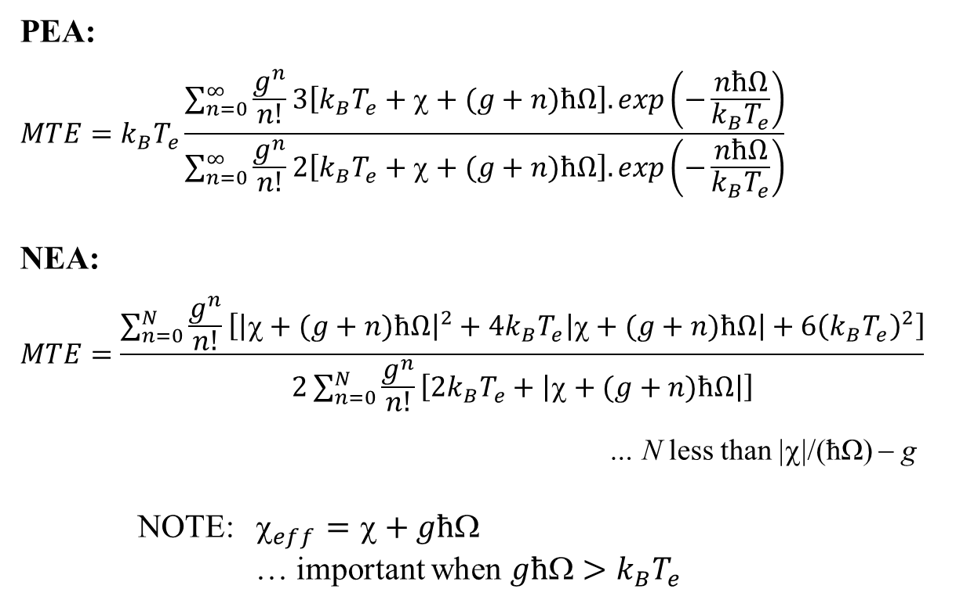
Modified FC analysis: Multi-phonon emission
− Large Fröhlich coupling constant g and finite ħΩ
PEA:
$$MTE=k_{B}T_{e}\frac{\sum_{n=0}^{∞}{\frac{g^{n}}{n!}}3\left[k_{B}T_{e}+χ+(g+n)ħΩ\right].exp\left(−\frac{nħΩ}{k_{B}T_{e}}\right)}{\sum_{n=0}^{∞}{\frac{g^{n}}{n!}}2\left[k_{B}T_{e}+χ+(g+n)ħΩ\right].exp\left(−\frac{nħΩ}{k_{B}T_{e}}\right)}$$
NEA:
$$MTE=\frac{\sum_{n=0}^{N}{\frac{g^{n}}{n!}\left[{\left|χ+(g+n)ħΩ\right|}^{2}+4k_{B}T_{e}\left|χ+(g+n)ħΩ\right|+6{\left(k_{B}T_{e}\right)}^{2}\right]}}{2\sum_{n=0}^{N}{\frac{g^{n}}{n!}\left[2k_{B}T_{e}+\left|χ+(g+n)ħΩ\right|\right]}}$$
… N less than |χ|/(ħΩ) − g
NOTE: $_{eff}=+għ$
… important when $għ>k_{B}T_{e}$
CB
Polaron
għΩ
n = 0
n = 1
n = 2
ħΩ
ħω
Emission
ħΩ
:
L.A. Angeloni, I-J. Shan, and W.A. Schroeder, Phys. Rev. Accel. & Beams 28, 123401 (2025)

Slide 15
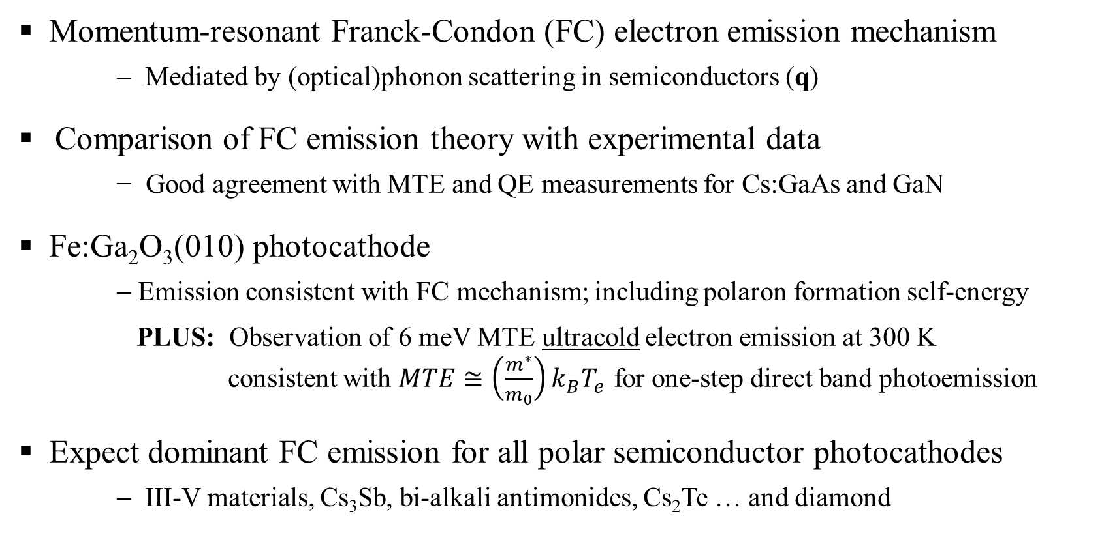
Summary
Momentum-resonant Franck-Condon (FC) electron emission mechanism
− Mediated by (optical)phonon scattering in semiconductors (q)
Comparison of FC emission theory with experimental data
− Good agreement with MTE and QE measurements for Cs:GaAs and GaN
Fe:Ga₂O₃(010) photocathode
− Emission consistent with FC mechanism; including polaron formation self-energy
PLUS: Observation of 6 meV MTE ultracold electron emission at 300 K
consistent with $MTE≅\left(\frac{m^{∗}}{m_{0}}\right)k_{B}T_{e}$ for one-step direct band photoemission
Expect dominant FC emission for all polar semiconductor photocathodes
− III-V materials, Cs₃Sb, bi-alkali antimonides, Cs₂Te … and diamond
NOTE: “Evidence for Umklapp electron scattering emission from metal photocathodes”
I-J. Shan, L.A. Angeloni, and W.A. Schroeder, APS Open Science (accepted for publication)

Slide 16
Cesiated GaAs: Sub-thermal emission
Evidence for direct band contribution?
Less than 5% of total emission
BUT MTE < 25 meV
[m* ≈ 0.067m₀ for GaAs
with m*(E) ⇒ m*(χ)]
NOTE
Other reports:
G. Vergara et al., J. Appl. Phys. 80, 1809 (1996)
V. Bakin et al., JETP Lett. 77, 167 (2003)
Z. Liu et al., J. Vac Sci. & Tech. B 23, 2758 (2005)
L.B. Jones, H.E. Scheibler, et al., J. Phys. D: Appl. Phys. 54, 205301 (2021)

Slide 17
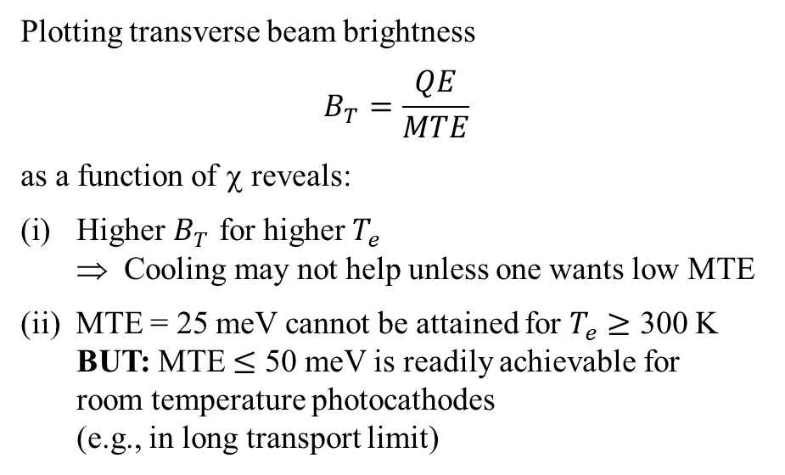

Beam brightness: FC emission prediction
− Optimum χ for maximum beam brightness: Analytical evaluation in ħΩ → 0 limit for one emission band
Plotting transverse beam brightness
$$B_{T}=\frac{QE}{MTE}$$
as a function of χ reveals:
Higher $B_{T}$ for higher $T_{e}$
⇒ Cooling may not help unless one wants low MTE
(ii) MTE = 25 meV cannot be attained for $T_{e}≥$ 300 K
BUT: MTE $≤$ 50 meV is readily achievable for
room temperature photocathodes
(e.g., in long transport limit)
$T_{e}$= 500 K
MTE = 100 meV
400 K
300 K
200 K
Brightness (a.u.)
MTE = 50 meV
100 K
For any polar semiconductor
photocathode maximum beam
brightness achieved for χ ≈ 0
at a fixed desired MTE
MTE = 25 meV
χ (eV)

Slide 18
Thank You !

Slide 19

One-step photoemission analysis
E
Exact 1-D quantum solution for triangular barrier
− Above and below threshold emission
Extension for photoemission simulation includes:
i) p_{T} conservation
ii) Band dispersion fits; e.g.
iii) Fermi-Dirac population distribution; T_{e}
iv) Bulk local DOS
v) Vacuum density of states
Vacuum states
E
Virtual states
Photoemission
ΔE
Field emission
ħω
p_{z}
p_{z}
E
Bulk states
−qE_{cath.}z
Ԑ_{F}
Crystal
(m_{z} , m_{T})
Vacuum
(m₀)
p_{z}
W.A. Schroeder and G. Adhikari, New J. Phys. 21 (2019) 033040

Slide 20
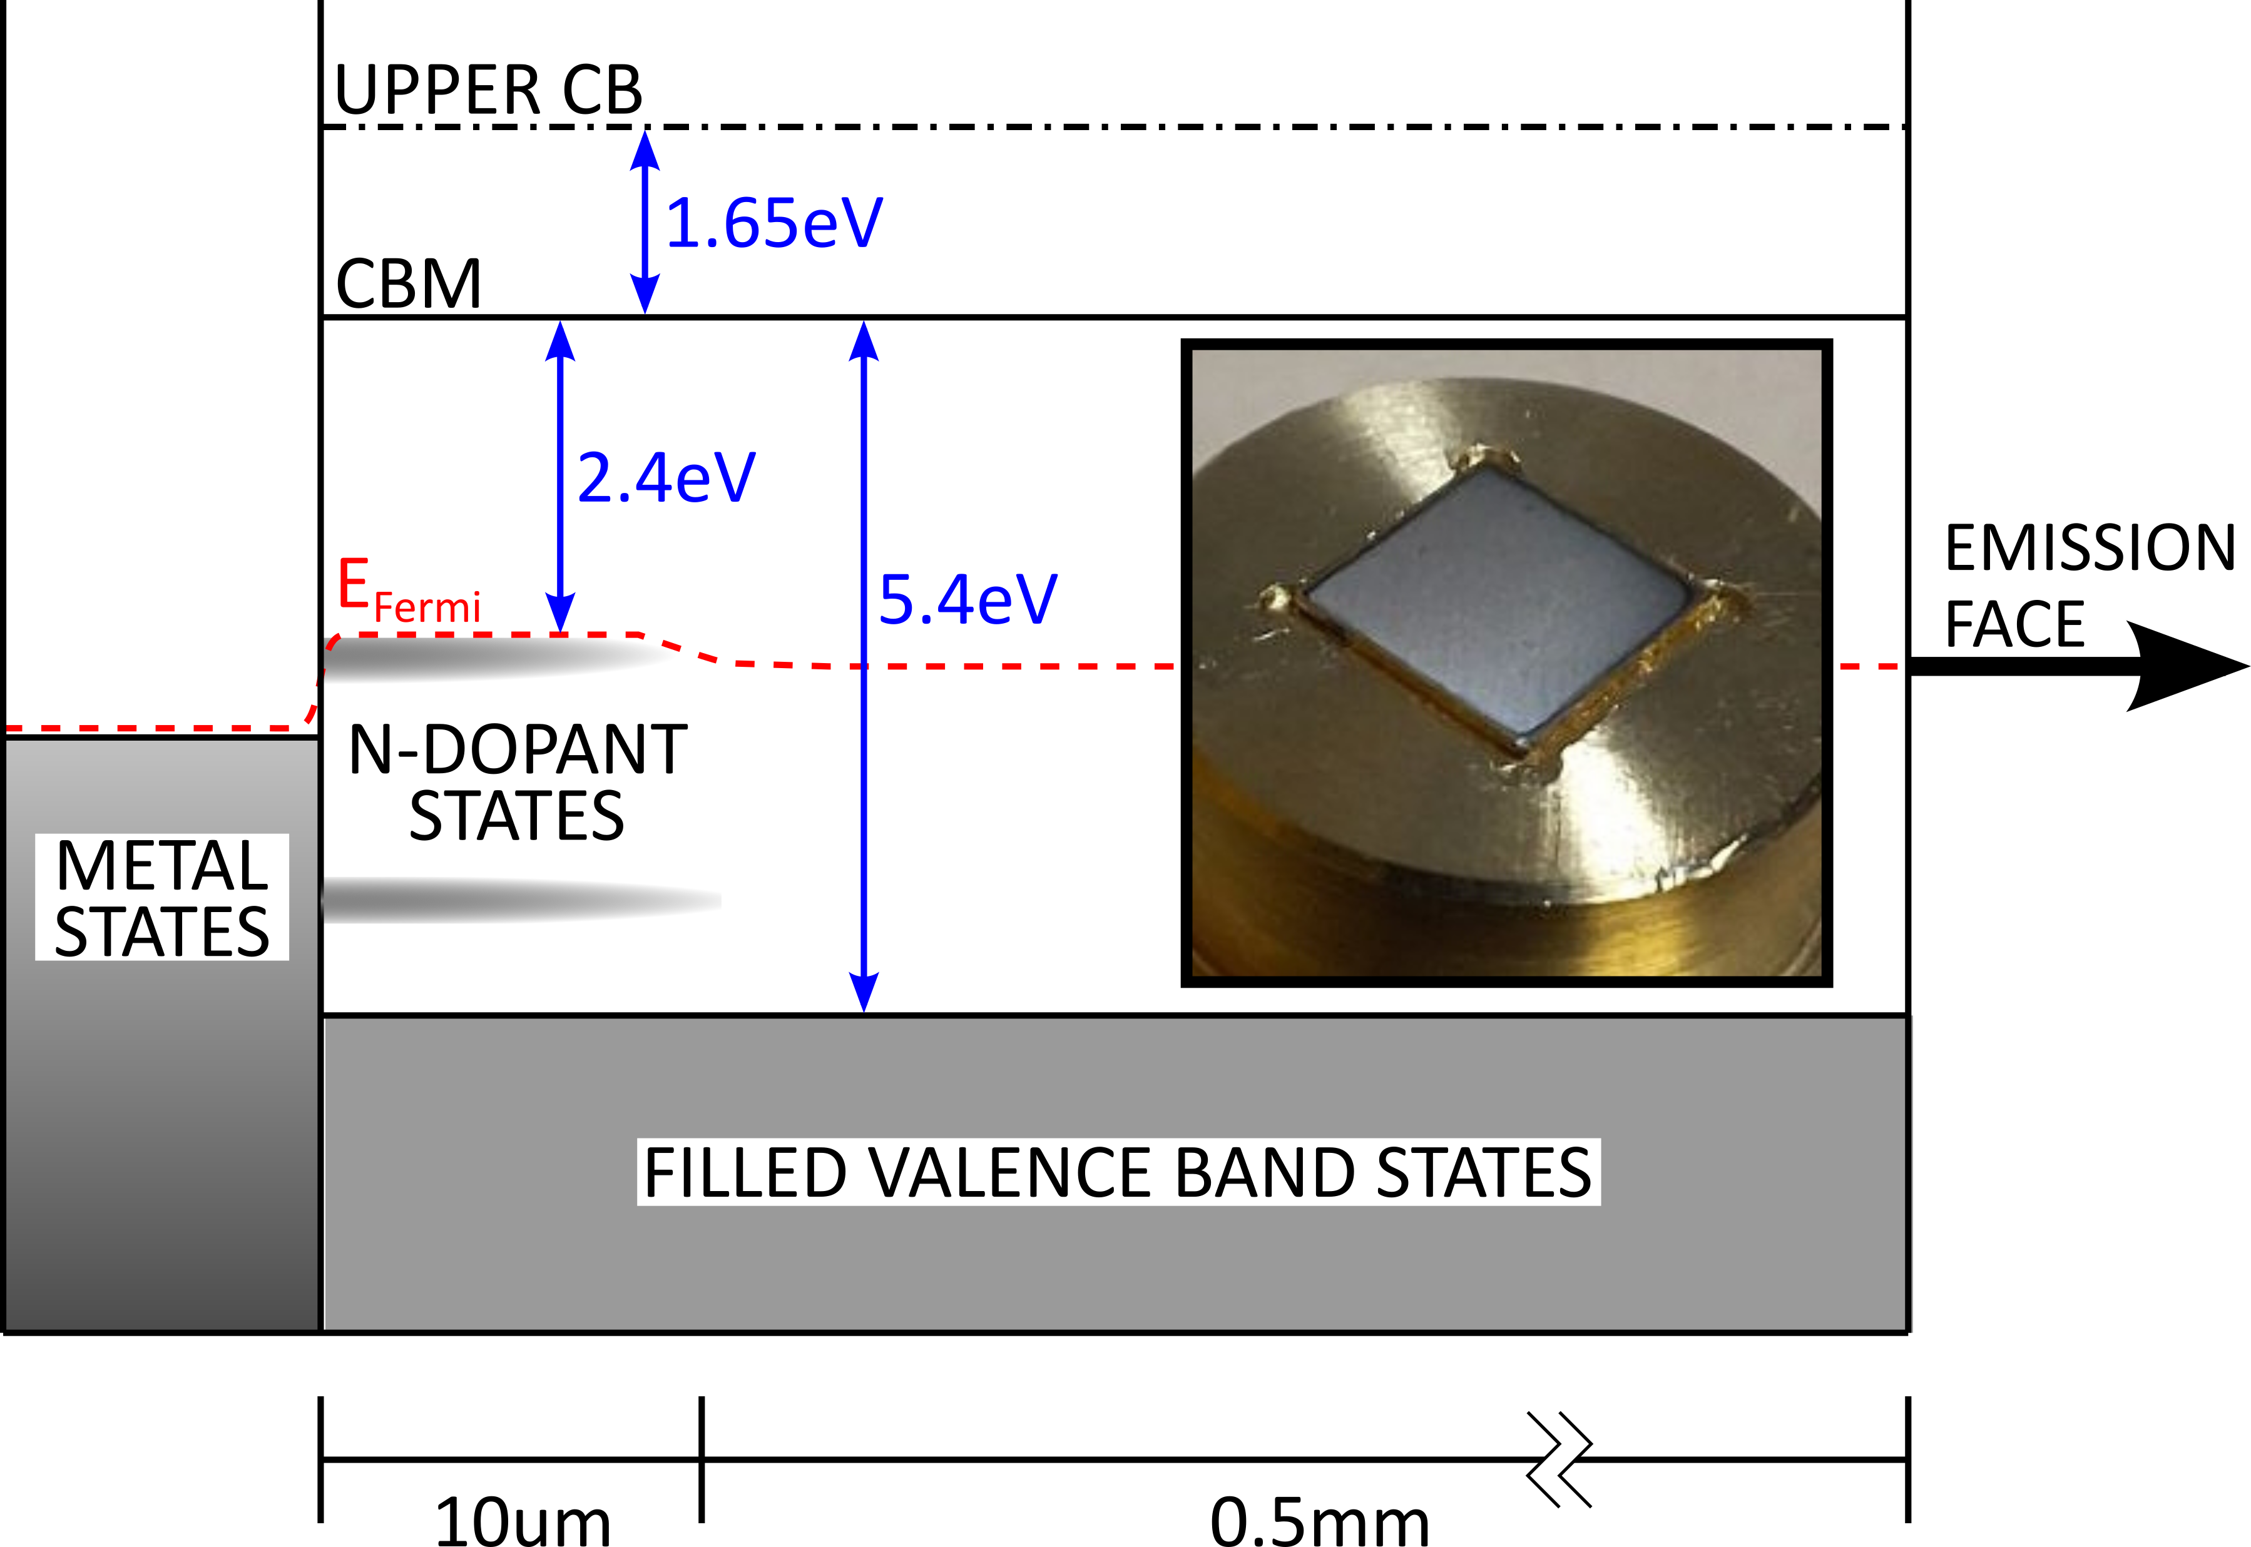
Metallized diamond(001): A hybrid photocathode
− 0.5 mm-thick CVD diamond: Back surface metallized [annealed C-Ti (+Pt+Au)]
Back surface photo-injection from Ti into diamond CB for ħω > 3.2 eV
Electron drift transport to emission face due to applied DC gun field
⇒ k_{B}T_{e} ≈ 30 meV
… E ≈ 3kV/cm, ħΩ = 165 meV
Emission from upper (χ ≈ −0.8 eV) and lower (χ ≈ 0.8 eV) CBs
⇒ Two emission signals
L.A. Angeloni, I-J. Shan, and W.A. Schroeder, arXiv.2506.12550 (accepted for publication in PRAB)

Slide 21
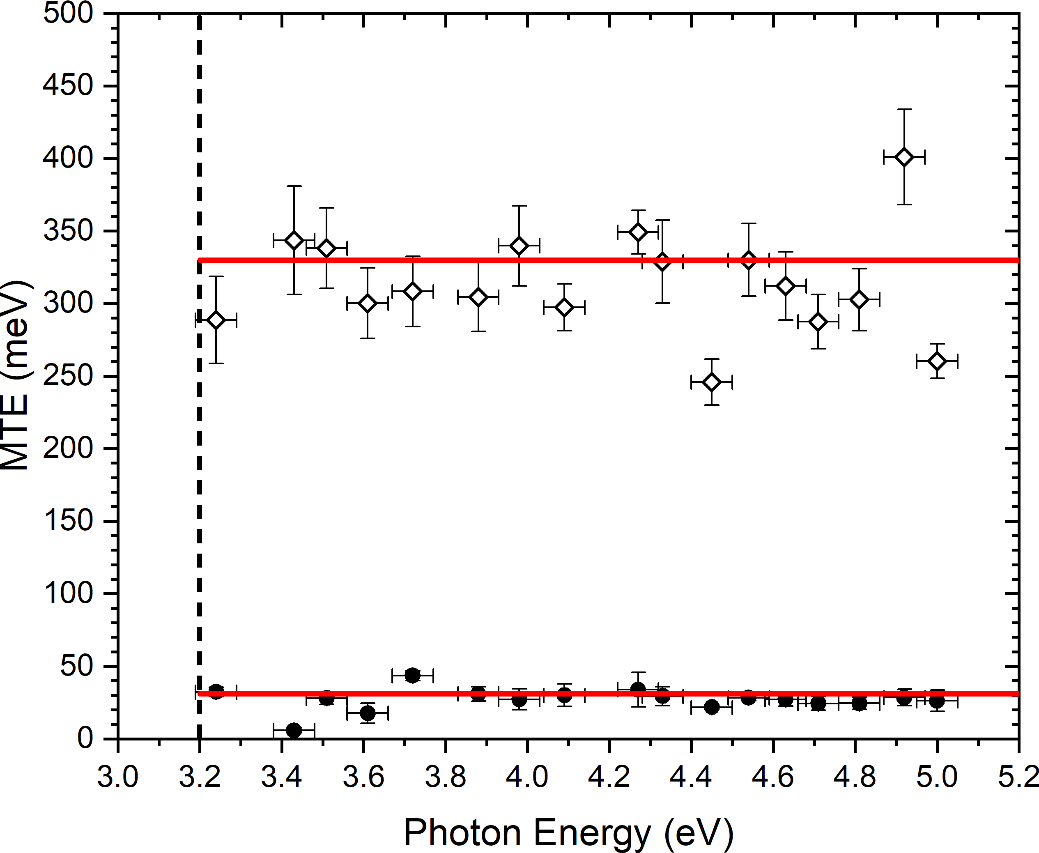
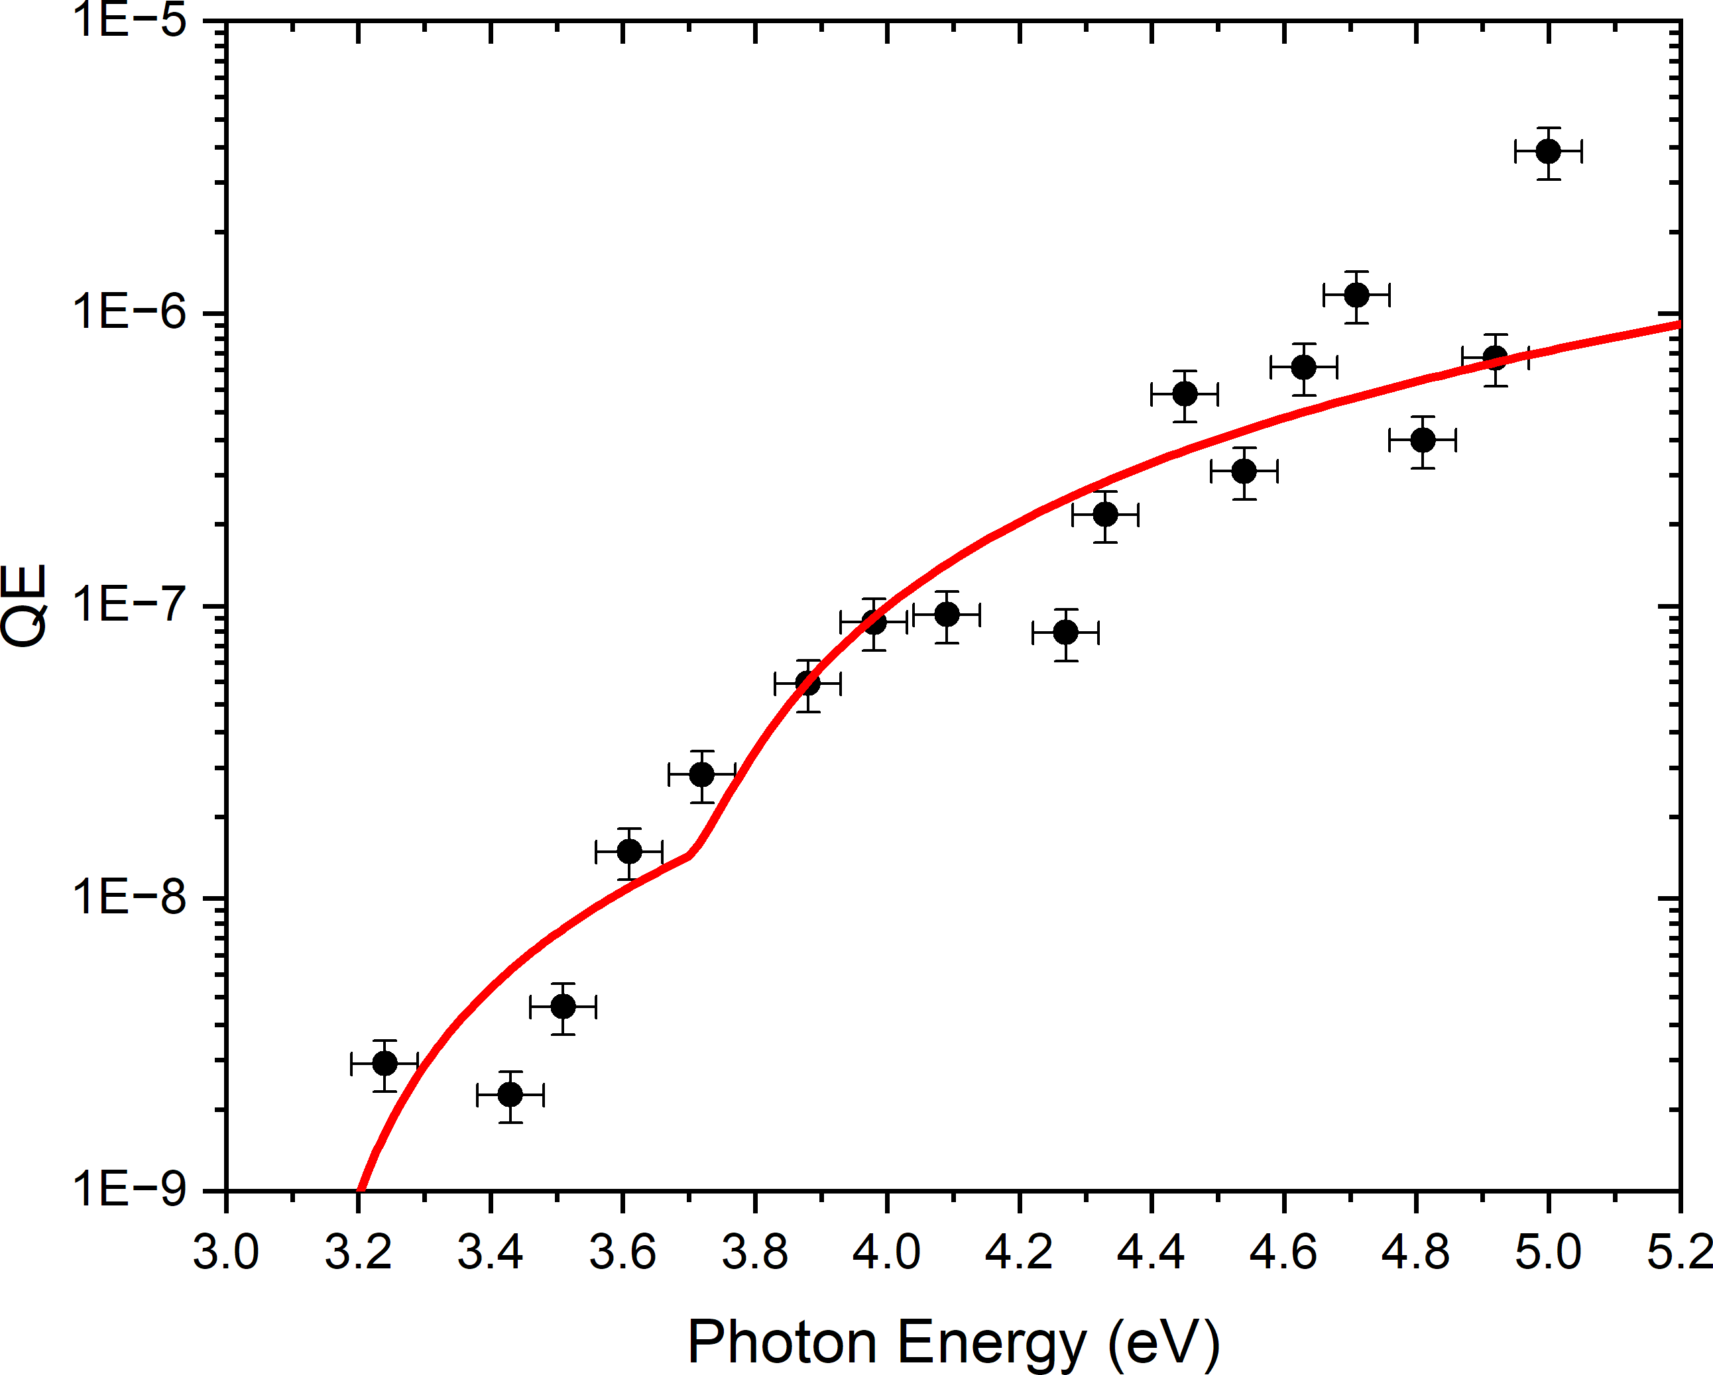
Metallized diamond(001): MTE and QE
− Multi-phonon emission: g = 1.1, ħΩ = 165 meV, plus polaron self energy
MTE
Total QE
Upper CB
Back surface injection efficiency with Ti DOS
Lower CB
L.A. Angeloni, I-J. Shan, and W.A. Schroeder, arXiv.2506.12550 (accepted for publication in PRAB)

