Slide 1
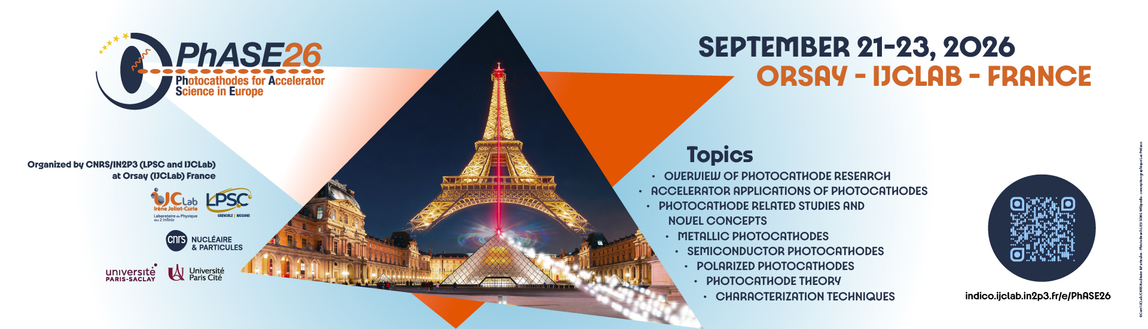
High polarization and high QE
Photocathodes for the EIC
Erdong Wang
Electron-Ion Collider, BNL
PhASE 2026
September 22, 2026

Slide 2
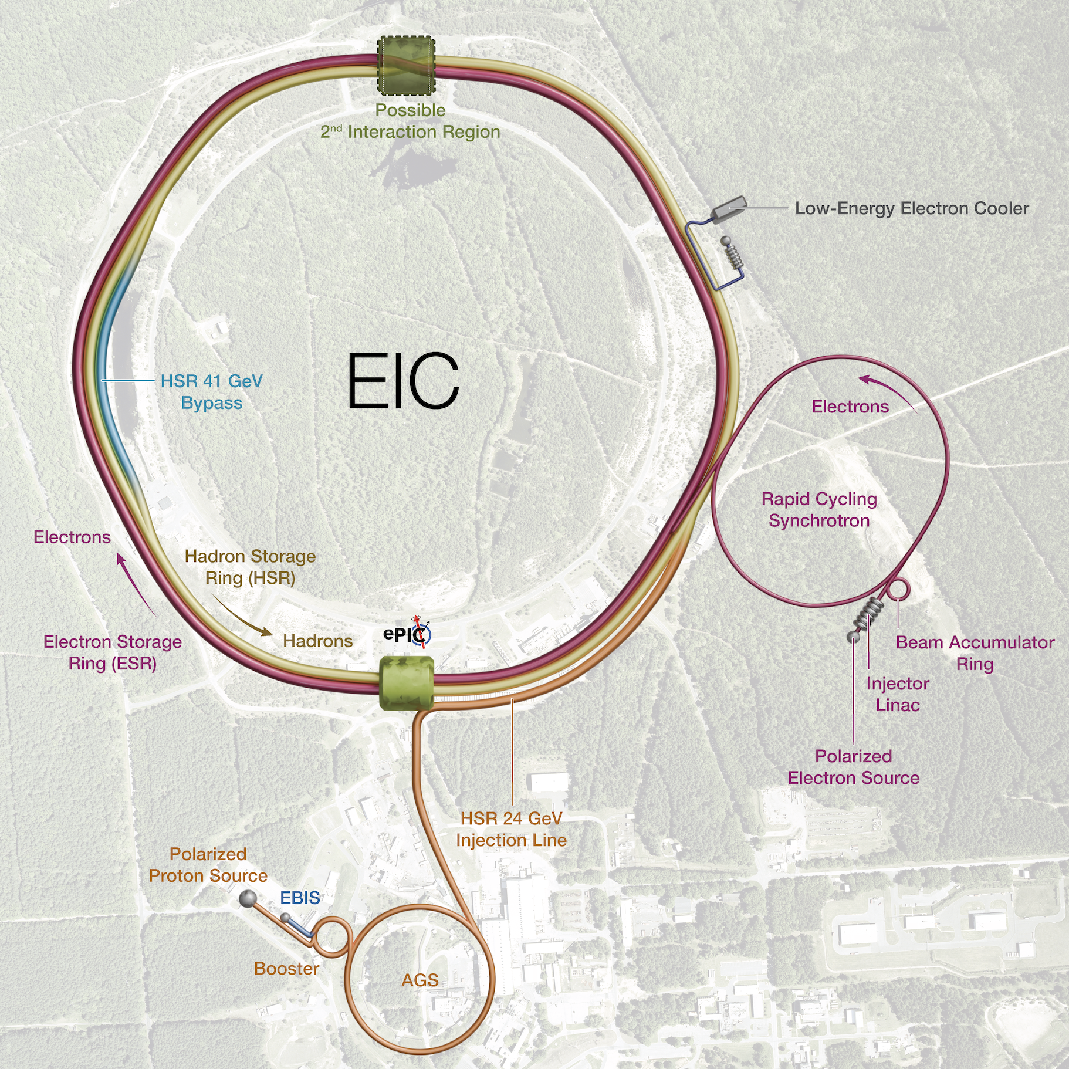
From RHIC to EIC
RHIC has operated for nearly 25 years, colliding heavy ions and high-energy polarized protons.
The Electron-Ion Collider (EIC) will serve the international nuclear physics community.
EIC is expected to be the only operating U.S. particle collider and one of the few new large colliders worldwide.

Slide 3
EIC electron polarization requirements
EIC must store spin-up and spin-down electron bunches simultaneously.
Sokolov–Ternov polarization opposes spin-down polarization, while spin diffusion reduces the average polarization.
  Frequent swap-out injection maintains 70% average polarization.
The injector produces polarized bunches and injects them into the electron storage ring at collision energy.
Energy boost ring has strong spin resonance at high energy. Expected some polarization loss. Required initial polarization: 80% at 5–9 GeV and at least 85% at 18 GeV.

Slide 4
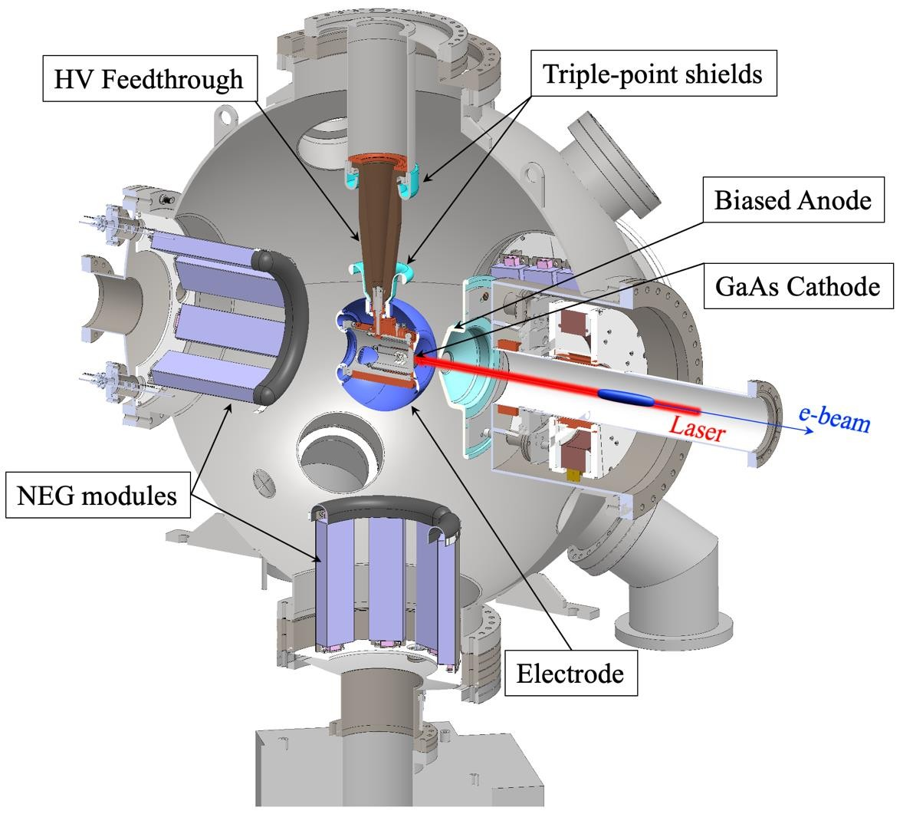
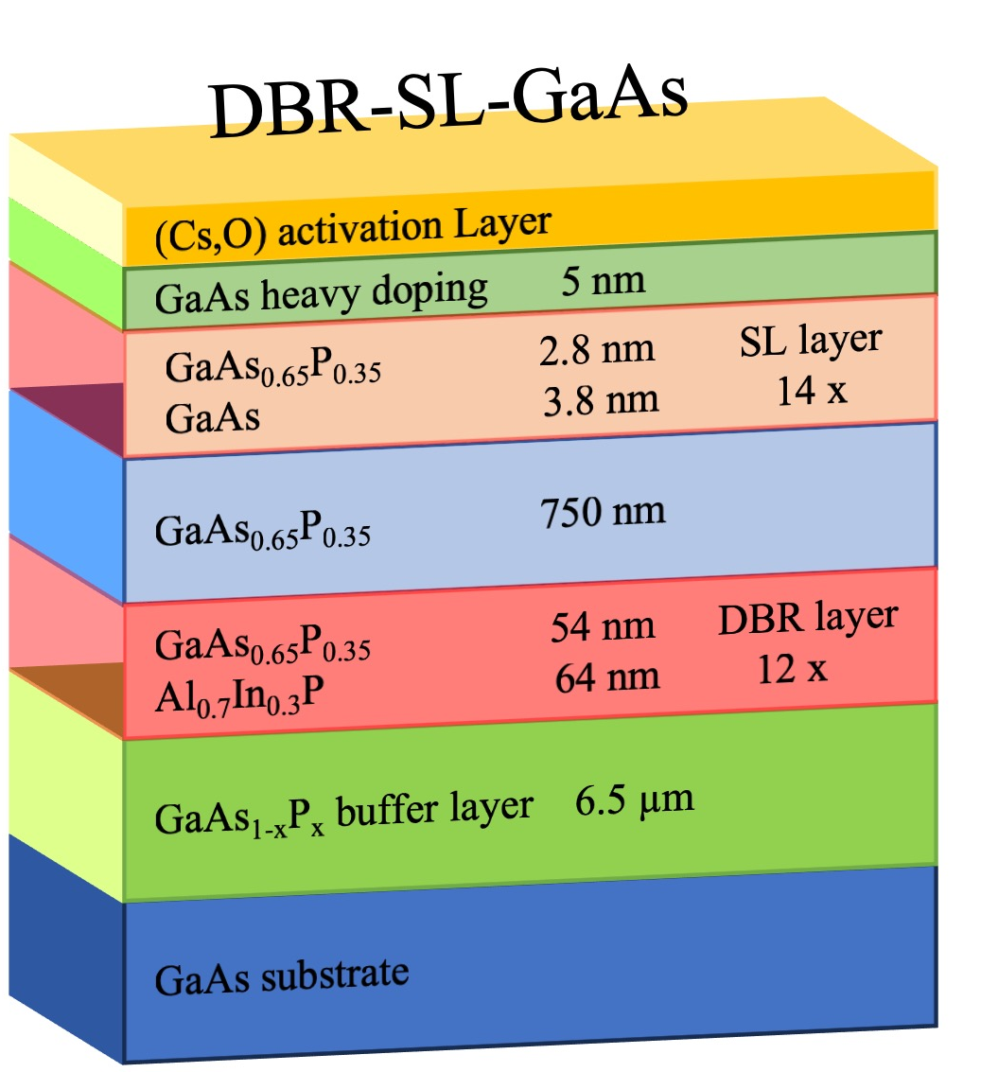
EIC polarized electron source R&D
Source R&D began in 2018 and met EIC goals in 2024.
DBR-SL-GaAs operated in an HVDC gun, generated up to 11.6 nC bunch charge. Lifetime measurements used 30 µA average current.
  One activation delivered more charge than 28 weeks of continuous EIC operation.
Measured SL-GaAs samples came from ODU, SVT, SNL, Nagoya, Acken, and SMI.

Slide 5
Photocathode R&D highlighted achievements
High charge: reduced the surface charge limit.
  Optimized surface doping and low-temperature cleaning.
QE, polarization, and charge: improved the balance.
  Studied doping levels and the number of DBR pairs.
MOCVD cathodes without an As cap:
  Developed wet cleaning.
DBR-SL nonuniformity:
  implemented a wavelength-tunable laser.
SL-GaAs supply: tested samples from multiple suppliers.
Polarization and robustness R&D: demonstrated graphene-coated GaAs.

Slide 6
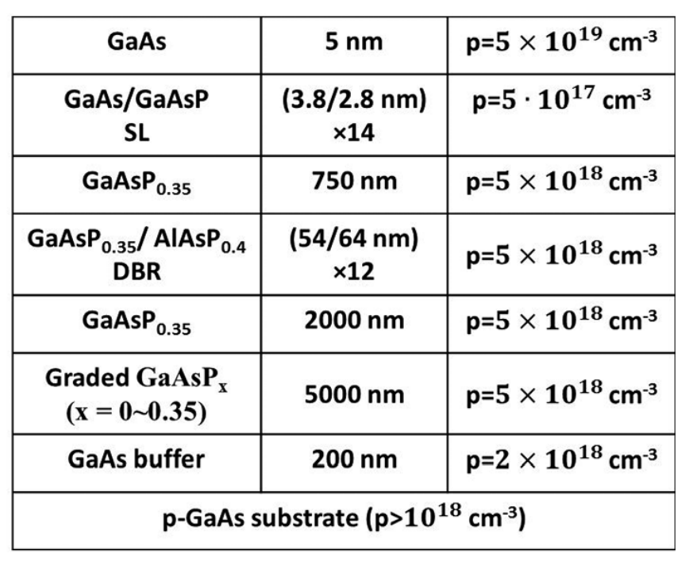
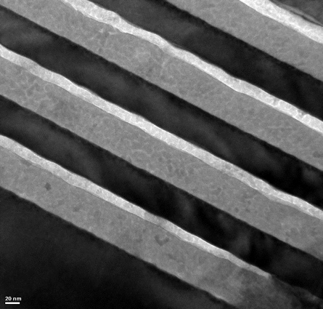

DBR superlattice photocathodes
A distributed Bragg reflector (DBR) enhances QE through a Fabry–Perot resonance between the DBR and the surface-vacuum interface.
ODU/JLab/BNL: GaAs/GaAsP superlattice with an AlAsP/GaAsP DBR.
DBR-cathode successful use in an HVDC gun. QE = 2.35%, ESP = 92%.
14 SL Pairs
$$96 nm$$
12 DBR Pairs
Benjamin Belfore et al., “High figure of merit spin-polarized electron sources grown via MOCVD,” Appl. Phys. Lett. 123, 222102 (2023).

Slide 7
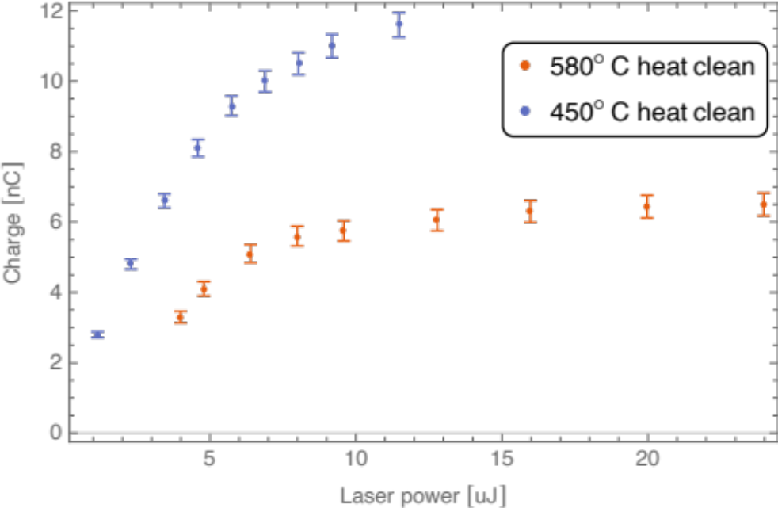
Reducing the surface charge limit
trapped electrons
Cathode
Vacuum
February 2023: 6 nC, limited by the surface charge limit.
June 2023: 11.6 nC after:
  Surface-doping optimization.
  Acid wet cleaning and 450 °C heat cleaning.
85–90% polarization at 785 nm.
DBR-SL-GaAs: 11.6 nC (8 mm), up to 30 µA.
Doubling size/power gives only 20% more charge (SCL).

Slide 8
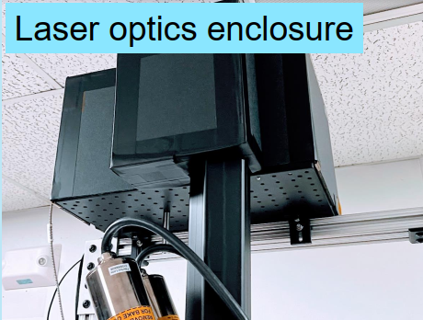
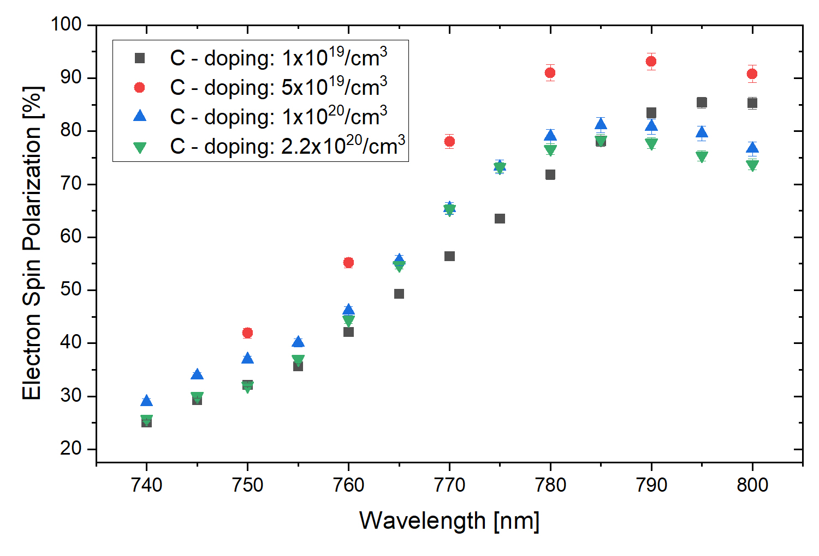
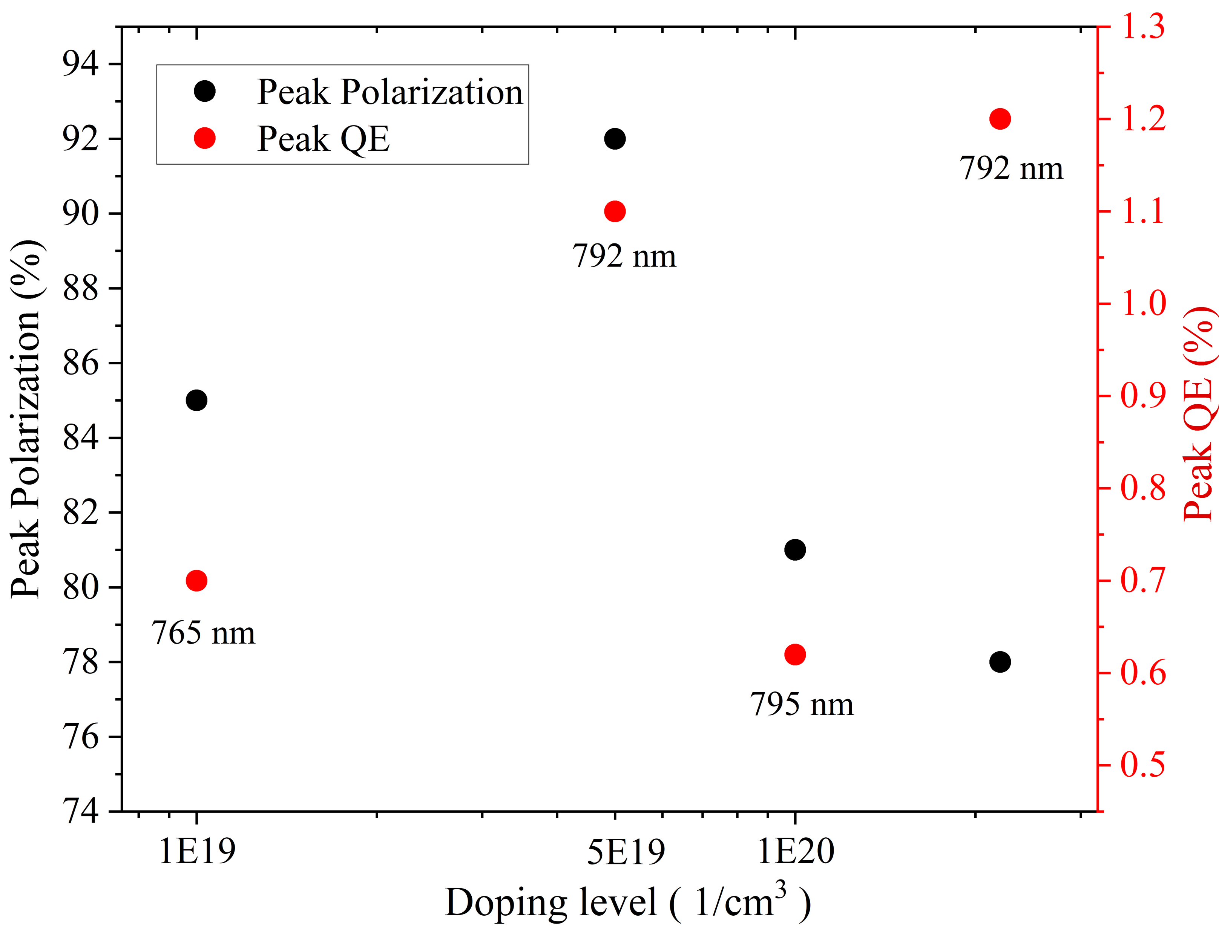
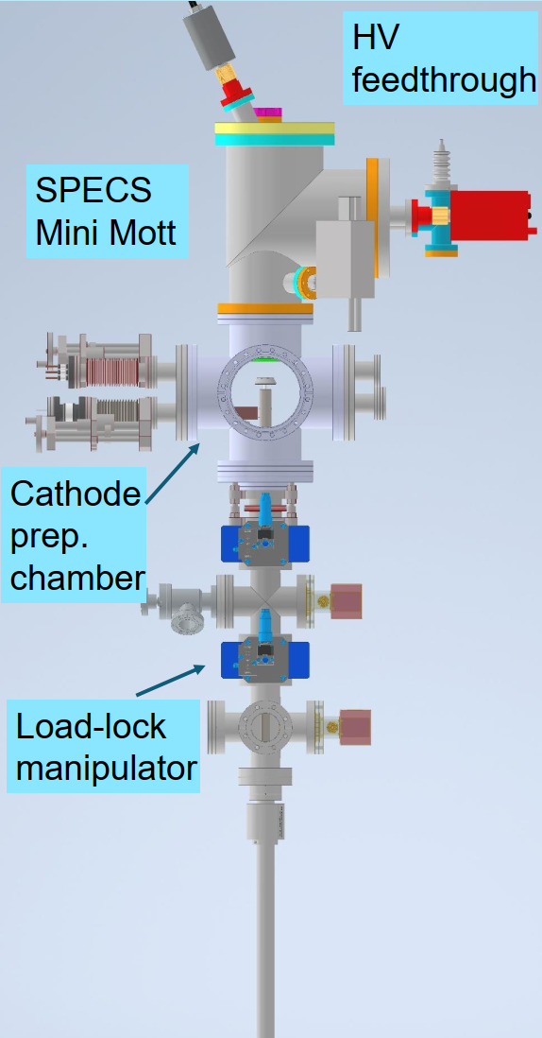
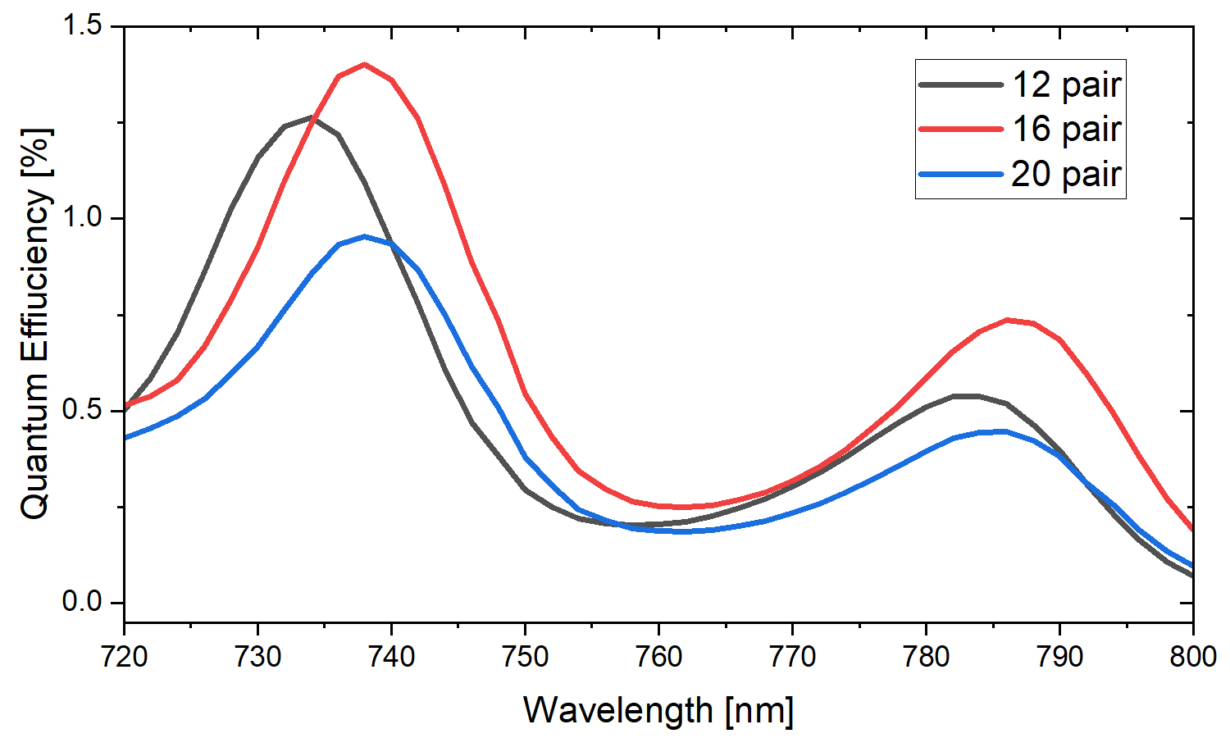
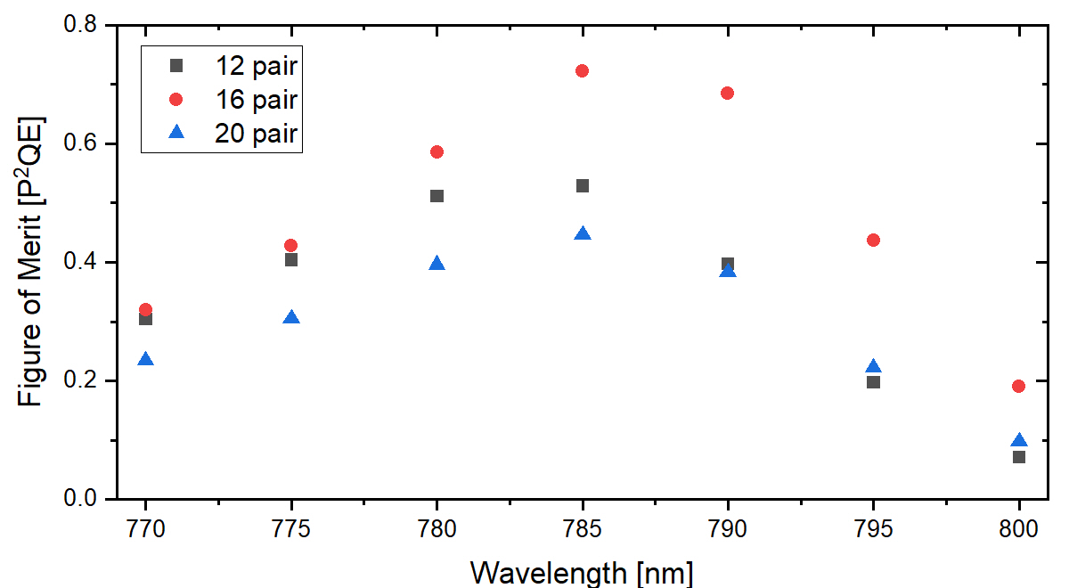
Surface doping and DBR pairs
EIC Mott polarimeter
Surface doping of 5 × 10¹⁹ cm⁻³ gives higher polarization. 16 DBR pairs give a higher figure of merit, P² × QE.
Polarization and QE measurements used the EIC Mott polarimeter.

Slide 9
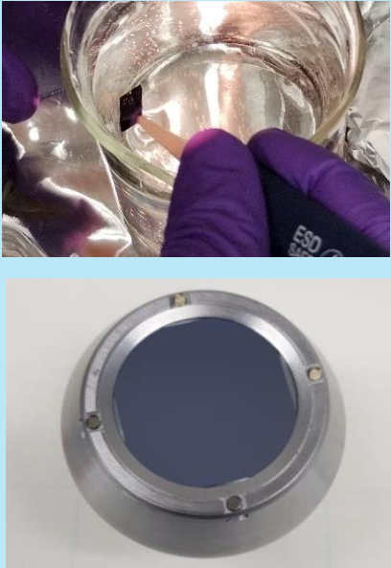
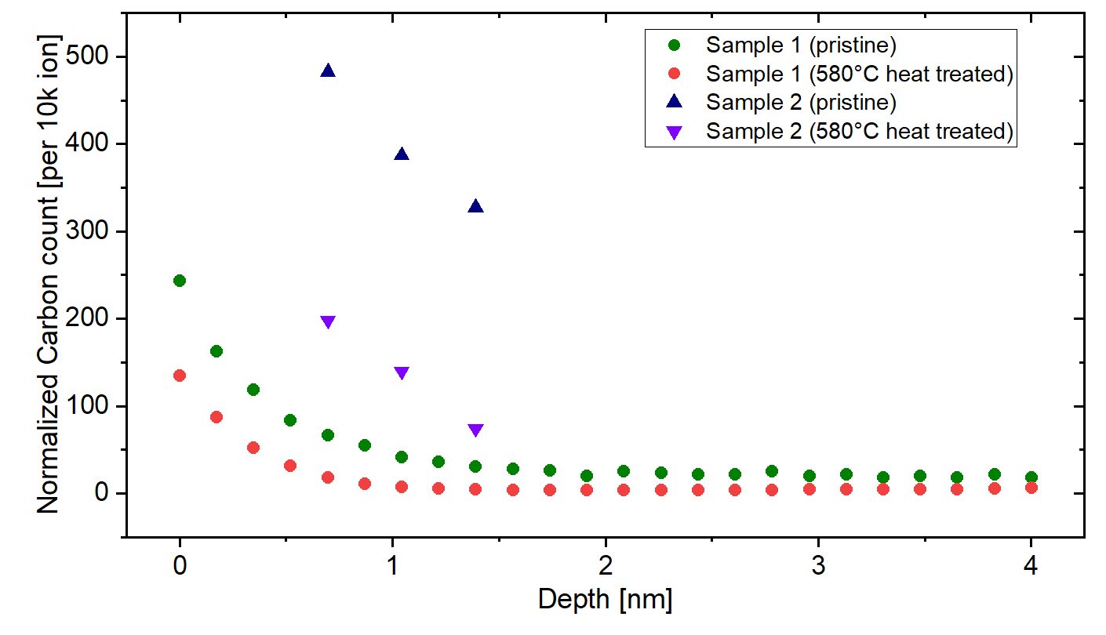
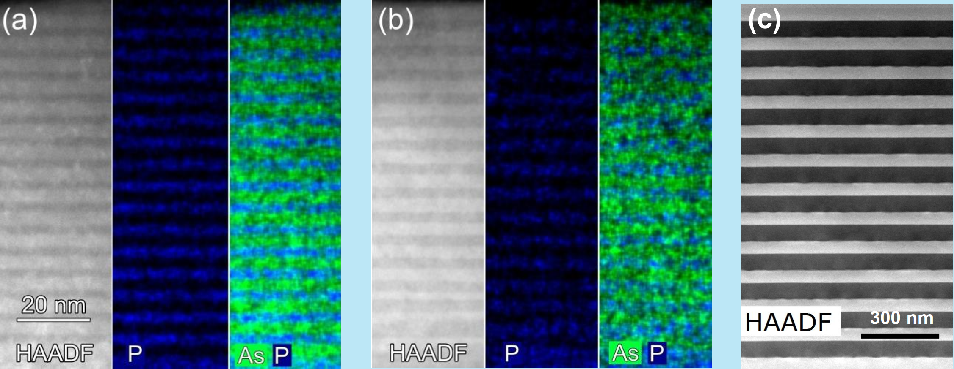
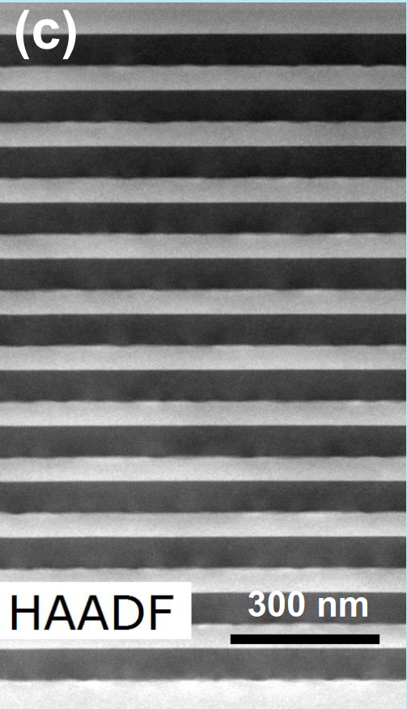
Wet-cleaning procedure development
MOCVD samples lack an As cap. High-temperature cleaning caused a surface charge limit.
Cleaning: HCl + 450 °C heat treatment.
  Acetone, then DI water (~30 s).
  36% HCl (~45 s), then DI-water rinse.
  N₂ blow-drying and N₂-filled storage.
HCl wet etch
TEM images
SIMS depth profile : the surface C diffused in heat treatment

Slide 10
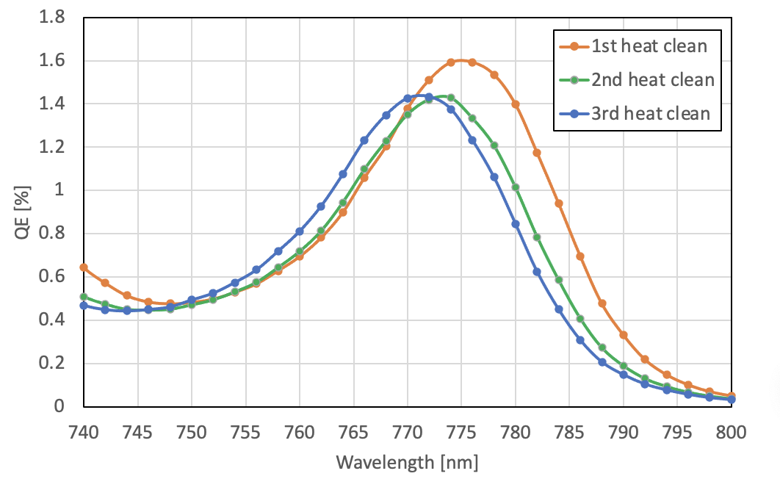
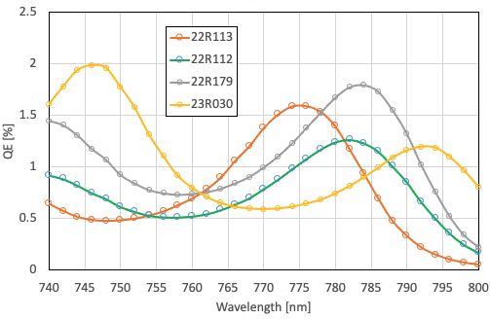
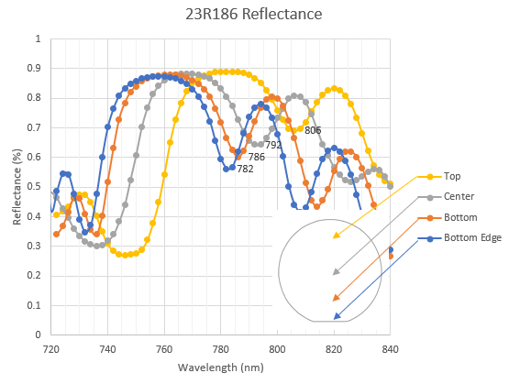
Variation in DBR resonance wavelength
Provided by A. Master
The DBR resonance wavelength varies by about 20 nm with:
  Repeated heat cleaning and QE measurements at the same location and temperature.
  Sample-to-sample differences and position on a sample.
Our approach: a circularly polarized, wavelength-tunable laser for DBR-SL-GaAs.

Slide 11
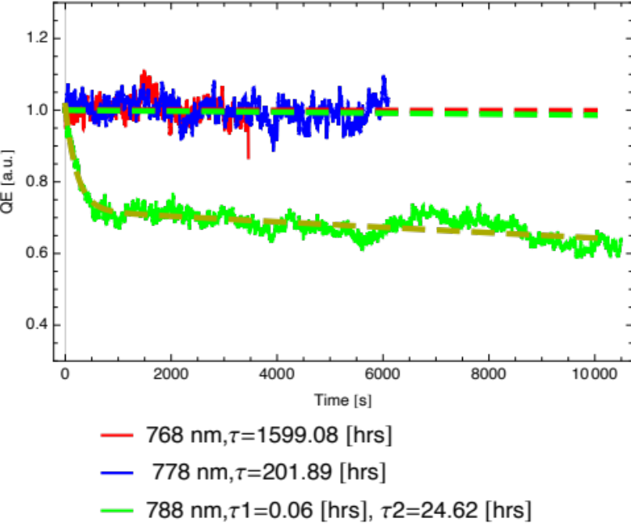
DBR-SL cathode lifetime
Working window: resonance to ESP drop
778
768
788
A negative slope
gives a short lifetime
A positive slope gives a
longer lifetime
Lifetime measurements used 30 µA average current.
The operating wavelength must balance high QE, high ESP, and long lifetime.
At 30 µA, 9 h = >28 EIC weeks of charge (10% decay).
Erdong Wang et al., “High-intensity polarized electron gun featuring distributed Bragg reflector GaAs photocathode,” Appl. Phys. Lett. 124, 254101 (2024).

Slide 12
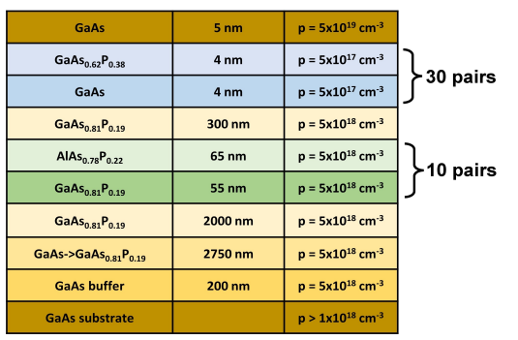
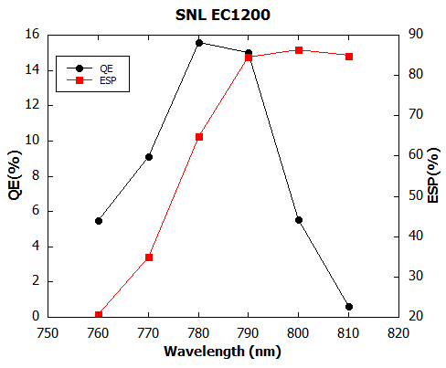
Superlattice photocathodes at Sandia
DOE supports national-laboratory and industrial efforts to strengthen the SL-GaAs supply chain alongside university suppliers.
Strain compensation mitigates polarization loss in thick superlattices and DBR structures.
26 pairs
Team | Wavelength (nm) | QE (%) | ESP (%)
BNL/SNL rev.1 | 775 | 18.8 | 66
BNL/SNL rev.2 | 780 | 9 | 72
BNL/SNL rev.3 | 790 | 15 | 84
Al_{0.15}Ga_{0.85}As_{0.18}P_{0.19}
10 pairs
Sandia uses MBE with sub-nanometer resolution.
SL-DBR achieved QE ≈ 15% and ESP ≈ 84% at 790 nm.
Record figure of merit: ESP² × QE.
Courtesy of Luca Cultrera

Slide 13
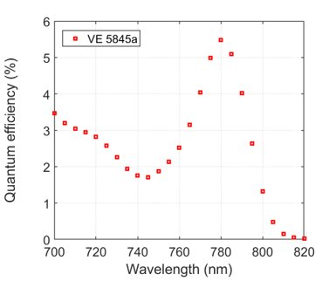
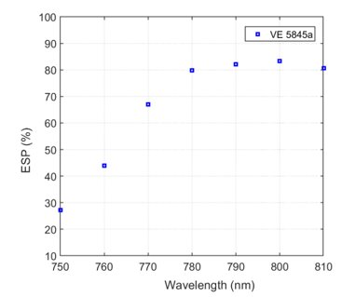
SL-DBR technology transfer to industry
With DOE-NP SBIR/STTR funding, BNL worked with Structured Material Industries and SRI International to transfer SL-DBR technology to industry.
MOCVD offers faster growth and multiple-wafer production, but these samples have no As cap.
30 pairs
Al_{0.15}Ga_{0.85}As_{0.18}P_{0.19}
10 pairs
SL-DBR samples achieved QE ≈ 5.5% and ESP ≈ 80%.
Nitrogen packaging limits surface oxidation.
Courtesy of Luca Cultrera

Slide 14
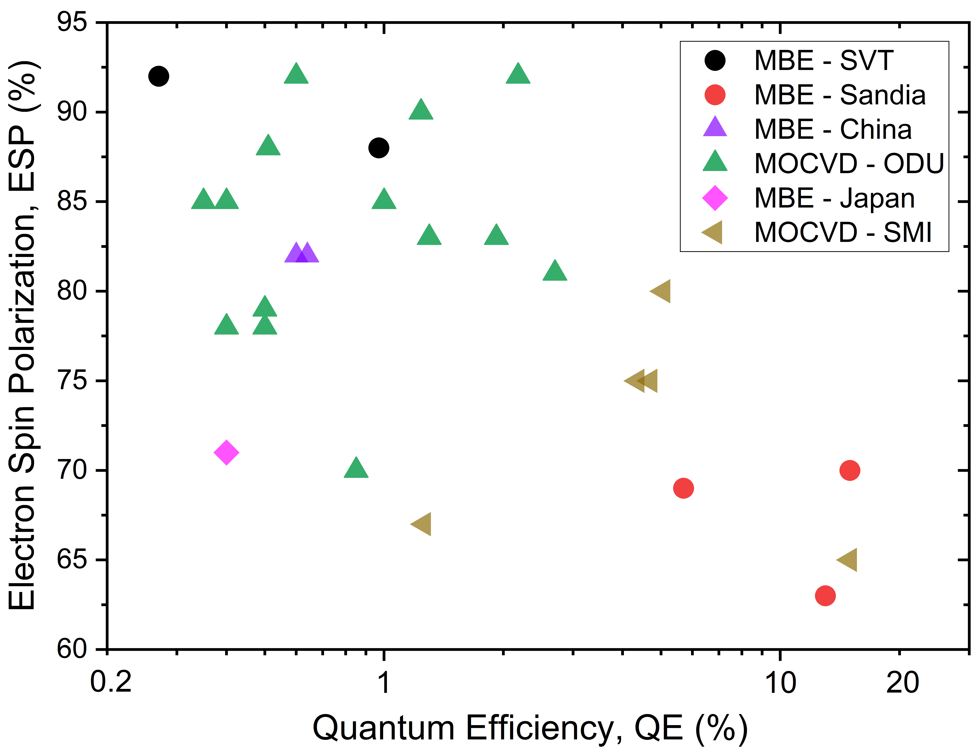
GaAs wafer performance and supply
More than 50 samples from multiple vendors and facilities were tested over five years.
About half met 80% polarization for 5–9 GeV for EIC. The 85% goal at 18 GeV needs sample selection or vendor improvements.
  Both approaches need substantial funding.
Export restrictions create supply risks. Government support or European suppliers may provide options.
EIC requirement

Slide 15
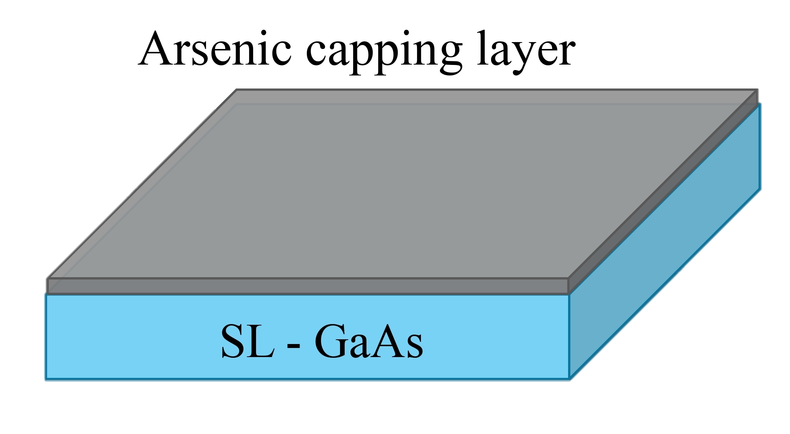
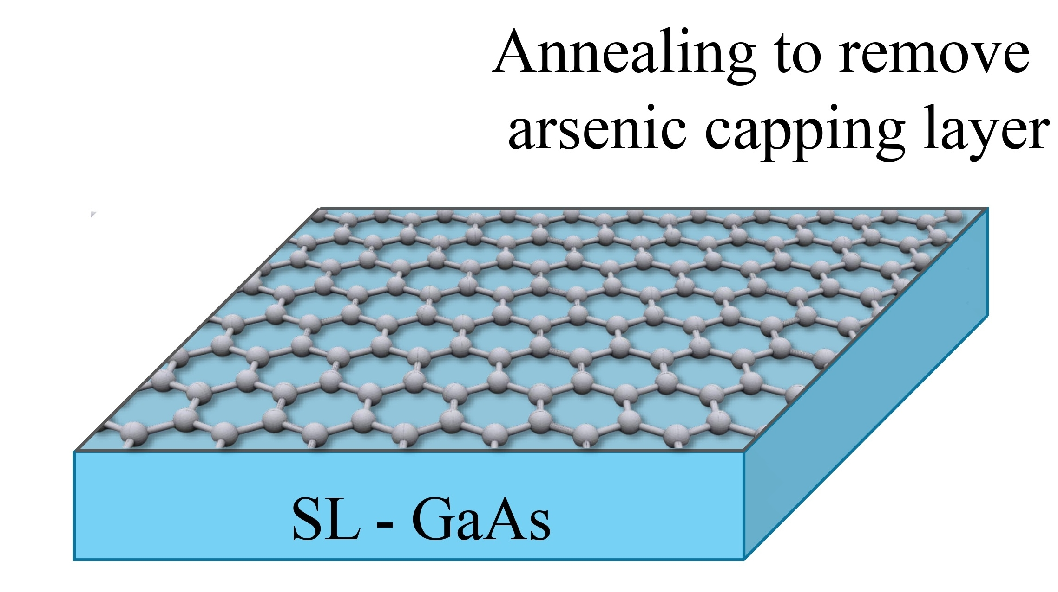
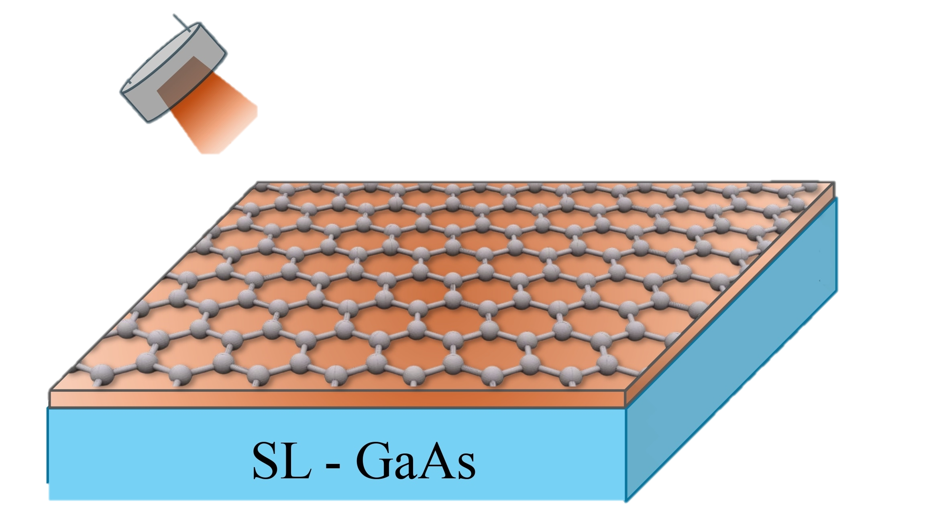
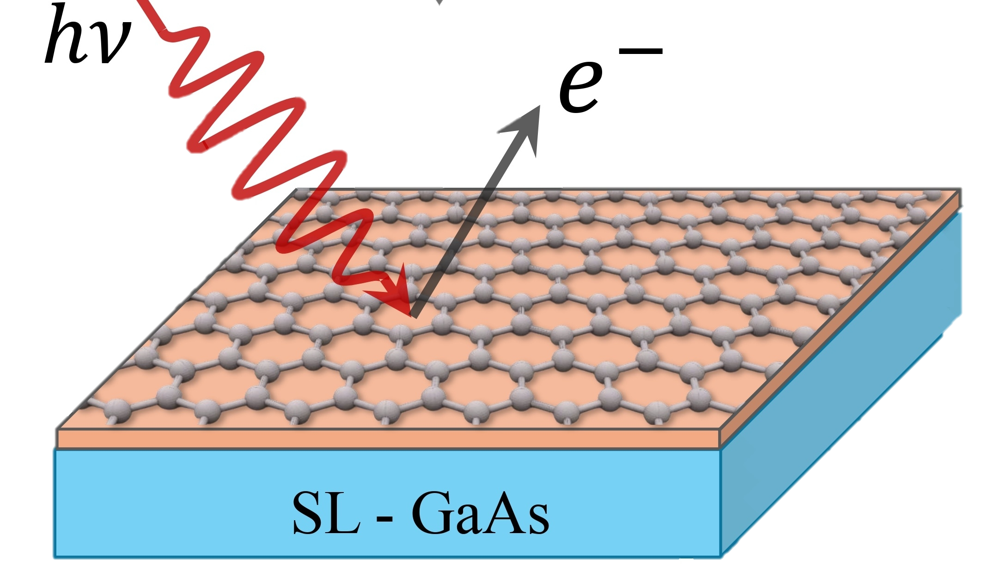
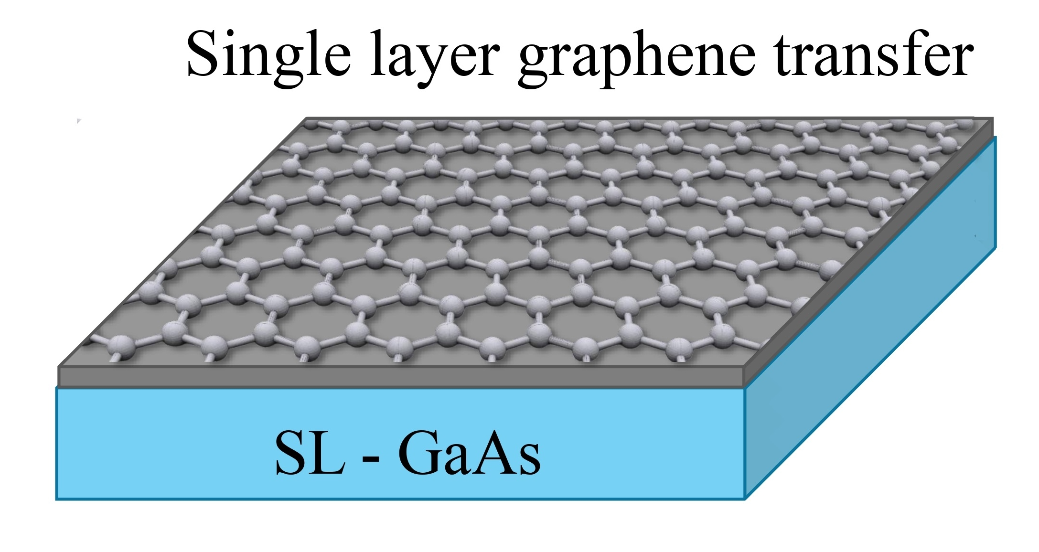
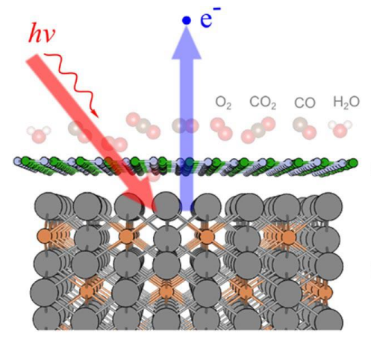
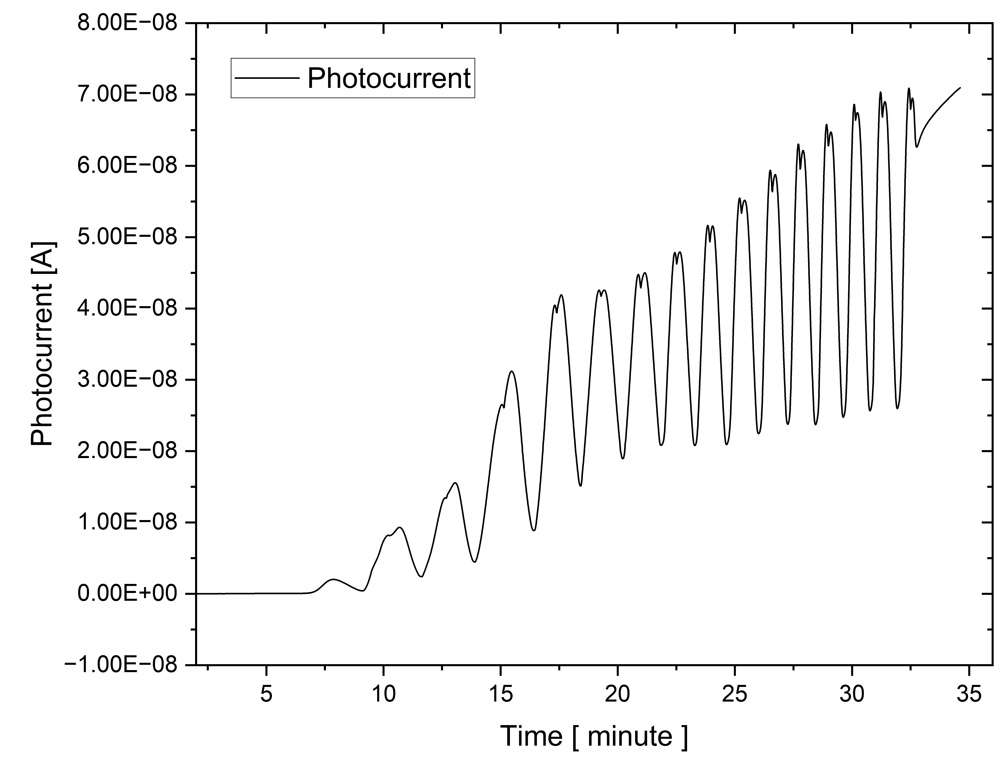
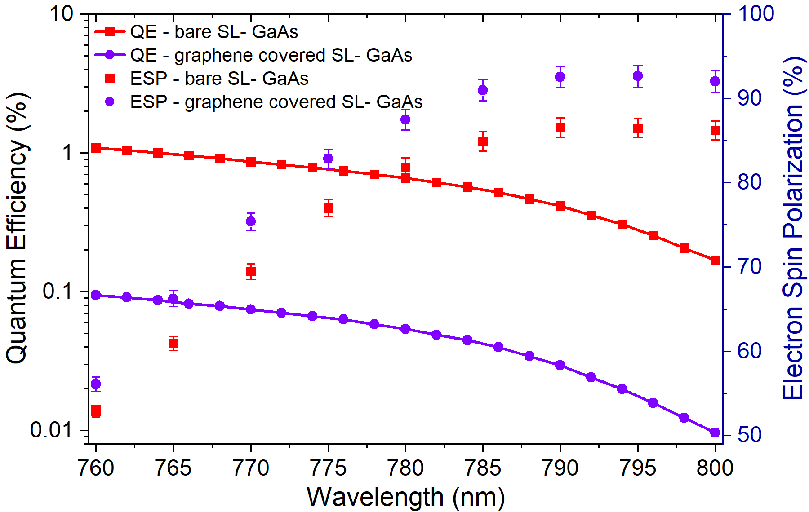
GaAs with a graphene protection layer
QE = 0.08% at 780 nm
SL-GaAs activation succeeded with a CsO layer beneath graphene.
Graphene reduces susceptibility to heating and gas exposure.
Graphene-coated GaAs shows higher polarization than regular O-Cs activation.
Jyoti Biswas et al., “Single-layer graphene protective layer on GaAs photocathodes for spin-polarized electron source,” APL Mater. 13, 061101 (2025).

Slide 16
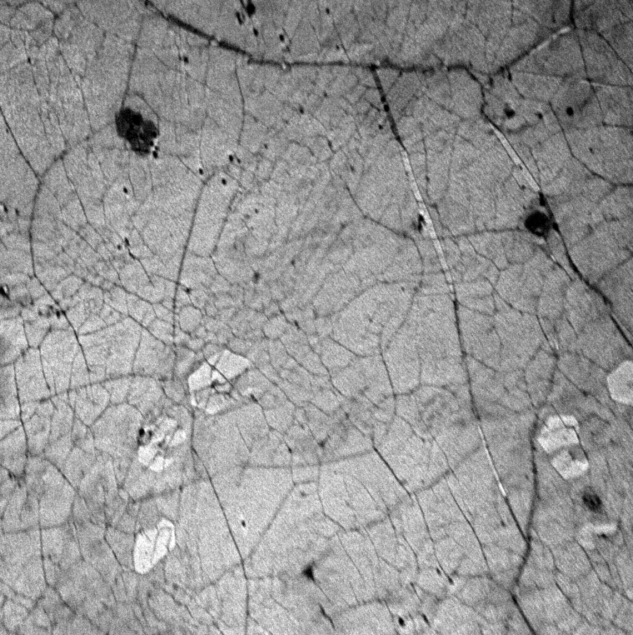
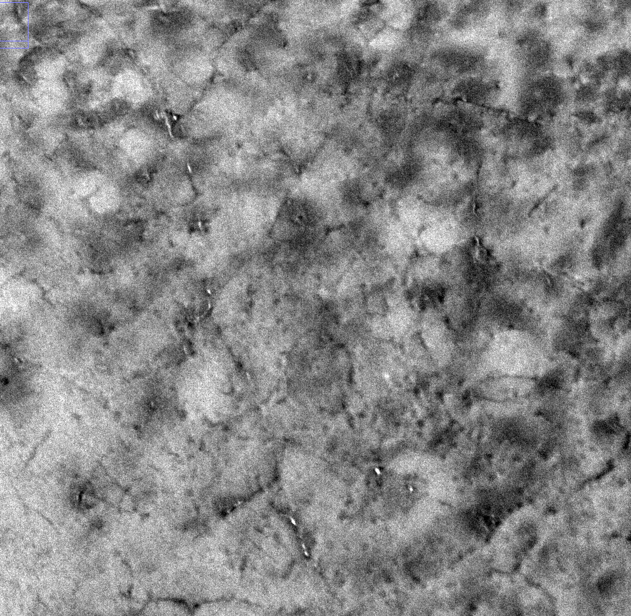
LEEM study of GaAs-CsO/graphene
Before activation
After activation
LEEM indicates intercalation.
The work function decreased by 3 eV, close to the 3.2 eV shift typical of CsO activation on GaAs.

Slide 17
GaAs-CsO/graphene at high temperature
QE: 0.7%
QE > 0.55%
Intercalation
and activation
Excess surface
Cs desorbs
Cs begins to leave
beneath graphene
Cs remains
beneath graphene
45 °C
>100 °C
>250 °C
>500 °C
After activation, heat treatment near 500 °C, air exposure, and return to vacuum, the cathode retained QE ≈ 0.009%.
The result suggests a possible route for transferring activated GaAs in air.
The graphene-covered activation layer shows high-temperature resilience.

Slide 18
Summary
Successful EIC polarized photocathode development
  High charge: achieved 11.6 nC in the gun after doping and cleaning optimization.
  QE and polarization: achieved 2.35% QE and 92% using DBR-SL GaAs.
  MOCVD surface treatment: established HCl cleaning and 450 °C heat treatment.
  DBR nonuniformity: used a tunable laser to accommodate resonance shifts.
  SL-GaAs supply: tested multiple suppliers and vendor development.
R&D achievements
  Graphene-coated GaAs: improved polarization and robustness, but with lower QE.

Slide 19
Thank you!
Thanks to Jyoti Biswas ,Mengjia Gaowei, and Luca Cultrera, for their contributions.

Slide 20
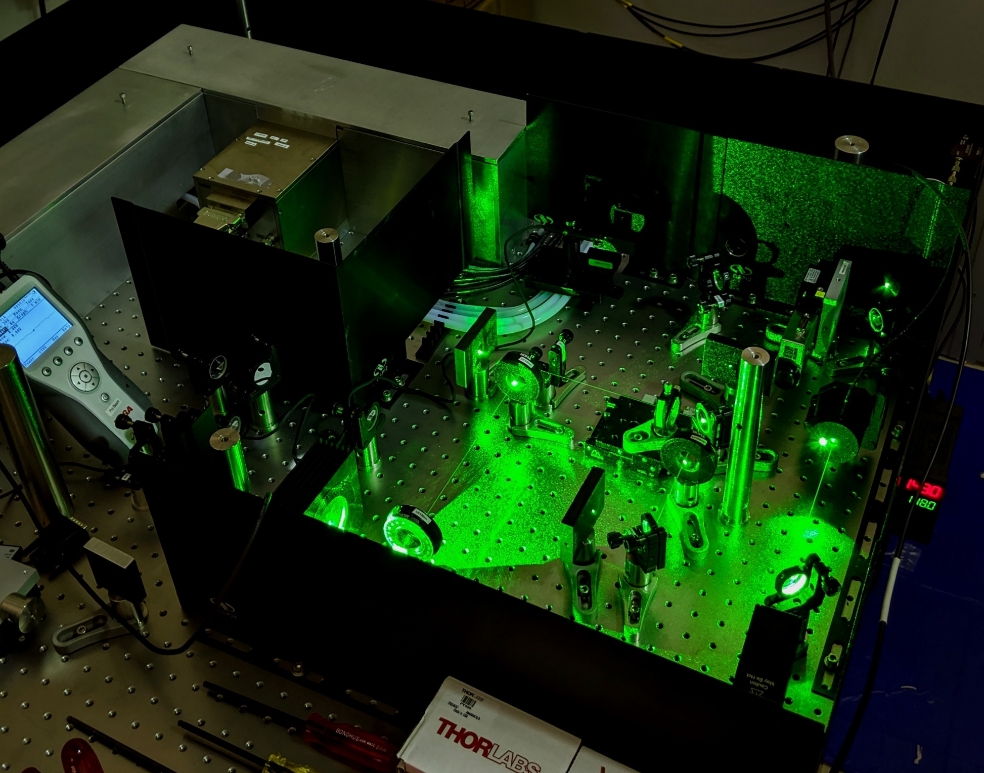
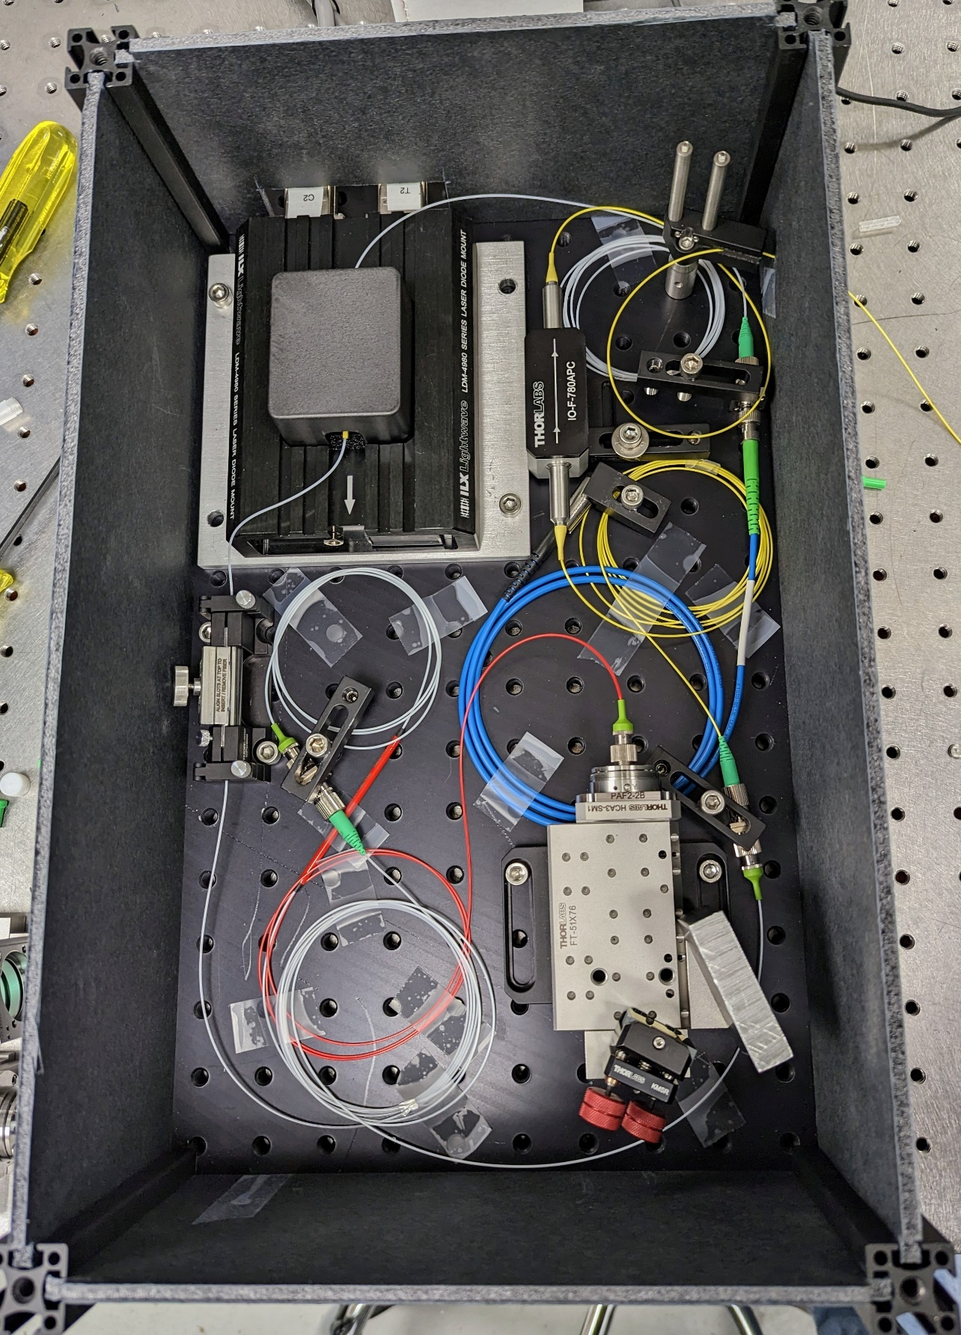
Tunable Nd:YAG OPA laser
OPA pump laser
Amplifier
Seed
Intensity Fdbk
Oscillator Output
Pulse Picking
SHG
Seed Laser
2 ns Flat-Top Pulses
Collimation Lens
OPA
OPA Pump Laser
Pulse Picking
Pol. Beamsplitter
SHG
Output
10 kHz, 300 µJ,
tunable output
Intensity Control
Isolator
½ WP
760–790 nm tunable
CW/Pulsed OPA Seed
¼ WP
Repetition rate: 10 kHz
Pulse energy: 340 µJ
Tuning: 760–790 nm
Bandwidth: ~50 pm
Cavity Mirror
Gain Module
Pockels Cell
Nd:YAG Regenerative Amplifier
10 kHz, 1.7 mJ output
Tunable Seed Laser
Notes:
The retroreflector and reflective grating form a cavity. The gas gain chip generates random photons at wavelengths of 760–790 nm. The grating reflects only a certain wavelength, controlled mechanically. After the cavity, the bandwidth is only 50 pm. The output coupler extracts power. The optical isolator blocks reflected light from downstream.

Slide 21
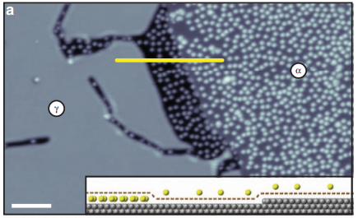
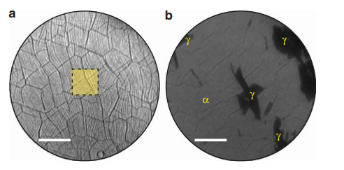
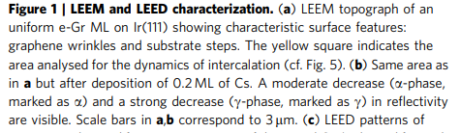
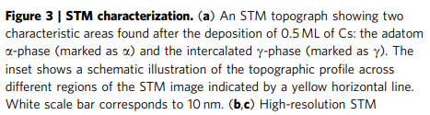
Cs intercalation of graphene
Cs intercalation through monolayer graphene
Petrović, M., Šrut Rakić, I., Runte, S. et al. “The mechanism of caesium intercalation of graphene.”
Nature Communications 4, 2772 (2013). https://doi.org/10.1038/ncomms3772

Slide 22
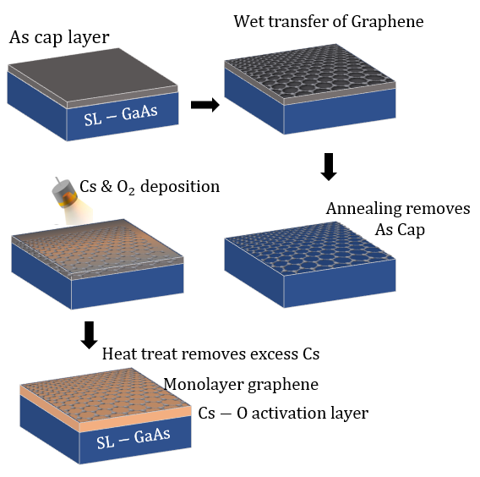
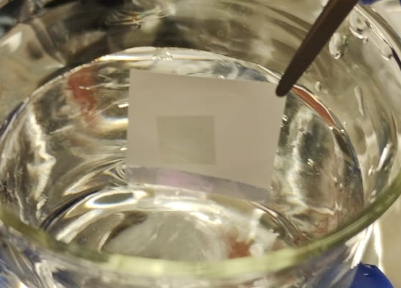
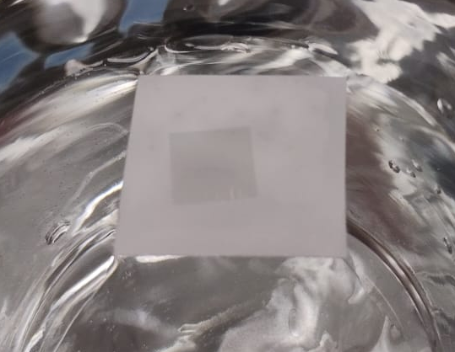
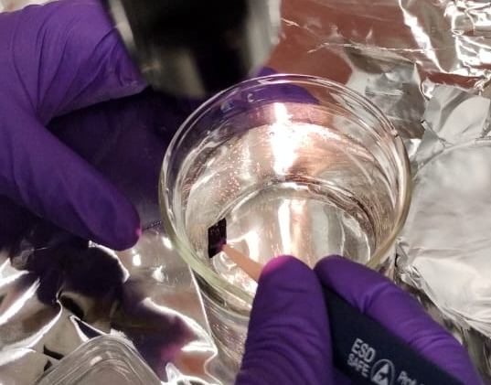
Graphene transfer onto GaAs
Graphene transfer onto GaAs
Inspired by earlier work on cesium intercalation of graphene: Biswas et al., APL Mater. 10, 111115 (2022).

