Slide 1

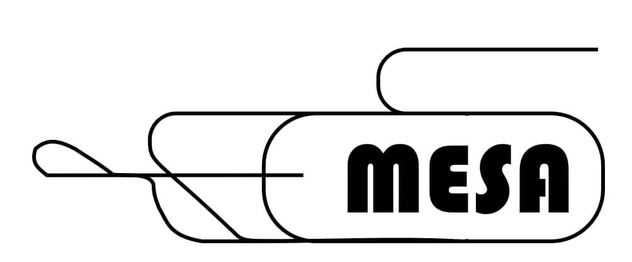

High polarization photocathodes at Mainz
Kurt Aulenbacher for the MESA Team
Institut für Kernphysik
JGU Mainz
ERL Workshop, Orsay, 22. 09. 2026

Slide 2
Outline
MESA Photocathode requirements
Cathode for ERL-commissioning
Surface Photovoltage
Cathode supply chain problem
Ion backbombardment mitigation

Slide 3
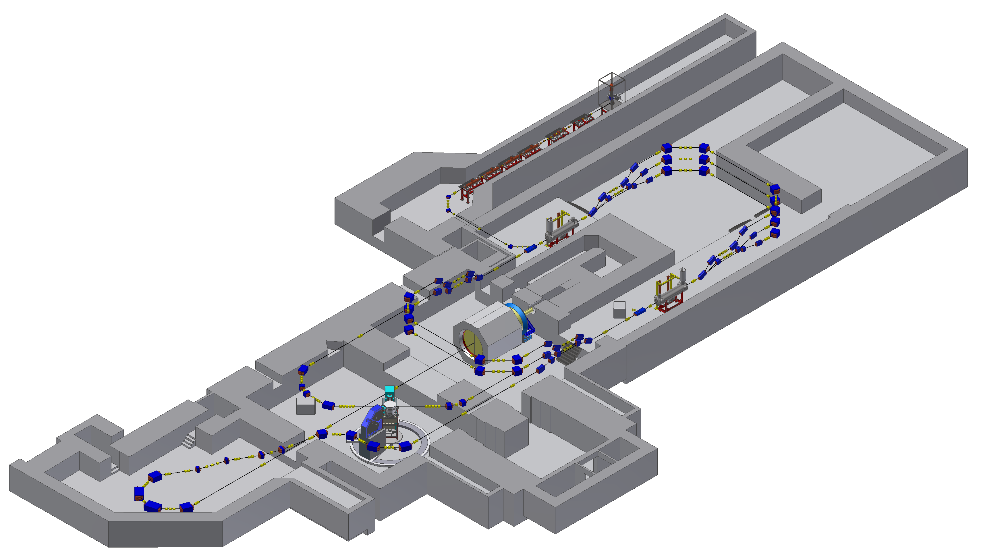
MAINZ ENERGY-RECOVERING ACCELERATOR (MESA)
Op-mode | Target | Av. Beam current/Charge lifetime | Polarisation requirement
Ext. Beam (EB) „P2 Experiment“ | Solid/ Liquid | 0.15mA/ >1000C | >80%
Energy recovery(ERL) | Gas-jet | >1mA (10 mA later) >1000C | Not yet
80 Meter
P2 Experiment

Slide 4
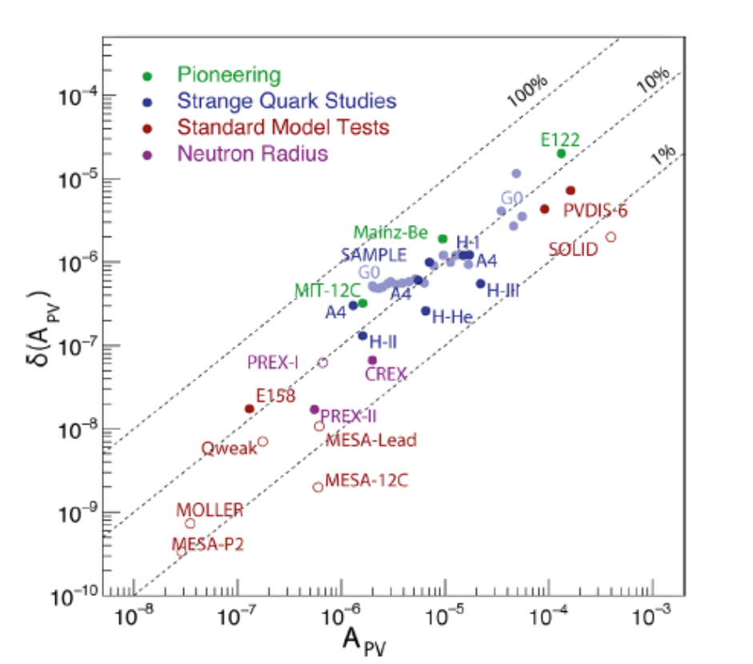
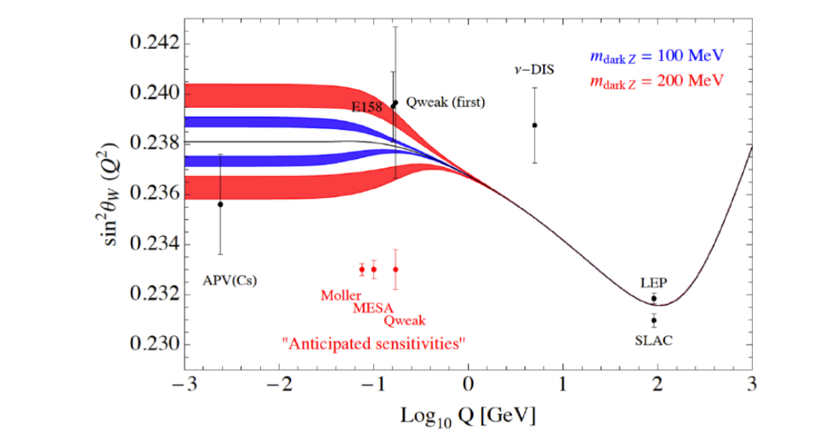
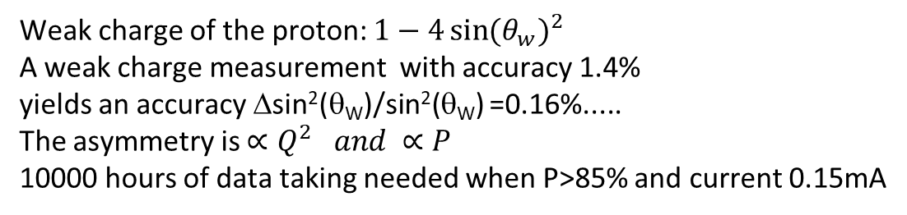
Experiment P2
Weak charge of the proton: $1−4{\sin{(θ_{w})}}^{2}$
A weak charge measurement with accuracy 1.4%
yields an accuracy Δsin²(θ_{W})/sin²(θ_{W}) =0.16%.....
The asymmetry is $∝Q^{2 }and ∝P$
10000 hours of data taking needed when P>85% and current 0.15mA
D. Becker et al. Eur. Phys. J. A 54 (2018) 11, 208
DOI: 10.1140/epja/i2018-12611-6 &166,

Slide 5
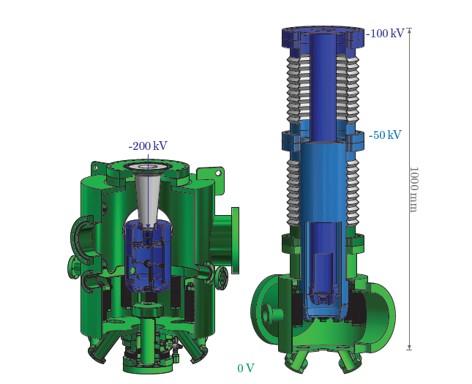
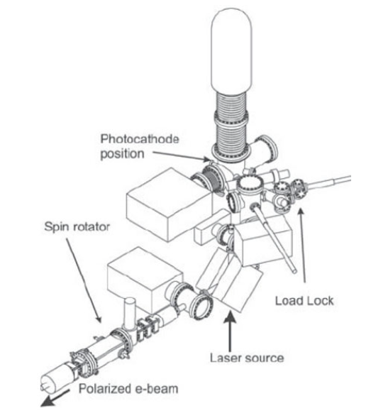
DC-Sources at MAINZ
STEAM=
Small Thermalized-Source At Mainz
MESA source „STEAM“ (inverted, no HV-cage)
– in comparison to
MAMI source ( shown without HV- cage)
„old MAMI source, PKA1“ ; 2 in operation (3 until 2022)

Slide 6
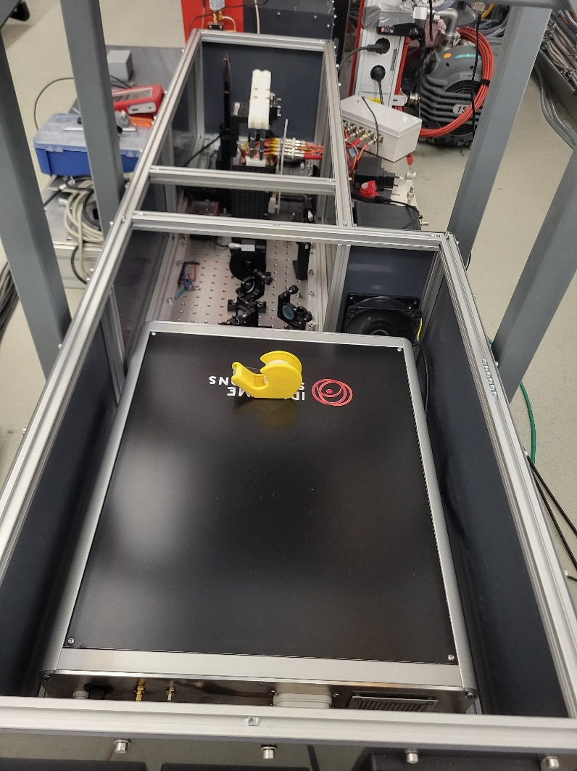
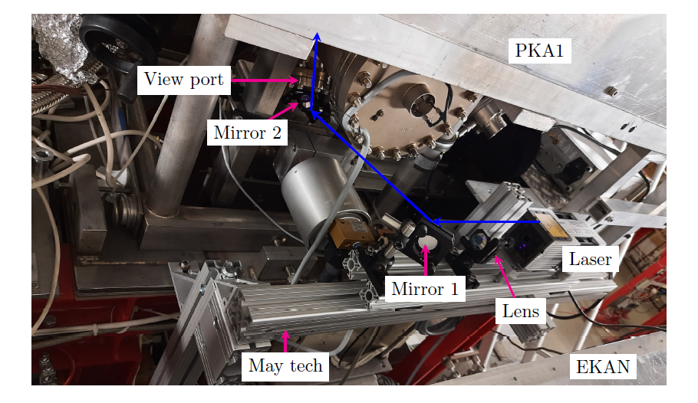
STEAM Synchro-Laser Systems
TYPE | Wavelength | Time structure | Av. power | Remark
Gain Switched Diode „TAIKO“ | 405nm | Single shot to 100MHz 50ps or DC | 0.05 W (0.5nJ /pulse) | Tuning of MESA Unpolarized QE for 10pC: 6%
Er:doped fiber MOPA „MANNY“ | 778 nm | 1300MHz/2^{N} N<10 50-200ps | >3 W >100nJ /pulse | Polarized beam QE for 10pC: 0.2%
TAIKO-Laser at test installation
Size about 10cm
Injected by „side window“

Slide 7
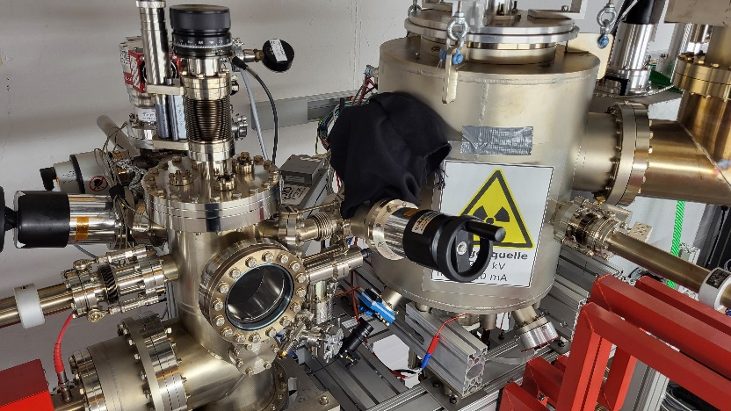
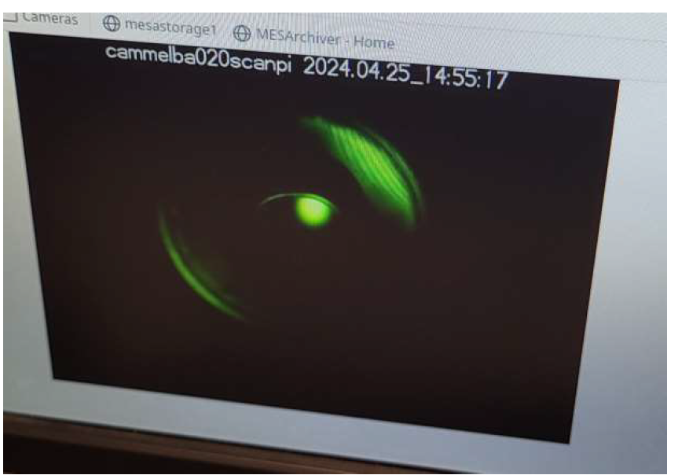
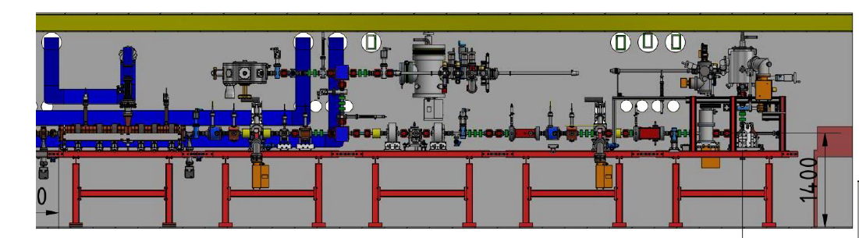
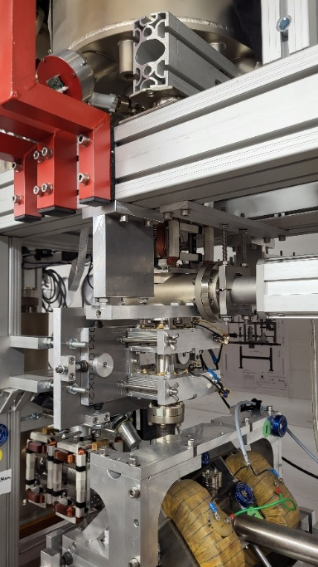
MESA source in operatiON (SO FAR)!
Normalized Emittance measured
(405nm, DC, low current):0.09 μm.
3*larger than expected)
Spin rotator and beam diagnostics
for Parity experiment

Slide 8
High bunch charge cathode FoR MESA?
Cooperation with Heinrich Hertz Institut /Fraunhofer Gesellschaft
Goal to reproduce high polarization cathodes
First issue gradient doping: high QE low SPV, low depolarization
Test structures delivered by Heinrich Hertz Institut Berlin:
High doped
GaAs
Low doped
GaAs
5nm-GaAs:C 5e19cm⁻³ auf 1μm-GaAs:C 5e17cm⁻³
5nm-GaAs:Be 5e19cm⁻³ auf 1μm-GaAs:Be 5e17cm⁻
Photocurrent
Diff current
Photons
Majority of diffusion current ends up in surface zone/band bending region
High doping required for fast recombination (nanosecond time scale)
High doping for thin band bending region

Slide 9
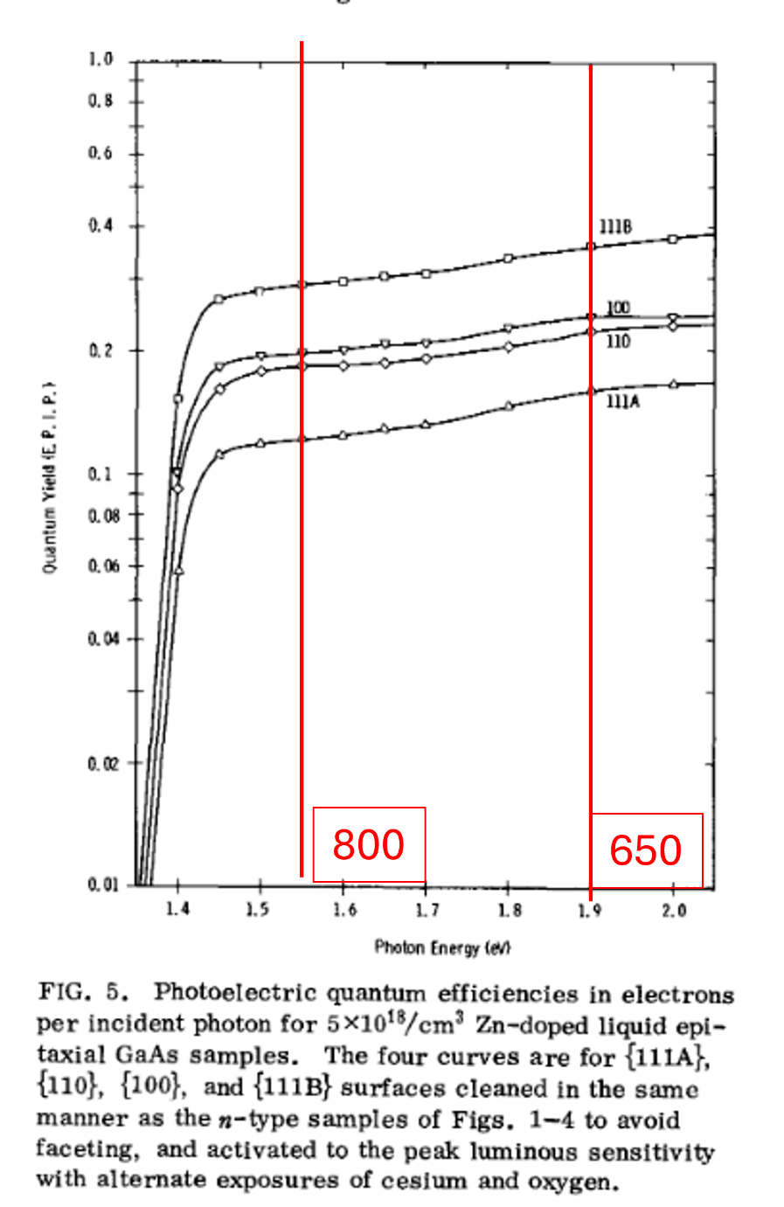
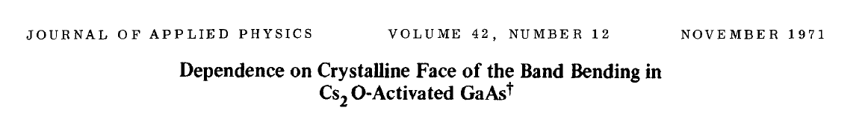
-QE good enough for 10pC bunches
(15% at 650nm)
-thin enough for resonable bunch length
-very suitable for optimization of MESA with TAIKO Laser in single bunch mode
But polarization too low (est. 40-45 %)

Slide 10
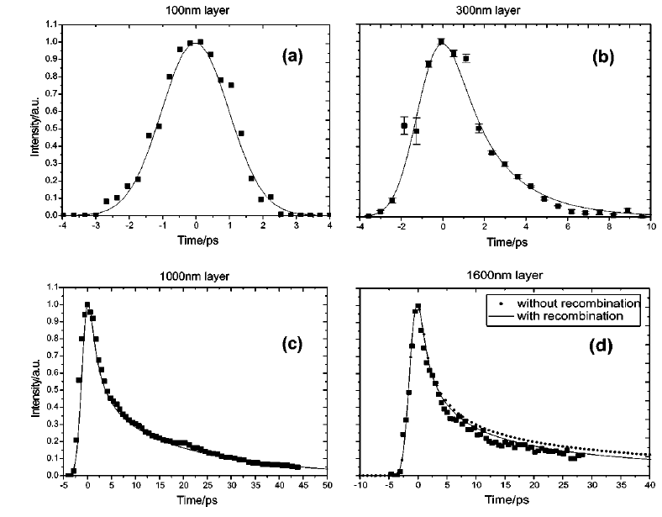
1μm suitable for 80ps long laser pulses from MESA lasers

Slide 11
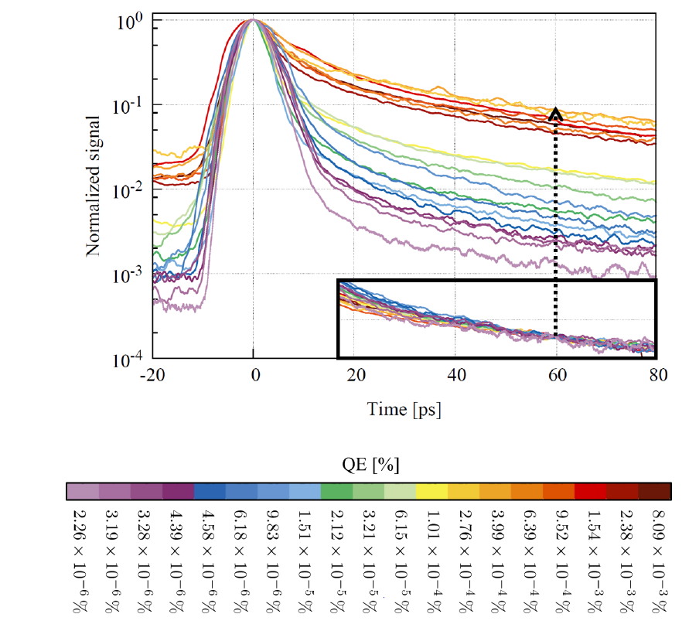
Surface photO-voltage?
High doped
GaAs
Low doped
GaAs
Photocurrent
Diff current
Experiment: Bulk GaAs, doping 2E19cm⁻³ λ=800nm
Produce short pulse with
constant Fluence of 2*10⁻⁴ pC/mm² at varying QE
Pulse Tail supression below QE=10⁻⁴ %
QE is reduced after a certain fluence of diffusion current is reached
Effect is attributed to surface photovoltage, see Mulhollan et al :Physics Letters A, 282(4-5):309–318, 2001.
To produce 0.1pC/mm² for MESA polarized beam requirement we need a QE of > 0.05%.
N. Scahill, PhD thesis Mainz 2022

Slide 12
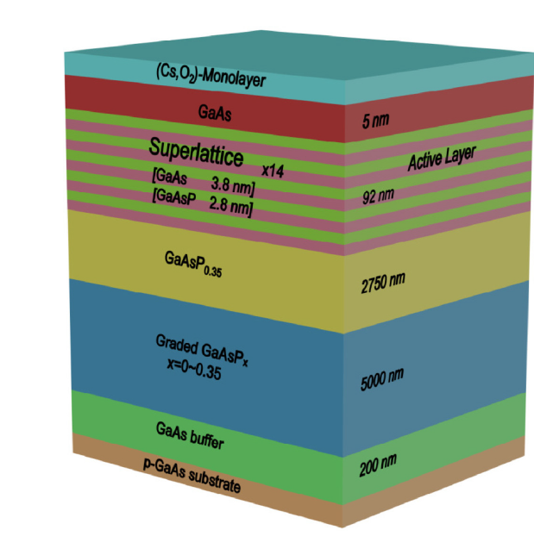
Commercial Cathode at MAMI
Manufactured by SVT company until 2015
Last deliveries: too low polarisation
Surface defects?
N. Scahill and K.A:
J. Appl. Phys. 132, 185702 (2022); doi: 10.1063/5.0108675

Slide 13
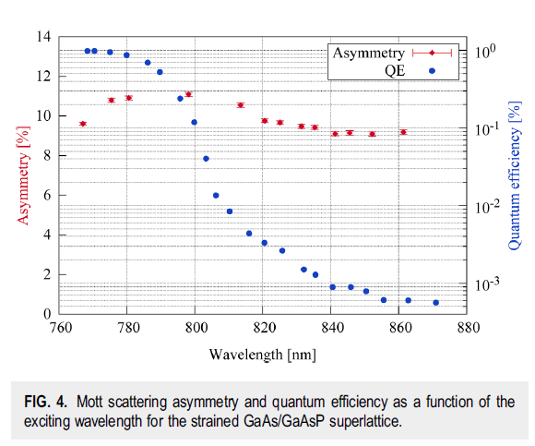
SVT Cathode in USE aT MAINZ
Mott scattering asymmetry measured at 44 keV
Very low analysing power
→ Polarisation 80-90% in maximum
QE~0.5%-0.9% at maximum Polarization
The strained superlattice cathode from SVT can do the job at MESA….
But …….
It is no longer possible to purchase from company … Our Stocks are empty
N. Scahill and K.A:
J. Appl. Phys. 132, 185702 (2022); doi: 10.1063/5.0108675

Slide 14
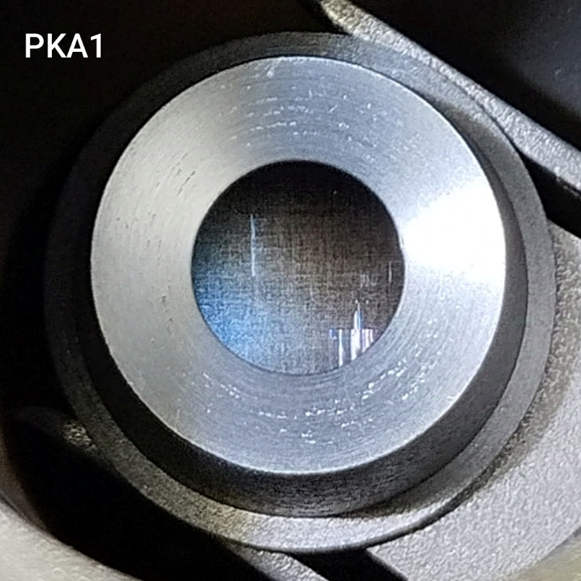
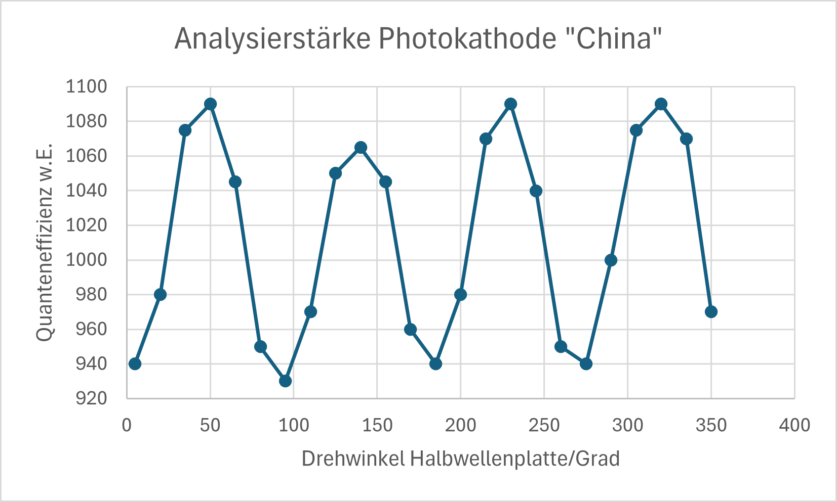
SVT Cathode Alternative
Chinese Company ACKEN:
Quarter of a Wafer delivered
Defects on surface visble
Polarisation as good as SVT, measured in direct comparison at MAMI
QE a bit lower
→activation problem? wavelength?
High linear analysing power (6%)
→ inhomogeneous strain relaxation?

Slide 15
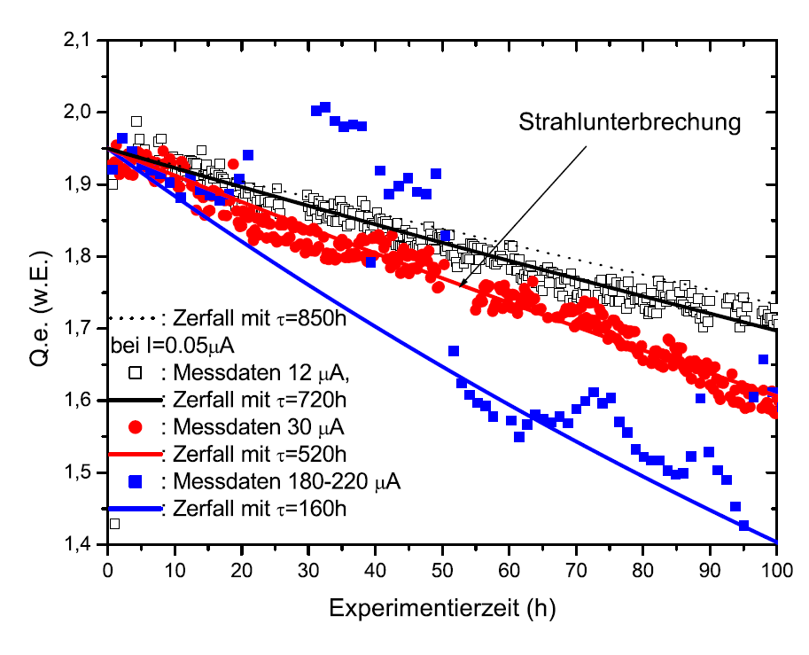
Charge Lifetime –Ion backbordment
Best result of MAMI-source PKA1 (2004)
Vacuum lifetime >1000 hours
Charge lifetime 200C (*)
→ Cathode would be reactivated every 2 weeks for P2 (13Coulomb/day)
MESA-source „STEAM“ (**): (2026)
Vacuum 3*10⁻¹⁰ Pa
Vacuum-lifetime >10000 h (405nm)
Charge lifetime: ???
(*): achieved with bulk GaAs (>10mA/Watt) to avoid heating
(**) STEAM= Small Thermalized-Source At Mainz

Slide 16
How to Cope with Ion Backbombardment /outlook:
+ Pressure level in MESA source „STEAM“ probably lower than at MAMI (longer vacuum lifetime observed)
+ shorter acceleration stage in STEAM compared to MAMI/PKA1
+ repeller available in STEAM to supress ion backstreaming from beamline
If all this does not help, possibilities nevertheless remain :
Larger and more excentic laser spot (Fluence lifetime at MAMI ~2500C/mm² )
BUT: Keep beam losses low!
Idea: Less sputtering by using heavy Activation/Protection CsBr/CsTe
Materials with large value of negative affinity: GaN/AlGaN superlattices?

Slide 17
SUMMARY/OUTLOOK
Challenging cathode requirements from the PV-experiments at MESA/MAINZ, in particular charge lifetime
Q_{bunch}/Pulse Energy linearity (surface photovoltage) requires relatively high QE at maximum P
Commercial vendor for GaAs/GaAsP found
Research activities concerning higher charge lifetime: beam dynamics, acivation layers, alternative material with high NEA value.

Slide 18
Thank You !

Slide 19
MESA spin polarized photosource „STEAM“
Laser
type | Er-doped fiber
wavelength | 780nm
Av. power | Up to 4 Watt
Rep-rate | 5-1300 Mhz
Pulse length | 50-250ps
STEAM
photocathode
type | GaAs/GaAsP SL
wavelength | 780nm
Spin-polarization | 80-90%
Quantum efficiency | ~0.5% (3mA/Watt)
Response time | ~1ps
Beam current | 150μA
Charge lifetime | >100 Coulomb
Spin-polarized cathodes are „activated“ on-site and transferred
to source in UHV
First beam from
Spin-polarized
Photosource
„STEAM“
Laser

Slide 20
MESA Phot0cathode requirements
Source | Operation Voltage | Laser/Time structure | Av. Laserpower/Wavelenght/Pulselenght | Remark
PKA1 | 100kV | Semiconductor MOPA , 2.449 GHz CW. | 0.3W/778nm /80ps | Serves MAMI Accelerator
PKA2 (copy of PKA1) | 100kV | Semiconductor DC | 0.05 W, 808/786nm | Test source for pol. photcathode developments
PKAT (copy of PKA1) | 100kV | Ti:SP, Mode-locked 78 MHz CW | 0.5 W 750-850 nm DC or 0.1ps | Time resolved measurements Dismantled in 2022!
STEAM(*) | 100-150 (200)kV | Er:Fibre MOPA 1-1300MHz CW | >3 W 778 MHz 50-200 ps | Serves MESA Accelerator Alternative laser: Diode 405nm

