Slide 1

GaAs photocathodes in an SRF gun
Erdong Wang
Electron-Ion Collider, BNL
PhASE 2026
September 22, 2026

Slide 2
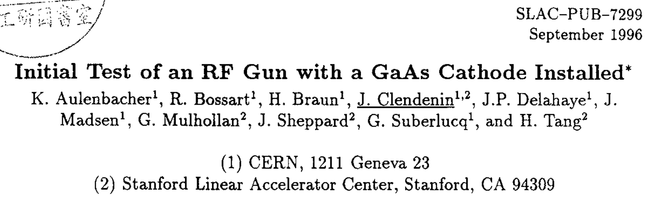
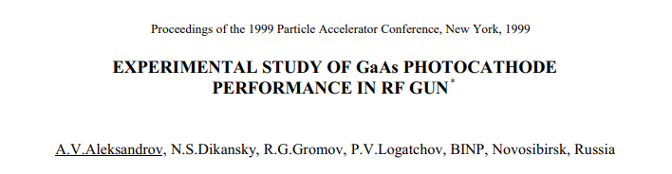
Motivation
RF guns provide higher gradients than DC guns, enabling high-brightness, high-charge beams.
  The ion back-bombardment range is shorter in an RF gun.
  Early normal-conducting RF gun tests were limited by poor vacuum and electron back bombardment.
  GaAs is sensitive to residual gases, which shorten cathode lifetime.
  Cryogenic pumping in an SRF gun can improve the vacuum.

Slide 3
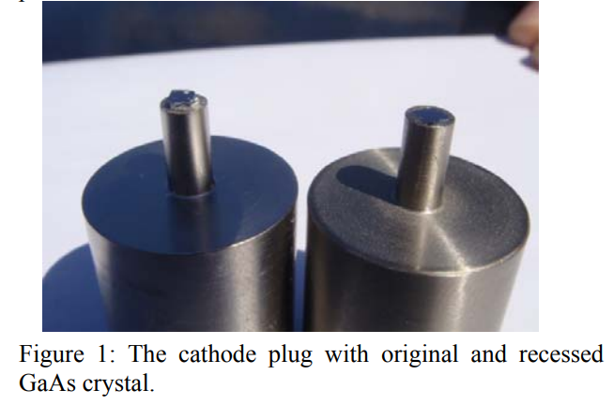
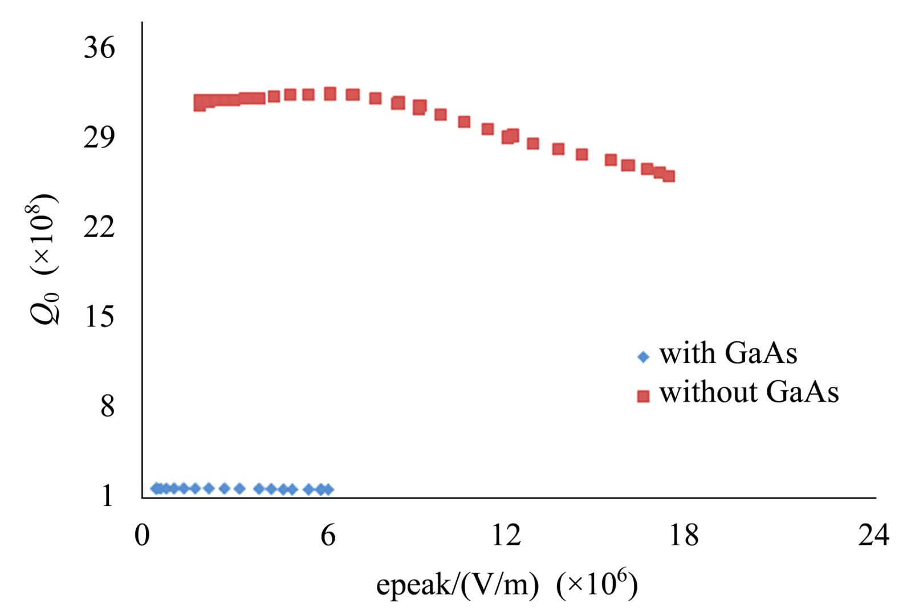
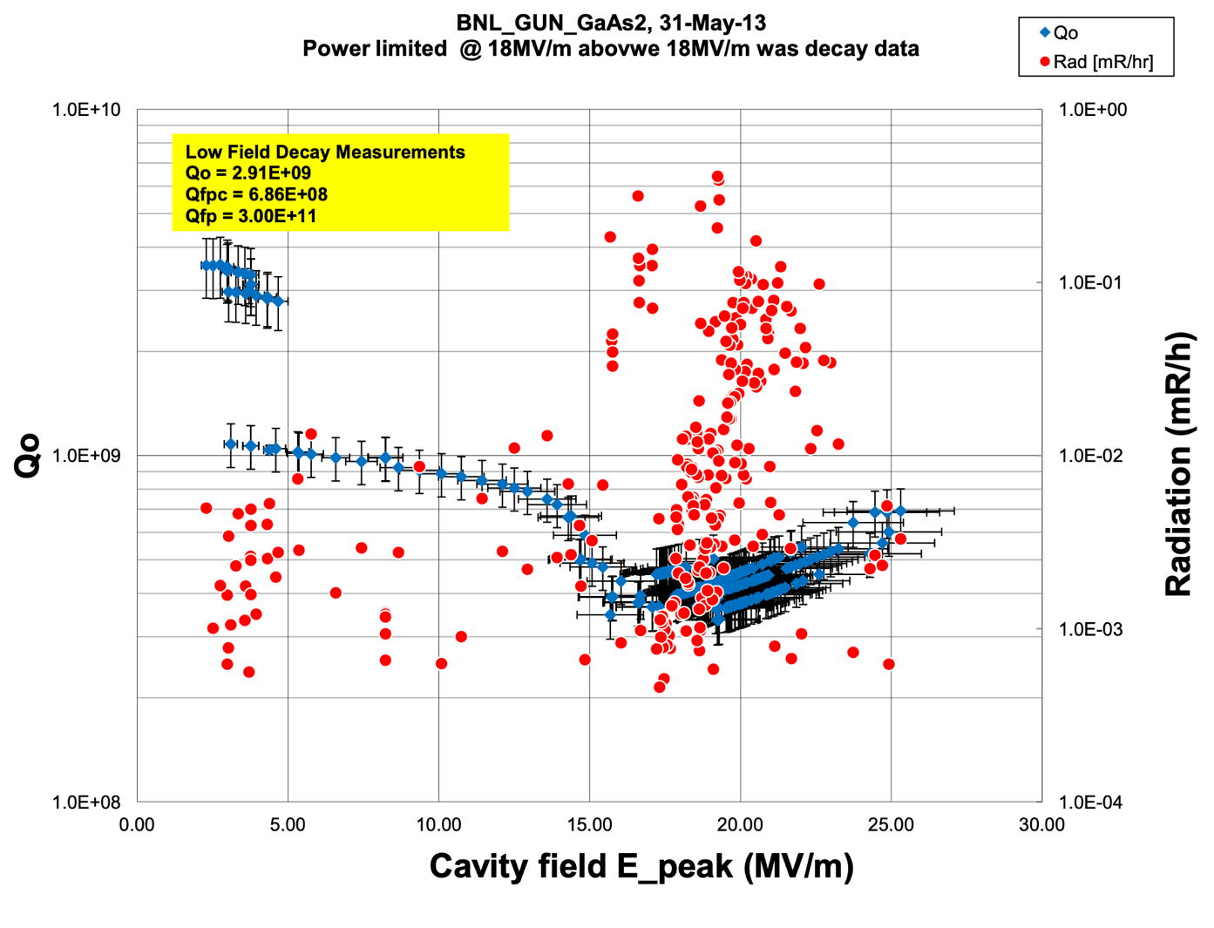
RF heating of GaAs
E. Wang et al., Chinese Physics C 35, 387 (2011).
2010: An unshielded 0.3 mm cathode fell during the vertical test. Simulations predicted 170 °C.
2013: A 0.1 mm cathode with edge shielding achieved a higher quality factor Q and a higher gradient.
Estimated RF losses: 80% edge ohmic loss and 20% dielectric loss.

Slide 4
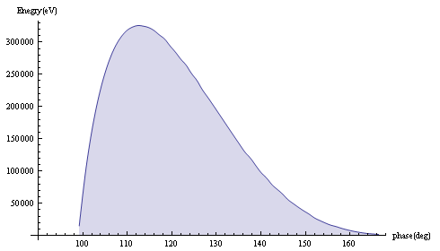
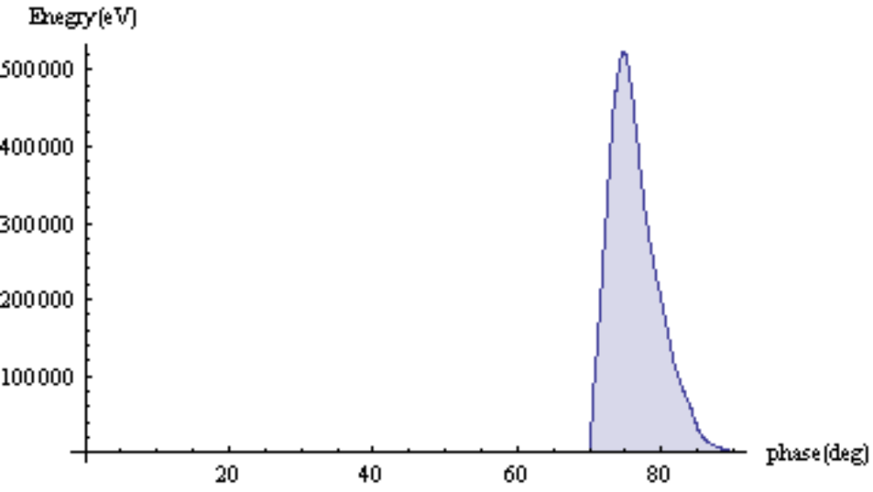
Electron back bombardment
The BINP test reported initial QE loss attributed to electron back bombardment.
β = 0.5
β = 0.12
Back-bombarding electron energy versus laser phase
The earlier tests motivate a low-β cavity to reduce the phase range of electron back bombardment.

Slide 5
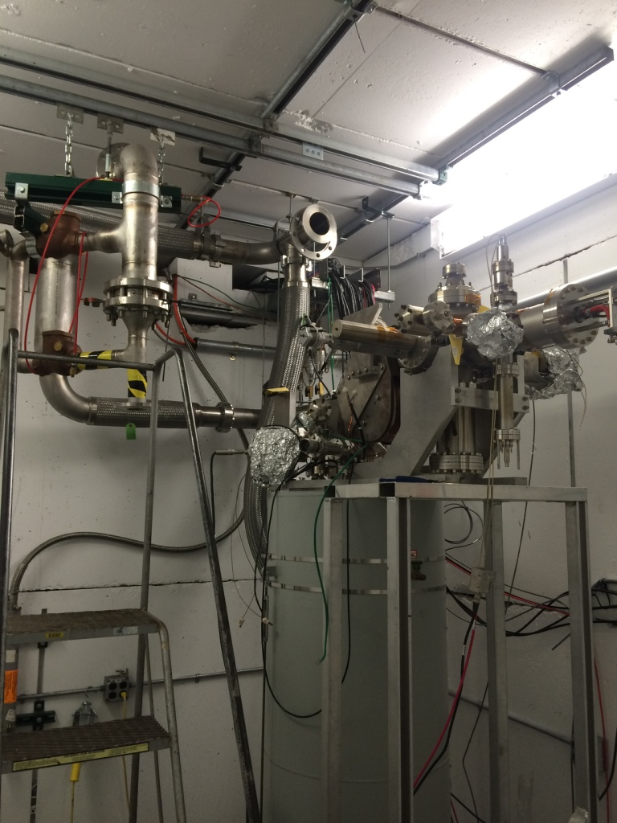
Early test: QE loss during transfer
A vacuum suitcase was needed to transfer cathodes between the preparation system and the gun in different buildings.
QE fell from 6% to 0.3% during transfer. No beam was observed in the SRF gun, and QE was zero after removal.
Experiment shows the GaAs QE drops 3 orders of magnitude at 2 K.
Funding ended that year, so only one test was performed.
The short Cs–O/GaAs lifetime motivated a more robust Te-Cs-O/GaAs activation.

Slide 6
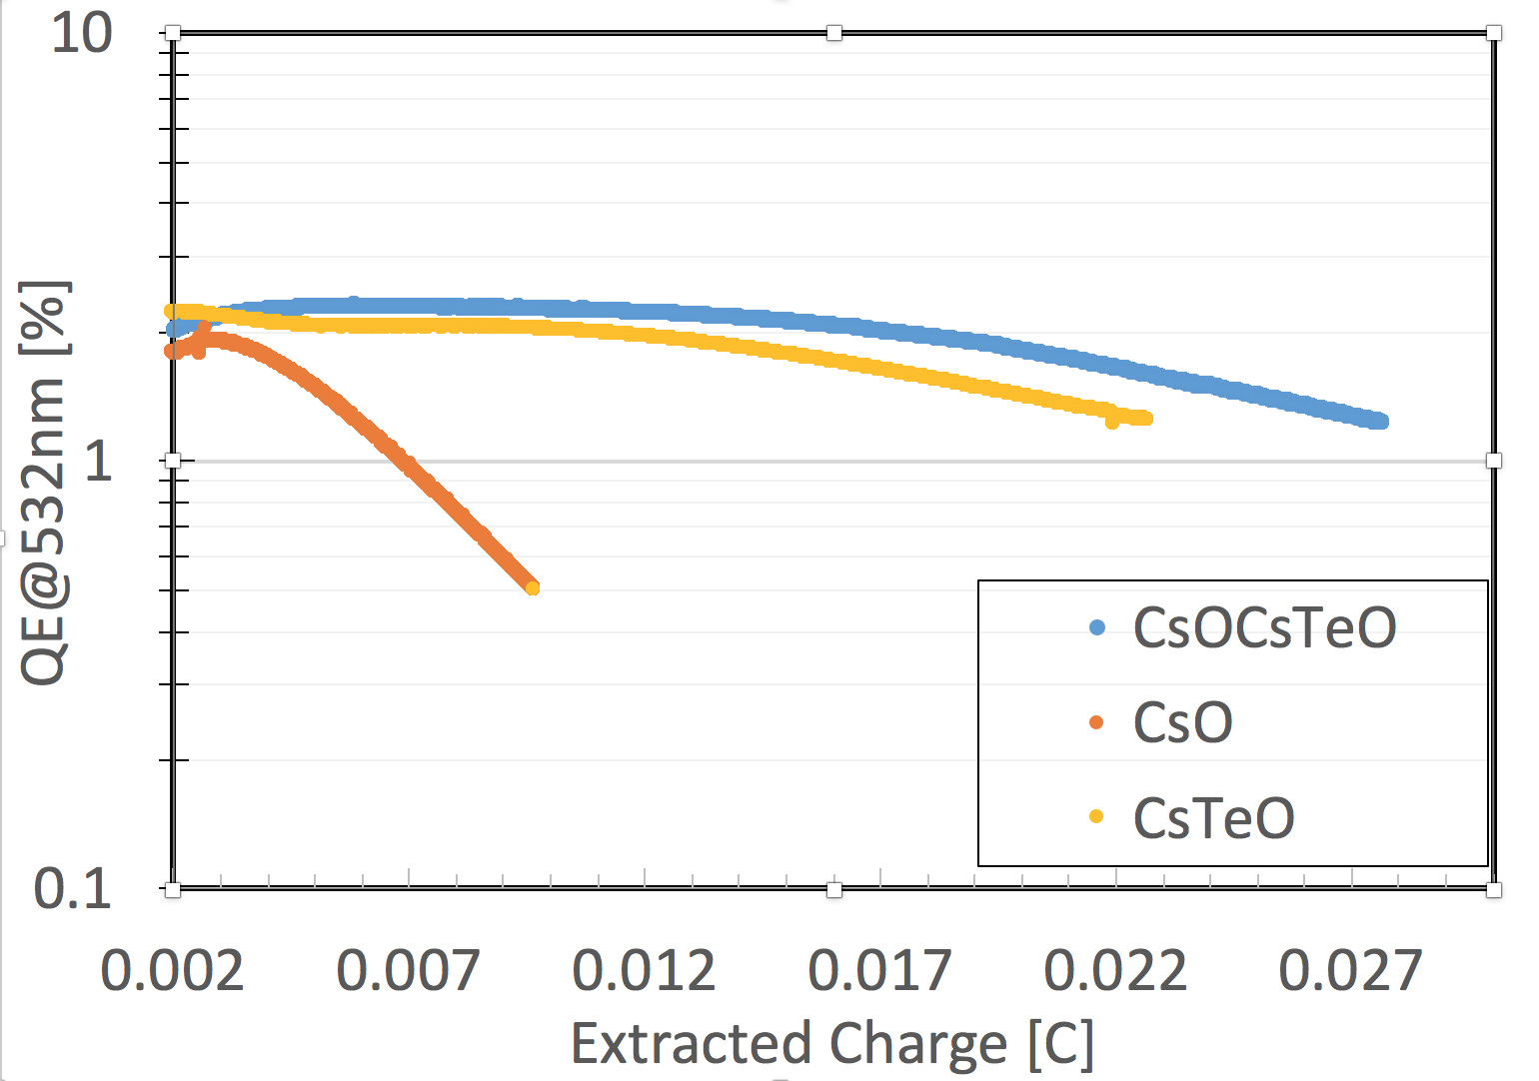
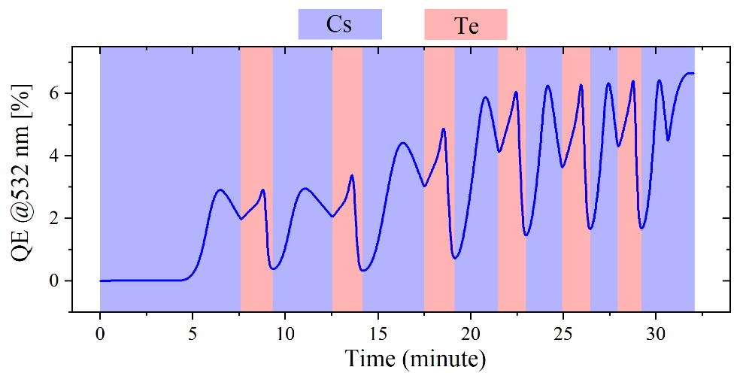
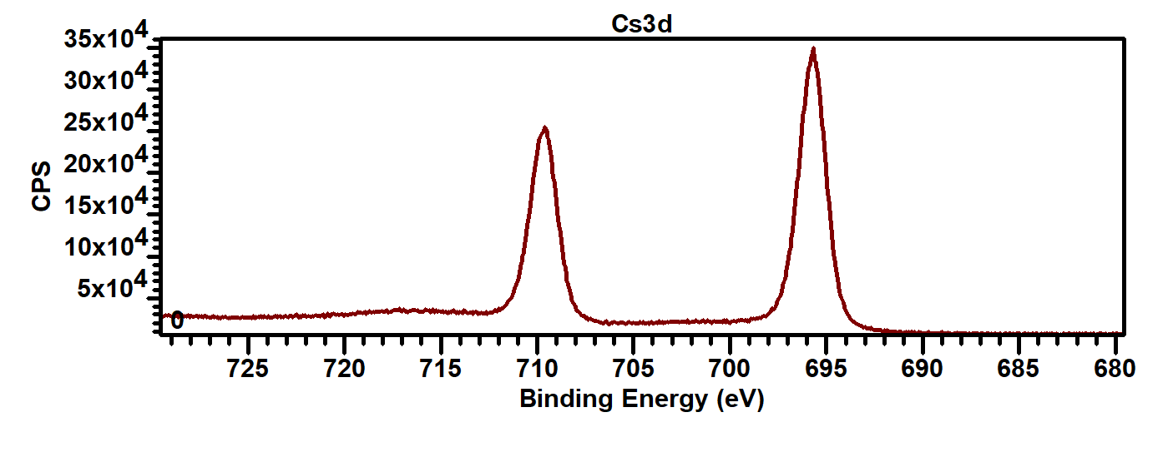
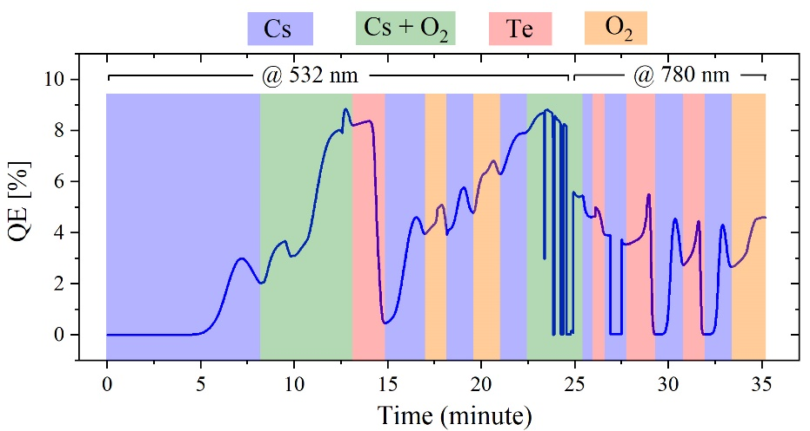
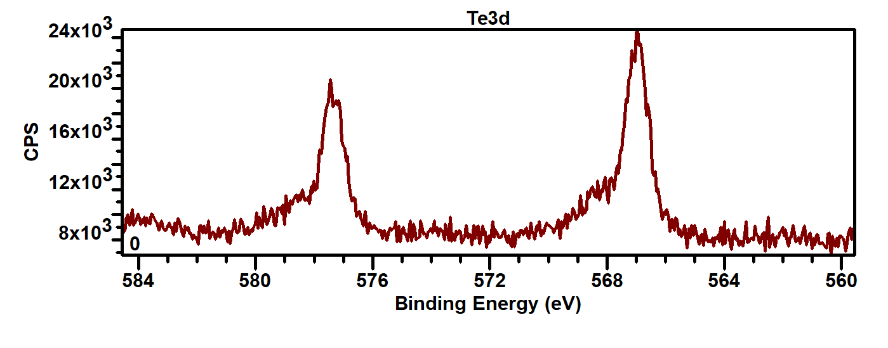
Robust Cs–O–Te/GaAs cathodes
at 2020-2021, we developed Cs–O–Te activation GaAs for high QE and greater robustness.
2.2 keV X-rays at NSLS-II probed the chemical composition.
Typical QE: 8% in green light and >3% in infrared light.
Survival near 10⁻⁹ Torr remained limited.
GaAs
7e-11 torr
x6
2e-11 torr
Cs 3d3/2
Cs 3d5/2
Te 3d3/2
Te 3d5/2
Te oxide
J. Biswas, E. Wang et al., AIP Advances 11, 025321 (2021).

Slide 7
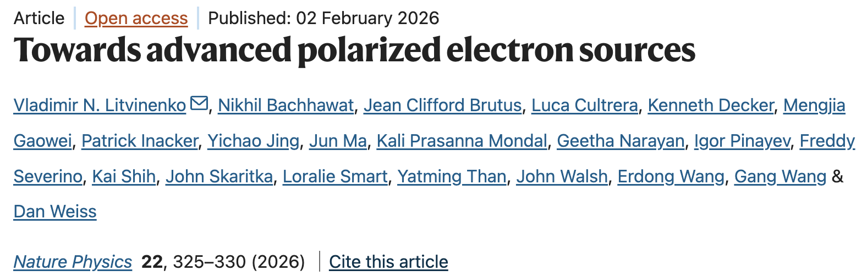
Lessons from earlier tests
Cryogenic pumping makes SRF guns attractive for achieving the vacuum needed by GaAs.
Thin GaAs and effective edge shielding reduce RF heating. Edge shielding is especially important.
GaAs in the cryo temperature has very low QE. Cathode has to be at close to RM temperature.
Te-O-Cs activation layers improve robustness during transfer and operation.
A low-β cavity reduces the phase range of electron back bombardment.
These knowledge guided the subsequent successful beam test in the BNL113 MHz SRF gun.

Slide 8
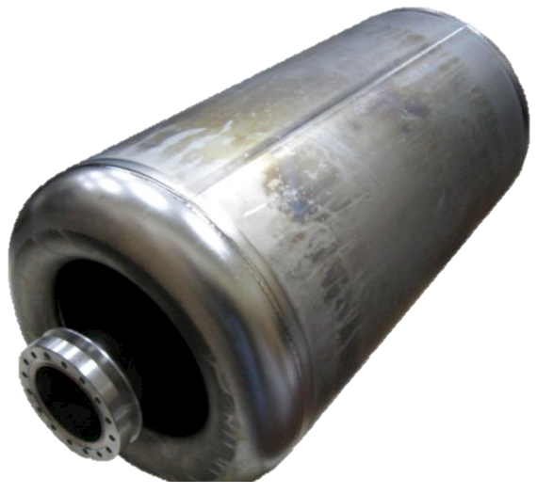
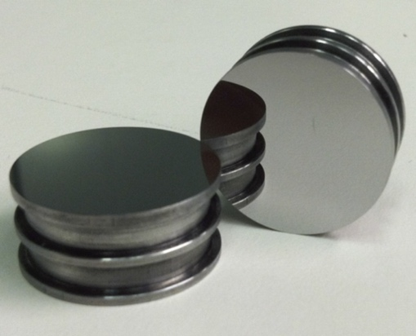
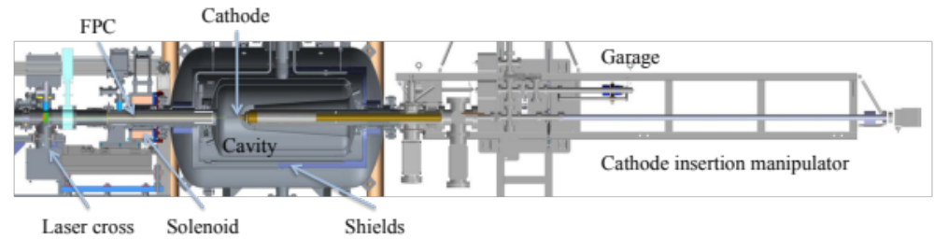
The 113 MHz SRF gun
 | Design Goal | Achieved
Charge per electron bunch | 0.5-5 nC | 0.1- 10.7 nC
Peak current | 100 A | 50 -100A
Bunch duration, psec | 10-50 | 12
Normalized beam emittance | < 5 mm mrad | < 3 mm mrad
Repetition rate | 78.17 kHz | 78.17 kHz
CW beam | <400 μA | 150 μA
Quarter-wave SRF resonator operated at 4 K, with β = 0.11.
Cathode temperature control by the water temperature.
The cavity was built for R&D and later upgraded for use as an SRF gun.
The cathode preparation and transfer systems support routine CeC operation with K₂CsSb cathodes at about 10% QE at 532 nm.

Slide 9
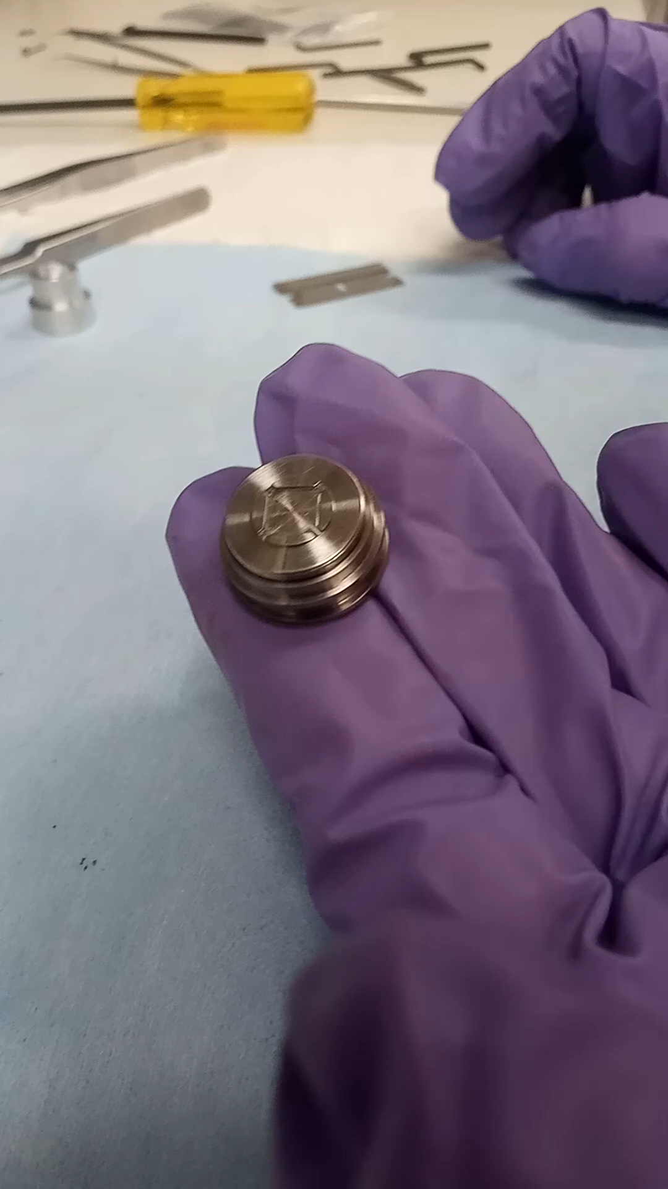
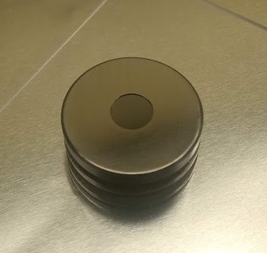
GaAs photocathode holders
RF heating is reduced by thin GaAs and edge shielding.
Two puck holders were manufactured for 7 mm GaAs wafers with thicknesses of 350 μm and 100 μm.
The recessed puck and shielding cap expose only the activated area to the RF field.

Slide 10
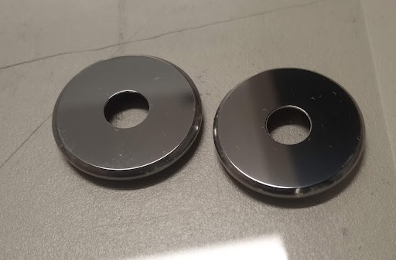
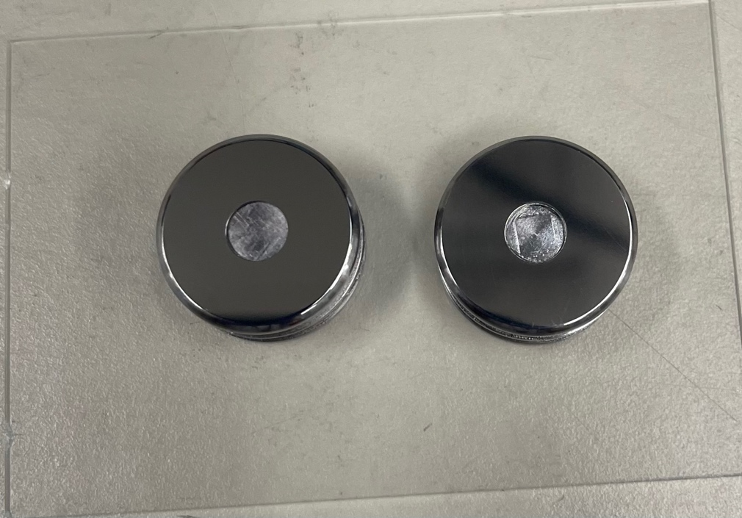
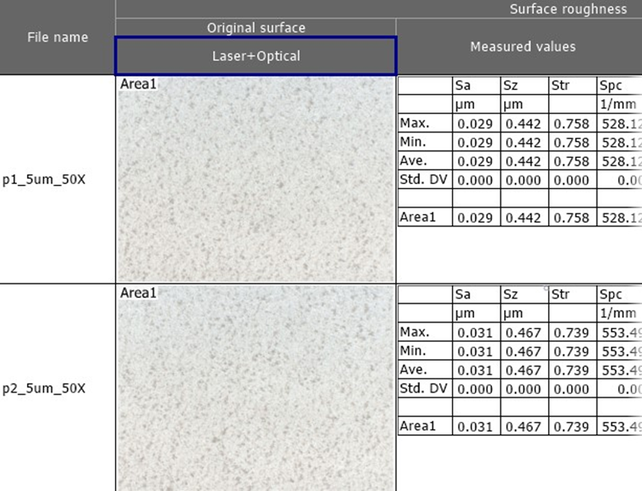
Polishing the shielding caps
Polishing the shielding-cap surface helps reduce dark current.
Puck #1
Puck #2
The polished surfaces show surface roughness is at 10s nm.

Slide 11
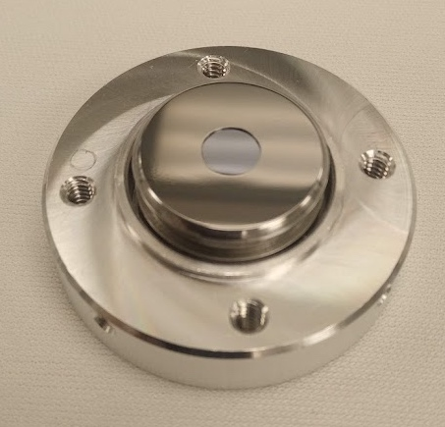
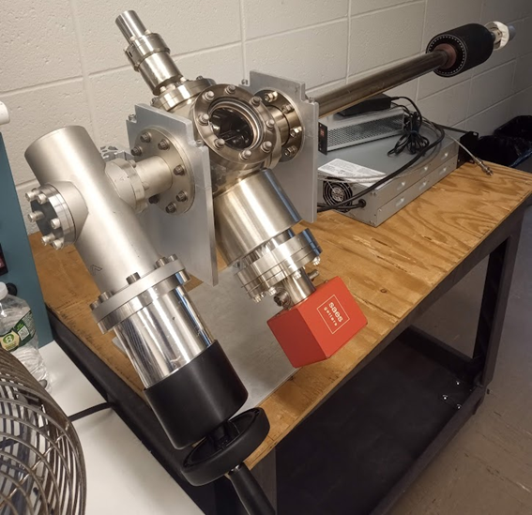
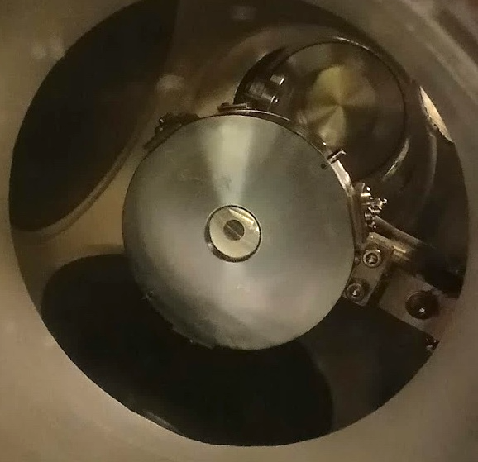
Final preparation steps
High-pressure water rinsing and final assembly were performed in an SRF cleanroom.
Pucks were loaded into a UHV suitcase with an all-metal gate valve at pressures near 10⁻¹¹ Torr.
Samples were activated in an K₂CsSb growth system equipped with a Te evaporator and an oxygen leak valve.

Slide 12
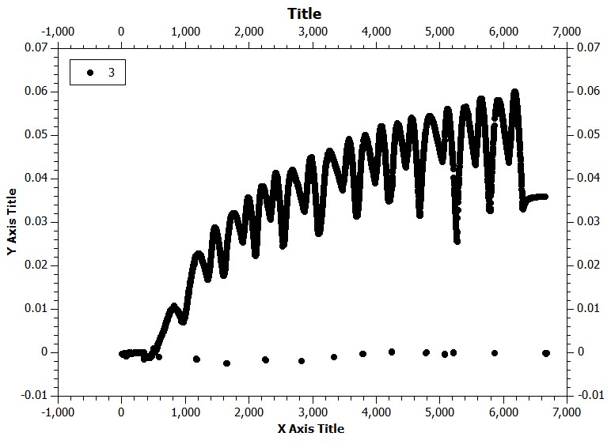
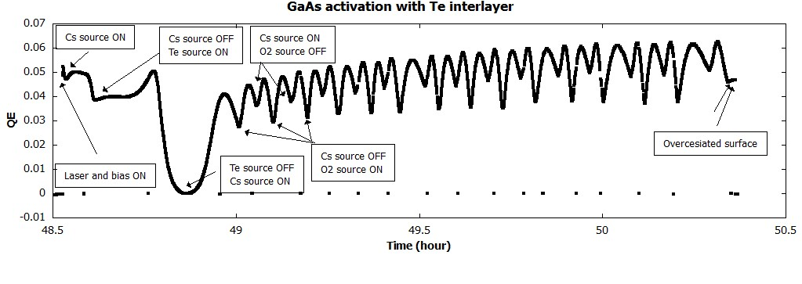
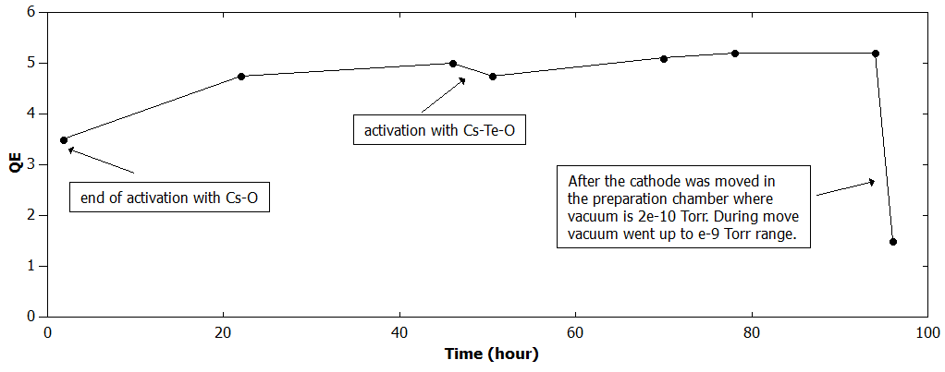
First CsO–Te–CsO activation

Slide 13
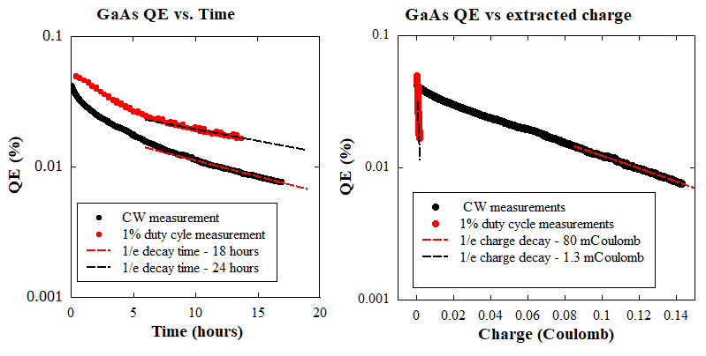
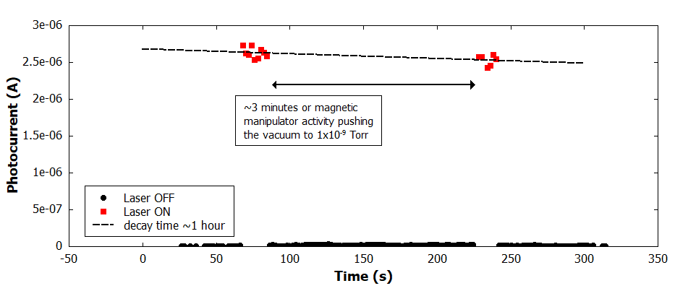
Lifetime in the preparation system
Lifetime was measured at about 5 × 10⁻¹⁰ Torr using a 532 nm laser in CW mode and at 1% duty cycle. Chemical poisoning in the storage chamber limited the lifetime.
A second measurement at a few × 10⁻⁹ Torr simulated transfer with a magnetic manipulator.
  The dark lifetime is about 1 hr.

Slide 14
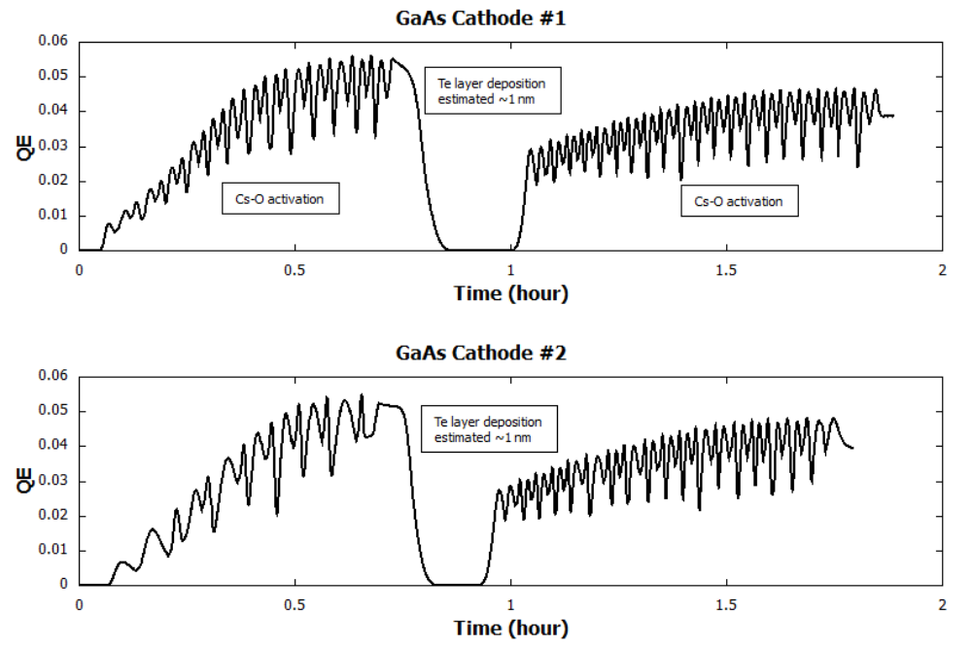
Final cathode activations
Cs-O-Te-GaAs

Slide 15
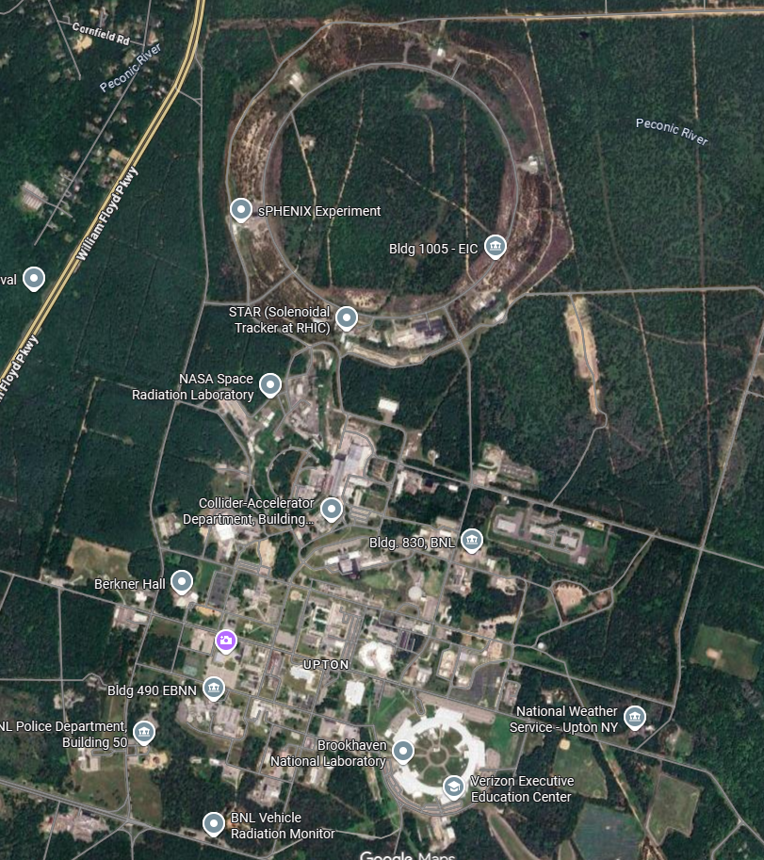
Transport to the SRF gun
The UHV transport chamber was moved 1.4 miles to the RHIC tunnel and connected to the SRF gun load-lock.
Photoemission was confirmed immediately after connection. Photocurrent was comparable to the values measured before transport.
The gun load-lock was then baked at about 150 °C for one week. QE drops to 0.5%
1.4 miles

Slide 16

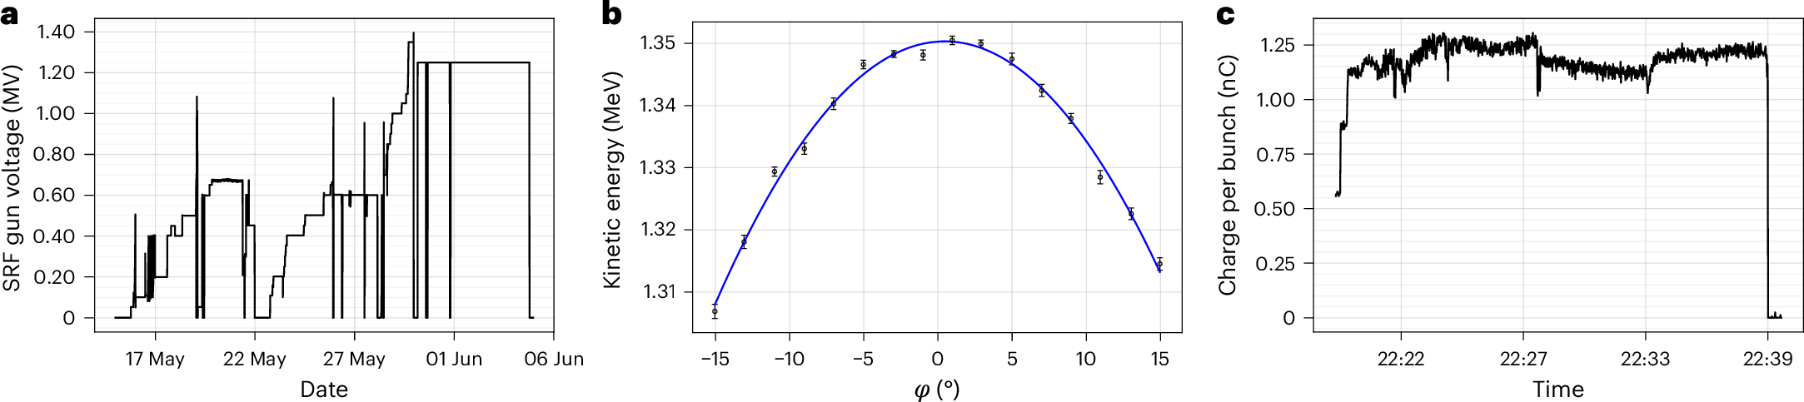
Gun field and bunch charge
Gap voltage: 1.25-1.35 MV
Electric field: 12 MV/m
Bunch charge: up to 1.2 nC

Slide 17
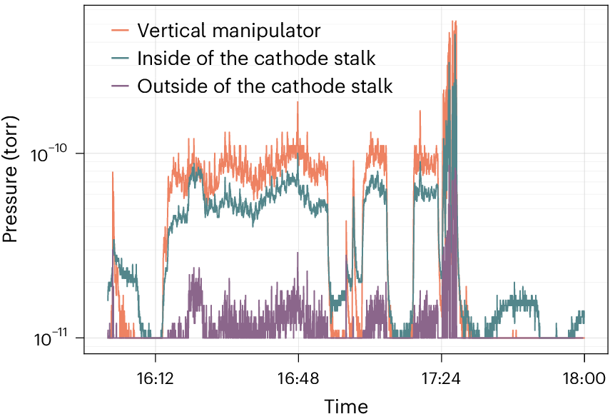
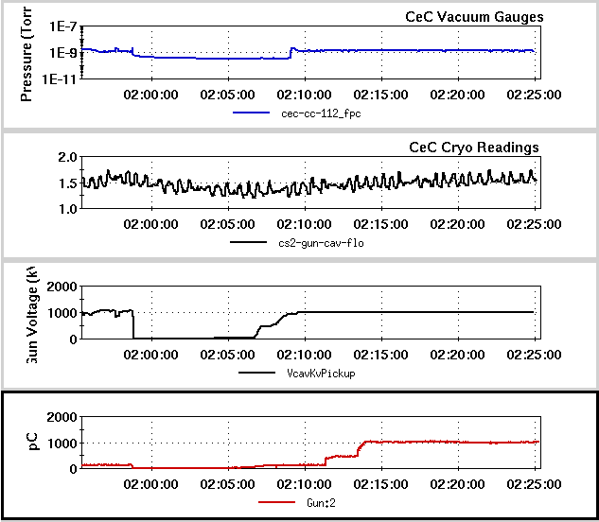
Cathode performance in the gun
Initial QE at 532 nm: about 0.1%
One week of conditioning before insertion reduced multipacting and vacuum spikes in the fundamental power coupler (FPC).
No evidence of field emission was observed.

Slide 18
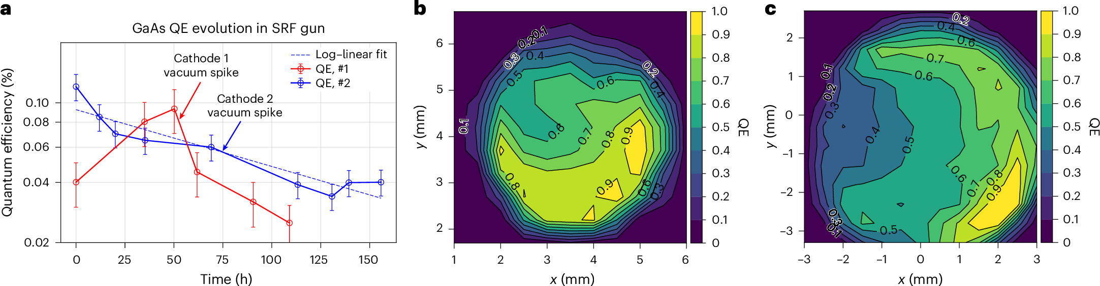
GaAs cathode lifetime
Dielectric losses : about 0.5 W for 100 μm GaAs and 1 W for 300 μm GaAs. Cooling water removes the heat.
Bunch charge: 1–1.2 nC at 78 kHz.

Slide 19
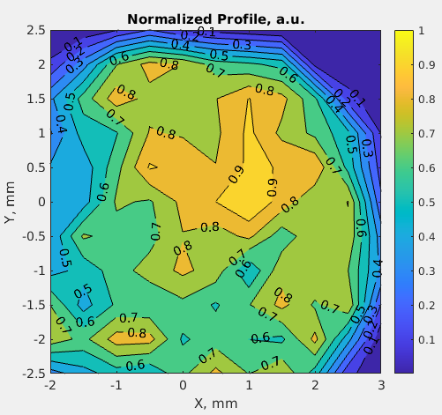
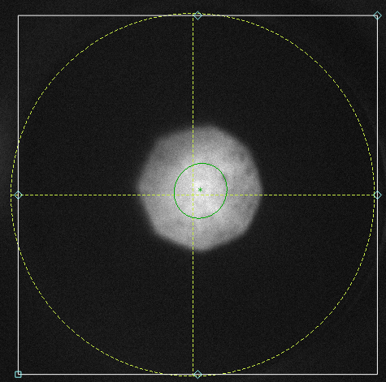
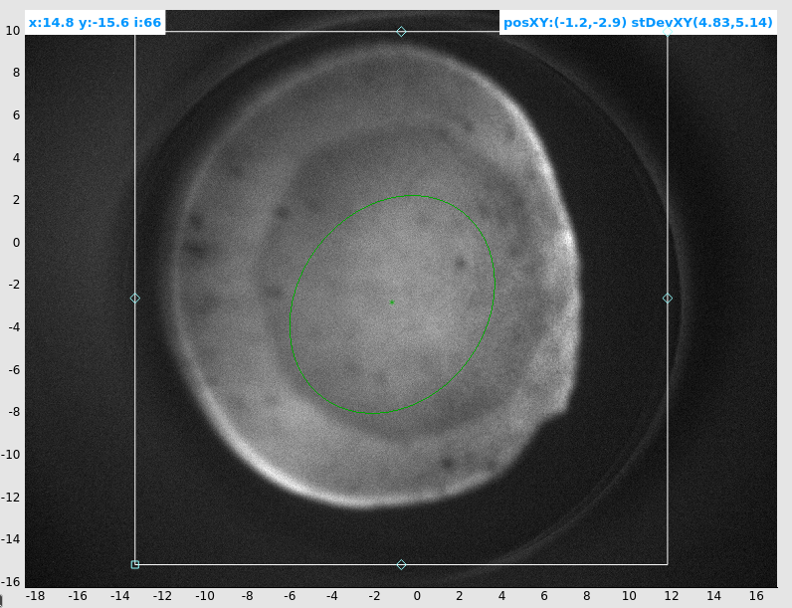
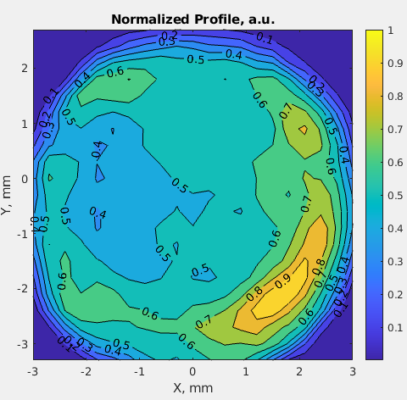
QE distribution after 3 days operation
Normalized QE scans
YAG images show dark spots and lower QE in the laser-illuminated region.
Possible cause: electron back bombardment.
Average QE decreased
from 0.1% to 0.05%.

Slide 20
Summary
Two bulk-GaAs cathodes were tested in the CeC SRF gun in May–June 2024.
Thin GaAs, edge-shielded holders, cathode at room temperature, Te-O-Cs activation and a low-β cavity enabled successful operation.
The cathodes survived transfer, but has significant QE loss due to the poor vacuum and outgas when moving the manipulator.
produced bunches up to 1-1.2 nC in the measurements shown, with a gun field of 12 MV/m. QE at 10⁻⁴ shows stable in the gun.
The experiments demonstrated beam generation from GaAs photocathode in an SRF gun.

Slide 21
Thank you !
Thanks to Vladimir Litvinenko, and Luca Cultrera for their contributions.

Slide 22
Related publication

Slide 23
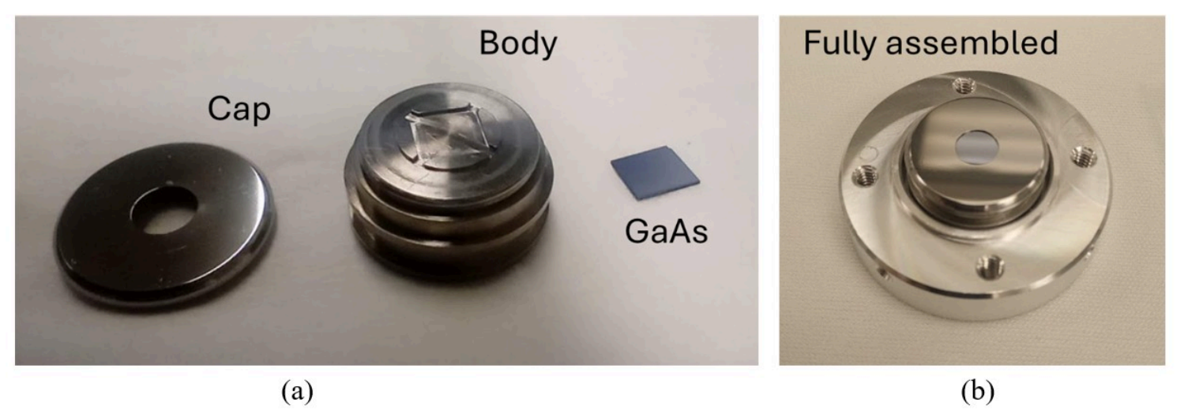
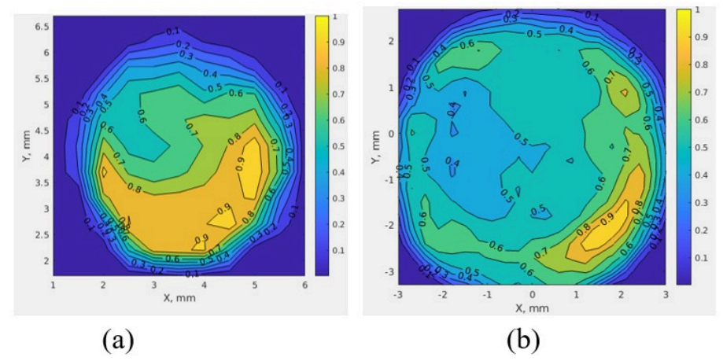
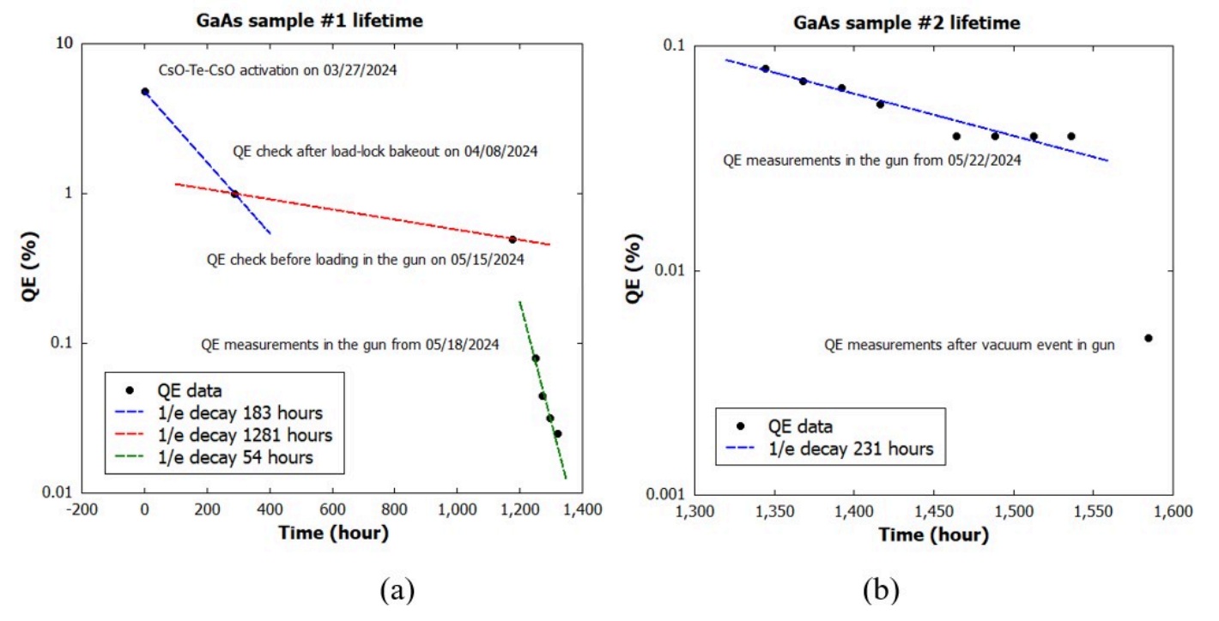
Summary: cathode performance
Relative QE maps
Edge-shielded holders protected the cathodes.
Vacuum transfer preserved photoemission.
Operation at 532 nm continued for hundreds of hours.
Maxima: 12 MV/m and 1.3 nC per bunch.
V. Litvinenko et al., “Towards advanced polarized electron sources,” Nature Physics 22, 325–330 (2026).

