Slide 1
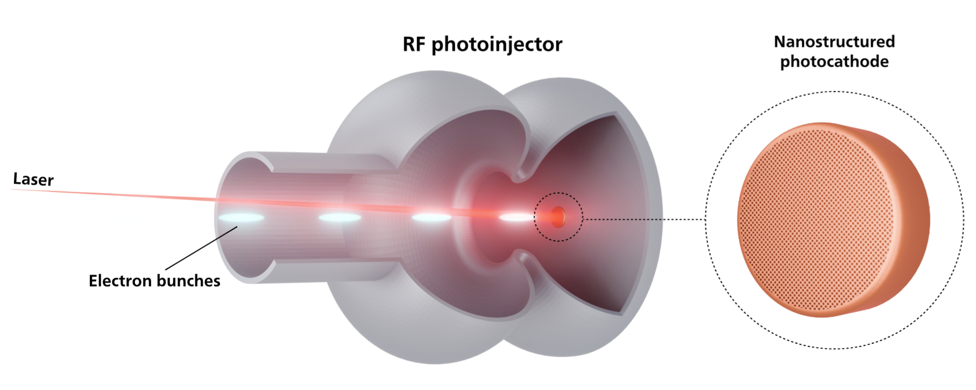
Simulation study of nanostructured plasmonic metallic photocathodes
M.Bulgacheva, E.Gjonaj
Technical University of Darmstadt, Germany

Slide 2
Motivation & workflow
Nanostructured copper photocathodes use surface-plasmon field enhancement to increase QE and therefore photocurrent, which means: the laser energy needed to generate the bunch can be reduced.
The open question: what impact does the enhanced emission have on the beam quality?
Workflow:
Electromagnetic
(Absorption)
Photoemission model
PIC beam dynamics

Slide 3
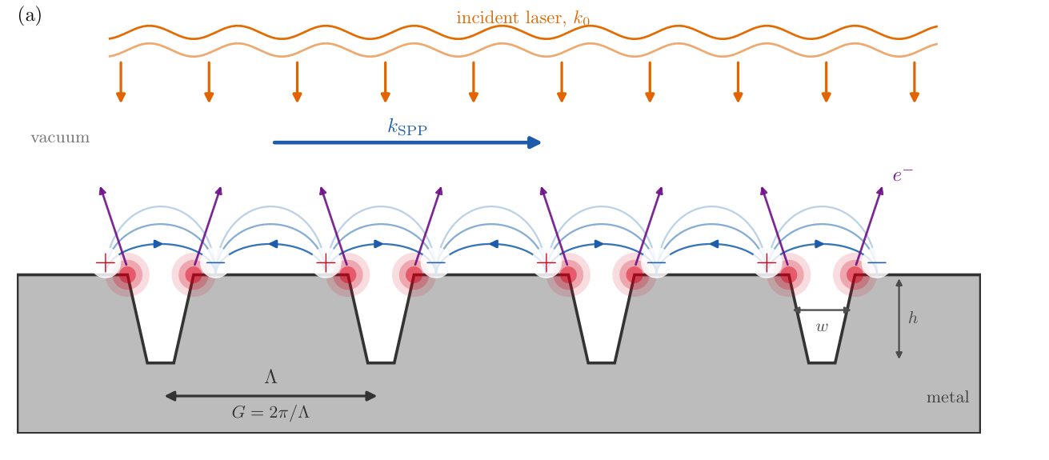
Surface-plasmon-enhanced photoemission
Periodic structure
Surface Plasmon Polariton (SPP) modes
Increased local absorption
+
Laser pulse

Slide 4
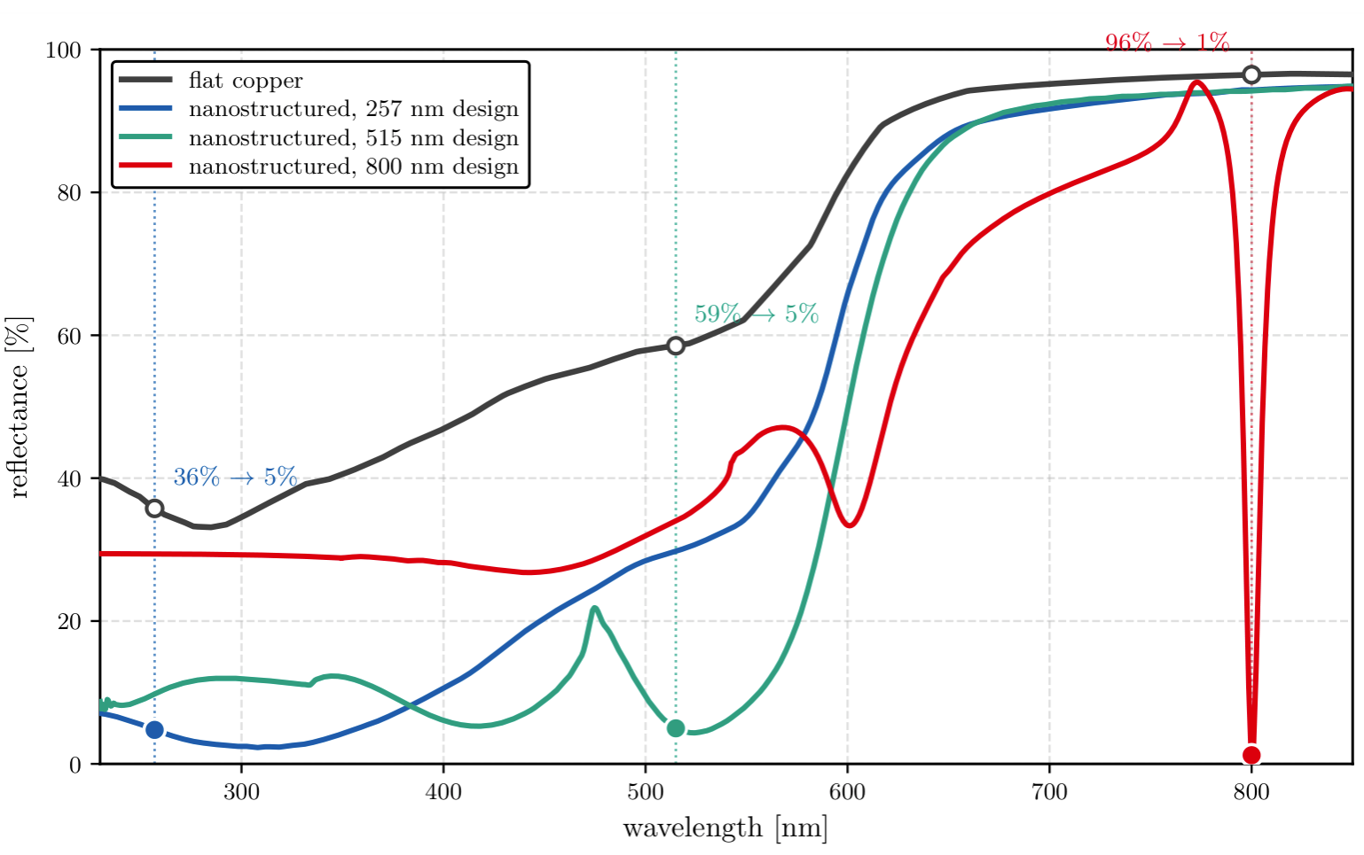
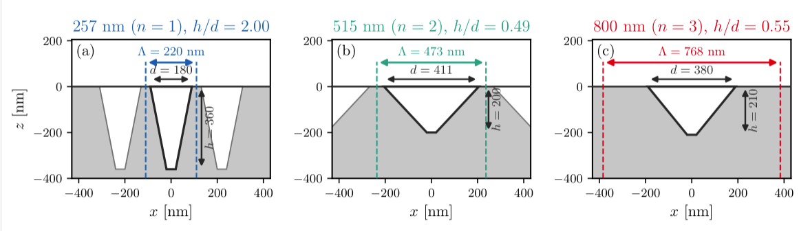
Electromagnetic characterization
Geometry: conical nanoholes
Periodic boundary conditions
Plane wave excitation
Optimization objective:
Reflectance minimization at given λ
3 drive wavelengths:
257 nm (UV), 515 nm (green), 800 nm (IR)

Slide 5
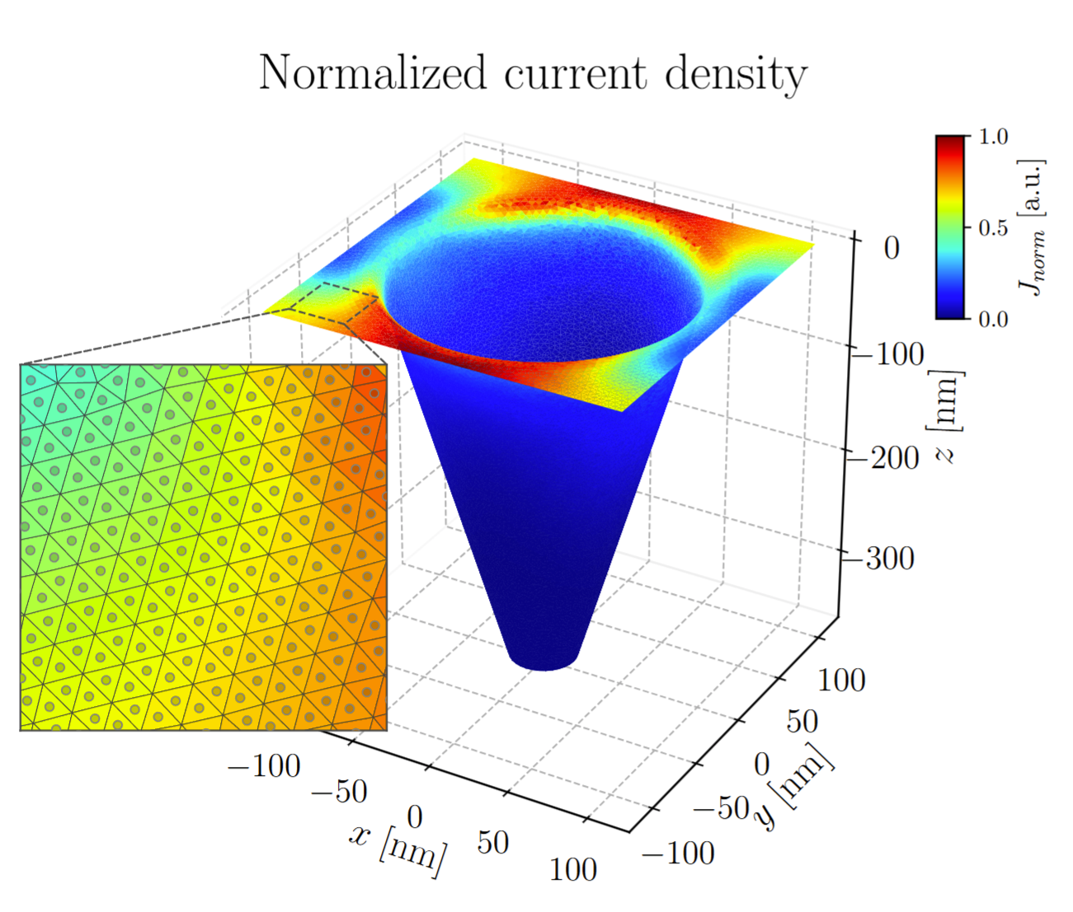
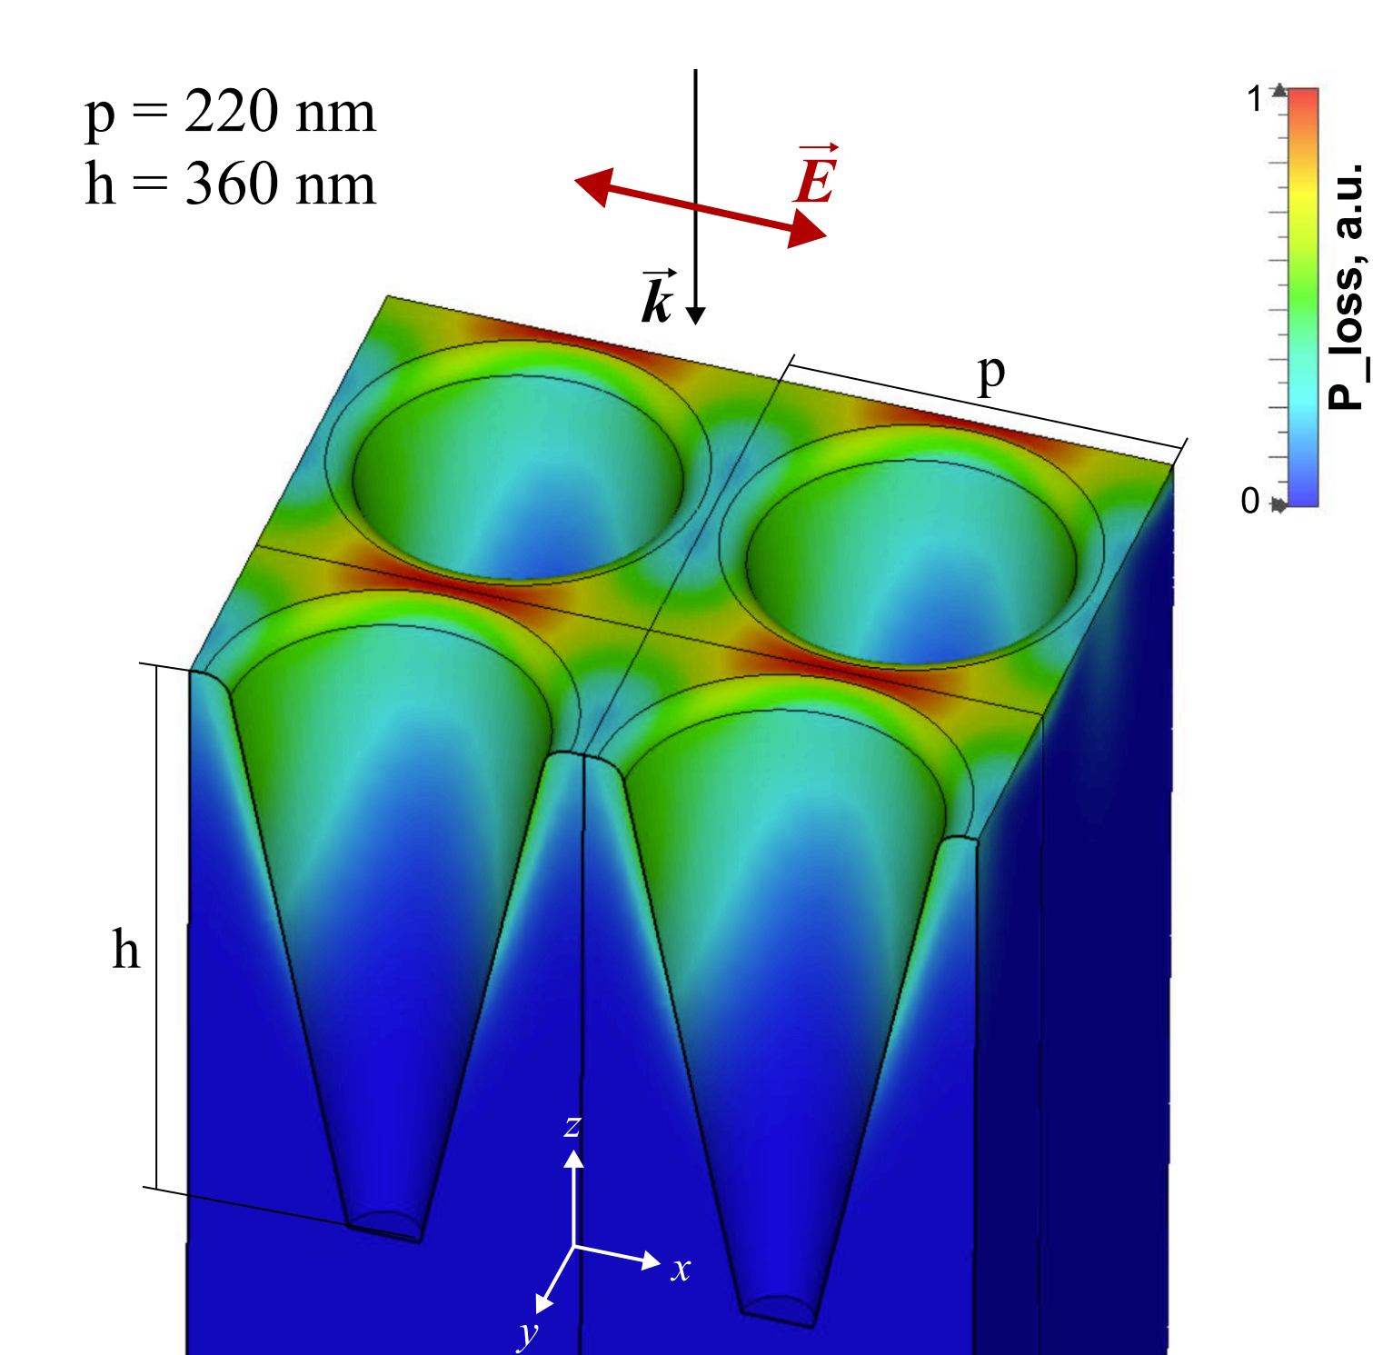

Nanostructured photocathode simulation
Electromagnetic simulation
  FIT-TD with plane wave excitation
  Geometry optimization
Photoemission model
  Spatially-resolved photocurrent calculation including Schottky
  Emission samples (particle interface)
Beam dynamics simulations
  Near-cathode PIC
  Micro- to macroscale
Power loss density
Normalized current density
Fowler-Dubridge + Schottky
Fowler-Dubridge photoemission model
P_{λ} — absorbed power from FIT (spatially resolved)
Φ(r) — work function, lowered by the Schottky effect
n — photoemission order from local work function
$$J_{n}\left(r,ω\right)=a_{n}A_{0}{\left(\frac{e}{hν}P_{λ}\left(r,ω\right)\right)}^{n}T^{2}F​\left(\frac{nhν−eΦ\left(r\right)}{k_{B}T}\right)$$

Slide 6
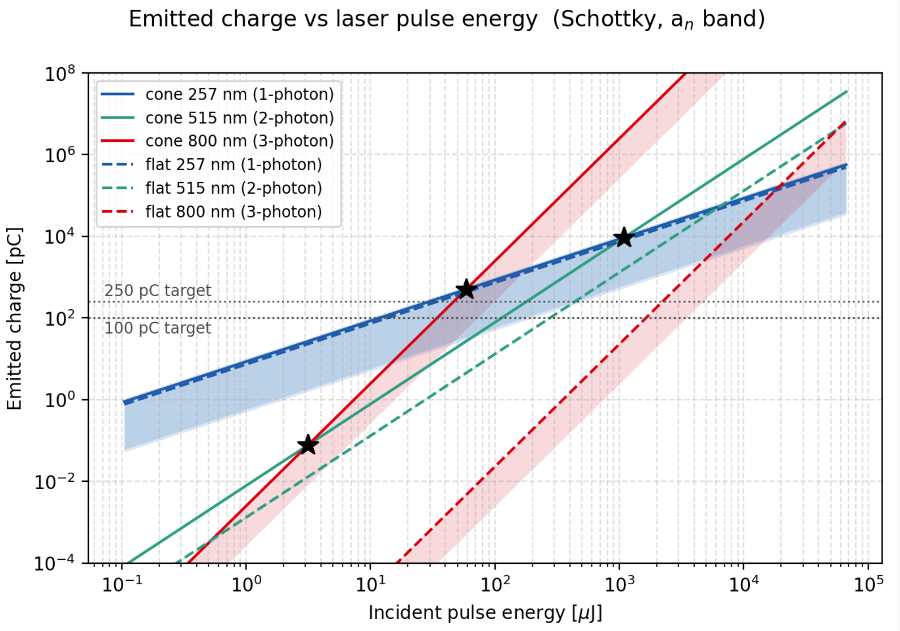

Charge yield grows sharply with photon order
1-photon (257 nm)
~ 1.2×
2-photon (515 nm)
~ 6×
3-photon (800 nm)
~ 10⁵×
3-photon
Which NS cathode requires less pulse energy
to produce a 100pC/250pC bunch?
  UV
  When noting IR→DUV conversion: IR
1-photon
2-photon
a_n caveat: the multiphoton coefficients are empirical, with a spread of about an order of magnitude. They affect absolute yields and the comparison between emission orders, not the NS-vs-flat ratio at a fixed wavelength.
$$J_{n}\left(r,ω\right)=a_{n}A_{0}{\left(\frac{e}{hν}P_{λ}\left(r,ω\right)\right)}^{n}T^{2}F​\left(\frac{nhν−eΦ\left(r\right)}{k_{B}T}\right)$$

Slide 7
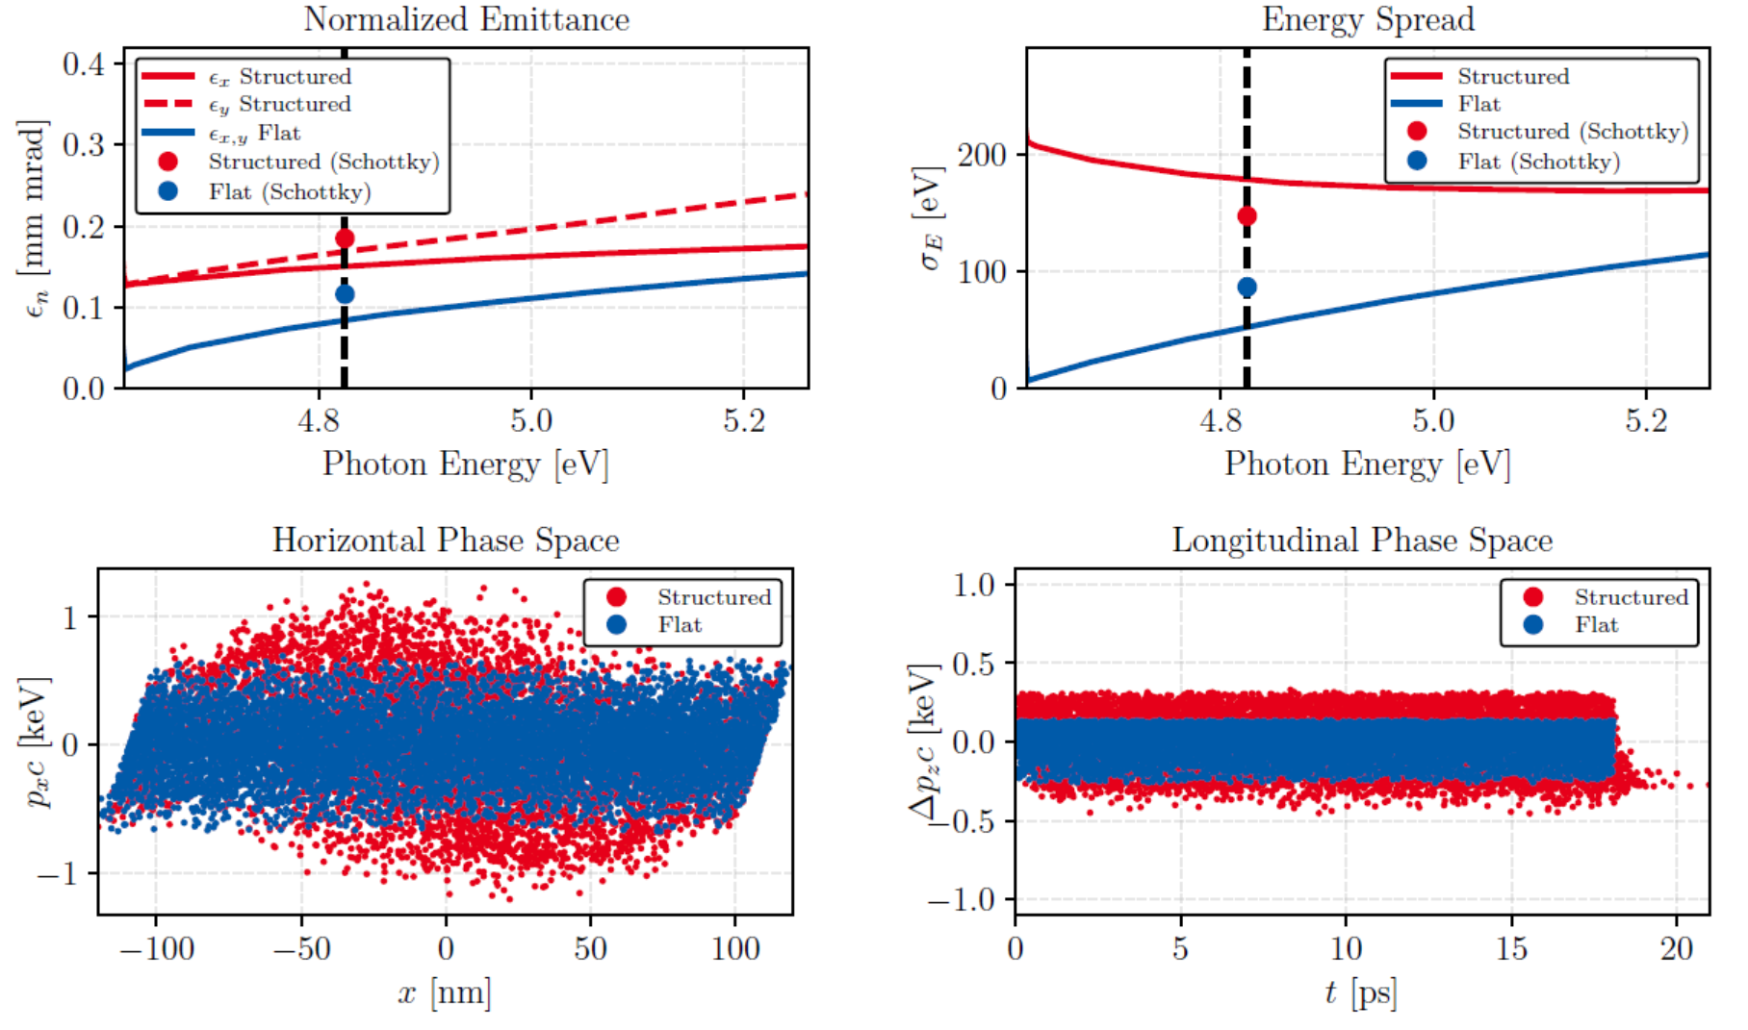
Beam dynamics near the cathode
UV (257 nm) cathode
Asymmetric transverse phase space aligned with laser polarization due to SPP field localization at nanohole edges
Larger energy spread than flat Cu: low-energy tail from electrons emitted deep inside the nanohole
Schottky effect suppresses low-energy tail by enhancing top-surface emission
The geometry causes a charge loss inside the UV nanostructure

Slide 8
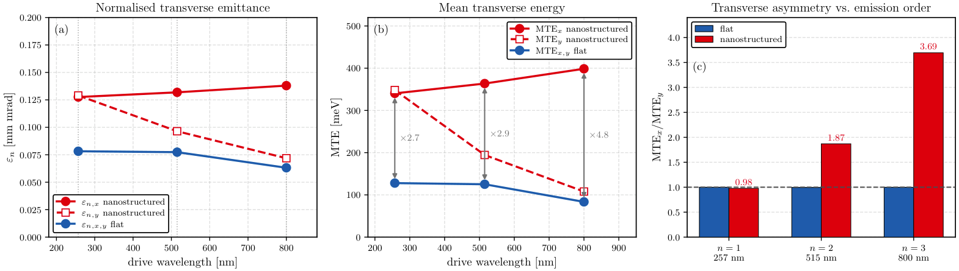
Anisotropy vs. photoemission order
With the photoemission order increasing, the beam asymmetry also increases because of the stronger enhanced field localization on the rims of the nanohole.

Slide 9
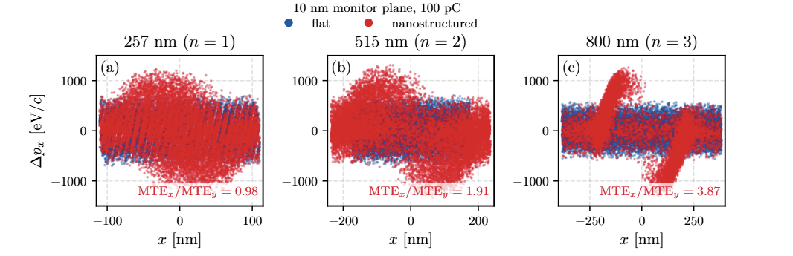
Anisotropy vs. photoemission order
With the photoemission order increasing, the beam asymmetry also increases because of the stronger enhanced field localization on the rims of the nanohole.

Slide 10
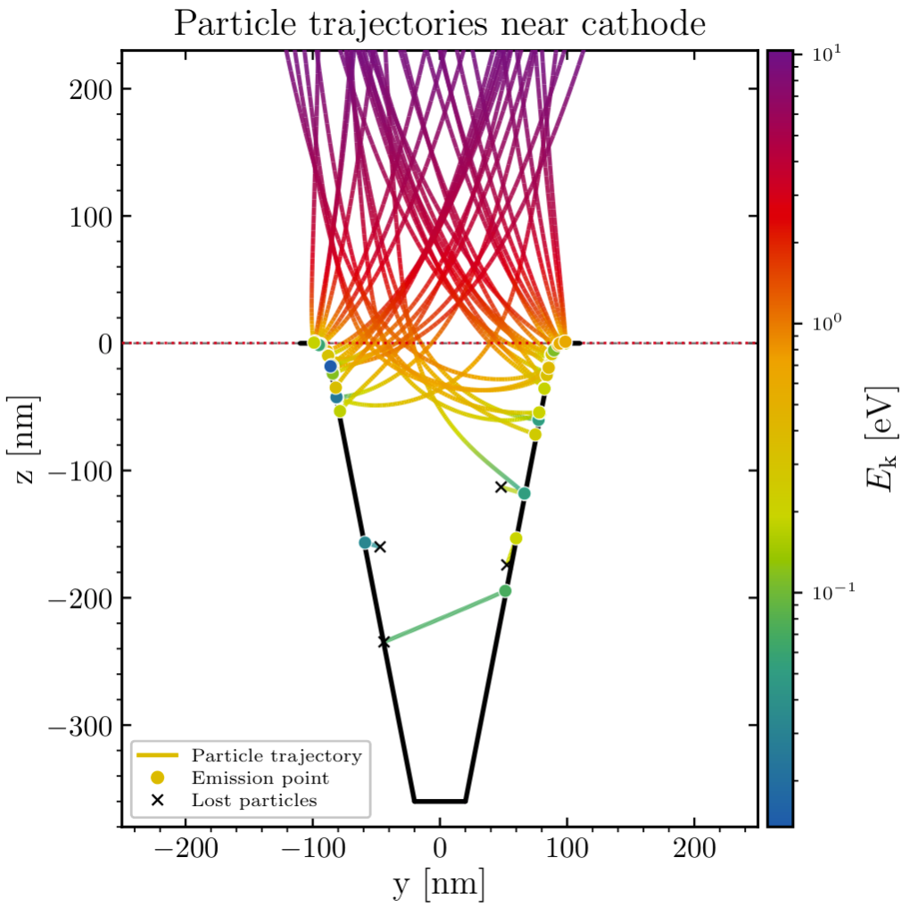
Charge loss is geometric
 | 100 pC | 250 pC
transverse | flat-top, σ = 0.16 mm | flat-top, σ = 0.25 mm
temporal | Gaussian, σ_t = 7 ps | Gaussian, σ_t = 3 ps
Transmission at 100 pC (10 nm plane): flat cathode 99% at all wavelengths; NS: 92% (UV), >98% (green, IR).
UV: the deep nanohole (360 nm) traps electrons emitted from the inner walls: about 8% are lost, plus a further 1% during the drift to 500 nm → the loss is geometric.
IR, green: negligible charge loss at 100 pC and 250 pC.
Space charge maximum is located at roughly 100 nm above the surface; inside the cones the charge density decreases.

Slide 11
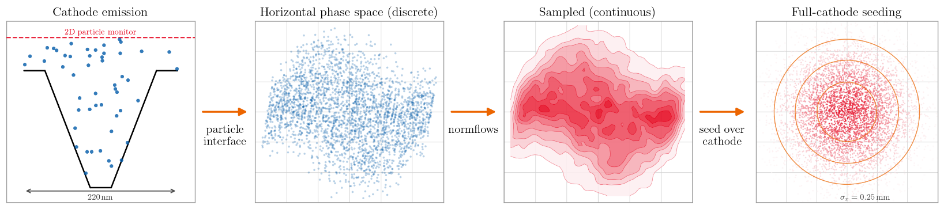
Micro- to macroscale: scale-up procedure
PIC near-cathode simulation (micro-scale)
Homogenization with ML and scale-up
Full-scale e-gun simulations (cluster)
Virtual cathode
Planar reference plane at a distance above the nanostructure.
Discrete 6D data
Macroparticle distributions from single-cell PIC runs.
Normalizing flows
Invertible network mapping particles → continuous 6D density.
Full-cathode seeding
Model replicated across the cathode, weighted by the laser intensity profile.
Notes:
This is an invertible neuronal network, which is trained by the particle data

Slide 12
Conclusions
Charge yield increases sharply with photon order: nanostructuring increases the charge by ~1.2× (1-photon, 257 nm), ~6× (2-photon, 515 nm), and ~10⁵× (3-photon, 800 nm) vs flat copper.
Nanostructuring leads to beam quality degradation: emittance and energy spread increase over flat copper; the Schottky effect partially compensates by suppressing the low-energy tail.
UV charge loss is geometric: geometric trapping in the deep UV structure (92% transmission), independent of bunch charge; no space-charge-driven loss at any wavelength.
Electromagnetic optimization (max. QE)
TRADEOFF
Beam dynamics optimization
(min. emittance)

