Slide 1

Collective and surface charge effects
in high brightness electron bunch production for FCC-ee
PhASE26| Orsay | 23 September 2026
Anahita Omoumi
A. Latina , S. Doebert, M. Calderon and E. Granados (CERN)
L. Jones (STFC, Daresbury)
S. Bettoni (PSI)
B. O’Shea, R. Loney and C. Emma (SLAC)

Slide 2
Content:
01 Motivation
02 Dynamic Photoemission Model
03 Experimental Benchmarking
05 Conclusion and Outlook
A. Omoumi | PhASE26 | 23.09.26

Slide 3
Content:
01 Motivation
A. Omoumi | PhASE26 | 23.09.26

Slide 4
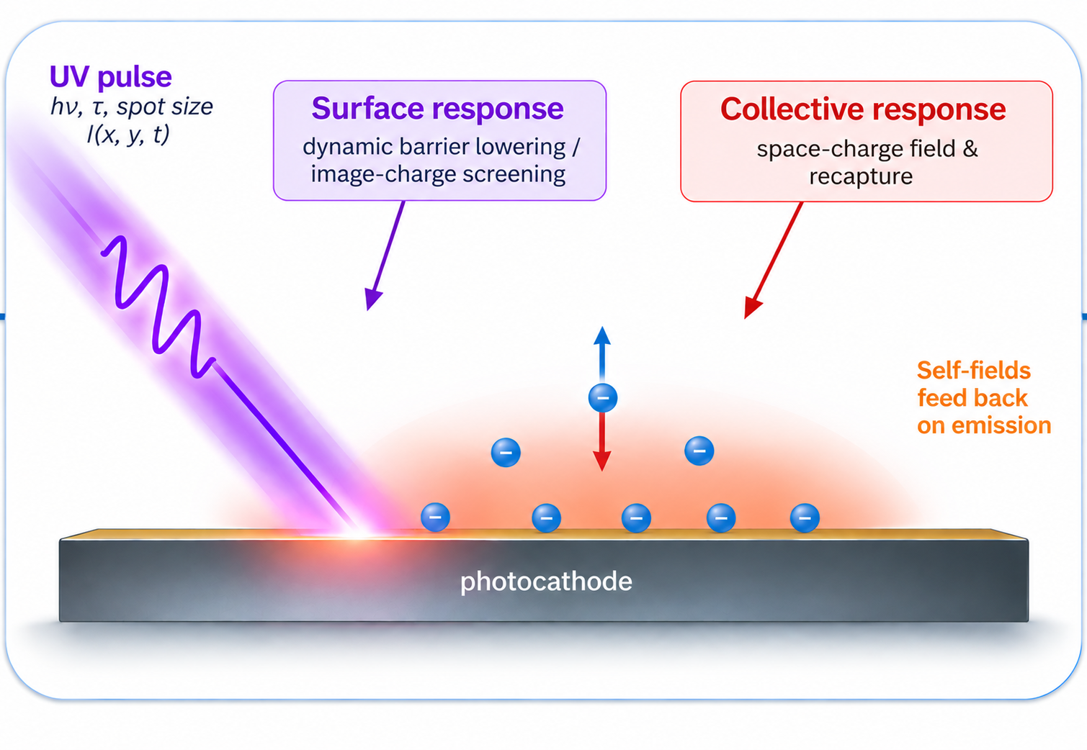
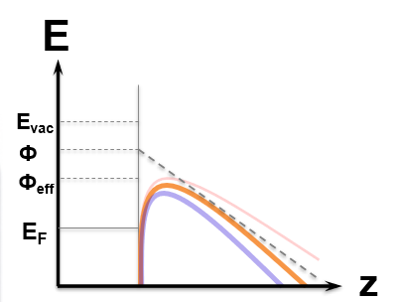

Motivation — Why collective & surface effects matter
A general challenge for high-brightness photoelectron sources
The high-brightness objective
What changes at high charge density?
Why it matters
More charge
Extractable charge
saturation / clamping
+
Shorter bunch
Temporal dynamic
+
bunch-shape distortion
Smaller emittance
→ high phase-space density
at the cathode
Transverse dynamic
emittance growth
At high brightness, photoemission is no longer only a material response to the laser: the emitted bunch modifies the surface and extraction conditions while emission is still occurring.
A. Omoumi | PhASE26 | 23.09.26
4

Slide 5
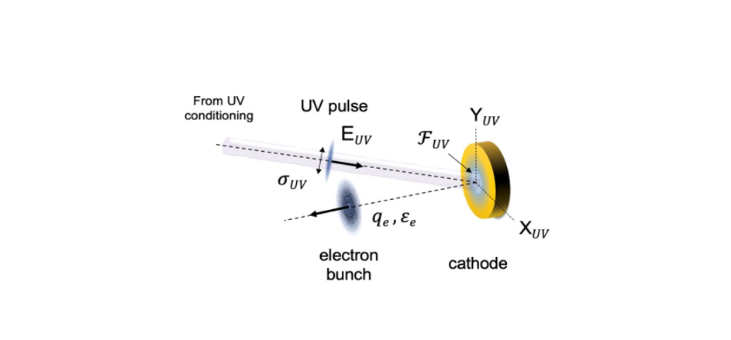
Motivation — Why this is critical for FCC-ee
The source must combine high charge, fast tunability and controlled phase space
BASELINE OPERATION
TOP-UP SCHEME
1- TAILORING OF TRANSVERSE BEAM PROFILE
Bunch charge
5-7 nC
Dynamic charge range
0-7 nC
Bunch spacing
25 ns
Response time
< 25 ms
Bunch per train
2 - 4
Transverse profile
Maximum repetition rate
2- FAST AND PRECISE AMPLITUDE MODULATION SCHEME
On-demand
shaping capability
≤ 200 Hz
Bunch duration
Transverse emittance
~ 3ps (rms)
~ 7 mm.mrad*
(depending on the damping ring)
Energy spread
390 keV (0.2%)
25 ns
50 ms
A. Omoumi | PhASE26 | 23.09.26
5

Slide 6
From source requirements to a predictive photoemission model
State of the art: the relevant physics exists — but usually in separate descriptions
Analytical / canonical
models
Microscopic / quantum emission models
PIC / particle tracking
Fast & interpretable
Detailed surface physics
Self-consistent beam dynamics
Fast, local estimates of emission
Microscopic barrier physics / scaling laws
Typically prescribed or quasi-static fields
No self-consistent collective feedback
Evolving space-charge fields & transport
Realistic geometries and boundaries
Requires a cathode emission law / closure
Expensive for wide parameter scans and source optimization
Time-dependent emission
Barrier transmission / tunneling
Near-threshold physics
No self-consistent collective feedback
Our goal: a reduced self-consistent model that couples dynamic surface-barrier physics to collective charge evolution — fast enough for scans, yet rich enough to predict saturation and losses.
A. Omoumi | PhASE26 | 23.09.26
6

Slide 7
Content:
01 Motivation
02 Dynamic Photoemission Model
A. Omoumi | PhASE26 | 23.09.26

Slide 8
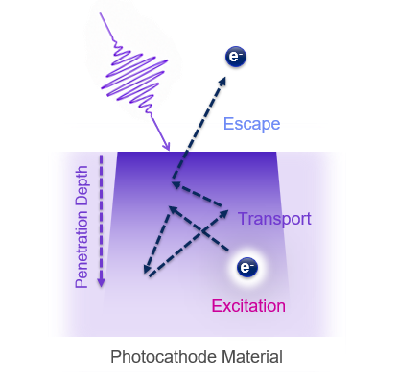
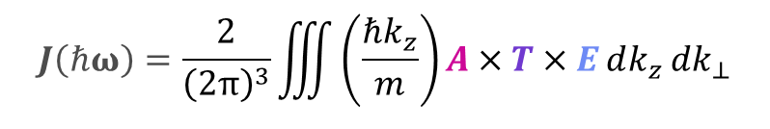



From Laser Pulses into Electron Bunches
$$J\left(ℏω\right)=\frac{2}{{\left(2π\right)}^{3}}\iiint{\left(\frac{ℏk_{z}}{m}\right)A×T×E dk_{z} dk_{⊥}}$$
$$R\left(ω\right), δ(ω)$$
Moment Model (MM)
DFT
A
Absorption
$τ$, $f_{λ}$
Relaxation time
e- scattering losses
T
Transport
$$D(k)$$
Dynamic Field
Temperature
E
Emission
A. Omoumi | PhASE26 | 23.09.26
8

Slide 9


From Laser Pulses into Electron Bunches
$$J\left(ℏω\right)=\frac{2}{{\left(2π\right)}^{3}}\iiint{\left(\frac{ℏk_{z}}{m}\right)A×T×E dk_{z} dk_{⊥}}$$
$$R\left(ω\right), δ(ω)$$
Moment Model (MM)
DFT
A
Absorption
$τ$, $f_{λ}$
Relaxation time
e- scattering losses
T
Transport
$$D(k)$$
Dynamic Field
Temperature
E
Emission
A. Omoumi | PhASE26 | 23.09.26
9

Slide 10
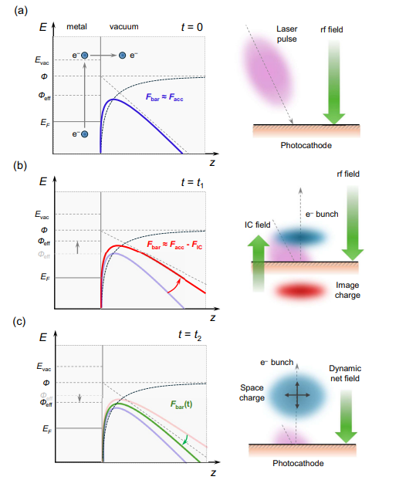
A Time-resolved Photoemission Model
WHY
Top-up injection needs high, tunable bunch charge
At high charge density, the photocathode is no longer a passive emitter.
CORE PHYSICS
Emission modifies the field that controls subsequent emission.
F_{bar}(t) = F_{RF} − E_{IC}
F_{dyn}(t,z) = F_{RF} − E_{SC}
surface barrier
vacuum transport
UV
pulse
Emission
IC / SC
fields
Barrier
FIELD DECOMPOSITION
•
The image field affects the barrier.
The space charge field affects transport.
•
A. Omoumi | PhASE26 | 23.09.26
10

Slide 11
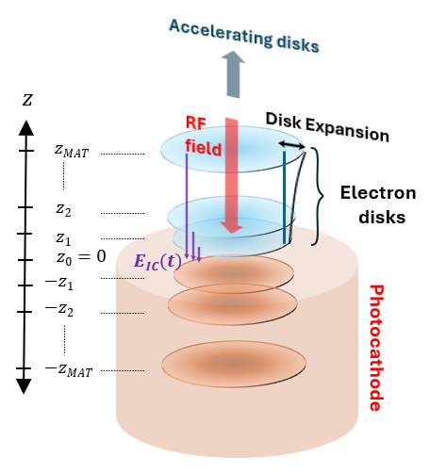
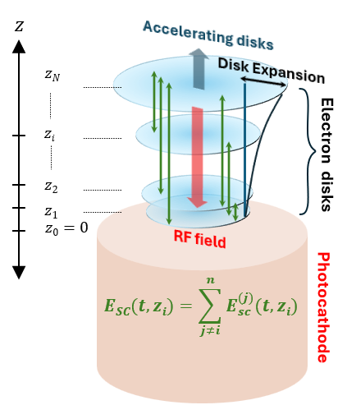

Finite Disc Model
!
Infinite sheet → Constant field → Overestimates screening → Artificial clamping
We consider instead, finite uniformly charged disks of radius a :
$$E_{z}\left(Δz\right)=\frac{σ}{2ε_{0}}\left(1−\frac{Δz}{\sqrt{Δz^{2}+a^{2}}}\right)$$
Image Charge
Composite Field at Surface
Electron
image
disks
𝐹_{bar} (𝑡) = 𝐹_{RF} − 𝐸_{IC} (𝑡)
𝐹_{dyn} (𝑡, 𝑧_{𝑖}) = 𝐹_{RF} − 𝐸_{SC} (𝑡, 𝑧_{𝑖})
A. Omoumi | PhASE26 | 23.09.26
11

Slide 12
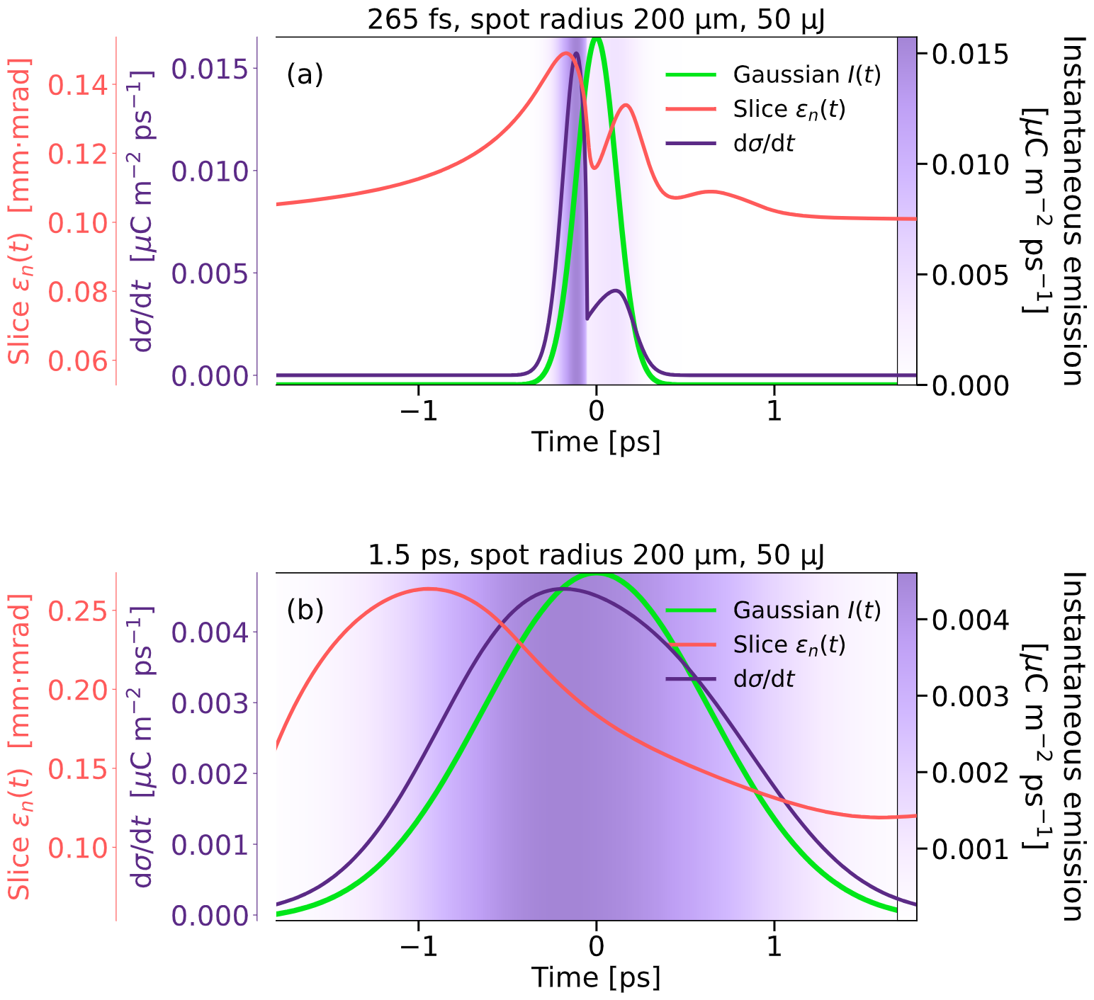
Time-Resolved Emission Dynamics
For 265 fs:
Rapid image buildup
Mid-pulse suppression
Double emittance peak
For 1.5 ps:
Slower buildup
Smoother emittance evolution
Faster pulses enhance dynamic barrier modulation.
A. Omoumi | PhASE26 | 23.09.26
12

Slide 13
Content:
01 Motivation
02 Dynamic Photoemission Model
04 Experimental Benchmarking
A. Omoumi | PhASE26 | 23.09.26

Slide 14
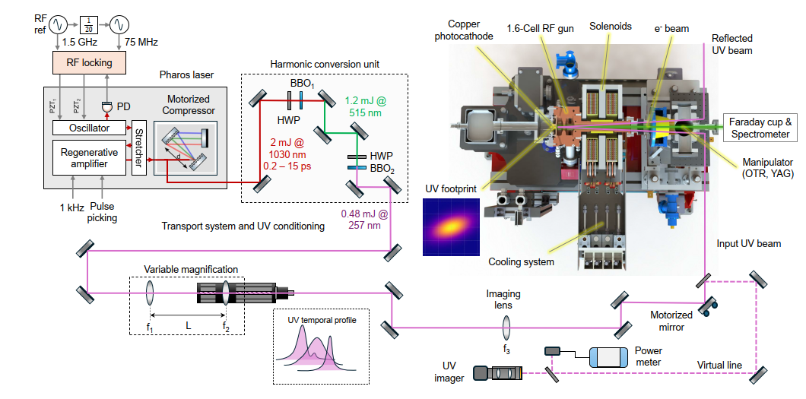
Validation With Experimental Data
Experimental Setup for Charge Production Tests at CTF2
A. Omoumi | PhASE26 | 23.09.26
14

Slide 15
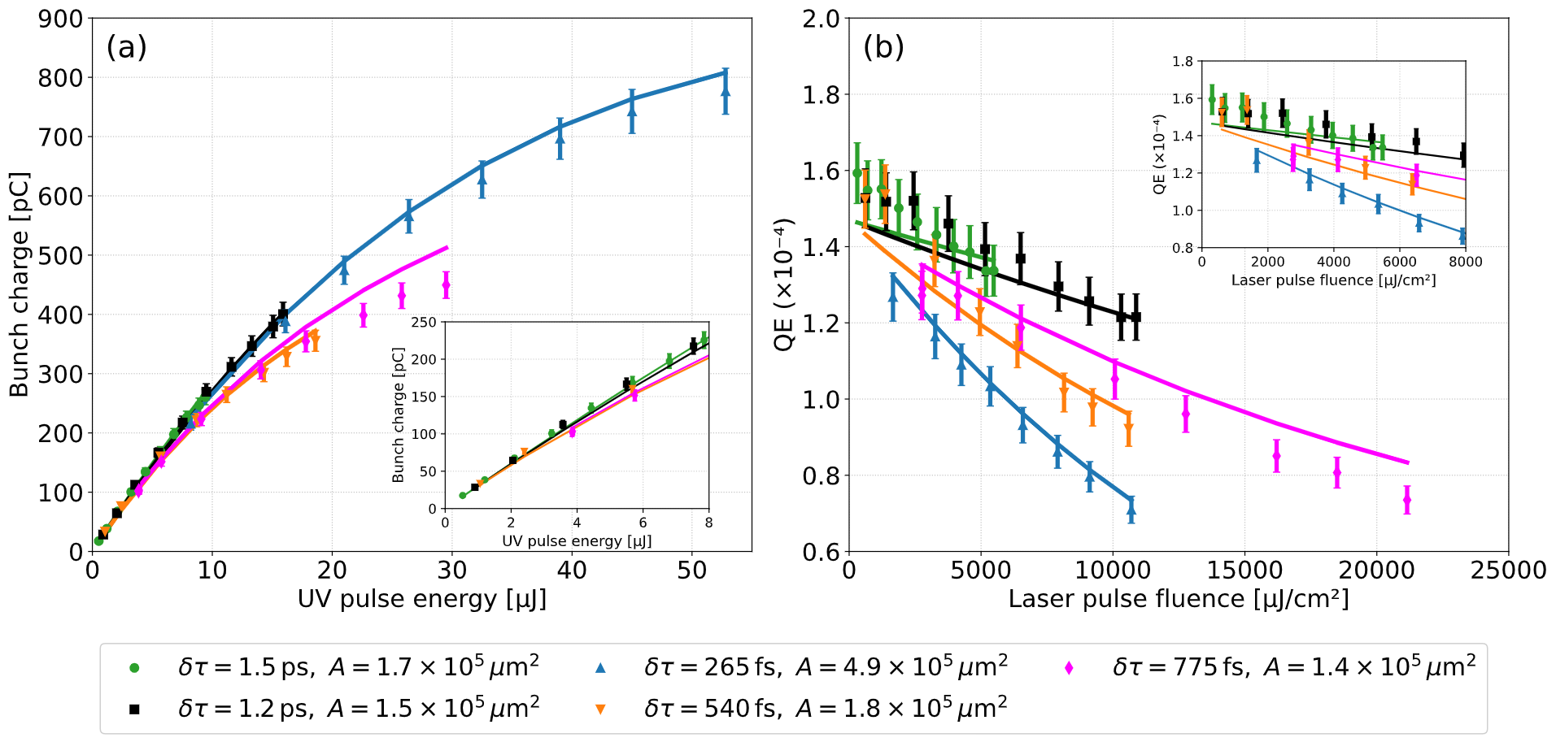
Charge vs Laser Energy
The model reproduces saturation without invoking ad-hoc limits, it emerges naturally from dynamic field screening.
A. Omoumi | PhASE26 | 23.09.26
15

Slide 16

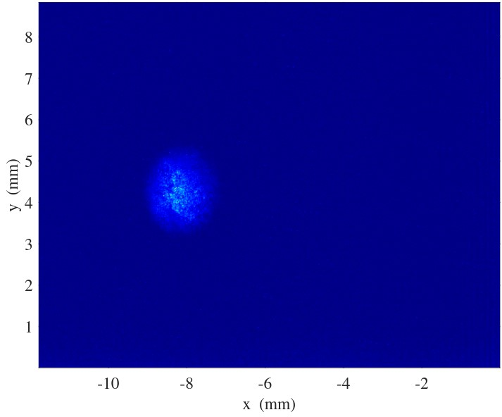
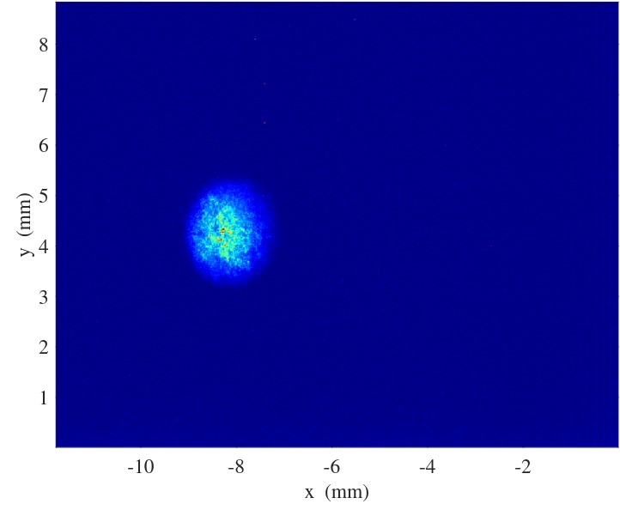
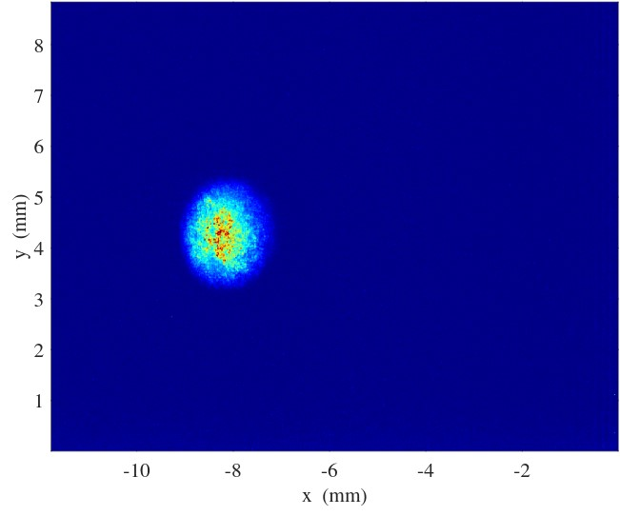
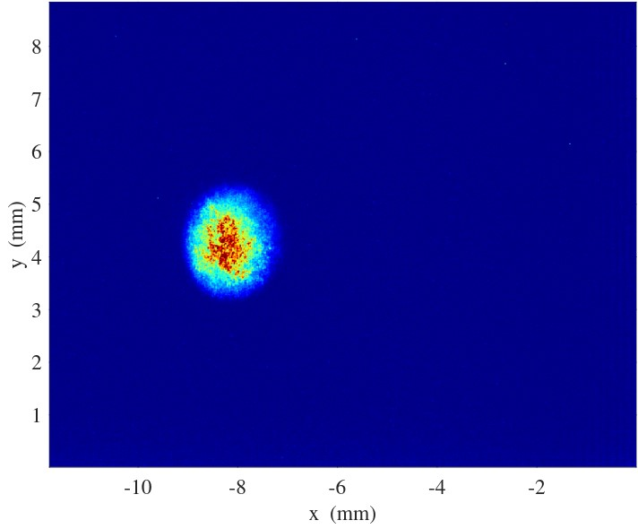
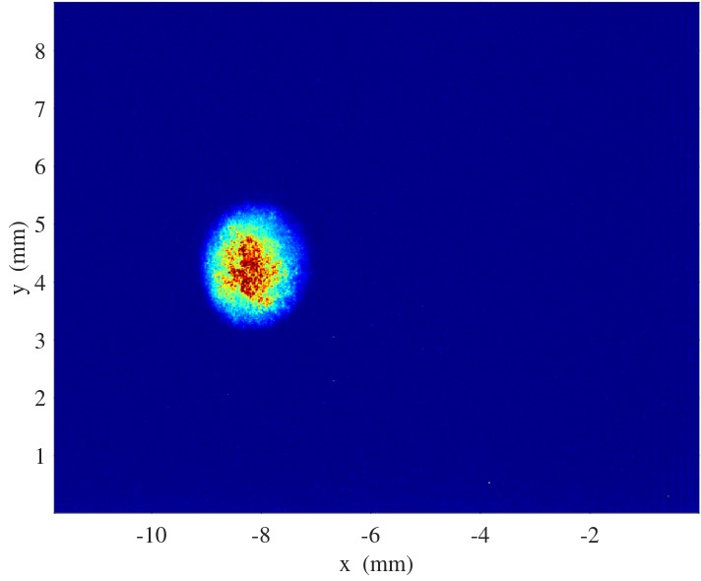
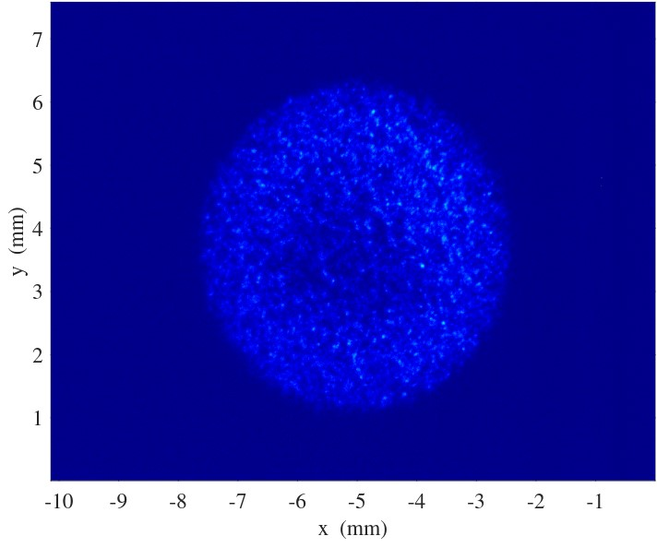
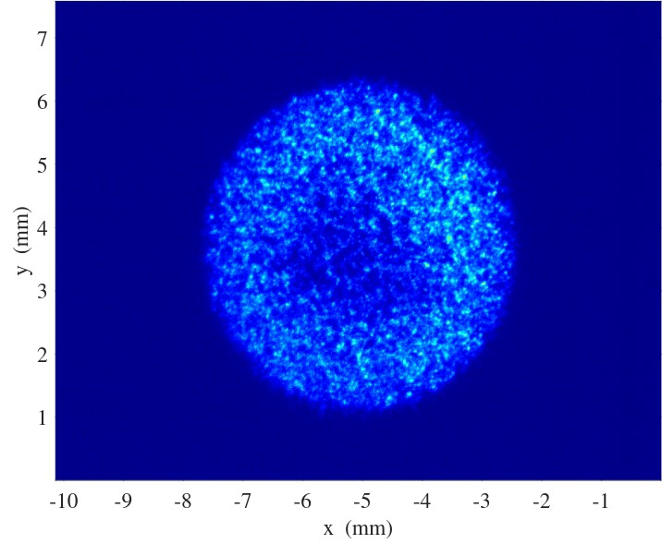
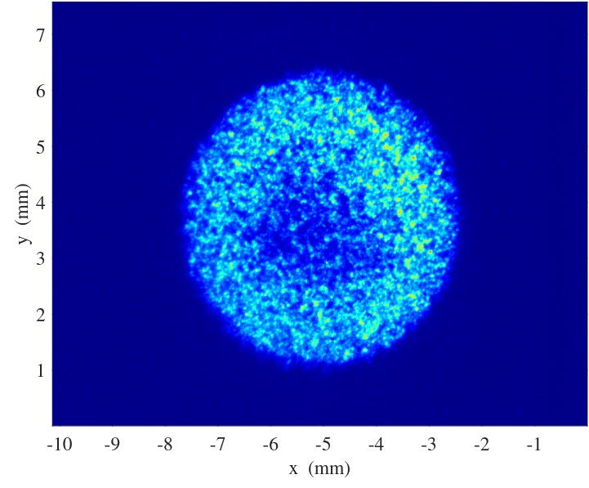
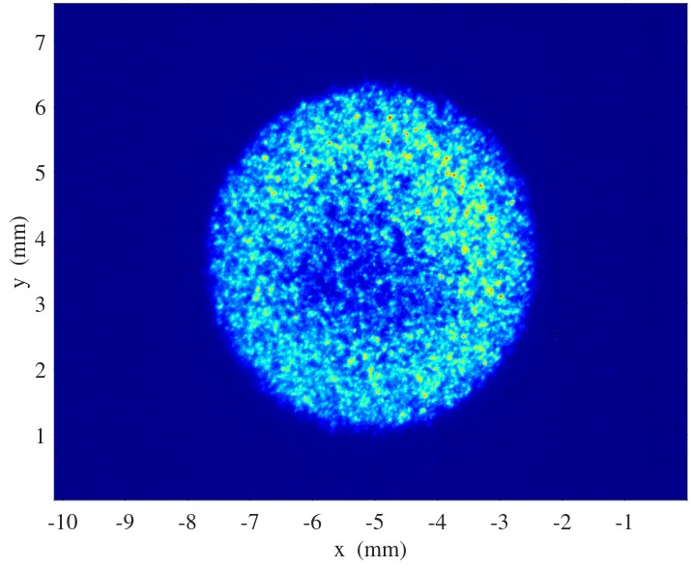
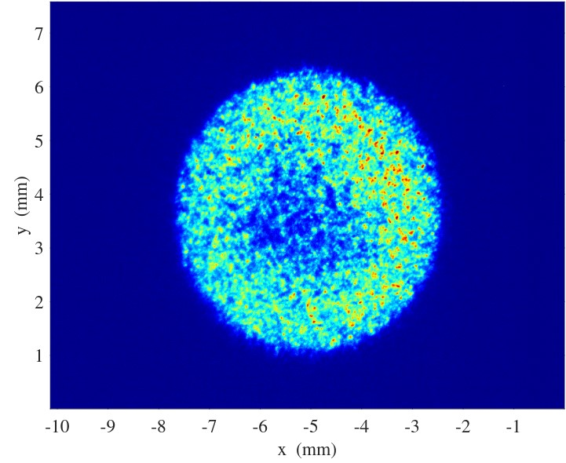
Benchmarking the Model: SLAC Results
FACET-II Injector Parameters:
Charge (nC)
Laser pulse energy (µJ)
Flat-top spot size (mm)
Pulse length (ps rms)
1.0 | 1.6 | 2.0 | 2.5 | 2.8
56 | 87 | 112 | 145 | 172
5.5 | 5.5 | 5.5 | 5.5 | 5.5
1.2 | 1.2 | 1.2 | 1.2 | 1.2
Cathode
VCCF
A. Omoumi | PhASE26 | 23.09.26
16

Slide 17
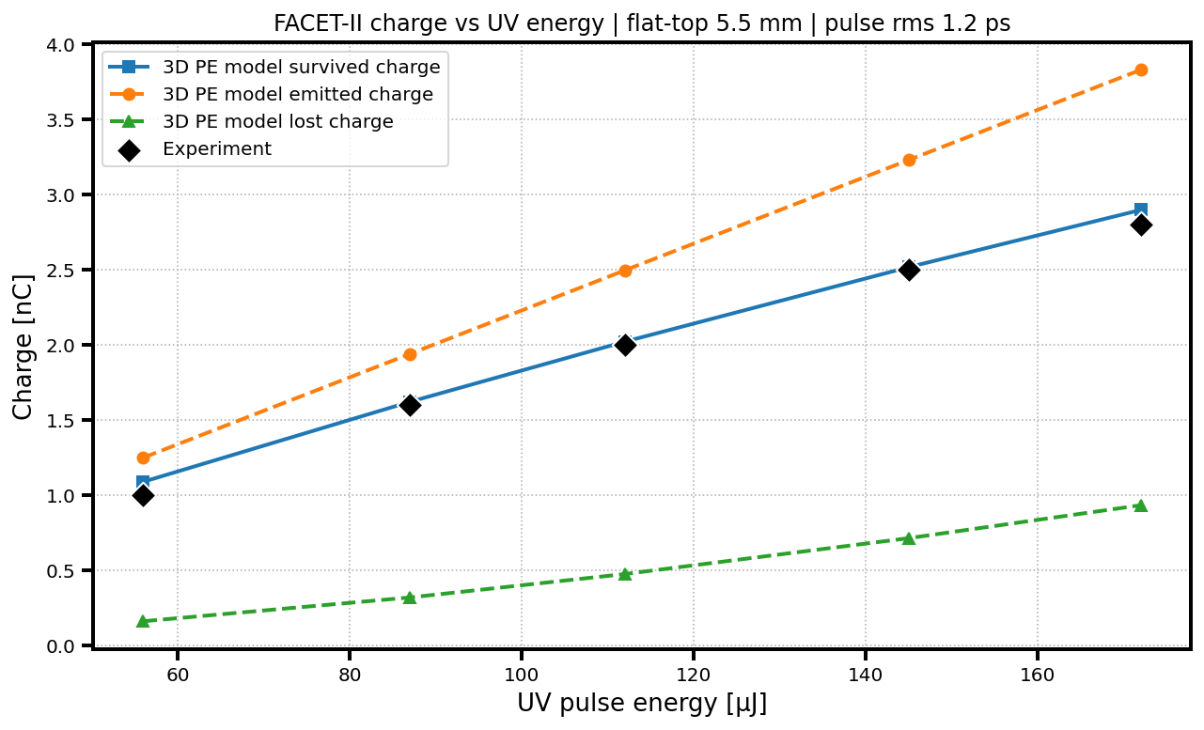
Benchmarking the Model: SLAC Results
FACET-II Charge vs. UV Pulse Energy | Flat-top 5.5 mm | Pulse RMS 1.2 ps
A. Omoumi | PhASE26 | 23.09.26
17

Slide 18
From “charge dynamics” to “spatially resolved emission and emittance”
3D emission grid
Local space-charge field
Each cell carries a local emitted charge qᵢ(t)
E_{SC}(xᵢ,yᵢ,t) = Σⱼ Kᵢⱼ(t) qⱼ(t)
Kᵢⱼ : geometrical coupling between source cell j and observation cell i
1
Laser profile
sets qⱼ across the grid
cell i
2
Neighbour coupling
each cell feels surrounding charge
3
Local field
E_SC differs from cell to cell
4
3D dynamics
local forces feed transverse phase space
surrounding cells j
Key idea: the model is cell-to-cell coupling on a 2D transverse grid.
Each surrounding cell contributes according to its charge and relative position.
A. Omoumi | PhASE26 | 23.09.26
18

Slide 19
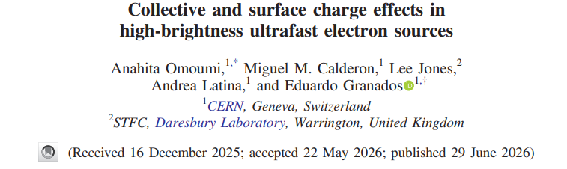


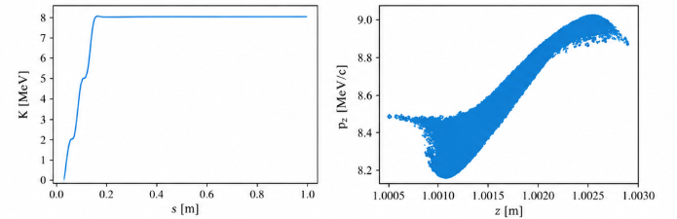

For more information…
Read the paper
Example: RF-Track simulation of 5nC bunch in the CLEAR photoinjector using the dynamic photoemission model
RF-Track on Git-Lab
A. Omoumi | PhASE26 | 23.09.26
19

Slide 20
Content:
01 Motivation
02 Dynamic Photoemission Model
03 Experimental Benchmarking
05 Conclusion and Outlook
A. Omoumi | PhASE26 | 23.09.26

Slide 21
Motivation — High-brightness beams start at the cathode
Charge scaling production is studied for copper-based photoinjectors.
A new model including dynamic field effects on the photocathode surface is presented:
  Sub-ps field dynamics strongly affect the scaling laws
  The real-time QE becomes nonlinear as a function of illumination parameters
The model has been benchmarked with RF guns at CERN and SLAC, showing good agreement.
To deliver up to 7 nC per bunch, several limitations need to be addressed:
  The spot size on the cathode needs to be very large → implications for RF frequency and gun design
  Pulse duration → it can be a knob for changing the extracted charge,
  but also, for charge scaling longer pulses are preferred.
Emittance: Transverse emittance is included, longitudinal emittance coming soon…
Outlook
We need to:
  Complete the 3D extension of the model
  Enable the capability of simulating arbitrary UV wavepackets → detailed studies of UV shaping techniques
  Explore the modeling of semiconductor photocathodes
  How can we reliably modulate the bunch charge and emittance in a shot-to-shot basis?
A. Omoumi | PhASE26 | 23.09.26
21

Slide 22
Thank you!

