Slide 1
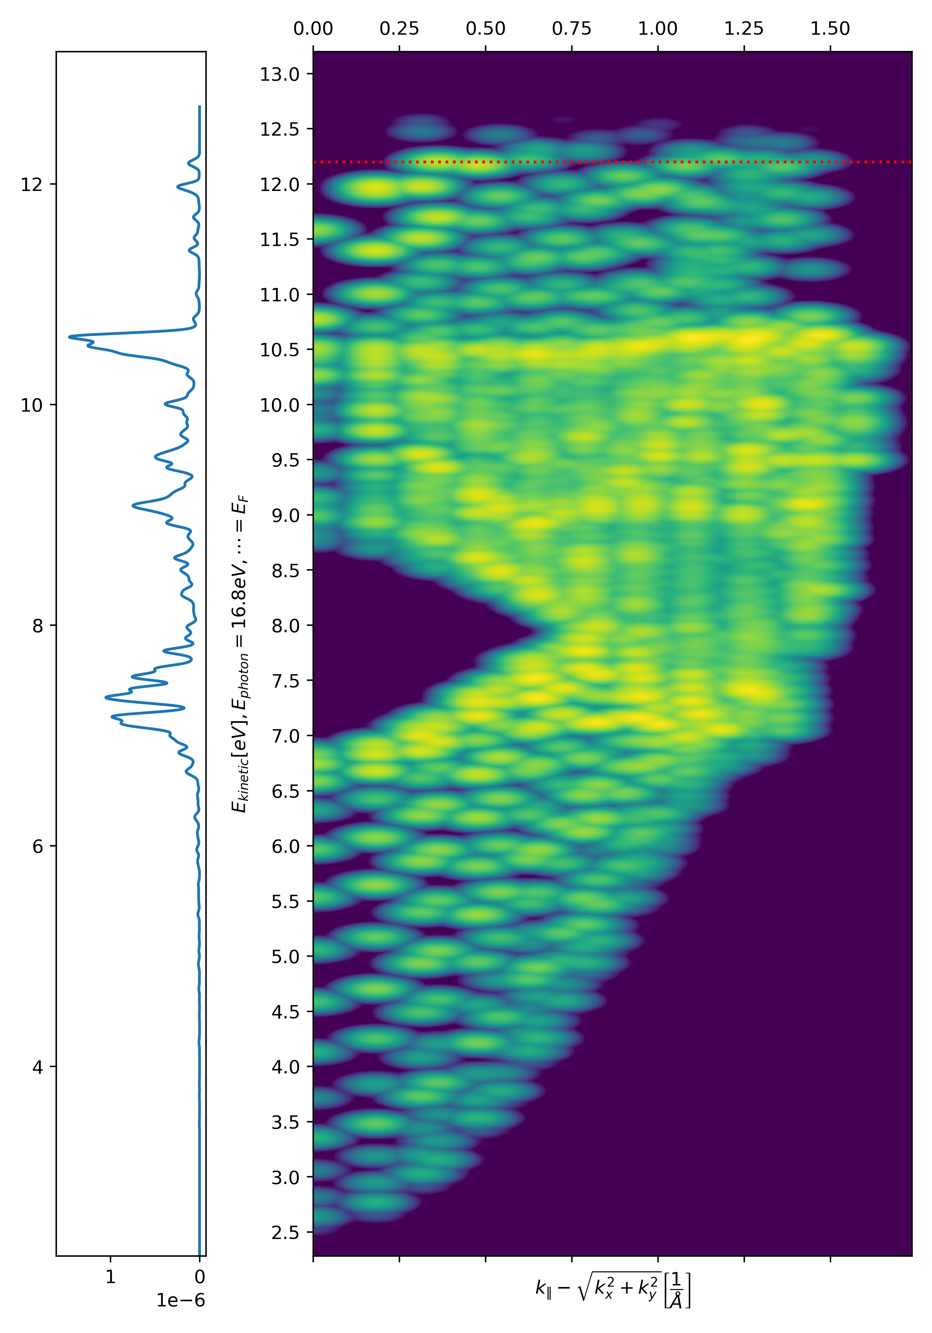
Photoemission from ab initio slabs
Finding a happy medium between effort and fidelity.
Felix Mildner, Prof Nicholas Harrison
23/09/2026

Slide 2
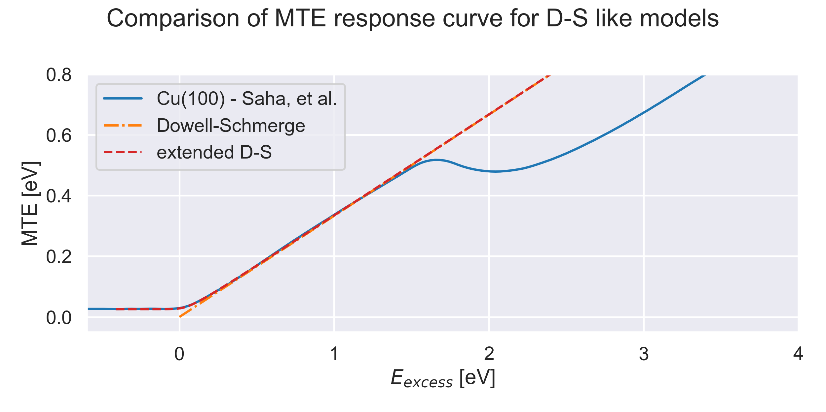
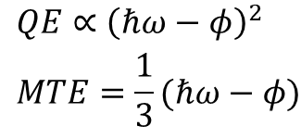

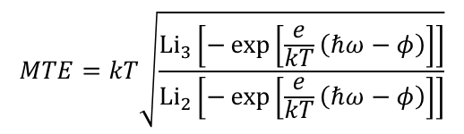
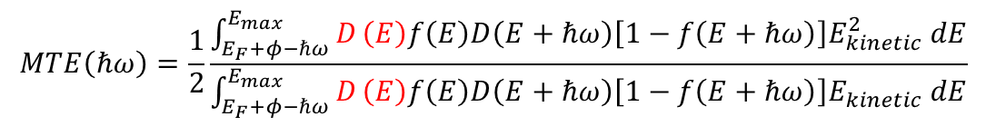
Emission Modelling
Comp. requirements vs granularity
$$QE∝{\left(ℏω−φ\right)}^{2} \\ MTE=\frac{1}{3}(ℏω−φ)$$
Dowell - Schmerge model
extended Dowell - Schmerge
Vecchione, et al.
DOS dependent
Saha et al.
Full Scattering Formalism
Pendry
$$MTE=kT\sqrt{\frac{{\text{Li}}_{3}\left[−\exp\left[\frac{e}{kT}\left(ℏω−φ\right)\right]\right]}{{\text{Li}}_{2}\left[−\exp\left[\frac{e}{kT}\left(ℏω−φ\right)\right]\right]}}$$
$$MTE\left(ℏω\right)=\frac{1}{2}\frac{\int_{E_{F}+φ−ℏω}^{E_{max}}{D}\left(E\right)f\left(E\right)D\left(E+ℏω\right)\left[1−f\left(E+ℏω\right)\right]E_{kinetic}^{2} dE}{\int_{E_{F}+φ−ℏω}^{E_{max}}{D}\left(E\right)f\left(E\right)D\left(E+ℏω\right)\left[1−f\left(E+ℏω\right)\right]E_{kinetic} dE}$$
$$I\left(k_{∥},E+ω\right)=−\frac{1}{π}\text{Im}\left\langle φ\left|G_{2}^{+}ΔG_{1}^{+}\left(E\right)Δ^{†}G_{2}^{−}\right|φ\right\rangle$$
D. H. Dowell and J. F. Schmerge, Physical Review Special Topics - Accelerators and Beams, 2009, 12, 074201.
T. Vecchione, D. H. Dowell, W. Wan, J. Feng and H. A. Padmore, New York, 2013.
P. Saha, O. Chubenko, J. Kevin Nangoi, T. Arias, E. Montgomery, S. Poddar, H. A. Padmore and S. Karkare,
Journal of Applied Physics, 2023, 133.
J. B. Pendry, Surface Science, 1976, 57, 679–705.

Slide 3
Emission Modelling
Comp. requirements vs granularity
$$QE∝{\left(ℏω−φ\right)}^{2} \\ MTE=\frac{1}{3}(ℏω−φ)$$
Dowell - Schmerge model
extended Dowell - Schmerge
Vecchione, et al.
DOS dependent
Saha et al.
Full Scattering Formalism
Pendry
$$MTE=kT\sqrt{\frac{{\text{Li}}_{3}\left[−\exp\left[\frac{e}{kT}\left(ℏω−φ\right)\right]\right]}{{\text{Li}}_{2}\left[−\exp\left[\frac{e}{kT}\left(ℏω−φ\right)\right]\right]}}$$
$$MTE\left(ℏω\right)=\frac{1}{2}\frac{\int_{E_{F}+φ−ℏω}^{E_{max}}{D}\left(E\right)f\left(E\right)D\left(E+ℏω\right)\left[1−f\left(E+ℏω\right)\right]E_{kinetic}^{2} dE}{\int_{E_{F}+φ−ℏω}^{E_{max}}{D}\left(E\right)f\left(E\right)D\left(E+ℏω\right)\left[1−f\left(E+ℏω\right)\right]E_{kinetic} dE}$$
Happy medium? – slabs with DFT + individual band excitations
$$I\left(k_{∥},E+ω\right)=−\frac{1}{π}\text{Im}\left\langle φ\left|G_{2}^{+}ΔG_{1}^{+}\left(E\right)Δ^{†}G_{2}^{−}\right|φ\right\rangle$$
D. H. Dowell and J. F. Schmerge, Physical Review Special Topics - Accelerators and Beams, 2009, 12, 074201.
T. Vecchione, D. H. Dowell, W. Wan, J. Feng and H. A. Padmore, New York, 2013.
P. Saha, O. Chubenko, J. Kevin Nangoi, T. Arias, E. Montgomery, S. Poddar, H. A. Padmore and S. Karkare,
Journal of Applied Physics, 2023, 133.
J. B. Pendry, Surface Science, 1976, 57, 679–705.

Slide 4
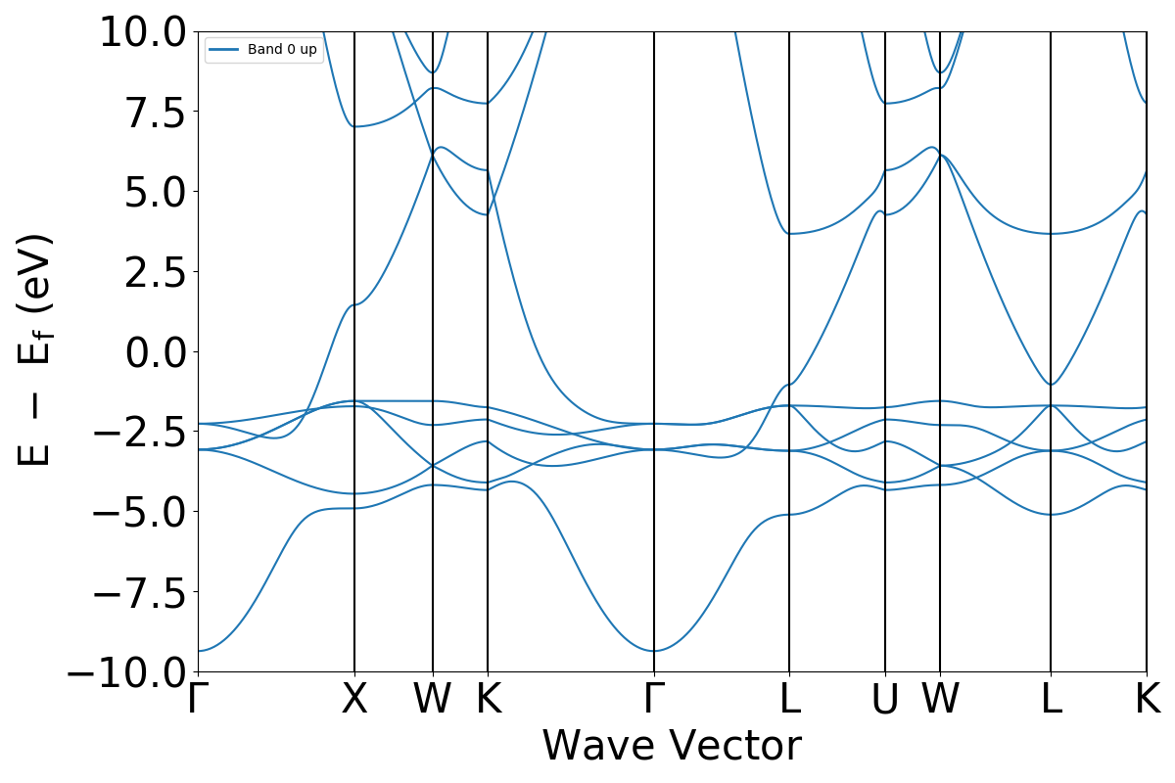
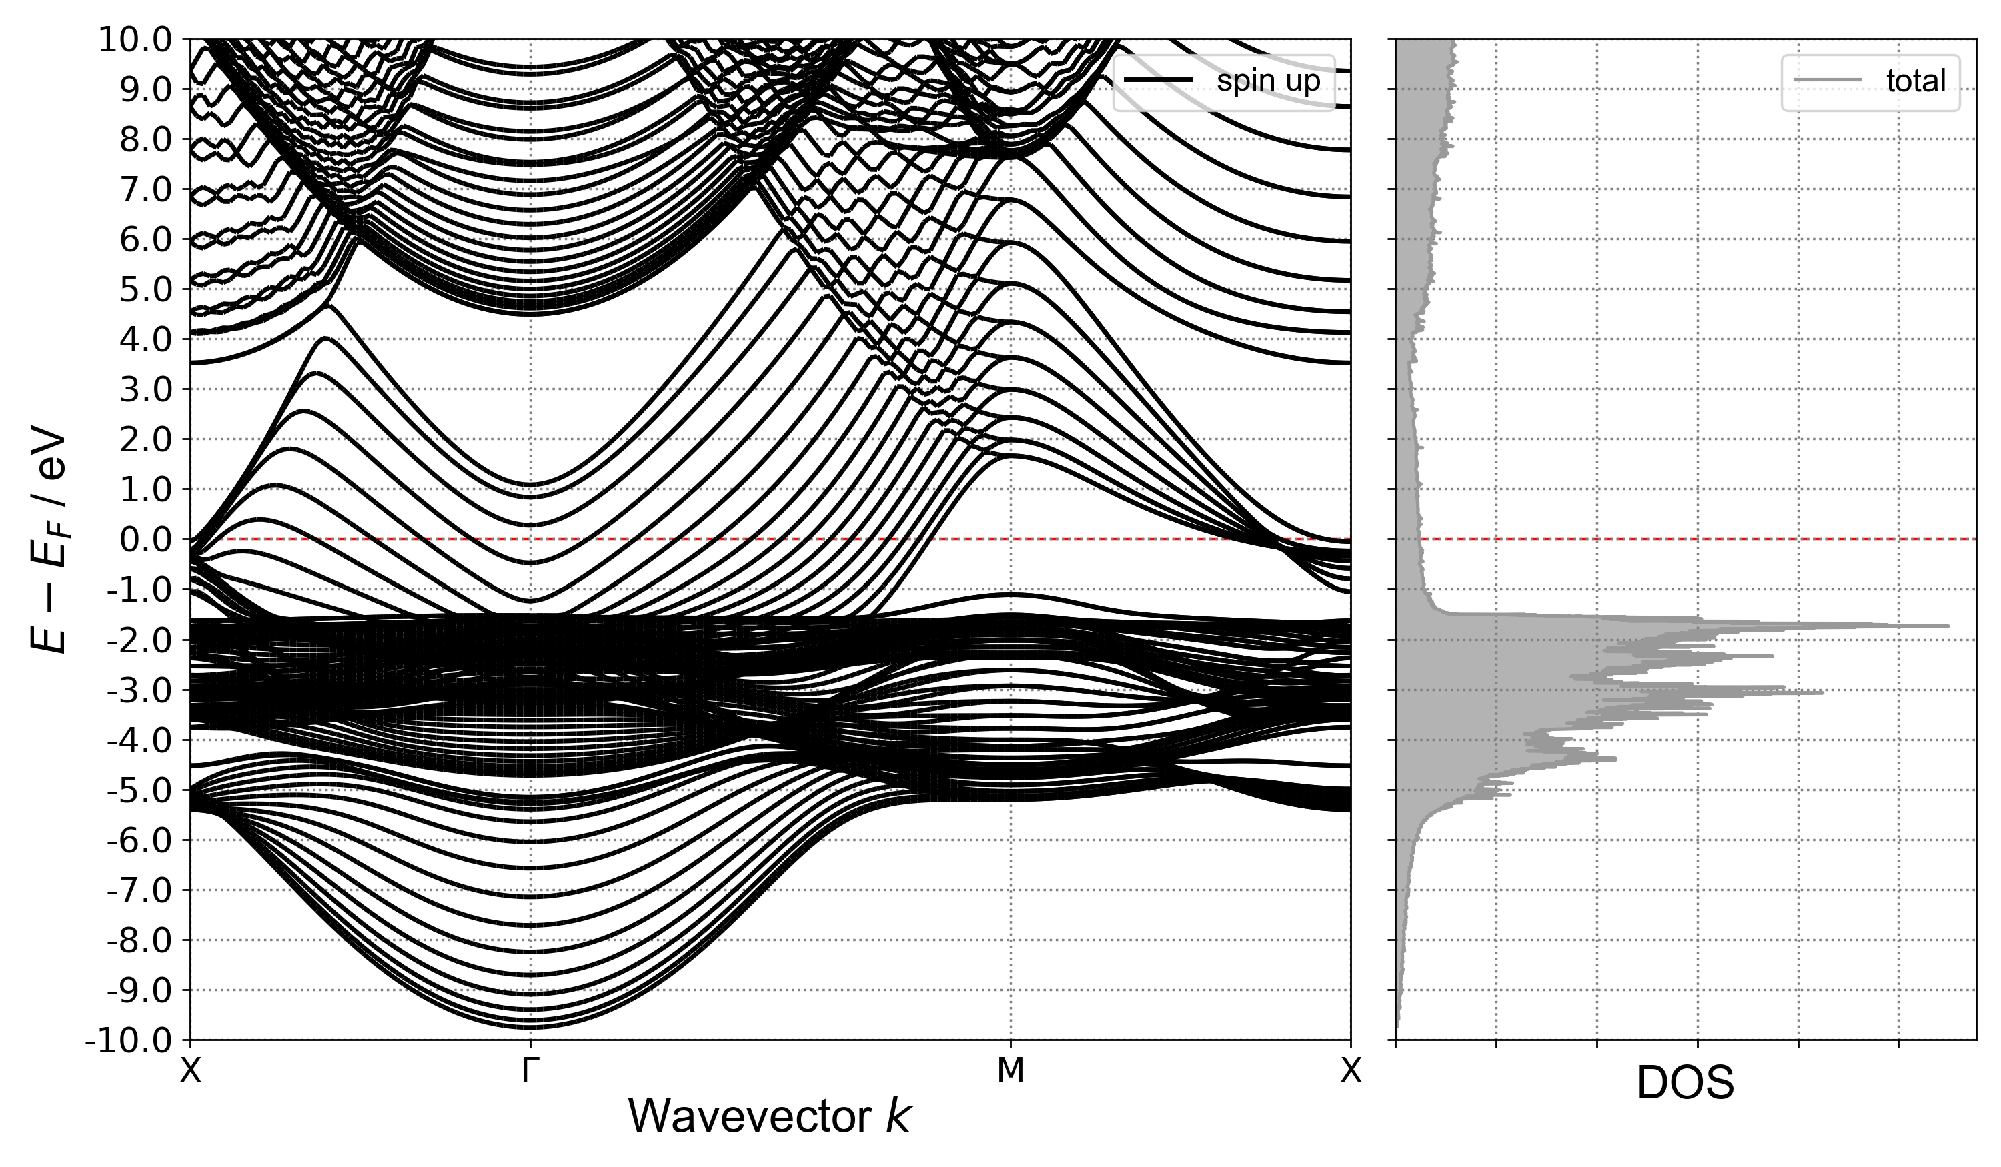
The specifics of our approach
Slabs vs Bulk, DOS vs Single K
Cu Bulk
Cu(100) 16 layers

Slide 5
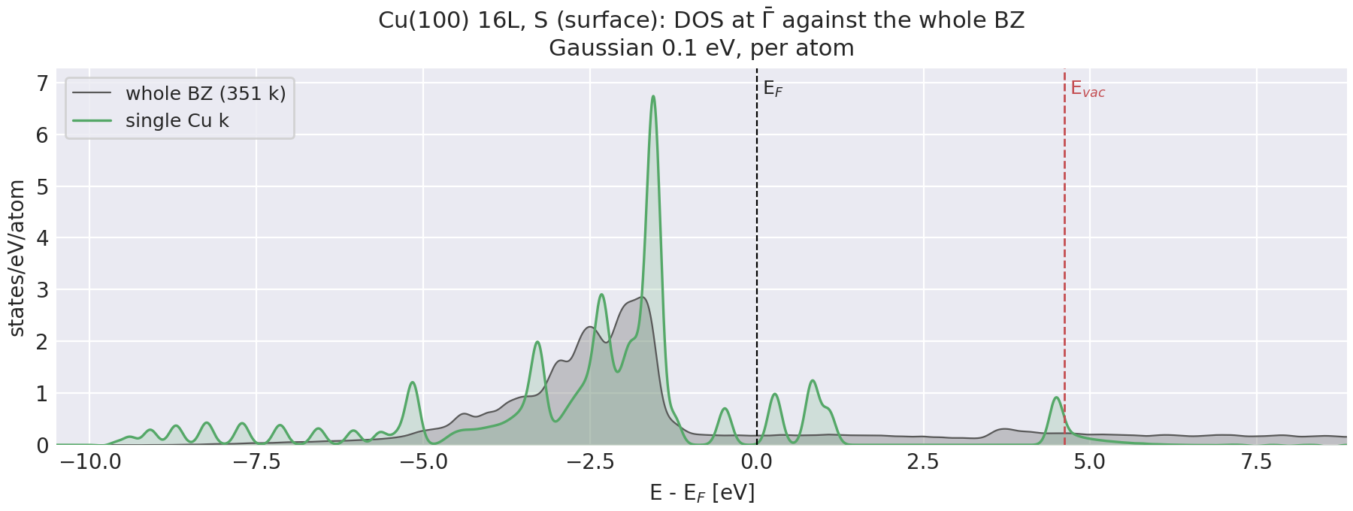
The specifics of our approach
Slabs vs Bulk, DOS vs Single K
Cu Bulk
Cu(100) 16 layers

Slide 6
The specifics of our approach
Slabs vs Bulk, DOS vs Single K
Cu Bulk
Expectations:
can explicitly model surfaces and surface features
largest uncertainties at threshold
QE/MTE curves noisy without broad smearing
Cu(100) 16 layers

Slide 7
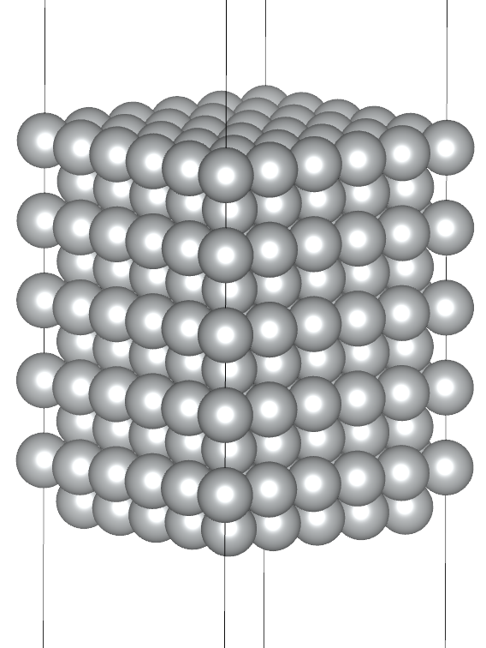
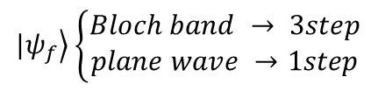

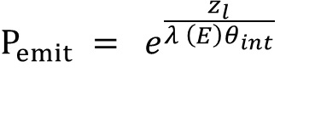
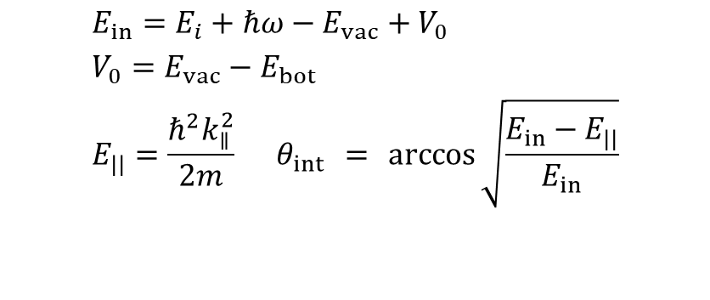
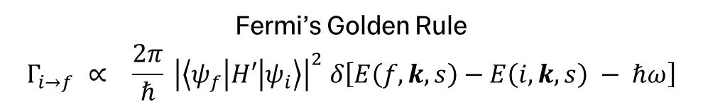
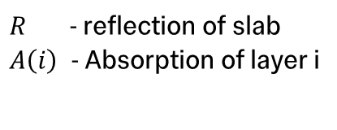

Emission model
Layer dependent contributions
Depth dependent light intensity
Depth dependent excitation probability
Depth dependent transmission + emission probability
      $$I\left(N\right)=1−R−\sum_{i=1}^{N−1}{A(i)}$$
$R$ - reflection of slab
$A\left(i\right)$ - Absorption of layer i
$$|\left.ψ_{f}\right\rangle \left\{\begin{aligned}Bloch band → 3step \\ plane wave →1step\end{aligned}\right.$$
Fermi’s Golden Rule
$$Γ_{i→f} ∝ \frac{2π}{ℏ} {\left|\left\langle ψ_{f} | H′ | ψ_{i}\right\rangle \right|}^{2} δ\left[E\left(f,k, s\right)−E\left(i,k,s\right) − ℏω\right]$$
$$E_{in}=E_{i}+ℏω−E_{vac}^{}+V_{0} \\ V_{0}=E_{vac}^{}−E_{bot} \\ E_{||}=\frac{ℏ^{2}k_{∥}^{2}}{2m} θ_{int} = \arccos{\sqrt{\frac{E_{in}−E_{||}}{E_{in}}}}$$
$$\left(E_{⊥}>0\right)$$
$$P_{emit} = e^{\frac{z_{l}}{λ \left(E\right)θ_{int}}}$$
Ag(100) 10L

Slide 8
Emission model
Layer dependent contributions
Depth dependent light intensity
Depth dependent excitation probability
Depth dependent transmission + emission probability
      $$I\left(N\right)=1−R−\sum_{i=1}^{N−1}{A(i)}$$
$R$ - reflection of slab
$A\left(i\right)$ - Absorption of layer i
$$|\left.ψ_{f}\right\rangle \left\{\begin{aligned}Bloch band → 3step \\ plane wave →1step\end{aligned}\right.$$
Fermi’s Golden Rule
$$Γ_{i→f} ∝ \frac{2π}{ℏ} {\left|\left\langle ψ_{f} | H′ | ψ_{i}\right\rangle \right|}^{2} δ\left[E\left(f,k, s\right)−E\left(i,k,s\right) − ℏω\right]$$
$$E_{in}=E_{i}+ℏω−E_{vac}^{}+V_{0} \\ V_{0}=E_{vac}^{}−E_{bot} \\ E_{||}=\frac{ℏ^{2}k_{∥}^{2}}{2m} θ_{int} = \arccos{\sqrt{\frac{E_{in}−E_{||}}{E_{in}}}}$$
$$\left(E_{⊥}>0\right)$$
$$P_{emit} = e^{\frac{z_{l}}{λ \left(E\right)θ_{int}}}$$
Ag(100) 10L

Slide 9
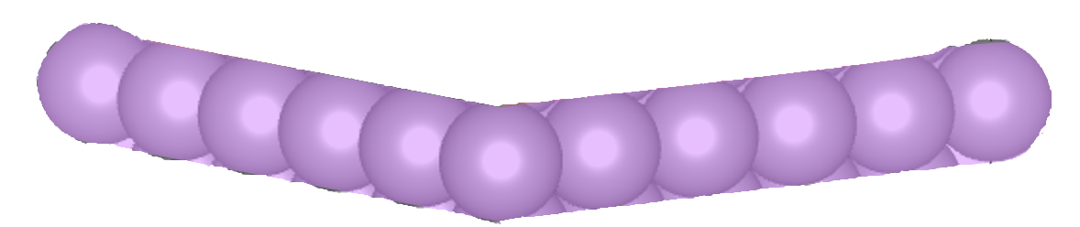
Emission model
Layer dependent contributions
Depth dependent light intensity
Depth dependent excitation probability
Depth dependent transmission + emission probability
      $$I\left(N\right)=1−R−\sum_{i=1}^{N−1}{A(i)}$$
$R$ - reflection of slab
$A\left(i\right)$ - Absorption of layer i
$$|\left.ψ_{f}\right\rangle \left\{\begin{aligned}Bloch band → 3step \\ plane wave →1step\end{aligned}\right.$$
Fermi’s Golden Rule
$$Γ_{i→f} ∝ \frac{2π}{ℏ} {\left|\left\langle ψ_{f} | H′ | ψ_{i}\right\rangle \right|}^{2} δ\left[E\left(f,k, s\right)−E\left(i,k,s\right) − ℏω\right]$$
$$E_{in}=E_{i}+ℏω−E_{vac}^{}+V_{0} \\ V_{0}=E_{vac}^{}−E_{bot} \\ E_{||}=\frac{ℏ^{2}k_{∥}^{2}}{2m} θ_{int} = \arccos{\sqrt{\frac{E_{in}−E_{||}}{E_{in}}}}$$
$$\left(E_{⊥}>0\right)$$
$$P_{emit} = e^{\frac{z_{l}}{λ \left(E\right)θ_{int}}}$$
Ag(100) 10L

Slide 10
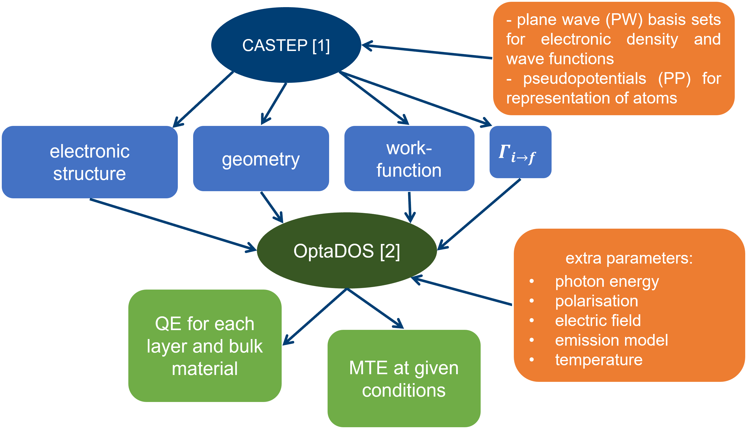
Workflow
From DFT to Curves

Slide 11
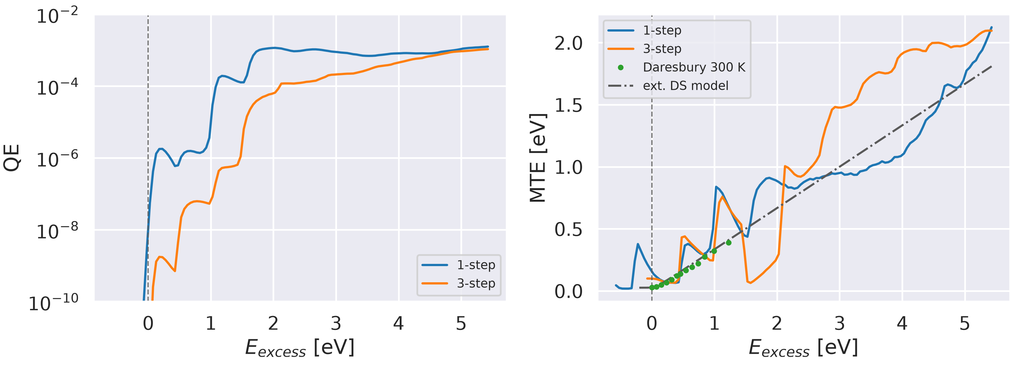
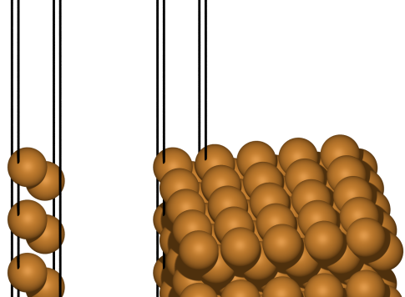
Calculating Metallic Surfaces
Cu data

Slide 12
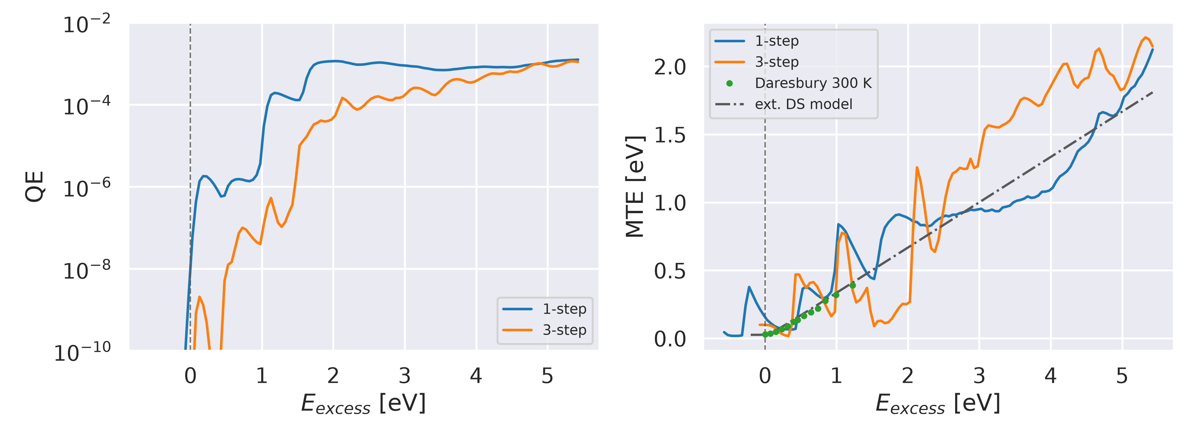
Calculating Metallic Surfaces
Cu data

Slide 13
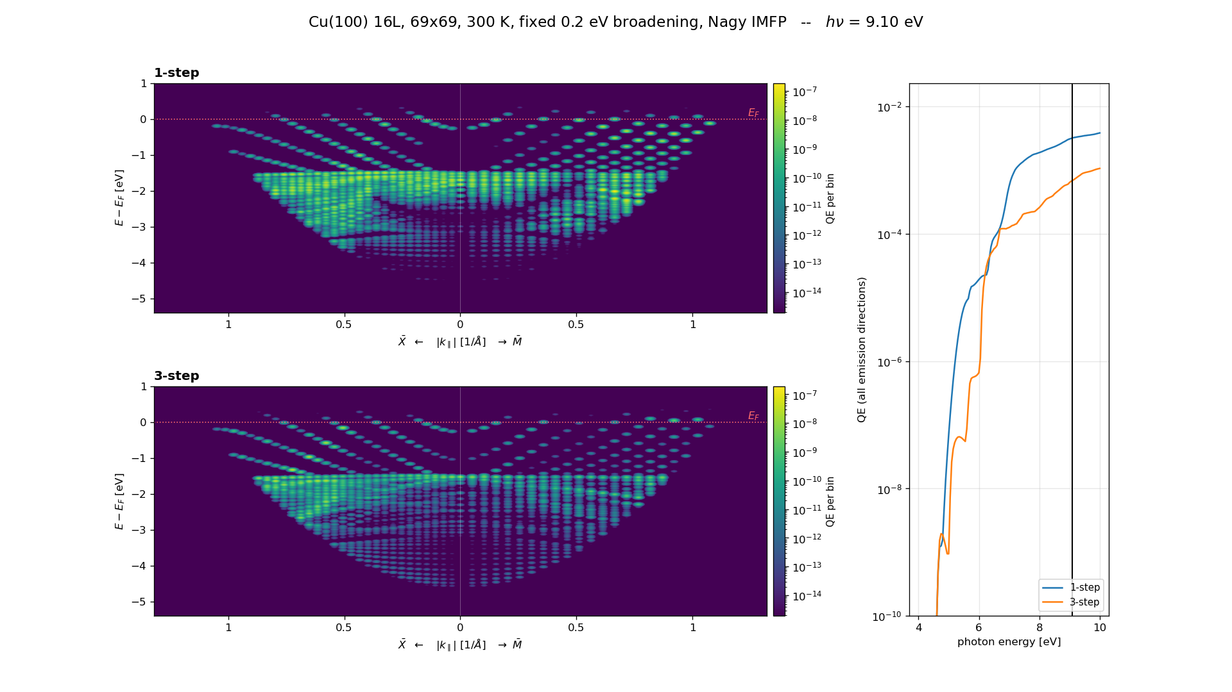
Calculating Metallic Surfaces
Cu data

Slide 14
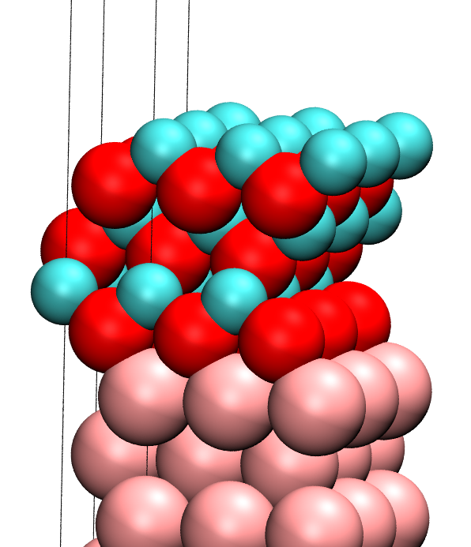
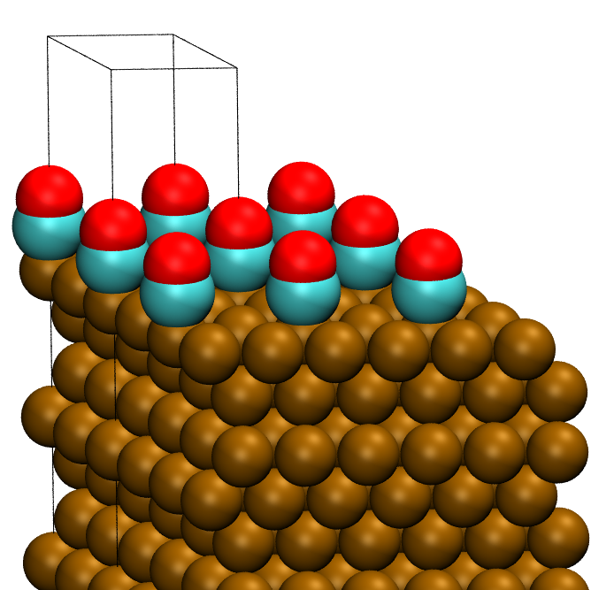
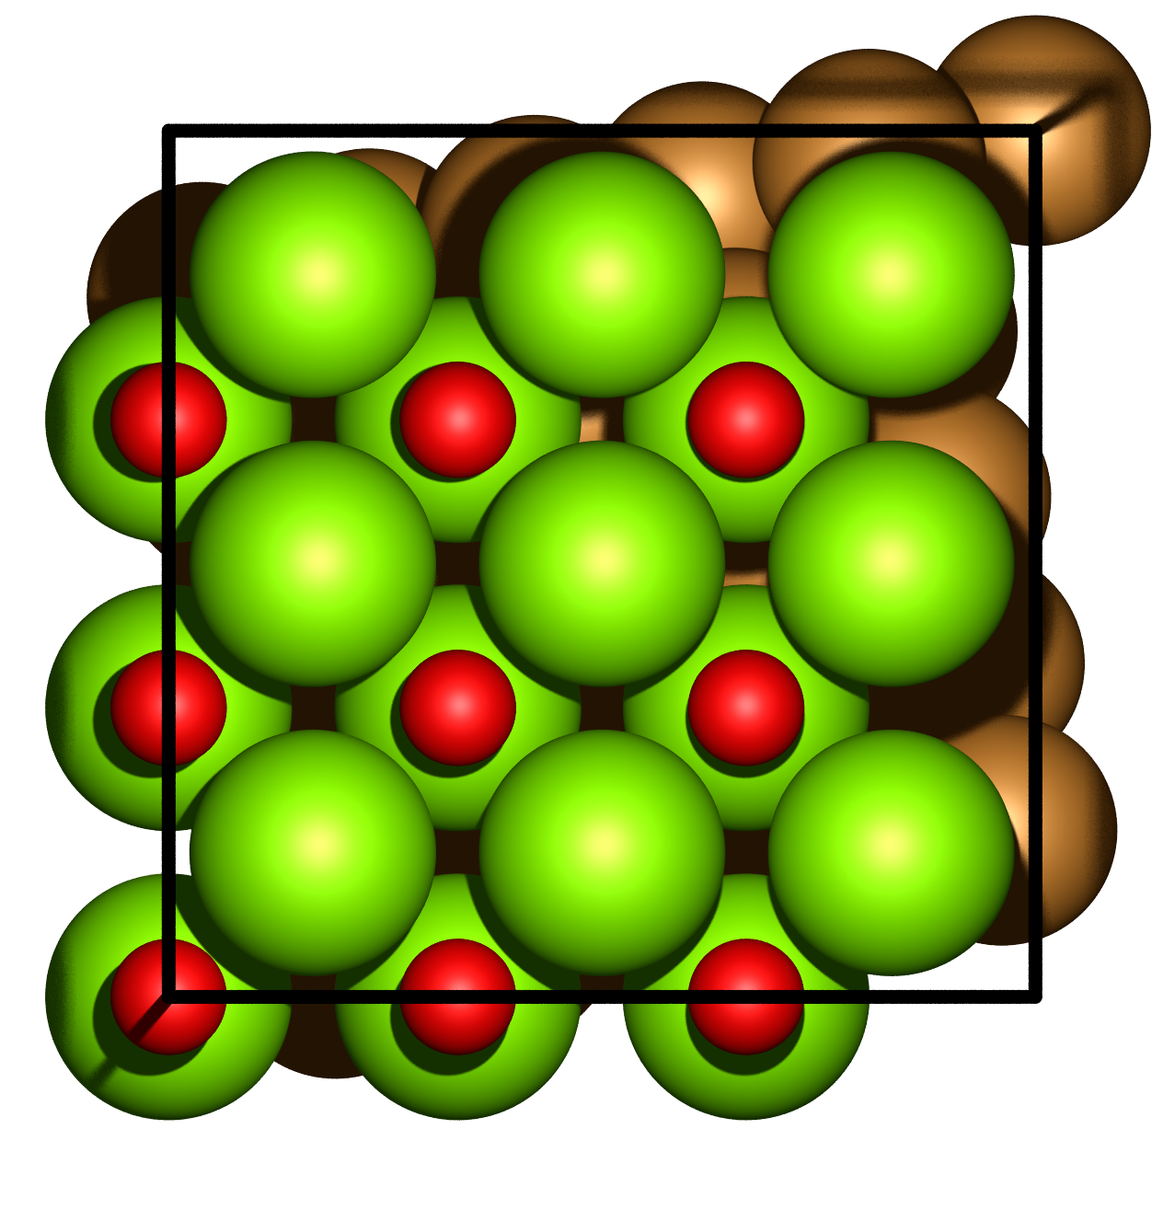
Supercell Structures
Doing interesting material combos!
Ag/MgO(100)
Cu(100) 1x1
primitive cell
CO on Cu(100)
Cu/MgO(100)
super-cell structures

Slide 15
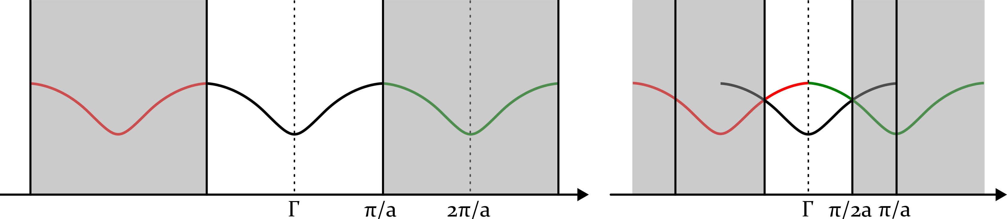
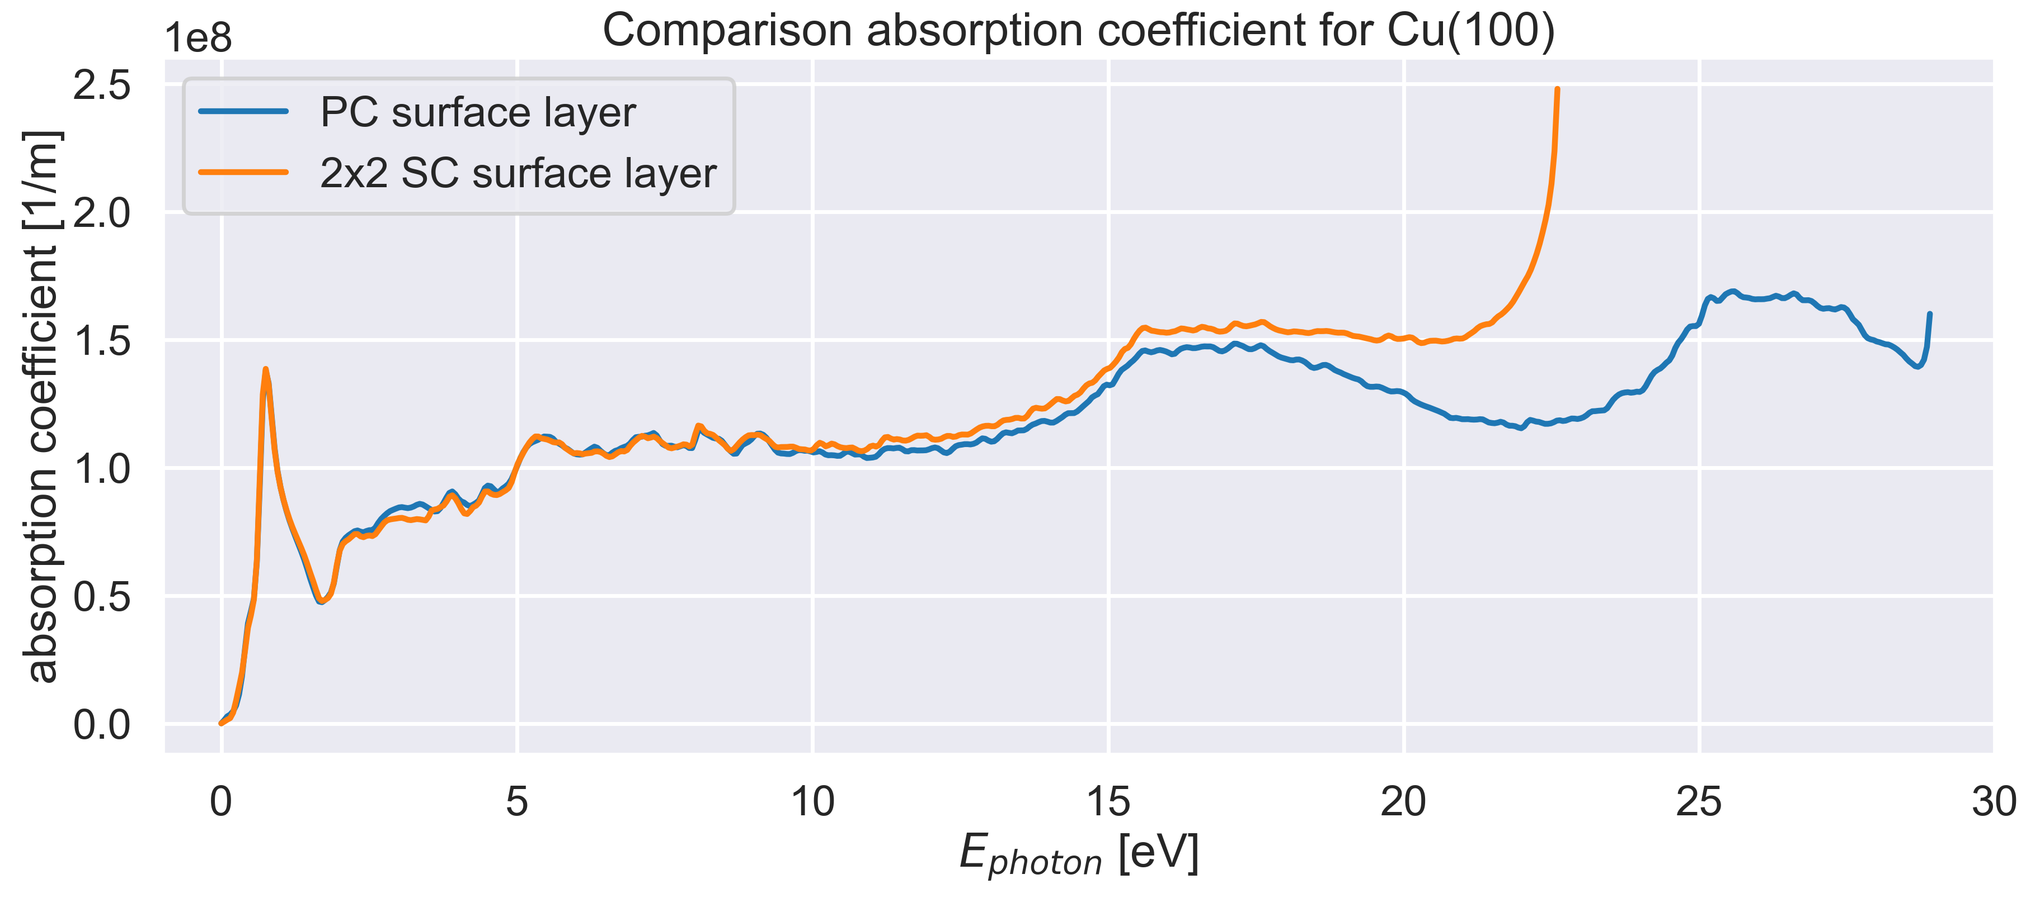

Supercell Emission
Mapping $p_{||}$ to reclaim PC behaviour
primitive cell
Cu(100) 1x1
Ag/MgO(100)
super-cell
Cu(100) 2x2
Cu/MgO(100)

Slide 16
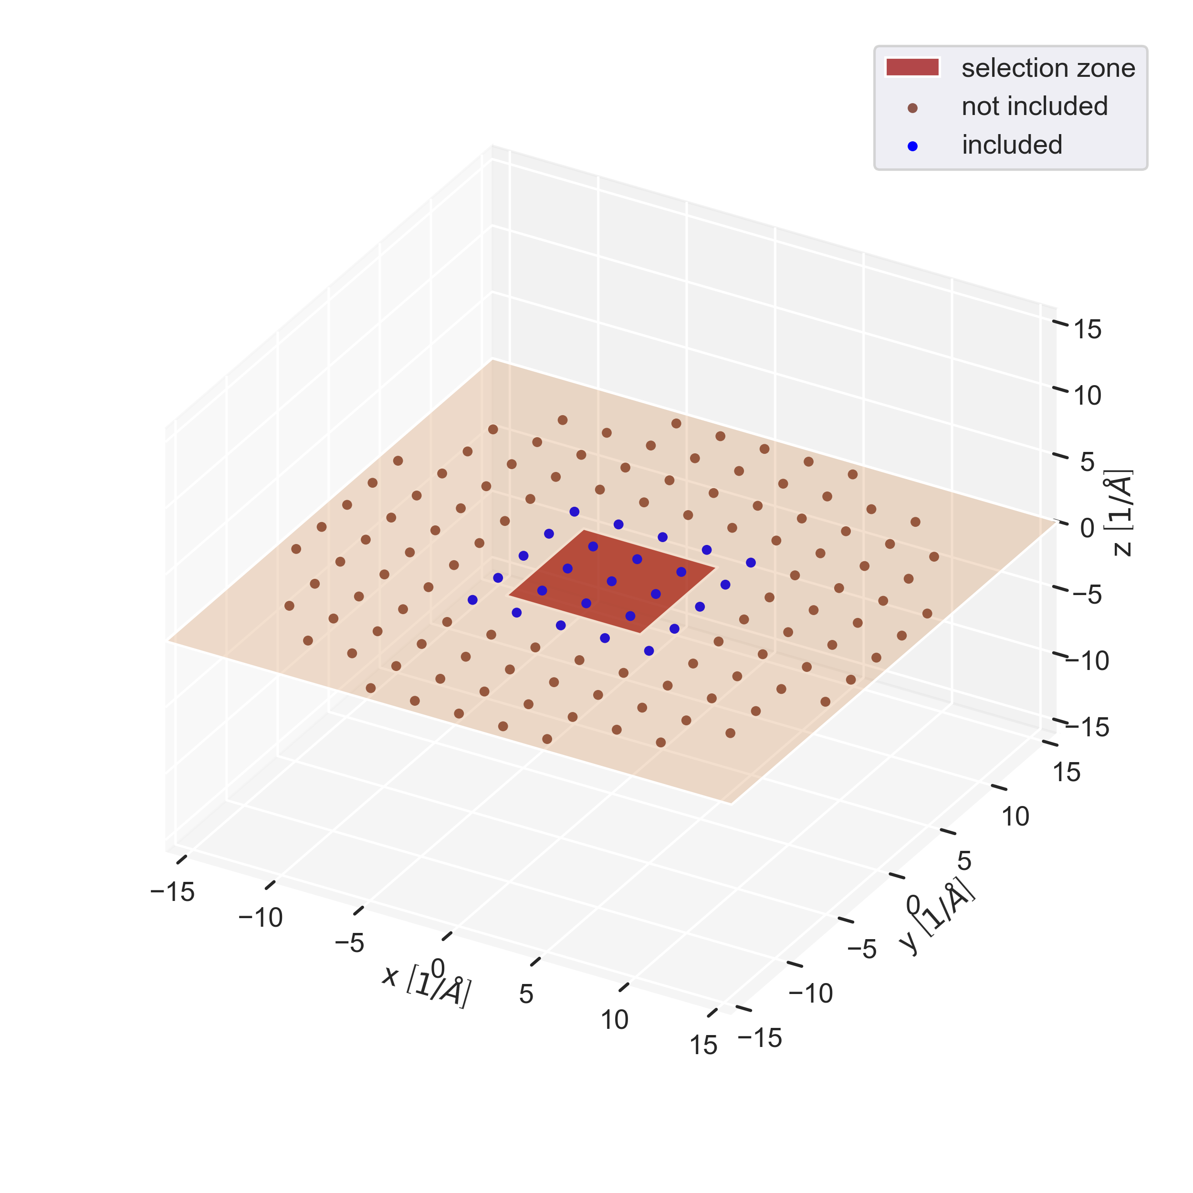
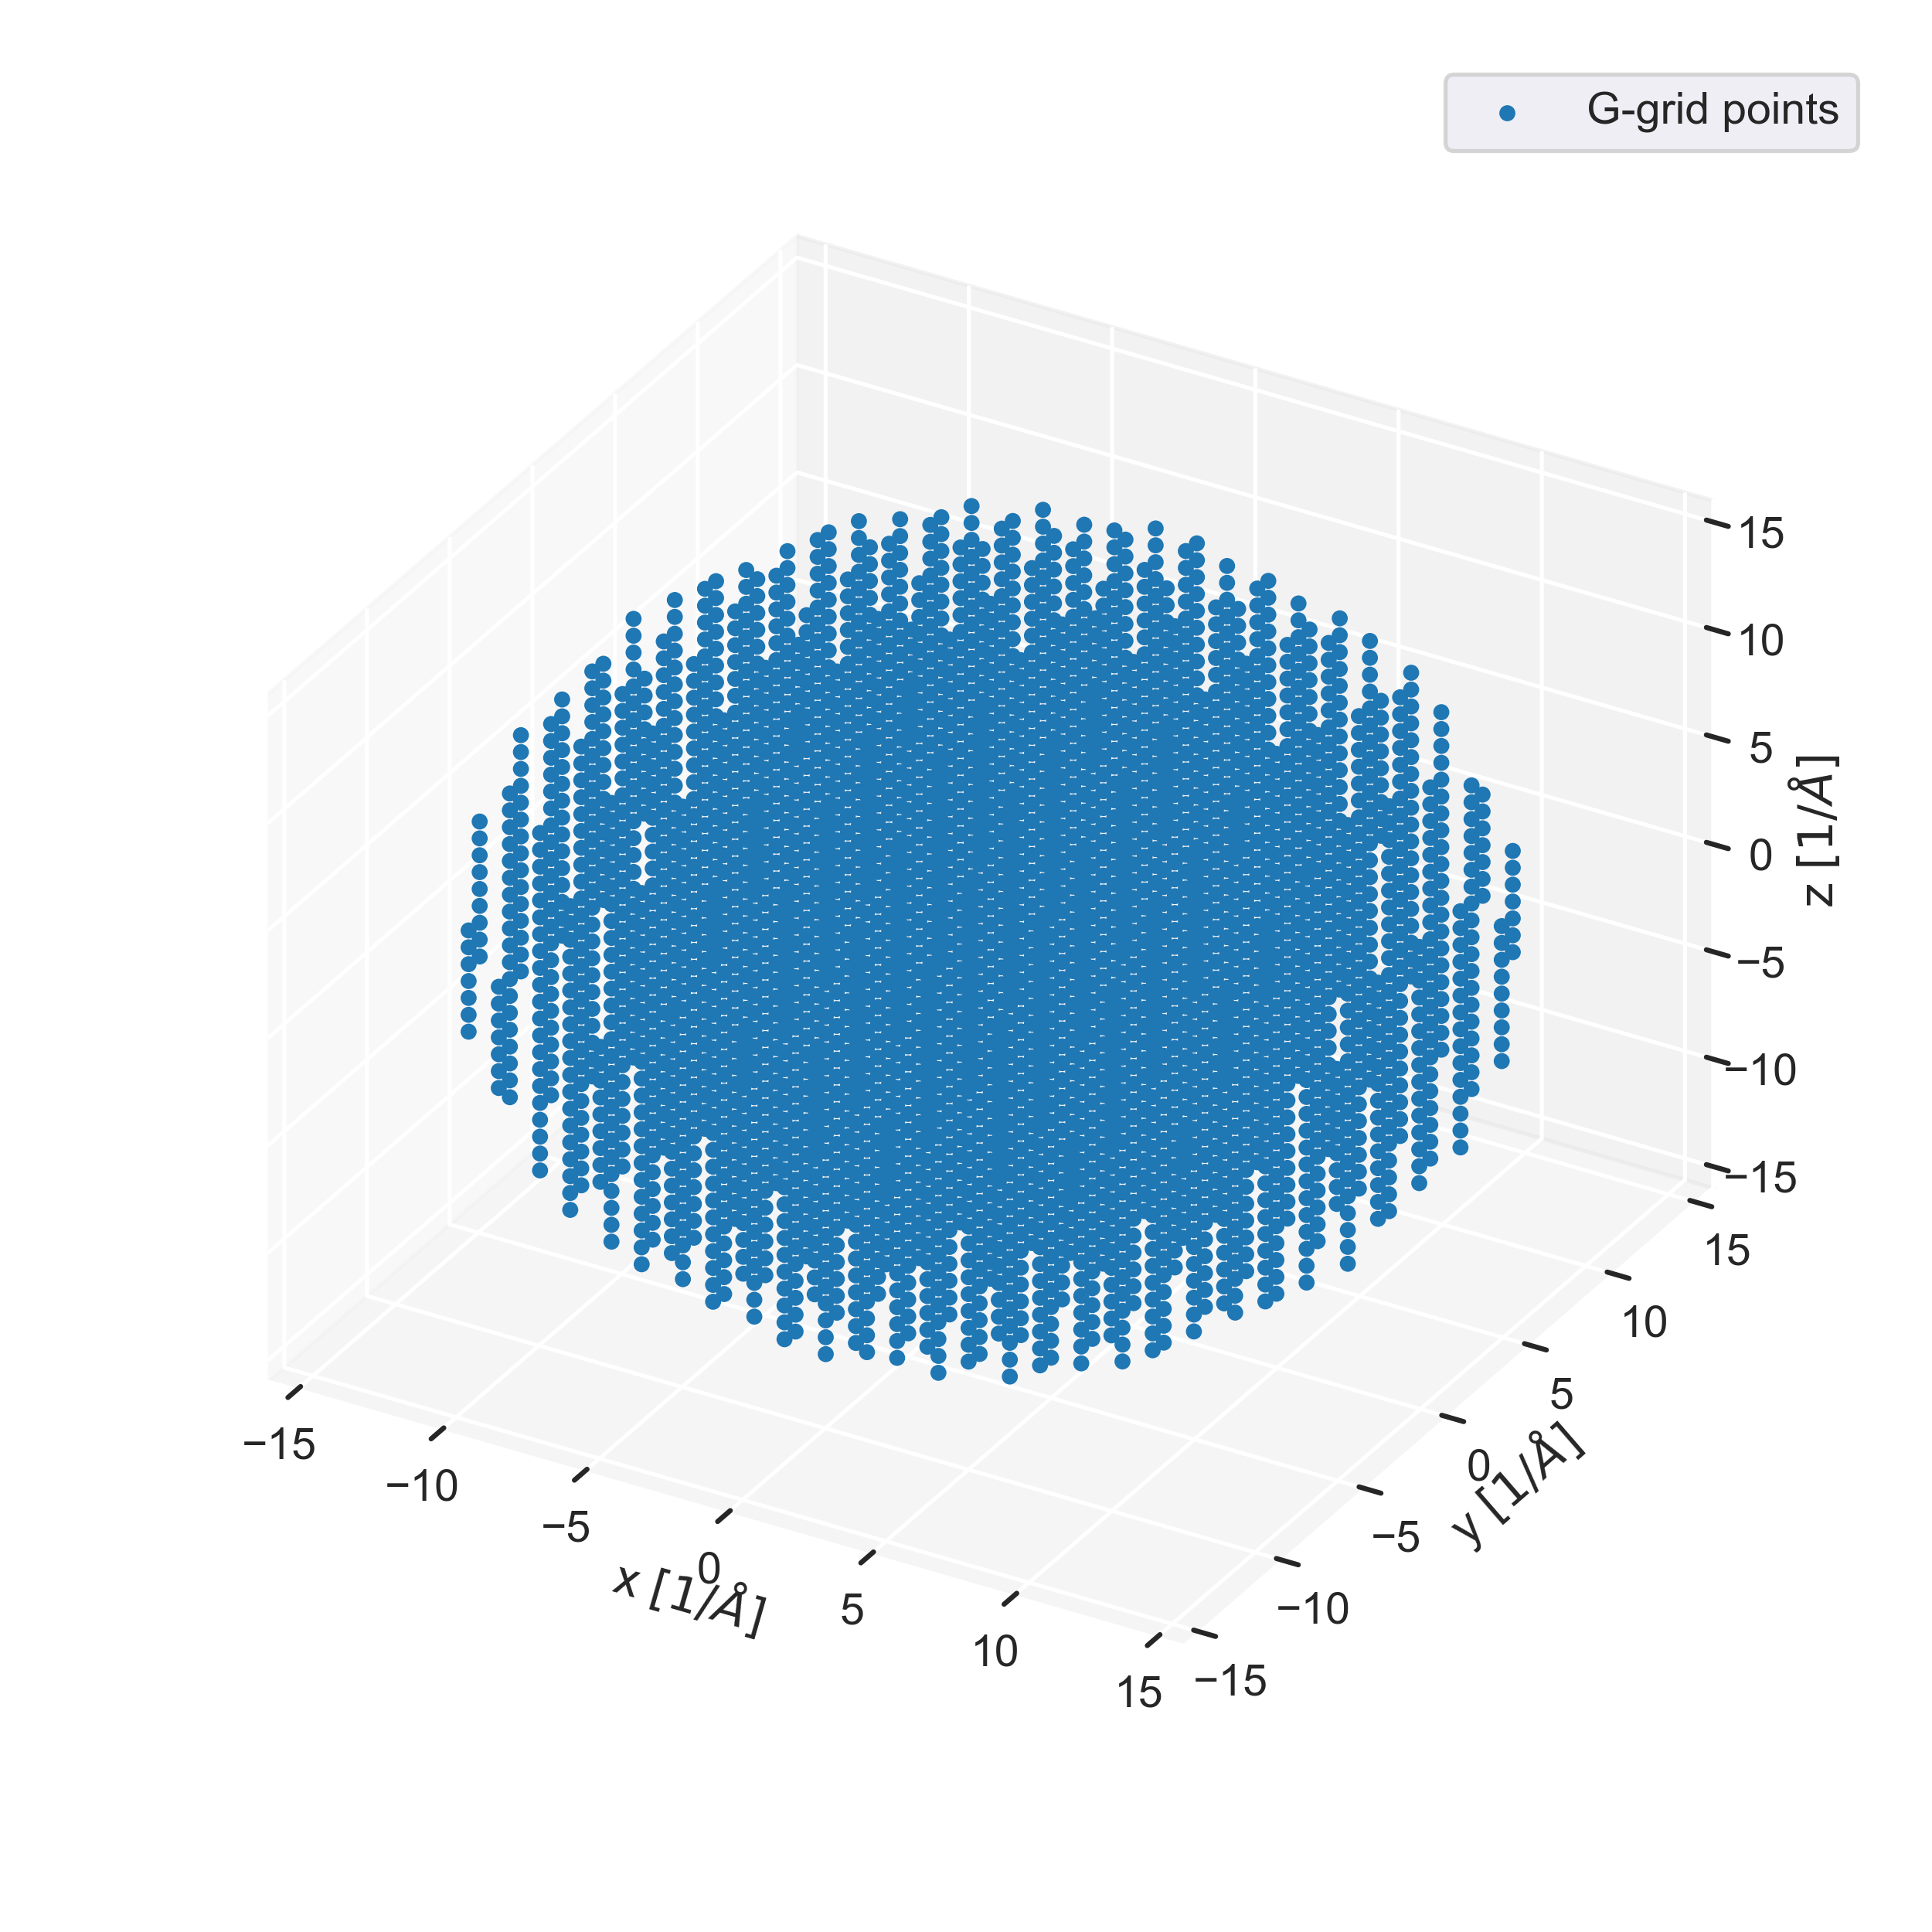
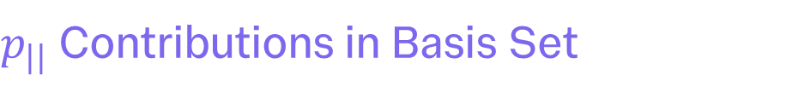
Supercell Emission
$p_{||}$ Contributions in Basis Set

Slide 17
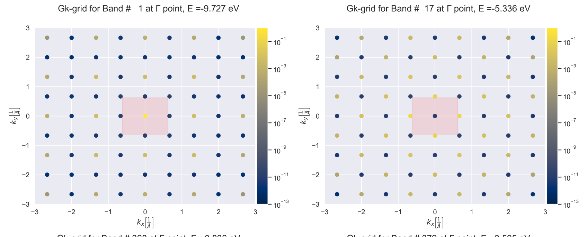
Supercell Emission
Mapping $p_{||}$ to reclaim PC behaviour
primitive cell
Cu(100) 1x1
Ag/MgO(100)
super-cell
Cu(100) 2x2
Cu/MgO(100)

Slide 18
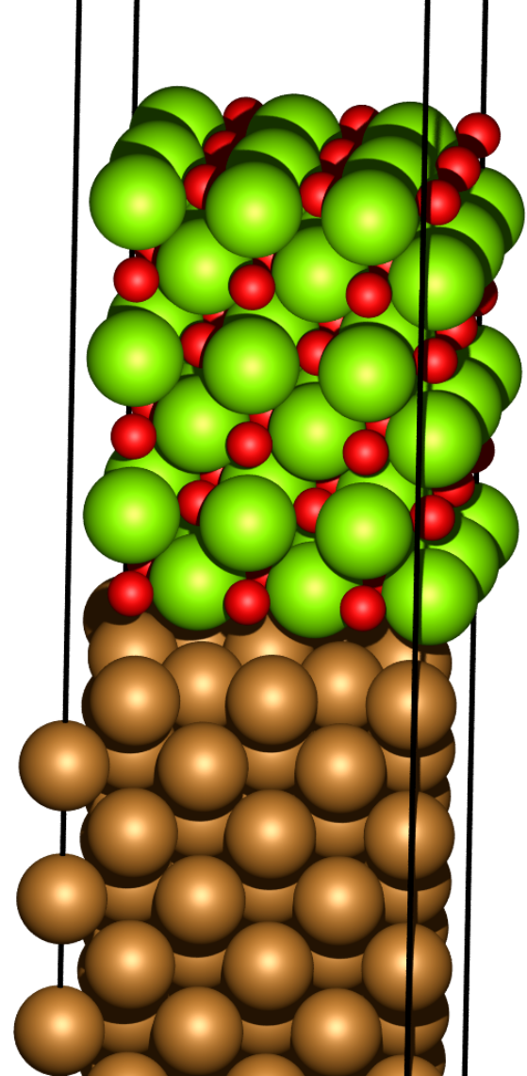
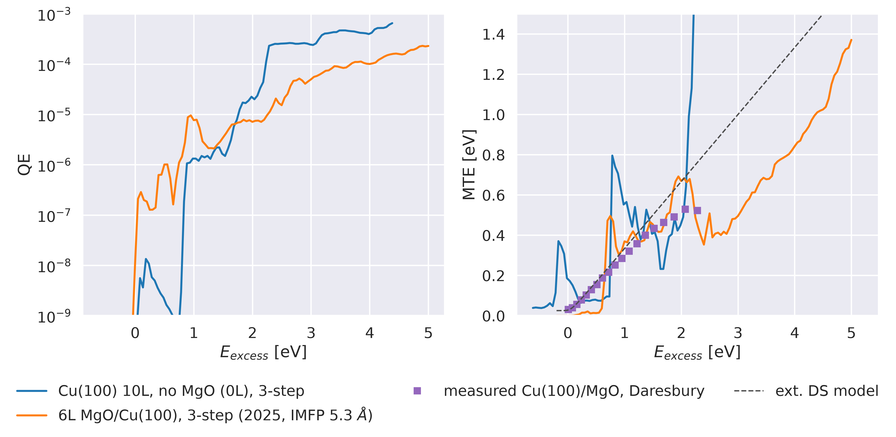
Heterostructure Photocathodes
MgO(100)/Cu(100) Interface – 3step

Slide 19
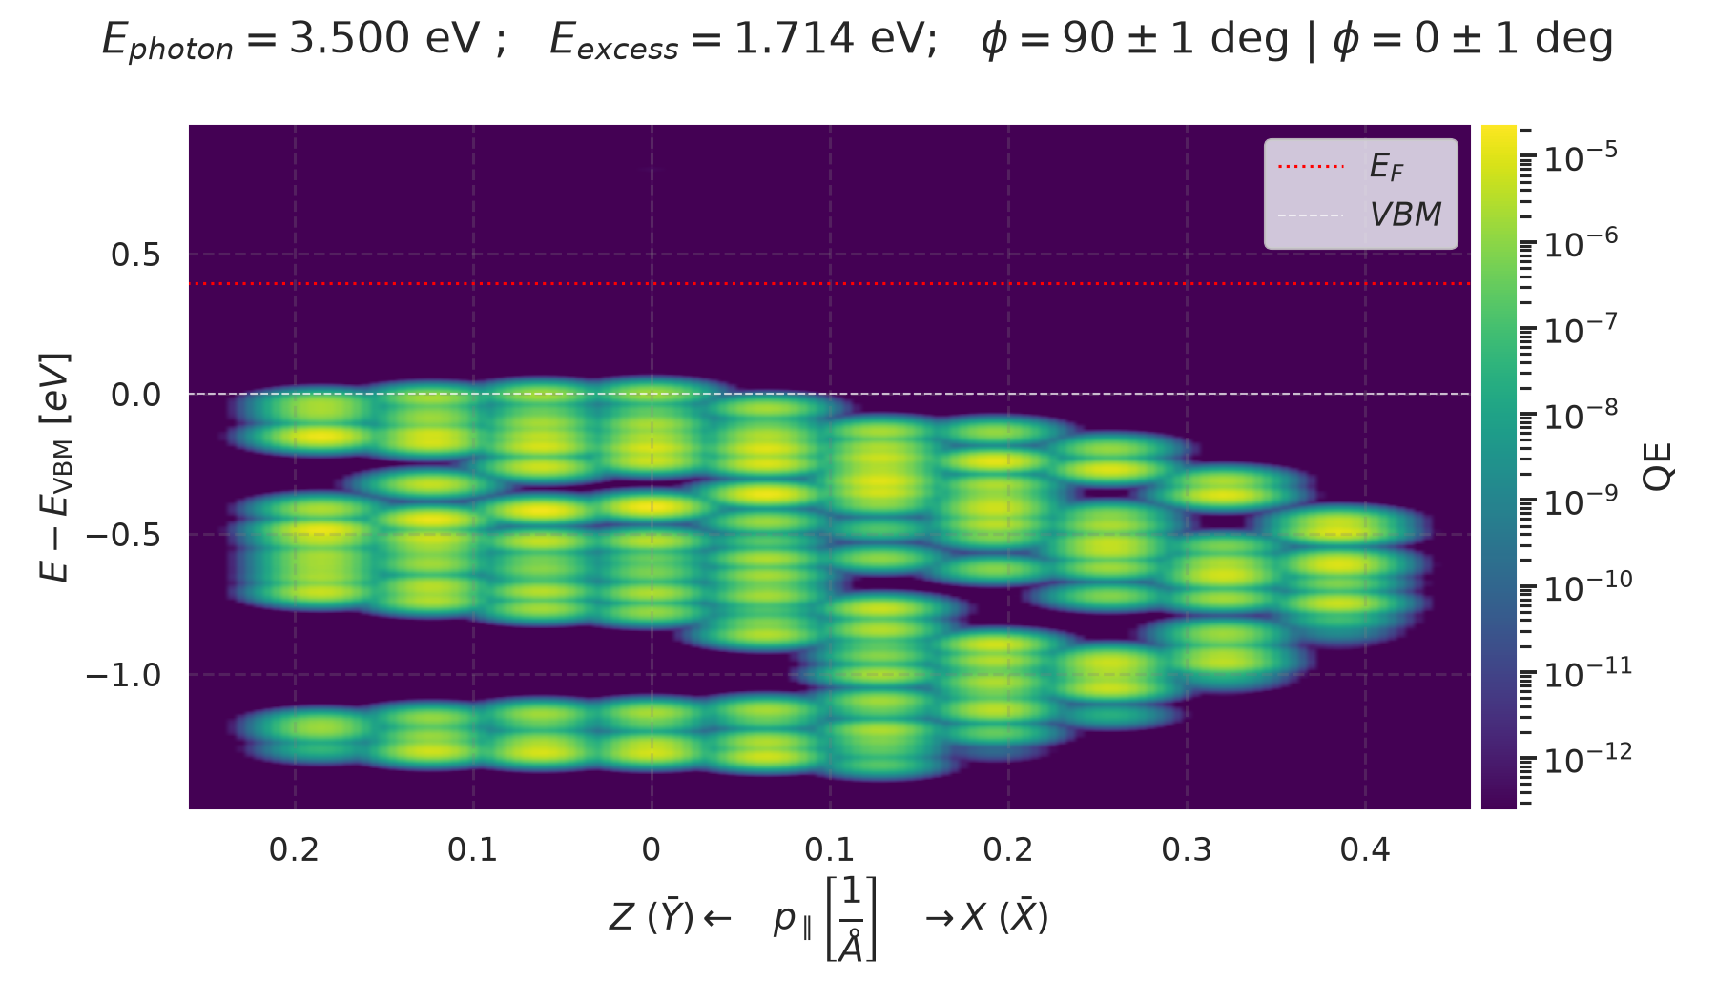
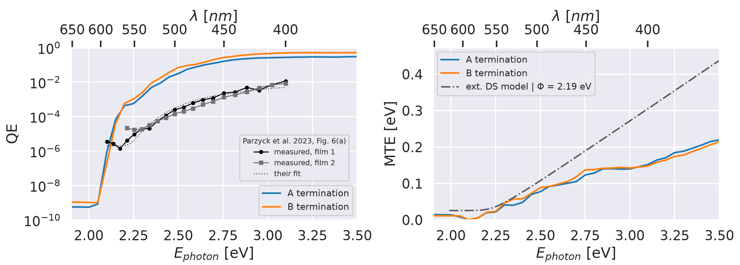
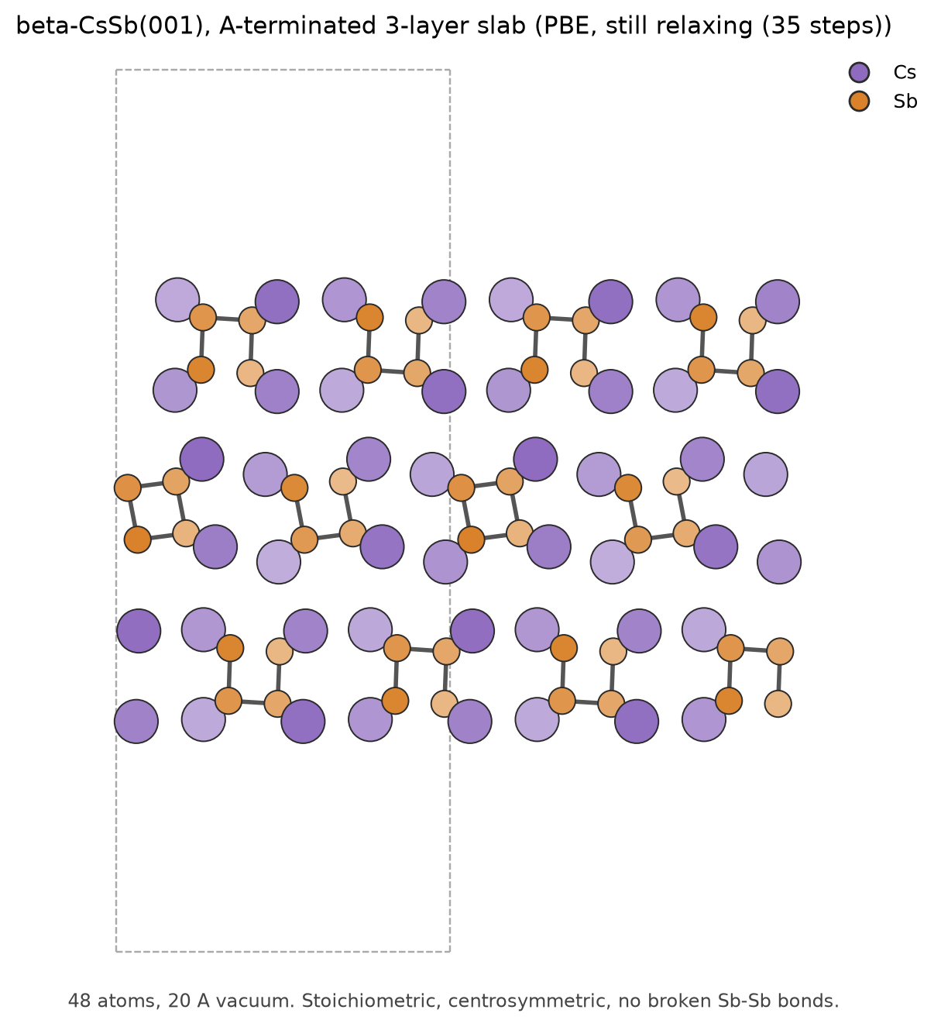
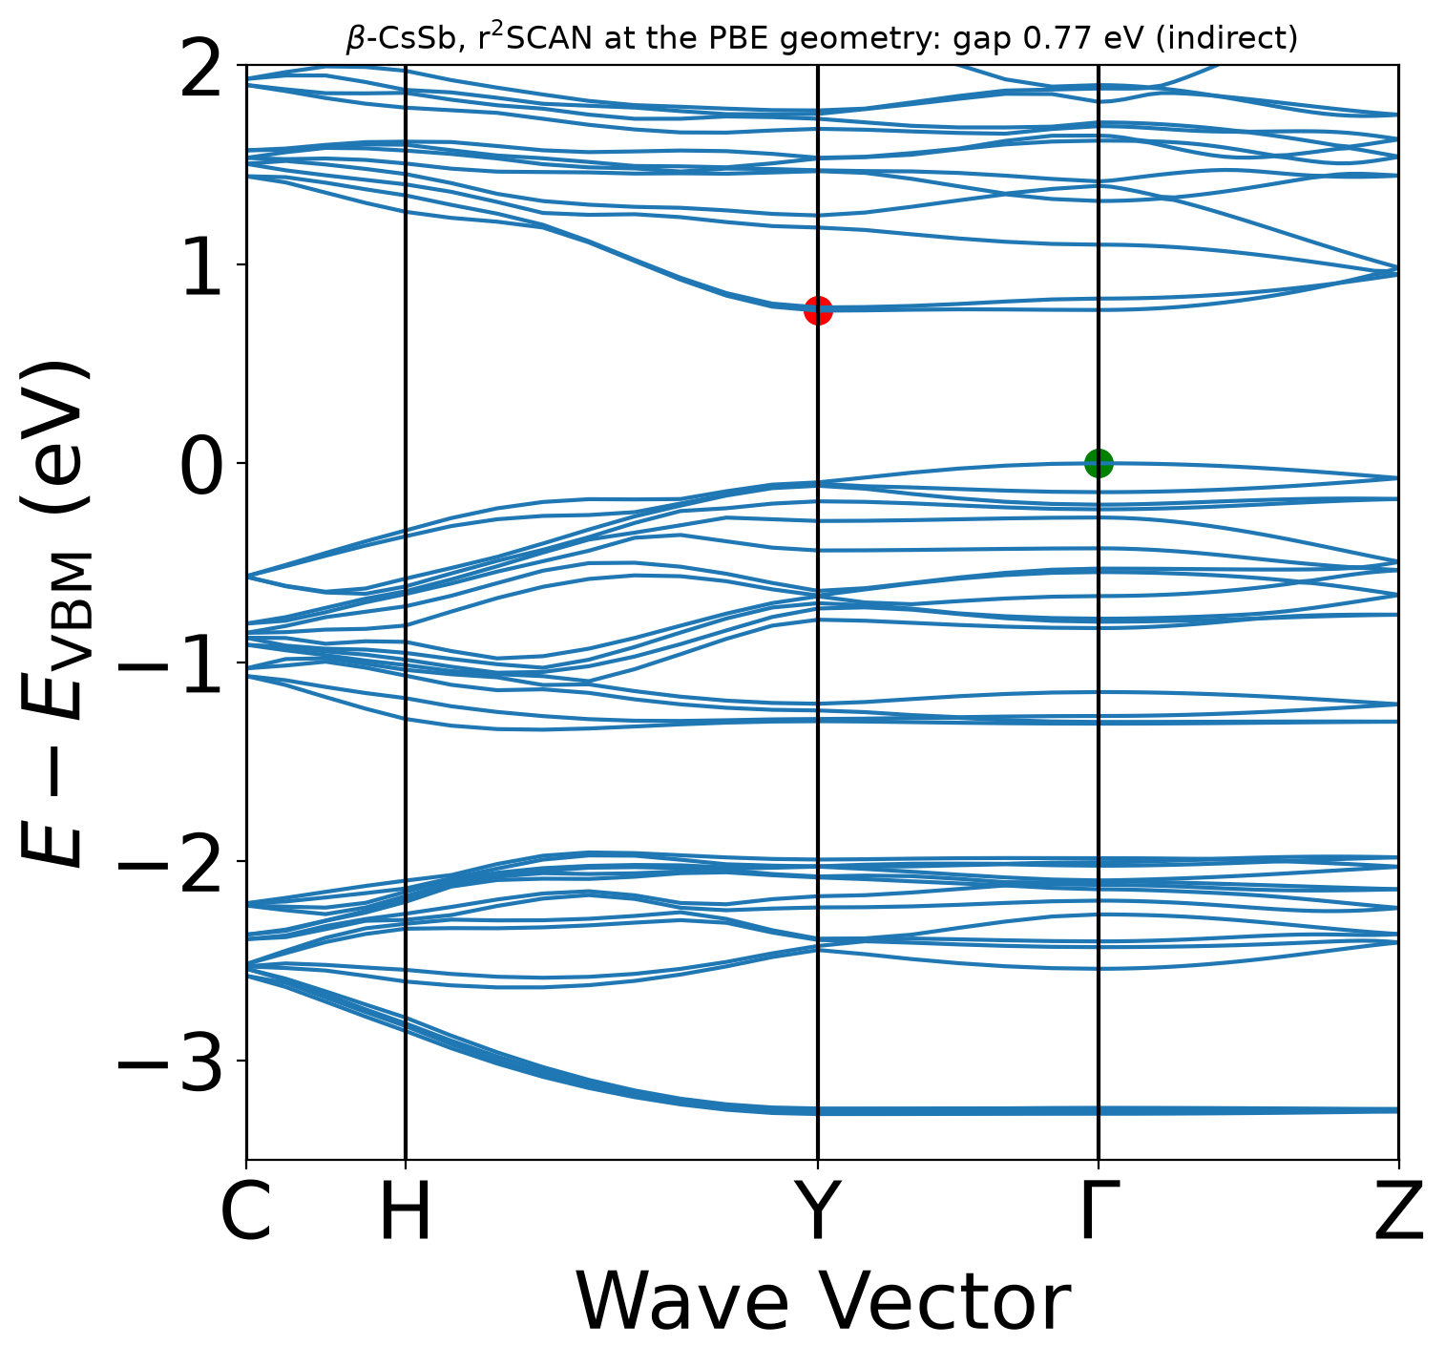
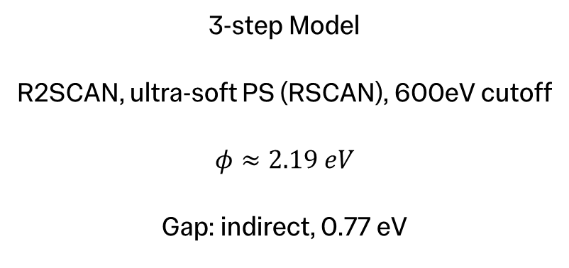

Semiconducting Photocathodes
PRELIMINARY – monoclinic $β$-CsSb
3-step Model
R2SCAN, ultra-soft PS (RSCAN), 600eV cutoff
$$φ≈2.19 eV$$
Gap: indirect, 0.77 eV
Bulk bands
C. T. Parzyck et al., APL Mater. 11, 101125

Slide 20
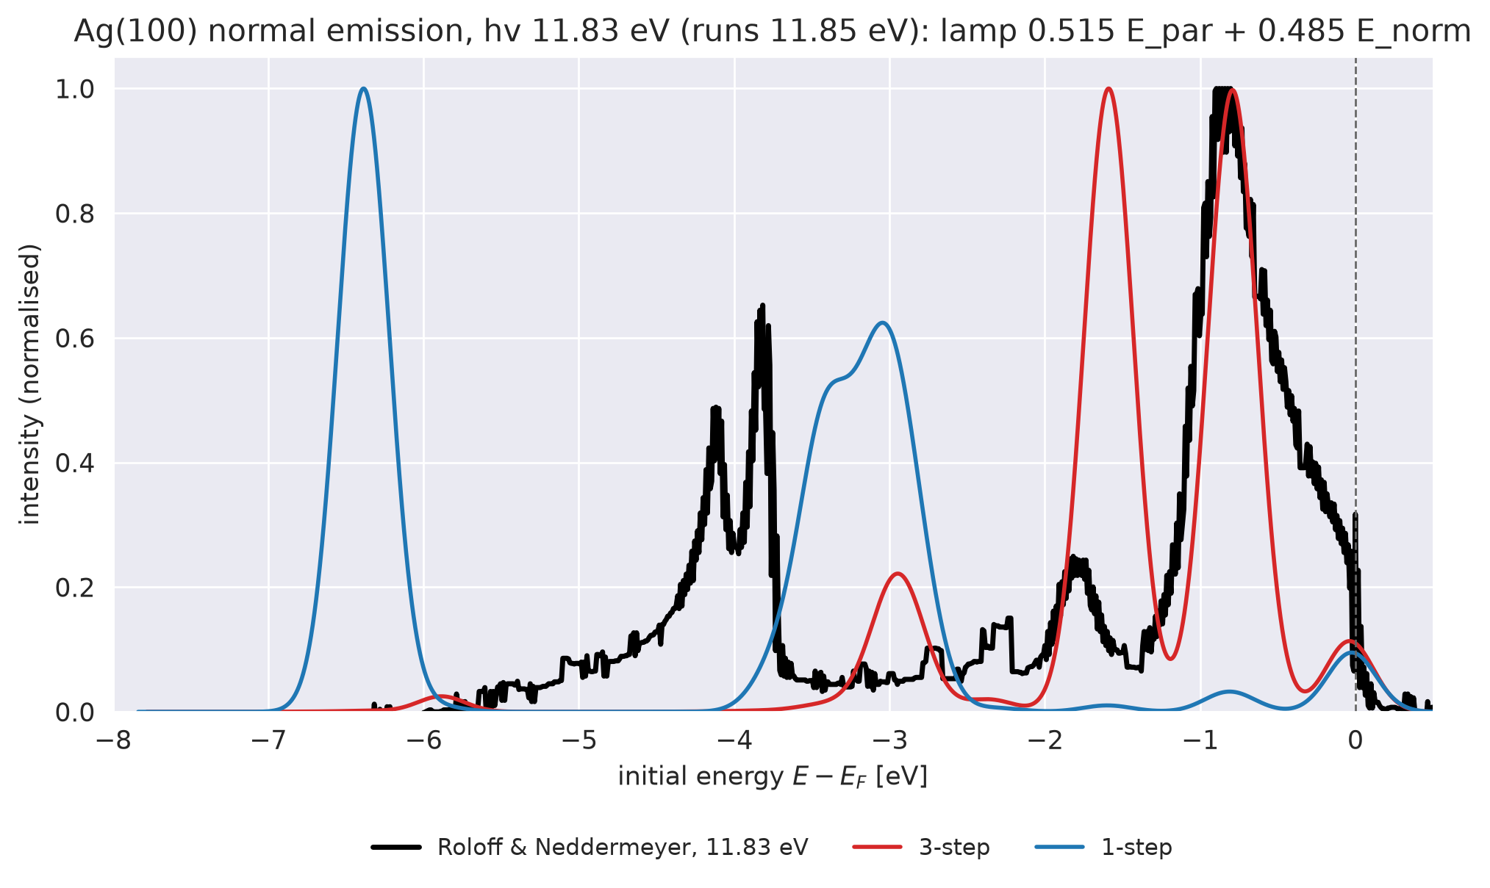
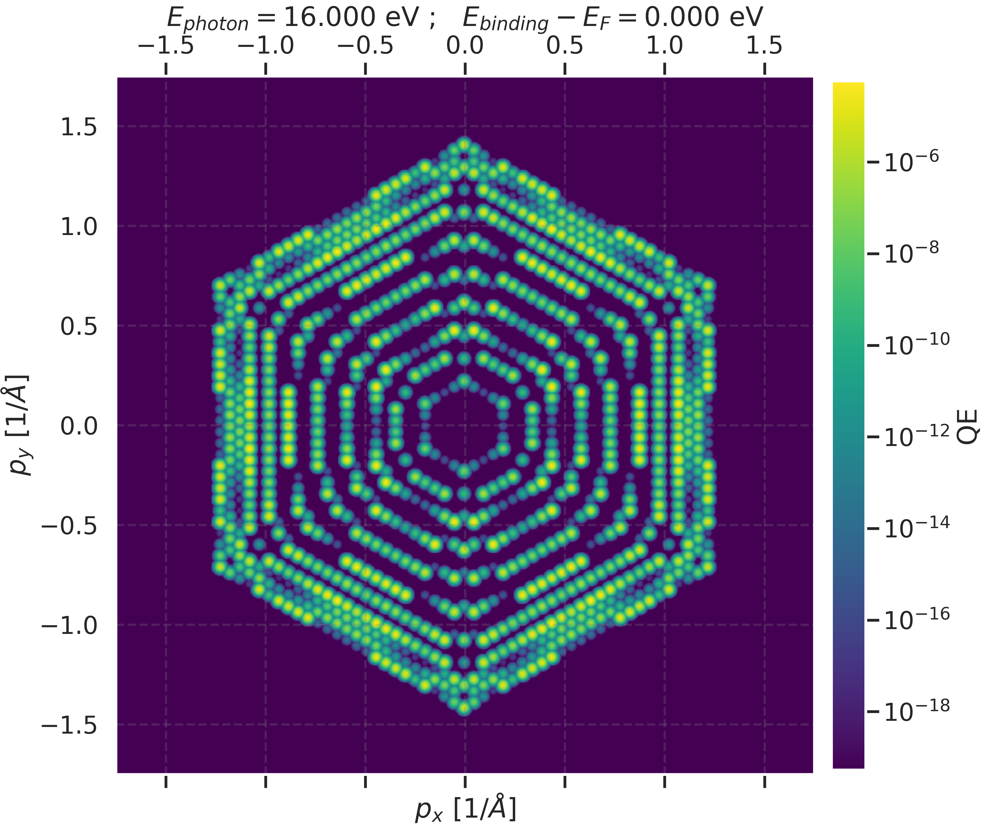
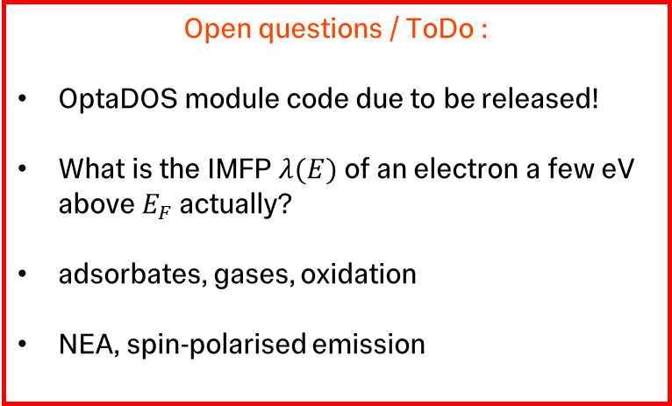
More current + future work
Open questions / ToDo :
OptaDOS module code due to be released!
What is the IMFP $λ(E)$ of an electron a few eV above $E_{F}$ actually?
adsorbates, gases, oxidation
NEA, spin-polarised emission
Have we found a happy medium?
higher energy response curves for Bloch and PW final states (3-step vs 1-step)
photo-response of other heterointerface structures
More detailed analyses

Slide 21
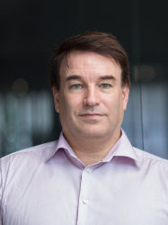

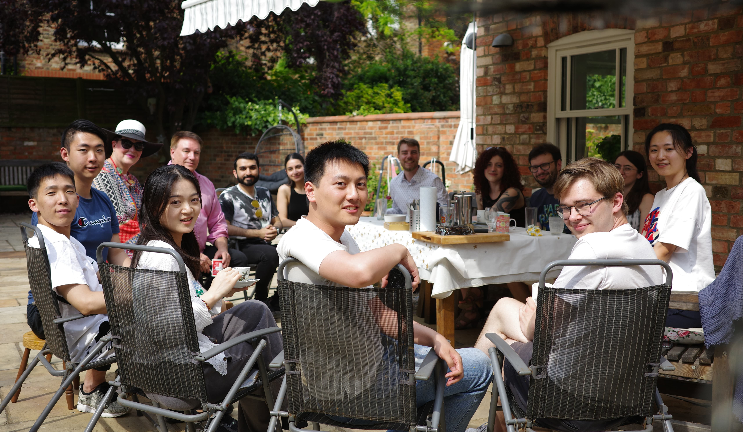
Thank you!
Dr Tim Noakes, Dr Lee Jones,
Dr Chris Benjamin, Hugh Churn
Prof Nicholas Harrison
and the other members of the
Computational Materials Science Group
Prof Sam Cooper
Photoemission from Ab initio slabs
23/09/2026

Slide 22
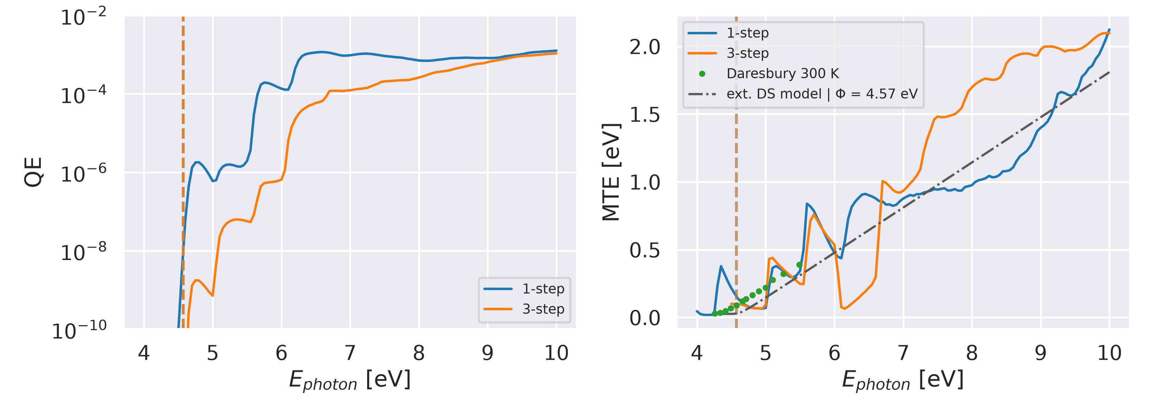
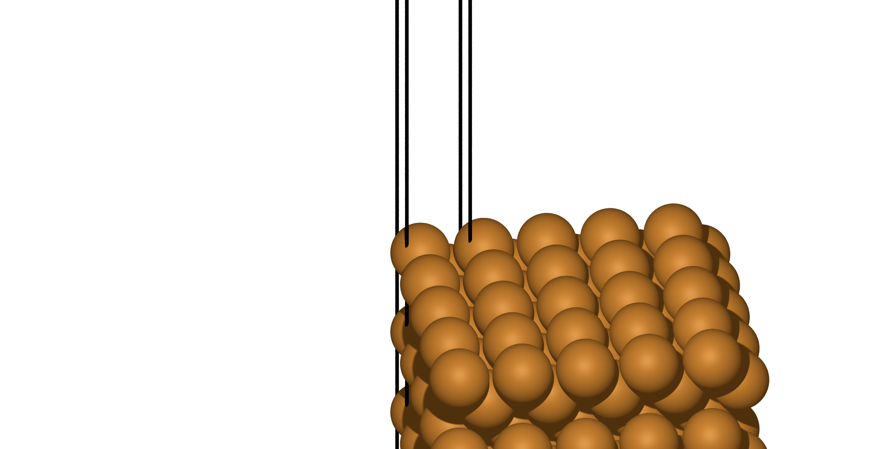
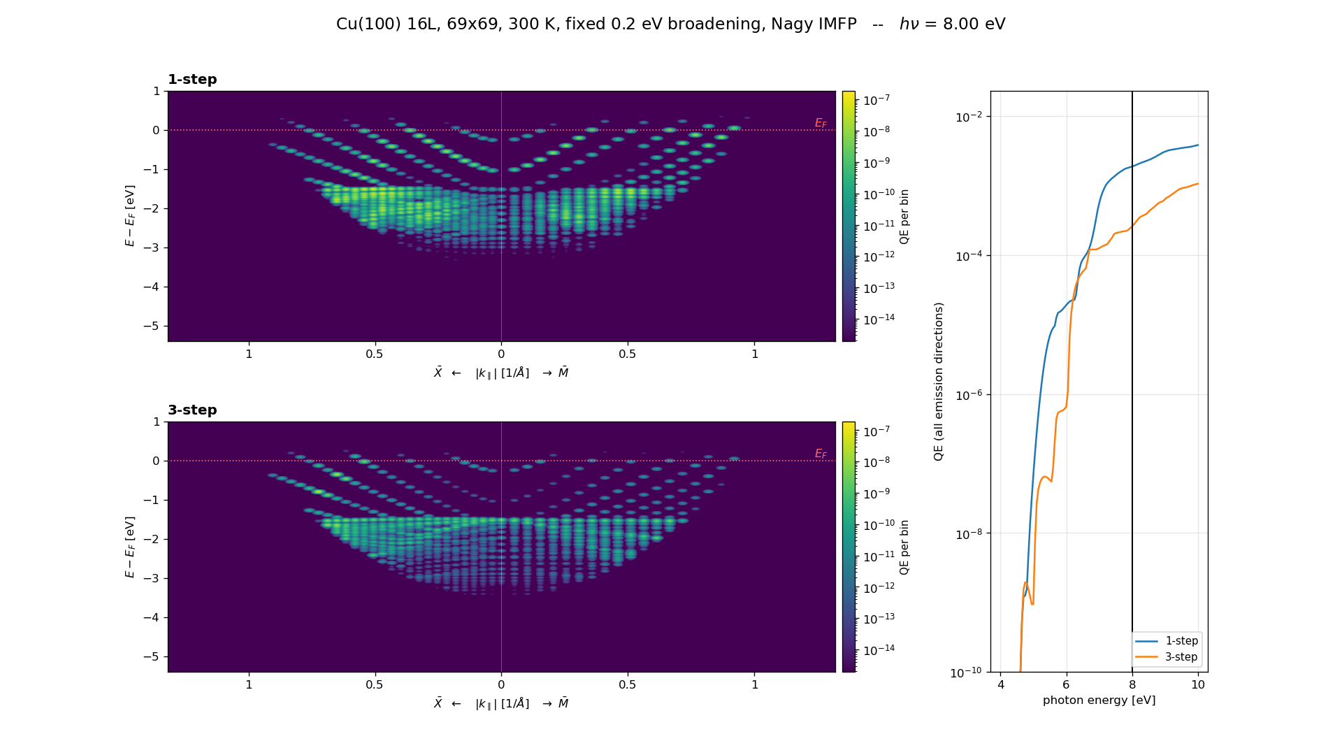
Metal Photocathodes
Cu(100)

Slide 23
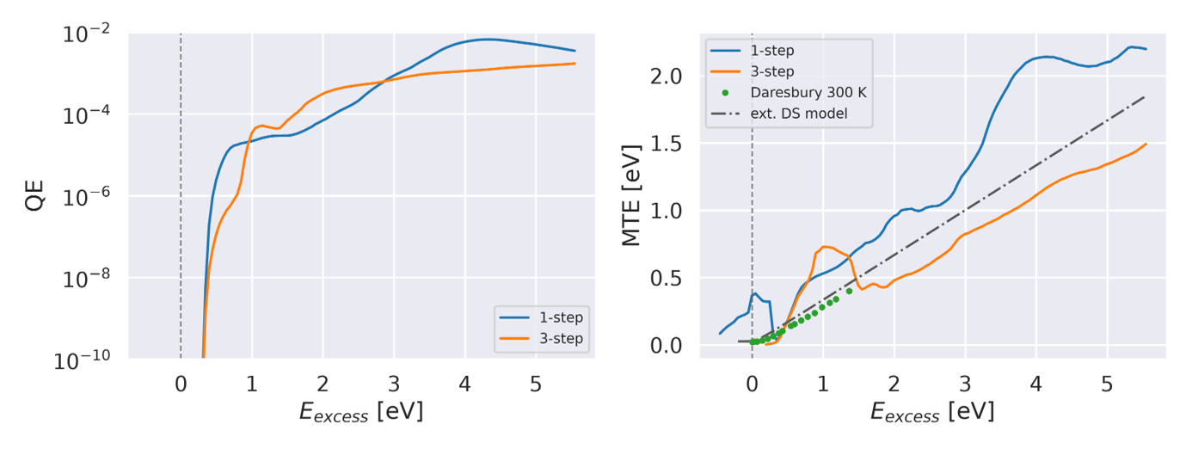
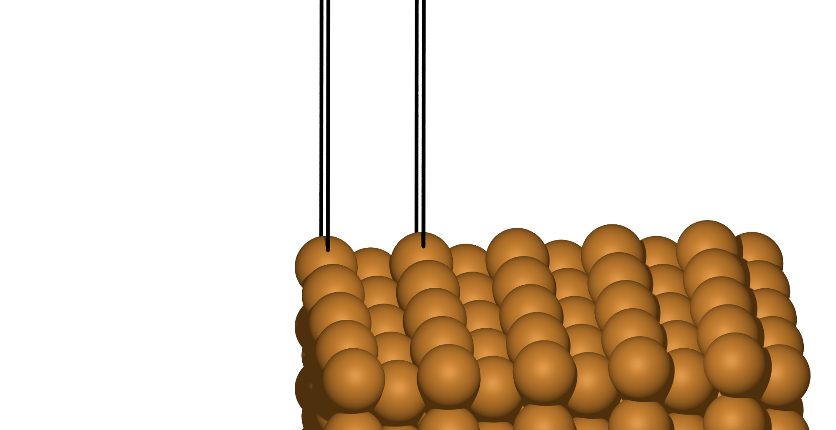
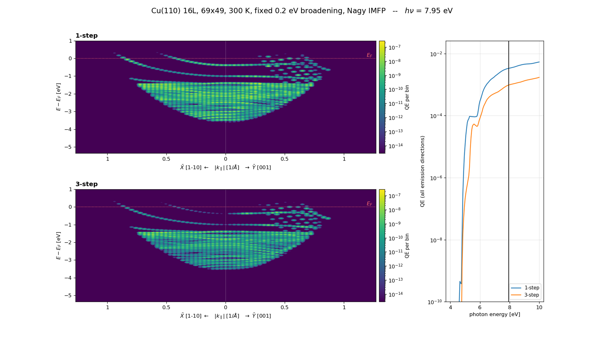
Metal Photocathodes
Cu(110)

Slide 24
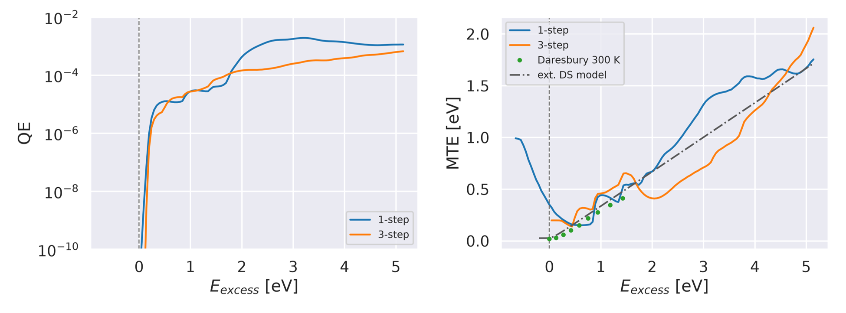
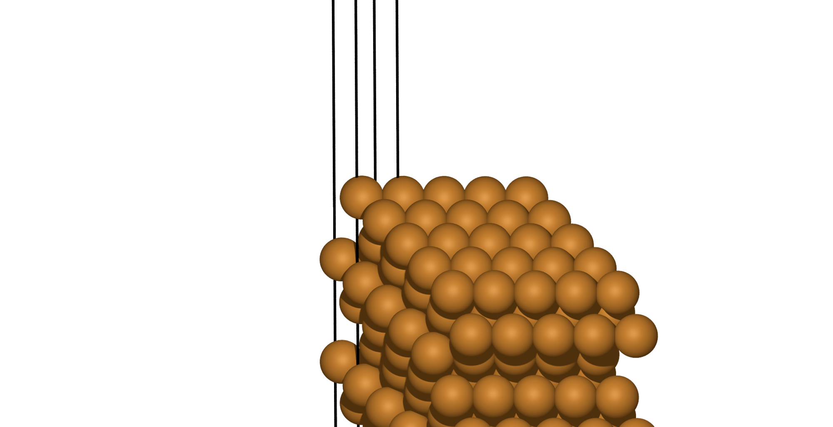
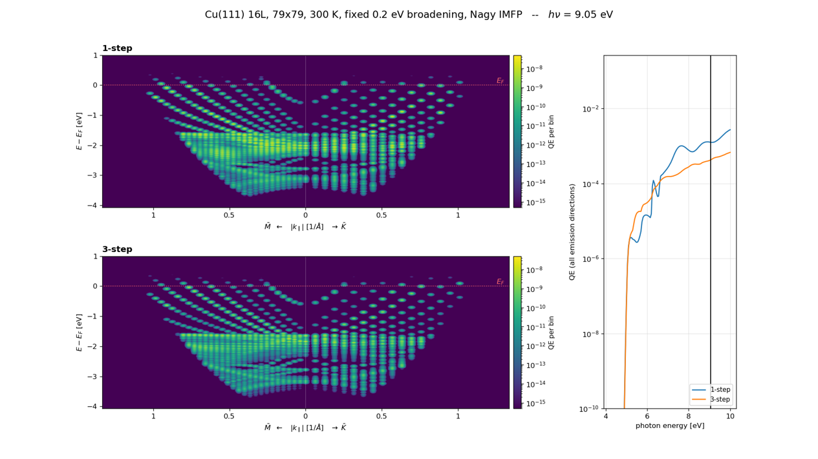
Metal Photocathodes
Cu(111)

Slide 25

Heterointerface
Photocathode
MgO(100)/Ag(100) interface

Slide 26


Higher Energy EDCs
Ag(100)

Slide 27

1Step Emission

