Slide 1


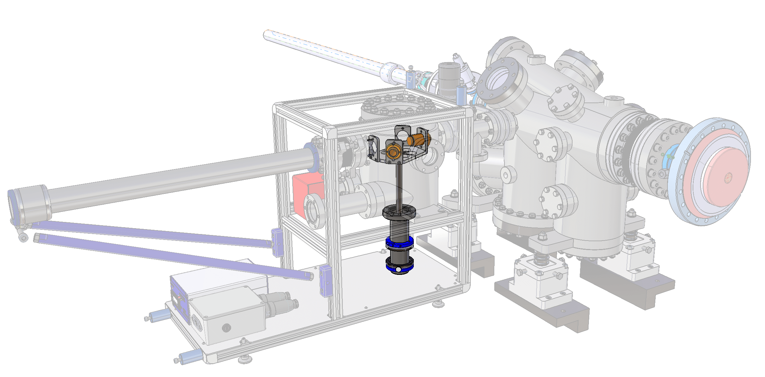
UHV Transfer Solution for Photocathodes
How we Enable Big Scientific Discoveries with Our UHV Technology
Content:
Brief History
UHV Suitcase
SwissFEL Setup
Manipulation of the Cathode
Potential
Cyrill Strässle, 2026

Slide 2
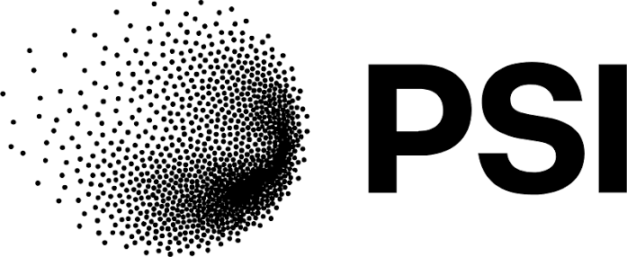
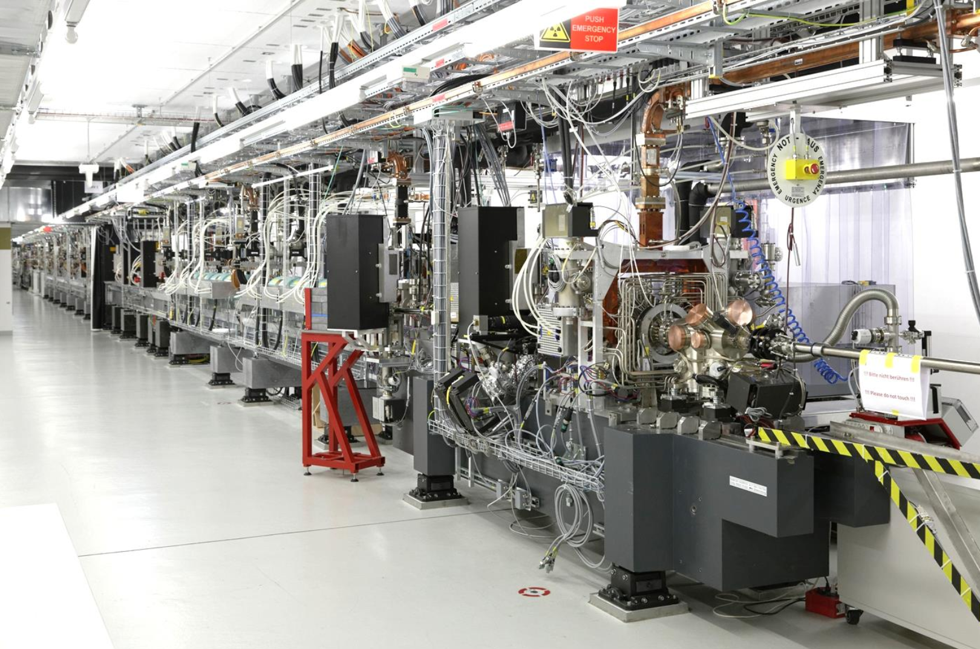
Cathode Handling @SwissFEL
Hard X-Ray FEL
740 m Long
Sample Handling System and
Load Lock chamber behind Photoinjector
installed in 2019
Notes:
Why am I here? -> Installation and running since 2019
Now we are bulding an additinal system there. With improve ments.
How did we get here?

Slide 3
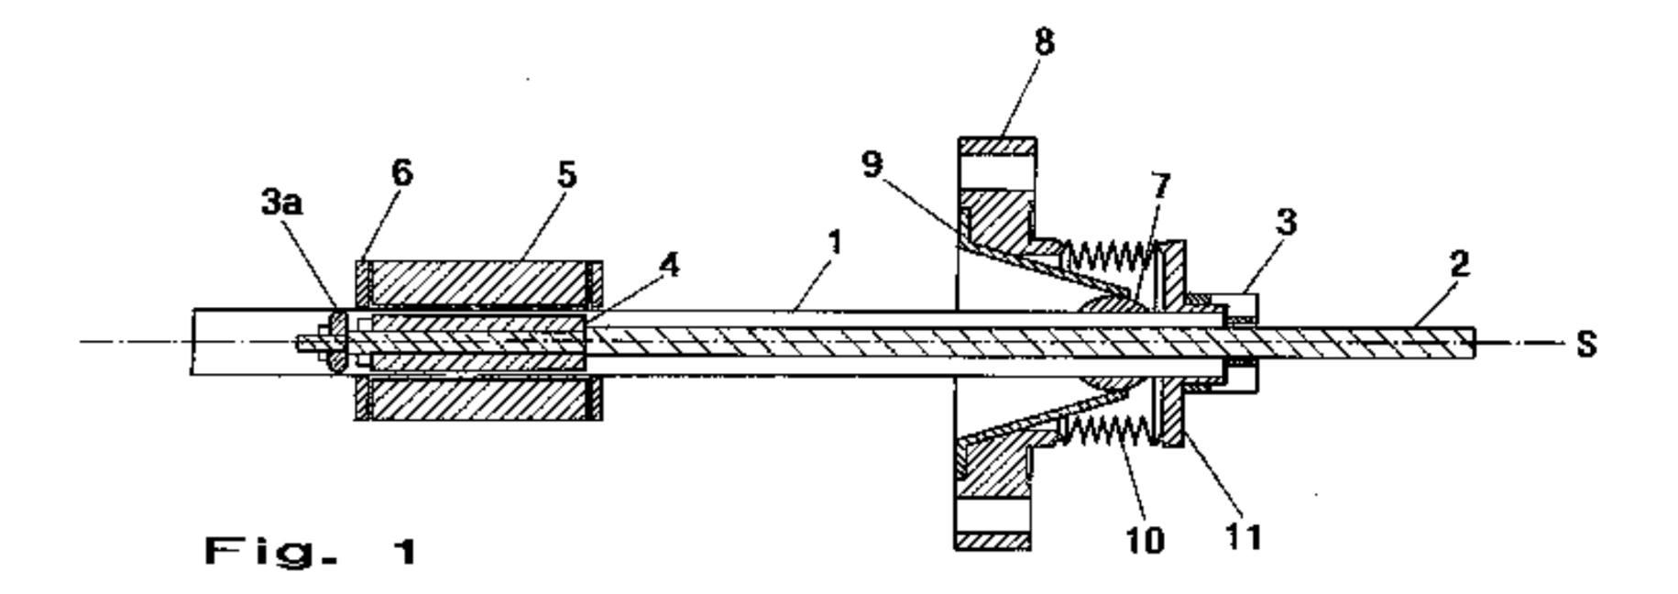

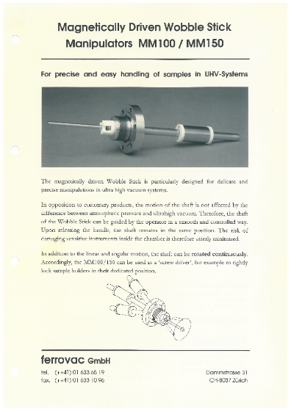
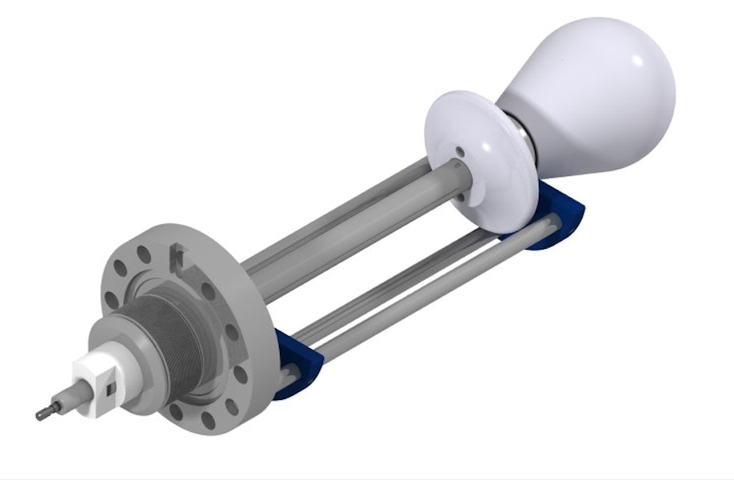
Ferrovac - Swiss UHV technology since 1996
Overview Drawing for Patent Application, 1994, ETH
Notes:
When starting the company 30 years ago, it all begann with developing a magnetically driven
wobblestick manipulator – at that time such thing did not exist. For Sample Handling!
The Wobblestick remaisn mainly the same ever since.

Slide 4
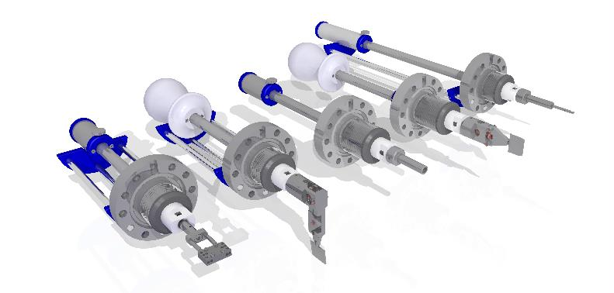
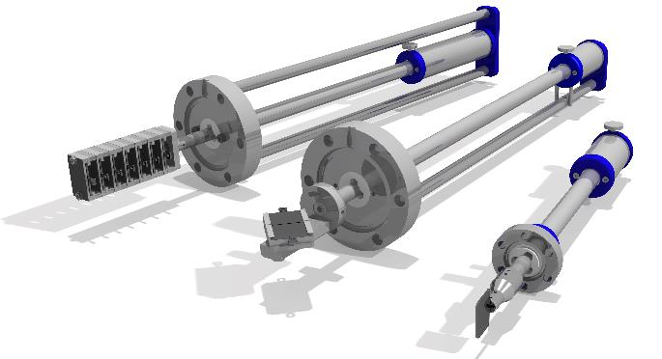
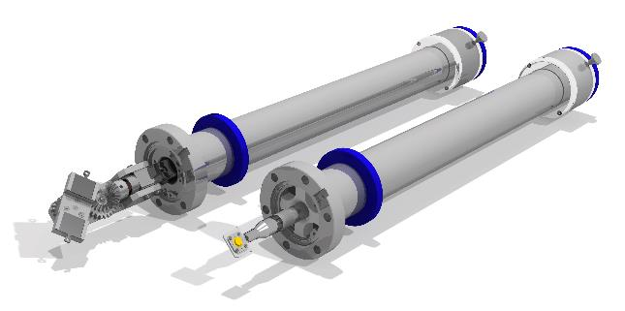
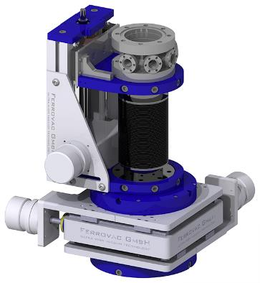
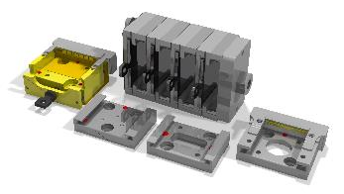
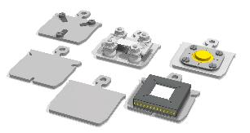
The Selection of Components grows
Wobblestick manipulators
Linear-/Rotary translators
Sample transporters
Sample holders and accessories
XYZ Manipulators
Notes:
Further Problems arise, enable
However, selection of products grows
Dirfent shape of manipulators,
Also the sample holder it self. In our case of photocathod,

Slide 5
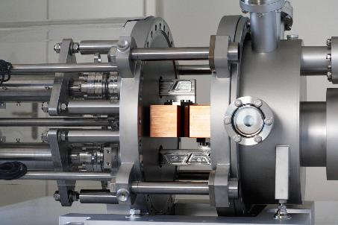
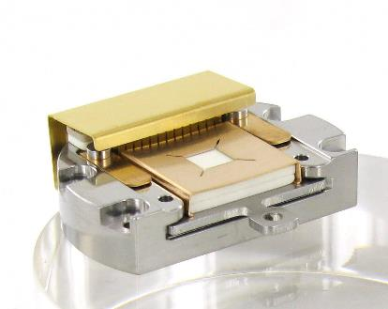
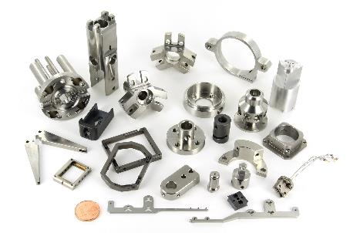
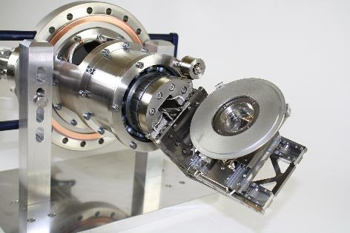
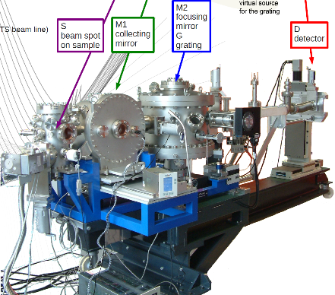
You name it – we build it
HOENCOL @ Swiss FEL
Energy Collimator for the Swiss Free Electron Laser
SHOM/RECOMEC13
Transferable Sample Holder with 13 electrical contacts
Contract Manufacturing
precision engineering
RIXS resonant interference X-ray scattering @ SOLEIL
Design and performance of AERHA, a high acceptance high resolution soft x-ray spectrometer.
Chiuzbăian SG¹, Hague CF¹, Avila A¹, Delaunay R¹, Jaouen N², Sacchi M², Polack F², Thomasset M², Lagarde B², Nicolaou A², Brignolo S¹, Baumier C¹, Lüning J¹, Mariot JM¹.
Rev Sci Instrum. 2014 Apr;85(4):043108.
Doi: 10.1063/1.4871362.
NPSTAGE @ Ioffe Institute
6 Axis nanopositioning stage for 4 inch wafers
Notes:
Later also System development: Scanning Transmision Microscopy (STM), End Stations, ...
Project for numerous Scientific experiments
Sample Loading and transport allway present!
Made us consentrate on Loadlock, Suitcase and Docking Solutions

Slide 6
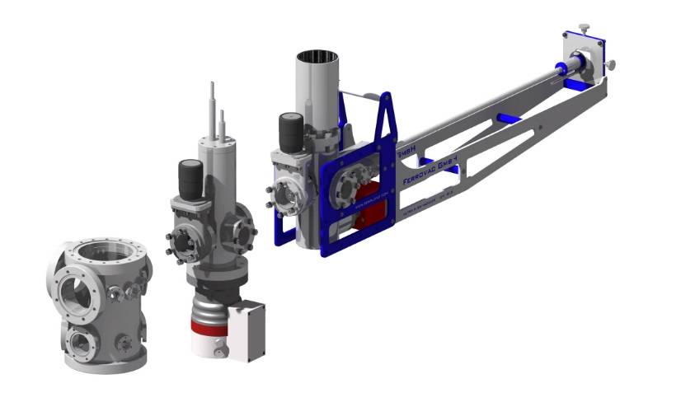
How to UHV Transfer
UHV Suitcase
p < 1E-10 mbar
Docking Station
p < 1E-8 mbar
Can potentially also serve as Load Lock (Antechamber)
Analytical or
Prep System
p < 1E-10 mbar
Turbo
Notes:
Introduce sample through Load Lock, or else Antechamber, place it there
UHV Chamber: remains under Vacuum all the time. Roughing Pump, Trubo-Pump, UHV Pump (ION-Pump).
Docking Station, with rough in Trubo, ponetnially with Cryo UHV Booster. -> 5h to

Slide 7
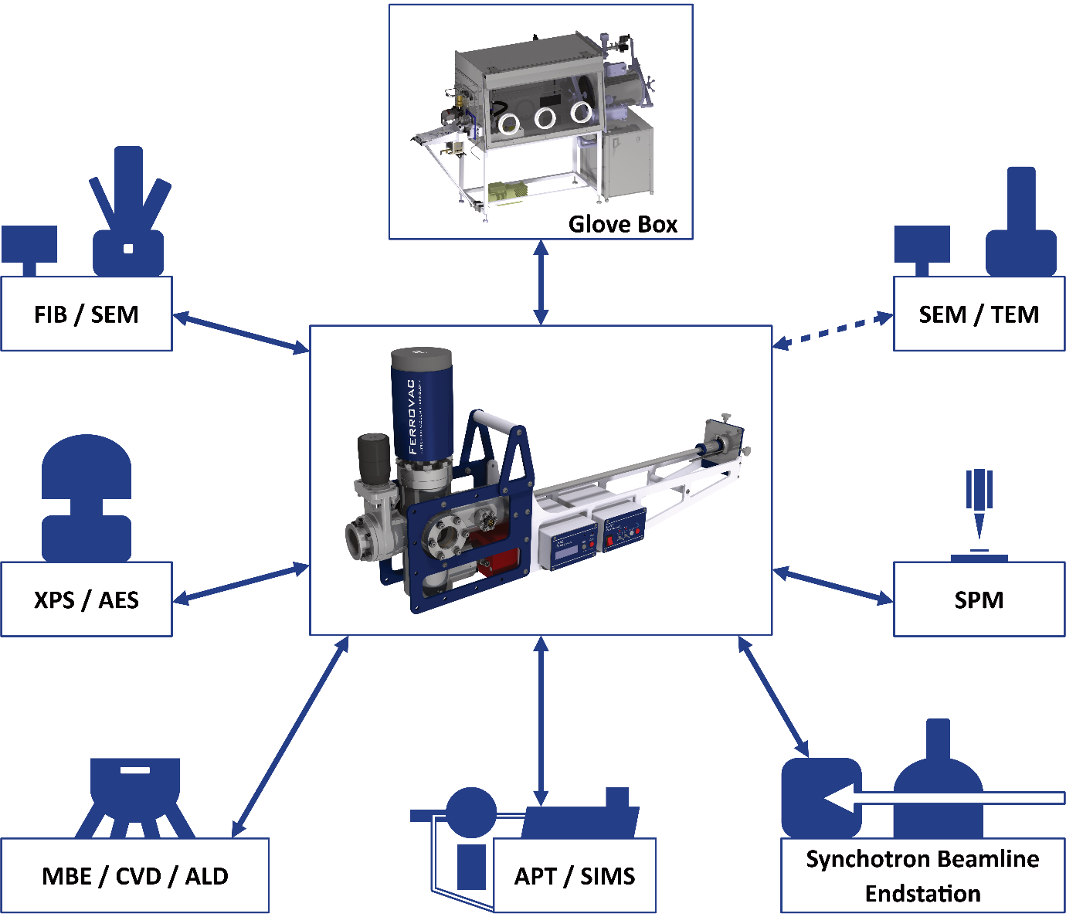
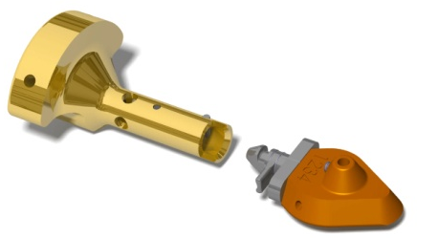
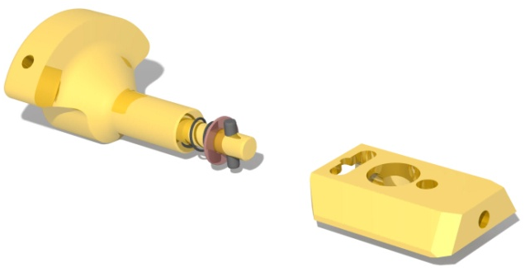
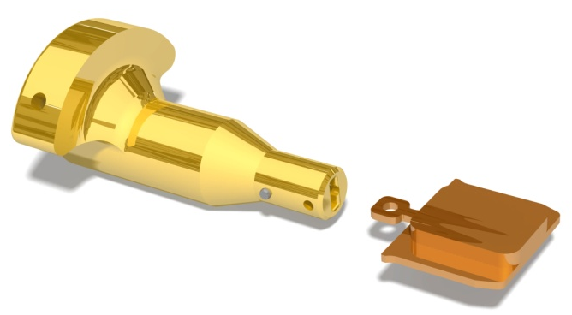
The Suitcase as Connecting Link
Selection of standardised Sample Holders and Grippers
Atom Probe Puck
Dovetail
Flag Stlye Plate
Notes:
Standart / Compatible asset zu OEM Manufatureres. Example: Cameca, ThermoFisher, ...

Slide 8
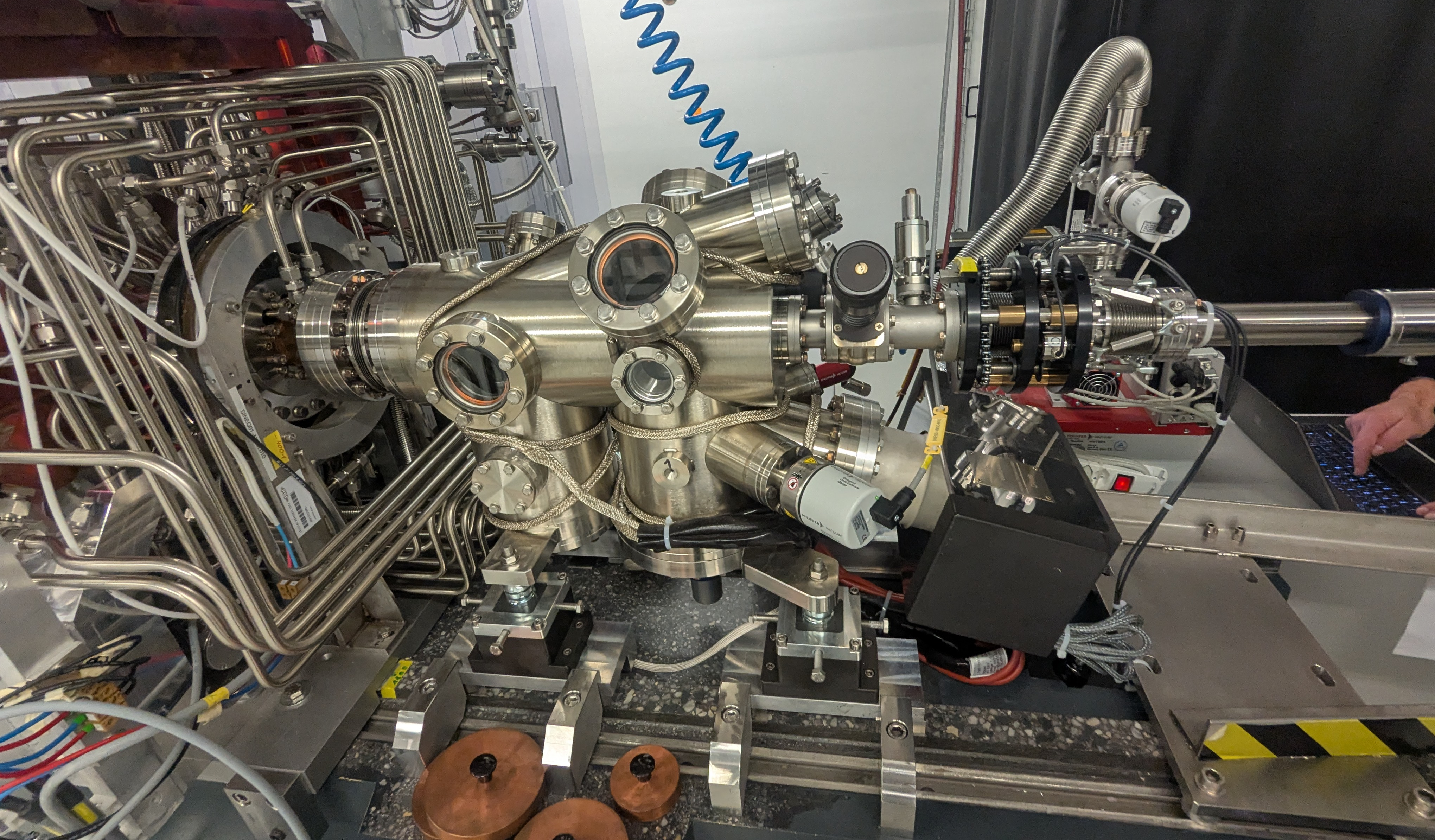
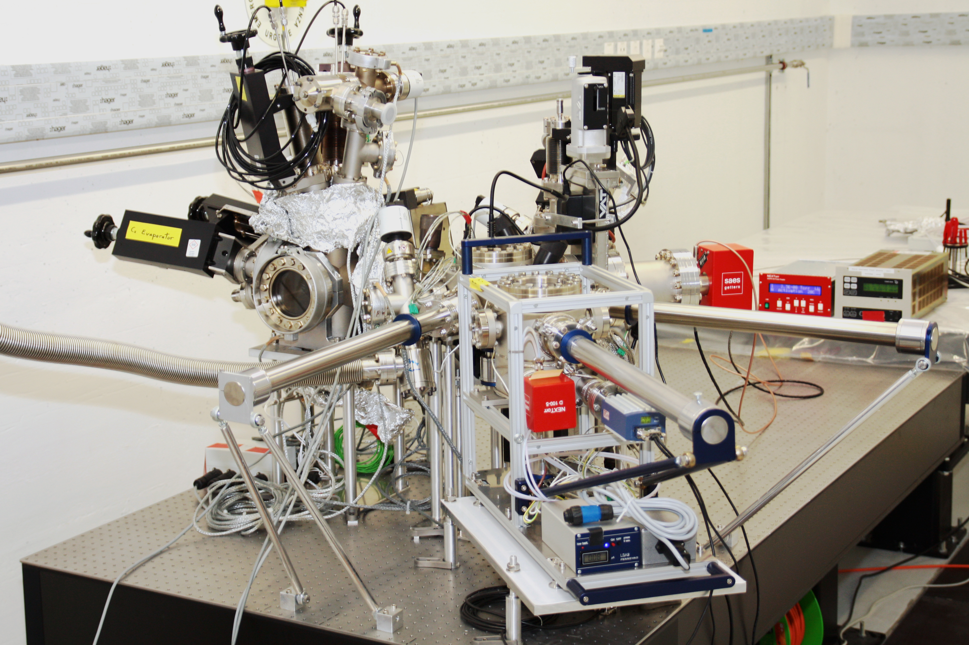
Recap: System @ SwissFEL
Cathode load-lock system (Photo injector)
p < 5E-10 mbar
Cathode preparation system:
Linking chamber (p < 5E-10 mbar)
Carousel for storage of 4 cathodes
sample transorter
with bayonet coupling
Docking Station (separate)
Carousel for storage of 4 cathodes
linear translator
with 2600 N
NEG/SIP Pump
Suitcase
Notes:
Installation and running since 2019
Non-Evaporable Getter (NEG) Pumpen und Sputter Ion Pumps (SIP)
The cathode pressed into the photo-injector gun with ~ 500 N to stabilize the resonant frequency.

Slide 9
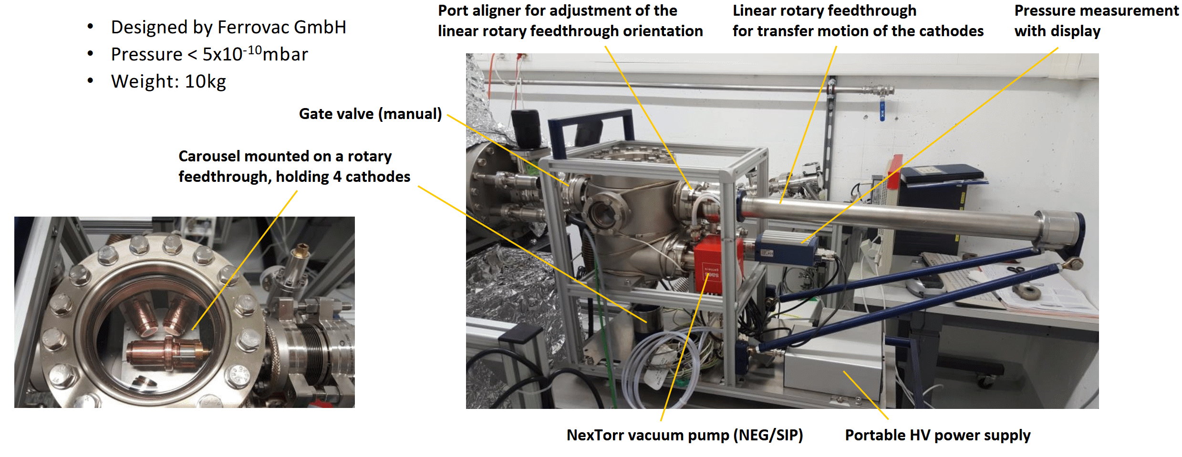
The UHV Suitcase
Cathode Suitcase
p < 5E-10 mbar
DN40CF connecting flange
[Graphic by Romain Ganter]
Notes:
Weight closer to 15kg.
Non-Evaporable Getter (NEG) Pumpen und Sputter Ion Pumps (SIP)
NexTorr Z200: 290l/s

Slide 10
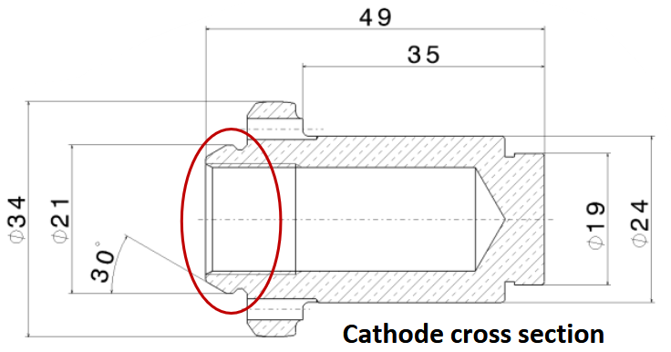
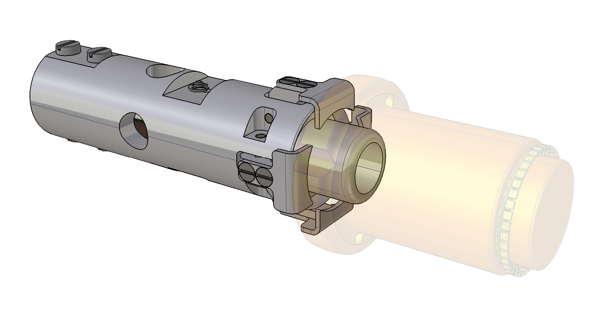
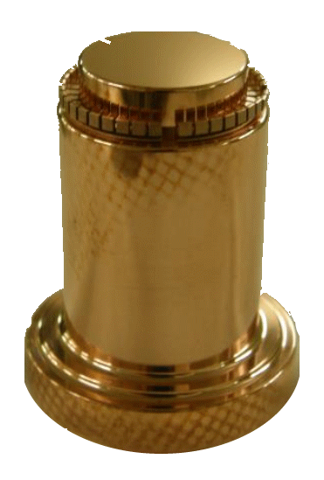
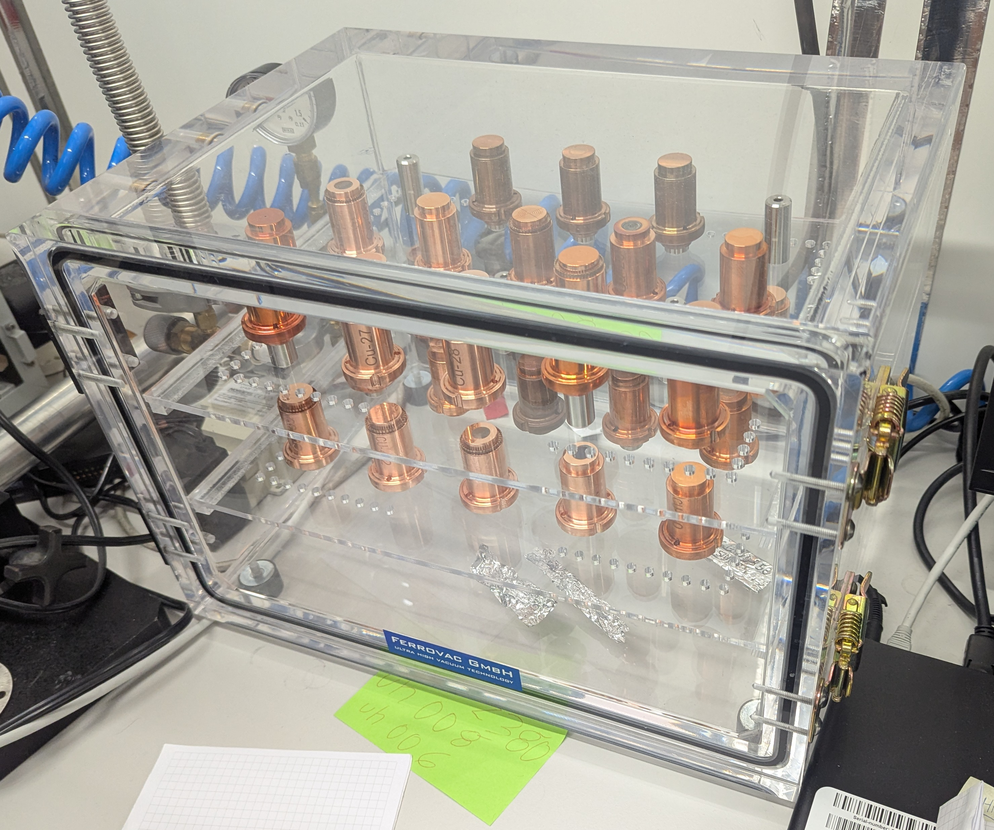
Cathode Handling
Cathode Gripper
The search for a secure gripper
Now compatible with SwissFEL and CERN Cathodes
CERN design:
CLIC Note 303 (1996)
Notes:
Aka the Puck
I think the 6th version now

Slide 11

Operation
The gripper and receiver were just assembled this Monday.
This is an initial test for demonstration purposes.
[The video shows the gripper retrieving the cathode from the receiver and placing it back again.
The receiver is part of the carousel. The gripper is operated by a dual-shaft, dual-rotary sample transporter.]

Slide 12
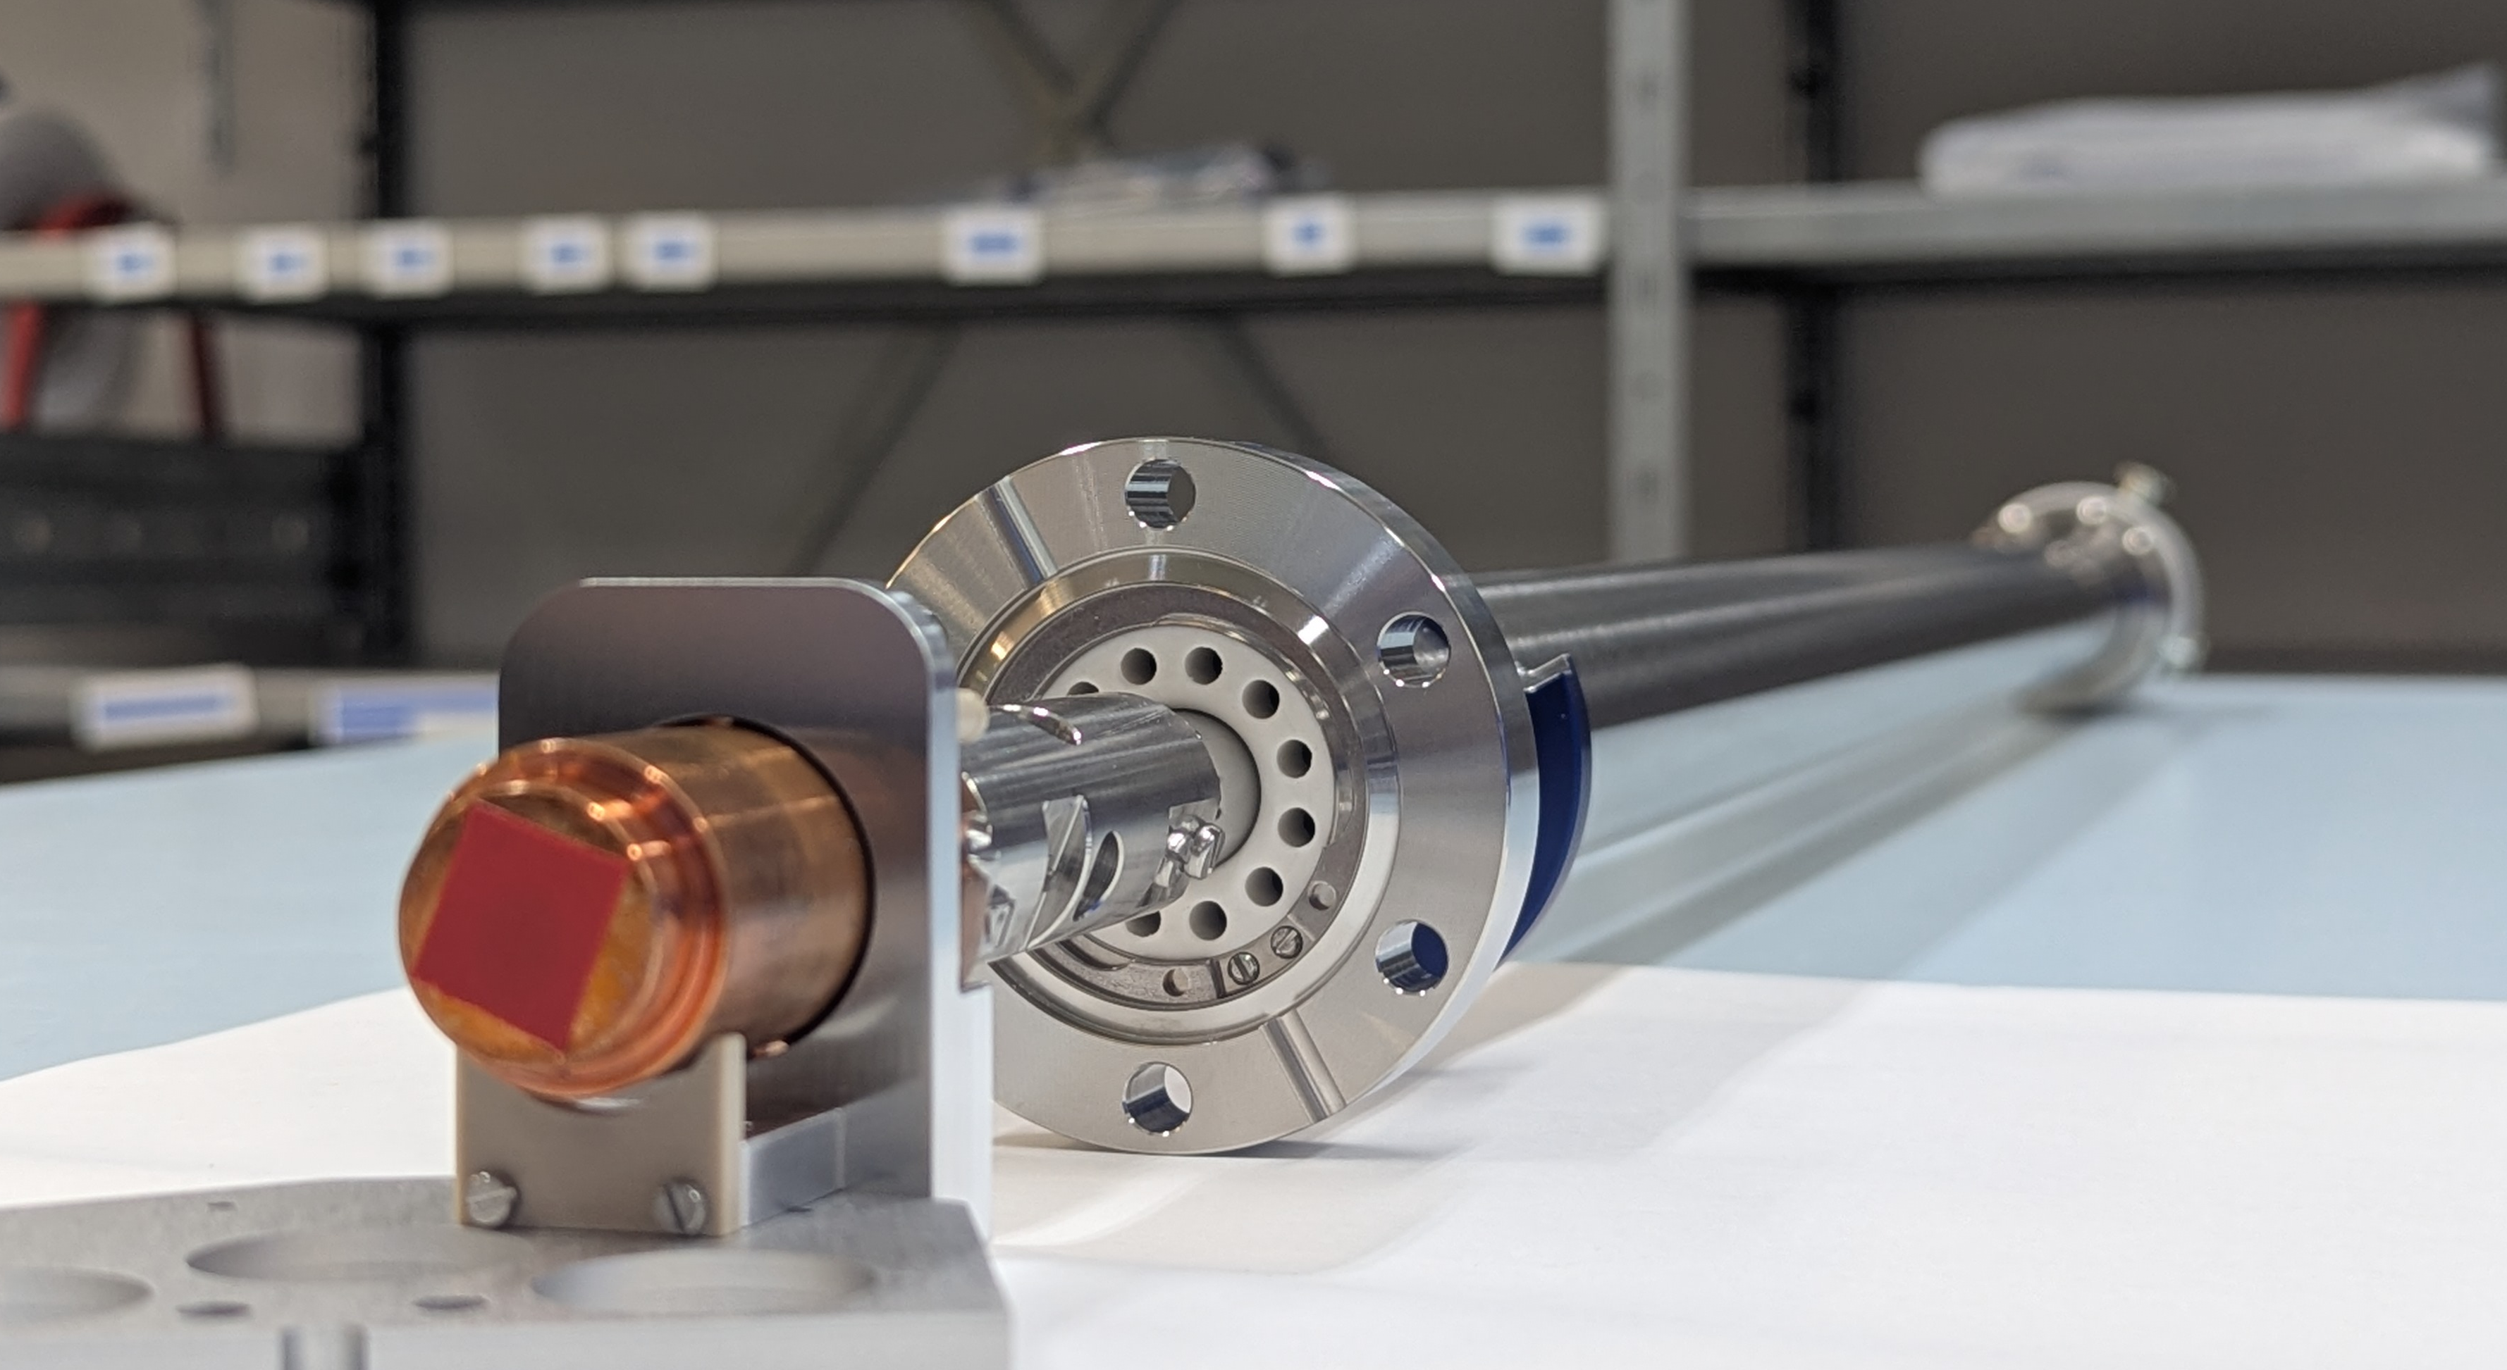
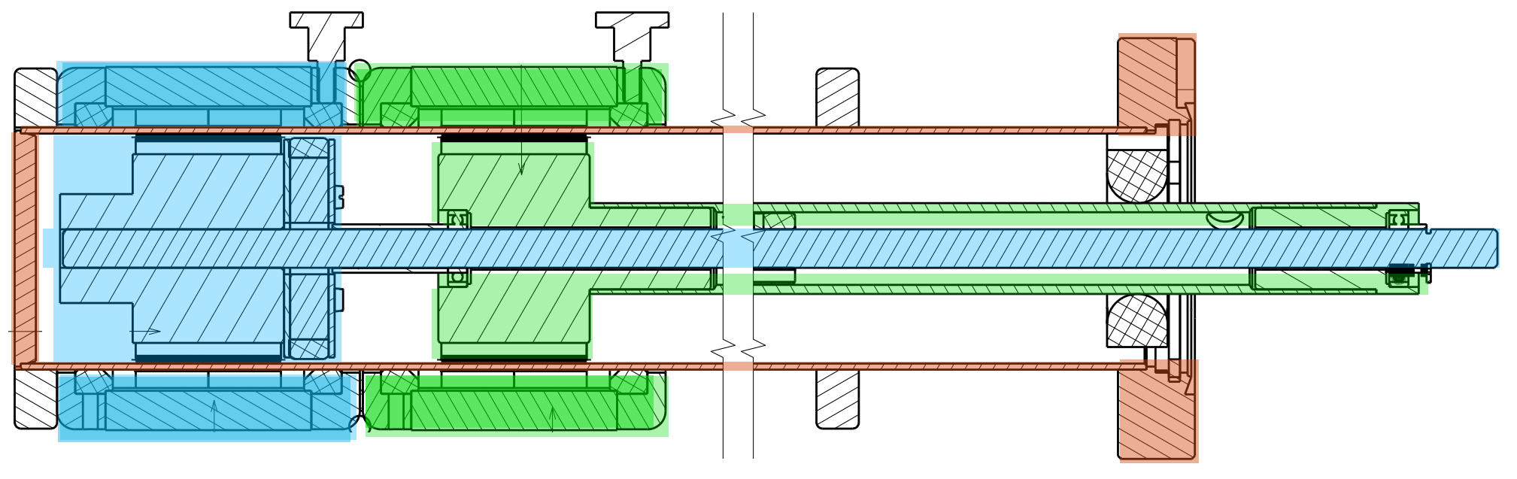
Cathode Handling
Dual Shaft, Dual Rotary Sample Transporter
*contains a special bayonet coupling
Specifications:
linear Travel to 1250 mm
reinforced Teflon
Magnetic coupling: Linear Force: 70N, Torque: 5Nm
Cathode PSI/CERN
Grabber
Receptor
(part of the carousel)
Inner Shaft
Outer Shaft
Welded Tube Unit
Notes:
lass-fiber-reinforced Teflon (PTFE)

Slide 13
Potential
Standardised interfaces enable a unified handling system
Cathode exchange without borders
Ferrovac AG
Thurgauerstrasse 72
CH - 8050 Zürich
+41 44 273 16 38
sales@ferrovac.com
ferrovac.com
Thank you very much for your CONTRIBUTION!
Special thank to Romain Ganter and David Stephan for collaboration on the Project.
Notes:
Romain instpired me to come here and share the system.

