Slide 1
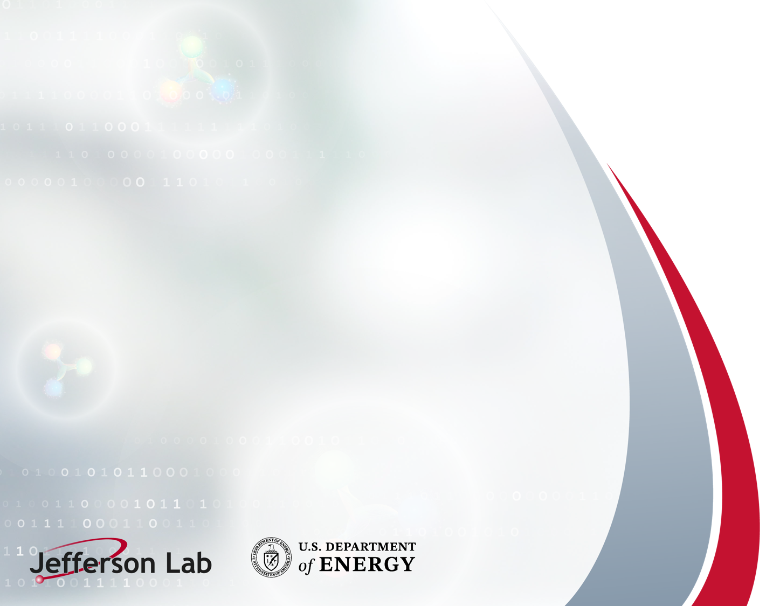
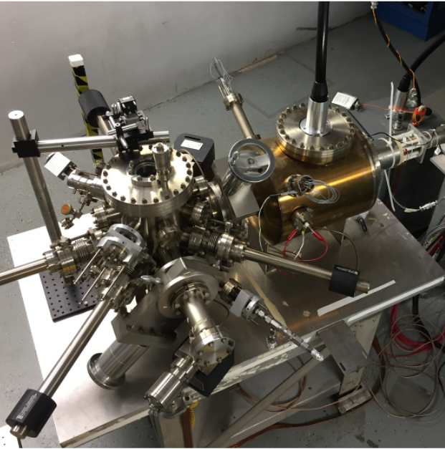
Operating and Innovating a Polarized Electron Source
A continuing story.
Joe Grames
Jefferson Lab
PhASE26
Sep 21-23, 2026
Notes:
Tip: Keep titles under 60 characters for readability
To change the photo: Right-click on photo and select change photo

Slide 2
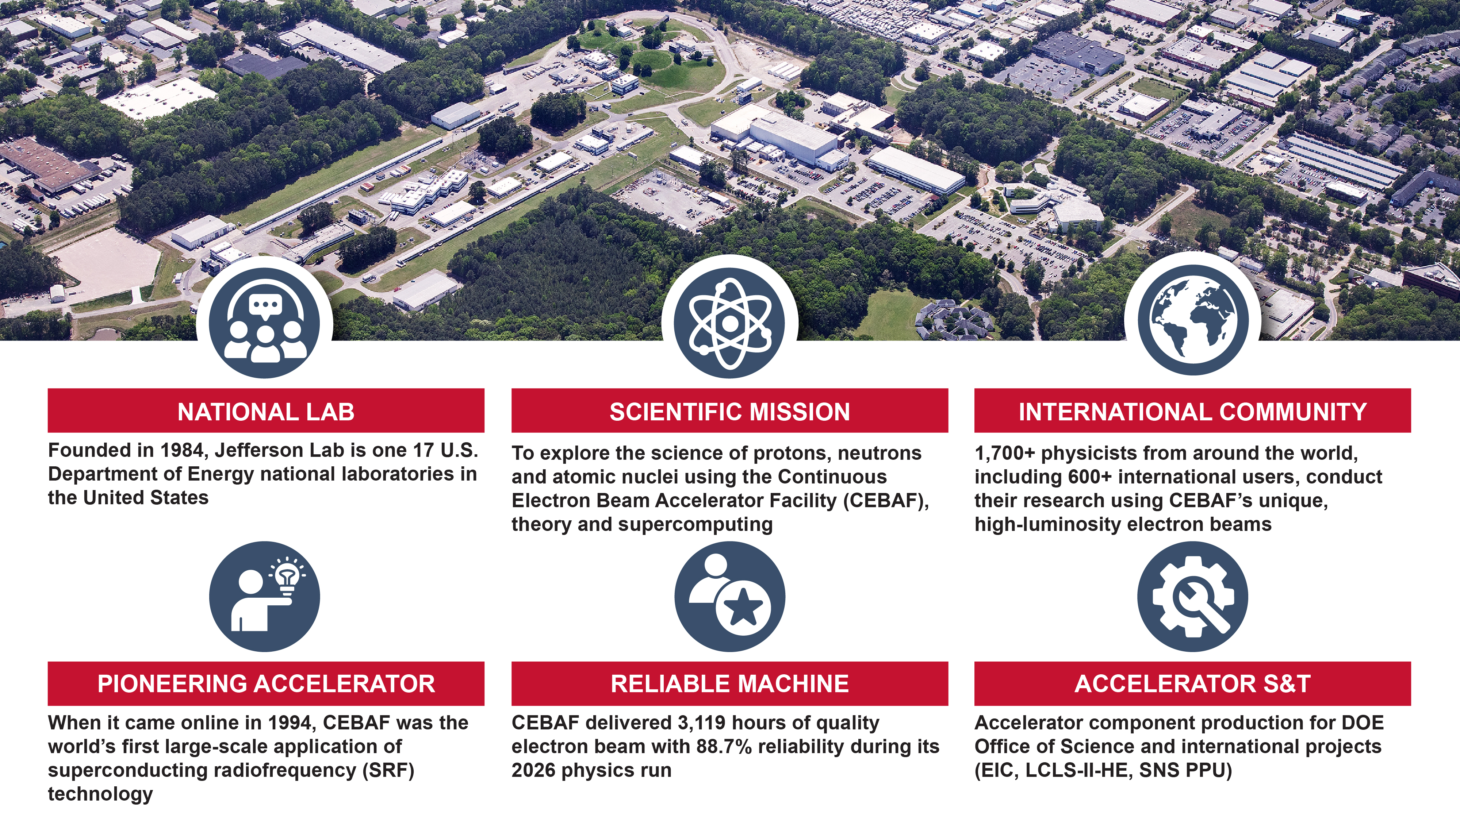
Jefferson Lab campus
Notes:
Guidelines: 6-8 bullets per slide; Use sentence fragments for bullets
To change the photo: Right-click on photo and select change photo

Slide 3
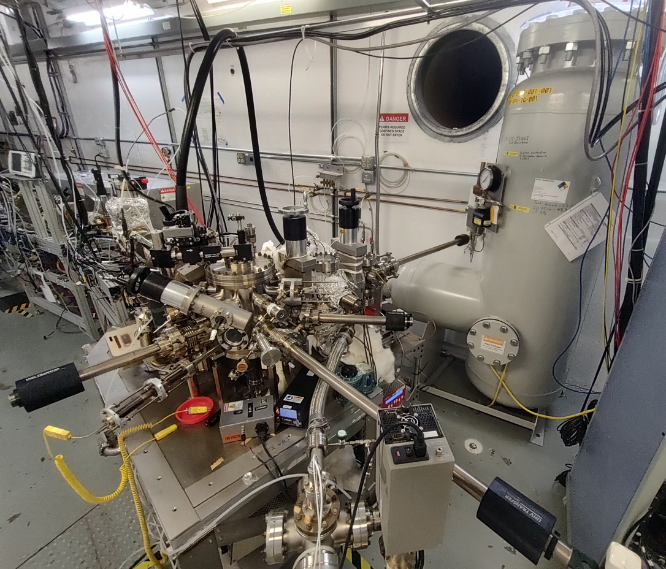
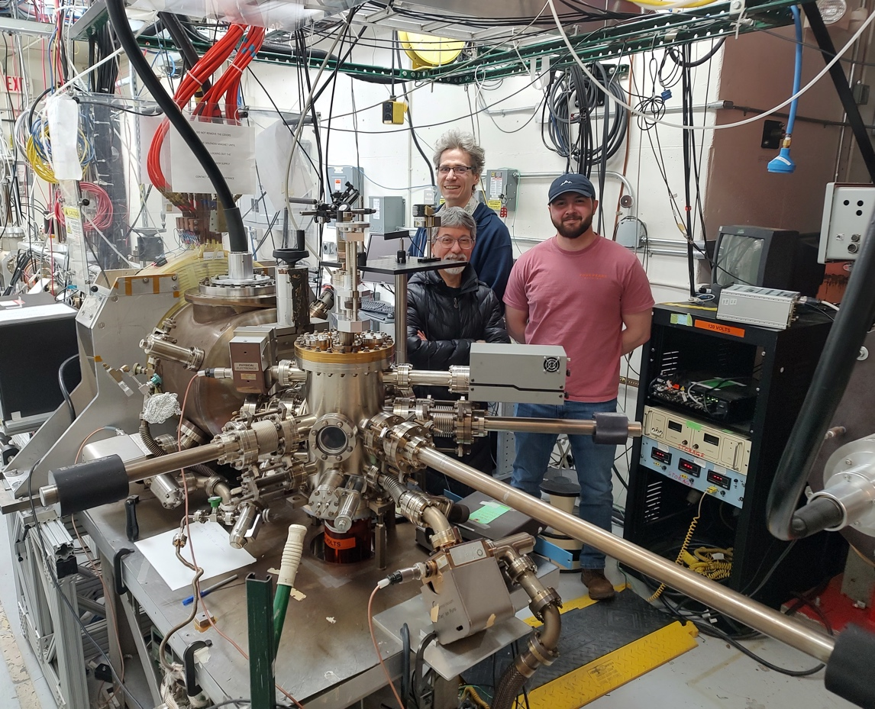
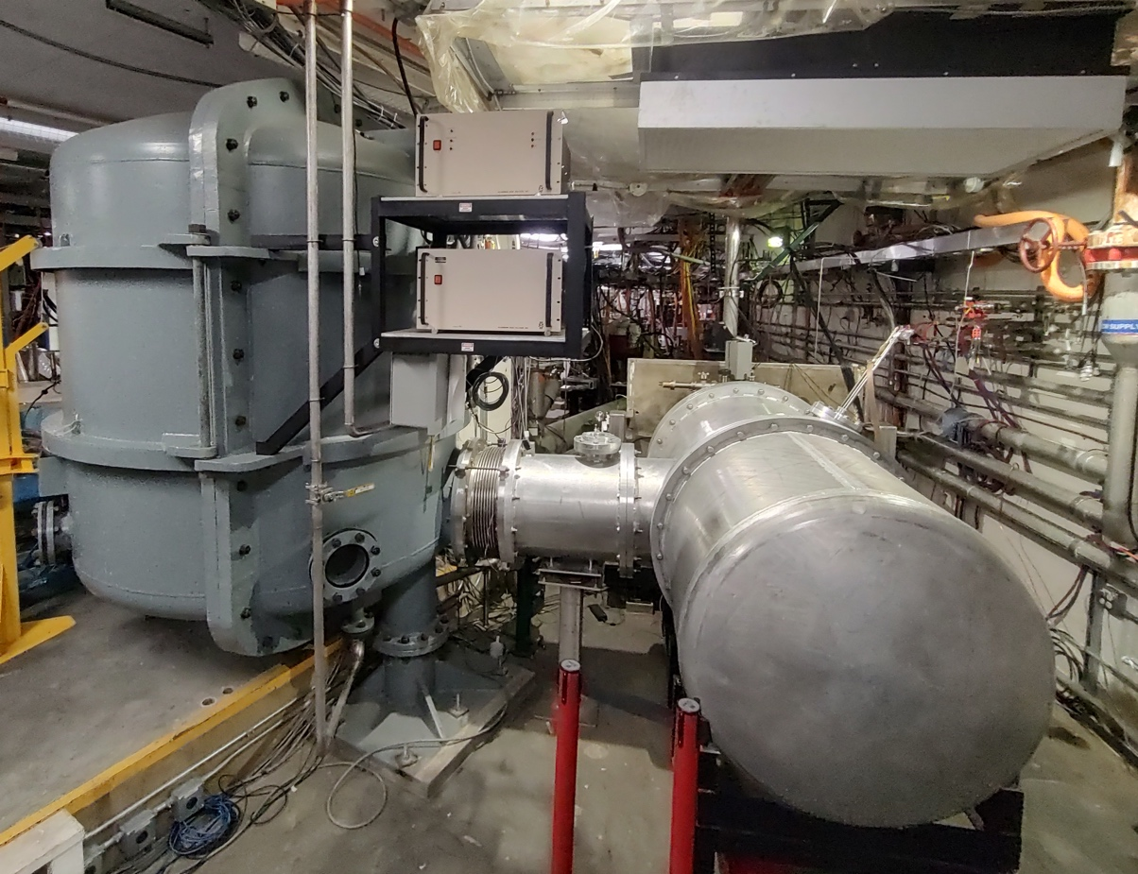
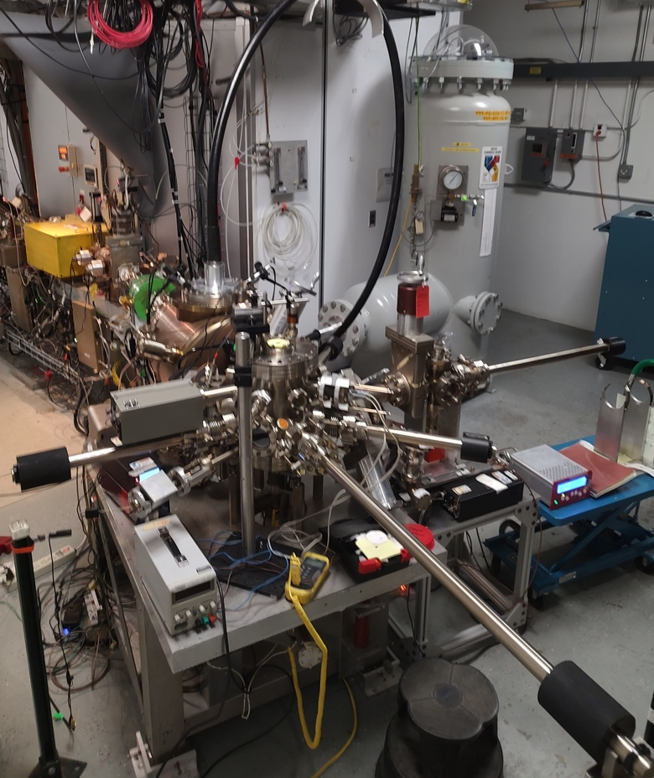
Jefferson Lab has four DC high-voltage XHV CW photoguns
(3) modern load-locks operating 200-350 kV with inverted ceramic insulators connected to their HVPS via cables; each has the capability to transport samples into a deposition chamber, where bulk GaAs, superlattice GaAs or alkali photocathodes are typical
(1) vent/bake gun which operated at >300 kV is planned to be upgraded to a load-lock
Continuous Electron Beam Accelerator Facility (CEBAF)
200 kV gun (350 kV 4.5 mA PS)
Upgraded Injector
Test Facility (UITF)
200 kV gun (450 kV 3 mA PS)
Gun Test
Stand (GTS)
>300 kV gun (600 kV 5 mA PS)
Low Energy Recirculator
Facility (LERF)
>300 kV gun (600 kV 10 mA PS)
Supports 12 GeV NP with 30 wks/year of 90% polarized beams (150 μA)
Supports DOE BeamNetUS program (10 uA/10 MeV) or Accelerator R&D (500 μA)
Supports DOE SBIR, LDRD and Accelerator R&D typically with higher currents (> mA)
Supports DOE SBIR, NP, LDRD and Accelerator R&D with a planned upgrade for 10 MeV (10 mA) beams
J. Yoskowitz et al., “Charge lifetime improvement of the Continuous Electron Beam Accelerator Facility photogun with a biased anode”, Phys. Rev. Accel. Beams 27, 123401 (2024)
A. Masters et al., “Impact of superlattice size on quantum efficiency and polarization in MOCVD-grown strained GaAs/GaAsP photocathodes”, Appl. Phys. Lett. 128, 083501 (2026)
Md Aziz Ar Rahman et al., “Effect of Activation Temperature on Quantum Efficiency and Lifetime of NEA Truncated Nanocone Array GaAs Photocathode”, Nanotechnology 37 015204 (2025)
V. Lizarraga-Rubio, “Design of a high power 8 MeV electron beam injector for the LERF”, to appear in Proc. of Low Energy Electron Positron Physics Workshop at Jefferson Lab (2026)
Notes:
Guidelines: 6-8 bullets per slide; Use sentence fragments for bullets
To change the photo: Right-click on photo and select change photo

Slide 4
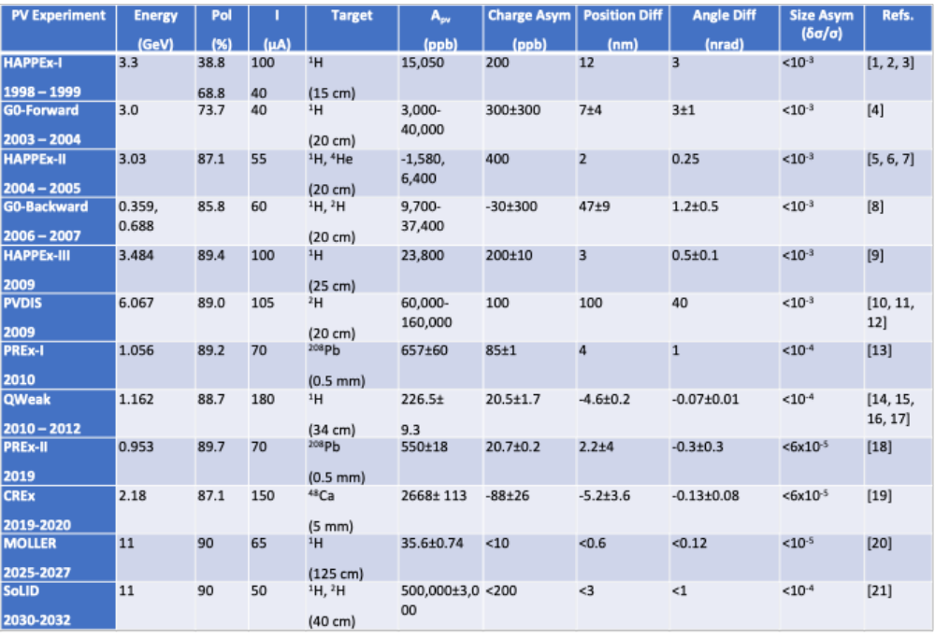
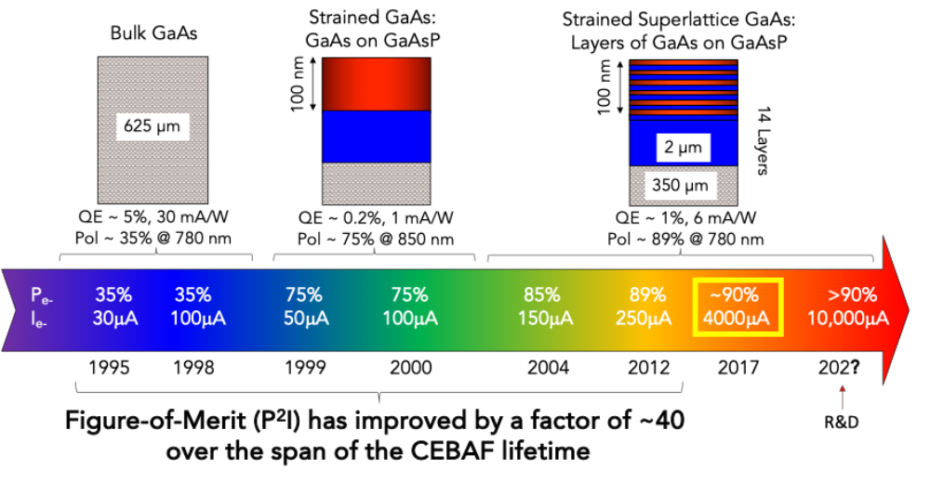
CEBAF Nuclear Physics Program
Parity violation experiments have motivated the progress of highly spin polarized GaAs photocathodes
Additionally, key objectives have been achieving high quantum efficiency and long operating photogun lifetime
Notes:
Guidelines: 6-8 bullets per slide; Use sentence fragments for bullets
To change the photo: Right-click on photo and select change photo

Slide 5
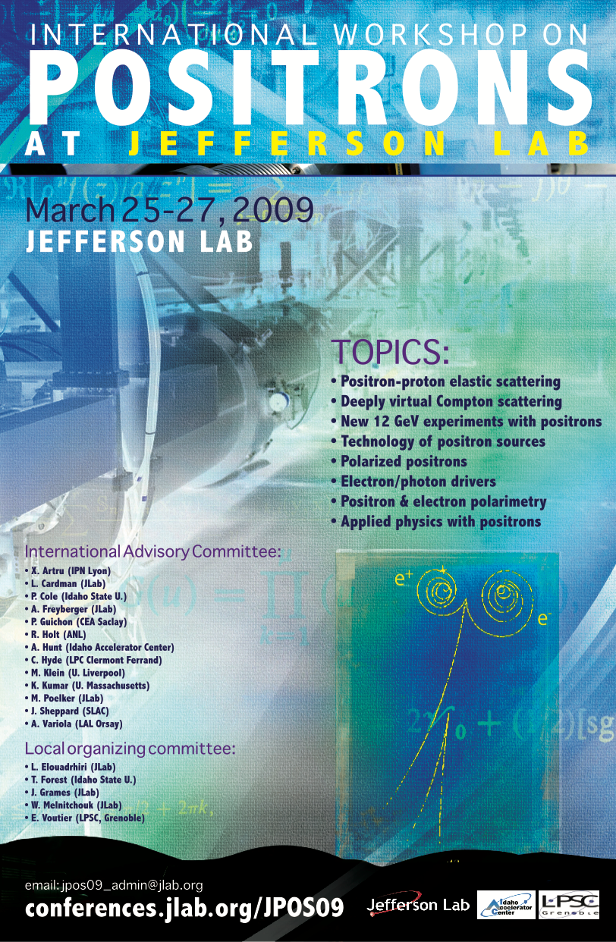
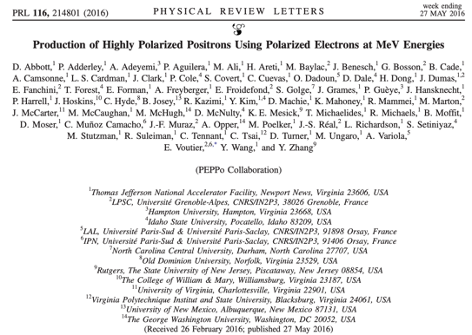

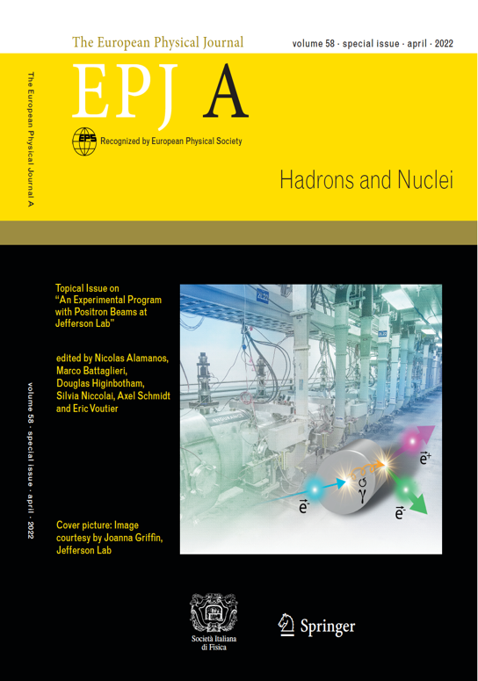
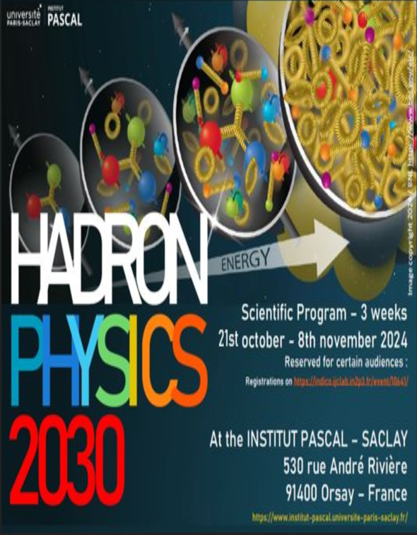

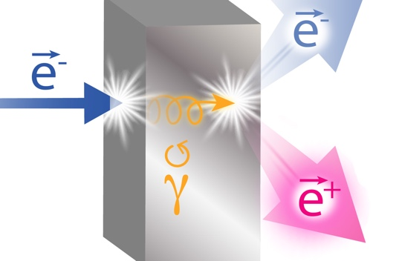
Physics with (Polarized) Positron Beams
NUMBER | TITLE | PHYSICS THEME | CONTACT PERSON | HALL | DAYS AWARDED | SCIENTIFIC RATING | PAC DECISION
PR12+23-002 | Beam Charge Asymmetries for Deeply Virtual Compton Scattering on the Proton at CLAS12 | GPDs | Eric Voutier | B | 100 | A- | C1
PR12+23-003 | Measurement of Deep Inelastic Scattering from Nuclei with Electron and Positron Beams to Constrain the Impact of Coulomb Corrections in DIS | MPE | Dave Gaskell | C | 9.3 | A- | C1
PR12+23-006 | Deeply Virtual Compton Scattering using a positron beam in Hall C | GPDs | Carlos Muñoz Camacho | C | 137 | A- | C1
PR12+23-008 | A Direct Measurement of Hard Two-Photon Exchange with Electrons and Positrons at CLAS12 | TPE | Axel Schmidt | B | 55 | A | C1
PR12+23-012 | A measurement of two-photon exchange in unpolarized elastic positron–proton and electron–proton scattering | TPE | Michael Nycz | C | 56 | A- | C1
PR12+24-005 | A dark photon search with a JLab positron beam | BSM | Bogdan Wojtsekhowski | B | 55 | A- | C1
PR12+25-006 | Meazsurement of Two-Photon Exchange in Electron-Neutron and Positron-Neutron Elastic Scattering | TPE | Eric Fuchey | C |  |  | C2
PR12+25-011 | Multi-Photon Effects in Inclusive and Semi-Inclusive Deep Inelastic Scattering | MPE | Tyler Hague | C | 58.5 | B+ | C1
The Jefferson Lab Positron Working Group formed in 2018 grew to 250 members from 75 institutions
There are 8 conditionally approved nuclear physics experiments representing 471 days of operation
Today, the interest at Jefferson Lab has broadened to include “low energy” materials science and atomic physics
2009
2016
2017
2022
2024
2026
Notes:
Guidelines: 6-8 bullets per slide; Use sentence fragments for bullets
To change the photo: Right-click on photo and select change photo

Slide 6
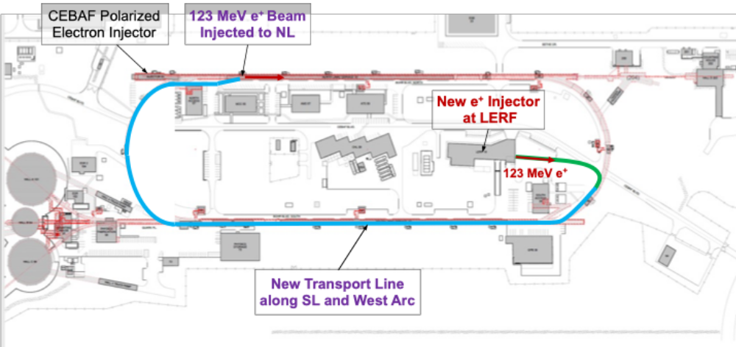
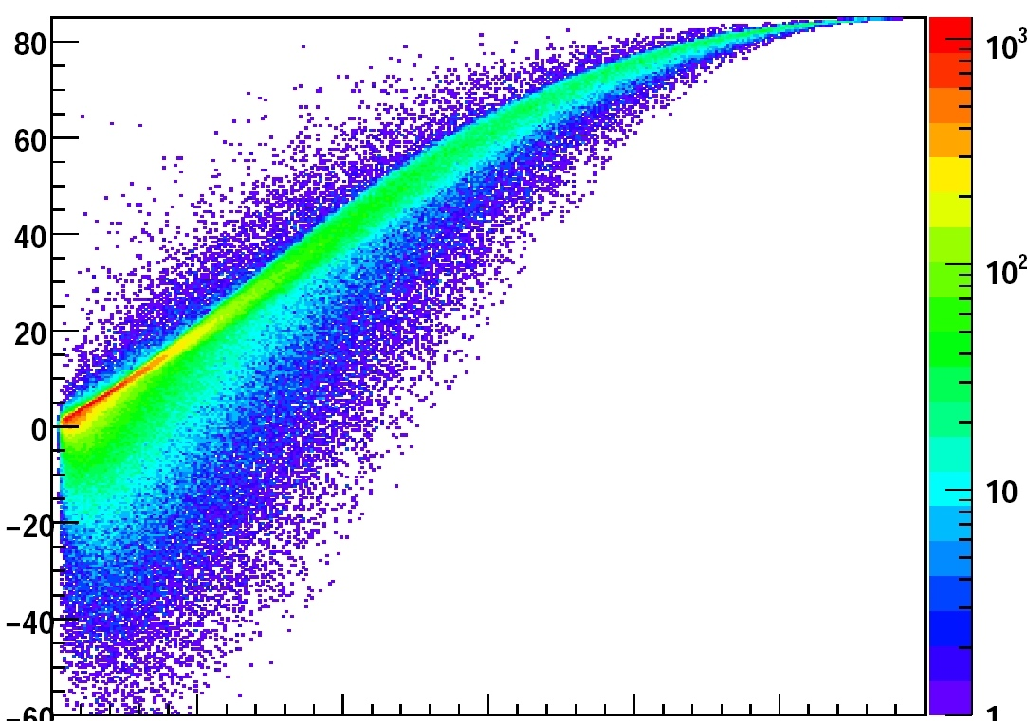

Polarized Positron Generation
Polarized Electrons for Polarized Positrons (PEPPo), creates a useful spectrum of positrons
>50 nA (polarization >60%)
>500 nA (no polarization)
Conceptual Development –
100-300 MeV polarized e⁻ injector @ LERF
Injection into Ce⁺BAF for 12 GeV acceleration
Critical Risk Prototypes –
Build prototype high-power production targets
Build prototype 1 mA polarized electron source
Create polarized e⁻/e⁺ testbed –
Restore LERF 10 mA/10 MeV injector area to irradiate targets and test gun operation
Positron Polarization (%)
0
Positron Energy
Notes:
Guidelines: 6-8 bullets per slide; Use sentence fragments for bullets
To change the photo: Right-click on photo and select change photo

Slide 7
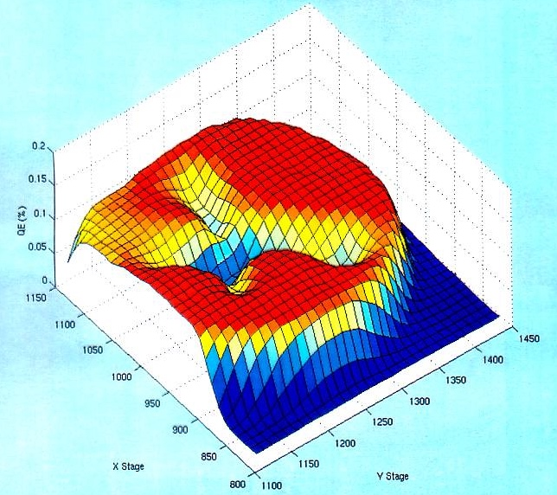
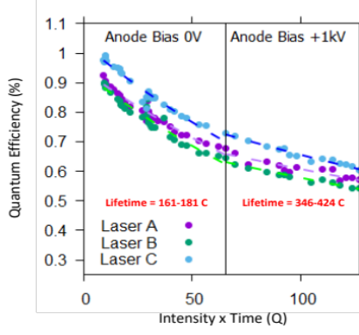
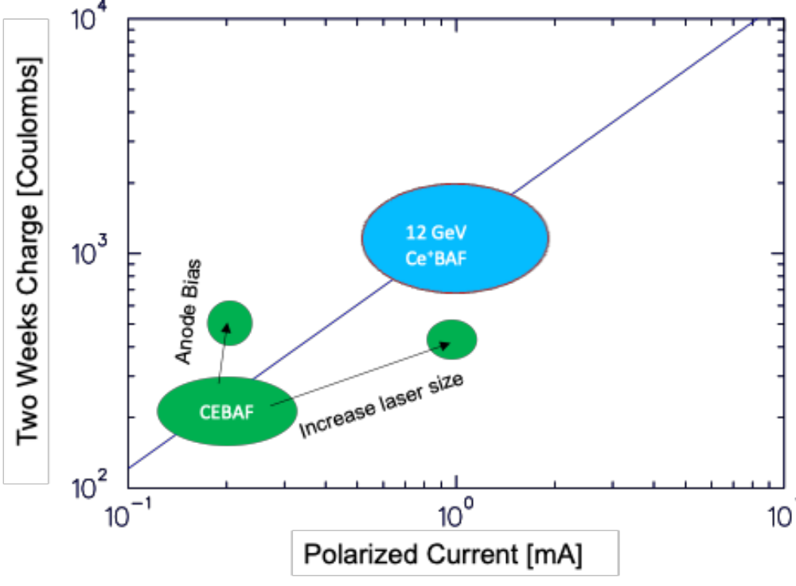
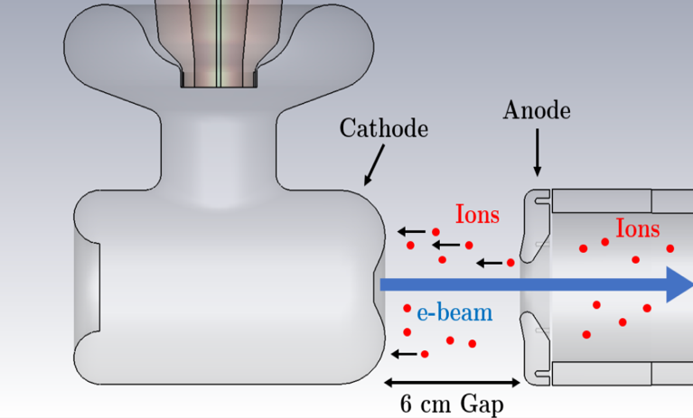
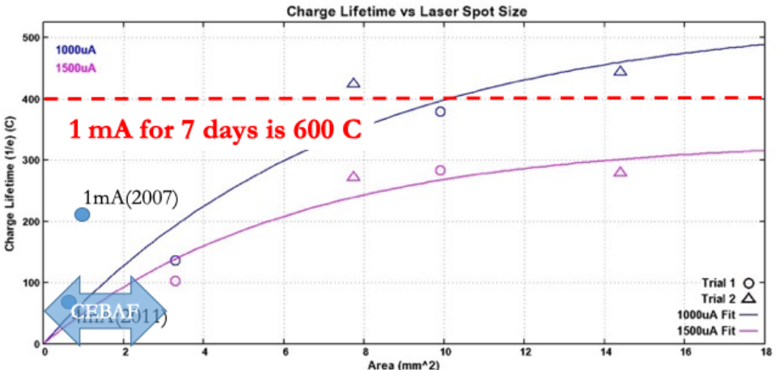
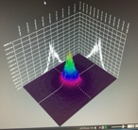
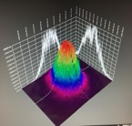
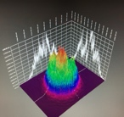
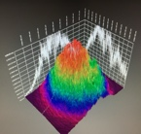
Sustaining QE during gun operation “old news”
Low base and dynamic Vacuum
Degassing and optimization of vacuum components
Massive NEG pumping and coatings
Compact and reliable High Voltage
“load-lock” geometry to avoid field emission
Inverted insulator minimizes metal at high voltage
Optimizing the Photocathode
Masking emission area to minimize ”stray beam”
Limiting the absorbed power to mitigate heating
Suppressing Ion Back-Bombardment (IBB) Fluence
Increasing the laser size
Biasing the anode from downstream ions
J. Yoskowitz et al., Phys. Rev. Accel. Beams 27, 123401 (2024)
Where we want to be
Minimum
needed
J. Grames et al., PSTP, Daejeon (2017)
Notes:
Guidelines: 6-8 bullets per slide; Use sentence fragments for bullets
To change the photo: Right-click on photo and select change photo

Slide 8

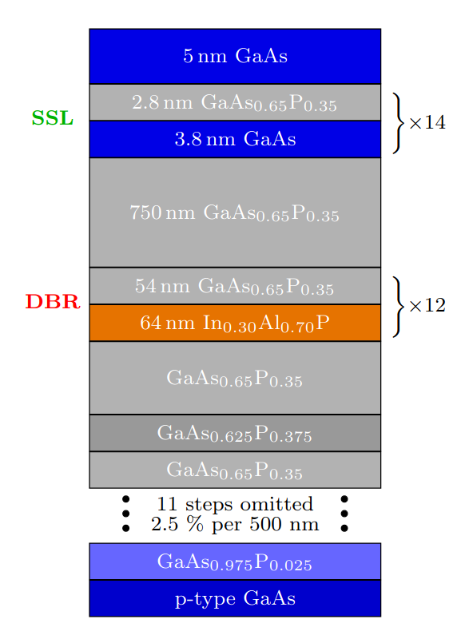
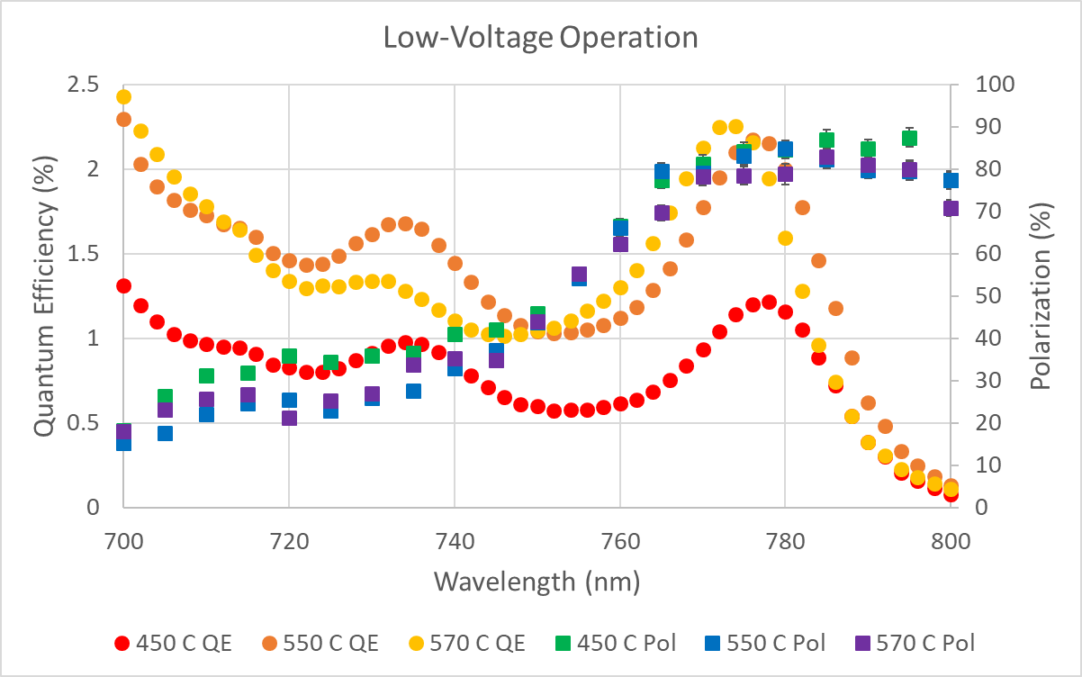
R&D strategy
Begin operating with SSL DBR photocathodes
Build a gun designed to minimize ion-back bombardment
Use lower out-gassing materials
This work is supported by Research and Development for Next Generation Nuclear Physics Accelerator Facilities solicitation DE-FOA-0003261 by the U.S. Department of Energy Office Science Nuclear Physics.
…
Strained SuperLattice (SSL) Distributed Bragg Reflector (DBR)
G. Blume, A. Masters, C. Kirk, S. Poudel, J. Hill, A. Kachwala, J. Grames, M. L. Stutzman, M. Grau, S. Marsillac, “The Impact of Surface Condition for MOCVD-grown Distributed Bragg Reflector Strained-Superlattice Photocathodes” (draft in preparation)
Notes:
Guidelines: 6-8 bullets per slide; Use sentence fragments for bullets
To change the photo: Right-click on photo and select change photo

Slide 9
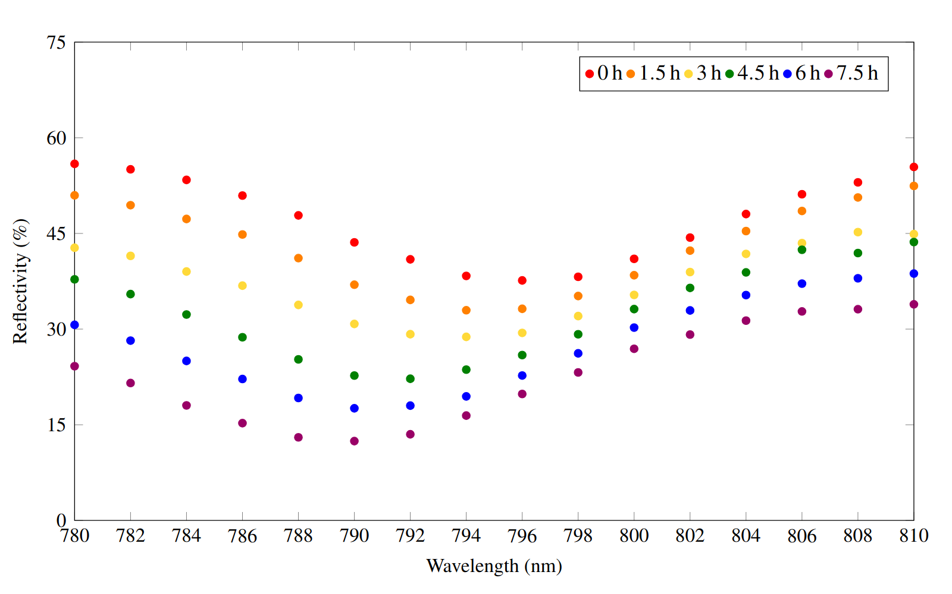
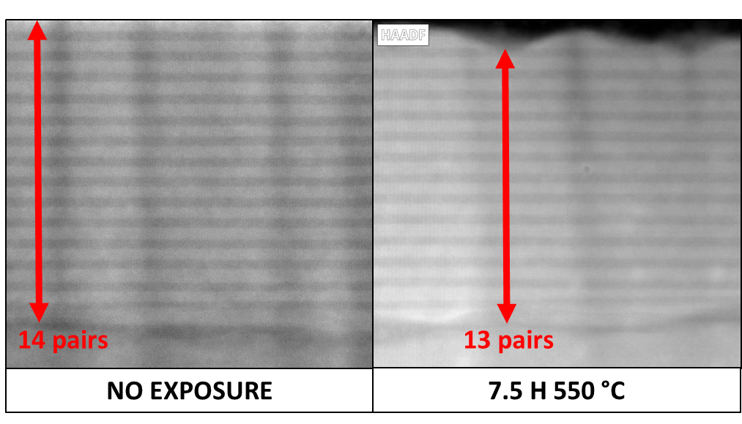
R&D strategy
Begin operating with SSL DBR photocathodes
Build a gun designed to minimize ion-back bombardment
Use lower out-gassing materials
This work is supported by Research and Development for Next Generation Nuclear Physics Accelerator Facilities solicitation DE-FOA-0003261 by the U.S. Department of Energy Office Science Nuclear Physics.
waterfall plot
Absorption peak shifts to lower wavelength
Affects highly doped capping layer, SSL volume and Fabry-Perot resonance
G. Blume, C. Kirk, S. Poudel, J. Hill, A. Kachwala, J. Grames, M. L. Stutzman, M. Grau, S. Marsillac, “Fabry-Perot Resonance Shifts as a Novel Non-destructive In Situ Surface Damage Diagnostic” (submitted Appl. Phys. Lett.)
Notes:
Guidelines: 6-8 bullets per slide; Use sentence fragments for bullets
To change the photo: Right-click on photo and select change photo

Slide 10
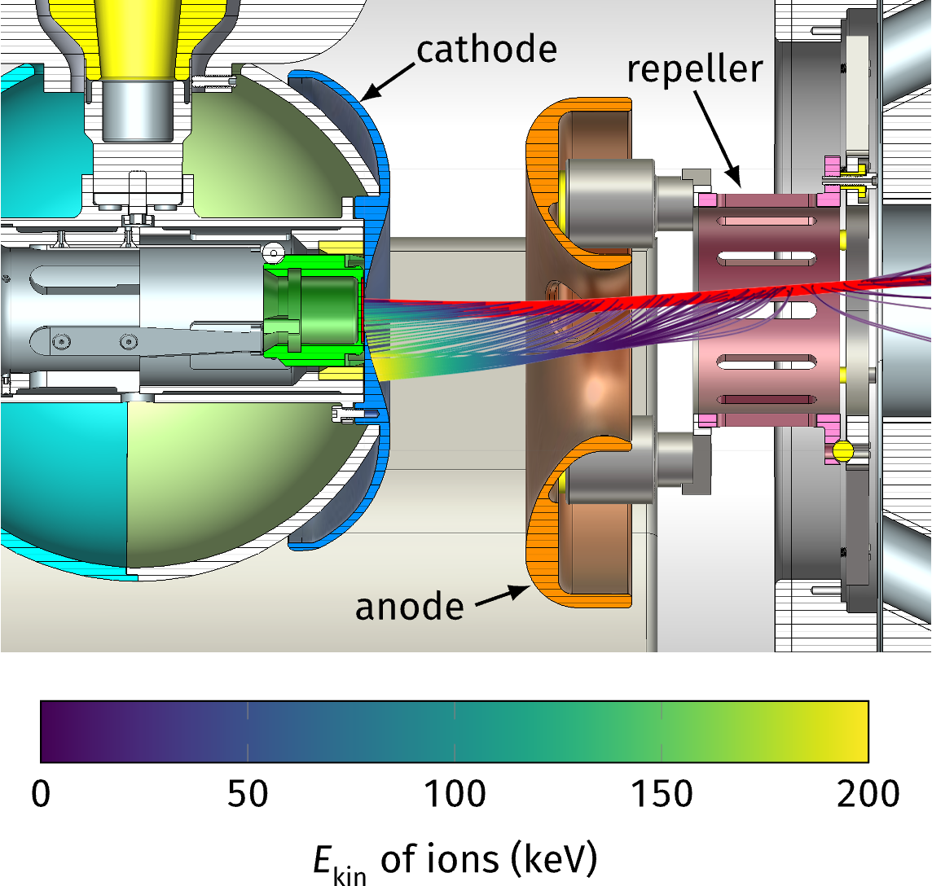
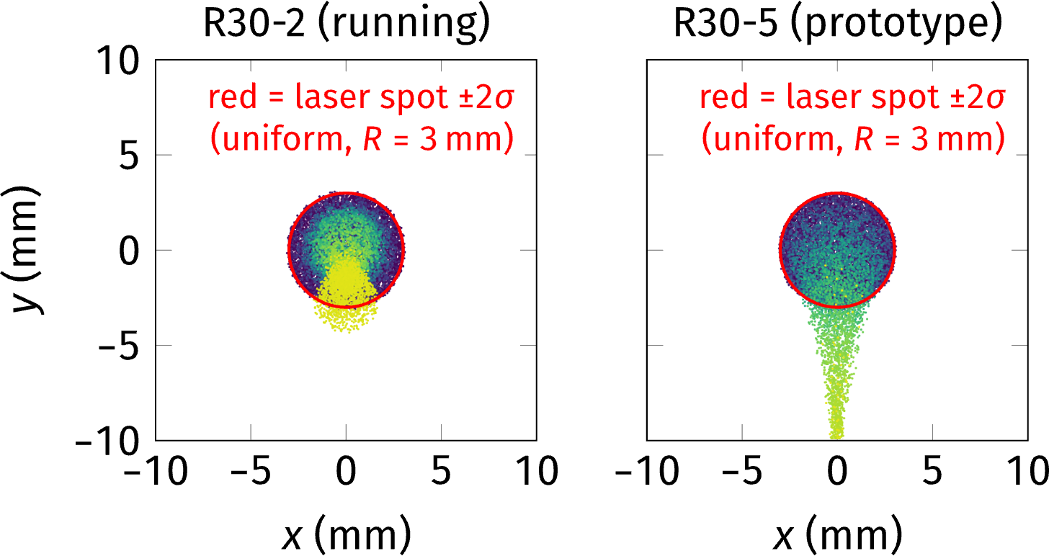
R&D strategy
Begin operating with SSL DBR photocathodes
Build a gun designed to minimize ion-back bombardment
Use lower out-gassing materials
The research described in these slides was conducted under the Laboratory Directed Research and Development Program at Thomas Jefferson National Accelerator Facility for the U.S. Department of Energy.
JLab LDRD: M. Bruker, “A high-intensity, polarized-beam prototype photogun for the Ce+BAF positron source”
Prototype design for an ion-resistant gun
Driven by combined beam/ion simulations (CST/GPT/IONATOR)
(J. T. Yoskowitz et al., Proc. IPAC'21 (2021), p. 2843)
Dilute low-energy ions by maximizing beam size
-> large active area, homogeneously emitting
Keep high-energy ions out of the active area
-> shifted anode adds a deflecting field, no off-center emission
(O. Rahman et al., PRAB 22 (2019), p. 083401)
-> potential barrier (“repeller”) rejects downstream ions
(J. T. Yoskowitz et al., PRAB 27 (2024), p. 123401)
Low-aberration field design to support a large, strongly bent beam
(W. Peter, M. Jones, Particle Accelerators 24 (1989), p. 231)
Notes:
Guidelines: 6-8 bullets per slide; Use sentence fragments for bullets
To change the photo: Right-click on photo and select change photo

Slide 11
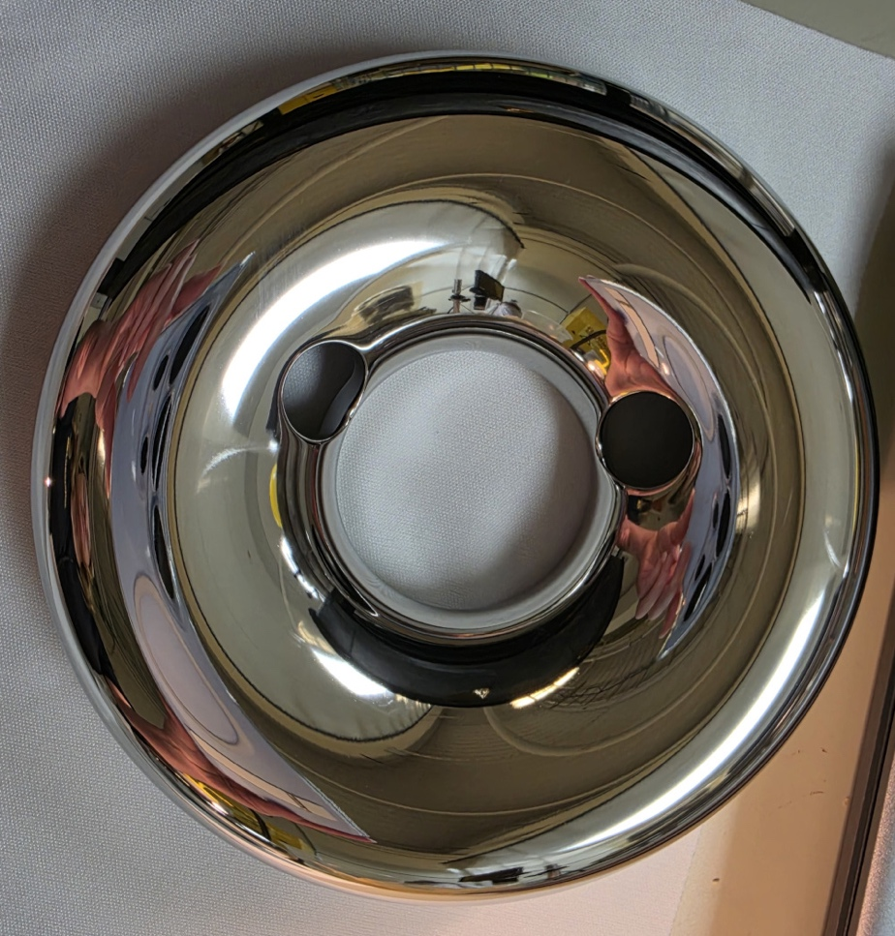
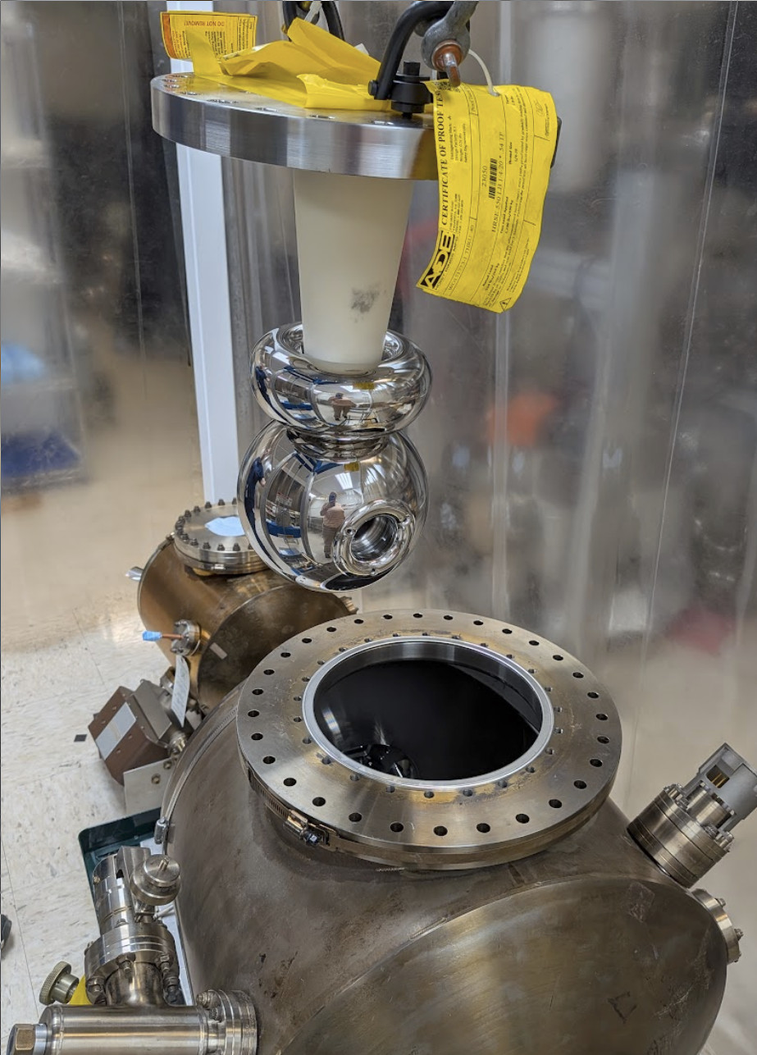
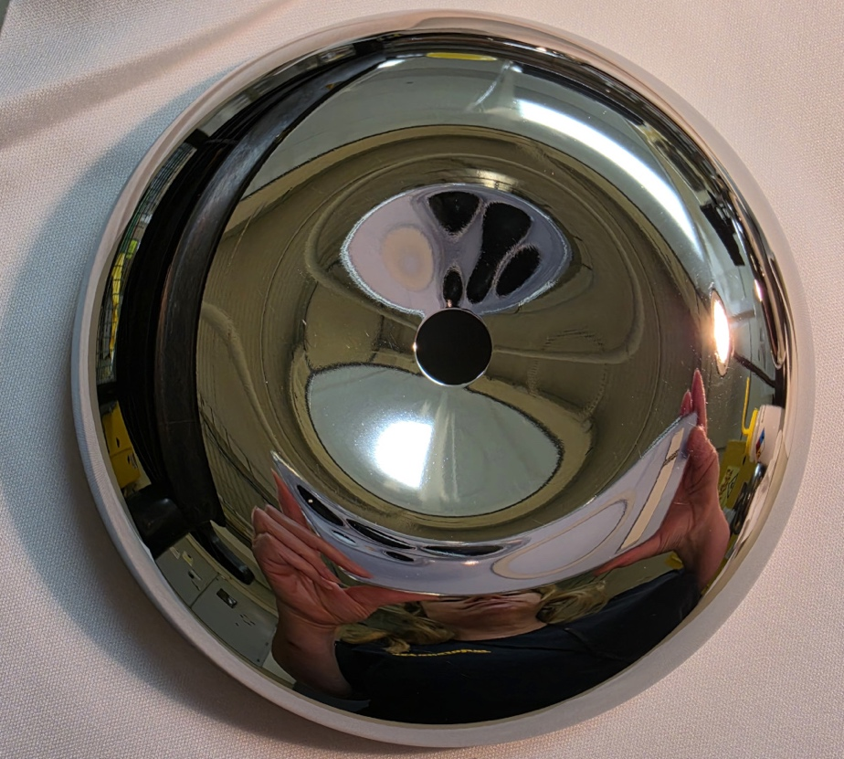
R&D strategy
Begin operating with SSL DBR photocathodes
Build a gun designed to minimize ion-back bombardment
Use lower out-gassing materials
The research described in these slides was conducted under the Laboratory Directed Research and Development Program at Thomas Jefferson National Accelerator Facility for the U.S. Department of Energy.
Gun rebuild in progress
Re-using components from 300 kV prototype gun
at Jefferson Lab's Gun Test Stand (GTS)
(S. Wijethunga et al., Rev. Sci. Instr. 93 (2022), p. 073303)
Electrode fabrication finished
Ready to re-assemble and integrate into GTS in early 2027
Ion damage measurements
Verify & calibration simulation models: spatially resolved QE loss shows ion deflection
Parametric studies: charge lifetime vs. emission area,
operating voltage, beam current
Objective is to demonstrate > 1000 C charge lifetime at 1 mA
(DBR SSL, 780 nm)
14 cm
Top: anode; bottom: cathode
JLab LDRD: M. Bruker, “A high-intensity, polarized-beam prototype photogun for the Ce+BAF positron source”
Notes:
Guidelines: 6-8 bullets per slide; Use sentence fragments for bullets
To change the photo: Right-click on photo and select change photo

Slide 12
R&D strategy
Begin operating with SSL DBR photocathodes
Build a gun designed to minimize ion-back bombardment
Use lower out-gassing materials
H₂ outgassing rate
2,300× lower
Aiman Al-Allaq, “Ultra-High Vacuum Outgassing Characterization of Thermally Processed Low-Carbon Steel for Advanced Particle Accelerator and Gravitational Wave Detector Applications”
Baseline
Activation energy Eₐ (kJ/mol)
27.0
62.3
Post Bake gas purity (%)
>99% H₂
~60% H₂
Stainless: 316L (FCC)
Relative material cost
5–10× cheaper
Low Carbon: AISI 1020 (BCC)
Baseline
BCC crystal structure → faster H₂ diffusion, lower trapping energy
GWD collaboration identified 1020 as the leading candidate for the beampipe
Magnetic property beneficial for JLab photogun (shields photocathode)
316L — FCC unit cell
AISI 1020 — BCC unit cell
H trapped
(octahedral site)
H diffuses
(tetrahedral site)
Notes:
Guidelines: 6-8 bullets per slide; Use sentence fragments for bullets
To change the photo: Right-click on photo and select change photo

Slide 13
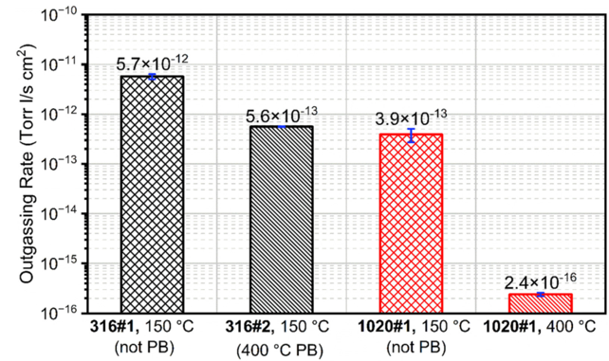
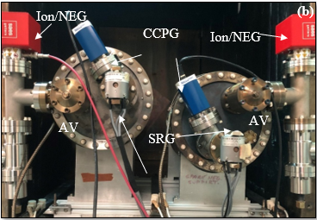
R&D strategy
Begin operating with SSL DBR photocathodes
Build a gun designed to minimize ion-back bombardment
Use lower out-gassing materials
A. H. Al-Allaq, Md A. Mamun, M. Poelker, and A. Elmustafa, J. Vac. Sci. Technol. B 43, 034203 (2025)
Next Steps
Fabricate an all–low-carbon-steel photogun chamber
Fabricate low-carbon steel electrodes – test high voltage performance
MolFlow suggests >800x vacuum improvement (after eliminating 316L stainless steel)
Test performance with specially designed vacuum gauge (if successful, plan a beam test)
Notes:
Guidelines: 6-8 bullets per slide; Use sentence fragments for bullets
To change the photo: Right-click on photo and select change photo

Slide 14
Conclusions
Jefferson Lab is preparing for the long-term MOLLER parity-violation experiment; need to provide 90% polarization at 65 uA with long operational lifetime.
Users are motivating a future capability for providing positron beams for nuclear physics; more recently there is interest to develop intense moderated slow-positron beams.
To provide even longer operating lifetime for MOLLER and developing sustainable milliampere polarized beams we have an R&D strategy to innovate the polarized electron source.
Notes:
Guidelines: 6-8 bullets per slide; Use sentence fragments for bullets
To change the photo: Right-click on photo and select change photo

