Slide 1
BriXSinO and
Photocathode Development
D. Sertore
INFN Milano – LASA
On Behalf of
Photocathode Group
HB²TF Group

Slide 2
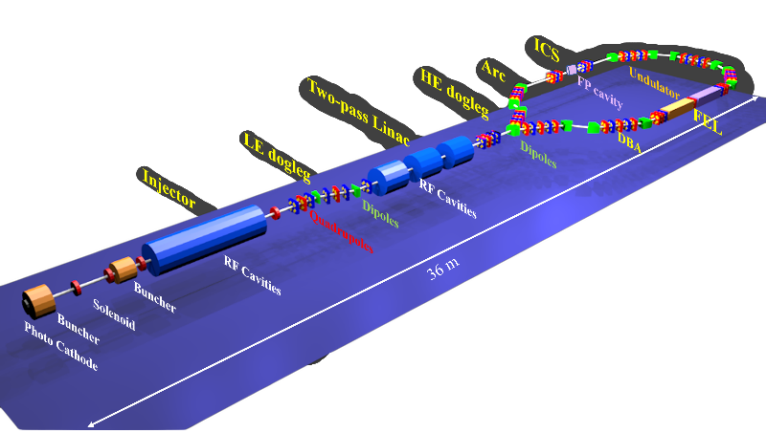

BriXSinO Project
Brilliant Source of X-Rays Based on Sustainable and Innovative Accelerators

Slide 3
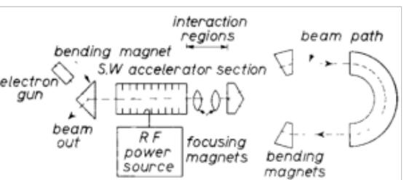
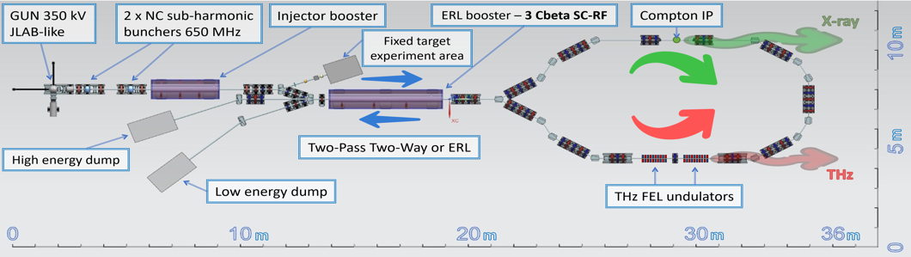
BriXSinO Principle of Operation
A “newly” conceived scheme of ERL with counter propagating beams is proposed in BriXSinO.
This scheme allows:
  ERL operation
    Inverted Compton Scattering (ICS)
    THz FEL
  Two-pass operation: the beam is
  reaccelerated when reinjected in the accelerating module (low current)
BriXSinO will act as test facility for fundamental questions of
accelerator physics and strategies of Dynamics and Energetic
by hosting experiments for maximizing the energy sustainability and
minimizing the AC power consumption.
Moreover, it will work as user facility by providing large quality
coherent THz and X-Rays emission from its high brightness
accelerated electron beam, enabling important and advanced applications.
Parameter | two-pass acc. | ERL
Energy (MeV) | 80 | 45
Bunch charge (pC) | 100 | 100
Repetition rate (MHz) | 0.9286 | 92.86
Average Current (mA) | 5 10⁻³ | 5
Beam power @ dump (W) | 22.5 10³ | 400
e^{n}_{x,y} (mm − mrad) | < 1.6 | < 1.6
Energy spread (%) | < 0.2 | < 0.2

Slide 4
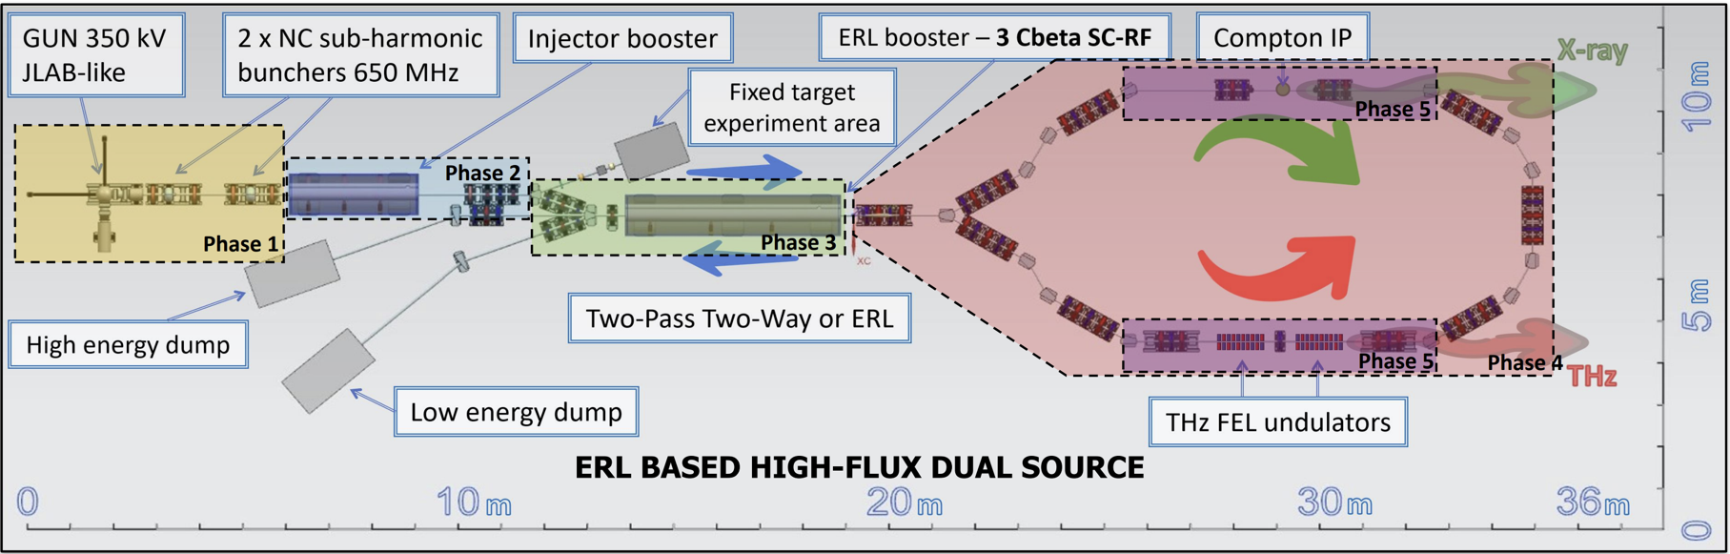
BriXSinO foreseen Schedule
BriXSinO evolution is based on five Phases approach; the completion of one phase leads to a discussion about the next phase.

Slide 5
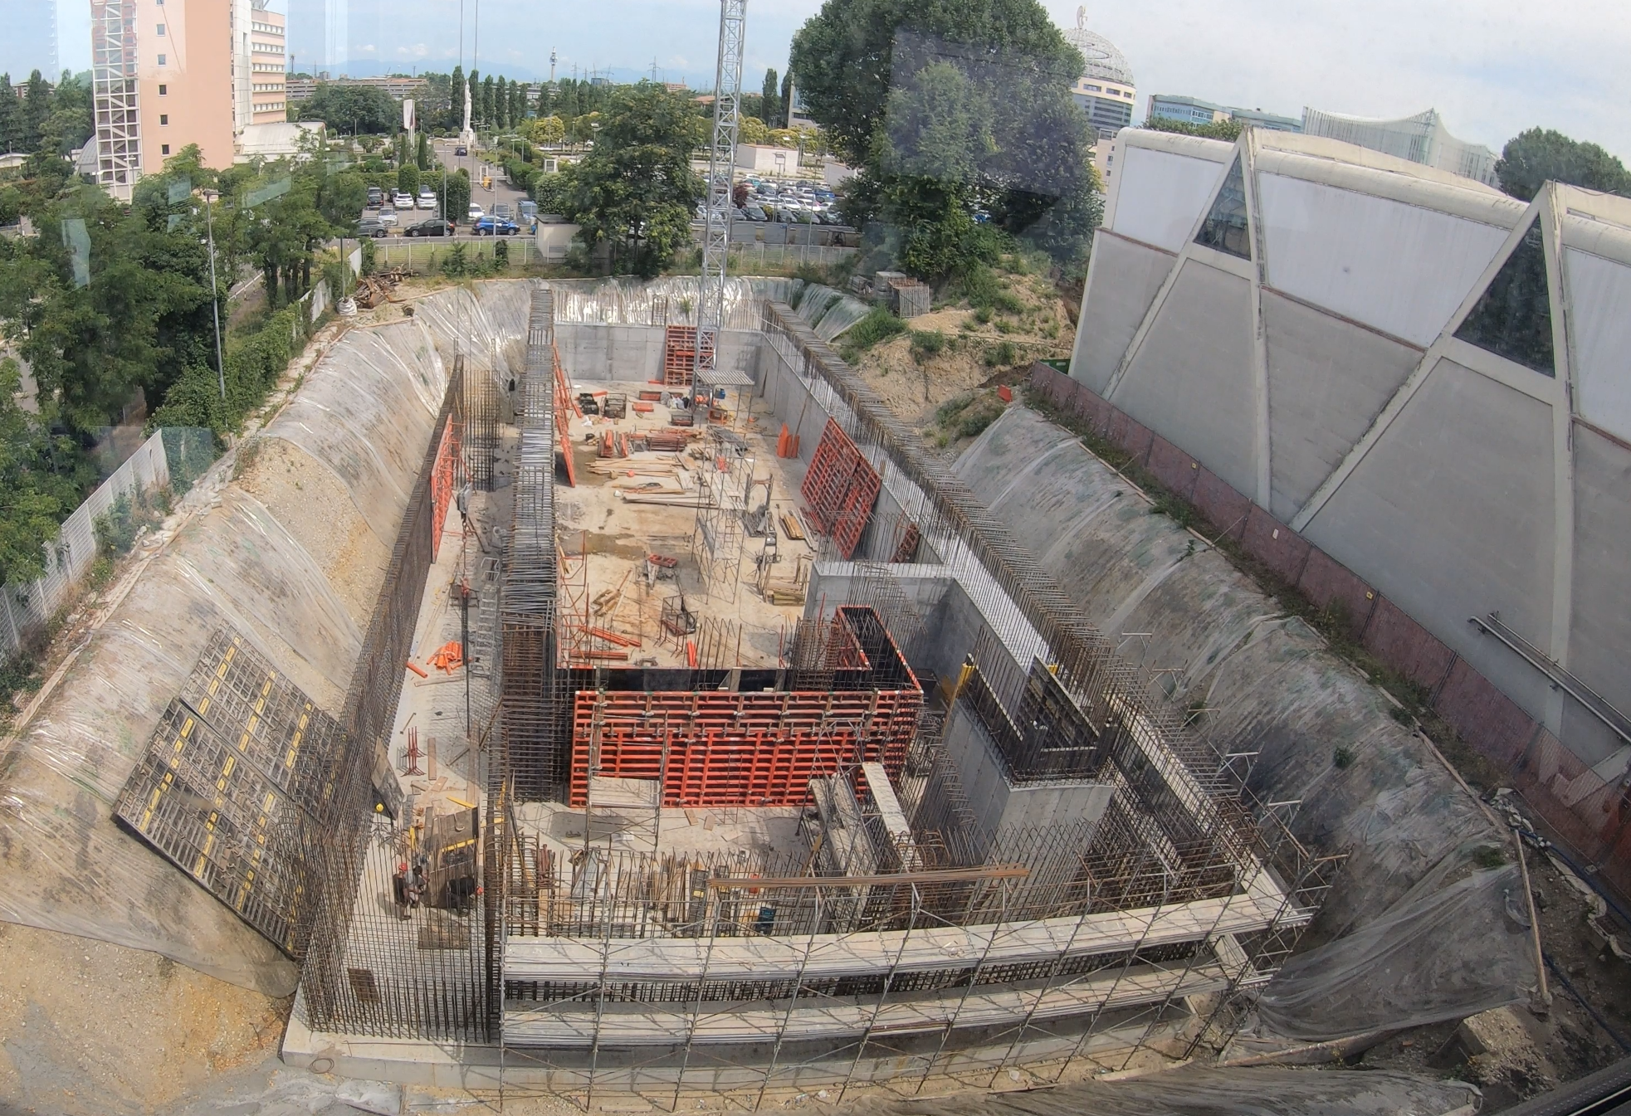
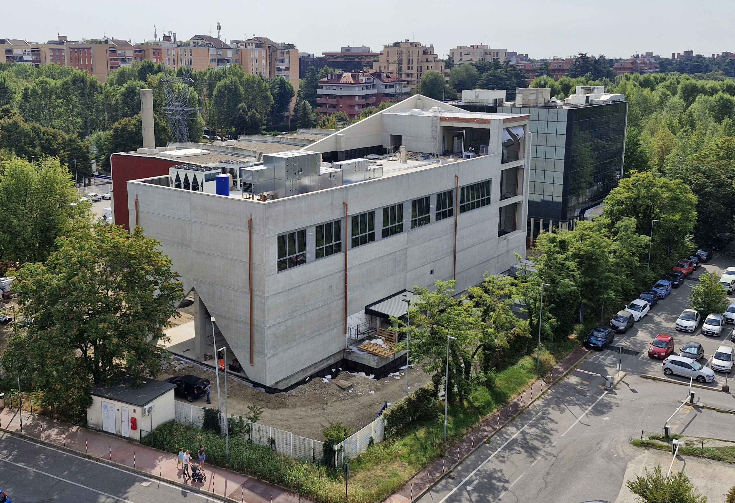
Civil Engineering Status
2025
2026

Slide 6
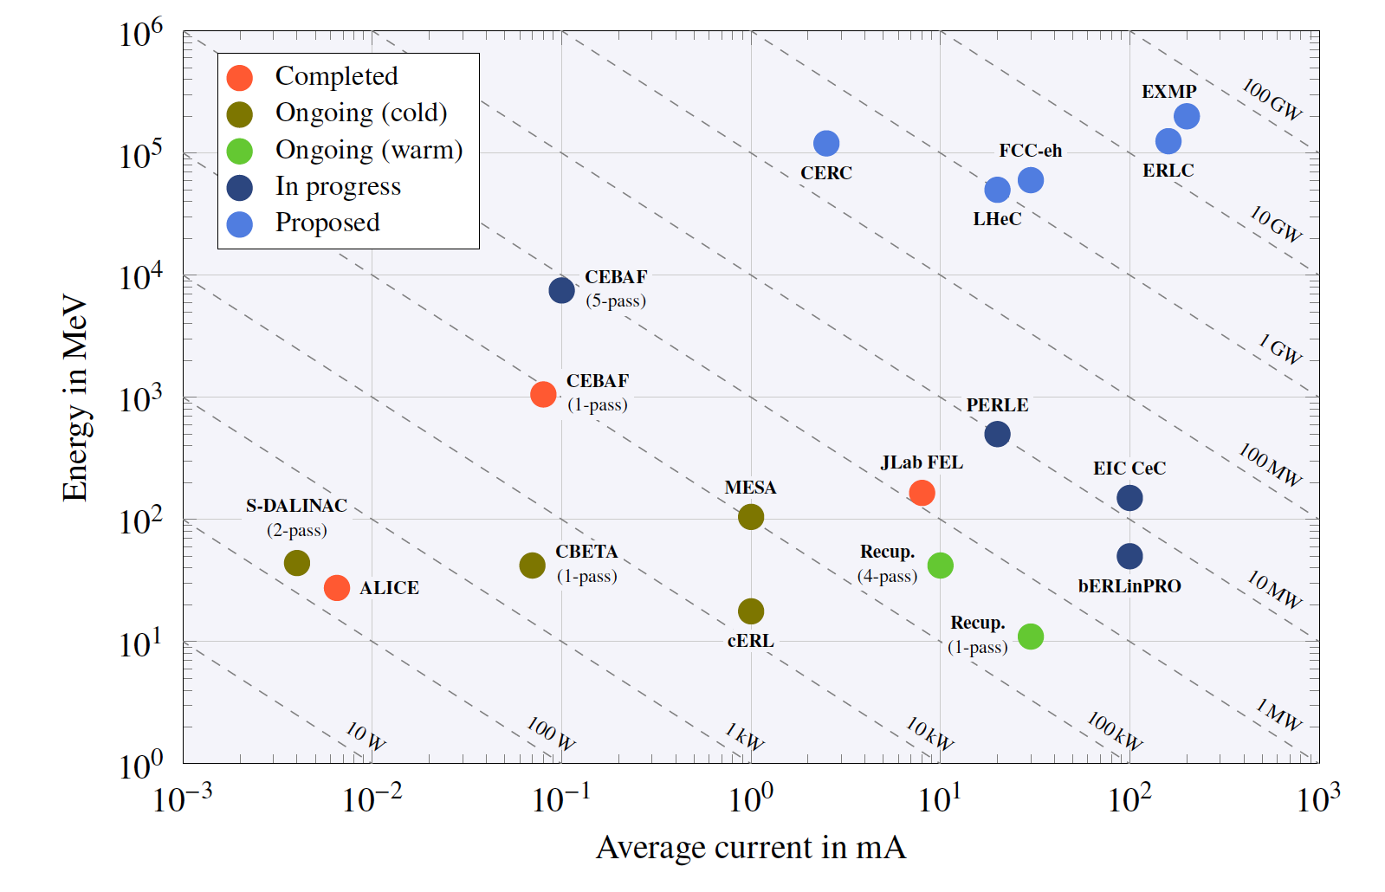
Overview of ERL Facilities
BriXSinO
BriXSinO
45 MeV@5 mA
225 kW 50% efficiency
Costs
The Development of Energy-Recovery Linacs – C. Adolphsen et al.
Technology

Slide 7
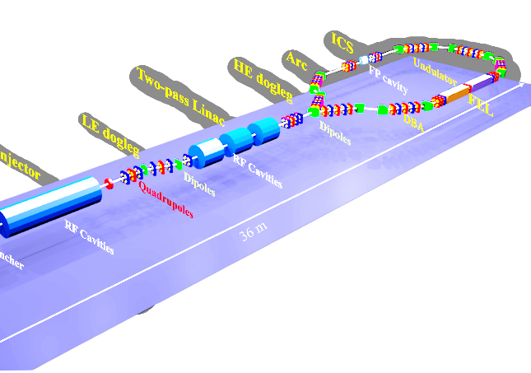

HB²TF : BriXSinO Phase One
High Brightness Beam Test Facility

Slide 8
HB²TF in a nutshell
The HB²TF project aims to provide a high power and high brightness CW beam. The beam will provide different bunch charges at different repetition rate and energies.
Moreover, BriXSinO injector might be used for:
  Fixed target experiments performed with maximum electron energy of 10 MeV and
  5 mA average current.
  Experiments of flash therapy (total charge in a 200 ms time interval up to 1 mC)
  Bremsstrahlung photons with energy peaked at 7 - 8 MeV at an impressive flux of 10¹⁶ photons/s (i.e. up to 30 kW X-Ray beam).
  Positronium generation for fundamental studies of matter-antimatter asymmetry can be conducted at this test station.
Electron Source
First acceleration stage
Beam manipulation stage
Photocathode
DC Gun
Bunchers and solenoids

Slide 9
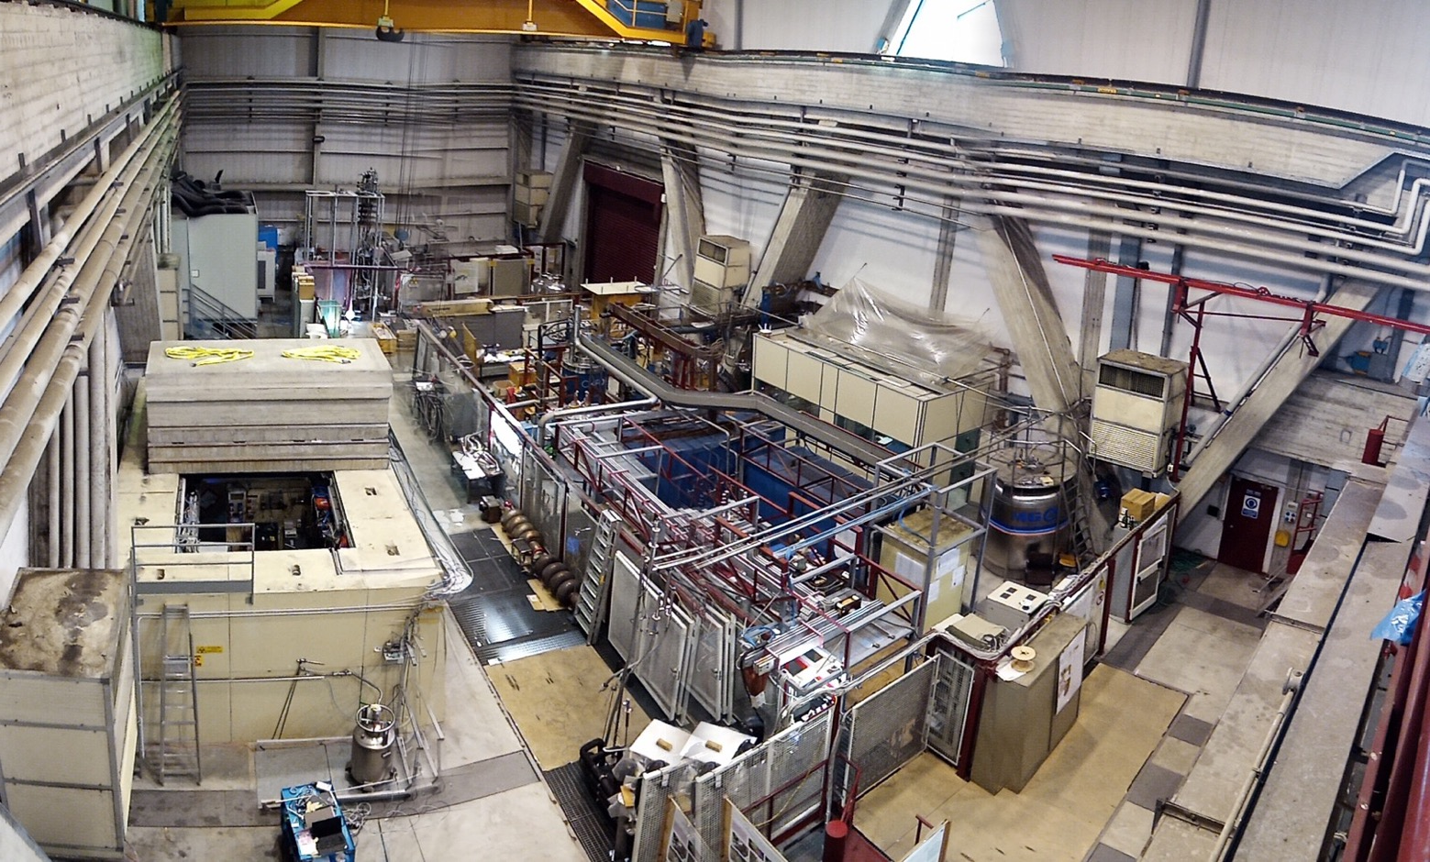


HB²TF at INFN LASA
Clean room
class 100
& HPR
High Brightness Beam Test Facility
UPW production
High field solenoids
SC wire testing area
SCRF cavities
Vertical test area
High current PS
~1MeV
Test Station for long magnets & High Current
He pumping system for subatmospheric op. and
He Recovery balloons

Slide 10
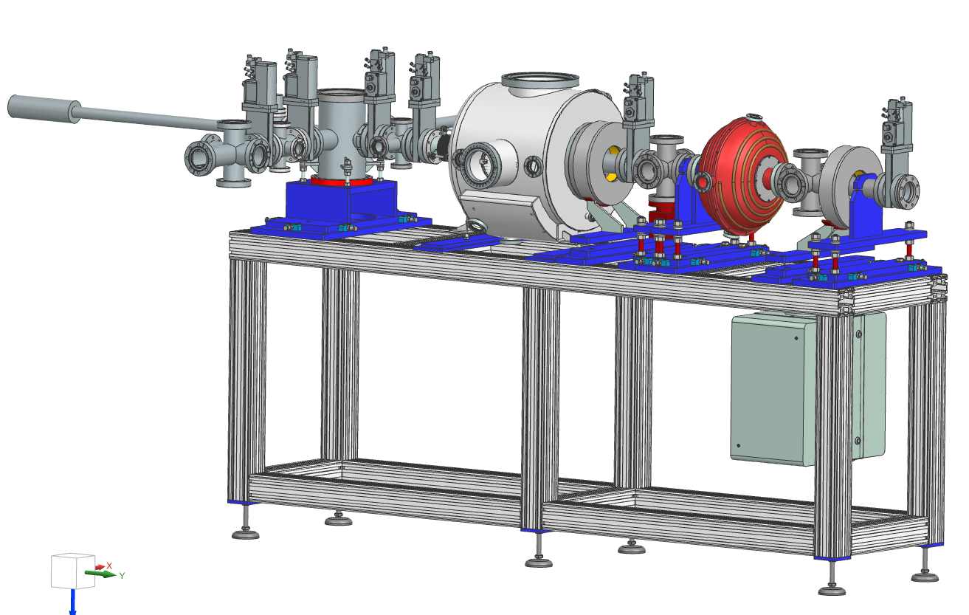
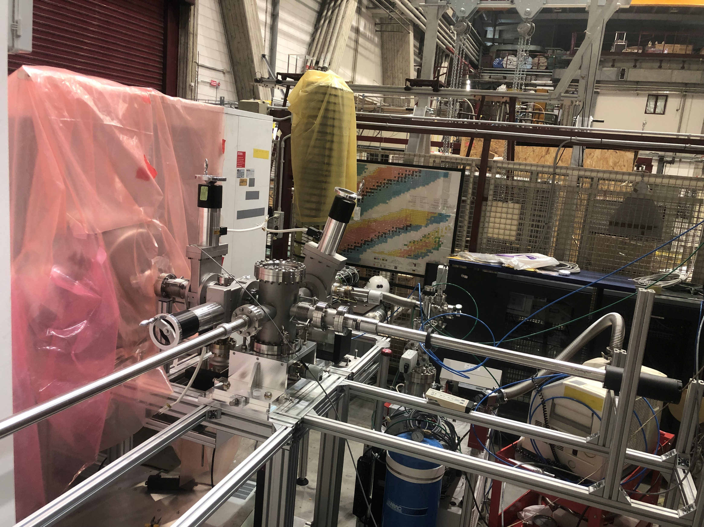
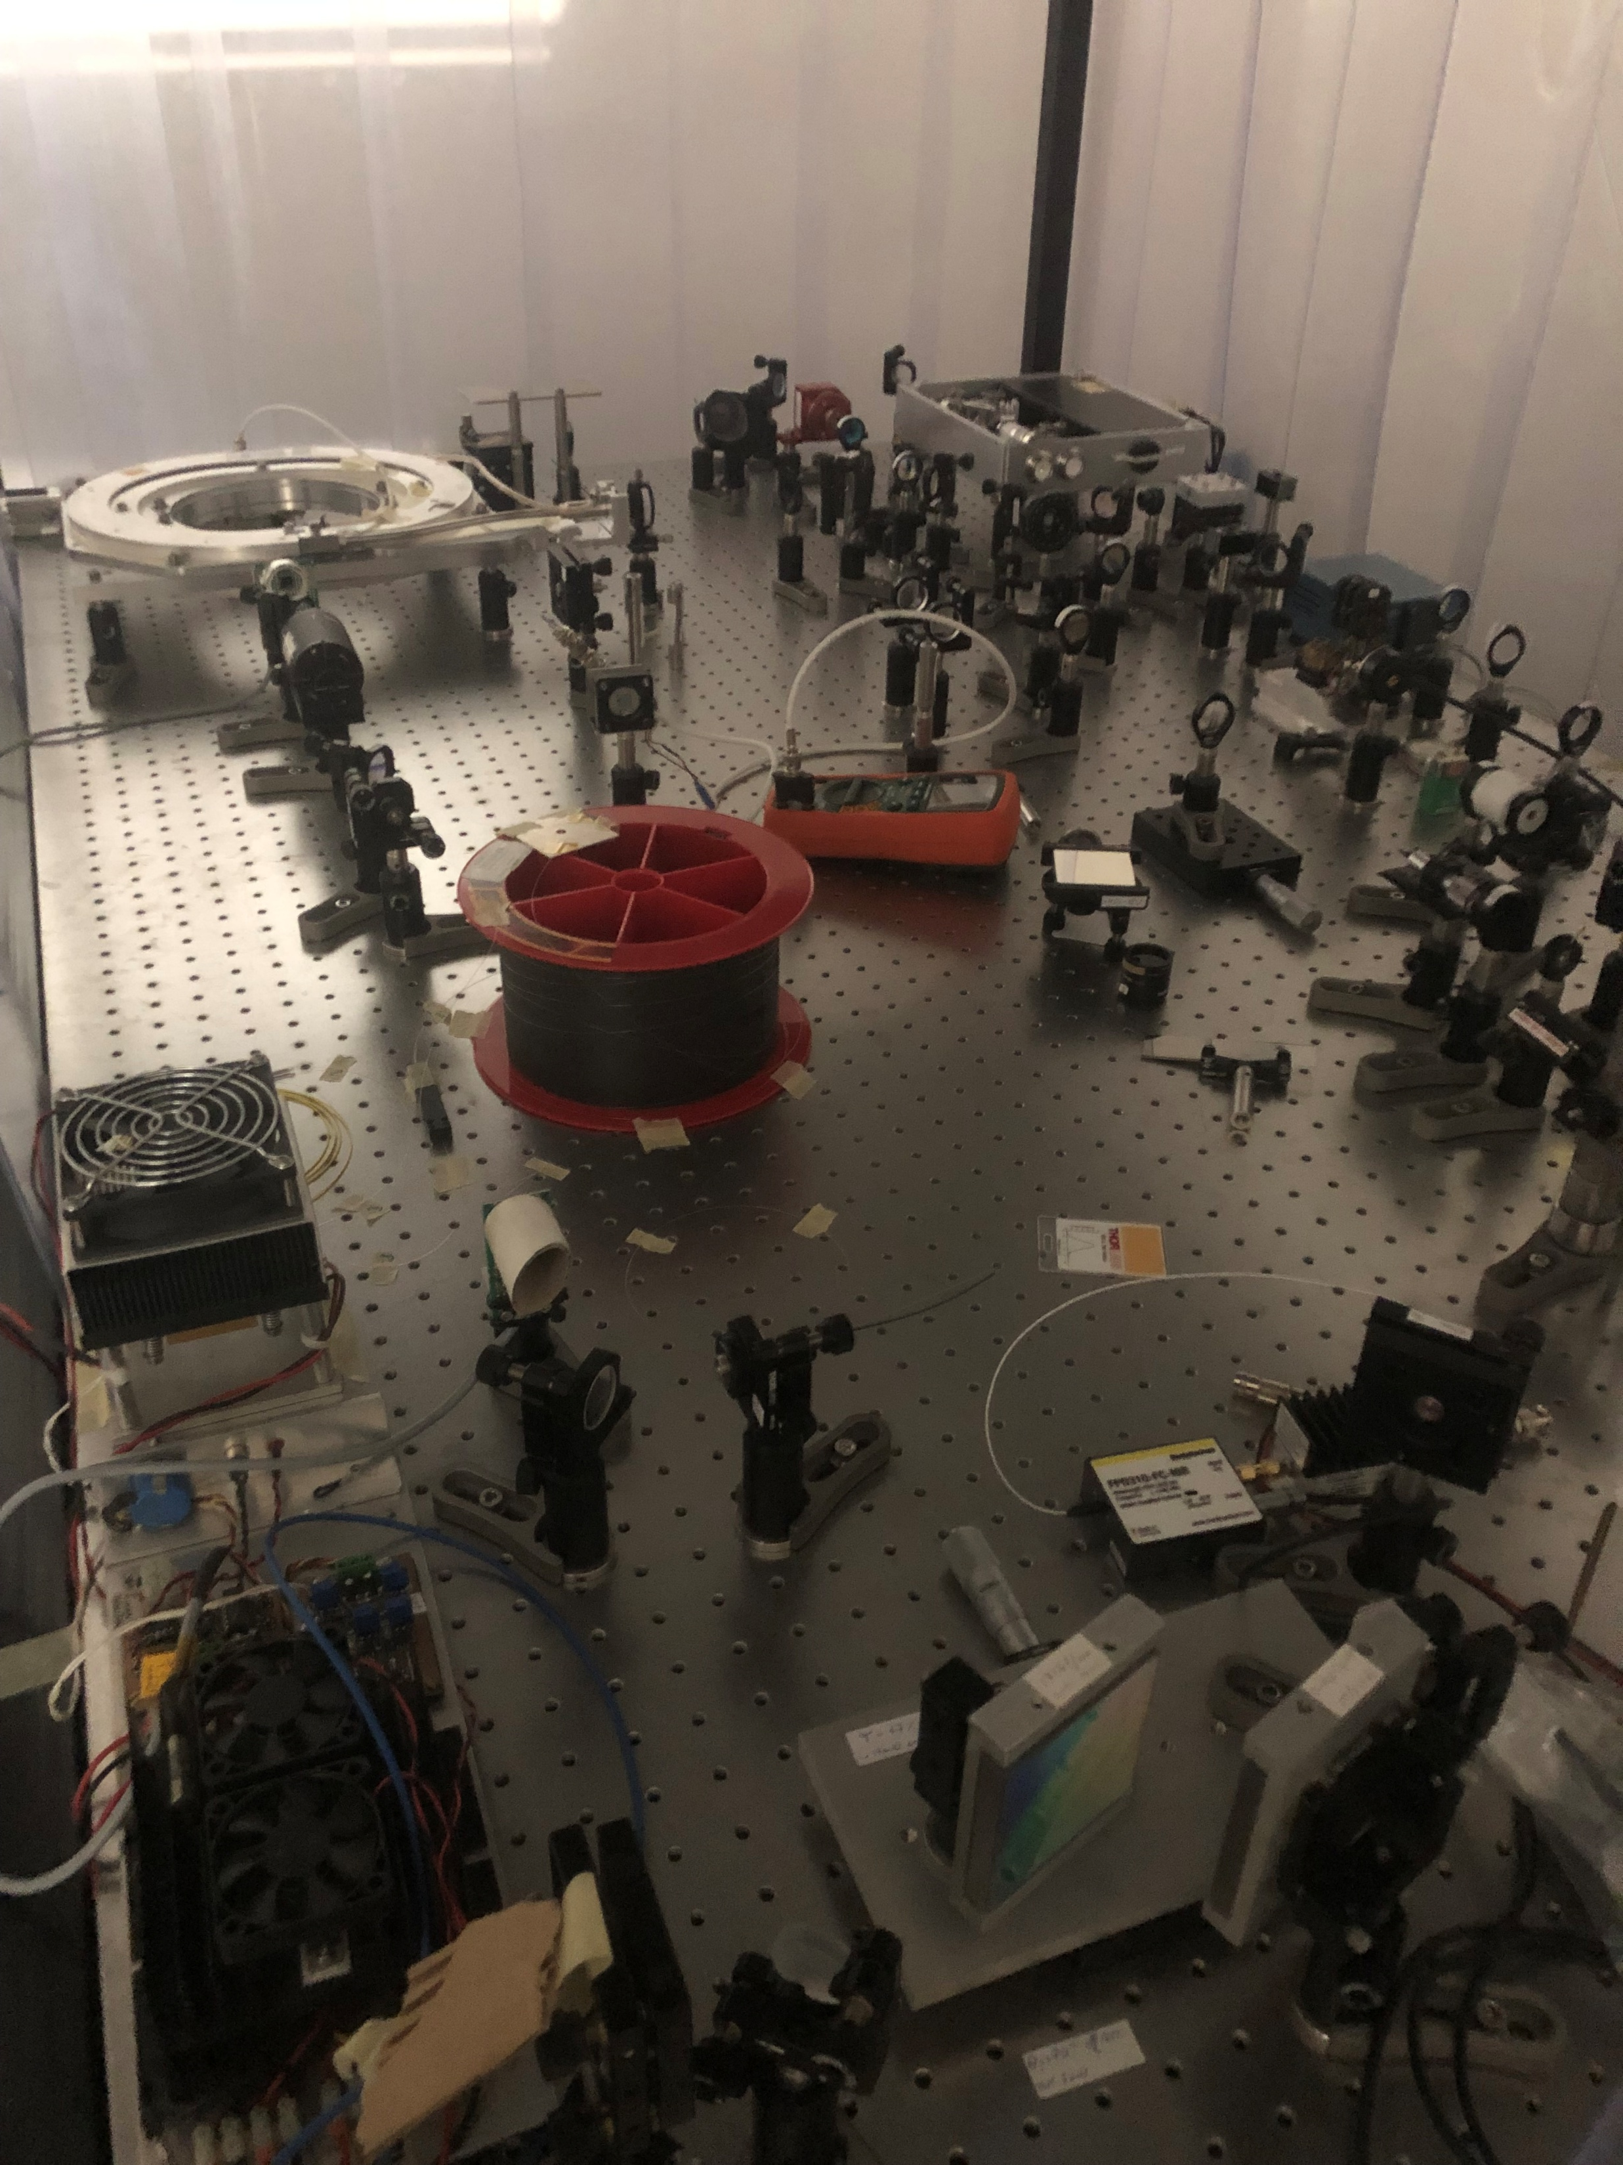
HB²TF Assembly
HB²TF
The facility is on daily evolution
All subsytems are already installed or under final preparation at vendor.
Laser and “INFN” photocathode handling system installed and ready to run
DC Gun
Buncher
“Suitcase”
Photocathode
Transfer Chamber
Solenoids
HB²TF Beam Line
Laser Parameters
Power | Up to 60 W
Wavelength | 258.3 nm
Pulse Length | 440 ps
Rep rate | Up to 100 MHz
Laser Cathode System
Photocathode Handling System

Slide 11
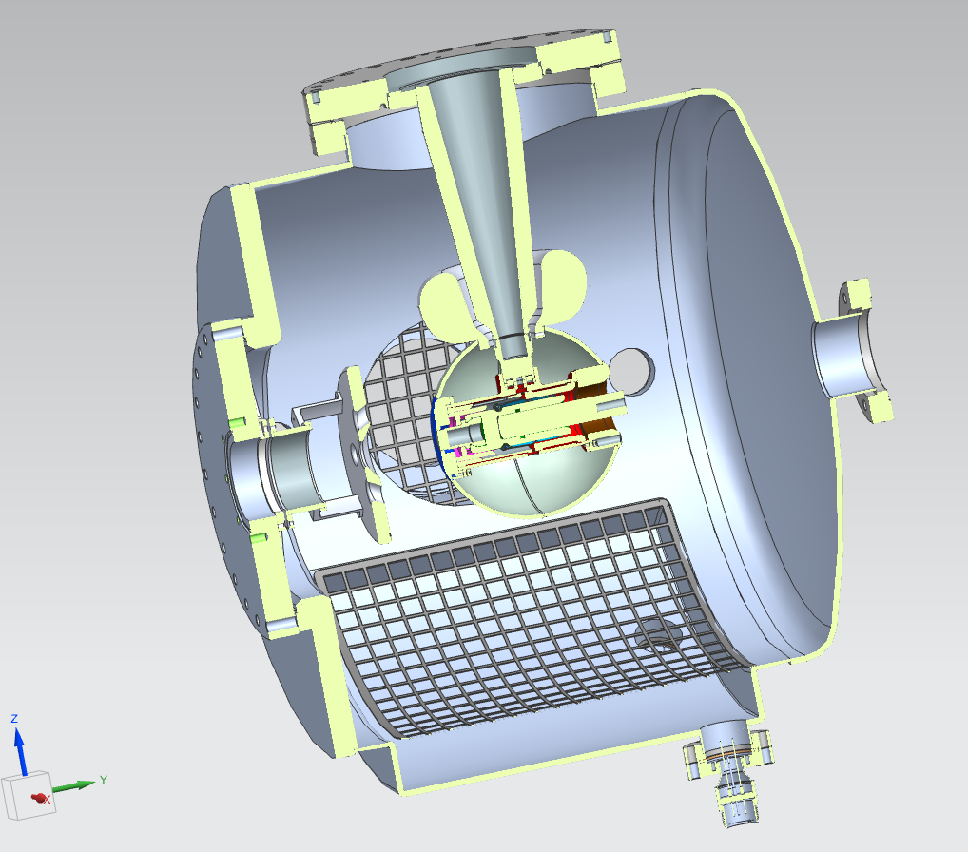
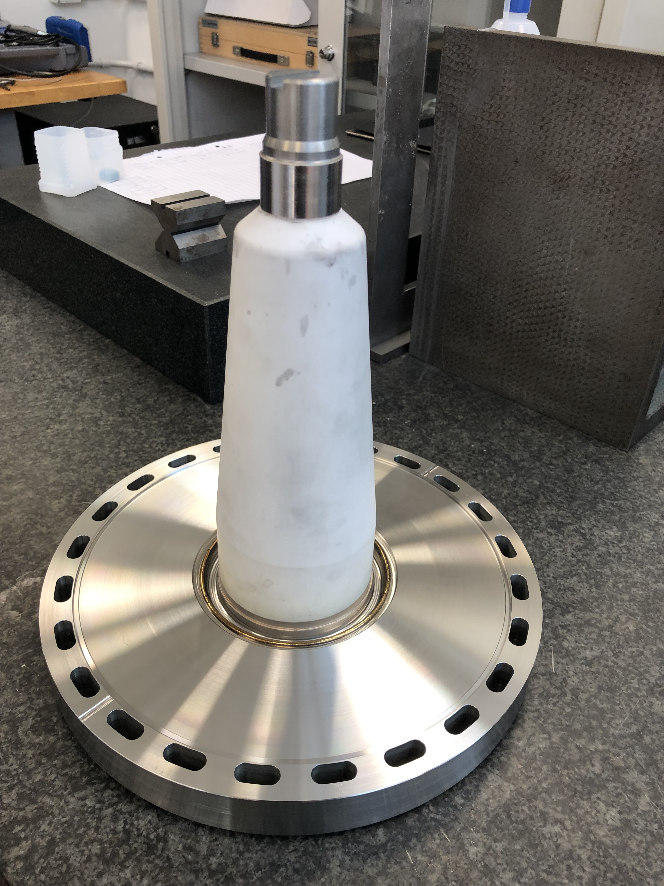
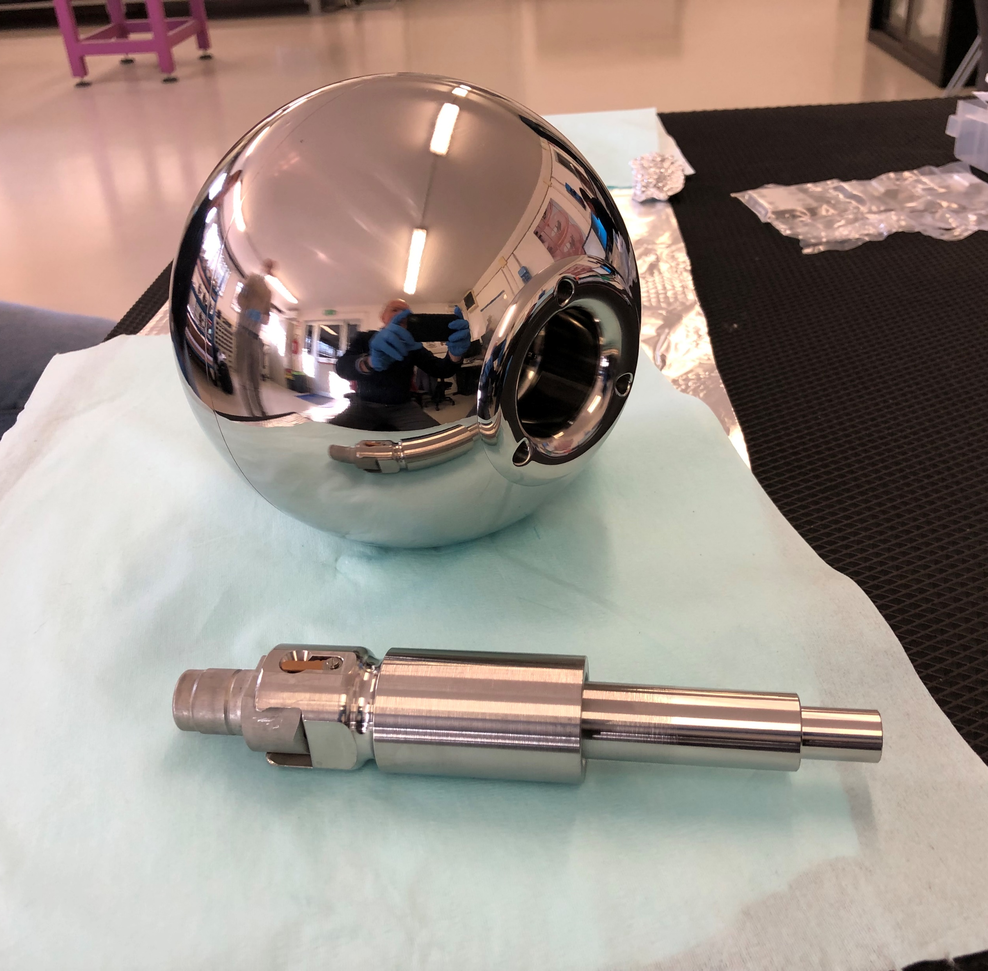
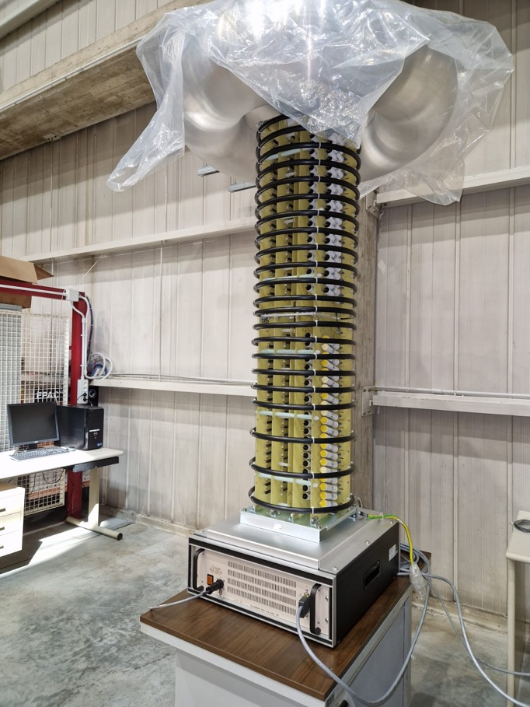
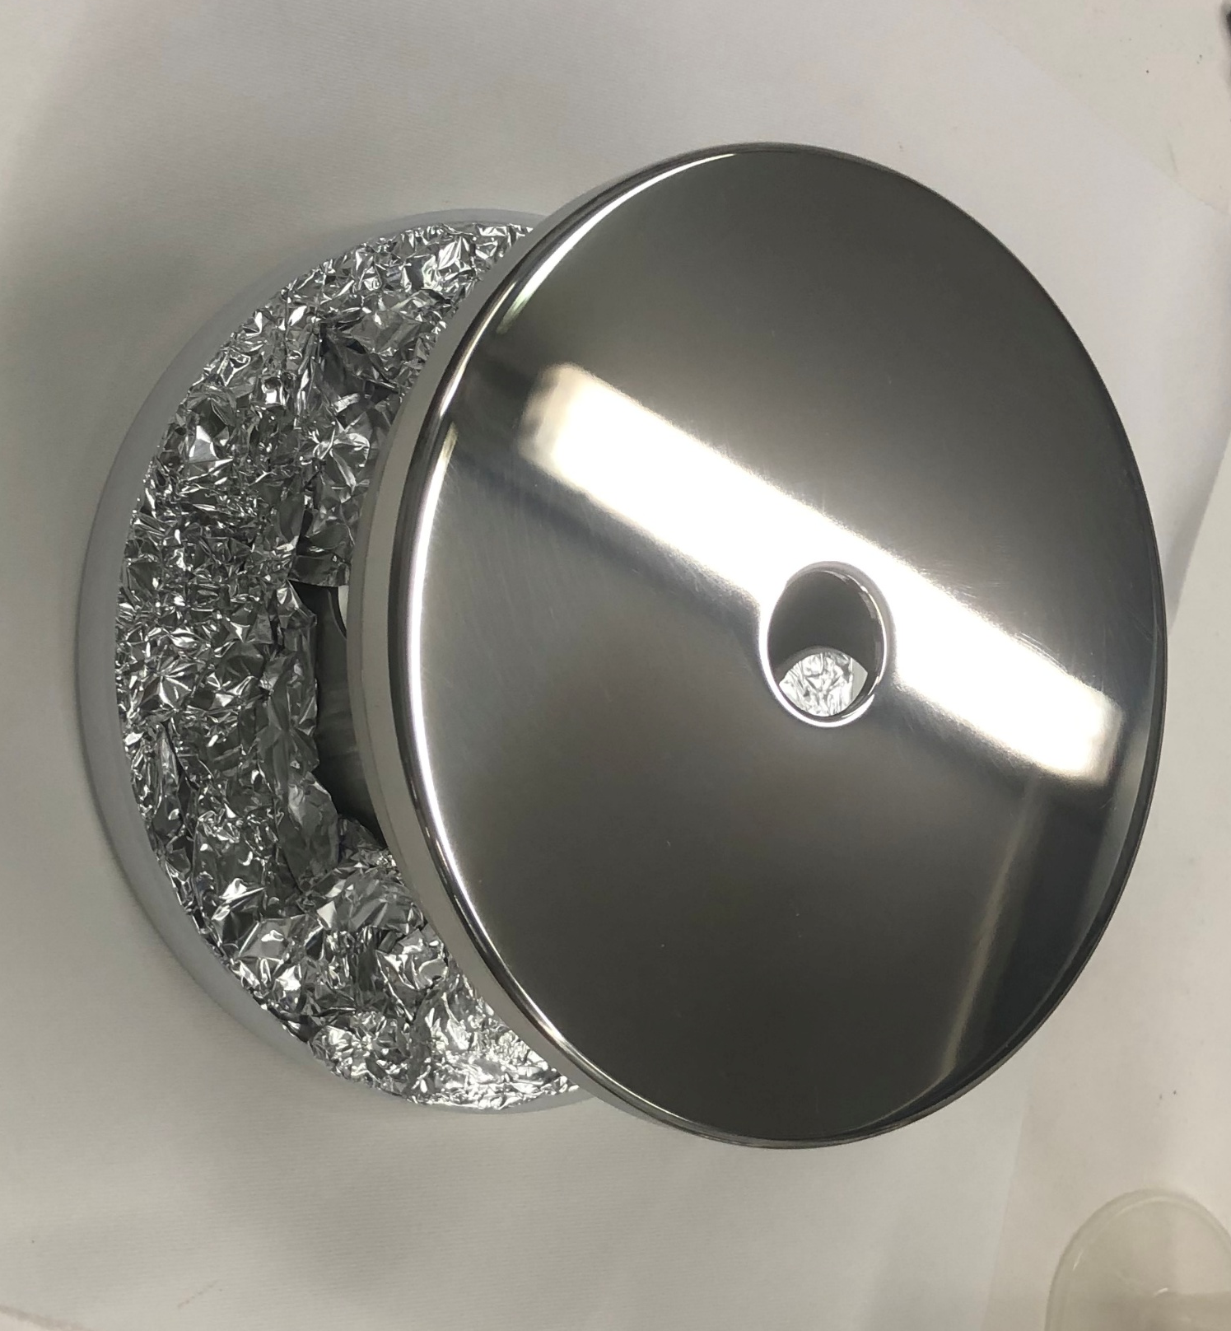
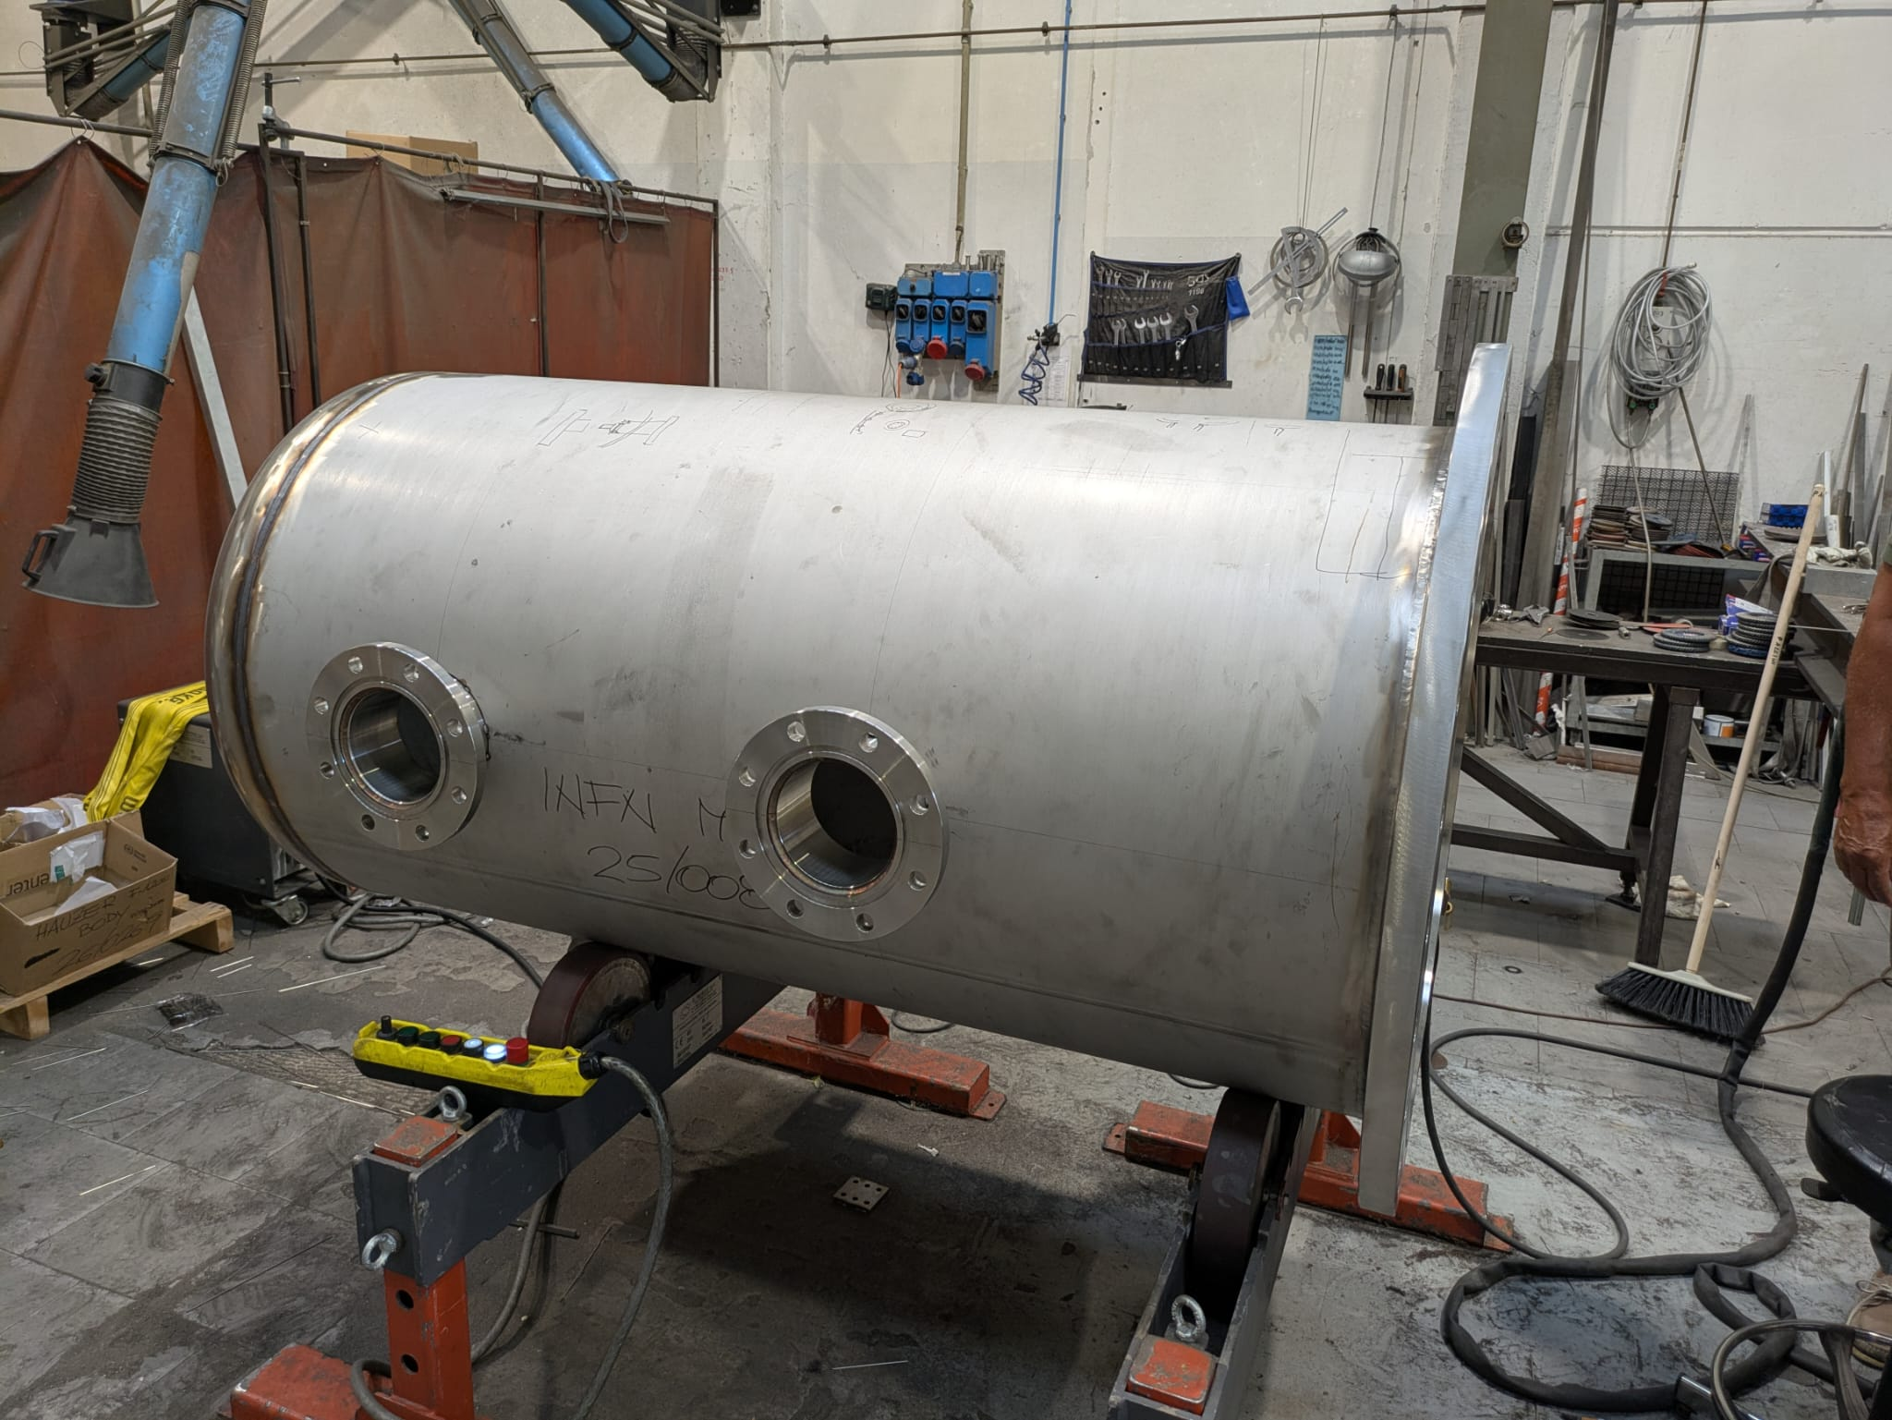
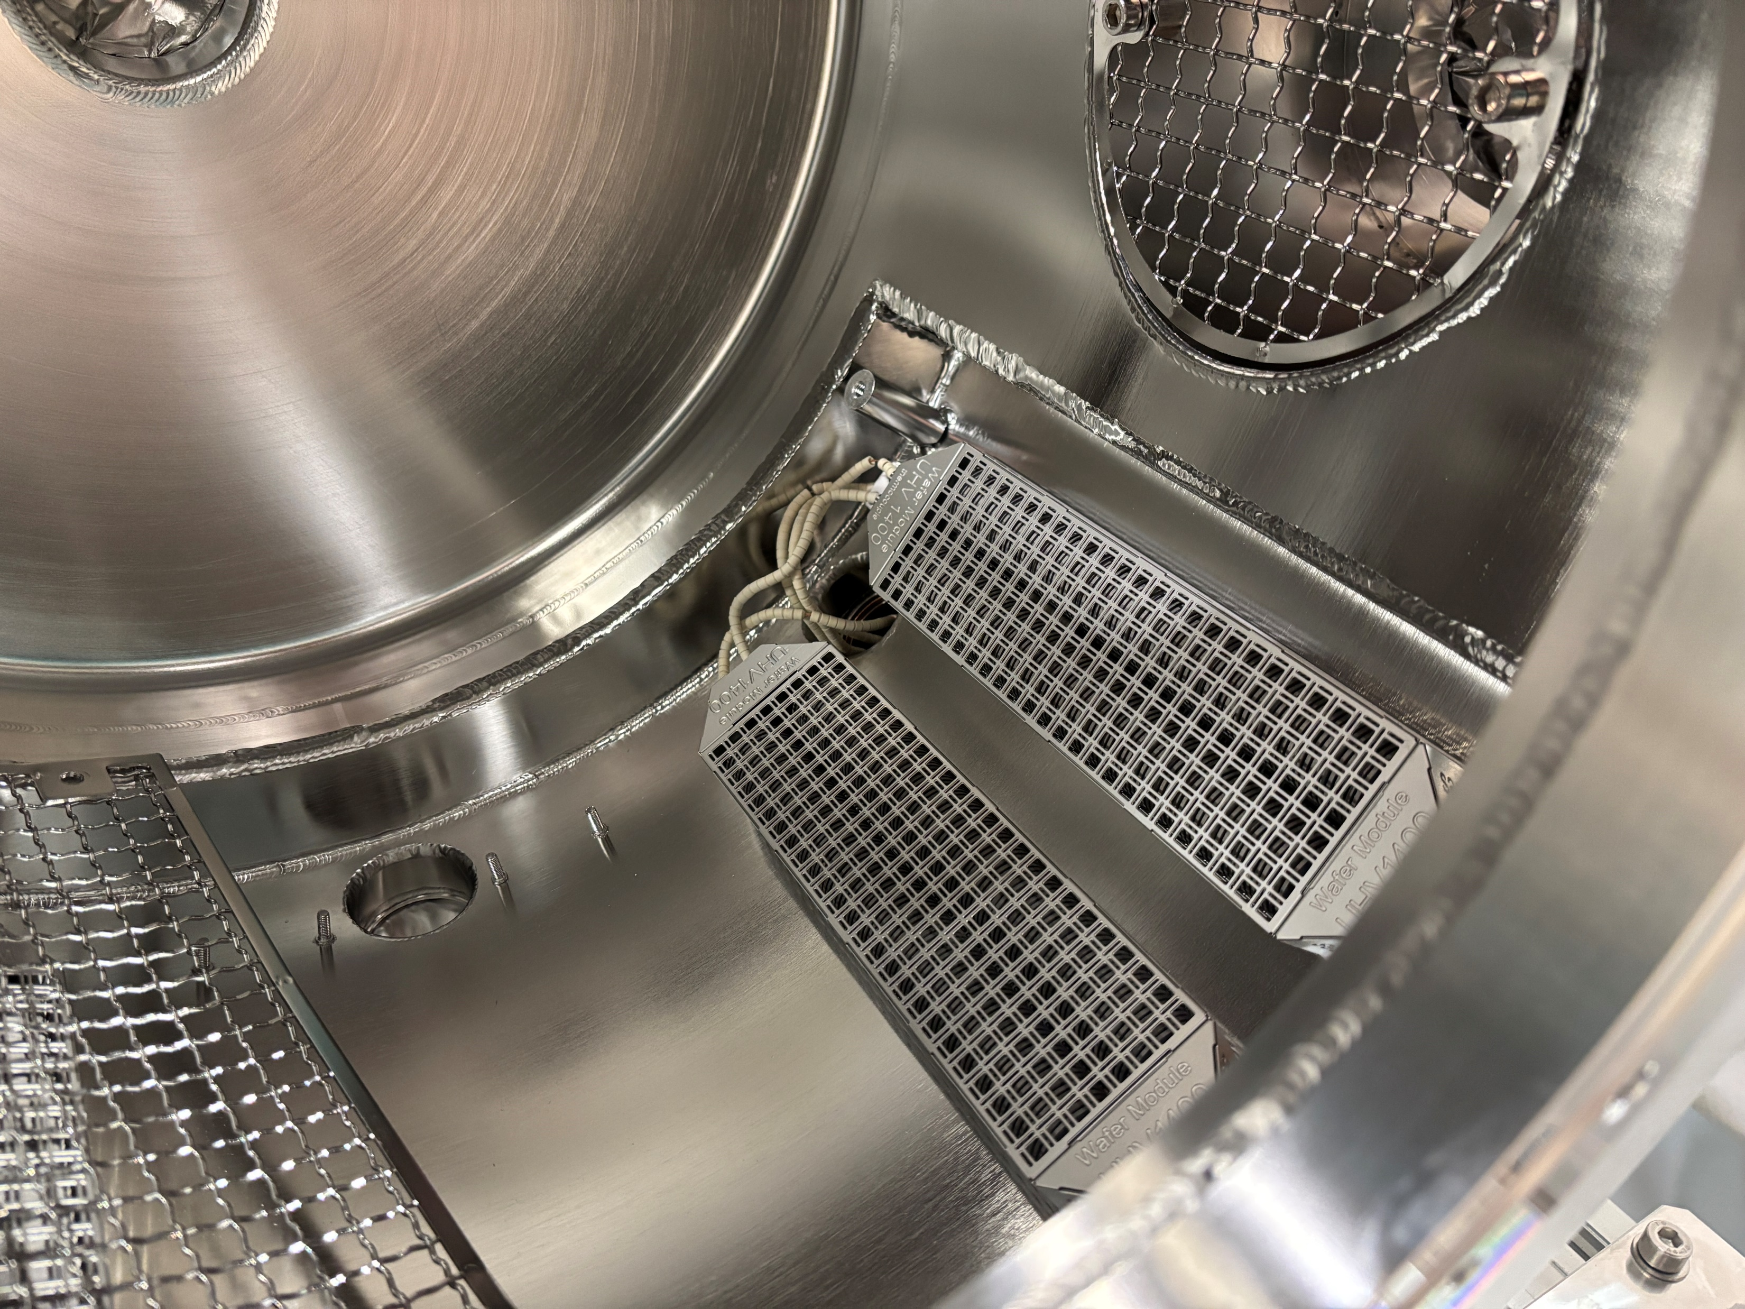
HB²TF Assembly
HB²TF
DC Gun, based on “inverted” insulator, and HV system are under assembly
DC Gun
Buncher
“Suitcase”
HV Insulator
Cathode Sphere
Photocathode
Transfer Chamber
Inverted Insulator
Solenoids
INFN Mo plug
HB²TF Beam Line
Cathode
Anode
DC Gun (inner view)
HV PS @ LASA
-450 kV – 3 mA
NEG modules
N₂ High Pressure Vessel
Courtesy D. Sertore, L. Monaco
11

Slide 12
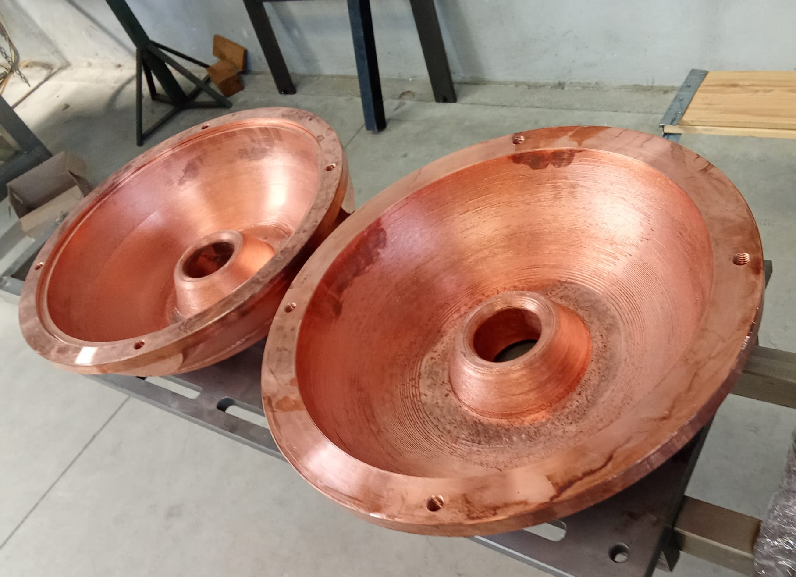
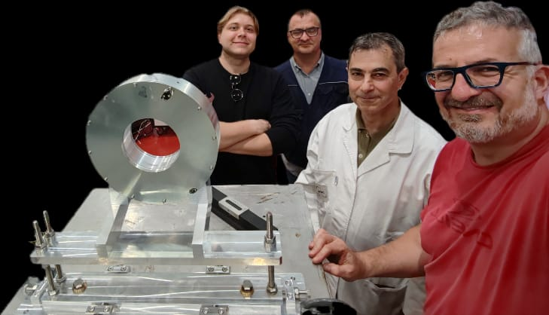
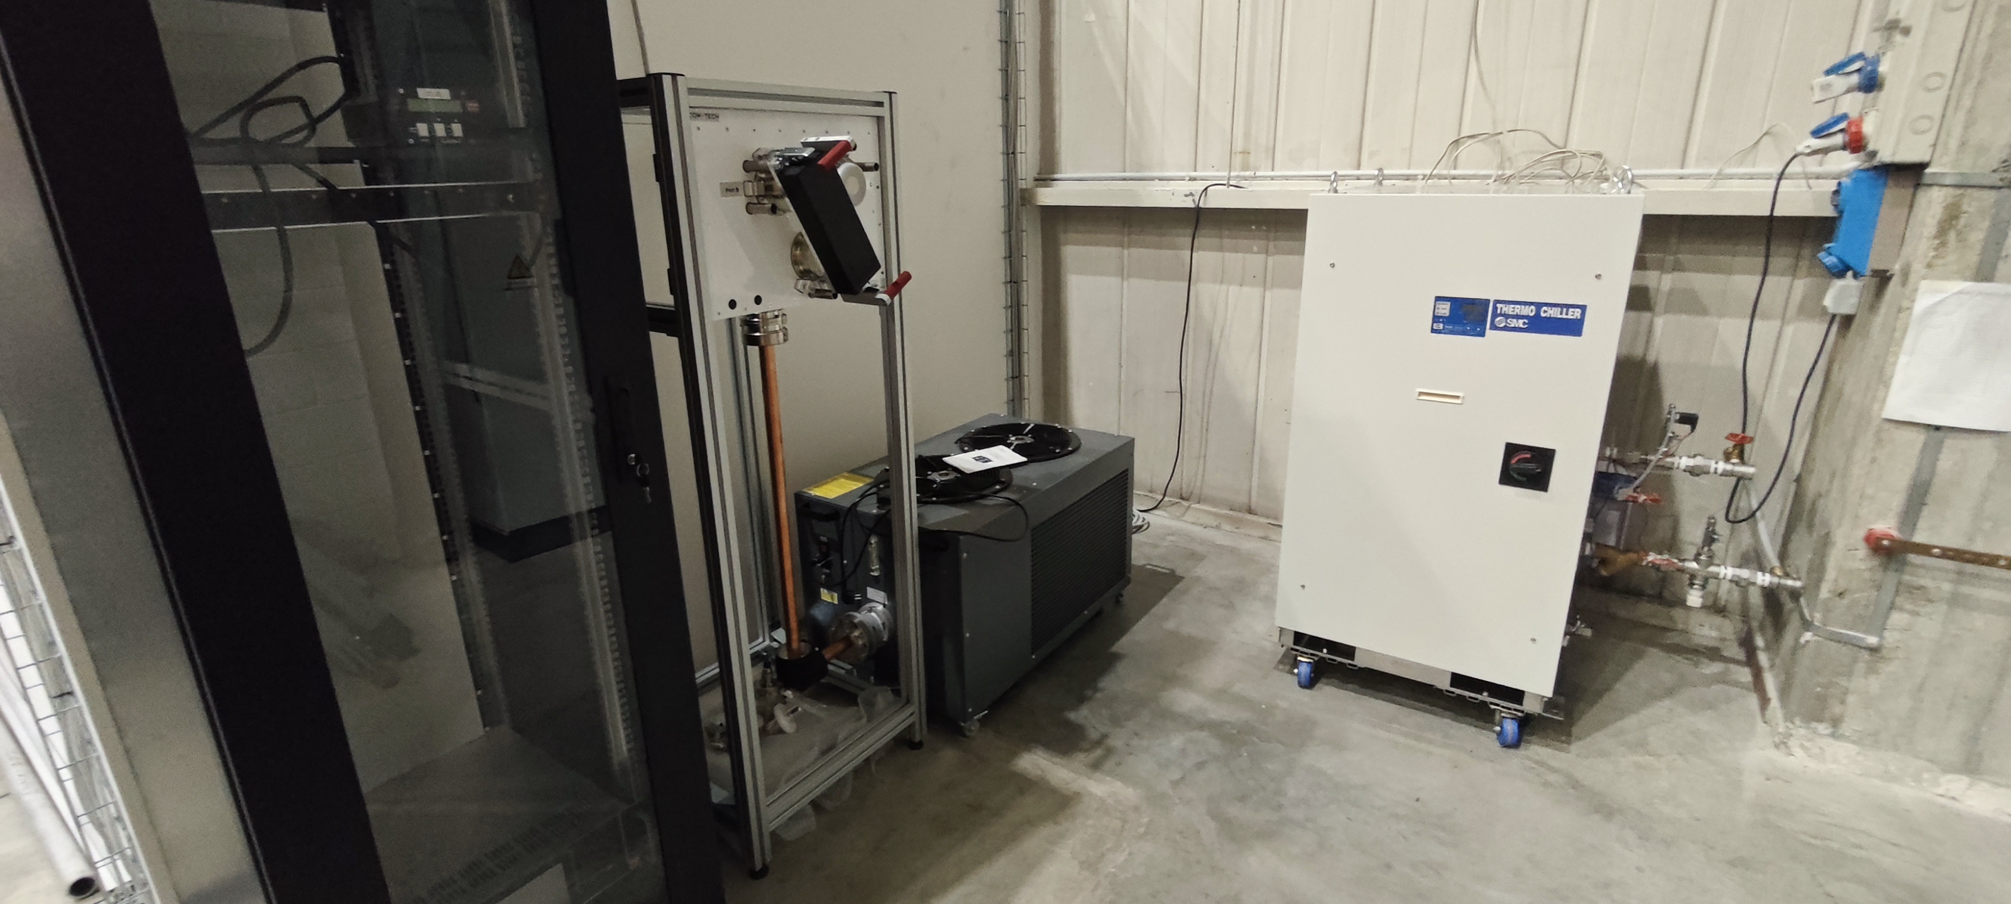
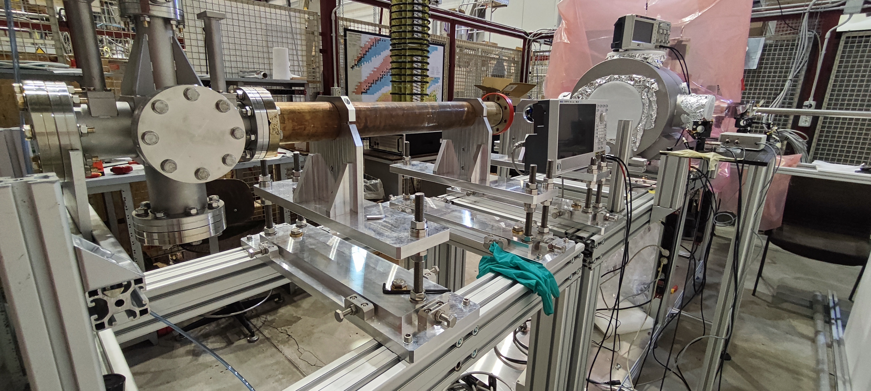
HB²TF Assembly
HB²TF
Solenoids measured, buncher in fabrication, beam line under assembling.
All service systems, RF and LLRF are being installed
DC Gun
Buncher
“Suitcase”
Buncher two halves after
machining
Photocathode
Transfer Chamber
Solenoid
Solenoids
HB²TF Beam Line
 | Buncher 1 | Buncher 2
f₀ (π-mode) [MHz] | 650
β (v/c) | 0.74 | 0.906
Input energy [MeV] | 0.3 | 0.638
E-field ampl. [MV/m] | 2.7
Active length [m] | 0.171 | 0.209
Quality factor Q₀ | 3.2 10⁴ | 3.67 10⁴
Ext.quality factor Q_{ext} | 3.02 10⁴ | 3.24 10⁴
R/Q [Ω] | 195.7 | 223
Geometry factor G [Ω] | 211 | 244
E_{pk}/E_{acc} | 3.07 | 3.88
B_{peak}/E_{acc} [mT/(MV/m)] | 2.94 | 3.73
Chiller, RF Switch and RF Load (20 kW)
Temporary beam line and diagnostic cross
12

Slide 13
Photocathode Development

Slide 14
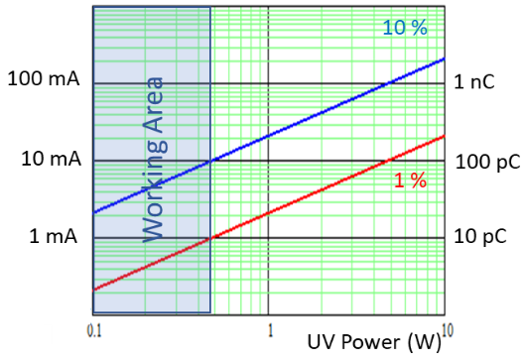
Photocathodes for HB²TF
For HB²TF Cs₂Te photocathodes will be used as electron sources
  Average QE at the production ≥ 10% in UV range, in operation typically used until QE 0.5%
  Vacuum quality: low 10⁻¹⁰ mbar (in the production stage), low 10⁻⁹ mbar (in operation mode)
Laser system (Yb laser, λ_{fund} = 1035 nm, P = 10 W, rep. rate 1 ÷ 93 MHz, 190 fs):
  UV is needed for the photocathode operation:
  λ^{4th} = 258.75 nm, P = 0.5 W
Photocathode requirements in operation:
  Q: up to 50 pC; I_{ave} up to 5 mA
  Lifetime: as long as possible
  On-line measurement: QE and reflectivity
  characterization
  Post-usage analysis: after operation, photocathodes
  will be analyzed in the production system

Slide 15
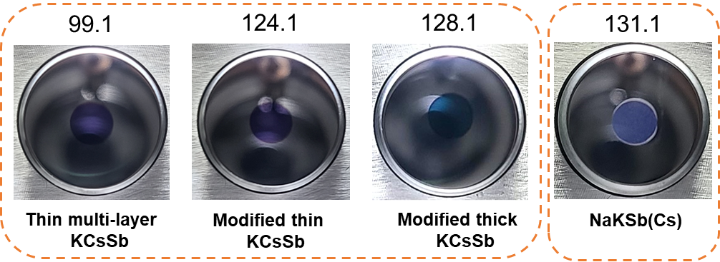
Sb based photocathodes
100 MHz operation for 5 mA beam has stimulated the investigation alkali antimonide photocathodes. These studies have been initiated in collaboration with DESY PITZ to investigate the operation of these photocathodes in RF gun.
Different materials and thickness have been investigated. NaKSb(Cs) has emerged as a possible candidate due to its robustness
Second Batch at PITZ
3 KCsSb cathodes (modified recipes):
  1 thin multi-layer “yo-yo” cathode (cathode 99.1)
  1 modified thin cathode* (cathode 124.1, Sb = 5 nm)
  1 modified thick cathode* (cathode 128.1, Sb = 10 nm)
1 NaKSb(Cs) cathode (cathode 131.1)

Slide 16
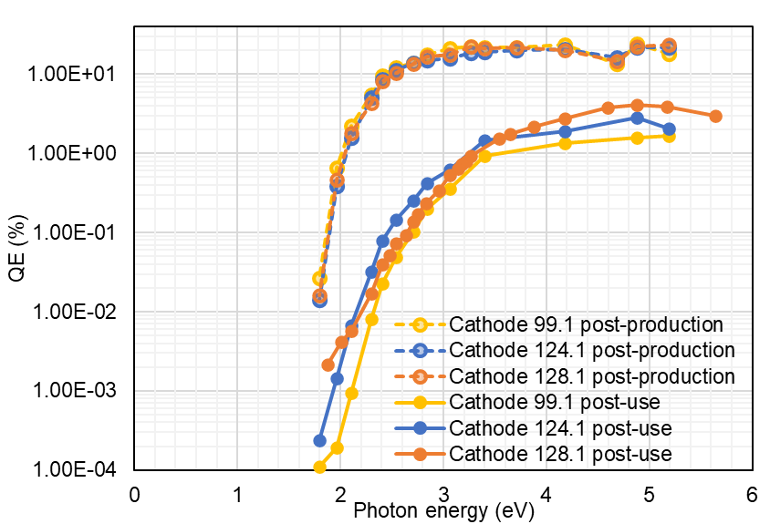
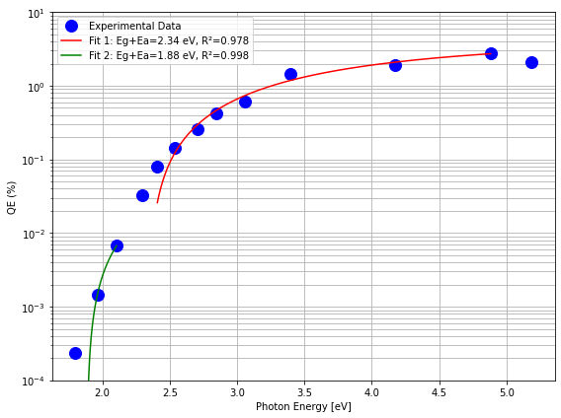
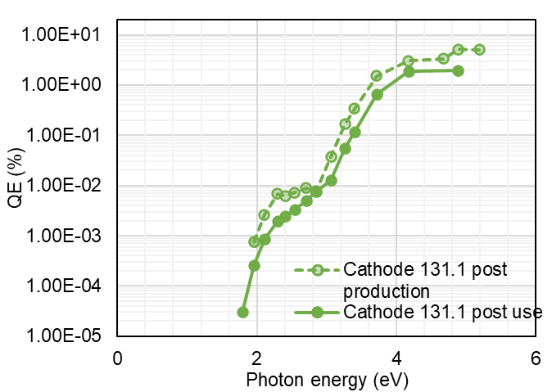
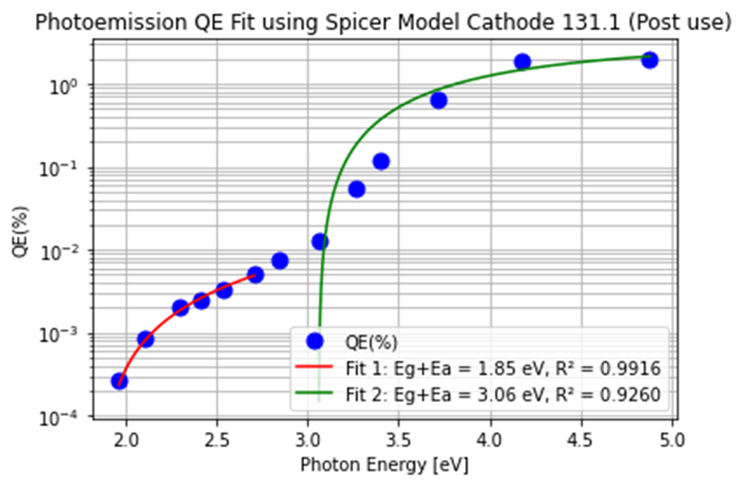



Spectral Response
  Spectral response + reflectivity measured for all four cathodes.
    KCsSb cathodes: QE decreased at all wavelengths.
    NaKSb(Cs) cathodes: No significant QE change was noticed.
  Eg+Ea: No significant change observed in any of these four cathodes.
Spectral reflectivity behavior is similar between fresh and used cathodes.
No significant change in the spectral reflectivity peaks indicates the fundamental arrangement of energy bands is largely intact in the bulk.
Production
KCsSb
Post- Use
Cathode | Post use Eg+Ea
All 3 KCsSb cathodes | Fit1: 2.34 eV Fit2: 1.9 eV
NaKSb(Cs) | Fit1: 1.85 eV Fit 2: 3.06 eV
NaKSb(Cs)

Slide 17
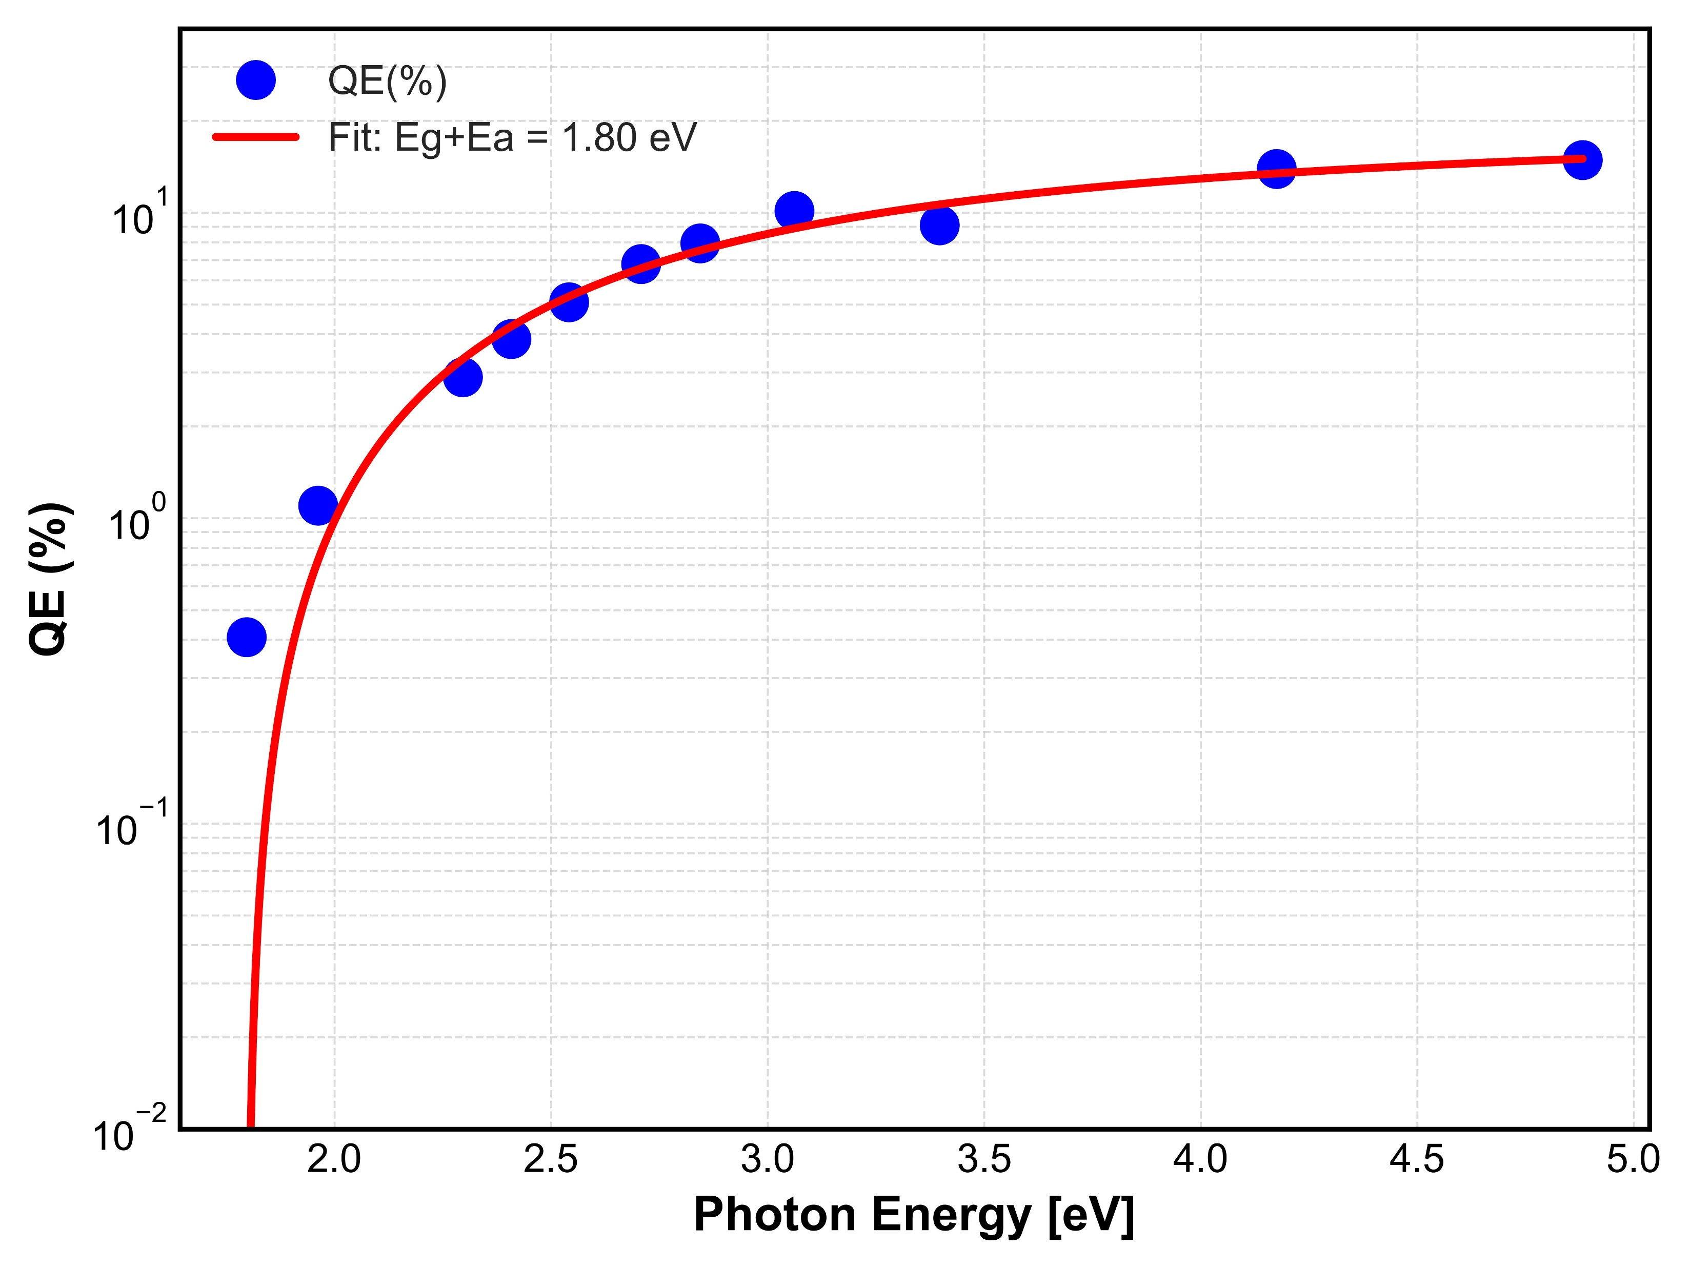
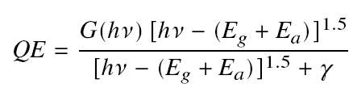
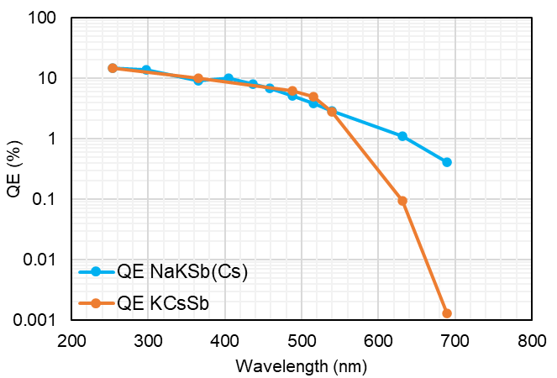
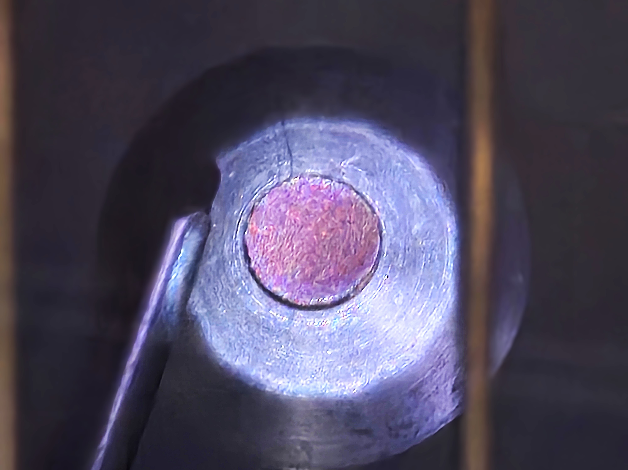
NaKSb(Cs) preparation
One NaKSb(Cs) cathode (cathode 128.2) was produced through sequential deposition in the new preparation system at LASA.
QE Achievement: QE of 3.7 % at 515 nm for NaKSb(Cs).
The estimated Eg + Ea value of NaKSb(Cs) is 1.8 eV.
Spectral Response Comparison: NaKSb(Cs) exhibits an improved QE at higher wavelengths compared to KCsSb, particularly in response to red laser light.
Sb until reflectivity drops to 30 % from the initial value.
K and Na deposited sequentially at 120 °C and 90 °C respectively until the QE reached a maximum value.
To restore the correct Na:K ratio, a small amount of Sb and K were added in an alternated manner until the peak of QE was obtained at 90 °C.
Then Cs was deposited until the sensitivity reached a maximum value at 90 °C.
NaKSb(Cs)

Slide 18
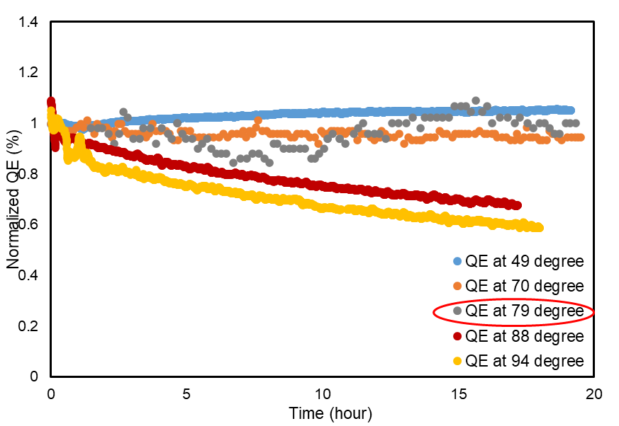
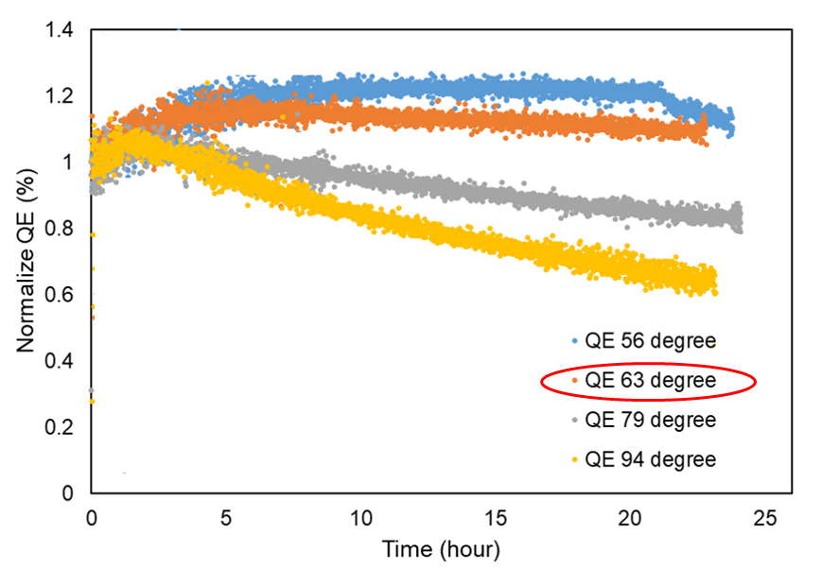

Thermal robustness
Operation of photocathodes in RF guns or at high extracted charge has motivated an investigation of the thermal response of these photocathode to substrate temperature increase.
Lifetime comparison at different substrate temperatures:
    NaKSb(Cs) cathodes can withstand temperatures up to ~79 °C.
    KCsSb cathodes can withstand temperatures up to ~63 °C.
NaKSb(Cs) cathode has higher thermal stability compared to the KCsSb cathode.
Temperature (°C) | NaKSb(Cs) Life-time [h] | KCsSb Life-time [h]
79 | > 1000 | 103
94 | 42 | 38
103 | 28 | 22
QE at 49 °C
QE at 70 °C
QE at 79 °C
QE at 88 °C
QE at 94 °C
QE at 56 °C
QE at 63 °C
QE at 79 °C
QE at 94 °C
NaKSb(Cs)
KCsSb (thin)

Slide 19
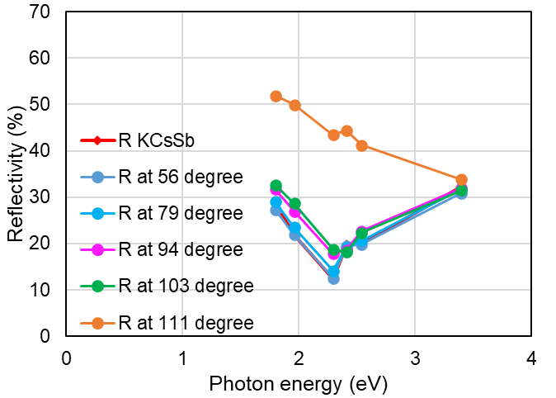
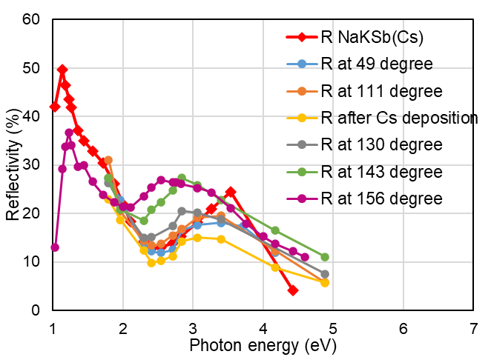
Temperature stability
Reflectivity analysis shows electronic structure stability up to:
  103 °C for KCsSb
  130 °C for NaKSb(Cs) (same Sb thickness)
KCsSb (thin)
NaKSb(Cs)
R NaKSb(Cs)
R at 49 °C
R at 111 °C
R after Cs deposition
R at 130 °C
R at 143 °C
R at 156 °C
R KCsSb
R at 56 °C
R at 79 °C
R at 94 °C
R at 103 °C
R at 111 °C

Slide 20
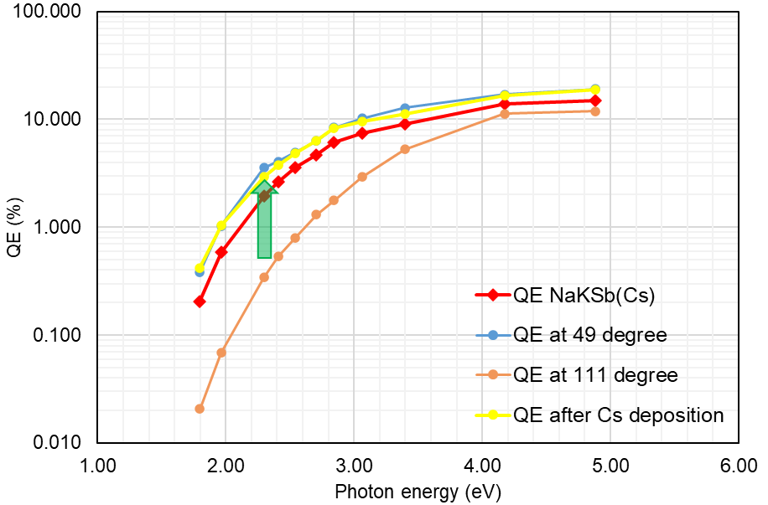
NaKSb(Cs) Rejuvenation by Cs
After heating the cathode to 111 °C, a few nm of Cs were re-deposited onto the cathode surface.
QE across all wavelengths
recovered to above original
level, demonstrating effective
rejuvenation of the
photocathode
In some cases, the QE after
rejuvenation might be even
higher than the original one.
QE NaKSb(Cs)
QE at 49 °C
QE at 111 °C
QE after Cs deposition

Slide 21
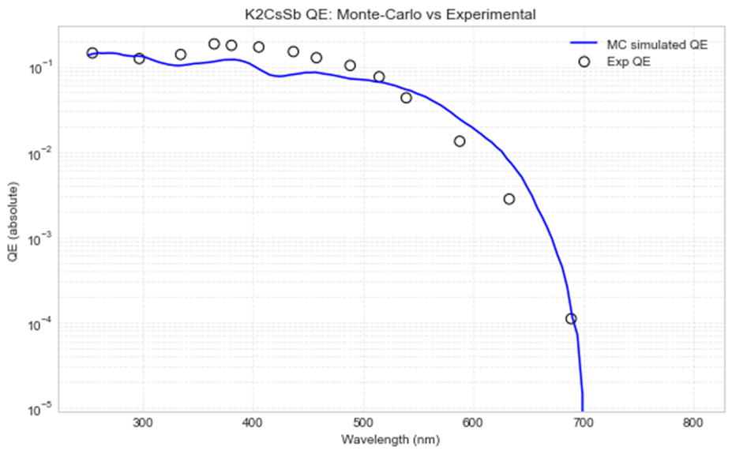
MC Simulation of QE using DFT Optical Constants
Objective
  Model spectral quantum efficiency (QE) of K₂CsSb photocathode
  Use DFT-derived n(E), k(E) as input for realistic optical response
Goal
  Simulate spectral QE of K₂CsSb using DFT n, k
Model (3-step photoemission)
  Absorption: R(E), α(E) from DFT + Urbach tail
  Transport: MC with e–e, elastic, inelastic scattering
  Emission: Surface escape with energy-dependent transmission
Key Features
  Energy-dependent η(hν), scattering, and escape probability
  Adaptive Monte Carlo statistics
Results (Preliminary)
  Good agreement with experimental QE trend
  Captures:
    UV enhancement
    Sharp cutoff near bandgap
  Remaining deviation at high wavelength
Future Work
Emittance modelling
Stoichiometry variation analysis
Sandeep on-going work
Preliminary result

Slide 22
Conclusions
BriXSinO will be an important opportunity for INFN LASA
HB²TF, the first phase, is successfully in progress and we expect soon to have the first electron beam
HB²TF use “INFN” plugs and its transport boxes. Testing of different films is one of its applications.
Photocathode development towards further understanding of the NaKSb(Cs) properties is on-going, supported also by the development of a “first principle” photoemission model.

Slide 23
BackUp Slides

Slide 24
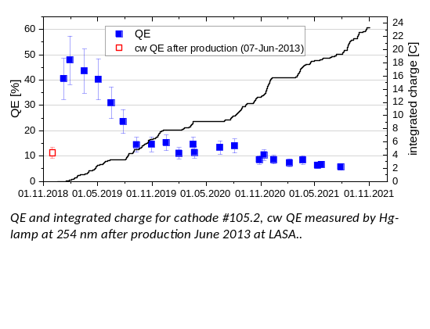

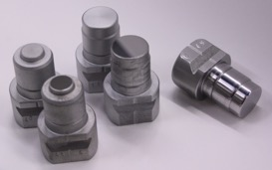
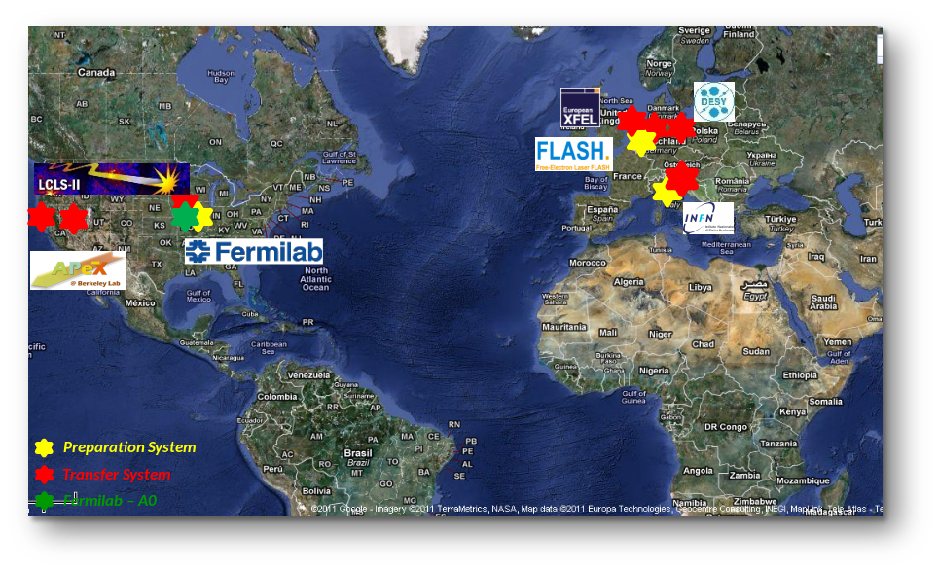
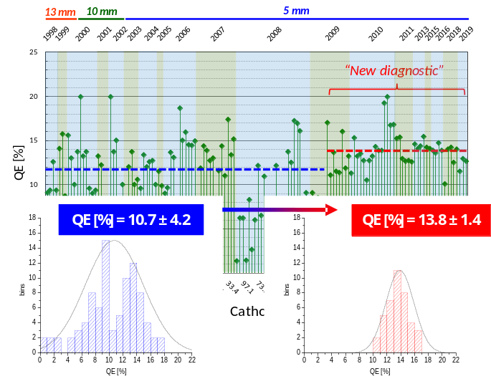
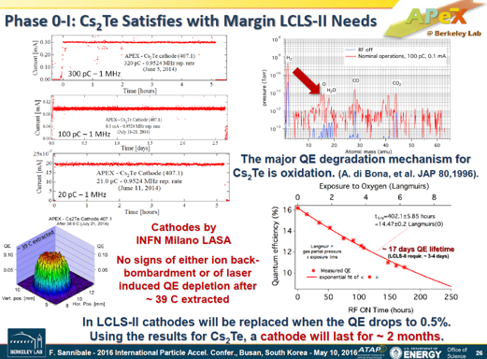
INFN LASA Cs₂Te Photocathodes
Extracted charge: ~ 23 C
1063 days of oper. until now
INFN LASA produces Cs₂Te photocathode since 90s and it’s a reference lab
With a continuous interplay between collaborators and R&D, we today growth
cathodes with an operational lifetime (24/7) in the user facilities increased
from few months to few years, that are a reference for many accelerator complex for users
More than 150 photocathodes delivered up to now
Cs₂Te photocathodes have been demonstrated usable also for CW operation
Facilities/injectors: FLASH and PITZ (DESY), FAST (FNAL), APEX (LBNL), LCLS-II (SLAC)
INFN Mo plug is now a “standard” allowing exchange of photocathodes between
facilities: EU (DESY, STFC), US (FNAL, LBNL, BNL, SLAC, UCLA, Cornell), China (IHEP, SHINE, Dalian)
INFN Mo plug
CW (1 MHz) operation in APEX gun

Slide 25
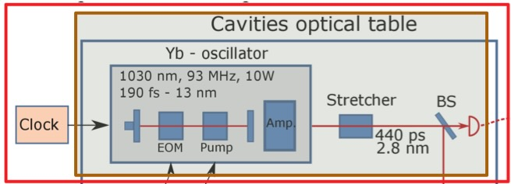
Laser scheme
The aim of the optical system is to excite the photocathode for the generation of the electron bunches.
The main oscillator is a 1035 nm mode-locked Yb laser with a 92.857 MHz repetition frequency (7th sub-harm of 1.3 GHz).
An internal amplification system
guarantees a maximum output
power of 10 W, with a spectral
width of 13 nm and a pulse duration
of 190 fs.
The pulses from the oscillator are
temporally stretched by a Chirped
Volume Bragg Grating (CVBG) up to
440 ps, with a spectral width of 2.8 nm.
After this stretching stage, a 100 mW laser power is coupled into a fiber (about 30m long) and then used for the photoemission process.

Slide 26
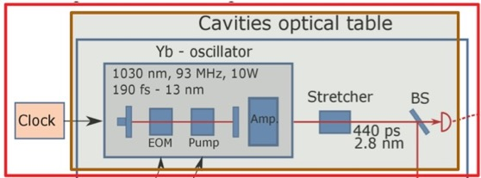
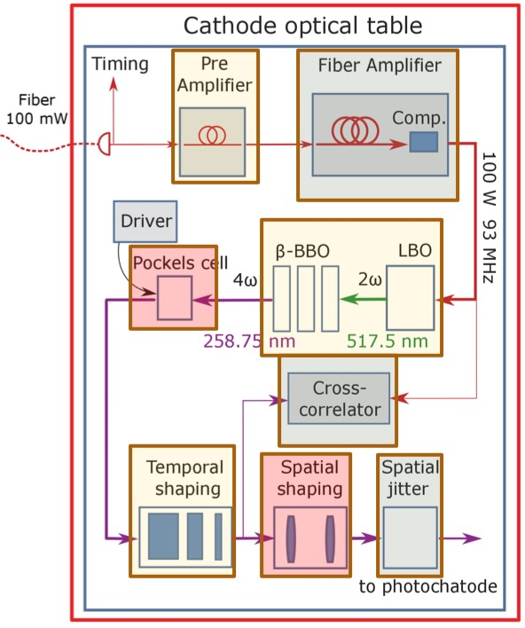
Laser scheme
The 100 mW laser pulses are amplified using a
2 stage process up to 60 W.
The high power pulses are converted from IR
to the 4th harmonic at 258.75 nm to obtain
pulses suitable for the Cathode Material.
The repetition rate of the laser pulses is
controlled by a Pockels cell from kHz up to the
repetition rate of the oscillator.
Subsequently, the 4th harmonic pulses undergo
an intensity profile shaping, both in temporal
and spatial domains.

Slide 27
Beam Physics
The beam dynamics study developed for this project aims to design an injector that in a near future will be used for an ERL.
This concept can be made explicit as follows: beam energies as low as possible (they will never be recovered) compatible with a beam brightness high enough to drives experiments.
In this view, the beam dynamics studies carried out aimed to couple the injector of HB²TF to a SC booster to produce a beam with energy of 4.5 MeV, an emittance of about 1.2 mm- mrad and a rms bunch length of about 1.2 mm.
To obtain high brightness beam it is of paramount importance to keep emittance growth under control.
Low energy and high brightness results into a BD space charge dominated that is one of the points of interest of this proposal.

Slide 28
Beam Manipulation
This design is innovative because it uses two bunchers instead of one and employs a 650 MHz rf frequency instead of the commonly used 1.3 GHz.
The choice to use a longer rf bucket allows for the trapping of longer cigar-like electron bunches having lower emittances. Additionally, the use of two bunchers provides better control over longitudinal bunch compression.
The injection phases of the two bunchers are not at the rf zero-crossing, allowing for acceleration while mitigating space-charge effects and bunching to increase the final beam brightness.
The whole HB²TF beamline has been studied using the tracking code Astra that is designed to consider space-charge collective effects, a key point for HB²TF beam dynamics, further the beam line working point (WP) has been optimized using an AI code already developed in our group named GIOTTO.

Slide 29
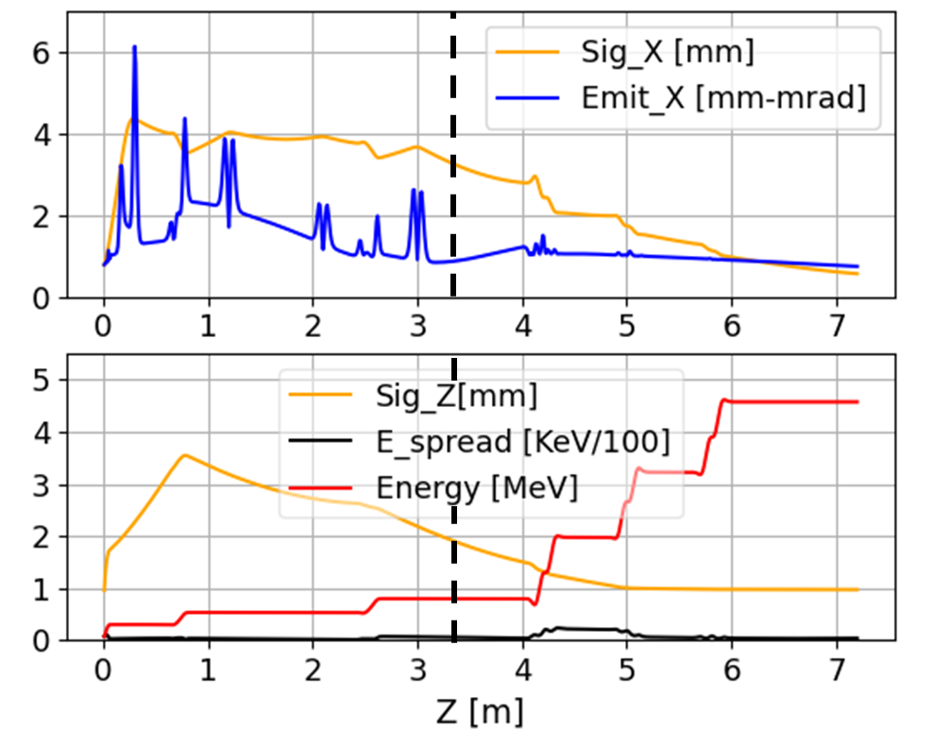
Beam Manipulation
SC booster
emit-compensation in space charge regime:
σ_{x} & ε_{n} behaviour well tuned
Bunchers
compression & acceleration
Bunch extraction:
Q_{b} = 50 [pC]; σ_{x,y} = 650 [μm]; τ_{laser} = 18 [ps] (rise-time = 1ps)
DC-gun:
ΔV=300 kV
The two Bunchers:
E_{p} = 2.7 MV/m Φ_{inj_1} = -31°, Φ_{inj_2} =-35°
SC inj. booster (three two-cells):
E_{p} = 11.5 MV/m Φ_{inj_1} = -25°, Φ_{inj_2} = 21°, Φ_{inj_3} = 0.0°
beam-line solenoids peak fields [T]:
B_{z_1} = 0.0276, B_{z_2} = 0.0172, B_{z_3} = 0.0128, B_{z_4} = 0.0246

