Slide 1

Photocathode for Accelerator Science in Europe (PhASE26) Workshop
IJC Lab, Orsay, France, September 21-23, 2026.
Photocathode Physics:
A Band Structure Perspective
W. Andreas Schroeder
Professor of Physics (retired)
University of Illinois Chicago
UIC researchers: Gowri Adhikari
Louis A. Angeloni
Ir-Jene Shan
Lee B. Jones
ASTeC, STFC Daresbury Laboratory, UK
Department of Energy
DE-SC0020387
Theodore Vecchione
SLAC

Slide 2
Outline
Introduction
Direct ‘one-step’ band photoemission
− Physics of emitting band states and recipient vacuum states
− Comparison to Cu(001) and Cu(111) data
Optical phonon mediated Franck-Condon (FC) electron emission
− Energy (E) and momentum (p) resonant
− Examples: Cesiated GaAs, GaN(0001), and Fe:Ga₂O₃(010)
… includes observation of ultracold emission: MTE ≈ 6meV at 300K
Umklapp electron scattering FC emission
− Reciprocal lattice vector (G) mediated
− QE and MTE measurements: Cu(001) vs. W(111)
Summary

Slide 3
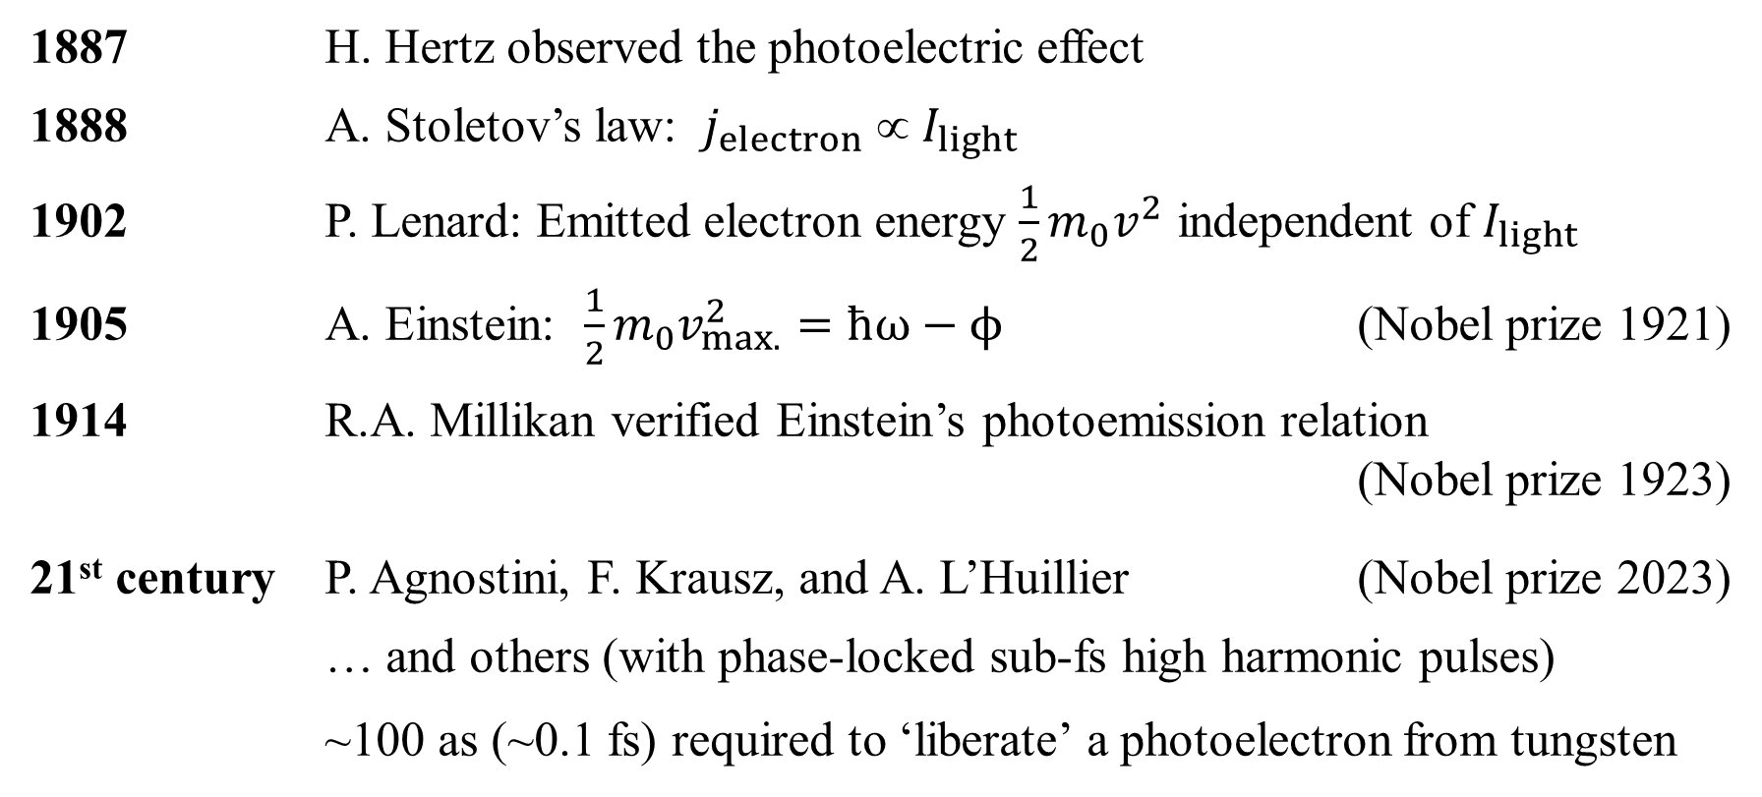
A brief (and incomplete) history of photoemission
1887 H. Hertz observed the photoelectric effect
1888 A. Stoletov’s law: $j_{electron}  I_{light}$
1902 P. Lenard: Emitted electron energy $\frac{1}{2}m_{0}v^{2}$ independent of $I_{light}$
1905 A. Einstein: $\frac{1}{2}m_{0}v_{max.}^{2}=ħω−ϕ$ (Nobel prize 1921)
1914 R.A. Millikan verified Einstein’s photoemission relation
(Nobel prize 1923)
21st century P. Agnostini, F. Krausz, and A. L’Huillier (Nobel prize 2023)
… and others (with phase-locked sub-fs high harmonic pulses)
~100 as (~0.1 fs) required to ‘liberate’ a photoelectron from tungsten
A.L. Cavalieri et al., Nature 449, 1029 (2007)
M. Ossiander et al., Nature 561, 374 (2018)

Slide 4
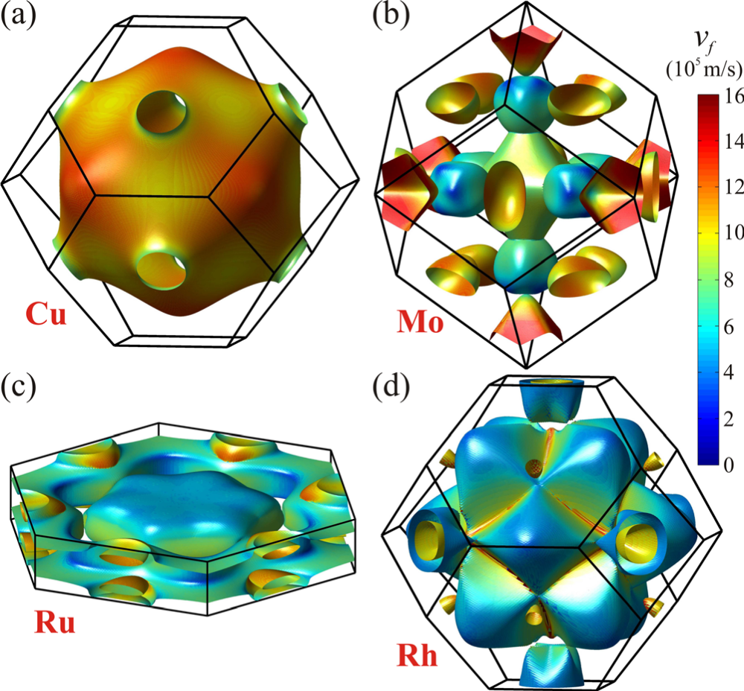
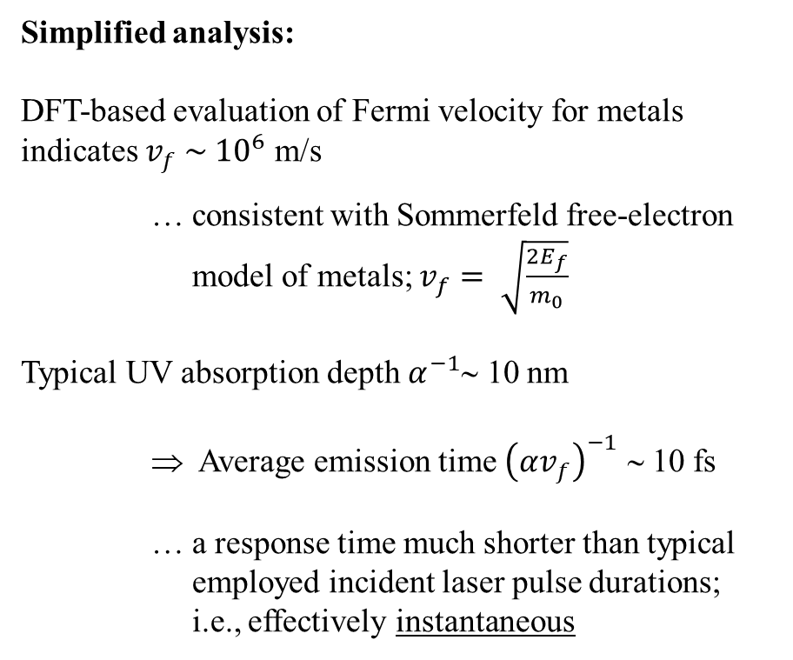
Metal photocathodes: Response time
Simplified analysis:
DFT-based evaluation of Fermi velocity for metals
indicates $v_{f} \sim {10}^{6}$ m/s
… consistent with Sommerfeld free-electron
model of metals; $v_{f}= \sqrt{\frac{2E_{f}}{m_{0}}}$
Typical UV absorption depth $α^{−1}$∼ 10 nm
⇒ Average emission time ${\left(αv_{f}\right)}^{−1}$ ∼ 10 fs
… a response time much shorter than typical
employed incident laser pulse durations;
i.e., effectively instantaneous
D. Gall, J. Appl. Phys. 119, 085101 (2016)

Slide 5
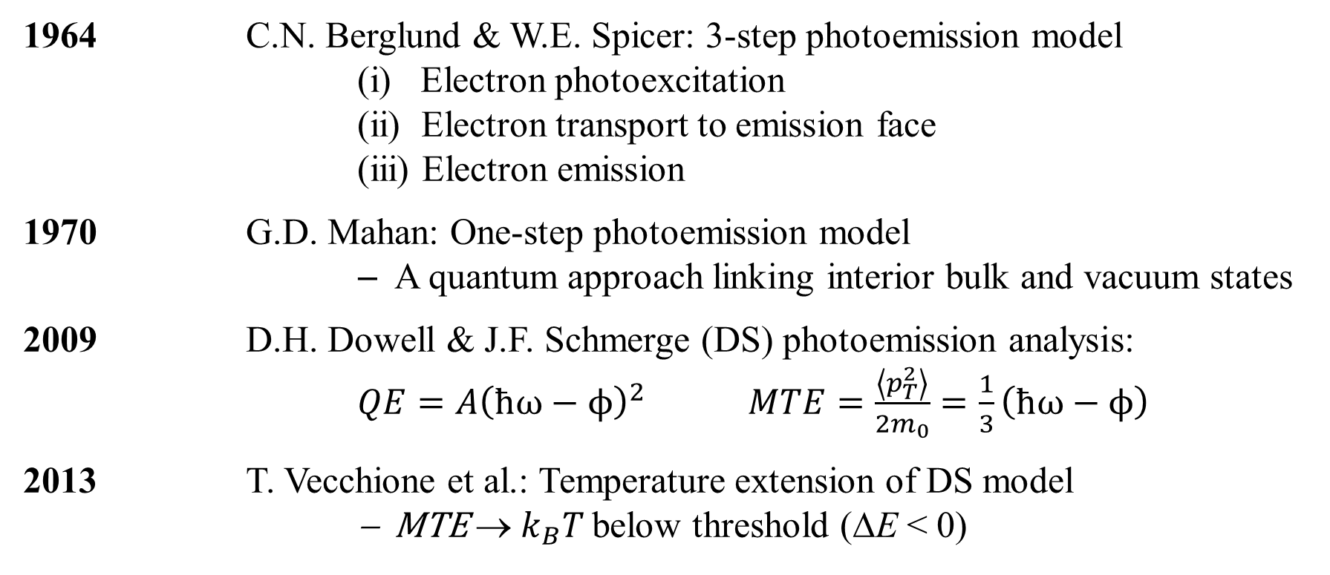
A brief history of contemporary photocathode physics
1964 C.N. Berglund & W.E. Spicer: 3-step photoemission model
(i) Electron photoexcitation
(ii) Electron transport to emission face
(iii) Electron emission
1970 G.D. Mahan: One-step photoemission model
− A quantum approach linking interior bulk and vacuum states
2009 D.H. Dowell & J.F. Schmerge (DS) photoemission analysis:
$QE=A{\left(ħω−ϕ\right)}^{2}$ $MTE=\frac{\left\langle p_{T}^{2}\right\rangle }{2m_{0}}=\frac{1}{3}\left(ħω−ϕ\right)$
2013 T. Vecchione et al.: Temperature extension of DS model
− MTE → $k_{B}T$ below threshold (ΔE < 0)
C.N. Berglund & W.E. Spicer, Phys. Rev. 136, A1030 (1964)
G.D. Mahan, Phys. Rev. B 2, 4334 (1970)
D.H. Dowell & J.F. Schmerge, Phys. Rev. ST Accel & Beams 12, 074201 (2009)
T. Vecchione et al., paper TUPSO83 in Proceedings of FEL2013 (JaCOW Publishing, NY)

Slide 6
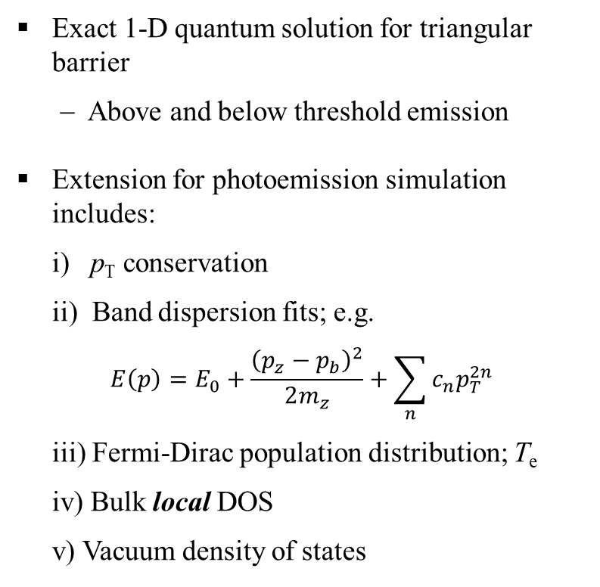
One-step photoemission analysis
E
Exact 1-D quantum solution for triangular barrier
− Above and below threshold emission
Extension for photoemission simulation includes:
i) p_{T} conservation
ii) Band dispersion fits; e.g.
$$E\left(p\right)=E_{0}+\frac{{\left(p_{z}−p_{b}\right)}^{2}}{2m_{z}}+\sum_{n}{c_{n}p_{T}^{2n}}$$
iii) Fermi-Dirac population distribution; T_{e}
iv) Bulk local DOS
v) Vacuum density of states
Vacuum states
E
Virtual states
Photoemission
ΔE
Field emission
ħω
p_{z}
p_{z}
E
Bulk states
−qE_{cath.}z
Ԑ_{F}
Metal
crystal
(m_{z} , m_{T})
Vacuum
(m₀)
p_{z}
W.A. Schroeder and G. Adhikari, New J. Phys. 21 (2019) 033040

Slide 7
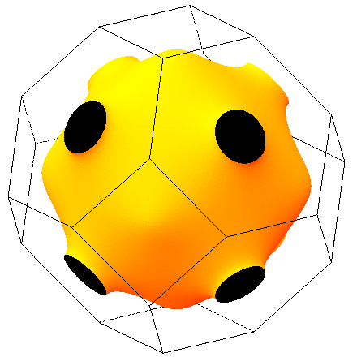
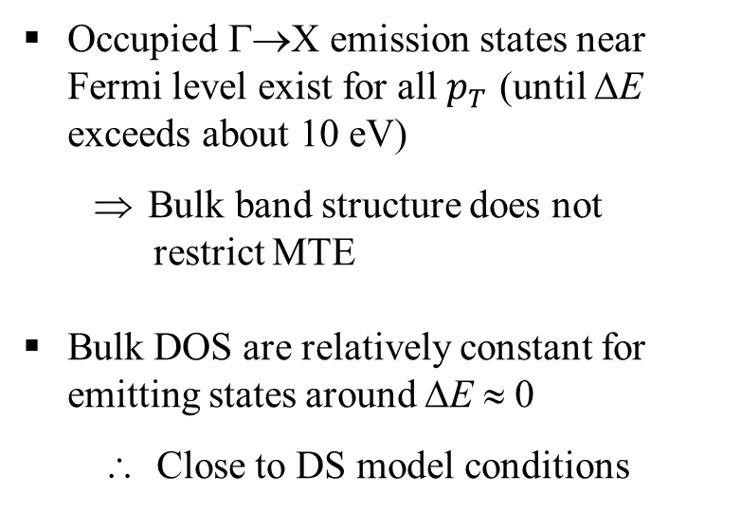



Cu(001): A ‘canonical’ metal photocathode
Occupied Γ→X emission states near Fermi level exist for all $p_{T}$ (until ΔE exceeds about 10 eV)
  Bulk band structure does not
  restrict MTE
Bulk DOS are relatively constant for emitting states around ΔE ≈ 0
∴ Close to DS model conditions
$$p_{T}$$
$$e^{−}$$
$$p_{z}$$
www.hzdr.de/projects/fermisur/cu.html

Slide 8
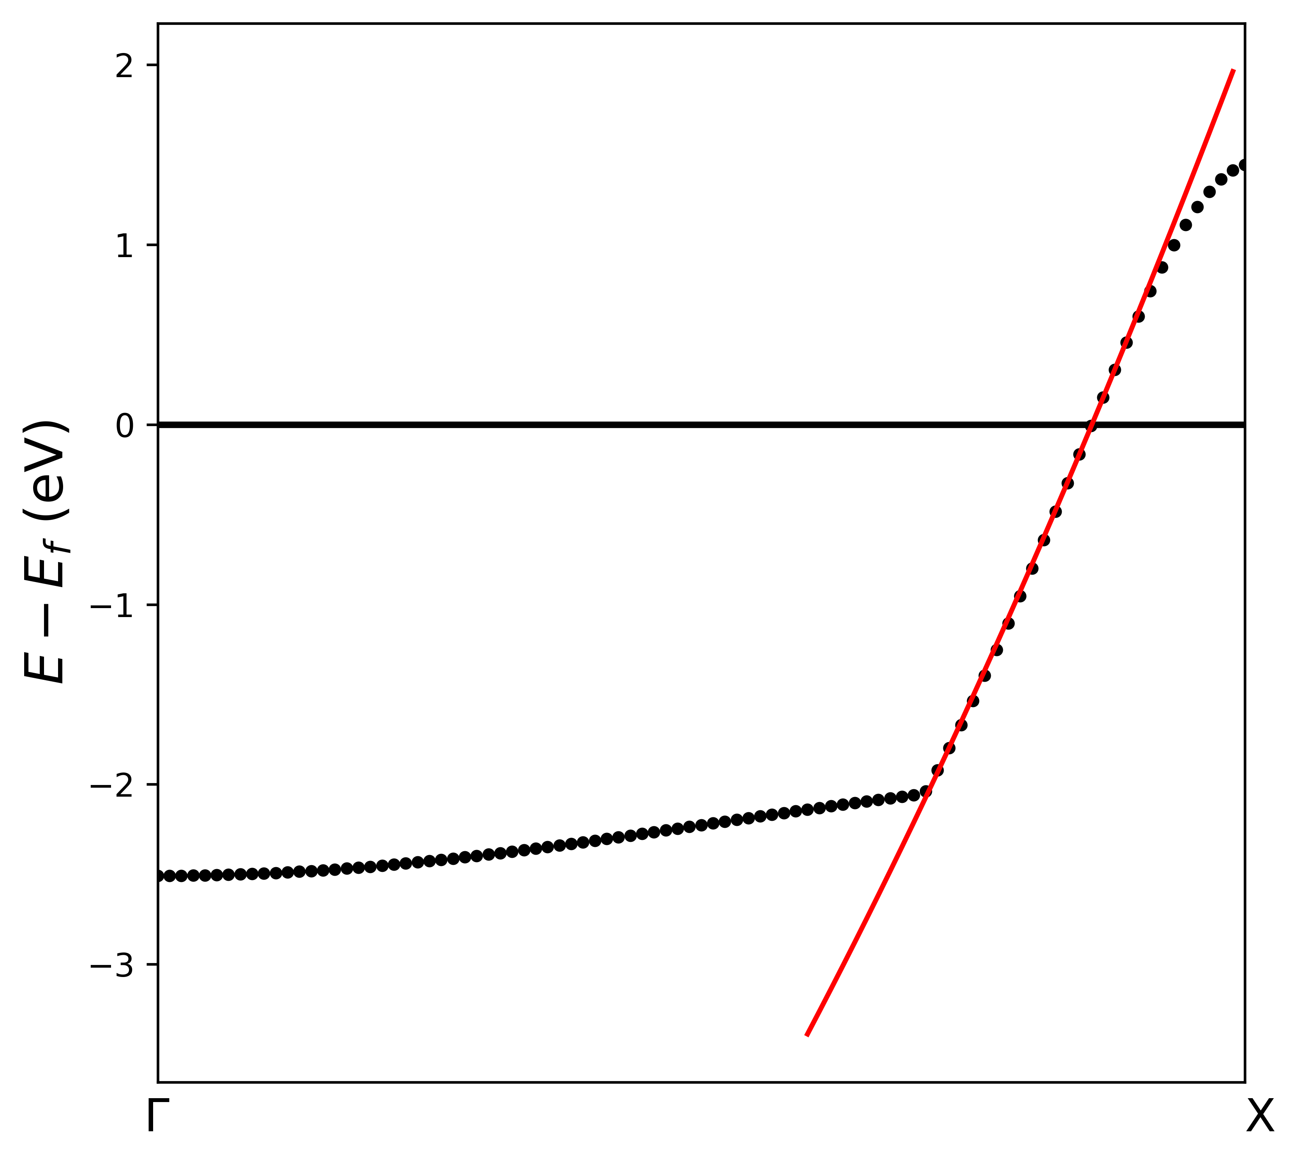
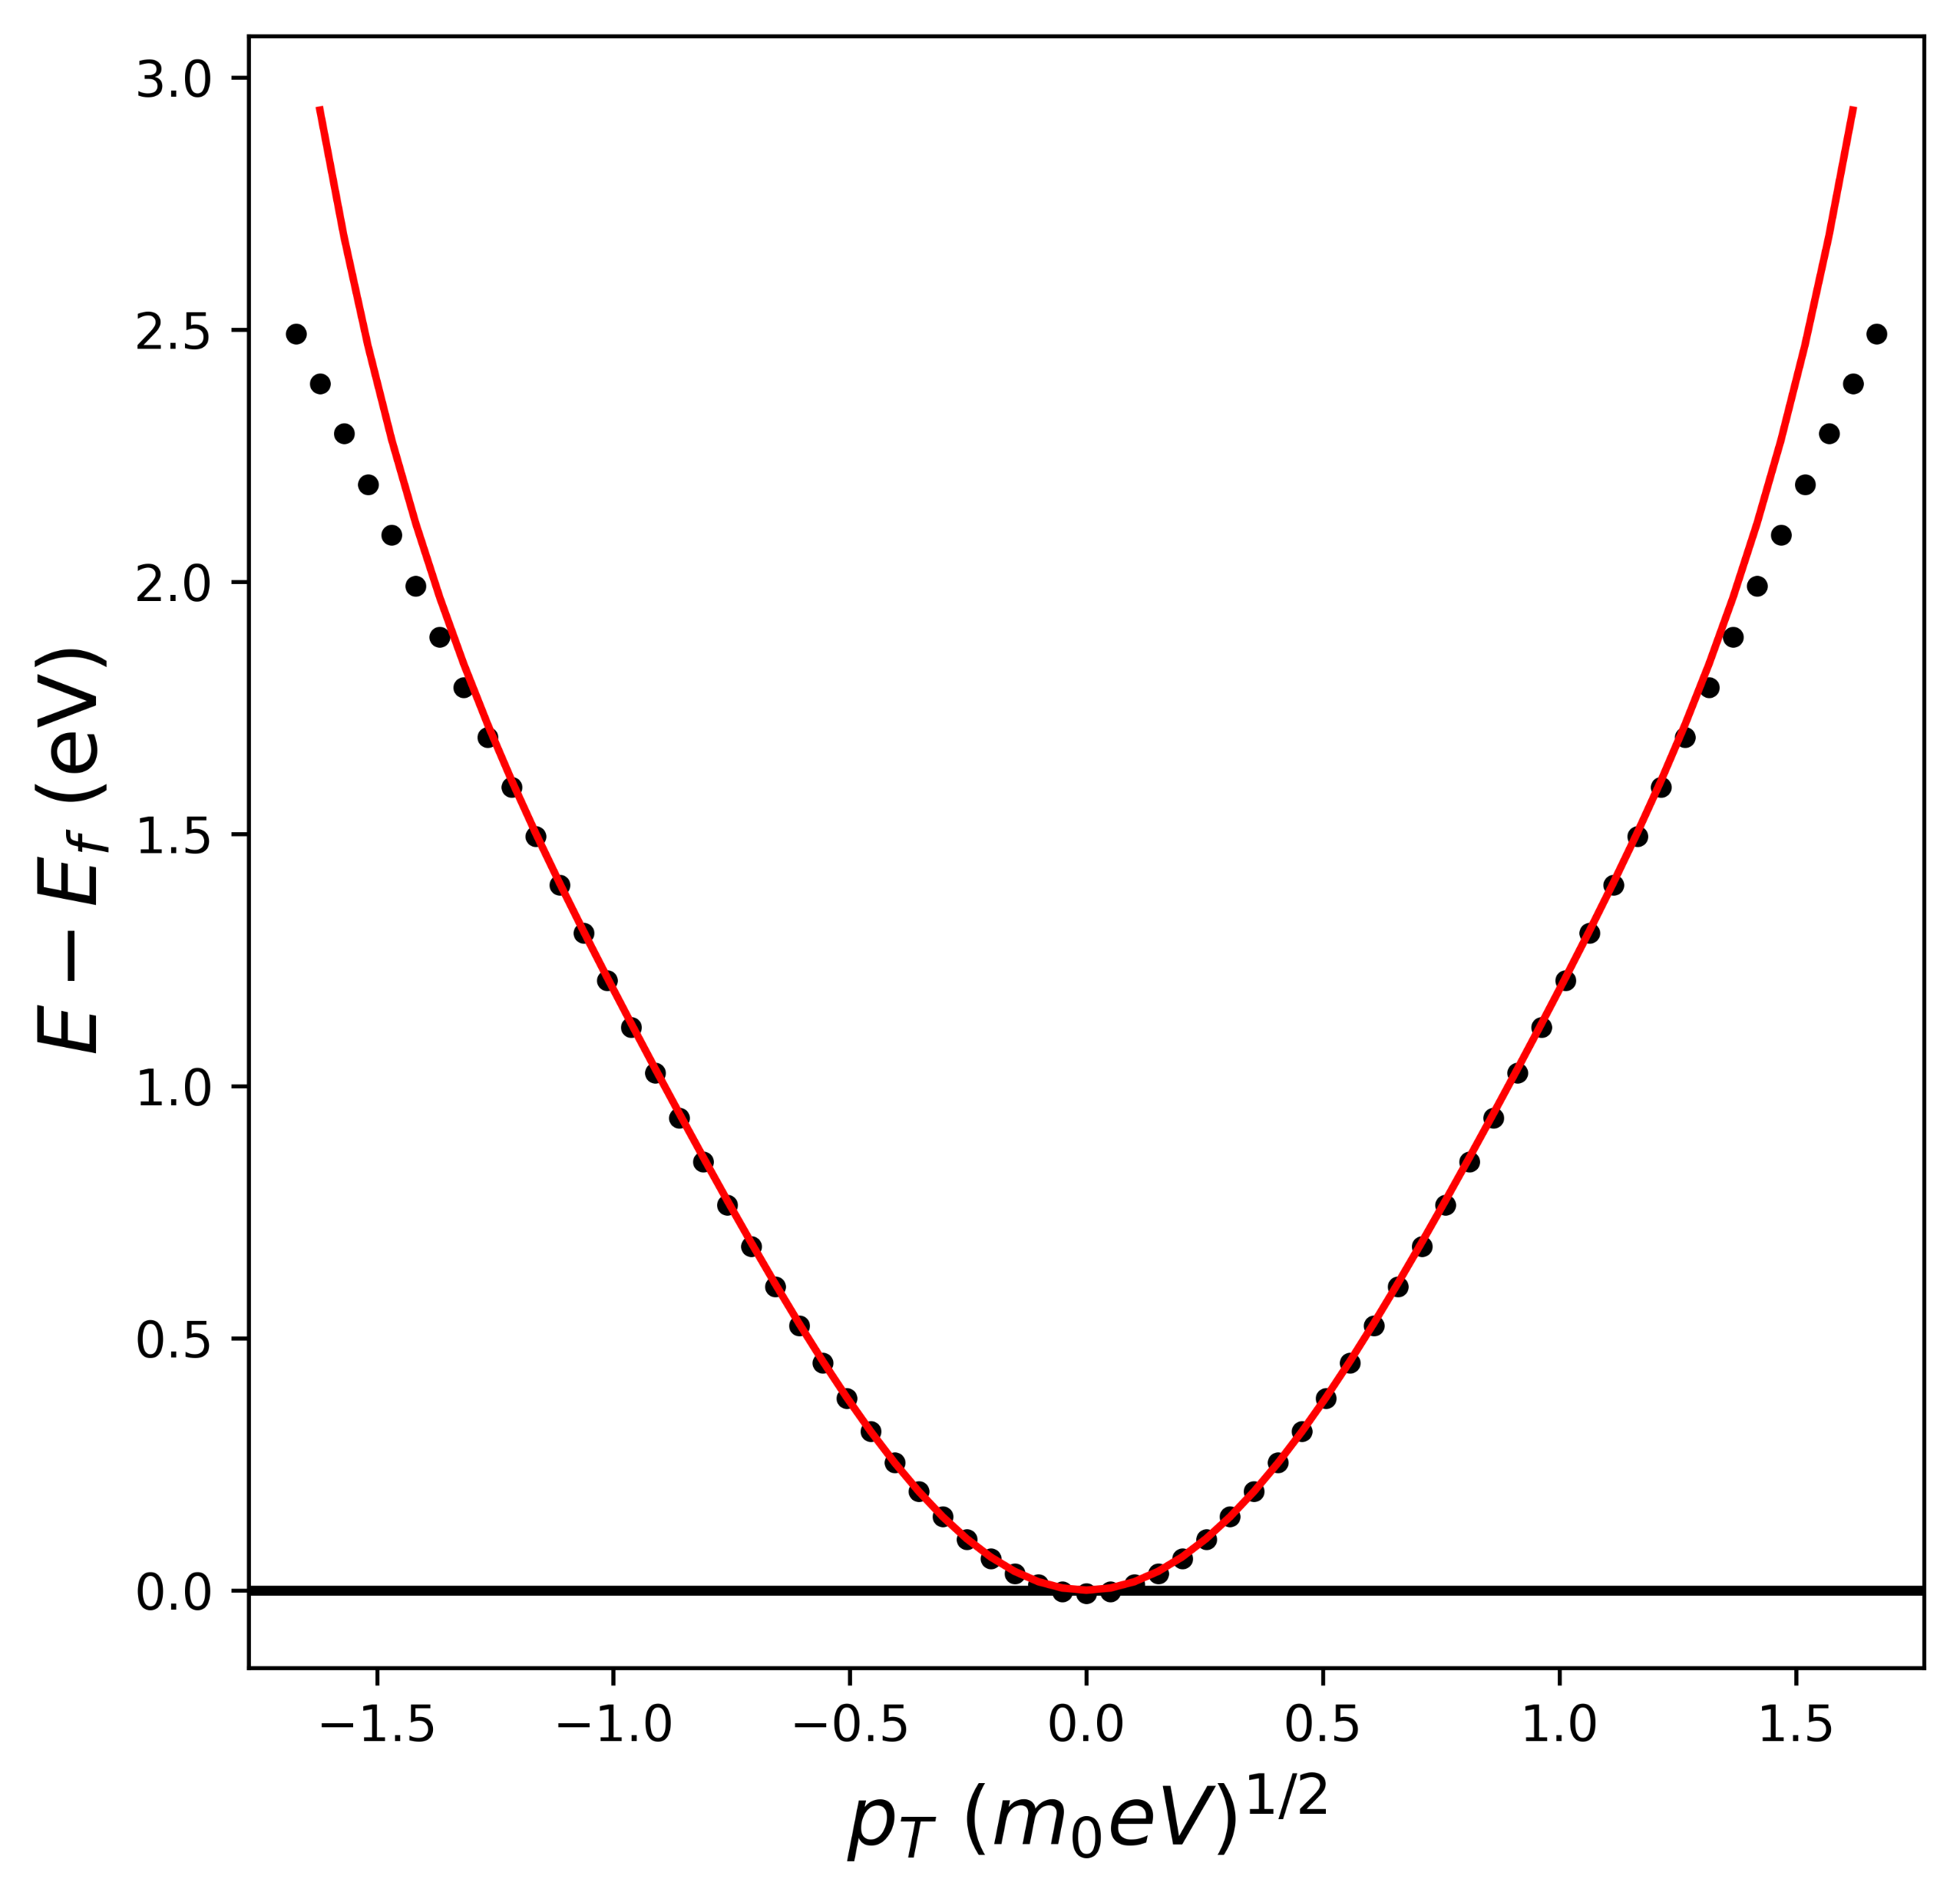
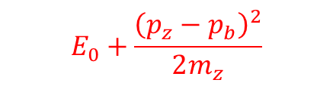
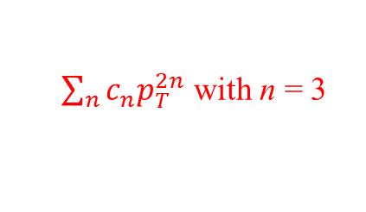

Cu(001): Fits to emitting bands
− DFT evaluation of electronic structure; Amsterdam suite with r2SCAN potentials
Longitudinal (z)
Transverse (T)
$$E_{0}+\frac{{\left(p_{z}−p_{b}\right)}^{2}}{2m_{z}}$$
$\sum_{n}{c_{n}p_{T}^{2n}}$ with n = 3
$$p_{z}$$

Slide 9
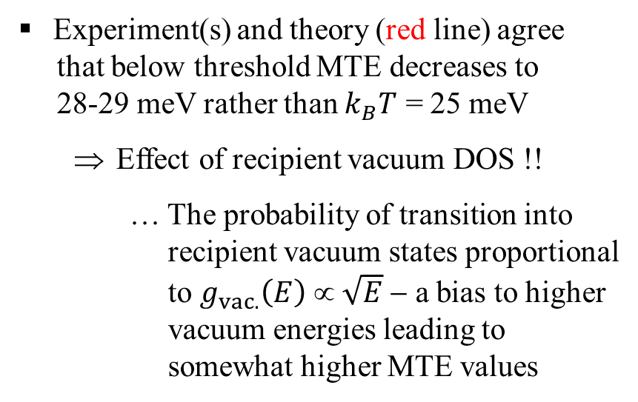
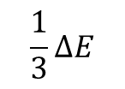
Cu(001): Experiment vs.Theory
− Experimental data from LBNL and UIC at 300 K
Experiment(s) and theory (red line) agree
that below threshold MTE decreases to
28-29 meV rather than $k_{B}T$ = 25 meV
  Effect of recipient vacuum DOS !!
… The probability of transition into
recipient vacuum states proportional
to $g_{vac.}\left(E\right) ∝ \sqrt{E}$ − a bias to higher
vacuum energies leading to
somewhat higher MTE values
LBNL
UIC
UIC
25 meV
$$\frac{1}{3}∆E$$
Any photocathode emission
model must include the physics
of the recipient vacuum states

Slide 10

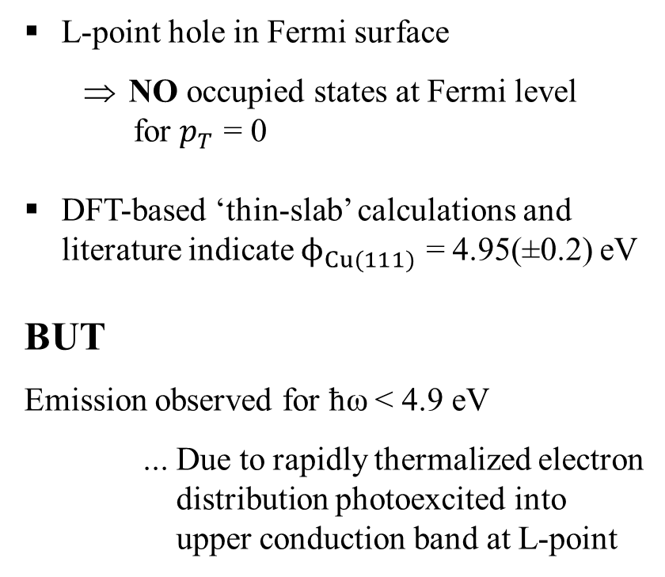


Cu(111) photocathode
L-point hole in Fermi surface
  NO occupied states at Fermi level
  for $p_{T}$ = 0
DFT-based ‘thin-slab’ calculations and literature indicate $ϕ_{Cu(111)}$ = 4.95(±0.2) eV
BUT
Emission observed for ħω < 4.9 eV
... Due to rapidly thermalized electron
distribution photoexcited into
upper conduction band at L-point
$$p_{T}$$
$$e^{−}$$
$$p_{z}$$
E. Pedersoli et al., Appl. Phys. Lett. 93, 183505 (2008)

Slide 11
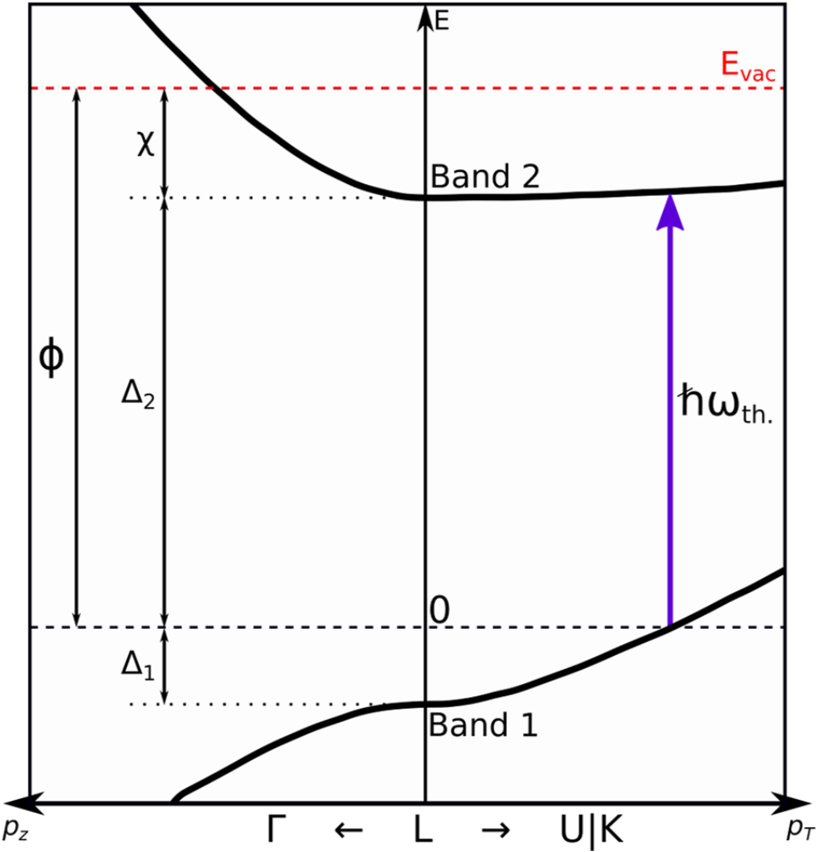
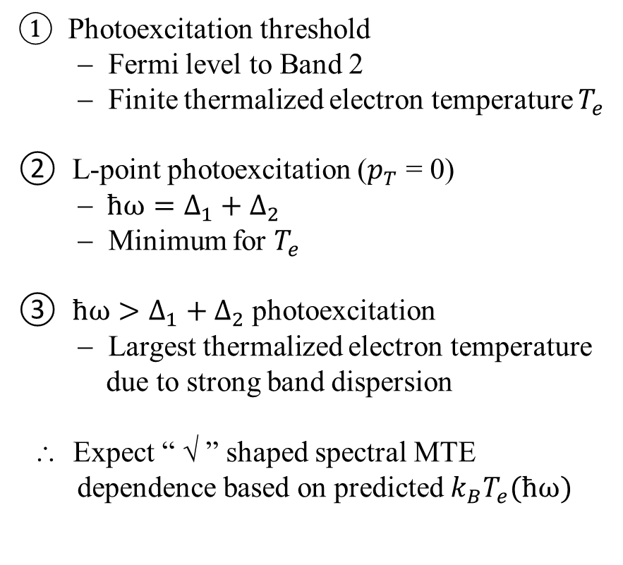


Cu(111): Photoexcitation
① Photoexcitation threshold
− Fermi level to Band 2
− Finite thermalized electron temperature $T_{e}$
② L-point photoexcitation ($p_{T}$ = 0)
− $ħω=∆_{1}+∆_{2}$
− Minimum for $T_{e}$
③ $ħω>∆_{1}+∆_{2}$photoexcitation
− Largest thermalized electron temperature
due to strong band dispersion
∴ Expect “ √ ” shaped spectral MTE
dependence based on predicted $k_{B}T_{e}(ħω)$
$$E_{vac.}$$
③
②
①
$$E_{F}$$

Slide 12
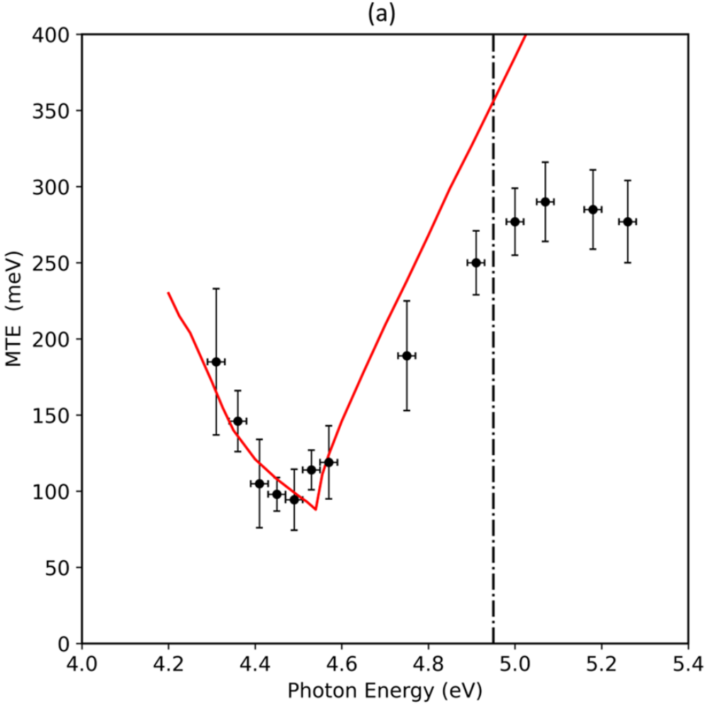

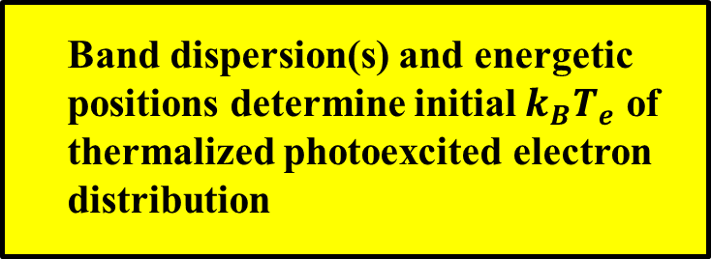
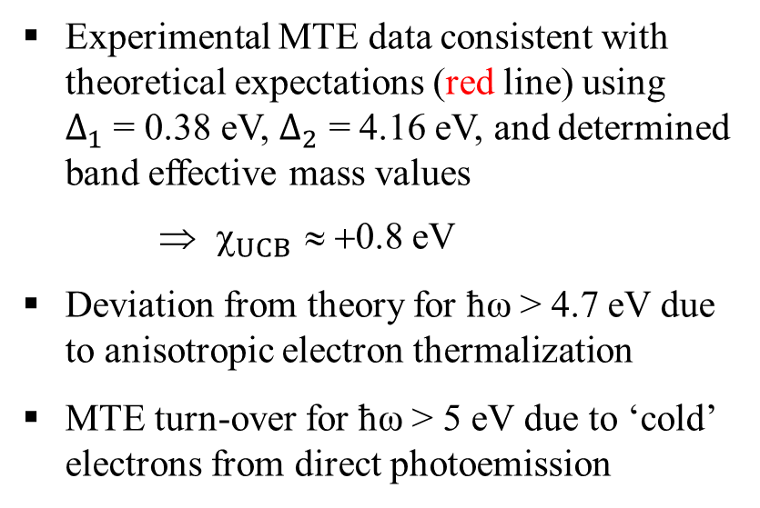
Cu(111): MTE
Experimental MTE data consistent with theoretical expectations (red line) using $∆_{1}$ = 0.38 eV, $∆_{2}$ = 4.16 eV, and determined band effective mass values
⇒ $_{UCB}$ ≈ +0.8 eV
Deviation from theory for ħω > 4.7 eV due to anisotropic electron thermalization
MTE turn-over for ħω > 5 eV due to ‘cold’ electrons from direct photoemission
①
③
②
$$ϕ_{Cu\left(111\right)}=4.95 eV$$
Band dispersion(s) and energetic
positions determine initial $k_{B}T_{e}$ of
thermalized photoexcited electron
distribution
L.A. Angeloni, I-J. Shan, and W.A. Schroeder, AIP Advances 12, 105129 (2022)

Slide 13
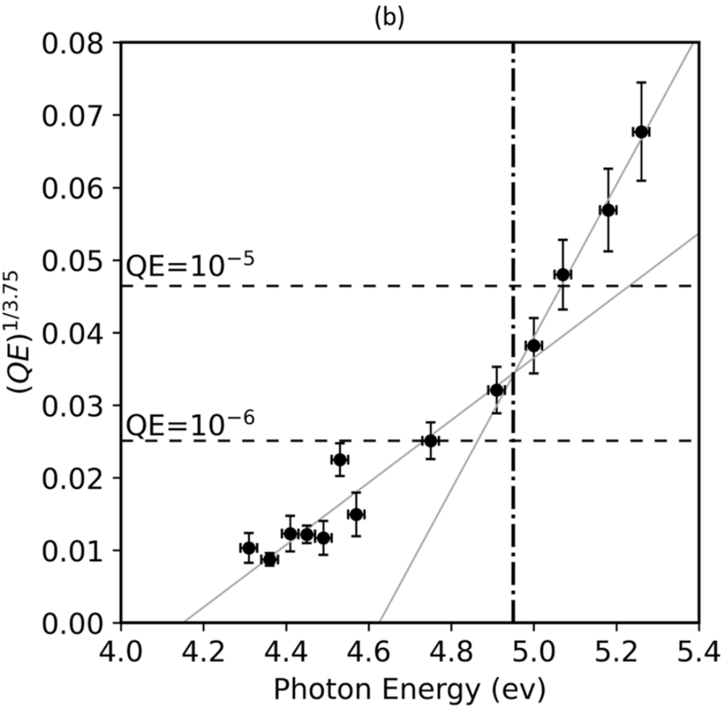
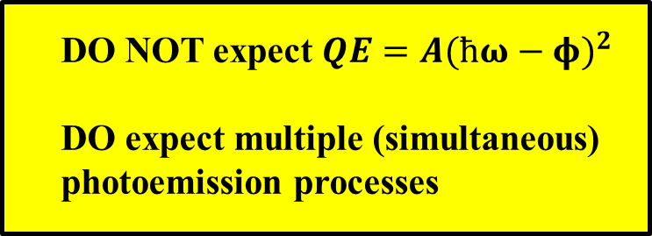
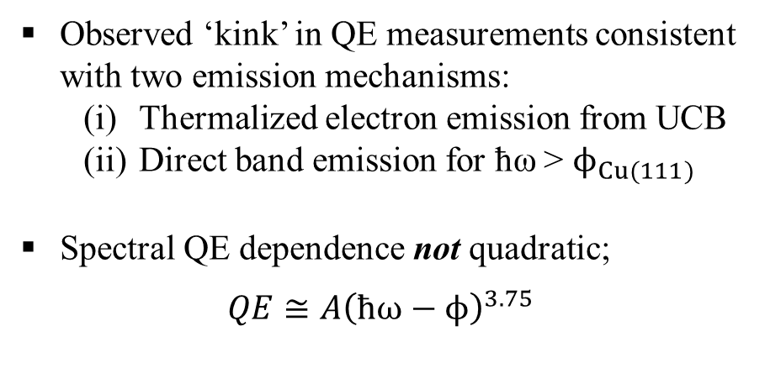

Cu(111): QE
Observed ‘kink’ in QE measurements consistent with two emission mechanisms:
  Thermalized electron emission from UCB
  Direct band emission for ħω > $ϕ_{Cu(111)}$
Spectral QE dependence not quadratic;
$$QE≅A{\left(ħω−ϕ\right)}^{3.75}$$
$$ϕ_{Cu\left(111\right)}=4.95 eV$$
DO NOT expect $QE=A{(ħω−φ)}^{2}$
DO expect multiple (simultaneous)
photoemission processes
(eV)
G. Gobeli and F. Allen, Phys. Rev. 137, A245 (1965)

Slide 14
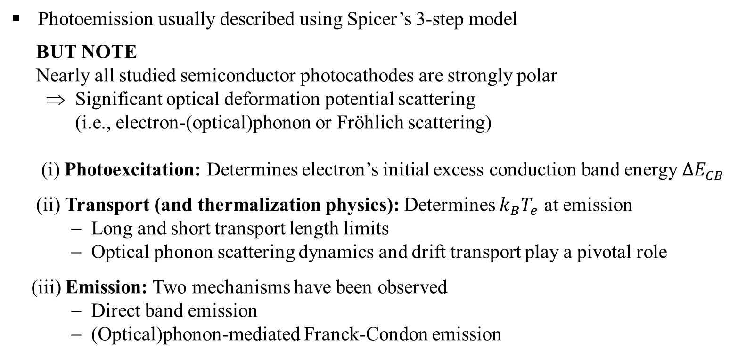
Semiconductor photocathodes
− Polar semiconductors: Cs:GaAs, GaN, CsTe, alkali antimonides, bi-alkali antimonides, etc. … and diamond!
Photoemission usually described using Spicer’s 3-step model
BUT NOTE
Nearly all studied semiconductor photocathodes are strongly polar
⇒ Significant optical deformation potential scattering
(i.e., electron-(optical)phonon or Fröhlich scattering)
(i) Photoexcitation: Determines electron’s initial excess conduction band energy $∆E_{CB}$
(ii) Transport (and thermalization physics): Determines $k_{B}T_{e}$ at emission
− Long and short transport length limits
− Optical phonon scattering dynamics and drift transport play a pivotal role
(iii) Emission: Two mechanisms have been observed
− Direct band emission
− (Optical)phonon-mediated Franck-Condon emission
Semiconductor Physics – An Introduction, K. Seeger, 4th Ed., Springer-Verlag

Slide 15
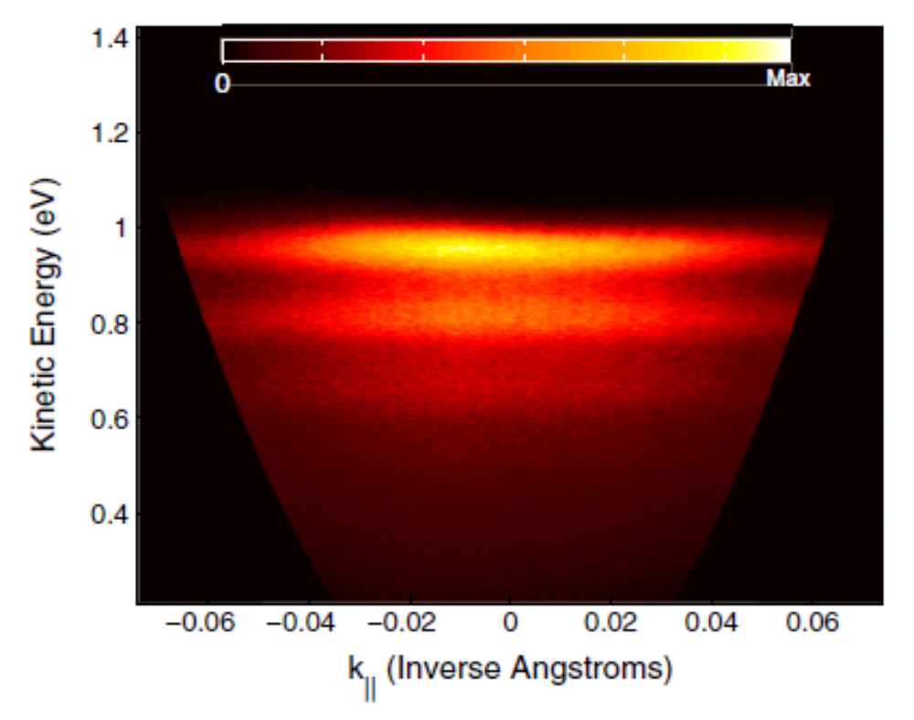
Prior work: H-terminated diamond(001)
− ARPES measurement; ħω = 6.01 eV (208 nm) ⇒ α ≈ 4000 cm⁻¹ (absorption depth ≈ 2.5 μm)
Emitted electrons from NEA CBM
χ_{eff} = E_{vac} – (E_{CBM} − għΩ) ≈ −0.96 eV
… għΩ is real part of the electron-
polaron self energy and the
dimensionless Fröhlich coupling
constant for diamond g = 1.1
Emission ‘bands’ are replicas of electron distribution in CB separated by ħΩ = 165 meV optical phonon energy
I(n) = e^{-g}g^{n}/n! Poisson statistics govern emission strength for n^{th} phonon band
(n = 0, 1, 2, …)
n = 0
n = 1
n = 2
n = 3
.
.
J.D. Rameau, J. Smedley, E.M. Muller, T.E. Kidd, and P.D. Johnson, Phys. Rev. Lett. 106, 137602 (2011)

Slide 16
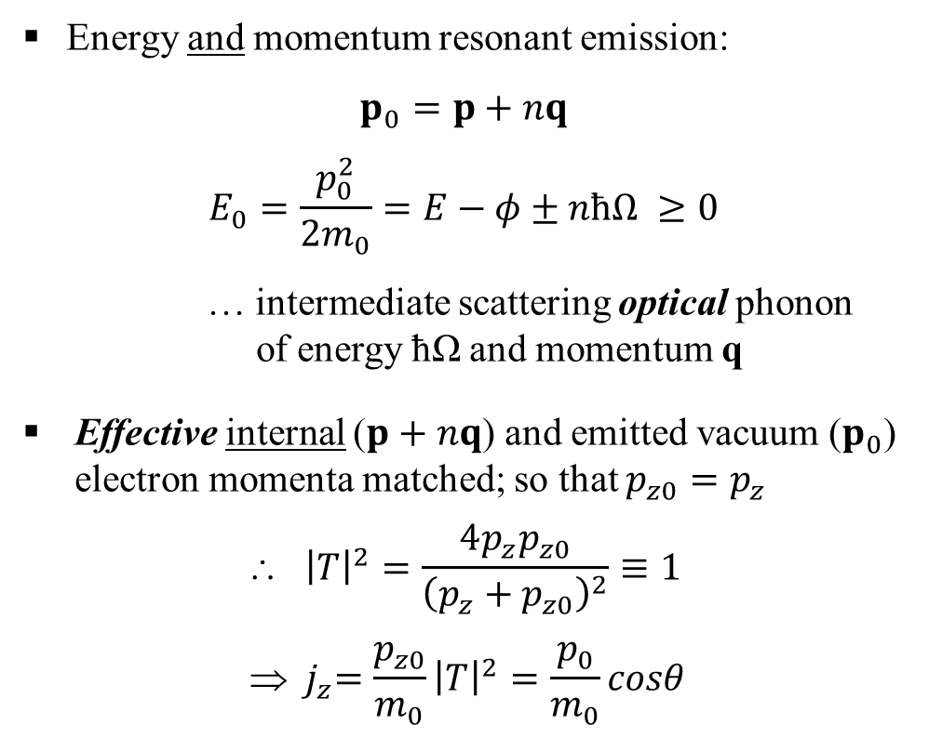
Franck-Condon mechanism in photoemission
− Phonon scattering based electron emission from semiconductor photocathodes
Energy and momentum resonant emission:
$$p_{0}=p+nq$$
$$E_{0}=\frac{p_{0}^{2}}{2m_{0}}=E−φ±nħΩ ≥0$$
… intermediate scattering optical phonon
of energy ħΩ and momentum q
Effective internal ($p+nq$) and emitted vacuum ($p_{0}$) electron momenta matched; so that $p_{z0}=p_{z}$
$${ \left|T\right|}^{2}=\frac{4p_{z}p_{z0}}{{\left(p_{z}+p_{z0}\right)}^{2}}≡1$$
$${  j}_{z}=\frac{p_{z0}}{m_{0}}{\left|T\right|}^{2}=\frac{p_{0}}{m_{0}}cosθ$$
x,y
n = 1
q
p
p₀
θ
z
Photocathode
Vacuum

Slide 17
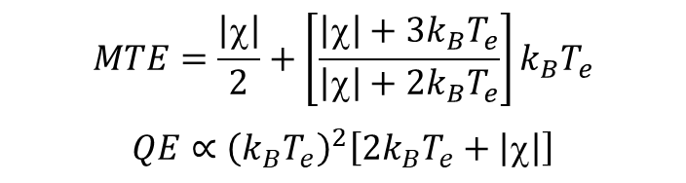
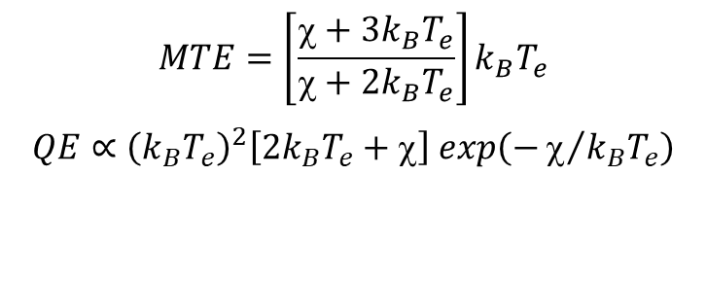
Franck-Condon emission theory
− Analytical evaluation in parabolic band approximation with thermalized electron distribution at T_{e}; ħΩ → 0
PEA
(χ > 0)
NEA
(χ < 0)
E
E
E
E
p₀ = p + nq
p₀ = p + nq
χ
p
χ
p₀
p
p₀
bulk
vacuum
bulk
vacuum
$$MTE=\left[\frac{χ+3k_{B}T_{e}}{χ+2k_{B}T_{e}}\right]k_{B}T_{e}$$
$$QE∝{\left(k_{B}T_{e}\right)}^{2}\left[2k_{B}T_{e}+χ\right] exp\left(−χ/{k_{B}T_{e}}\right)$$
$$MTE=\frac{\left|χ\right|}{2}+\left[\frac{\left|χ\right|+3k_{B}T_{e}}{\left|χ\right|+2k_{B}T_{e}}\right]k_{B}T_{e}$$
$$QE∝{\left(k_{B}T_{e}\right)}^{2}\left[2k_{B}T_{e}+\left|χ\right|\right]$$
W.A. Schroeder, L.A. Angeloni, I-J. Shan, and L.B. Jones, Phys. Rev. Applied 23, 054065 (2023)

Slide 18
Cesiated p-GaAs photocathode
− Measurements performed using TESS (Daresbury Laboratory, U.K.); λ = 808 nm, T = 300 K
Absorption depth ~1 μm at 808 nm
⇒ Long transport limit with low excess photo-
excitation energy in CB (ΔE_{CB} < 100 meV)
∴ Expect k_{B}T_{e} ≈ 25 meV due to rapid carrier
cooling during drift to emission face
Surface depletion region w_{d} ≈ 10 nm traversed in less than ~200 fs optical phonon emission time by 25 meV electrons (m* = 0.067m₀)
Controlled oxygen ‘poisoning’ of cesiation used to vary electron affinity χ from −0.1 eV to +0.2 eV
BOTH QE and MTE measured as a function of χ
CB
χ
ħω
E_{vac.}
[Zn] = 10¹⁹ cm⁻³
VB
w_{d}
L.B. Jones, H.E. Scheibler, et al., J. Phys. D: Appl. Phys. 54, 205301 (2021)

Slide 19
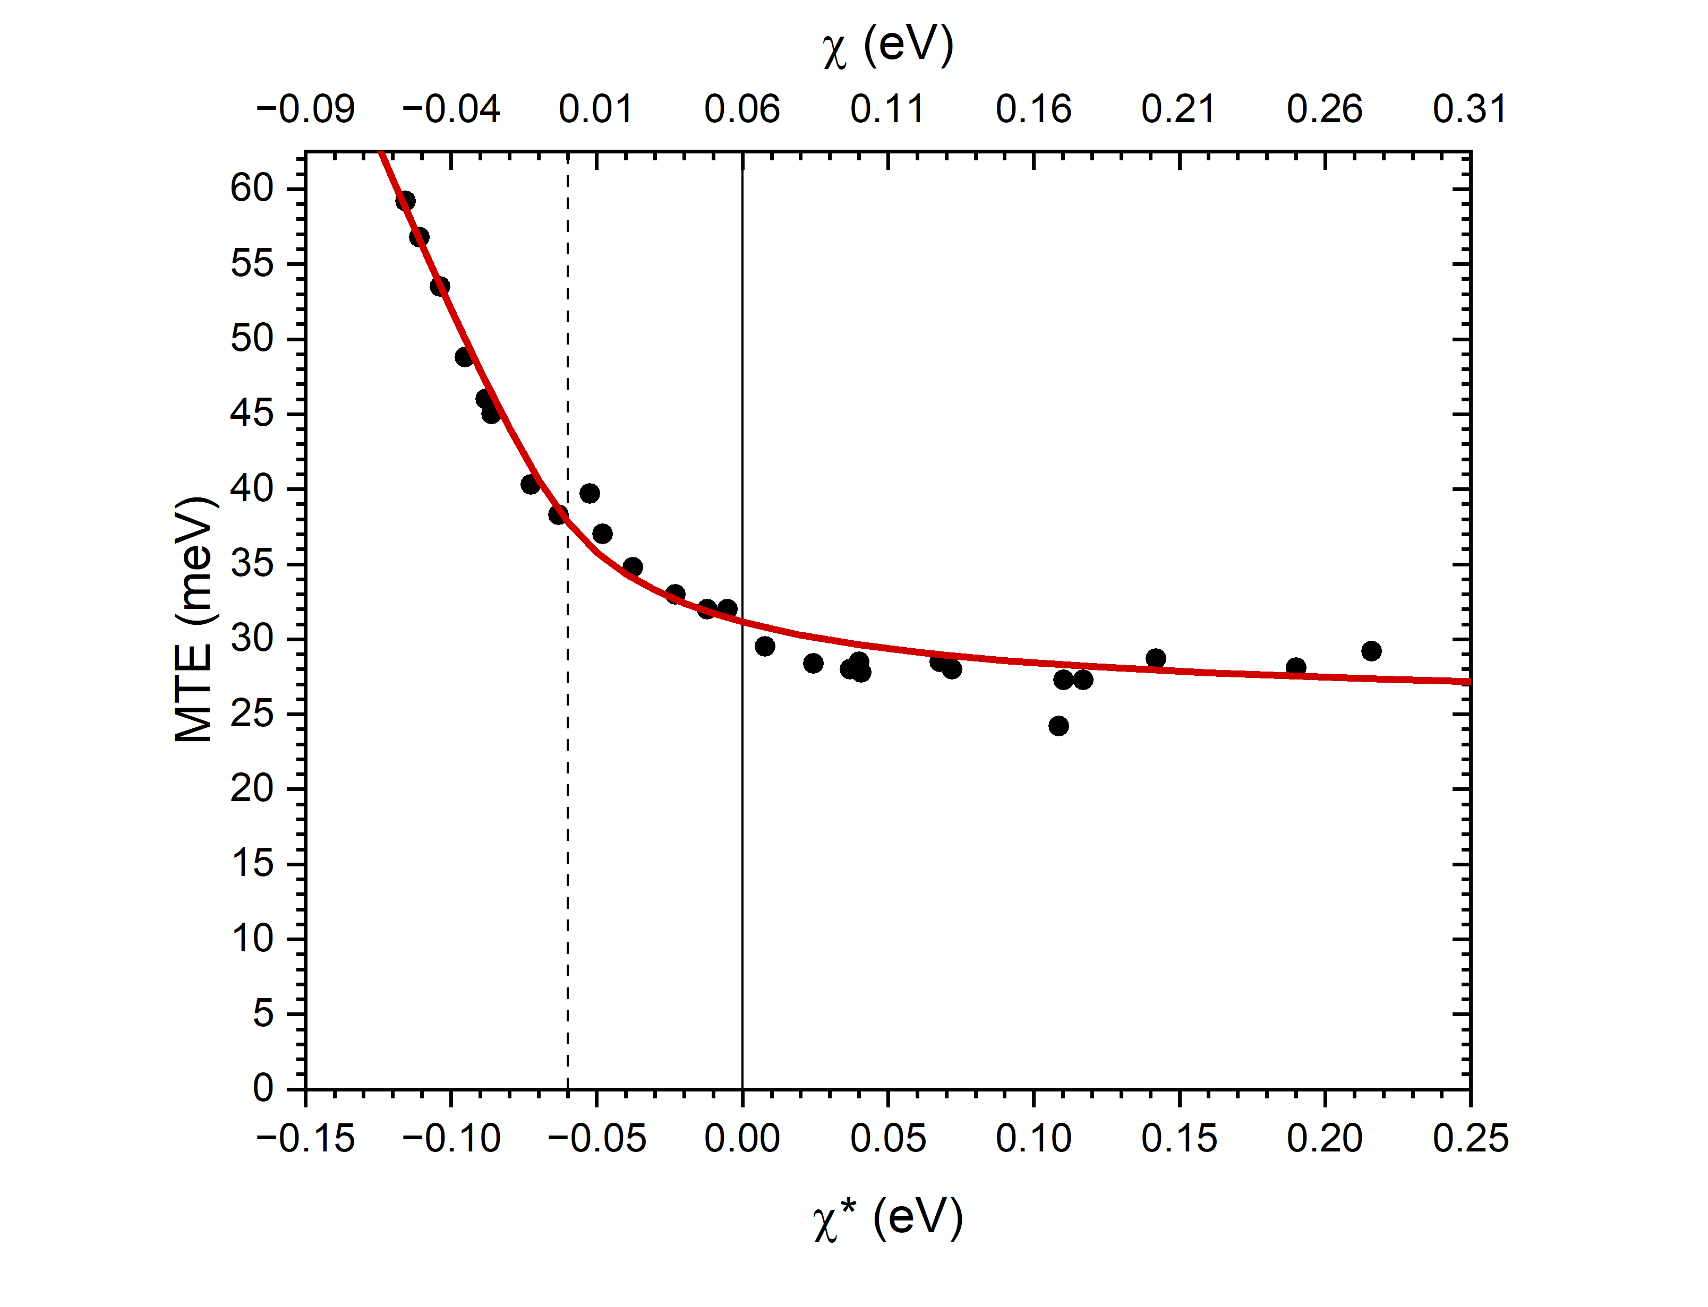
Cesiated p-GaAs: MTE
Fit to experimental data employs one parameter: k_{B}T_{e} = 27 meV
− Consistent with expected drift of
electron distribution to emission
face in GaAs under E ≈ 3 kV/cm
acceleration field
MTE → k_{B}T_{e} for large PEA
− Expected for Boltzmann tail emission
NOTE:
χ = χ* + 60 meV shift due to error in
assumption of instrument resolution
NEA
PEA
χ = χ* + 60meV
L.B. Jones, H.E. Scheibler, et al., J. Phys. D: Appl. Phys. 54, 205301 (2021)

Slide 20
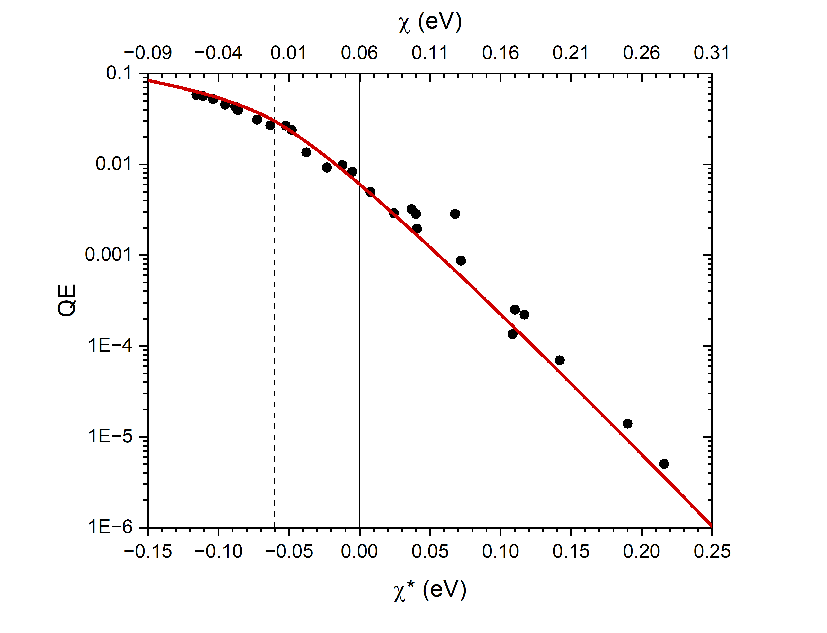
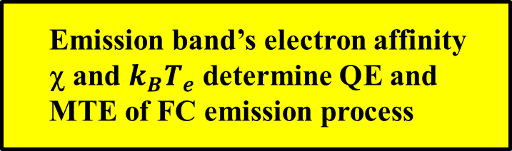
Cesiated p-GaAs: QE
Fit to experimental χ dependence again employs k_{B}T_{e} = 27 meV
− Consistent with MTE data !!
Boltzmann tail emission drives exponential decay in QE with χ for
large PEA
NEA
PEA
Emission band’s electron affinity
χ and $k_{B}T_{e}$ determine QE and
MTE of FC emission process
L.B. Jones, H.E. Scheibler, et al., J. Phys. D: Appl. Phys. 54, 205301 (2021)

Slide 21
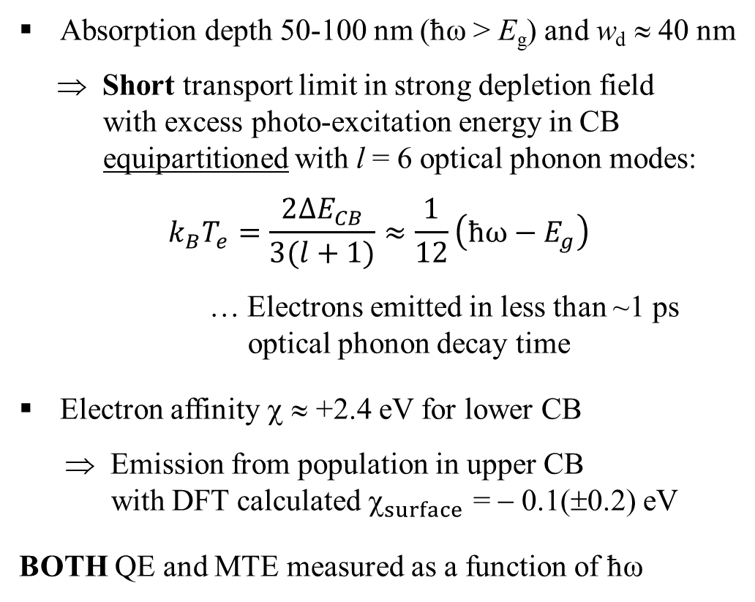
Mg-doped p-GaN(0001) photocathode
− Spectral measurements performed at UIC; λ = 230-410 nm, T = 300 K
Absorption depth 50-100 nm (ħω > E_{g}) and w_{d} ≈ 40 nm
⇒ Short transport limit in strong depletion field
with excess photo-excitation energy in CB
equipartitioned with l = 6 optical phonon modes:
$$k_{B}T_{e}=\frac{2∆E_{CB}}{3(l+1)}≈\frac{1}{12}\left(ħω−E_{g}\right)$$
… Electrons emitted in less than ~1 ps
optical phonon decay time
Electron affinity χ ≈ +2.4 eV for lower CB
⇒ Emission from population in upper CB
with DFT calculated $_{surface}$ = − 0.1(±0.2) eV
BOTH QE and MTE measured as a function of ħω
Upper CB
2.5 eV
χ
CB
E_{vac.}
ħω
[Mg] = 5x10¹⁷ cm⁻³
VB
w_{d}
W.A. Schroeder, L.A. Angeloni, I-J. Shan, and L.B. Jones, Phys. Rev. Applied 23, 054065 (2023)

Slide 22
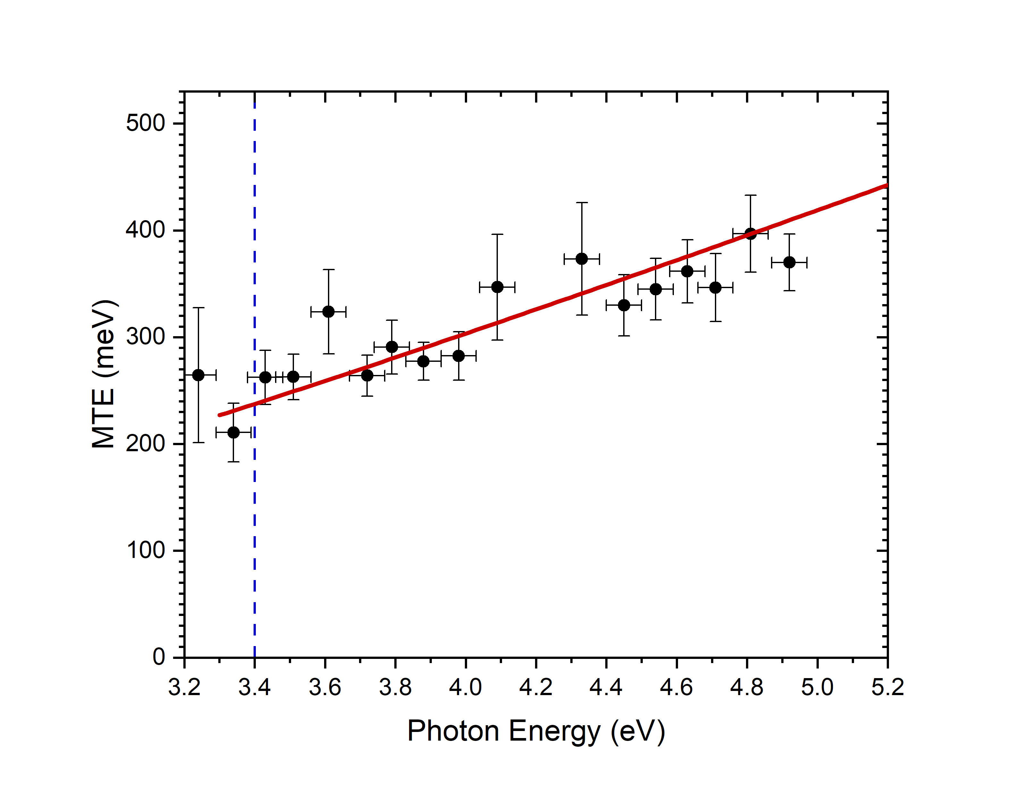
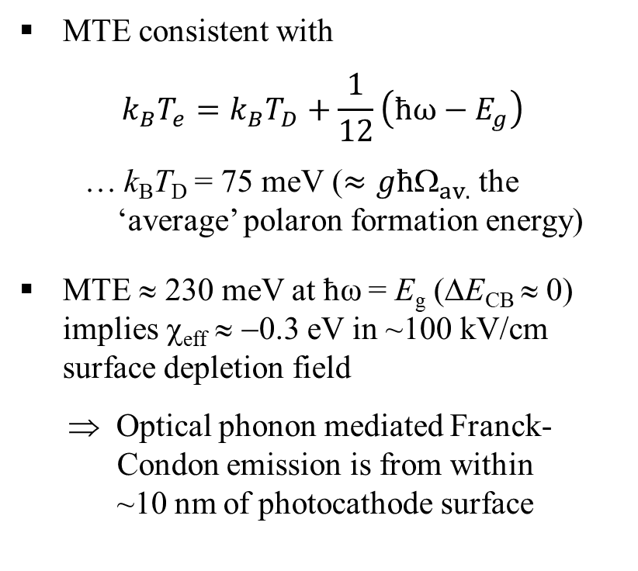
GaN(0001): MTE
MTE consistent with
$$k_{B}T_{e}=k_{B}T_{D}+\frac{1}{12}\left(ħω−E_{g}\right)$$
… k_{B}T_{D} = 75 meV ($≈għ_{av.}$ the
‘average’ polaron formation energy)
MTE ≈ 230 meV at ħω = E_{g} (ΔE_{CB} ≈ 0) implies χ_{eff} ≈ −0.3 eV in ~100 kV/cm surface depletion field
⇒ Optical phonon mediated Franck-
Condon emission is from within
~10 nm of photocathode surface
E_{g} = 3.4eV
W.A. Schroeder, L.A. Angeloni, I-R. Shan, and L.B. Jones, Phys. Rev. Applied 23, 054065 (2023)

Slide 23
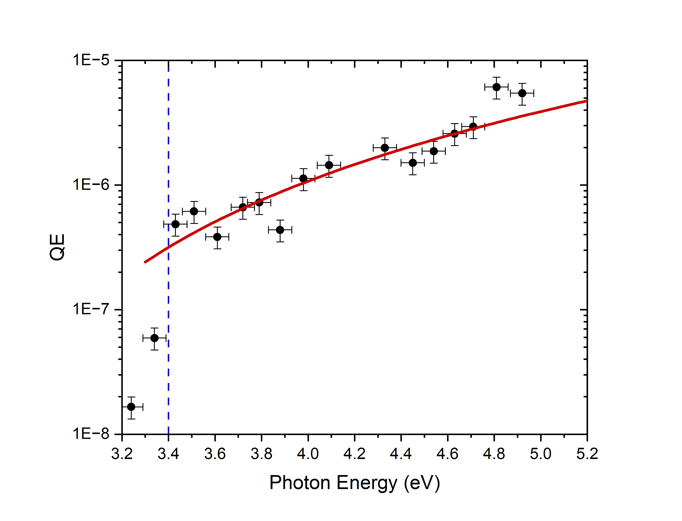
GaN(0001): QE
E_{g} = 3.4eV
Same k_{B}T_{e}(ħω) dependence using
χ = −0.3 eV also consistent with
measured spectral QE dependence
Overall QE significantly lower than for Cs:GaAs photocathode as χ_{CB} = +2.4 eV
Signal below E_{g} due to photoexcitation from Mg dopants (E_{A} = 0.1-0.2 eV)
NOTE:
Untreated epi-polished GaN wafer (Ra < 1 nm)
∴ Surface roughness effects negligible
W.A. Schroeder, L.A. Angeloni, I-R. Shan, and L.B. Jones, Phys. Rev. Applied 23, 054065 (2023)

Slide 24
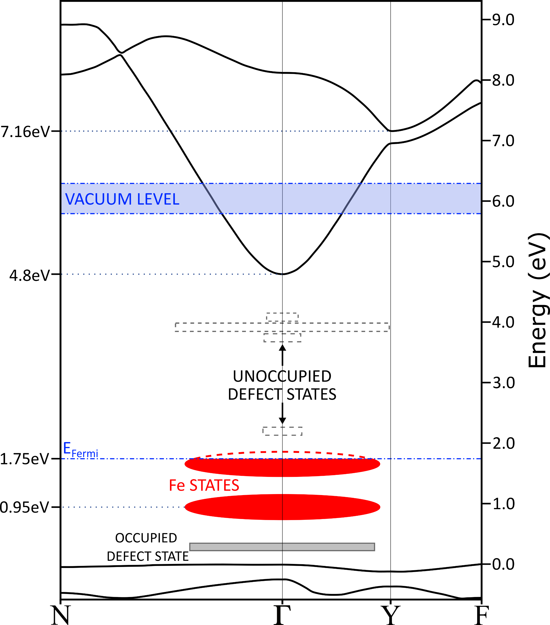
Fe-doped Ga₂O₃(010): Band structure
− Amsterdam Suite with rSCAN functionals
Thin-slab calculations give E_{vac.} = 6.0(±0.2) eV above valence band Γ point
⇒ Lower CB χ ≈ +1.2 eV
AND first ‘closed’ upper CB χ ≈ −1.1 eV
Photoexcitation into lower CB primarily from
(i) Two Fe dopant states (ħω < E_{g})
([Fe] ≈ 10¹⁸ cm⁻³ for semi-insulating behavior)
(ii) Valance band (ħω > E_{g})
UCB
LCB

Slide 25
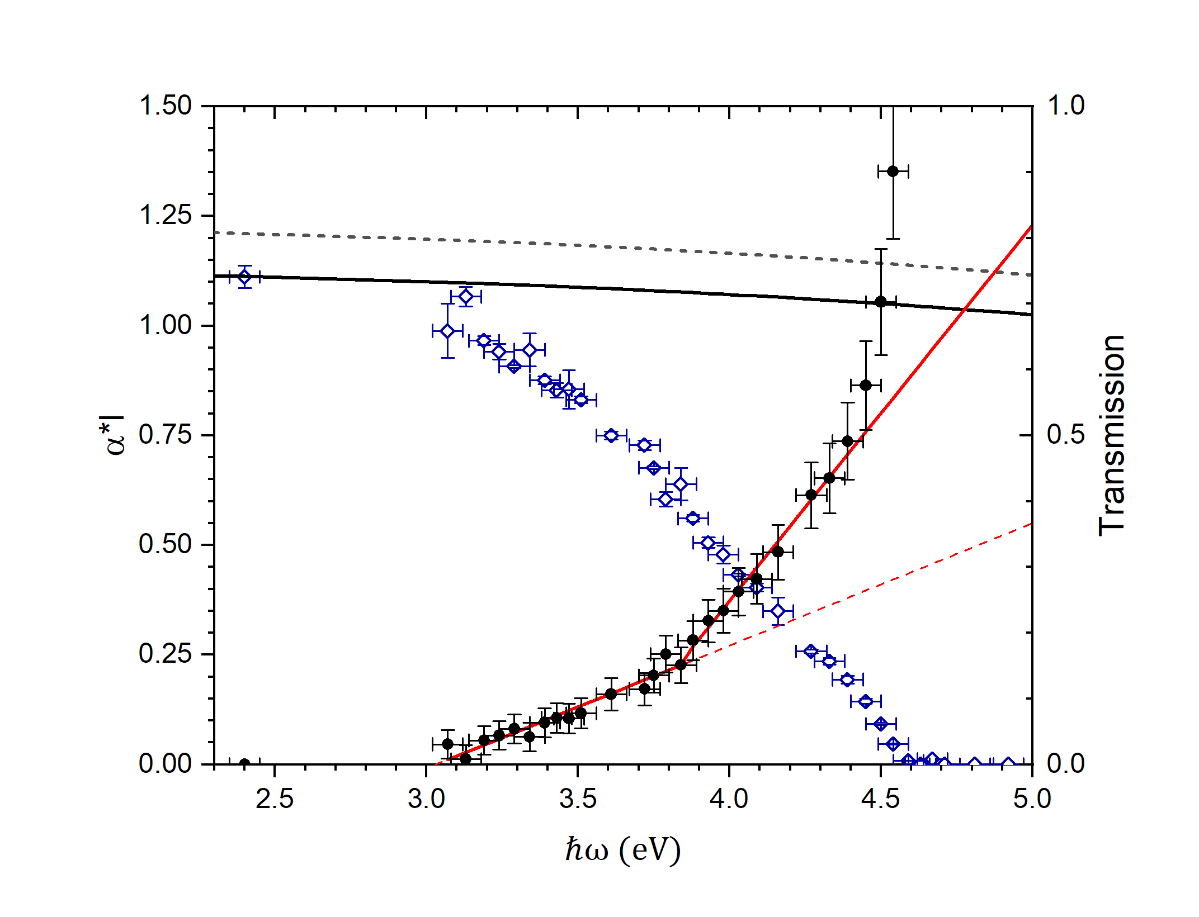
Fe-doped Ga₂O₃(010): Absorption α(ħω)
− Sample thickness: 450(±50) μm
BOTH electron transport regimes expected in one photocathode:
‘Long’ transport for ħω < 4.5 eV
− Absorption depth > 400 μm;
Fe dopant state to CB transitions
‘Short’ transport for ħω > 4.5 eV
− Absorption depth < 100 nm;
band-to-band transitions
NOTE:
Strong E_{g}(T) variation, Urbach absorption
tail, and anisotropic valence band
contribute to E_{g,eff.} ≈ 4.5 eV at 300 K
αl
‘long’ transport
‘short’ transport
L.A. Angeloni, I-J. Shan, J.H. Leach, and W.A. Schroeder, Appl. Phys. Lett. 124, 252104 (2024)

Slide 26
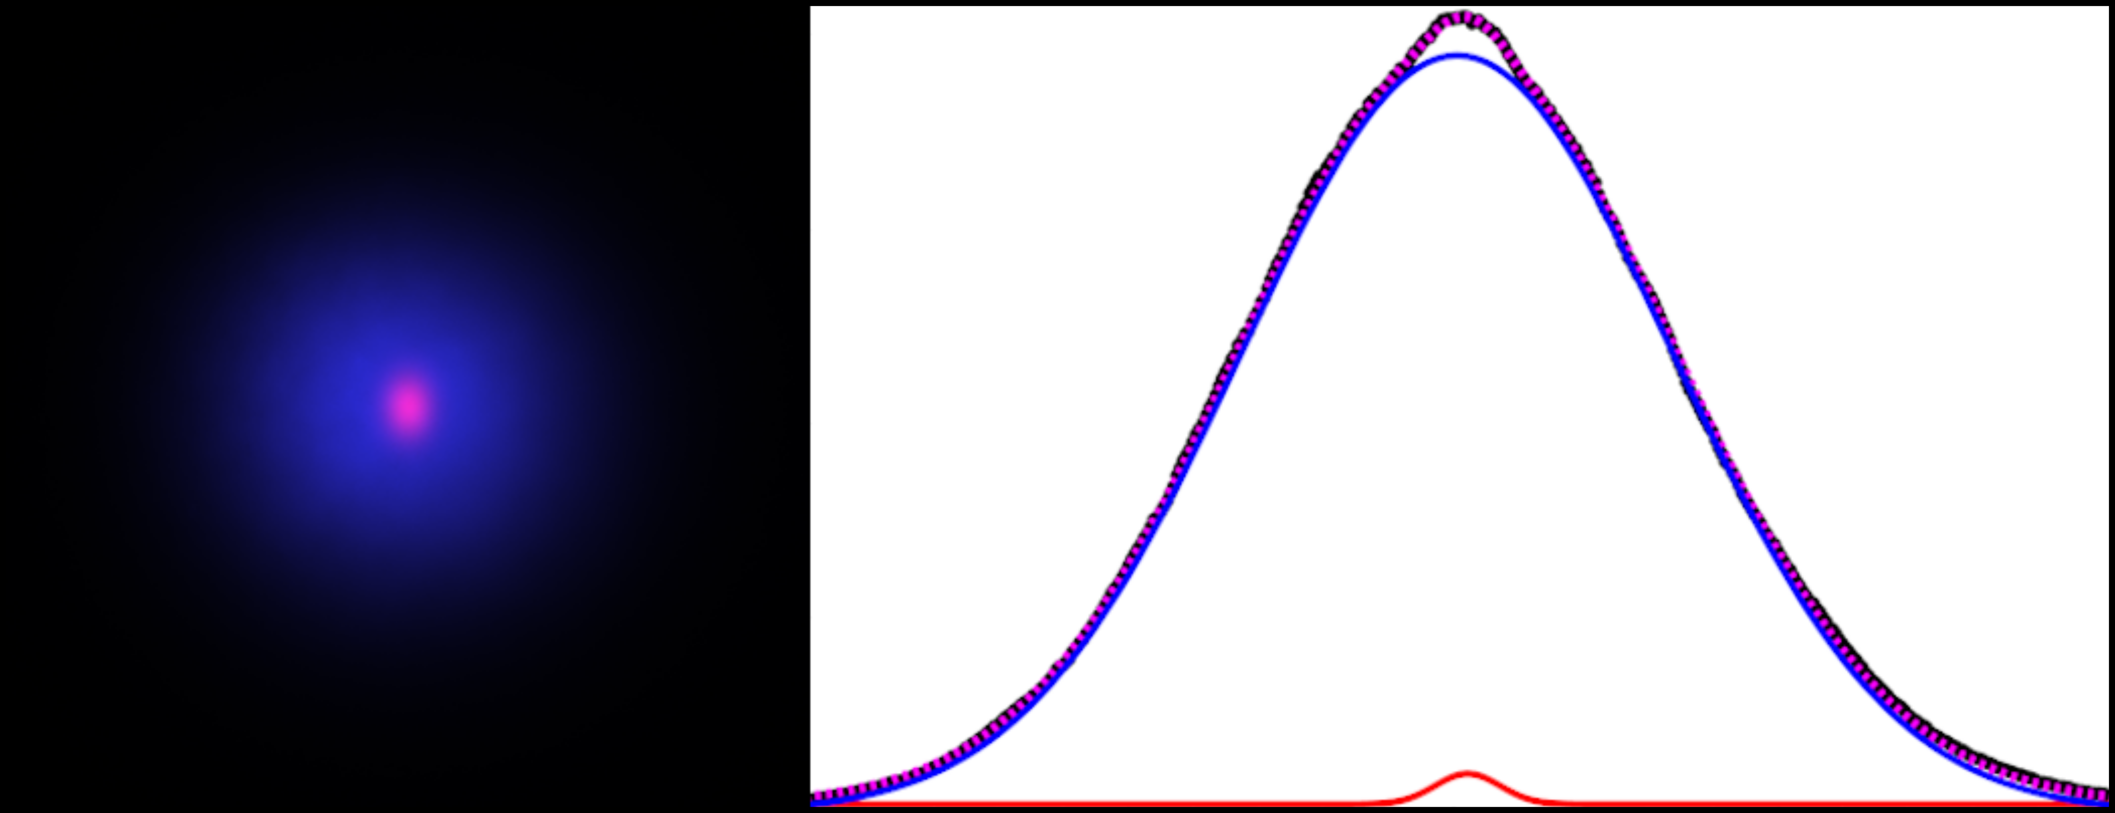
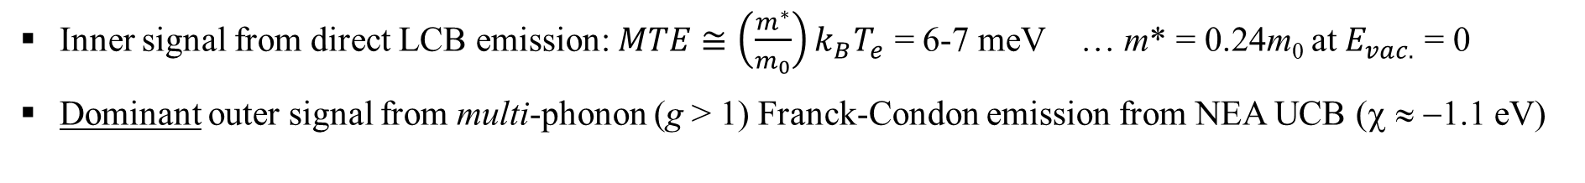
Fe-doped Ga₂O₃(010): Two emission signals
− Two Gaussian decomposition reveals sub-thermal emission signal !!
ħω = 4.33 eV
Outer signal
MTE ≈ 280 meV
300 K
Long transport regime
(ħω < E_{g} ≈ 4.5 eV)
⇒ T_{e} → T_{lattice}
Transport analysis in
internal drift field gives
k_{B}T_{e} ≈ 27 meV
Inner signal
MTE ≈ 6 meV
p_{T}
Inner signal from direct LCB emission: $MTE≅\left(\frac{m^{∗}}{m_{0}}\right)k_{B}T_{e}$ = 6-7 meV … m* = 0.24m₀ at $E_{vac.}$ = 0
Dominant outer signal from multi-phonon (g > 1) Franck-Condon emission from NEA UCB (χ ≈ −1.1 eV)
L.A. Angeloni, I-J. Shan, J.H. Leach, and W.A. Schroeder, J. Appl. Phys. 139, 095706 (2026)

Slide 27
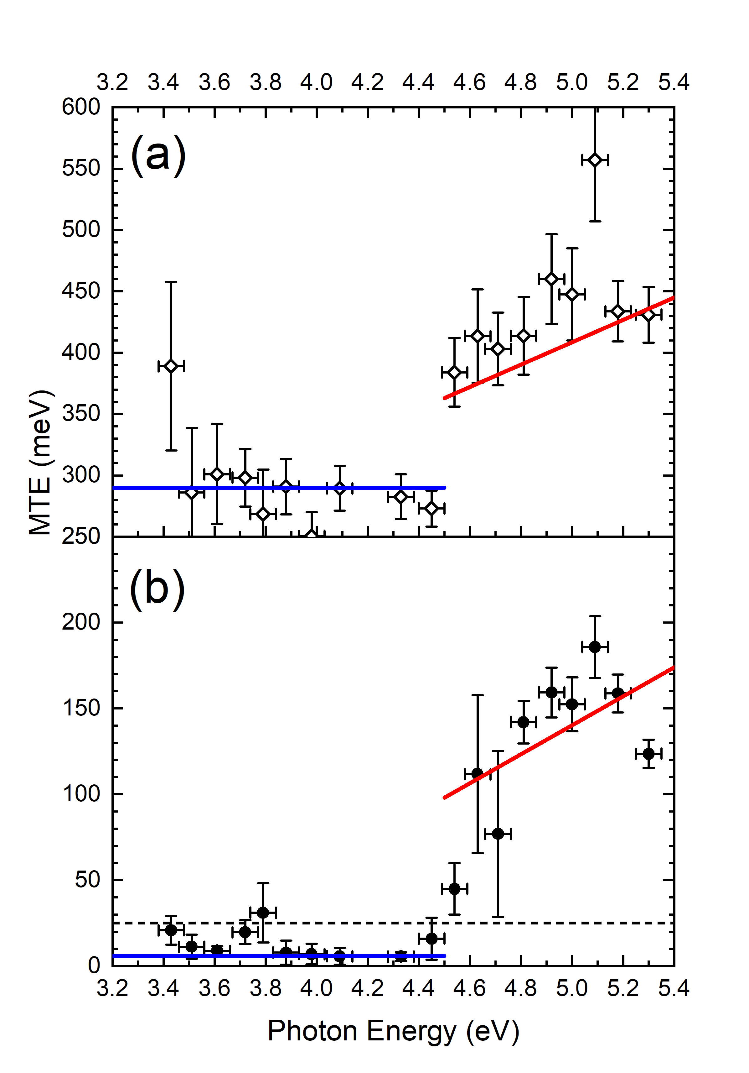
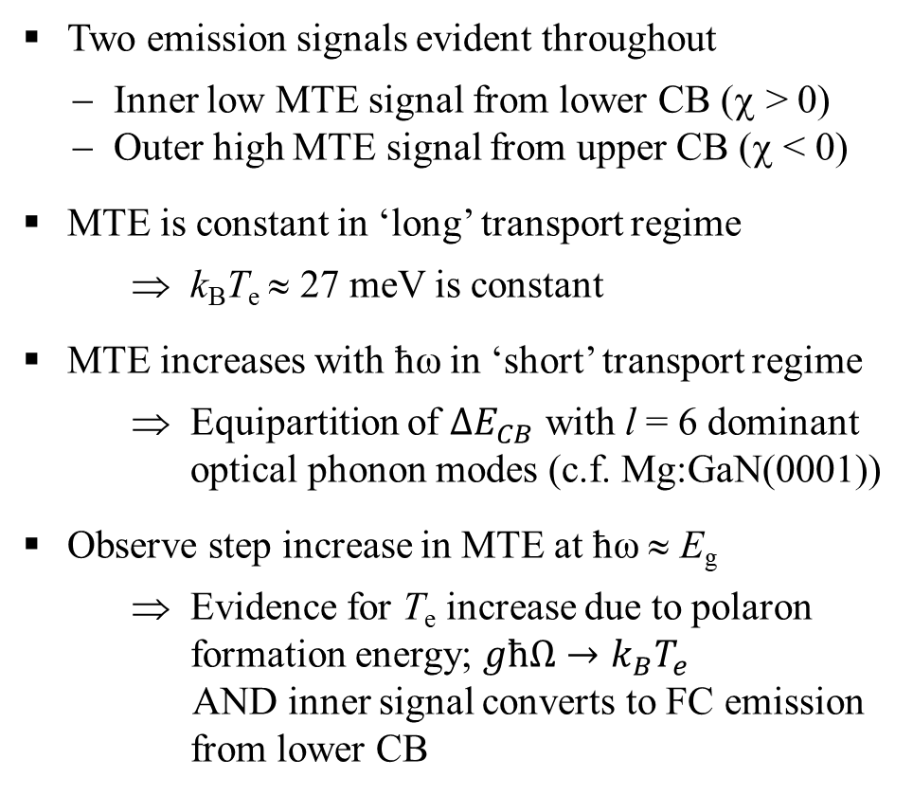
Fe-doped Ga₂O₃(010): MTE
Two emission signals evident throughout
− Inner low MTE signal from lower CB (χ > 0)
− Outer high MTE signal from upper CB (χ < 0)
MTE is constant in ‘long’ transport regime
⇒ k_{B}T_{e} ≈ 27 meV is constant
MTE increases with ħω in ‘short’ transport regime
⇒ Equipartition of ${∆E}_{CB}$ with l = 6 dominant
optical phonon modes (c.f. Mg:GaN(0001))
Observe step increase in MTE at ħω ≈ E_{g}
⇒ Evidence for T_{e} increase due to polaron
formation energy; $għΩ→k_{B}T_{e}$
AND inner signal converts to FC emission
from lower CB
Outer signal
‘Short’ transport
Inner signal
‘Long’ transport
25meV

Slide 28
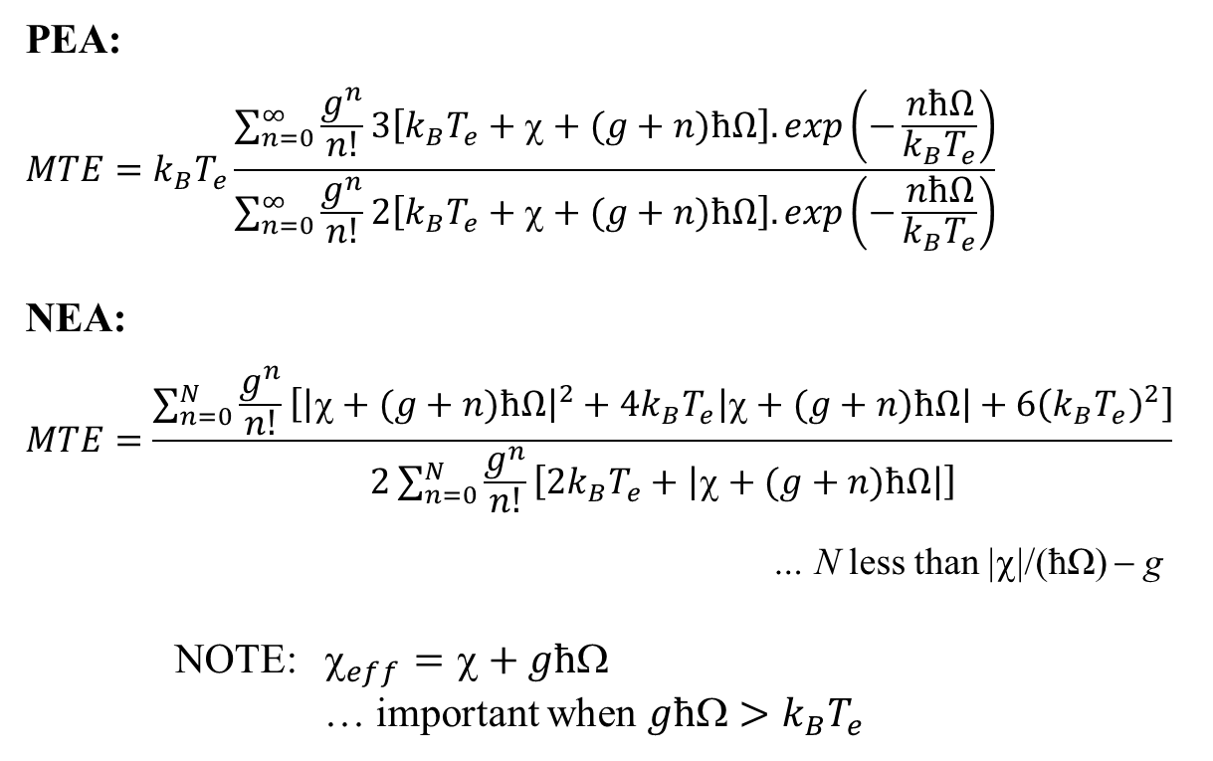
Modified FC analysis: Multi-phonon emission
− Large Fröhlich coupling constant g and finite ħΩ ⇒ Significant polaron energy għΩ
PEA:
$$MTE=k_{B}T_{e}\frac{\sum_{n=0}^{∞}{\frac{g^{n}}{n!}}3\left[k_{B}T_{e}+χ+(g+n)ħΩ\right].exp\left(−\frac{nħΩ}{k_{B}T_{e}}\right)}{\sum_{n=0}^{∞}{\frac{g^{n}}{n!}}2\left[k_{B}T_{e}+χ+(g+n)ħΩ\right].exp\left(−\frac{nħΩ}{k_{B}T_{e}}\right)}$$
NEA:
$$MTE=\frac{\sum_{n=0}^{N}{\frac{g^{n}}{n!}\left[{\left|χ+(g+n)ħΩ\right|}^{2}+4k_{B}T_{e}\left|χ+(g+n)ħΩ\right|+6{\left(k_{B}T_{e}\right)}^{2}\right]}}{2\sum_{n=0}^{N}{\frac{g^{n}}{n!}\left[2k_{B}T_{e}+\left|χ+(g+n)ħΩ\right|\right]}}$$
… N less than |χ|/(ħΩ) − g
NOTE: $_{eff}=+għ$
… important when $għ>k_{B}T_{e}$
CB
Polaron
għΩ
n = 0
n = 1
n = 2
ħΩ
ħω
Emission
ħΩ
:
L.A. Angeloni, I-J. Shan, and W.A. Schroeder, Phys. Rev. Accel. & Beams 28, 123401 (2025)

Slide 29
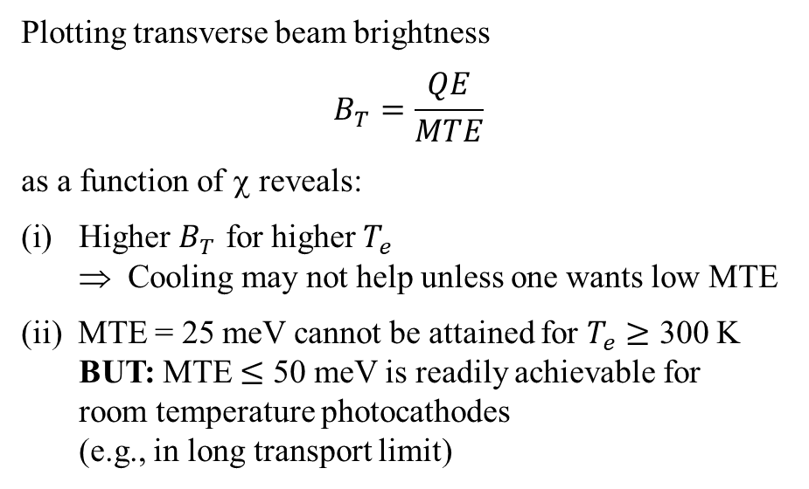

Beam brightness: FC emission
− Optimum χ for maximum beam brightness: Analytical evaluation in ħΩ → 0 limit
Plotting transverse beam brightness
$$B_{T}=\frac{QE}{MTE}$$
as a function of χ reveals:
Higher $B_{T}$ for higher $T_{e}$
⇒ Cooling may not help unless one wants low MTE
(ii) MTE = 25 meV cannot be attained for $T_{e}≥$ 300 K
BUT: MTE $≤$ 50 meV is readily achievable for
room temperature photocathodes
(e.g., in long transport limit)
$T_{e}$= 500 K
MTE = 100 meV
400 K
300 K
200 K
Brightness (a.u.)
MTE = 50 meV
100 K
For any polar semiconductor
photocathode maximum beam
brightness achieved for χ ≈ 0
at any desired MTE
MTE = 25 meV
χ (eV)

Slide 30
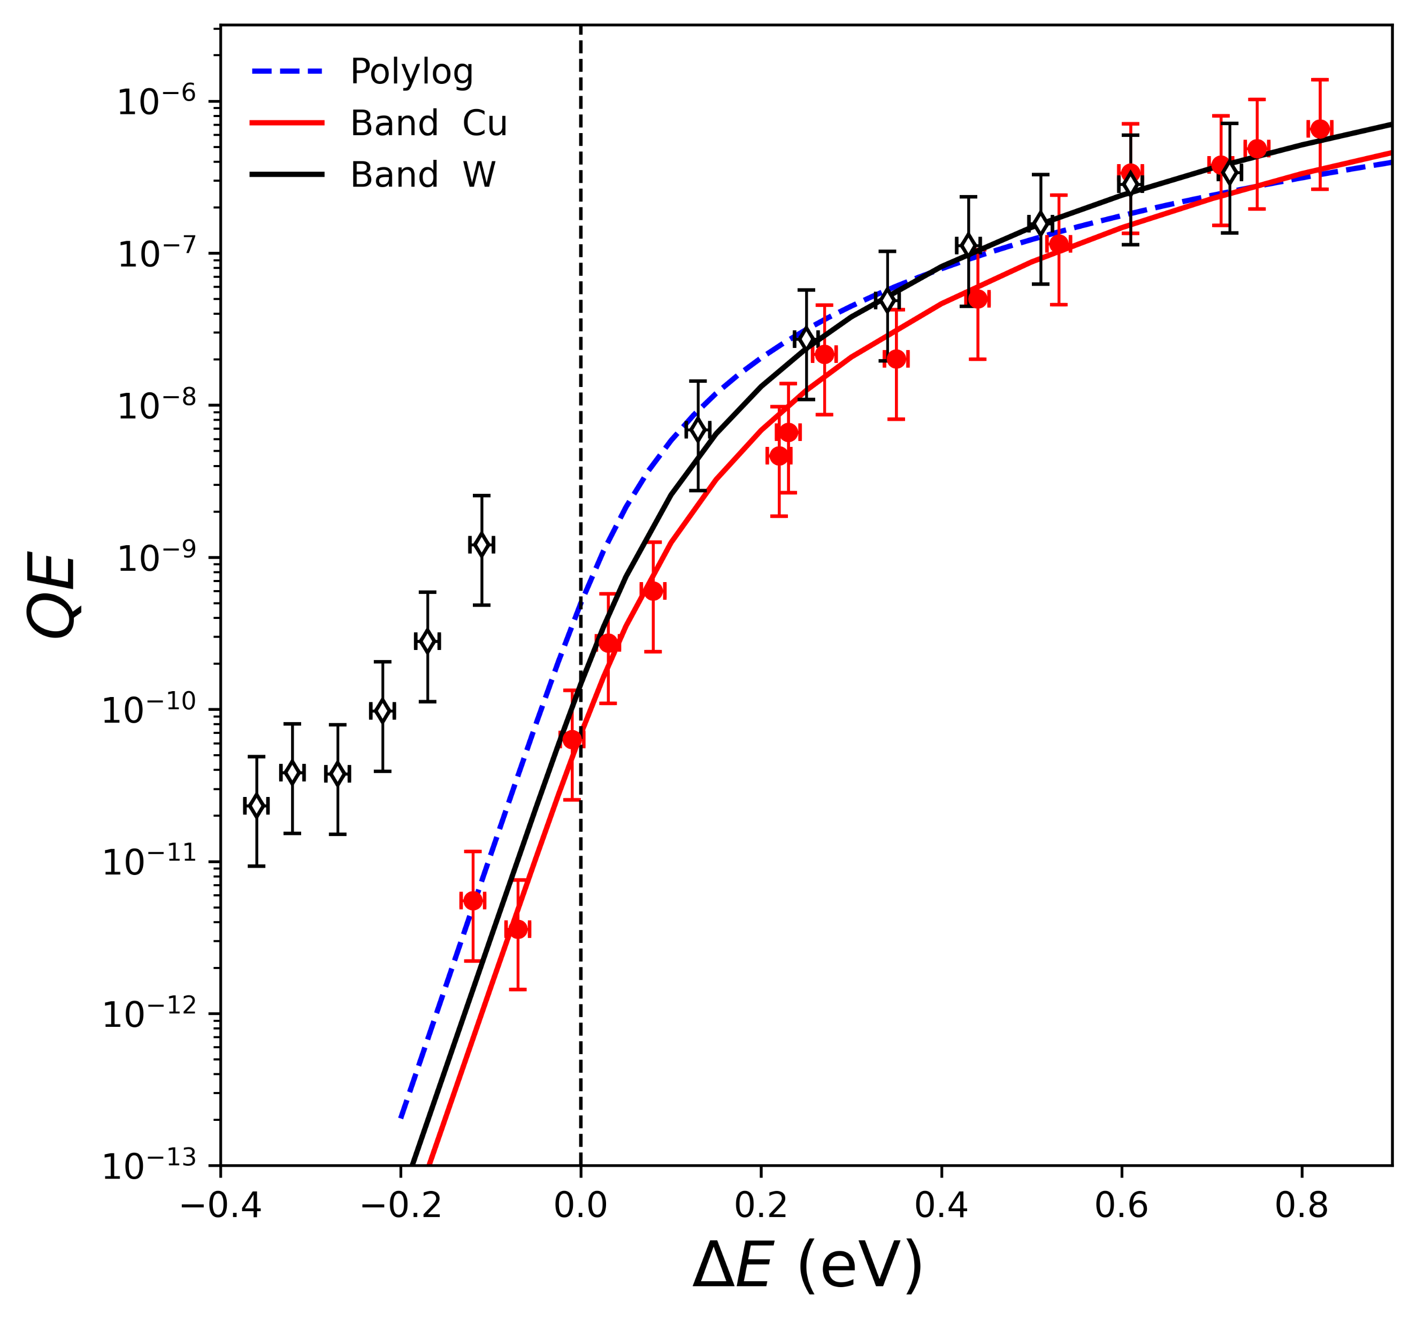
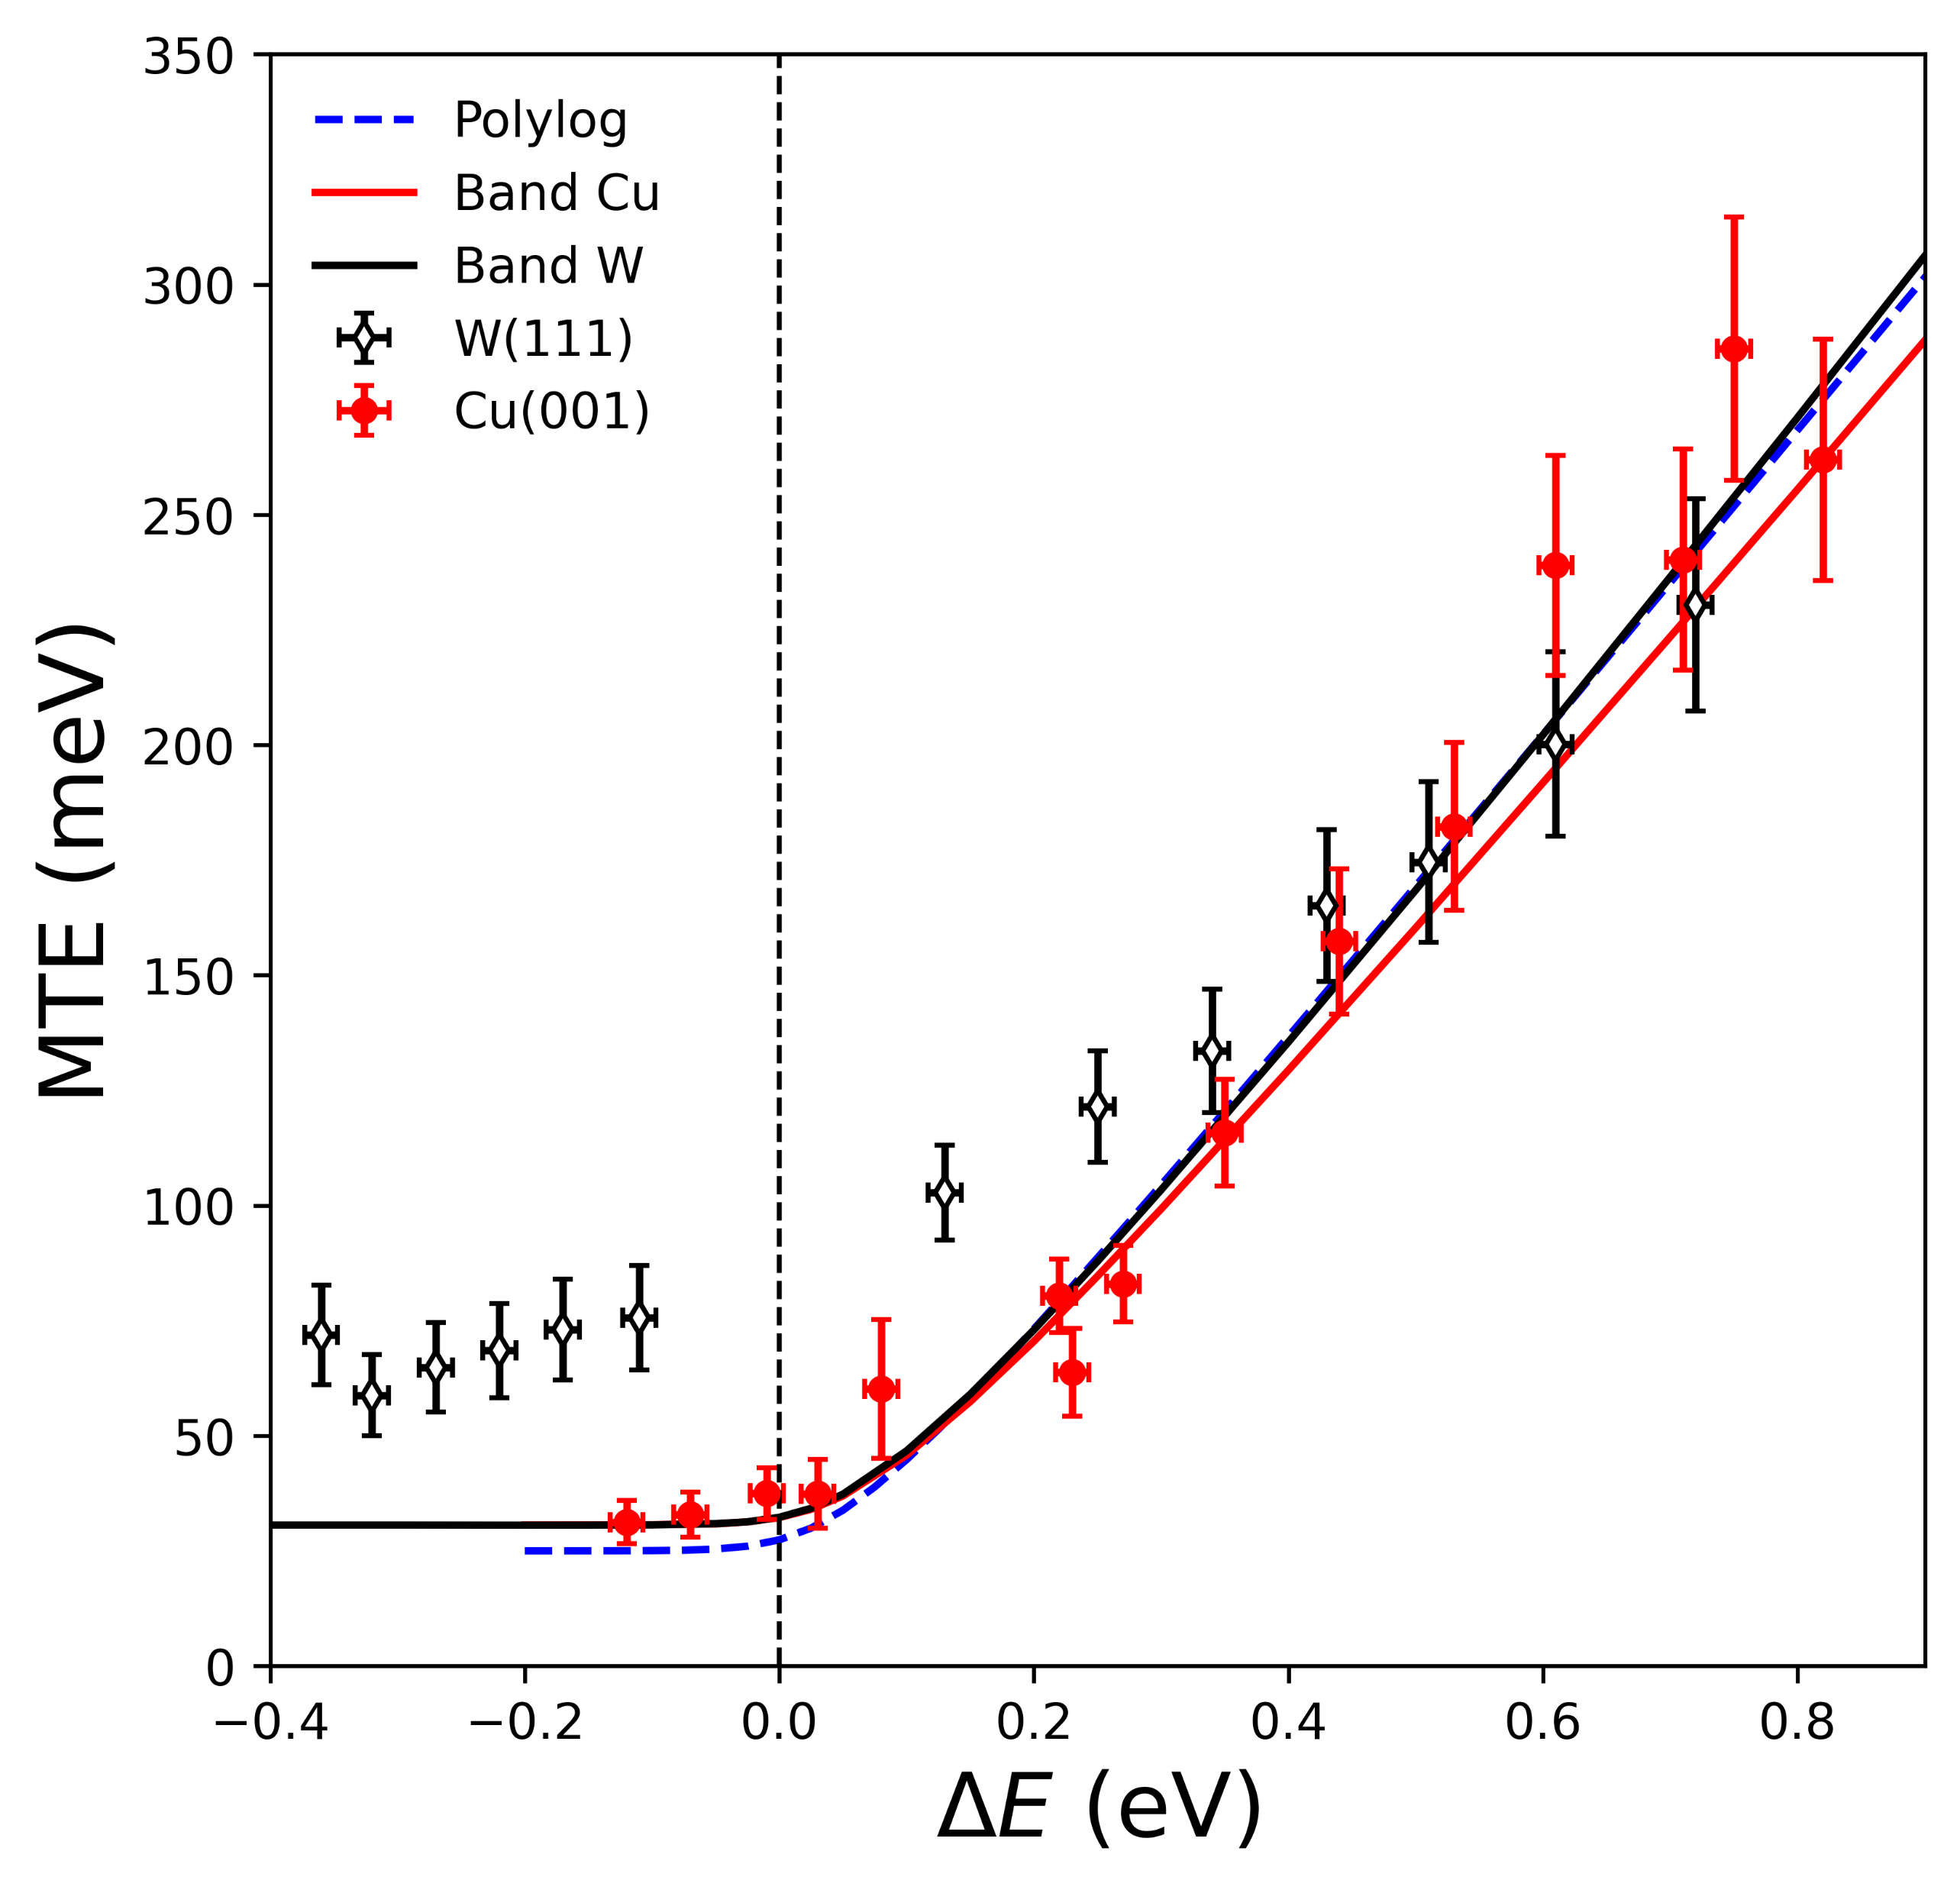
Metal photocathodes: Cu(001) and W(111)
− Single emitting band for both Cu(001) and W(111) and no upper conduction band emission

Slide 31
Metal photocathodes: Cu(001) and W(111)
− Single emitting band for both Cu(001) and W(111) and no upper conduction band emission
W(111) photoemission NOT in agreement
with direct ‘one-step’ band emission theory
near and below threshold
⇒ Additional emission mechanism (?)

Slide 32

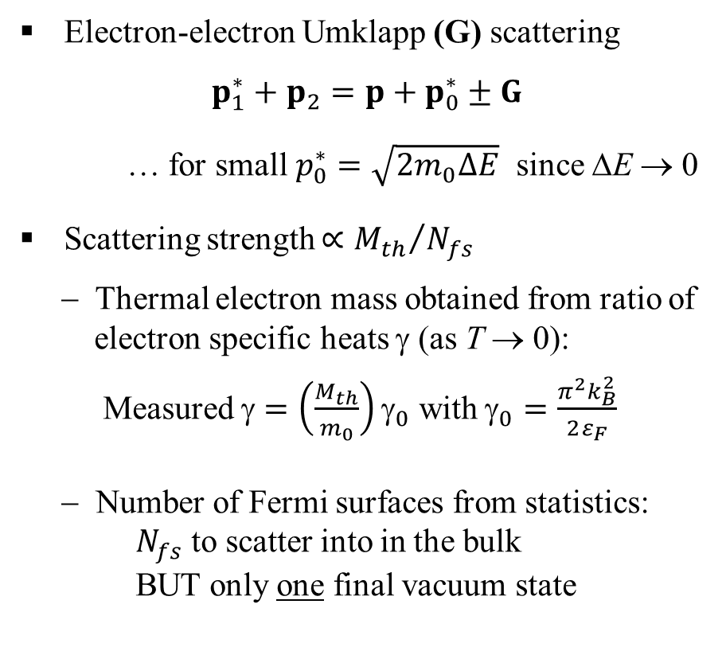

Umklapp electron scattering (UES) emission
− Near threshold emission; Spherical Fermi surface approximation
Electron-electron Umklapp (G) scattering
$$p_{1}^{∗}+p_{2}=p+p_{0}^{∗}±G$$
… for small $p_{0}^{∗}=\sqrt{2m_{0}∆E}$ since ΔE → 0
Scattering strength $∝{M_{th}}/{N_{fs}}$
− Thermal electron mass obtained from ratio of
electron specific heats γ (as T → 0):
Measured $=\left(\frac{M_{th}}{m_{0}}\right)γ_{0}$ with $_{0}=\frac{π^{2}k_{B}^{2}}{2ε_{F}}$
− Number of Fermi surfaces from statistics:
$N_{fs}$ to scatter into in the bulk
BUT only one final vacuum state
Brillouin zones
Γ/
p
G
$$p_{1}^{∗}$$
Γ
p₂
$$p_{0}^{∗}$$
Fermi surface

Slide 33
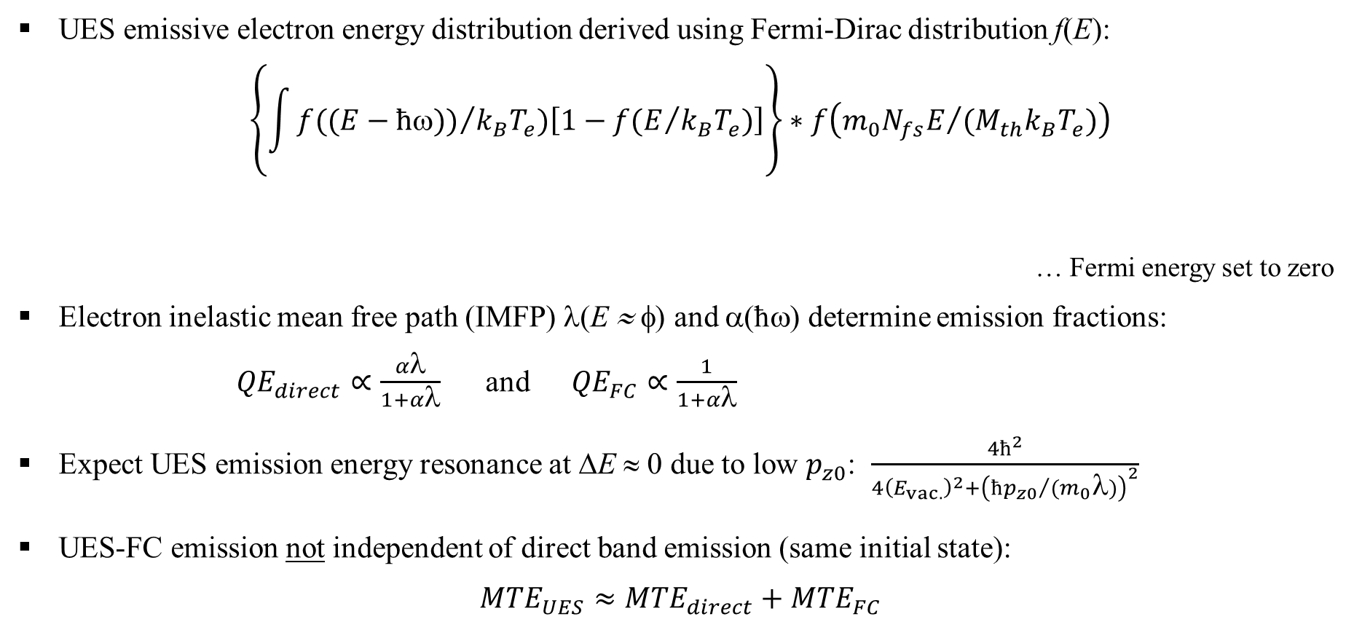
Umklapp electron scattering (UES) emission (contd.)
UES emissive electron energy distribution derived using Fermi-Dirac distribution f(E):
$$\left\{\int{f({(E−ħω))}/{k_{B}T_{e}})\left[1−f(E/{k_{B}T_{e}})\right]}\right\}∗f\left({m_{0}N_{fs}E}/{(M_{th}k_{B}T_{e})}\right)$$
… Fermi energy set to zero
Electron inelastic mean free path (IMFP) λ(E ≈ φ) and α(ħω) determine emission fractions:
${QE}_{direct}∝\frac{αλ}{1+αλ}$ and ${QE}_{FC}∝\frac{1}{1+αλ}$
Expect UES emission energy resonance at ΔE ≈ 0 due to low $p_{z0}$: $\frac{4ħ^{2}}{4{\left(E_{vac.}\right)}^{2}+{\left({ħp_{z0}}/{(m_{0}λ)}\right)}^{2}}$
UES-FC emission not independent of direct band emission (same initial state):
$${MTE}_{UES}≈{MTE}_{direct}+{MTE}_{FC}$$
Excited distribution
Unoccupied states
Scattered distribution (UES physics)
R. F. Willis and N. E. Christensen, Phys. Rev. B 18, 5140 (1978)

Slide 34
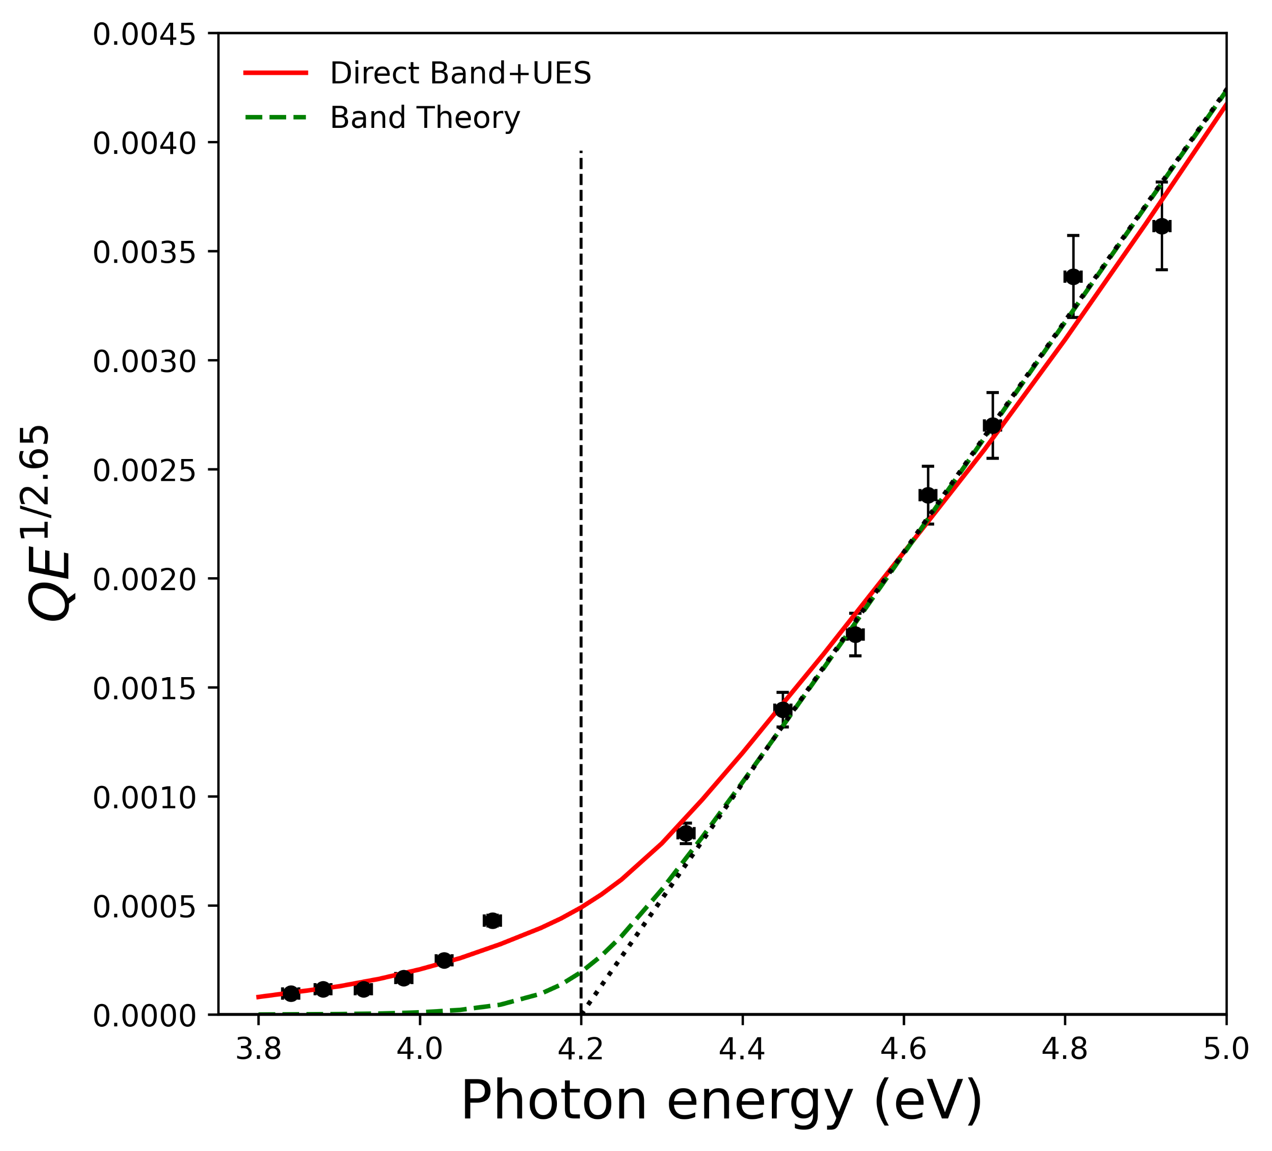
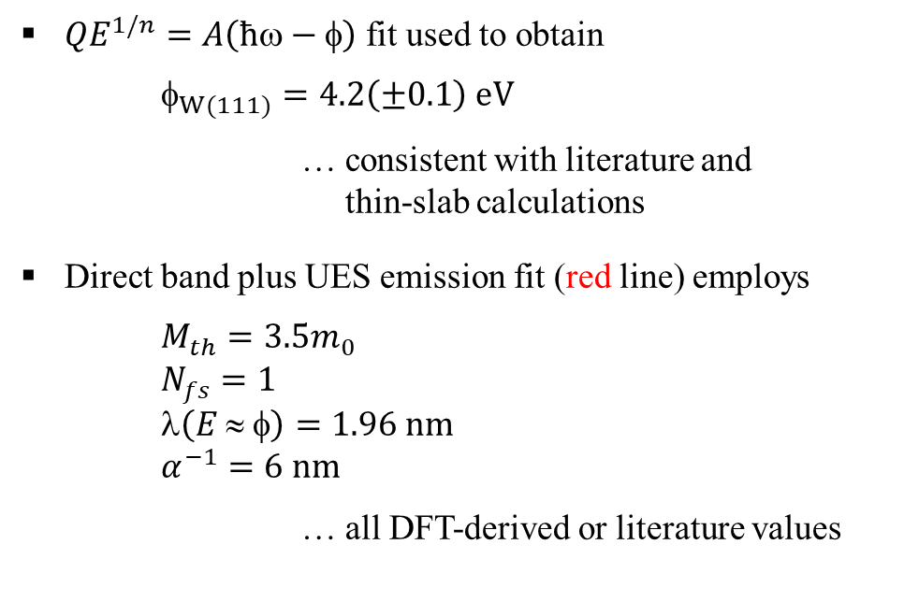
W(111) QE: Theory vs. experiment
${QE}^{1/n}=A\left(ħω−φ\right)$ fit used to obtain
$_{W(111)}=4.2\left(±0.1\right) eV$
… consistent with literature and
thin-slab calculations
Direct band plus UES emission fit (red line) employs
$M_{th}=3.5m_{0}$
$N_{fs}=1$
$\left(E ≈ φ\right)=1.96 nm$
$α^{−1}=6 nm$
… all DFT-derived or literature values

Slide 35
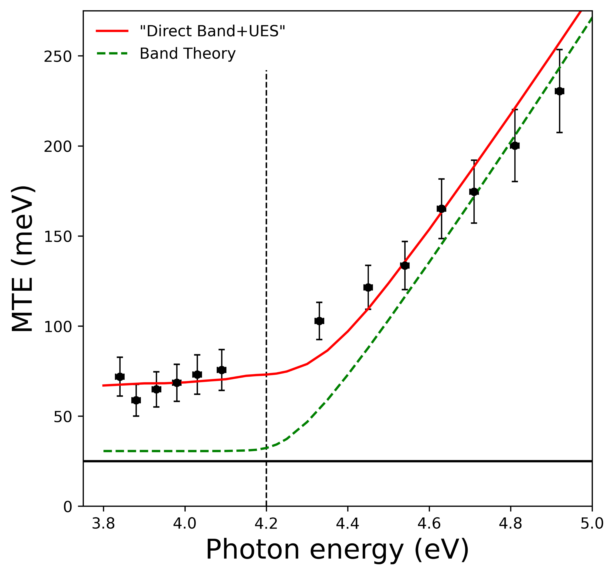
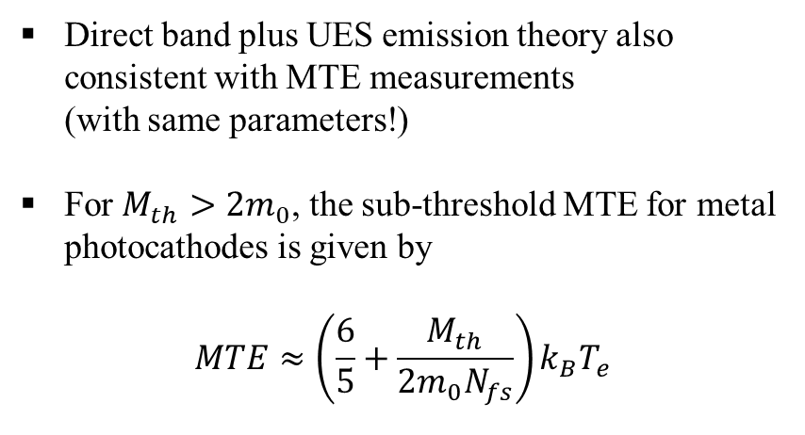

W(111) MTE: Theory vs. experiment
Direct band plus UES emission theory also consistent with MTE measurements
(with same parameters!)
For $M_{th}>2m_{0}$, the sub-threshold MTE for metal photocathodes is given by
$$MTE≈\left(\frac{6}{5}+\frac{M_{th}}{{2m}_{0}N_{fs}}\right)k_{B}T_{e}$$
Band structure calculations:
Direct one-step emission band parameters E(p)
$N_{fs}$
$M_{th}$ (using DFT-determined $γ$ and $γ_{0}$ from $N_{e}$)
Thin-slab evaluations of $_{(ijk)}$

Slide 36

Summary
Direct ‘one-step’ photoemission simulation
− Emitting band(s) physical properties: E(p), local DOS
− Photoemission barrier quantum physics ($p_{T}$ conservation) and recipient vacuum DOS
⇒ $QE=C{(ħ−)}^{n}$ with n > 2 and $MTE\left(∆E≤0\right)>k_{B}T$ for good metals
$MTE∝ k_{B}T_{e}$ (not $k_{B}T$) for upper CB emission
BUT sub-thermal emission observed; $MTE≅\left(\frac{m^{∗}}{m_{0}}\right)k_{B}T_{e}$
Momentum-resonant Franck-Condon (FC) electron emission
− Mediated by (optical)phonon scattering in polar semiconductors (q)
⇒ $cosθ$ emission dependence and $MTE>\frac{1}{2}|χ|$ for NEA
− Umklapp electron scattering emission in metals (G)
… Preliminary analysis: $M_{th} , N_{fs} ,  ,$ and α
Predicted QE and MTE consistent with experimental data
− Good agreement for Cu(001), Cu(111), W(111), Cs:GaAs, GaN, and Fe:Ga₂O₃(010)

Slide 37
Thank You !

Slide 38

Cs:GaAs transverse energy distribution
Evidence for direct band contribution?
Less than 5% of total emission
BUT MTE < 25 meV
(m* ≈ 0.067m₀ for GaAs)
NOTE
Other reports:
G. Vergara et al., J. Appl. Phys. 80, 1809 (1996)
V. Bakin et al., JETP Lett. 77, 167 (2003)
Z. Liu et al., J. Vac Sci. & Tech. B 23, 2758 (2005)
L.B. Jones, H.E. Scheibler, et al., J. Phys. D: Appl. Phys. 54, 205301 (2021)

Slide 39

Metallized diamond(001): A hybrid photocathode
− 0.5 mm-thick CVD diamond: Back surface metallized [annealed C-Ti (+Pt+Au)]
Back surface photo-injection from Ti into diamond CB for ħω > 3.2 eV
Electron drift transport to emission face due to applied DC gun field
⇒ k_{B}T_{e} ≈ 30 meV
… E ≈ 3 kV/cm, ħΩ = 165 meV
Emission from upper (χ ≈ −0.8 eV) and lower (χ ≈ 0.8 eV) CBs
⇒ Two emission signals
L.A. Angeloni, I-J. Shan, and W.A. Schroeder, PRAB 28, 123401 (2025)

Slide 40


Metallized diamond(001): MTE and QE
− Multi-phonon emission: g = 1.1, ħΩ = 165 meV, plus polaron self energy
MTE
Total QE
Upper CB
Back surface injection efficiency with Ti DOS
Lower CB
L.A. Angeloni, I-J. Shan, and W.A. Schroeder, PRAB 28, 123401 (2025)

