Slide 1



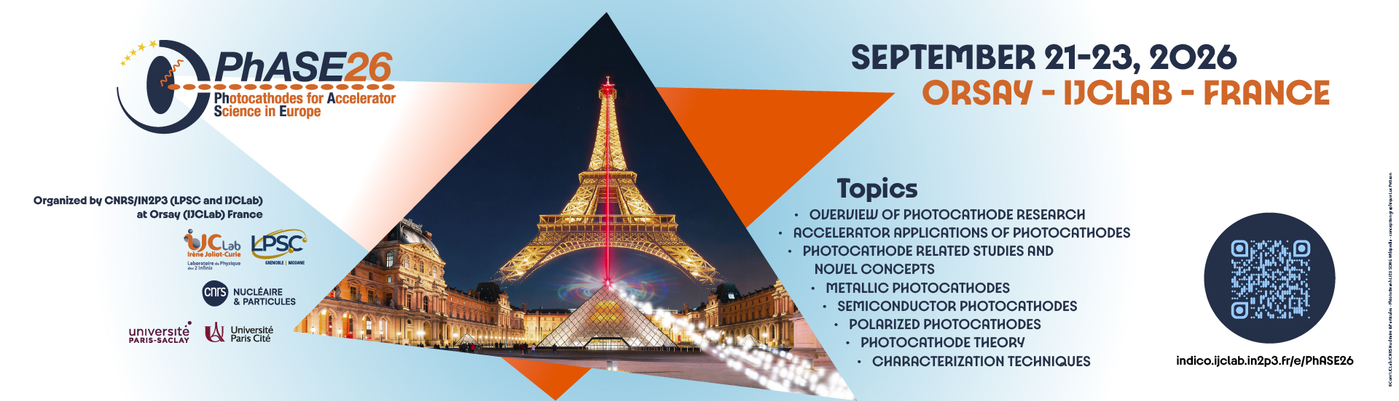
Photocathodes for Accelerator Science in Europe
Orsay, France
Closing of PhASE26
1

Slide 2

Summary
2026 edition of the PhASE (formerly EWPAA) european workshop on photocathodes
Increasingly growing participation to this workshop since 20 years
PhASE26
  71 participants, almost all them physically in Orsay
  34 talks in different sessions (only 2 remote)
  Tutorial « Photocathode physics, a band structure perspective », by Andreas Schroeder
    Intended to students
2

Slide 3
PhASE26
3

Slide 4
Thanks to all of you
Thanks to all the participants of PhASE26 who contribute to the success of the event
Special thanks to speakers and presenters of posters
Speakers : proceedings
  1-page abstract for each talk with template provided, due September 30 to lee.jones@stfc.ac.uk
  A list of posters will be included
  To be submitted to arXiv (DOI) and on the CNRS/IN2P3 document portal HAL
4

Slide 5
Posters and cocktail
5

Slide 6
Posters and cocktail
6

Slide 7
Posters
7

Slide 8
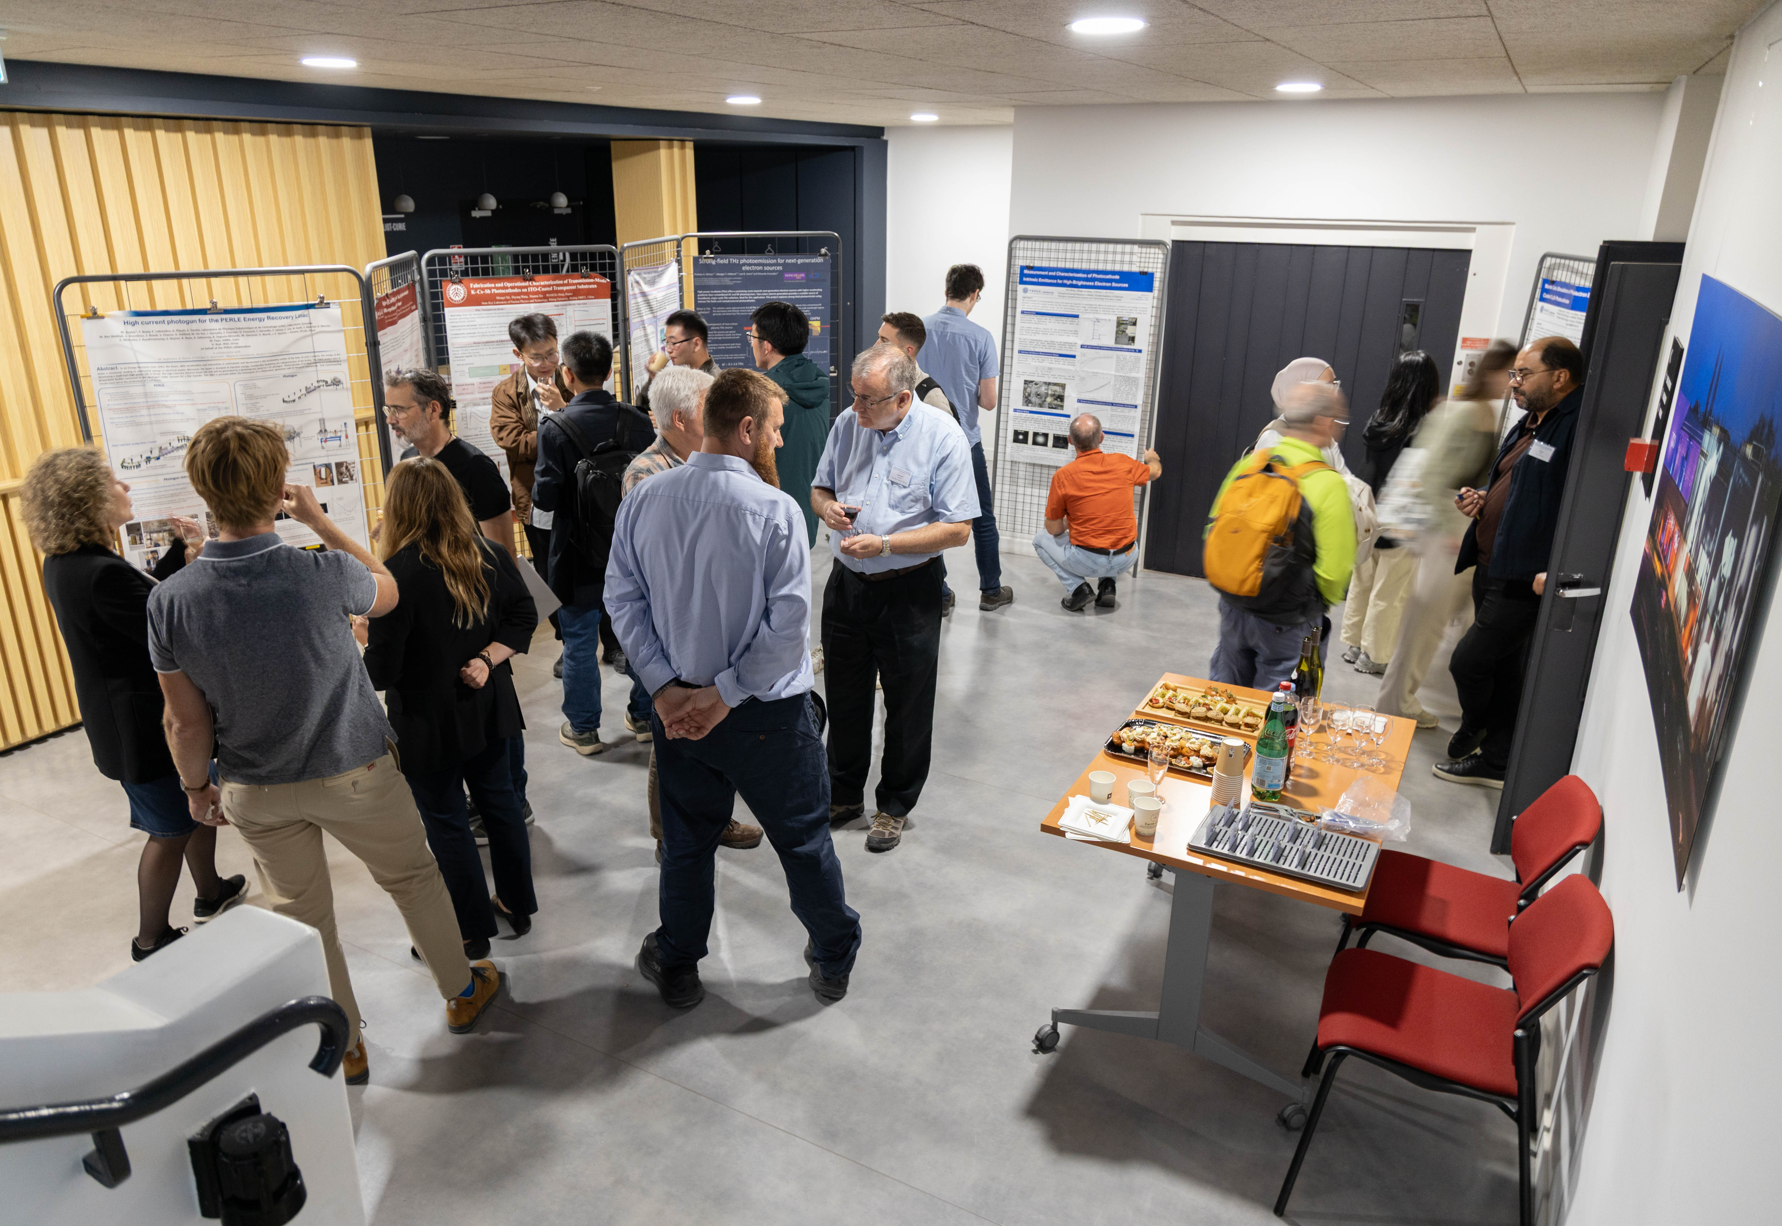
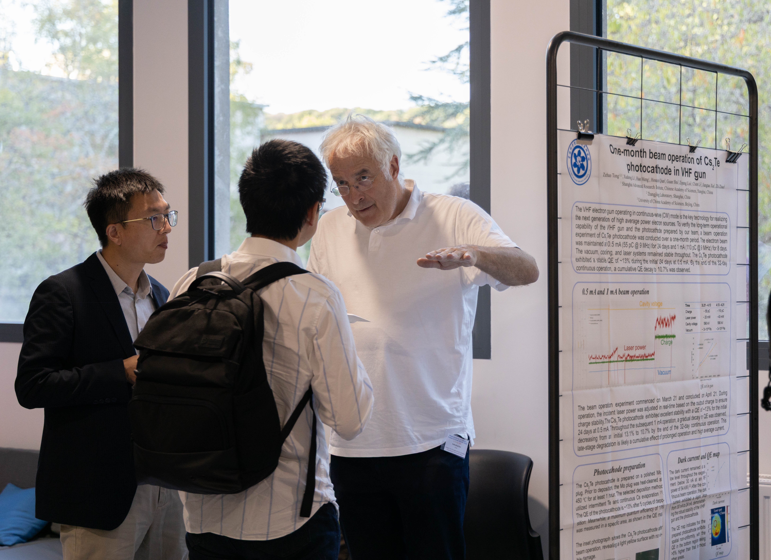
Posters
8
All photos available from the indico site

Slide 9
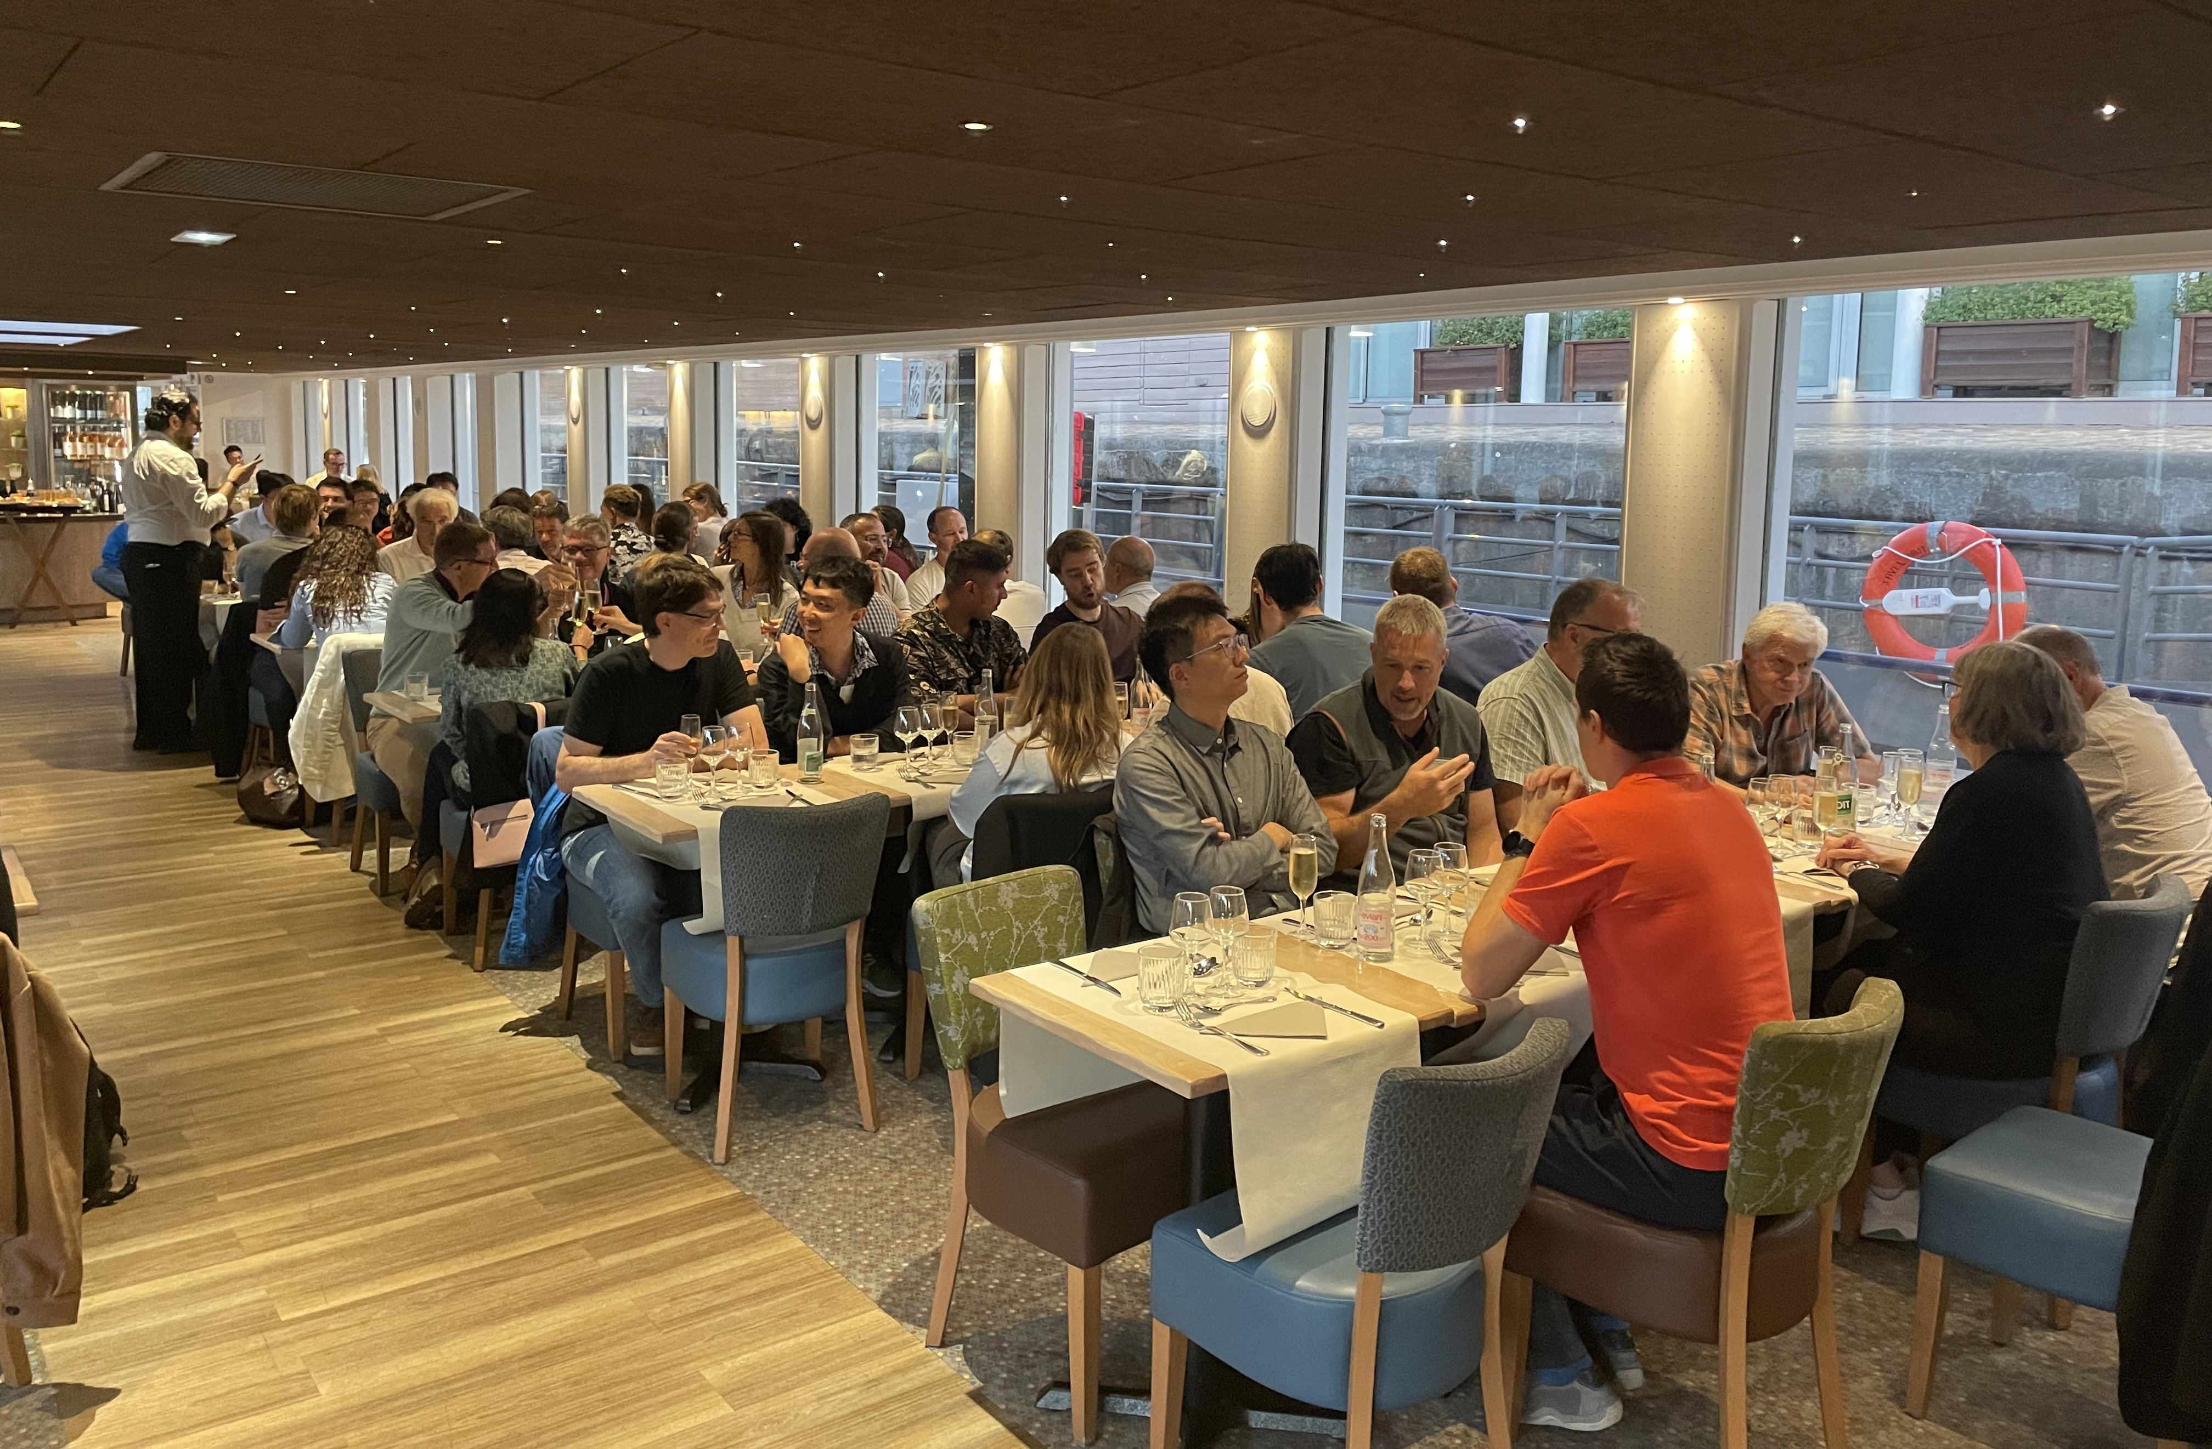
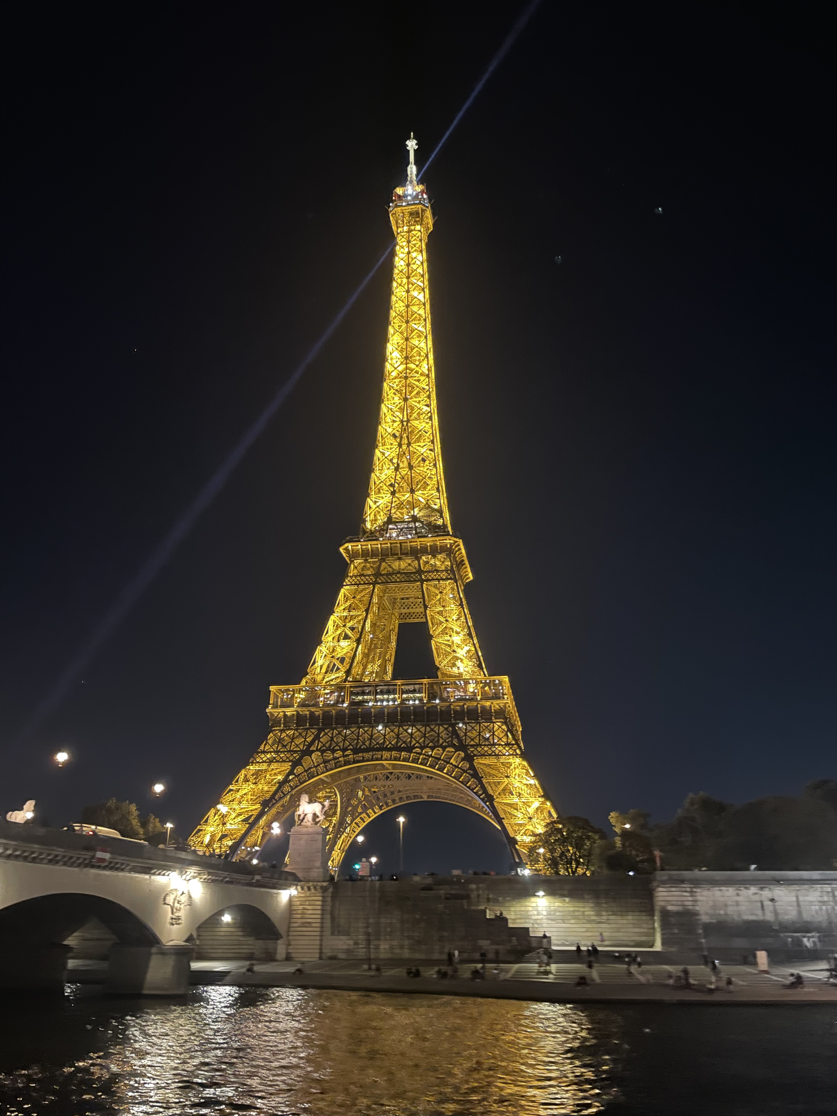
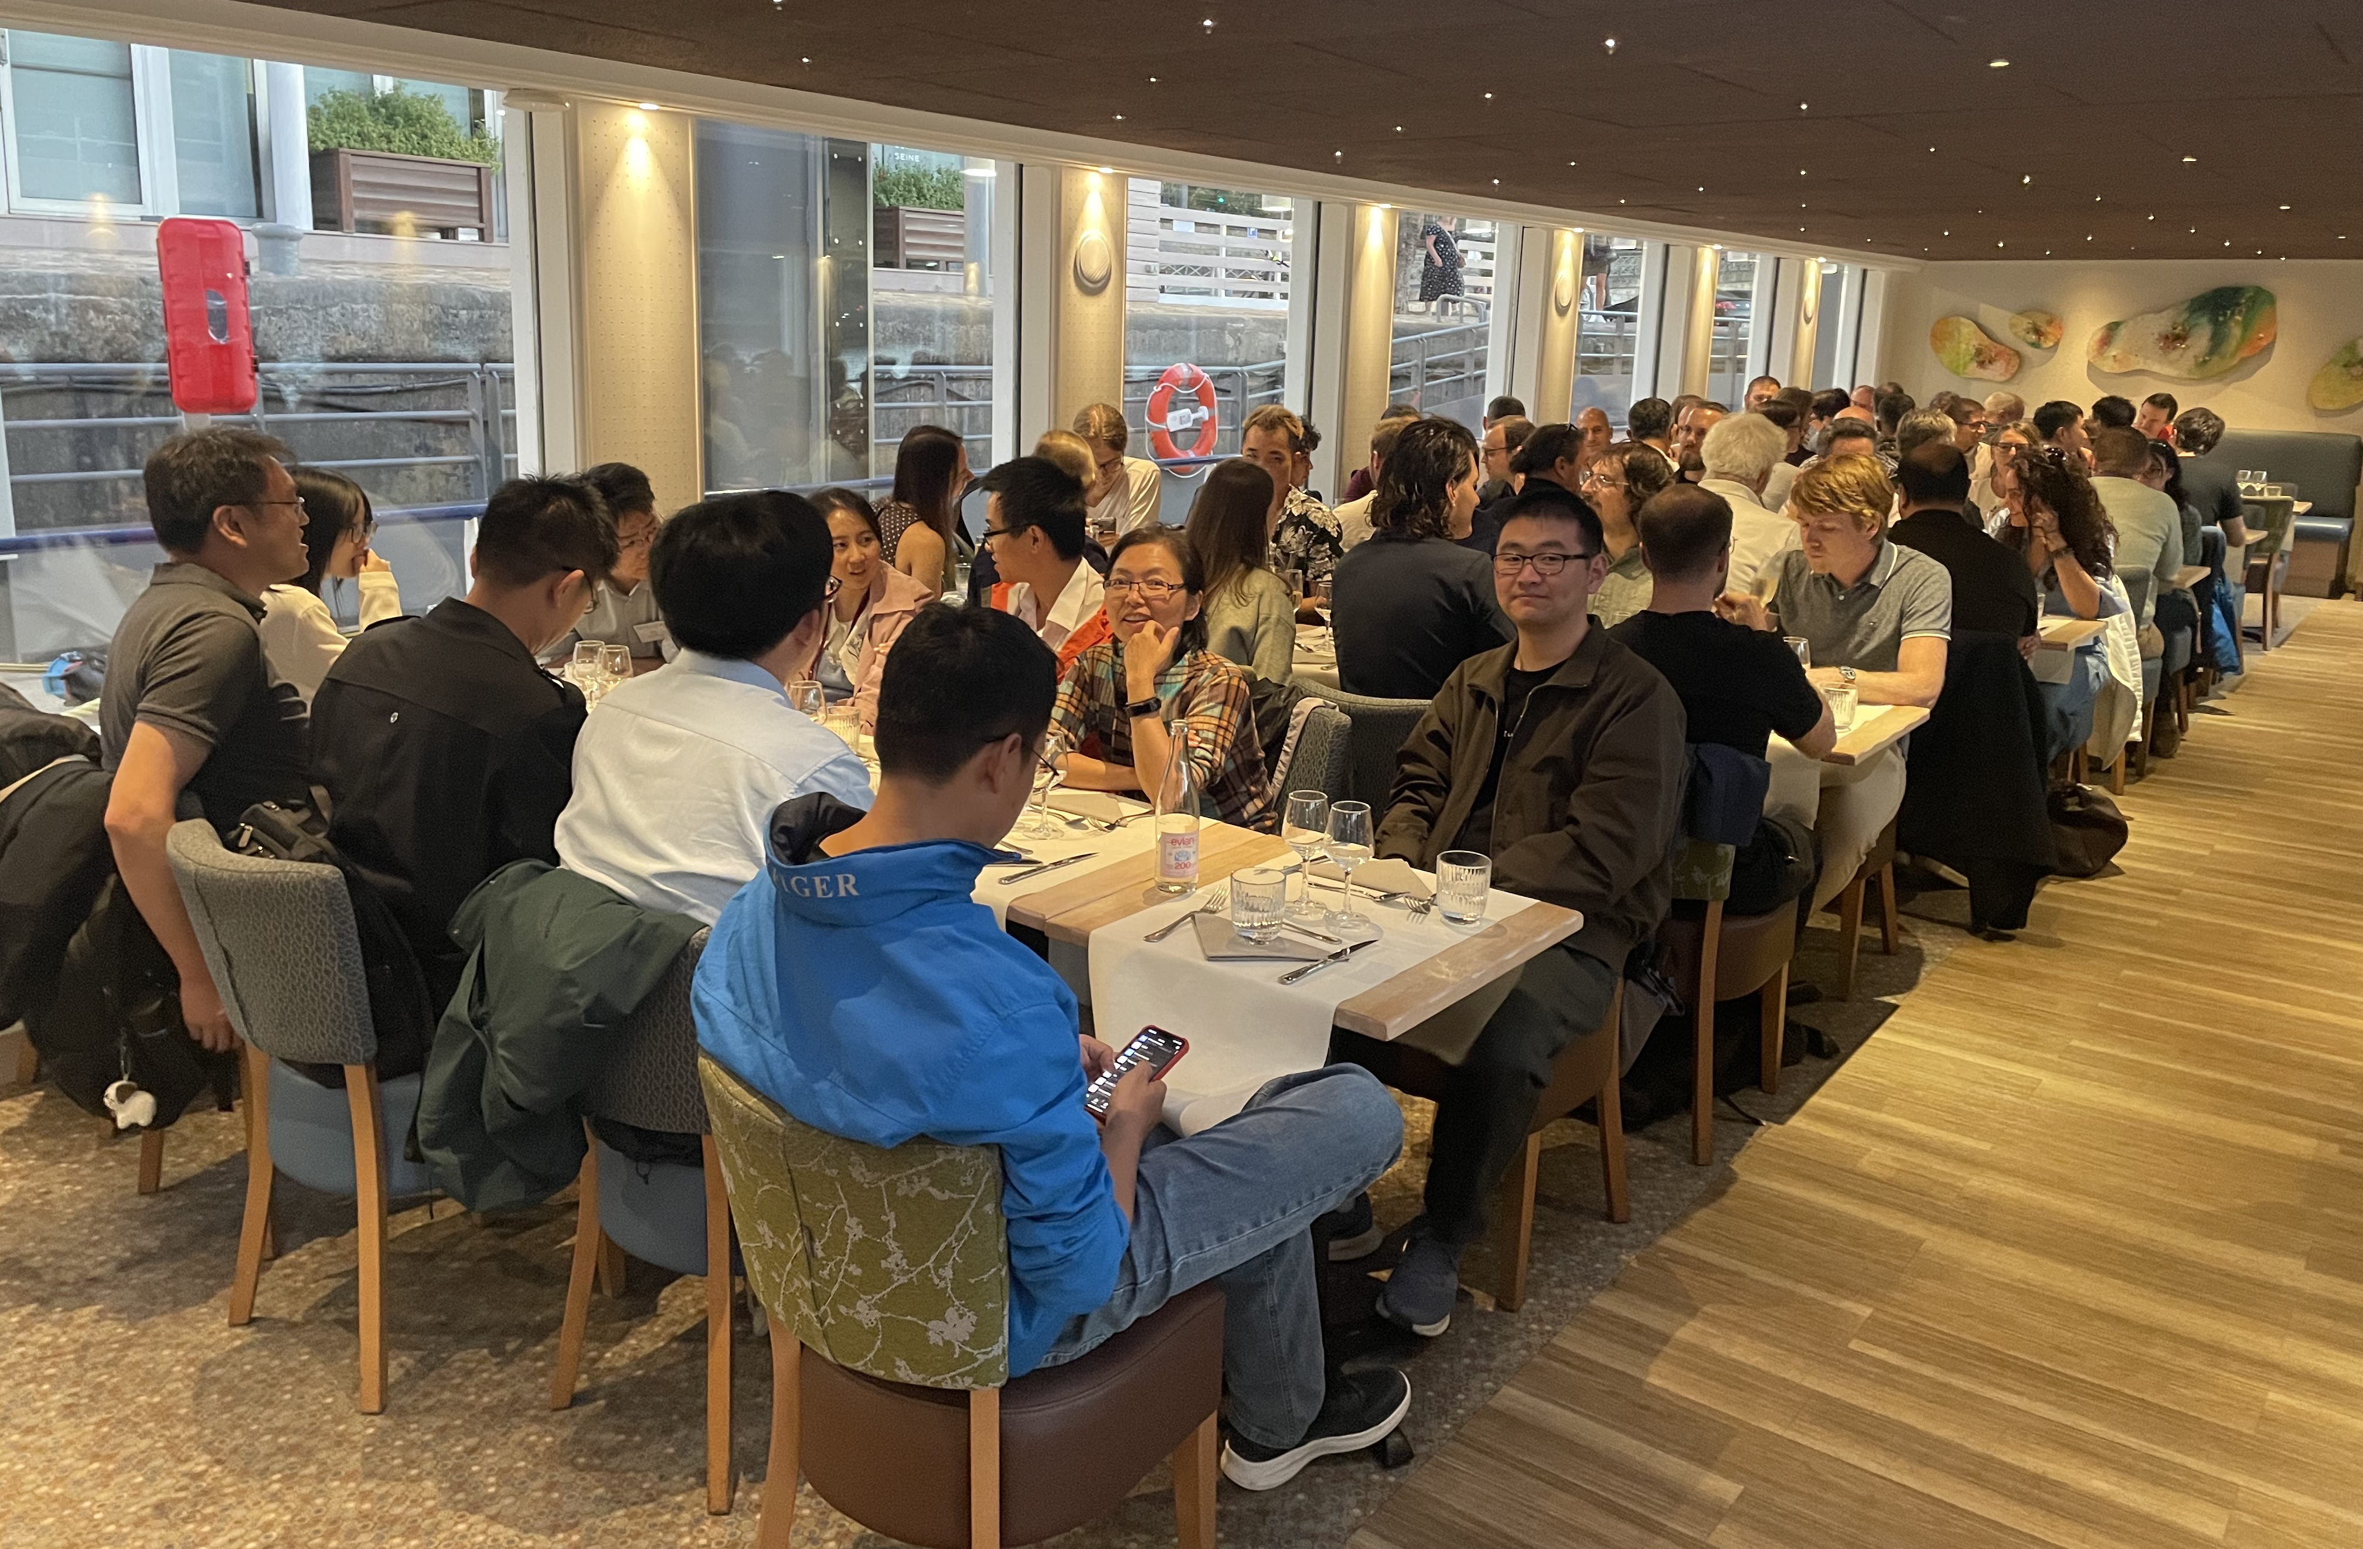
Dinner cruise
9

Slide 10

PhASE26 organizers
Chair persons : Maud Baylac and Walid Kaabi
Scientific Organizing Committee
  Maud Baylac (CNRS-LPSC)
  Dmitry Bzyl (DESY)
  Caterina Cocchi (Universität Oldenburg)
  Romain Ganter (PSI)
  Eduardo Granados (CERN)
  Lee Jones (UKRI STFC)
  Julius Kühn (HZB)
  Tim Noakes (UKRI STFC)
  Daniele Sertore (INFN Milano - LASA)
  Rong Xiang (HZDR)
  Local Organizing Committee (CNRS-IJCLab)
  Valérie Brouillard
  Émilie Bonnardel
  Dominique Longiéras
  Walid Kaabi (CNRS-IJCLab)
  Mélanie De Vos (CNRS-IJCLab)
10

Slide 11
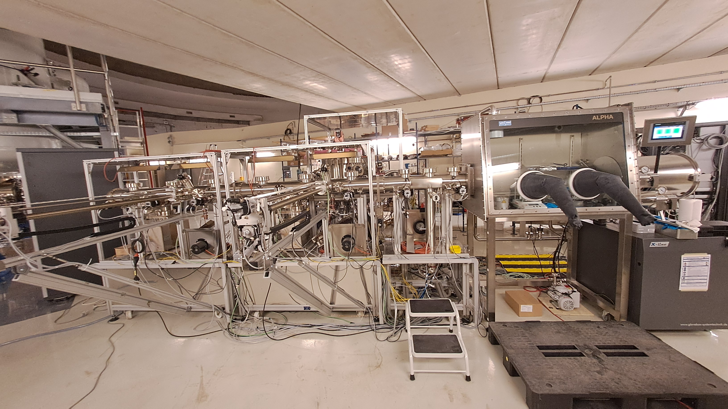
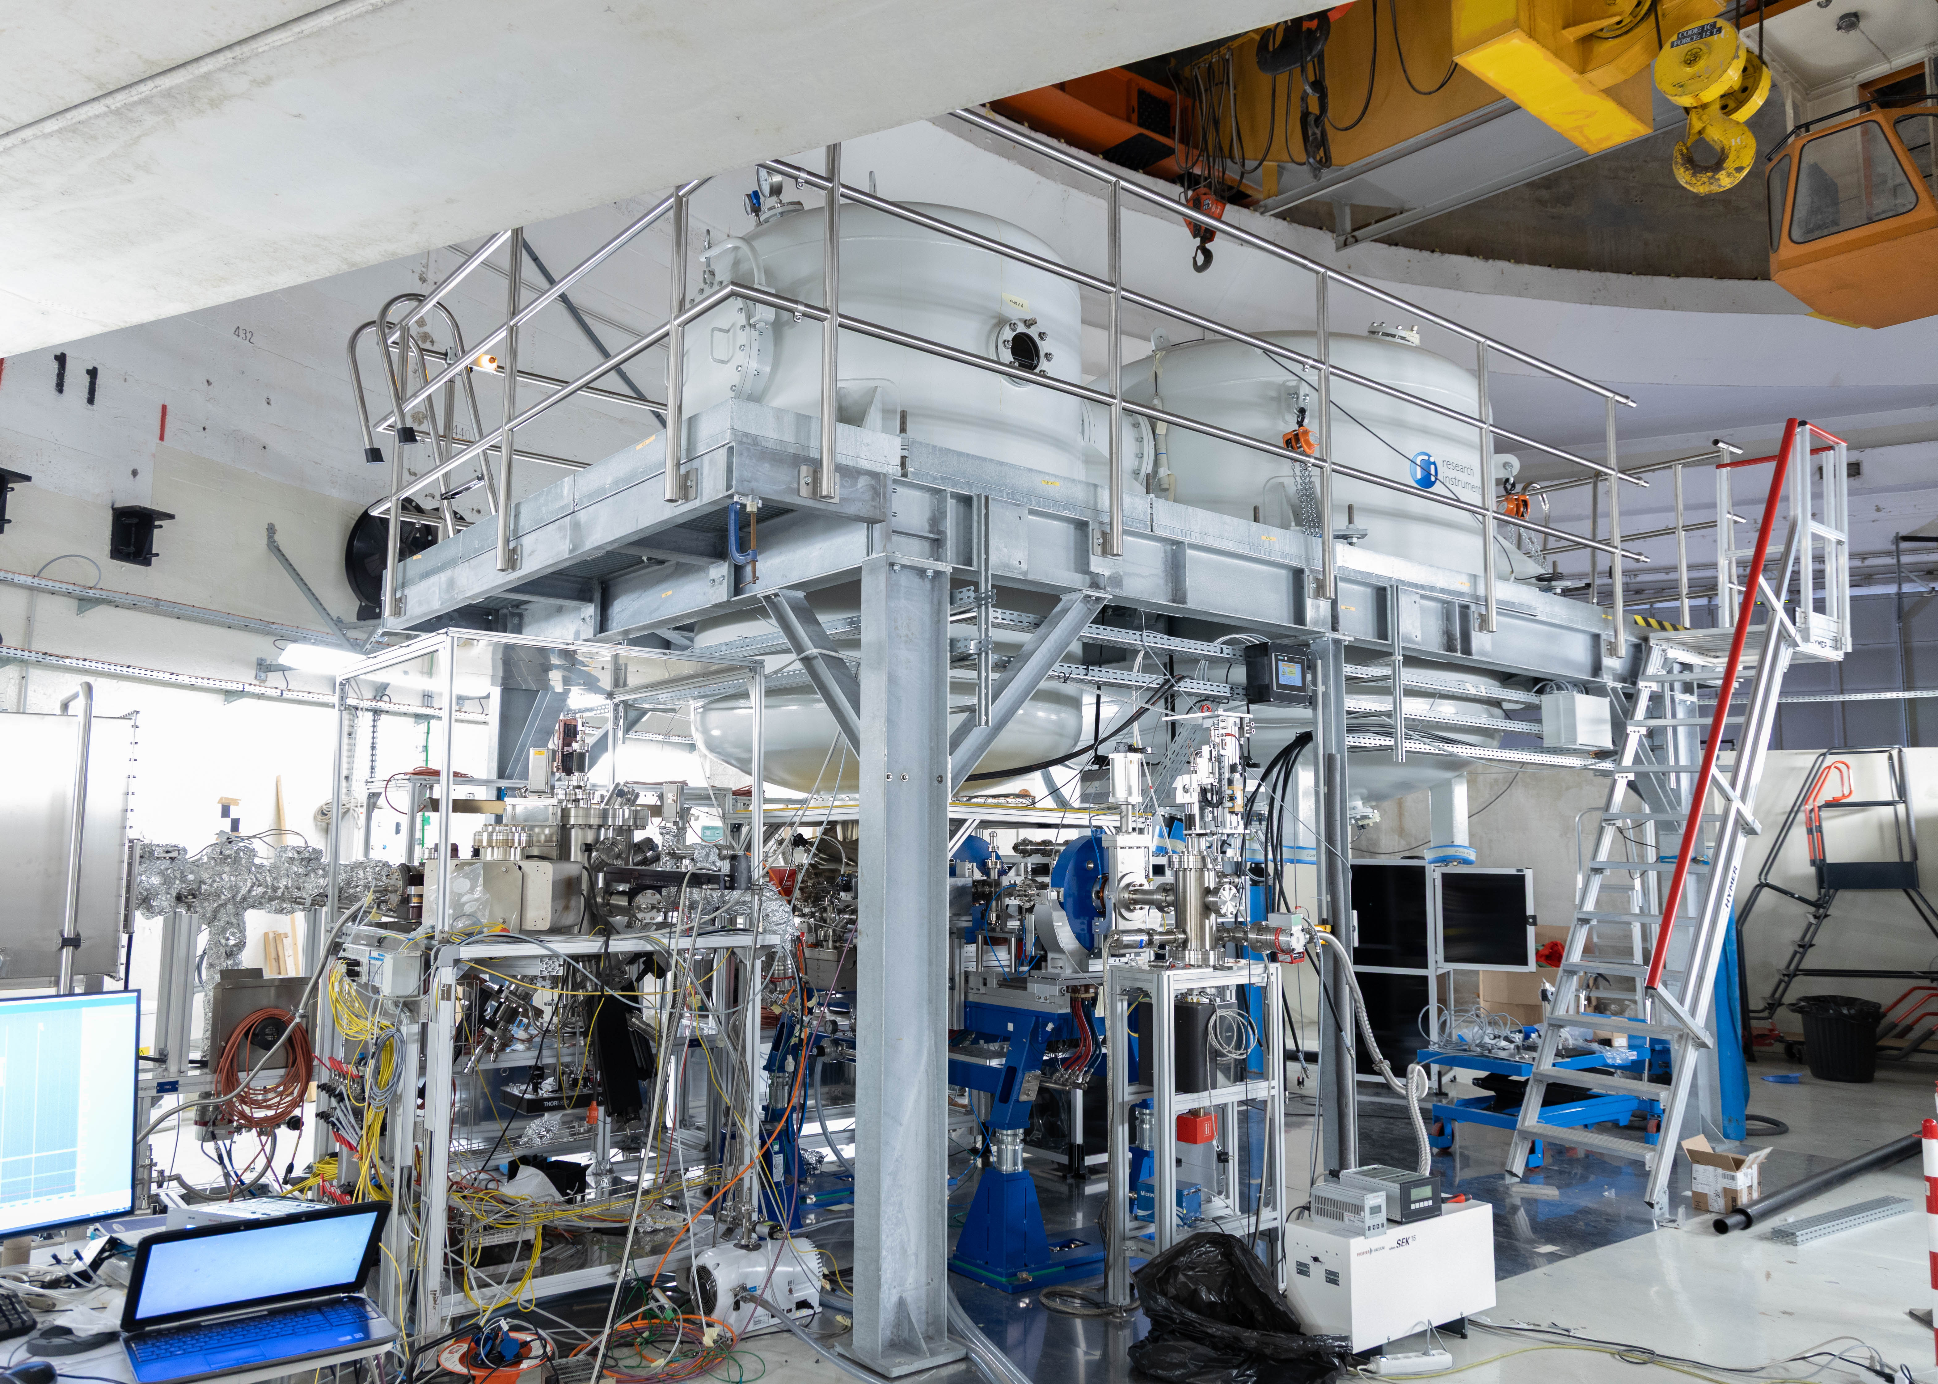
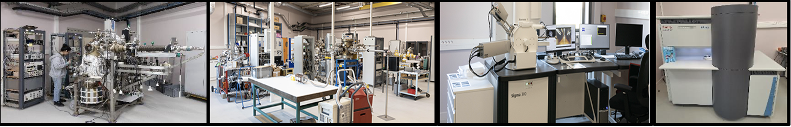
Visits of lab infrastructures
Visits scheduled Wednesday 23, 2:30-4:30 :
  PERLE photogun and photocathode preparation facility (PPF) : 50’
  Characterization platform « Vacuum and surface » : 50’
Photocathode preparation facility (PPF)
11

Slide 12
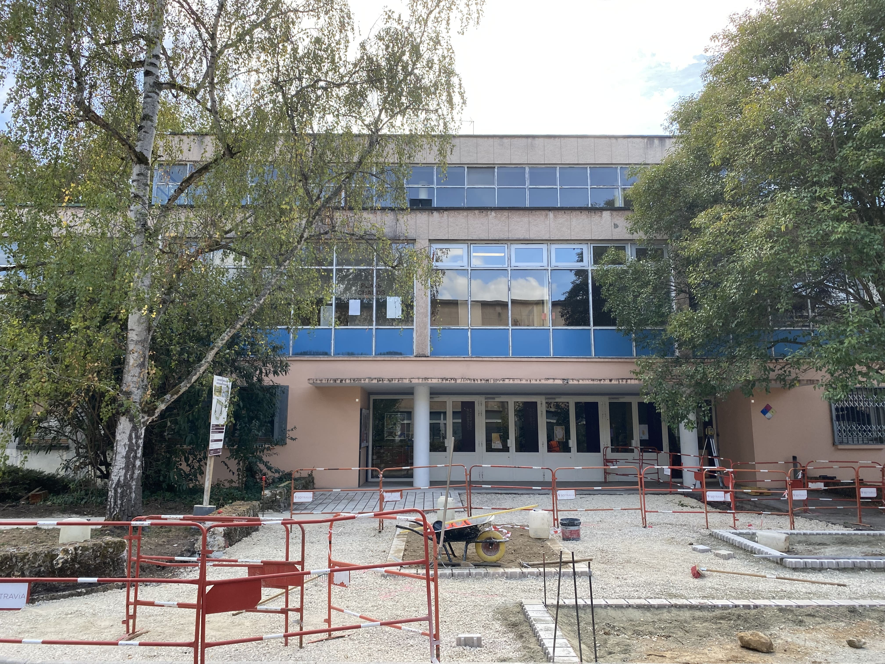
Visits of lab infrastructures
During lunch and visit: lugage can be stored in auditorium (it will be locked)
Lunch at the cafeteria building
Please register and provide your nationality (email)
Two groups will be formed in front of the cafeteria building at 2:30 : meeting point
Walk to the sites of visits
Each group will visit one platform,
  then groups will be swapped
Return to building 100 (auditorium) for the
  final coffee break at 4:30
If you have to leave before the end, let us know
cafeteria building, 2:30 pm
12

Slide 13
What’s next ?
28
13

Slide 14
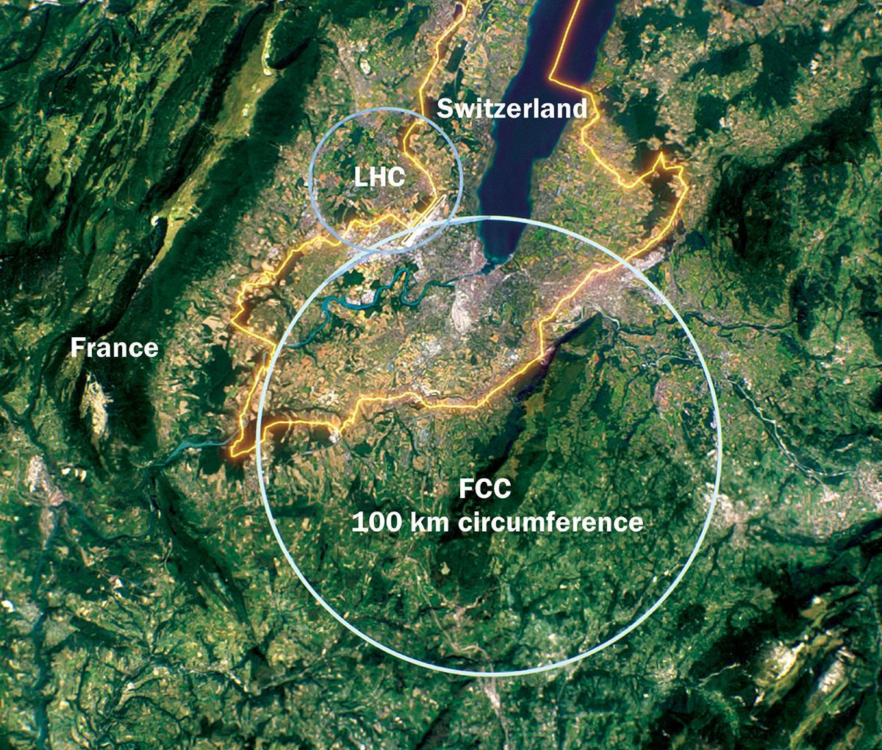
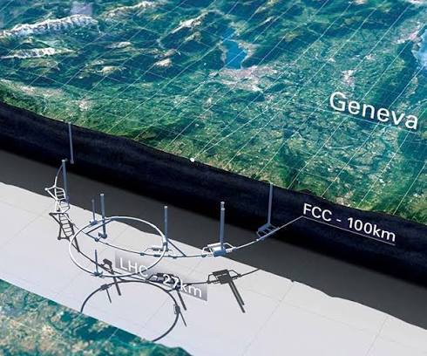
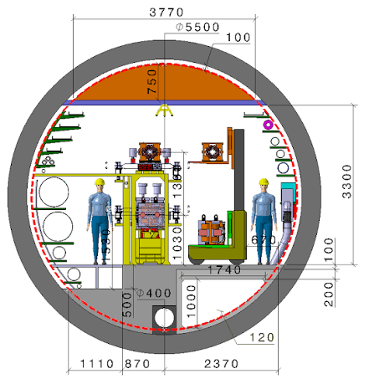

Slide 15
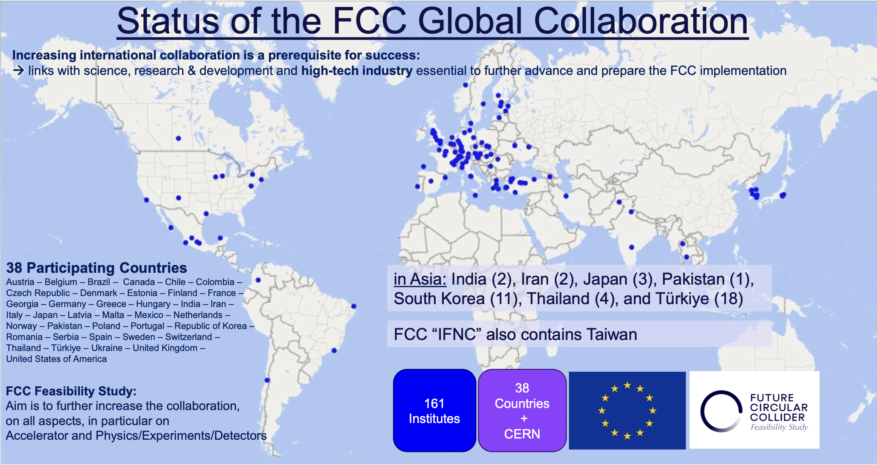

Slide 16
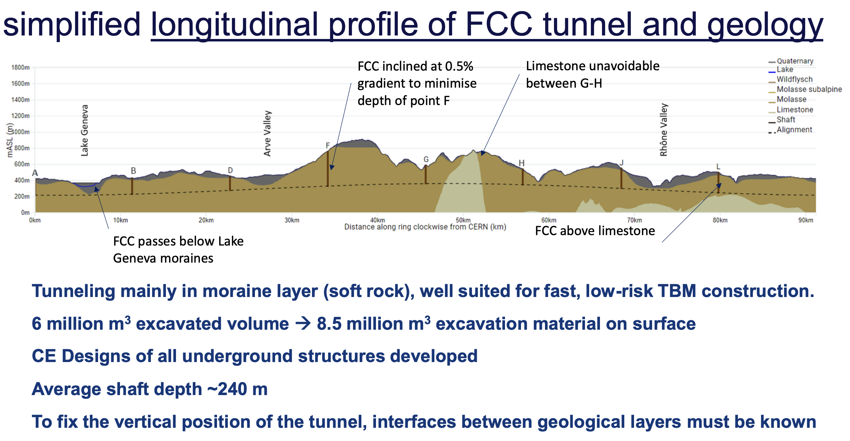

Slide 17
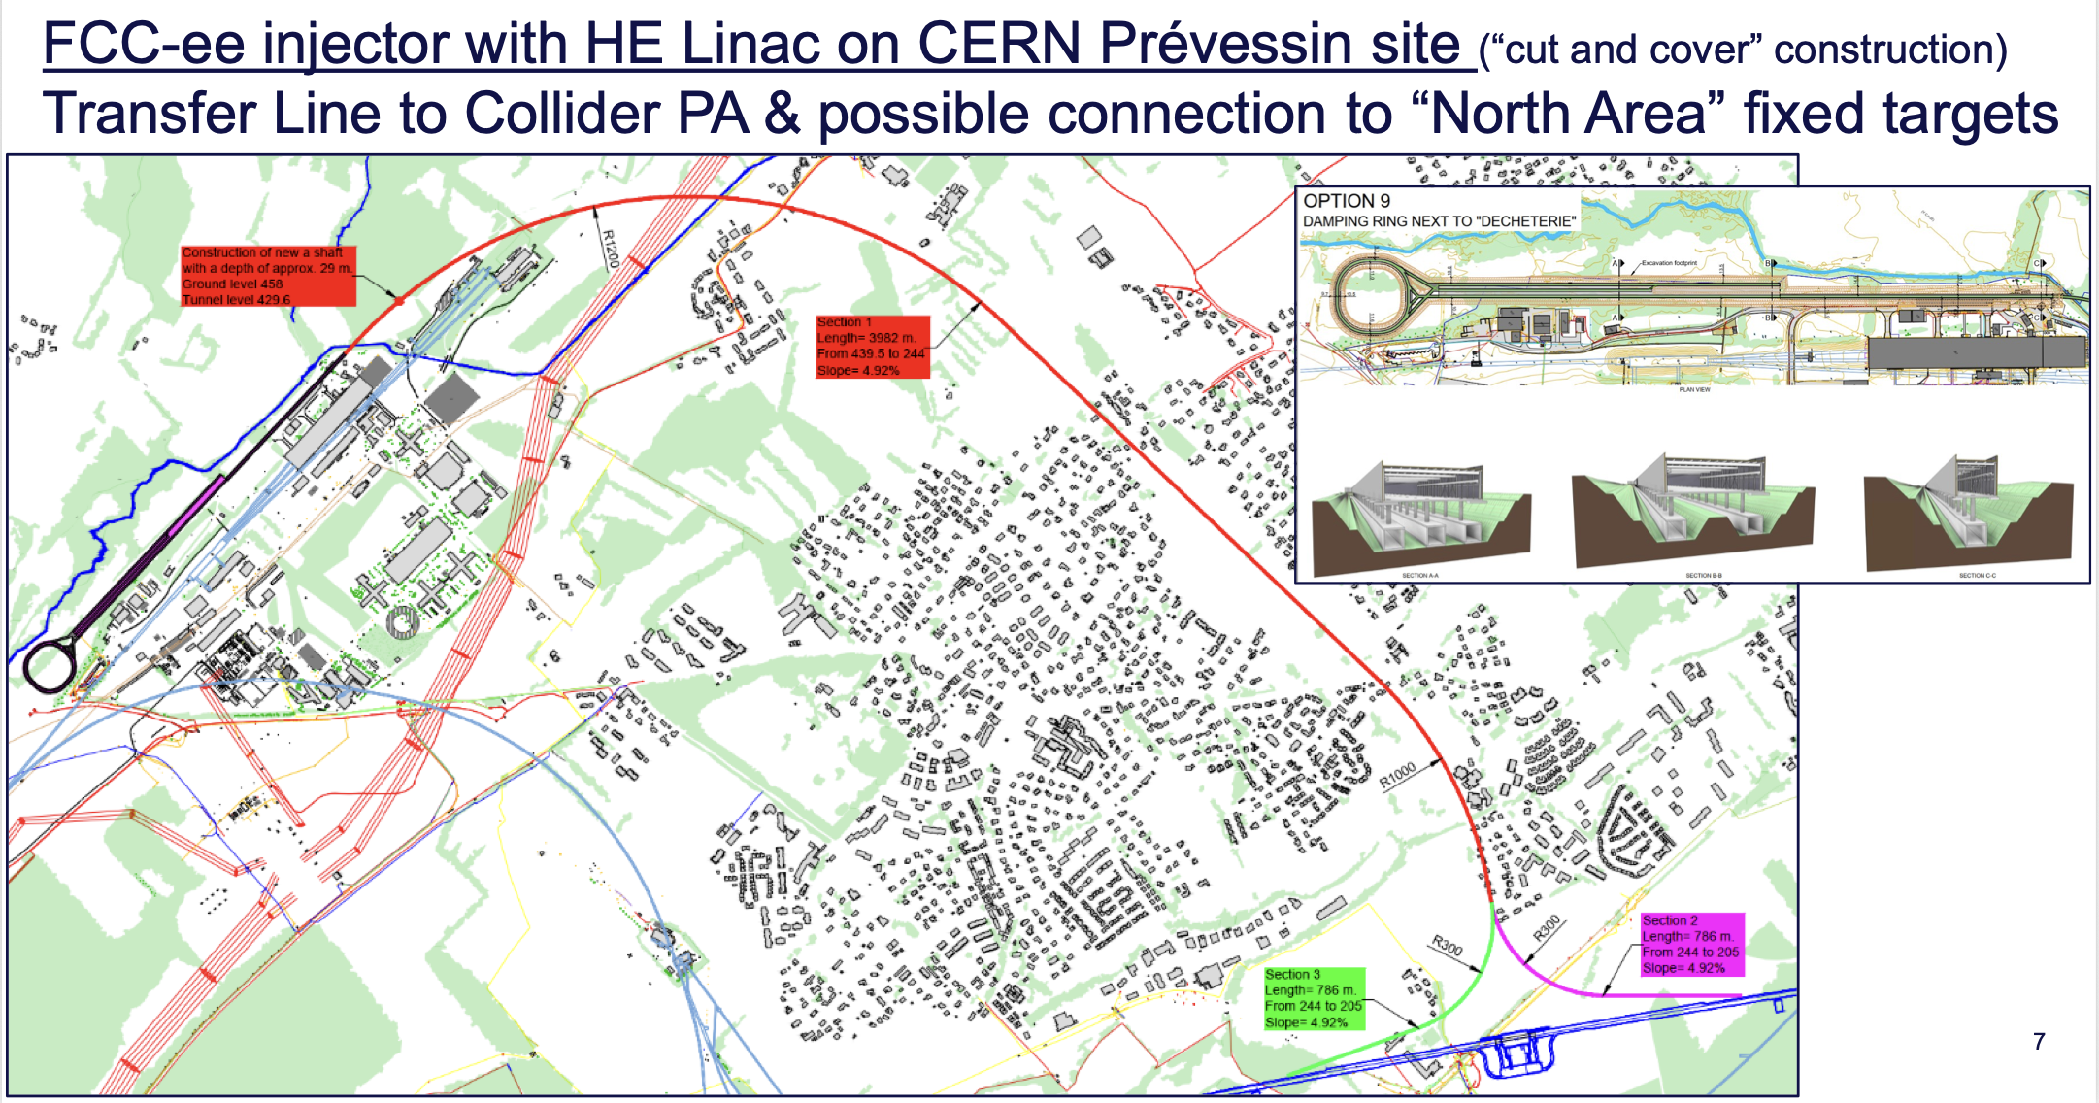

Slide 18
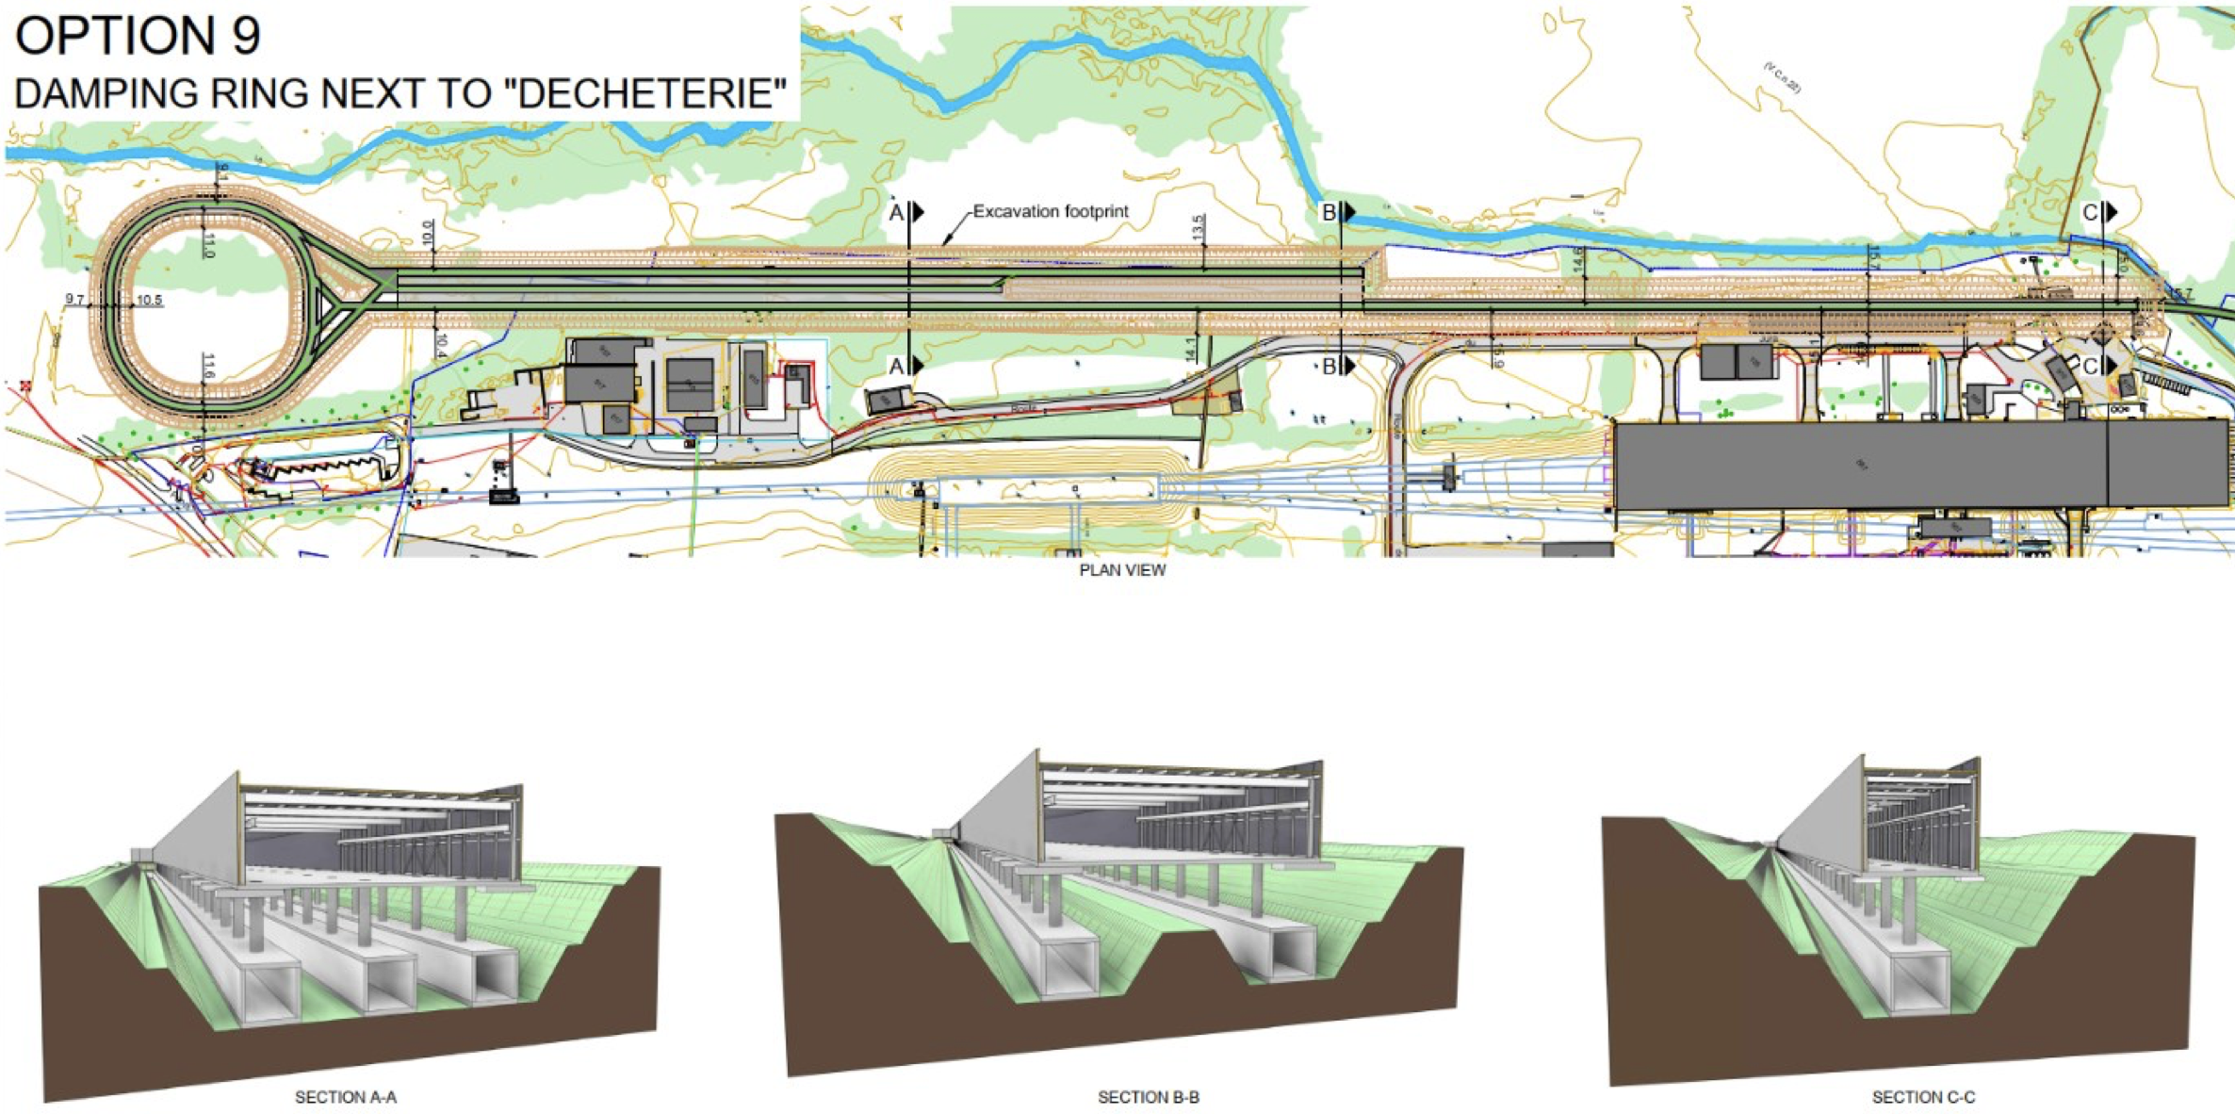

Slide 19
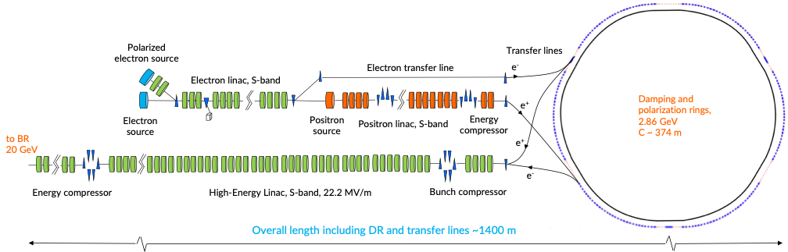
FCC-ee injector complex

Slide 20




FCC-ee electron sources
Injection / dynamics
“baseline”
Photoinjector
To LINAC and rings
“Colliding bunches”
PSI + SY-STI + SY-RF
BE-ABP + SY-RF + PSI + IJCLab
“under consideration”
Thermionic source
Buncher system
SY-RF
“baseline”
“Pilot bunches”
Polarized source
+ international collab.
SY-STI

Slide 21
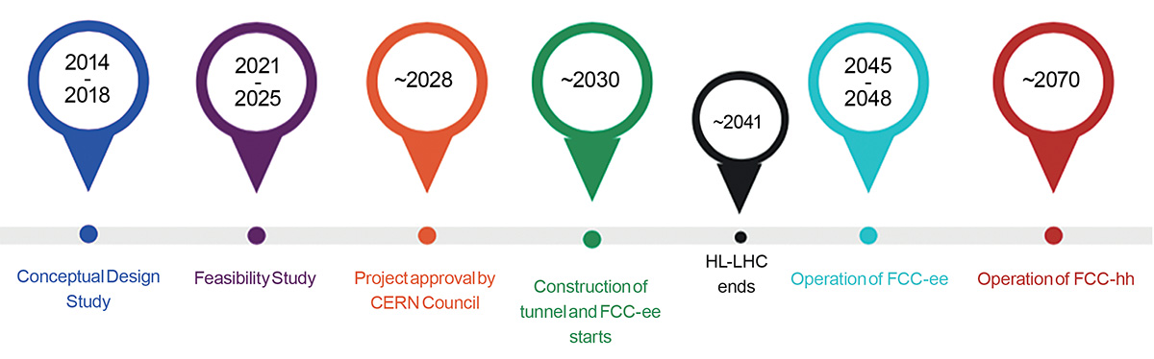
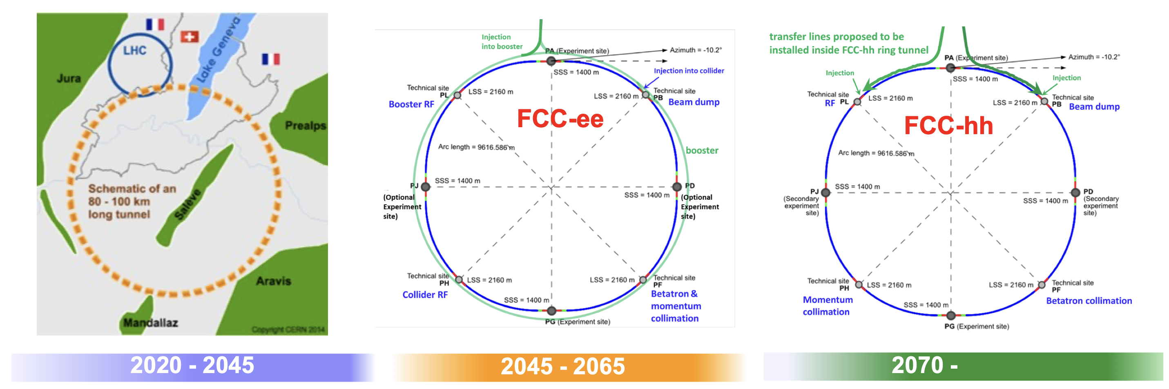

Slide 22


Slide 23
