Slide 1
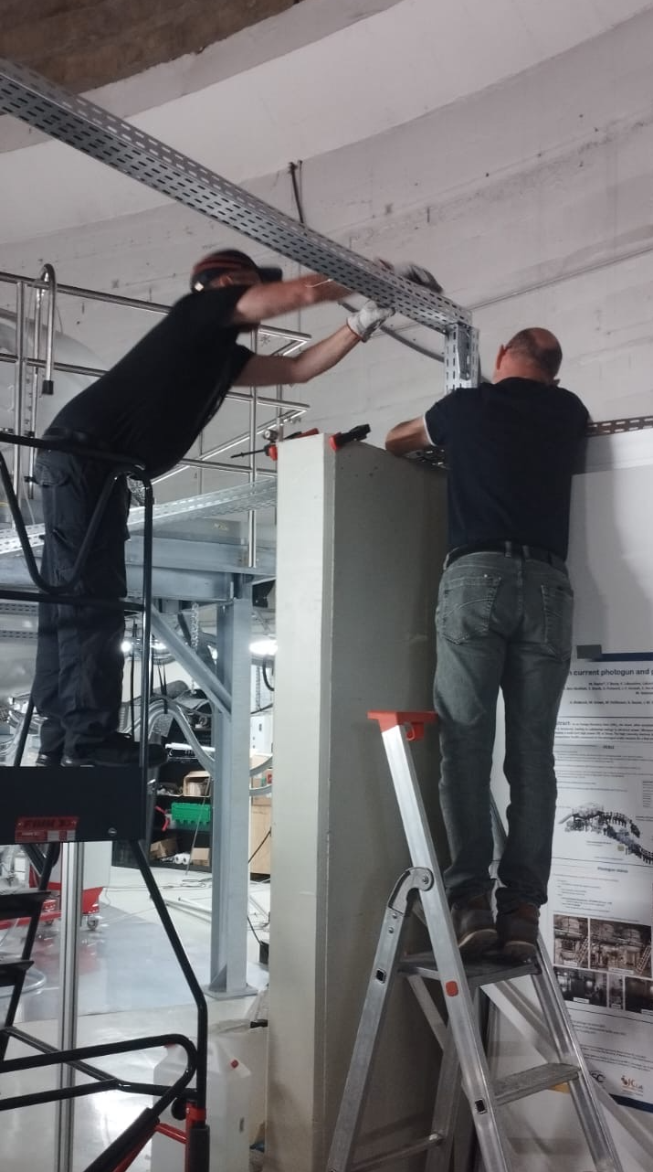
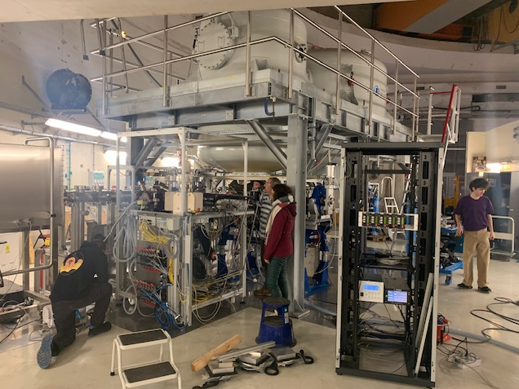
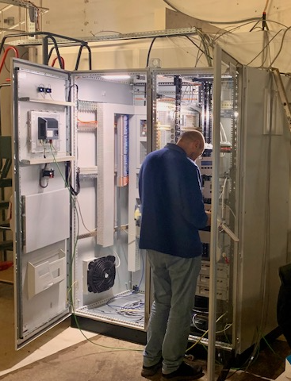
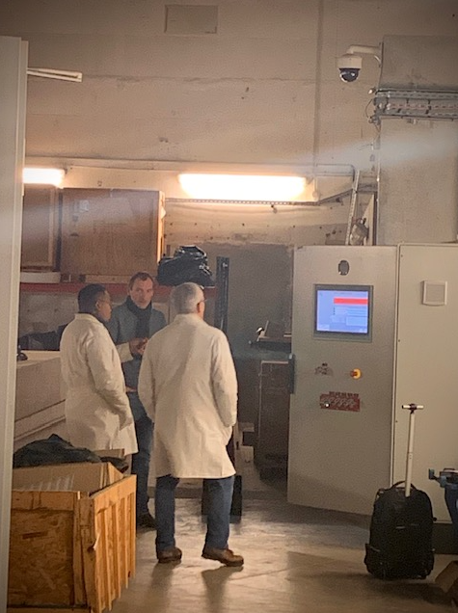
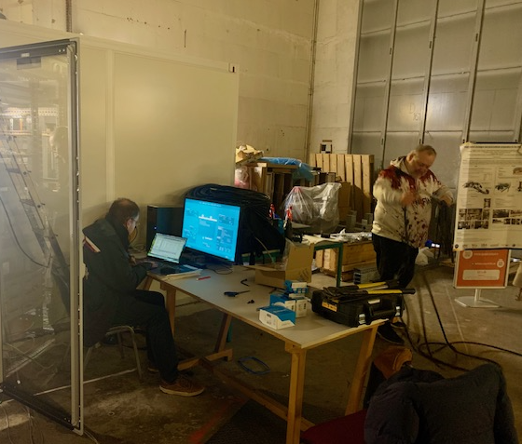
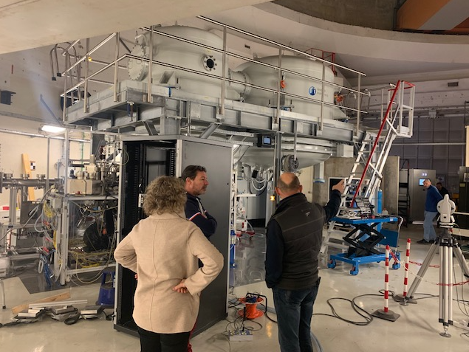
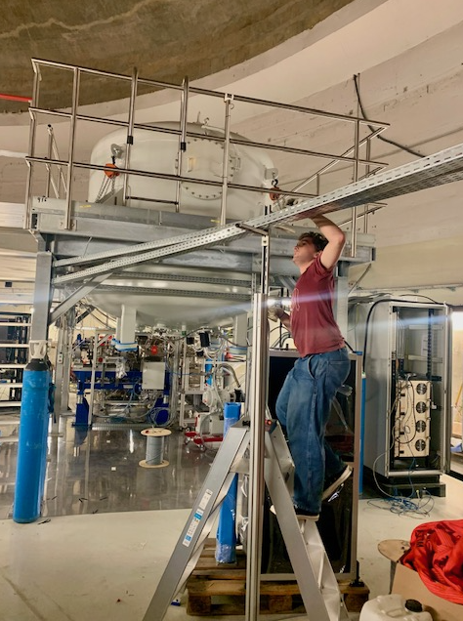
PERLE Collaboration Board Meeting
Project advancements & collaboration matters
Walid Kaabi & Achille Stocchi
January, 28th 2026

Slide 2

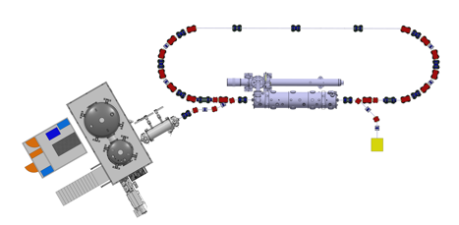

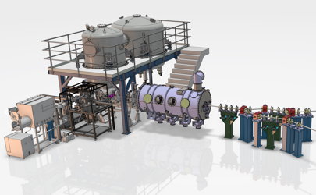
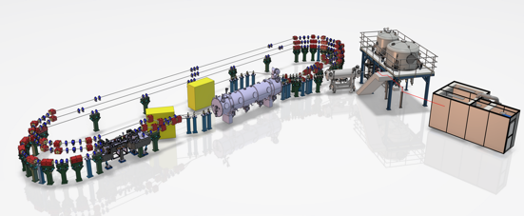
PERLE Timeline (macroscopic view)
“Partially”
TDR and prototyping phase
Phase 2: PERLE 1 tour
CM funded by EU Program iSAS + Matching funds (IN2P3)
Phase 1: Injection line
Phase 3: PERLE 250 MeV
By CNRS National Program RI2
2022
2023
2024
2025
2026
2027
2028
2029
2030
2031

Slide 3
PERLE global planning
Design
First electrons April 2026
Upgrade
Laser
Procurement/Construction/Installation
5 mA
20 mA
Commissioning
DC Gun @ 350 keV
Buncher installation
Booster installation
Booster
RF sources upgrade
20 mA
5 mA
Injector @ 7 MeV
Cryomodule installation
0.5 MW
2 MW
ERL 1-loop @ 89 Mev
Civil engineering work
5 MW
ERL 3-loop
TDR
2025
2026
2027
2028
2029
2030
2031
We are here

Slide 4
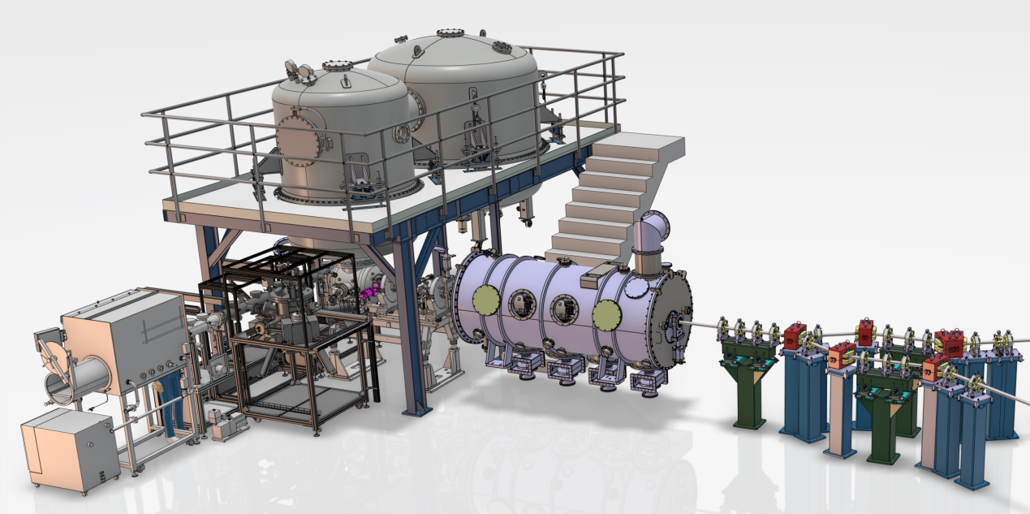
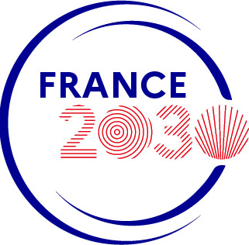
The injection line
HV system
Booster
DC Photogun
Merger
Buncher
Photocathode Preparation Facility (PPF)
Diagnostics line
"This work received government funding managed by the Agence Nationale de la Recheche (ANR) in the France 2030 framework - reference ANR-24-RRII-0001"

Slide 5
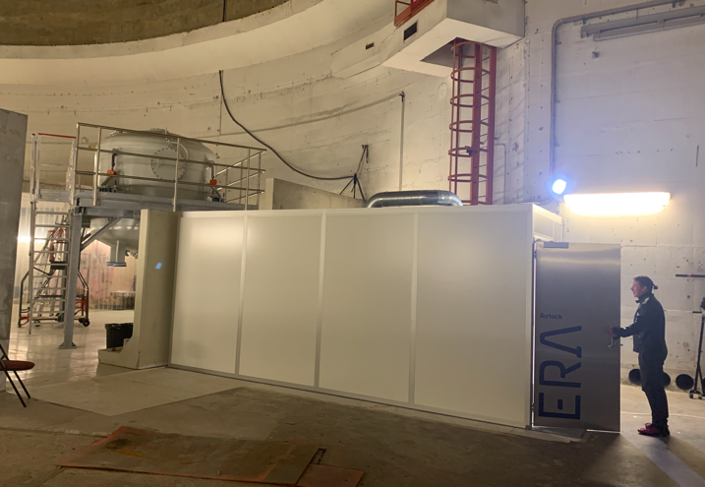
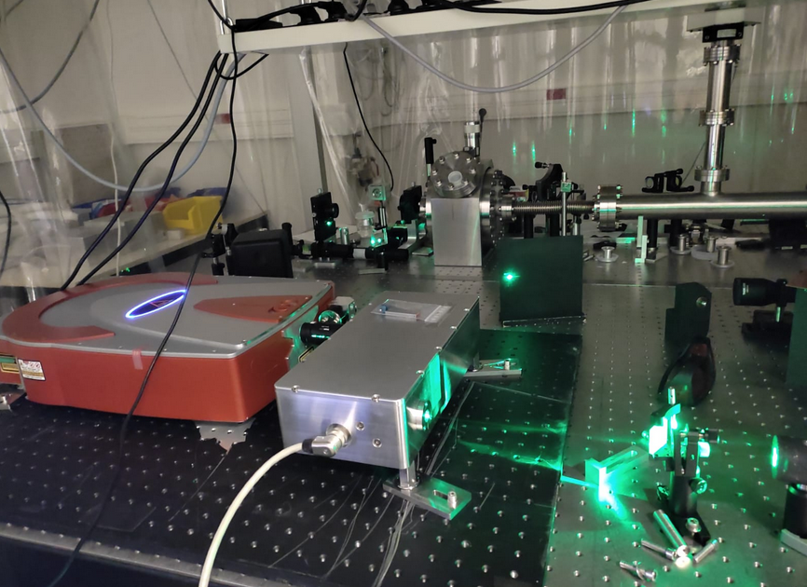
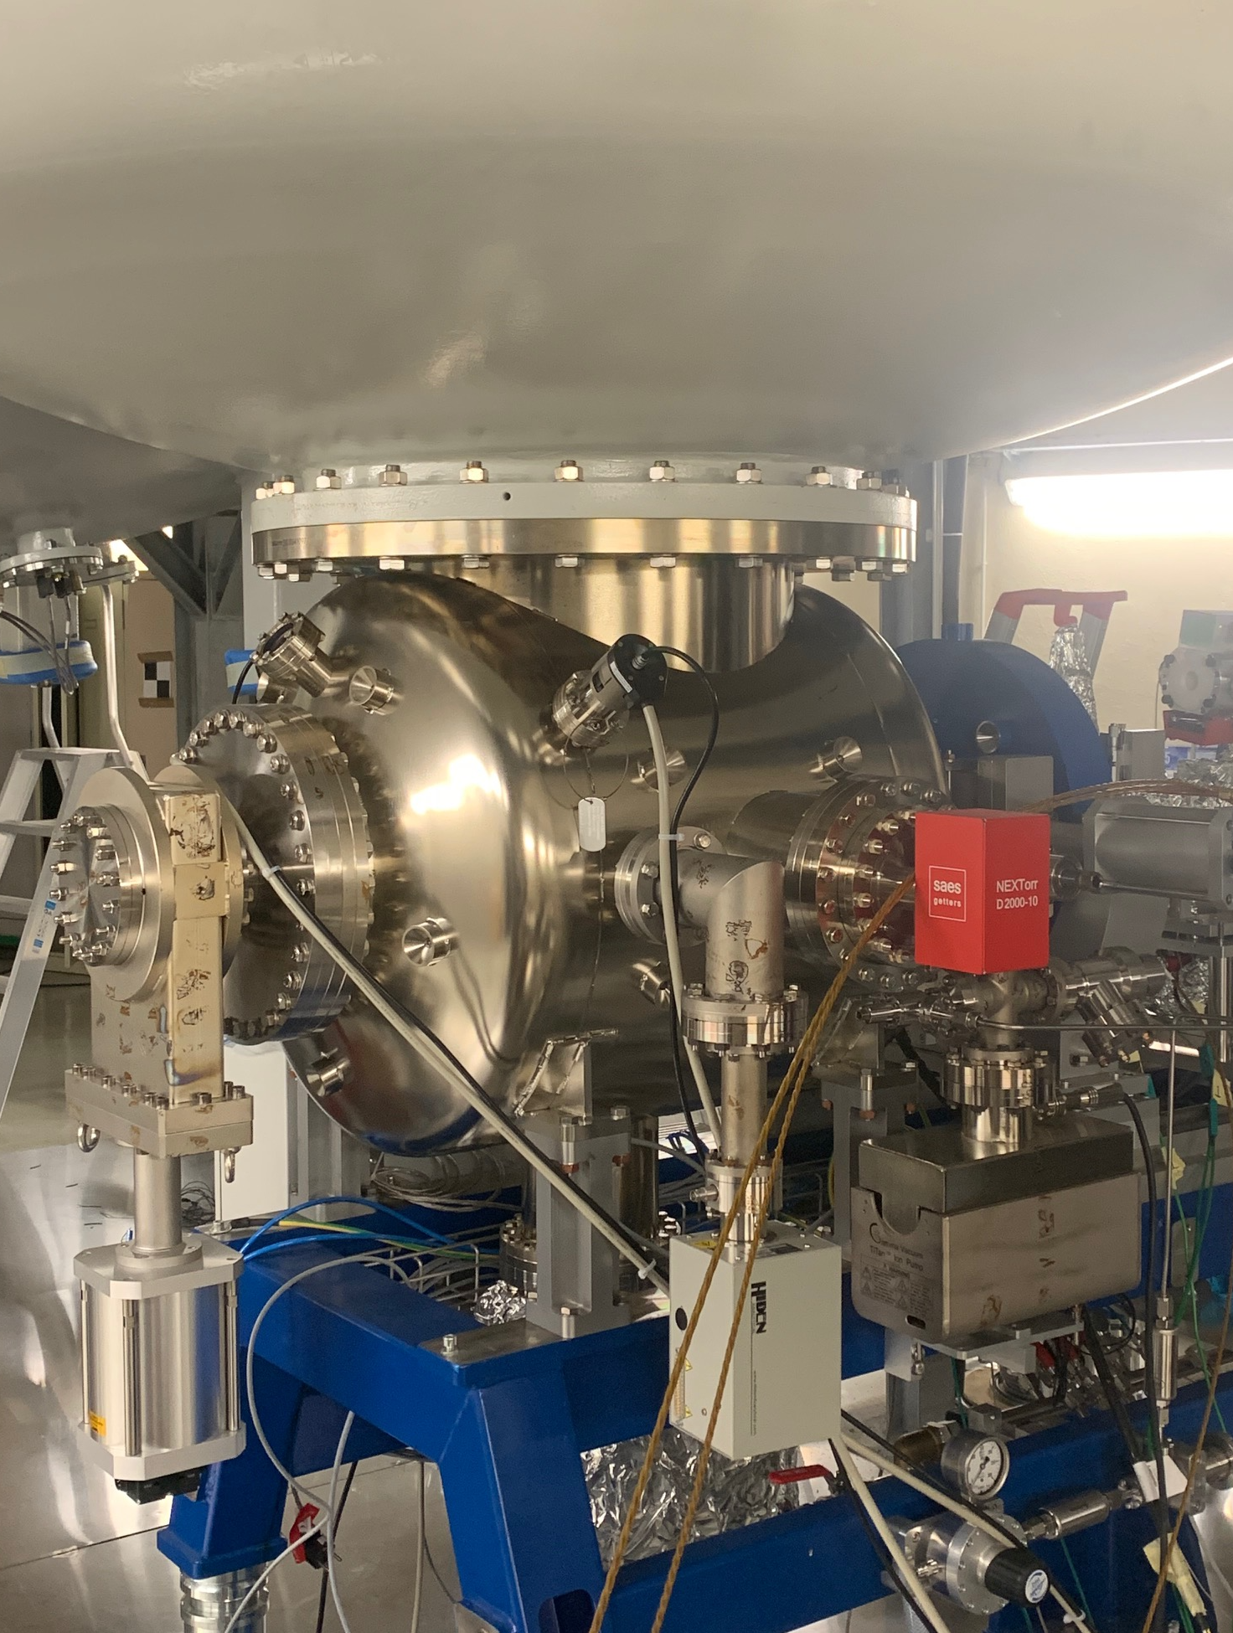
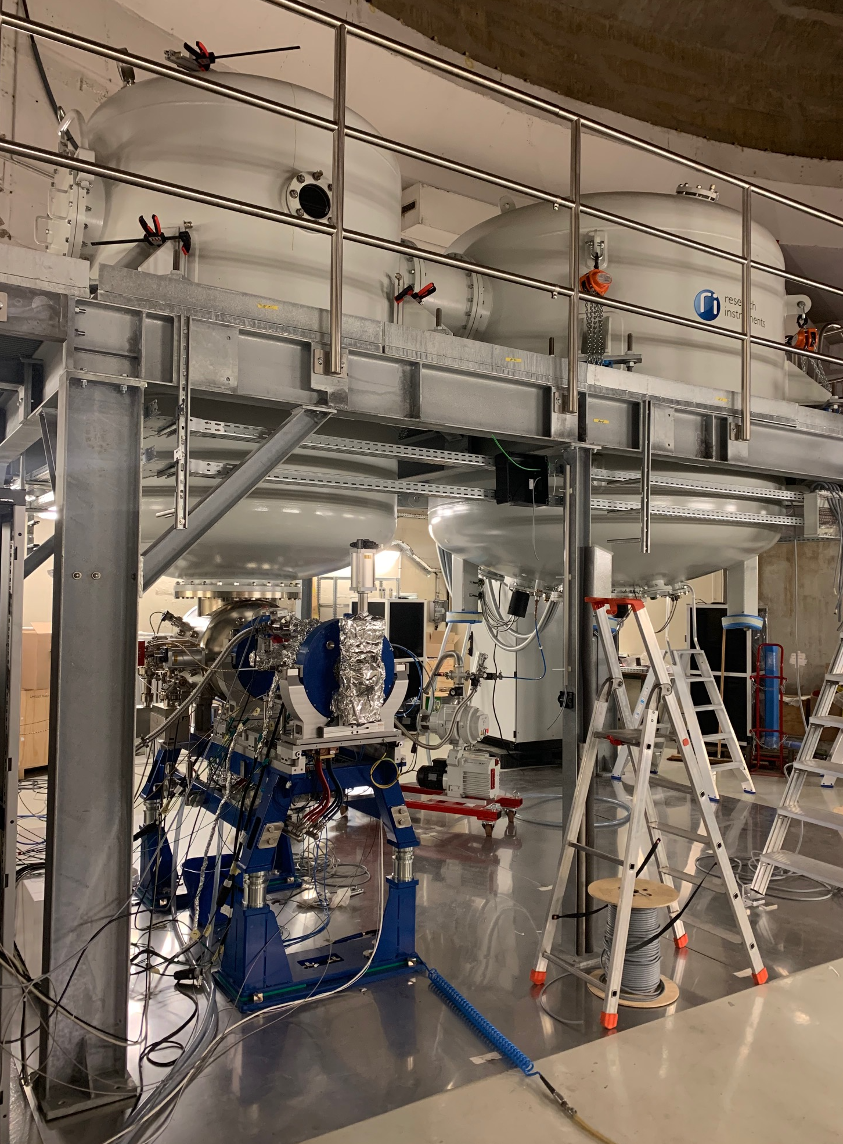
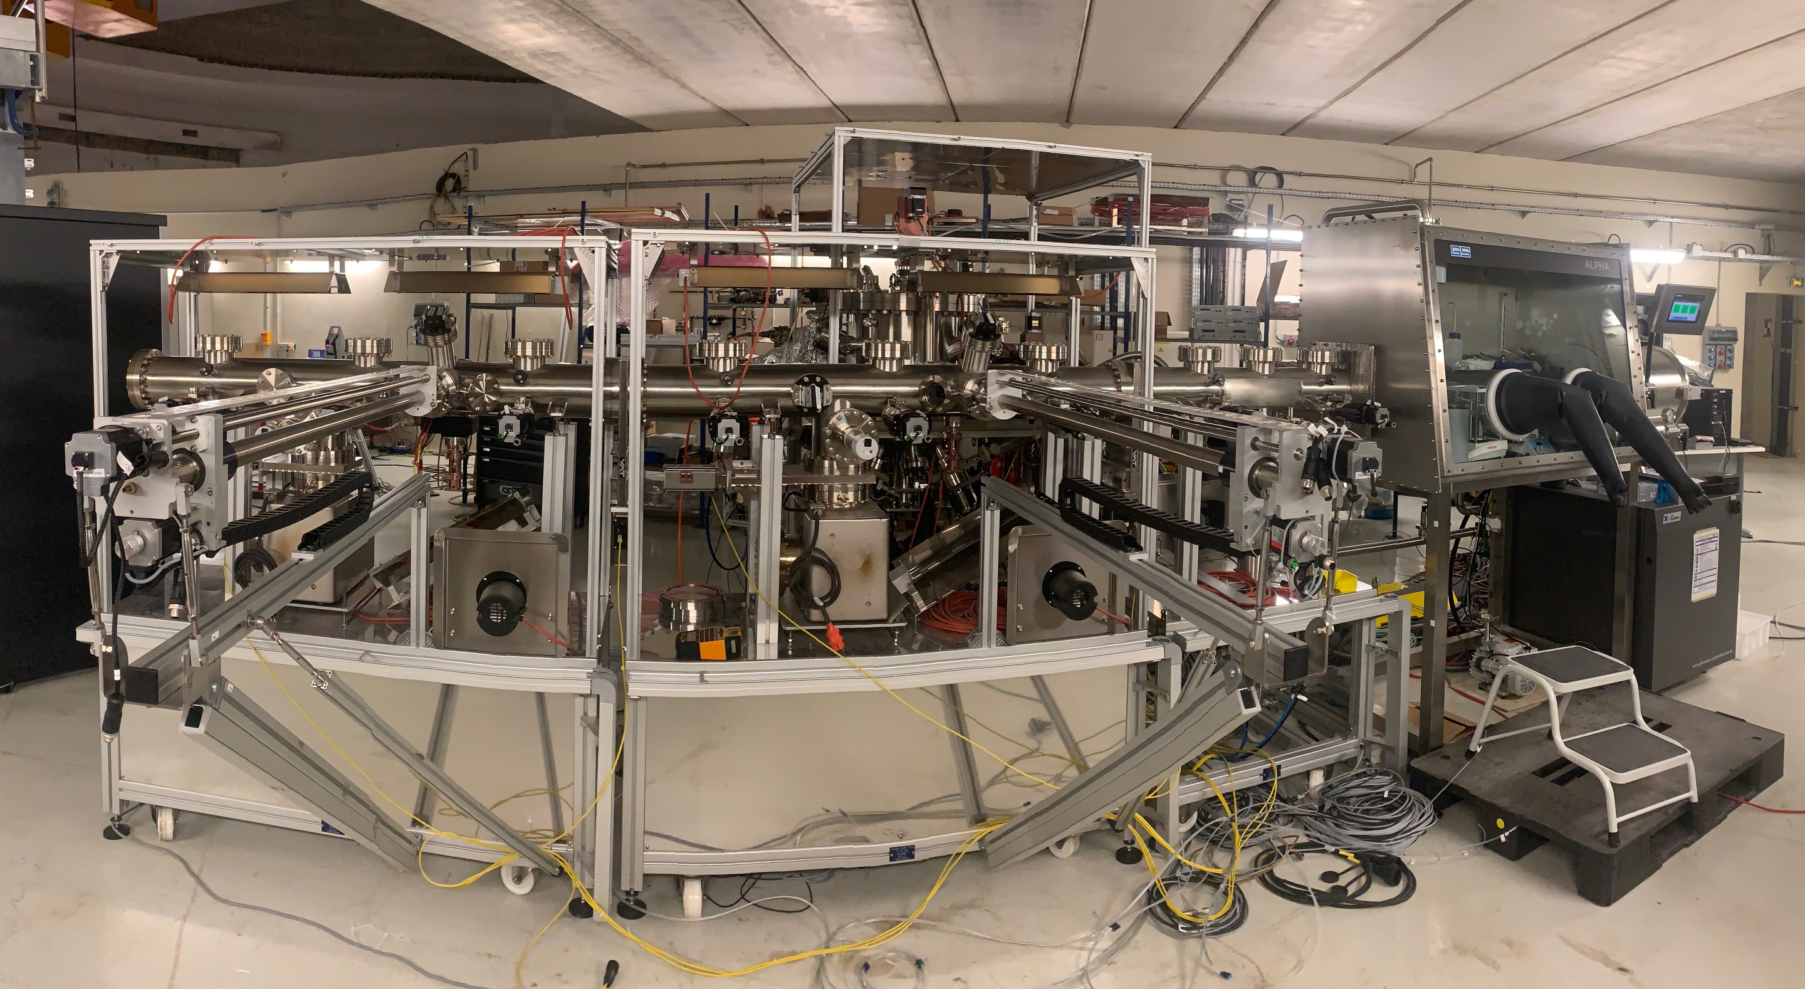
PERLE e- Source:
Electron source Installation in the « Igloo »:
Photocathode Laser room
Laser system
DC Gun
DC Gun & HV system
Photocathodes Production Facility (PPF)
"This work received government funding managed by the Agence Nationale de la Recheche (ANR) in the France 2030 framework - reference ANR-24-RRII-0001"

Slide 6
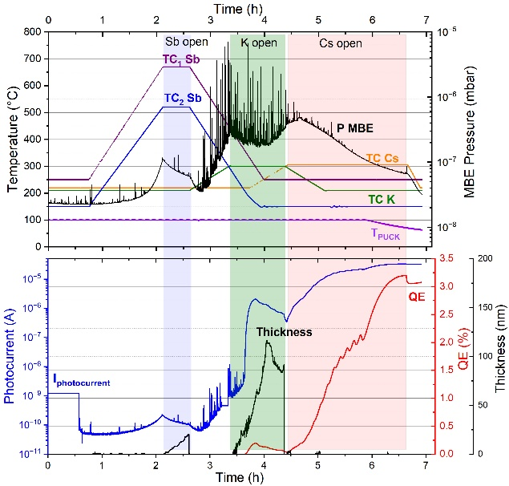
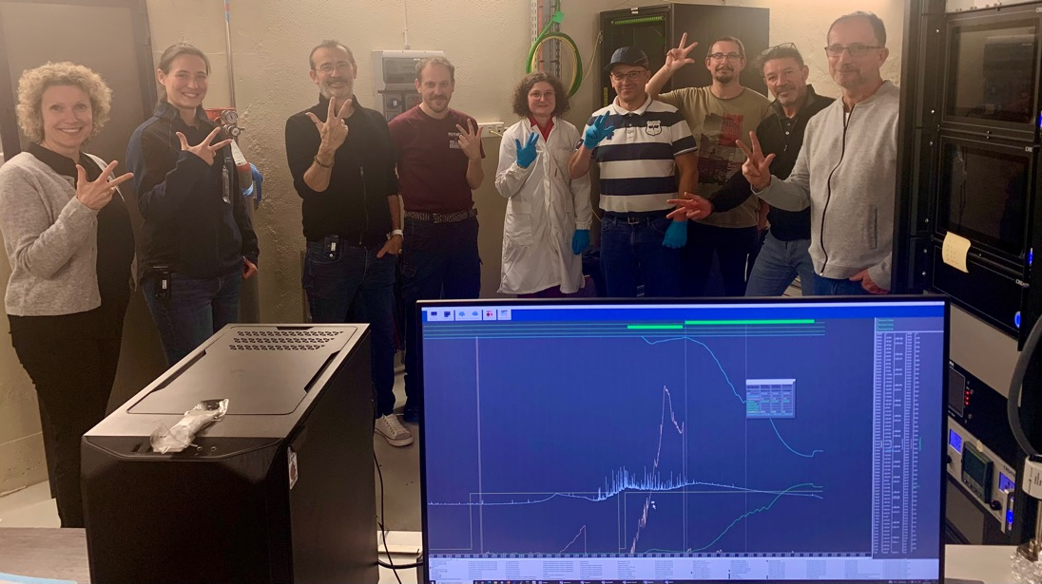
PERLE e- gun: Achieved milestones
Production of the 1st photocathode:
The Photocathode Production Facility (PPF) was assembled:
Glove box with load-lock system & motorised substrate transfer.
A Molecular Beam Epitaxy chamber (MBE) (pumped & backed) with 3 prepared evaporators (Cs, K, Sb) and a low-power green laser for quantum efficiency ((QE) monitoring during deposition.
Photocathode with QE= 3% in the first attempt, that decrease the following days
Sep 30, 2025

Slide 7
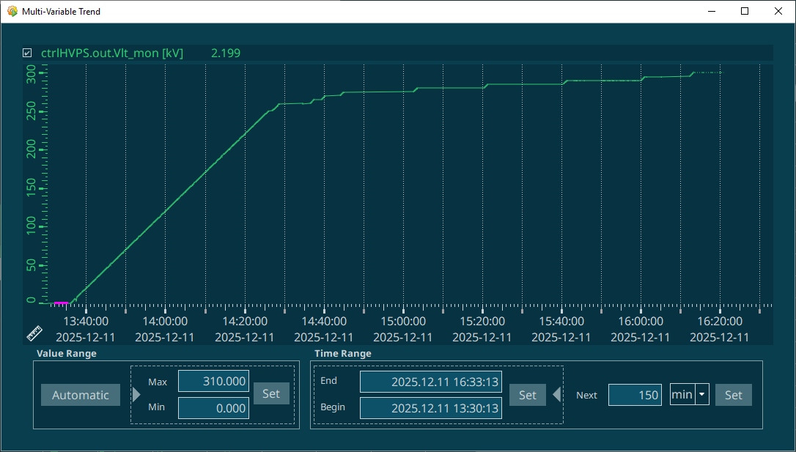
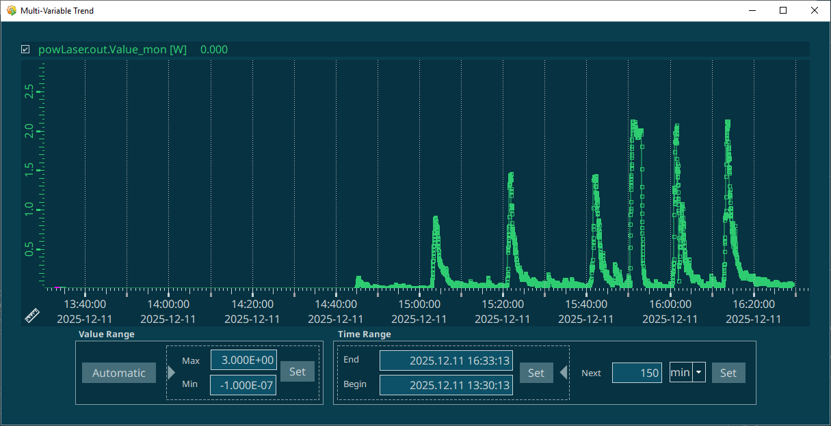
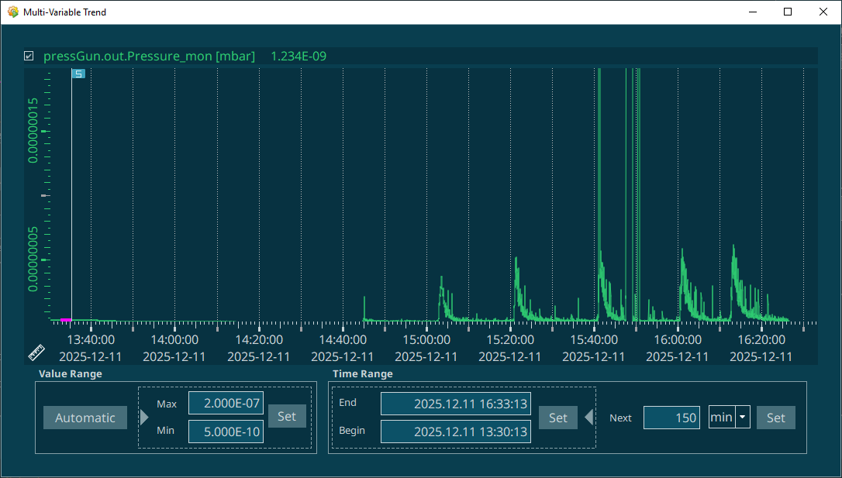
PERLE e- gun: Achieved milestones
HV vs time
2. DC gun HT conditioning under 2 bar of dried N2 (300 kV achieved)
The HT Conditionning was performed in 3 days (9-11 déc)
Automatic Slow HV ramp-up
Vacuum and radiation level control during the HV processing:
Threshold: Max : 10⁻⁷ mbar et 2,1 mSv/h
Balise gamma vs time
Pressure vs time

Slide 8
PERLE e- gun: Achieved milestones
DC-Gun under utra-high vacuum:
DC Gun assembled, pumped, baked (@ 200°C during 10 days) and integrated to the beam line.
Vacuum level reach to date : 5 10⁻¹² mbar.
Installation and test of the photocathode laser:
Green laser (515 nm), Satsuma model (Amplitude) tested in laser clean room salle: Power 1,5 W @ 40 MHz at the laser exit → 1W foreseen at photocathode surface.
Production of the first CsK2Sb photocathode:
PPF assembled: composed of a glove box with a load-lock system, automatised system for substrate trolly transfer, a deposition chamber (backed and under ultra-high vacuum) with 3 evaporators (Cs, K, Sb) and a low power green laser for photo-current measurement during depositions.
First photocathode production beginning of October → QE: 3%, degraded the following days 1% and 0,1% after 1 month (investigations ongoing).
Installation of the command-control and safety systems:
Command-control system and the Machine Protection System (MPS) of the gun developed and installed.
Personnel Safety System (PSS) also installed.
Beam Diagnostics:
BPM successfully tested (Libera module- Readout Electronics).
Faraday cup (charge and beam current measurements): Ordered, received and assembled in the beam line.
Installation and conditioning of the HV system:
HV system assembled and tested at 30 kV under air, HV tanks assembled, HV interconnection settled and tested, leak tested then left under dried nitrogen at low pressure.
Successful HV system conditioning (December 2025), up to 300 kV under 2 bar of dried nitrogen.
A report describing the achieved milestones was drafted and sent to CNRS.
→ Phase 1 of ERL4ALL programme validation (Go/No Go milestone) and moving to the next phase (with 2 M€ released)

Slide 9
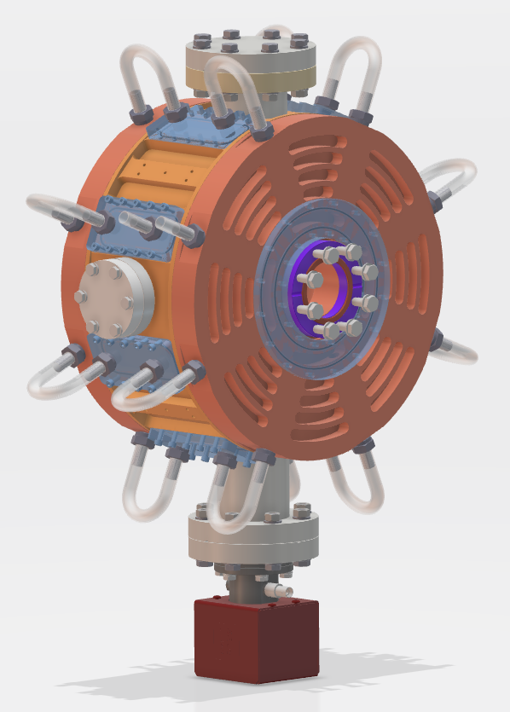
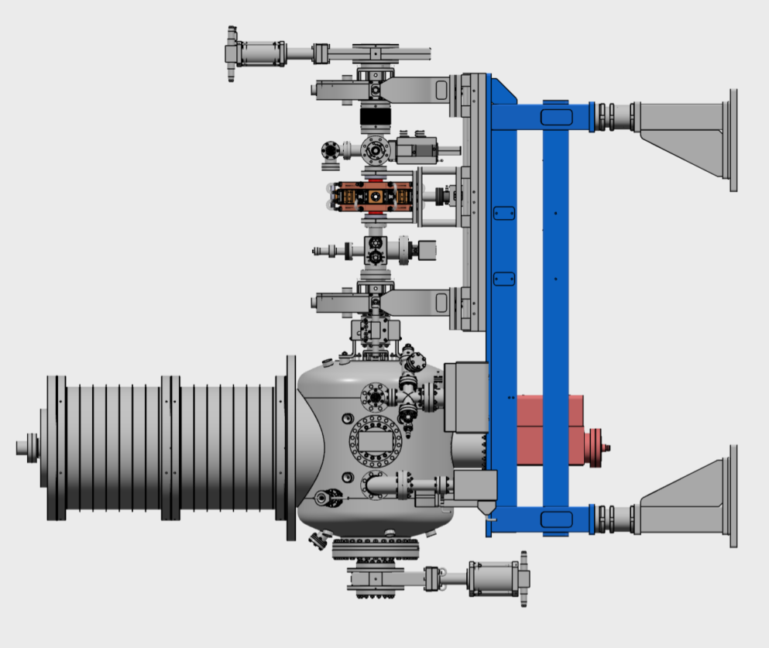
Design of the buncher cavity:
Specifications :
Frequency = 801 MHz
Maximum length = 200 mm
Targeted temperature = 30°C
Power dissipated = 1kW
Material : OFHC
Beam axes flange : CF50
Antenna port : CF 16
Plunger port : CF 40
Vacuum port : CF63
RF power coupler port : CF63

Slide 10
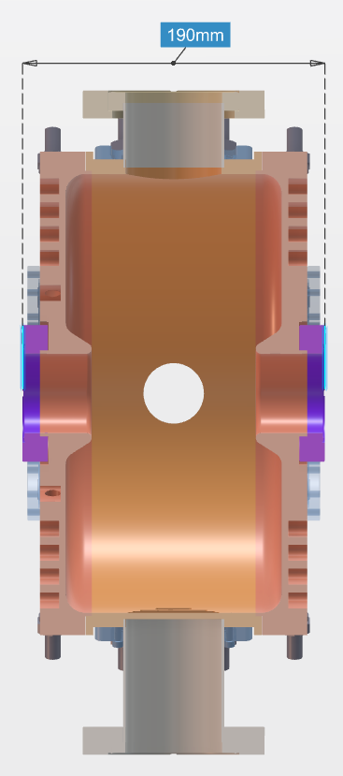
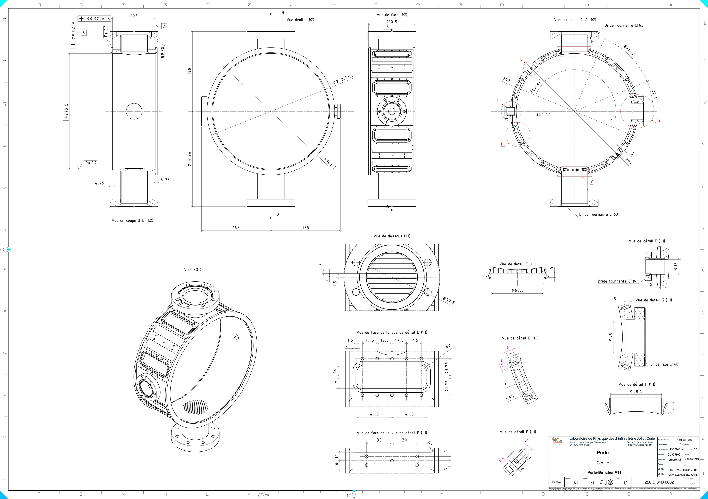
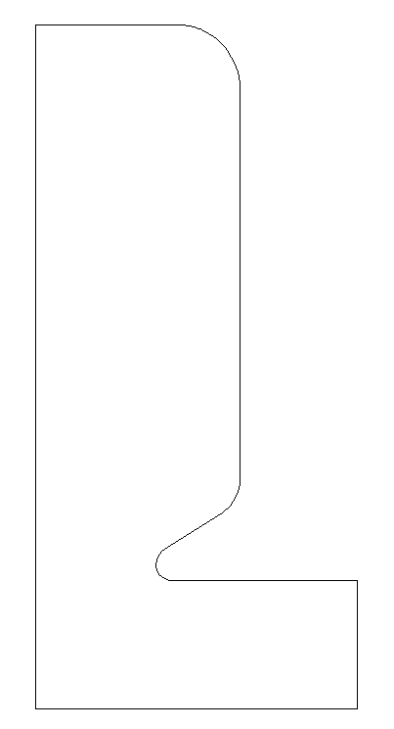
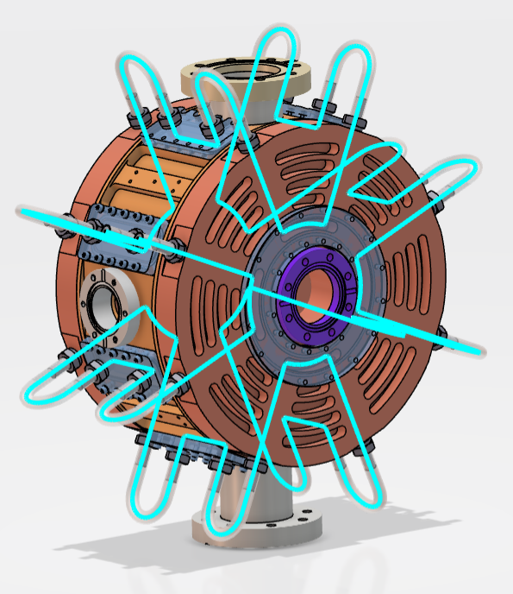

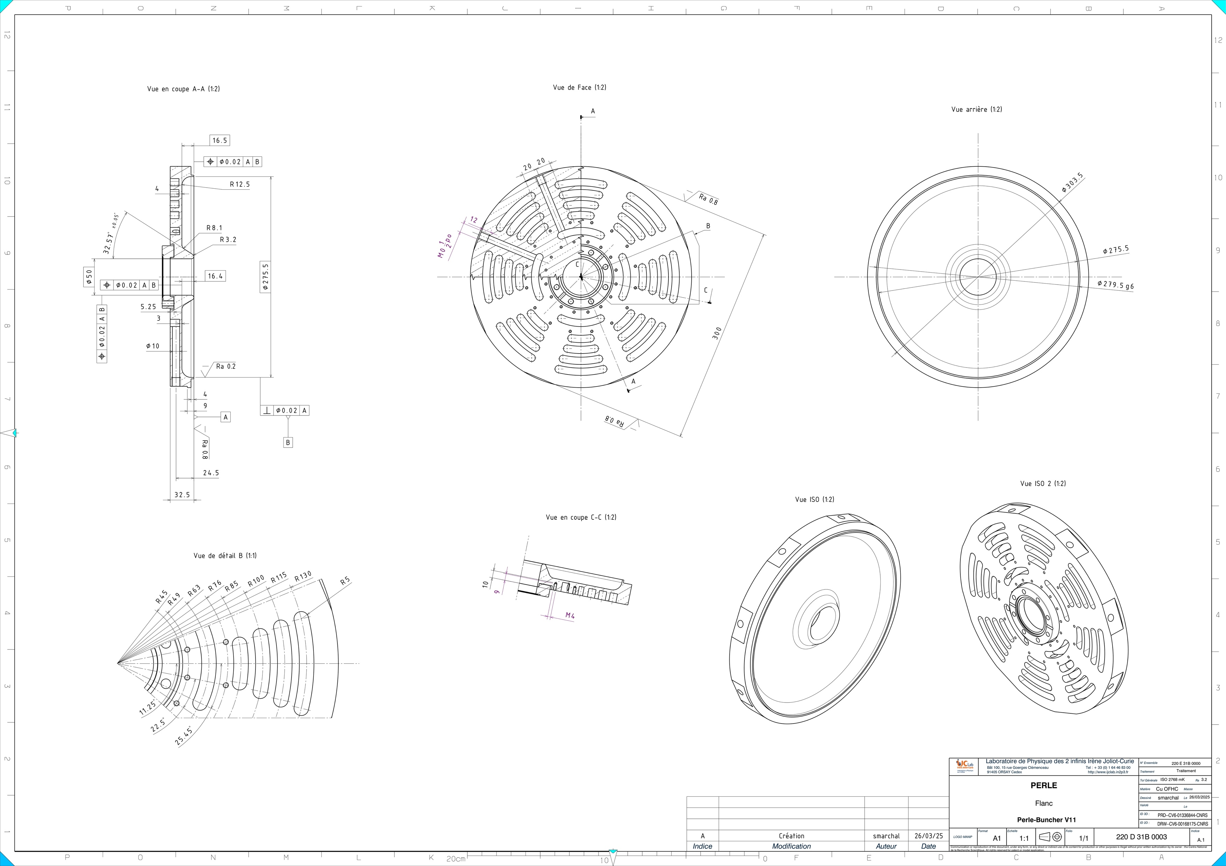
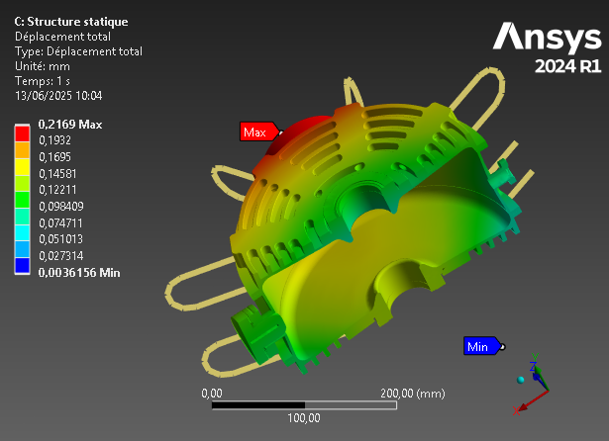
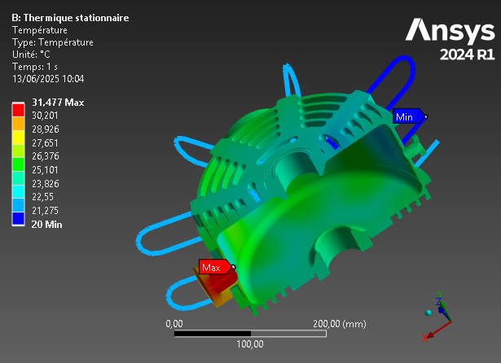
Design of the buncher cavity:
W/2
g/2
Lcav/2
Cooling scheme optimization
Mechanical drawings folder preparation
RF studies & geometry optimization
Thermal & mechanical studies

Slide 11
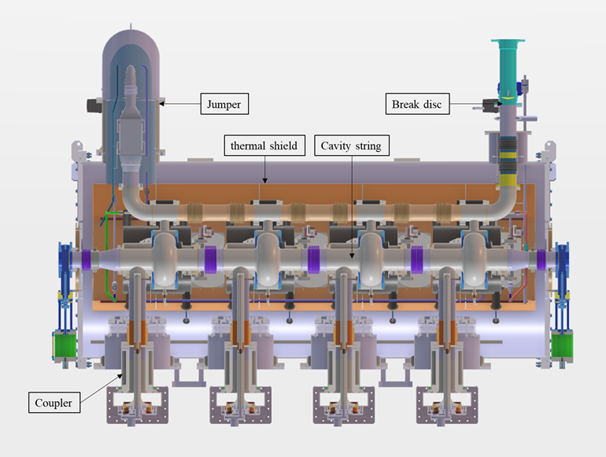
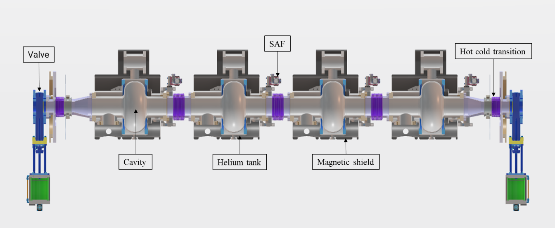
Design of the booster cryomodule:
The booster specifications are:
Bring the beam energy up 7 MeV:
x 4 single cell SRF cavities, Qo > 3E+10 @ 10 MV/m
T= 2K (dynamic losses < 5W /cavity)
F = 801.58 MHz
RF Power/cavity~40kW
No HOM couplers but absorbers needed (under discussion)
Adapt as much as possible the Linac cryomodule design to the booster requirements:
Same vacuum vessel type (same diameter, alignment supports, openings for accessibility, end-caps...)
Same cryogenic interface (jumper connection)
Same power couplers
Same interface to the RF network
Same tuning systems
1.2 m
2.9 m

Slide 12
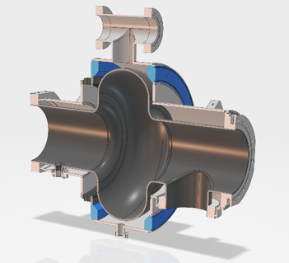
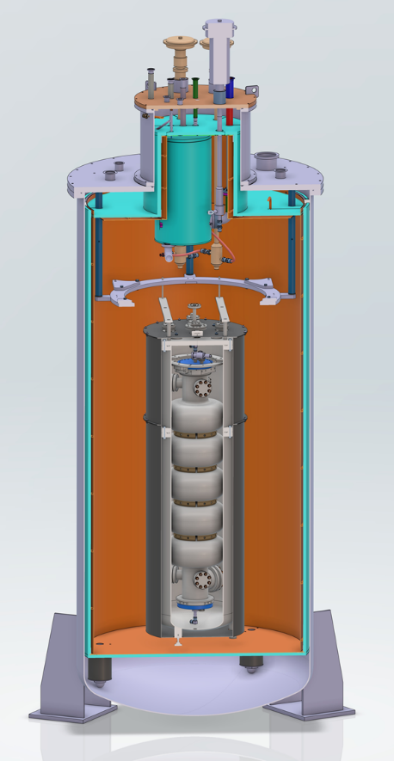
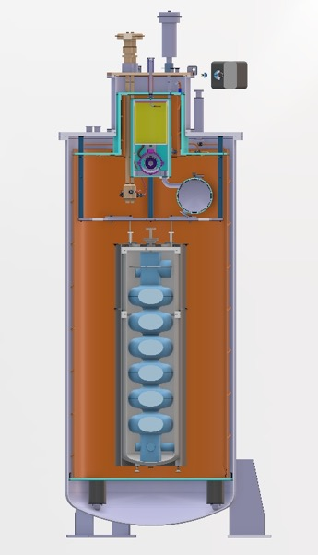
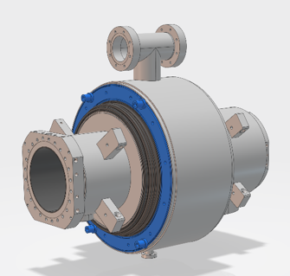
Booster single cell cavity
We tried to standardize its design as much as possible w.r.t the 5-cell cavity design:
RF design from the 5-cell cavity
Helium vessel made also of Titanium
Same flanges
Same coupler port aperture
Same bellows
Same tuning system
... no HOM coupler port, but BLAs?
To be compatible with our vertical cryostat configuration for testing at 2K
PERLE 5-cell cavity in vertical cryostat
Cryostat compatible also with FCC 6-cell cavity

Slide 13
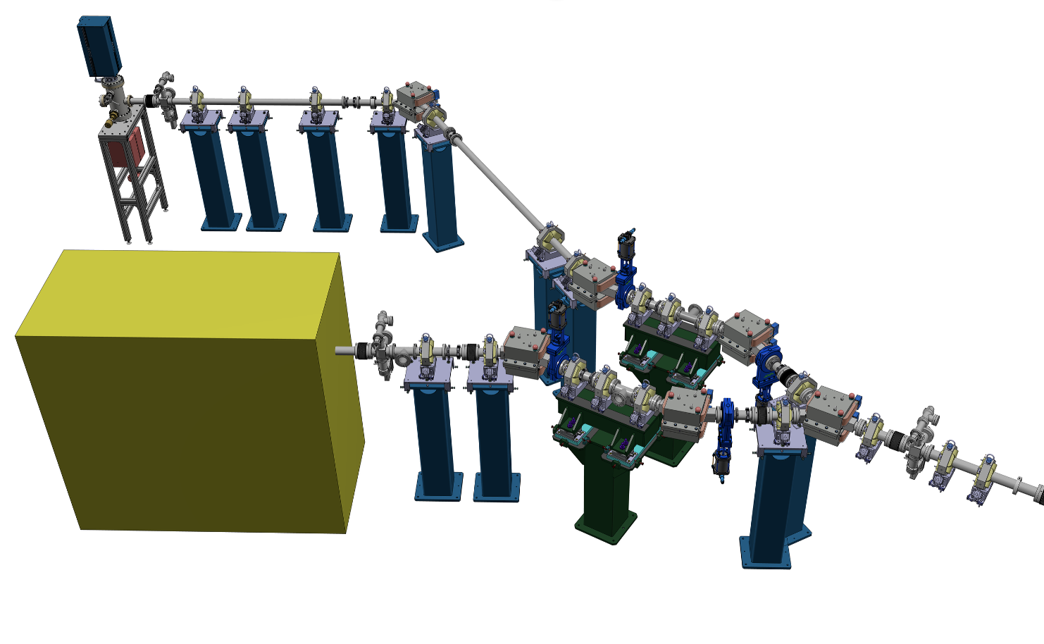
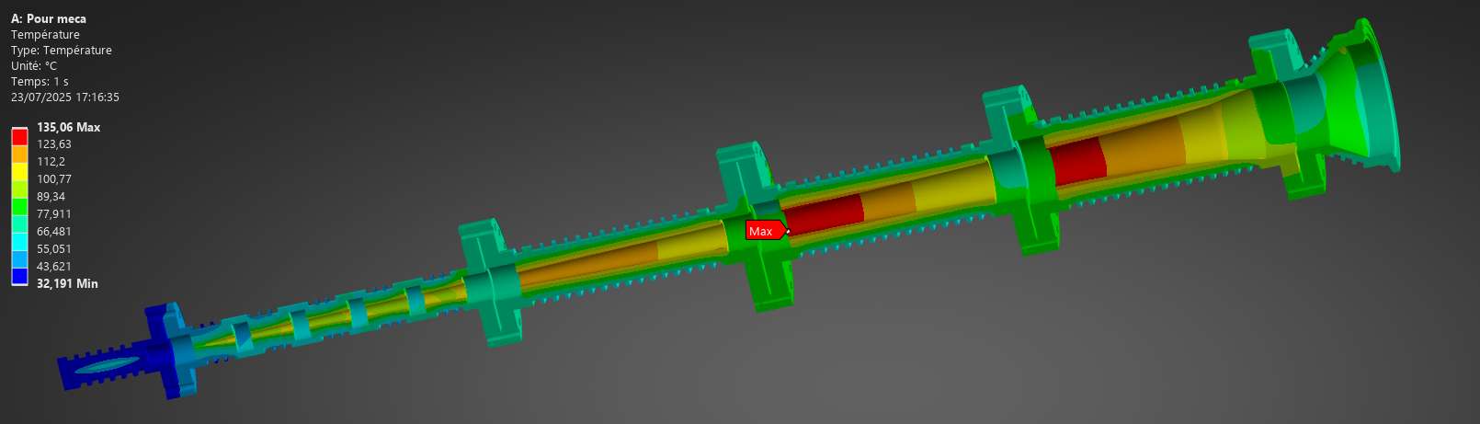
Other systems of the injector:
The Diagnostic line: merroir symmetric w.r.t the merger, with the same optics, containing diagnostics to characterise the beam at the ERL loop entry.
Faraday cup
Beam Dump: for a 7 MeV/ 20 mA → 140 kW beam
The merger: Connecting the injector and the ERL loop, composed of optic elements (Dipoles, quads, steerers) and BPMs.

Slide 14

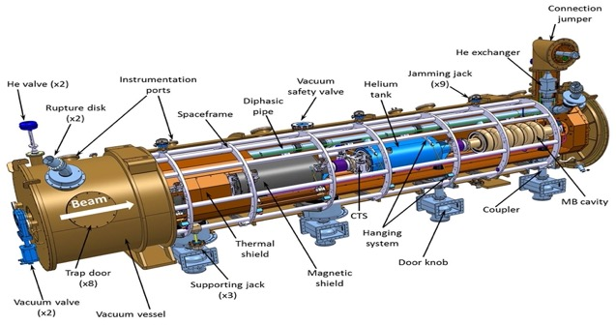
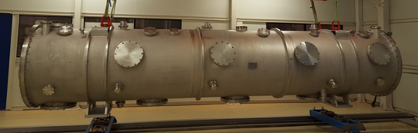
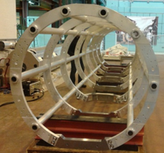
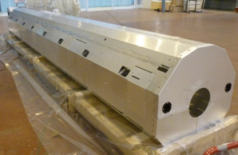
Linac cryomodule design
PERLE cryomodule is adapted from ESS design and will be optimised for efficient high current ERL operation. It will integrate the RF systems (SRF Cavities, HOM couplers & absorbers, Fundamental Power Couplers) optimized and developed within the European project ISAS.
As In-kind contribution of ESS to iSAS, the cryomodule of the linac will reuse ESS medium beta prototype components:
Vacuum vessel
ESS, CEA, CERN and INFN-LASA
are involved in this work
Spaceframe
Thermal shield
And will host new optimized components developed within the iSAS project
Cavity string (SRF cavities, RF couplers, Tuning systems, Beam Line Absorbers, HOM couplers...)
Magnetic shield
Cryogenics circuit...

Slide 15
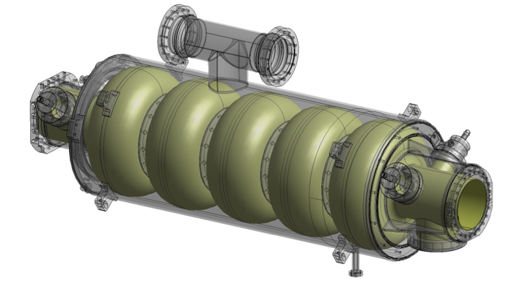
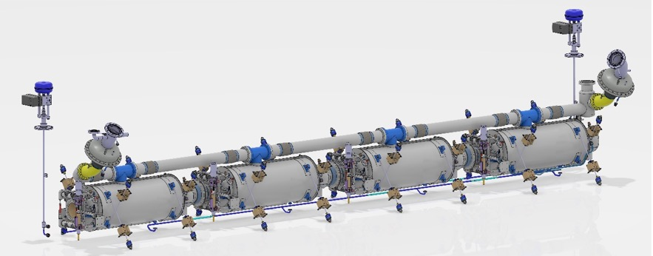
SRF cavity : latest news
Collaboration IJCLab-CERN and JLab
With the results of the previous studies, we complete the design of the 5-Cell cavity by adapting and integrating:
A helium jacket made of Titanium (including the beam pipes)
4 HOM couplers and the FPC ports to the end-groups
A “classical” tuning system as the one developed for the ESS Spoke cavities
Cold BLAs between cavities (PhD just started in this thematic)
A “cold” magnetic shield
A review meeting on the cavity post-production processes recipes (EP, BCP, Mid-T baking…) was organised in 2024 with international experts.
→ An R&D program ongoing for recipe optimization (Coll. IJCLab, Jlab, Fermilab, CERN and KEK)
→ A call for tender for four 5-cell cavities was published last summer and the order was placed end of October 2025 (with Zanon) (Kick-off meeting on January 16th).
2 years to get the 4 cavities ready for clean room assembly
(NB: no spare cavity!)
Goal: High Qo > 3 10¹⁰ (at 2K) @ Eacc=22 MV/m

Slide 16

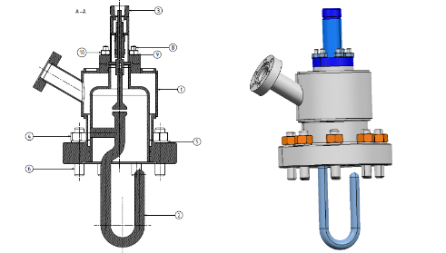
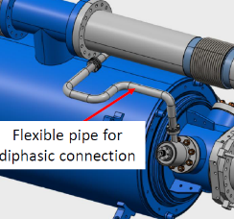
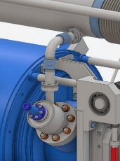
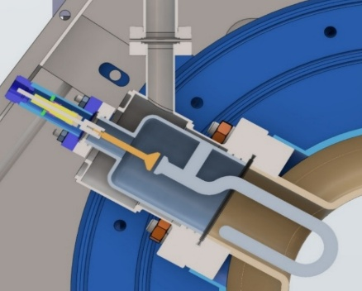
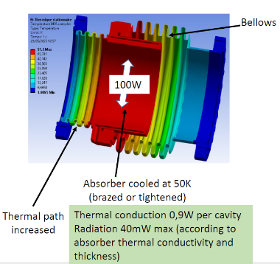

Coupleurs HOM et absorbeurs:
Two Hook-type HOM couplers are needed per cavity → 8 in total to equip the CM.
To reduce manufacturing costs:
The RF design has been optimized to integrate a commercial RF feedthrough (PHOM max 2W @ 2K).
Optimization of the cooling circuit and two He jacket designs are proposed (SS and Ti).
→ Only 4 will be produced by CERN within the iSAS framework.
→ Quotations requested from manufacturers for the production of the 4 additional HOM couplers.
Cold absorbers: A PhD thesis has just started on this topic, to be investigated:
What material to use (SiC, AlN, others...)?
How many BLAs in the CM? Two options: 3 cold BLAs + 2 hot or 5 cold.
Cooling with gaseous He at 50K via a dedicated cryo circuit.
A preliminary design to extract PHOM = 100W still needs optimization.
design simplification by adding a standard RF feedthrough on CF16 flange
Cooling circuit Optimization
He jacket
BLA Thermal mapping
Config with 5 cold BLAs

Slide 17



Coupleur de puissance:
Power couplers
SPL is the baseline with some adaptations to cope with PERLE requirements
Design completed and validated (technical review last June)
4 couplers will be produced by CERN by end of 2026
Same cooling configuration than the one of ESS: helium circulation from 4/5 K to 300 K through a double wall tube
Double-wall tube procurement was not included in ISAS: need to be ordered in 2026. We got 2 options:
Take the ESS design (baseline) → need to sign an NDA with CEA.
Mitigation: modify/adapt the DWT of the ESS double-spoke → Study about to start.

Slide 18
TDR- Structure and advancement:
X. Vacuum Systems (indicatif : ~ 20 pages max)
XI. Machine Protection system (indicatif : ~ 10 pages max)
XII. Control systems (indicatif : ~ 15 pages max)
XIII. Infra & Integration (indicatif : ~ 15 pages max)
XIV. Quality management (indicatif : ~ 10 pages max)
XV. Commissioning (indicatif : ~ 10 pages max)
XVI. Sustainability (indicatif : ~ 10 pages max)
XVII. Experiments (indicatif : ~ 15 pages max)
XVIII. Safety & Radiation Management (indicatif : ~ 10 pages max)
References
I. Introduction (indicatif : ~ 5 à 10 pages max)
A. Context
B. PERLE in the ERL worldwide landscape
C. PERLE Project
1. Scheme and option
2. Organisation
3. Programme
D. General layout
E. Application & experiment
F. Machine parameters
II. Accelerator Physics/design (indicatif : ~ 40 pages max)
III. Injector (indicatif : ~ 20 pages max )
IV. Merger, diagnostic line & Dump (indicatif : ~ 20 pages max)
V. Beam diagnostics (indicatif : ~ 25 pages max)
VI. Magnets (indicatif : ~ 20 pages)
VII. Cryomodules and superconducting RF (indicatif : ~ 30 pages max)
VIII. RF systems (indicatif : ~ 25 pages max)
IX. Cryogenics systems (indicatif : ~ 25 pages max)

Slide 19

TDR- Structure and advancement:
Advancement:
a < 25% : No plan or detailed advancement
a=25% : plan received but draft of V₀ on-going
a= 50 % : V₀ received, in editing process or correction
a > 50 % : V₁ corrected
a ≥ 75% : Final version ready and/or remain minor corrections
a = 100 % : Finale version integrated to TDR. Edited & approved by Chapter Coord. & Coord. Board.

Slide 20
Organization of the beam dynamics review:
Goal:
Validation of the scientific choices related to lattice design and beam dynamics studies.
Inputs to be provided:
Final lattice design will be presented in details, including optical functions, optical elements parameters and the phasing strategy.
Current state of diagnostics studies, error studies and various beam dynamics studies will also be shown.
The reports will be sent to the reviewers at least a month in advance, along with a list of questions for the reviewers.
Practical Information:
The review will be held at IJCLab, by Mid/End June 2026, so it does not overlap with the IPAC conference.
A hybrid (zoom-presential) format can be envisaged, considering potential travel issues.
PERLE collaboration will afford all expenses (travel, meals, accomodation) of reviewers if they wish to attend in person.
A visit of the installation is planned.

Slide 21
Organization of the beam dynamics review:
Expert panel: A panel of experts (mainly beam dynamics experts in ERLs) from various labs and fields will be invited and kindly asked to advise & comment on a bunch of general and specific topics by the PERLE beam dynamics team. → We ask the CB for comment of the expert list and approval.
 | Proposed name(s)
Internal experts | Alex Bogacz and Peter Williams
CEBAF Expert (USA) | David Douglas (Retired)
CBETA experts (USA) | Stephen Brooks/ Georg Hoffstaetter
sDalinac/bERLinPro (Germany) | Michaela Arnold/ Alex Neumann
cERL (Japan) | Miho Shimada
CERN | Yannis Papaphilippou/ Bernard Holzer
NON-ERL experts | Antoine Chance (CEA Saclay), Alexandre Loulergue (Soleil)/ Simon White (ESRF)/ Simone Liuzzo (ESRF)
Local team | Julien Michaud, Alex Fomin, Frederic Bouly

Slide 22



HR involvement in PERLE : review & projections
2nd semester 2025: 33,32 FTE for 95 involved persons, reparteed as the following:
IJCLab: 29,2 FTE
Accelerators Pole: 19,15 FTE
Engineering Pole: 8,13 FTE
Support services + Supratech platform: 1,51 FTE
Nuclear Pole: 0,17
Direction: 0,24
LPSC: 3,62 FTE
Ganil: 0,5 FTE
In average, 31.35 FTE involved in 2025 in French labs

Slide 23



HR involvement in PERLE : review & projections
4 new PhD students joined PERLE:
Nawal Belouchrani: LLRF Optimisation LLRF and study of a real-time simulation cavity.
Janine ISSA: Beam dynamics studies
Alex Perez-Ruiz: Beam Line Absorbers (BLA) study
Arnaud Cieplak: Study, control and mitigation of beam losses
2 new post-doc and 1 non-permanent position (Engineer) also:
Damien Till (CDD- IR): Cryogenic process design and optimisation.
Anahi Segovia-Miranda (post-doc): implementation & commissioning of the photocathode laser system.
Rasha Abukechek (post-doc): Magnet design and optic errors study and mitigation
In addition to new contributions on diagnostics development from other CNRS-IN2P3 labs:
LPSC- Grenoble: Electronics development of BPMs
IPHC-Strasbourg: Beam Loss Monitor (BLM) design and fabrication + Electronics development (BLMs) + Control-command.
IP2I- Lyon: BLM Electronics development

Slide 24

PERLE Cost Assessment: Available and missing budget
A detailed costing & multi-year spending profile was performed, taking into account the phasing strategy of PERLE, the available budget and the in-Kind contributions secured. Here the global picture:

Slide 25



PERLE Cost Assessment: Available and missing budget
Available and missing budget for PERLE single-turn, 5 mA
Funding options :
June 2026: Sesame €450k (Booster valve box + cryo lines)
Horizon-Infratech 2026 = RF2.0 + iSAS merged: application submitted June 2026
→ RF budget (Booster amplifiers for 0.7M€?)
New opportunities to follow-up after ESPP 2026 recommendations (Cf. next slides)

Slide 26




News of the Collaboration:
In addition to CERN commitments within iSAS (providing FPCs and HOM couplers for PERLE CM), there is continuous and fruitful discussions between IJCLab & CERN, to strength the potential synergies and interactions between PERLE and FCC:
800 MHz Cryomodule design for FCC,
First test of FCC cryomodule with beam in PERLE facility,
Development of high performance 800 MHz SRF cavities,
Development of “cold” beam line absorbers
→ imminent signature of an Addendum to FCC MoU already signed with IN2P3.
PERLE CM
FCC CM

Slide 27





News of the Collaboration:
Finalization and signature of the Cooperation Agreement between IJCLab/LPSC and Helmholtz Zentrum Berlin (HZB) for the transfer of the Cryo-plant and related equipment and collaboration on SRF activities of mutual interest and activities related to ERLs.
Gas management panel
Cold Box
Helium pumping station for 2 K operation
C&C cabinets
Cycle compressors

Slide 28

ERL/PERLE in the ESPP 2026
The European Strategy for Particle Physics: 2026 Update
Recommendations by the European Strategy Group
The Recommendations Document has now been made public, following its presentation to the CERN Council at the end of December after the drafting session in Ascona. We are currently working on a new, more detailed document: the Deliberation Document.
Here, we provide a brief overview of the sections of these documents that address ERL-related matters.

Slide 29
LINK between ERL/PERLE and LHeC
The electron–positron Future Circular Collider (FCC-ee) is recommended as the preferred option for the next flagship collider at CERN.
Several other alternative options listed here in alphabetical order, were also assessed. They offer substantially reduced precision physics programmes and would not be competitive with a collider like the FCC-ee. Moreover, in themselves, they currently lack a viable path towards energies of 10 TeV. At this stage, without knowing the reasons for which the FCC-ee would not be feasible, the other alternative options are not ranked.
(AMONG THEM LHeC)
The performance of the LHeC critically depends on a three-pass, very-high-current Energy Recovery Linac (ERL) operating with extremely low beam losses and at beam power levels exceeding those achieved to date by at least three orders of magnitude. This ambitious operational regime explains the presently low TRL, the expected performance uncertainty and the consequent need for a 10 demonstrator, PERLE, which is currently under construction. If the current three-pass ERL concept under development turns out to not be viable, the luminosity of the LHeC would be lower by a factor ten (10). Implementation of the LHeC would require the construction of a new electron accelerator, with a 9 km tunnel to the existing LHC tunnel. While the territorial implementation work is expected to be modest, potential interference between CE works and HL-LHC operations could affect the overall schedule. The project timeline can only be reliably established following the successful completion of the PERLE programme. The current estimate for the construction cost of LHeC is 2.1 BCHF

Slide 30
Accelerator Priorities : ERL/PERLE well positioned
Advanced accelerators rely on detailed beam physics models, powerful simulations and key technologies such as high-field magnets, high-gradient normal-conducting and superconducting RF accelerating systems, high-gradient plasma-wakefield acceleration, bright muon beams and energy recovery linacs (ERLs). Several technology approaches directly address the requirement of greater sustainability for future accelerator-based facilities. These include superconducting magnets and resonators operated at higher cryogenic temperature, superconducting current links, use of permanent magnets, and more efficient RF power sources, complemented by a more extensive use of robotics and artificial intelligence.
B. In order to realise the visionary plan presented, the highest priority must be the development and industrialisation of key technologies: advanced superconducting and normal-conducting RF structures, efficient RF power sources and accelerator-quality magnets in the 14–20 T range, including those based on high-temperature superconductors.
C. Demonstration of high-current multi-turn energy recovery in linacs constitutes an important step towards power-efficient lepton accelerators for a broad range of applications and should be pursued.
D. The longer-term development of advanced technologies, such as high-gradient wakefield acceleration and those underpinning bright muon beams, should be supported at an appropriate level. Synergies with the US initiative on muon collider R&D should be exploited.

Slide 31
Accelerator SRF developments for ERL important for FCC-ee. Role of PERLE and Link PERLE/FCC-ee
…In the deliberation documents we are more explicit about SRF and ERL
B. In order to realise the visionary plan presented, the highest priority must be the development and industrialisation of key technologies: advanced superconducting and normal-conducting RF structures, efficient RF power sources and accelerator-quality magnets in the 14–20 T range, including those based on high-temperature superconductors.
SRF developments for ERLs are also highly relevant for the FCC-ee. ERLs offer intense lepton beams for diverse applications, although the feasibility of high-current, high-power operation remains to be demonstrated. The PERLE demonstrator at IJCLab will explore this regime while supporting sustainable SRF technology development.
C. Demonstration of high-current multi-turn energy recovery in linacs constitutes an important step towards power-efficient lepton accelerators for a broad range of applications and should be pursued.

Slide 32
Thank you for your attention!

