Slide 1
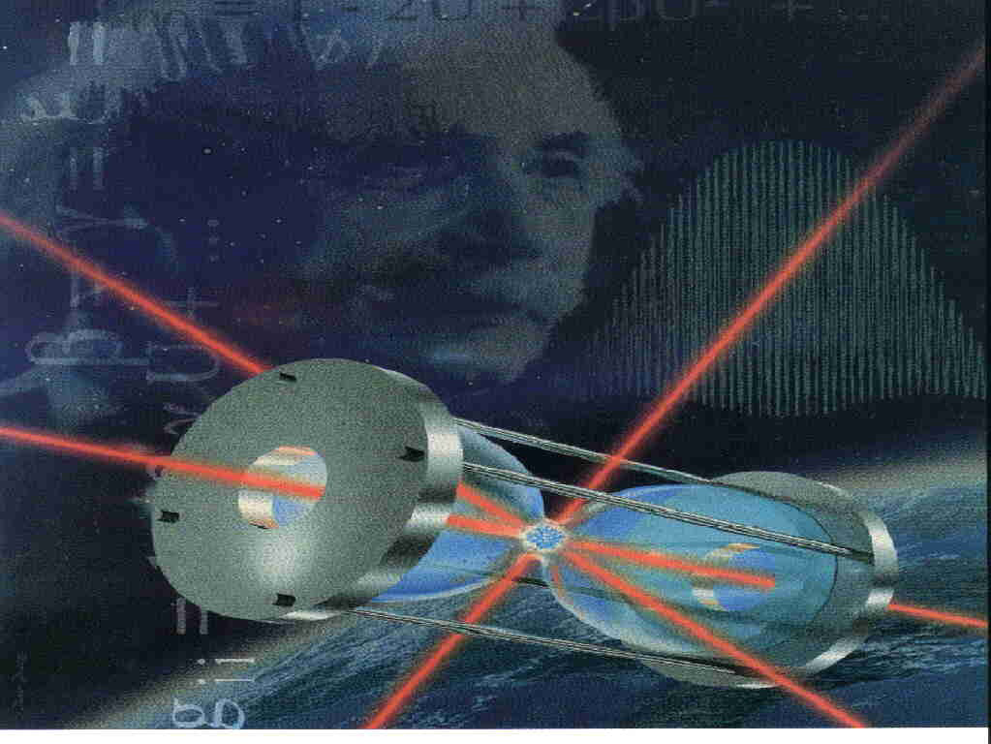
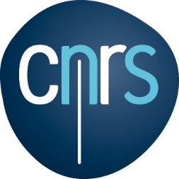



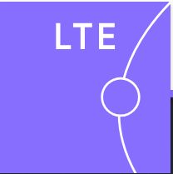





Atomes froids et mesure precise du temps
SFP- Orsay, 15 octobre 2026
Christophe Salomon
Notes:
In this presentation, I would like to report on the spectacular advances made on the measuremnt of time thanks to the quantum control of atoms obtained by cooling and trapping atoms. On this graph you have a sketch illustating this concept. Laser cooled cesium atoms are laser cooled using lsto 1 microKelvin first results obtained with a cold atom cesium clock called PHARAO a french acrronym operating as a primary standard in Eart Orbit and to describe the fundamental physics tests that we are planning to perform by comparing its frequency to ground microwave and optical clocks. the principles of atomic quantum sensors and show how they can be used for fundamenatl physics applications. In the last decade, there have been spectacular advances on clocks, and atom interferometers using cold atoms. The reason is simple: cold atoms have very low velocities and can be measured for long times either in free flight or in a trapped configuration. This opens new perspectives for fundamental physics tests both on Earth and in space. as well as new applications.
an important application of cold atoms, the application to atomic clocks. Laaser Cooling has brought a révolution in time keeping enabling several orders of magnitude gain in clock rpecision. Cooling and trapping of atoms enable record long coherence times betweeen internal states of atomic samples. isn nthing but getting a better control about the velocity spread of a dilute cloud of atoms. Now if atoms are cooled to microkelvin temperatures their velocity spread is only 7mm/s. This means that you can observe a sample of unperturbed atoms for a long duration, hence precision measurements. The second motivation is that with these new tools, you can perform new tests of fundamental physical laws and this is was this image aims to convey. As you know there is no satisfactory unification of quantum mechanics with GR and this is a motivation to perform tests at the frontier between QM and Relativity.

Slide 2
Cette conférence
Introduction: What is time ?
Atomic clock
Atomic fountain clocks
The PHARAO/ACES space mission
Optical clocks

Slide 3
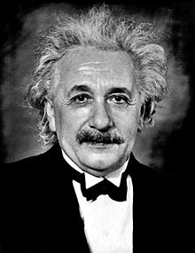
Does Time exist ?
After Minkowski, Poincaré, Lorentz, Einstein’s answer is NO !
Space and Time form a single block with 4 dimensions, 3 for space and 1 for time
Space-Time is continuously deformed by matter.
The ensemble Space-Time Matter-Energy is described by the equations of General Relativity
1905-1915
Notes:
Let me start with a somewhat provocative question. Does time exist ? Time as introduced by Newton, and used in classical mechanics flows regularly, is universal and the same for all. Following works of Poincaré, Lorentz, Einstein’s answer made here in Bern with special relativity is NO ! plus tard en 1915 est non. There as a many time as observers evolving on its universe line !
Est-ce a dire que le temps et la mesure du temps sont inutiles ? Does it mean that time measurements are useless .
Of course not ! So let us go back to fundamental concepts. Today the best clocks are atomic clocks, made of individual atoms which are described by quantum mechanics.

Slide 4
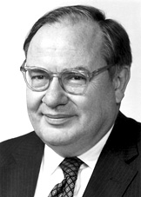
A clock is a local realization of proper time
At each space-time point, we associate an observer with a clock.
This clock provides a local realization of proper time as derived in GR. Synchronization between two clocks is achieved by transmission of electromagnetic signals propagating in curved space-time at speed of light.
There are thus as many times as observers !
Yet, time and frequency are today the best measured physical quantities !
Never measure anything but frequency !
Notes:
In Einstein’sview clocks and clock syncronization play a central role. How to reconcile this apparent paradox ? Let us place an observer along its universe line and attach a clock to him. This clock realizes the time coordinate of the metric introduced by Einstein.and it is called the local proper time. This time is not universal. There are thus as many times as observers. Clocks and their syncronization wre central in Einstein ideas which led him to develop genral relativity.

Slide 5
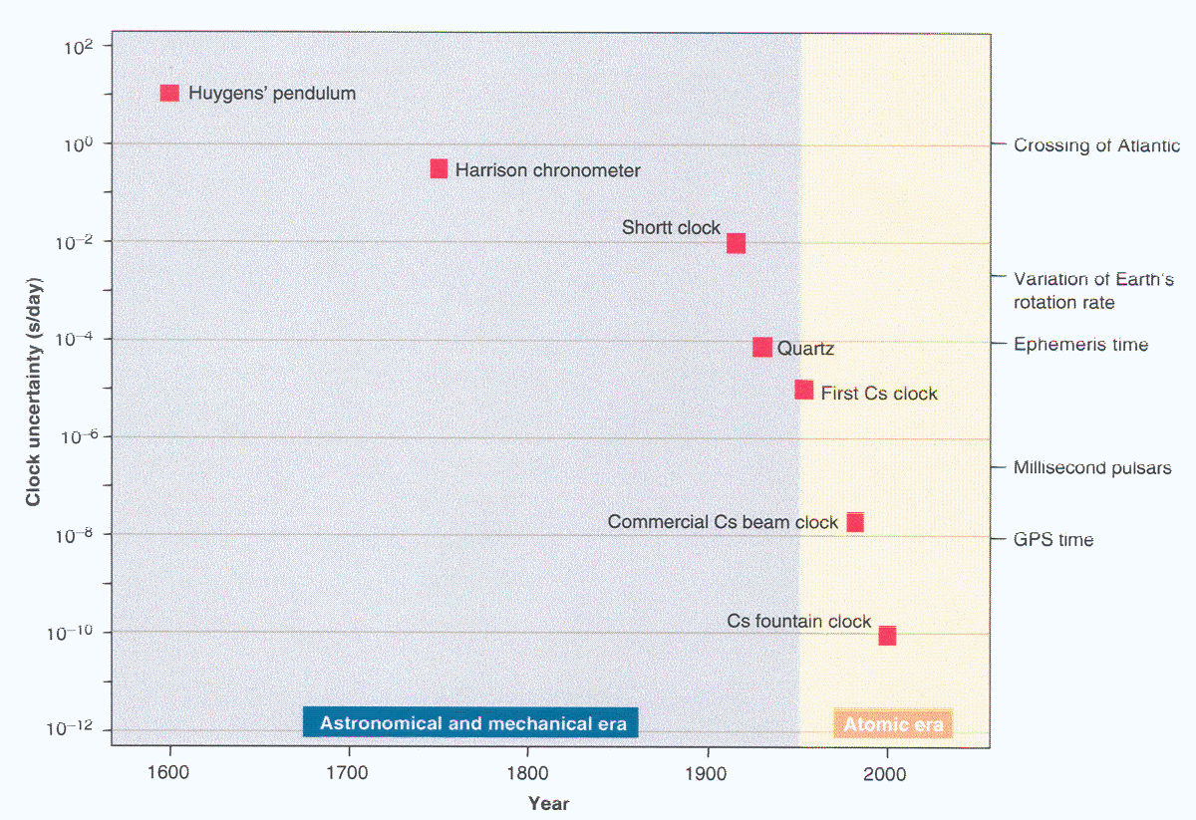
Precision of time measurements
ère atomique
1s
Navigation
Earth rotation
1ms
Clock uncertainty (second/day)
< 0.01 second error over 14 billion years, the age of the Universe !
1955: first atomic clock
1μs
Pulsars
GPS time
1ns
100 ps/day
Cold atoms & Fountains
10 ps/day
1ps
ère mécanique
0.1 ps/day
Optical clocks
Notes:
Il est intéressant de voir la progression de la mesure du temps au cous des 5 derniers siècles en partant du pendule de Galilée Huygens. Vitesse de progression un facter 10 tous les 10 ans. Gain exponentiel. Mais jusqu’ou ira-t-on ?

Slide 6
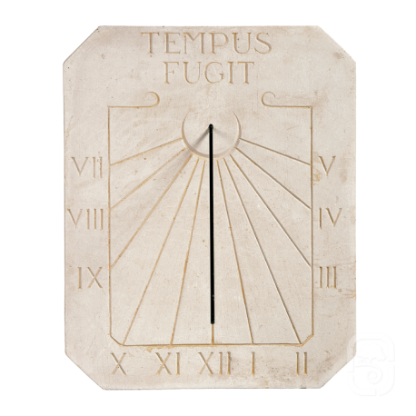
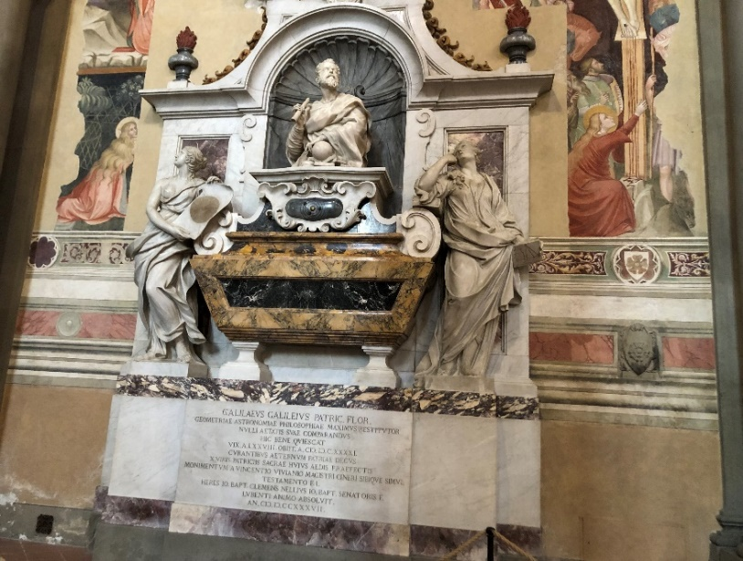
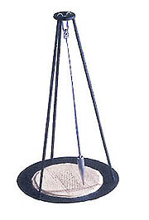
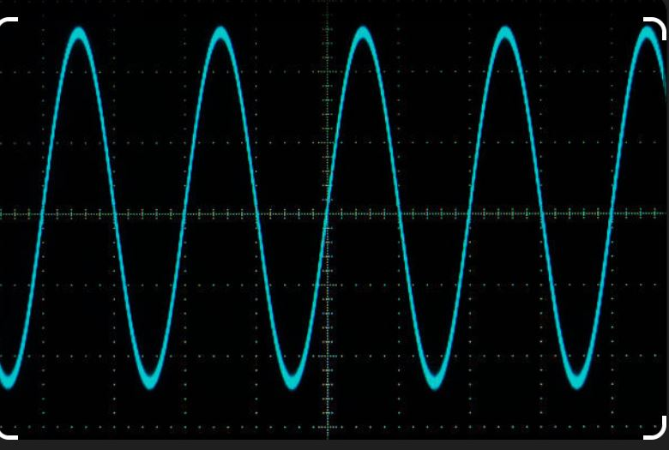
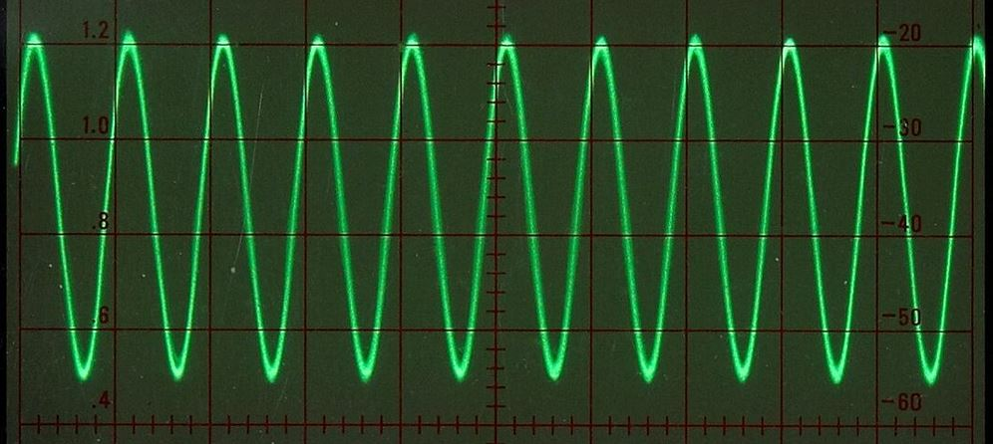
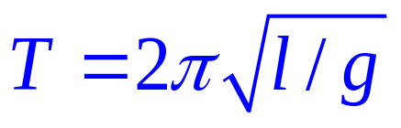
Clock concept
Find a regular or periodic phenomenon
and count a number of oscillations
1) Nature:
observation: Earth rotation: sundial,
moon, calendars,…
2) Human realization: Hourglass,
Galileo pendulum: simple phenomenon,
described by a small number of parameters
The shorter the period, the better the measurement
of a time interval dt
δt
δt
Notes:
Let us go back far in the past. Some millenia ago, humans observed that the Earth rotate around itself (days and nights) and around the Sun. This led to sundial or calendars but not always practical in everyday life.
ne sont pas bien pratiques dans la vie courante. Humans have realized objects to measure time intervals like the hourglass. But it was Galileo who introduced the concept of a clock with the invention of the pendulum. il a trouvé un phénomène simple bien regulier décrit par un petit nombre de paramètres: ici la periode est donnée par la longueur du fil et l’acceleration de la He found a regulare phenomenon, we say periodic described by a very small number of parameters, the length of the wire and the graviy acceleration. pesanteur. Avec une longueur d’un mètre, le tic tac d’une pendule donne une periode d’environ 2 secondes. Tic tac. A very important notion to remember is that the shorter the period the greater the number of oscillations and the smaller the error on the time interval will be.

Slide 7
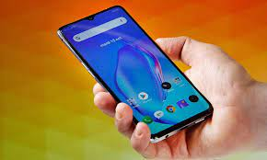
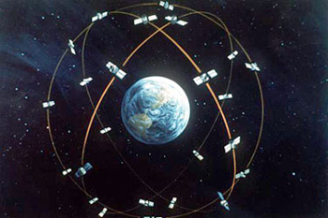
Atomic clocks
Today, the best clocks are atomic clocks
The oscillator is an electric or magnetic field which excites an atom, in the radiowaves or optical waves of laser light
Quantum Mechanics describes atoms and their excitations by light.
Atoms are all identical in any place
If atoms are very cold, they are slow, and we can observe them for a longer time.
One important application: satellite positioning and navigation
GPS
Galileo
constellations
Notes:
Today, the best clocks are atomic clocks.
Te oscillator is no longer a mechanical device as in the pendulum but
Now how do you realize practically an atomic clock ?

Slide 8
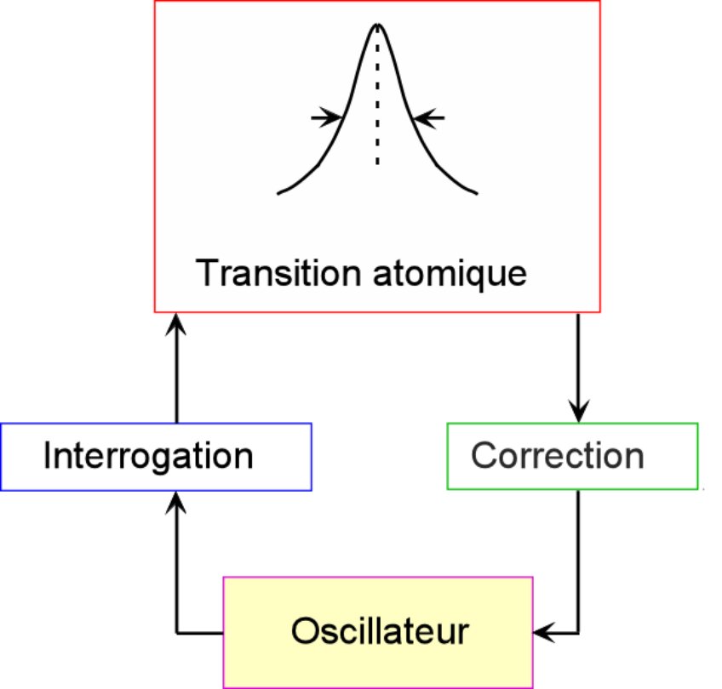
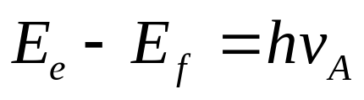

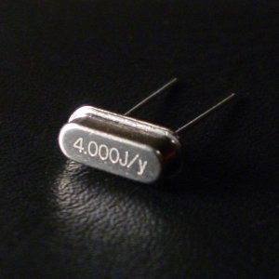
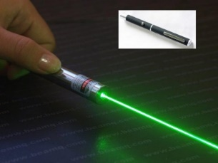

Principle of an atomic Clock
Atom
e
f
Planck-Einstein
Cesium Atom
Atomic transition
Oscillator
1second= 9 192 631 770 periods
exactly
Quartz
oscillator
The oscillator of frequency is locked to the frequency of a transition between two energy levels in an atom.
The narrower the resonance line, the better the clock will be.
Laser
Notes:
An atomic clock is a composite object with atoms and a source of radiation, for instance a quartz oscillator as in your watch.. Quantum physics tells us that atoms have well defined energy levels and they can be excited when some radiation is tuned near a transtion between two levels. Therefore when you scan the oscillator near a resonace you obtain a bell-shape curve peaked at the atomic frequency nuA. And then you create a servo system that forces the external radiation to stay exactly at the peak of th resonance curve.

Slide 9
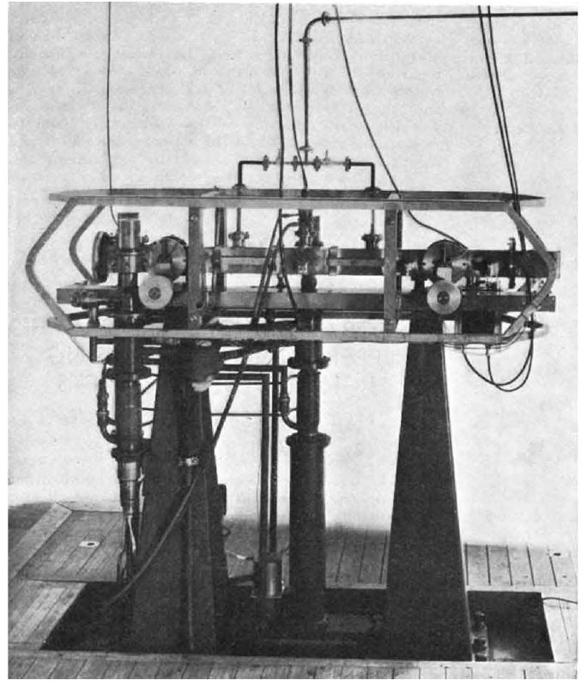
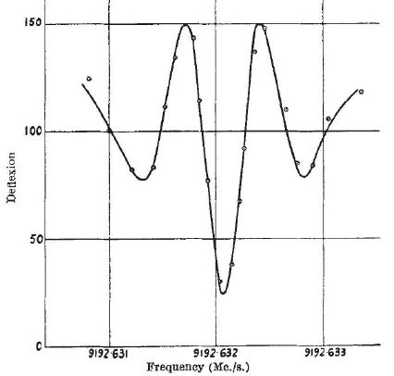
First cesium atomic clock 1955
Essen and Parry, Nature 176, 280, 1955
Cesium hyperfine
resonance
at 9.192 GHz
Stability: 10⁻⁹ better than the Earth mean day at 10⁻⁸
The ET second was: 1/31556925.975 of the tropical year 1900.
1967: redefinition of the SI second with cesium atoms
12 years later
Atom temperature 400 K, v=300 m/s
Resonance width: 300 Hz
Today, with cold atoms, resonance width : 1 Hz ,and 0.33 Hz in space
Stability 10⁻¹⁶ Gain: 7 orders of magnitude in 70 years
Notes:
It resembles the first atomic clock made in 1955 by Essen and Parry. Except that here the atoms have a velocity of 300 m/s intstead of 10 to 30 cm /s, a thousand times slower, hence a resonace width 1000 times narrover. They have built a cesium atomic beam which crossed two zones where a microwave field was applied and recorded the line shown here. I will come back to this method in a couple of minutes. and discussed the potential stability of the device which was 10^-9 alreday better than
How did we gain these 10 orders of magnitude ? A first crucial ingredient was laser cooling of atoms.

Slide 10
Laser cooling of atoms
1975: Hänsch, Schawlow,
Wineland, Dehmelt
Light exerts a force on atoms: the radiation pressure;
Absorption of photons followed by spontaneous emission
1983: first laser slowed atoms:
W.D. Phillips, H. Metcalf,
J.L. Hall and W. Ertmer, Balyukin, Minogin
Doppler effect
ω_{L}< ω₀
ω_{L}< ω₀
v
atom
Lab frame
e
ω₀
ω_{L}−kv
ω_{L}+kv
ω_{L}
Atom frame
g
If the atom moves: imbalance between the two radiation pressures
F = - α v (friction force) = mdv/dt
Photons act as a very viscous bath: optical molasses
Notes:
Alors on peut commencer cet exposé par cette question un peu provocante : Le temps existe-t il ?
A la suite des travaux de … la reponse
Est-ce a dire que le temps et la mesure du temps sont inutiles ?
Pas du tout ! Je vous ai meêm montré dans cet exposé les performances extraordinaires des horloges
Il se trouve même que le temps ou son inverse la fréquence sont….

Slide 11
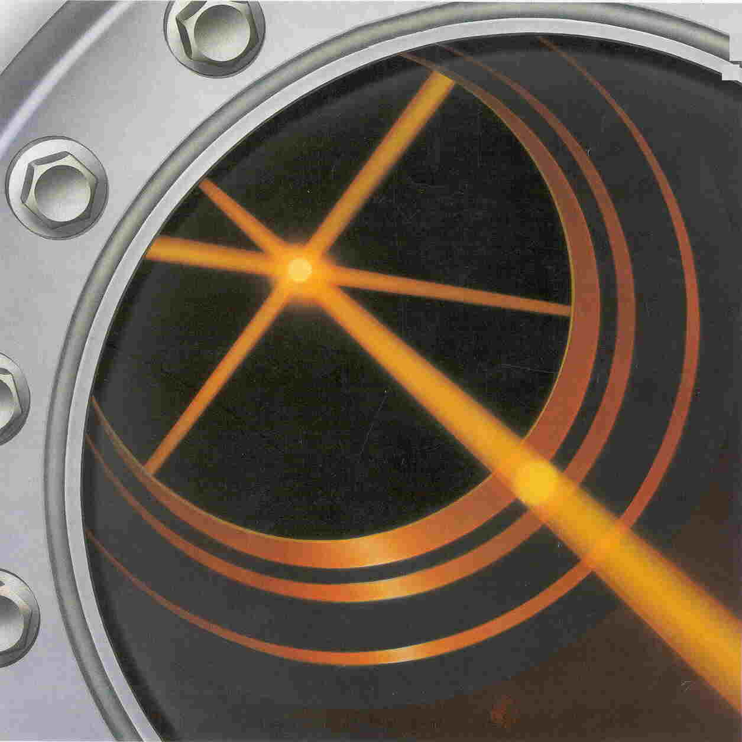
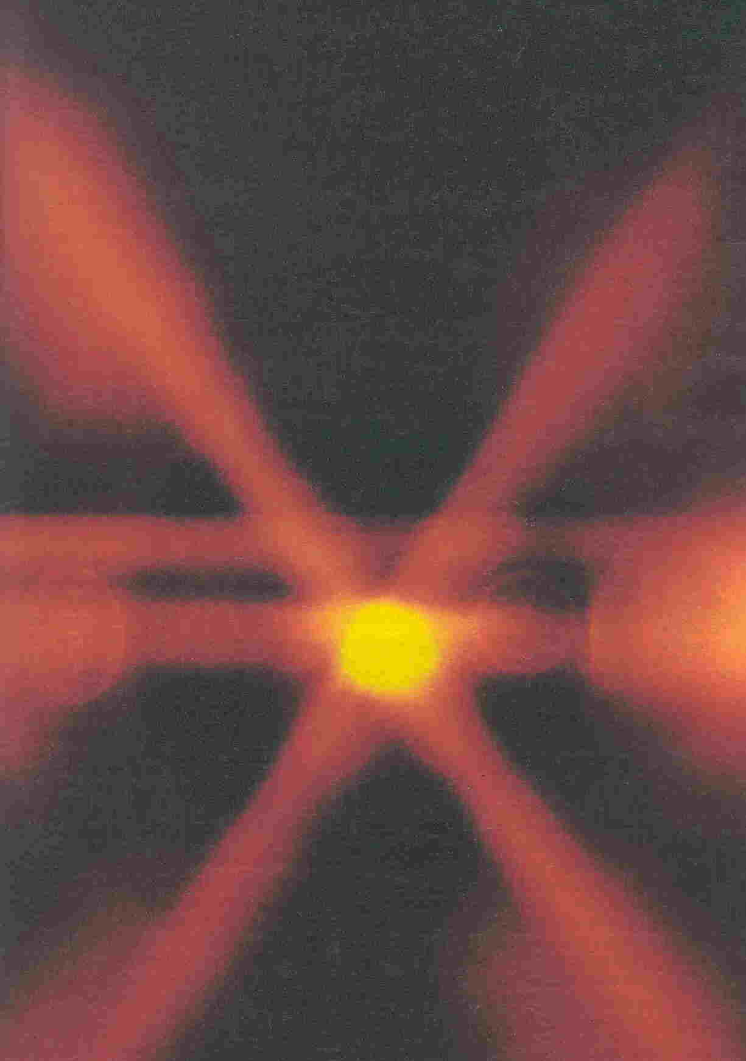
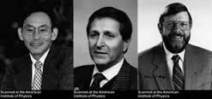
Laser cooled atoms
Sodium atoms laser cooled to 20 μK
Cesium :1μK, rms speed ~ 8 mm/s
Nobel prize1997
Long observation time
Notes:
L’origine de cette progression sepctaculaire a été l’invention du refroidissement par laser des atomes. Echange de quantitté de mouveme,t entre photons et atomes, une notion également introduite par Einstein,

Slide 12
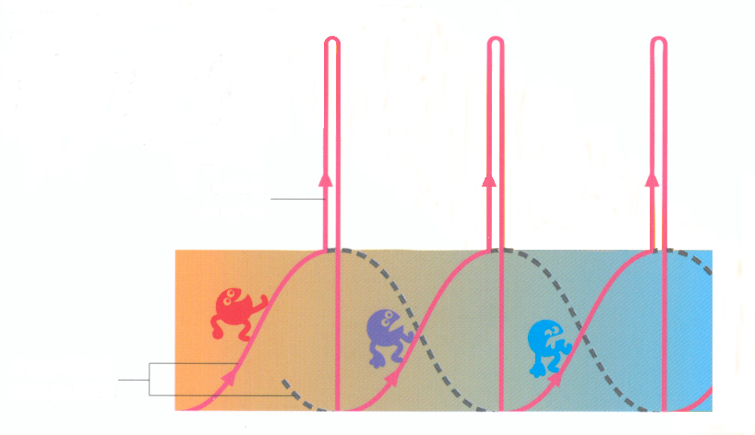
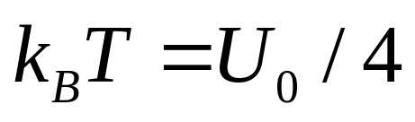
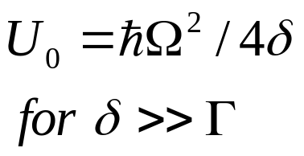
A surprise: very low temperatures
Sisyphus cooling
J. Dalibard, C. Cohen-Tannoudji
JOSA B 1989
Atoms have Zeeman sublevels
Light polarization gradient
Optical pumping
Nobel 1997
Optical pumping
Light-shifted sublevels
Lowest Temperature: about 10 times the single photon recoil energy
For cesium, T=1 μK v_{rms}=8 mm/s
Application to atomic clocks
Notes:
But how do we measure the gas temperature. The method we used at ENS was a time of flight method.

Slide 13
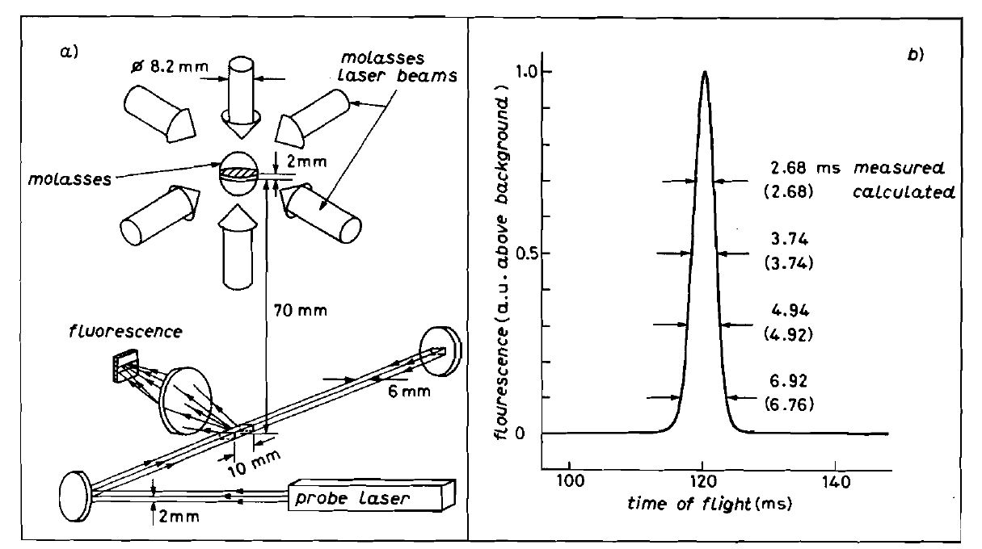
Laser cooling of cesium: the ENS experiment
T=2 μK
Cesium atoms fall with very little expansion !
C. SALOMON, J.. DALIBARD, W. PHILLIPS, A. CLAIRON,
and S. GUELLATI, Europhys Letters, 12, 683 (1990)
Notes:
When you switch-off the lasers beams forming the molasses, atoms fall down with their initial velocity. If they are hot they expan fast a bit like a fireworks. But if they are cold they expand very slowly and from the distribution of arrival times in a sheet of light we deduce the temperature alon the vertical. Laser cooling uses the radiation pressure of laser light to slow down and confine atoms, here in a vacuum chamber with three orthogonal laser beams. Here you see about 10 million sodium atoms laser cooled and viscously confined by laser light in what is called optical molasses. In our group in Paris we worked on cesium atoms and we measured the temperature by the expansion of the size of the cloud during free fall and we obtained a temperature of 1 to 2 microkelvin.

Slide 14
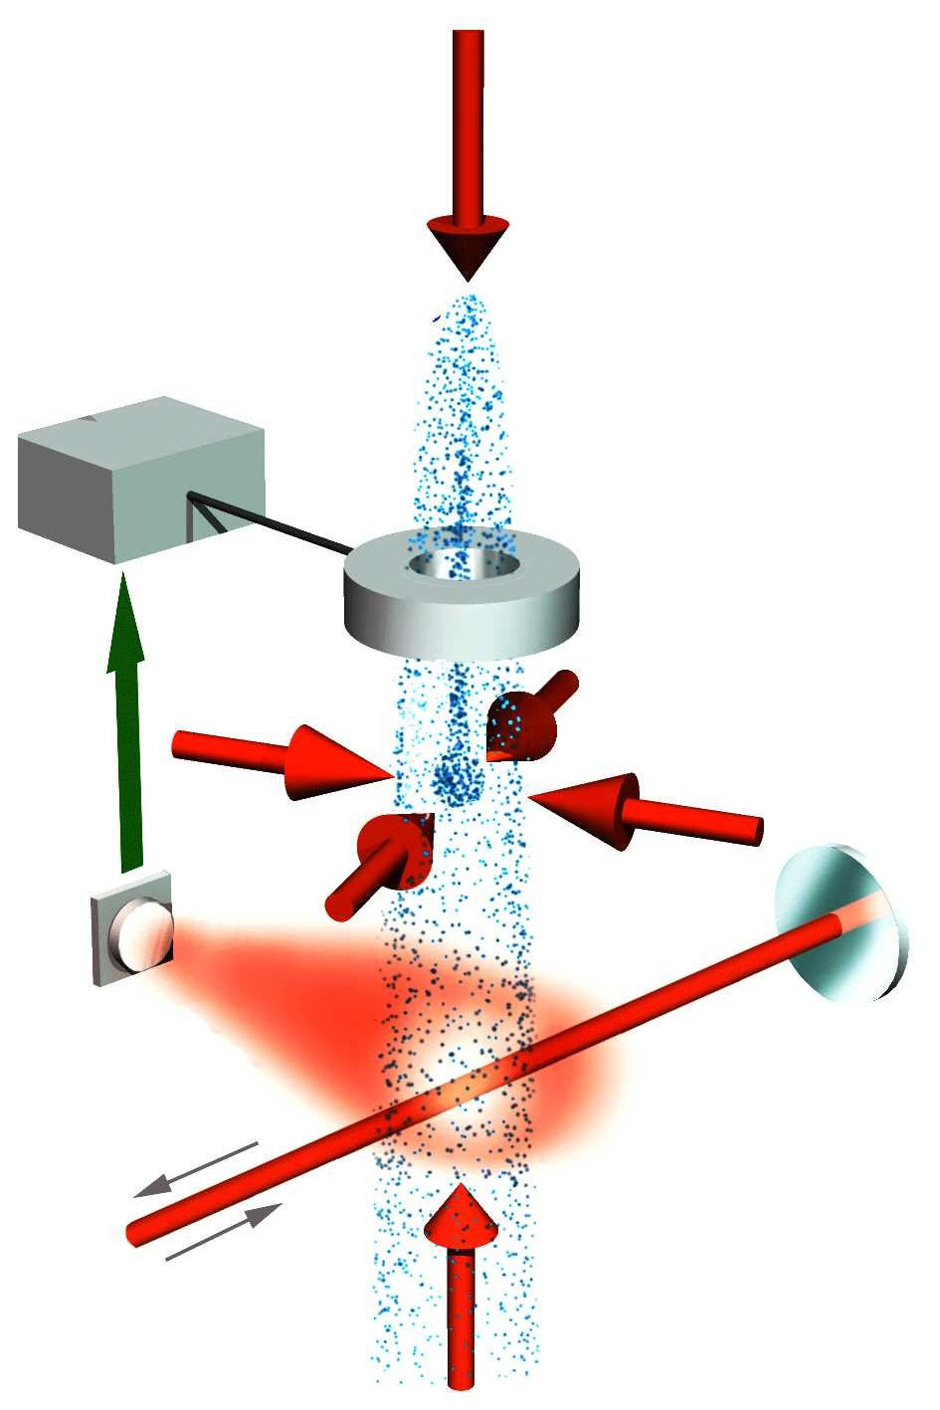
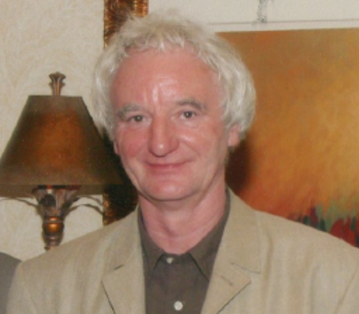
Current definition of the second: cesium atomic fountain
Atom
e
Τ
f
Planck – Einstein relation
Cesium atom
A. Clairon (1947-2015)
1 second= 9 192 631 770 periods, exactly
resonance width: δν = 1/2T
Clairon, C. Salomon, S. Guellati, W. Phillips, Europhys. Lett., 16 (1991)

Slide 15
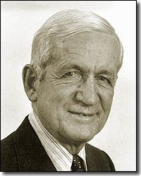
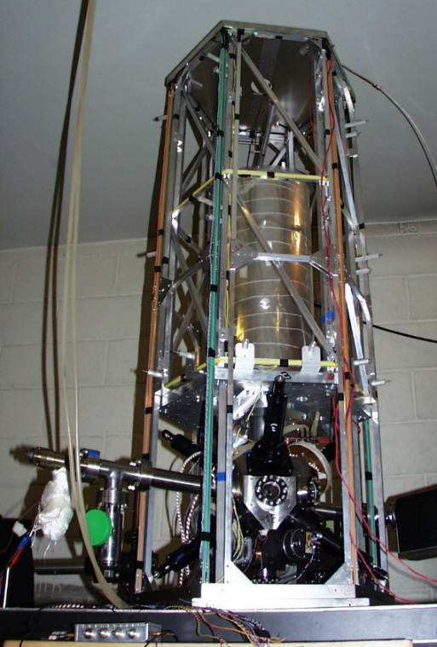
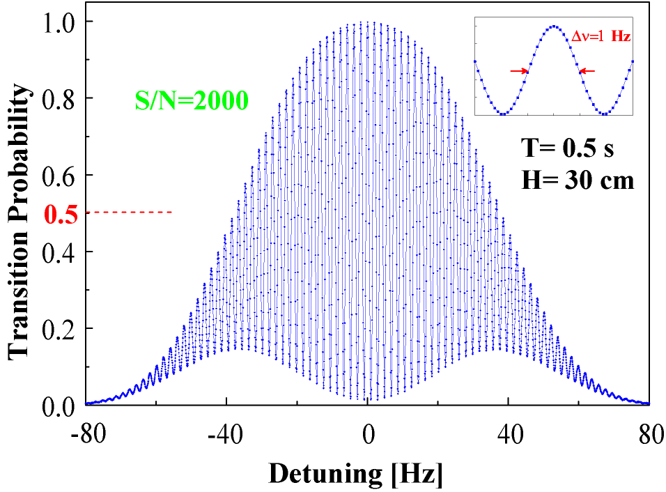
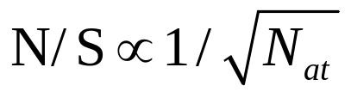
Ramsey interference
G. Santarelli et al. PRL ‘1999
S. Bize et al., 2005
S/N= 5000
per point
Nobel prize
1989
Current limit: quantum projection noise:

Slide 16
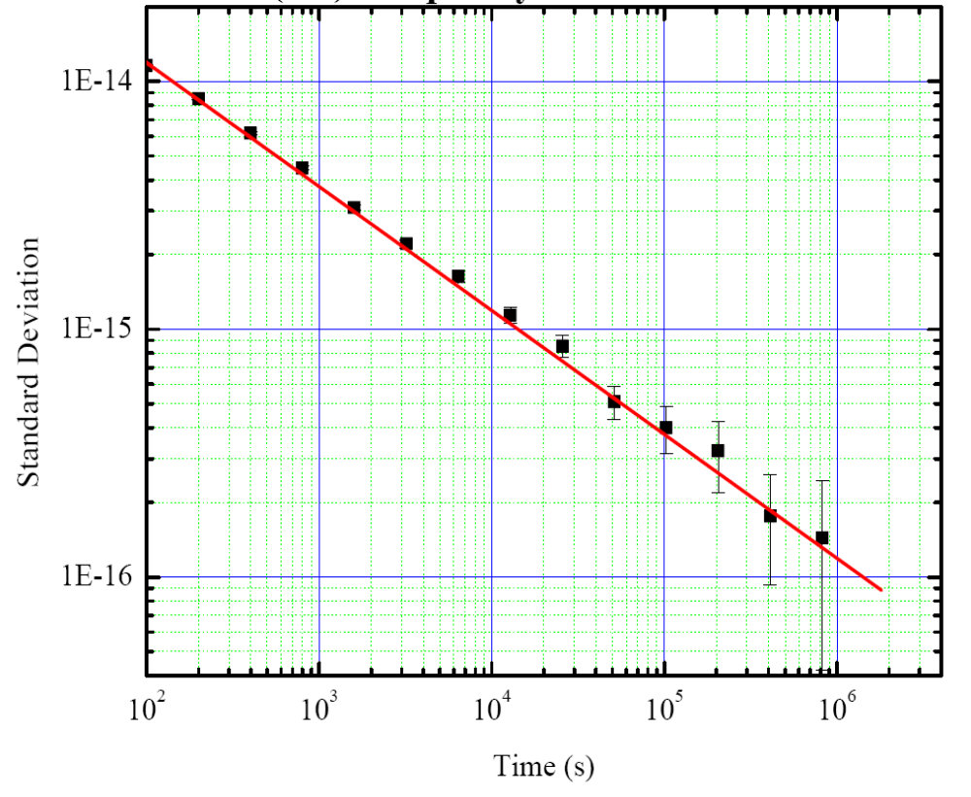
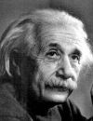
Comparison between two fountains
SYRTE, now LTE, Paris Observatory
σ_{y}(τ)=1.2 10⁻¹³ τ^{−1/2}
S. Bize et al., EFTF’08
J. Phys. B, 2005
1 m of gravitational shift
τ
1 Day
Frequency stability at 10⁻¹⁶ after 10 days of averaging
2 orders of magnitude below thermal beam clocks
Notes:
State of the Art: frequency stability below 10-16 afetr 5 to 10 days of averaging and aggreement between cesium frequencies
Run continuously for several months between maintenance work. 1 meter is 10-16 of gravitational redshift. Take a clock here or on the ground..

Slide 17
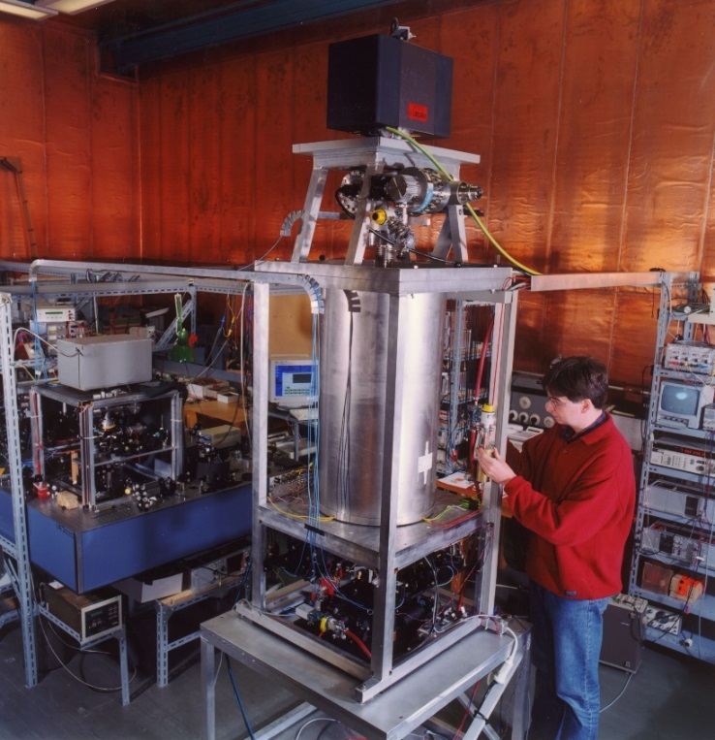
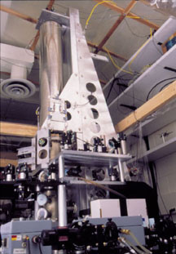
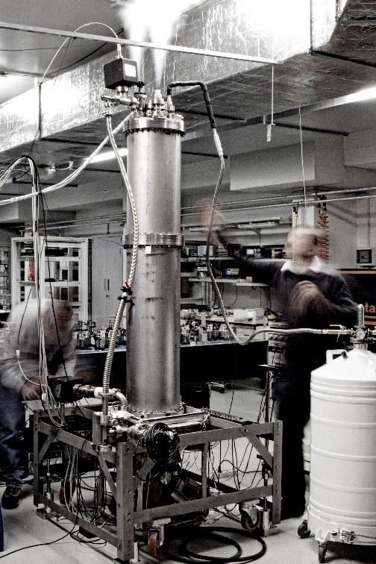
Fountains and Temps Atomique International
~ 15 fountains in the world are compared by GPS /GALILEO satellites
and steer the TAI computed by BIPM with an accuracy of 1-2 10⁻¹⁶
PTB, DE
NIST, USA
INRIM, IT
Notes:
These fountains now run nearly continuously and serve to construct the TAI the international Atomic Time. They have an accuracy of 1 to 2 10-16. The SI second is therefore realized with this uncertainty, 10 picosecond/day or equivalently 1 second error over 300 million years. How to increase further the interaction time ? Two methods: going to the microgravity onboard a satellite or trap the atoms. In 1997, we proposed

Slide 18
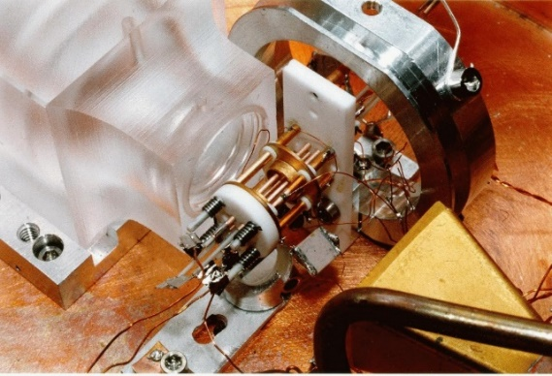
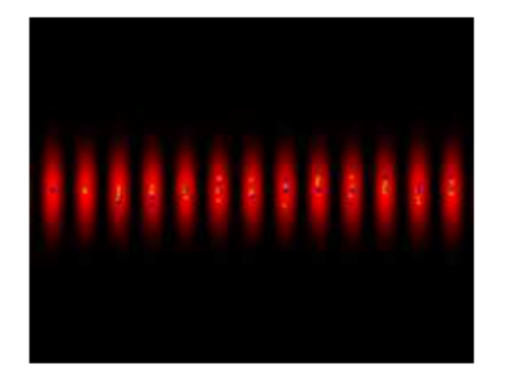
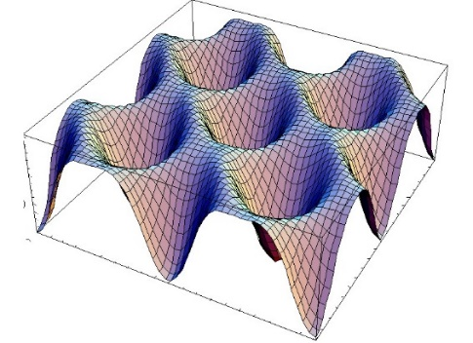
Clock Figure of Merit
Frequency: ν, resonance width Δν and interaction time T, Δν=1/2T
Signal to Noise ratio: S/N
F = ν /Δν x S/N = 2 ν T S/N
Increase T: microgravity or trapping atoms
Increase ν: optical clocks
Increase S/N, number of atoms
Microwave cesium fountain:
F= 2 10¹⁰ x 0.5 x 5000 = 5 10¹³
Optical clocks:
F= 5 10¹⁴ x 1 x 100 = 5 10¹⁷
Trapped ion
Neutral atoms
Sr, Yb, Hg, Ca
Al⁺, Yb⁺,Hg⁺, Ca⁺, Lu⁺,…..
NIST, PTB, NPL, Paris Obs, Tokyo, Torino, Innsbruck, Seoul, Singapore,….
Microwave cesium fountain: ~2 10¹⁰ x 0.5 x 5000 =5 10¹³
Optical clocks : ~2 10¹⁵ x 0.5 x 100= 10¹⁷
Trapped ions : T very long but only one ion in the trap.
Neutral atoms: T long and large numbers: improved stability
Hg⁺:optical transition
stability: 4 10⁻¹⁵ τ^{-1/2}
Accuracy: 1.9 10⁻¹⁷
Al⁺: 8.6 10⁻¹⁸ , Yb⁺ : 4 10⁻¹⁸
Neutral Sr,Yb, Hg lattice clocks
3 10⁻¹⁸ accuracy, J. Ye et al.
TOKYO, JILA, SYRTE, PTB, NIST, LENS, DUESSELDORF ….

Slide 19

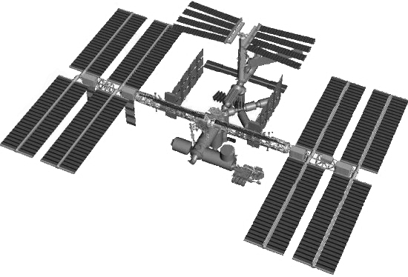


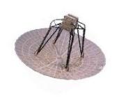
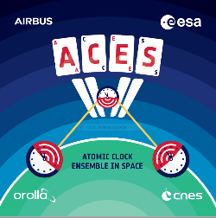




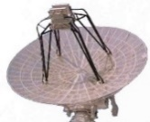
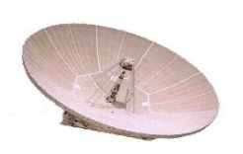


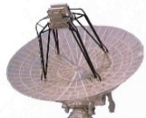
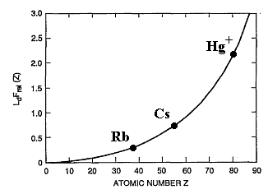
ACES Proposal
to ESA and CNES
in 1997
A cold atom cesium clock in space
Fundamental physics tests
Worldwide access
Hg⁺
Yb⁺
Cs
Ca⁺
Rb
In⁺
Sr⁺
Notes:
In the last 5 minutes of this presentation, I would like to tell you about our recent results with a space mission called ACES which aims at studying a cold atom clock in the microgravity of space. I made this proposal to the European space agency in 1997 with the group of andré Clairon at Paris observatory and the mission is now in flight. The ACES scientific objectives will use 3 unique properties of earth orbiting satellites: microgravity environment to realize a cesium primary frequency standard with very different operating conditions than on the Earth wher we use atomic fountains. high stability and accuracy. Second different gravitational potential will enable a precision test of the Einstein gravitational clock shift. Third Global world coverage; the ISS will fly over ground institutes with ultrastable clocks several times per day and make space to ground comparisons with both microwave and optical clocks at an unprecedented level.

Slide 20
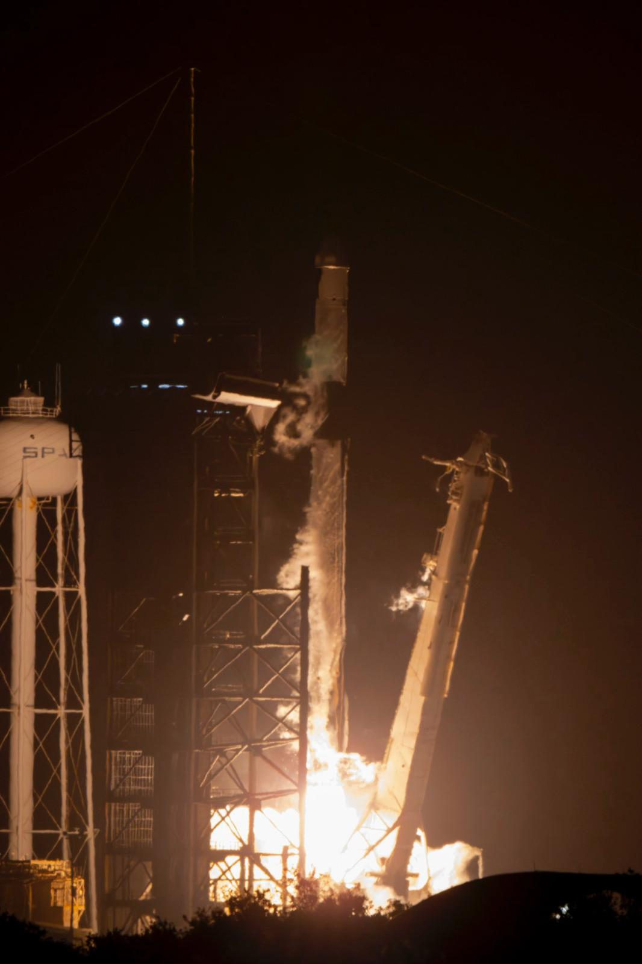
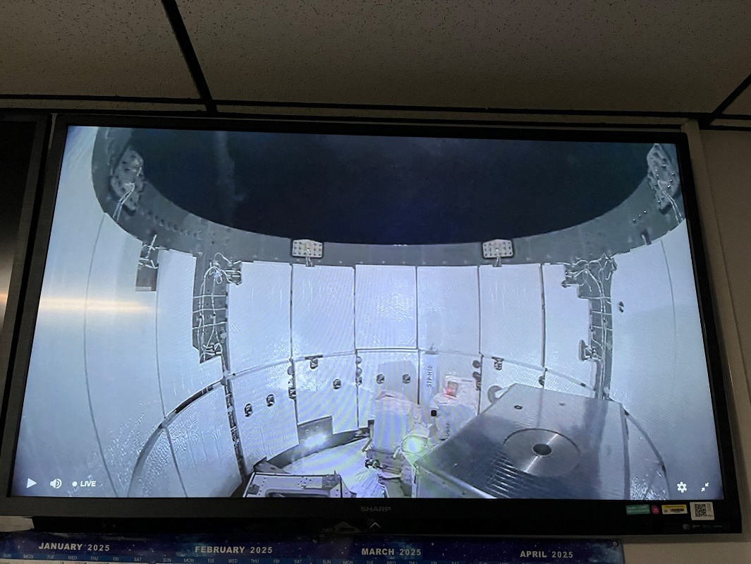


April 21, 2025
ACES launch
and installation
on Columbus module of the ISS
ACES
Notes:
After two decades of high tech developments in European industry, the payload shown here has been launched towards the International space station

Slide 21



PHARAO: a cold atom cesium clock on the International Space Station
Cooling zone
Selection
Ramsey Interrogation
State detection
Cesium
reservoir
Microwave cavity
3 Magnetic shields and solenoids
Ion pump
Launched April 21, 2025 by Space X
Design by LTE, LKB, built by SODERN, assembled and tested by CNES, LTE, LKB
Notes:
The cold atom clock PHARAO shown here works very well in the microgravity environment of space . Thanks to cold atoms this clock will be 100 times more accurate than the clocks onboard GPS and Galileo satellites.

Slide 22

Laser sources and optical bench
20.054 kg, 36W, 30 liters,
15 years of operation without manual adjustment on Earth and in space
Main active
components:
4 ECDL
4 DL
6 AOM
30 PZT
11 motors
6 photodiodes
8 peltier coolers
Notes:
This technology is available for other optical bench designs. All these elements have been qualified for temperature variations, and launch accelerations

Slide 23


Cesium Tube
L=900 mm, M= 45 kg, P= 5 W
capture
Detection
interrogation
Ramsey cavity
Tested in fountain
Notes:
Toutes ces technologies ouvrent la voie aux horloges optiques et interféromètres atomiques dans l’espace avec une très grande sensibilité.

Slide 24


Quantum technologies in space: PHARAO/ACES
1
Transition probability
P. Laurent et al.
LTE, Obs. Paris,
LKB
0
ν₀
detuning
ν-ν₀
Notes:
Here is an example of the measured resonance in space: You are now familiar with this type of resonance. The key point being now that we can use very slow atoms in the device, here 0,4 m/s . This is a nice example of quantum technologies developed for space applications.. For this, many technologies had to be space qualified including lasers, fibers and optoelectroncis equiments..

Slide 25


1.5 second coherence time for freely propagating atoms in space
0.332 Hz
For v=147 mm/s the resonance is
three times narrower than in fountains
Notes:
With this cold atom clock, we will make a new test of general relativity, by comparing its frequency to ground cesium fountains

Slide 26


Einstein gravitational clock shift
Pound-Rebka experiment, Harvard 1964, Test @ 10% and 1% later
Gravity probe A: R. Vessot et al. PRL 1980, Test @ 1.4 10⁻⁴
With Al+ ion optical clocks, C. W. Chou D. Wineland et al., Science, 2010, Test @30%
Galileo satellites on elliptical orbits
P. Delva et al. PRL 2018, S. Hermann et al., PRL 2018, Test @ 2.5 10⁻⁵
Near Earth ground wit transportable optical clocks, Tokyo tower,
Takamoto, Katori, Nature Photonics, 2020, Test @ 10⁻⁴
On a single 1 mm high atomic cloud,
T. Bothwell, J. Ye, JILA, Nature, 602, 2022, Test @ 10%
Notes:
One of the main ojectives of ACES/PHARAO is a new test of the gravitational clock shift. Einstein told us that two clocks in different gravitational potentials run at different rate.

Slide 27

ACES Goal:
Test with 1 10⁻¹⁶
Clocks
Redshift
at 3 ppm
Gain x10
vs existing tests
Notes:
Einstein told us that two clocks in different gravitational potentials run at different rate. With clock accuracies of 1 10-16 we will get a Redshift test at 2 parts per million. A factor 10 beyond existing limits. This research program will be conducted with the support of the Balzan foundation. Finally ACES will allow to compare distant clocks at 10 -17 or 10-18 level

Slide 28



ACES time transfer and distant clock comparisons: 8 terminals
With PHARAO and its advanced time transfer system, ACES
is connecting the best clocks around the world at 10⁻¹⁶ - 10⁻¹⁷ level
Notes:
The ACES mission will create a worldwide network of advanced microwave and optical clocks on various continents and compare them at a level which is not accessible to GPS methods, a factor 10 to 100 better. For applications in fundamental physics tests and for time and frequency metrology and the future redefinition of the second in 2030 or 2034.

Slide 29

Phase drift PHARAO - UTC (OP) over 14 days including relativity
3 E-8
Data analysis:
P. Wolf
M. Lilley
J. Rozé
LTE, Paris Obs.
phasedrift /s
Slope: frequency difference PHARAO- UTC (OP):
2.314 E-14 +- 6.3 E-16
0
31/10/2025
Time in days (MJD)
Notes:
Alors que mesure-ton avec lelien micro-onde ? On mesure l’evolution temporelle de la difference de phase entre PHARAO et le sol, le temps coordonné universel UTC de l’observatoire de Paris qui realise la seconde du système international d’unite. On a retranché le terme relativiste qui est très grand: -2.83 E-10Les points rouges sont les résulats de mesure, groupés en 3 paquets par jours, espacés d’environ une journée qui correspondent aux trois ou 4 passages de l’ISS au dessus du terminal micro-onde. À cette echelle cette différence de phase evolue linéairement ce qui signifie que la derivée de la phase la fréquence est stable.. Ce qui est rassurant, c’est qu’on a une belle droite sur 14 jours successifs qui montre que l’on peut bien suivre la difference de phase. Ensuite, ici sont reportés les évènements qui pertrube l’orbite de l’ISS, comme l’attache du vaisseau HTV, ou un reboost de l’ISS qui remonte son orbite d’une dizaine de kms, enfin, on a change les paramètres de PHARAO ici et là.

Slide 30

Towards a redshift test: ACES/ PHARAO-FO2 Cesium at LTE
Overall slope of -2.82E-10/s removed for clarity
1E-8
ISS Orbitography by DLR
+Earth geopotential model
GR prediction in green
ISS reboost
0
phasedrift /s
PHARAO frequency
corrected from
Zeeman, collision
and blackbody radiation
shifts.
640 mm/s low density
points in red
ISS reboost
07/11/2025
25/11/2025
Time in days (MJD)
Single fit parameter: overall phase offset such that ACES=GR on Day 60994.85

Slide 31

Towards a redshift test: ACES/PHARAO-FO2 Cesium at LTE
Zoom after ISS first reboost
~ 0.3 % orbit modulation of GR prediction
at ISS period 5400 s
Second order Doppler and redshift
Work in progress: PHARAO accuracy evaluation in 10⁻¹⁶ range
for high precision redshift test: collisions, cavity phase gradient

Slide 32

Frequency Stability of Optical Atomic Clocks
microwave
Al+
optical
1 cm of gravitational
red shift
Test of the gravitational shift
& Applications in Earth geodesy
Search for dark matter
Stability of fundamental constants
Initial Graph from C. Oates, NIST, Oct ‘19

Slide 33




Optical Clocks, ACES, and the future redefinition of the second
Neutral atoms
Sr, Yb, Hg, Ca
Lattice clocks
10⁻¹⁶
Trapped ions
Al⁺, Yb⁺,Hg⁺,
Ca⁺, Lu⁺,…..
10⁻¹⁸
Notes:
The scientific community is actively working today on the next generation of clocks, which operate in the visible part of the spectrum. The electromagnetic fields ticks 100 thousand times faster than in cesium clocks and they already display and stability and accuracy below 10-18, two orders of magnitude lower than cesium. This raises the prospect of a better realization of the second and a future redefintion of the SI second.

Slide 34

Perspectives
ACES commissioning is near completion: Science phase for two years
First photons detected onboard by ELT, the Maser finally works
Redshift test, intercontinental optical clock comparisons
The field of precision time measurements with optical and nuclear clocks 18 digit spectroscopy ! Quantum metrology
General relativity is a classical theory
Hard to unify with quantum mechanics and standard model
of particle physics.
Motivation to perform experiments at this boundary,
search for variation of fundamental constants, α, or m_{e}/m_{p}
search for new particles or dark matter
Search for violation of Einstein Equivalence Principle
Two post-doc positions available at LTE on ACES, optical clocks and data analysis

Slide 35
Thanks !
Cacciapuoti L¹, Abgrall M², Allart E³, Bauch A⁴, Bize S², Clairon A², Crescence P³, Delva P², Diener WA⁵, Eckl J⁶,
Enzer DG⁵, Esnault FX⁷, Fuijeda M⁸, Gibble K⁹, Goujon D¹⁰, Guerlin C¹¹, Heimbach F⁴, Helm A³, Ichikawa R.⁸,
Kannanthara J¹², Kehrer J³, Kodet J¹³, Lachaud R³, Laurent P², Léger B⁷, Le Poncin-Lafitte C², Lilley M², Liu S¹⁴,
Lorini L², Mamoru S⁸, Marz S¹³, Massonnet D⁷, McKelvy J⁵, Montenbruck O¹⁵, Niedermaier T³, Pataraia S¹, Patla B¹⁶,
Peignier T¹, Peik E⁴, Perri A¹⁰, Piester D⁴, Pittet J¹⁰, Plumaris M¹, Prochazka I¹⁷, Rahm J⁴, Roze J², Salomon C¹¹,
Savalle E¹⁸, Schaefer W¹⁴, Schlicht A¹³, Schreiber U¹³, Schwall T¹⁴, Schwatke C¹³, Shemar S¹², Thulliez E⁷, Tjoelker R⁵, T
unesi J¹², Vollmair P¹³, Wang Q¹⁰, Weinberg S¹, Wermuth M¹⁵, Weyers S⁴, Wolf P², Yu N⁵
¹European Space Agency, ESTEC, Noordwijk, The Netherlands,
²LTE, Observatoire de Paris-PSL, CNRS, LNE, Sorbonne Université, Université de Lille, Paris, France
³Airbus Defence and Space, Friedrichshafen, Germany, ⁴Physikalisch-Technische Bundesanstalt, Braunschweig, Germany
⁵Jet Propulsion Laboratory, California Institute of Technology, USA,
⁶Bundesamt für Kartographie und Geodäsie, Geodetic Observatory Wettzell, Bad Kötzting, Germany
⁷CNES, Toulouse, France, ⁸National Institute of Information and Communications Technology, Koganei, Tokyo, Japan
⁹The Pennsylvania State University, University Park, USA, ¹⁰Safran Timing Technologies SA, Neuchâtel, Switzerland
¹¹Laboratoire Kastler Brossel, ENS-PSL, Paris, France, ¹²National Physical Laboratory, Teddington, United Kingdom
¹³Technical University of Munich, Munich, Germany, ¹⁴Timetech, Stuttgart, Germany
¹⁵German Space Operations Center, DLR, Weßling, Germany, ¹⁶National Institute of Standards and Technology, Boulder, USA
¹⁷Czech Technical University in Prague, Prague, Czech Republic, ¹⁸IRFU, CEA, Université Paris-Saclay, Gif-sur-Yvette, France
Notes:
Ces premiers resultats ot été obtenus par les personnes surlignées en jaune ici. Tous les autres auteurs ont contribué au projet à dfférent stades d’advancement.

Slide 36
Thank you for your attention !

Slide 38
Variabilité des constantes fondamentales: limites actuelles
m_{e}/m_{p}
M. Filzinger et al. PRL 130, 253001 (2023)
R. Lange et al. Phys. Rev. Lett. 126, 011102 (2021)
En connectant de nombreuses horloges micro-ondes et optiques,
ACES contribuera à améliorer ces limites

Slide 39

The measurement of Time
From spectroscopy to atomic clocks and navigation
1938 I. Rabi molecular beam resonance spectroscopy
1940-1949 Cesium atomic clocks, Rabi, Ramsey, Essen & Parry,1955
1973 Atomic Clocks onboard satellite navigation system, GPS
Wide range of industrial applications, telecommunications, navigation, banking, …
Fundamental science
Satellite constellation, GPS or GALILEO
A revolution in society
and science
Notes:
L’une des applications les plus imporatantes des horloges atomiques est le systèmde positionnement par satellite . Savez vous qu’ bor de ces satellites il y a plusieurs horloges atomiques. L araison est que ces satellites envoient des signaux qui se propagent a la Vitesse de la lumière et si on fait une erreur de temps de 1 microseocnde on se trompe de 300 m sur la distance.
Let me now give a single example of the impact of quantum science on society by taking the example of atomic clocks. It all started with I. Rabi doing microwave spectroscopy on molecular beams. After the second world war came the birth of the concept that a molecular line or atomic line could be a way to stabilize an oscillator and measure time intervals. Today a revolution in society, personal navigation, commerce, ships, planes,….It is hard today to believe that we were using paper maps 20 years ago. Next is Peter Knight.

Slide 40


Notes:
So is all this business of clock makers useless ? Of course not ! The paradox is solved by realizing that time is what a clock measures along the observer universe line. There are as many times as observers ! Time flows differently on the Earth, on a satellite, or on distant stars ! So let me now go back to the concept of a clock.

Slide 41







MWL GTs network
☒
☑
☑
☑
☑
☑
Notes:
[~30 s]
And this is the MWL ground-terminal network we operate, designed specifically to track the high ISS signal dynamics
Three terminals in Europe — at SYRTE in Paris, PTB in Braunschweig, NPL at Teddington. Two in the US — JPL and NIST. One at NICT in Japan. Plus Wettzell where we co-locate with the SLR station for ELT.
Two transportable terminals are also available for calibration campaigns to perform time transfer experiments.

Slide 42








Nobel
laureates
1989: N. Ramsey, W. Paul, H. Dehmelt
1997: S. Chu, C. Cohen-Tannoudji, W. Phillips
Laser manipulation of atoms
Separated oscillatory fields method
for atomic clocks, ion trap techniques
Haloween 1990, Paris
2005: J. Hall, T. Haensch, R. Glauber
Laser precision spectroscopy
Optical frequency combs, Quantum optics
2012: S. Haroche, D. Wineland
Control of individual quantum objects
Photons and atoms, quantum metrology
Notes:
In fact clocks and precision precision measurements have been the subject of many breakthroughs awarded with Nobel prizes, without going back to Rabi and atomic beams and focussing only on the last 30 years , there gave been 4 series of Nobel prizes, even without counting the Nobel prize for Bose Einstein condensation and the rcent Nobel prize to Alain Aspect, John Clauser and A. Zeilinger. A less serious pecyure of Bill Phillips annd Claude Cohen-Tannoudji is shown gere. Cette photo a été prise a Haloween 1990 a Paris duant l’année sabatique de Bill a l’ecole Normale supérieure. Coming now to atomic clock it is always instructive to go back to the early littérature and find the first paper on atomic clocks by Essen and Parry, back in 1955.
Le domaine des mesures de précision a subi toute une série d’avancées majeures sur les 40 dernière années, illustrées par 4 séries de prix Nobel successifs.

Slide 43
Relativity and satellite positioning
24 satellites
at 20 000 kms
périod12 hours
Chaque satellite transmets un message avec:
instant d’émission et la position du satellite à l’instant d’émission
Propagation des signaux en provenance de 4 satellites à la vitesse c: distances.
Le récepteur calcule sa position 3D par l’intersection de 4 sphères (et son décalage de t)
Précision: qqs mètres et même centimètres avec systèmes additionnels
GPS: débuté en 1973 par US army
est devenu un service ouvert global spectaculaire
GALILEO, GLONASS, BEIDOU,…
Notes:
Tenir compte des effets relativistes est egalement indispensable dans le système de positionnemnt par satellite GPS. En effets les satellites orbitent a 20 000 kms de la terre ou le champ de gravité est bien plus faible qu’à la surface. Le système ne marcherait pas sans les corrections relativistes présentées auparavant.

Slide 44



Towards Heisenberg limit
Atomic clocks operate at the quantum projection noise: standard quantum limit for uncorrelated atoms: the frequency stability scales as 1/N^{1/2} for N atoms
N two level atoms form an ensemble of spin ½, a collective spin |J|= N/2 and
Spin squeezing: reduce variance in one direction, the measurement useful direction to approach 1/N
Kitagawa et Ueda, 1993, Wineland et al. 1994
Nature 2016
Non destructive measurement of refraction index of atoms in the cavity: J_{z}

Slide 45

Quantum metrology
Rotation of 660 μrad
Signal to Noise ratio: gain of x10 for 5 10⁵ atoms
Phase sensitivity: 147 microradians per cycle
This implies quantum entanglement of more than 680 atoms

Slide 46


Slide 47


2025: 100 years of Quantum Mechanics
Quantum mechanics describes the microscopic world made of elementary particles,
electrons, protons, neutrons, atoms, molecules, …
An atom can be excited by light, when the radiation is tuned
into resonance with a transition between two energy levels.
Invention of the laser in 1960: an intense, tunable light source.
Lasers and atoms are used to make atomic clocks
with exquisite precision:
Atom
e
f
Bohr -Einstein
relative frequency stability of optical clocks: 10⁻¹⁹
The time error is < 0.01 s over the age of the Universe 13.7 billion years
Today, frequency and time intervals are the best measured quantity
This progress of time measurements in the last 70 years
was made possible by several breakthroughs
Notes:
Les meilleures horloges aujourd’hui sont des horloges atomiques. Elles utilisent des atomes illumines par la lumière. La mécanique quantique décrit très bien la structure des atomes et leur excitation lumineuse. Condition de resonance. I is interesting to look at the precision of clocks over the last 4 centuries

