Slide 1


WP1: FE-FRT
RP1 review meeting, June 1st, 2026
All information contained in this presentation and any accompanying documents is for iSAS project only, and must be treated as strictly confidential.
Any dissemination, distribution or other use of this information without the consent of its owner is prohibited.
Funded by the European Union. Views and opinions expressed are however those of the authors only and do not necessarily reflect those of the European Union or the European Commission. Neither the European Union nor the granting authority can be held responsible for them.

Slide 2
WP1: FE-FRT
HZB, CERN, CNRS, Uni.Lancaster (associated)
Convener: Axel Neumann (HZB), deputy Alick Macpherson (CERN)
Main contacts with other partners: Alick Macpherson (CERN), Walid Kaabi (CNRS),
Graeme Burt (Uni.Lanc.), industry: Alexei Kanareykin (Euclid Techlabs)
WP1 Main goal within the iSAS consortium
WP1 is part of TA #1: Aim to lower the amount of power consumption by RF, especially SRF cavities by:
  Develop novel fast tuning systems compensating detuning by mechanical vibrations or beam induced
  transients, which both are usually compensated by adding a significant power overhead
  Most effectively applied on CW driven SRF cavities, especially for low beam-loading FELs or ERLs
  (EU XFEL, LHeC (PERLE)), eventually FCC use cases and transient beam-loading (switching, e.g. LHC HiLumi)
  All this should of course not compromise the stability and reliability of operation, better even improve
  it beyond current state of the art.
  The savings in RF power should be significant, to justify any required modification to a cavity system
  → retro-fitting to existing systems would be a significant breaktrough

Slide 3
WP1: FE-FRT
HZB, CERN, CNRS, Uni.Lancaster (associated)
Convener: Axel Neumann (HZB), deputy Alick Macpherson (CERN)
Main contacts with other partners: Alick Macpherson (CERN), Walid Kaabi (CNRS),
Graeme Burt (Uni.Lanc.), industry: Alexei Kanareykin (Euclid Techlabs)
Task 1.1: Coordination of R&D on FE-FRT – M1-M48 (HZB)
• General coordination by HZB as described above.
Task 1.2: FE-FRT for Transient Beam Loading – M1-M40 (CERN)
• Design a full FE-FRT-based 400 MHz tuner, applicable to LHC transient detuning scenarios.
• Perform full RF, mechanical and cryogenic evaluation of the FE-FRT-equipped . LHC cryo-module.
• Use design lessons learned to design a tuner for transient detuning of FCC 800 MHz multi-cell cavities.
Task 1.3: FE-FRT for Microphonics – M1-M48 (HZB)
• Establish characteristics and performance of FE-FRT ferroelectric material at frequencies ≥1300 MHz.
• Design, fabricate and validate an FE-FRT for microphonics suppression on a single-cell 1.3 GHz cavity.
• Design, fabricate and validate an FE-FRT for multi-cell cavity at 1300 MHz, in a cryomodule-like setup.
Task 1.4: FE-FRT in Energy-Recovery LINAC (ERL) mode – M1-M48 (CNRS)
• End-group design study for integration into ERL-type cavity, study HOM+BBU properties.
• FE-FRT design study for RF and mechanical integration into upgraded ERL cavity.

Slide 4
WP1 – FE-FRT: Key outcomes
WP1 Key outcomes
CERN is currently preparing for the next cold test of the transient detuning demonstrator of the FE-FRT
→ warm tests showed already expected tuning range
CERN developed a room temperature ferroelectric based phase shifter, which can be used for the high power demonstration of ferroelectric material (to bypass limited access to cold tests)
Ferroelectric material characterization at HZB triggered a more in detailed study of the surface properties,
impact material performance within FRT together with iSAS WP1 partners and Euclid Technologies LLC (industrial partner) to give feedback on the production batch and thus sintering parameters
High voltage breakdown tests were performed in collaboration with W. Wuensch group at CERN,
HV breakdown fields of 7.2 V/µm were achieved → sufficient for FE-FRT
At HZB, the prototype is ready for testing, due to a collaborative test with a lapping company, high accuracy in parallelism of the ferroelectric rings for the FE-FRT were achieved
→ Ready for assembly and testing
Task 1.2
Task 1.2
All
Task 1.2-1.3
Task 1.3

Slide 5
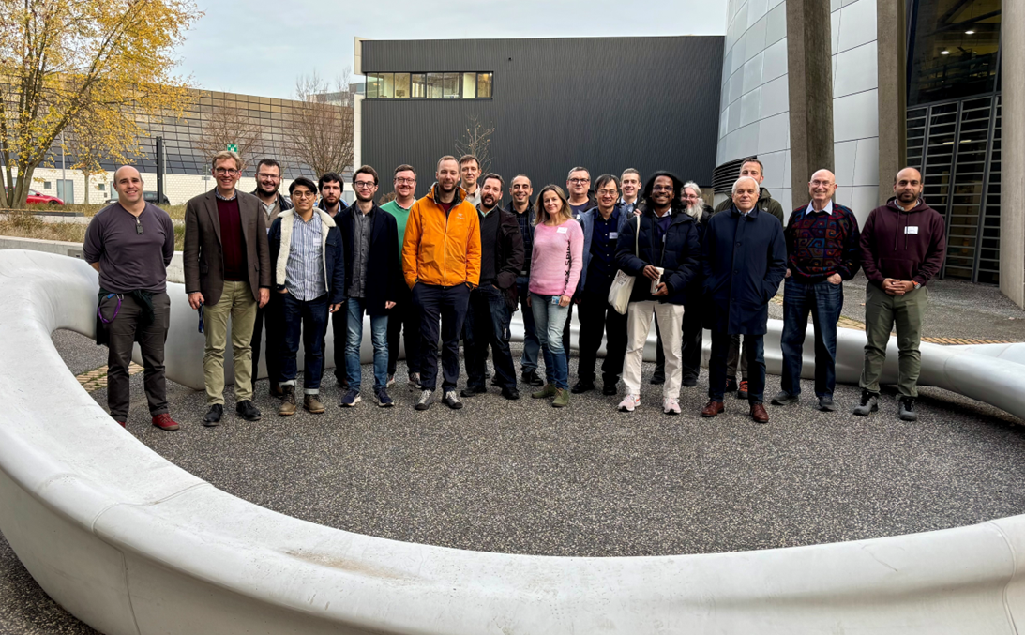
WP1 – FE-FRT: achievements of Task 1.1
Task 1.1 Achievements
Regularly held coordination meetings (every two weeks) with all work package partners, U Lancaster and
non-regularly with Euclid (industry partner)
Set up of a data base for ferroelectric BST materials with all measurement data available to help Euclid
in improving production of ferroelectrica (on-going).
Hired internship students (U Liverpool 4 weeks, University of the Basque country 6 month) to support material characterization at HZB
First Ferroelectric Fast Reactive Tuner workshop held at HZB November 2025 with partners beyond iSAS
Follow-up workshop under discussion
Exchange of personnel between labs: Visit of HZB engineer at CERN to
discuss mechanical FRT design, visit workshop, etc…
Common effort on working on milestone for task 1.4 with support by
U Lancaster, similar use case as for FCC 800 MHz FE-FRT
So far all milestones and deliverables on track
FE-FRT workshop at HZB

Slide 6
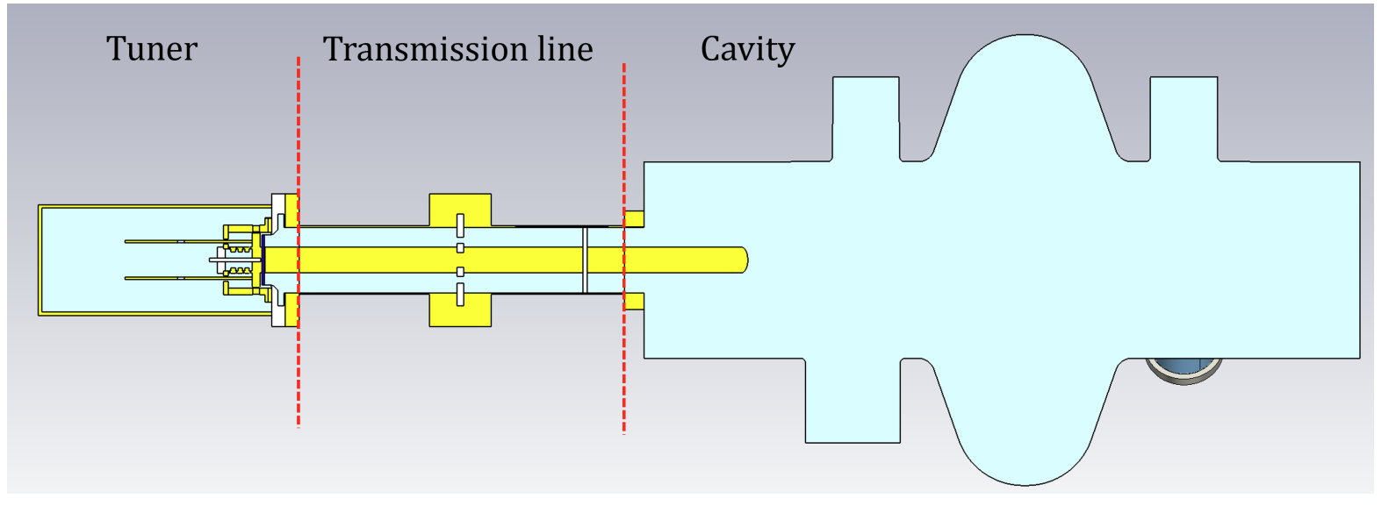
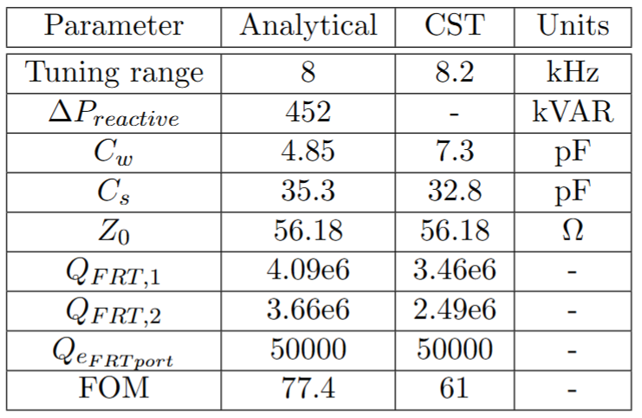
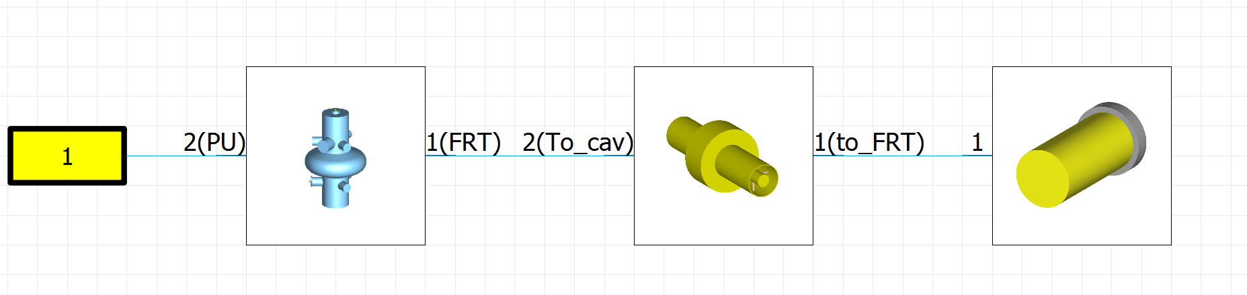
WP1 – FE-FRT: achievements of Task 1.2
Effect of a non-uniform beam pattern
on RF phase and amplitude in a SC cavity
Task 1.2 Achievements: FE-FRT for transient beam-loading
Transient beam-loading can alter the field experienced by following
bunched beam → increased energy spread, timing jitter or even bunch
length variations in storage ring/colliders, compensation by RF power
overhead
CERN designed and manufactured a prototype for a 400 MHz LHC cavity with 8 kHz tuning range at 100 ns switching time and 150 kHz switching rate
Response seen through cavity
0 – 7.2 kV bias
8.2 kHz
Tuner FoM 61: 3.8 kW P_{diss}

Slide 7
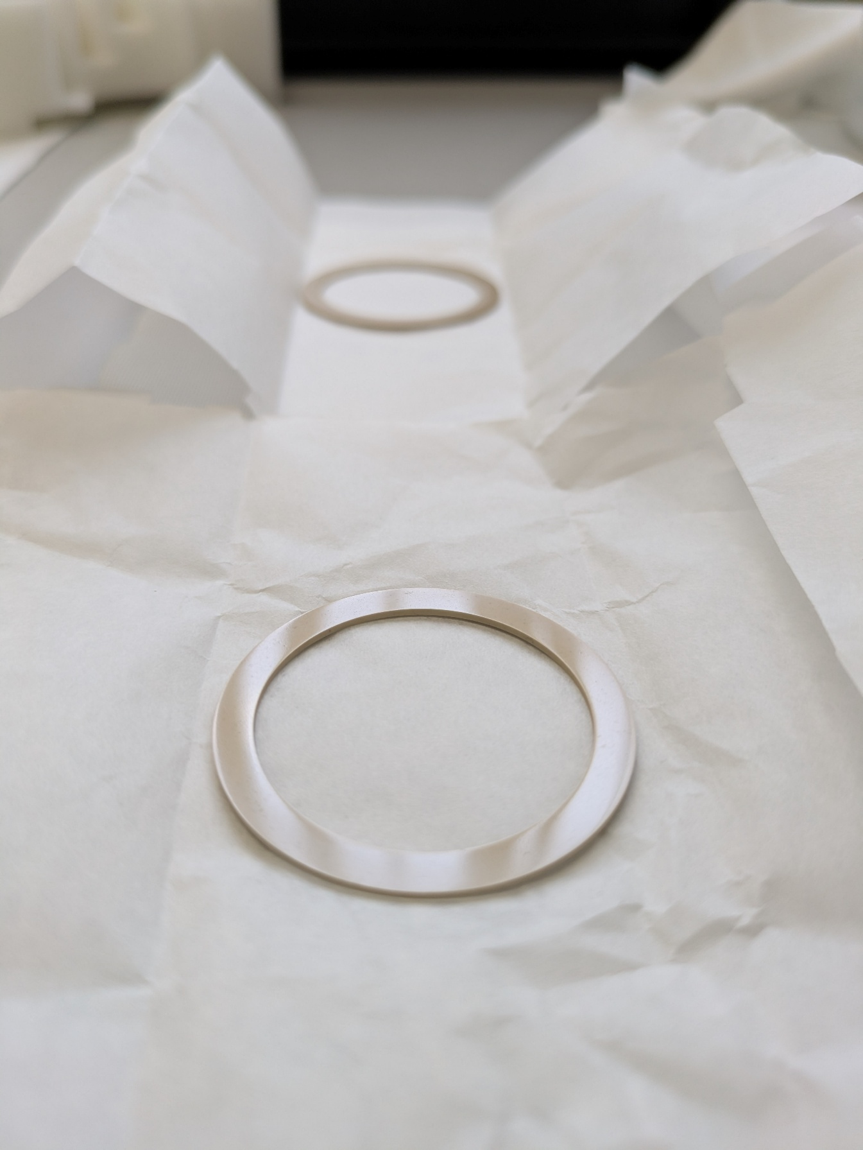
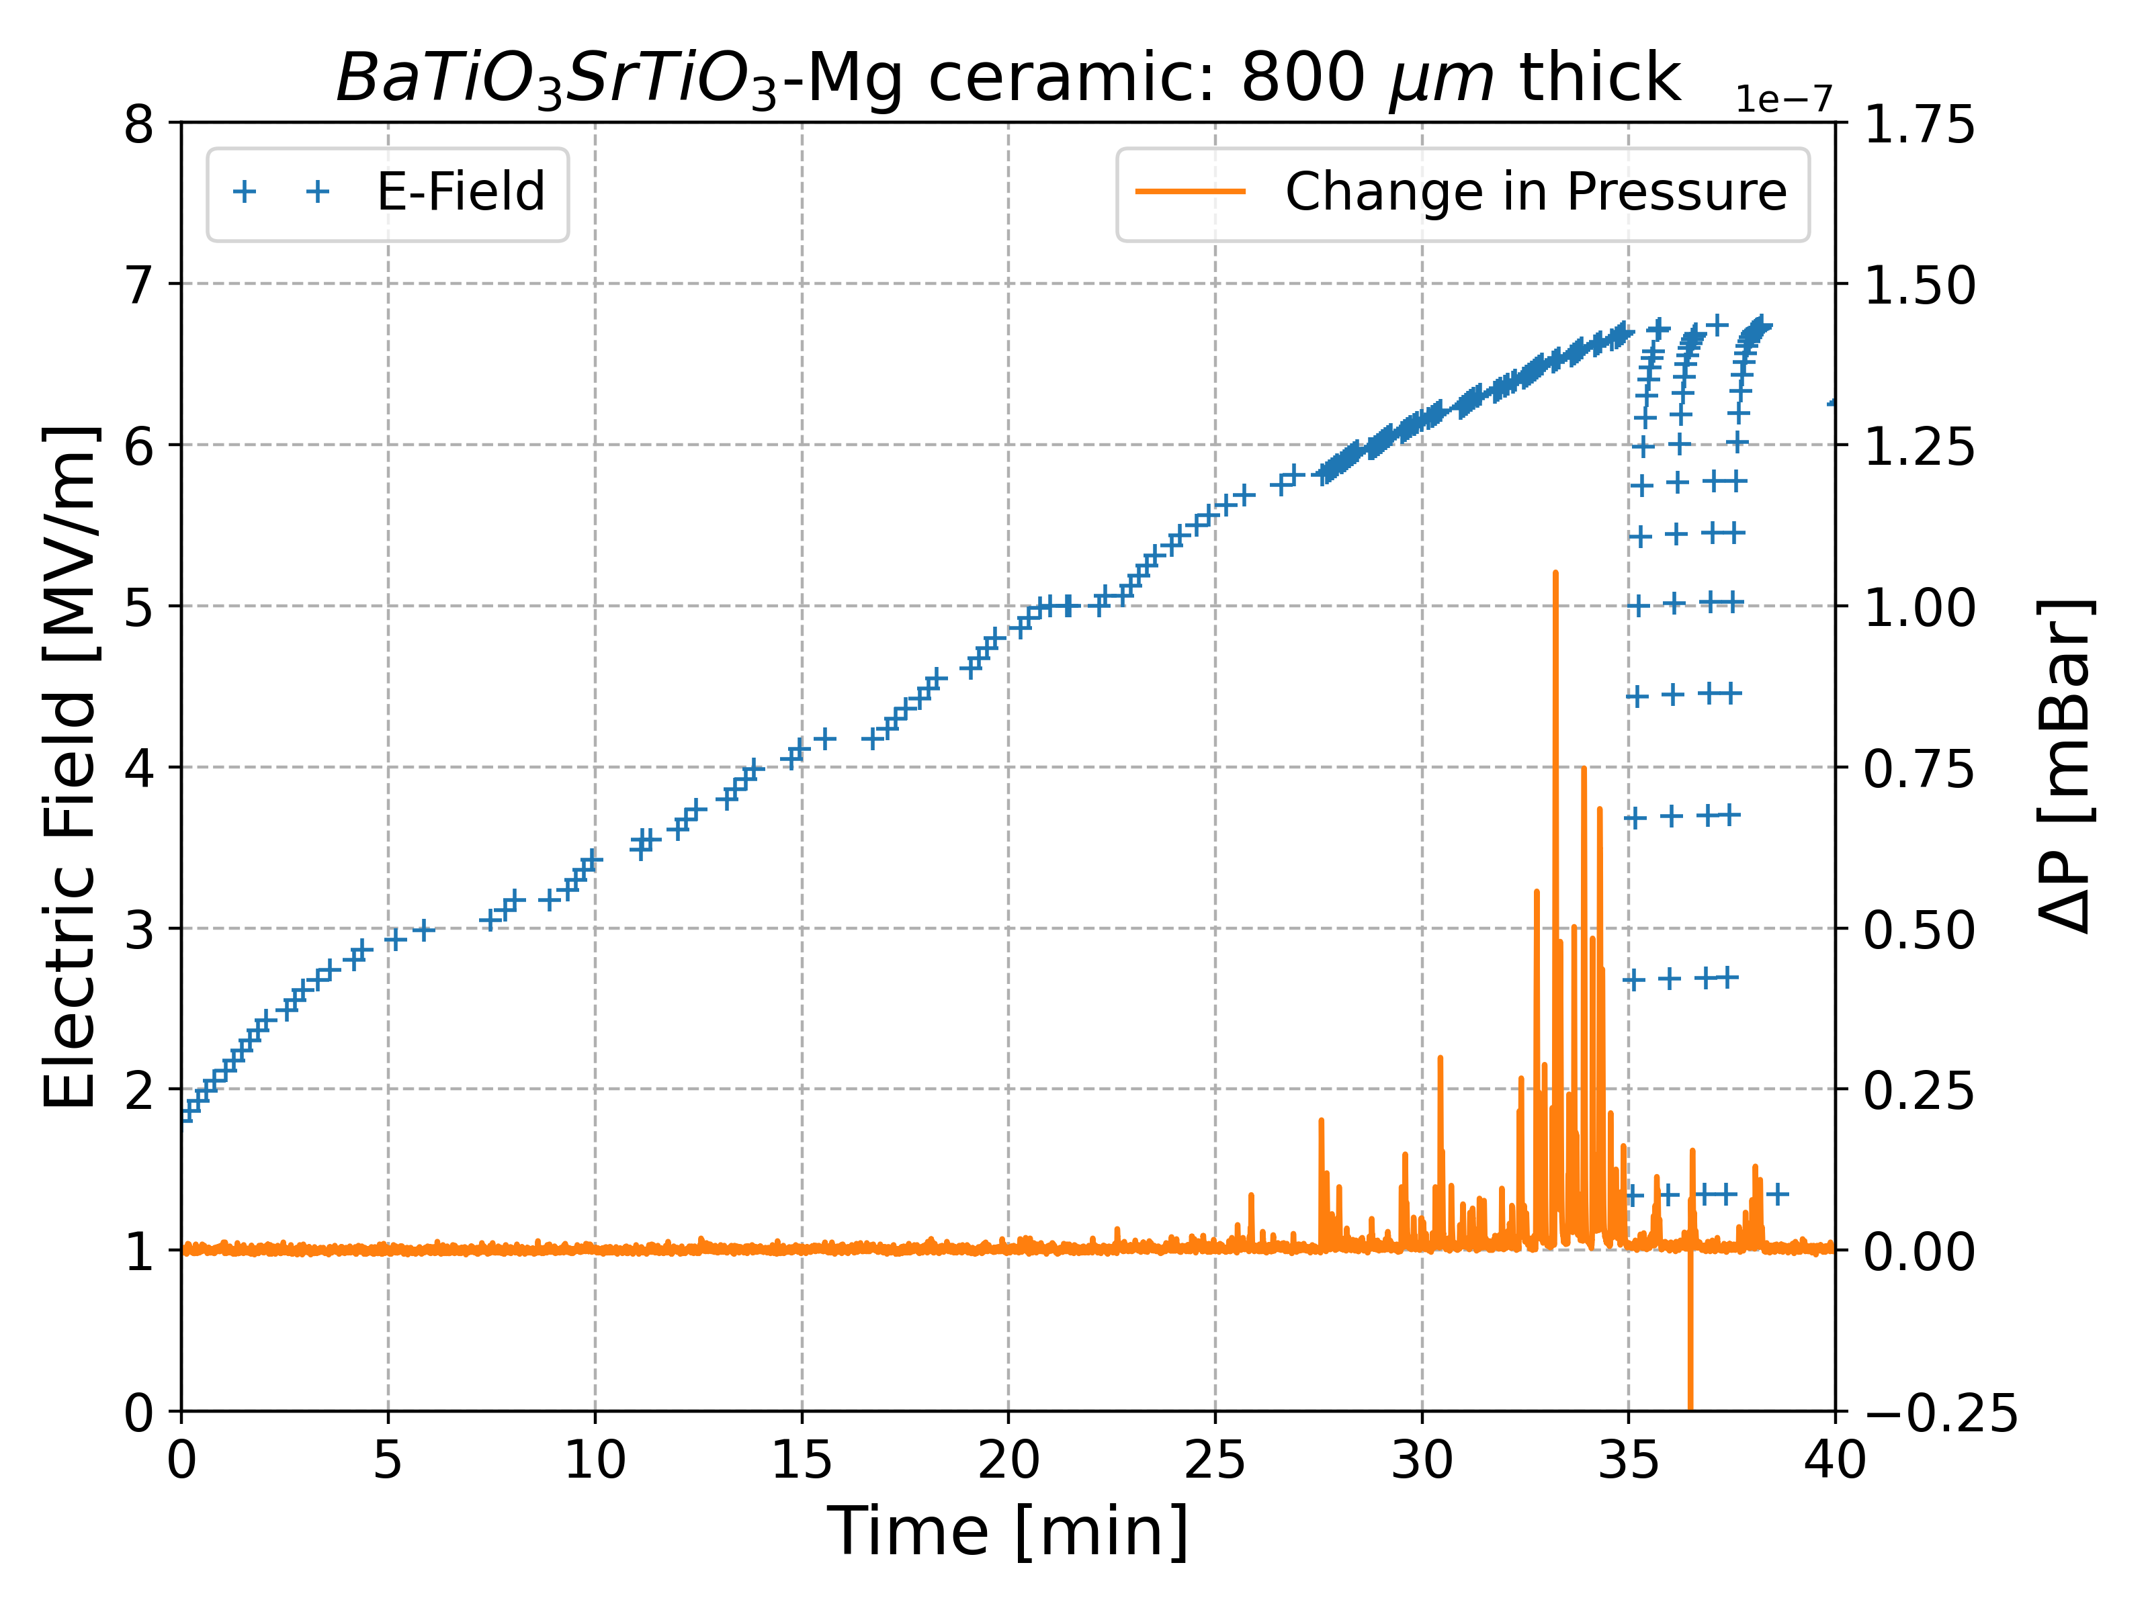
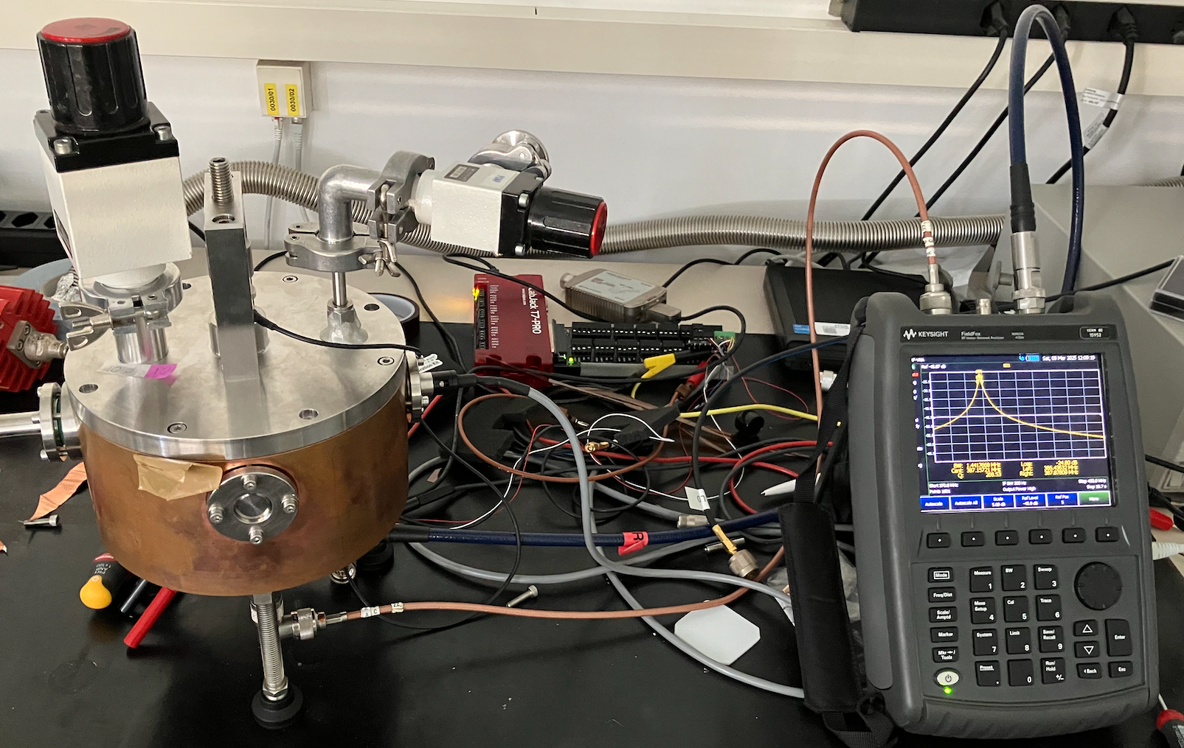
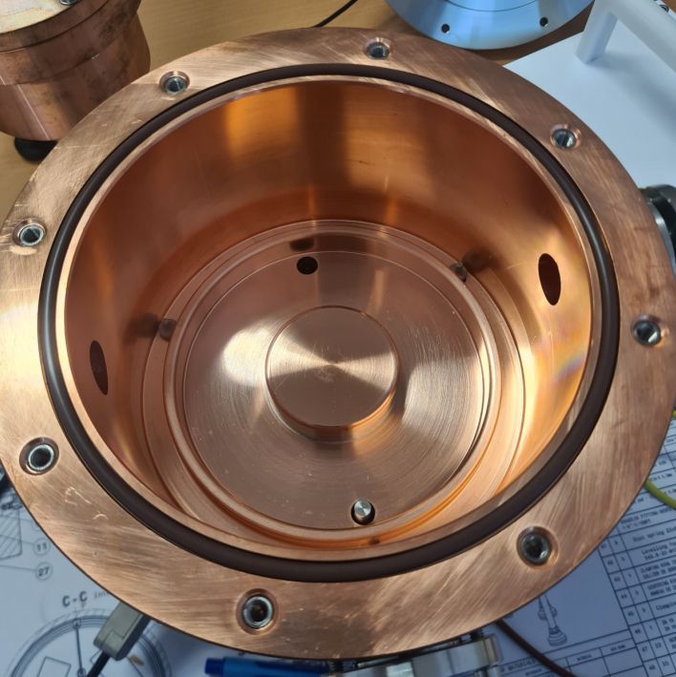
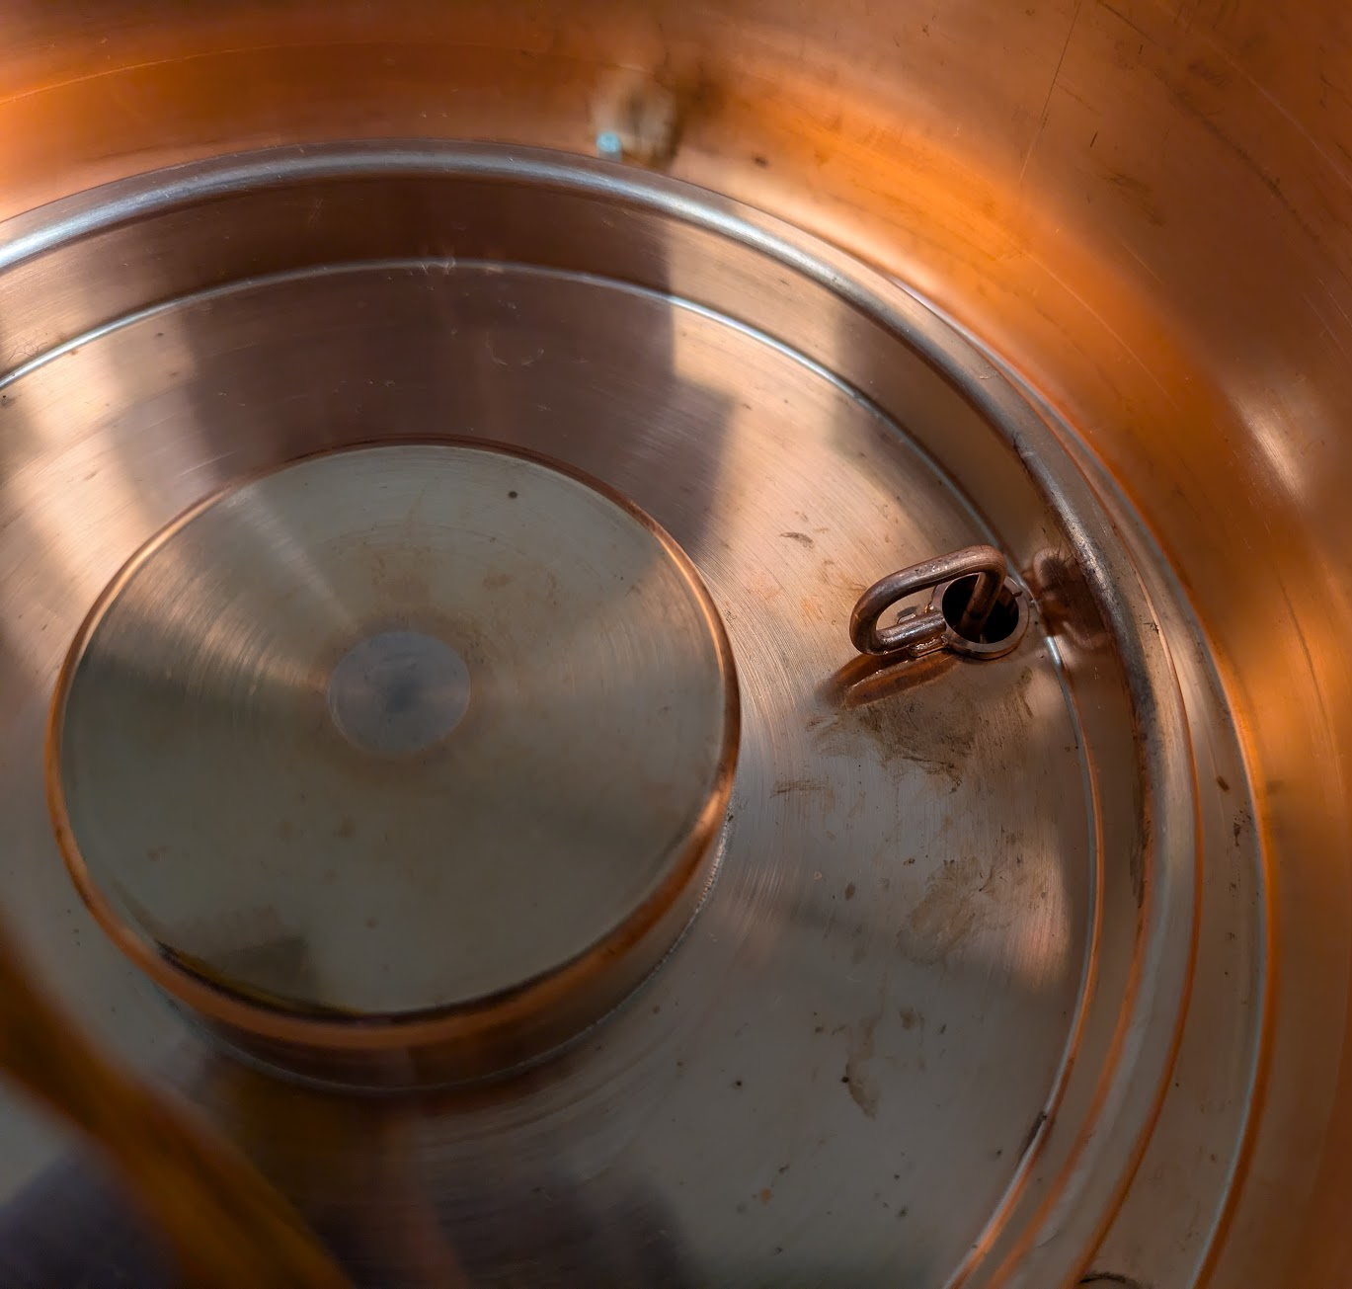
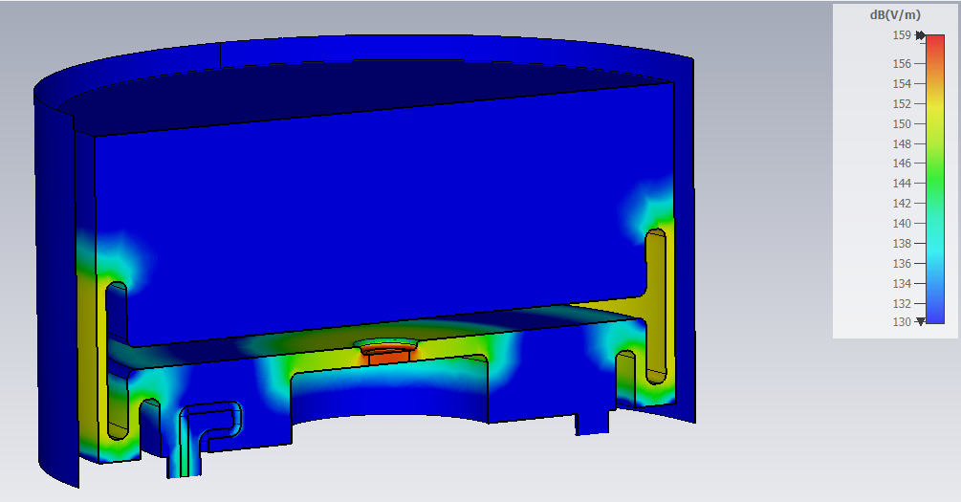
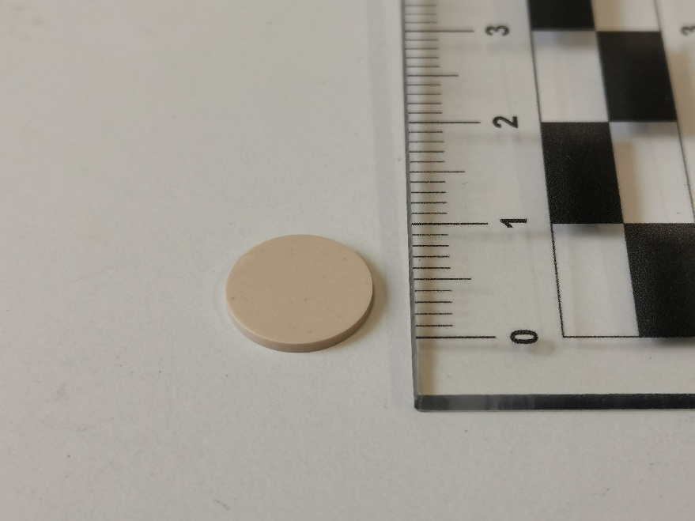
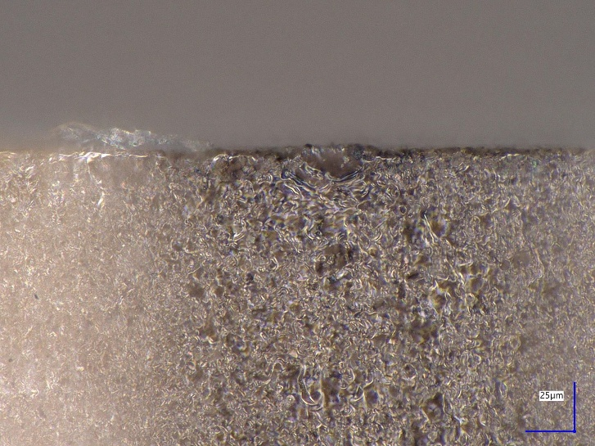
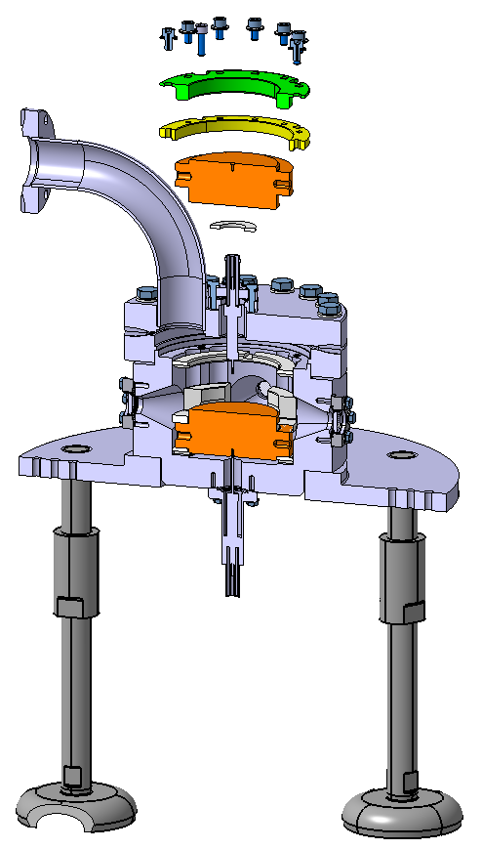
WP1 – FE-FRT: achievements of Task 1.2
Task 1.2 Achievements: FE-FRT for transient beam-loading
Characterized ferroelectric ceramic at 400 MHz and determined the HV breakdown limit
A preparation of the BST ferroelectric material was developed to fulfill the tuner’s requirements
Sample preparation:
Diamond saw cutting of slices
Grinding/polishing procedure for optical finish
Cleaning by US bath, alcohol wipe and 120°C bake
Provider: Industry partner Euclid Techlabs:
Water jet cutting → surface polish → vacuum bake
Compression w/o brazing with diamond machined copper parts
40mm
Surface quality
Impact on material performance with RF
Test of high voltage breakdown: LES (W. Wuensch group)
Validation of FE machining, preparation and cleaning
Reached 7.2 V/µm
Detailed campaign with optimized geometry in Q3 2026

Slide 8
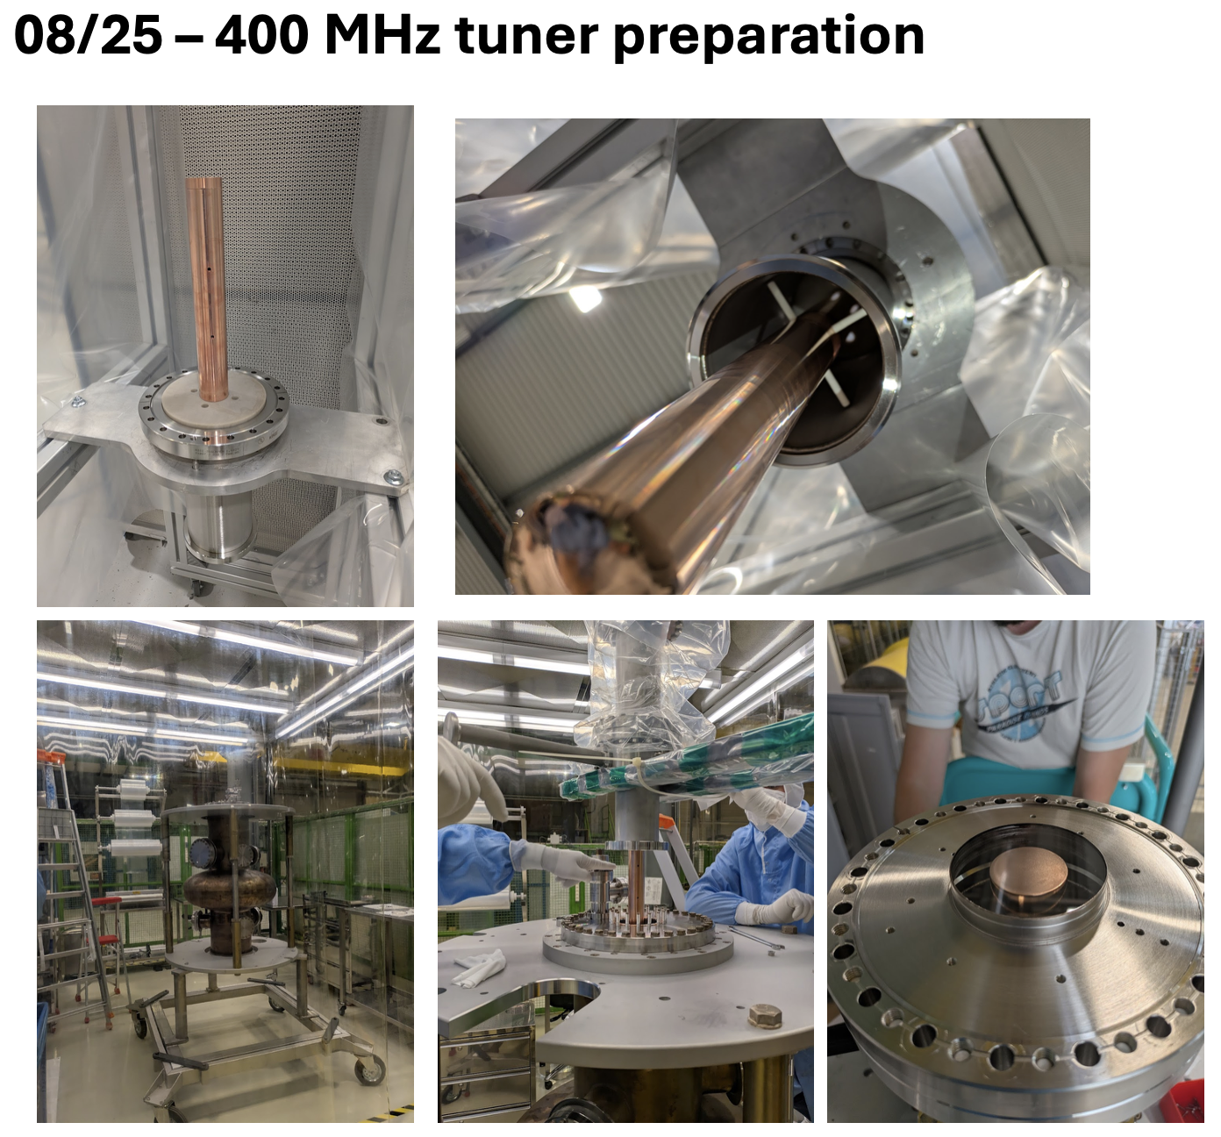
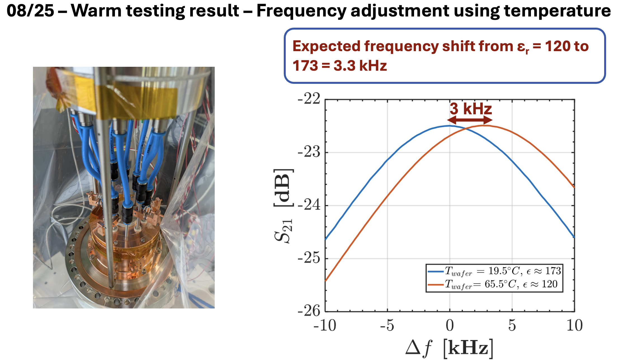
WP1 – FE-FRT: achievements of Task 1.2
Steps taken in 2025: Tuner assembly, warm test validation preparation of cold test:
Goal: Obtain results for MS3 (Due in Feb. 27, Cold test + high power tests D2 June 27)
By temperature change of FE material

Slide 9
WP1 – FE-FRT: achievements of Task 1.2
QFRT
First Cold measurement in Q4 2025:
  Anti-cryostat in VTS setup validated
    Tuner operated at 320 K inside cold cryostat
  Measurement issues
    Cooling circuit: Porosity under vacuum
    RF leakage from tuner to notch filters
    Frequency sensitivity to cryostat pressure variations
Δf0
Q1 2026:
  Addressing RF and cryostat issues
    Modifications ongoing: 4-week RF test in June 2026
    → MS3 Test of 400 MHz cavity with FE-FRT
  High power test for D3
    Go as high as reasonable possible with cold test
    High power (100 kW) demonstration with Spin-off
    developed FE phase shifter
Tuner @ 4.2 K: QFRT tuning
Sensitive to cryostat pressures

Slide 10
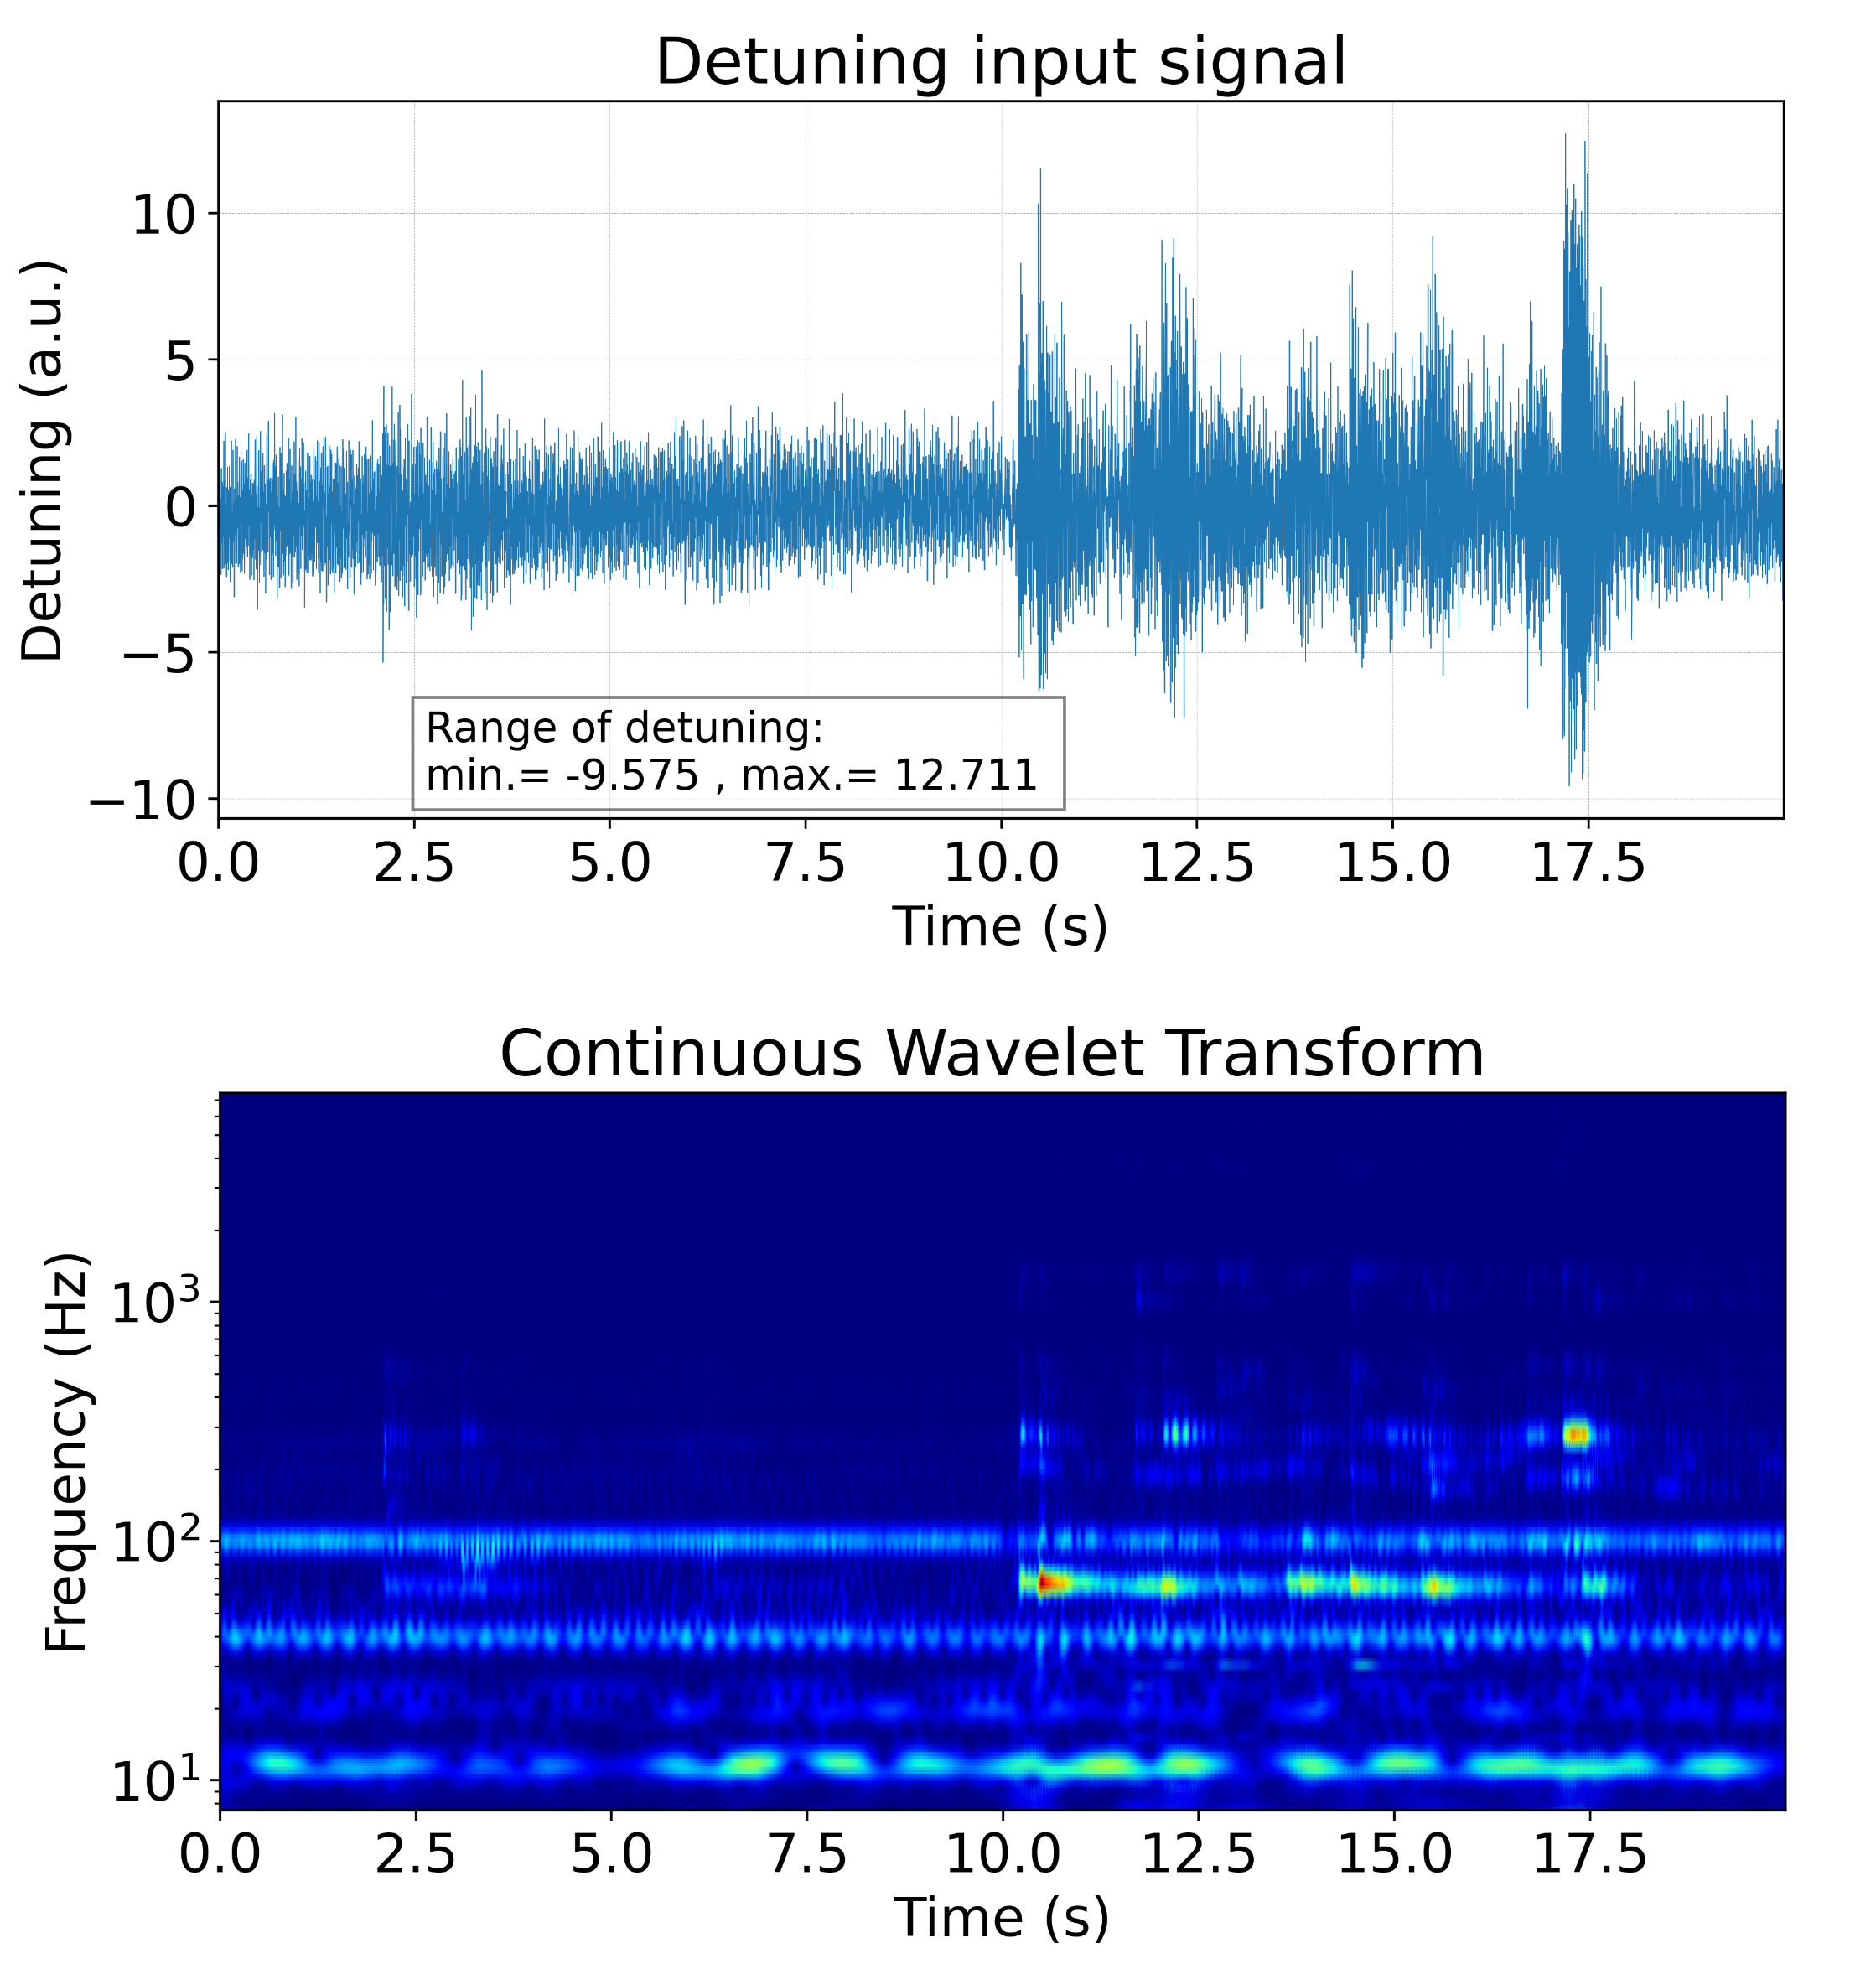
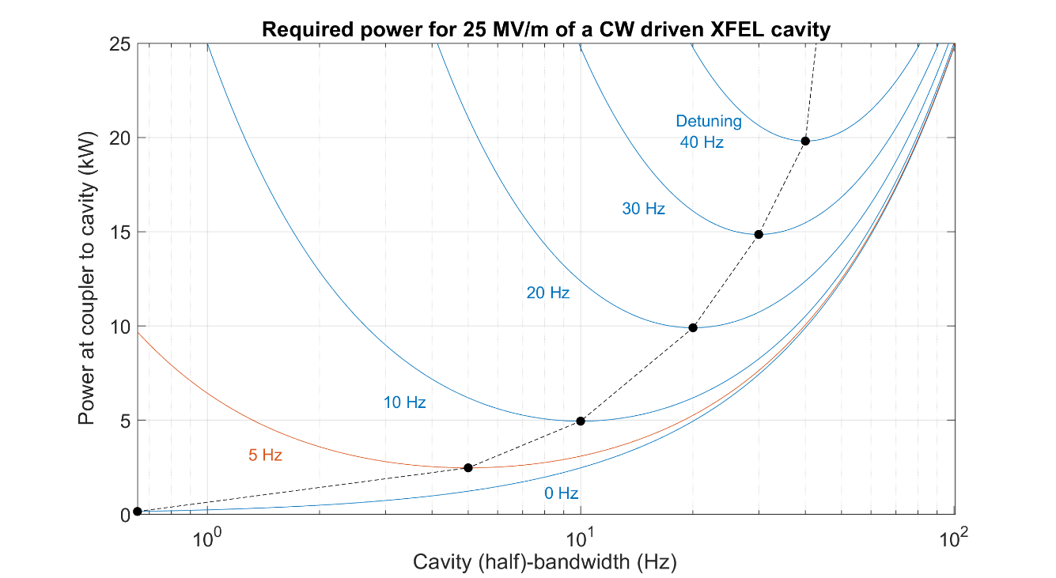
WP1 – FE-FRT for microphonics: achievements of Task 1.3
Task 1.3 Achievements
Developed a design for a 1300 MHz cavity FE-FRT to compensate microphonics
detuning to allow operation at high loaded quality factor and thus lower RF
power:
Start by characterizing the ferroelectric material at 1300 MHz, design an FE-FRT for the microphonics use case, build a prototype, perform first cold test, finalize the project with a system to compensate microphonics with a fully equipped nine cell cavity in a cryo-stat
J.S. Romero-Jiménez et al., IPAC 26
0 Hz

Slide 11
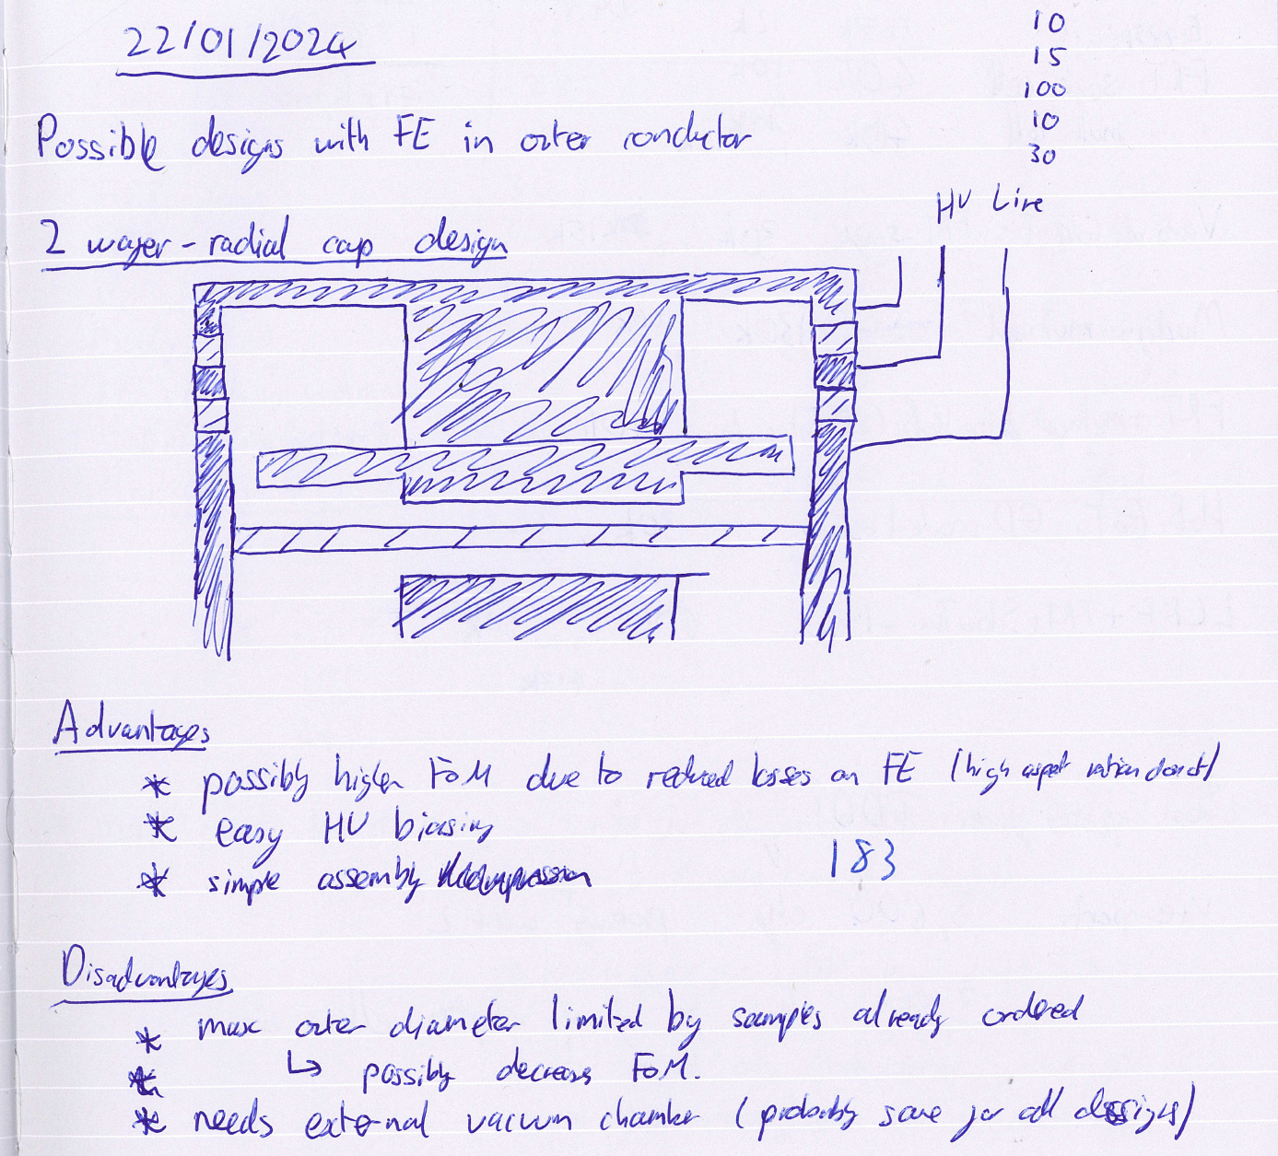
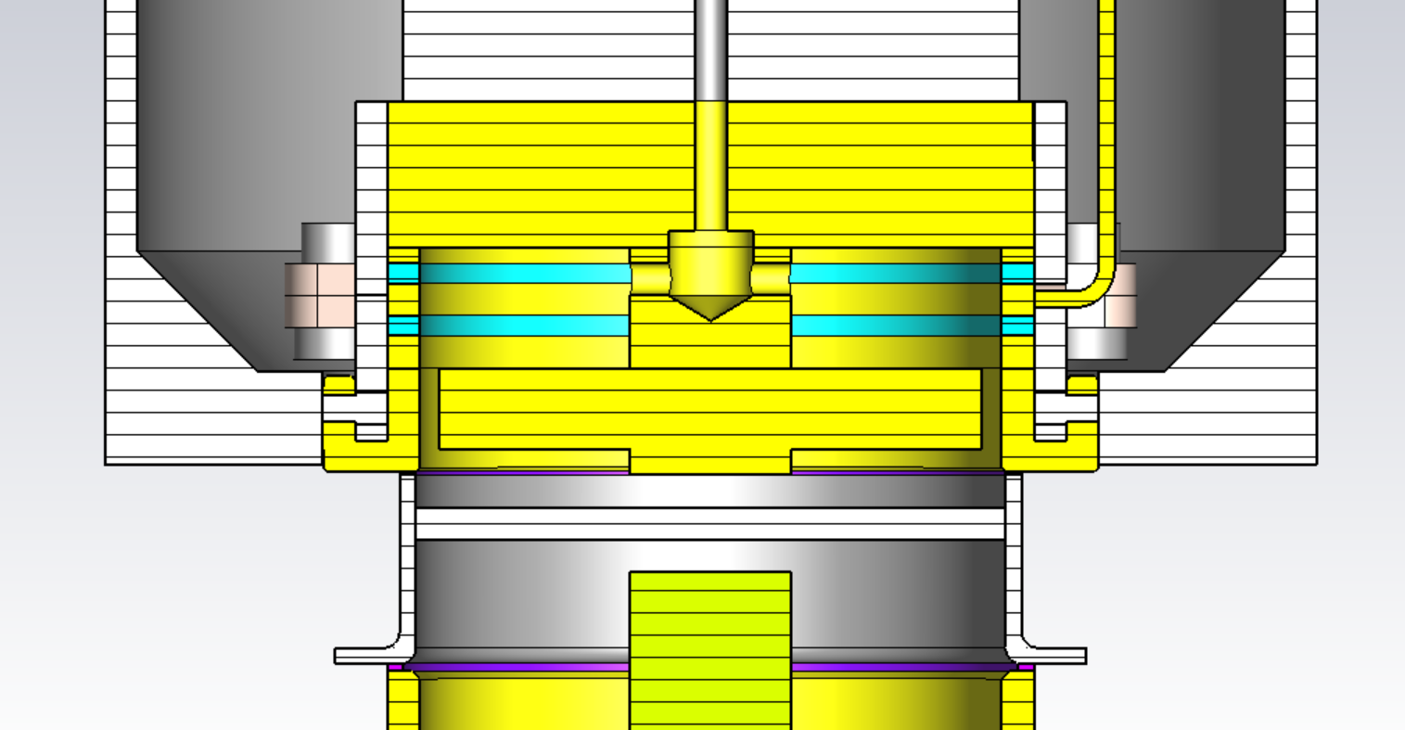
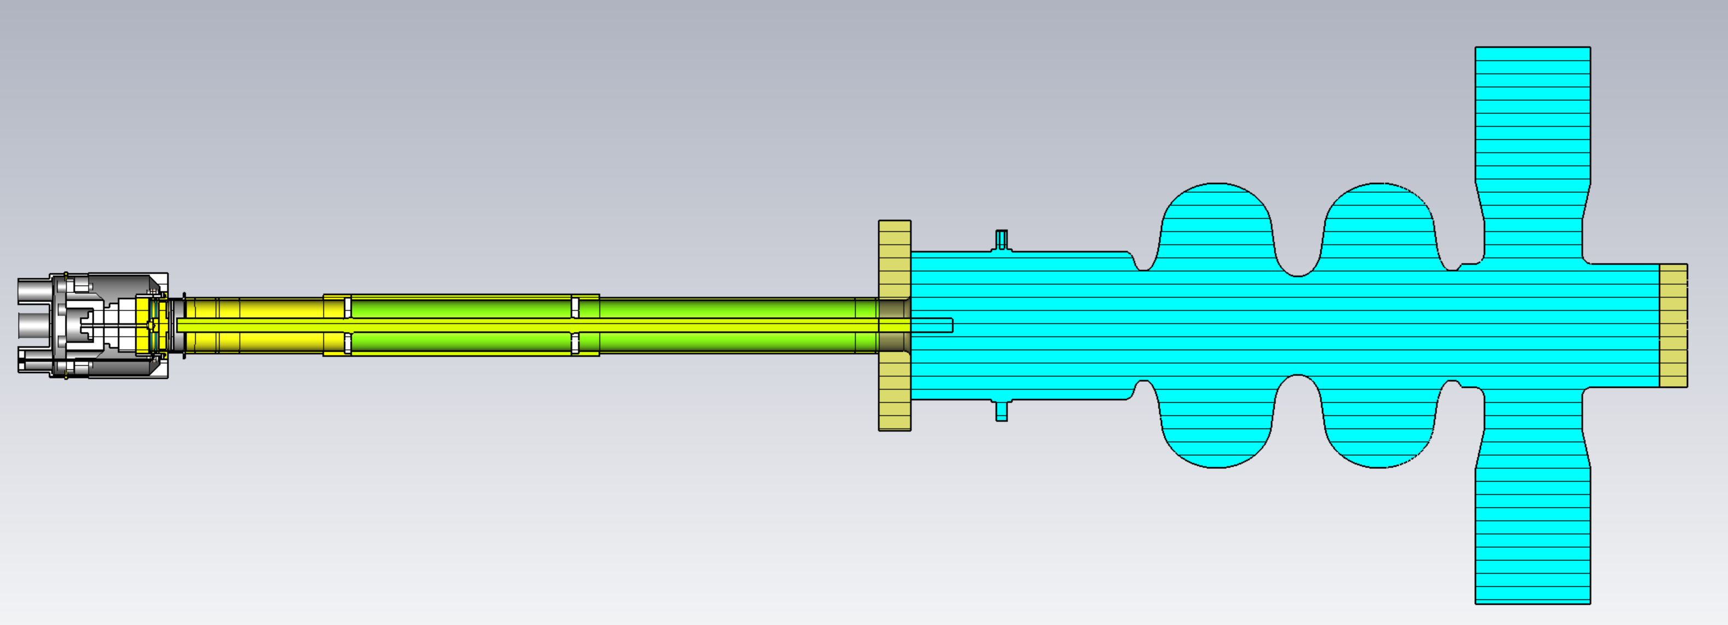
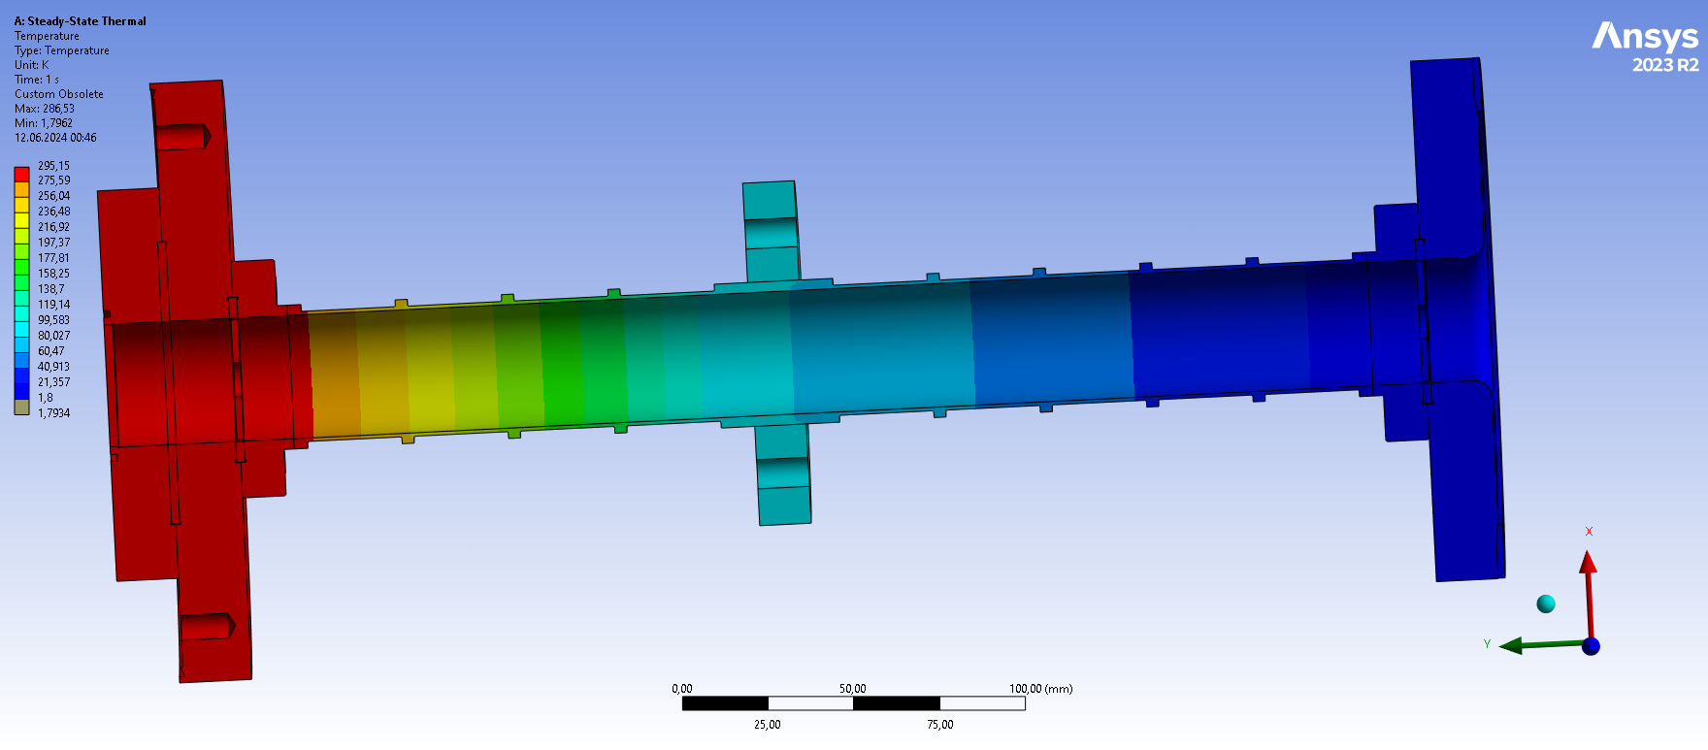
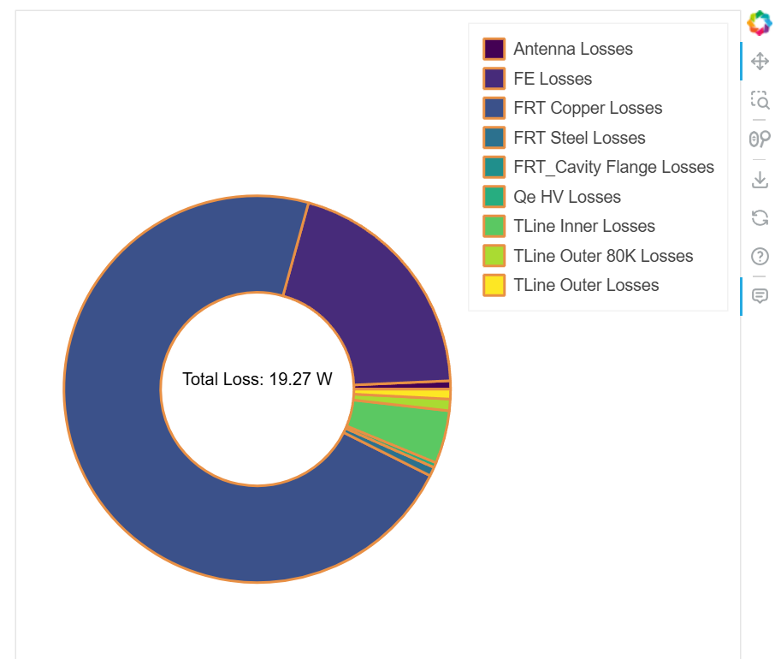
WP1 – FE-FRT for microphonics: achievements of Task 1.3
Performed steps:
  RF design finalized in May 25 (Bi-resonant design), mechanical design ready in June 25,
  thermal analysis, transmission line and antenna optimization
For HoBiCaT test we aim to limit heat transfer to cavity to ~2W
For eventual integration into a cryomodule we would aim to reduce this further
Use thin walled steel for transmission line
Ridges for mechanical strength
80K intercept to further reduce heat flow
Required additional cooling power ~270W
RF power saved:
  2 cell Booster Cavity @ 2.1MV ~ 190W
  7 cell LINAC cavity @ 15MV ~3.2kW
How it started……
Transmission line
FRT
2-cell Booster

Slide 12
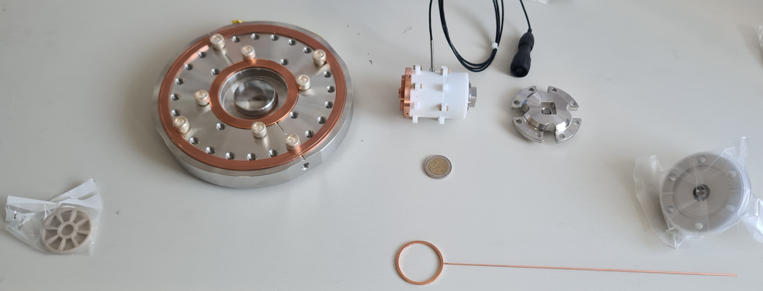
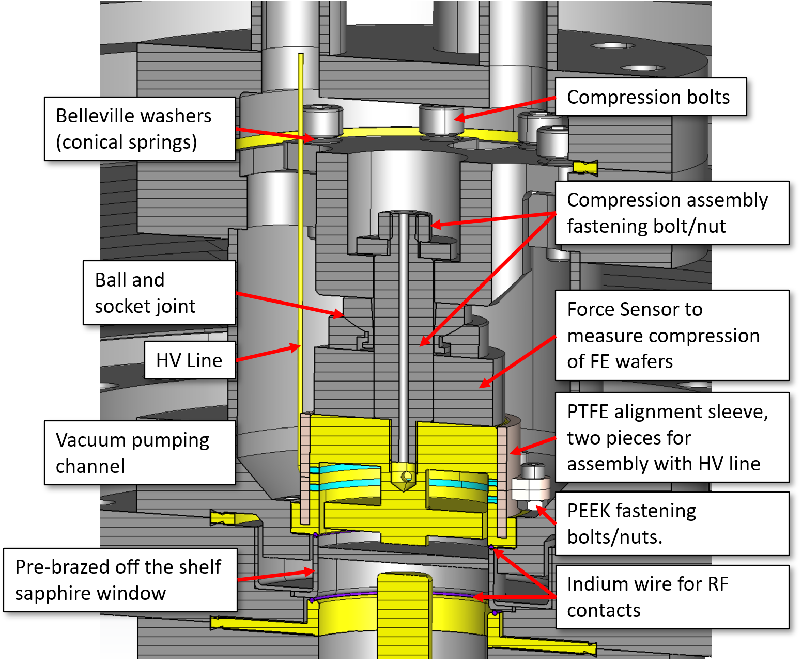
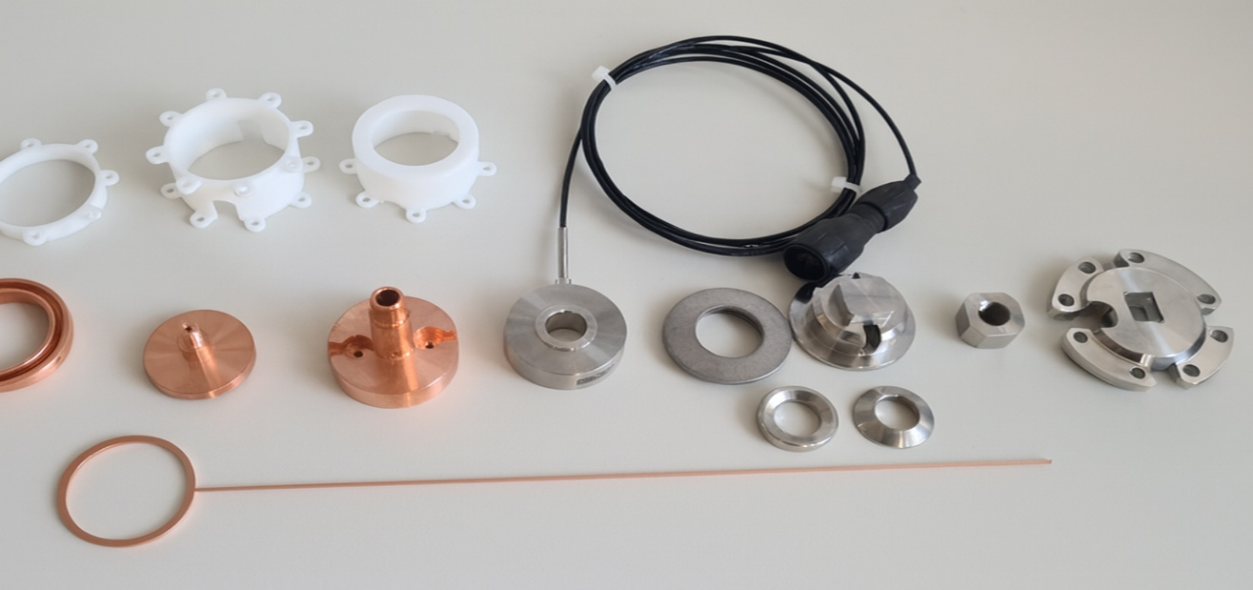
WP1 – FE-FRT for microphonics: achievements of Task 1.3
2 euro coin
FE-FRT parts left to right: antenna holder, bottom flange with sapphire window, main stack, top of compression assembly, HV feedthrough. Bottom: HV electrode.
Thanks and acknowledgments to A. Frahm.
Mechanical design: All parts done, but
we need ferroelectrica→recently received
lapped ceramics with great accuracy
Disassembled stack. Top: PTFE sleeve. Middle left to right: Lower electrode, inner conductor, top electrode, compression sensor, belleville washers, ball and socket joint, top parts of compression assembly. Bottom: HV electrode. Not shown: heater catridge, FE wafers.

Slide 13
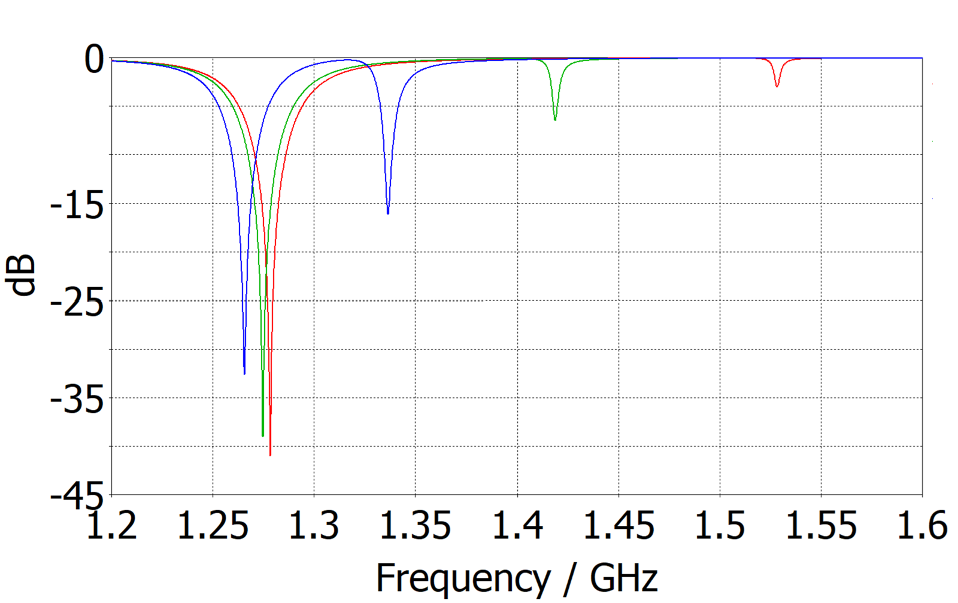
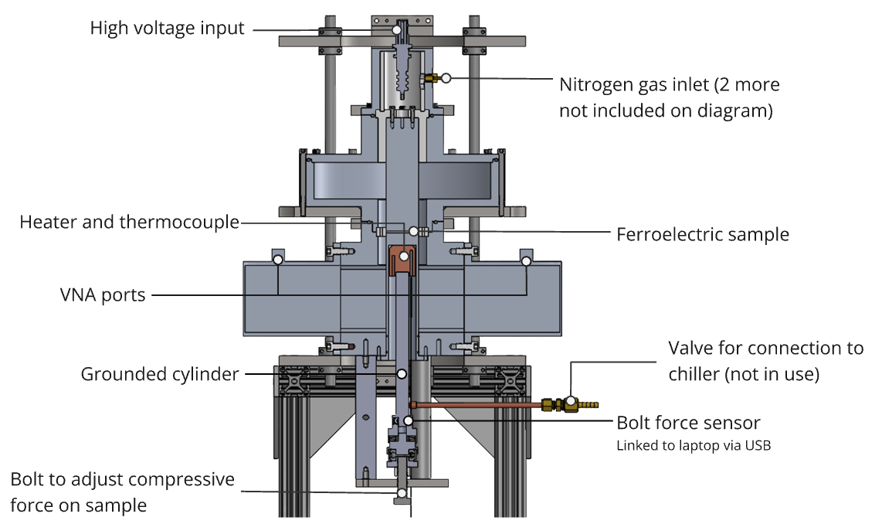
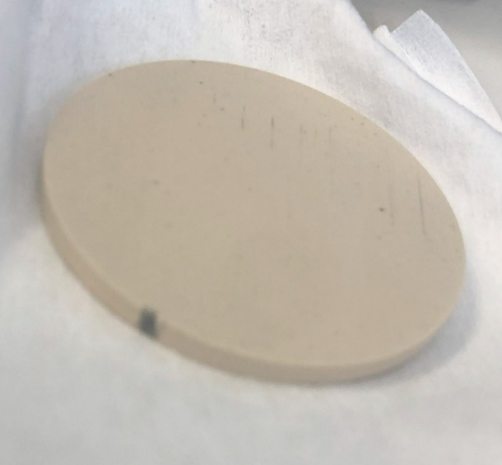
WP1 – FE-FRT for microphonics: achievements of Task 1.3
Characterization of FE ceramics at 1300 MHz, sample preparation
Measure permittivity by
variation of frequency of
modes interacting with
the ceramic
Relies on accurate simulations
Function of voltage, force,
temperature, inert gas press.
ε=160, 140, 120
In short:
Permittivity versus voltage was measured
Results were not always consistent and lower
as expected (not fully linear) → lower tuning range?
We assume more a problem of gaps between electrodes
and samples (voltage drop across gap)
→ sample preparation, surface quality, electrical contact
All this improved after Euclid refurbished FERMAT, but
still questions remain open
Still enough results to fulfill MS 1
FERMAT teststand by Euclid
Damage from breakdown in FERMAT at 9kV (3.6V/µm) in 2.3bar N₂ atmosphere.

Slide 14
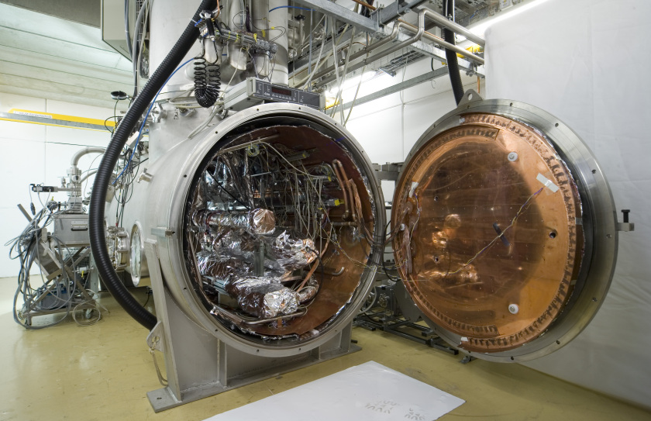
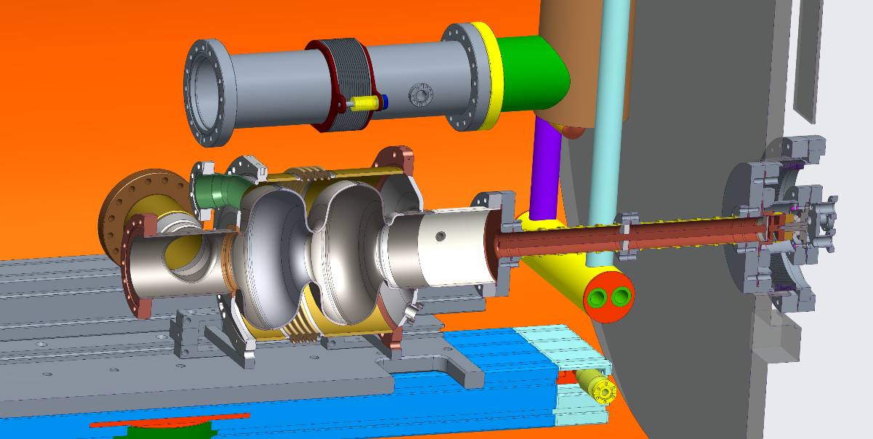
WP1 – FE-FRT: achievements of Task 1.3
Preparation of HoBiCaT cavity tes´t (on-going):
FE-FRT was already tested for leaks and performed well
A test assembly with a second cavity will be performed,
including cleanroom assembly
An RF bench test of the FE-FRT will be performed
(Tuning via temperature) Q3 2026
Up to three available Booster cavities will be tested and
the most suitable picked for the FE-FRT (baseline) Q3 2026
  Understand loss mechanisms due to FE-FRT (ΔQ₀)
  Are there new field emitters activated (cleanliness of
  assembly)
  Cavity presumable equipped with magnetic shielding
  and classic blade tuner including piezos
  → eventually study interaction of both tuning systems
  (Lf-detuning, coarse tuning, switching at FE-FRT limits)
Assemble for 2-cell FE-FRT test, microphonics
compensation using SEL and HV controller loop
(A. Ushakov, WP2, task 2.4) Q4 2026

Slide 15
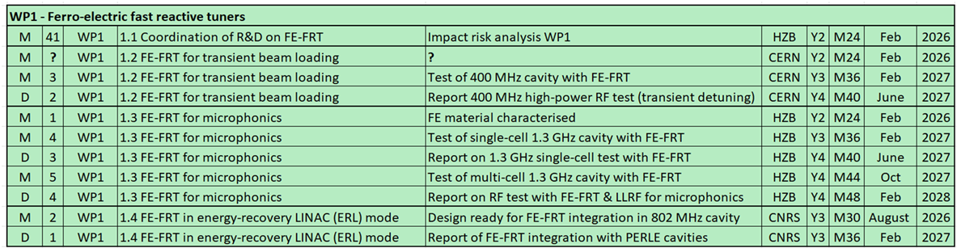
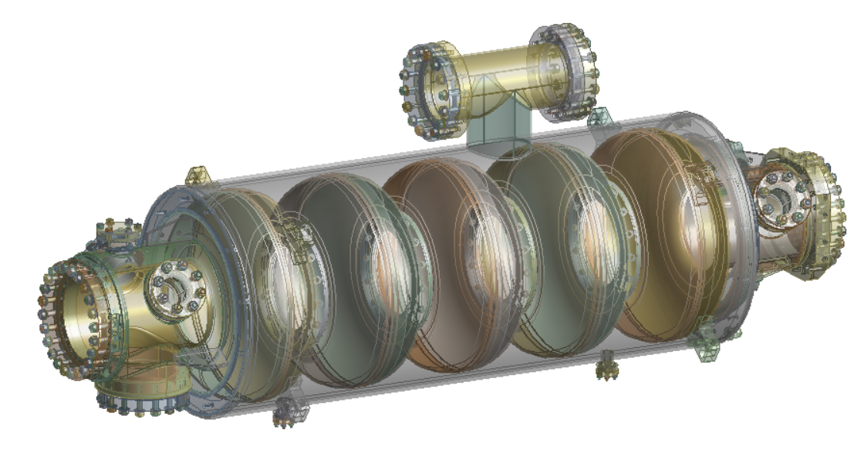
WP1 –FE-FRT in ERL : achievements of Task 1.4
MS 2 for design of FE-FRT ready to integrate in PERLE cavity due this summer
A PERLE cryo-module with cavities w/o FE-FRT is also a deliverable for iSAS
Personnel at PERLE is tight to design a cavity optimized for FE-FRT and fulfills ERL requirements
  Decided to join forces between IJCLab, CERN, U Lancaster and HZB to work on a design, as:
PERLE cavity + tank
Similar 800 MHz use case for FCC Booster
and PERLE (more relaxed than FCC)
A common 2-wafer coaxial design can be used
Study started with first analysis from HZB,
RF designs by CERN and Lancaster, coordination,
models etc. by IJCLab → MS 2 (back) on track
FRT on free HOM port
FPC
Studies on impact of FE-FRT used port on HOM spectrum, coupler kicks, port size dimensions suitable
Can Qext be reduced to achieve real power savings for RF or is multi-turn beam transient during
ramp up the driver for choice of Qext (multi-turn ERL)

Slide 16
WP1 – FE-FRT: Next steps
WP1 Next steps
Cold RF test at CERN with transient detuning prototype in June 26
High power (100 kW) test will be performed with an FE based phase shifter
→ will prove power handling capability of material
Further analysis of breakdown fields and correlation to material properties and
surface quality (CERN, HZB, Euclid)
Baseline RF test of 2-cell cavity for microphonics prototype in June 26 at HZB
Full assembly of microphonics FE-FRT and bench test to prepare prototype cold
RF test in December 26 at HZB
Joint design effort started at IJCLab, CERN, HZB and U Lancaster for a PERLE FE-FRT design at 800 MHz to fulfill upcoming milestone in August 26

Slide 17
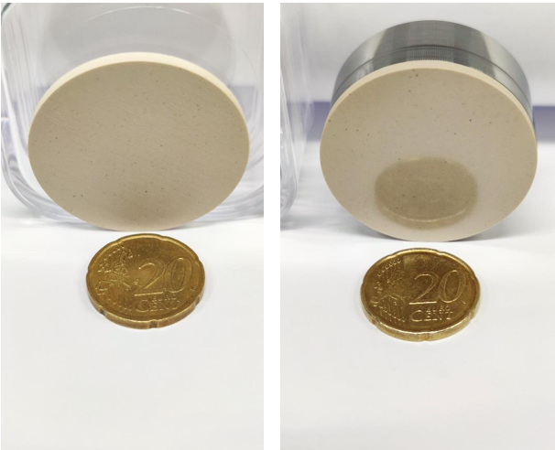
WP1 – FE-FRT: Thanks for listening
Thanks for your attention
Alick Macpherson, Sam Smith, Graeme Burt, Walid Kaabi, André Frahm, Nick Shipman,
Alexei Kanareykin, Chunguang Jing et al. from Euclid , Jens Knobloch, Axel Neumann,
Maleesh Dissanayake, Hingpong Jiang, Victoria Almaraz, Ilan Ben-Zvi, Alena Prudnikava, Paul Schneider,
Mickael Crouvizier and more involved co-workers at CERN, HZB, Lancaster and IJCLab

