Slide 1


WP2: LLRF
RP1 review meeting, June 1st, 2026
All information contained in this presentation and any accompanying documents is for iSAS project only, and must be treated as strictly confidential.
Any dissemination, distribution or other use of this information without the consent of its owner is prohibited.
Funded by the European Union. Views and opinions expressed are however those of the authors only and do not necessarily reflect those of the European Union or the European Commission. Neither the European Union nor the granting authority can be held responsible for them.

Slide 2
WP2: Low Level RF controls 01.06.2026
DESY, HZB, CNRS
Convener & deputy: Julien Branlard (DESY) & Christian Schmidt (DESY)
Main contacts with other partners: Axel Neumann (HZB), Christophe Joly (CNRS)
WP02’s task with iSAS
Main goal:
Investigate and demonstrate techniques to achieve efficient field-control of narrow-bandwidth SRF cavities
through
    improved algorithms to achieve RF field control
    improved algorithms to achieve resonance control
    improving efficiency of RF sources and their usage
    investigation of what can be achieved with FE-FRT for resonance control
    improving diagnostics (detuning measurement and fault detection) making use of AI / ML

Slide 3
WP2: Low Level RF controls 01.06.2026
DESY, HZB, CNRS
Convener & deputy: Julien Branlard (DESY) & Christian Schmidt (DESY)
Main contacts with other partners: Axel Neumann (HZB), Christophe Joly (CNRS)
Task 2.1: Coordination of R&D on LLRF – M1-M48
Work package organization, meeting coordination, status reporting, milestones and deliverables
Task 2.2: Efficient field control for high loaded-quality factor cavities – M1-M48
Develop techniques to efficiently drive cavities very narrow bandwidth
Task 2.3: Vibration analysis and detuning control of cavities – M1-M36
Microphonics measurements and development of counter measures for accurate detuning control
Task 2.4: Integrated LLRF control using Ferro-Electric Fast Reactive Tuners – M13-M48
Investigate and develop use of FE-FRT for detuning control
Task 2.5: Energy efficient supervision and fault diagnosis – M1-M48
Develop new techniques, including machine learning, to improve fault diagnosis and RF system supervision

Slide 4
WP2 – LLRF: Key outcomes
WP2 Key outcomes
Waveguide device to shift cavity to narrower bandwidth, reducing power needs
  Qext range shifted by factor 10 (i.e. Qext(max)= 1e7 → 1e8)
More sustainable technique for Lorentz Force Detuning compensation
  Half the energy deposited into piezo → increased lifetime
Noise suppression techniques using piezos on SRF cavities
  Microphonics-limited cavity operating at 9 MV/m can now operate at 15 MV/m
Machine-learning based models to predict calibration drifts as a function of weather forecast
  Provide reliable calibration needs 2-3 days in advance
Task 2.2
Task 2.3
Task 2.3
Task 2.5

Slide 5


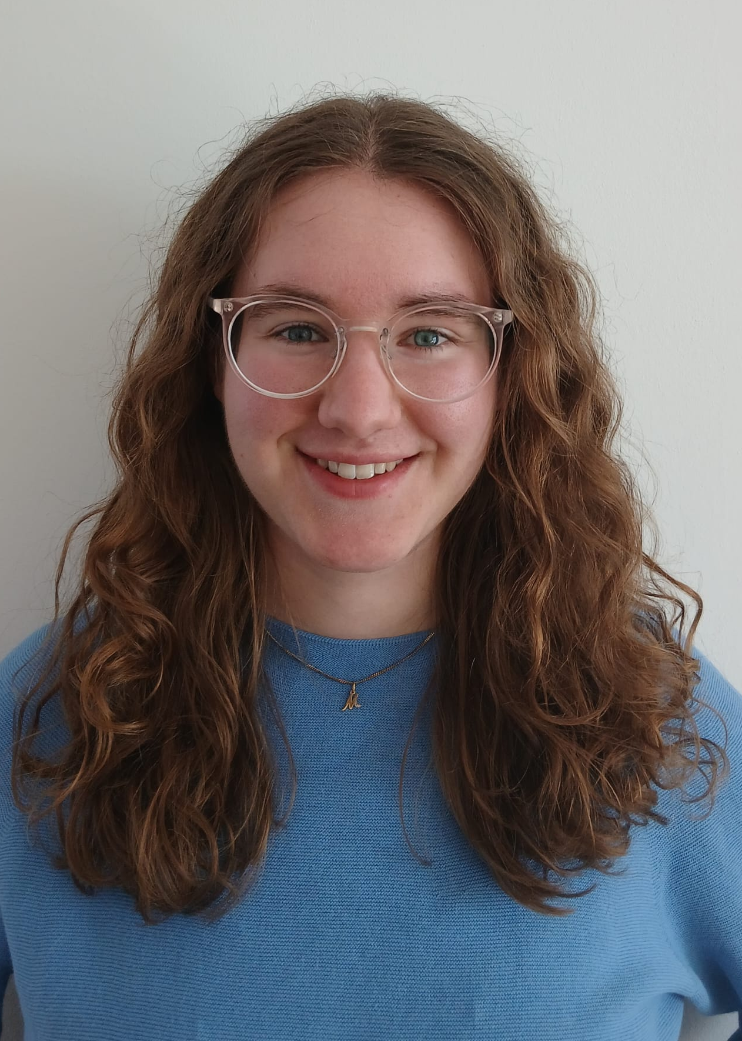
WP2 – LLRF: achievements of Task 2.1
Coordination of R&D on LLRF – M1-M48
Task 2.1 Achievements
  WP2 coordination meetings (~ every 2 months)
  Email list and shared repository
  Identified test stands infrastructure for shared tests
  Euclid Techlabs is WP2’s industrial partner (overlap with FE-FRT development)
  New hire for iSAS WP2
    HZB (2025) : Andrei Maalberg, postdoc for iSAS (ML for detuning)
    DESY (2026) : Mona Ebernez , Bachelor’s student for cryomodule testing support
    DESY (2027) : consulting position for soon-to-be retired RF expert
  Change in WP2 management
    Lead (2025) : Holger Schlarb → Julien Branlard
    Deputy (2025) : Julien Branlard → Christian Schmidt
  Updates, reporting, preparation of milestone & deliverables
Andrei Maalberg
Mona Eberenz

Slide 6
WP2: Low Level RF controls 01.06.2026
DESY, HZB, CNRS
Convener & deputy: Julien Branlard (DESY) & Christian Schmidt (DESY)
Main contacts with other partners: Axel Neumann (HZB), Christophe Joly (CNRS)
Task 2.1: Coordination of R&D on LLRF – M1-M48
Task 2.2: Efficient field control for high loaded-quality factor cavities – M1-M48
Task 2.3: Vibration analysis and detuning control of cavities – M1-M36
Task 2.4: Integrated LLRF control using Ferro-Electric Fast Reactive Tuners – M13-M48
Task 2.5: Energy efficient supervision and fault diagnosis – M1-M48

Slide 7
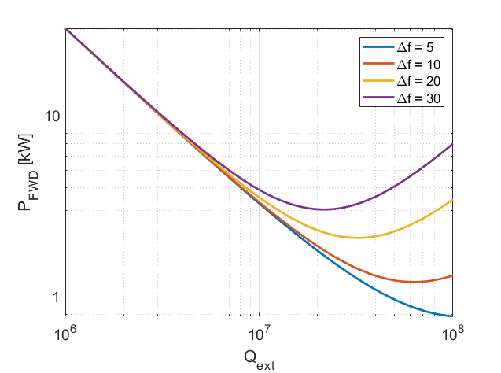
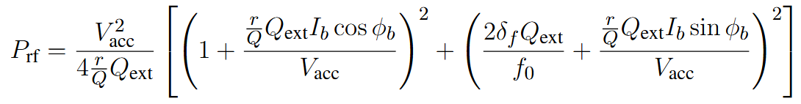
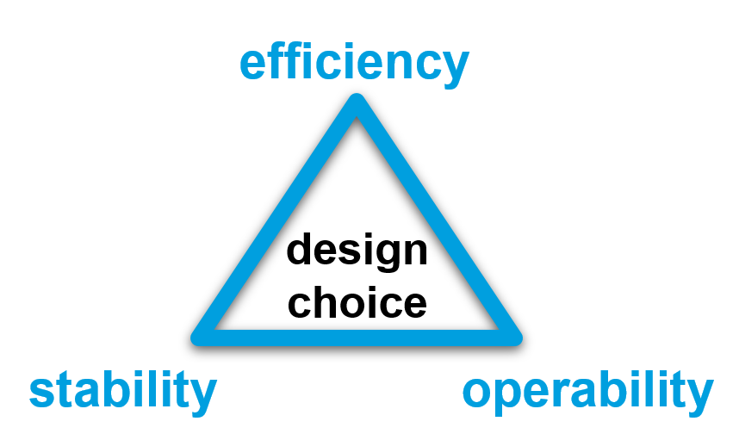
Why is control of bandwidth and resonance crucial for efficiency?
Bandwidth (Qext) and Resonance (Δf) control
Operating at higher Qext (narrower bandwidth)
  reduces the power needs IF resonance control can be guaranteed
  makes resonance control extremely challenging
Forward power required to reach a certain gradient as a function of cavity bandwidth (Qext), for several resonance control performances
Parameters for SRF gun
r/Q = 208 Ohm
V_{acc} = 5 MV (energy gain from the gun at 50 MV/m -> 5 MeV)
I_{b} = 100 uA (100 pC at 1 MHz)
φ_{b} = 0 deg.
4 kW
3.3 kW
2 kW
1.3 kW
The challenge is to find the highest Qext one can operate the cavity at while still meeting the resonance control goals and without compromising operability and reliability of the system.
1 kW
Q_{ext} = 1e7
Q_{ext} = 4e7

Slide 8
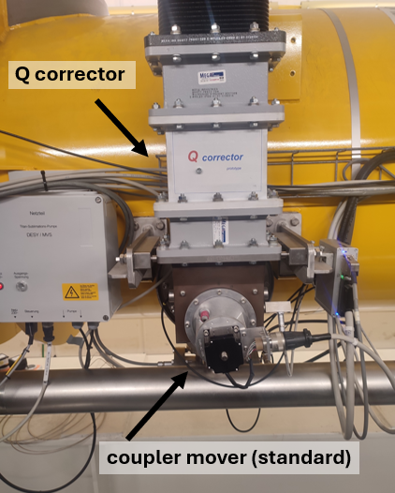
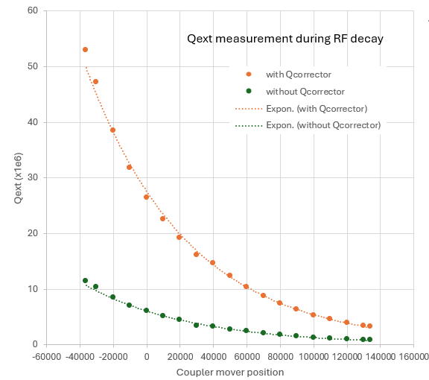
WP2 – LLRF: status/evolution of Task 2.2
Efficient field control for high loaded-quality factor cavities – M1-M48
Achievements for Task 2.2
  Developed prototypes (“Q-corrector”, similar to stub tuner) to shift Qext to higher range
The Q corrector can effectively shift the Qext range
For e.g. for a standard L3 cryomodule
Qext = [1e6 – 1e7]
Qext = [3e6 – 5e7]
Q corrector

Slide 9
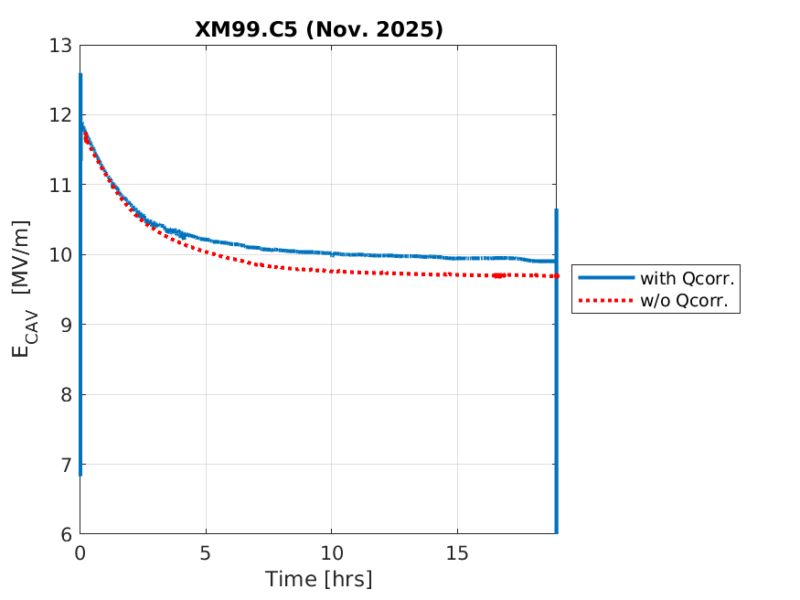
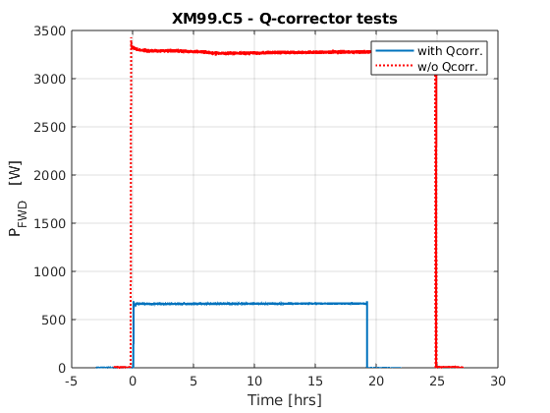
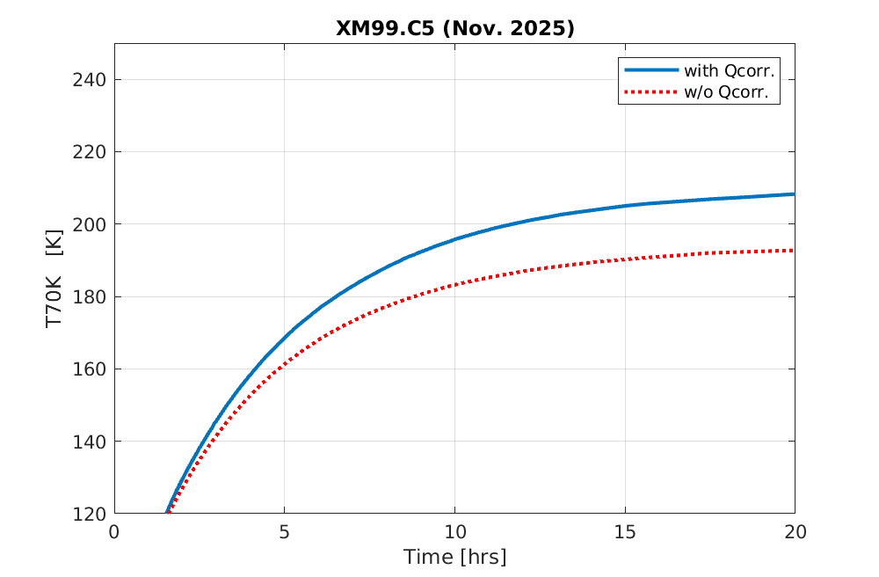
WP2 – LLRF: status/evolution of Task 2.2
Efficient field control for high loaded-quality factor cavities – M1-M48
Achievements for Task 2.2
  Developed prototypes (“Q-corrector”, similar to stub tuner) to shift Qext to higher range
  Show factor 5 reduction in forward power for only 8% coupler temperature increase
3.3 kW
Gradient drops due to coupler heating
(steady state reached after ~ 20h)
a fraction (1/5)
of the power is necessary with Q corrector
similar gradient with and without Q corrector
650 W
the price to pay is an increased heating of the coupler (16K, 8%)

Slide 10
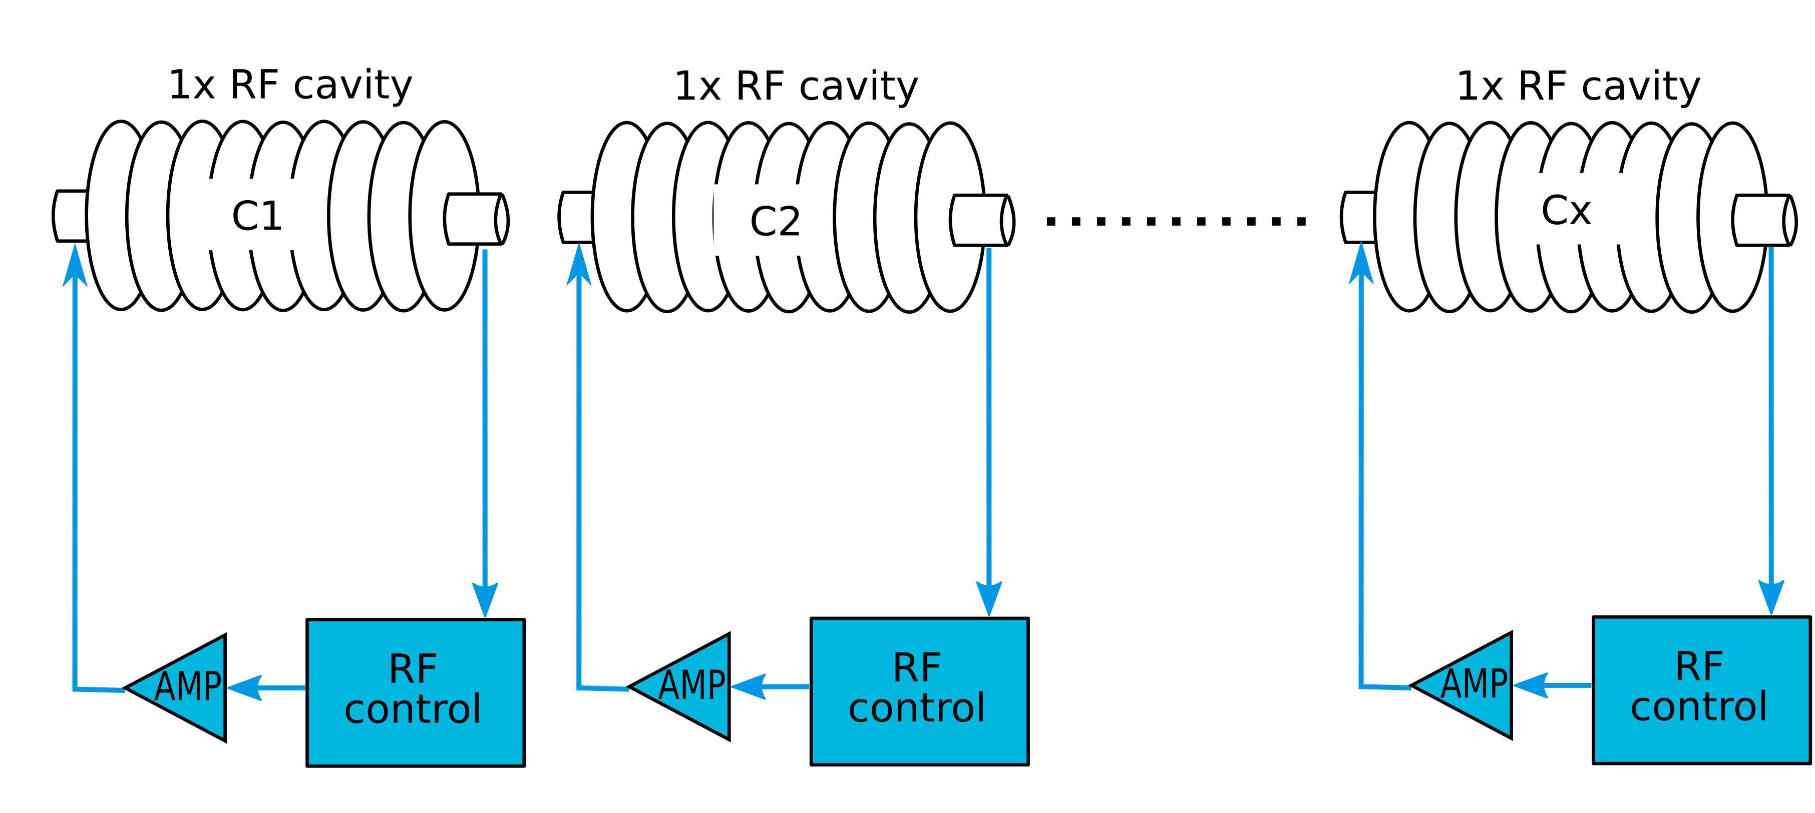
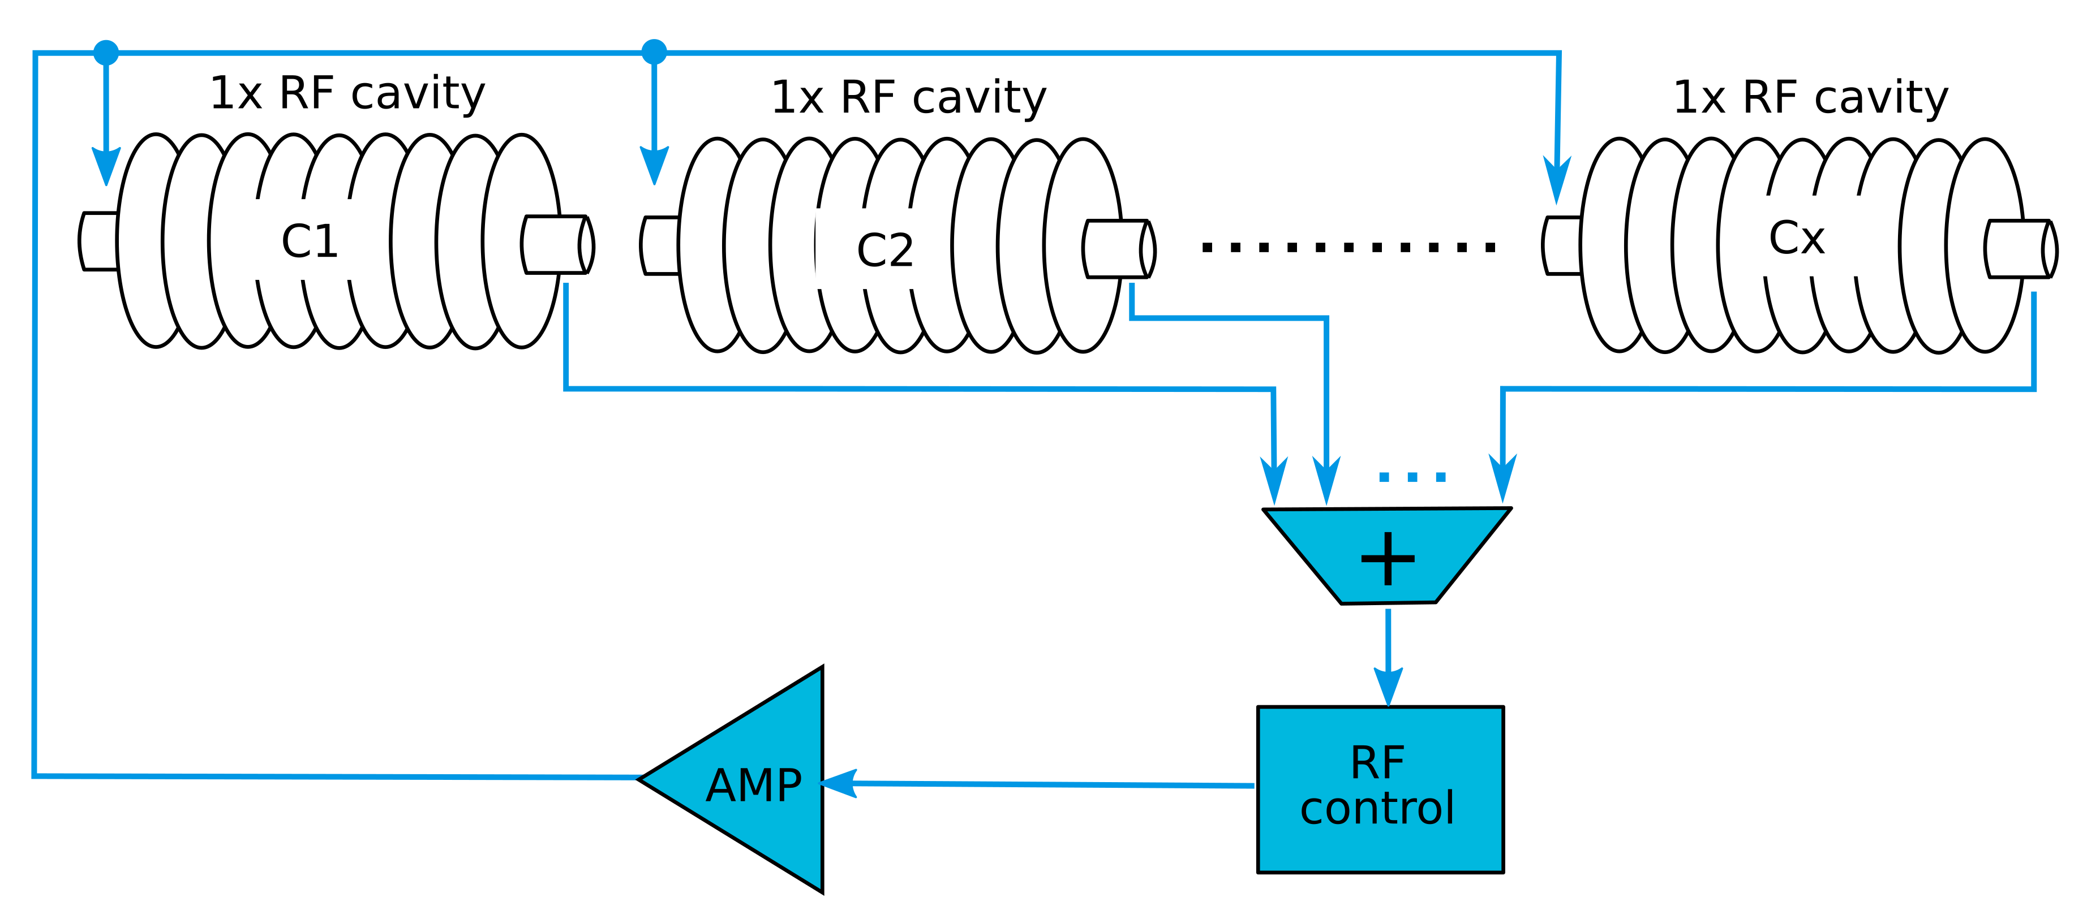
WP2 – LLRF: status/evolution of Task 2.2
Efficient field control for high loaded-quality factor cavities – M1-M48
Achievements for Task 2.2
  Developed techniques (“resonant filling”) to drive high loaded-quality factor (narrow bandwidth) cavities (not using self-excited loop or PLL), adapted to pulsed and vector sum operation
  (i.e. interesting for XFEL upgrade)
SCAV (i.e. 1 amplifier ↔ 1 cavity)
MCAV (i.e. 1 amplifier ↔ multiple cavities)

Slide 11
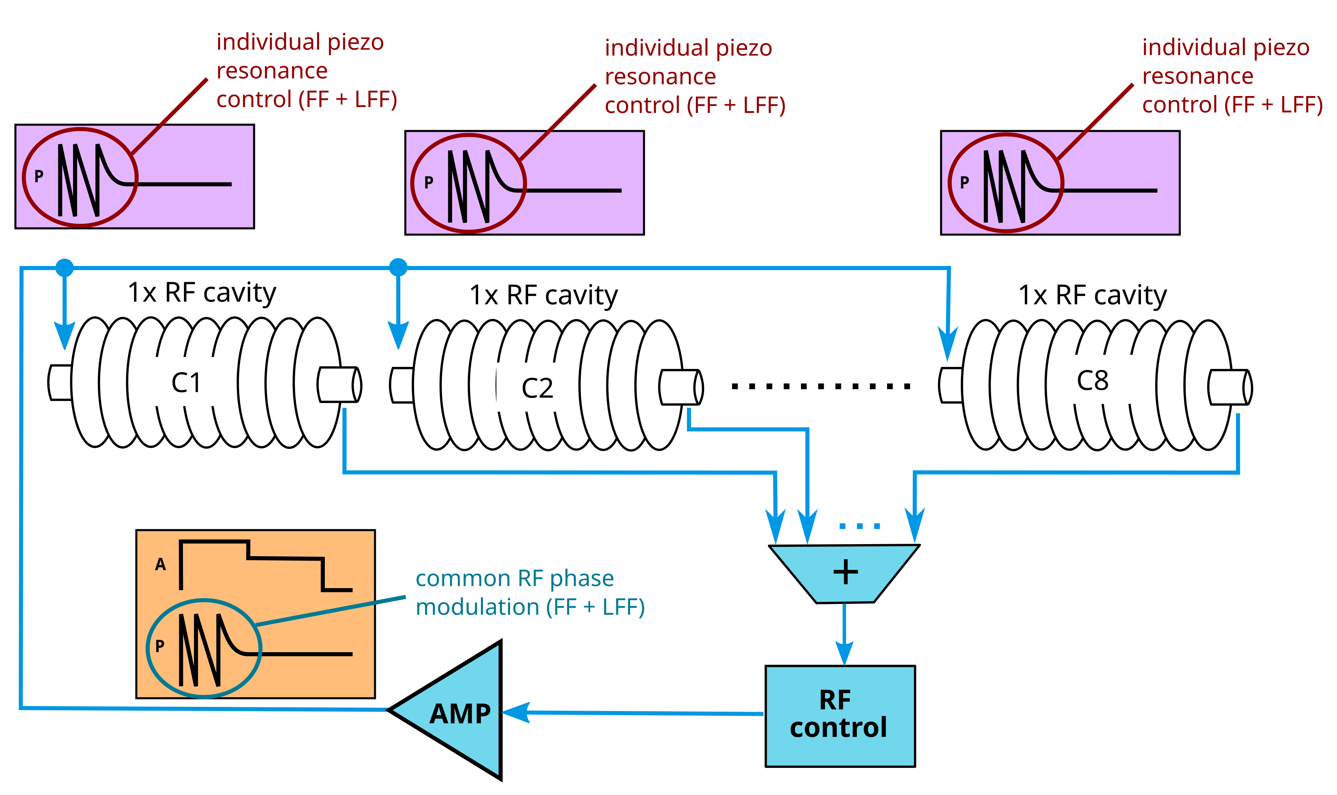
WP2 – LLRF: status/evolution of Task 2.2
Efficient field control for high loaded-quality factor cavities – M1-M48
Achievements for Task 2.2
  Developed techniques (“resonant filling”) to drive high loaded-quality factor (narrow bandwidth) cavities (not using self-excited loop or PLL), adapted to pulsed and vector sum operation
  (i.e. interesting for XFEL upgrade)
SCAV (i.e. 1 amplifier ↔ 1 cavity)
MCAV (i.e. 1 amplifier ↔ multiple cavities)

Slide 12
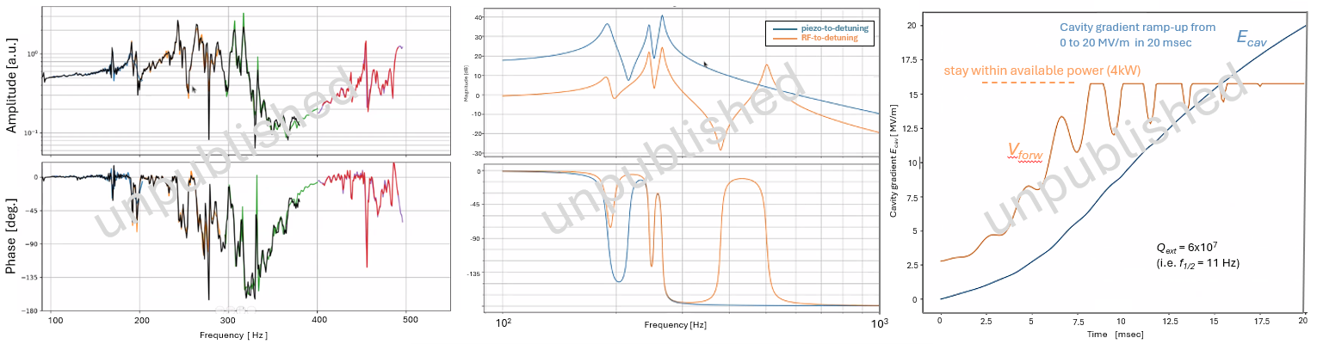
WP2 – LLRF: status/evolution of Task 2.2
Efficient field control for high loaded-quality factor cavities – M1-M48
Achievements for Task 2.2
  Developed techniques (“resonant filling”) to drive high loaded-quality factor (narrow bandwidth) cavities (not using self-excited loop or PLL), adapted to pulsed and vector sum operation
  (i.e. interesting for XFEL upgrade)
Step 1: identify RF-to-detuning and piezo-to detuning transfer functions
Step 2: fit model to experimental transfer function
Step 3: compute piezo and RF drive (given power limit) to bring cavity to target setpoint in allocated time
Courtesy : Bozo Richter
Currently acquiring experimental data. Next publish !

Slide 13
WP2: Low Level RF controls 01.06.2026
DESY, HZB, CNRS
Convener & deputy: Julien Branlard (DESY) & Christian Schmidt (DESY)
Main contacts with other partners: Axel Neumann (HZB), Christophe Joly (CNRS)
Task 2.1: Coordination of R&D on LLRF – M1-M48
Task 2.2: Efficient field control for high loaded-quality factor cavities – M1-M48
Task 2.3: Vibration analysis and detuning control of cavities – M1-M36
Task 2.4: Integrated LLRF control using Ferro-Electric Fast Reactive Tuners – M13-M48
Task 2.5: Energy efficient supervision and fault diagnosis – M1-M48

Slide 14
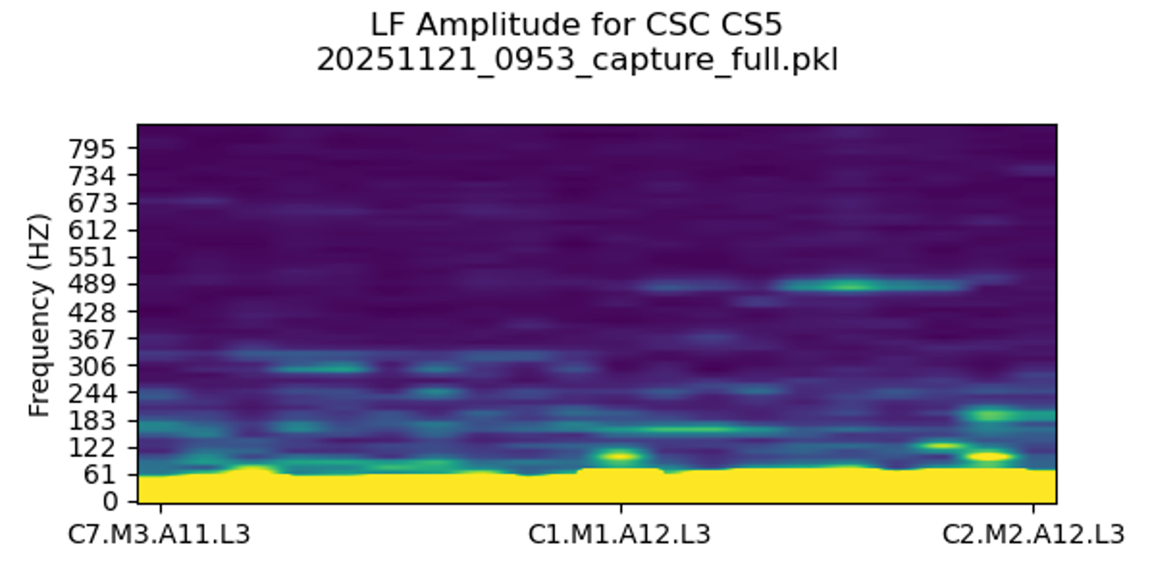
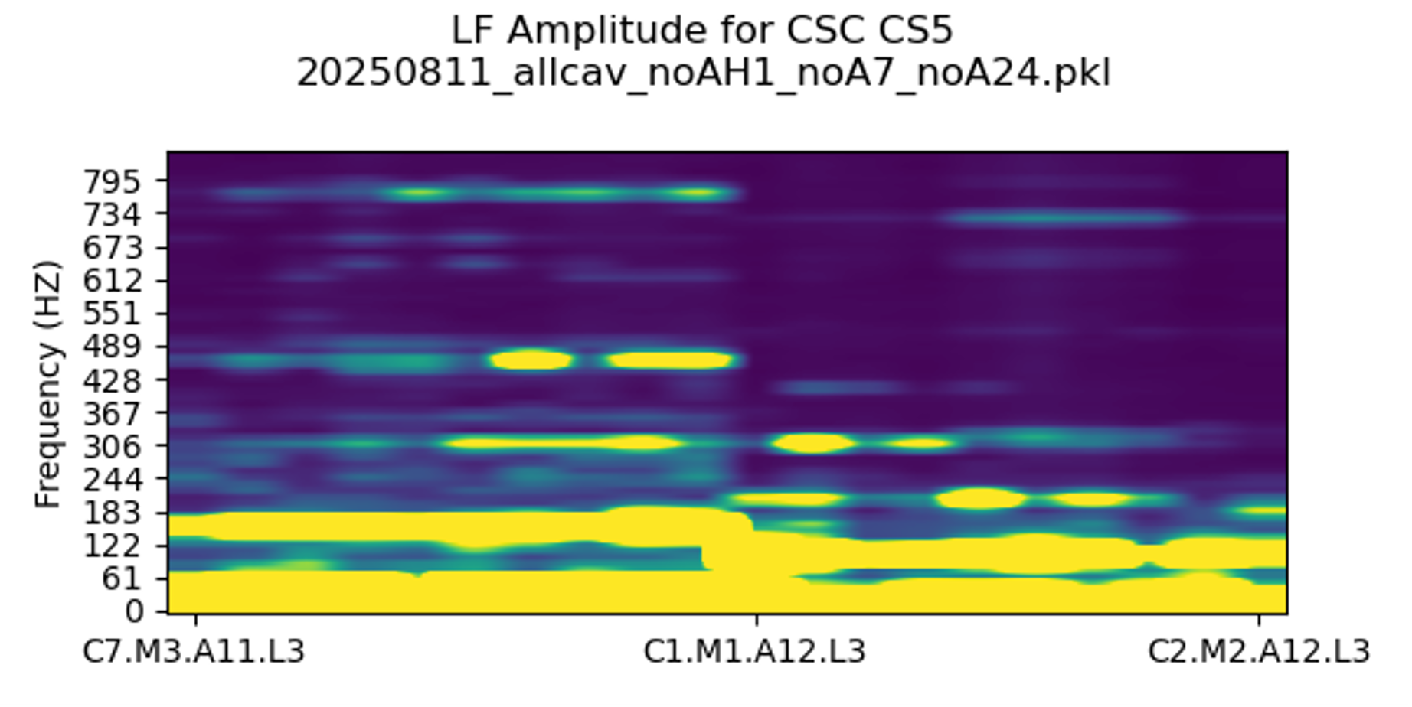
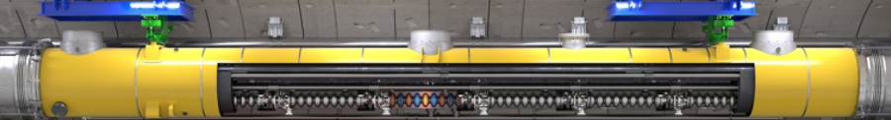
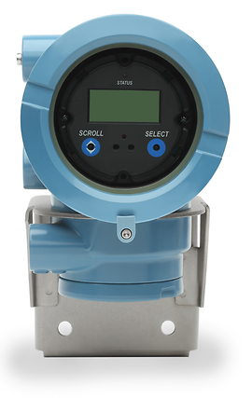
WP2 – LLRF: status/evolution of Task 2.3
Vibration analysis and detuning control of cavities – M1-M36
Courtesy Josh Einstein-Curtis
Flow sensor OFF
Achievements for Task 2.3
  Detuning measurements
    Microphonics measurements and analysis
Flow sensor ON
Coriolis flow sensor

Slide 15
WP2 – LLRF: status/evolution of Task 2.3
Vibration analysis and detuning control of cavities – M1-M36
Achievements for Task 2.3
  Detuning measurements
    Microphonics measurements and analysis
    Exploring new techniques to estimate or learn detuning for RF cavities
      Luenberger observer-based
      KIND : Kalman filter-based
      Wavelets-based
      XFEL gun observer-based
PRAB publication (2026)
IFAC publication (2026)
See publications list at the end of the talk
IPAC publication (2026)
IPAC publication (2026)

Slide 16
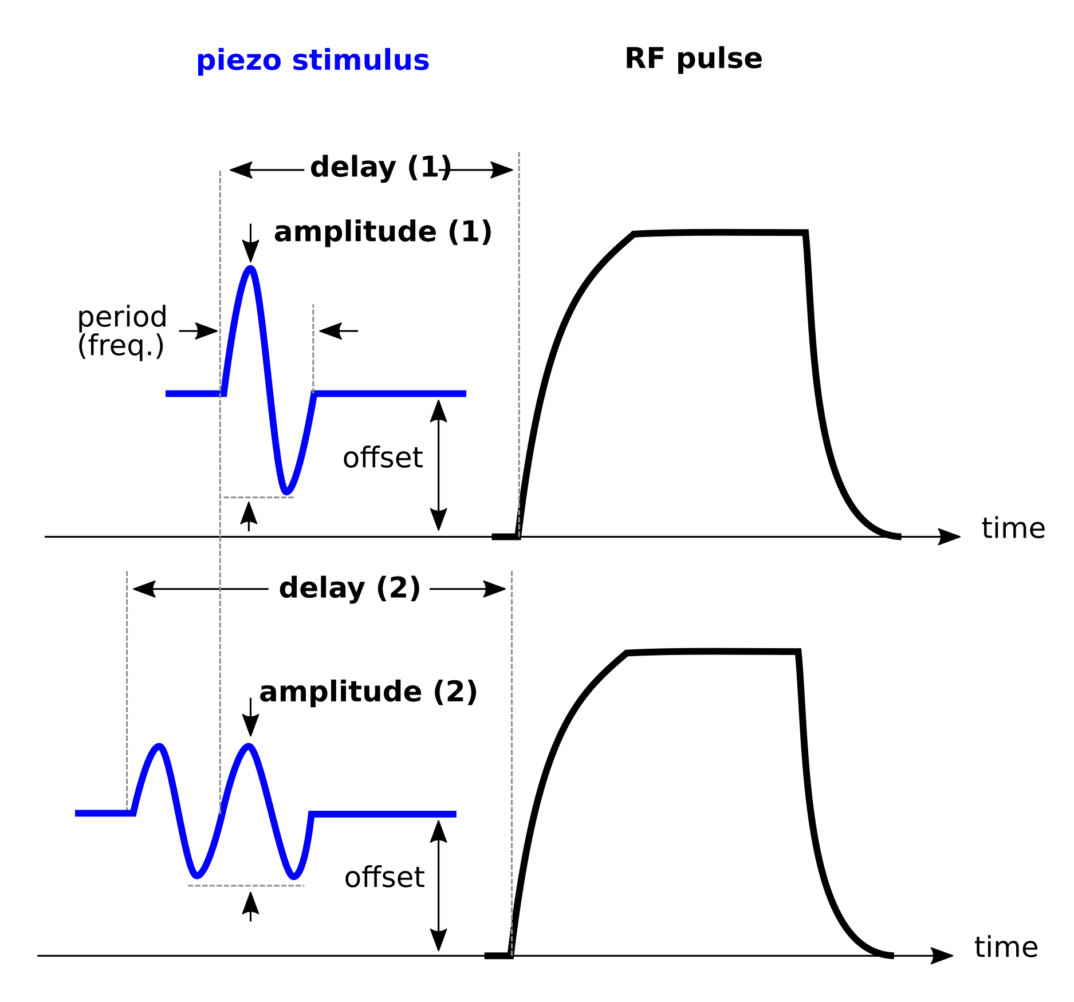
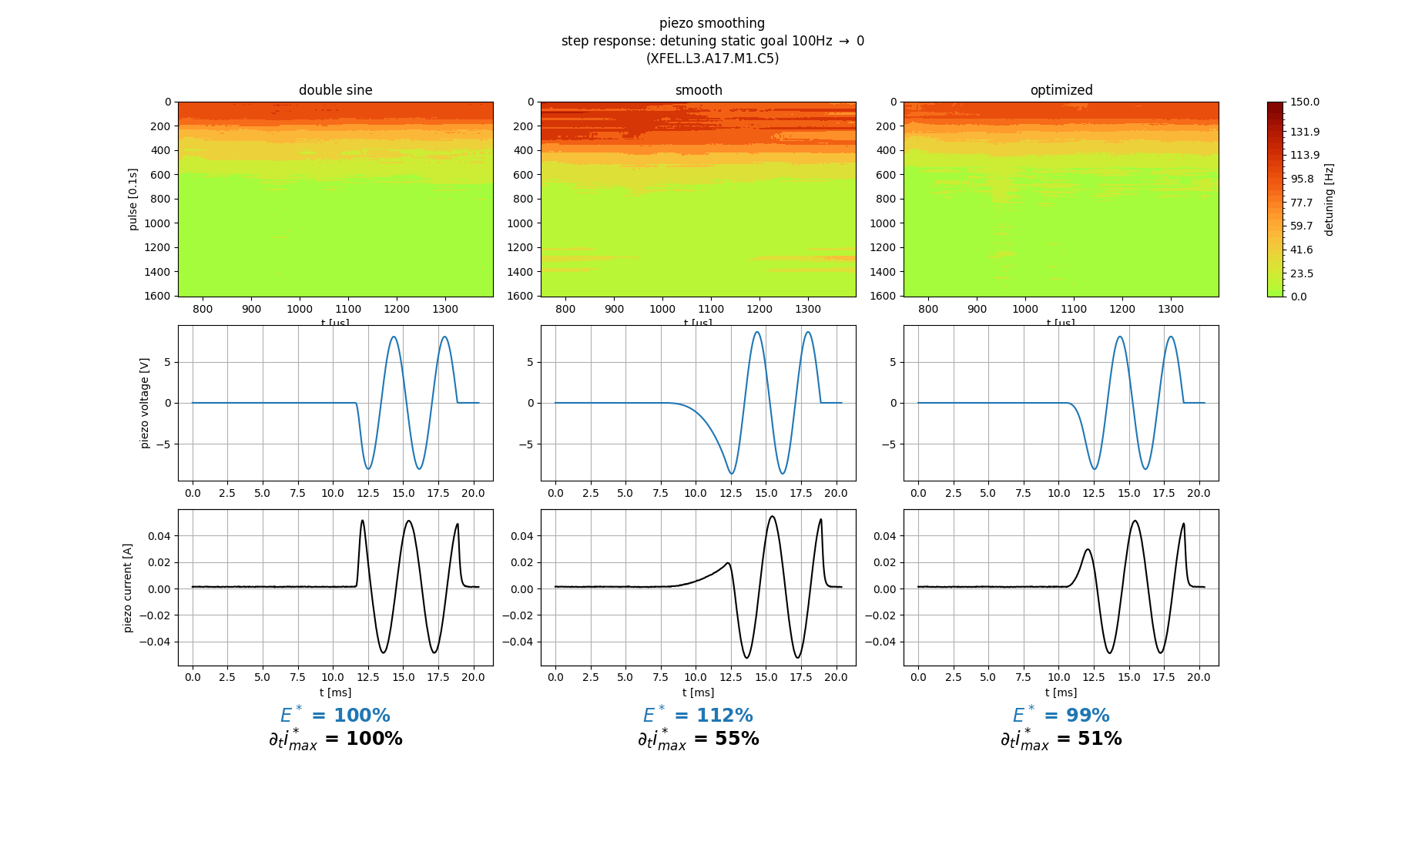
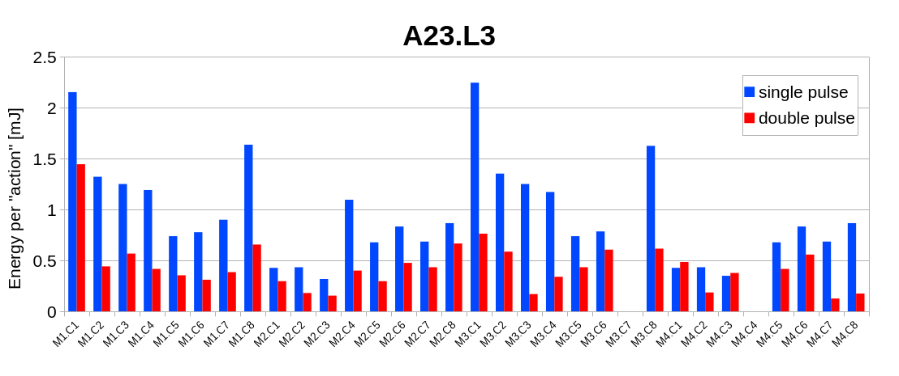
WP2 – LLRF: status/evolution of Task 2.3
Vibration analysis and detuning control of cavities – M1-M36
1. Using ‘2x’ instead of ‘1x’ sine
2. Smoothing the rising edge
Achievements for Task 2.3
  Detuning measurements
    Microphonics measurements and analysis
    Exploring new techniques to estimate or learn detuning for RF cavities
      Luenberger observer-based
      KIND : Kalman filter-based
      Wavelets-based
      XFEL gun observer-based
  Detuning control
    Improved piezo stimulus to
    achieve Lorentz Force Detuning
    (LFD) compensation in a more
    sustainable way
PRAB publication (2026)
IFAC publication (2026)
IPAC publication (2026)
IPAC publication (2026)
Ex. A23 at EuXFEL
IPAC publication (2025)
On average half the energy deposited in piezo (= longer life time)

Slide 17
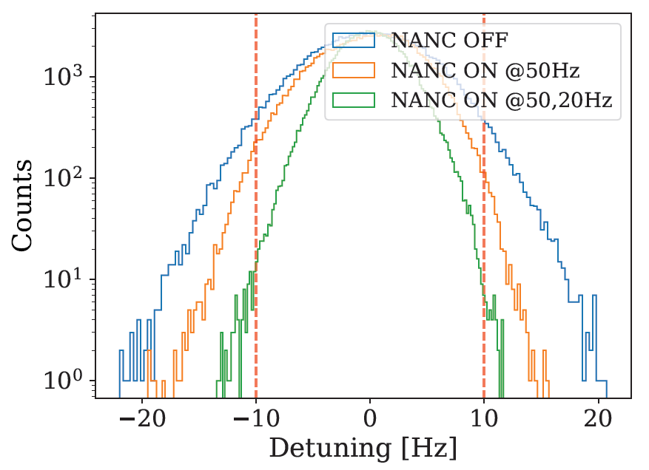
WP2 – LLRF: status/evolution of Task 2.3
Vibration analysis and detuning control of cavities – M1-M36
Achievements for Task 2.3
  Detuning measurements
    Microphonics measurements and analysis
    Exploring new techniques to estimate or learn detuning for RF cavities
      Luenberger observer-based
      KIND : Kalman filter-based
      Wavelets-based
      XFEL gun observer-based
  Detuning control
    Improved piezo stimulus to
    achieve Lorentz Force Detuning
    (LFD) compensation in a more
    sustainable way
    Developed active noise
    cancellation techniques
    to improve resonance control
With NANC off, the cavity could operate at max 9 MV/m
With NANC ON, the cavity can be operated at 15 MV/m
(70% improvement!)
PRAB publication (2026)
IFAC publication (2026)
IPAC publication (2026)
IPAC publication (2026)
IPAC publication (2025)
Experimental demonstration in CW at LCLS-II, SLAC
IPAC publication (2026)

Slide 18
WP2: Low Level RF controls 01.06.2026
DESY, HZB, CNRS
Convener & deputy: Julien Branlard (DESY) & Christian Schmidt (DESY)
Main contacts with other partners: Axel Neumann (HZB), Christophe Joly (CNRS)
Task 2.1: Coordination of R&D on LLRF – M1-M48
Task 2.2: Efficient field control for high loaded-quality factor cavities – M1-M48
Task 2.3: Vibration analysis and detuning control of cavities – M1-M36
Task 2.4: Integrated LLRF control using Ferro-Electric Fast Reactive Tuners – M13-M48
Task 2.5: Energy efficient supervision and fault diagnosis – M1-M48

Slide 19
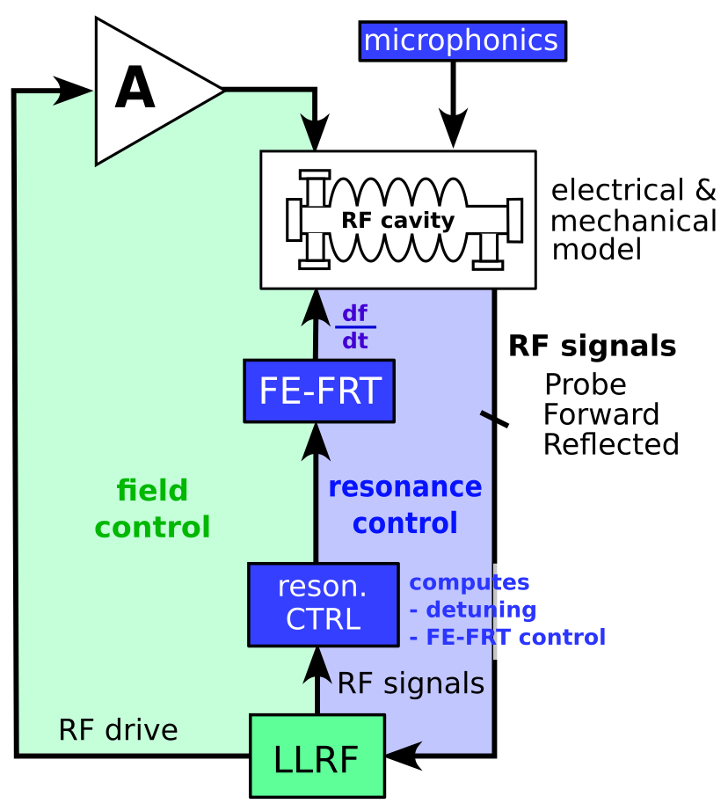
WP2 – LLRF: status/evolution of Task 2.4
Integrated LLRF control using Ferro-Electric Fast Reactive Tuners– M13-M48
Achievements for Task 2.3
  Goal is to integrate a ferro-electric fast reactive tuner (FE-FRT) with a digital LLRF system
    Hardware development 2026/27 within WP1
    Measure FE-FRT voltage response and temperature dependence
    Evaluation of existing MTCA hardware as potential FE-FRT driver
  Development of Matlab/Simulink model of RF control loop to simulate resonance control
    Using FE-FRT voltage response, include it in LLRF control simulation environment
    Set back : joint-PhD program on this topic stopped
    Work taken over by colleagues from IJCLab and LPSC
  RF and resonance control using FE-FRT
    High-voltage amplifier transfer function measurement using capacitive load (to emulate FE-FRT)
    Controller development on RF SoC on going, HZB
    First measurements at HoBicat, HZB
Roadmap toward 2027 milestone
Synergy with WP1

Slide 20
WP2: Low Level RF controls 01.06.2026
DESY, HZB, CNRS
Convener & deputy: Julien Branlard (DESY) & Christian Schmidt (DESY)
Main contacts with other partners: Axel Neumann (HZB), Christophe Joly (CNRS)
Task 2.1: Coordination of R&D on LLRF – M1-M48
Task 2.2: Efficient field control for high loaded-quality factor cavities – M1-M48
Task 2.3: Vibration analysis and detuning control of cavities – M1-M36
Task 2.4: Integrated LLRF control using Ferro-Electric Fast Reactive Tuners – M13-M48
Task 2.5: Energy efficient supervision and fault diagnosis – M1-M48

Slide 21
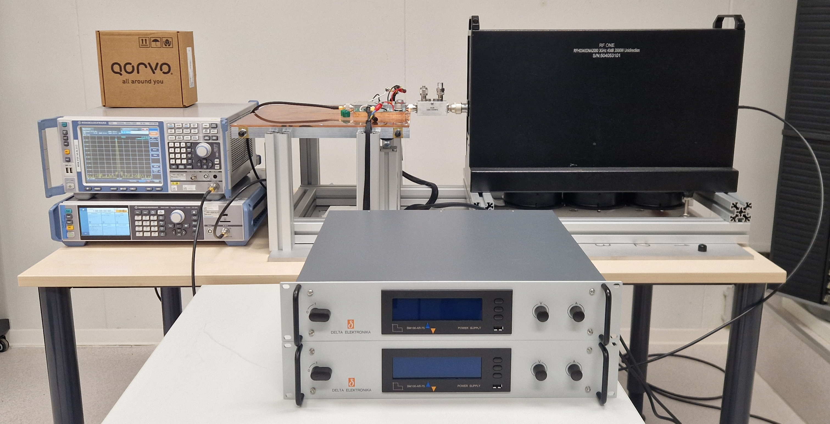
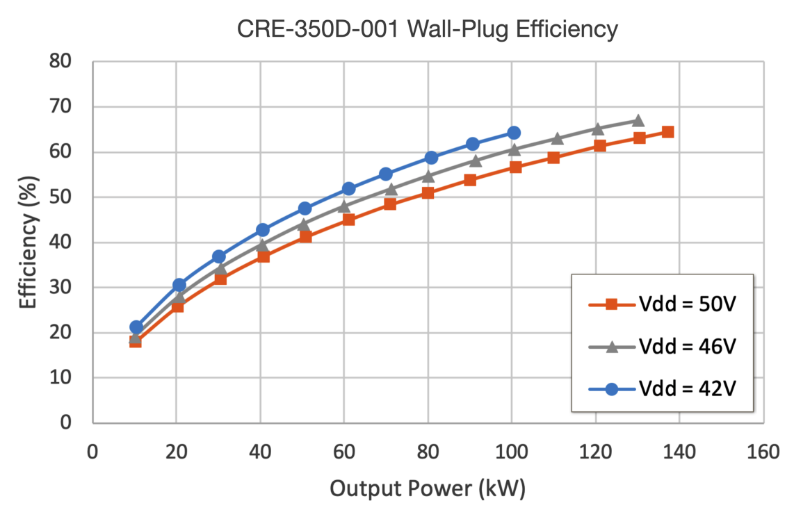
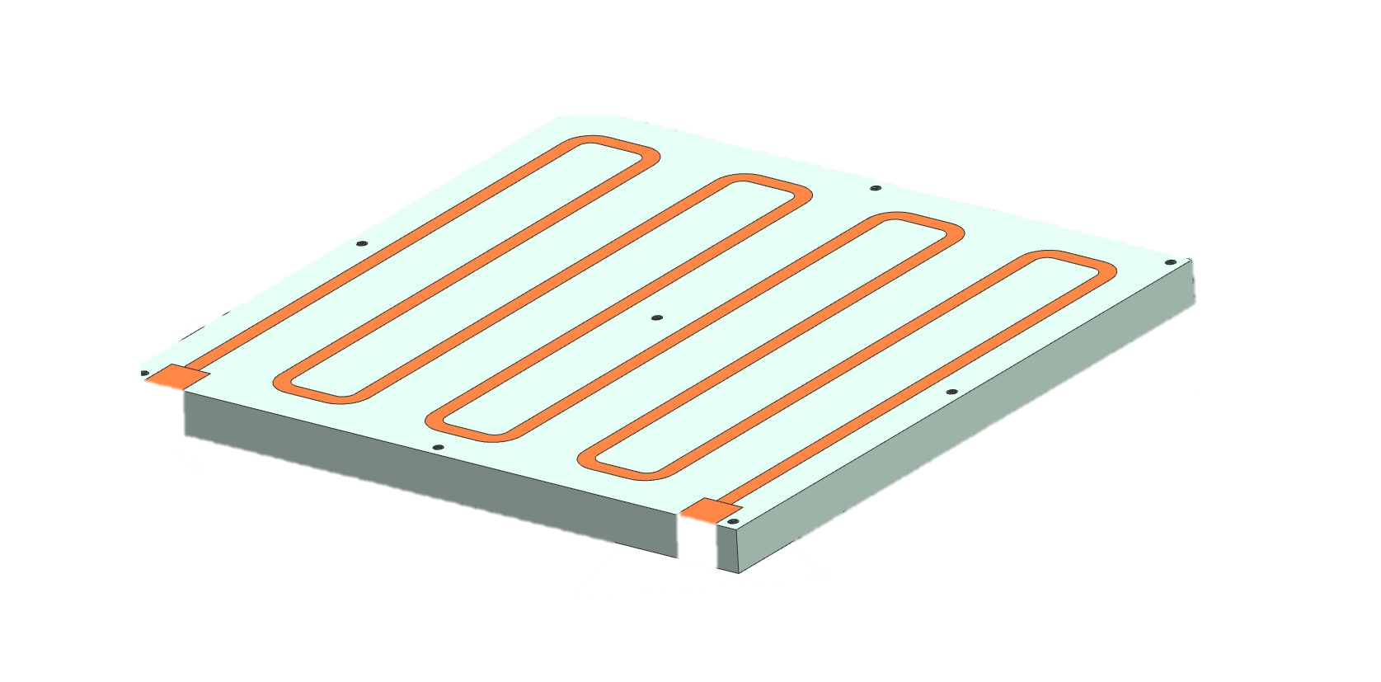
WP2 – LLRF: status/evolution of Task 2.5
Energy efficient supervisory control and fault diagnosis– M1-M48
Achievements for Task 2.5
  Development of SSPA test stand to investigate efficient operation depending on working point
Courtesy H. Pryschelski
1kW GaN
amplifier
high-power
bi-directional
coupler
Preparation of a SSA test stand
GaN 1 kW prototype
Cooling / load / power supply
Experiment with pulsed/CW operation
Understand efficiency optimization with drain voltage adjustments
2 kW load
1.3 GHz
source and instrumentation
drain voltage (Vdd) adjustments
Example
GaN technology
1.3 GHz
130 kW SSA
water-cooled plate
high-performance power supplies
Reference: “High-efficiency industrial 130 KW CW solid-state RF amplifier for 1.3 GHz”, M. Nedos, N. Pupeter et al. in proc. IPAC 2023

Slide 22
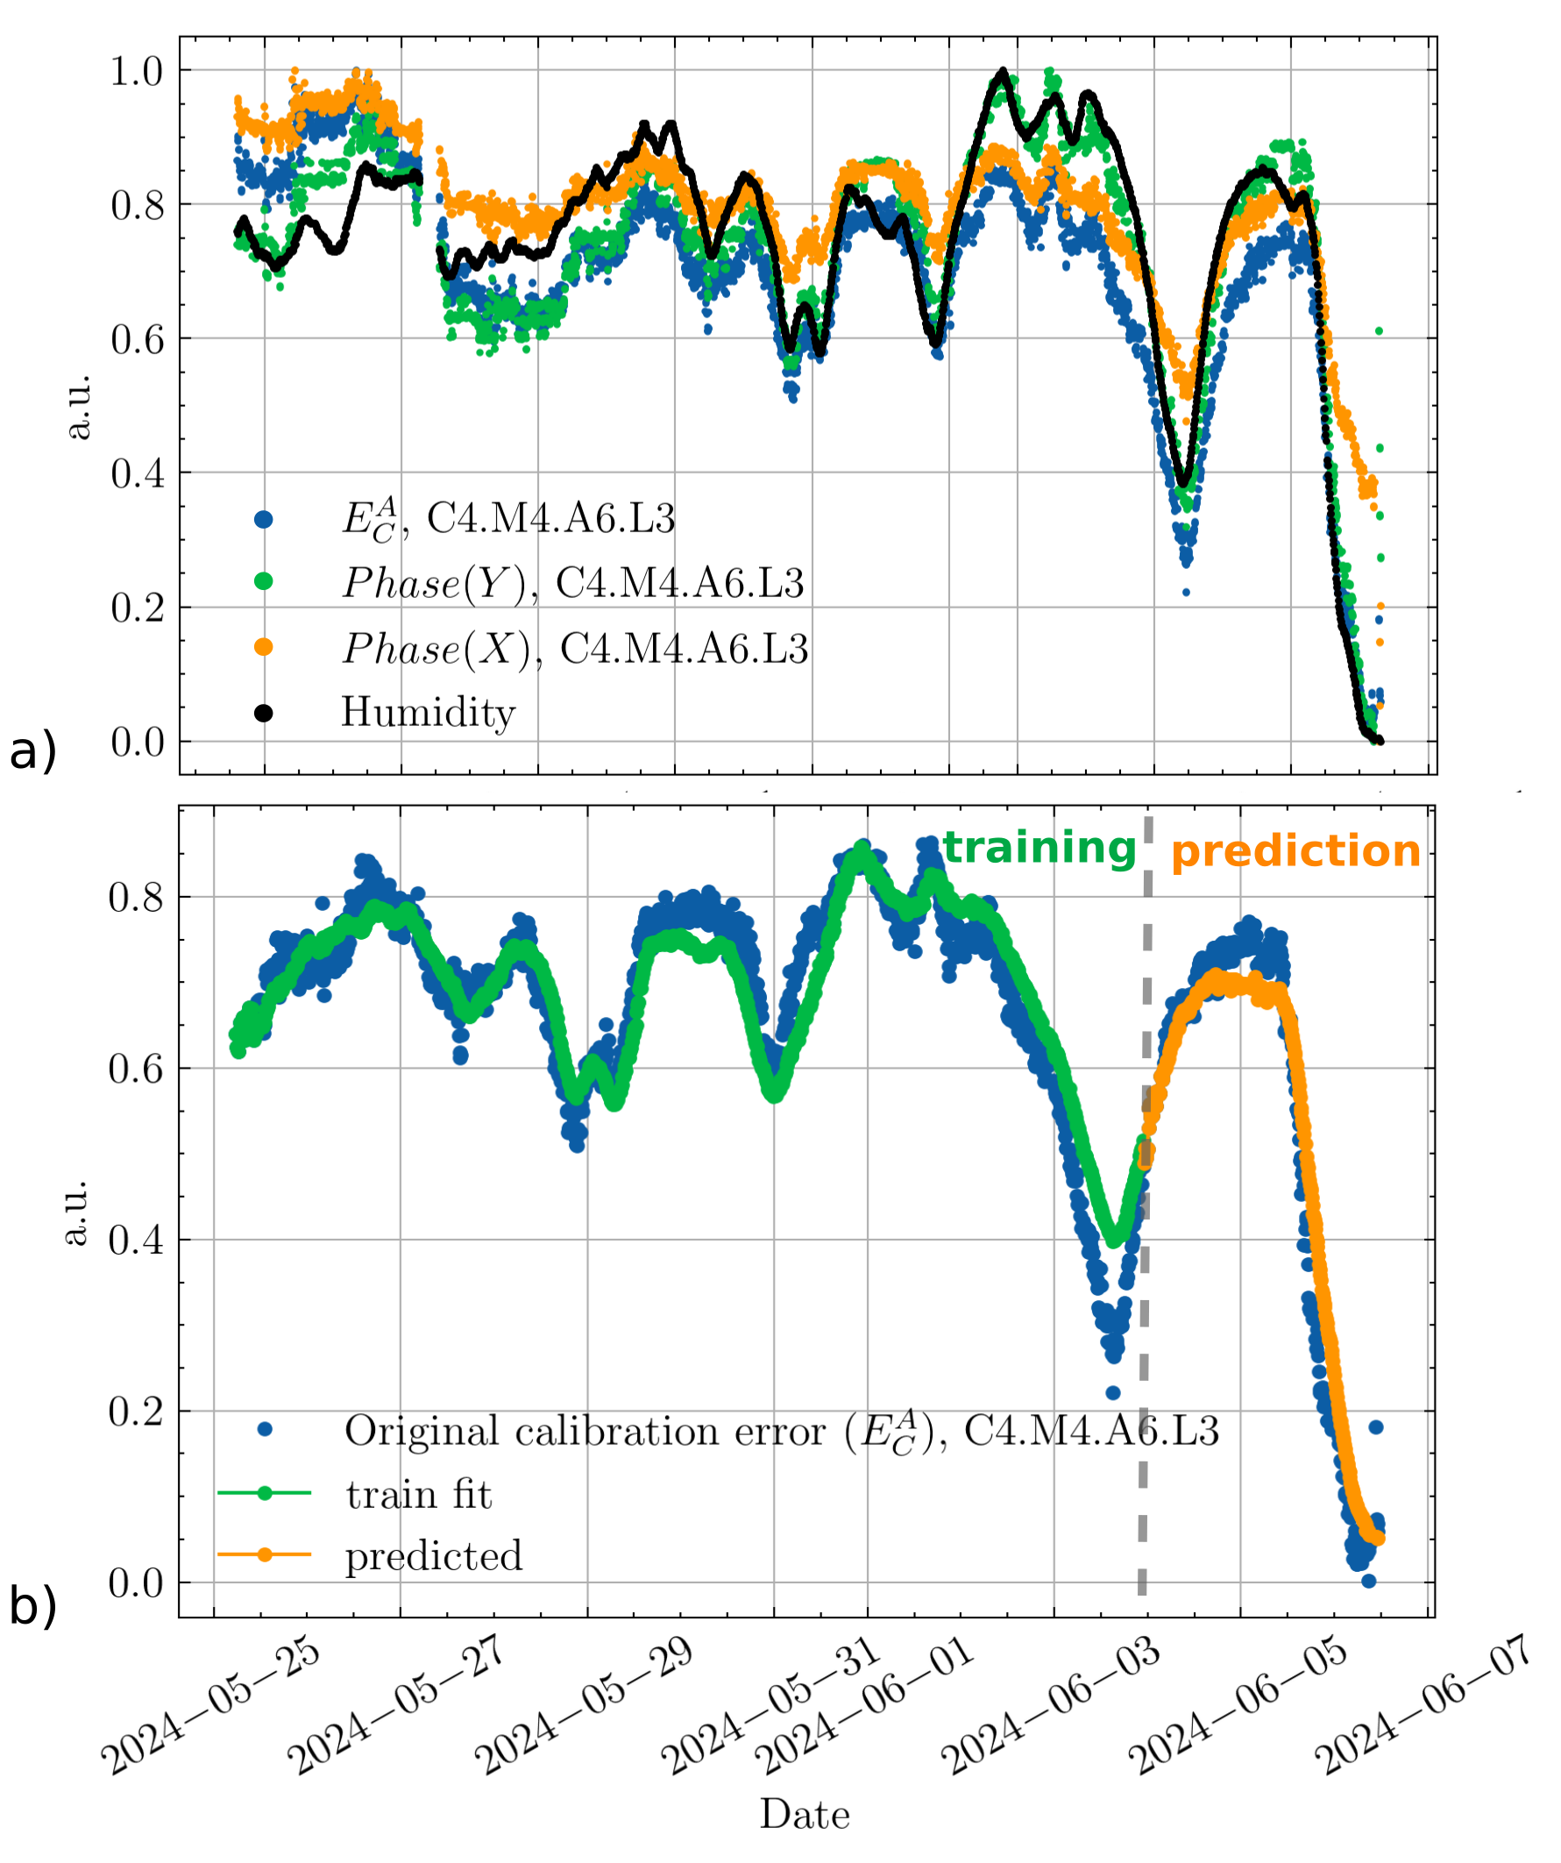
WP2 – LLRF: status/evolution of Task 2.5
Energy efficient supervisory control and fault diagnosis– M1-M48
Achievements for Task 2.5
  AI-based diagnostic for LLRF (presented at IPAC last year, full article submitted for peer-review)
  a) Strong correlation between RF waveform calibration coefficients and relative humidity
  b) Using weather forecast, a trained model can predict 2 days in advance the calibration error!
First results presented at IPAC 2025, full article submitted for peer-review

Slide 23
WP2 – LLRF: Next steps
Milestones & Deliverables
D35
ML implementation plan
D5 Report uphonics study and
ML-based mitigation
D6
Report on
LLRF/SSA interface study
D7 Report on RF control studies
D9 Report on RF control studies
D8 Report on RF control studies
2024
2025
2026
2027
2028
Dx Deliverables
M40 Impact analysis WP2
M6 Energy-efficient SSA oper.
M7 Detuning control techni
-ques
M8 Field control for high Qext cavs.
M9 demo
ML and anomaly detect.
M10 demo
uphonic FE-FRT
Compensa-tion
Mx Milestones
Accounted for

Slide 24
WP2 – LLRF: iSAS publications
List of iSAS publications to date
IPAC2025
[1] M. Grecki et al., “Optimization of Piezo Operation for superconducting TESLA cavities at EuXFEL”, in Proc. IPAC'25, Taipei, Taiwan, Jun. 2025, pp. 3051-3053.
doi:10.18429/JACoW-IPAC2025-THPS040
[2] Y. Sun et al., “Machine learning for calibration drift forecasting in superconducting RF cavities”, in Proc. IPAC'25, Taipei, Taiwan, Jun. 2025, pp. 3230-3233.
doi:10.18429/JACoW-IPAC2025-THPS135
[3] A. Eichler et al., “Enhancing quench detection in SRF cavities at the EuXFEL: Towards machine learning approaches and practical challenges”, in Proc. IPAC'25, Taipei,
Taiwan, Jun. 2025, pp. 3226-3229. doi:10.18429/JACoW-IPAC2025-THPS134
Physical Review Accelerator and Beams
[4] B. Richter et al., “Estimation of superconducting cavity bandwidth and detuning using a Luenberger observer”, Phys. Rev. Accel. Beams, 2026, Feb, American Physical
Society, doi:10.1103/48zw-grdp, url = https://link.aps.org/doi/10.1103/48zw-grdp
IPAC2026
[5] M. Herrmann et al., “Detuning Estimation for a doubly-fed Normal Conducting Gun", presented at the IPAC'26, Deauville, France, May 2026, paper WEP6148
[6] B. Richter et al., “Narrowband Active Noise Control for Continuous for Continuous Wave Operation of Tesla Cavities", presented at the IPAC'26, Deauville, France, May 2026,
paper 6149
[7] J. S. Romero Jiménez, et al. “SRF cavity detuning characterization by continuous wavelet transform: a time-frequency analysis”, presented at the IPAC'26, Deauville,
France, May 2026, paper 7036
IFAC2026
[8] A. Maalberg et al., “KIND: a Kalman-inspired adaptive estimator for SRF cavity detuning", presented at IFAC'26, Busan, Republic of S. Korea, Aug. 2026

Slide 25
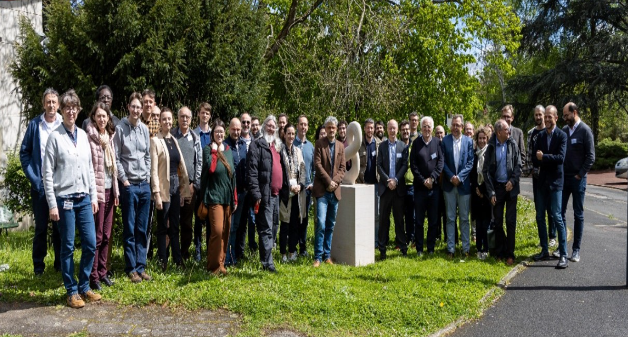
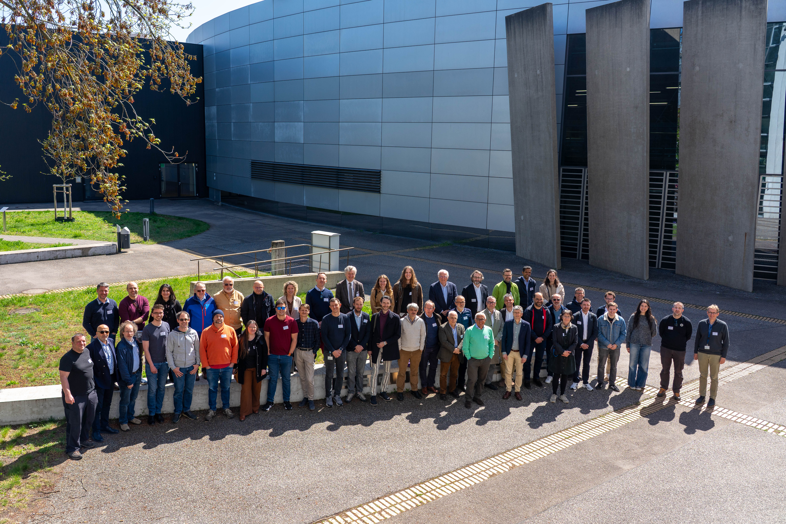
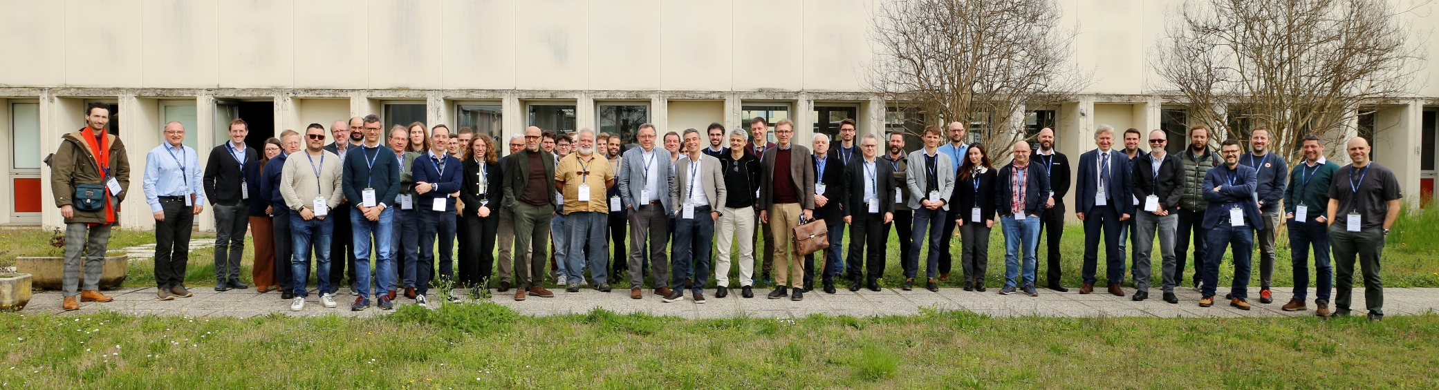
Thank you for your attention !
Orsay 2024
Berlin 2026
iSAS annual meetings
Padova 2025

Slide 26
BACKUP

Slide 27
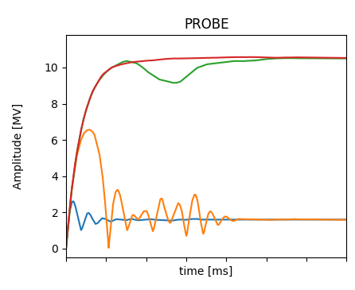
WP2 – LLRF: status/evolution of Task 2.2
Efficient field control for high loaded-quality factor cavities – M1-M48
Current developments
Adaptive resonance filling
  Cavities with narrow bandwidth experience during field ramp-up a detuning induced by Lorentz forces equivalent to tens of bandwidths (i.e. several 100 Hz compared to BW ≈ 20 Hz)
  The frequency of the RF must be modulated to always drive the cavity on resonance during the fill time (in pulsed mode): so called “resonance filling”
  Use iterative learning techniques to learn this frequency modulation in a robust and reproducible way
4
3
Consecutive “learning” pulses
2
1
Demonstrated at DESY’s cryomodule test stand (paper in preparation)
Courtesy : Bozo Richter

Slide 28
Optimizing Lorentz force detuning at EuXFEL
Use double instead of single sine
2. Using a double sine excitation
  doubles the stimulus time → ×2 energy
  requires half of the amplitude → ÷ 4 energy
= net energy saving factor of 2
Courtesy Mariusz Grecki

Slide 29
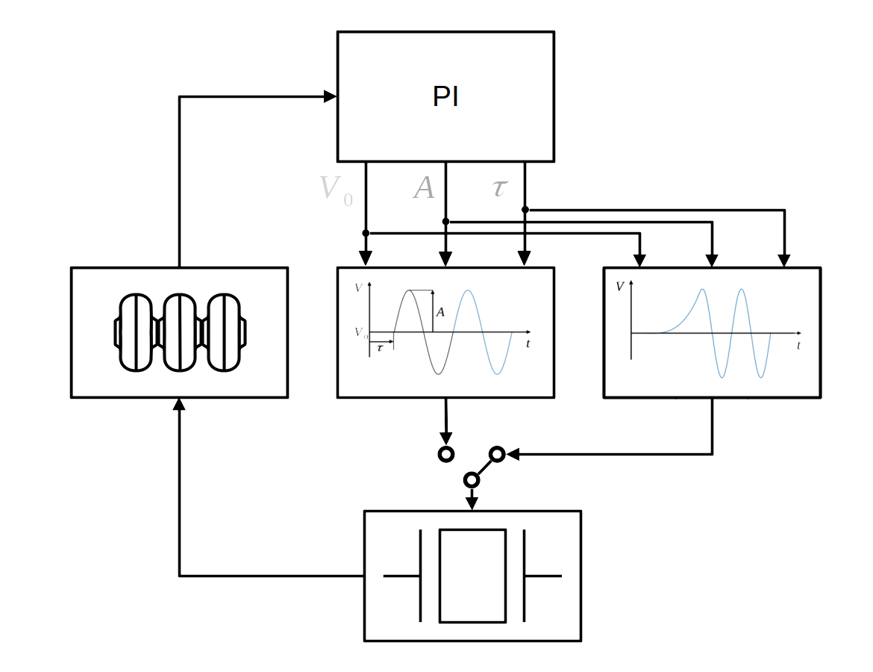
Optimizing Lorentz force detuning at EuXFEL
Minimizing the in-rush current reduction
Smoothing the leading edge of a double sine piezo pulse to reduce the in-rush current
  reduces energy
  Increase piezo life time
Courtesy Max Herrmann

Slide 30
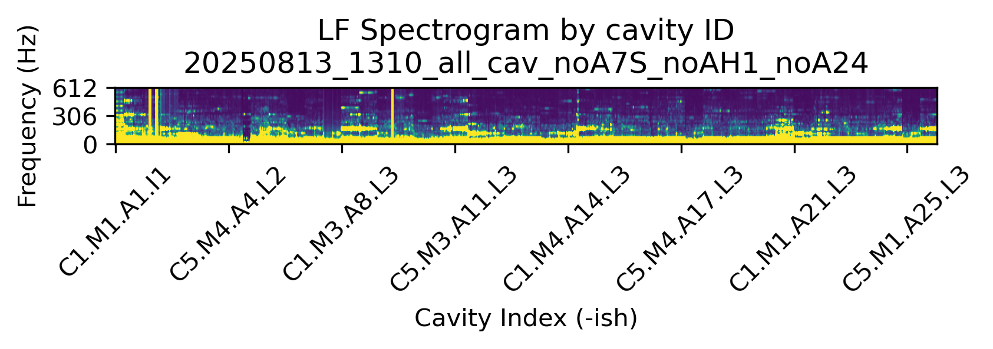
WP2 – LLRF: status/evolution of Task 2.3
Vibration analysis and detuning control of cavities – M1-M36
Current developments
  Assessment of microphonics level at XFEL
  Microphonics measured without RF, using installed piezos during last year summer shutdown
  Identified vibration source at cryostring junction (propagating up-/down-stream) coming from flow sensor
2025-08-13 XFEL w.o. AH1, A7S, A24
CS# = CryoString#
612
A# Accelerating RF station (4 cryomod. = 32 cav.)
306
Frequency (Hz)
0
CS1
CS2
CS3
CS4
CS5
CS6
CS7
CS8
CS9
A1
A2
A3 – A4 – A5
A6 – A7 – A8
A9 – A10 – A11
A12 – A13 – A14
A15 – A16 – A17
A18 – A19 – A20
A21 – A22 – A23
A24 – A25
0
200m
400m
620m
760m
910m
1060m
1200m
1350m
tunnel
Courtesy Josh Einstein-Curtis

Slide 31
WP2 – LLRF: status/evolution of Task 2.3
Vibration analysis and detuning control of cavities – M1-M36
Current developments
  Assessment of microphonics level at XFEL
  Microphonics measured without RF, using installed piezos during last year summer shutdown
  Identified vibration source at cryostring junction (propagating up-/down-stream) coming from flow sensor
  No direct impact on current operation of the EuXFEL but valuable information for the upgrade.
Flow sensor ON
Flow sensor OFF
Coriolis flow sensor
Courtesy Josh Einstein-Curtis

Slide 32
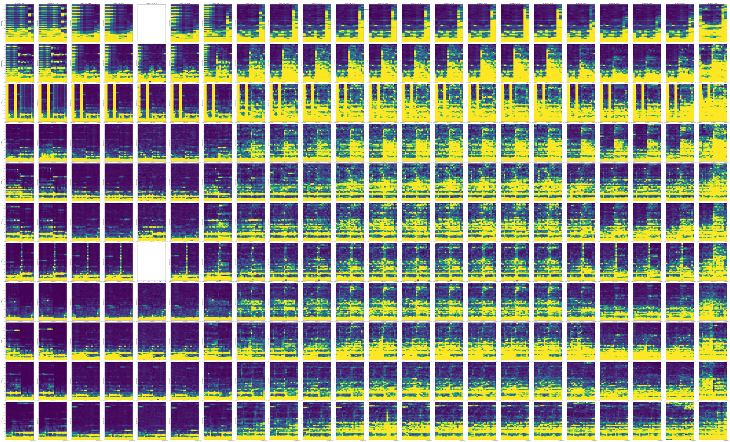
time
Along
tunnel

Slide 33
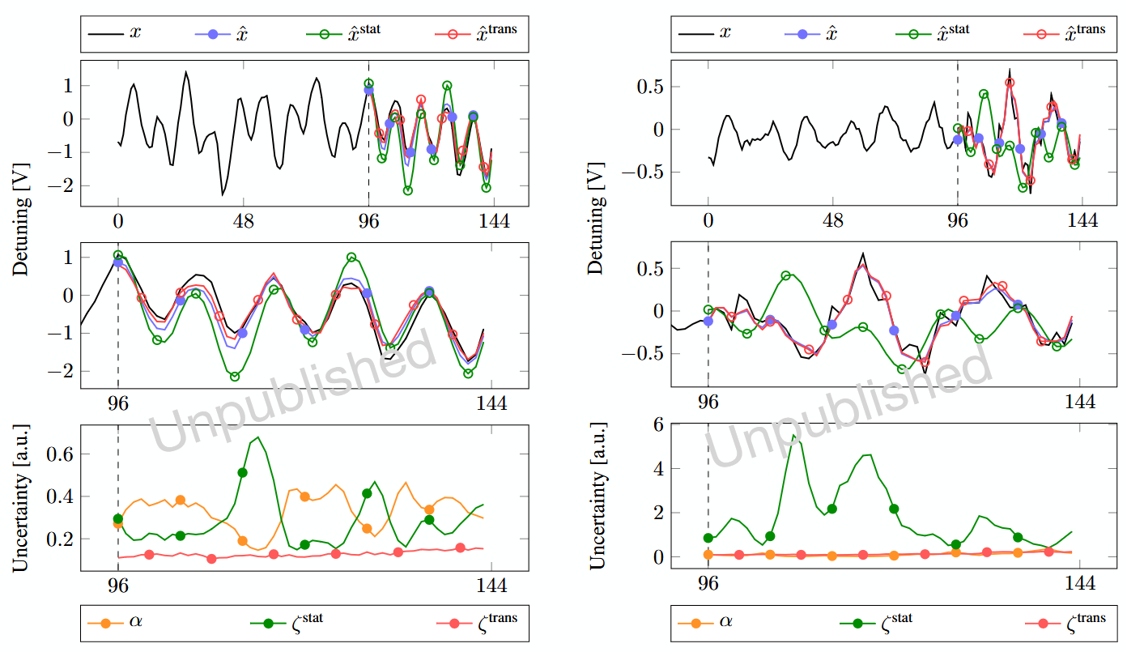
WP2 – LLRF: status/evolution of Task 2.3
Vibration analysis and detuning control of cavities – M1-M36
Current developments
Exploration of AI-based methods for RF detuning compensation
1. AI-based detuning compensation
  Designed a hybrid dynamical model architecture
“KIND: a Kalman-inspired adaptive estimator for SRF cavity detuning” , accepted
  Proved stability under recursive model rollout
“Stable multi-step rollouts via uncertainty guided hybrid dynamics”, under review
To be presented (+ proceeding) at IFAC 2026
Figure: Rollout behavior of a KIND model on measured SRF gun cavity data.
On nominal data: hybrid model parts - stationary and transient - track the ground truth.
On transient data: compared to transient model part, nominal part misses the right dynamics.
In both cases hybrid parts are correctly blended to produce the final prediction.
a)
b)
Courtesy A. Maalberg

Slide 34
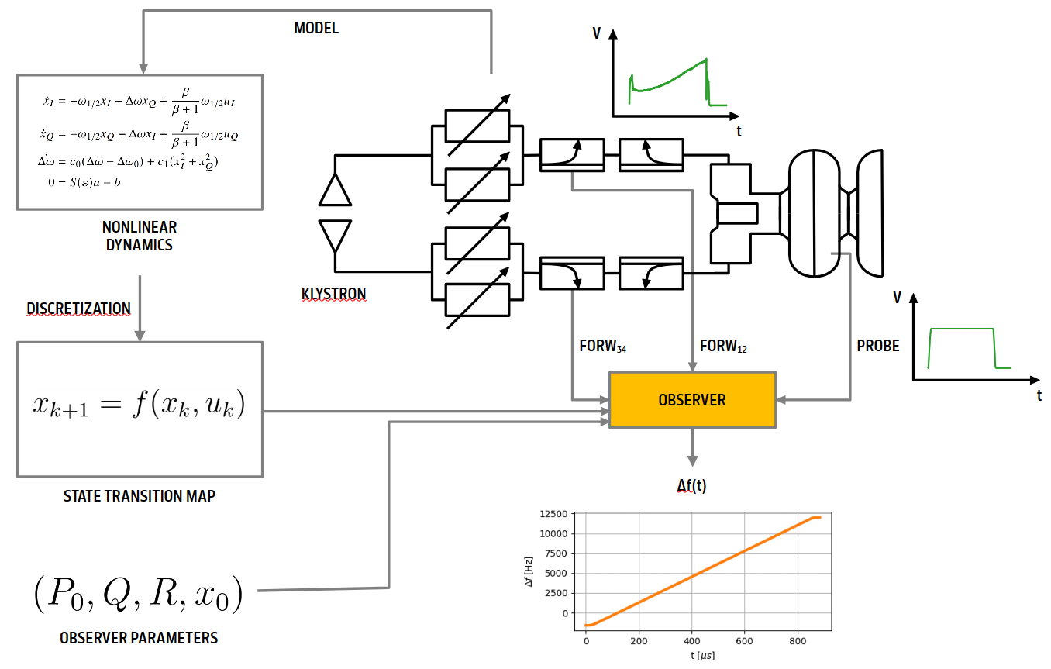
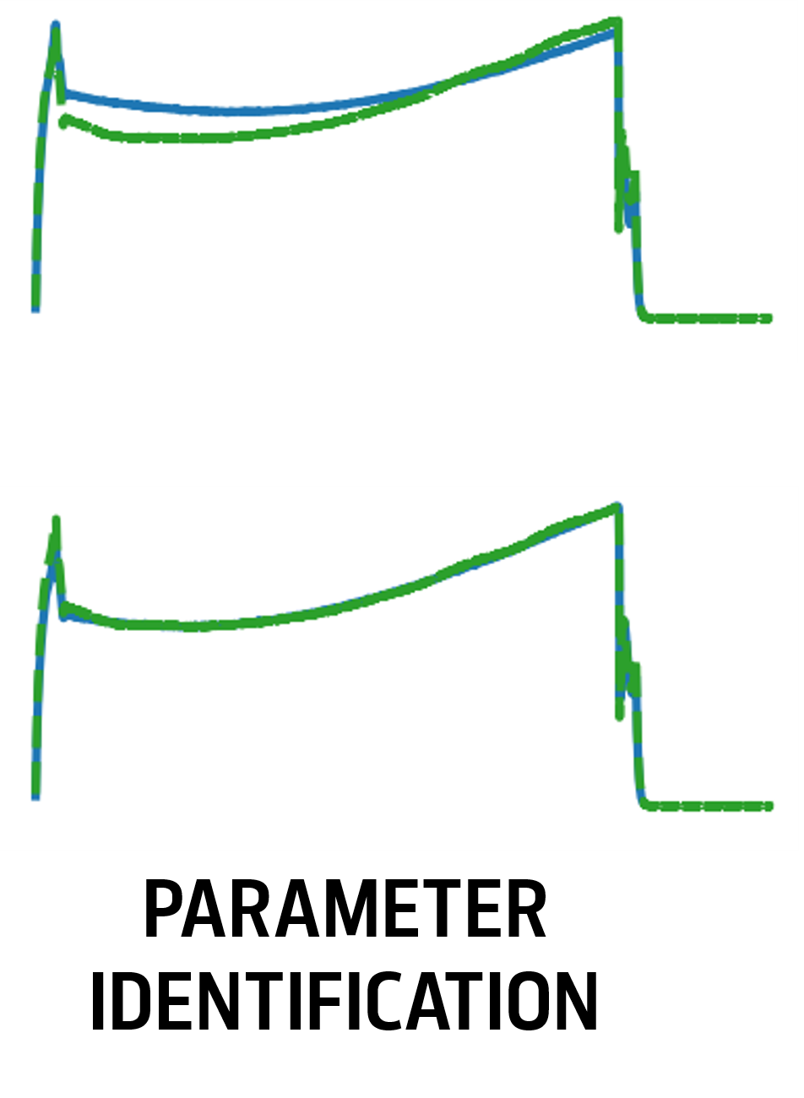
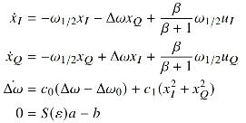

WP2 – LLRF: status/evolution of Task 2.3
Vibration analysis and detuning control of cavities – M1-M36
Current developments
Exploration of observer-based methods for RF detuning computation, at the EuXFEL NRF gun
  One challenge comes from the double input coupler architecture of the NRF gun
  After parameter identification, a model-based observer provides online detuning estimation
2. observer-based detuning estimation
Courtesy M. Herrmann
1
NORMAL CONDUCTING GUN
arm1
2
arm2
3
bi-direction couplers
DISCRETIZATION
KLYSTRON
4
phase shifters
Δf(t)
To be presented (+ proceeding) at IPAC 2026

Slide 35
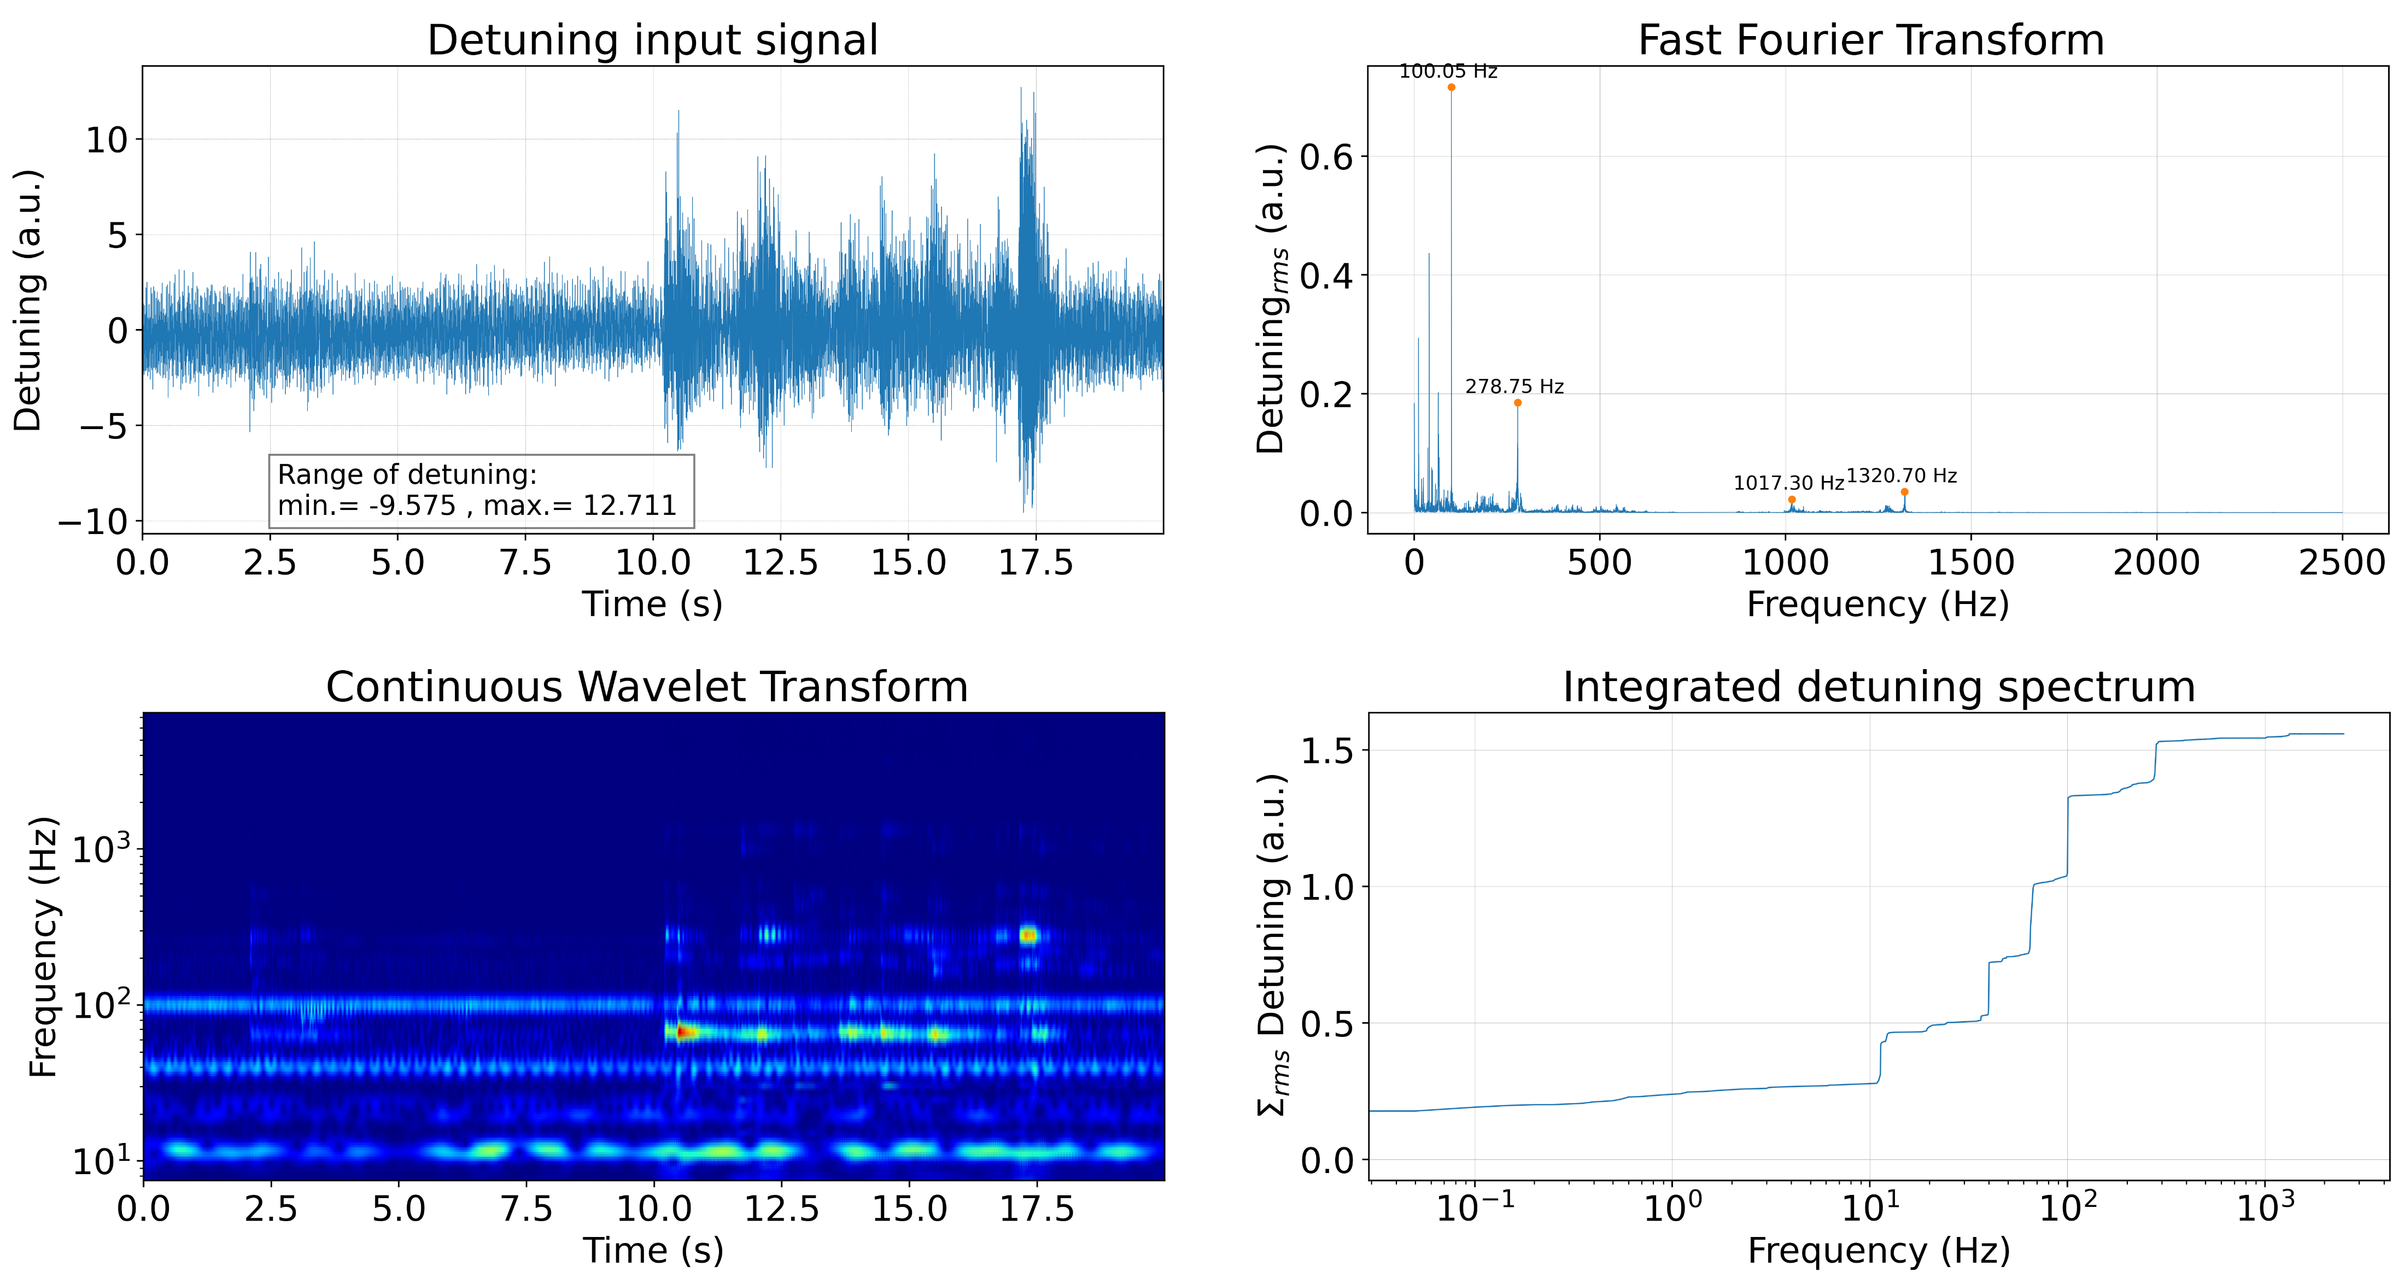
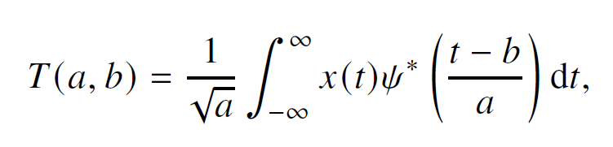
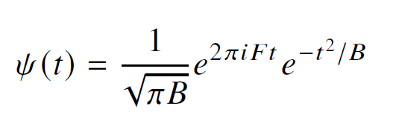
WP2 – LLRF: status/evolution of Task 2.3
Vibration analysis and detuning control of cavities – M1-M36
Current developments
Exploration of wavelets for RF detuning computation, at SeaLAB, HZB
  Classical Fourier analysis provides a global description that does not retain temporal information.
  Short-time Fourier transform (STFT) introduce time localization by applying the transform over sliding windows, but uses a fixed window length, leading to a trade-off between time and frequency resolution that remains constant across all frequencies.
  Benefit of continuous wavelet transform (CWT): provides a time-frequency representation with adaptive resolution.
3. wavelets-based detuning estimation
Microphonics measured at SEALab‘s photoinjector
Morlet wavelet offers a well-defined central frequency and is particularly suitable for analyzing oscillatory signals
Courtesy P. Echevarria
To be presented (+ proceeding) at IPAC 2026

Slide 36
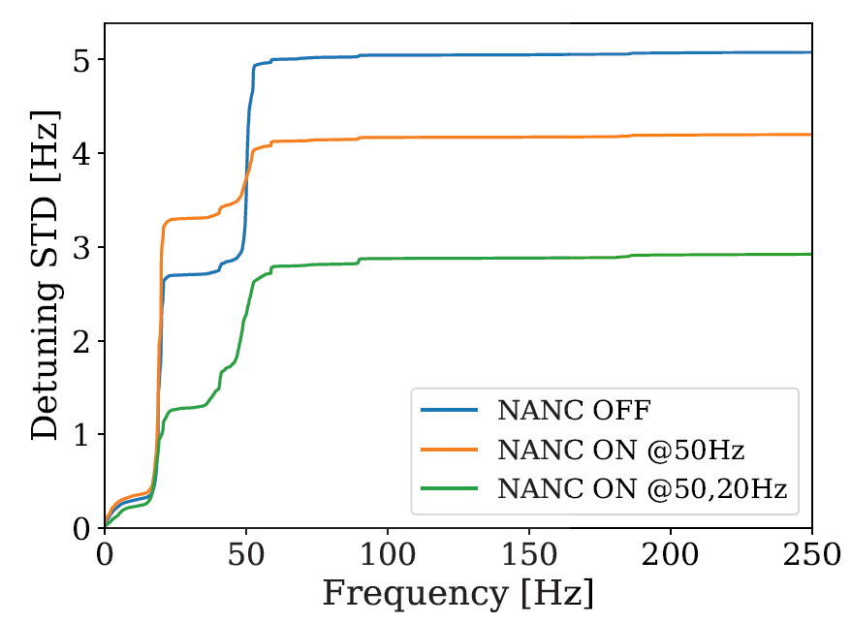
WP2 – LLRF: status/evolution of Task 2.3
2026 milestone M33
Vibration analysis and detuning control of cavities – M1-M36
Current developments
Microphonics suppression to allow higher gradient operation
  Developed a Narrow Bandwidth Active Noise Cancellation (NANC) algorithm and demonstrated at SLAC (LCLS-II)
  With NANC off, the cavity could operate at max 9 MV/m
  With NANC ON, the cavity can be operated at 16 MV/m (78% improvement!)
Courtesy B. Richter, J. Diaz
UNPUBLISHED
To be presented (+ proceeding) at IPAC 2026
UNPUBLISHED

Slide 37
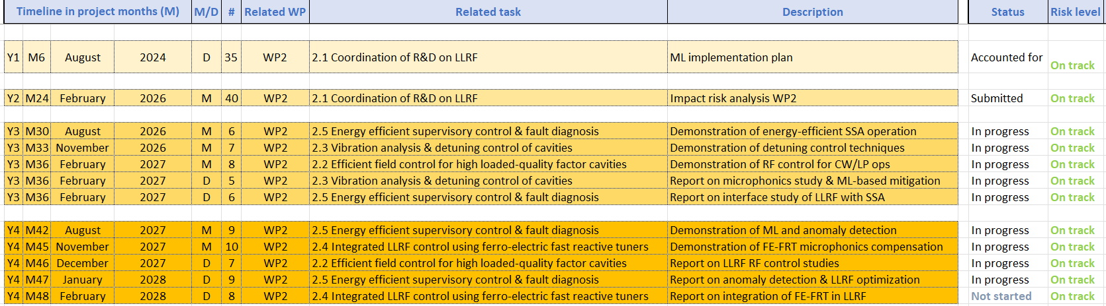
WP2 – LLRF: plans to achieve milestones & deliverables
Milestones & deliverables on track? → yes
Plans to achieve milestones & deliverables
  Delay risks to be anticipated? → some unknowns but nothing critical. Plan B as back up
  Cooperation with other WP(s) to be reactivated? → clearly potential to increase collaboration, not always easy in practice due to daily “emergency” in home institute + budget / travel restrictions
  Risk mitigation measures to be implemented? → risks were identified and mitigations strategies presented in official impact risk analysis (milestone M40 submitted in Feb. 2026)

Slide 38
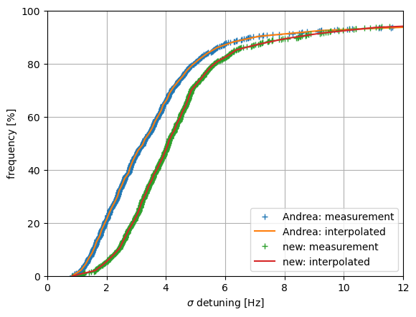
WP2 – LLRF: status/evolution of Task 2.3
Vibration analysis and detuning control of cavities – M1-M36
Past developments
  …
Current developments
  Assessment of microphonics level at XFEL
  80% of cavities are below 6 Hz (rms)
Fraction of cavities [ % ]
+ 2025 meas.
+ 2026 meas.
Detuning standard deviation [ Hz]

Slide 39
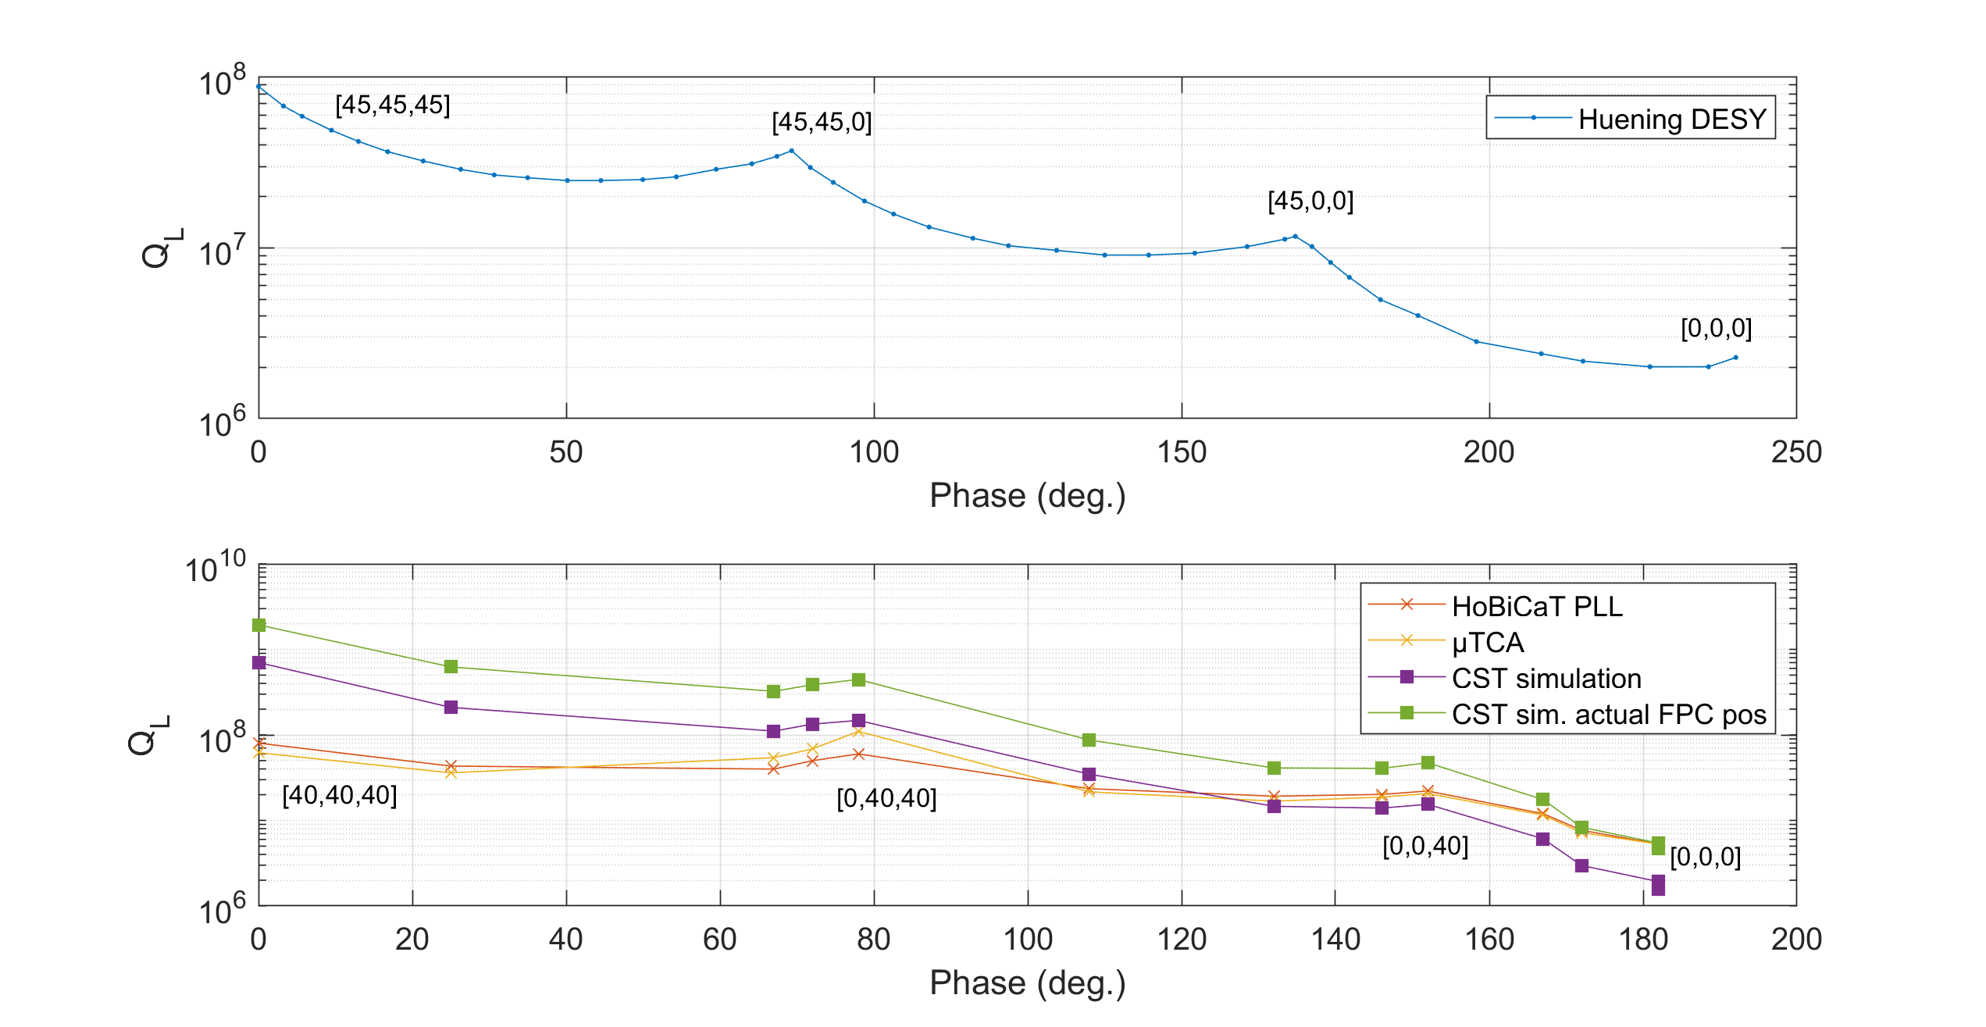
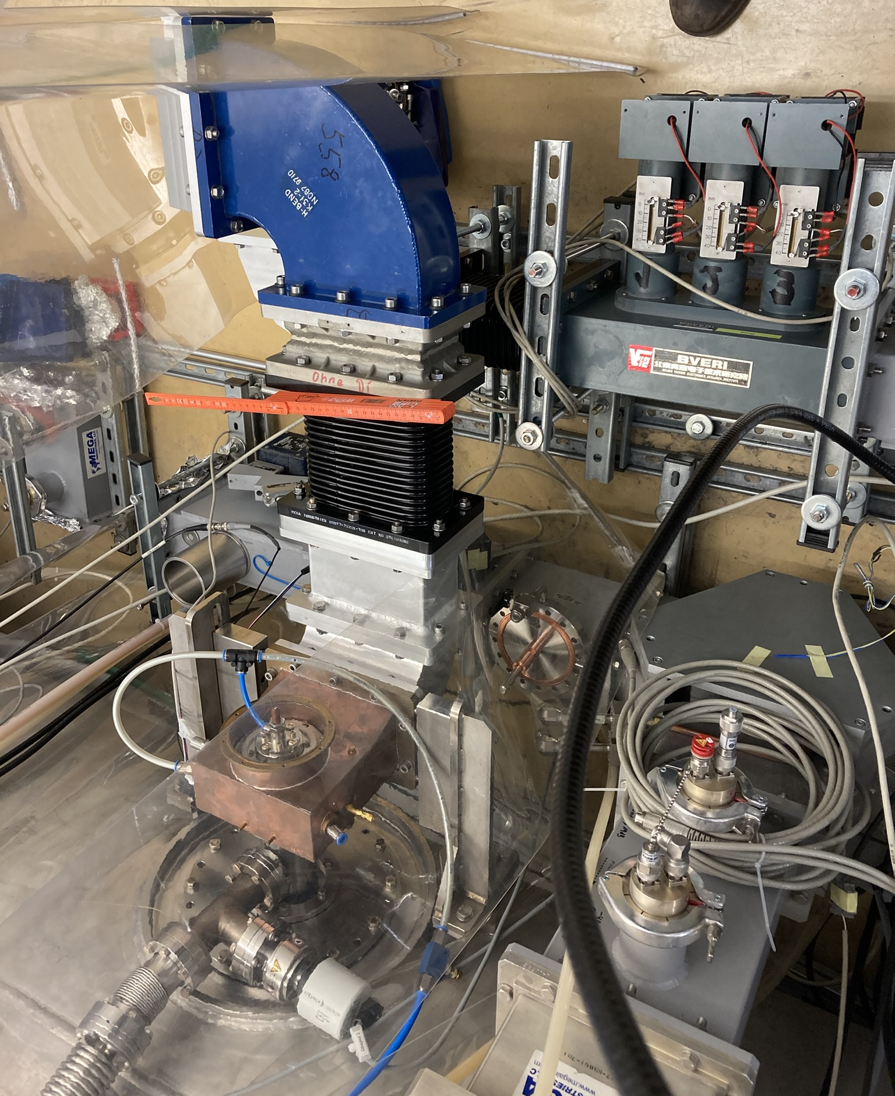
Extending the Qext range
First test with 3-stub tuner at HobiCat
(HZB) re-measured Qext change with 3-stub tuner at HobiCat (had already been done a long time ago…)
Cross checked results with CST simulations.
3-stub tuner
CST simulation
Courtesy A. Neumann

Slide 40
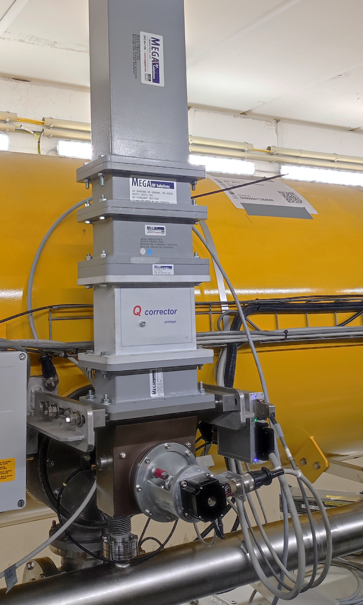
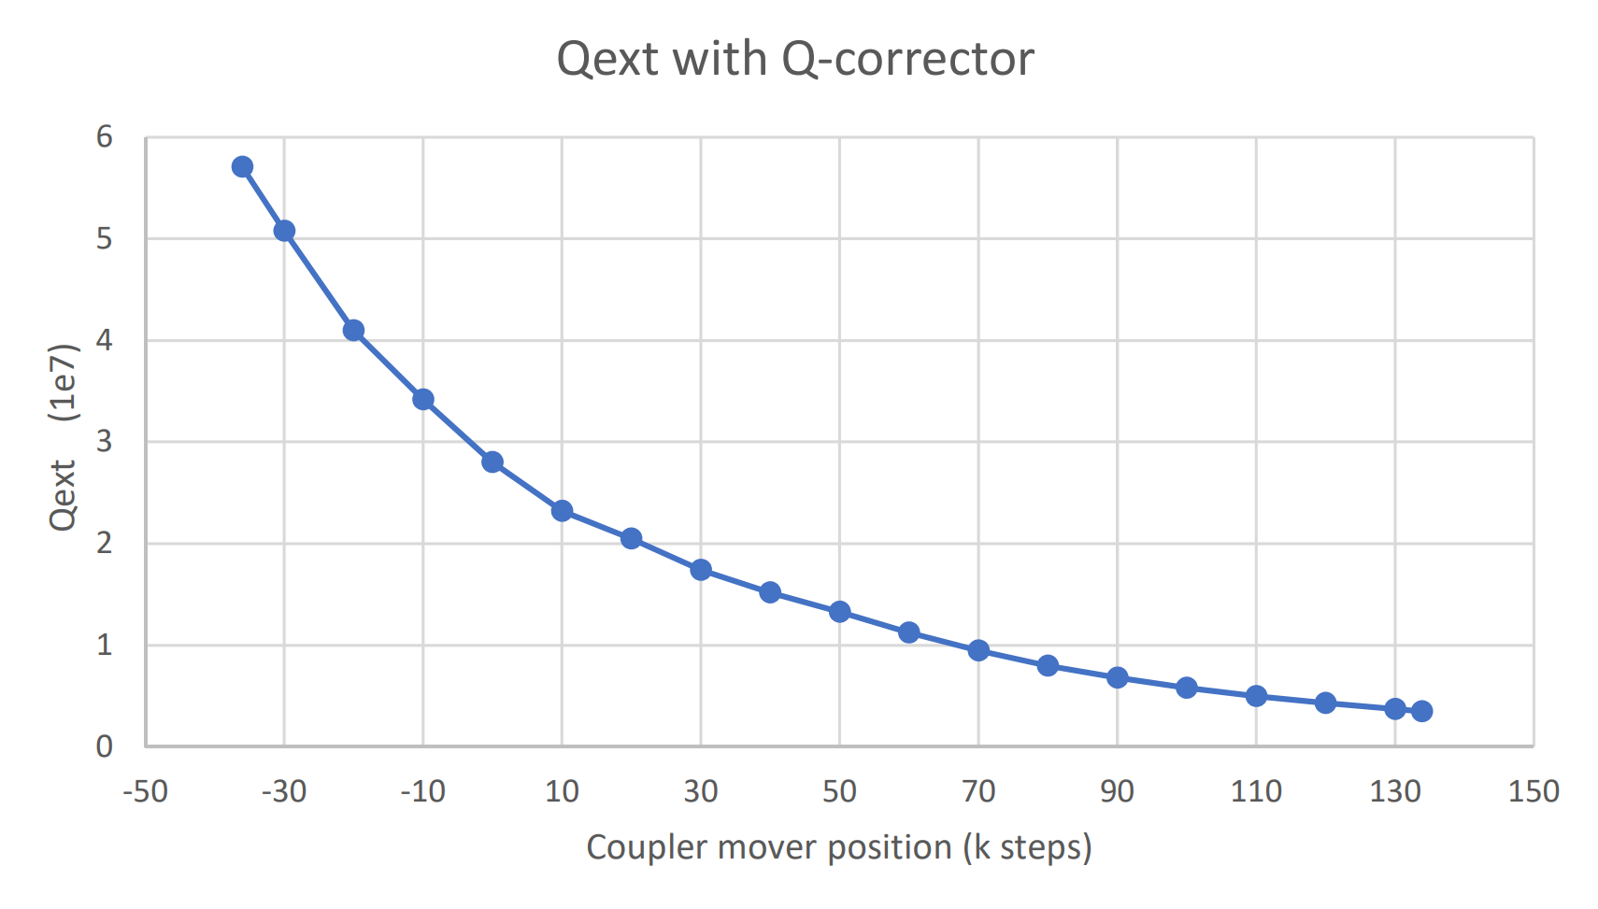
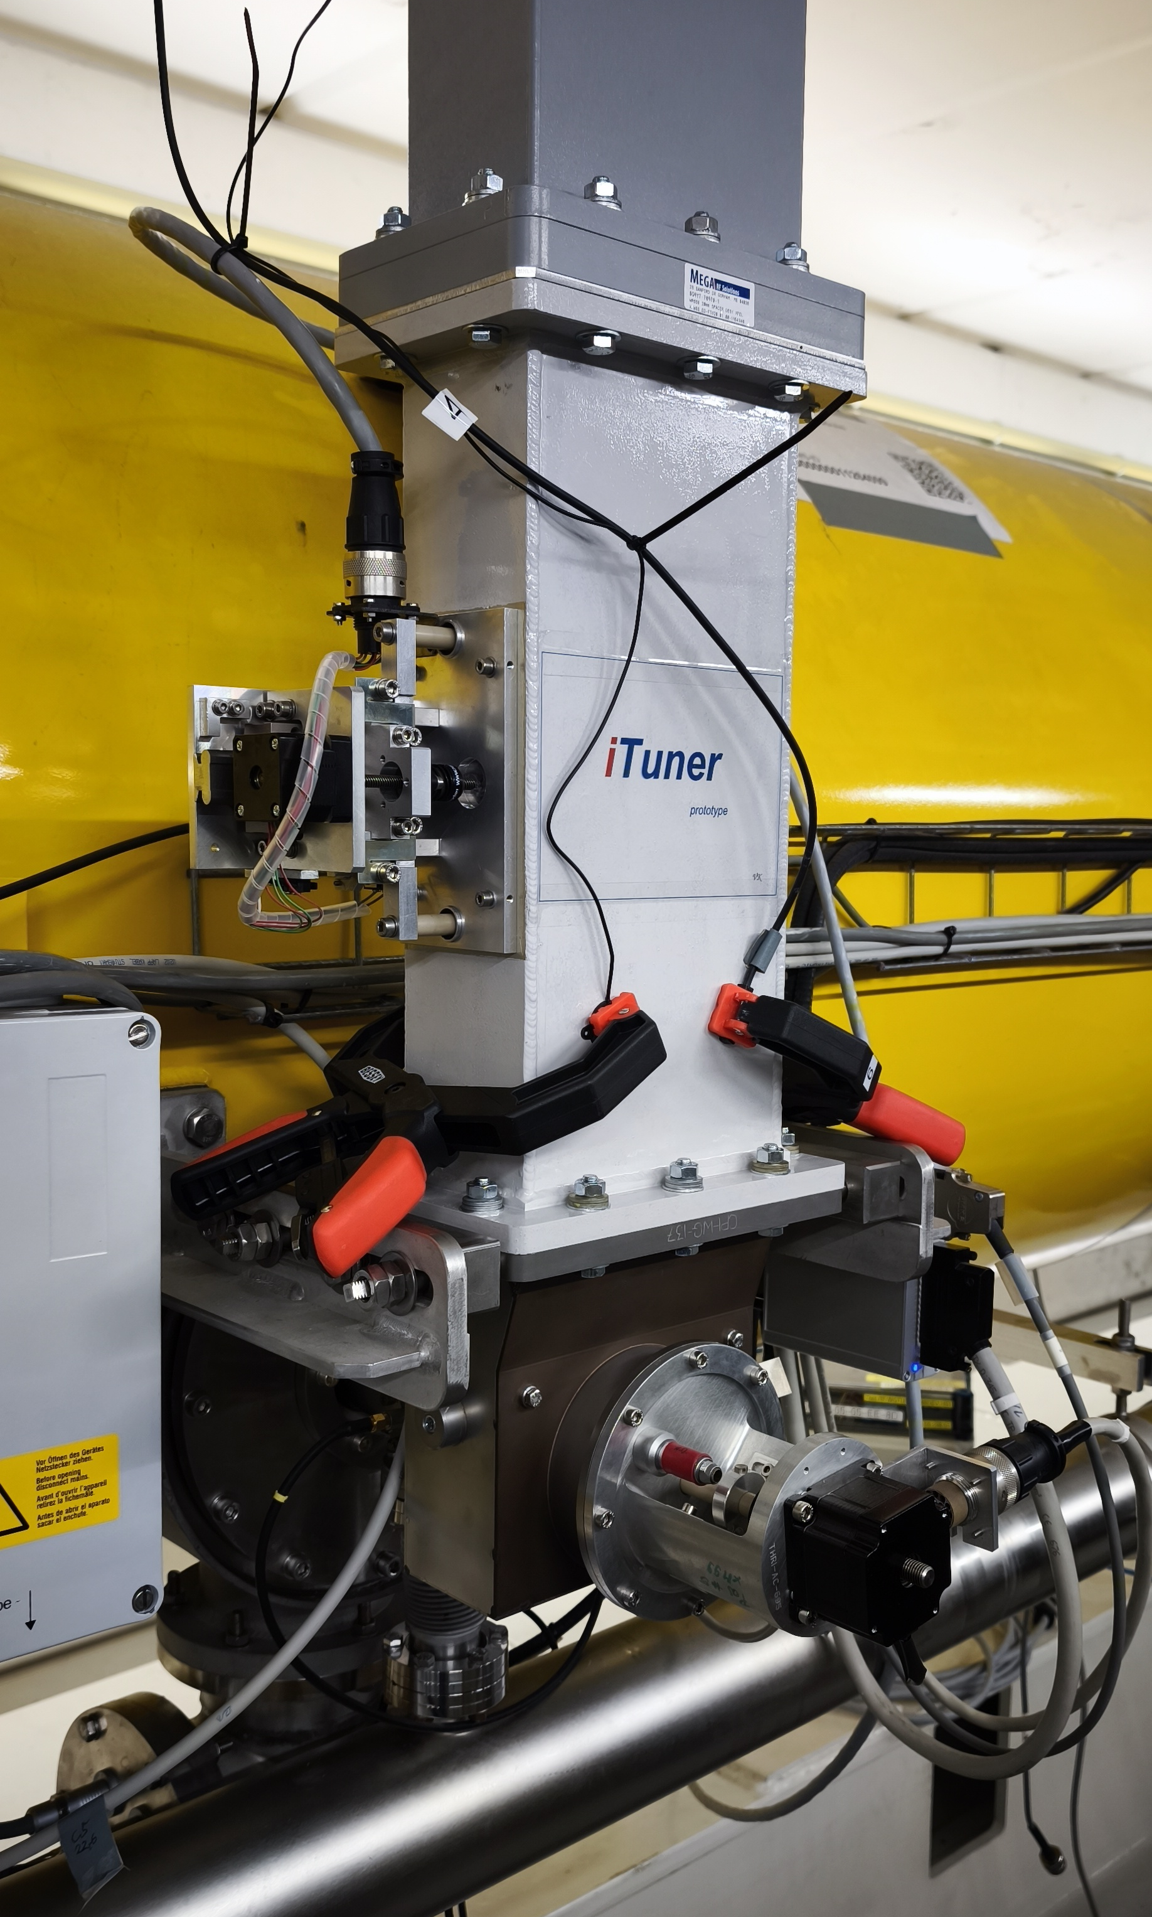
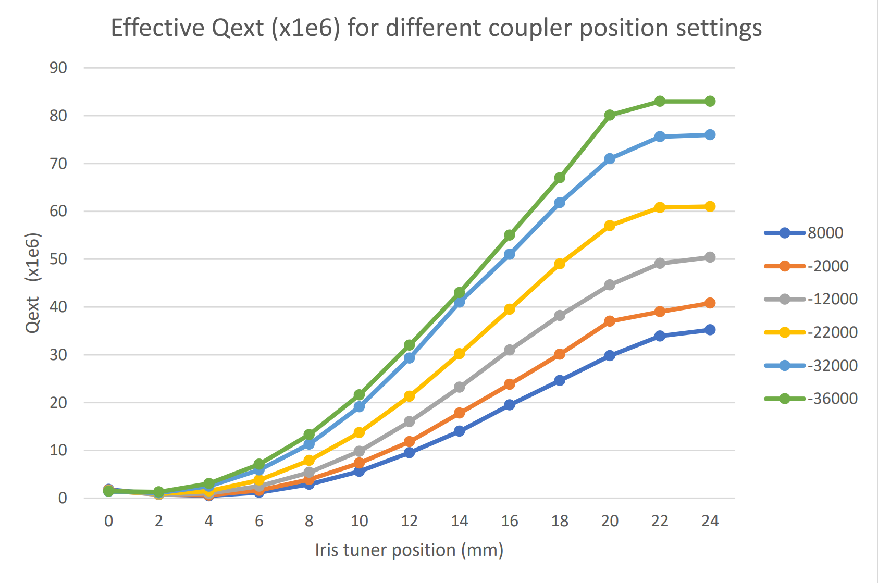
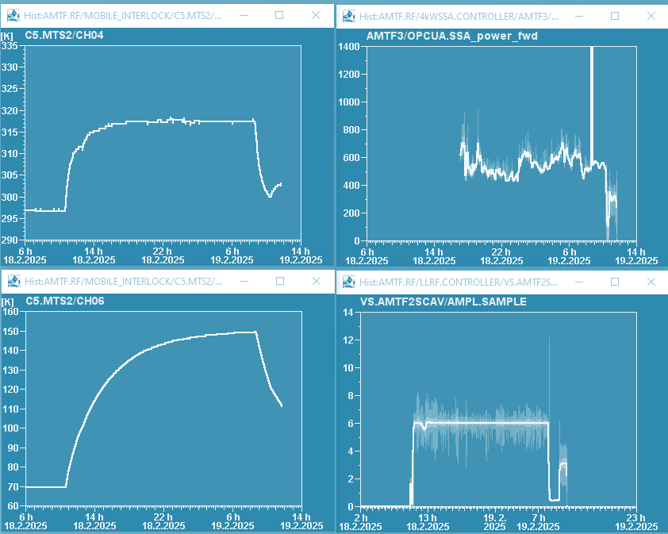
Developed 2 prototypes to extend the Qext range
Waveguide components to increase Qext range
Q-corrector (fixed)
Iris-tuner (variable)
I-tuner
motor
coupler motor
fixed stud
coupler
motor
coupler
motor
Courtesy V. Katalev
Several devices are being developed to increase or
shift the Qext tuning range
High-power test started
Currently investigating induced heating of coupler
T300K heating
T70K heating

Slide 41


WP2 – LLRF: status update
Example 1: improving efficiency of resonance control algorithms (DESY)
Piezo stimulus used to compensate Lorentz force detuning in pulsed operation at EuXFEL.
Bayesian optimization of piezo stimulus parameters (delay, amplitude, offset)
Using a double sine excitation (instead of just 1)
Smoothing the leading edge (to minimize inrush current)
= net energy saving factor of 2
Presented at IPAC 2025: “Optimization of Piezo Operation for Superconducting TESLA Cavities at EuxXFEL”, M. Grecki et al.
Example 2: developing machine learning–based diagnostics for SRF cavities (HZB)
Deep learning of cavity detuning
  Can one use machine learning (auto encoders) to predict detuning in CW
  Use deep learning to adapt the cavity model to real-time variations
  Use Koopman filter to make dynamics of the system appear linear
  Simulated detuning data, then used to train and test model
iSAS WP2 LLRF | J. Branlard | WP2 status update

Slide 42



Carrier Suppression Interferometer
Courtesy: M. Hoffmann
Concept
Overcome noise limits of the post-IQ system
CSI performance scales with RF input power
Source → very low amplitude noise !
Replace the DUT with the LLRF system
CSI signal contains no carrier
  no absolute information of amplitude and phase
CSI signal as amplified error signal
  Combination of CSI and standard measurement as controller input

Slide 43


Measurement Results from CMTB
Lab MO as Reference (best results)
Cavity at Q_{L} ~ 10⁷ (f₁₂ = ~ 65 Hz)
Open loop vs. PI controller vs. CSI with PI
Reached noise floor of FSWP
Requires stable condition of the cavity (steady state CW)
Cavity tuning (PZT) to maintain operation at resonance
Courtesy: M. Hoffmann

