Slide 1






WP3: Nb₃Sn on Cu films for 4.2K cavity operation
RP1 review meeting, June 1st, 2026
Cristian Pira (INFN LNL) on behalf of ISAS WP3 Collaboration
All information contained in this presentation and any accompanying documents is for iSAS project only, and must be treated as strictly confidential.
Any dissemination, distribution or other use of this information without the consent of its owner is prohibited.
Funded by the European Union. Views and opinions expressed are however those of the authors only and do not necessarily reflect those of the European Union or the European Commission. Neither the European Union nor the granting authority can be held responsible for them.

Slide 2
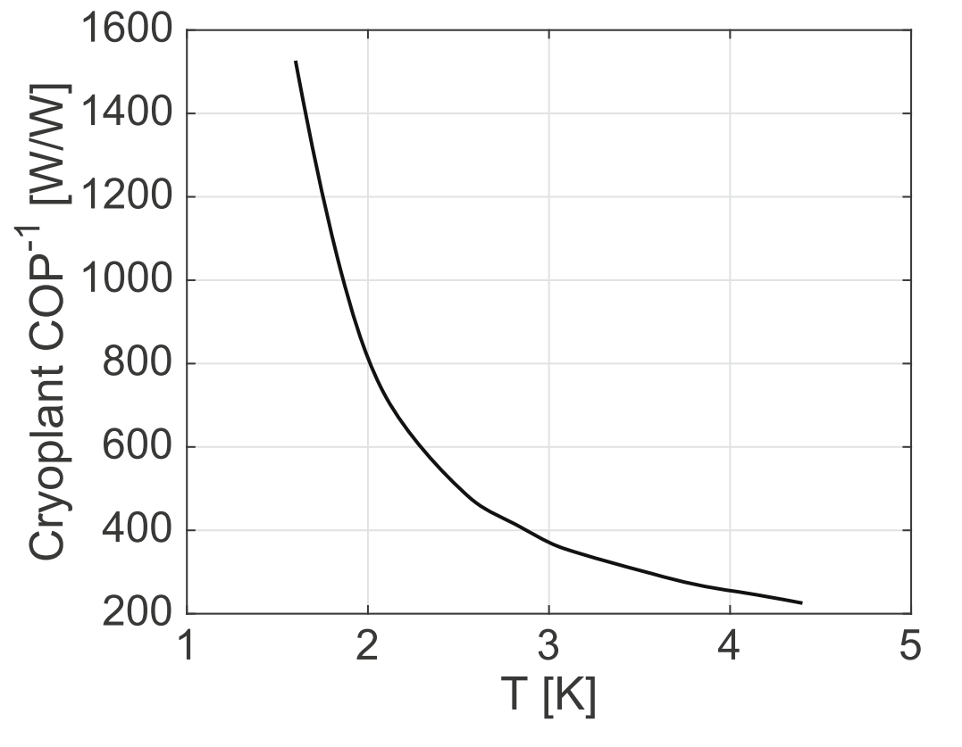
WP3: Nb₃Sn on Cu films for 4.2K cavity operation
INFN, CEA, HZB, UKRI
Convener & deputy: Cristian Pira (INFN) & Oleg Malyshev (UKRI)
Main contacts with other partners: Thomas Proslier (CEA), Oliver Kugeler (HZB), Reza Valizadeh (UKRI)
WP3 GOAL
Move SRF cavities technology from bulk Nb @2K to Nb₃Sn on Cu @4.5 K
to reduce cryogenic power by a factor of 3
Power at 300 K required to extract 1 W at cryogenic temperature
The aim of iSAS WP3 is the optimization of Nb₃Sn on Cu technology
WP3 Objectives:
minimize trapped flux
increase coating mechanical strength to allow cavity tunability
Nb
Nb₃Sn
S. Posen et al, Supercond. Sci. Technol. 30 (2017) 033004

Slide 3
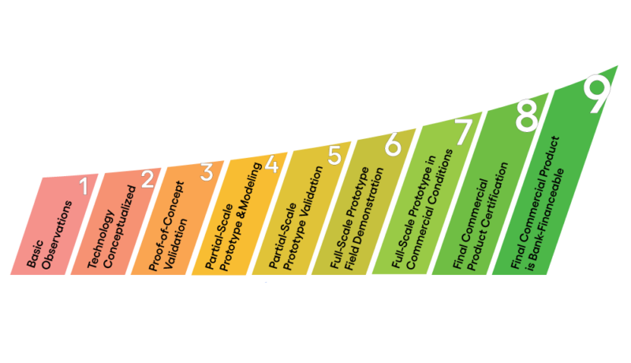




WP3: Nb₃Sn on Cu films for 4.2K cavity operation
INFN, CEA, HZB, UKRI
Convener & deputy: Cristian Pira (INFN) & Oleg Malyshev (UKRI)
Main contacts with other partners: Thomas Proslier (CEA), Oliver Kugeler (HZB), Reza Valizadeh (UKRI)
WP3 GOAL
Move SRF cavities technology from bulk Nb @2K to Nb₃Sn on Cu @4.5 K
to reduce cryogenic power by a factor of 3
ISAS WP3 is built on the results of previous I.FAST and ARIES EU collaborations and will further increase TRL with EPITA project
(Zanon and RI are partners in EPITA)
Study on planar samples
First RF test
Flux Trapping and Tunability
Conduction Cooling Cryomodule

Slide 4
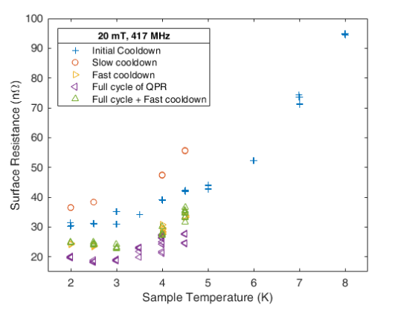
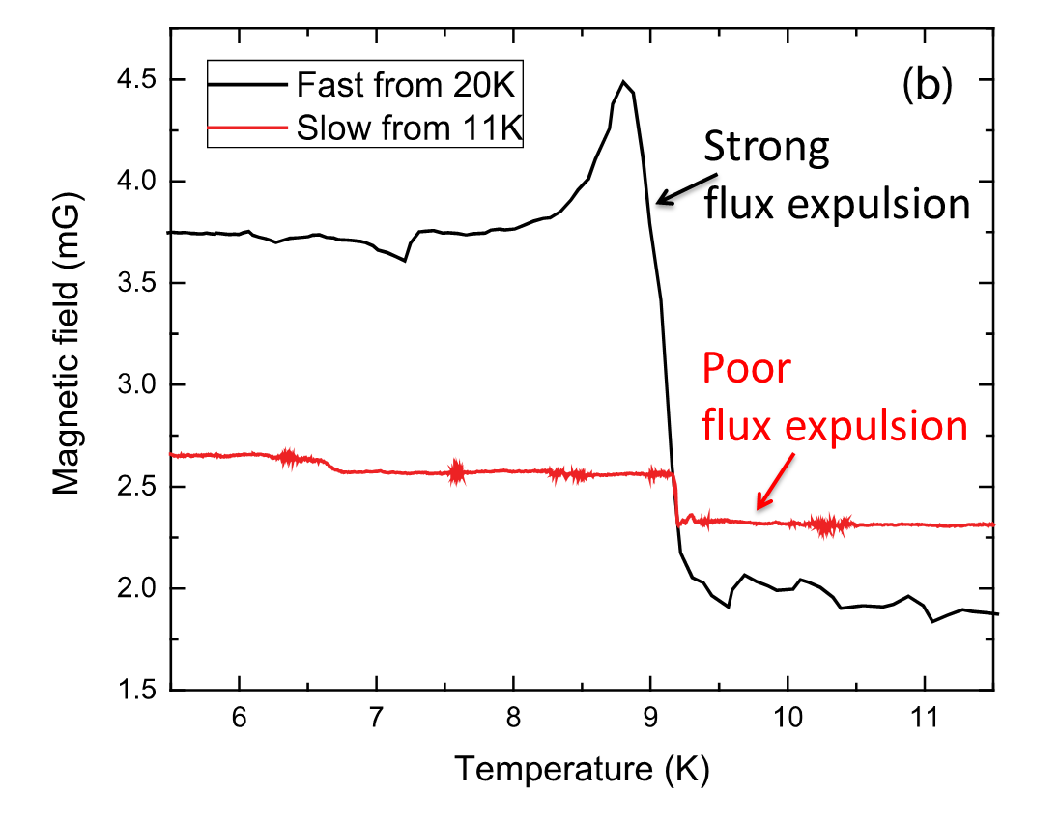
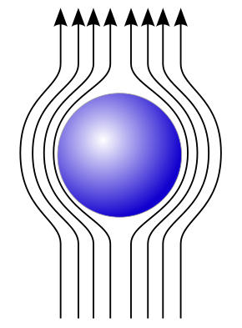
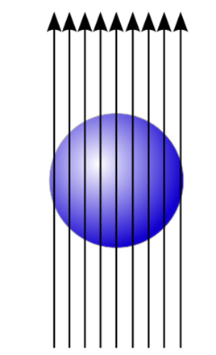

WP3 Nb₃Sn on Cu films for 4.2K cavity operation: Motivation
Trapped Flux
$$Q_{0}∝\frac{1}{R_{BCS}+R_{res}+η S B}$$
Slow cooldown
Fast cooldown
Nb₃Sn coating suffer flux trapping
Cooldown procedure influence Rs
A. Romanenko, A. Grassellino, O. Melnychuk, D. A. Sergatskov, J. Appl. Phys. 115, 184903 (2014)

Slide 5
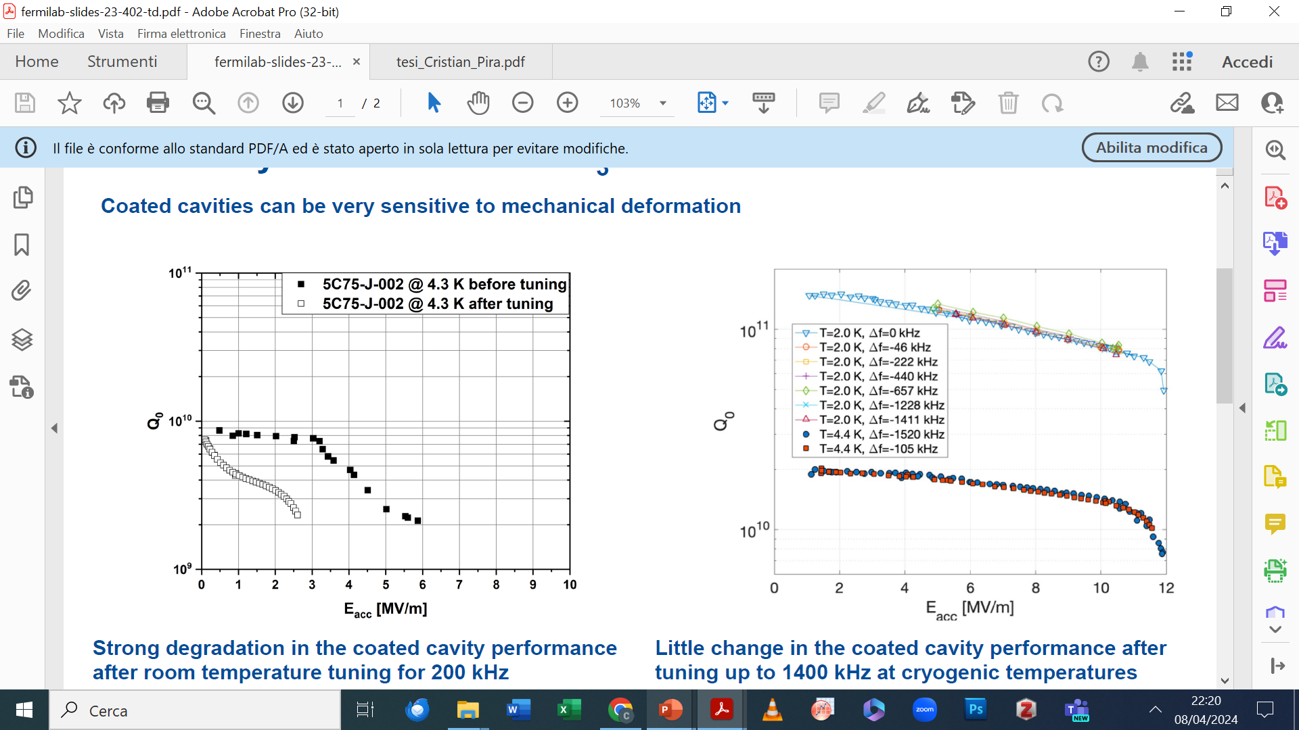
WP3 Nb₃Sn on Cu films for 4.2K cavity operation: Motivation
Cavity Tunability
Nb₃Sn is extremally brittle
Eremeev, G. (2023). Tunability/robustness of Nb3Sn (No. FERMILAB-SLIDES-23-402-TD). Fermi National Accelerator Laboratory (FNAL), Batavia, IL (United States).
Strong performance degradation after room temperature tuning for 200 kHz
Little change in the coated cavity performance after tuning up to 1400 kHz at cryogenic temperatures
Vapor Tin Diffusion Nb₃Sn on Nb cavities can be tuned only at cryogenic T
An interlayer in Nb₃Sn on Cu coatings can be added to enhance film mechanical stability and tunability

Slide 6
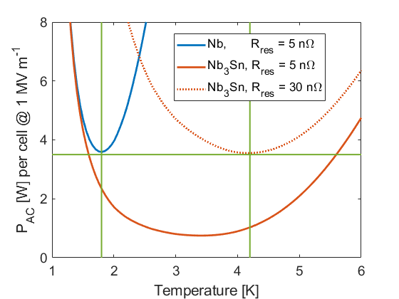
WP3: Nb₃Sn on Cu films for 4.2K cavity operation
INFN, CEA, HZB, UKRI
Convener & deputy: Cristian Pira (INFN) & Oleg Malyshev (UKRI)
Main contacts with other partners: Thomas Proslier (CEA), Oliver Kugeler (HZB), Reza Valizadeh (UKRI)
WP3 PROPOSED METRICS
Calculated AC power dissipation of Nb and Nb₃Sn cavity cells at cryogenic temp. 1.3 GHz
    AC power dissipation of each cavity cell
    (P_{acc} per cell @ 1 MV/m)
    Methodology
      Measurement of Q₀ vs E_{acc} via an RF test
      → deduce surface resistance → Q₀ = G/ R_{s}
      (R_{s} = R_{BCS} (T) + R_{res} determines the efficiency of the cavity)
      Estimate the grid power of Nb₃Sn at 4K
      Comparison with bulk Nb at 2K at same gradient
    Study case
      QPR data (already available)
      1.3 GHz cavity baseline by I.FAST
      new cavity optimized at the end of ISAS
    Expected: 0.7 – 3.5 W per cell @ 1 MVm⁻¹ (R_{res} = 5-30 nΩ)
Nb₃Sn at 4.2 K outperforms Nb at 1.8 K
C. Antoine et al., “Thin-film SRF roadmap”, I.FAST deliverable report D9.1, 2025. doi:10.5281/zenodo.14731411

Slide 7
WP3: Nb₃Sn on Cu films for 4.2K cavity operation
INFN, CEA, HZB, UKRI
Convener & deputy: Cristian Pira (INFN) & Oleg Malyshev (UKRI)
Main contacts with other partners: Thomas Proslier (CEA), Oliver Kugeler (HZB), Reza Valizadeh (UKRI)
Task 3.1: Coordination of R&D on SC cavities – M1-M48 (INFN, CEA, HZB, UKRI) – Cristian Pira
This task aims to coordinate the different task activities and organize the periodic WP meetings.
Task 3.2: Flux Trapping – M1-M32 (INFN, CEA, HZB, UKRI) – Oleg Malyshev
This task aims to minimize flux trapping in Nb3Sn thin films studying and optimizing coating parameters and cooling procedure
Task 3.3: RF Tunability – M1-M32 (INFN, CEA, HZB, UKRI) – Oliver Kugeler
This task aims to study and improve mechanical properties of SC thin films to assess the impact of future cavity tuning during normal 4.2 K operation
Task 3.4: Adaptive Layers – M1-M40 (INFN, CEA, HZB, UKRI) – Thomas Proslier
This task aims at developing suitable adaptative layers synthesized by Atomic Layer Deposition (ALD) to reduce the detrimental effect of mechanical deformation on the superconducting properties of Nb₃Sn
Task 3.5: Working Cavity – M1-M48 (INFN, CEA, HZB, UKRI) – Reza Valizadeh
This task encompasses the main outcome of WP3: to optimize the SC cavity coating procedure at 1.3 GHz using the experience and knowledge gained in Tasks 3.2-3.4. and demonstrate suitability for operation at 4.2 K.

Slide 8
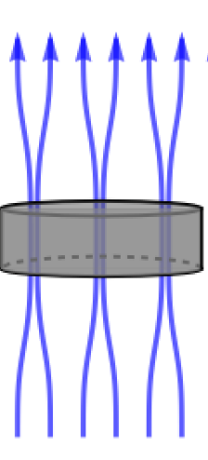
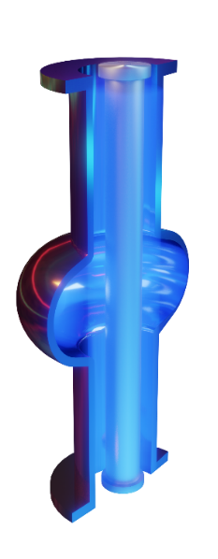
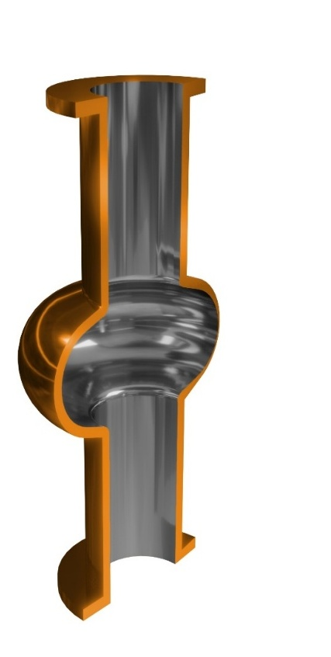

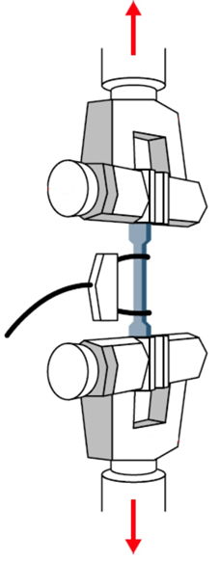
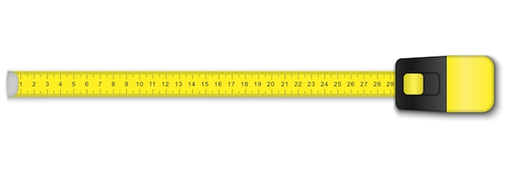
WP3: Nb₃Sn on Cu films for 4.2K cavity operation
INFN, CEA, HZB, UKRI
Convener & deputy: Cristian Pira (INFN) & Oleg Malyshev (UKRI)
Main contacts with other partners: Thomas Proslier (CEA), Oliver Kugeler (HZB), Reza Valizadeh (UKRI)
WP3 WORK-FLOW
Improve Nb₃Sn coating performances
(Task 3.5)
flux trapping test on planar samples
(Task 3.2)
Coat a 1.3 GHz cavity with optimized recipe
(Task 3.5)
Nb₃Sn
Al₂O₃
Cu
Develop an Adaptive Layer to insert between Nb₃Sn coating and Cu substrate
(Task 3.4)
mechanical strenght test on planar samples and cavities
(Task 3.3)
4.2 K SRF vertical test of Nb₃Sn on Cu optimized cavity
(ISAS WP3 final goal)
(Task 3.5)

Slide 9
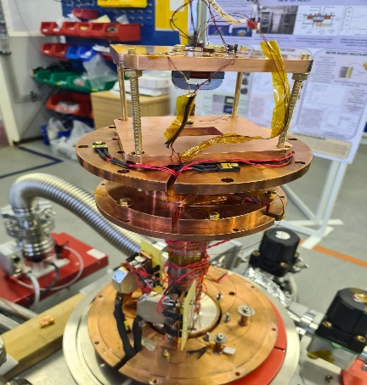
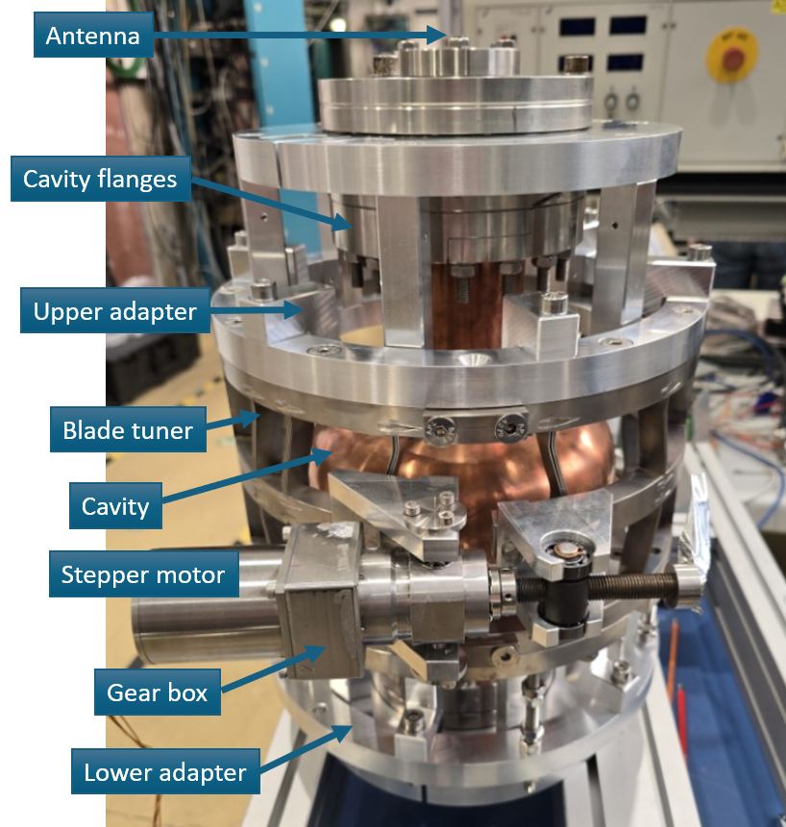
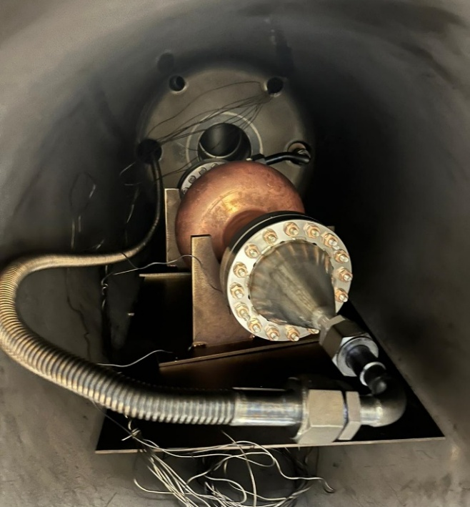

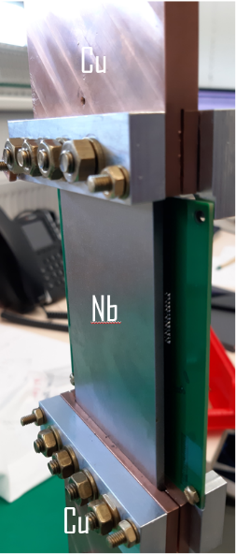


WP3 Nb₃Sn on Cu: Key Outcomes (1)
Advanced characterization facilities
(task 3.2 and 3.3)
Adaptive layers
(task 3.4)
Flux trapping
Tunability
Al₂O₃, ZrO₂ and AlZrO_{x} oxides successfully coated by ALD and stable up to 750 °C
Mitigation of thermo-electric currents proved on Nb
Choke cavity and field penetration facility upgrade done
ZrO₂ (20 nm) / Al₂O₃ (5 nm) / Cu
CRAFT Facility built and tested
Blade Tuner built and tested
Milestone 3.2 completed
Deliverable 3.1 completed
Milestone 3.1 completed

Slide 10


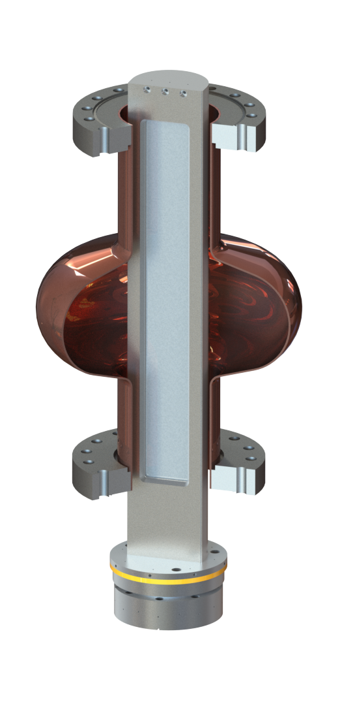
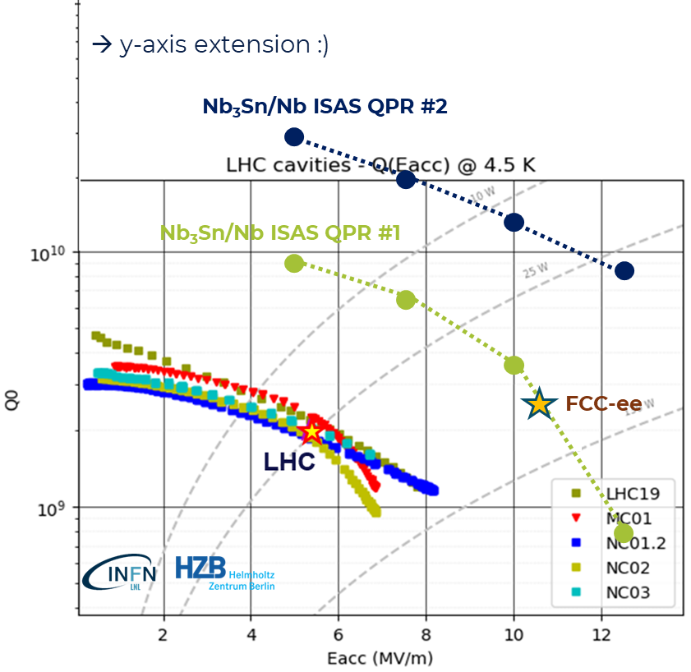
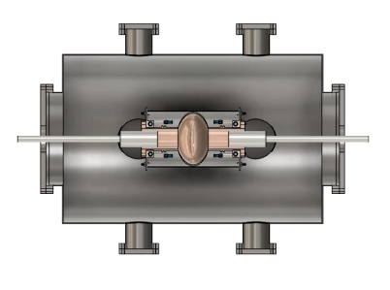
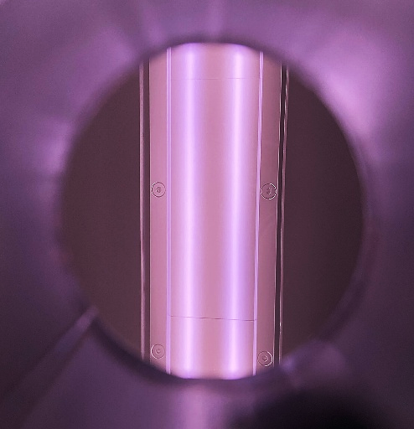
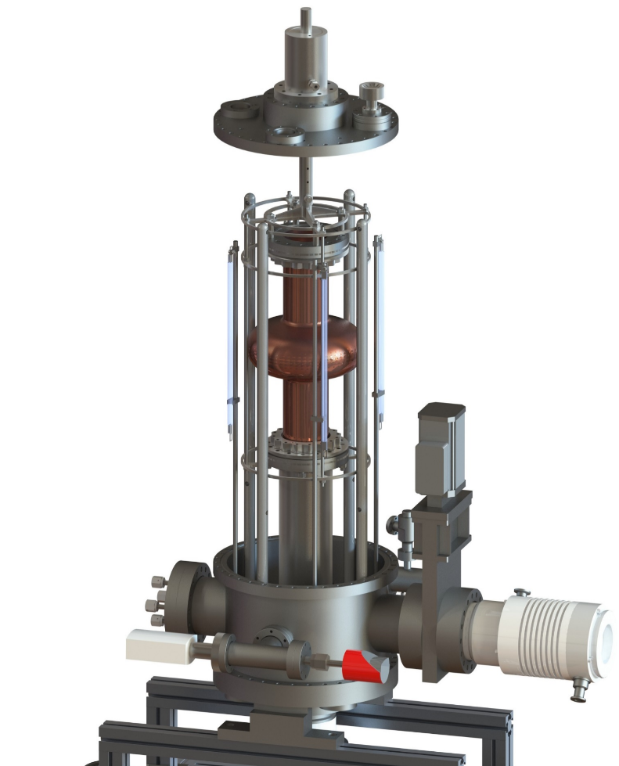
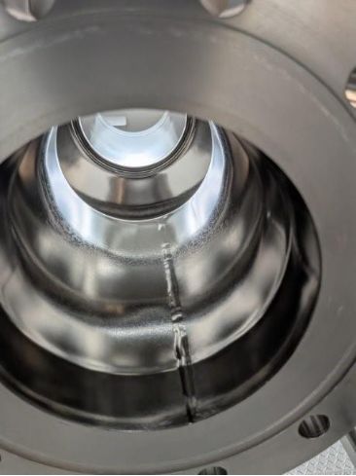
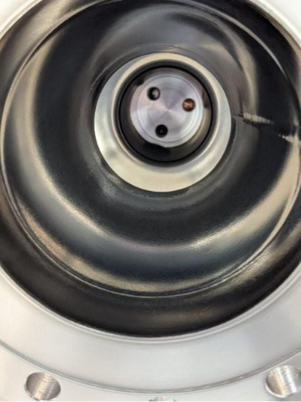
WP3 Nb₃Sn on Cu: Key Outcomes (2)
Coating recipe optimized and validated
on small planar resonator (QPR)
2 Different 1.3 GHz coating system ready (testing phase)
(task 3.5)
Rectangular magnetron
Rotating Cavity
Double movable magnetrons
Fixed cavity
(task 3.5)
ignited plasma
before coating
after coating
Q value 10 times > LHC!
D. Fonnesu et al., Recipe optimization and SRF test of Cu-compatible Nb3Sn films by DC magnetron sputtering from a stoichiometric target. Sci Rep 16, 3539 (2026)
M. Lazzari et al., "Development of a new system for Nb₃Sn thin film deposition on 1.3 GHz cavities", in Proc. SRF2025, Tokyo, doi:10.18429/JACoW-SRF2025-TUP31
N. Leicester et al., "Development of a 1.3 GHz longitudinally split RF research cavity for use in testing of superconducting thin films", in Proc. SRF2025, Tokyo, doi:10.18429/JACoW-SRF2025-TUP19

Slide 11
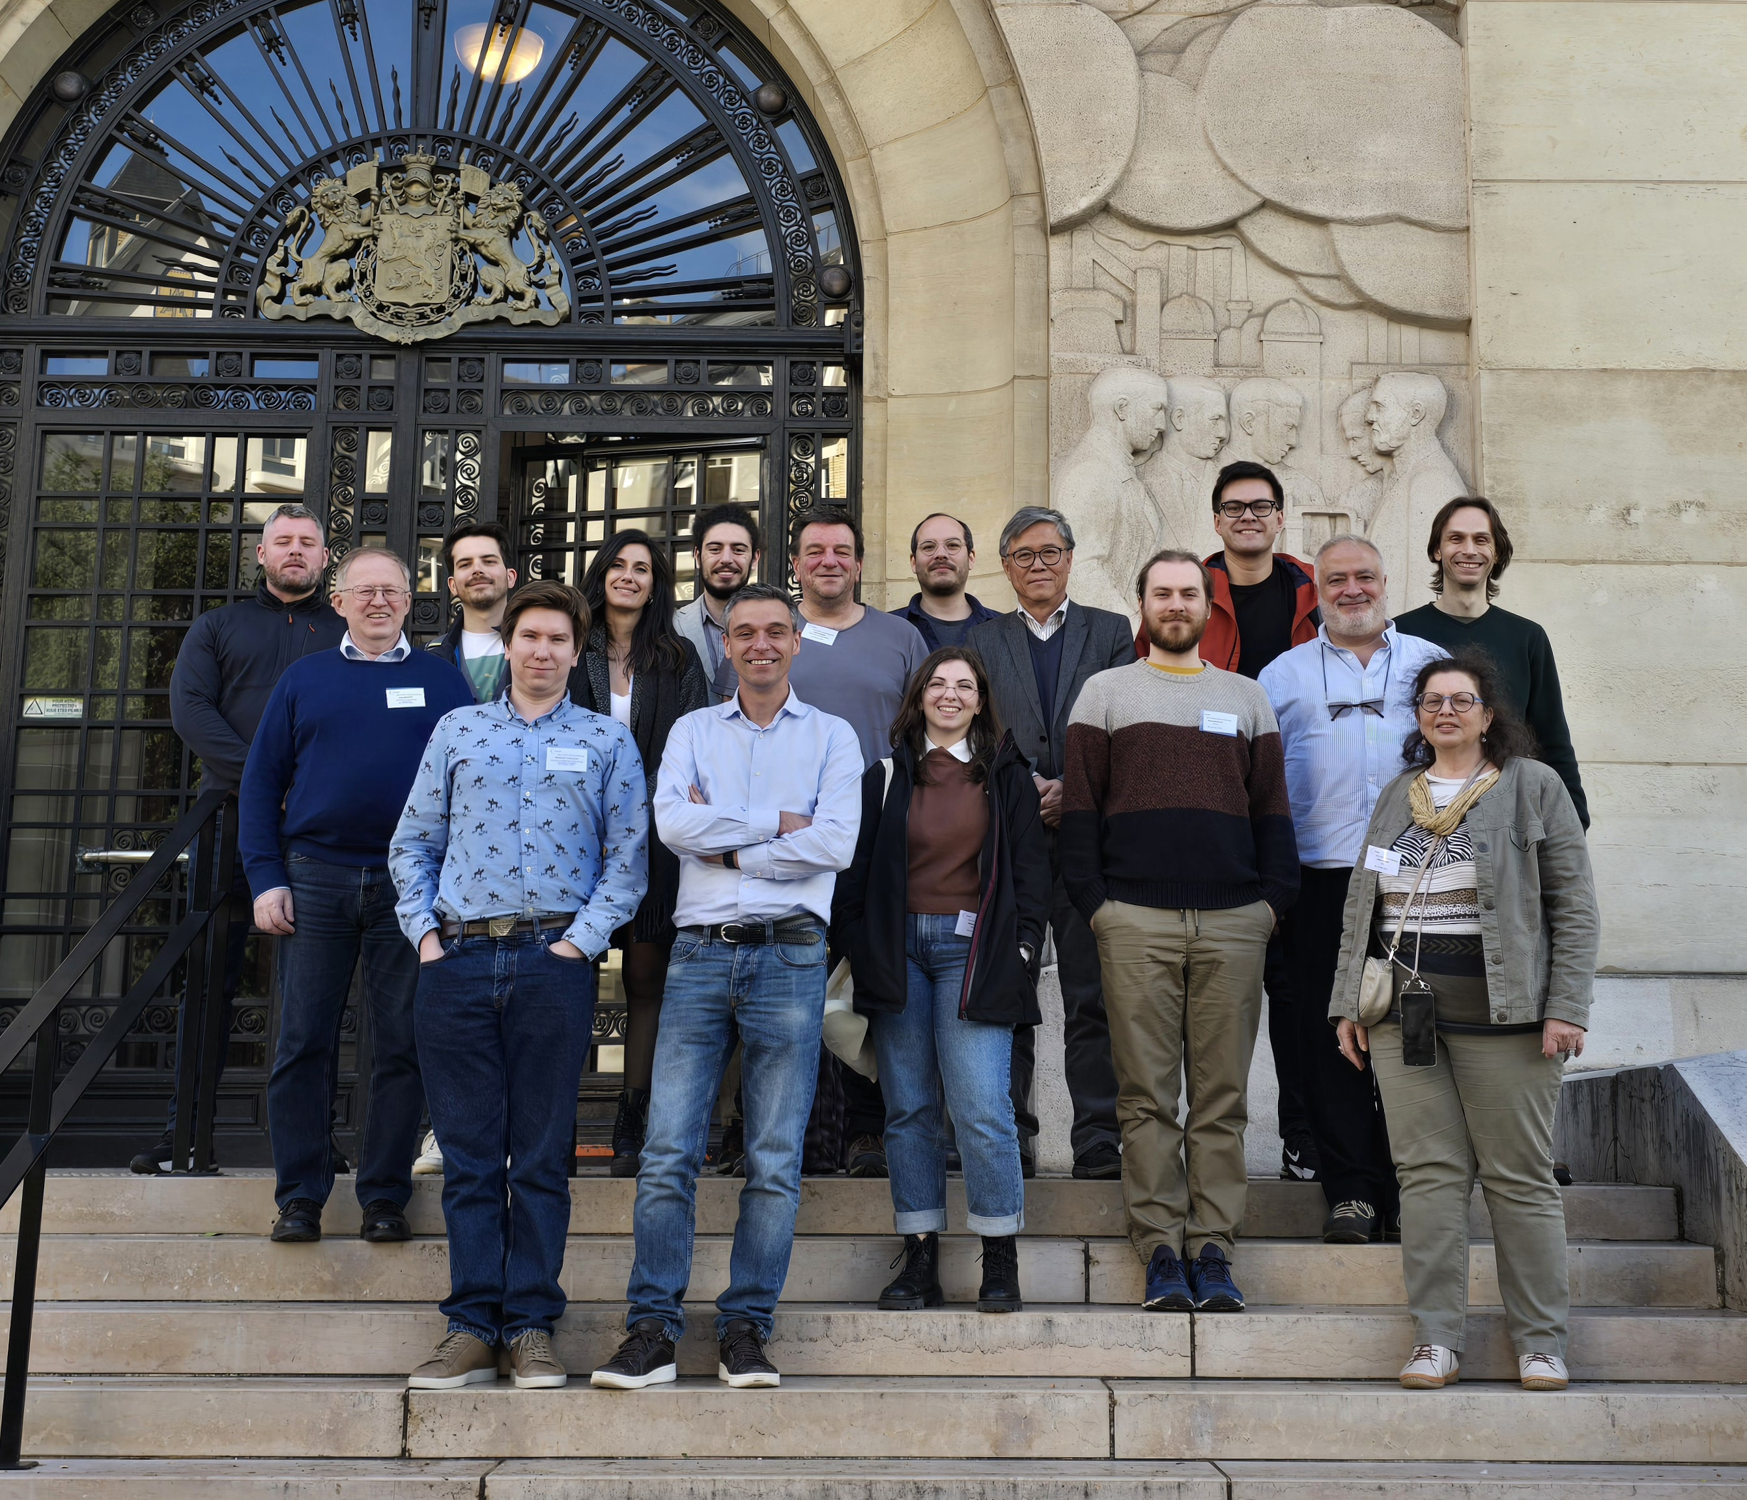
WP3 Nb₃Sn on Cu films for 4.2K cavity operation: Task 3.1
Coordination (INFN, CEA, HZB, UKRI) – Cristian Pira
Periodic meeting (in person and online) every 2-3 months
(possibly in collaboration with I.FAST → EPITA)
Zanon is joining WP3 meetings as industrial reviewer
ISAS WP3 kick-off Meeting in Paris
WP3 Meeting 01 - Task leaders Pre-Kick-Off remote meeting on 21/02/2024 https://agenda.infn.it/event/40107/
WP3 Meeting 02 - Kick-Off meeting in Paris (hybrid) on 16/04/2024 (in collaboration with I.FAST WP9) https://indico.cern.ch/event/1357302/sessions/528505/#20240416
WP3 Meeting 03 - Task Leaders remote meeting on 17/07/2024 (in collaboration with I.FAST WP9) https://indico.cern.ch/event/1437516/
WP3 Meeting 04 - Hybrid meeting in Berlin on 02-03/12/2024 (in collaboration with I.FAST WP9) https://events.hifis.net/event/1875/
WP3 Meeting 05 - Annual meeting in LNL (hybrid) on 12/03/2025 https://indico.ijclab.in2p3.fr/event/11291/timetable/#20250312
WP3 Meeting 06 - I.FAST Annual meeting in Cracow (hybrid) on 08/04/2025 http://indico.cern.ch/event/1464979/timetable/#20250408.detailed
Informal update during SRF2025 Conference in Tokyo (21-26/09/2025)
WP3 Meeting 07 - Online meeting on 24/11/2025 https://indico.ijclab.in2p3.fr/event/12433/
WP3 Meeting 08 - Online meeting on 20/03/2026 https://indico.ijclab.in2p3.fr/event/13566/
WP3 Meeting 09 - Annual meeting in HZB (hybrid) on 22/04/2026 https://indico.ijclab.in2p3.fr/event/11960/timetable/#20260422

Slide 12

WP3 Nb₃Sn on Cu films for 4.2K cavity operation
Task 3.1 achievements
Coordination (INFN, CEA, HZB, UKRI) – Cristian Pira
Milestone 39 Impact Risk Analysis WP3 – INFN – Presentation/report M24
Completed
Critical risks & risk management strategy
Risk No | Description | Probability (scale 1<4) | Severity (scale 1<4) | Criticality (PxS) | Mitigation measures
1 | Beneficiary leaves the project | 1 | 3 | 3 | Pro-actively: documentation, collaboration, strong coordination; Post-facto: redistribute tasks
2 | Lack of candidates for temporary positions | 1 | 4 | 4 | Maximize job advertisements as early as possible and as wide as possible (professional networks), leverage on the iSAS consortium
3 | Appearance of small defects on the superconducting layers dramatically affecting the RF performance | 3 | 4 | 12 | Test the coatings on smaller prototypes before depositing on the 1.3 GHz prototype; thermometry measurements will identify defects and help improving deposition (Task 3.5)
4 | Scaling the SC coatings from planar samples to 3D geometry more difficult than expected | 2 | 3 | 6 | Additional R&D on small 3D structures to find and solve technical issues in advance (Task 3.2, Task 3.4)
5 | Fragility of A15 film may results in reduced tunability of the coated cavity | 3 | 4 | 12 | Initial test on small sample in Task 3.3 to optimize thin-film coating procedure, followed by coating on a 1.3 GHz cavity in Task 3.2
6 | Delamination of ALD layers on Cu at high Temperature | 1 | 1 | 1 | Test of multilayers and different alloys to mitigate this risk
7 | Further increase of costs for Helium and/or power | 1 | 3 | 3 | Proportional reduction of number of tests or test duration
Notes:
Task 3.1 was in charge of the milestone on impact risk analysis. During the first 2 years of project we adressed 4 risks identified in the grant agreement and reduce the risk of 3. It remain very crytical the risk 3, so the risk that… , but that one can be reduced only when a production protocol has been established and industrialized. For the moment we have to live with him

Slide 13
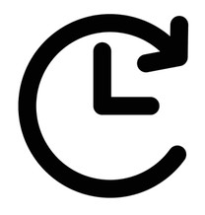
WP3 Nb₃Sn on Cu films for 4.2K cavity operation: Task 3.2
Flux Trapping (INFN, CEA, HZB, UKRI) – Oleg Malyshev
Objectives
Explore new coating parameters for planar samples and small resonators to minimize flux trapping in SC A15 films.
Upgrade the STFC choke cavity and the HZB QPR to support detailed flux trapping analyses of coated superconducting films.
Characterize trapped flux, flux viscosity and the interaction with the RF field with SC A15 films in small resonators and samples with the upgraded systems.
On track
Deliverable 3.2 Flux trapping Report on flux dynamics study in Nb3Sn on Cu samples - HZB - Report M30
Milestone 3.1 Modification of choke cavity for flux trapping study - Engineering report M12
Completed

Slide 14
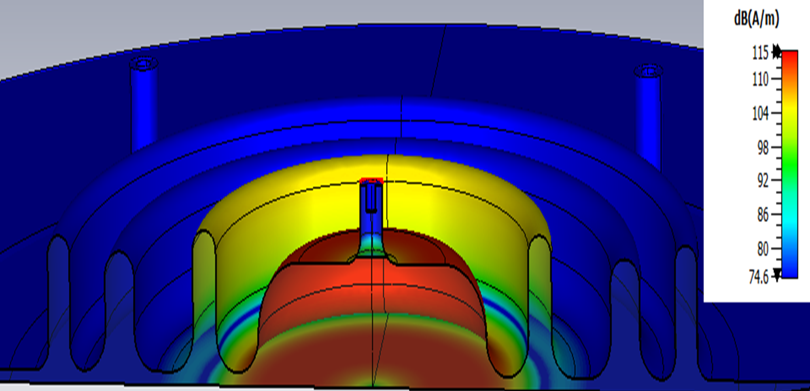
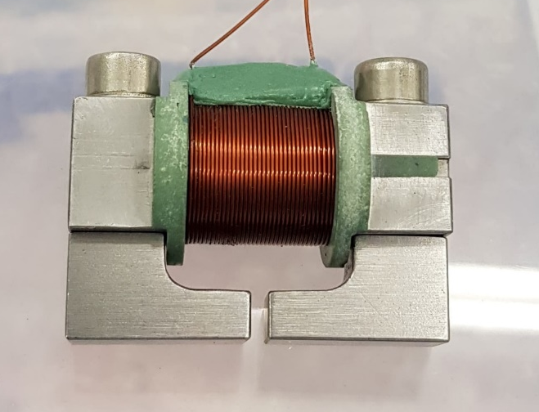
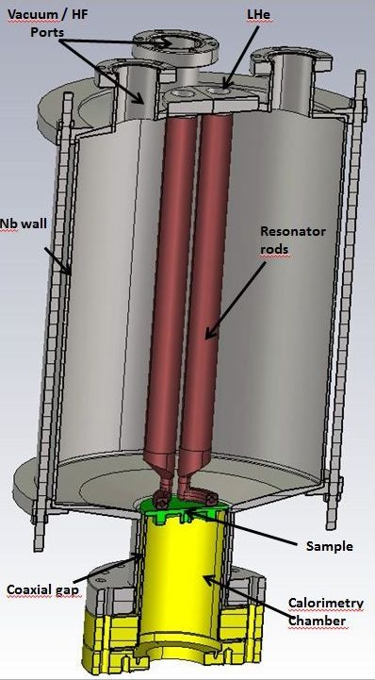
WP3 Nb₃Sn on Cu films for 4.2K cavity operation
Task 3.2 - Flux Trapping - achievements
Milestone 3.1 Modification of choke cavity for flux trapping study - Engineering report M12
Completed
4 Characterization Facilities Updated during ISAS
Choke Cavity Field Penetration Facility
(R_{S} measurements with 7.8 GHz cavity)
Magnetic Field Penetration Facility
HP1
HP2
CRAFT Facility (Measurement of flux trapping and flux dynamics)
Quadrupole Resonator (QPR) Facility

Slide 15
WP3 Nb₃Sn on Cu films for 4.2K cavity operation: Task 3.3
RF Tunability (INFN, CEA, HZB, UKRI) – Oliver Kugeler
Objectives
Explore new coating parameters on planar samples and small resonators to enhance the mechanical strength in SC A15 films.
Mechanical film-stability tests with planar samples.
Build cavity tuning system and perform vertical cryo-tests of coated cavities to explore RF performance limits and acceptable tuning without incurring film damage.
Devise cavity tuning schemes for Nb3Sn cavities fulfilling the required tuning parameters while taking into account the constraints of Nb3Sn. The implementation of FE-FRT to assist will be considered.
Deliverable 3.1 Cavity tuning Report on implementation of cavity Q vs F tuning tool - HZB - Report M24
Completed
On track
Milestone 3.3 Report on mechanical strength test of SC coatings - Test report M30

Slide 16
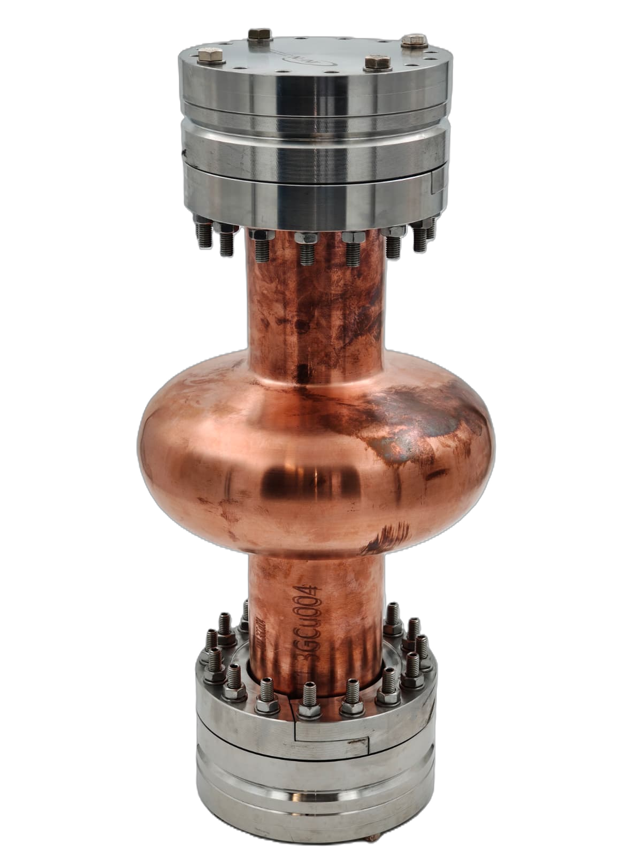
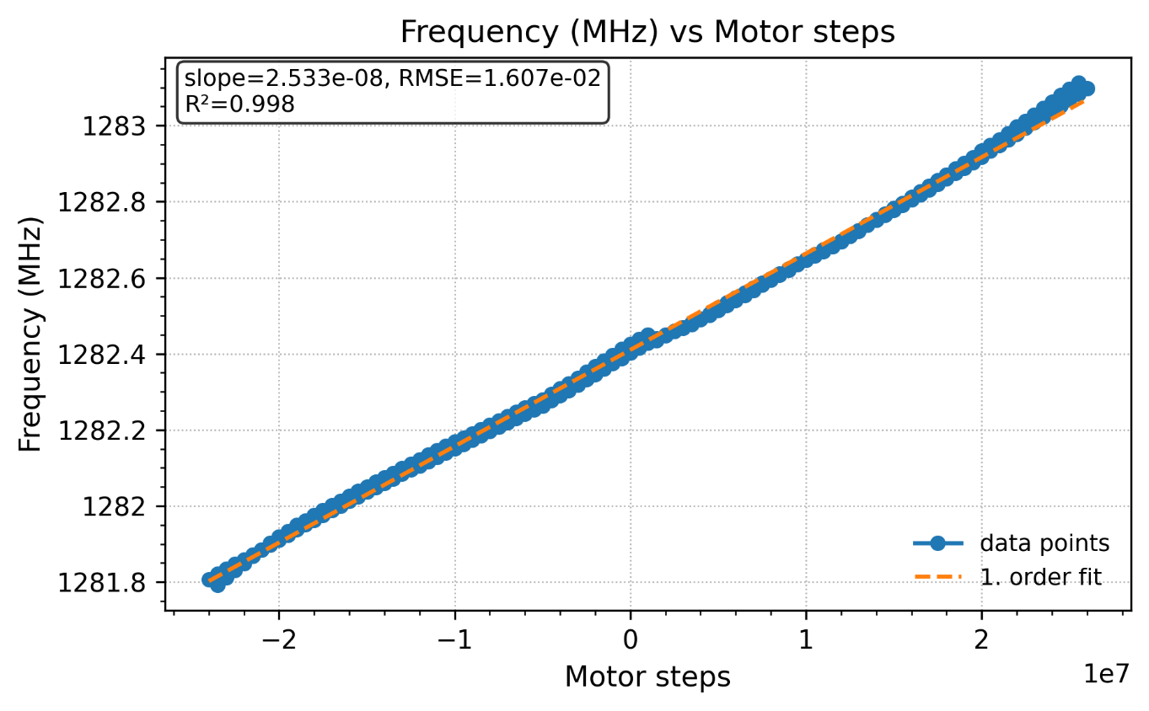
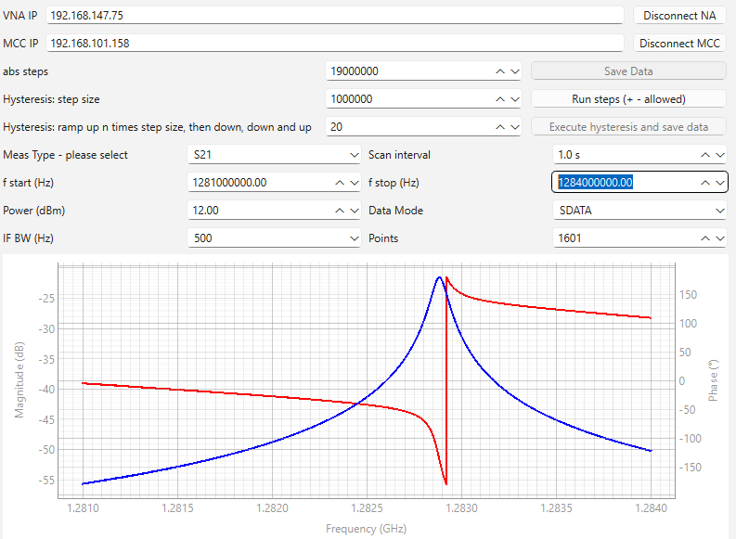
WP3 Nb₃Sn on Cu films for 4.2K cavity operation
Task 3.3 – RF Tunability - achievements
Deliverable 3.1 Cavity tuning Report on implementation of cavity Q vs F tuning tool - HZB - Report M24
Completed
Blade Tuner Facility
Actuation & RF Measurement
Stepper motor (Phytron) + harmonic drive
→ precise, reproducible cavity length control
Two antennas:
    One strongly coupled
    One weakly coupled
Vector Network Analyzer (VNA):
  Measures S-parameters
  → resonance frequency & bandwidth
Automated via Python GUI (ChatGPT-assisted)
Courtesy of O. Kugeler

Slide 17
WP3 Nb₃Sn on Cu films for 4.2K cavity operation: Task 3.4
Adaptive Layers (INFN, CEA, HZB, UKRI) – Thomas Proslier
Objectives
Develop adaptative layers by atomic layer deposition on Cu that are stable up to 650 °C.
Insulating oxides layer: Al₂O₃, ZrO₂, ZrAlO_{X} as diffusion barriers
Compare performance Nb₃Sn on Cu with and without adaptive layers on planar samples and QPR.
Deliverable 3.3 Adaptive Layer Report on QPR study of Nb₃Sn on Cu & adaptive layers - CEA - Report M38
On track
Milestone 3.2 Developed ALD adaptive layers on Cu - Test report M24
Completed

Slide 18
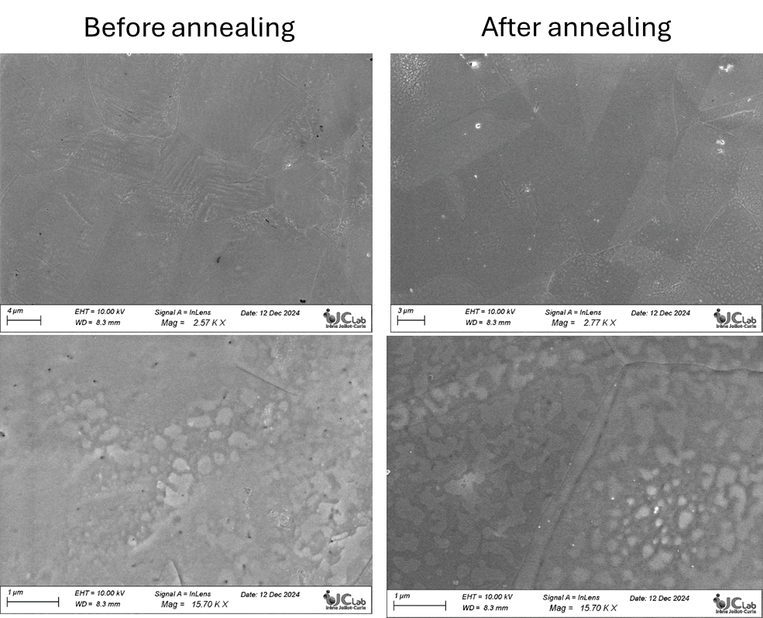
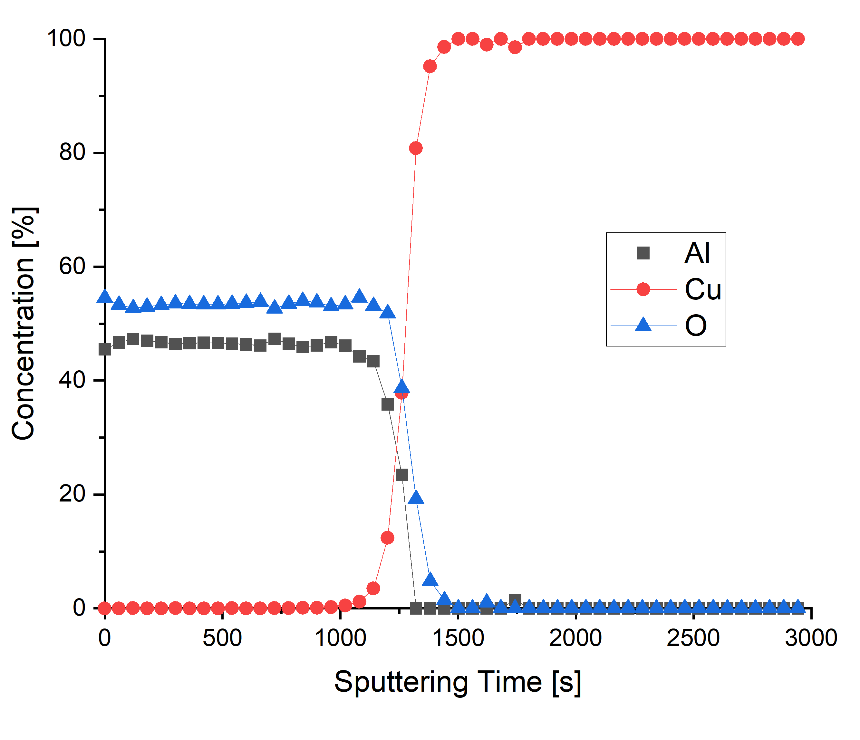
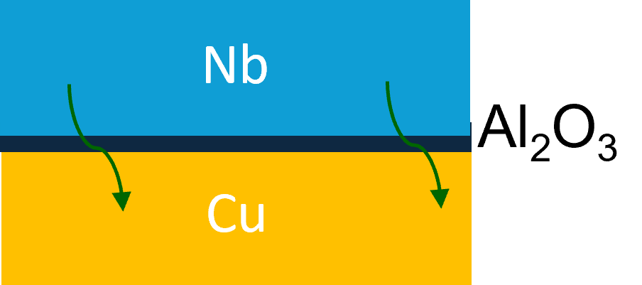
WP3 Nb₃Sn on Cu films for 4.2K cavity operation
Task 3.4 – Adaptive Layers - achievements
Milestone 3.2 Developed ALD adaptive layers on Cu - M24
Completed
  MAIN RESULTS ACHIEVED
  Developed several insulating ALD layers:
  Al₂O₃; ZrO₂, AlZrO_{X}, bilayers Al₂O₃ - ZrO₂
    stable up to 700°C for 2 hrs in high vacuum
    (Nb/Nb3Sn deposition conditions)
    High Pressure Rinsing (HPR) test passed
  Studied the influence of the film structure and chemical composition on the superconducting film growth
    The presence of an ALD Al₂O₃ layer does bot affect the structural and superconducting properties of Nb films deposited on top
    (XRD, Tunneling spectroscopy, TEM).
After annealing 700°C-2hrs + HPR
XPS
  FIRST IMPLEMENTATIONS
  Coated a 1.3 GHz Cu cavity (deposition system built in IFAST) from CERN with 20 nm thick Al₂O₃ layer – sent back to CERN for Nb deposition by HiPIMS
  → problem of Nb delamination after HPR
  Coated EP Cu samples from INFN-LNL with several oxide ALD layers alloys sent back to INFN for Nb and Nb₃Sn deposition
Courtesy of T. Proslier

Slide 19
WP3 Nb₃Sn on Cu films for 4.2K cavity operation: Task 3.5
Working Cavity (INFN, CEA, HZB, UKRI) – Reza Valizadeh
Objectives
Improve I.FAST 1.3-GHz superconducting coating recipe based on Tasks 3.2-3.4 results.
Prepare 1.3-GHz thin film cavities with an optimized coating recipe.
Perform full cavity characterization @4.2 K (Q vs E, Q vs F, and flux trapping in the VTS@SupraLab vertical test stand).
Deliverable 3.4 4.5-K Cavity Report on 4.5-K Cavity performance & tunability tests - INFN - Report M46
On track
Milestone 3.4 Characterization of Nb3Sn reference cavity - Test report M34
On track

Slide 20
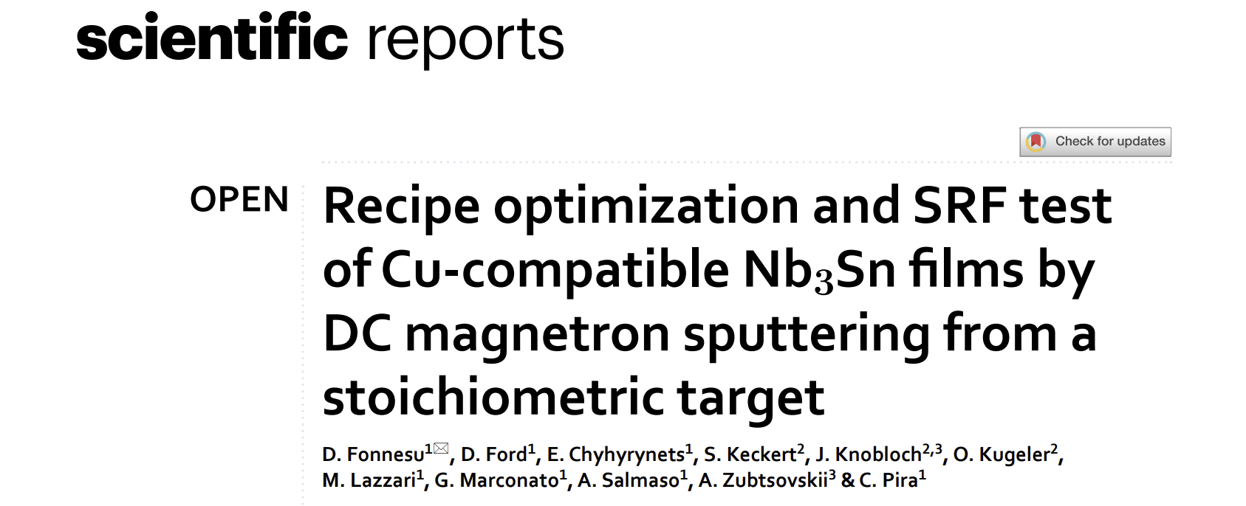
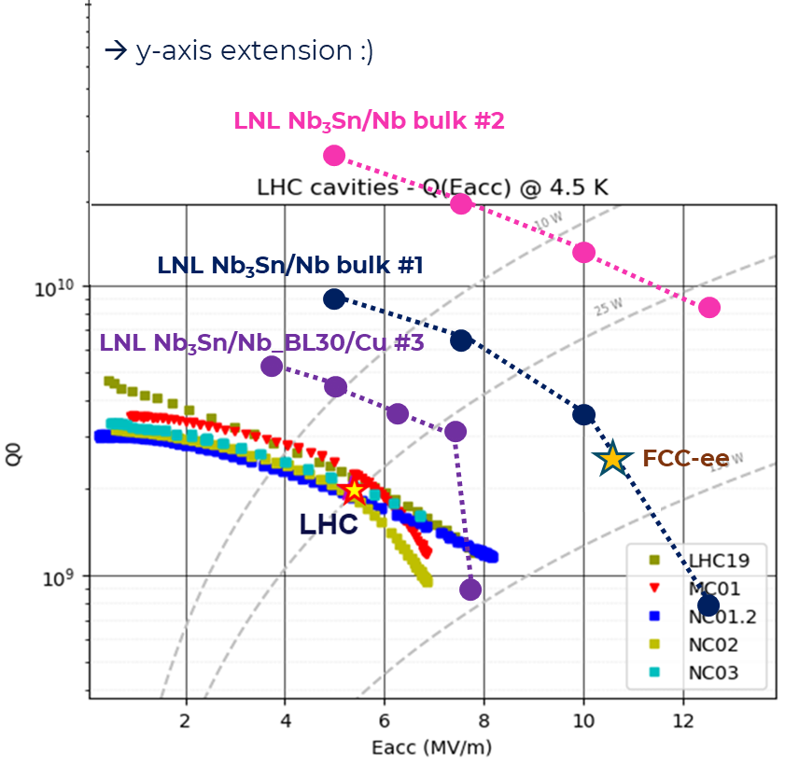
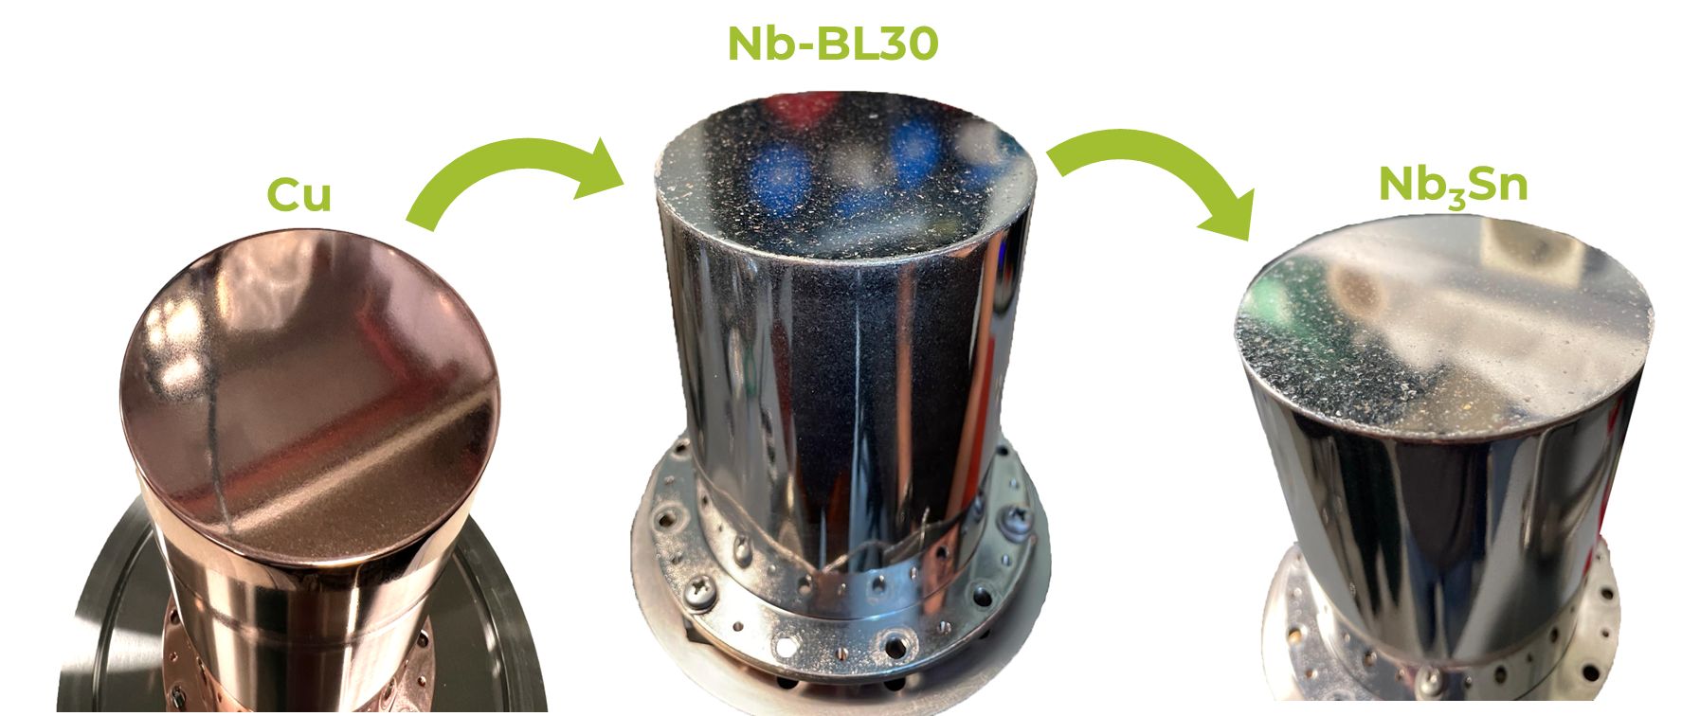
WP3 Nb₃Sn on Cu films for 4.2K cavity operation
Task 3.5 – Working Cavity - achievements
1. Optimized coating recipe
2 . RF Test on QPR (recipe validation)
Sample #2 on Nb3Sn on Nb bulk (State of the art)
T_{c} = 17.45 K
Quench > 85 mT extrapolated @ 0 K
R_{s} < 9 nΩ @ 4 K, 20 mT
Better than VTD sample up to 50 mT
Q value 10 times > LHC!

Slide 21
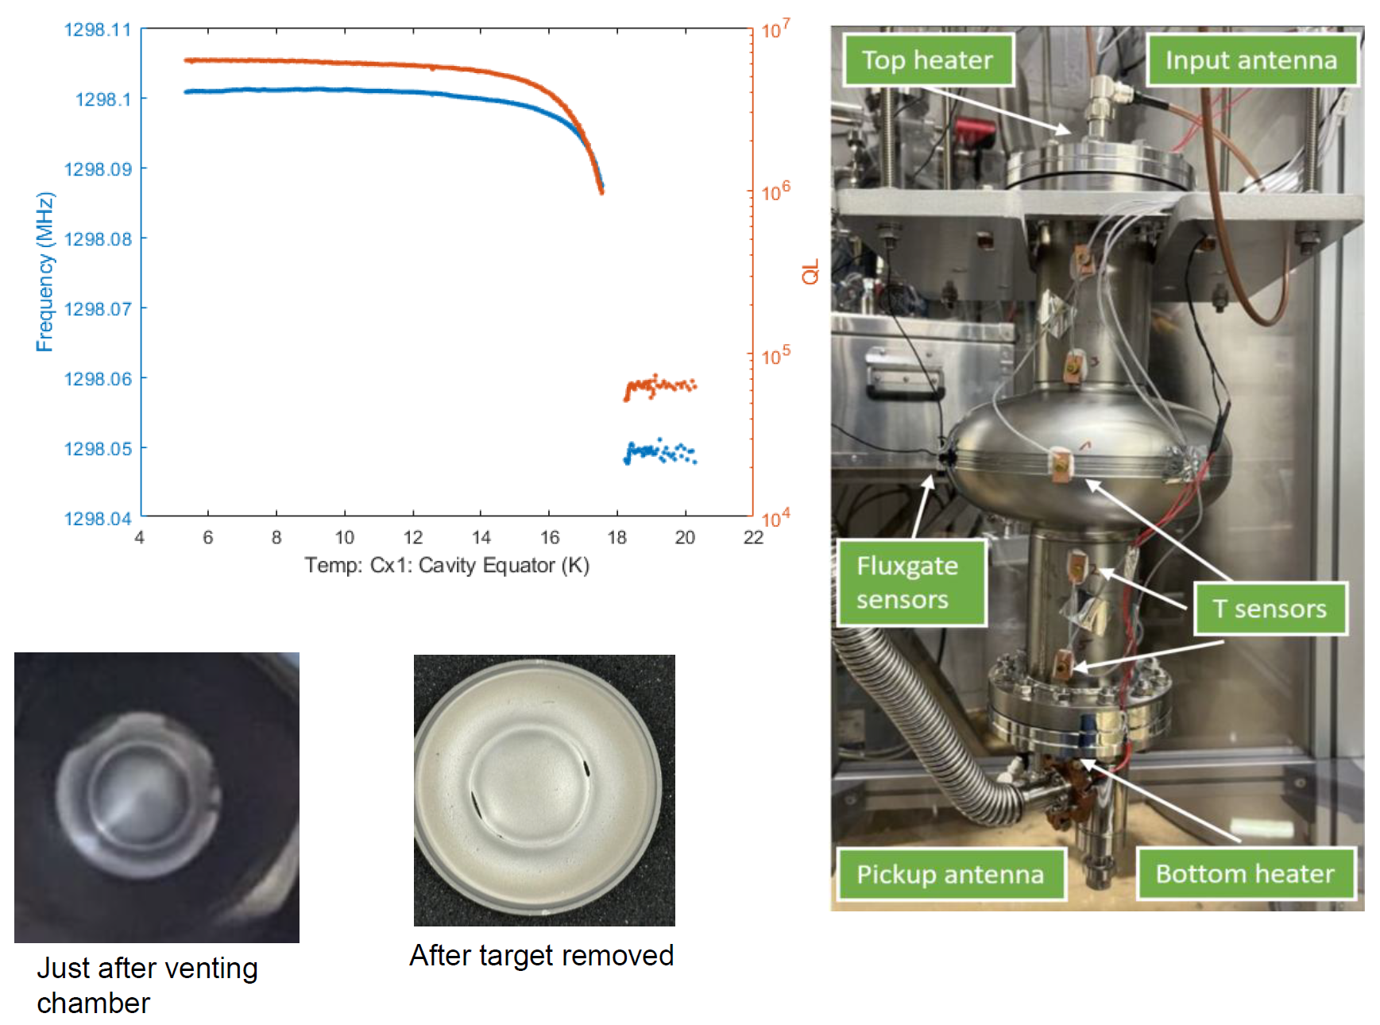
WP3 Nb₃Sn on Cu films for 4.2K cavity operation
Task 3.5 – Working Cavity - achievements
First Cavity Coated @UKRI
before coating
after coating
Nb₃Sn on Nb bulk (reference cavity)
Tested at HZB
No HPR after Deposition
Fixed RF couplers (designed for Q_{o} of 10⁹)
Manually slow cool Down
No thermo-currents were recorded
with the azimuthally placed sensors.
Tc =18.1 K
No Tc of Nb was detected: Possibly cavity fully coated
RF surface resistance of 8 x 10⁶
Poor Q factor:
  Cu contamination at surface layer due to diminishing target
  Present of other normal conducting material due to poor cavity handling.
  Or other reasons to be determined.
Courtesy of R. Valizadeh

Slide 22
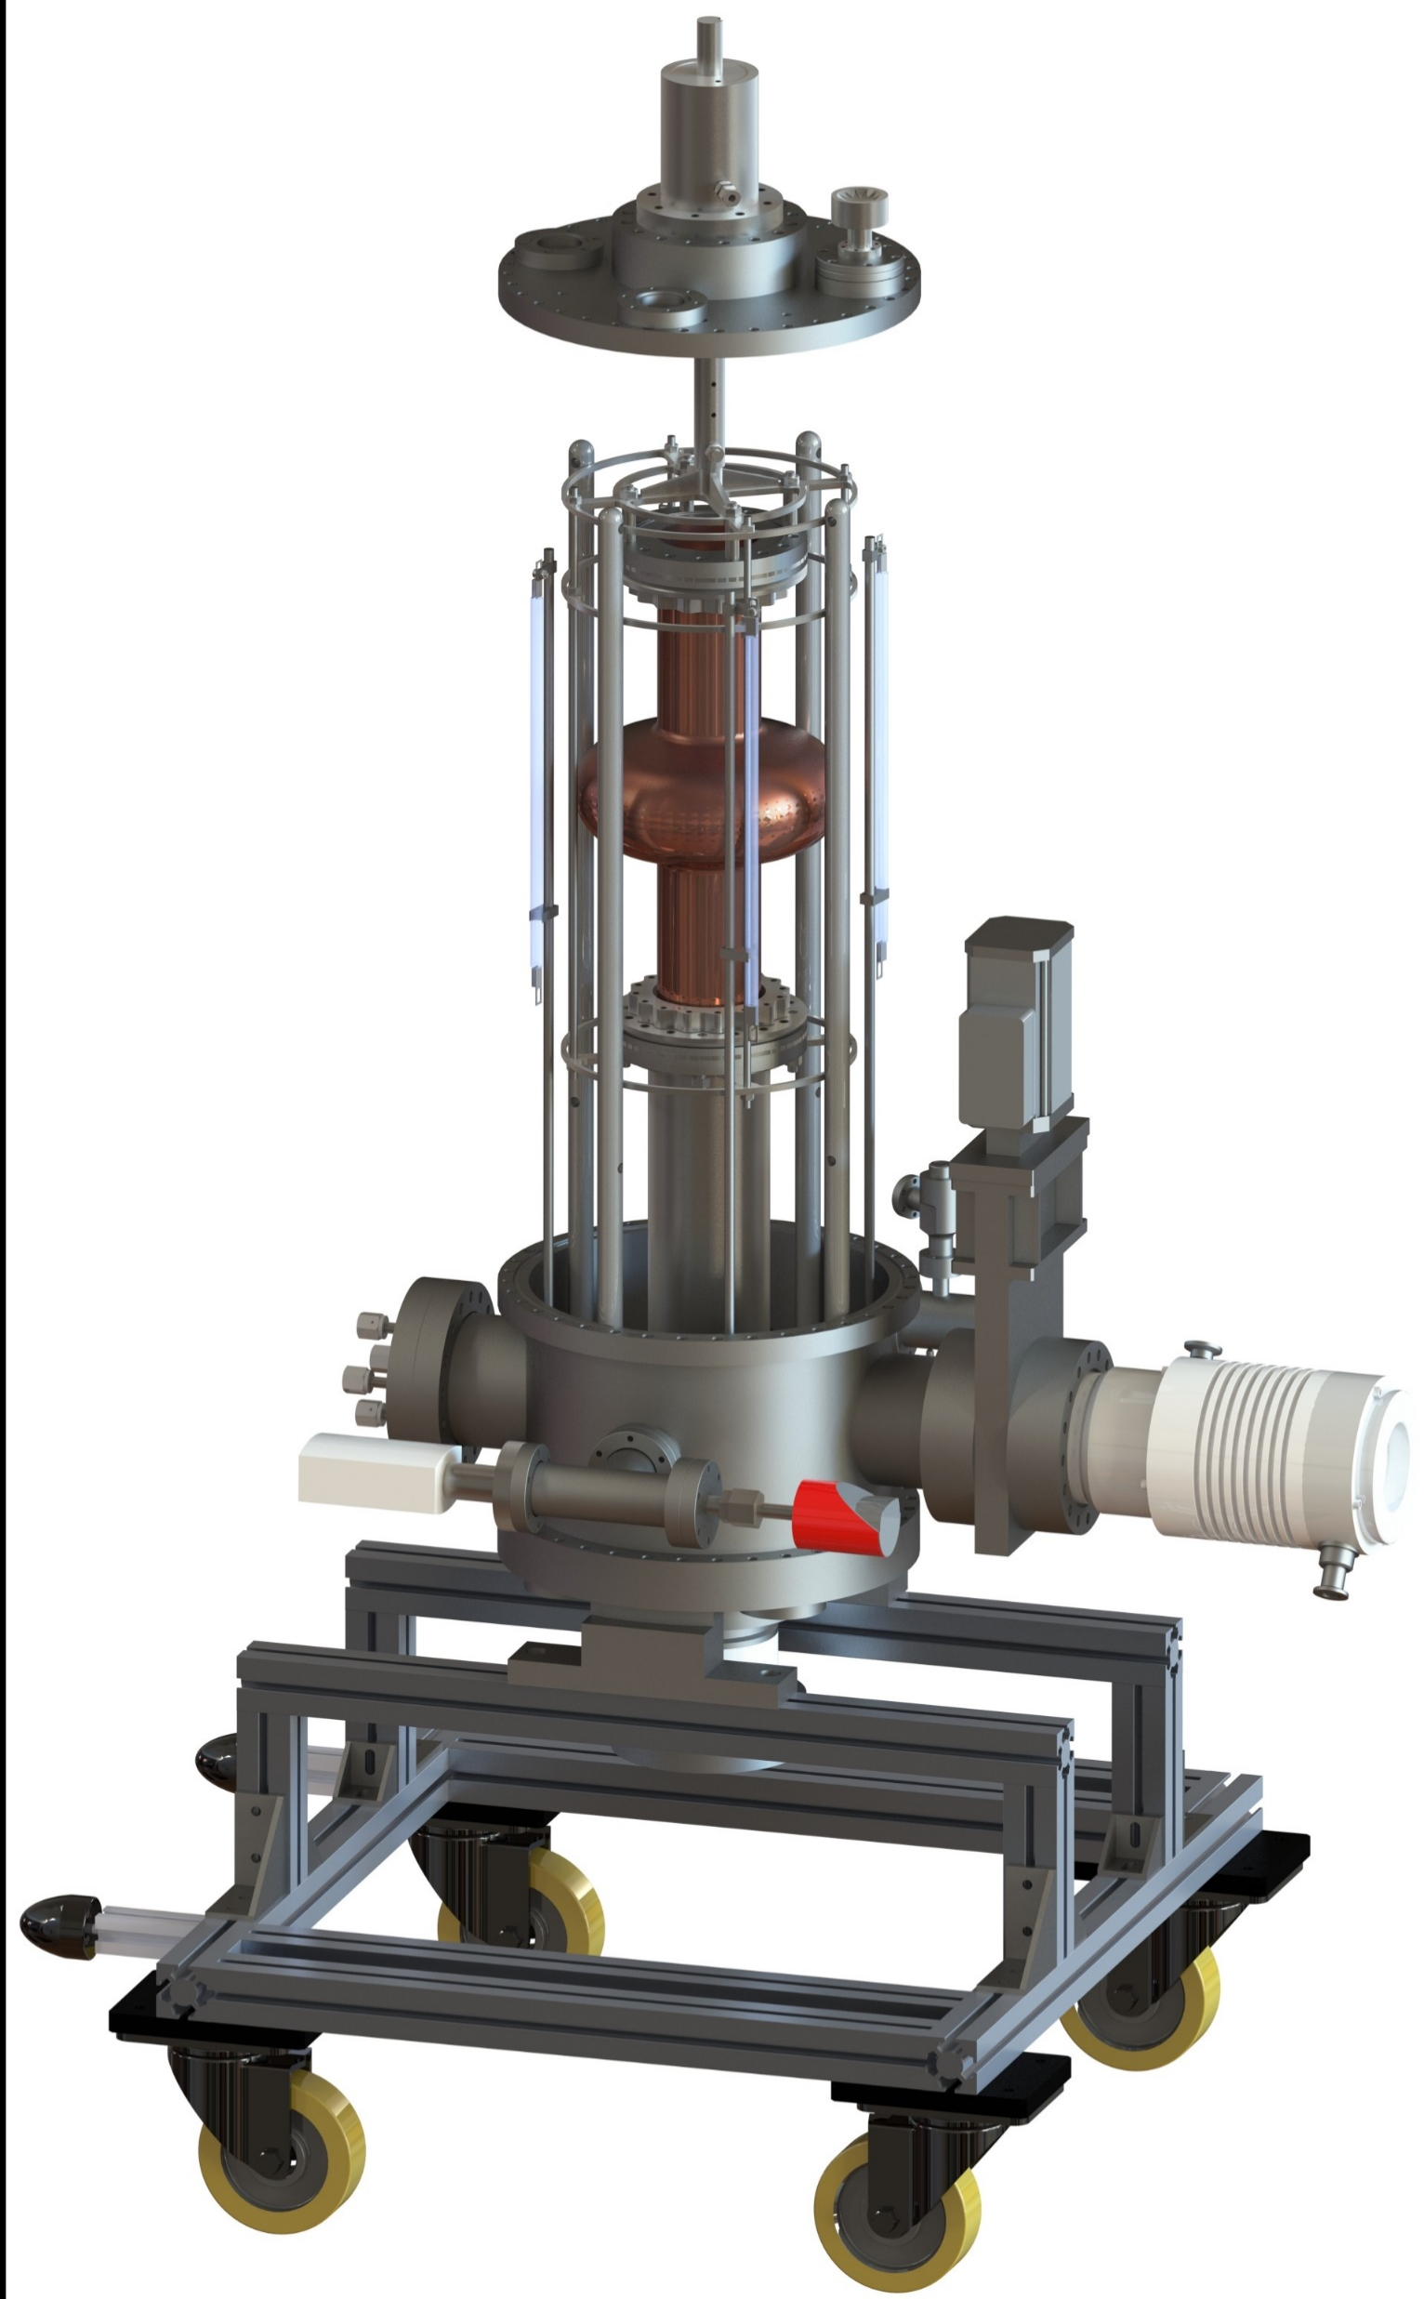
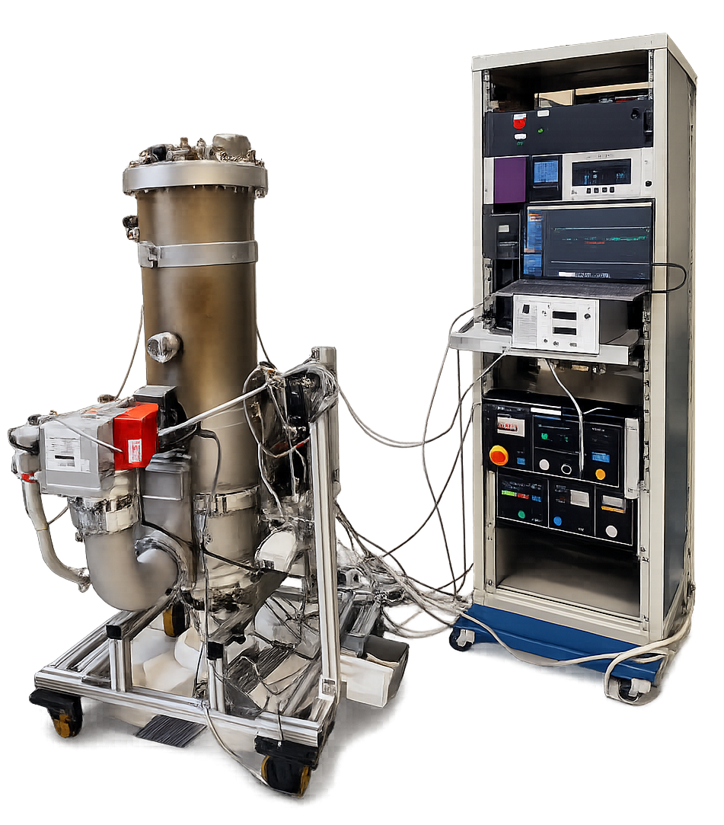
WP3 Nb₃Sn on Cu films for 4.2K cavity operation
Task 3.5 – Working Cavity - achievements
2 Different 1.3 GHz coating system ready (testing phase)
Rectangular magnetron
Rotating Cavity
Double movable magnetrons
Fixed cavity
ignited plasma
M. Lazzari et al., "Development of a new system for Nb₃Sn thin film deposition on 1.3 GHz cavities", in Proc. SRF2025, Tokyo, doi:10.18429/JACoW-SRF2025-TUP31
N. Leicester et al., "Development of a 1.3 GHz longitudinally split RF research cavity for use in testing of superconducting thin films", in Proc. SRF2025, Tokyo, doi:10.18429/JACoW-SRF2025-TUP19

Slide 23
WP3 Nb₃Sn on Cu: plans to achieve milestones & deliverables
Milestones & deliverables
on track
M3.1 Modification of choke cavity for flux trapping study - Engineering report M12
M3.2 Developed ALD adaptive layers on Cu - Engineering report M24
M39 Impact risk analysis WP3 – Presentation/report M24
M3.3 Report on mechanical strength test of SC coatings - Test report M30
M3.4 Characterization of Nb₃Sn reference cavity - Test report M34
D3.1 Cavity tuning Report on implementation of cavity Q vs F tuning tool - Report M24 - HZB
D3.2 Flux trapping Report on flux dynamics study in Nb3Sn on Cu samples - Report M30 - HZB
D3.3 Adapt. Layer Report on QPR study of Nb₃Sn on Cu & adaptive layers - Report M38 - CEA
D3.4 4.5-K Cavity Report on 4.5-K Cavity performance & tunability tests - Report M46 - INFN
M39
TODAY
M3.1
M3.2
M3.3
M3.4
D3.3
D3.4
Y0
Y1
D3.1
Y2
D3.2
Y3
Y4
2024 | 2025 | 2026 | 2027 | 2028
M | A | M | J | J | A | S | O | N | D | J | F | M | A | M | J | J | A | S | O | N | D | J | F | M | A | M | J | J | A | S | O | N | D | J | F | M | A | M | J | J | A | S | O | N | D | J | F
Task 3.1 - Coordination
Task 3.2 – Flux Trapping
Task 3.3 – RF Tunability
Task 3.4 – Adaptive Layers
Task 3.5 – Working Cavity @4.2K

Slide 24
WP3 Nb₃Sn on Cu films for 4.2K cavity operation
Next Steps
On track
Deliverable 3.2 Flux trapping Report on flux dynamics study in Nb3Sn on Cu samples - HZB - Report M30
New samples from INFN and STFC in preparation
Search for correlation between deposition parameters and the initial penetration field is currently in progress
Milestone 3.3 Report on mechanical strength test of SC coatings - Test report M30
On track
The Cu traction samples in preparation at CEA. Will be sent to INFN and UKRI for Nb₃Sn/Nb deposition
Deliverable 3.3 Adaptive Layer Report on QPR study of Nb₃Sn on Cu & adaptive layers - CEA - Report M38
On track
Continue R&D on planar coupons trying different configurations
Coat and test QPR with optimized configuration
On track
Deliverable 3.4 4.5-K Cavity Report on 4.5-K Cavity performance & tunability tests - INFN - Report M46
Characterize the Reference Cavity with Blade Tuner and flux trapping probe @HZB
Milestone 3.4 Characterization of Nb3Sn reference cavity - Test report M34
On track
Continue test on coupons to optimize SC film quality along the cavity and and ensure performance reproducibility
Coating Nb₃Sn on Bulk Nb cavity first + RF test
Coating Nb₃Sn on Cu cavity + RF test

Slide 25
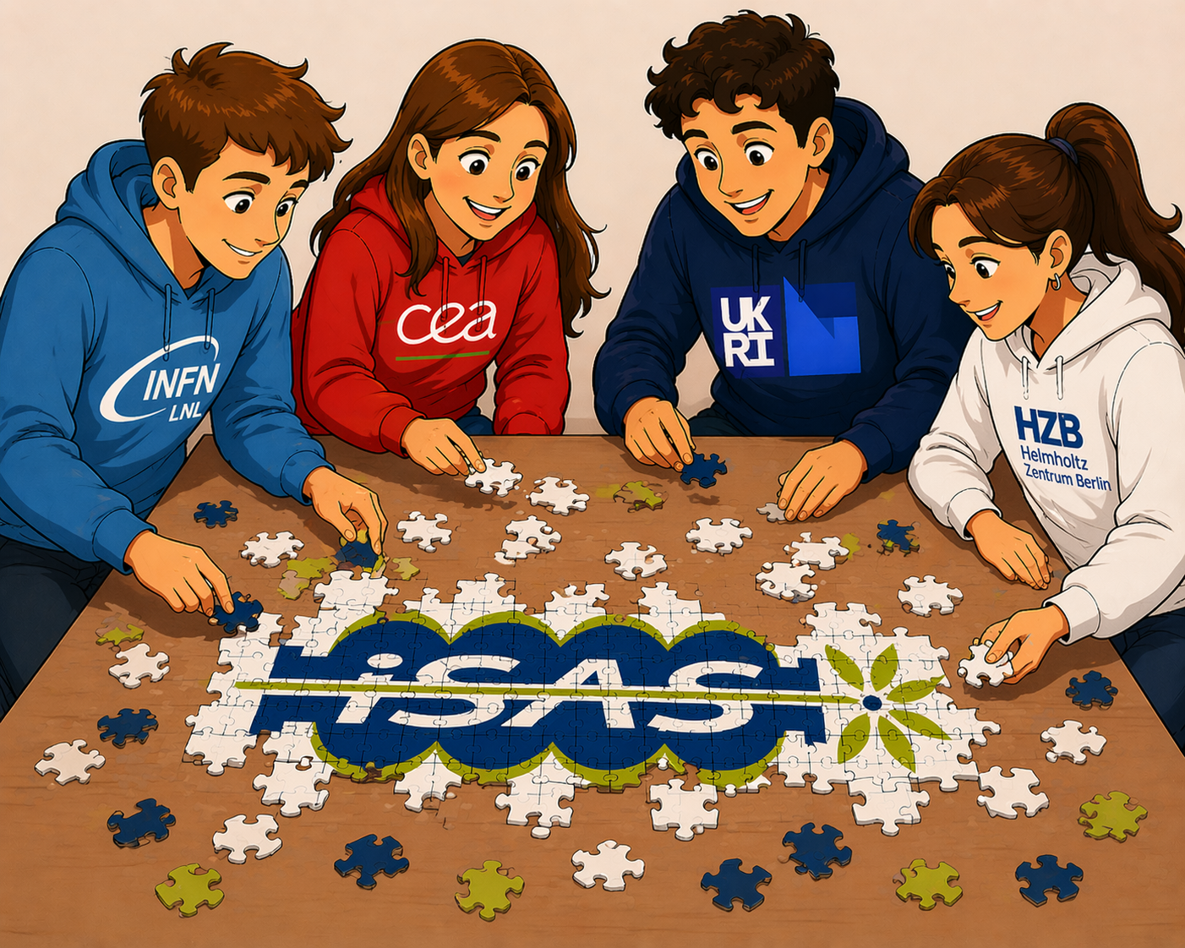
WP3: Nb₃Sn on Cu films for 4.2K cavity operation
Conclusion
Milestone and deliverables on track
During Period 1, the individual components of the puzzle were produced
(coating facilities, characterization facilities, optimized coating recipes, …)
During Period 2, these pieces will be combined to produce the 1.3 GHz cavity
Generated with ChatGPT
Notes:
Let's hope all these pieces fit together well and that none are missing!

Slide 26
Thank You!

