Slide 1


WP4:
High-Order Mode dampers &
Fundamental Power couplers
RP1 review meeting, June 1st, 2026
All information contained in this presentation and any accompanying documents is for iSAS project only, and must be treated as strictly confidential.
Any dissemination, distribution or other use of this information without the consent of its owner is prohibited.
Funded by the European Union. Views and opinions expressed are however those of the authors only and do not necessarily reflect those of the European Union or the European Commission. Neither the European Union nor the granting authority can be held responsible for them.

Slide 2
WP4: HOM dampers and FPC
CERN, CNRS ( IJCLab, LPSC), INFN
Convener: Y. GOMEZ MARTINEZ (CNRS/LPSC)
Main contacts with other partners: V. PARMA (CERN), P. DUCHESNE (CNRS/IJCLab),
D. GIOVE (deputy INFN)
Context :
-High order modes (HOM) can be excited in cavities by high-power beams. Energy Recovery Linacs ERLs (as PERLE and BriXSinO) are particularly subject to HOM excitations due to recirculation of high-current beams Improper extraction of HOMs can strongly limit the beam intensity due to beam breakup instabilities and induce excessive RF losses in the superconducting cavity walls
HOM dampers deposit them into loads at higher temperatures reducing significantly cryogenic heat loads:
  HOM couplers (HOC) damp the HOMs trapped in the cavity
  Beam-Line Absorbers (BLAs) damp the HOMs propagating through the beam pipes
-Fundamental Power Couplers (FPCs) introduce power into the cavities at their Fundamental Mode (FM) to accelerate the beam
WP4: Main goal ‘ energy saving from the beam’:
Provide 4 FPC, 4 HOM couplers and 1 BLA durable and with a minimum of energy consumption, for their integration into ERL superconducting cryomodules

Slide 3
WP4 –HOM dampers and FPC : Key outcomes
Successfully design, fabricate, and test 4 FPCs and 4 HOM couplers for PERLE ( WP6 cryomodule), and design and fabricate 1 BLA for BriXSinO
Focus on thermal design optimization, as FPCs and HOM dampers heat power can account for up to half of the cryogenic load on a linac*
Explore various ceramic materials for BLA applications at cryogenic temperatures, to improve energy savings in supraconducting accelerators
*estimated for the Cornell CBETA ERL linac

Slide 4
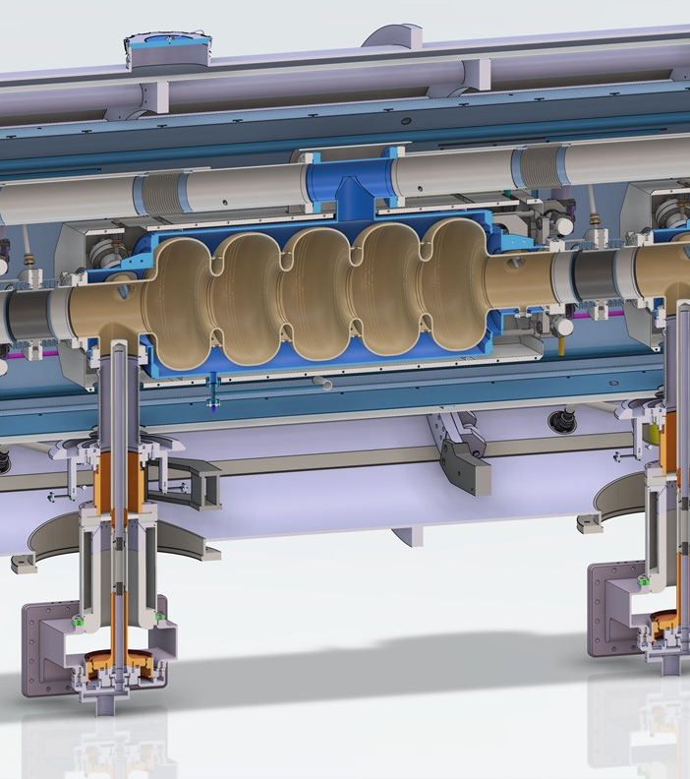
WP4 – HOM dampers and FPC
CERN, CNRS ( IJCLab, LPSC), INFN
Convener: Y. GOMEZ MARTINEZ (CNRS/ LPSC)
Main contacts with other partners: V. PARMA (CERN), P. DUCHESNE (CNRS/IJCLab), D. GIOVE (deputy INFN)
Task 4.1: General coordination of WP4 March 24 – March 28 CNRS, INFN
Task 4.2: HOM coupler design March 24 – August 25 INFN, CNRS, CERN
At 802MHz
Task 4.3: Fabrication of HOM couplers May 25 – December 2026 CERN, CNRS, CERN
Fabrication of 4 HOM couplers
Task 4.4: Test of HOM couplers Nov 25 – (March 27)- September 27 CNRS, INFN
At 802 MHz at room temperature
Task 4.5: FP coupler design March 24 – June 25 CERN, CNRS
At 802 MHz 50 kW CW
Task 4.6: Fabrication of FP couplers July 25 – January 27 CERN, CNRS
4 FPC at 802 MHz
Task 4.7: Test of FP couplers Feb 26 – (June 27) – December 27 CERN, CNRS
Preparation & RF conditioning 802 MHz, 50 kW CW
Task 4.8: BLA design January 26– May 26 INFN, CNRS
With the goal to cover a very significant gap in the sector (at 1,3 GHz and 800 MHz and up to 100 W )
Task 4.9: Fabrication of BLA May 26 – August 26 INFN, CNRS
Build 1 prototype at 1,3 GHz BLA
Task 4.10: Test of ceramics of BLA Jan 26 – (March 27)- Dec 27 INFN, CNRS, CERN
At room and cryogenic temperature
c/o G.Olivier (IJCLab/CNRS)

Slide 5
WP4 – HOM dampers and FPC : achievements of Task 4.1
General coordination
WP4 coordination meetings : 24
2 technical review organised (HOM coupler & FPC)
3 tasks finished (4.2 ‘HOM coupler design’, 4,5 ‘FPC design’, 4.8 ‘ BLA design’ )
3 milestones (FPC, HOMC, BLA design report) sent in time
Interaction with WP5, WP6 and WP7

Slide 6
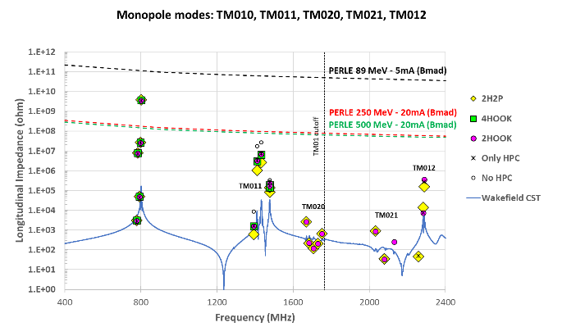
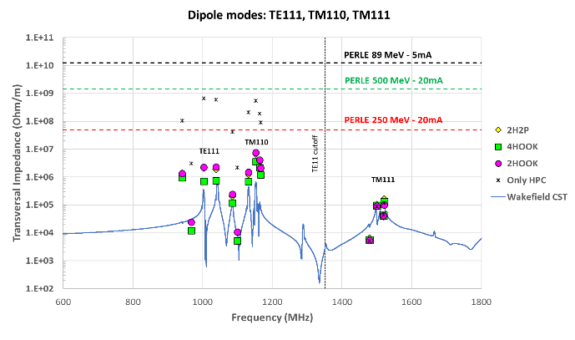
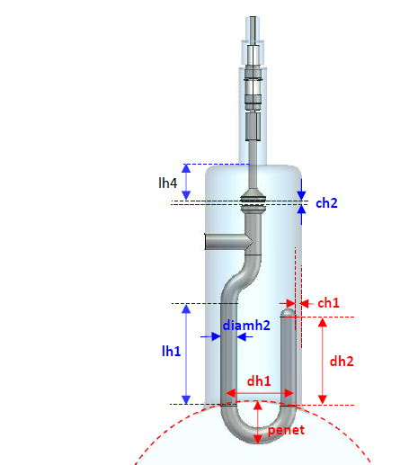
WP4 – HOM dampers and FPC : achievements of Task 4.2
HOM coupler design (1/3)
The HOM coupler damping scheme for PERLE was chosen (IJCLab/ CNRS)
Several configurations studied ( 2 probes and 2 hooks & 4 hooks & 2 hooks/ cav) : 2 Hooks/cav selected @5mA beam
The Hook HOM coupler optimization was completed ( IJC Lab/CNRS)
Based on the RF design of 800 MHz HOOK coupler for HL-LHC (CERN)
  Mechanical integration into the WP6 PERLE cryomodule
  RF simulations
    To ensures the HOM damping requirements, obtain the best transmission at dangerous mode (TE111 & TM110), ensuring an effective rejection of the fundamental mode (TM010)
    Using standard material when possible as RF feedthrough
c/o P.Duchesne (JCLab)
Parameters considered for the RF sensitivity studies
Impedances vs frequencies for monopole and dipole modes

Slide 7
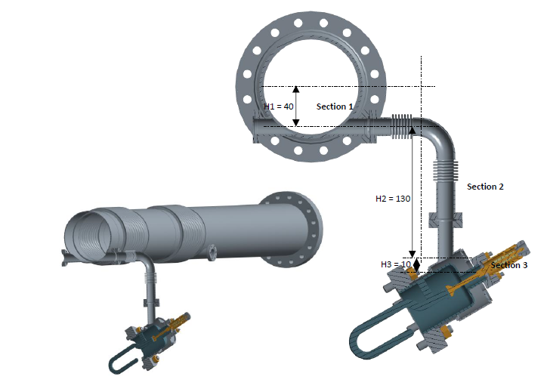
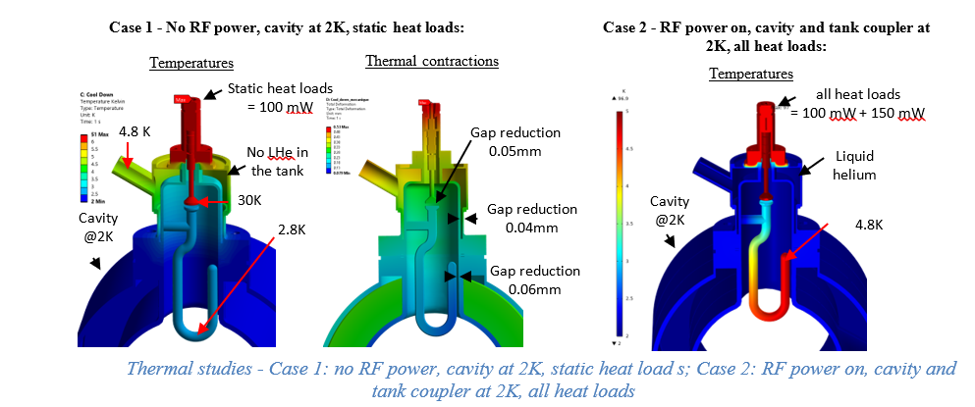
WP4 – HOM and FPC: achievements of Task 4.2
HOM coupler design (2/3)
Thermal calculations
  Minimization of the heat loads on the cryogenic circuits of the cryomodule:
    Static heat loads of the thermal conduction from room temperature : 100mW @2W over 2m length is expected
    Dynamic losses due to the RF power extracted of <150 mW at 2 K for HOMs and <490 mW for FM is expected
      →Thermalisation 50 K at the center and cables type RG142 PTFE
      →A high RRR niobium required to avoid thermal quench (RRR300)
  Optimization of the cooling circuit
    →Helium superfluid in the tank of the HOM coupler required : 2185mW lowest capacite of heat transport
    →Maximum heat that can be evacuated depends on the helium level H1
    Cooling down and nominal conditions ( RF= ON/ OFF) studied
c/o P. Duchesne (IJCLab)
H1
Overview of the cooling circuit for the HOM coupler
Thermal simulations

Slide 8

WP4 – HOM and FPC: achievements of Task 4.2
HOM coupler design (3/3)
Estimation of HOM power (P.Duchesne/ IJC Lab)
  Wakefield simulations on the 5-cell cavity
with In normalized fourier spectrum of the beam current.
P_{HOM} | TOTAL | 2 beam pipes | FPC | 2 Hook
W | 130 | 113 | 13 | 1
% | 100 | 87 | 10 | 0,8
c/o P. Duchesne (IJCLab)
As 87% of the HOM power goes into the beam pipes, we proposed in January 2026 three new tasks (task 4.8, 4.9 and 4.10) to work on BLA instead the study of HOM coupler at 1,3 GHz ( planned in task 4.2)

Slide 9
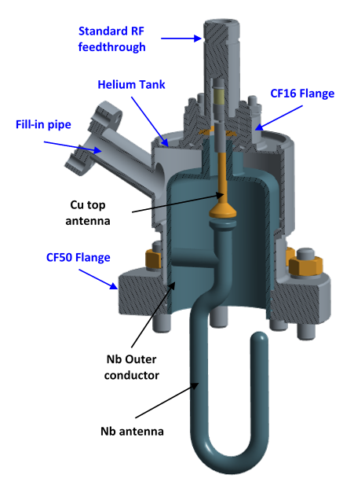
WP4 – HOM and FPC: achievements of Task 4.3 and 4.4
HOM couplers manufacture and test
HOM couplers manufacture (CERN)
  A detailed manufacturing sequence has been established
  Raw materials have been ordered and received
c/o S. Blivet (IJCLab)
Hook coupler

Slide 10
WP4 – HOM dampers and FPC : achievements of Task 4.5
FP coupler design (1/2)
c/o S. Blivet (IJCLab)
    FPC optimization done
      RF simulations and mechanical integration into the WP6 PERLE cryomodule (CNRS)
        Based on the design of the CERN’s 704 MHz SPL coupler
Antenna
c/o C. Sharp ( CERN)
Ceramic
SPL FPC
Parameter | Specification | Comment
Frequency | 801,58 MHz
Traveling wave (TW) maximal power | 50 kW CW | 4*50kW: E_{max} < 1 MV/m , E _{max triple points} < 0,3 MV/m
Standing wave (SW) maximal power | 50 kW CW
Max. reflection S₁₁ @ 801,58 | <- 30 dB | -61 dB obtained
S₁₁ bandwidth at -20dB | > 10 MHz | 10 MHz at -20 dB
Qext range ( at cold temperature) | 7×10⁶ < Qext < 1×10⁷ | Antenna penetration: -18.5 mm; -15.5 mm
PERLE FPC

Slide 11
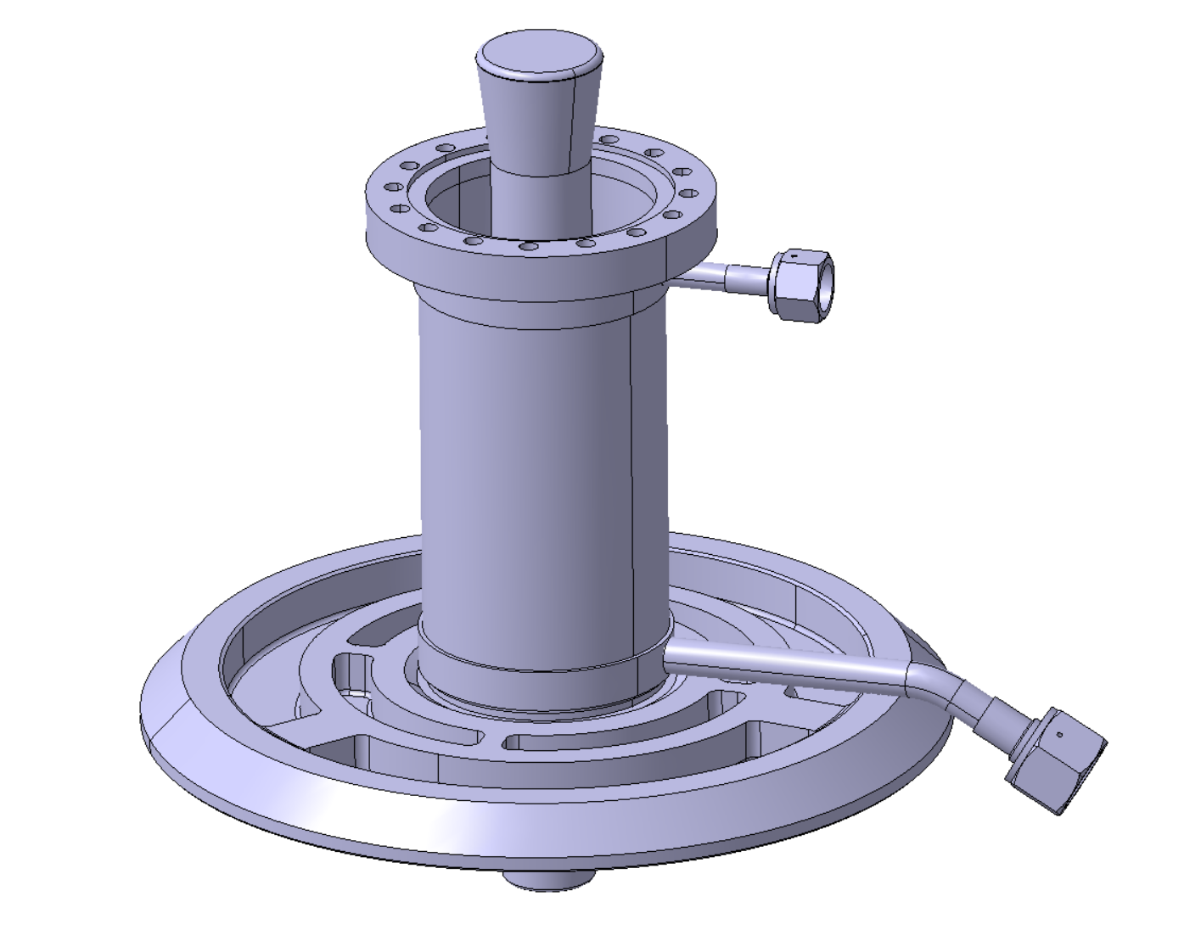
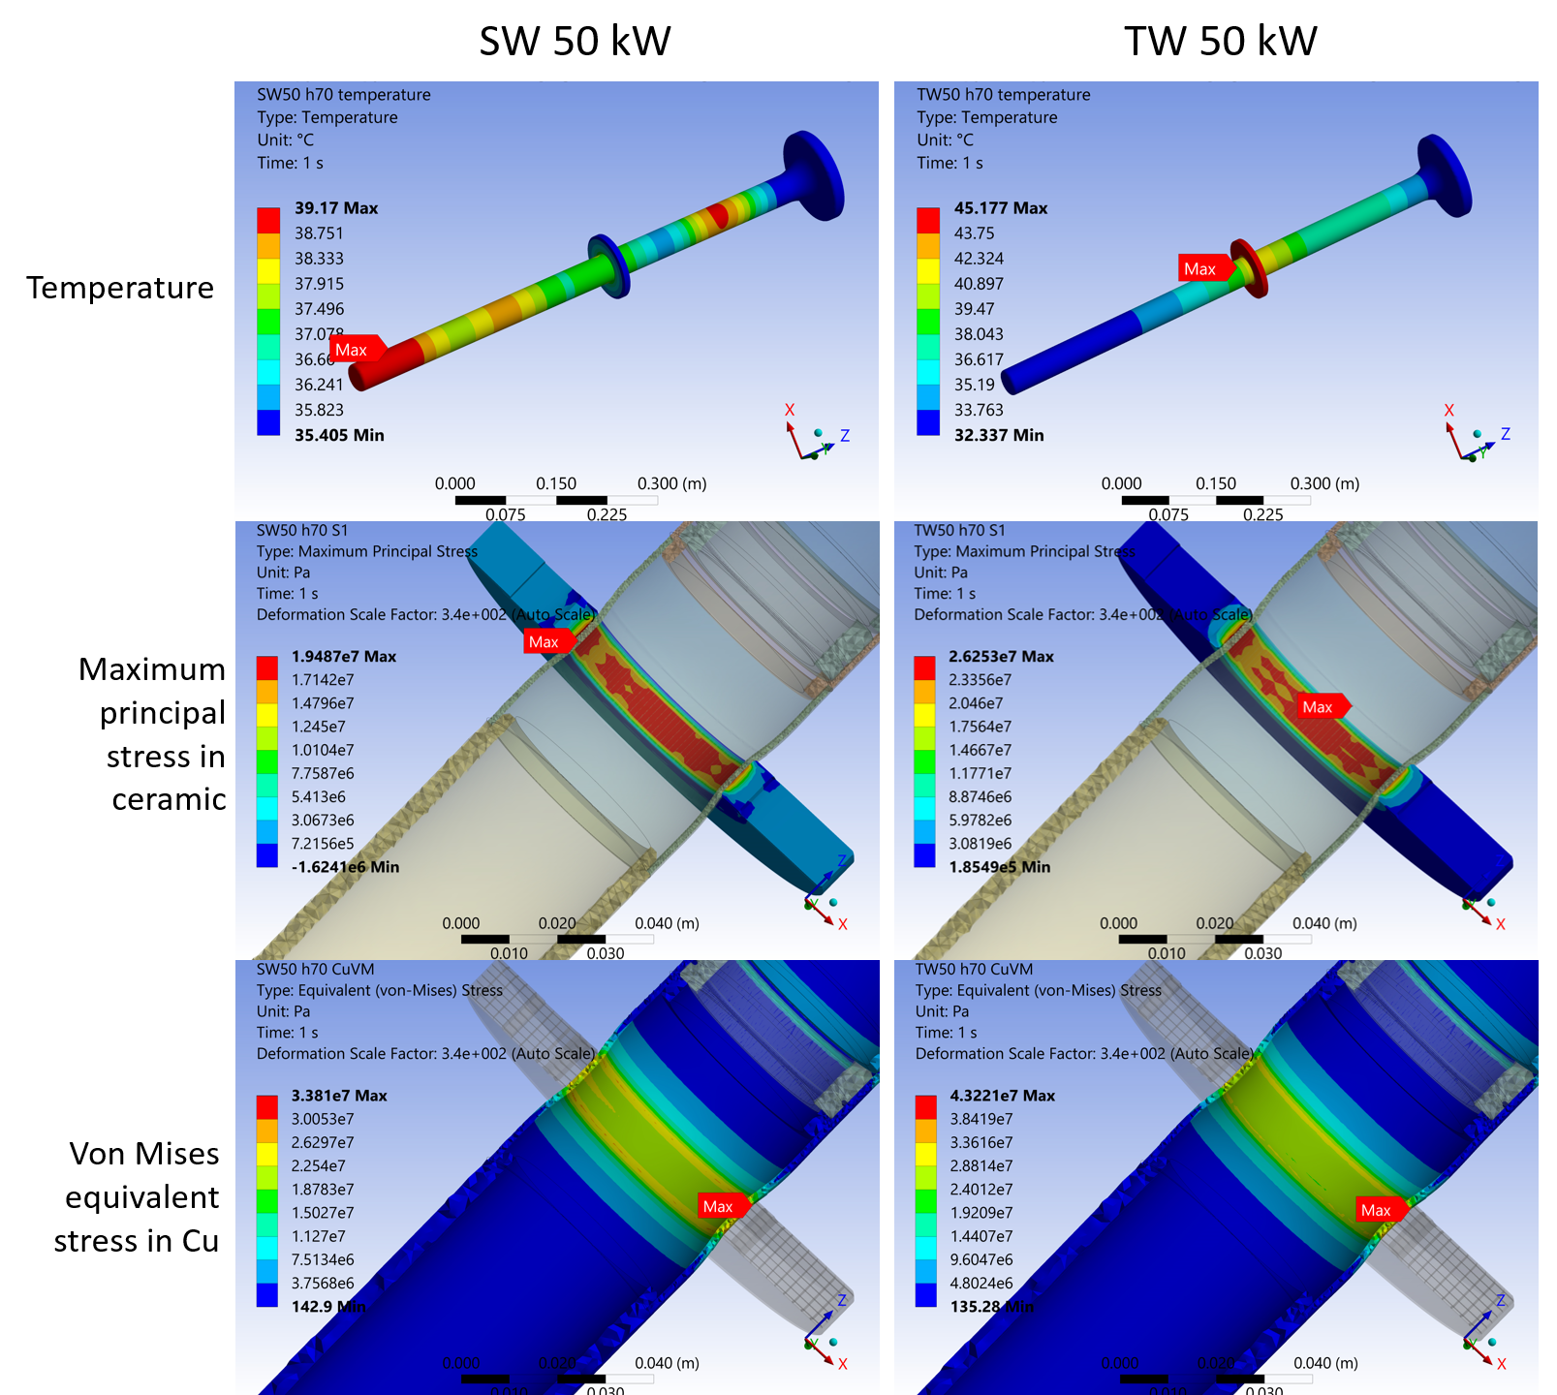
WP4 – HOM dampers and FPC : achievements of Task 4.5
FP coupler design (2/2)
    Thermal simulations (CERN)
        Antenna and window air cooling studies (C.Sharp)
          Thermo-structural finite element studies on antenna/window assembly
            →Air cooling > 400 l/min in antenna circuit and electrical heaters on the window to mitigate the risk of condensation
        Outer conductor cooling with supercritical helium flow (K. Canderan)
          Estimation with numerical model including the worst case full reflection case.
          Optimisation of the cryogenic costs → Lower the inlet temperature to lower the heat loads
          Comparison of heat intercept versus Helium flow→ Up to 65% saving with He flow
 | RF on (full reflection)
Heat released to the He bath @2K | 0.5 W (inlet 5.1K) – 1.8W (inlet 9K)
RF power dissipated in the DWT | 6.25 W
Radiation heat load to the DWT | 0.77 W
Radiation heat load to the He bath @2K | 0.5 W
Input heat required | 34 W ( at warm flange) – 8,2 W ( at He outlet pipe)
Liquefaction capacity | 23.1 mg/s
Total cryogenic cost [W_{el}] (*) | 0,96 kWel ( inlet 5,1 K) -2.2 kWel ( inlet 9K)
Results for the antenna temperature
Results for the outer conductor
(*) W_{el} calculated assuming 15% of the Carnot efficiency

Slide 12
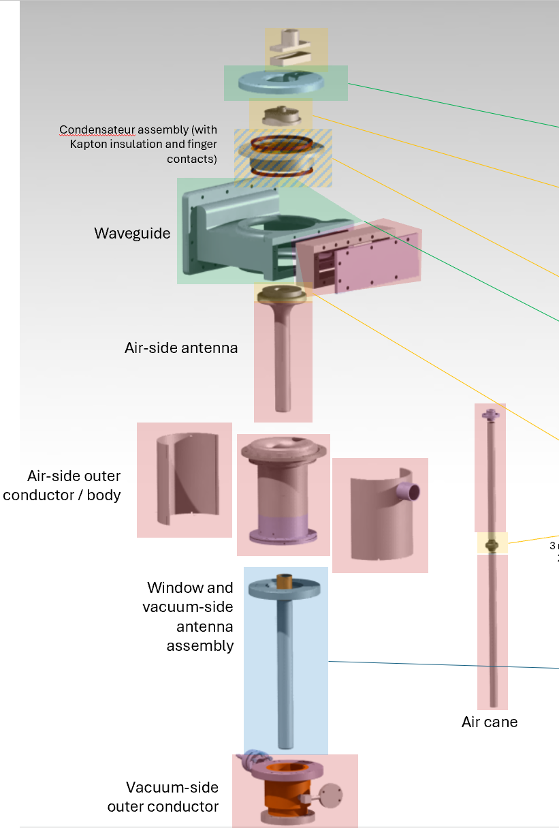
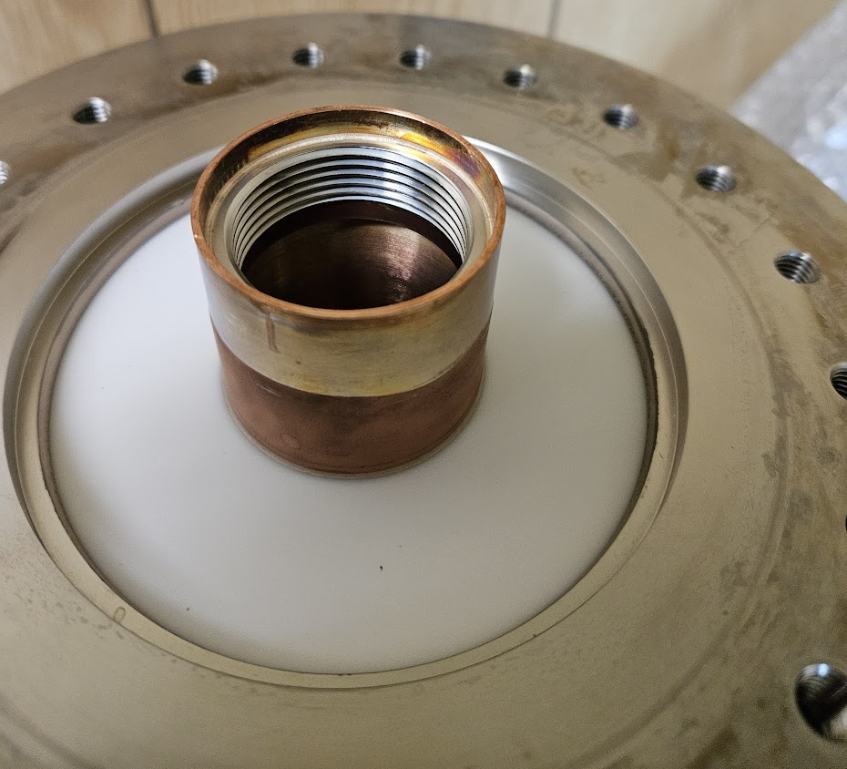
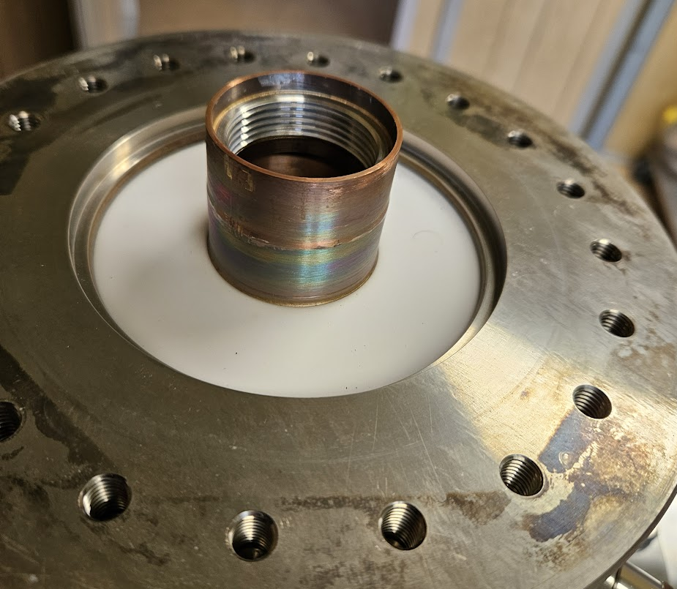
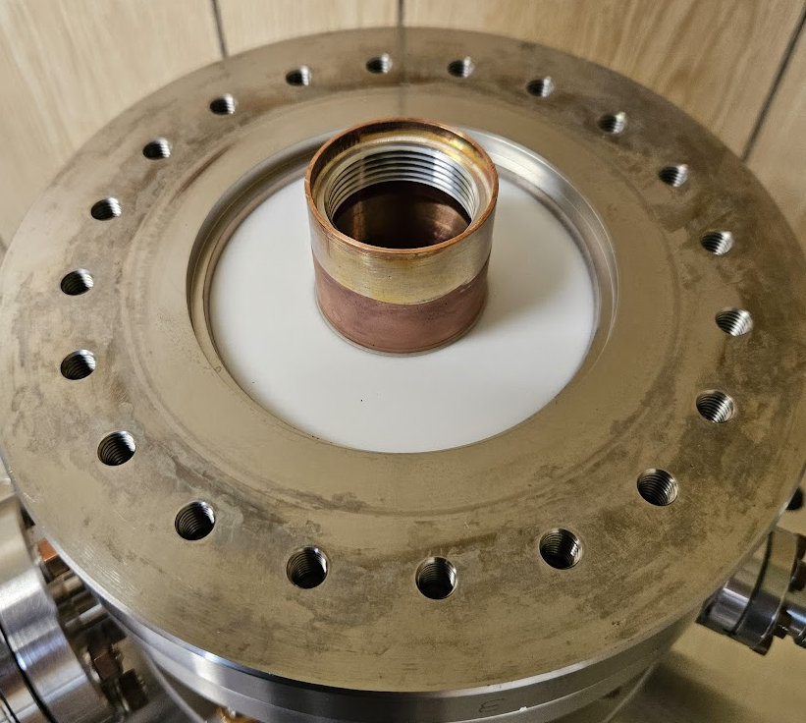
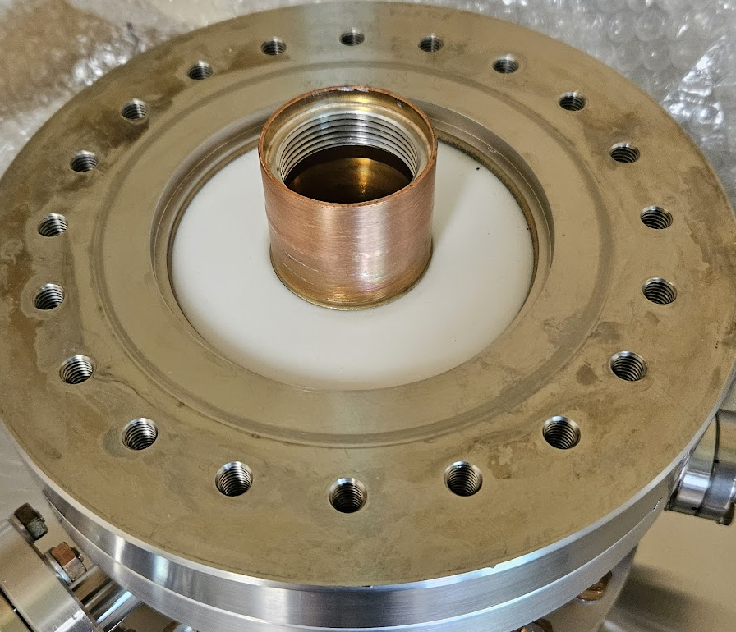
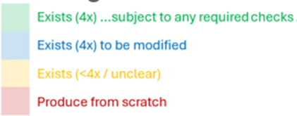
WP4 – HOM dampers and FPC achievements of Task 4.6
Fabrication of FP couplers
FPC components
  Inventory of existing components completed
  Reusing components: SPL antenna/window , ESS cylindrical double walled tube and waveguide.
c/o C. Sharp (CERN)
Existing antenna/window assemblies

Slide 13
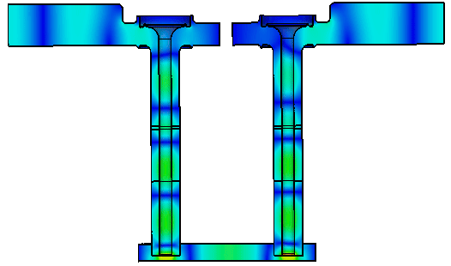
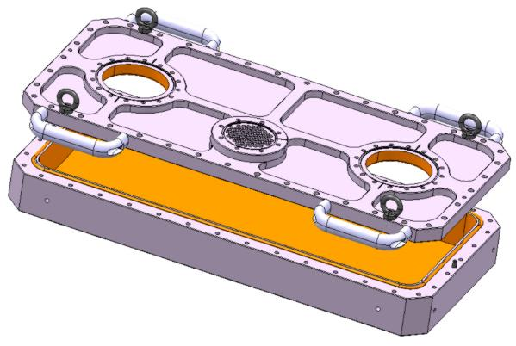
WP4 – HOM dampers and FPC : achievements of Task 4.7
Test of FP couplers
  RF simulations ( CERN)
    Test box RF studied completed → reusing the CERN 704 MHz test box at 800 MHz. To be modified
704 MHz test bench test box
$RF simulation : f=801 MHz, d_{tip}=18.5 mm$, Pin=0.5 W
c/o S. Gorgi Zadeh (CERN)
c/o C. Sharp (CERN)

Slide 14
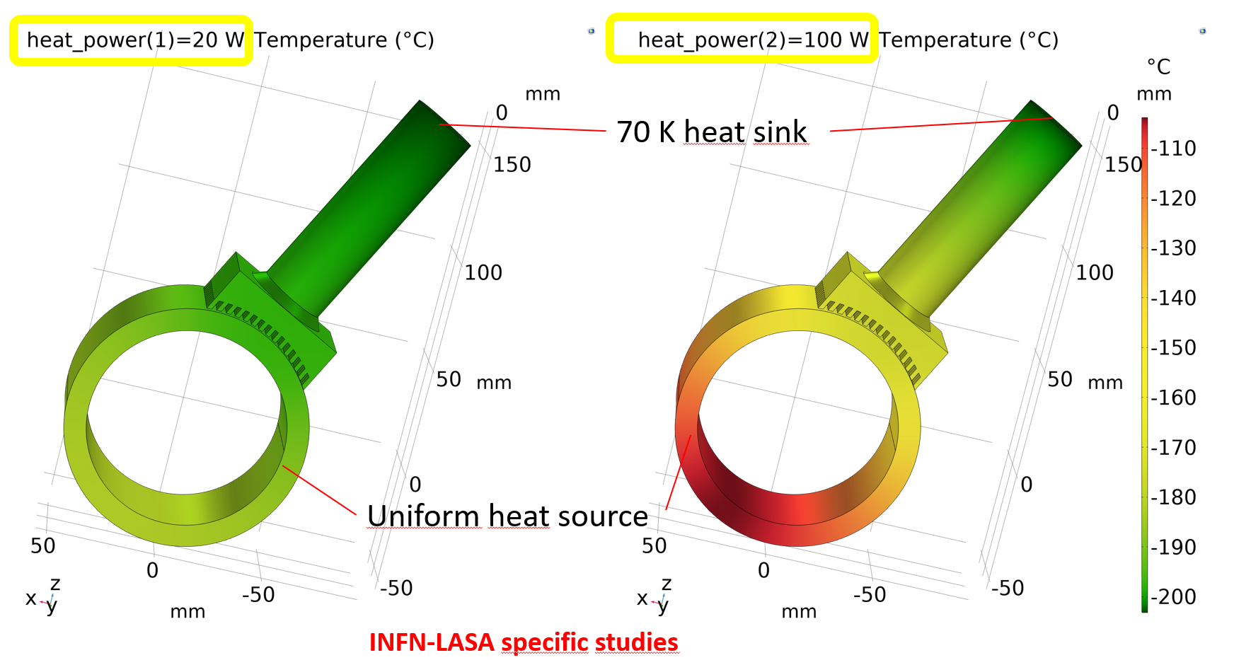
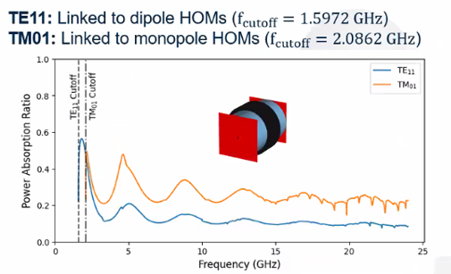
WP4 – HOM dampers and FPC : achievements of Task 4.8
BLA design
c/o B. Giove
Scouting work (INFN)
  BLA modern developments in accelerators
  For BriXSino :
  →BLA design type XFEL/ LCLS II using conduction through copper stubs directly at the cryogenic temperature
  →SiennaTech STL150D ceramic chosen
Thermal analysis (INFN)
  Development of a thermal model (COMSOL)
  Thermal analysis and a cryogenic design appropriate up to 100 W covering a very significant gap in the sector
RF simulations (CNRS/ IJCLab)
  Power absorption simulation for SiennaTech STL150D ceramic and Kyocera SC1000
Thermal simulation : Static load
Courtesy of D. Giove
RF simulation
c/o A. Miyazaki , A. Perez Ruiz
14

Slide 15
WP4 – HOM dampers and FPC : achievements of Task 4.9
Fabrication of BLA
Contacted companies (INFN)
    Kubara Lamina
    Sienna Technology
    Rial Saes Getters
    COMEB-Rome
    Coorstek
    Maruwa
    …

Slide 16
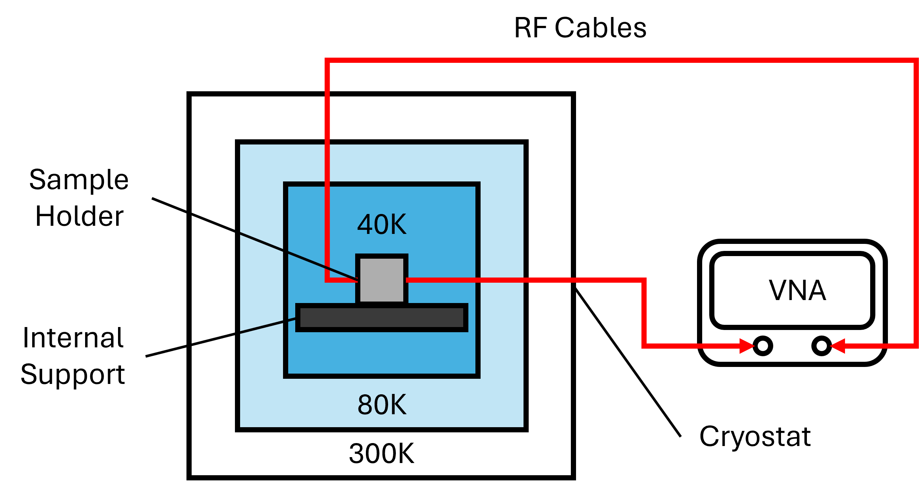
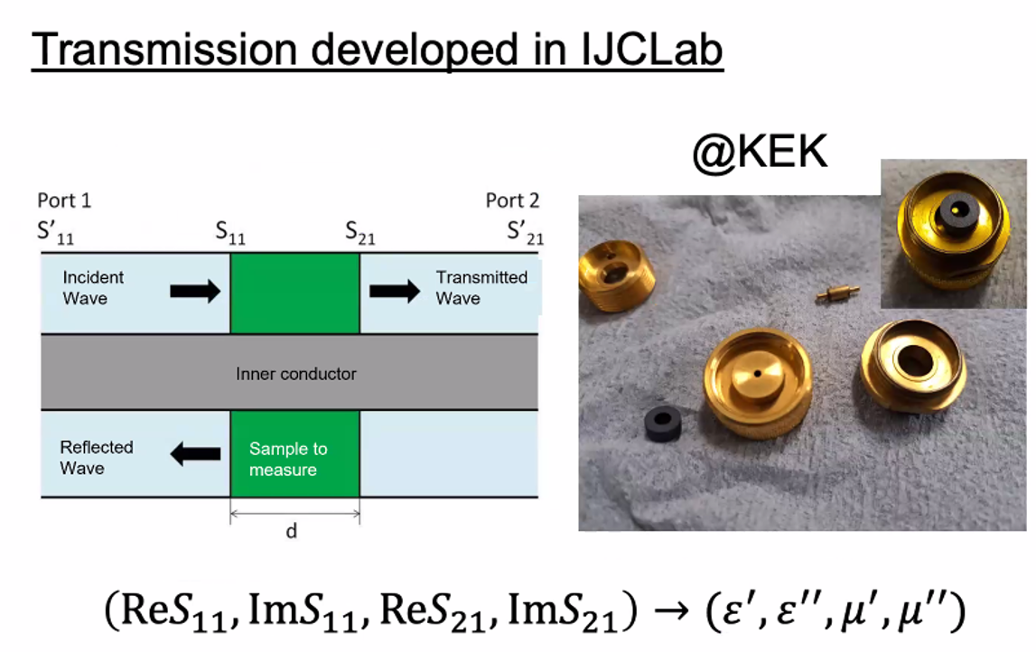
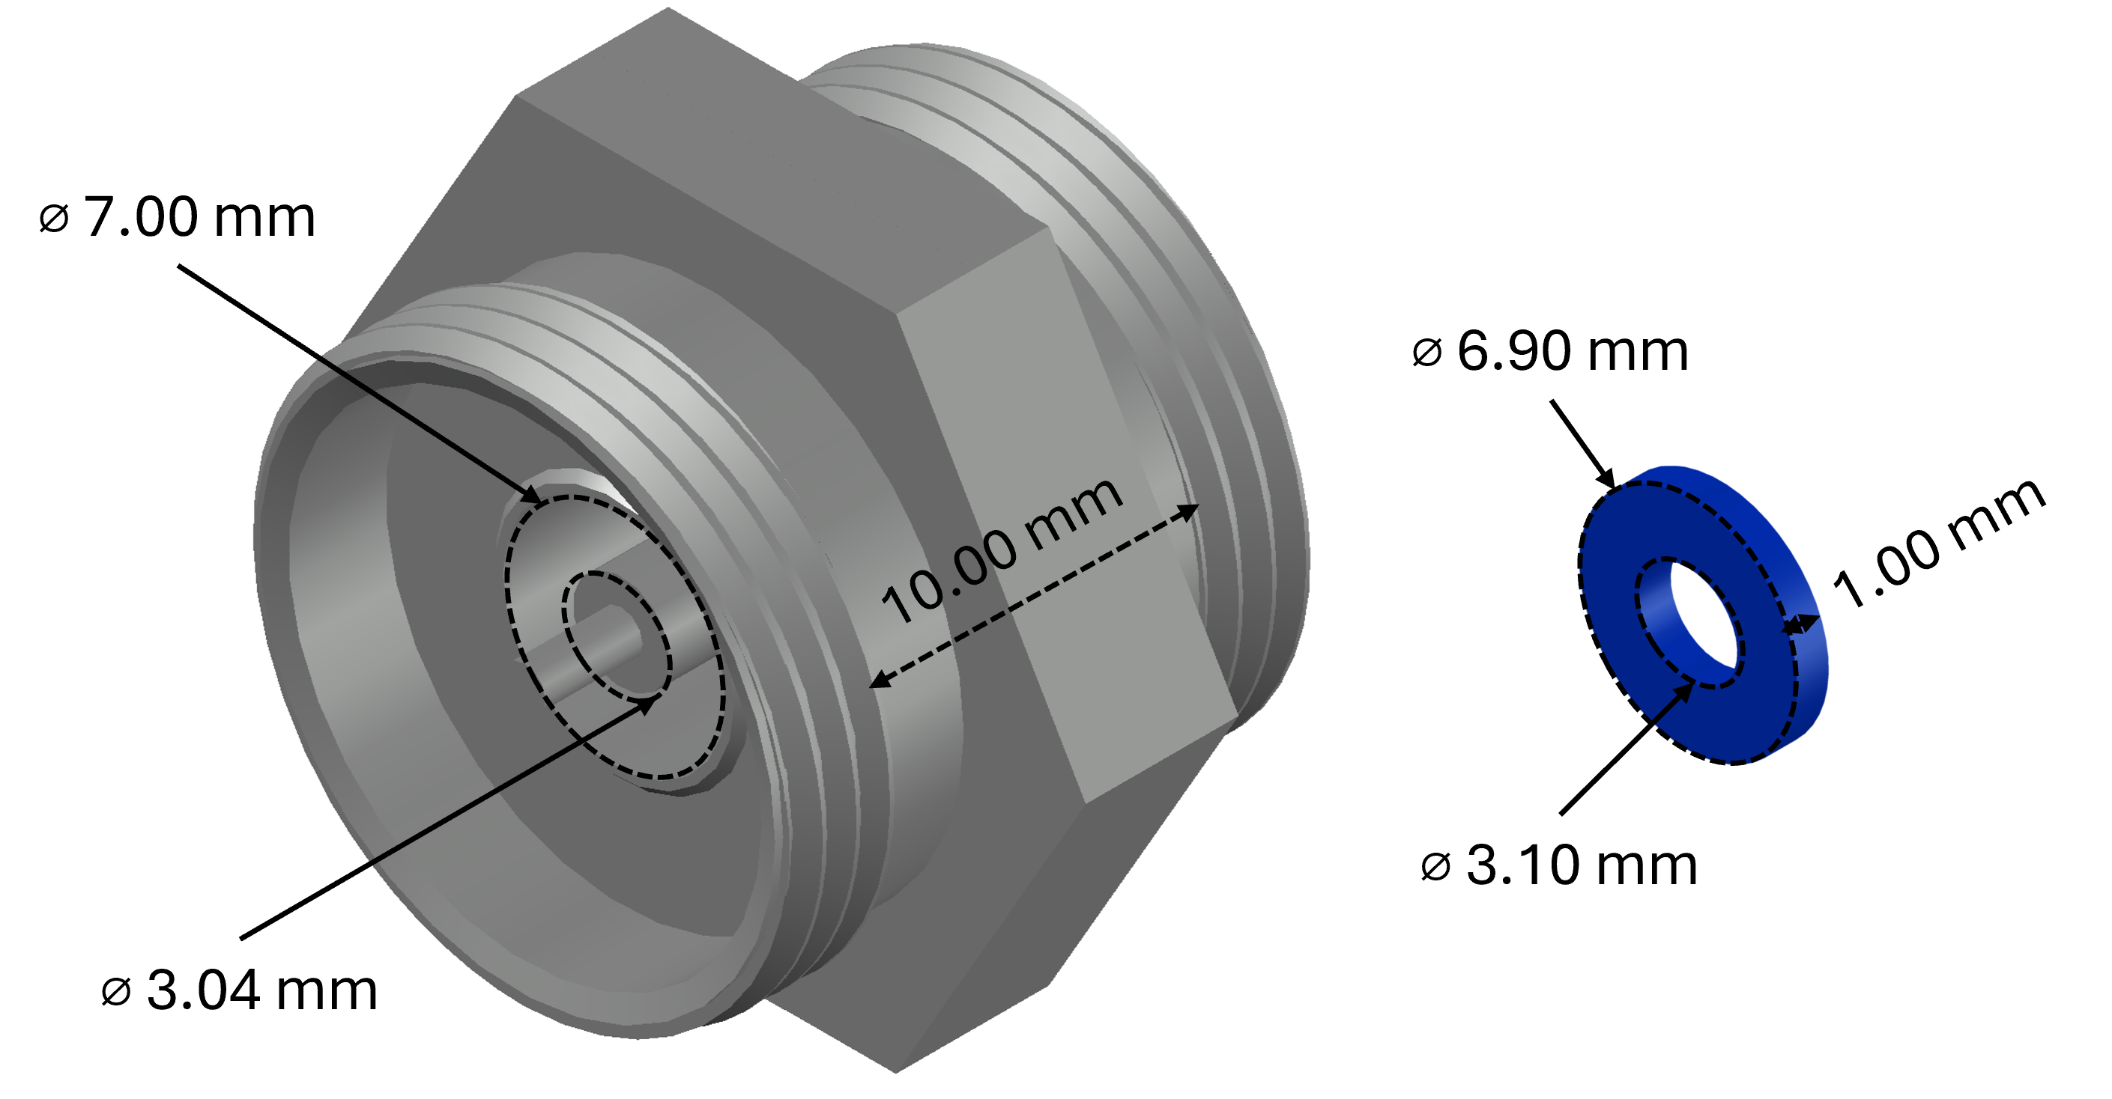
WP4 – HOM dampers and FPC : achievements of Task 4.10
Test of ceramics of BLA
  Innovante and new experimental setup at cryogenic temperature (IJC Lab/CNRS)
    Transmission and at cryogenic temperature measurement
  Reconstruction algorithm to retrieve ceramic properties from S-parameters ( IJC Lab/CNRS)
sample holder
sample under test
IJC lab transmision measurements set up
c/o A.Miyazaki ( IJCLab)
NRW : Nicolson Ross Weir

Slide 17
WP4 –HOM dampers and FPC : Next steps
FPC
  Detailed production drawings to be finished (within a few weeks)
  The fabrication of the 4 FPC (by January 2027)
  FPC test bench operational (by January 2027)
  Test of FPC (by June 2027)
HOM coupler
  The fabrication of the 4 HOM couplers has started, to be finished (until December 2026
  HOM test bench operational (by December 2026)
  HOM coupler tests (by March 2027)
BLA
  Launch of orders for the fabrication (within a few weeks)
  Manufacture follow-up (by August 2026)
  Test materials at room and cryostat temperature (by March 2027)

Slide 18
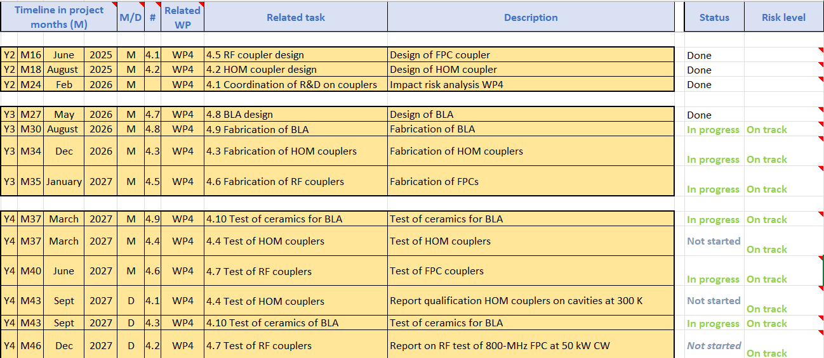
WP4 – HOM dampers and FPC :
plans to achieve milestones & deliverables

Slide 19
Thank-you for your attention
Yolanda Gómez Martínez on behalf of the WP4 team:
CERN : Simon Barriere, Sebastien Calvo, Karin Canderan, Marco Garlasche, Vittorio Parma, Calum Sharp
INFN: Dario Giove (deputy)
CNRS / IJCLab : Sebastien Blivet, Patricia Duchesne, Akira Miyazaki, Gilles Olivier, Guillaume Olry, Axel Perez Ruiz
CNRS / LPSC : J. Angot, Yolanda Gómez Martínez (convener), Adrien Plaçais

Slide 20
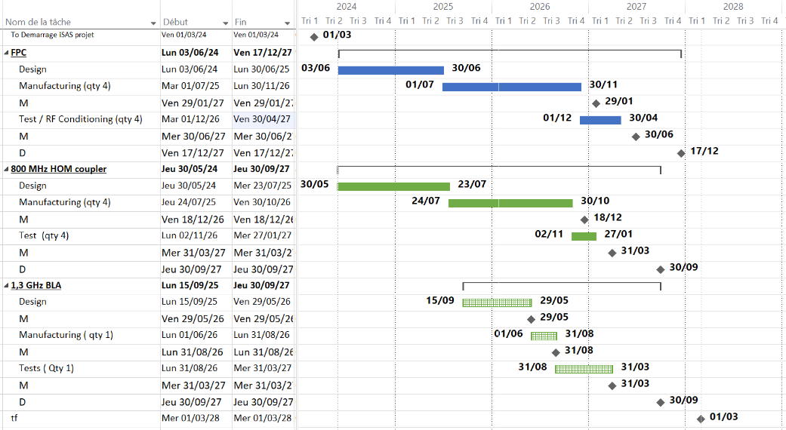
WP4 – HOM dampers et FPC :
plans to achieve milestones & deliverables
today

Slide 21
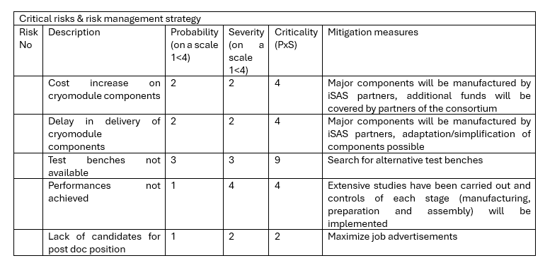
WP4 – HOM dampers and FPC :
Points of attention
For risk analysis :
To add:
    For FPC, there are only 4 SPL antennas/windows (zero contingency) → Extreme care is required for transport, cutting, new machining and EB welding
    For HOM, the next milestone 'BLA design report' due in a month, last exchanges ongoing

Slide 22
WP4 – HOM dampers and FPC : achievements of Task 4.1
General coordination
Task | Status | Comments
General coordination | Finished | Participation in the periodic report
FPC design | Finished | Milestone completed: Calum Sharp et al., ‘FPC design report’, June 2025.
FPC manufacture | In progress | Fabrication report : Milestone on January 2027
FPC test | In progress | Test report: Milestone on June 2027
HOMC design | Finished | Milestone completed: P. Duchesne et al., ‘800 MHz HOMC design report’ August 2025.
HOMC manufacture | In progress | Fabrication report : Milestone on December 2026
HOMC test | To do | Test report : Milestone on March 2027 Report qualification: Deliverable on September 2027
BLA design | Finished | Milestone completed: D.Giove at al., ‘ BLA design report’, May 2026
BLA manufacture | In progress | Engineering report: Milestone on August 2026
BLA ceramics test | In progress | Test report : Milestone on March 2027 Report qualification: Deliverable on September 2027

Slide 23
WP4: HOM dampers and FPC
CERN, CNRS ( IJCLab, LPSC), INFN
Convener: Y. GOMEZ MARTINEZ (CNRS/LPSC)
Main contacts with other partners: V. PARMA (CERN), P. DUCHESNE (CNRS/IJCLab),
D. GIOVE (deputy INFN)
Context :
-Fundamental Power Couplers (FPCs) introduce power into the cavities at their Fundamental Mode (FM) to accelerate the beam
-High order modes (HOM) can be excited in cavities by high-power beams. Energy Recovery Linacs (as PERLE and BriXSinO) are particularly subject to HOM excitations due to recirculation of high-current beams. Improper extraction of HOMs can strongly limit the beam intensity due to beam breakup instabilities and induce excessive RF losses in the superconducting cavity walls.
HOM dampers deposit them into loads at higher temperatures reducing significantly cryogenic heat loads:
  HOM couplers damp the HOMs trapped in the cavity
  Beam-Line Absorbers (BLAs) damp the HOMs propagating through the beam pipes.
WP4: Main goals
Ensure that 4 sustainable FPCs and HOM couplers are ready for integration into the PERLE cryomodule of WP6.
Ensure that a BLA is ready for integration into BriXSinO cryomodule and explore various ceramic materials for the BLA applications at cryogenic temperature.
Focusing o, thermal design optimization because is of utmost importance as FPCs and HOM dampers can account for half of the cryogenic load on a Linac (estimated on the Cornell CBETA ERL Linac)’

Slide 24

WP4: High-Order Mode (HOM) dampers & Fundamental Power couplers (FPC)
Berlin meeting, April 23, 2025
All information contained in this presentation and any accompanying documents is for iSAS project only, and must be treated as strictly confidential.
Any dissemination, distribution or other use of this information without the consent of its owner is prohibited.
Funded by the European Union. Views and opinions expressed are however those of the authors only and do not necessarily reflect those of the European Union or the European Commission. Neither the European Union nor the granting authority can be held responsible for them.

Slide 25
WP4 – HOM dampers and FPC
CERN, CNRS ( IJCLab, LPSC), INFN
Convener: Y. GOMEZ MARTINEZ (CNRS/ LPSC)
Main contacts with other partners: V. PARMA (CERN), P. DUCHESNE (CNRS/IJCLab), D. GIOVE (deputy INFN)
Task 4.1: General coordination of WP4 March 24 – March 28 CNRS, INFN
Task 4.2: HOM coupler design March 24 – August 25 INFN, CNRS, CERN
At 800MHz with the goal to minimize static and dynamic heat loads on the cryogenic circuits of the cryomodule
Task 4.3: Fabrication of HOM couplers May 25 – December 2026 CERN, CNRS, CERN
4 HOMs 800 MHz with the goal of employing cost and production-time reduction techniques
Task 4.4: Test of HOM couplers Nov 25 – (March 27)- September 27 CNRS, INFN
On mono-cell and multi-cell 800 MHz at 300 K
Task 4.5: FP coupler design March 24 – June 25 CERN, CNRS
With the goal to improve sustainability
Task 4.6: Fabrication of FP couplers July 25 – January 27 CERN, CNRS
4 new 800 MHz FPC with the goal of employing cost and production-time reduction techniques.
Task 4.7: Test of FP couplers Feb 26 – (June 27) – December 27 CERN, CNRS
Preparation & RF conditioning 800 MHz, 50 kW CW
Task 4.8: BLA design January 26– May 26 INFN, CNRS
With the goal to cover a very significant gap in the sector
Task 4.9: Fabrication of BLA May 26 – August 26 INFN, CNRS
Build 1 prototype of the 1,3 GHz BLA with the goal of employing cost and production-time reduction techniques
Task 4.10: Test of ceramics of BLA Jan 26 – (March 27)- Dec 27 INFN, CNRS, CERN
At room and cryogenic temperature
Only 800 MHz HOMC
New tasks about BLA
( remplace 1.3 GHz HOMC)

Slide 26
WP4 – HOM dampers and FPC: status/evolution of Task 4.1
General coordination of WP4
Past developments
  22 WP4 meetings organised, participation to the WP5 meetings
  2 technical review ( 800 MHz HOMC & FPC)
  2 tasks finished (4.2 ‘800 MHz coupler design’ and 4,5 ‘FPC design’ )
  2 milestones (FPC and HOMC design report) sent in time
  Participation to impact risk analysis, 1st periodic report, workplan, amendment
Current developments
  With WP6 : Post doc position transfert INFN to IJCLab on progress
  With WP7: Interaction with RI (Research Instruments)

Slide 27
WP4 – HOM dampers and FPC : status/evolution of Task 4.2
800 MHz HOM coupler design
HOMC scheme (CNRS, CERN):
Configurations studied: 2 probe and 2 hook & 4 hook & 2 hook couplers per cavity
→baseline proposed@5mA : 2 Hook/cav (IJC Lab)
It ensures the HOM damping requirements (the longitudinal and transversal impedance thresholds) according to the machine configuration
It damps better the dangerous mode that are confined within the cavity, exhibit a high (R/Q) (shunt impedance)* QL(loaded quality factor) and are close to a beam harmonic because they can present a risk of resonant effects: TM110 & TE111
Task finished
Courtesy of P. Duchesne

Slide 28
WP4 – HOM and FPC: status/evolution of Task 4.2
HOM coupler design
HOOK HOMC optimization (CNRS/IJCLab):
Based on the RF design of 800 MHz HOOK coupler for HL-LHC (CERN), the coupler was optimized by CNRS
  RF simulations ( P.Duchesne/IJC Lab) to obtain the best transmission at dangerous mode (TE111 & TM110) and ensuring an effective rejection of the Fundamental mode (TM010)
  Mechanical integration (S. Blivet and G. Olivier/IJC Lab) compatible with the WP6 cryomodule
  Mechanical and thermal calculations (P. Duchesne/IJC Lab) to minimize static and dynamic heat loads on the cryogenic circuits of the cryomodule, to verify the mechanical strength
  Multipacting simulations (A. Placais/LPSC) to check multipacting
  Taking into account the feedback from M. Garlasche & S.Barriere (CERN) about feasibility fabrication
Courtesy of P. Duchesne
Task finished
Parameters considered for the RF sensitivity studies

Slide 29
WP4 – HOM and FPC: status/evolution of Task 4.3
Fabrication of 800 MHz HOM couplers
Past developments
  CERN has finalised preparation activities for fabrication, based on requests and functional specification from IJC Lab, with fabricability input from CERN
  A detailed manufacturing sequence has been established
  Raw materials have been ordered and received, based on the same specification as the HL-LHC WP4 couplers (316LN stainless steel, OFE copper, RRR300 niobium)
  (M.Garlasche & S.Barriere / CERN)
Current developments
  The fabrication of the 4 HOM couplers has started
  Tooling design for final welding steps is ongoing
  Estimated completion date (before final acceptance tests) for 4 prototypes is end Q3-2026
  (M.Garlasche & S.Barriere / CERN)
Courtesy of S. Blivet
Hook coupler

Slide 30
WP4 – HOM dampers and FPC : status/evolution of Task 4.4
Test of HOM couplers for WP6
Start of the task planned for October 2026
1 month required to have the HOM test bench operational

Slide 31
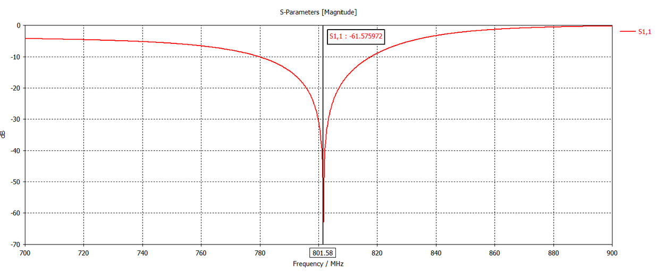
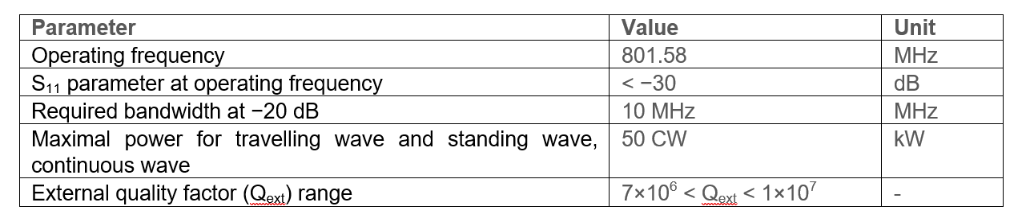
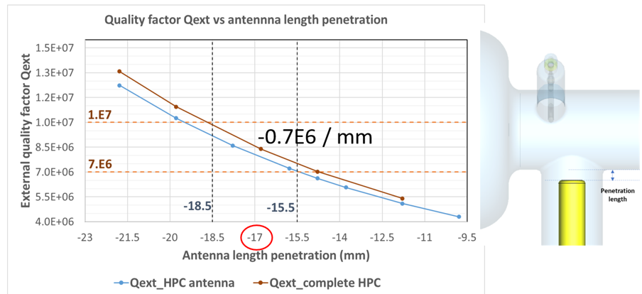
WP4 – HOM dampers and FPC: status/evolution of Task 4.5
FP coupler design
Courtesy of J. Angot
Mechanical and RF studies (CNRS/CERN):
FPC based on the RF design of the 704 MHz SPL (Superconducting Proton Linac) coupler developed at CERN
  Made compatible in the mechanical integration in the WP6 cryomodule and ESS test bench ( S. Blivet and G. Olivier)
  RF simulations to adapt it to the RF characteristics of the iSAS WP6 Cryomodule (J. Angot and P. Duchesne)
  Preliminary multipacting simulations carried out with results similar to those of SPL FPC (A.Placais and Y. Gómez)
Adaptation of the coupler ( S11 parameter)
Task finished
Courtesy of P. Duchesne
Quality factor Qext versus antenna penetration length)

Slide 32
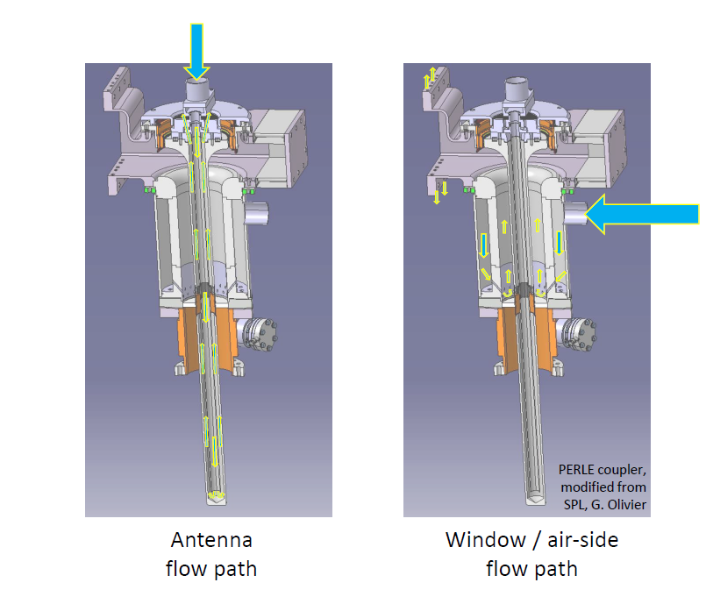
WP4 – HOM dampers and FPC : status/evolution of Task 4.5
FP coupler design
Task finished
Thermal studies (CERN):
  Antenna and window air cooling ( C. Sharp)
  Goal : to maintain temperatures everywhere in an acceptable range, minimize antenna deformation, prevent condensation on the window, avoid induced stresses in the window and reduce radiation heat loads to the cavity in all operational configuration
  Thermo-structural finite element studies on antenna/window assembly.
    →Air cooling of at least 400 l/min in antenna circuit (Re 10000 strong turbulent flow)
    →Electrical heaters installed on the window to mitigate the risk of condensation if the air supply is interrupted.
Courtesy of C. Sharp

Slide 33
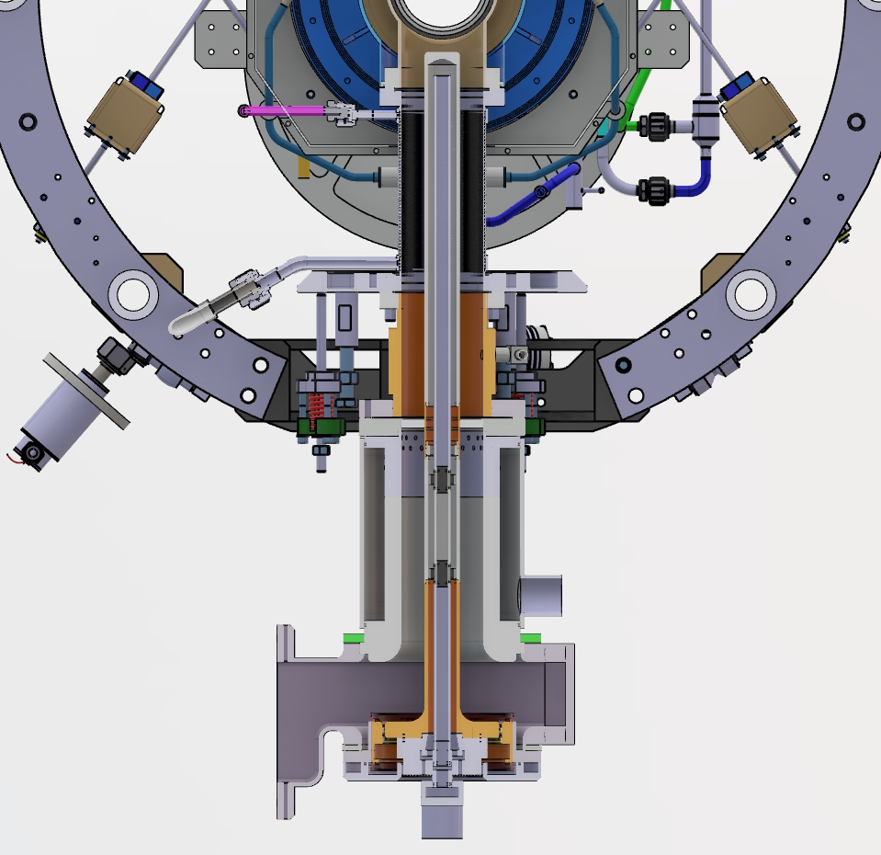
WP4 – HOM dampers and FPC : status/evolution of Task 4.5
FP coupler design
Thermal studies (CERN):
  Outer conductor cooling ( K. Canderan)
  ESS cylindrical double walled tube cooled with supercritical helium flowing
  Studies were performed with a numerical model to:
    estimate the heat loads in the outer conductor (conduction, convection, radiation), temperature profiles and RF dissipation according to the position of the maximum magnetic field
    →To be considered electrical heaters at warm flange and outlet He pipe don’t drop below the dew point
    the equivalent cost to the cryogenic plant in operation
    the helium mass flowrate to minimize the heat loads to the cavity helium bath at 2K
    Impact of the He inlet temperature on cryogenic costs
    →Lower the inlet temperature lower the heat loads
    Comparison heat intercepts versus Helium flowing
    →Up to 65% energy saving with He flow ( 0,9 kWel@inlet 5K vs 2kWel@intercepts 5 & 50 K)
Task finished
He flow
 | RF on (full reflection)
Heat released to the He bath @2K | 0.5 W (inlet 5.1K) – 1.8W (inlet 9K)
RF power dissipated in the DWT | 6.25 W
Radiation heat load to the DWT | 0.77 W
Radiation heat load to the He bath @2K | 0.5 W
Input heat required | 34 W ( at warm flange) – 8,2 W ( at He outlet pipe)
Liquefaction capacity | 23.1 mg/s
Total cryogenic cost [W_{el}] (*) | 0,96 kWel ( inlet 5,1 K) -2.2 kWel ( inlet 9K)
Courtesy of K. Canderan
(*) W_{el} calculated assuming 15% of the Carnot efficiency

Slide 34
WP4 – HOM dampers and FPC : status/evolution of Task 4.6
Fabrication of FP couplers
FPC components
Past developments
  Inventory of existing components completed
  Vacuum leak tightness of 4x existing SPL antenna/window assemblies verified to 10⁻¹⁰ mbar.l.s⁻¹ with He sprayed around ceramic, braze joints, flange and antenna air volume
Courtesy of C. Sharp
Existing antenna/window assemblies

Slide 35
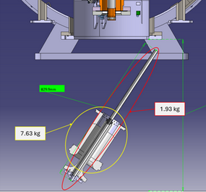
WP4 – HOM dampers and FPC : status/evolution of Task 4.6
Fabrication of FP couplers
Current developments
  Drafting of detailed production drawings is nearing finalisation
  An assembly issue was found with the antenna air supply cane being too long to insert as planned in the WP6 cryomodule
    An alternative assembly manoeuvre was proposed but challenging due to space constraints.
    Options to split air cane in two parts were explored but presented risk to FPC function
    Decision was taken to keep single-part design, at least for tests at ESS.
    Assembly process is being reviewed, with N. Elias proposing to prepare a raised cryomodule support stand to facilitate insertion in the preparation area at ESS
    CERN, ESS and CNRS to participate in finding a handling/assembly solution and prepare any required tooling
  Manufacturing plan in preparation pending drawing finalisation.
  Design and preparation of transport cases for handling of existing antenna/window assemblies
    Extreme care required (only 4 exist – zero contingency)
    To then allow antenna extraction and inspection to determine modification steps for cutting, re-machining and EB welding while protecting ceramics
Air cane assembly issue
Courtesy of C. Sharp

Slide 36

WP4 – HOM dampers and FPC : status/evolution of Task 4.7
Test of FP couplers
Past developments
  Strategy chosen: Do the FPC conditioning up to 50 kW@800MHz
  Studied done to utilize the CERN 704 MHz test box at 800 MHz (S. Gorgi Zadeh /CERN)
Current developments
  Checking the availabilities of electricity and water networks at CERN. Alternative : move the test bench at IJC Lab
  Test cavity external conductor modifications to be prepared
  Cooling requirements to be verified
  (C. Sharp)
Courtesy of
S. Gorgi Zadeh
$f=801 MHz, d_{tip}=18.5 mm$, P_{in}=0.5 W
Test bench with 704 MHz test box
Courtesy of C. Sharp

Slide 37
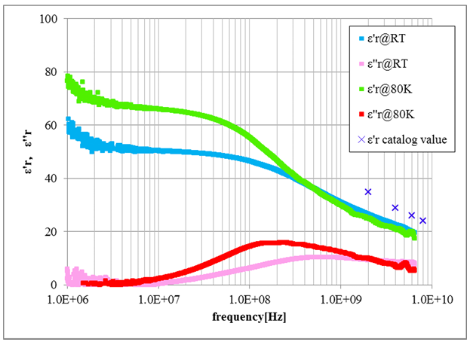
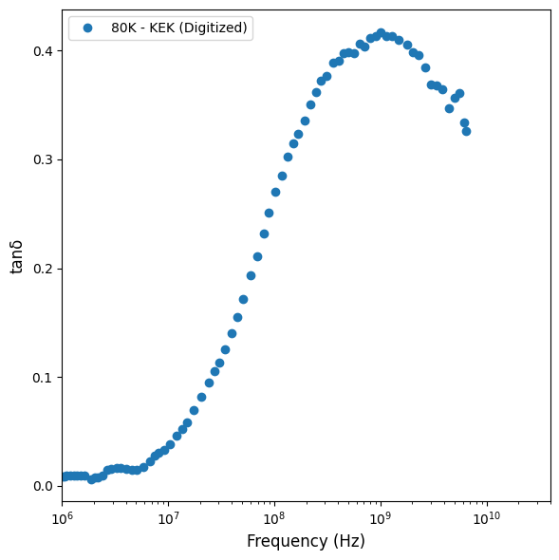
WP4 – HOM dampers and FPC : status/evolution of Task 4.8
BLA design
Goal : to study a BLA at 1,3 GHz dedicated to BriXSino projet and study the feasibility of the technology chosen for the requirements of the iSAS WP6 cryomodule so covering a very significant gap in the sector
Past developments
  BLA design chosen ( INFN)
    XFEL/ LCLS II design
    Cooling technology : convey the heat load by conduction through copper stubs directly at the cryogenic temperature (40 – 70 K thermal shield intercept of the cryomodule)
  Baseline ceramic chosen : STL-150D14 from Sienna Technologies (INFN)
European X-FEL BLA
SiennaTech STL150D14 specifications. from T. Ota et al., Development of HOM dampers for superconducting cavities”, in Proc. PASJ2016, Chiba, Japan, August 2016.
Courtesy of D. Giove
Courtesy of A. Perez Ruiz

Slide 38
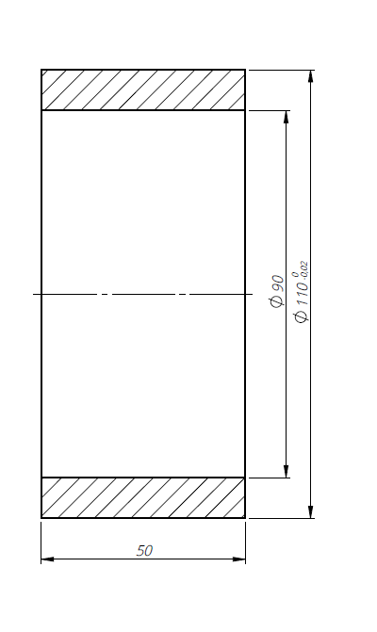
WP4 – HOM dampers and FPC : status/evolution of Task 4.8
BLA design
Past developments
  For a 1,3 GHz BLA (INFN, CNRS):
    Mechanical studies to adapt for BriXSino configuration (INFN)
    Thermal analysis and a cryogenic design appropriate for 20 W ( larger than BriXSino requirements) and 100 W (INFN)
    Power absorption simulation for different HOM for SiennaTech STL150D ceramic (A. Perez Ruiz, IJC Lab)
Static load
Ceramic size for BriXSino BLA
Thermal analysis
RF simulation
Courtesy of D. Giove
Courtesy of A. Perez Ruiz

Slide 39
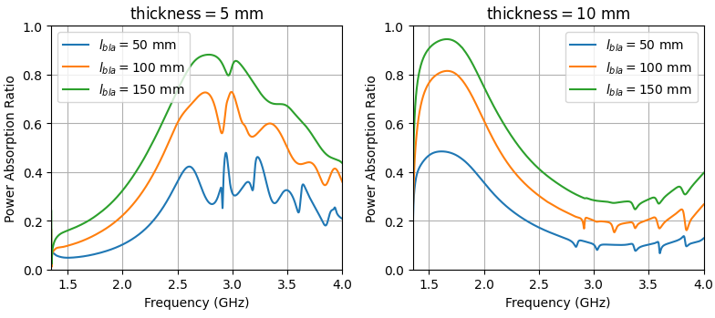
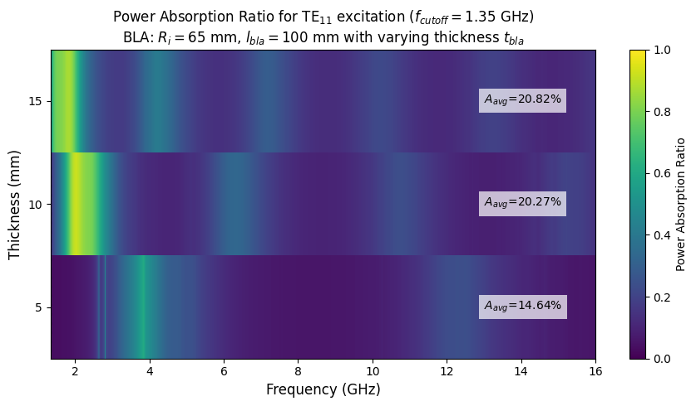
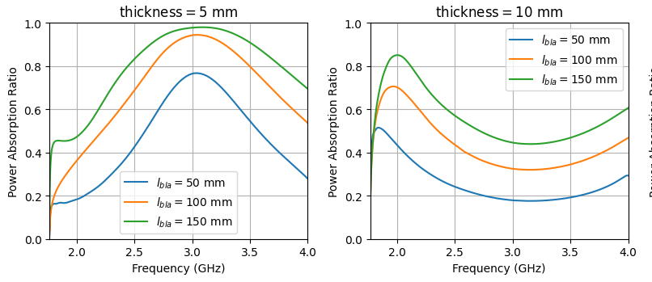
WP4 – HOM dampers and FPC : status/evolution of Task 4.8
BLA design
Past developments
  For 800 MHz BLA (IJCLab/ CNRS)
    Power absorption simulation for SiennaTech STL150D and Kyocera SC1000 ceramics (A. Perez Ruiz)
SiennaTech STL150D
Kyocera SC1000
TE11 mode
TM01 mode
Courtesy of A. Perez Ruiz

Slide 40
WP4 – HOM dampers and FPC : status/evolution of Task 4.8
BLA design
Current developments
  Last CNRS – INFN exchanges to determine last simulations to perform

Slide 41
WP4 – HOM dampers and FPC : status/evolution of Task 4.9
Fabrication of BLA
Goal : Manufacture one prototype of the 1,3 GHz BLA for BriXSino requirements
Current developments
  Orders prospect to ( D.Giove/ INFN)
    Sienna Technology (ceramic)
    Kubara Lamina (full BLA w/wo ceramic)
    Rial Saes Getters (alternative supply of full BLA (except ceramic and copper)

Slide 42
WP4 – HOM dampers and FPC : status/evolution of Task 4.10
Test of ceramics of BLA
Goal : Explore various ceramic materials for the BLA applications testing them at room temperature (at CLIC test stand at CERN ) and at cryogenic temperature ( at new test stand at IJCLab)
Past developments
  Experimental setup at cryogenic temperature (IJC Lab)
    Design finished
    Samples dimensions, sample holder have been defined ( A. Miyazaki/ IJC Lab)
sample holder
sample under test
Courtesy of A. Perez Ruiz
IJC lab transmision measurements set up

Slide 43
WP4 – HOM dampers and FPC : status/evolution of Task 4.10
Test of ceramics of BLA
Past developments
  Reconstruction algorithm for retrieving (ε’, ε’’) from S parameters ‘S11, S21’ ( A. Miyazaki& A. Perez Ruiz / IJC Lab)
Courtesy of A. Miyazaki
NRW : Nicolson Ross Weir

Slide 44
WP4 – HOM dampers and FPC : status/evolution of Task 4.10
Test of ceramics of BLA
Rₐ ≈ 1–3 μm
Current developments
  Fabrication of experimental setup at cryogenic temperature ( IJC Lab/ CNRS)
  Buying APC-7 calibration kit, the samples ceramic ( IJCLab/ CNRS)

Slide 45
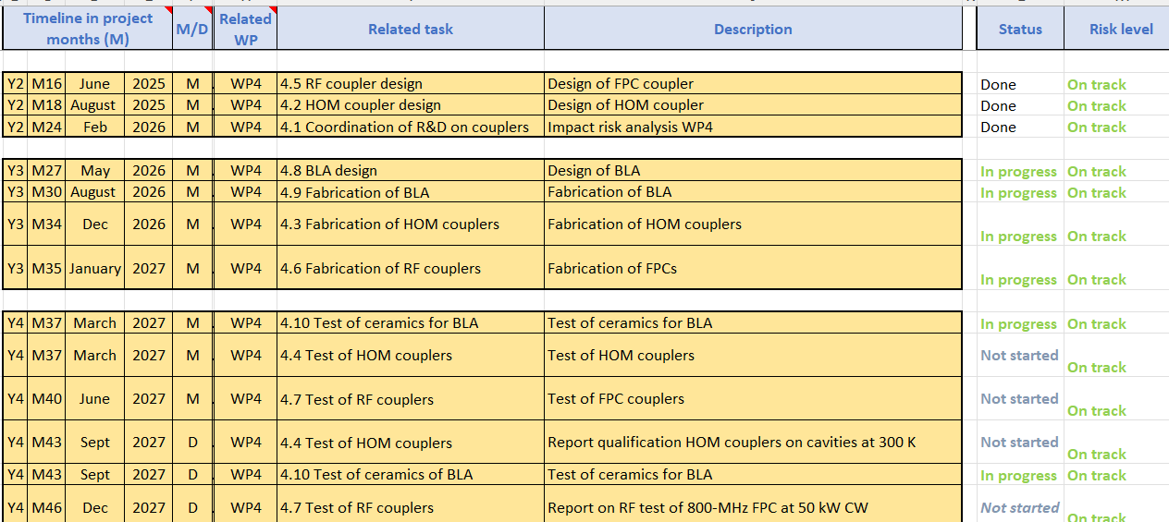
WP4 – HOM dampers and FPC :
plans to achieve milestones & deliverables

Slide 46
WP4 – HOM dampers et FPC :
plans to achieve milestones & deliverables
today

Slide 47
WP4 – HOM dampers and FPC :
Points of attention
For risk analysis :
To add:
    For FPC, there are only 4 SPL antennas/windows (zero contingency) → Extreme care is required for transport, cutting, new machining and EB welding
    For HOM, the next milestone 'BLA design report' due in a month, last exchanges ongoing

Slide 48
Thank-you for your attention
Yolanda Gómez Martínez on behalf of the WP4 team:
CERN : Simon Barriere, Sebastien Calvo, Karin Canderan, Marco Garlasche, Vittorio Parma, Calum Sharp
INFN : Dario Giove (deputy)
CNRS / IJCLab : Sebastien Blivet, Patricia Duchesne, Akira Miyazaki, Gilles Olivier, Guillaume Olry, Axel Perez Ruiz
CNRS / LPSC : J. Angot, Yolanda Gómez Martínez (convener), Adrien Plaçais

