Slide 1


WP5: Integration into a new LINAC Cryomodule
RP1 review meeting, June 1st, 2026
WP Leader: Nuno Elias (ESS)
WP Deputy: Vittorio Parma (CERN)
With contributions of colleagues from ESS, CERN, CNRS, EPFL
All information contained in this presentation and any accompanying documents is for iSAS project only, and must be treated as strictly confidential.
Any dissemination, distribution or other use of this information without the consent of its owner is prohibited.
Funded by the European Union. Views and opinions expressed are however those of the authors only and do not necessarily reflect those of the European Union or the European Commission. Neither the European Union nor the granting authority can be held responsible for them.

Slide 2
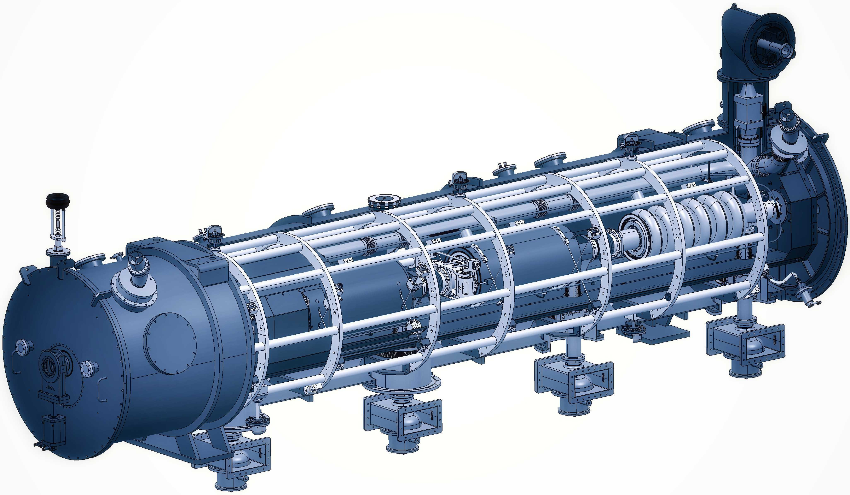
WP5: Integration into a new LINAC Cryomodule
ESS | CNRS | CERN | EPFL
Convener: Nuno Elias (ESS)
Main contacts with other partners: G. Olry (CNRS), V. Parma. CERN); M. Siedel (EPFL)
WP5 Main goal
The design of any LINAC cryomodule is optimised to meet the specific research objectives of the accelerator facility, while addressing common challenges such as high-power electric fields, ultra-low temperatures, ultra-high vacuum, precise alignment, etc.
WP5's main goal is to tackle the common engineering challenges of integrating iSAS technologies into a parametric design of a new cryomodule, building on developments made with ESS cryomodules whilst benchmarking against other facilities.
In addition, to unlock the full energy-saving capability of this cryomodule, the objective of WP5 is to also address the challenging beam dynamics requirements when operating the new cryomodule in Energy Recovery Linacs with recirculating beams.

Slide 3
WP5: Integration into a new LINAC Cryomodule
ESS | CNRS | CERN | EPFL
Convener: Nuno Elias (ESS)
Main contacts with other partners: G. Olry (CNRS), V. Parma. CERN); M. Siedel (EPFL)
Task 5.1: Coordination on cryomodule design activities– M1-M48
• General coordination by ESS as described above.
Task 5.2: ESS cryomodules experience and benchmarking with other recent facilities– M1-M36
• Compile the lesson learned from the ESS CM testing activities, technical commissioning, and initial operation.
• Benchmarking with projects in the implementation phase (worldwide).
• Develop a roadmap to develop a new, sustainable CM design.
Task 5.3: Sustainable criteria for LINAC cryomodule design– M24-M48
• Integrate findings from the other iSAS WPs into a generic CM design.
• Explore the sustainability criteria for the design.
Task 5.4: Beam Dynamics for ERL-based accelerators with energy-efficient cryomodules – M1-M48
• Simulate the beam dynamics of ERL-based accelerators when the energy efficient CM is included.
• Study the lattice design to optimize the beam and energy saving performances.

Slide 4
WP5: Integration into a new LINAC Cryomodule
ESS | CNRS | CERN | EPFL
COMPLETED
In-Progress
COMPLETED
COMPLETED
Work Plan
Recently Started
Recently Started
In-Progress

Slide 5
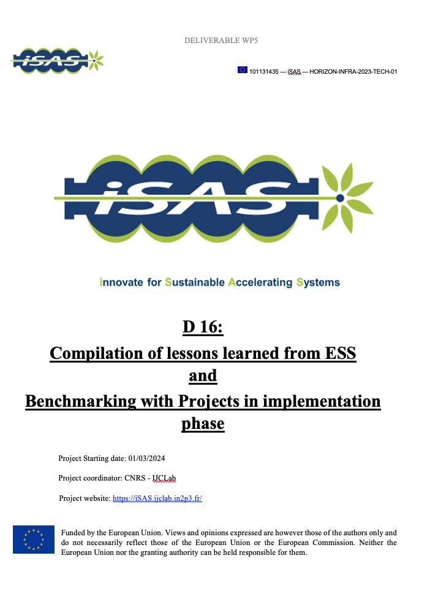
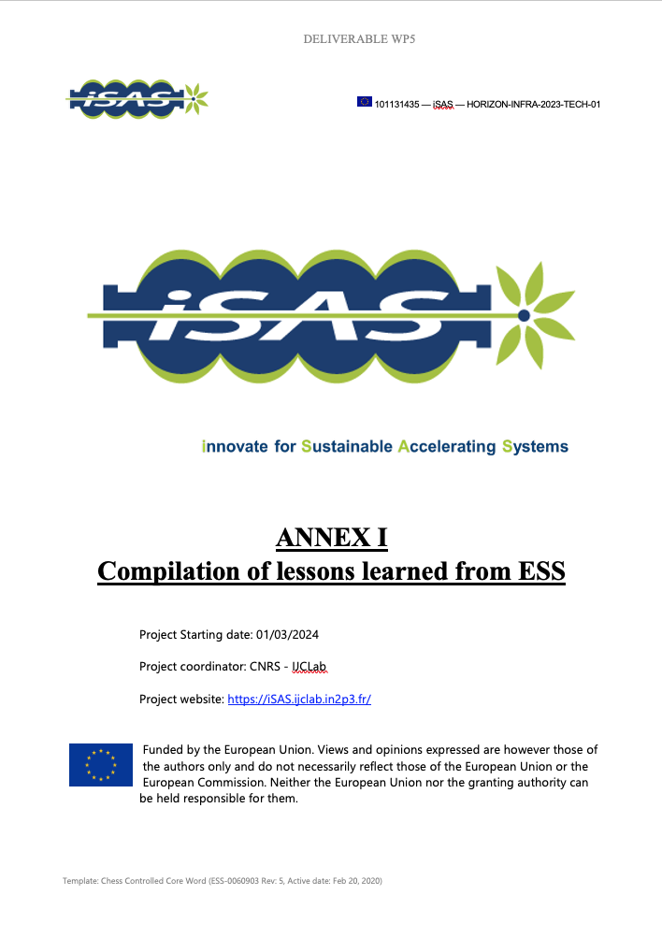
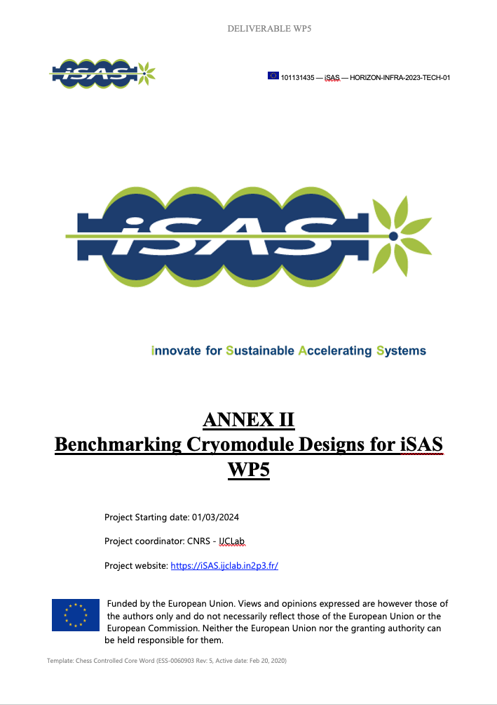
WP5 – Coordination: status/evolution of Task 5.1
Task 5.1: Coordination on cryomodule design activities– M1-M48
• General coordination by ESS as described above.
Activities
  Regular WP5 Coord.: meetings + dedicated meetings task specific (ongoing)
  Milestone 21: Completed “In-person WP kick-off meeting at ESS” :
  Milestone 42: Completed “WP5 impact Risk Analysis” :
  Deliverable 16: Completed Report “Compilation of ESS CM lessons learned
  & benchmarks from facilities in implementation phase”
    Annex I : Detailed Report on ”Compilation of Lessons Learned from ESS”
    Annex II: Detailed Report on “Benchmarking Cryomodule Designs for iSAS WP5”
  Recruitment PhD student (EPFL): Started: (Apr-2024) ; Completed (Oct-2024)
  Recruitment Junior Engineer (ESS): Started: (Mar-2025) ; Completed (Oct-2025)
  In-Person meeting at IJCLab: Workshop Prepare start of Task 5.3
Report Period 1
  Report on WP5 activities conducted up to RP1

Slide 6
WP5 – Coordination: status/evolution of Task 5.1
Task 5.1: Coordination on cryomodule design activities– M1-M48
• General coordination by ESS as described above.
Milestone : M21 In-person WP kick-off meeting at ESS (Due date: M3 or Jun-2024)
Milestone : M42 Impact Risk analysis (Due date: M24 or Feb-2026)
Deliverable: D16 Compilation of ESS CM lessons learned & benchmarks (Due date: M24 or Feb-2026)
Deliverable: D17 Roadmap for the CM design (Due date: M36 or Feb-2027)
Deliverable: D18 Parametric design for a sustainable CM with iSAS tech. (Due date: M46 or Dec-2027)
Deliverable: D19 Report on beam dynamics study for ERL with iSAS CM (Due date: M43 or Sep-2027)

Slide 7
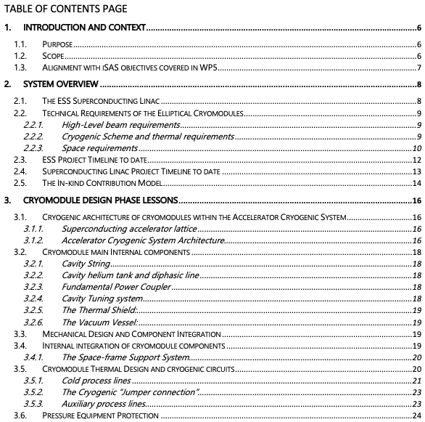
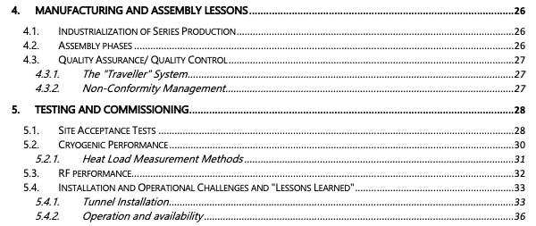
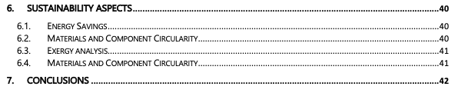
WP5 – Experience/Benchmark CMs: status of Task 5.2
Task 5.2: ESS cryomodules experience and benchmarking with other recent facilities – M1-M36
• Compile lesson learned from the ESS CM testing activities, technical commissioning, initial operation.
• Benchmarking with projects in the implementation phase (worldwide).
• Develop a roadmap to develop a new, sustainable CM design.
• Compile lesson learned from the ESS CM testing activities, technical commissioning, initial operation.
Activities: Delivered

Slide 8
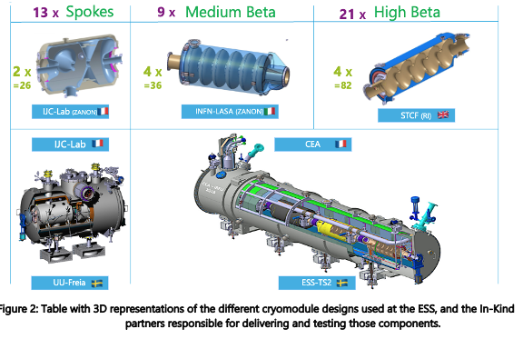
WP5 – Experience/Benchmark CMs: status of Task 5.2
Task 5.2: ESS cryomodules experience and benchmarking with other recent facilities – M1-M36
• Compile lesson learned from the ESS CM testing activities, technical commissioning, initial operation.
• Benchmarking with projects in the implementation phase (worldwide).
• Develop a roadmap to develop a new, sustainable CM design.
• Compile lesson learned from the ESS CM testing activities, technical commissioning, initial operation.
Scope
System Overview
CM Design Phase Lessons
Manufacturing and Assembly phase Lessons
Testing and Commissioning
Sustainability aspects
Conclusions

Slide 9
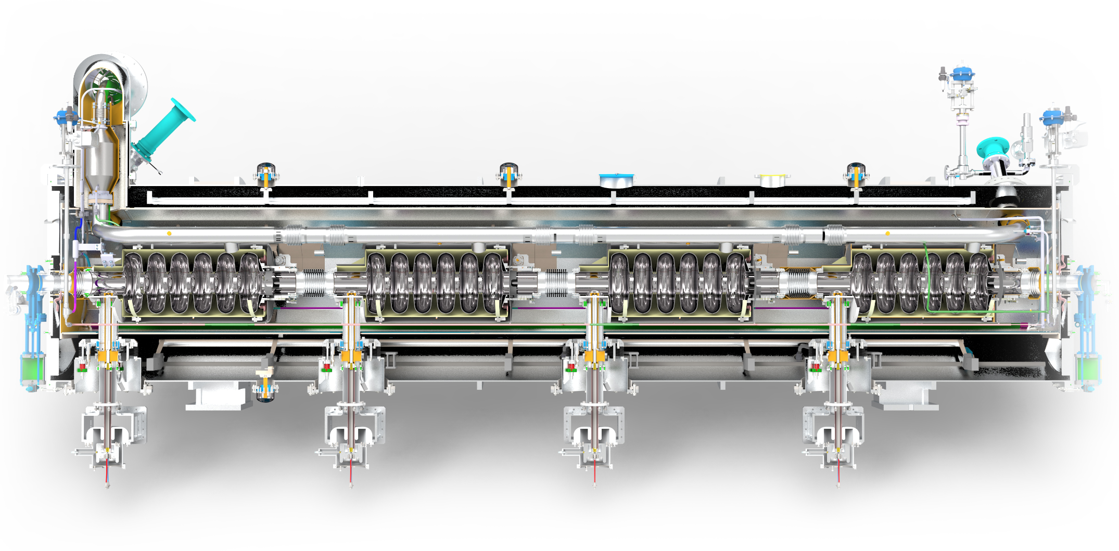
WP5 – Experience/Benchmark CMs: status of Task 5.2
Task 5.2: ESS cryomodules experience and benchmarking with other recent facilities – M1-M36
• Compile lesson learned from the ESS CM testing activities, technical commissioning, initial operation.
• Benchmarking with projects in the implementation phase (worldwide).
• Develop a roadmap to develop a new, sustainable CM design.
• Compile lesson learned from the ESS CM testing activities, technical commissioning, initial operation.
Scope
System Overview
CM Design Phase Lessons
Manufacturing and Assembly phase Lessons
Testing and Commissioning
Sustainability aspects
Conclusions

Slide 10
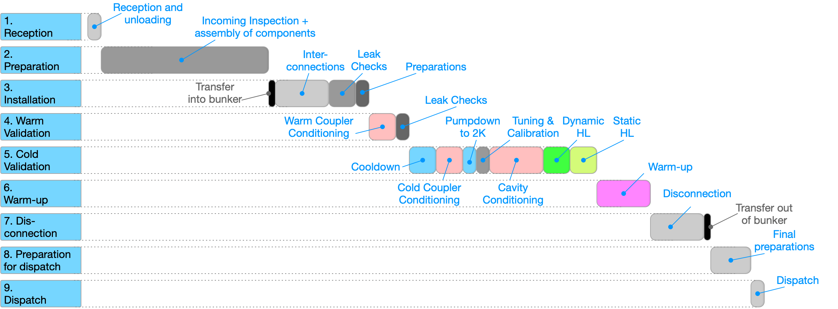
WP5 – Experience/Benchmark CMs: status of Task 5.2
Task 5.2: ESS cryomodules experience and benchmarking with other recent facilities – M1-M36
• Compile lesson learned from the ESS CM testing activities, technical commissioning, initial operation.
• Benchmarking with projects in the implementation phase (worldwide).
• Develop a roadmap to develop a new, sustainable CM design.
• Compile lesson learned from the ESS CM testing activities, technical commissioning, initial operation.
Scope
System Overview
CM Design Phase Lessons
Manufacturing and Assembly phase Lessons
Testing and Commissioning
Sustainability aspects
Conclusions

Slide 11
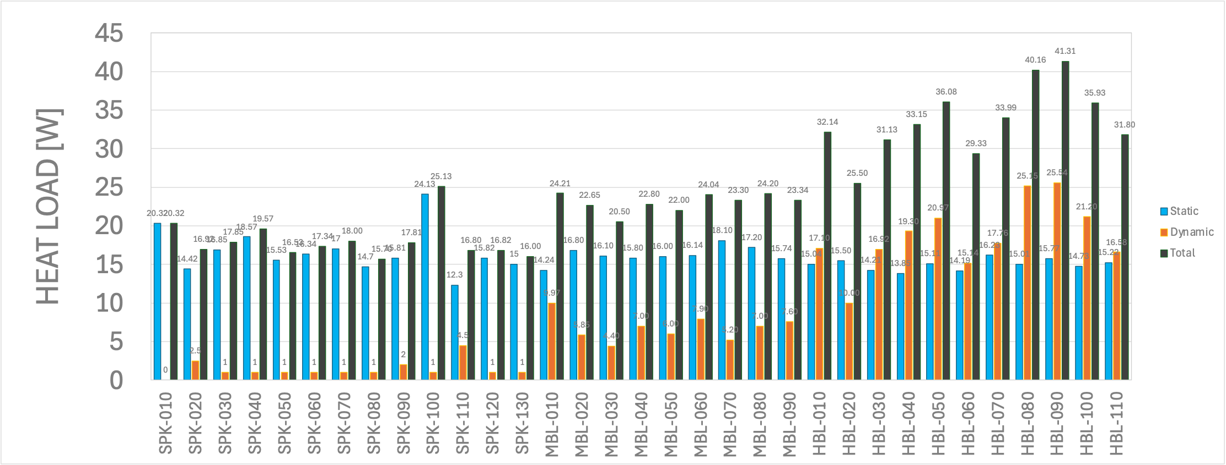
WP5 – Experience/Benchmark CMs: status of Task 5.2
Task 5.2: ESS cryomodules experience and benchmarking with other recent facilities – M1-M36
• Compile lesson learned from the ESS CM testing activities, technical commissioning, initial operation.
• Benchmarking with projects in the implementation phase (worldwide).
• Develop a roadmap to develop a new, sustainable CM design.
• Compile lesson learned from the ESS CM testing activities, technical commissioning, initial operation.
Scope
System Overview
CM Design Phase Lessons
Manufacturing and Assembly phase Lessons
Testing and Commissioning
Sustainability aspects
Conclusions

Slide 12
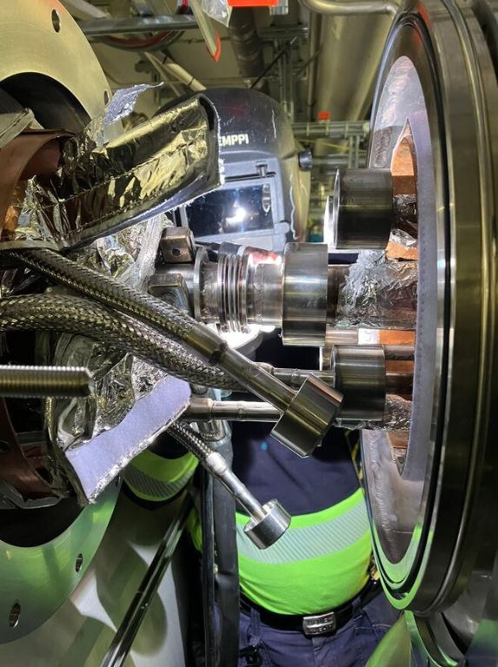
WP5 – Experience/Benchmark CMs: status of Task 5.2
Task 5.2: ESS cryomodules experience and benchmarking with other recent facilities – M1-M36
• Compile lesson learned from the ESS CM testing activities, technical commissioning, initial operation.
• Benchmarking with projects in the implementation phase (worldwide).
• Develop a roadmap to develop a new, sustainable CM design.
• Compile lesson learned from the ESS CM testing activities, technical commissioning, initial operation.
Scope
System Overview
CM Design Phase Lessons
Manufacturing and Assembly phase Lessons
Testing and Commissioning
Sustainability aspects
Conclusions
Paper at ICEC30-ICMC2026, Daejeon, South Korea: “Lessons Learned from the ESS Elliptical Cryomodule Design and Operation
: Paving the way for Sustainable Accelerating Systems (iSAS)”

Slide 13
WP5 – Experience/Benchmark CMs: status of Task 5.2
Task 5.2: ESS cryomodules experience and benchmarking with other recent facilities – M1-M36
• Compile lesson learned from the ESS CM testing activities, technical commissioning, initial operation.
• Benchmarking with projects in the implementation phase (worldwide).
• Develop a roadmap to develop a new, sustainable CM design.
• Benchmarking with projects in the implementation phase (worldwide).
The scope of the benchmarking study is to establish a robust baseline for the definition of the sustainability criteria to consider for the design of a new cryomodule.
The study has been conducted through a questionnaire across five key domains.
This comparative approach highlights how differing requirements, constraints, and strategic priorities shape design choices and lead to distinct technical configurations. Link
Study conducted for high-beta elliptical cryomodules with frequencies between 400MHz and 1.3GHz, across six facilities SNS, LHC, PIP-II, XFEL, LCLS-II, and ESS, to ensure a relevant comparison

Slide 14
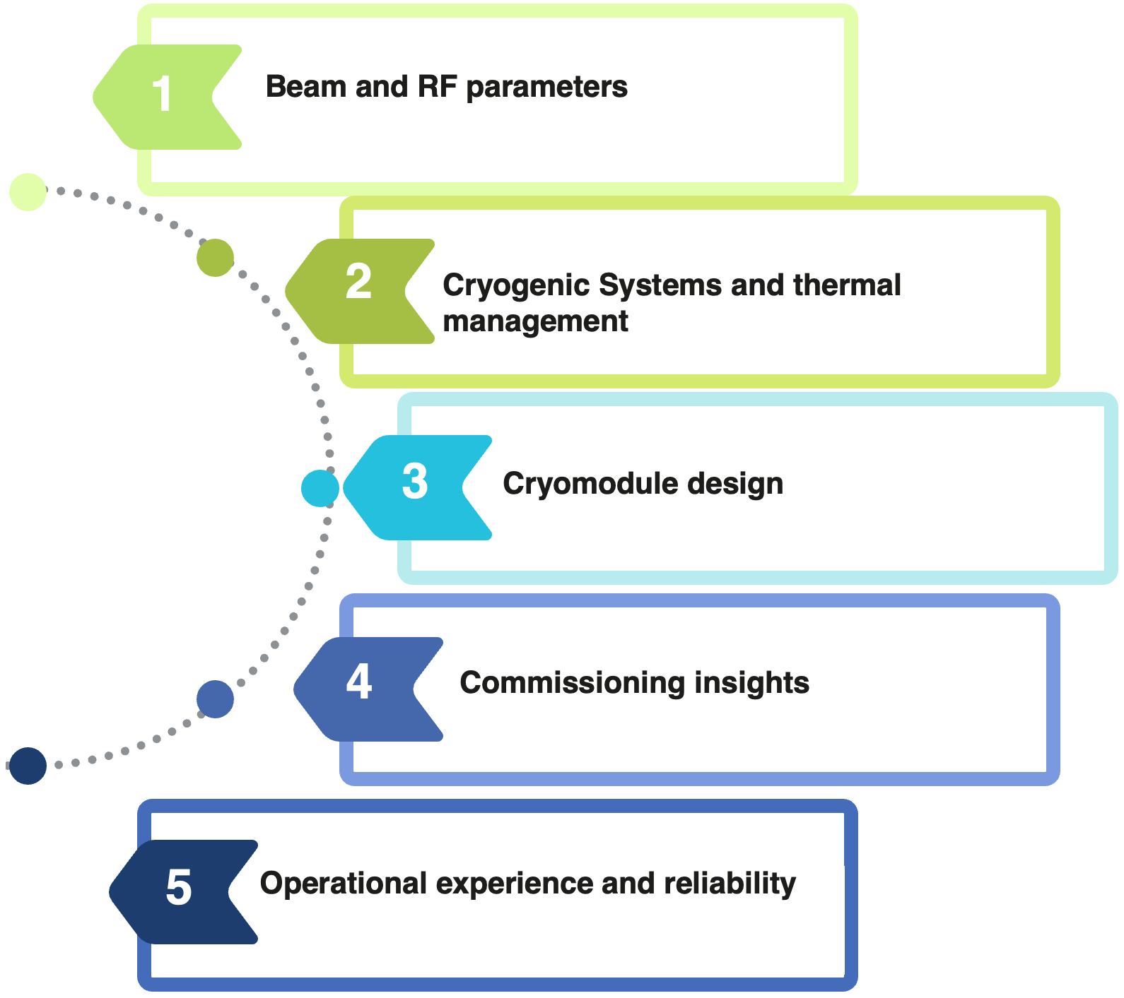
WP5 – Experience/Benchmark CMs: status of Task 5.2
Task 5.2: ESS cryomodules experience and benchmarking with other recent facilities – M1-M36
• Compile lesson learned from the ESS CM testing activities, technical commissioning, initial operation.
• Benchmarking with projects in the implementation phase (worldwide).
• Develop a roadmap to develop a new, sustainable CM design.
• Benchmarking with projects in the implementation phase (worldwide).
Main steps of the benchmarking methodology:
Definition of key technical areas of interest to be included in the benchmarking study
Proposal of cryomodule design concepts, facilities and experts
Definition of specific points of interest for each area and drafting of the questionnaire
Literature research and pre-filling of the answers
Initial contact and questionnaire distribution
Follow-up face-to-face interviews
Compilation of answers and final report.
2026-05-29
Nuno Elias - iSAS WP5 RP1 review - Jun/2026
14

Slide 15
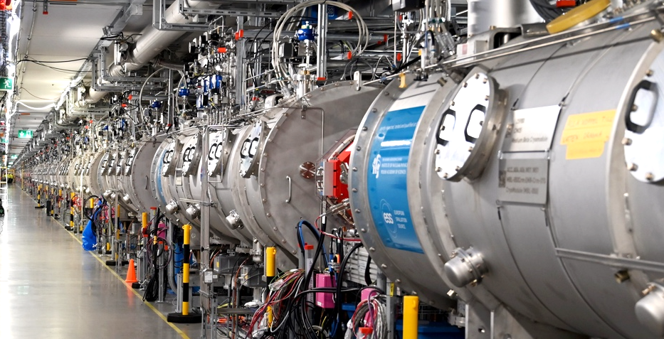
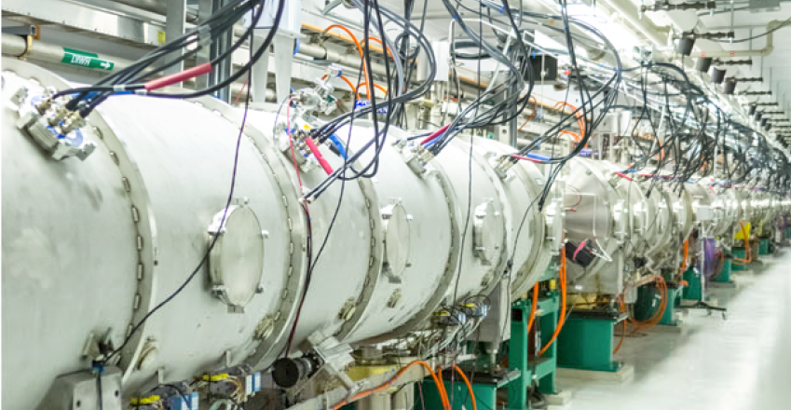
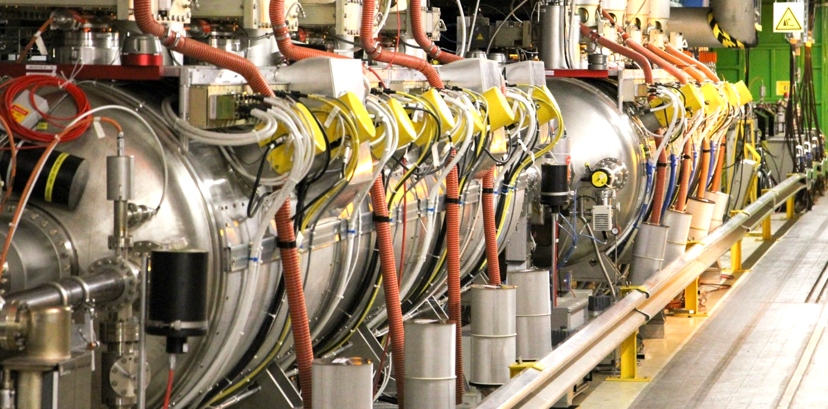
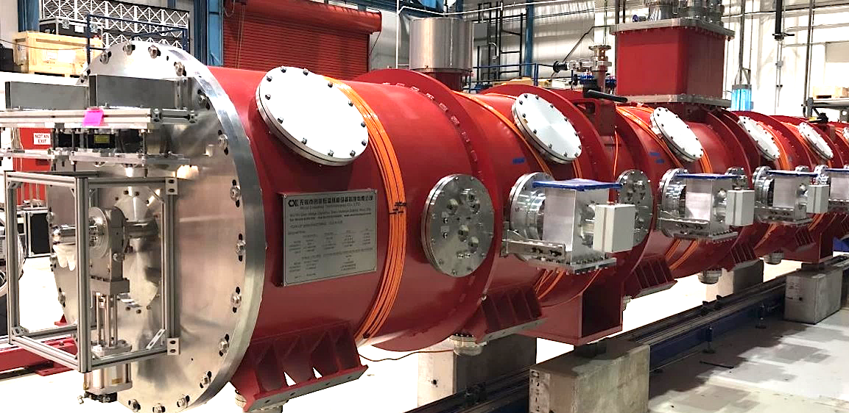
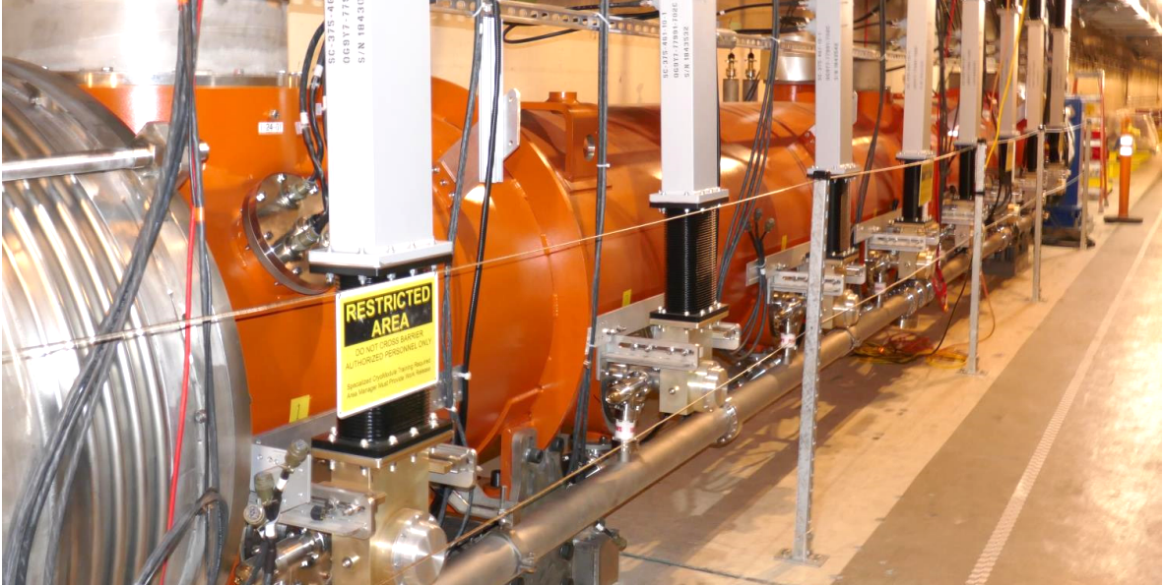
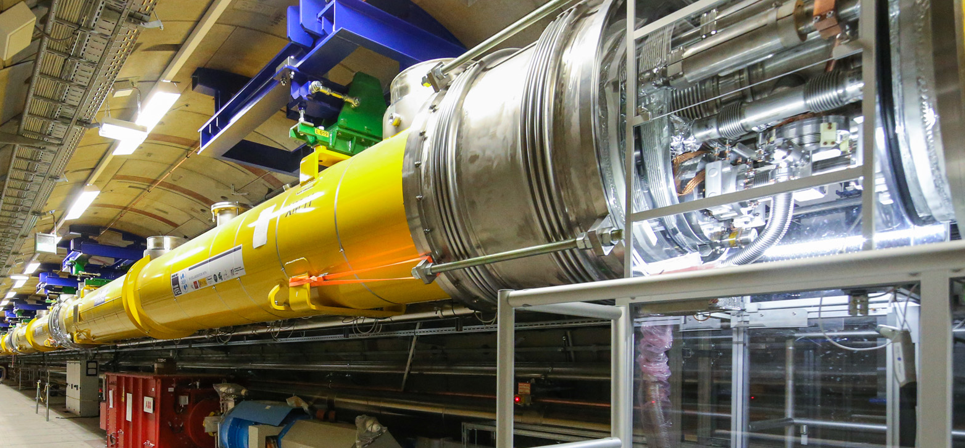
WP5 – Experience/Benchmark CMs: status of Task 5.2
Task 5.2: ESS cryomodules experience and benchmarking with other recent facilities – M1-M36
• Compile lesson learned from the ESS CM testing activities, technical commissioning, initial operation.
• Benchmarking with projects in the implementation phase (worldwide).
• Develop a roadmap to develop a new, sustainable CM design.
• Benchmarking with projects in the implementation phase (worldwide).
European Spallation Source
(ESS)
Spallation Neutron Source
(SNS)
Large Hadron Collider
(LHC)
Linac Coherent Light Source II (LCLS-II)
Proton Improvement Plan II
(PIP-II)
European X-ray Free-Electron Laser (XFEL)

Slide 16
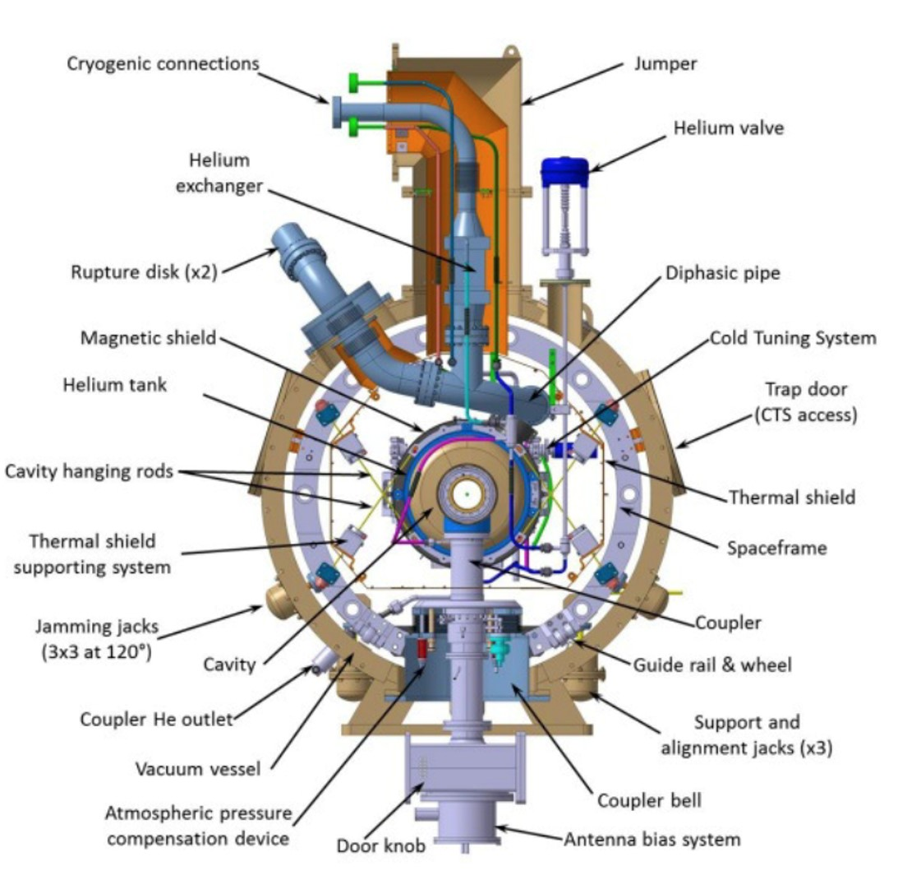
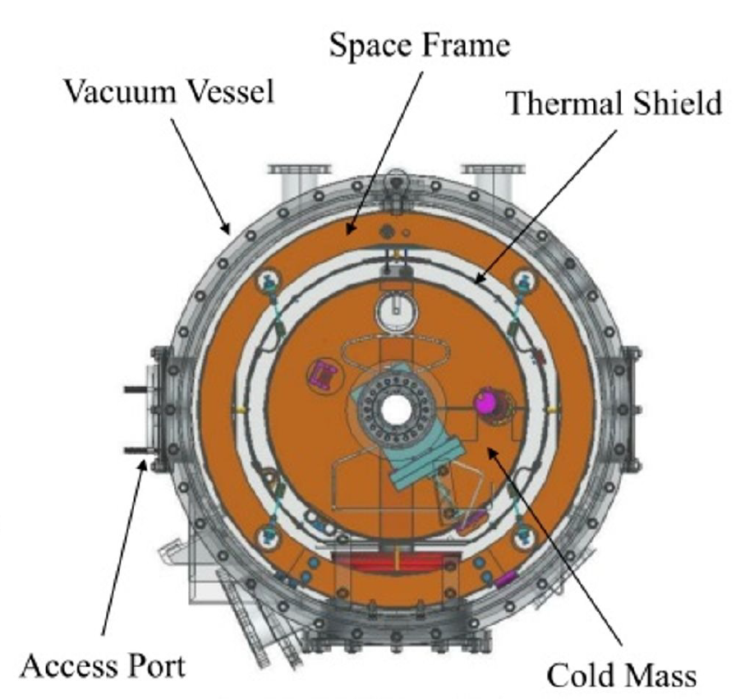
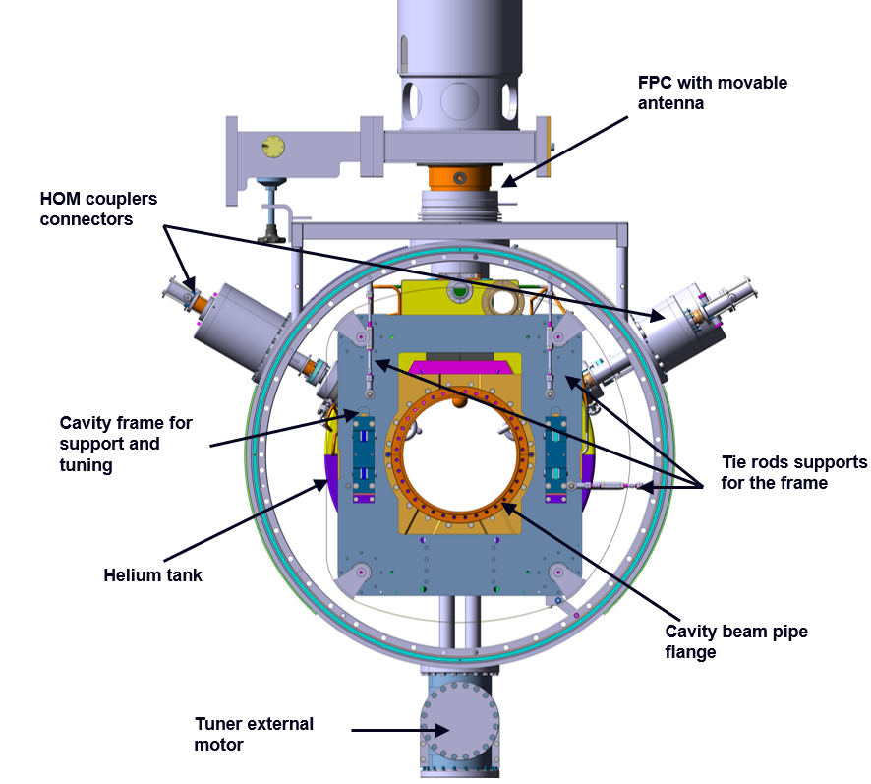
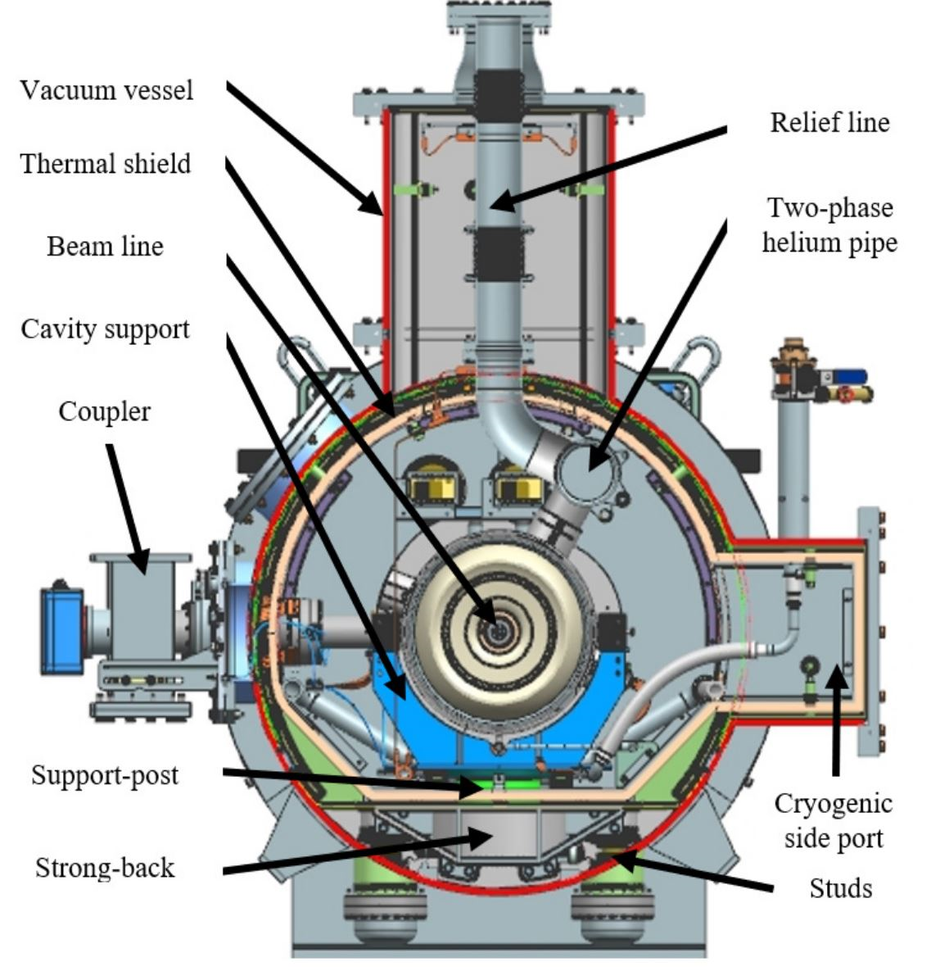
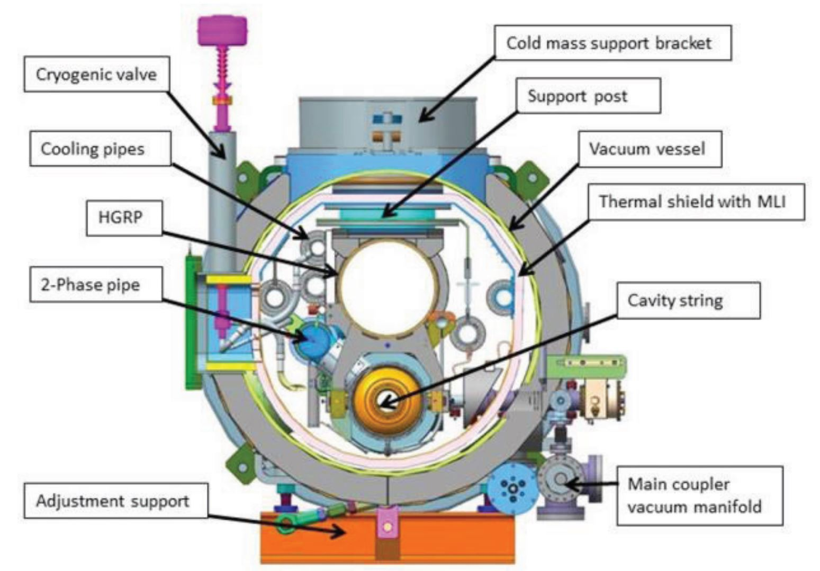
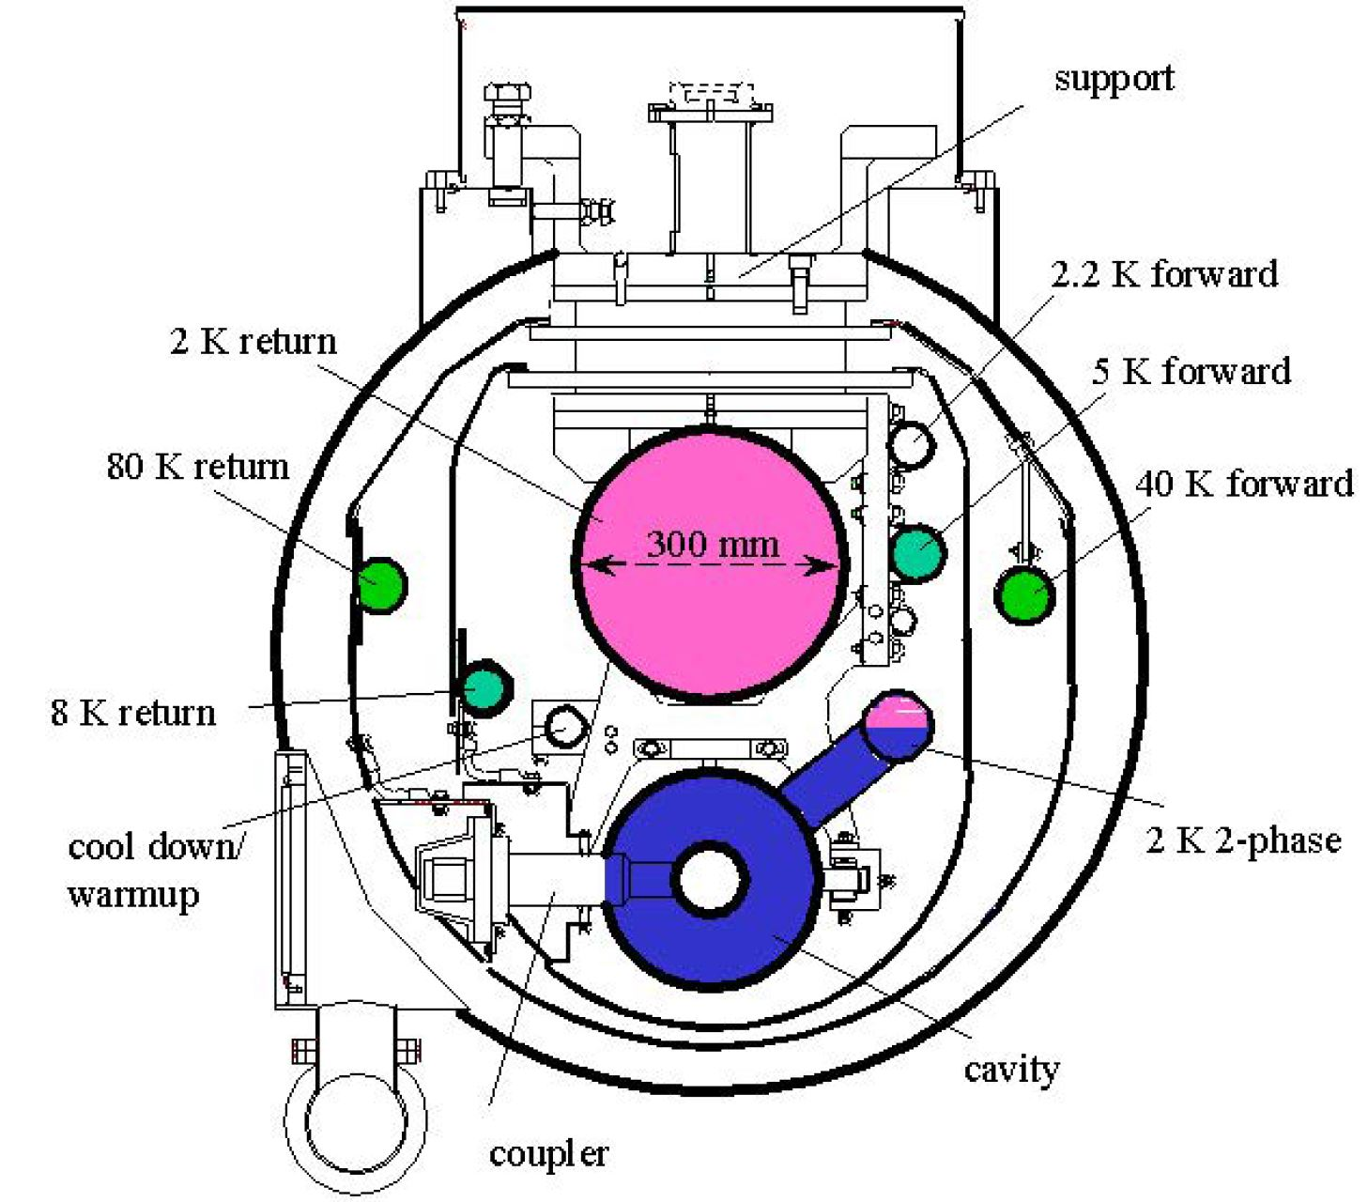
WP5 – Experience/Benchmark CMs: status of Task 5.2
Task 5.2: ESS cryomodules experience and benchmarking with other recent facilities – M1-M36
• Compile lesson learned from the ESS CM testing activities, technical commissioning, initial operation.
• Benchmarking with projects in the implementation phase (worldwide).
• Develop a roadmap to develop a new, sustainable CM design.
• Benchmarking with projects in the implementation phase (worldwide).
European Spallation Source
(ESS)
Spallation Neutron Source
(SNS)
Large Hadron Collider
(LHC)
Linac Coherent Light Source II (LCLS-II)
Proton Improvement Plan II
(PIP-II)
European X-ray Free-Electron Laser (XFEL)
2026-05-29
Nuno Elias - iSAS WP5 RP1 review - Jun/2026
16

Slide 17
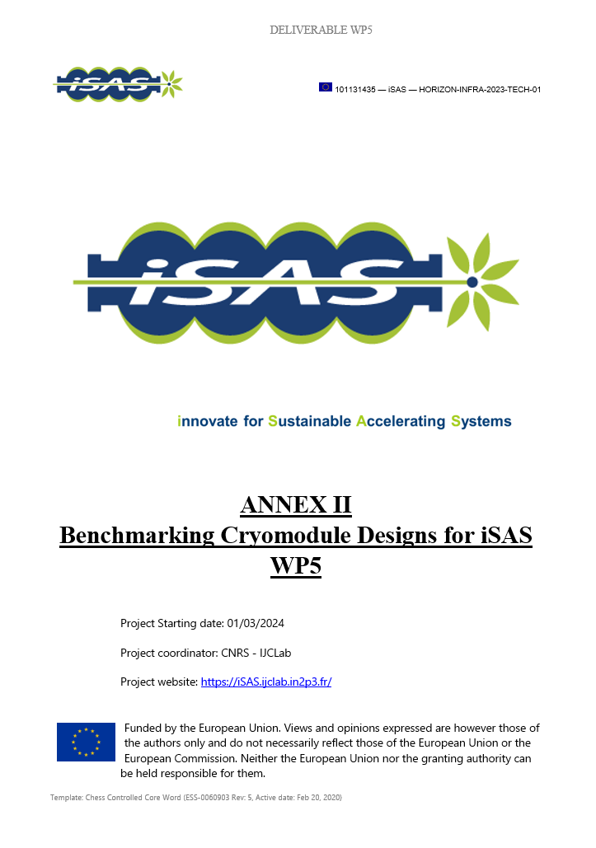
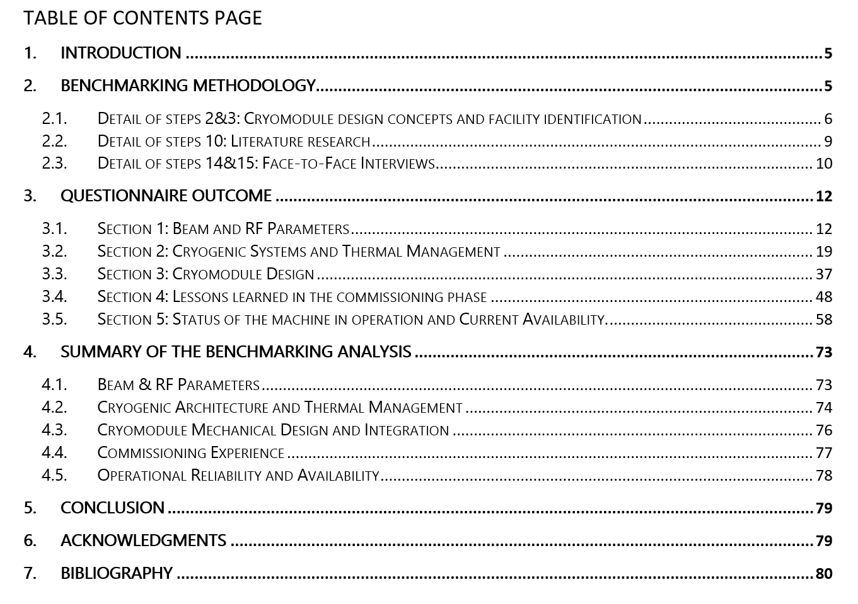
WP5 – Experience/Benchmark CMs: status of Task 5.2
Task 5.2: ESS cryomodules experience and benchmarking with other recent facilities – M1-M36
• Compile lesson learned from the ESS CM testing activities, technical commissioning, initial operation.
• Benchmarking with projects in the implementation phase (worldwide).
• Develop a roadmap to develop a new, sustainable CM design.
• Benchmarking with projects in the implementation phase (worldwide).
Methodology
Detailed Results
Summary
2026-05-29
Nuno Elias - iSAS WP5 RP1 review - Jun/2026
17

Slide 18
Summary of the benchmarking analysis
Beam and RF parameters
  1
•Focus: particles, accelerating gradients, operating frequencies, duty cycle.
•Goal: Understand how beam physics requirements drive the complexity and energy demands of the CM.
The beam structure requirements and RF parameters, including choice of frequency, fundamentally dictate the SRF and cryomodule architecture:
ESS | SNS | LHC | XFEL | LCLS-II | PIP-II
CW machines prioritize high Q₀ to minimize dynamic losses, while pulsed machines tend to push higher peak gradients
The type of machine (circular multi-pass, linear single-pass) and particles to be accelerated also dictate different requirement (alignment, losses, beam stability thresholds, etc.)
Wide range in delivered FPC power. Moreover, within the limit of the six facilities considered, two main families were identified, when it comes to orientation within the cryomodule, either vertical or horizontal.
In proton linear accelerators, the beam exhibits lower sensitivity to trapped HOM perturbations
 |  |  | LCLS-II and PIP-II use nitrogen-doped cavities to achieve a high Q₀: 2.7x10¹⁰ at 16 MV/m for LCLS-II and 3.3x10¹⁰ at 21 MV/m for PIP-II.
 |  |  | Peak value gradient above 16MV/m for all the facilities operating in pulsed mode. ESS and XFEL cavities are equipped with fast-piezo tuners, while SNS cavities do not need fast compensation with piezo actuators.
 |  |  | XFEL, LCLS-II, and PIP-II operates with average RF power of 2.15kW, 7kW and 35kW respectively, with FPCs designed for a peak power of 156 kW, 7 kW and 43kW respectively, at the nominal duty cycle. The FPCs have horizontal orientation and bellows in the transmission line ensure sufficient flexibility to compensate for the cold mass thermal contraction.
 |  |  | ESS, SNS and LHC operates with average RF power of 43 kW, 44kW and 300 kW respectively, with FPCs designed for a peak power of 1.1 MW, 550kW and 350 kW respectively, at the nominal duty cycle. The FPCs have a vertical - bottom or top for the LHC- orientation, these designs do not have bellows in the transmission line.
 |  |  | ESS and PIP-II cavities do not have HOM couplers. SNS originally included HOM couplers, however operational experience indicated they were not required to achieve goal performances, and given occasional leaks and failures, they have been progressively removed during cryomodule repairs.
 |  |  | Circular colliders like the LHC, and electron machines like XFEL and LCLS-II require the integration of HOM couplers in the cavity design.

Slide 19
Summary of the benchmarking analysis
Cryogenic Systems and thermal management
  2
•Focus: Machine architecture, Cooling circuit layouts, temperature and pressure levels, static and dynamic heat loads, and cooling capacity cryogenic plant. Management of helium inventory and ODH risk
•Goal: Characterizing design choices for cryogenic systems.
Significant diversity exists in cooling circuit segmentation, temperature levels, and thermal shield configurations
A multi-level temperature architecture (2K, 4.5/ 5-10K, 35–80 K) is standard across all facilities.
For cavities operating at low duty cycles, static heat loads strongly impact the total cryogenic consumption. For cavities operating in CW instead, the cryogenic losses are driven by the dynamic heat loads (except for LHC).
For the FPC outer conductor, it was observed a preference for the active cooling with helium, for operation with high average RF power (>40/50 kW). Active cooling is considered more flexible / adjustable, than fixed thermal intercepts.
Cryogenic distribution strategy (continuous vs segmented) strongly affects maintainability and failure recovery capability.
ESS | SNS | LHC | XFEL | LCLS-II | PIP-II
 |  |  |  |  | A three-level architecture (typically 2 K, 4.5–10 K, and 35–80 K) is the standard for optimizing thermal efficiency across all facilities.
 | Due to assembly compromises, the LHC uses a single temperature level (4.5 K) and a floating thermal shield made of MLI blankets.
 |  |  |  | The percentage of static heat load, compared to the total heat load to the cavity bath, is indicated per facility: ESS 44.1%, SNS 73.7%, LHC 83.7%, XFEL 45.8%
 |  | The percentage of static heat load, compared to the total heat load to the cavity bath, is small for facilities operating in CW, LCLS-II 10%, PIP-II 12.5%.
 |  |  | Active helium cooling is considered more flexible for high average RF power operations or for designs qualified for higher values of peak power, ESS, SNS and LHC use ~5 K helium to cool the FPC outer conductors.
 |  |  | Facilities with lower average power, such as XFEL, LCLS-II, and PIP-II, the outer conductor is cooled with fixed temperature thermal intercepts (copper braids) connected to the cryogenic lines.
 |  | Accelerating modules are integrated into a single vacuum vessel string. In case of maintenance the entire linac must be warmed up.
 |  | Cryomodules are stand-alone units, with access hatches, connected to the external distribution line via bayonets. The maintenance work may be performed through the access hatches, otherwise the cryomodule can be removed with the rest of the machine cold.
 |  | Cryomodules are stand-alone units, with access hatches, connected to the external distribution line via jumper with welded connections. The maintenance work may be performed through the access hatches, otherwise the cryomodule can be removed, warming up the linac

Slide 20
Summary of the benchmarking analysis
Cryomodule design
  3
•Focus: characterize internal components, cavity string assemblies, power couplers, tuners, and magnetic shielding.
•Goal: Map the constraints, design choices and integration aspects regarding the cryomodule design and its assembly sequence
While cavity technology is broadly similar (elliptical SRF cavities), integration philosophies differ:
Variations in cavity supporting schemes, vacuum forces compensation, longitudinal references and alignment strategies have been identified.
Helium tank design influences mechanical stiffness and microphonics sensitivity.
Variations in Magnetic shielding implementation (cold vs warm, single vs multi-layer) with impact on achievable Q₀
Some facilities reported design compromises made to facilitate assembly, reduce cost, or drivers related to schedule
The integration of a second thermal shield, when in presence of the 8-10K heat intercept, was evaluated but not always considered convenient
It appears now a standard to include access hatches in the cryomodule design.
ESS | SNS | LHC | XFEL | LCLS-II | PIP-II
 |  | Cavities are supported by the Helium Gas Return Pipe (GRP), which acts as the main structural backbone and an Ivar rod that provides longitudinal anchoring.
 |  | Cavities are supported and aligned with spaceframe at ambient temperature connected to the vacuum vessel. For the SNS cryomodule, a Nitronic rod is added for longitudinal anchoring.
 | Cavities are supported by a frame anchored to the vacuum vessel through six tie rods.
 | Cavities are supported by two support posts (one fixed, one sliding) mounted on a strongback support at ambient temperature.
 |  |  |  |  | The introduction of a cold magnetic shield outside the helium tank is a common practice for all the facilities using Niobium cavities. LCLS-II cavities have two layers of cold magnetic shielding.
 |  | SNS and PIP-II cryomodules have also a warm global magnetic shield.
 |  | LCLS-II and PIP-II cavities rely as well on fast cooldown across the Nb transition temperature to sweep out the trapped magnetic flux and reach the required Q₀.
 | LHC cavities in copper with Nb coating are not sensitive to magnetic field.
 |  | For LCLS-II and PIP-II, given the availability of a low temperature heat intercept, it was evaluated the possibility of having a second thermal shield. Although, the effective reduction of the heat load to the 2K was not considered sufficient to justify the cost, complexity and space occupation of a second shield.
 | In the XFEL cryomodule instead, there are two thermal shields, resulting in very minimal heat loads to the cavity bath.

Slide 21
Summary of the benchmarking analysis
Commissioning insights
  4
•Focus: Knowledge gained during the assembly, testing, and initial installation phases.
•Goal: Document technical difficulties in the commissioning phase, providing useful feedback for future sustainable designs.
Several key elements emerged during the discussion on commissioning experience and lessons learned:
A primary goal across facilities is to minimize discrepancies between "as-designed" and "as-tested/operated" performance, specifically addressing issues like cryoplant limitations and unexpected heat load differences
Success depends on maximizing preparation before tunnel installation, maintaining strong in-house expertise, accurate planning that allows smooth sequence and sufficient flexibility
It is strongly recommended to develop the design of cryomodules and their associated services together, to ensure system compatibility and avoid late-stage conflicts
Focusing on continuous quality controls and accurate interface matching is essential to reduce rework

Slide 22
Summary of the benchmarking analysis
Operational experience and reliability
  5
•Focus: Factors limiting cryomodule performance, mitigation strategies, machine availability, capability for maintenance, repair and replacement.
•Goal: Use real-world operational data to ensure that energy-saving innovations do not compromise the facility's scientific output.
Long-term availability emerged as a critical sustainability metric. Facilities emphasized:
Redundancy of internal equipment is critical in operation (ex: facilities now design for extra RF capacity, when possible, to compensate for individual cavity failures without beam degradation).
Different experiences have been described regarding cavity performance degradation and strategies for compensation with the remaining cavities.
Modular cryogenic systems and replacement strategies. The ability or not to isolate a single cryomodule for maintenance without affecting adjacent units strongly impacts overall machine uptime.
Importance of accessibility was emphasized, more specifically for couplers and tuners.
Failure modes reported include FPC degradation, tuner actuator failure, and vacuum-related incidents.
Cryoplant trips remain a major bottleneck for availability.
The cryoplant design includes safety margins to compensate for uncertainty in the estimation of cryomodule static and dynamic heat loads.

Slide 23
Beam and RF parameters
Conclusions and next steps
  1
•Focus: particles, accelerating gradients, operating frequencies, duty cycle.
•Goal: Understand how beam physics requirements drive the complexity and energy demands of the CM.
Beam and RF parameters are the design drivers, while cryogenic efficiency impacts the overall sustainability.
Common trends, (multi-level temperature architectures, modular cryogenic segmentation, accessibility) have emerged as industry standards.
High availability and long-term reliability are primary metrics for sustainability.
The collected data will be translated into practical engineering strategies, to build a Roadmap for the development of sustainable cryomodules (D17).
The resulting guidelines will directly contribute to the development of a parametric tool for cryomodule design (Task 5.3 - D18).
Cryogenic Systems and thermal management
  2
•Focus: Machine architecture, Cooling circuit layouts, temperature and pressure levels, static and dynamic heat loads, and cooling capacity cryogenic plant. Management of helium inventory and ODH risk
•Goal: Characterizing design choices for cryogenic systems.
Cryomodule design
  3
•Focus: characterize internal components, cavity string assemblies, power couplers, tuners, and magnetic shielding.
•Goal: Map the constraints, design choices and integration aspects regarding the cryomodule design and its assembly sequence
Commissioning insights
  4
•Focus: Knowledge gained during the assembly, testing, and initial installation phases.
•Goal: Document technical difficulties in the commissioning phase, providing useful feedback for future sustainable designs.
Operational experience and reliability
  5
•Focus: Factors limiting cryomodule performance, mitigation strategies, machine availability, capability for maintenance, repair and replacement.
•Goal: Use real-world operational data to ensure that energy-saving innovations do not compromise the facility's scientific output.

Slide 24
Acknowledgments
We wish to extend our sincere gratitude to all the experts who participated in the benchmarking process, the amount of information shared have exceeded our expectations. iSAS WP5 as a Forum to promote efficient CM design
SNS (Spallation Neutron Source, Oak Ridge, USA)
John Mammoser
Paolo Pizzol
ESS (European Spallation Source, Lund, Sweden)
Paolo Pierini
Nuno Elias
Emma Simpson
Henry Przibliski
Marek Skiba
CERN (LHC, Geneva, Switzerland)
Vittorio Parma
Karin Canderan
Katarzyna Turaj
Krzysztof Brodzinski
David Smekens
PIP-II (Fermi National Laboratory, Batavia, Illinois, USA)
Donato Passarelli
Vincent Roger
XFEL (European X-ray Free Electron Laser, Hamburg, Germany)
Serena Barbanotti
Kay Jensch
Julien Branlard
Joshua Einstein-Curtis
LCLS-II (Linac Coherent Light Source II, SLAC, California, USA)
Thomas Petersen
Sebastian Aderhold

Slide 25
WP5 – Design new CM: status/evolution of Task 5.3
Task 5.3: Sustainable criteria for LINAC cryomodule design – M24-M48
• Integrate findings from the other iSAS WPs into a generic CM design.
• Explore the sustainability criteria for the design.
Activities: Task planned start: M24 (Mar26)
  In-person workshop at IJCLAB in 28-Jan-2026, brainstorming towards parametric design (create a team)
PARAMETRIC
DESIGN for a
SUSTAINABLE
CRYOMODULE with
ISAS TECHNOLOGIES
- Which Parameters
are relevant?
- Design Drivers?
- Requirements?
- Constraints ?
- Uncertainty ?
- Energy Savings
- Main Functions
- State-of-the art
- Lifecycle
- Main Components
- Looking into the future at proposed acc. syst.
- Desired / Achievable degree of complexity?
- Availability
- Maintainability
- Repairability
- Systems Integration
- Best Practices
- Quantification of gains
- Systems Engineering approach
- Industrial Solutions?
- Design Dilemmas
Engineering Toolbox for CM design: Decision making tool
Deliverable 5.3 : Parametric design for a sustainable CM with iSAS tech. (Due date: M48 or Feb-2028)

Slide 26



WP5 – Design new CM: status/evolution of Task 5.4
Task 5.4: Beam Dynamics for ERL-based accelerators with energy-efficient cryomodules – M1-M48
• Simulate the beam dynamics of ERL-based accelerators when the energy efficient CM is included.
• Study the lattice design to optimize the beam and energy saving performances.
Beam Dynamics for ERL-based accelerators with energy-efficient cryomodules
Single- and multi-bunch instability studies in the iSAS/PERLE cryomodules
  Development of simulation tools
    Multi-pass recirculation model
    Wake field model
  Single- and multi-bunch beam breakup and beam loading studies
Energy-recovery efficiency studies

Slide 27
WP5 – Design new CM: status/evolution of Task 5.4
Task 5.4: Beam Dynamics for ERL-based accelerators with energy-efficient cryomodules – M1-M48
• Simulate the beam dynamics of ERL-based accelerators when the energy efficient CM is included.
• Study the lattice design to optimize the beam and energy saving performances.
Task 5.4 (EPFL, CNRS, CERN)
Task 5.4 aims to evaluate and optimise beam dynamics in Energy-Recovery LINAC (ERL) accelerators integrated with new energy-efficient cryomodules. Through simulations, it analyses how the sustainable SRF system affects beam quality, maximum beam intensity, and energy recovery efficiency.
A key focus is preventing beam quality degradation by defining engineering tolerances, such as cavity alignment and High-Order Mode (HOM) impedance thresholds, and studying instabilities like beam breakup (BBU) and beam loading (BL), which are critical limits for high-power ERL performance.
The simulation results serve two purposes: optimising the accelerator lattice for energy efficiency, and feeding back into cryomodule and hardware design in WP4 and WP5. Work is being conducted for general high-power ERLs and specific facilities such as PERLE.
The task is led by EPFL within iSAS, forming part of a PhD project by Lode Vanhecke under Prof. Mike Seidel and Dr. Tatiana Pieloni, reflecting iSAS's commitment to training the next generation of accelerator scientists.
Deliverable 5.4 : Report on beam dynamics study for ERL with iSAS CM (Due date: M48 or Feb-2028)

Slide 28
WP5 – Design new CM: status/evolution of Task 5.4
Task 5.4: Beam Dynamics for ERL-based accelerators with energy-efficient cryomodules – M1-M48
• Simulate the beam dynamics of ERL-based accelerators when the energy efficient CM is included.
• Study the lattice design to optimize the beam and energy saving performances.
Main activities carried out:
Comprehensive literature study of beam dynamics phenomena and evaluation of numerical codes
  - Wake fields, impedances and instabilities -> Deep analytical understanding
  - Evaluation of various simulation codes: RF-track Bmad/Tao, PLACET and X-suite
Collection of LINAC parameters and related design specifications of SRF cavities
  - LINAC geometrical parameters, field maps and HOM parameter or 5-cell cavities
Benchmarking of analytical cavity models
  Good agreements between various models
  Balancing precision, convergence and speed
Figure 1: Benchmark of the evolution of the transverse beta functions and beam size of a bunch through the PERLE cryomodule between Bmad/Tao, BDSIM, RF-Track, and the PERLE RF field map simulated in RF-Track; the grey rectangles on top indicate the location of the 5-cell standing-wave cavities.

Slide 29
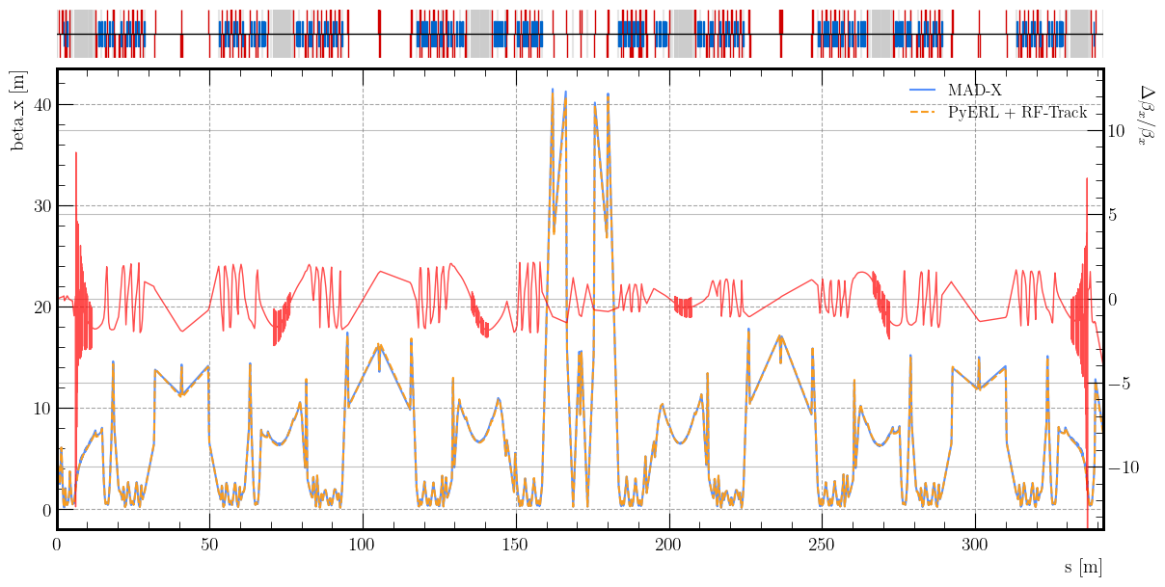
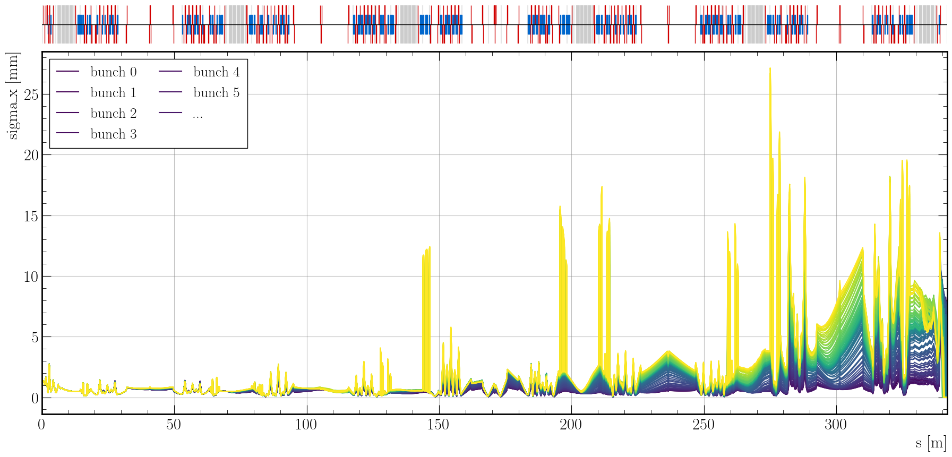
WP5 – Design new CM: status/evolution of Task 5.4
Task 5.4: Beam Dynamics for ERL-based accelerators with energy-efficient cryomodules – M1-M48
• Simulate the beam dynamics of ERL-based accelerators when the energy efficient CM is included.
• Study the lattice design to optimize the beam and energy saving performances.
Main activities carried out:
Development of extensive RF-Track Python wrapper for advanced beam simulations
  Developed an extensive RF-Track Python wrapper to enable fast parallel simulations, parameter scans, and analysis, with flexible definitions for lattices, SRF cavities, bunches, and beams.
  Built a recirculation model within the wrapper to support end-to-end ERL simulations — the only approach capable of capturing instabilities in complex lattices — compatible with any arbitrary recirculation accelerator.
  Completed a wakefield model in RF-Track enabling proper excitation and accumulation within the recirculation model, recently benchmarked against Xwakes with excellent agreement.
Systematic beam breakup study for PERLE with recirculation model
  Conducted a first systematic BBU study for the PERLE facility. Incorporated relevant dipole HOMs into the recirculation model to simulate beam breakup threshold currents.
  Results show the BBU threshold is at least an order of magnitude above the nominal operating current, indicating a robust lattice design with strong resilience against transverse instabilities at high-power operation.
  Gathered preliminary results on the threshold current in the 250 MeV PERLE lattice
Comparison of the horizontal beta function through the PERLE 250 MeV lattice (MAD-X and PyERL+RF-Track).
Horizontal beam size of 100 bunches passing through the PERLE 250 MeV lattice at 0.2 A with wakefields. (beam size growth due to instability)

Slide 30
WP5 – Design new CM: status/evolution of Task 5.4
Task 5.4: Beam Dynamics for ERL-based accelerators with energy-efficient cryomodules – M1-M48
• Simulate the beam dynamics of ERL-based accelerators when the energy efficient CM is included.
• Study the lattice design to optimize the beam and energy saving performances.
Main activities carried out:
High fidelity beam dynamics simulations for an integrated ERL system
  Running high-fidelity beam dynamics simulations using the Python wrapper, multi-pass recirculation model, and wakefield model to characterise the full integrated ERL system.
  Conducting systematic studies on BBU thresholds and HOM excitation impacts on both transverse and longitudinal beam stability.
  Using detailed cavity field maps and impedance data to define tolerances needed to maintain beam quality throughout the energy recovery process.
  Investigating the interplay between novel iSAS cryomodule designs and the recirculating beam to ensure energy-efficient hardware does not limit maximum beam intensity.
Implementation of LLRF within the simulation framework
  (ongoing) develop strategies for suppressing beam loading (BL) effects, particularly during the transient regime from injection to steady state
Next Steps
Provide feedback for iterative accelerator lattice refinement, defining hardware specifications to suppress instabilities for PERLE and future high-power ERL facilities.
Subsequent studies will assess maximum energy efficiency, quantifying efficiency limits at PERLE where beams are degraded by coherent synchrotron radiation.
For ERL-based colliders, energy efficiency will be evaluated under complex conditions involving collective effects such as intense beam-beam collisions.

Slide 31
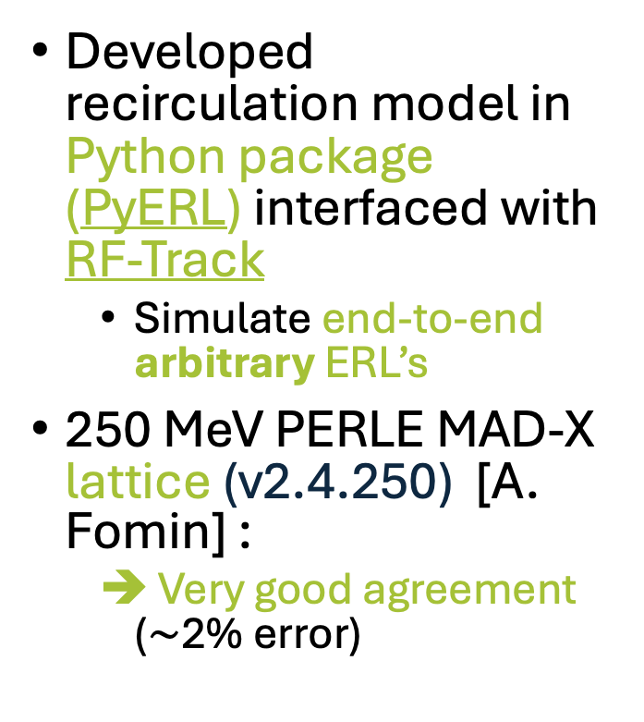
WP5 – Design new CM: status/evolution of Task 5.4
Task 5.4: Beam Dynamics for ERL-based accelerators with energy-efficient cryomodules
– M1-M48
Developed recirculation model in Python package (PyERL) interfaced with RF-Track
  Simulate end-to-end arbitrary ERL’s
250 MeV PERLE MAD-X lattice (v2.4.250) [A. Fomin] :
  Very good agreement ($\sim$2% error)
Figure 2: Comparison of the horizontal beta function through the PERLE 250 MeV lattice.

Slide 32
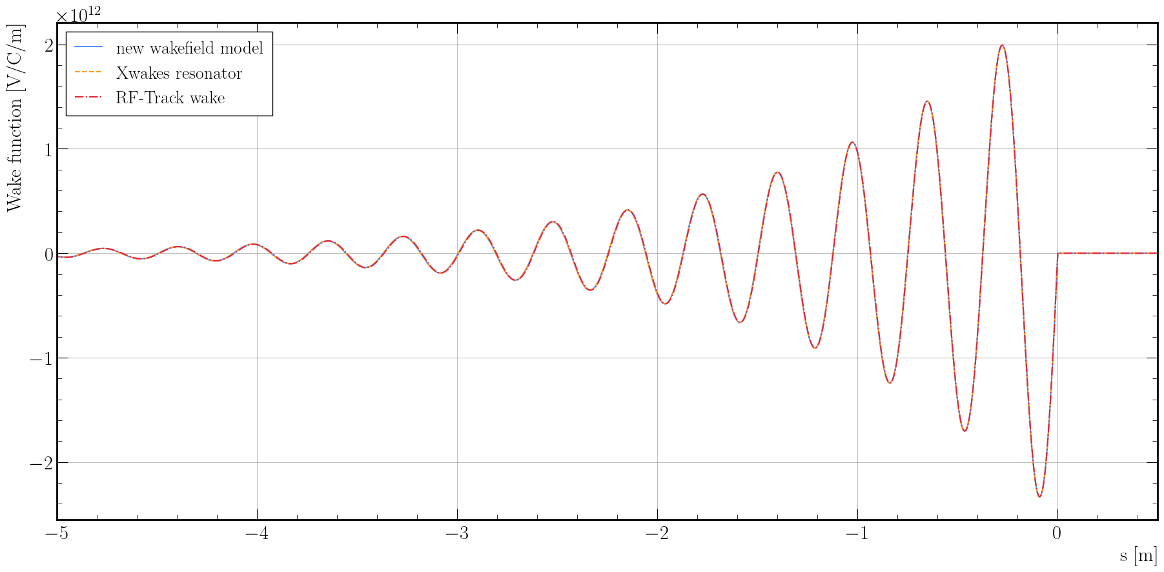

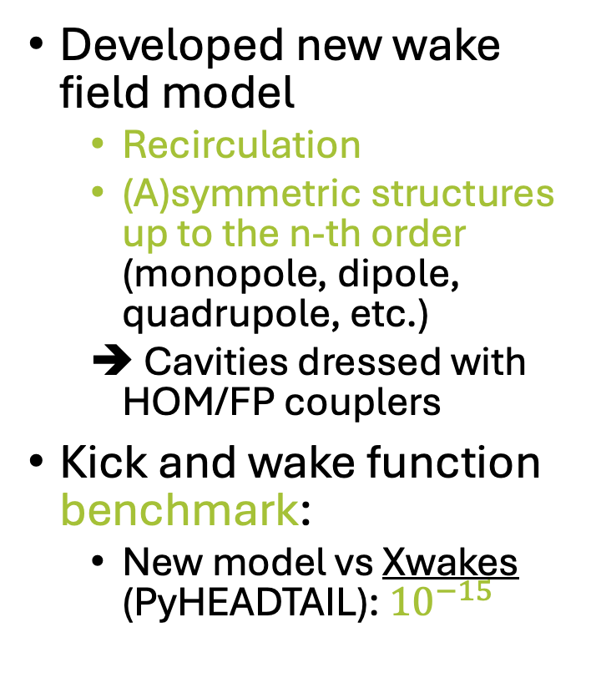
WP5 – Design new CM: status/evolution of Task 5.4
Task 5.4: Beam Dynamics for ERL-based accelerators with energy-efficient cryomodules
– M1-M48
Developed new wake field model
  Recirculation
  (A)symmetric structures up to the n-th order (monopole, dipole, quadrupole, etc.)
  Cavities dressed with HOM/FP couplers
Kick and wake function benchmark:
  New model vs Xwakes (PyHEADTAIL): ${10}^{−15}$
Figure 3: Transverse wake function comparison with $f =801.58 MHz$, ${ r}/Q=1$, and $Q =10$.

Slide 33
WP5 – Design new CM: status/evolution of Task 5.4
Task 5.4: Beam Dynamics for ERL-based accelerators with energy-efficient cryomodules
– M1-M48
Single- and multi-bunch instability studies in ERL-based accelerators (PERLE/general ERL):
  Current/HOM threshold: maximum beam current/quality factor/shunt impedance before an instability appears
  Effect of dipole modes (and monopole)
  (Regenerative) multi-pass beam breakup
  Beam loading effects
    Model LLRF system in beam dynamics framework to mitigate transient beam loading effects
Energy recovery efficiency studies:
  PERLE
  General ERL collider study
  Specific ERL-based collider project: LHeC, ERLC, erc@CERN, FCC-ee ERL, and more….

Slide 34
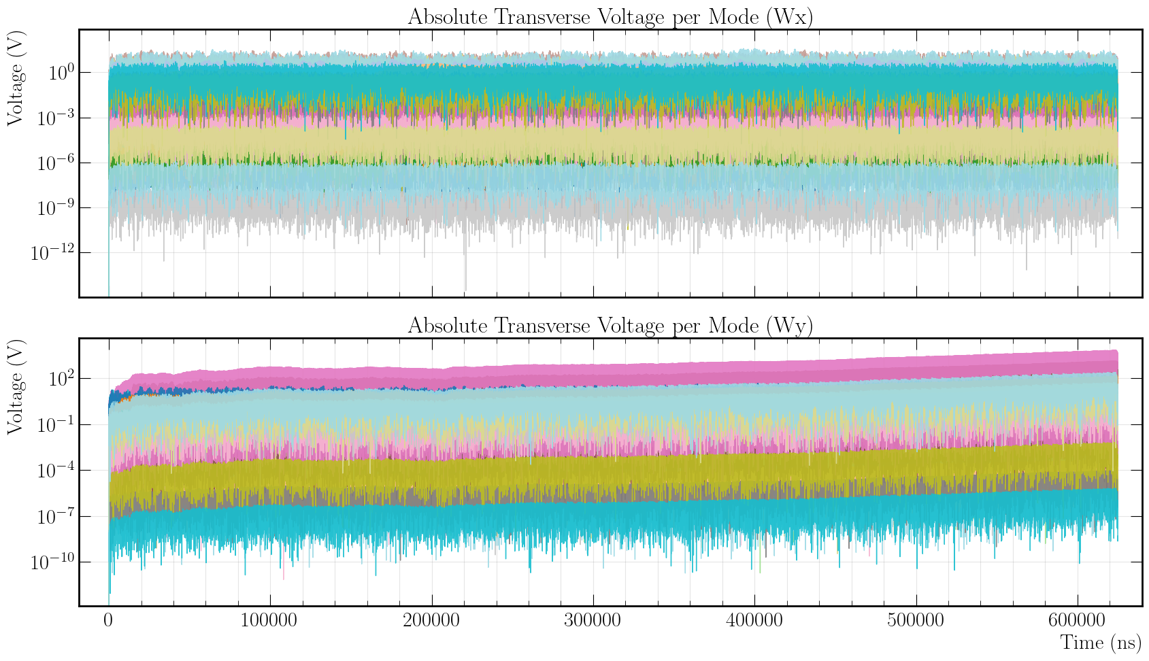
WP5 – Design new CM: status/evolution of Task 5.4
No instability
Instability appears
Figure 4: The average evolution of individual horizontal and vertical dipole HOM voltages experienced by a test particle at a 1 mm offset inside the 4th PERLE dressed 5-cell half-wave cavity excited by 25k bunches passing through the PERLE 250 MeV lattice at 435 mA.

Slide 35
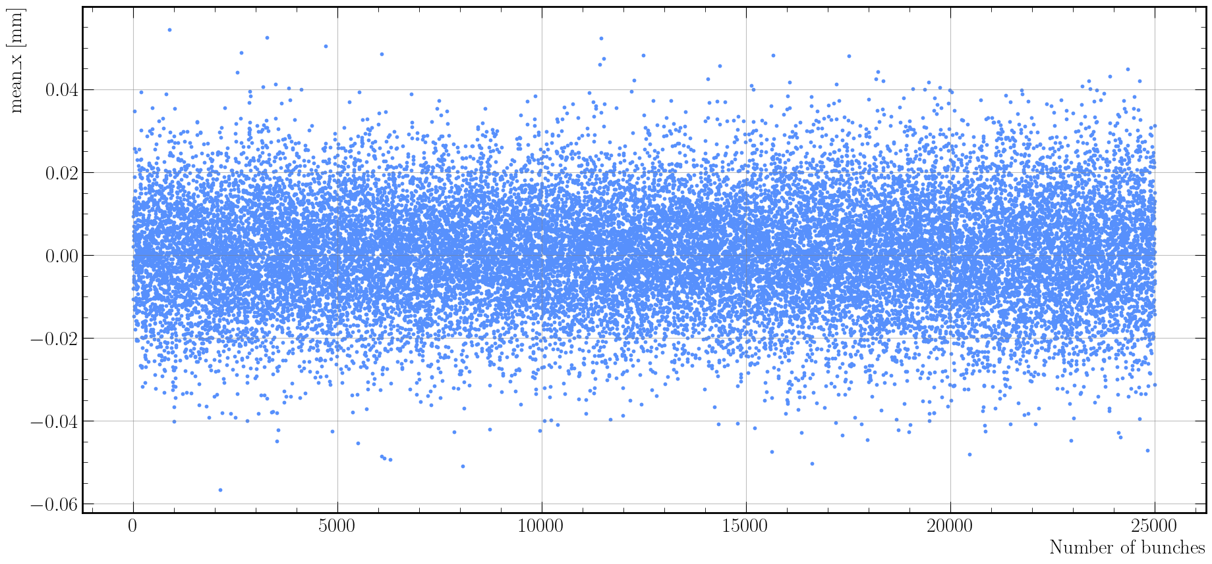
WP5 – Design new CM: status/evolution of Task 5.4
No instability
Figure 5: Average horizontal position of 25k bunches at the exit of the 250 MeV PERLE linac after the last decelerating pass at 435 mA.

Slide 36
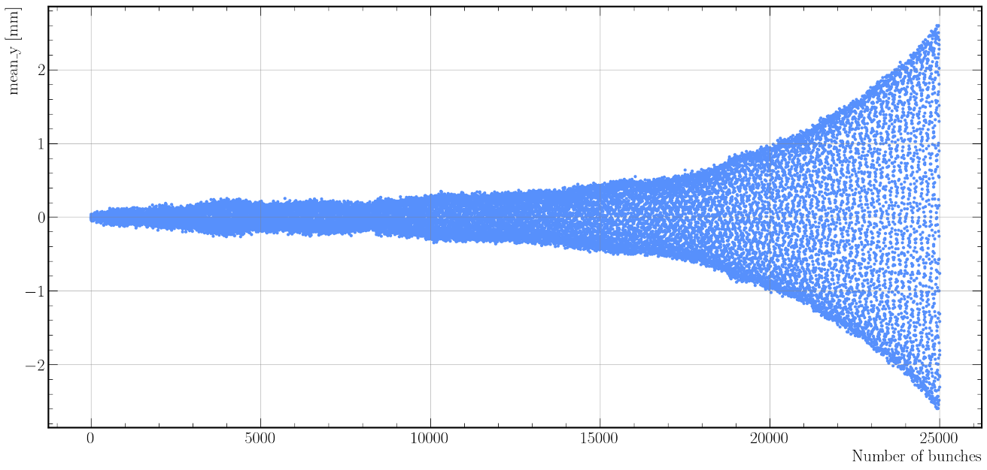
WP5 – Design new CM: status/evolution of Task 5.4
Instability appears
Figure 6: Average vertical position of 25k bunches at the exit of the 250 MeV PERLE linac after the last decelerating pass at 435 mA.

Slide 37
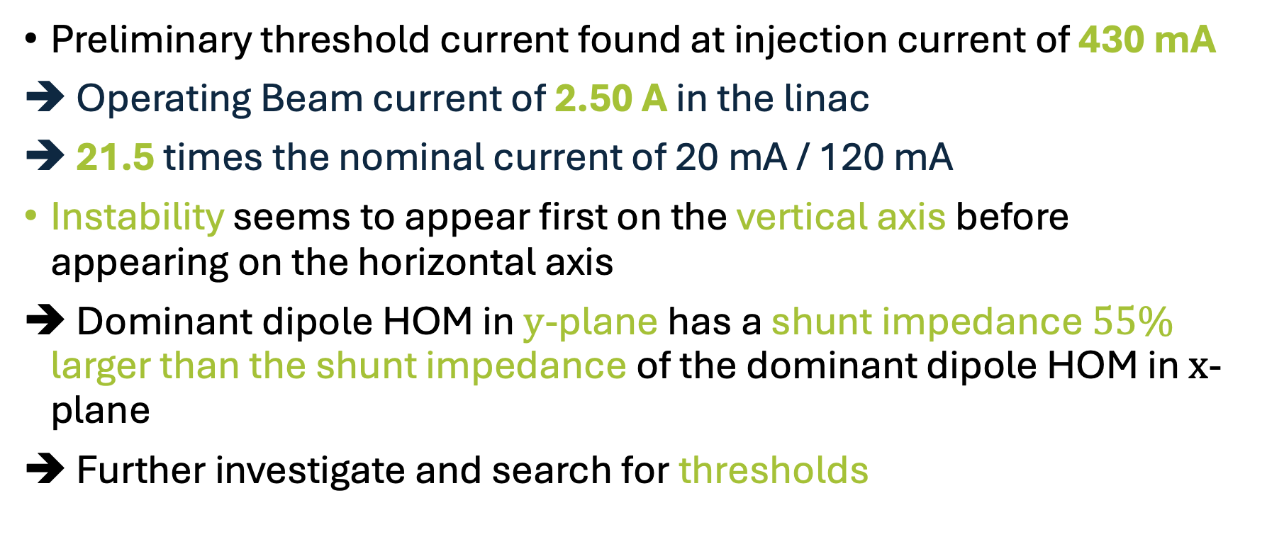
WP5 – Design new CM: status/evolution of Task 5.4
Task 5.4: Beam Dynamics for ERL-based accelerators with energy-efficient cryomodules
– M1-M48
Preliminary threshold current found at injection current of 430 mA
Operating Beam current of 2.50 A in the linac
21.5 times the nominal current of 20 mA / 120 mA
Instability seems to appear first on the vertical axis before appearing on the horizontal axis
Dominant dipole HOM in $y$-plane has a shunt impedance $55\%$ larger than the shunt impedance of the dominant dipole HOM in $x$-plane
Further investigate and search for thresholds

Slide 38
WP5 – Design new CM: status/evolution of Task 5.4
Task 5.4: Beam Dynamics for ERL-based accelerators with energy-efficient cryomodules
– M1-M48
Past developments:
  Meetings/communication with PERLE collaboration, discussing details on the lattice, RF structure and HOM parameters
  Evaluated and tested beam various dynamics codes to enable ERL simulations
  Developed recirculation tracking model that allows to track any arbitrary recirculating lattice in RF-Track
  Developed wake field model that allows for symmetric and asymmetric mode excitation in recirculating lattices
  Gathered preliminary results on the threshold current in the 250 MeV PERLE lattice (v2.4.250)
Current developments:
  Model optimisations
  Single- and multi-bunch instability studies for PERLE
  Beam loading studies for PERLE
    Modelling of LLRF system
  Evaluation of ERL collider/light source applications for iSAS technology

Slide 39
WP5 – Coordination: status/evolution of Task 5.1
Task 5.1: Coordination on cryomodule design activities– M1-M48
• General coordination by ESS as described above.
Impact Risk Analysis
Critical risks & risk management strategy
Risk No | Description | Prob | Sev | Critic. (PxS) | Mitigation measures
5.1 | Beneficiary leaves the project | 1 | 2 | 2 | Pro-actively: document, collaborate, strong coordination; Post-facto: redistribute tasks
5.2 | Lack of candidates for temporary positions | 1 | 2 | 2 | Maximize job advertisements as early as possible and as wide as possible (professional networks), leverage on the iSAS consortium
5.3 | Absence of WP leader | 1 | 2 | 2 | Assign a deputy WP leader
5.4 | CERN junior engineer leaves | 1 | 3 | 3 | Tasks sharing in progress with ESS junior engineer.
5.5 | ESS Junior Engineer only covers half of the project might enter project too late or leave project too early | 1 | 2 | 2 | The assignment of Junior Engineer position at ESS is valid for 2 years shared with WP6. Optimise the hiring process start to match project
5.6 | EPFL Ph.D candidate leaves | 1 | 3 | 3 | Maintain Candidate stimulated
5.7 | Benchmarking facilities low availability from external partners | 1 | 2 | 2 | Gather as much data from bibliographic references, create a spirit of collaboration with benchmarking facilities, share the results
5.8 | Task 5.3, parametric design of sustainable cryomodule resulting to be over-optimistic and complex to parameterise (multiple choices). | 2 | 2 | 4 | Re-define goals towards list of best practises, and decision-making guidelines supporting design choices.

Slide 40
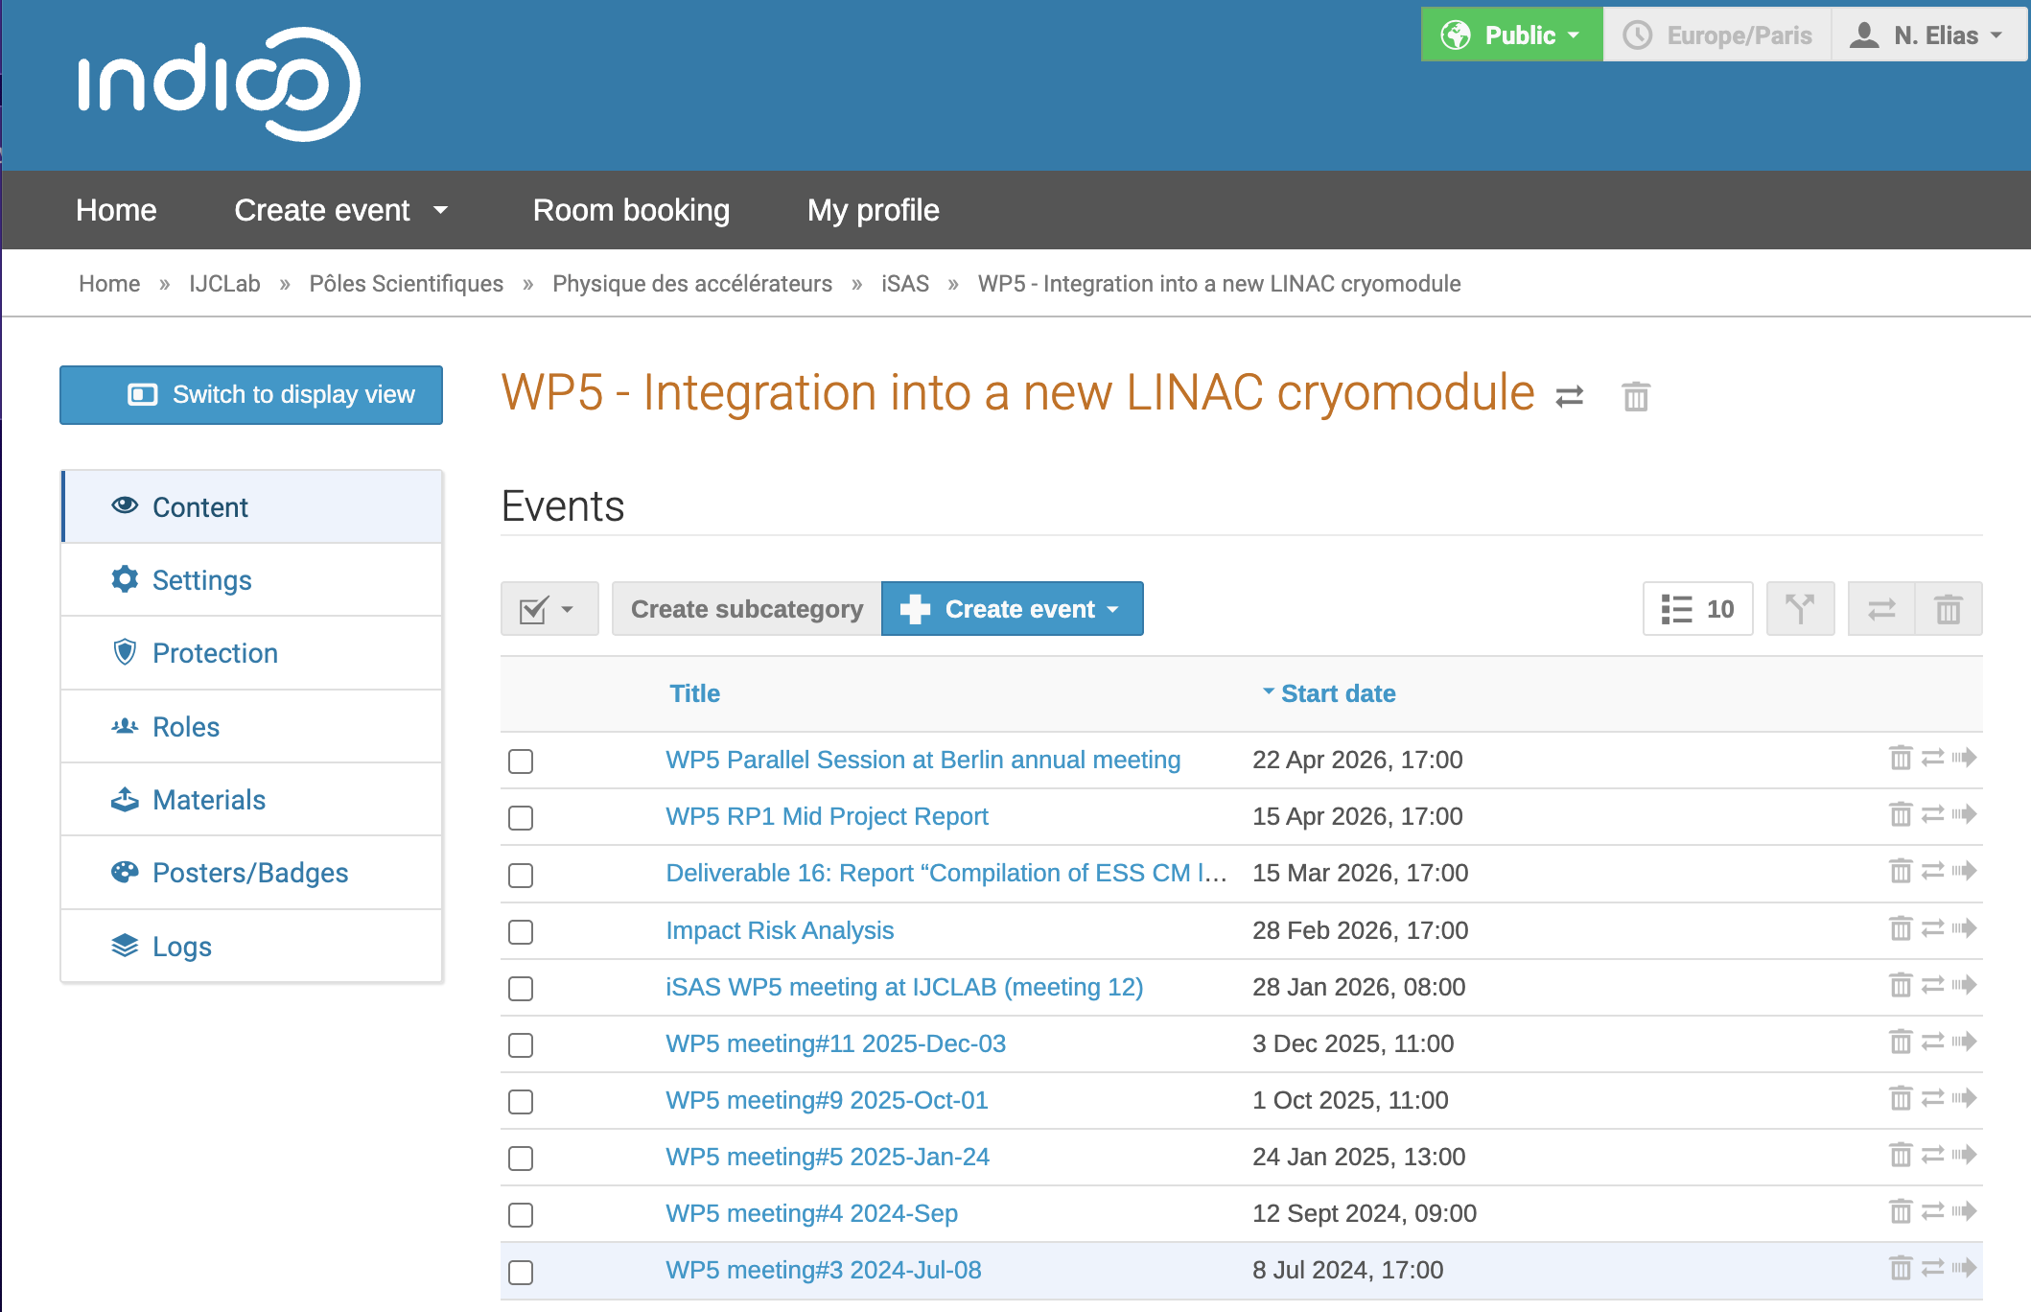
WP5 – Indico ShareSpace, links to reports
Benchmarking (Detailed Slides)
Beam Dynamics ( Detailed Slides)
Report WP5 RP1 (Link)
Deliverable 16 Report (Link)
Annex I (Link) : ESS Lessons
Annex II (Link ) : Benchmarking CM Designs
Impact Risk Analysis (Link)

Slide 41
Thank you
Thanks to all WP5 colleagues:
Vittorio Parma, Karin Canderan, Lode Vanhecke, Emma Simpson, Guillaume Olry, Gilles Olivier, Tatiana Pieloni, Mike Seidel, Paolo Pierini, Henry Przybilski, Marek Skiba, Nuno Elias
Upcoming:
- Presentation at Sustainable High Energy Physics workshop: 8-10 July 2026
“Developing a Roadmap for Sustainable Cryomodule Design”
- Poster and Paper at ICEC30-ICMC2026, Daejeon, South Korea:
“Lessons Learned from the ESS Elliptical Cryomodule Design and Operation : Paving the way for Sustainable Accelerating Systems (iSAS)”

