Slide 1


WP6: Integration into Accelerator and Collider Ris
RP1 review meeting, June 1st, 2026
Guillaume Olry on behalf of WP6 partners
All information contained in this presentation and any accompanying documents is for iSAS project only, and must be treated as strictly confidential.
Any dissemination, distribution or other use of this information without the consent of its owner is prohibited.
Funded by the European Union. Views and opinions expressed are however those of the authors only and do not necessarily reflect those of the European Union or the European Commission. Neither the European Union nor the granting authority can be held responsible for them.

Slide 2
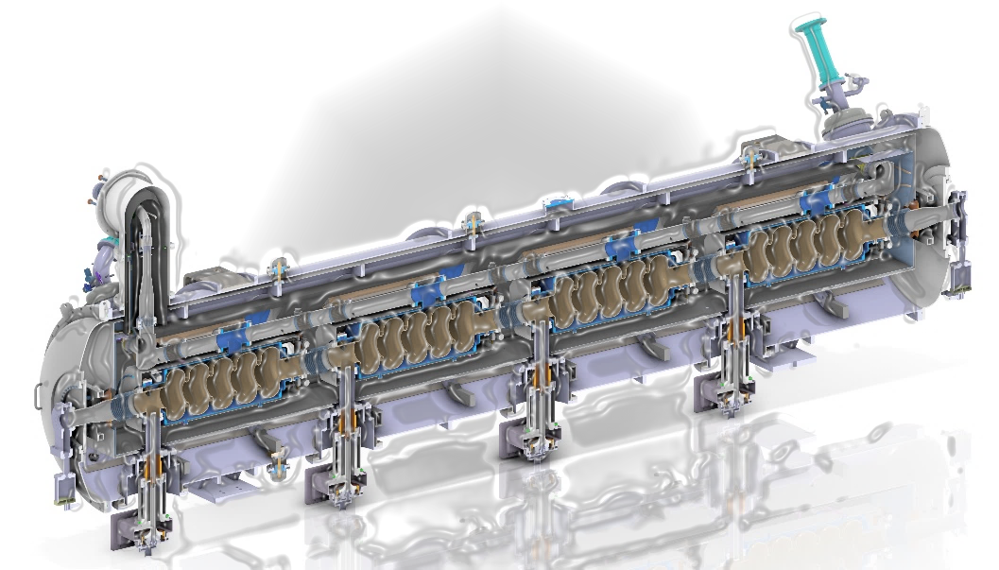
WP6: Integration into Acc&Collider RIs
Institutes participating: CNRS, CEA, ESS, INFN, University of Lancaster
Convener: G. Olry (CNRS/IJCLab) – Deputy: S. Berry (CEA),
Main contacts with other partners : N. Elias (ESS), D. Giove (INFN), G. Burt (UL)
Main objectives of the WP6:
• Expedite the integration of iSAS energy-saving technologies by retrofitting existing accelerating systems.
• Adapt an ESS prototype medium-beta cryomodule for PERLE, ready to demonstrate energy recovery with high-power recirculating beams.
• Integrate a new components: cavity string, optimized HOM/FPC components, BLAs, shielding and cryogenic circuits while reusing existing components.
• Prepare a concrete pathway toward high-energy, high-intensity electron beams with minimal energy consumption on PERLE facility.
Main people involved
CNRS: Guillaume Olry, Gilles Olivier, Sébastien Blivet, Patricia Duchesne, Patxi Duthil, Christophe Joly, Akira Miyazaki, Axel Perez-Ruiz, Nicolas Gandolfo, Hervé Saugnac, Damien Till
CEA: Stéphane Berry, Fabien Eozénou, Arnaud Madur
ESS: Nuno Elias, Paolo Pierini, Cecilia Maiano, Henry Przybilski, Marek Skiba, Emma Simpson
INFN: Dario Giove, Maria Rosaria Masullo, Luigi Celona, Gino Sorbello, Paolo Spruzzola
Uni. Lancaster: Graeme Burt
Cryomodule design
...in progress
iSAS-PERLE cryomodule adaptation: integration of sustainable technologies into an RI-ready system

Slide 3
WP6: Work plan and interfaces with other WPs
Institutes participating: CNRS, CEA, ESS, INFN, University of Lancaster
Convener: G. Olry (CNRS/IJCLab) – Deputy: S. Berry (CEA),
Main contacts with other partners : N. Elias (ESS), D. Giove (INFN), G. Burt (UL)
Task 6.1 (CNRS): Coordination – M1-M48
  • General coordination in collaboration with WP4 on HOM and RF couplers and WP1 on FE-FRT development.
Task 6.2 (UL, CNRS): Retrofitting Fast Reactive Tuners into existing cryomodules HL-LHC oriented – M1-M24
  • Investigate if the existing cavity end group can be used with an FE-FRT by combining the FE-FRT and a HOM coupler into a single device.
Task 6.3 (CNRS, CEA, ESS): Adapt the existing ESS cryomodule – M1-M18
  • Adaptation of the existing ESS cryomodule into a new configuration which will integrate a completely new cavity string equipped with the optimized HOM and FPC couplers developed in WP4
Task 6.4 (INFN, CNRS, ESS, UL): Fabrication and validation of cryomodule components – M1-M30
  • Fabrication, preparation and test of the critical components (SRF cavity, tuning systems, HOM couplers, ...)
Task 6.5 (CEA CNRS, ESS): Assembly and test of adapted cryomodule – M30-M48
  • Assembly and cryogenic & RF test of the cryomodule.
→ Link with WP1
→ Link with WP4 and WP5
→ Link with WP4
→ Link with WP5

Slide 4
WP6: Key outcomes
• Investigated interactions between FRT and Higher Order Modes and integrated FRT/HOM coupler design started
• Engineering design for adapting the ESS cryomodule to PERLE/iSAS is essentially complete and reviewed.
• Reuse strategy confirmed for the vacuum vessel, spaceframe, thermal shield, coupler interfaces, several cooling circuits and part of the instrumentation/cabling.
• Adapted cavity string defined with four 801.58 MHz 5-cell cavities, HOM/FPC integration, tuning systems, magnetic shielding and cold BLAs.
• Component procurements launched or progressing: niobium delivered, award for 5-cell cavities, and tenders prepared for remaining subsystems.
• Main risk is procurement/manufacturing delay; the scope remains valid and the project-extension request is the mitigation.

Slide 5
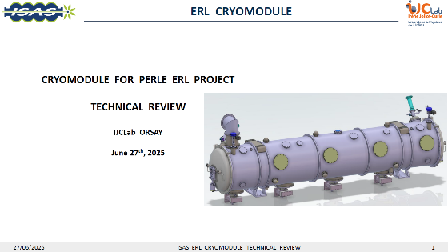
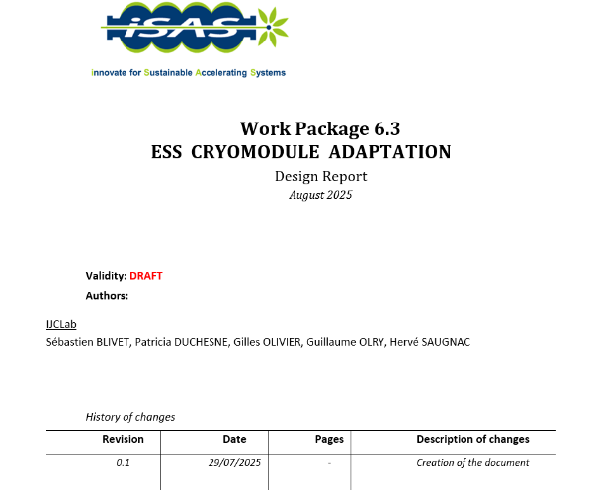
WP6: achievements of Task 6.1
• Monthly WP6 meetings established on a regular cadence.
• Joint coordination maintained with WP4 and WP5; Task 6.2 is strongly linked to WP1 FE-FRT studies.
• Technical review on ESS cryomodule adaptation held on 27 June 2025.
• M22 engineering report delivered
WP6 risk analysis updated in April 2026.

Slide 6
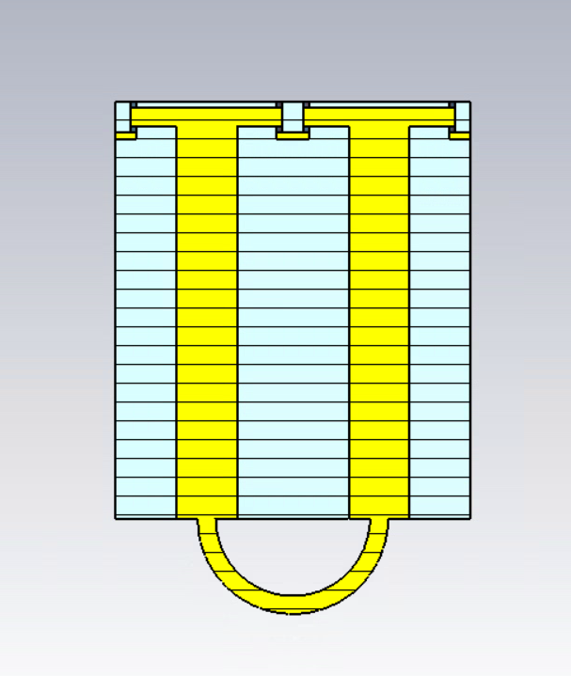
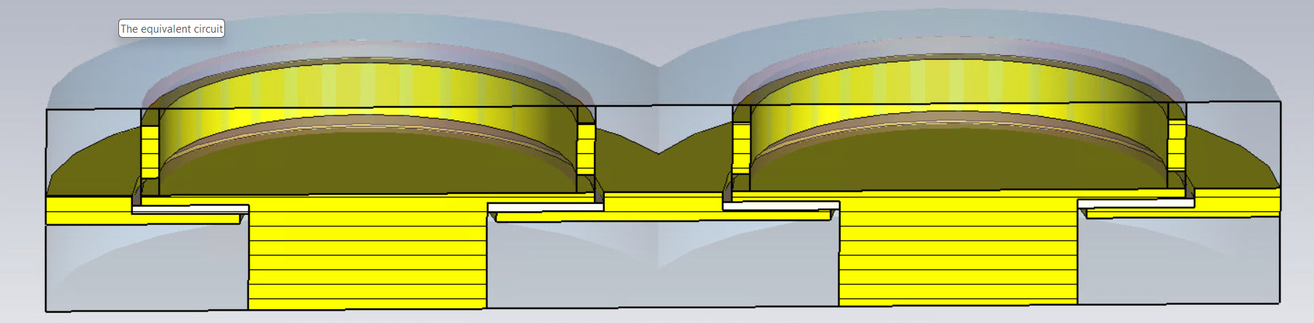
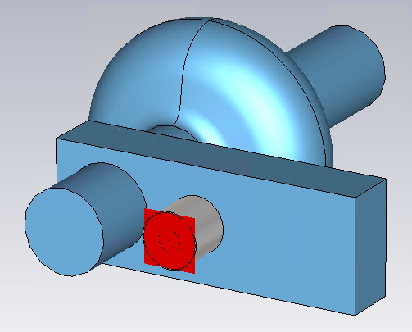
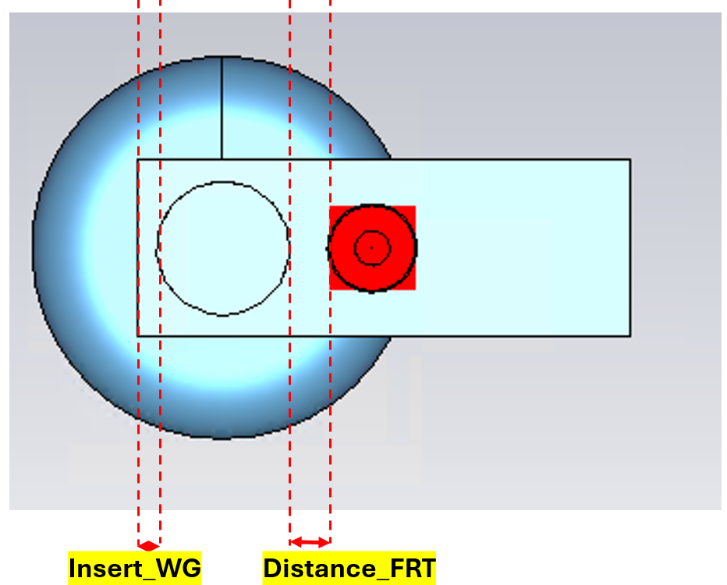
WP6: achievements of Task 6.2
• FRT/HOM interaction risks assessed: significant RF noise is only expected for rare exact resonance coincidences.
• Equivalent RF circuit developed including FPC matching and dynamic-loss trade-offs.
• Dual-FRT concept proposed to ease central-conductor cooling constraints.
• Integrated FRT/HOM coupler work started with waveguide-based first studies.
Dual-FRT concept
waveguide HOM damper with coax FRT coupler mounted on the waveguide

Slide 7
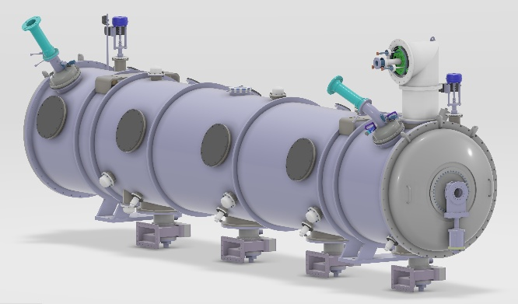
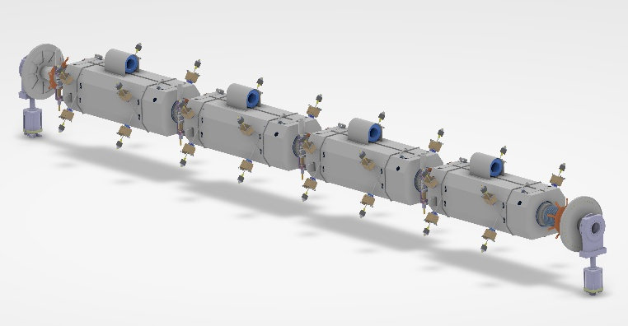
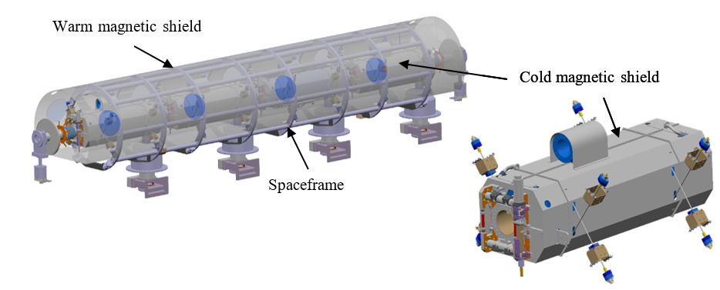
WP6: achievements of Task 6.3
• Reuse of ESS cryomodule parts is the sustainability backbone: vacuum vessel, spaceframe, thermal shield, coupler interfaces, selected cooling circuits and part of the instrumentation/cabling.
• New cavity string integrated with HOM couplers, FPCs, cold tuning systems, cold-to-warm transitions and BLAs.
• New dished-end covers create space for absorbers at both extremities, increasing the cryomodule length by about 400 mm.
• Cold/warm magnetic shielding and fast cool-down capability designed to target residual field below 1 mG at cavity surfaces.
Adapted cryomodule and cavity-string views used to consolidate the integration baseline

Slide 8
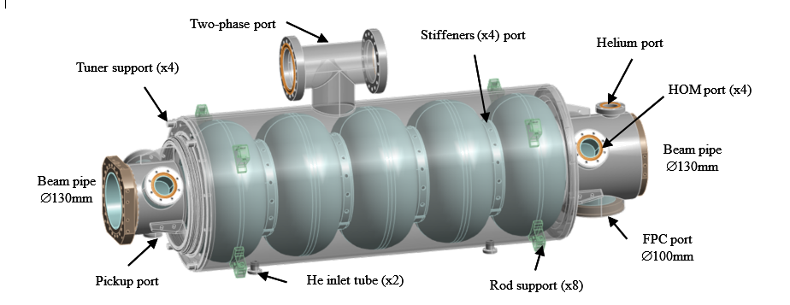
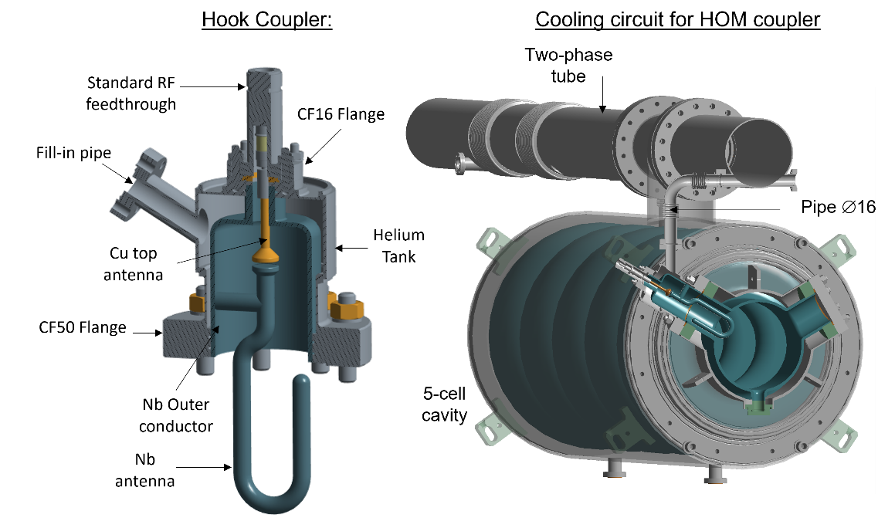
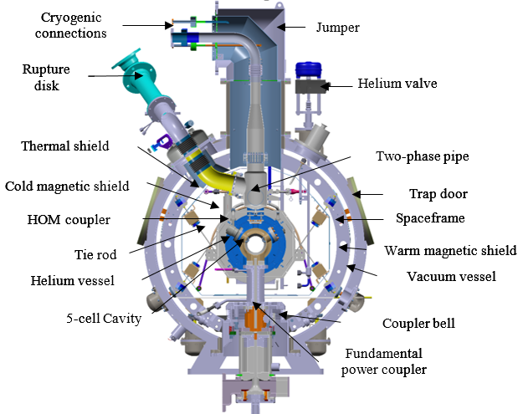
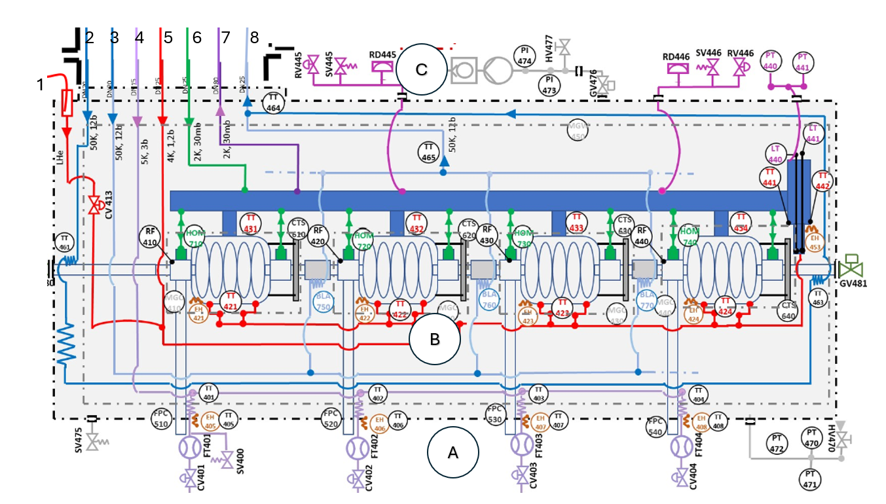
WP6: achievements of Task 6.3
• 5-cell cavity RF and mechanical design finalized; helium jacket optimized for vertical-test configuration and fabrication.
• HOM/FPC/tuner/BLA mechanical integration completed using WP4 inputs.
• Cold and warm magnetic shields designed; raw material ordered.
• Cryogenic circuits redesigned for CW operation, HOM coupler cooling, BLA cooling and fast-cooling capability.
• Instrumentation and cabling configuration converges on ESS-like interfaces with additional sensors and heaters.
5-cell cavity 3D model and HOM hook-type coupler integrated onto the cavity
Cryogenic circuit includes cavities fast cooling, HOM couplers and BLA cooling.

Slide 9
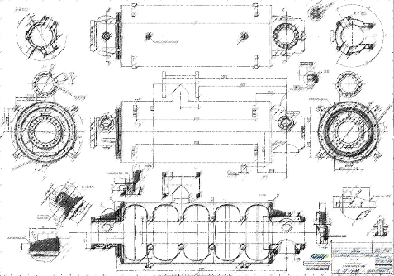
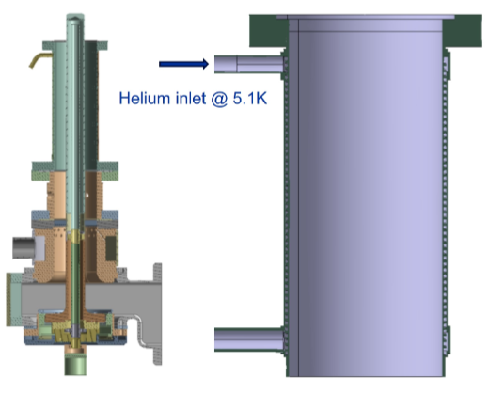
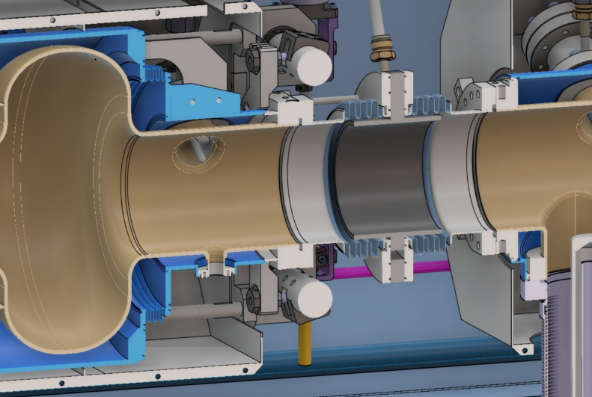
WP6: achievements of Task 6.4
• Niobium material purchased, delivered and shipped to Zanon.
• Contract for four 5-cell cavity manufacturing awarded to Zanon; manufacturing file almost ready and fabrication about to start.
• Cavity-preparation path defined: heat treatments, field flatness and clean-room preparation at IJCLab; vertical electro-polishing at CEA.
• Test strategy defined: bare cavity cold test before tank welding, followed by final cold test of the jacketed cavity.
• Tuner quotations received; HOM coupler/FPC activities remain coupled to WP4 design and fabrication progress.
5-cell cavity technical drawing
Double-wall tube
FPC 3D model
Cold BLA integration between two 5-cell cavities

Slide 10
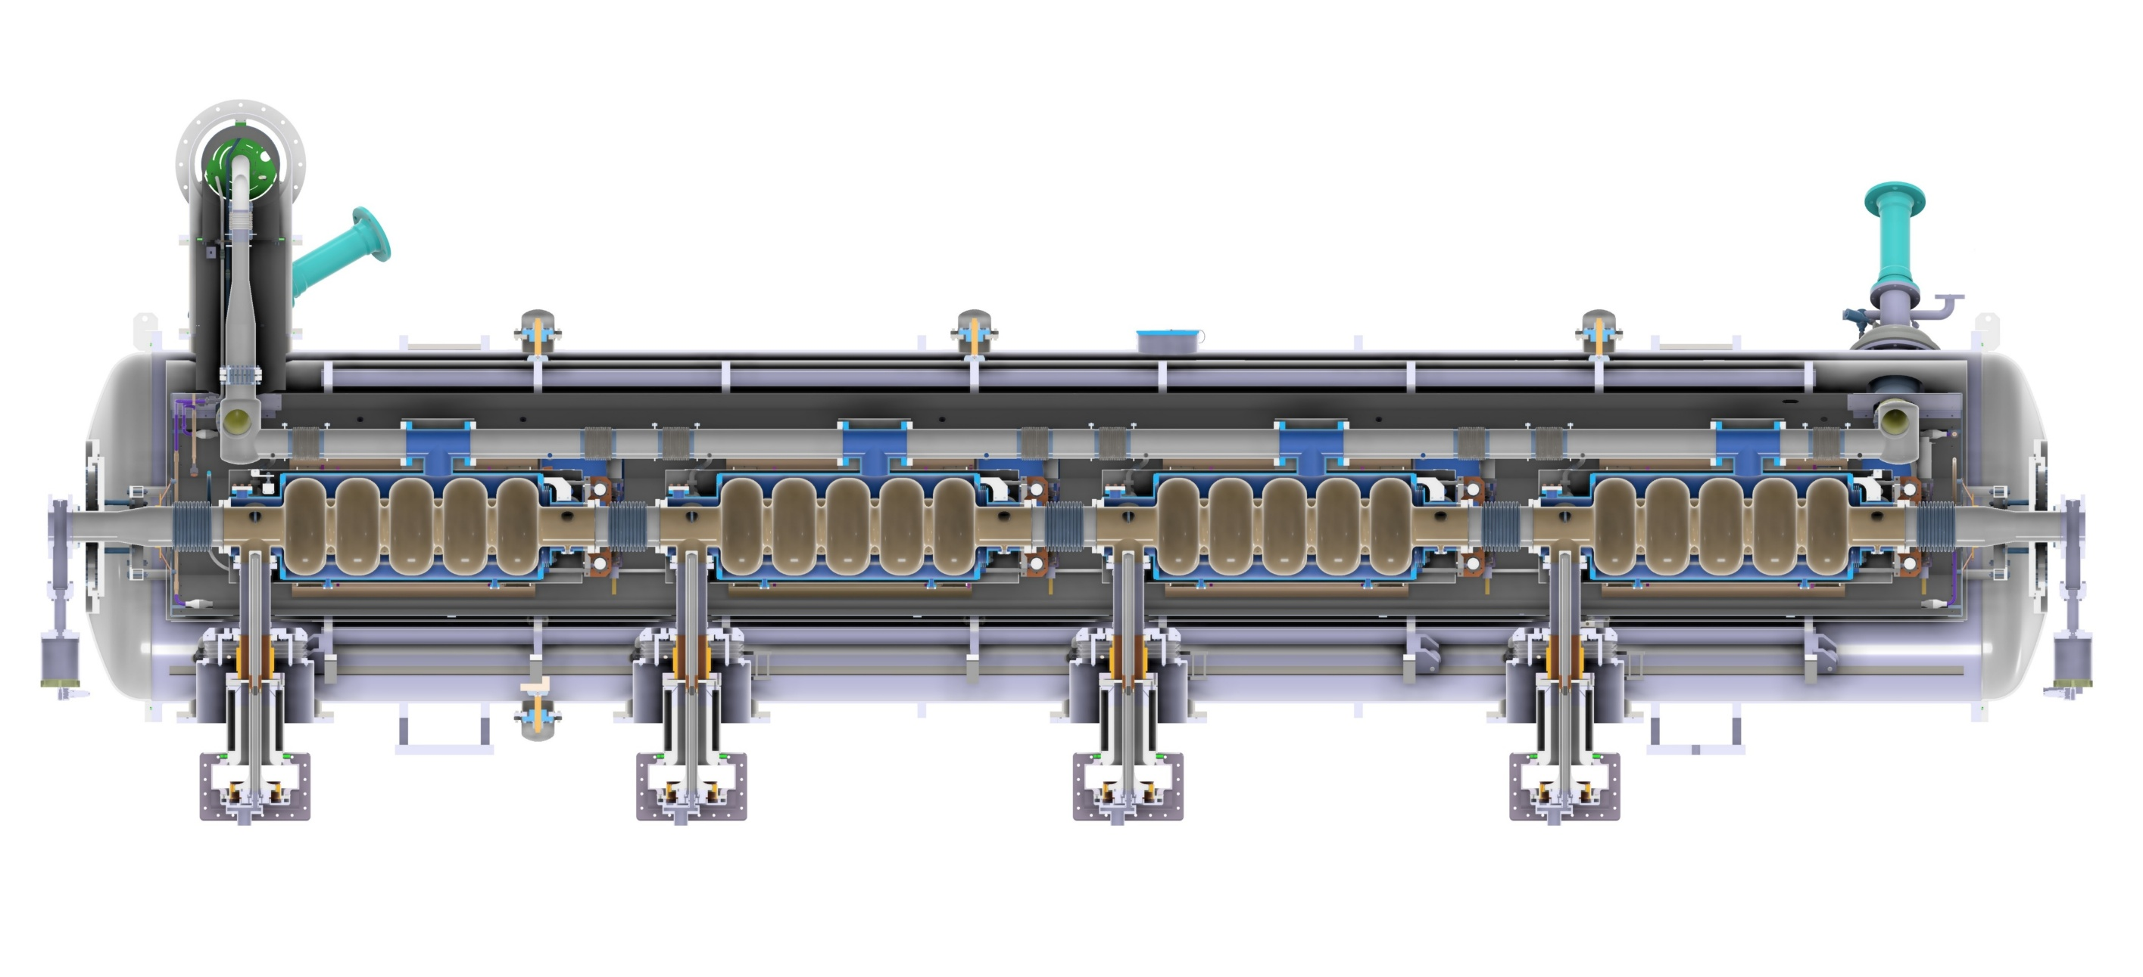
WP6: achievements of Task 6.5
• Assembly/test preparation has started while Task 6.3 is finalized; ESS interfaces are preserved wherever possible.
• Clean-room and hall assembly can reuse ESS tooling for cavity string and cryomodule supports.
• ESS test stand compatibility checked for cryogenic/RF connections, instrumentation and cabling.
• Technical review actions addressed: cryomodule footprint in bunker, FPC air cooling and doorknob dimensions validated.

Slide 11
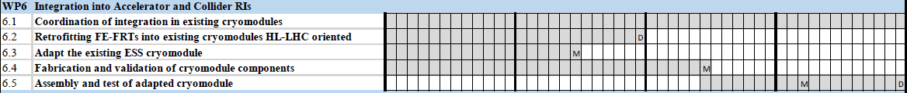
WP6: next steps
• Release D6.1 combined FE-FRT-HOM coupler design report (shifted to August 2026).
• Monitor 5-cell cavity fabrication and complete remaining tenders for shields, tuners, HOM/FPC parts and BLA-related components.
• Prepare cavity processing, cold-test tooling, cryomodule assembly and ESS cryogenic/RF test campaign.
• Consolidate the project-extension request linked to procurement delays.
Planning
Feb 2024
Feb 2025
Feb 2026
Feb 2027
Feb 2028
Aug 2026
Sept 2027
May 2028
Dec 2028

