Slide 1



WP7: Integration into Industrial Solutions
RP1 review meeting, June 1st, 2026
All information contained in this presentation and any accompanying documents is for iSAS project only and must be treated as strictly confidential.
Any dissemination, distribution or other use of this information without the consent of its owner is prohibited.
Funded by the European Union. Views and opinions expressed are however those of the authors only and do not necessarily reflect those of the European Union or the European Commission. Neither the European Union nor the granting authority can be held responsible for them.

Slide 2
WP7: Integration into Industrial Solutions
INFN LNL, CNRS, industrial partners
Conveners: Oscar Azzolini and Giorgio Keppel (INFN-LNL)
Task 7.1: Coordination with industry and Dissemination – M1-M48
• General coordination (INFN)
• Integrate (WP9 interaction) and update the iSAS website -> section on industrial aspects
• Organize iSAS industrial workshops (12 and 36 months) and online meetings with industrial partners
Task 7.2: Relations with industries – M1-M48
• Establish and coordinate the activities of the iSAS Industry Board (IB) 30th October 2024
• Involve companies from the earliest stages of R&D (engagement in low TRL developments)
• Promote Knowledge Transfer to industry to stimulate creation of new shared IPs
Task 7.3: Business opportunities – M24-M48
• Disseminate the developed iSAS technologies
• Create an iSAS project repository (hosted at STFC)
• Create new business opportunities, spin-offs, etc.

Slide 3
WP7 – Integration into Industrial
Solutions: Key outcomes
Task 7.1- D22: Creation of website for the iSAS - industrial section
PhD fellow fully financed by Zanon for research activities related to iSAS project
RI and Zanon pass from Partners status in iSAS to Beneficiary status in EPITA project

Slide 4
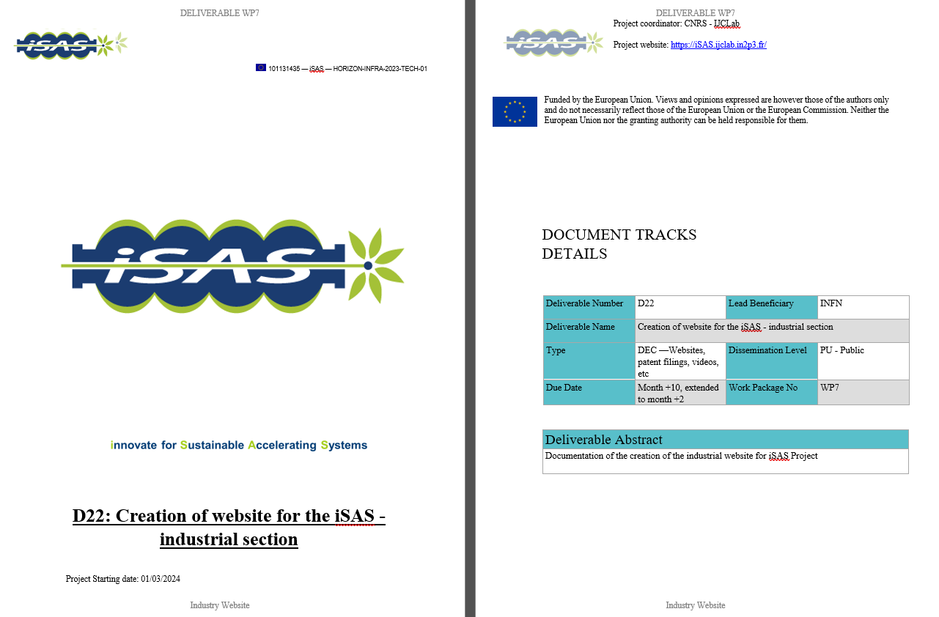

WP7 – Integration into Industrial
Solutions: achievements of Task 7.1
Task 7.1- D22:
Creation of website for the iSAS - industrial section

Slide 5
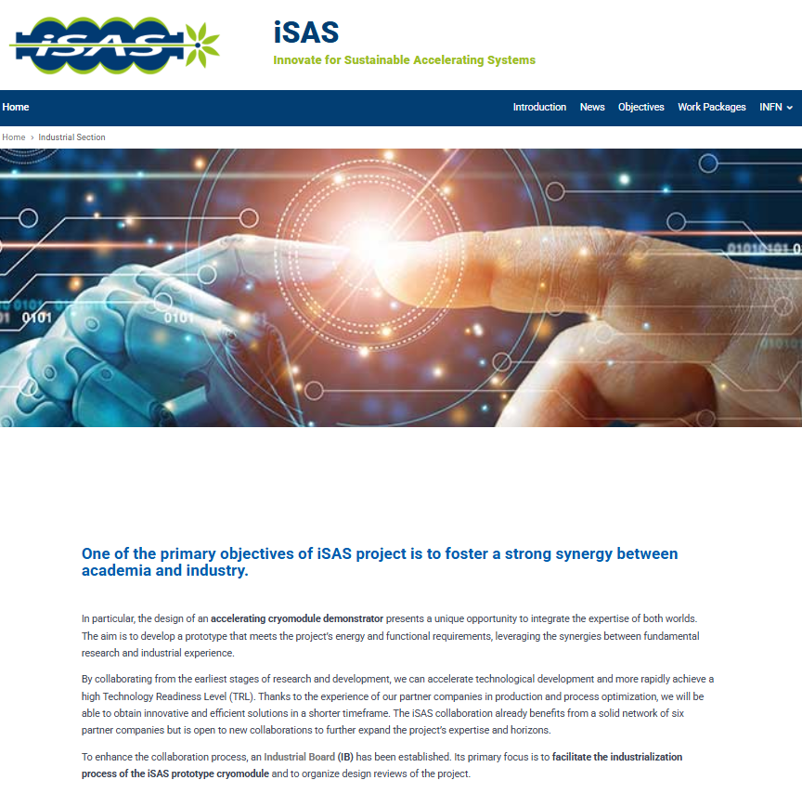
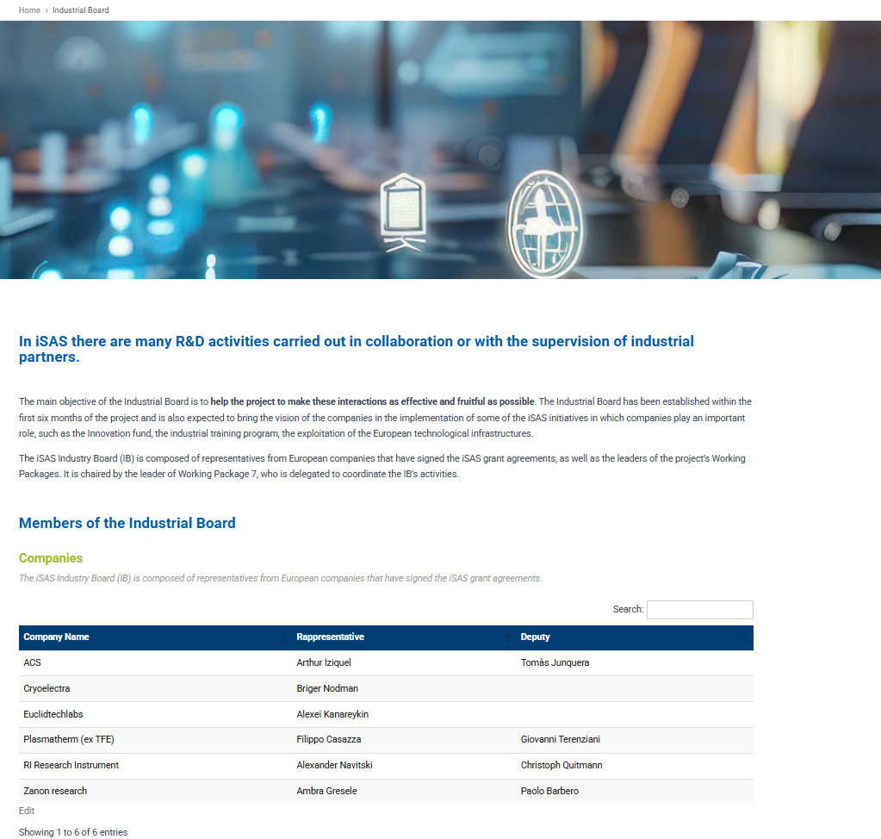
WP7 – Integration into Industrial
Solutions: achievements of Task 7.1
https://web.infn.it/isas/

Slide 6
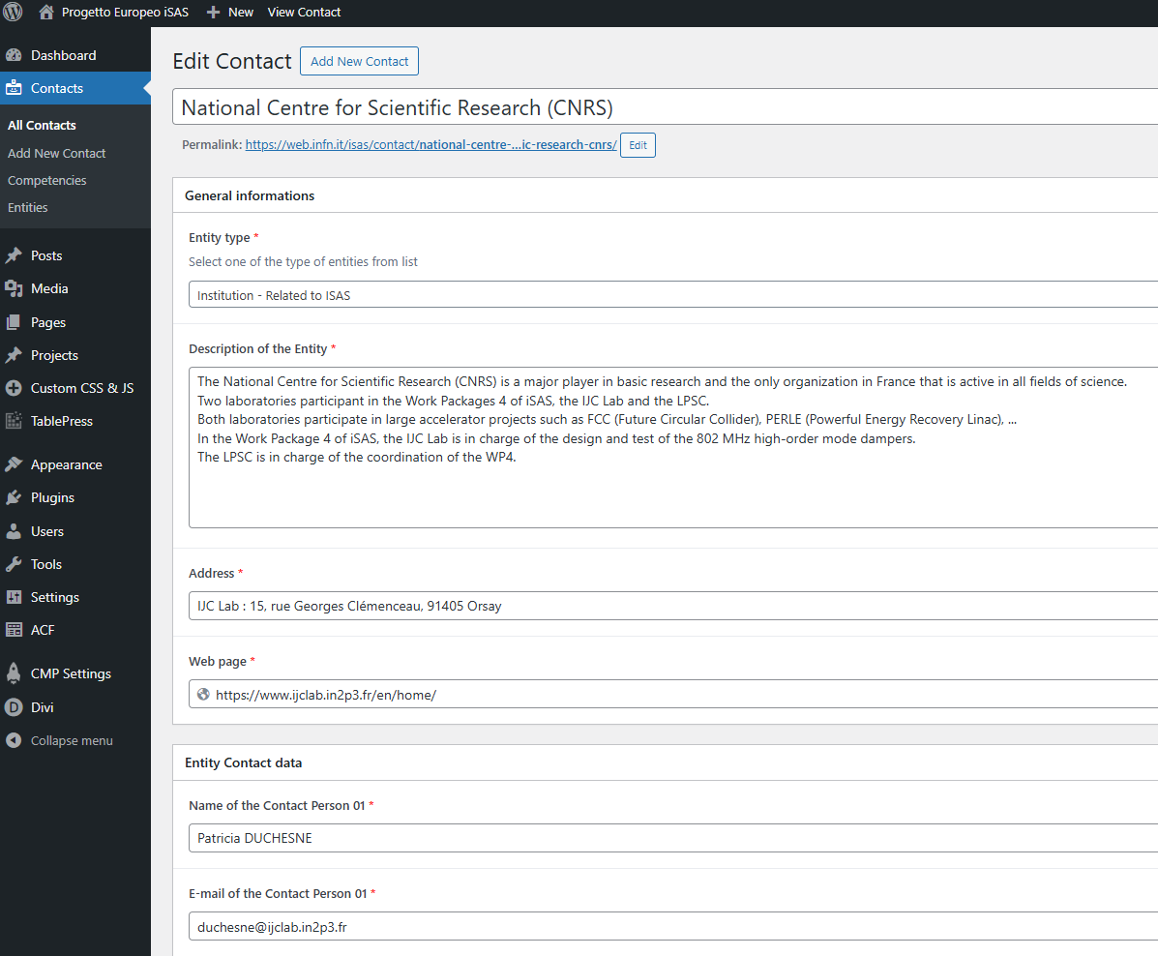
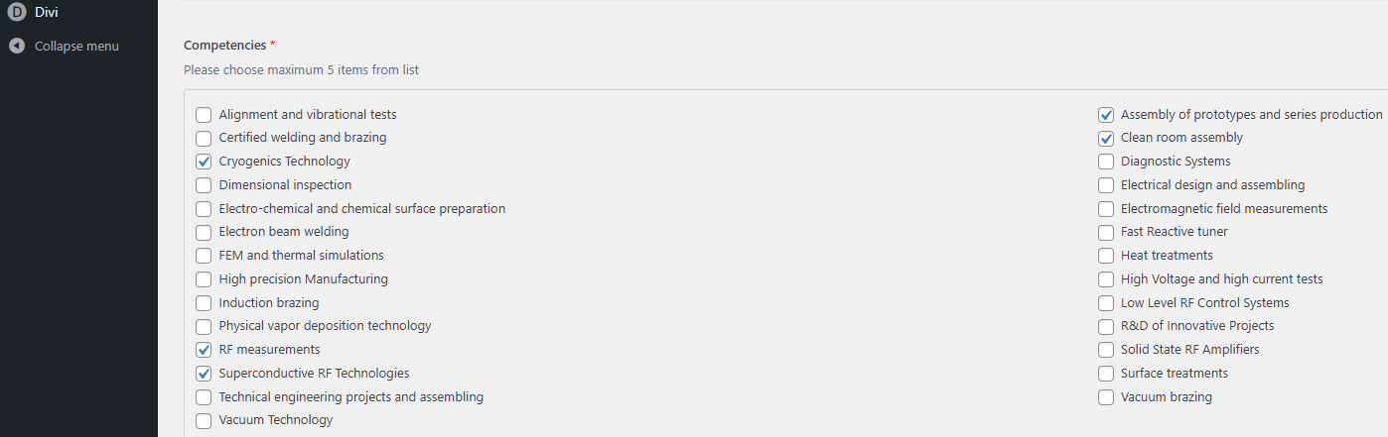
WP7 – Integration into Industrial
Solutions: achievements of Task 7.1
Competencies survey has been completed and the related webapge is now online

Slide 7
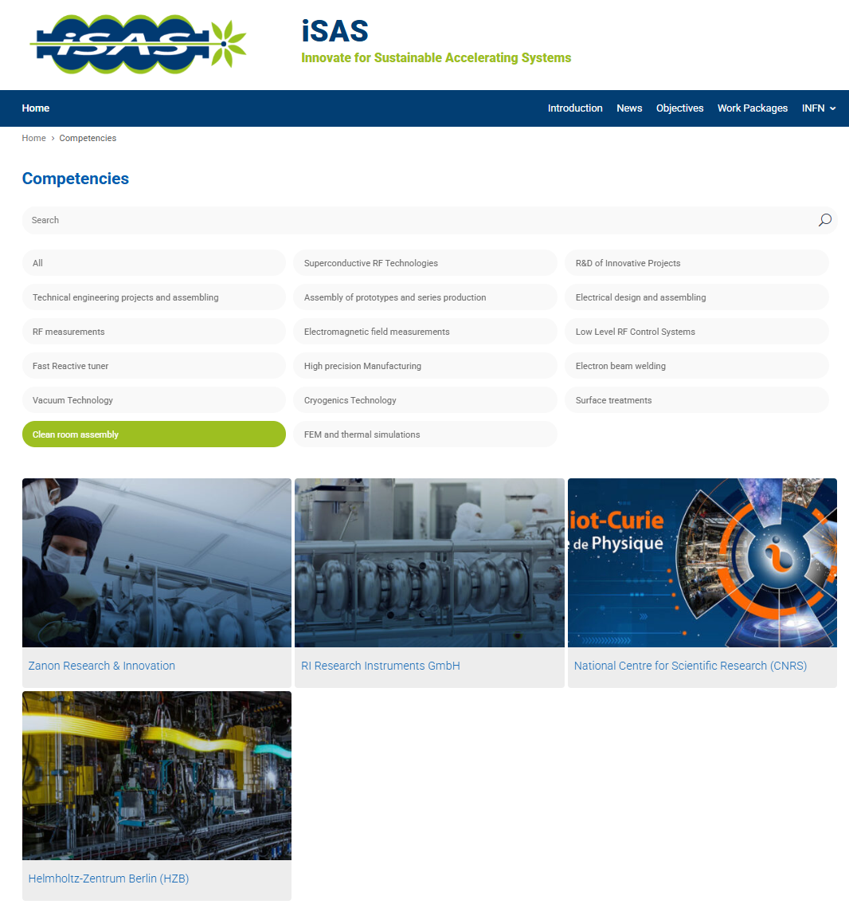
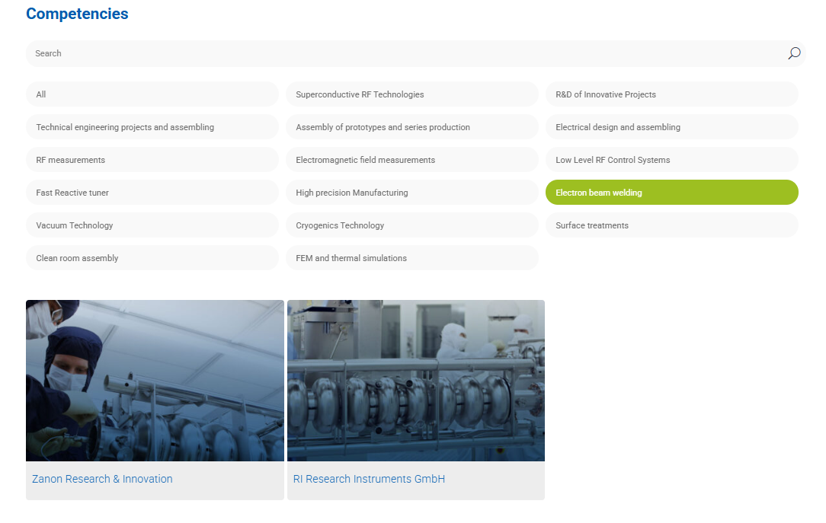
WP7 – Integration into Industrial
Solutions: achievements of Task 7.1

Slide 8
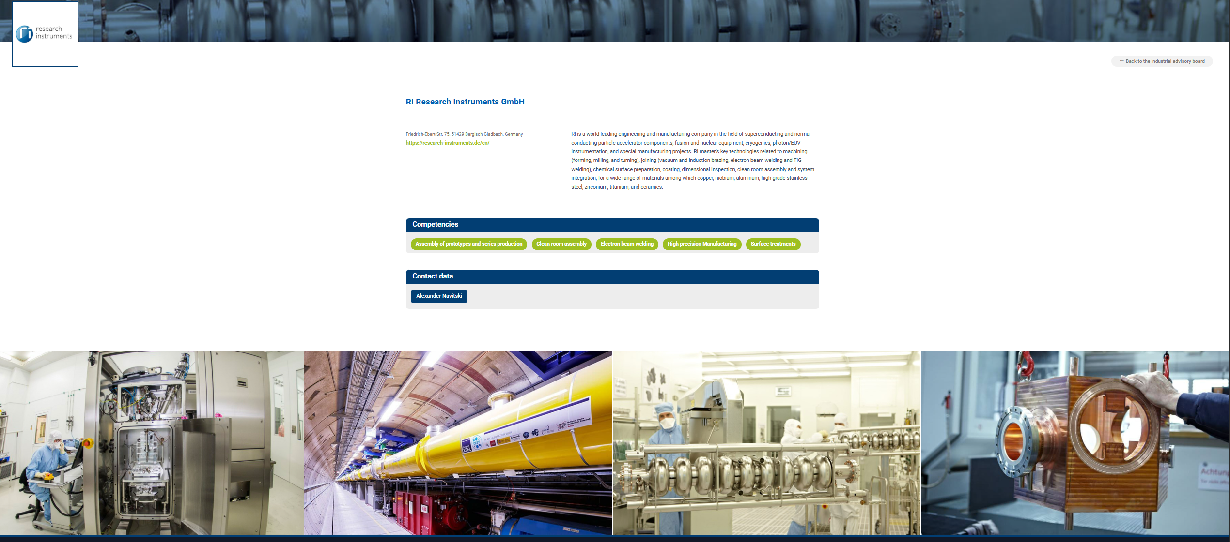
WP7 – Integration into Industrial
Solutions: achievements of Task 7.1

Slide 9
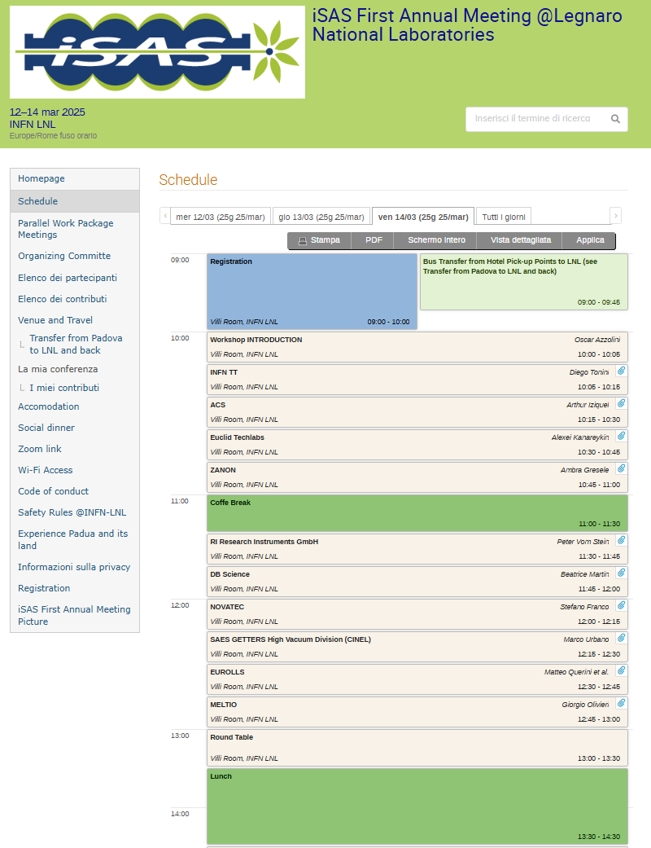
WP7 – Integration into Industrial
Solutions: achievements of Task 7.1
First Industrial workshop in Legnaro 2025:
  WP7 has also organized the dedicated industrial workshops (https://indico.ijclab.in2p3.fr/event/11291/timetable/#20250314) within the first annual meeting at Legnaro National Laboratories of INFN. The workshop also included the participation of new industrial entities with a potential interest in accelerator technologies:
    ‣DB Science (Power Supplies): Presented their accelerator-related applications, emphasizing energy-saving aspects through the use of GaN for high-efficiency power transistors and integrated circuit chips.
    ‣Novatec (Surface Treatments): A global leader in surface treatments, they introduced their company and customized products. From an iSAS perspective, effective surface preparation is crucial (e.g., reducing coating failures), which in turn lowers energy consumption. They also possess an in-house R&D team capable of developing customized surface treatment plants.
    ‣Saes Getters (Vacuum Technology & Thin Film Coating): A global leader in vacuum technology and thin film coating, this company can facilitate the industrialization of Nb3Sn coating on copper cavities.
    ‣Eurolls (Laser Cladding): Presented laser cladding as a new technique suitable for the production of complex shape sputtering targets, such as cylindrical Nb3Sn targets. This technology could also be applied to forming copper cavities, potentially reducing energy consumption in substrate production.
    ‣Meltio (Wire 3D Printing): Introduced wire 3D printing as a novel technique applicable to complex shape structures like copper cavities. Combining this technology with CNC machining could significantly reduce the power consumption required for cavity production.

Slide 10

WP7 – Integration into Industrial
Solutions: achievements of Task 7.1
Past developments
First Industrial workshop in Legnaro 2025:
  WP7 has also organized the dedicated industrial workshops (https://indico.ijclab.in2p3.fr/event/11291/timetable/#20250314) within the first annual meeting at Legnaro National Laboratories of INFN. The workshop also included the participation of new industrial entities with a potential interest in accelerator technologies:
    ‣DB Science (Power Supplies): Presented their accelerator-related applications, emphasizing energy-saving aspects through the use of GaN for high-efficiency power transistors and integrated circuit chips.
    ‣Novatec (Surface Treatments): A global leader in surface treatments, they introduced their company and customized products. From an iSAS perspective, effective surface preparation is crucial (e.g., reducing coating failures), which in turn lowers energy consumption. They also possess an in-house R&D team capable of developing customized surface treatment plants.
    ‣Saes Getters (Vacuum Technology & Thin Film Coating): A global leader in vacuum technology and thin film coating, this company can facilitate the industrialization of Nb3Sn coating on copper cavities.
    ‣Eurolls (Laser Cladding): Presented laser cladding as a new technique suitable for the production of complex shape sputtering targets, such as cylindrical Nb3Sn targets. This technology could also be applied to forming copper cavities, potentially reducing energy consumption in substrate production.
    ‣Meltio (Wire 3D Printing): Introduced wire 3D printing as a novel technique applicable to complex shape structures like copper cavities. Combining this technology with CNC machining could significantly reduce the power consumption required for cavity production.

Slide 11
WP7 – Integration into Industrial
Solutions: achievements of Task 7.2
Industrial Review Plan:
  The WP7 has identified the Industry Board (IB), composed by WP leaders and representatives of associate companies, during a dedicated meeting (https://indico.ijclab.in2p3.fr/event/11280/). The aim of the IB is to involve at the early stage the industrial partners in the research activity developed within each ISAS WPs. To achieve this goal, an industrial review panel focused on specific WPs (from 1 to 5) has been identified as reported in the following list during a dedicated IB meeting (https://indico.ijclab.in2p3.fr/event/12022/):
15Th July 2025 industrial review panel composition
  WP1 ▶ Euclid Techlabs
  WP2 ▶ Euclid Techlabs
  WP3 ▶ Zanon
  WP4 ▶ RI
  WP5 ▶ ACS

Slide 12
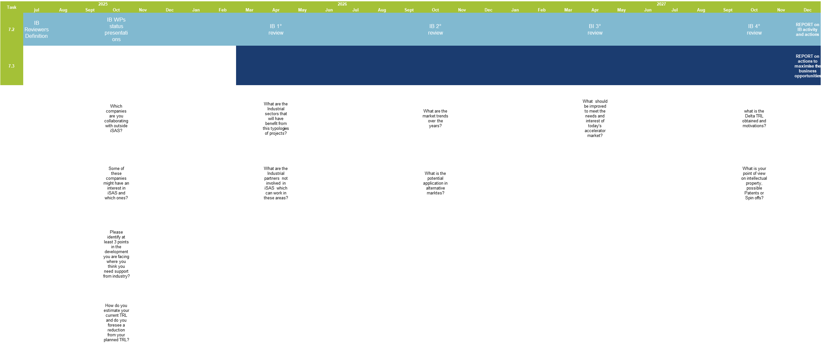
WP7 – Integration into Industrial
Solutions: achievements of Task 7.2

Slide 13
WP7 – Integration into Industrial
Solutions: achievements of Task 7.2
30 Oct 2025 Kickoff industrial review meeting:
  Which companies are you collaborating with outside iSAS?
  Some of these companies might have an interest in iSAS and which ones?
  Please identify at least 3 points in the development you are facing where you think you need support from industry.
  How do you estimate your current TRL and do you foresee a reduction from your planned TRL?
Apr 2026 1° IB review (Berlin meeting):
  What are the Industrial sectors that will have benefit from this typologies of projects?
  What are your Industrial partners not involved in iSAS which can work in these areas?
Oct 2026 2° IB review :
  What are the market trends over the years?
  What is the potential application in alternative markets and which market?
Apr 2027 3° IB review :
  What should be improved to meet the needs and interest of today's accelerator market?
Oct 2027 4° IB review :
  What is the Delta TRL obtained and motivations?
  What is your point of view on intellectual property, possible Patents or Spin-offs?

Slide 14

WP7 – Integration into Industrial
Solutions: achievements of Task 7.2
List of companies from WPs survey:
PMB Alcen: Avelion https://www.avelion-alcen.com/
VITAVE GmbH: https://vitave.com/
JEMA France: http://www.jema-power.com/
Struck: https://www.struck.de/index.html
NAT: https://nateurope.com/products/
CAEN ELS: https://www.caenels.com/products/amc-microtca/
D-tAcq: https://www.d-tacq.com/
nVent: https://www.nvent.com/en-us/schroff
iTech: https://www.i-tech.si/
elspec: https://www.elspecgroup.de/
KVG: https://kvg-gmbh.de/
AZ Concept: https://www.az-cpt.com/
Mallard: https://www.mallard-sa.fr/thermal-spray-coating-metallizing
Shakespeare Engineering: https://www.shakespeareengineering.co.uk/
Piccoli: https://www.piccolisrl.it/
Thales: https://www.thalesgroup.com/it/worldwide/italia
Comeb: http://www.comeb.it/?m=referenze&l=it_IT
Sienna Technologies: https://siennatech.com/

Slide 15
WP7 – Integration into Industrial
Solutions: achievements of Task 7.2
D7.1 Industry Website -Website, patent filings, videos, etc WebSite M10 - INFN
D7.2 Report from Industry Board - Report M46 – INFN From Industrial Reviews
D7.3 Report on actions to maximize business opportunities - Report M46 - INFN
IW1 Industrial Workshop 1 y
IW2 Industrial Workshop 3y
1st IB Review: Industrial Review
2nd IB Review: Industrial Review
3rd IB Review: Industrial Review
4th IB Review: Industrial Review
D7.1
IW1
IW2
D7.2
D7.3
Y0
Y1
Y2
Y3
Y4
2024 | 2025 | 2026 | 2027 | 2028
M | A | M | J | J | A | S | O | N | D | J | F | M | A | M | J | J | A | S | O | N | D | J | F | M | A | M | J | J | A | S | O | N | D | J | F | M | A | M | J | J | A | S | O | N | D | J | F
Task 7.1 – Coordination with industry and Dissemination
Task 7.2 – Relations with industries
Task 7.3 – Business opportunities
1st IB Review
2nd IB Review
3rd IB Review
4th IB Review

Slide 16
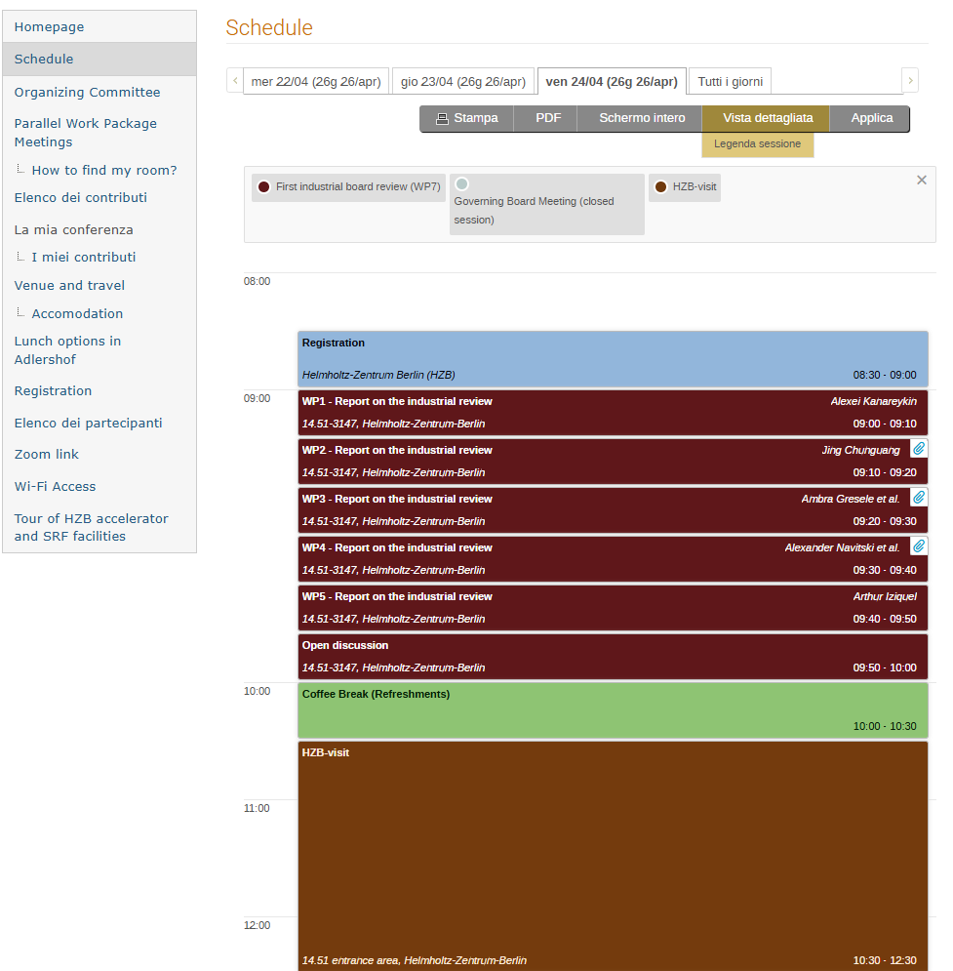
WP7 – Integration into Industrial
Solutions: achievements of Task 7.2
D7.1 Industry Website -Website, patent filings, videos, etc WebSite M10 - INFN
D7.2 Report from Industry Board - Report M46 – INFN From Industrial Reviews
D7.3 Report on actions to maximize business opportunities - Report M46 - INFN
IW1 Industrial Workshop 1 y
IW2 Industrial Workshop 3y
1st IB Review: Industrial Review
2nd IB Review: Industrial Review
3rd IB Review: Industrial Review
4th IB Review: Industrial Review
D7.1
IW1
IW2
D7.2
D7.3
Y0
Y1
Y2
Y3
Y4
2024 | 2025 | 2026 | 2027 | 2028
M | A | M | J | J | A | S | O | N | D | J | F | M | A | M | J | J | A | S | O | N | D | J | F | M | A | M | J | J | A | S | O | N | D | J | F | M | A | M | J | J | A | S | O | N | D | J | F
Task 7.1 – Coordination with industry and Dissemination
Task 7.2 – Relations with industries
Task 7.3 – Business opportunities
1st IB Review
2nd IB Review
3rd IB Review
4th IB Review

Slide 17
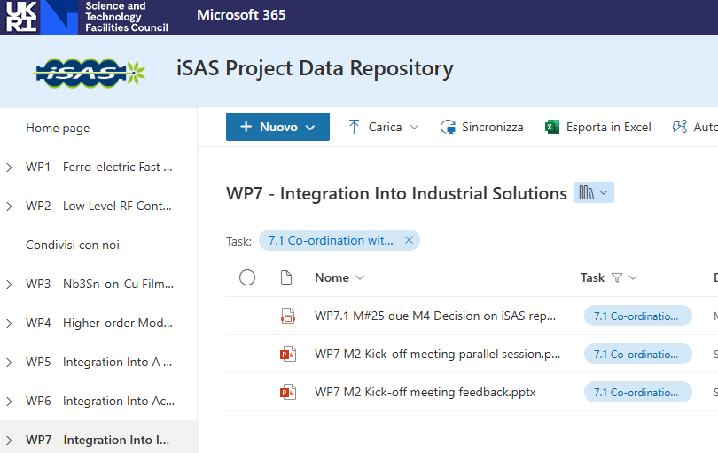
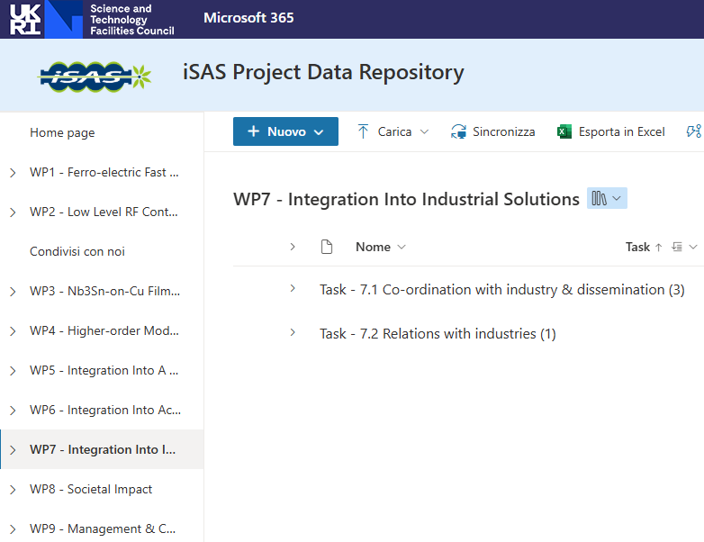
WP7 – Integration into Industrial
Solutions: achievements of Task 7.3
Past developments
  Create an iSAS project repository (hosted at STFC)

Slide 18
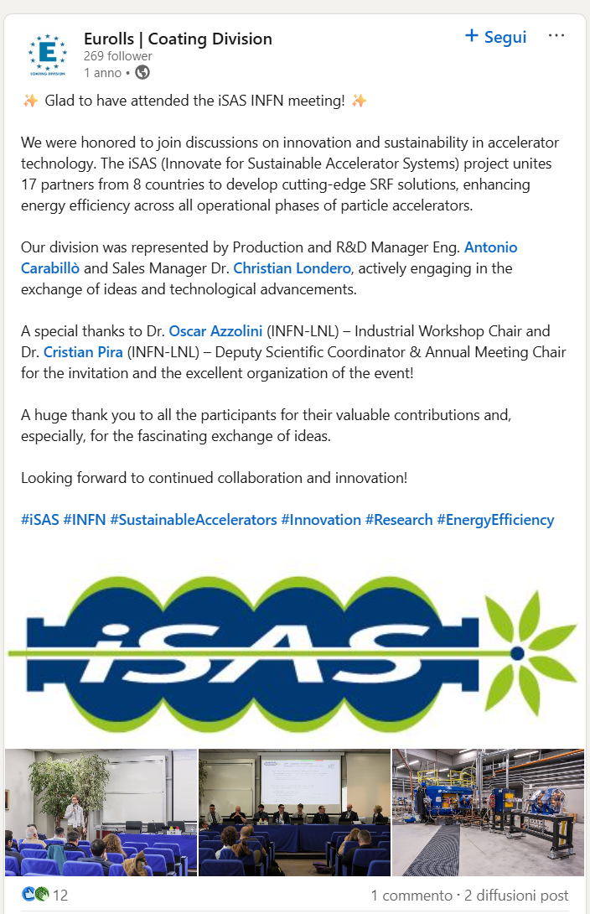
WP7 – Integration into Industrial
Solutions: achievements of Task 7.3
Past developments
Dissemination in collaboration with WP8: sharing of the promotional gadgets produced for the kick-off meeting with students of Padua University, and with the INFN technology transfer service, with the aim of promoting ISAS activities within the community and the industrial sector. Furthermore, to raise awareness of the activities developed within ISAS, WP7 facilitated the publication of informative articles in national newspapers, institutional websites, and social media posts about ISAS activities, which emerged from the interaction between companies and research entities during the ISAS industrial meeting at the National Laboratories of INFN in Legnaro.
1.web.infn.it/TechTransfer/innovazione-e-sostenibilita-il-contributo-di-infn-per-il-futuro-degli-acceleratori/
2.https://www.dire.it/02-04-2025/1136797-appello-dellinfn-di-padova-serve-maggior-contatto-diretto-fra-ricerca-e-industria/amp/
3.www.altovicentinonline.it/altri-comuni/imprese-lappello-serve-maggior-contatto-diretto-fra-ricerca-e-industria/
4.www.linkedin.com/posts/infn_isas-innovate-for-sustainable-accelerating-activity-7313576038502940672--K9E?utm_source=social_share_send&utm_medium=member_desktop_web&rcm=ACoAAATlEKkBV3_UnwAob2HffxInoRT-Wff9ZoY
5.www.linkedin.com/posts/eurollscoatingdivision_isas-infn-sustainableaccelerators-activity-7309846539345059840-QkE2?utm_source=social_share_send&utm_medium=member_desktop_web&rcm=ACoAAATlEKkBV3_UnwAob2HffxInoRT-Wff9ZoY

Slide 19
WP7 – Integration into Industrial
Solutions: Next steps
List of companies from WPs survey:
PMB Alcen: Avelion https://www.avelion-alcen.com/
VITAVE GmbH: https://vitave.com/
JEMA France: http://www.jema-power.com/
Struck: https://www.struck.de/index.html
NAT: https://nateurope.com/products/
CAEN ELS: https://www.caenels.com/products/amc-microtca/
D-tAcq: https://www.d-tacq.com/
nVent: https://www.nvent.com/en-us/schroff
iTech: https://www.i-tech.si/
elspec: https://www.elspecgroup.de/
KVG: https://kvg-gmbh.de/
AZ Concept: https://www.az-cpt.com/
Mallard: https://www.mallard-sa.fr/thermal-spray-coating-metallizing
Shakespeare Engineering: https://www.shakespeareengineering.co.uk/
Piccoli: https://www.piccolisrl.it/
Thales: https://www.thalesgroup.com/it/worldwide/italia
Comeb: http://www.comeb.it/?m=referenze&l=it_IT
Sienna Technologies: https://siennatech.com/

Slide 20
WP7 – Integration into Industrial
Solutions: Next steps of Task 7.2
Future improvements in WP7:
Involve Industrial Liaison Offices (ILOs) from major iSAS partner institutions
Engage existing industrial partners through a short survey to better understand their sustainability goals, constraints, and expectation in sustainability objectives
Investigate through a dedicated survey the supply chain robustness and the long-term availability of critical accelerators components developed or procured by industry

