Slide 1


WP9: Coordination & Management
RP1 review meeting, June 1st, 2026
All information contained in this presentation and any accompanying documents is for iSAS project only, and must be treated as strictly confidential.
Any dissemination, distribution or other use of this information without the consent of its owner is prohibited.
Funded by the European Union. Views and opinions expressed are however those of the authors only and do not necessarily reflect those of the European Union or the European Commission. Neither the European Union nor the granting authority can be held responsible for them.

Slide 2
WP9: Coordination & Management
CNRS
Convener: Adèle de Valera (CNRS)
Main contacts with other partners: Coordination panel
WP9 Main goal
• The main goal of the WP is to monitor the overall scientific progress, foster cross-coordination between WPs, share project results within the consortium, with the stakeholders of the accelerator landscape and beyond

Slide 3
WP9: Coordination & Management
CNRS
Convener: Adèle de Valera (CNRS)
Main contacts with other partners: Coordination panel
Task 9.1: Project Coordination and Management – M1-M48
• Management of the project, monitoring of the overall scientific and technical progress.
• Contractual and financial follow-up of the project and the use of resources.
Task 9.2: Scientific Coordination – M1-M48
• Foster general and targeted information flows between iSAS WPs, Governing and Advisory Boards.
• Establish effective and transparent cross-coordination between the technology-oriented, integration oriented, and societal impact WPs.
Task 9.3: Internal communication – M1-M48
• Establish an internal communication plan.
• Organise project events and share project information and results.
Task 9.4: External relations with other projects in the accelerator landscape – M1-M48
• Liaise with current major European R&D projects (I.FAST, EURO-LABS, AIDA Innova) and collaborations (TIARA),
and international experts
Task 9.5: Peer review of the energy-saving performance – M43-M48
• Report on the energy-saving performance of iSAS technologies.

Slide 4
WP9 – Coordination & Management:
Key outcomes
WP9 Key outcomes
Committees set up & running
Consortium Agreement signed
Amendment done
Kick-off meeting at IJCLab (CNRS) Orsay, 1st annual meeting at INFN Padova, 2nd annual meeting at HZB Berlin organised
Verifiable metric for energy-saving performances created

Slide 5
WP9 – Coordination & Management:
Achievements of Task 9.1 Project Coordination and Management
Task 9.1 Achievements
Contractual follow-up
  Grant Agreement (GA)
    Signed during the contractualisation phase with the support and recommendations from the Project Officer
  NDA for industrial partners
    Signed by the industrial Associated Partners to cover the collaboration within the Industry Board and the technical Reviews conducted in partnership with the WPs they have been paired with
  Consortium Agreement (CA)
    Negotiated and signed to organise the cooperation within the iSAS Consortium, settle disputes, IP issues, etc.
  Amendment to the Grant Agreement (AMD)
    Finalised to address a reworking of WP4 to introduce 3 tasks on Beam Line Absorbers (BLAs)
    To enable a young researcher’s hire at IJCLab instead of at INFN within the same WP4 via a lump sum transfer between institutes.
    To withdraw TFE as an industrial Associated Partner
  Project extension Amendment to the Grant Agreement
    An Amendment to the Grant Agreement is anticipated to become needed towards the end of the project to get a 1-year project extension, because of extensive procurement delays (cf. WP6 section)

Slide 6
WP9 – Coordination & Management:
Achievements of Task 9.1 Project Coordination and Management
Task 9.1 Achievements
Instances organisation
  The committees have been created and organised as follows
To ensure an effective management of the iSAS project, three levels are defined:
  An operational level with WP leaders & deputies
  A management level with the Cross-coordination between WPs in the Steering committee, and the Coordination panel supported by the European project manager
  The ultimate decision-making level of the project, performed by the Governing Board with the support of the Advisory Board.

Slide 7
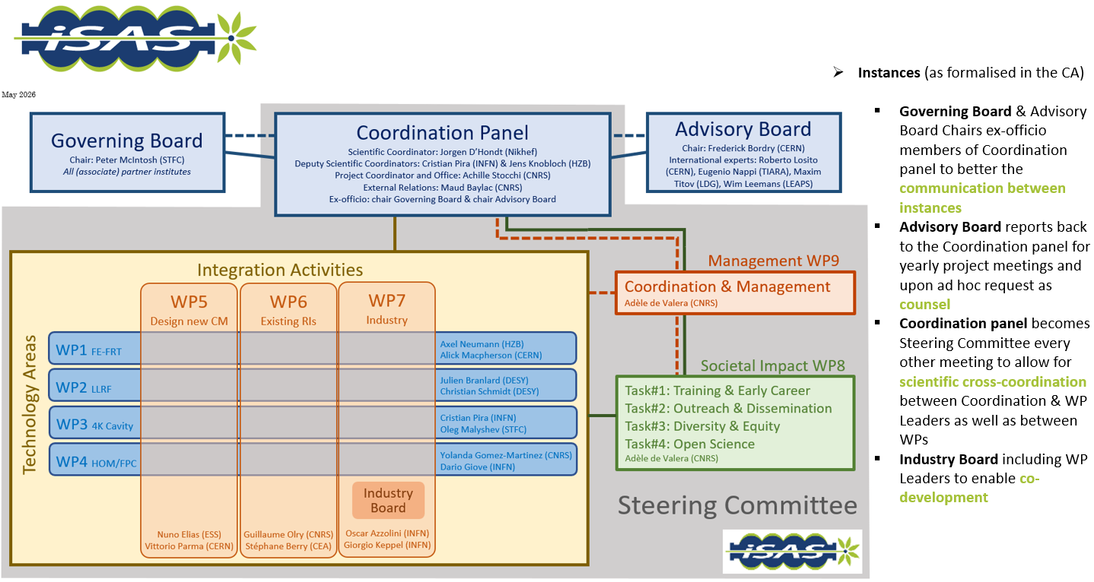
WP9 – Coordination & Management:
Achievements of Task 9.1 Project Coordination and Management

Slide 8
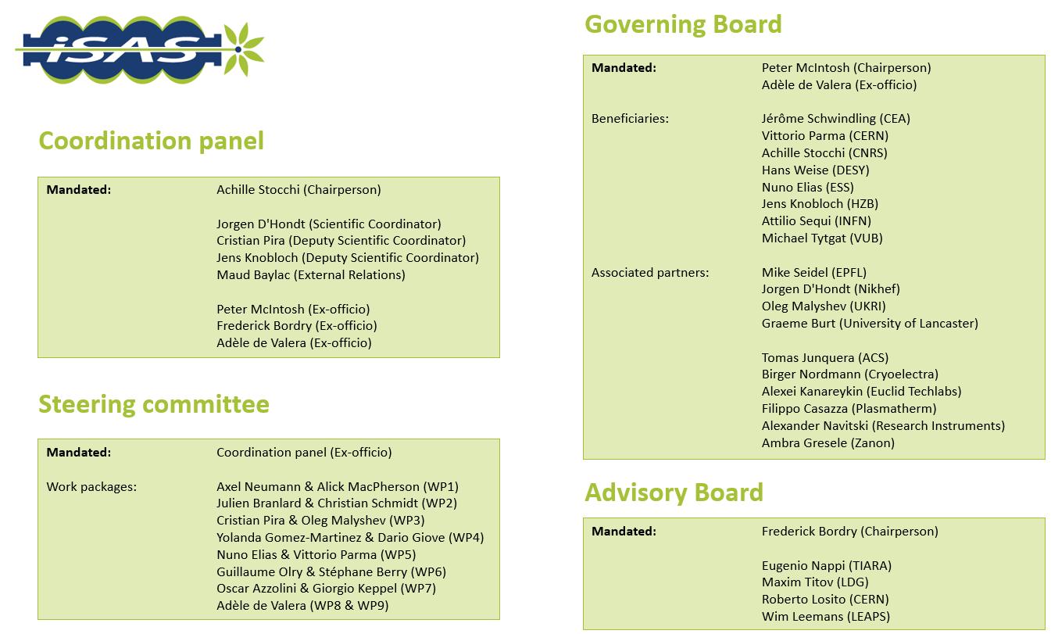
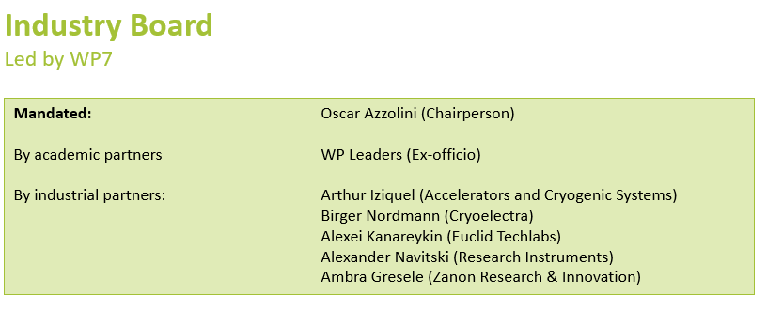
WP9 – Coordination & Management:
Achievements of Task 9.1 Project Coordination and Management

Slide 9
WP9 – Coordination & Management:
Achievements of Task 9.1 Project Coordination and Management
Task 9.1 Achievements
Follow-up of milestones and deliverables
  Monitoring tools
  Updated regularly and is recorded in the project data repository
    iSAS workplan
      An iSAS workplan by timeline and by WP created to follow-up on the overall progress of the achievement of milestones and deliverables, including status, risk-levels and comments has been created and is updated regularly and at least for every upcoming instance
    WPs work plans
      Detailed WPs work plans have also been created and updated regularly, to get a more granular follow-up at the WP level, including WPs interconnexions to show the interdependencies, test infrastructure to be prepared / available for the relevant tasks to plan adequately, and participants involved in the sub-tasks
    GANTT Chart

Slide 10
WP9 – Coordination & Management:
Achievements of Task 9.1 Project Coordination and Management

Slide 11
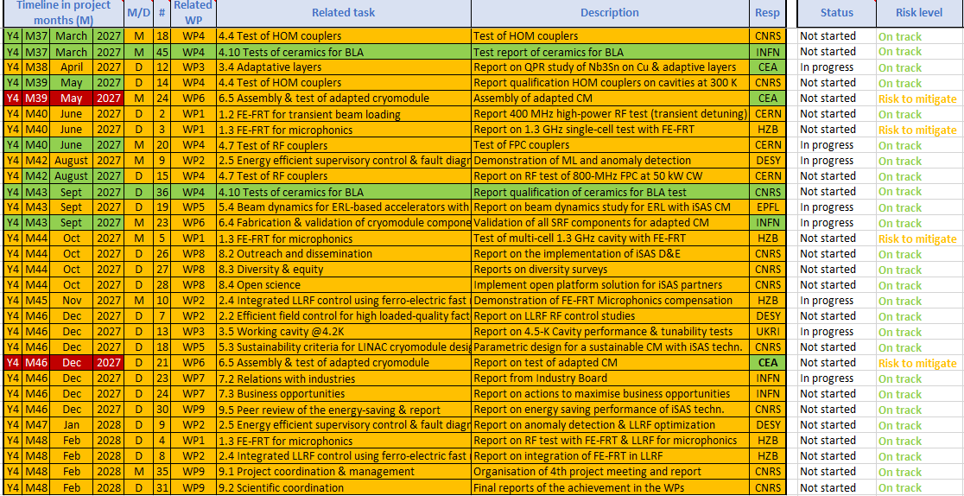
WP9 – Coordination & Management:
Achievements of Task 9.1 Project Coordination and Management
ISAS general workplan
  Example of project year 4 by timeline, with appearing in green the modifications integrated into the past amendment, in red the modifications to be made linked to the project extension foreseen

Slide 12
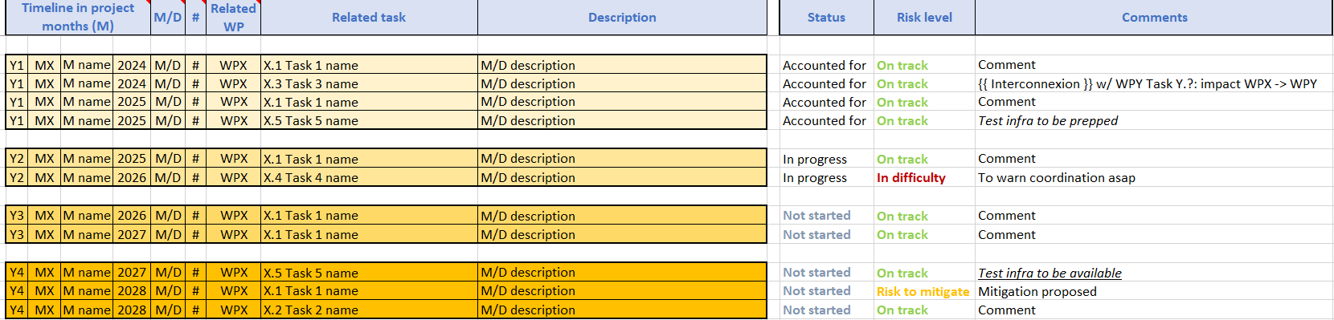
WP9 – Coordination & Management:
Achievements of Task 9.1 Project Coordination and Management
WP detailed work plan
  Monitoring template outline to be updated for each Steering Committee and annual meeting:
    By timeline tab

Slide 13
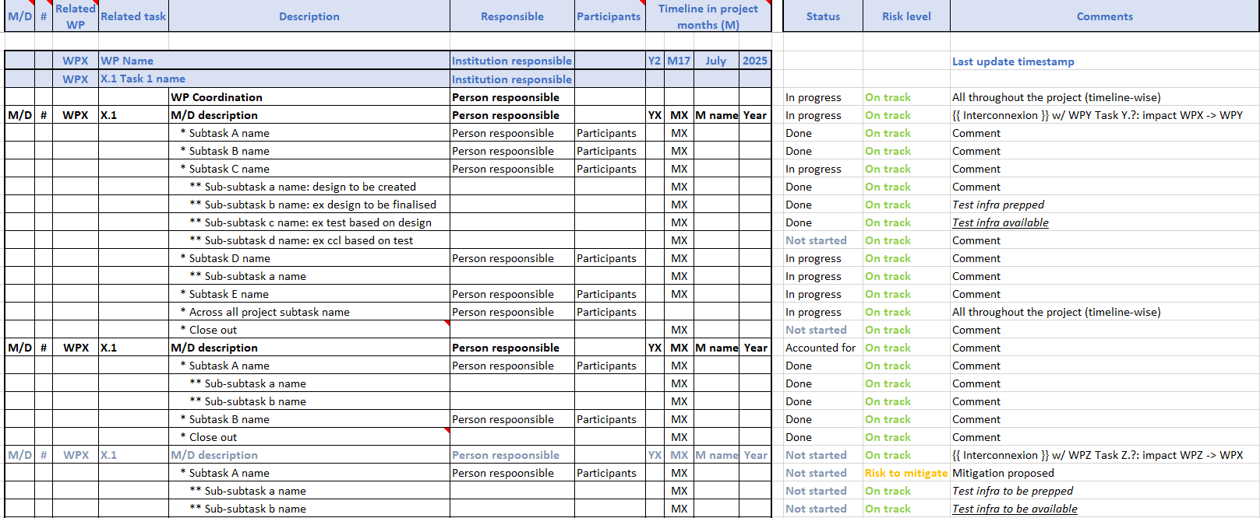
WP9 – Coordination & Management:
Achievements of Task 9.1 Project Coordination and Management
WP detailed work plan
  Monitoring template outline to be updated for each Steering Committee and annual meeting:
    By (sub)tasks tab
      Progress between updates seen by switching tabs from i.e. M17 tab to M19 tab

Slide 14
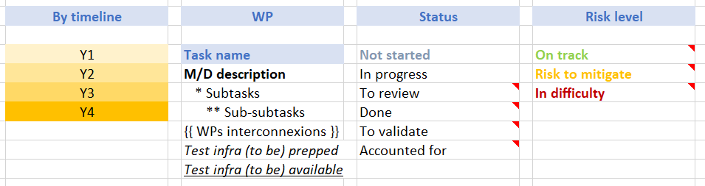
WP9 – Coordination & Management:
Achievements of Task 9.1 Project Coordination and Management
WP detailed work plan
  Monitoring template outline to be updated for each Steering Committee and annual meeting:
    By (sub)tasks tab
      Inclusion of infrastructures preparation and availability, risks by sub-task
      Risk to mitigate: if nothing changes, anticipated that we’re going to leave the tracks down the line, so periodization to get higher or creative solution to be found within the current parameters of the project
      In difficulty: tracks already left and change in current parameters of the project is necessary – to be discussed w/ PO (AMD)

Slide 15
WP9 – Coordination & Management:
Achievements of Task 9.1 Project Coordination and Management
Risks management
  Monitoring template outline to be updated for each Steering Committee and annual meeting:
  The proposal risks table (with mitigation measures), the Feb impact risk analyses for WP1-6 (which updates the proposal list to add new risks arisen if applicable, adds evaluation of probability, severity & criticality), the EU portal updated on critical risks for RP1 closure (which features boxes to tick like “has the risk materialised?”), the June 2026 deliverable on "Risk analysis related to impact of iSAS technologies" are the main steps planned in the project.
  The internal WPs work plans also feature a column dedicated to the risk level for each sub-task, updated for each Steering Committee, for a more regular check.
Dialogue with the Project Officer
  The Continuous reporting portal is regularly updated to report the project’s progress as it unfolds, and comment on the context when necessary
  The anticipated and unanticipated changes occurring are discussed as they arise, to give context to for example to the amendment that will most probably be needed towards the end of the project to get an extension.

Slide 16
WP9 – Coordination & Management:
Achievements of Task 9.1 Project Coordination and Management
Task 9.1 Achievements
M#30 Organisation of the iSAS kick-off meeting and report due M2 April 2024
  Hosted by IJCLab, Orsay, April 2024
M#36 Organisation of 1st project meeting and report due M12 Feb 2025
  Hosted by LNL, INFN, Padova, 12th-14th March 2025
M#33 Organisation of 2nd project meeting and report due Feb 2025
  Hosted by HZB, Berlin, April 22-24, 2026
Annual meetings have been structured as follows:
  Day 1
    Parallel WP meetings
  Day 2
    a plenary with an invited talk opening and dedicated to the overview of the status of the project’s WPs with the Advisory Board invited
  Day 3
    an Industry workshop, a Governing Board meeting, and a visit of the host lab

Slide 17
WP9 – Coordination & Management:
Achievements of Task 9.2 Scientific Coordination
Task 9.2 Achievements
Steering committee
  Every other meeting (so each trimester) the Coordination panel becomes the Steering committee (includes the WP leaders & deputies), so as to integrate a cross-coordination of feedback
Advisory Board
  The Advisory Board Chairperson participates to the Coordination panel meetings, the Advisory Board participate to the annual meetings and provides expert counsel in recommendations reports bi-annually and on an ad-hoc basis
  As an example of their role in the iSAS project, the proposed metric (M#32) has been submitted to and approved by the advisory board of iSAS (April 2025)

Slide 18
WP9 – Coordination & Management:
Achievements of Task 9.3 Internal communication
Task 9.3 Achievements
M#31 Internal communication plan
  To ensure a cross-communication between committees, ex-officio members are part of each committee, as the Chairperson of the Advisory Board is part of the Coordination panel for example
  iSAS opened 3 digital spaces with 3 different purposes:
    iSAS website: To showcase the project to wider audiences
    Project Indico page: To meet – to find upcoming project meetings
    Data repository: To share project documents on SharePoint
    Opened on Nov 2024 by STFC

Slide 19
WP9 – Coordination & Management:
Achievements of Task 9.3 Internal communication
Task 9.3 Achievements
D#29 Creation of the iSAS website
  The creation of the iSAS website responds to the objective to showcase the project’s results to a wider audience, to gain widespread acceptance for our deliverables, inform the community about our efforts to make accelerator systems more sustainable from an energy consumption point of view.
  The website design follows the coherence of the project. The layout was created with simplicity, in order to ensure its energy low consumption and efficiency.

Slide 20
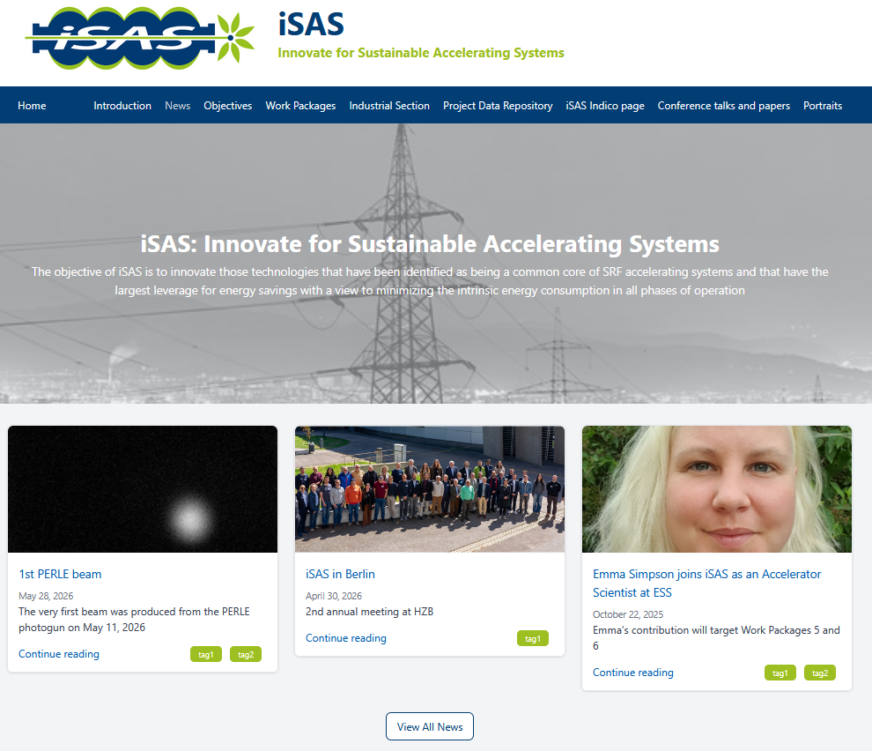
WP9 – Coordination & Management:
Achievements of Task 9.3 Internal communication

Slide 21
WP9 – Coordination & Management:
Achievements of Task 9.4 External relations with other projects
in the accelerator landscape
Task 9.4 Achievements
The External relations role
  Attributed to Maud Baylac, and as such participates to the Coordination panel
  As an example of her contributions in this role, she led the Policy briefing report discussions
The Advisory Board links the project to the accelerator landscape
  CERN accelerators for Frederic Bordry & Roberto Losito
  TIARA for Eugenio Nappi
  LDG for Maxim Titov & Roberto Losito
  LEAPS for Wim Leemans
Invited talks to the annual meetings opportunities taken to connect the project beyond
  At the Kick-off meeting, 3 invited speakers provided keynote talks to frame the objectives and potential impact of the iSAS project in the broader context of the accelerator R&D landscape. The focus was on addressing the energy efficiency of future SRF accelerators
  In Padova, the iFAST project Coordinator at CERN has been invited to present in-person in the plenary meeting the developments towards the continuation of the IFAST project
  In Berlin, Oliver Brüning at CERN has been invited to present in-person in the plenary meeting the European strategy goals for accelerators and colliders latest developments to inform the continuation of the iSAS project
Notes:
TIARA Test Infrastructure and Accelerator Research Area
Large Particle Physics Laboratory Directors Group (LDG)
LEAPS – the League of European Accelerator based-Photon Sources

Slide 22
WP9 – Coordination & Management:
Achievements of Task 9.4 External relations with other projects
in the accelerator landscape
Task 9.4 Achievements
D#32 Policy briefing report due M24 Feb 2026
  To inform EU policy for Research Infrastructures
  To inform policymakers of the relevance of the project for policy purposes
  Highlight policy recommendations:
    Most accelerator-driven research infrastructures use superconducting radiofrequency accelerating systems, which is one of the 2 main sources of energy consumption of the accelerators. Developing technologies to minimize their energy consumption while maintaining performances is essential for future accelerators.
  Key potential impacts of recommendations:
    Energy-efficient technologies of the building block of superconducting radiofrequency accelerators can dramatically reduce the energy consumption of these large-scale infrastructures. If efficiently developed and combined together, they could lower the energy bills of accelerators by a factor of 2.

Slide 23
WP9 – Coordination & Management:
Achievements of Task 9.5
Peer review of the energy-saving performance
Task 9.5 Achievements
The milestone "Verifiable metric for energy-saving performances" has been presented in the 1st annual meeting in Padova (March 2025)
In its review report, the iSAS Advisory Board confirmed its support of the presented approach focused on OPEX (instead of CAPEX).
The report details a fully quantitative metric for all the technologies developed within iSAS:
  FE-FRT, optimized LLRF, Nb₃Sn films on Cu and couplers, that is for WP1 to WP4. The indicator is the power consumption: the consumption will be measured for each use case with the iSAS device and without it (or without the specific option or optimization) for all devices which will be operational at the project’s end. When measurements are not possible, for example, for couplers, calculations of different cooling schemes will be compared.
In addition, regarding the cryomodule design, a broader approach is proposed within WP5 to include sustainability criteria such as life cycle analysis, availability, reparability and maintainability.
Notes:
Operating expenses (opex) are ongoing expenses that are inherent to the operation of the asset. Opex includes items like electricity or cleaning
Capital expenditures (capex) is the money an organization or corporate entity spends to buy, maintain, or improve its fixed assets, such as buildings, vehicles, equipment, or land

Slide 24
WP9 – Coordination & Management:
Achievements of Task 9.5
Peer review of the energy-saving performance
Task 9.5 Achievements
M#32 Verifiable metric for energy-saving performances due M15 May 2025
For this energy saving metric, the selected approach is focused on operational costs. We will evaluate and compare the power consumption with and without the « iSAS technology » under similar conditions:
  We will measure (or calculate) the electrical power consumption
  We will compare this consumption with and without the iSAS technology (or iSAS option)
  The comparison will be performed for different use cases (specific to each technology) but always under similar conditions for each technology.
The metric to be defined for all the iSAS technologies, that is:
  FE-FRT (Ferro-Electric Fast Reactive Tuners)
  LLRF (Low Level Radio Frequency) control system
  Nb3Sn on Cu films cavity
  Couplers
    FPC (Fundamental Power Coupler)
    HOM (Higher Order Mode)
    BLA (Beam Line Absorber)
In addition, a consumption model of the PERLE ERL will be developed to evaluate the accelerator efficiency

Slide 25
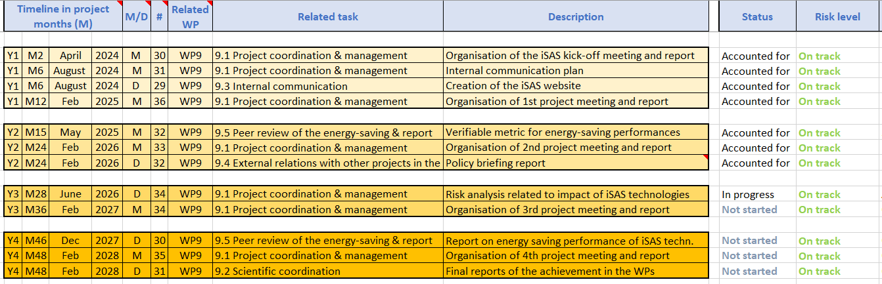
WP9 – Coordination & Management:
Next steps
WP9 Next steps

