Slide 1


iSAS 1st reporting period review meeting
1st June, 2026
Jorgen D’Hondt (Scientific coordinator)
Achille Stocchi (Project coordinator)
Adele De Valera (Project Manager)
Maud Baylac (External Relations coordinator),
Jens Knobloch (Deputy SC),
Christian Pira (Deputy SC)
the iSAS Coordination Panel
Funded by the European Union. Views and opinions expressed are however those of the authors only and do not necessarily reflect those of the European Union or the European Commission. Neither the European Union nor the granting authority can be held responsible for them.

Slide 2

















Innovate for Sustainable
Accelerating Systems
Spread over 4 years (2024-2028): ∼1000 person-months of researchers and ∼12.6M EUR
(of which 5M EUR is provided through Horizon Europe)
LNL
Milano
+ industrial companies: ACS Accelerators and Cryogenic Systems (France), RI Research Instruments GmbH (Germany), Cryoelectra GmbH (Germany), Zanon Research (Italy), EuclidTechLab (USA)

Slide 3

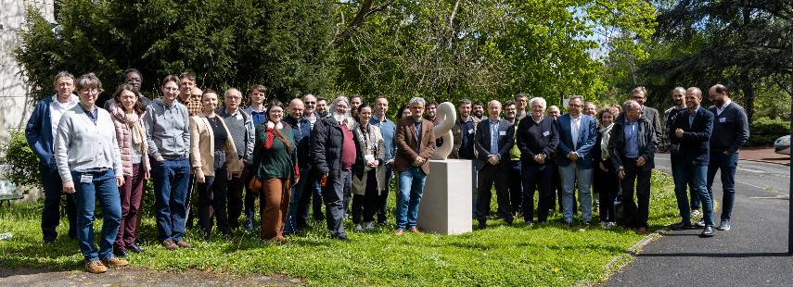
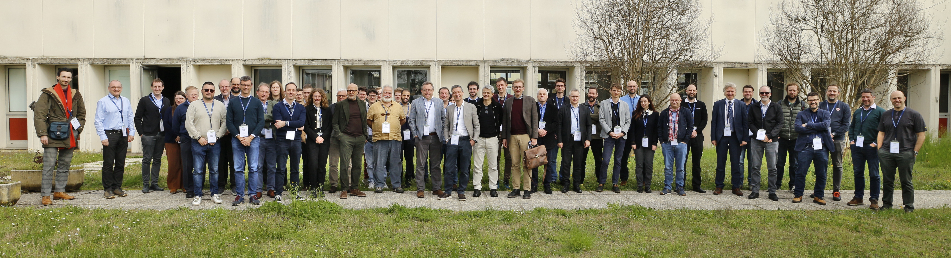
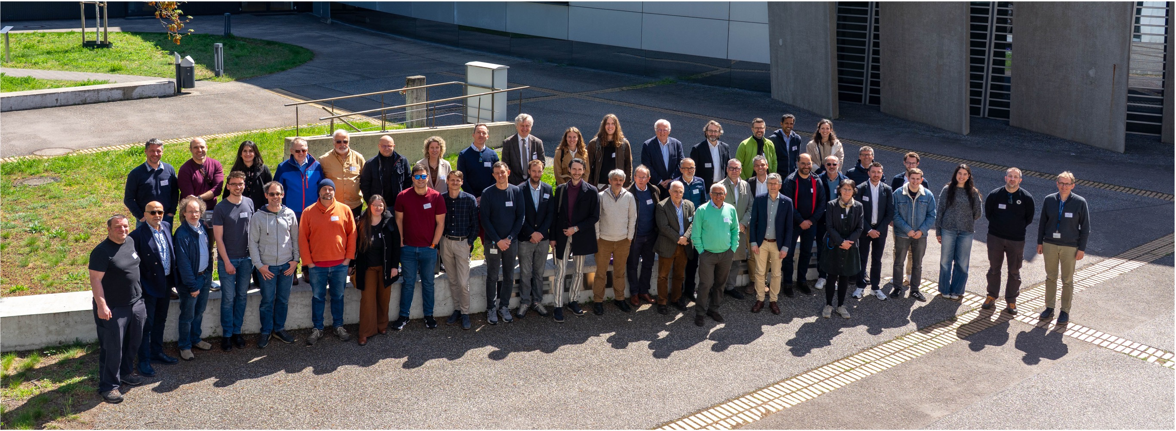
Kick-off meeting 15-16 April 2024 @ IJCLab: https://indico.ijclab.in2p3.fr/event/10302/https://isas.ijclab.in2p3.fr
1st Annual Meeting 12-14 March 2025 @ LNL: https://indico.ijclab.in2p3.fr/event/11291/registrations/892/
2nd Annual Meeting 22–24 apr. 2026 @ HZB https://indico.ijclab.in2p3.fr/event/11960/overview

Slide 4
iSAS and the European Strategies - ESPP2020
The iSAS project was conceived also in response to the recommendations of the ESPP2020 to address the energy efficiency of present and future accelerators.
The energy efficiency of present and future
accelerators […] is and should remain an area
requiring constant attention.
A detailed plan for the […] saving and re-use of
energy should be part of the approval process
for any major project.

Slide 5
iSAS and the European Strategies - ESPP2026
Strengthening the sustainability and energy efficiency of accelerators
has become a central theme in the recommendations of ESPP2026.
Technologies -Accelerator science and technology
Several technology approaches directly address the requirement of greater sustainability for future accelerator-based facilities. These include superconducting magnets and resonators operated at higher cryogenic temperature, superconducting current links, use of permanent magnets, and more efficient RF power sources, complemented by a more extensive use of robotics and artificial intelligence.
…R&D efforts to enhance the sustainability and energy efficiency of accelerators from design to operation and decommissioning should be supported.
Sustainability and environmental impact
For new proposed projects, a detailed life cycle assessment should be carried out at each stage, from concept to design and implementation, in order to quantify and minimise environmental impact.
The particle physics community should continue and intensify its efforts to develop and adopt sustainable solutions.

Slide 6
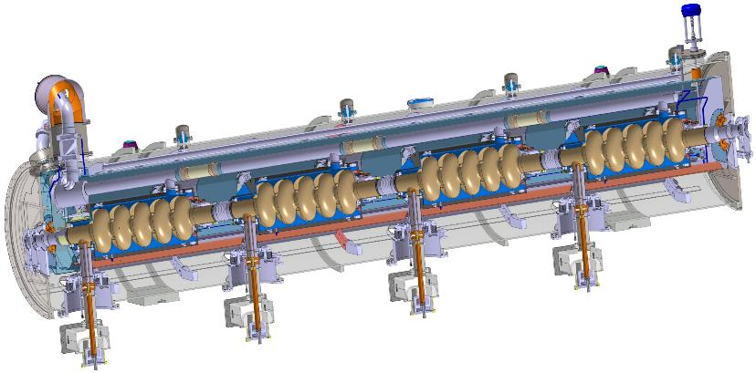
Key building block for beam acceleration: the SRF cryomodule
SRF: Superconducting Radio Frequency
cryogenic cooling
beam
RF power
Transferring grid power to the particle beam

Slide 7
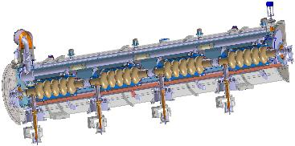

RF power generation
GRID
cryogenics
Picture adopted from M. Seidel (IPAC 2022)

Slide 8
Three key innovation directions
RF power generation
energy savings from the RF power
GRID
energy savings from the beam
cryogenics
energy savings from the cryogenics

Slide 9


AMBITION – Innovate those technologies related to the cryomodule that have been identified as being a common core of SRF accelerating systems and that have the largest leverage for energy savings with a view to minimizing the intrinsic energy consumption in all phases of operation.
particle therapy
nanometer
semiconductors
INNOVATE TECHNOLOGIES TOWARDS
A SUSTAINABLE ACCELERATING SYSTEM
TODAY
NEW DESIGN

Slide 10
METHODOLOGY – Several interconnected technologies will be developed, prototyped, and tested, each enabling significant energy savings.
DEVELOP ENERGY-SAVING TECHNOLOGIES ESSENTIAL TO INTEGRATE IN THE DESIGN OF A SUSTAINABLE LINAC CRYOMODULE
particle therapy
nanometer
semiconductors
WP1, WP2
R&D Pathfinders for new
energy-saving technologies
WP4
WP3
TA: Technology Area

Slide 11
DEVELOP ENERGY-SAVING TECHNOLOGIES ESSENTIAL TO INTEGRATE IN THE DESIGN OF A SUSTAINABLE LINAC CRYOMODULE
particle therapy
nanometer
semiconductors
WP1, WP2
INT#1
R&D Pathfinders for new
energy-saving technologies
WP5
INTEGRATING
integrating new technologies in the design of a new sustainable LINAC cryomodule
WP4
WP3
METHODOLOGY – Integration into the parametric design of a new LINAC SRF cryomodule optimised to achieve high beam-power in accelerators with an as low as reasonably possible energy consumption.
TA: Technology Area, INT: Integration Activities

Slide 12



IMPACT – The long-term ambition is to reduce the energy footprint of SRF accelerators in future research infrastructures by half, and even more when the systems are integrated in Energy-Recovery LINACs.
DEVELOP ENERGY-SAVING TECHNOLOGIES ESSENTIAL TO INTEGRATE IN THE DESIGN OF A SUSTAINABLE LINAC CRYOMODULE
particle therapy
nanometer
semiconductors
WP1, WP2
INT#1
R&D Pathfinders for new
energy-saving technologies
WP5
INTEGRATING
integrating new technologies in the design of a new sustainable LINAC cryomodule
WP4
WP3
WP6
SC XFELs
HL-LHC
ESS upgrade
TA: Technology Area, INT: Integration Activities
RIs: Research Infrastructures
INT#2: full deployment of energy saving in current and future accelerator RIs

Slide 13


INT#3: accelerator turn-key solutions with breakthrough applications
particle therapy
DEVELOP ENERGY-SAVING TECHNOLOGIES ESSENTIAL TO INTEGRATE IN THE DESIGN OF A SUSTAINABLE LINAC CRYOMODULE
WP7
particle therapy
nanometer
semiconductors
nanometer
semiconductors
WP1, WP2
INT#1
R&D Pathfinders for new
energy-saving technologies
WP5
INTEGRATING
integrating new technologies in the design of a new sustainable LINAC cryomodule
WP4
WP3
WP6
SC XFELs
HL-LHC
ESS upgrade
INT#2: full deployment of energy saving in current and future accelerator RIs

Slide 14
iSAS project outcomes at half-time (very concise view)
Kick-off
March 2024 project start date
April Kick-off meeting
2024
iSAS website, industrial section, data repository
Dissemination plan, internal communication plan, DMP
Y1
30th April RP1 report
1st June RP1 review meeting
1st yearly meeting at INFN in Padova
2025
WP9 Verifiable metric for energy-saving performances
2026
WP1 Characterisation of 400 MHz cavity with FE-FRT
Y2
2nd yearly meeting at HZB in Berlin
next
WP2 ML implementation plan
WP3 Modification of choke cavity for flux trapping study
WP4 Design of FPC & HOM coupler
WP5 Configure ESS CM
WP1 FE material characterised
WP3 Report on implementation of cavity Q vs F tuning tool
WP3 Developed ALD adaptive layers on Cu
WP5 Compilation of ESS CM, lesson learned & benchmarks
Shared NDA for industrial partners done
Amendment (AMD) to Grant Agreement (GA) done
Consortium Agreement (CA) done
AMD to GA request to be started ~first half of Y4
  A 1 year project extension to expect
  (Presentation/Discussion during the meeting)
All the milestones / deliverable released in time
Delays/modifications were anticipated and treated in the 1st AMD of the GA
Procurements issues already identified and treated we will imply a 2nd AMD to GA for the request of 1y extension

Slide 15
Some already visible objectives reached by iSAS
WP1, WP2. Significant progress in the development of FE-FRTs, particularly in material characterization and the exploration of potential applications. Innovative iterative learning techniques for the control of high-loaded quality factor cavities have been successfully demonstrated experimentally. New methods to increase Qext and improve vibration and detuning control of SRF cavities have also shown promising initial power reduction results
WP3 Significant progress in the development of Nb₃Sn-coated copper SRF technologies, building on the results of the I.FAST project. Key milestones include the successful commissioning of dedicated measurement and coating facilities, as well as the validation of innovative tuning and flux-trapping investigation. The developed infrastructures and coating solutions are now entering the testing phase, paving the way for further optimization and experimental validation.
WP4. Successful completion of the design of the FPCs and HOMCs, enabling the manufacturing of four prototypes of each component underway at CERN. Performance will be tested before integration into a cryomodule for ERL operation. From studies made an additional activity was launched for the design/ development of Beam Line Absorbers (BLA), under development to improve HOM power management.

Slide 16
Some already visible objectives reached by iSAS
WP5. Strong progress in consolidating expertise and preparing the next generation of superconducting cryomodules. Lessons learned from previous cryomodule designs and operations was collected, leading to the dissemination of a dedicated report. The roadmap for the development of a new cryomodule parametric design is currently progressing
WP6. Successful completion of the engineering design required to adapt the existing ESS medium-beta cryovessel into a new LINAC cryomodule compatible with iSAS technologies and PERLE operation. Procurement of the necessary components is currently ongoing. Although some delays have been encountered during the procurement phase, they are being managed and do not compromise the overall project objectives or planned deliverables.
WP7. The Industrial Board has been successfully established and briefed on ongoing and planned iSAS developments. It is now fully operational, providing continuous monitoring and review of all iSAS technologies to ensure their industrial feasibility.

Slide 17
Some already visible objectives reached by iSAS
WP8.
Training and Early Career :
  7 people hired (within iSAS budget)
  In total, ~100 people are involved, including 20 young researchers (<PhD+7y).
  Dissemination : about 30 talks/proceeding/publications referenced and available on repository/indico pages. Remarkable example at the last IPAC 2026. ~10 news/articles in iSAS Website + Several interviews/posts in external communication (CERN courier, Actu CNRS, …) and social media
Diversity : we signed Mou to enter Genera network / Three portraits of role models (women researchers)
WP9.
All the project structure set and working with regular meetings : Coordination Panel, Steering Committee, Advisory and Governing Boards
Grant, Consortium Agreements, NDA signed, + 1st GA Amendment
A verifiable metric for energy-saving performance was produced

Slide 18
Very concise : Some already visible impact from iSAS
The design of a cryomodule integrating the innovations developed within iSAS (WP4,WP5,WP6) has made substantial advances and is on track to be adopted for the future 800 MHz cavity cryomodule for the FCC-ee booster, and subsequently for the higher-energy stage up to the top production threshold
existing accelerators can already benefit from reduced energy consumption, if retrofitted with digital RF control system with AI-optimization, developed in WP2. Furthermore, whenever FE-FRT can be implemented, it could reduce it even further (WP1)
Thin-film-on-copper technologies for accelerating cavities were developed in WP3 collaboration with I-FAST. This technology is about to be tested on some accelerating cavities. If successful and validated, it could be deployed on future accelerators for substantial energy reduction.
An Industry Board (IB) from WP7, composed of WP leaders, company representatives (one for each WP) and Technology Transfer offices at research infrastructures, has been established to advise on maximizing the TRL of each R&D activity to foster direct industry involvement in future EU projects and support the industrialization of iSAS technologies.

Slide 19
The project has benefited from excellent synergies and is already opening new perspectives
The work done in WP3 is in excellent synergy/complementing with the European project iFAST. A natural continuation has recently emerged in the newly approved European project EPITA.
FE-FRT developments in WP1 got a great momentum with an extension of initial partners and inclusion in the EPITA project.
We established contacts with project RF 2.0 and will propose a new European project (RF 2.0+iSAS). The results already achieved across these projects demonstrate significant synergies and pave the way for a future integration project aimed at systematically optimizing energy usage, from the electrical grid all the way to the particle beam.

Slide 20
…and now let’s move to the WP talks !

