Slide 1
Laser spectroscopy of radionuclides & development of experimental methods for S³-LEB
On behalf of : S³-LEB & FRIENDS³ collaboration
V. Marchand¹
¹IJCLab, Université Paris-Saclay & CNRS/IN2P3, 91405 Orsay, France

Slide 2
Laser spectroscopy of radionuclides & development of experimental methods for S³-LEB
Introduction to laser spectroscopy and links with nuclear physics.
Presentation of the different setups.
Advances made on a CW tunable Ti:sa laser.
Stable Dysprosium spectroscopy with CW tunable Ti:sa laser.

Slide 3
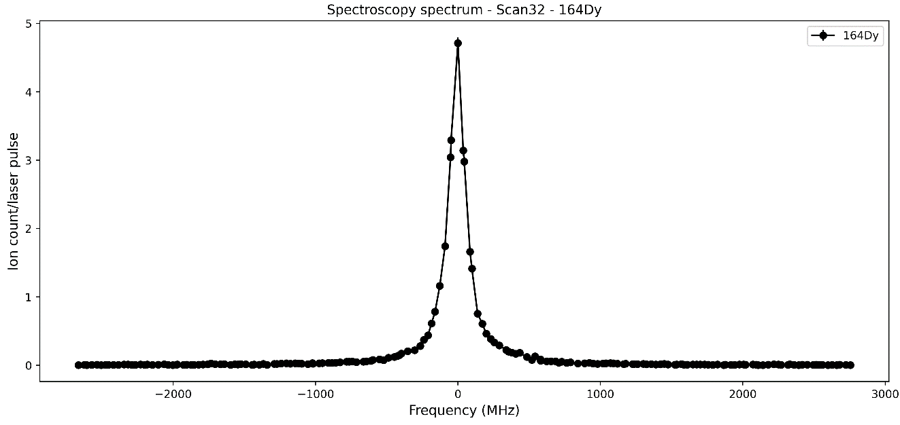






What is laser spectroscopy ?
NR.I ($σ\sim {10}^{−17} {cm}^{2})$
A.I ($σ\sim {10}^{−15} {cm}^{2})$
IP
Rydberg ($σ\sim {10}^{−12} {cm}^{2})$
MCP
$$E_{k}$$
$$E_{g}$$
$$λ_{1}$$

Slide 4


What is laser spectroscopy ?
NR.I ($σ\sim {10}^{−17} {cm}^{2})$
A.I ($σ\sim {10}^{−15} {cm}^{2})$
IP
Rydberg ($σ\sim {10}^{−12} {cm}^{2})$
MCP
$$E_{k}$$
$$λ_{1}$$
Laser $λ_{1}$
$$E_{g}$$

Slide 5




What is laser spectroscopy ?
$$e^{−}$$
$$λ_{1}$$
$$e^{−}$$
$$e^{−}$$
$$e^{−}$$
NR.I ($σ\sim {10}^{−17} {cm}^{2})$
A.I ($σ\sim {10}^{−15} {cm}^{2})$
IP
Rydberg ($σ\sim {10}^{−12} {cm}^{2})$
MCP
Laser $λ_{2}$
$$E_{k}$$
Laser $λ_{1}$
$$E_{g}$$

Slide 6





What is laser spectroscopy ?
$$e^{−}$$
$$e^{−}$$
+1 counts
+1 counts
+1 counts
NR.I ($σ\sim {10}^{−17} {cm}^{2})$
+1 counts
+1 counts
A.I ($σ\sim {10}^{−15} {cm}^{2})$
+1 counts
$$e^{−}$$
+1 counts
IP
$$λ_{1}$$
+1 counts
+1 counts
Rydberg ($σ\sim {10}^{−12} {cm}^{2})$
+1 counts
MCP
Laser $λ_{2}$
$$e^{−}$$
$$E_{k}$$
Laser $λ_{1}$
$$E_{g}$$

Slide 7
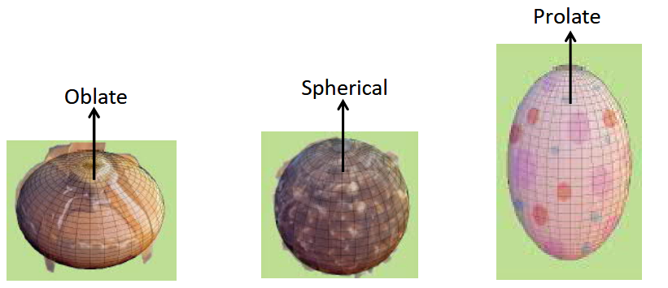
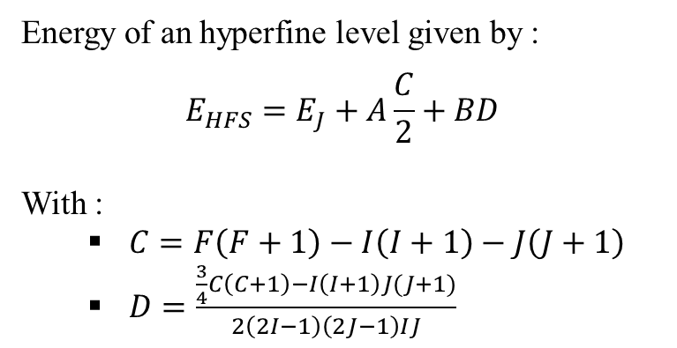
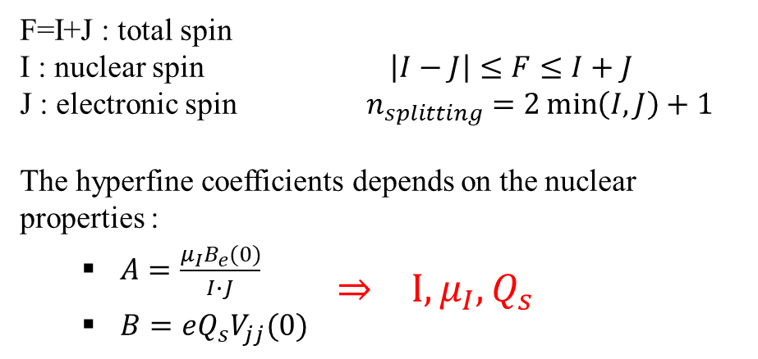
Why laser spectroscopy ?
Energy of an hyperfine level given by :
$$E_{HFS}=E_{J}+A\frac{C}{2}+BD$$
With :
  $C=F\left(F+1\right)−I\left(I+1\right)−J\left(J+1\right)$
  $D=\frac{\frac{3}{4}C\left(C+1\right)−I\left(I+1\right)J(J+1)}{2\left(2I−1\right)\left(2J−1\right)IJ}$
Fine
structure
Hyperfine structure
F=1
n=1
1S_{1/2}
F=0
F=I+J : total spin
I : nuclear spin $\left|I−J\right|≤F≤I+J$
J : electronic spin $n_{splitting}=2\min\left(I,J\right)+1$
The hyperfine coefficients depends on the nuclear properties :
  $A=\frac{μ_{I}B_{e}(0)}{I∙J}$
          $⇒ I, μ_{I}, Q_{s}$
  $B=eQ_{s}V_{jj}(0)$
Possible shapes for nuclei,
Image from Iain Moore
X.F. Yang et al., PPNP 129 (2023)

Slide 8
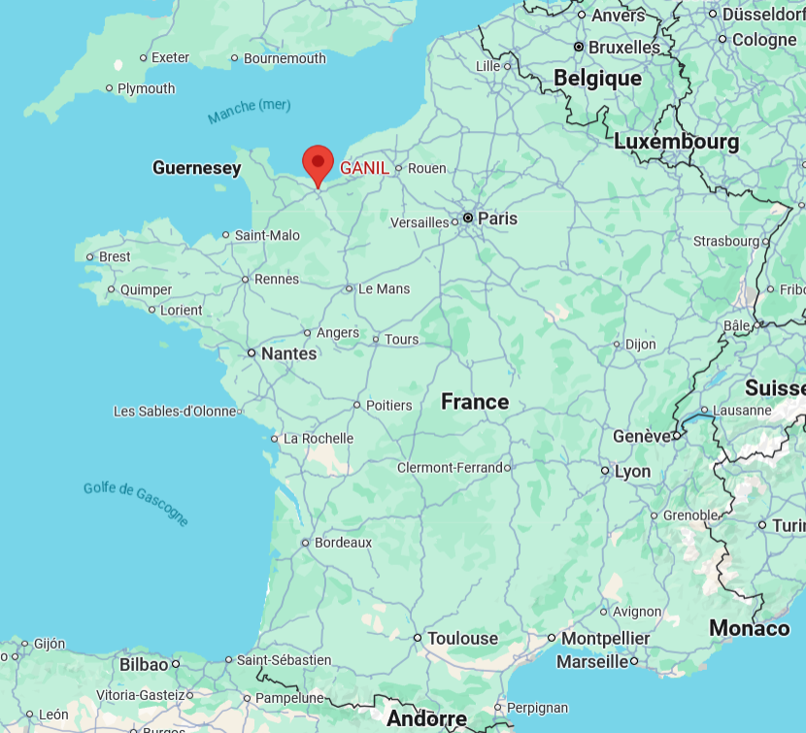
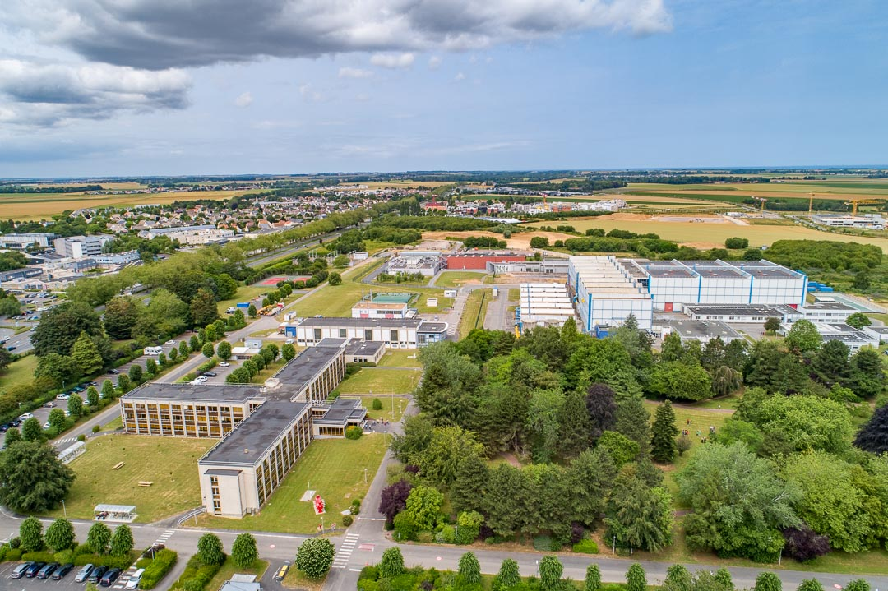
Where are we performing laser spectroscopy ?
GISELE &
FRIENDS3
S³-LEB@S³
aerial view of GANIL,
image from GANIL
France,
Google maps

Slide 9
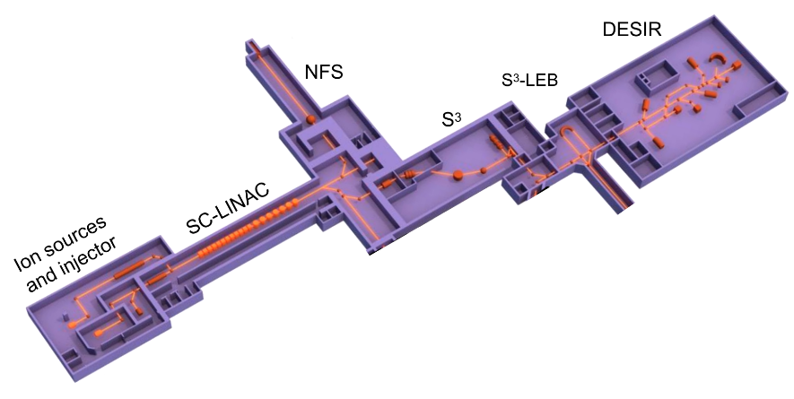
Where are we performing laser spectroscopy ?
Overview of the SPIRAL2 facility

Slide 10
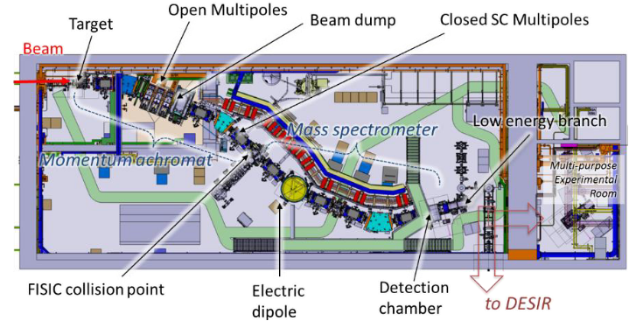
Where are we performing laser spectroscopy ?
Super Separator Spectrometer S³,
A. Drouart et al., J. Phys, 1643 (2020)

Slide 11

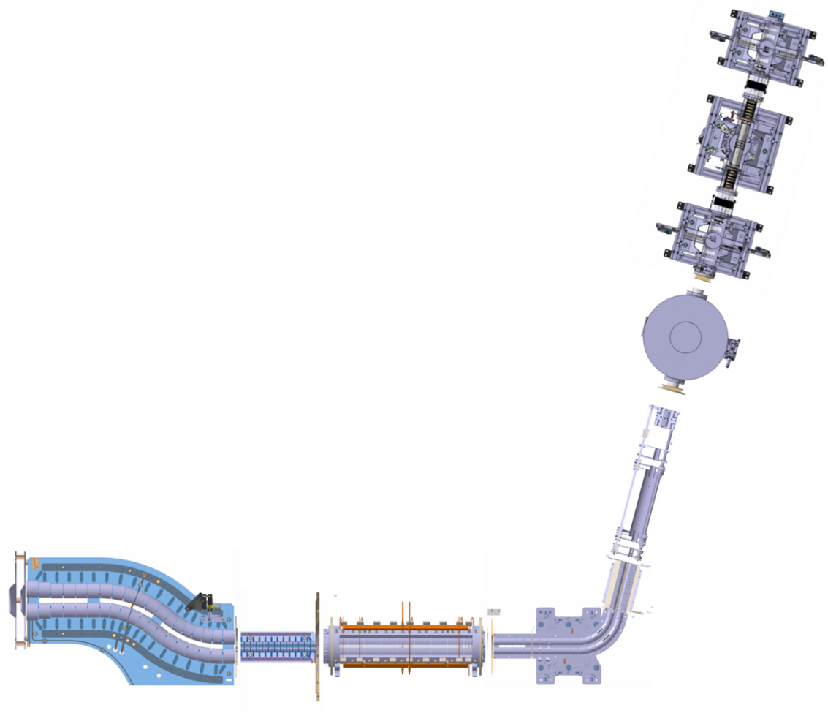
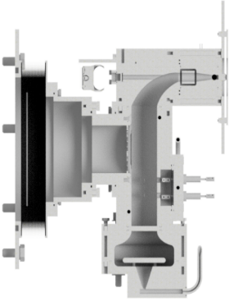


S³-LEB Overview
MagneToF
S³-Low Energy Branch :
  Goals : probe structure of exotic nuclei
  Technique : In-Gas Laser Ionization Spectroscopy
PILGRIM
(MR-TOF-MS)
MCP1
MCP2
MCP3
Gas cell
$$λ_{1}$$
$$λ_{2}$$
Pulse-up
S³
exotic ions
Cooler-buncher
S-RFQ
miniRFQ
QMF
A. Ajayakumar et al., NIMB 539 (2023)

Slide 12
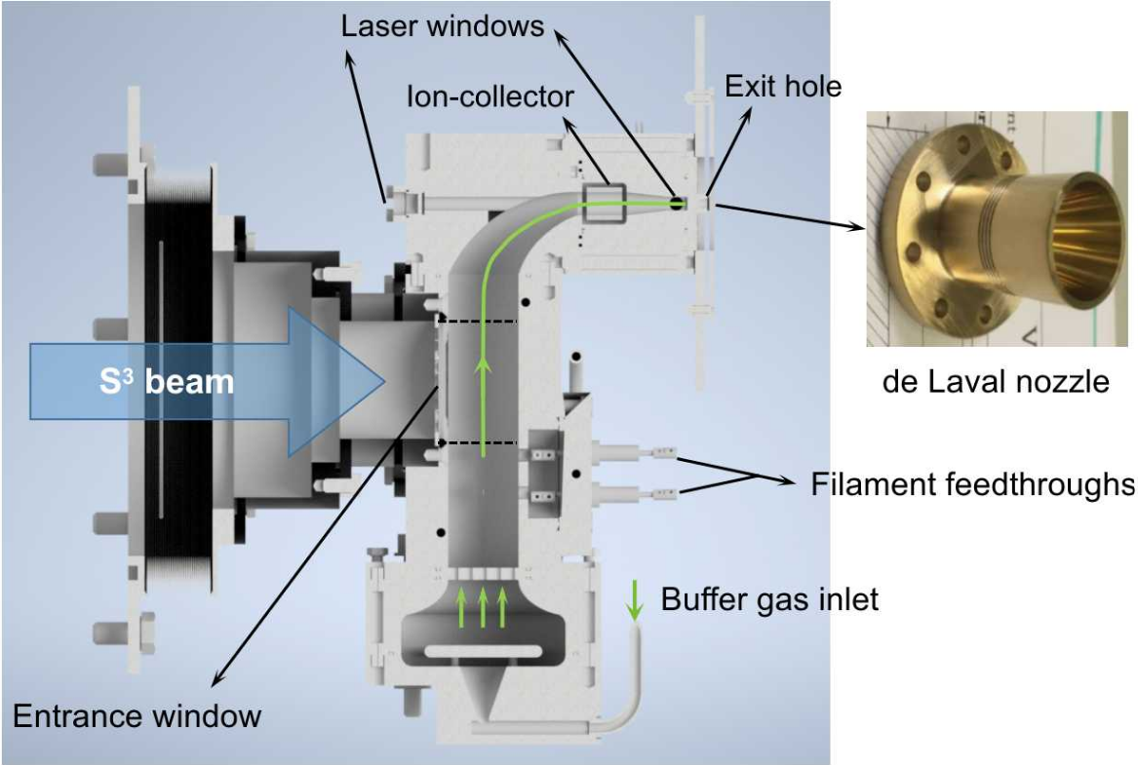
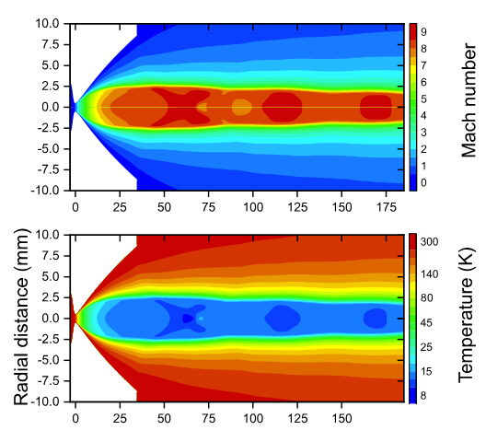
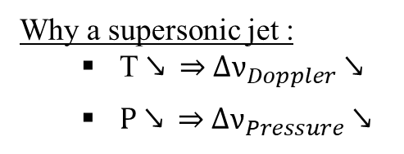
S³-LEB : Gas cell principle
Why a supersonic jet :
  T ↘ ⇒ $∆ν_{Doppler}$ ↘
  P ↘ ⇒ $∆ν_{Pressure}$ ↘
Characterization of the gas jet,
R. Ferrer et al., Phys. Rev. Research. (2021)
Gas cell,
W.Dong., PhD thesis (2024)

Slide 13














S³-LEB Overview
+1 counts
+1 counts
+1 counts
MagneToF
$$T=40,3 \%$$
$$e^{−}$$
S3-Low Energy Branch :
  Goals : probe structure of exotic nuclei
  Technique : In-Gas Laser Ionization Spectroscopy
$$e^{−}$$
PILGRIM
(MR-TOF-MS)
$$P \sim {10}^{−8} mbar$$
MCP_{inj}
$$T=64,8 \%$$
MCP1
MCP2
$$T=80 \%$$
MCP3
$$T=80 \%$$
Gas cell
$$λ_{1}$$
$$λ_{2}$$
$$e^{−}$$
$$e^{−}$$
Pulse-up
$$e^{−}$$
$$e^{−}$$
S³
exotic ions
He
Cooler-buncher
Ar
S-RFQ
miniRFQ
QMF
$$P \sim {10}^{−2} mbar$$
$$P \sim 350 mbar$$
$$P \sim {10}^{−1} mbar$$
$$P \sim {10}^{−3} mbar$$
$$P \sim {10}^{−8} mbar$$
A. Ajayakumar et al., NIMB 539 (2023)

Slide 14


S³-LEB Overview
+1 counts
+1 counts
+1 counts
MagneToF
$$T=40,3 \%$$
$$e^{−}$$
Status :
  S³-LEB fully connected from S³ to PILGRIM.
  Commissioning until deflector done.
  Trapping test in PILGRIM ongoing.
$$e^{−}$$
PILGRIM
(MR-TOF-MS)
$$P \sim {10}^{−8} mbar$$
MCP_{inj}
$$T=64,8 \%$$
Towards SEASON
MCP1
MCP2
$$T=80 \%$$
MCP3
$$T=80 \%$$
Gas cell
$$λ_{1}$$
$$λ_{2}$$
Pulse-up
S³
exotic ions
He
Cooler-buncher
Ar
S-RFQ
miniRFQ
QMF
$$P \sim {10}^{−2} mbar$$
$$P \sim 350 mbar$$
$$P \sim {10}^{−1} mbar$$
$$P \sim {10}^{−3} mbar$$
$$P \sim {10}^{−8} mbar$$
A. Ajayakumar et al., NIMB 539 (2023)

Slide 15
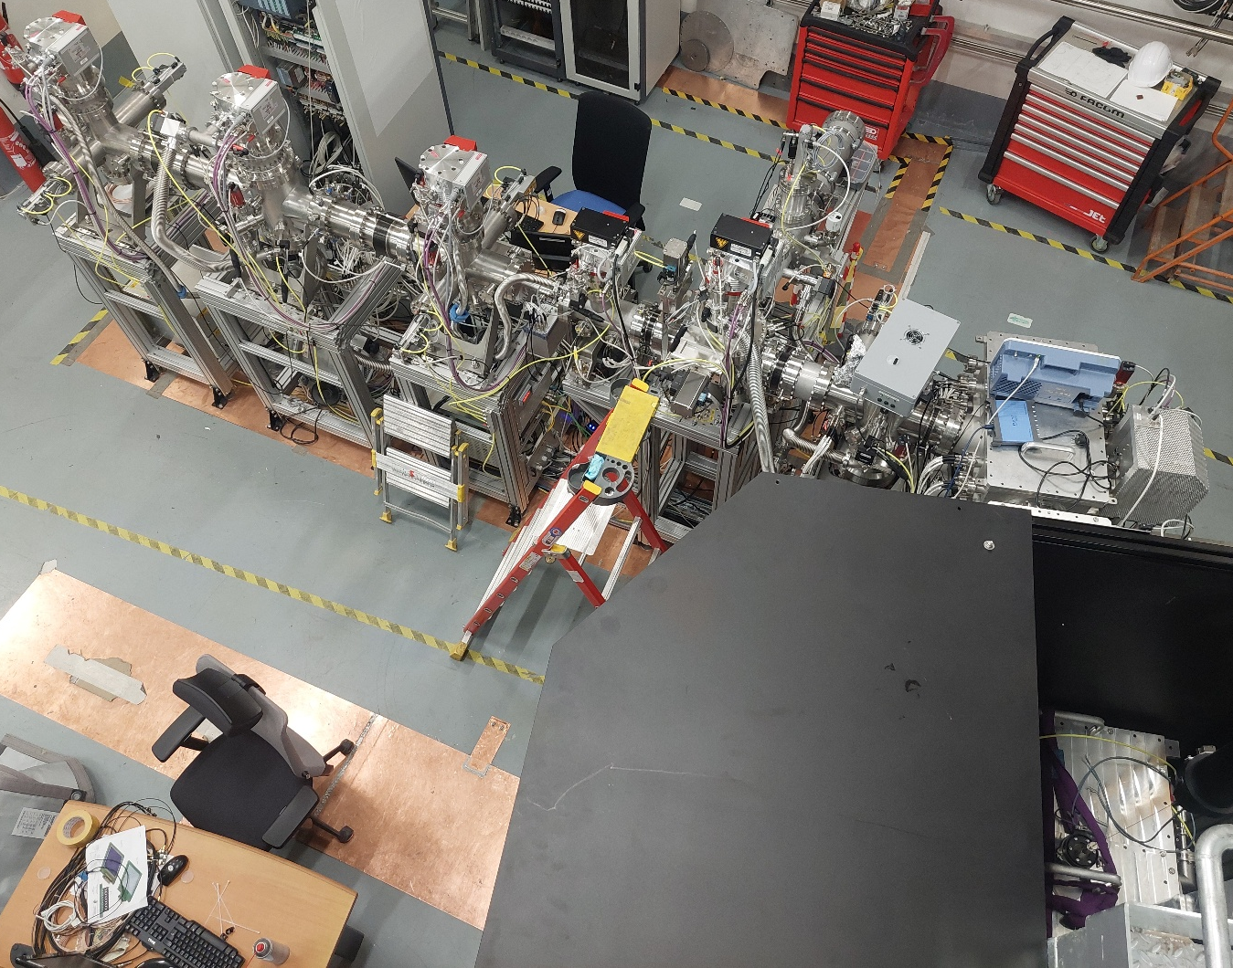
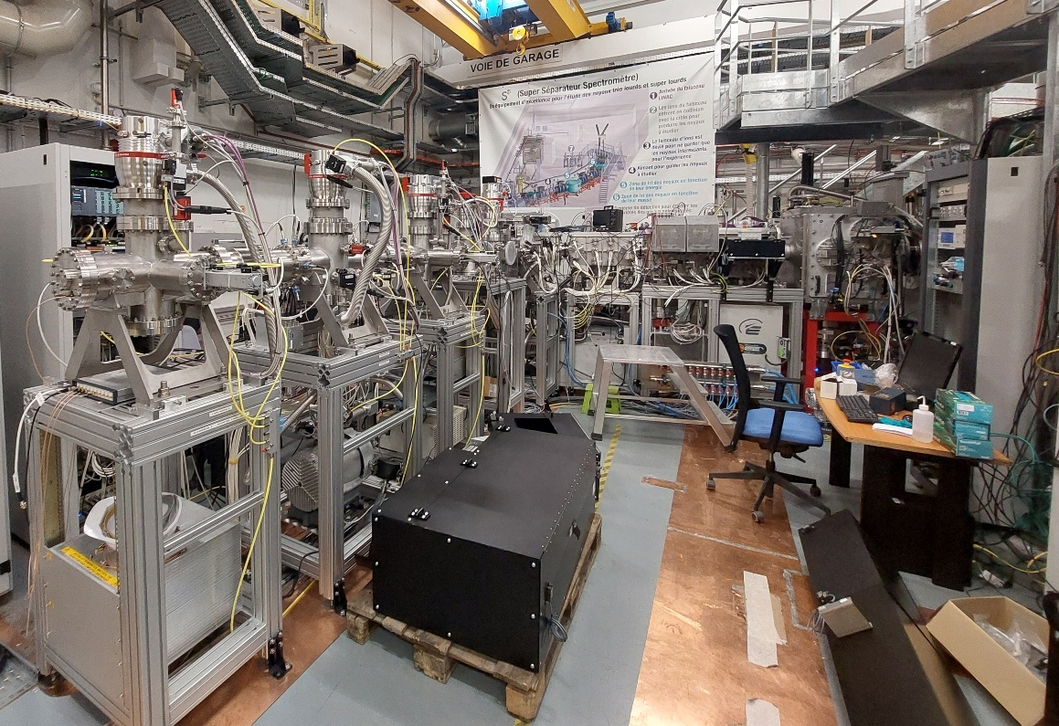
S³-LEB Overview

Slide 16
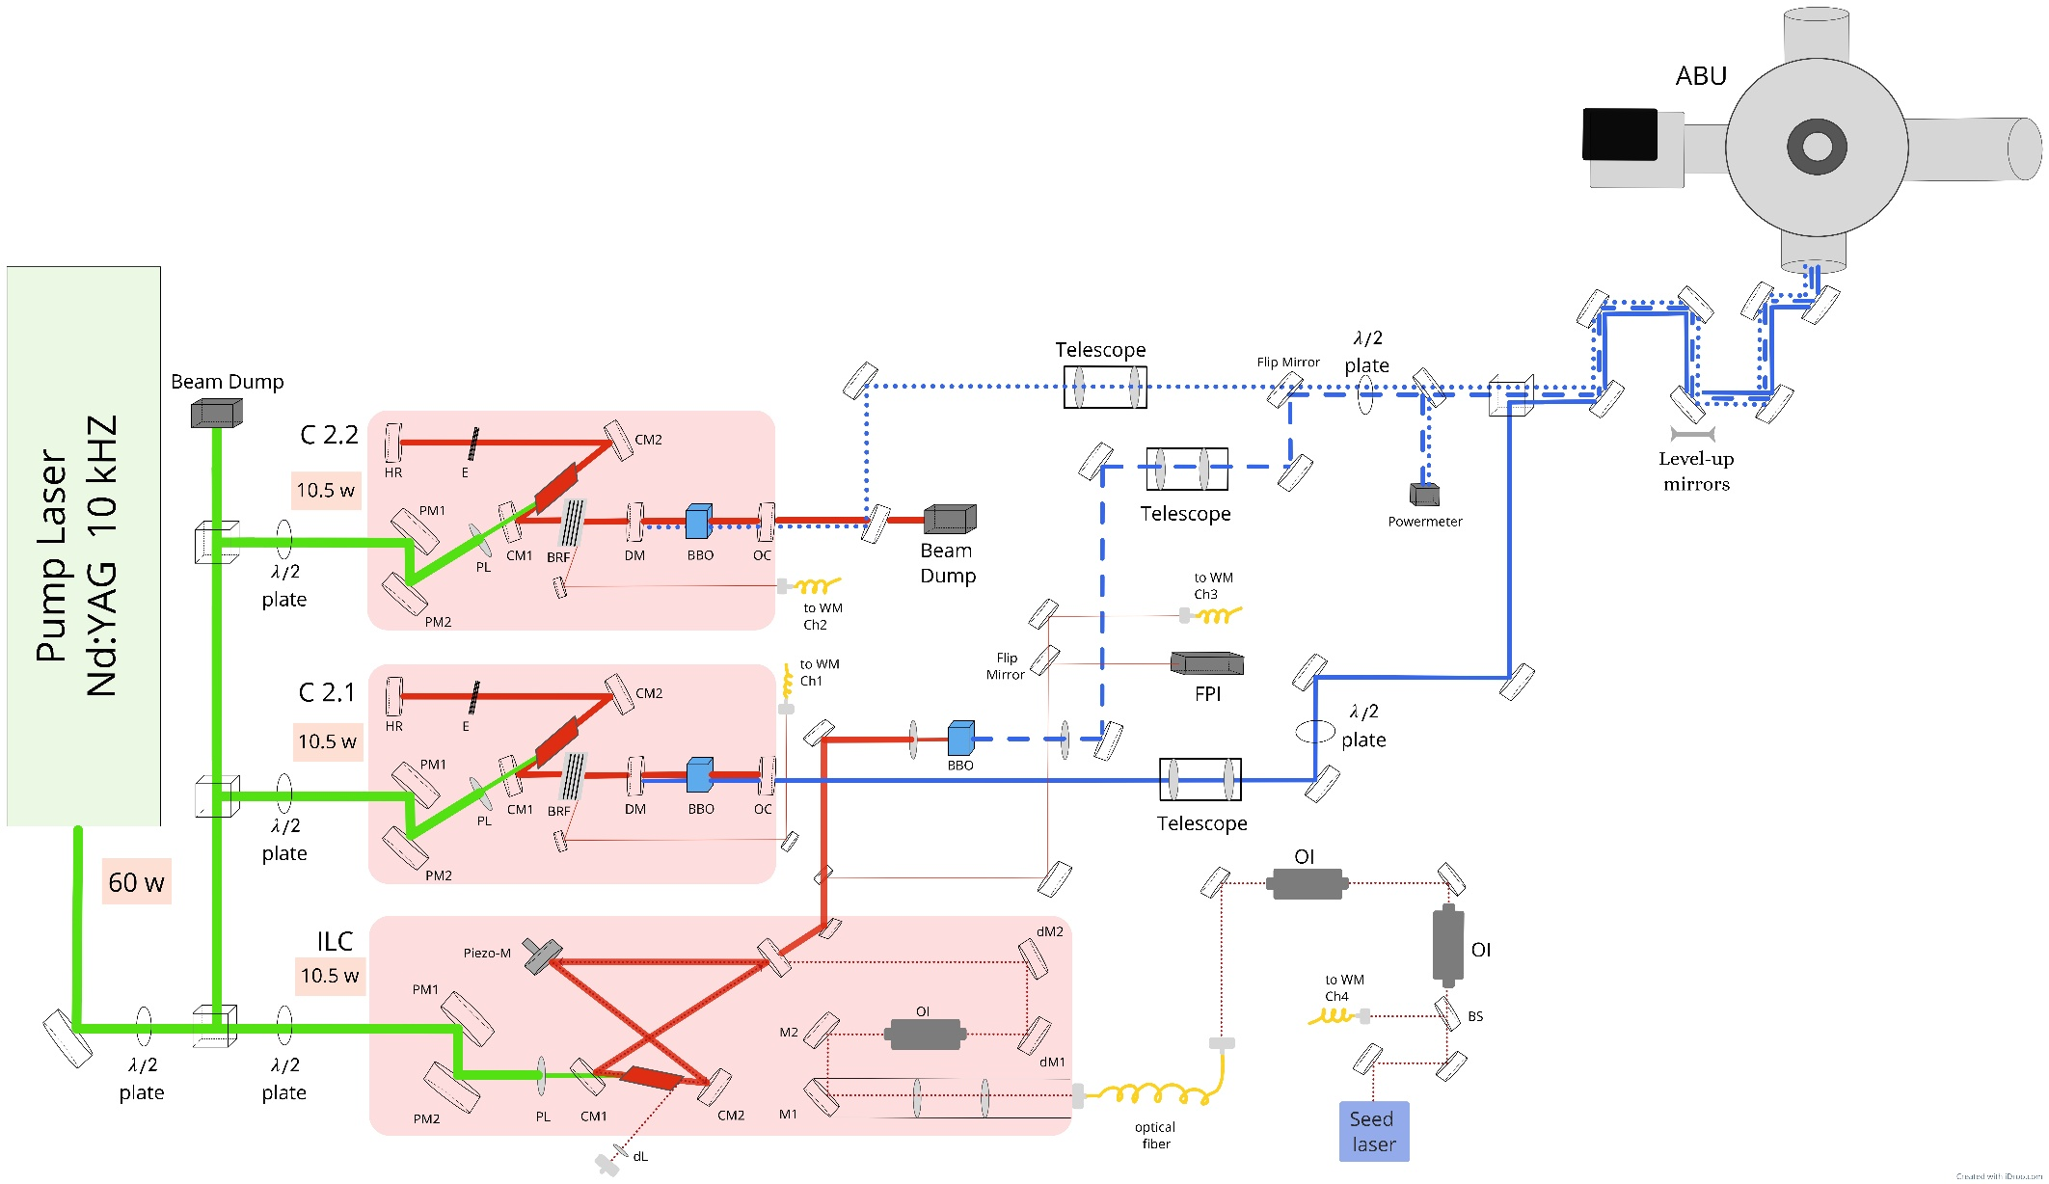
GISELE Laboratory

Slide 17

GISELE Laboratory
Goals :
Development of new laser/laser system.
Development of ionization scheme.
Send beam towards off-line experimental area such as FRIENDS³ & LRC.
Laser layout at GISELE,

Slide 18
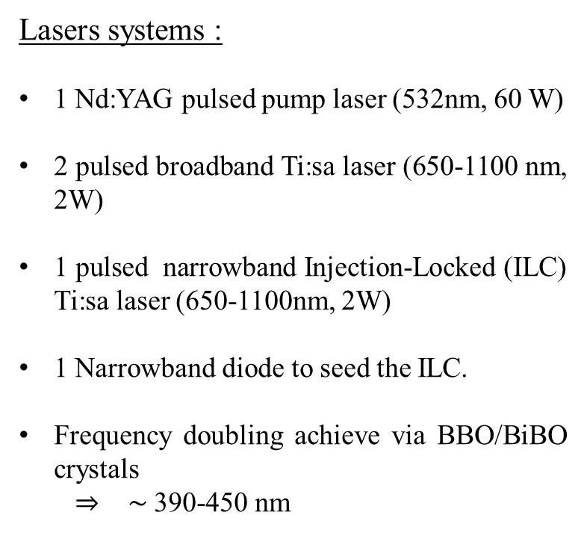
GISELE Laboratory
Lasers systems :
1 Nd:YAG pulsed pump laser (532nm, 60 W)
2 pulsed broadband Ti:sa laser (650-1100 nm, 2W)
1 pulsed narrowband Injection-Locked (ILC) Ti:sa laser (650-1100nm, 2W)
1 Narrowband diode to seed the ILC.
Frequency doubling achieve via BBO/BiBO crystals
  ⇒ $\sim$ 390-450 nm

Slide 19
GISELE Laboratory
Atomic Beam Unit (ABU) :
Goal : Laser spectroscopy
How ?
  Evaporation of the atomic sample.
  2-steps ionization.
  Accélération via 2 electrodes ⇒ MCP

Slide 20
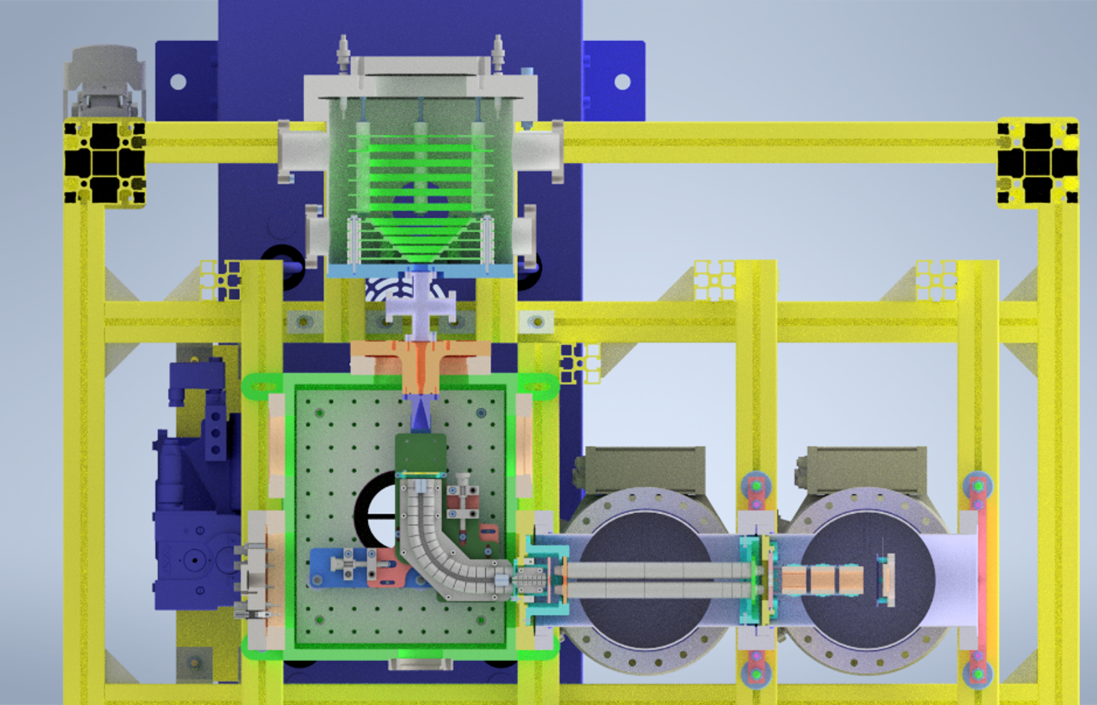
FRIENDS³ setup
3D drawing of FRIENDS3 experimental setup,
E. Morin et al., NIMB 573 (2026).

Slide 21
FRIENDS³ setup
Fast
Radioactive
Ion
Extraction
Neutralization
Device
S3
3D drawing of FRIENDS3 experimental setup,
E. Morin et al., NIMB 573 (2026).

Slide 22
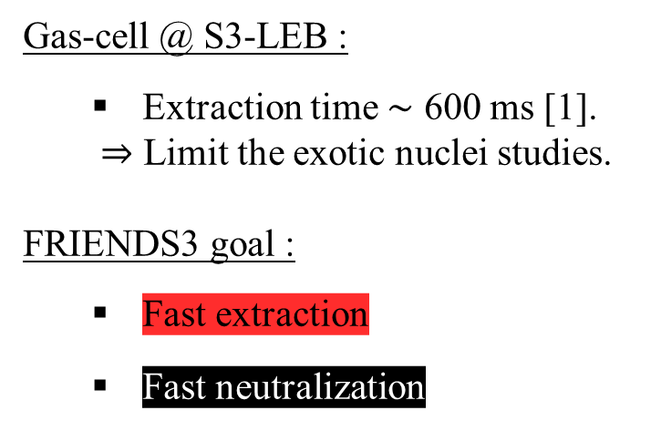
FRIENDS³ setup
Gas-cell @ S3-LEB :
  Extraction time $\sim$ 600 ms [1].
  ⇒ Limit the exotic nuclei studies.
  FRIENDS3 goal :
    Fast extraction
    Fast neutralization
3D drawing of FRIENDS3 experimental setup,
E. Morin et al., NIMB 573 (2026).
[1] W. Dong et al., arXiv:2601.12009 [physics.ins-det] (2026)

Slide 23
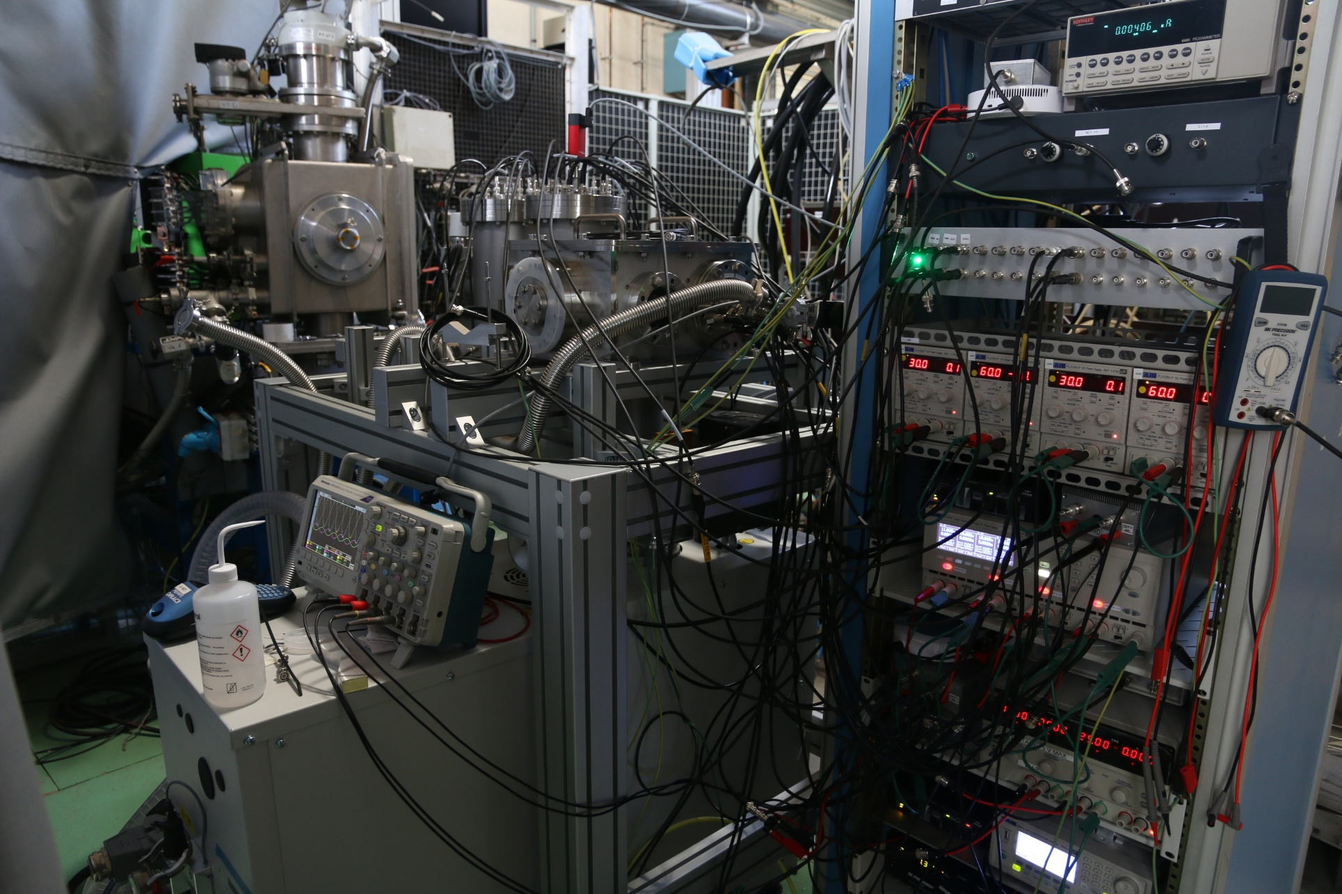
FRIENDS³ setup IRL

Slide 24
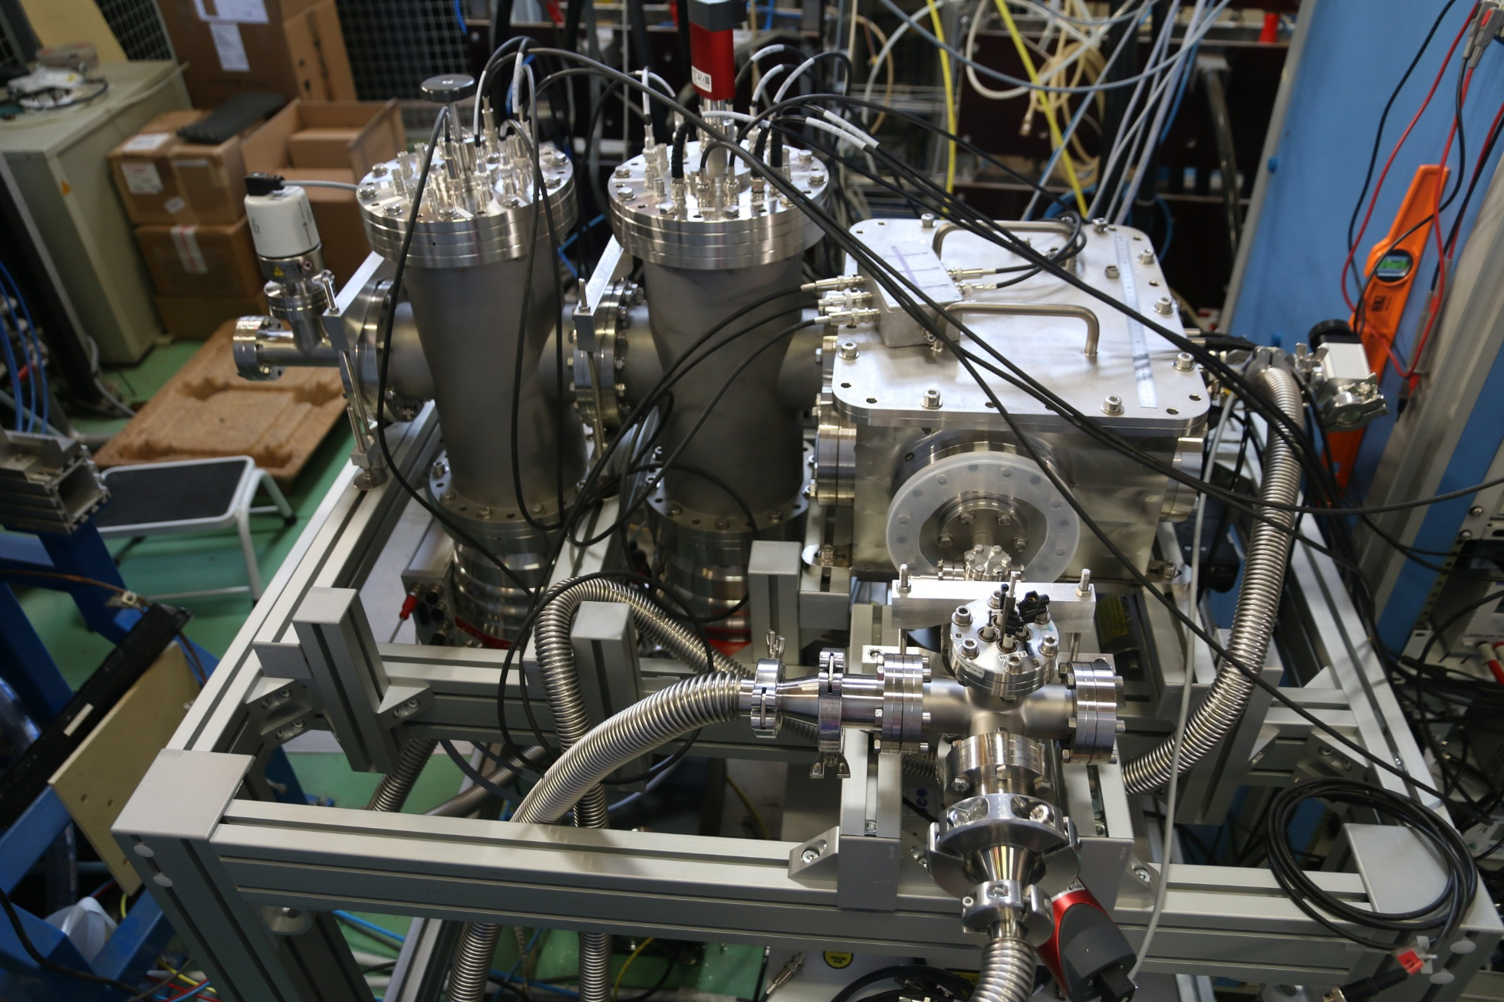
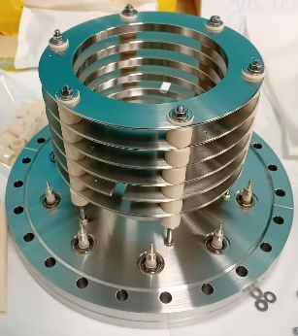
FRIENDS³ setup IRL

Slide 25
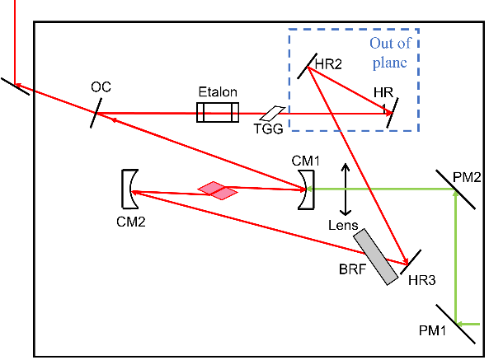
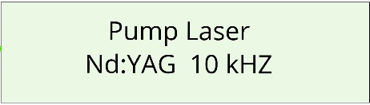
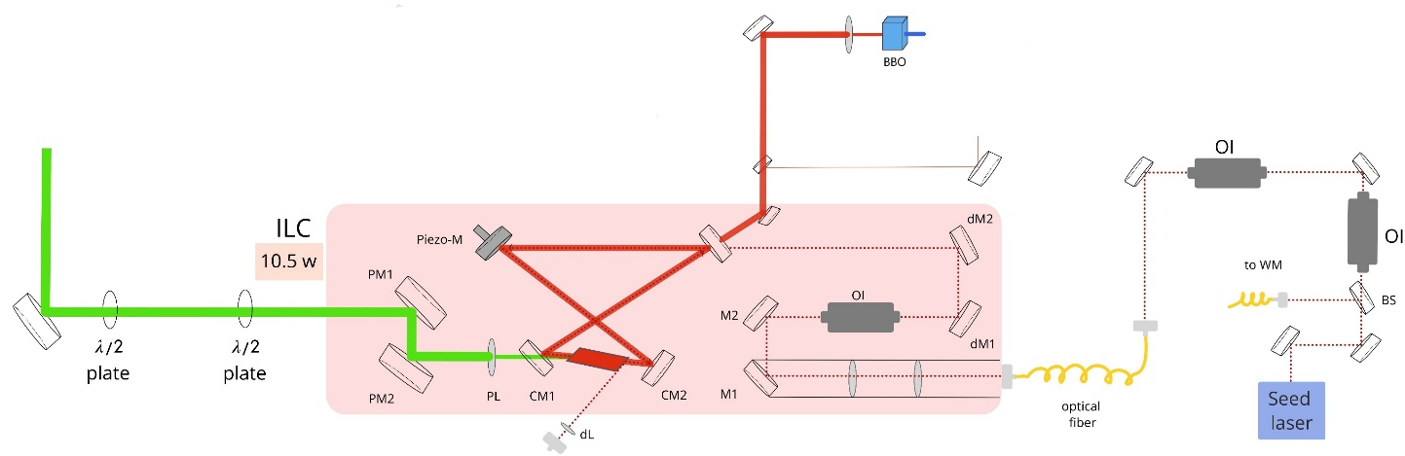

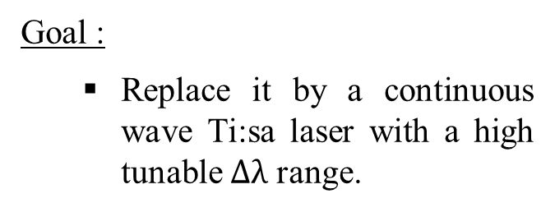
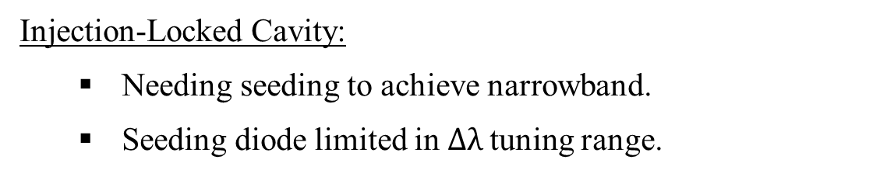
My work : CW Ti:sa
CW Ti:sa laser
Injection-Locked Cavity:
  Needing seeding to achieve narrowband.
  Seeding diode limited in $Δλ$tuning range.
ABU
Goal :
  Replace it by a continuous wave Ti:sa laser with a high tunable $Δλ$ range.
Seeding diode

Slide 26
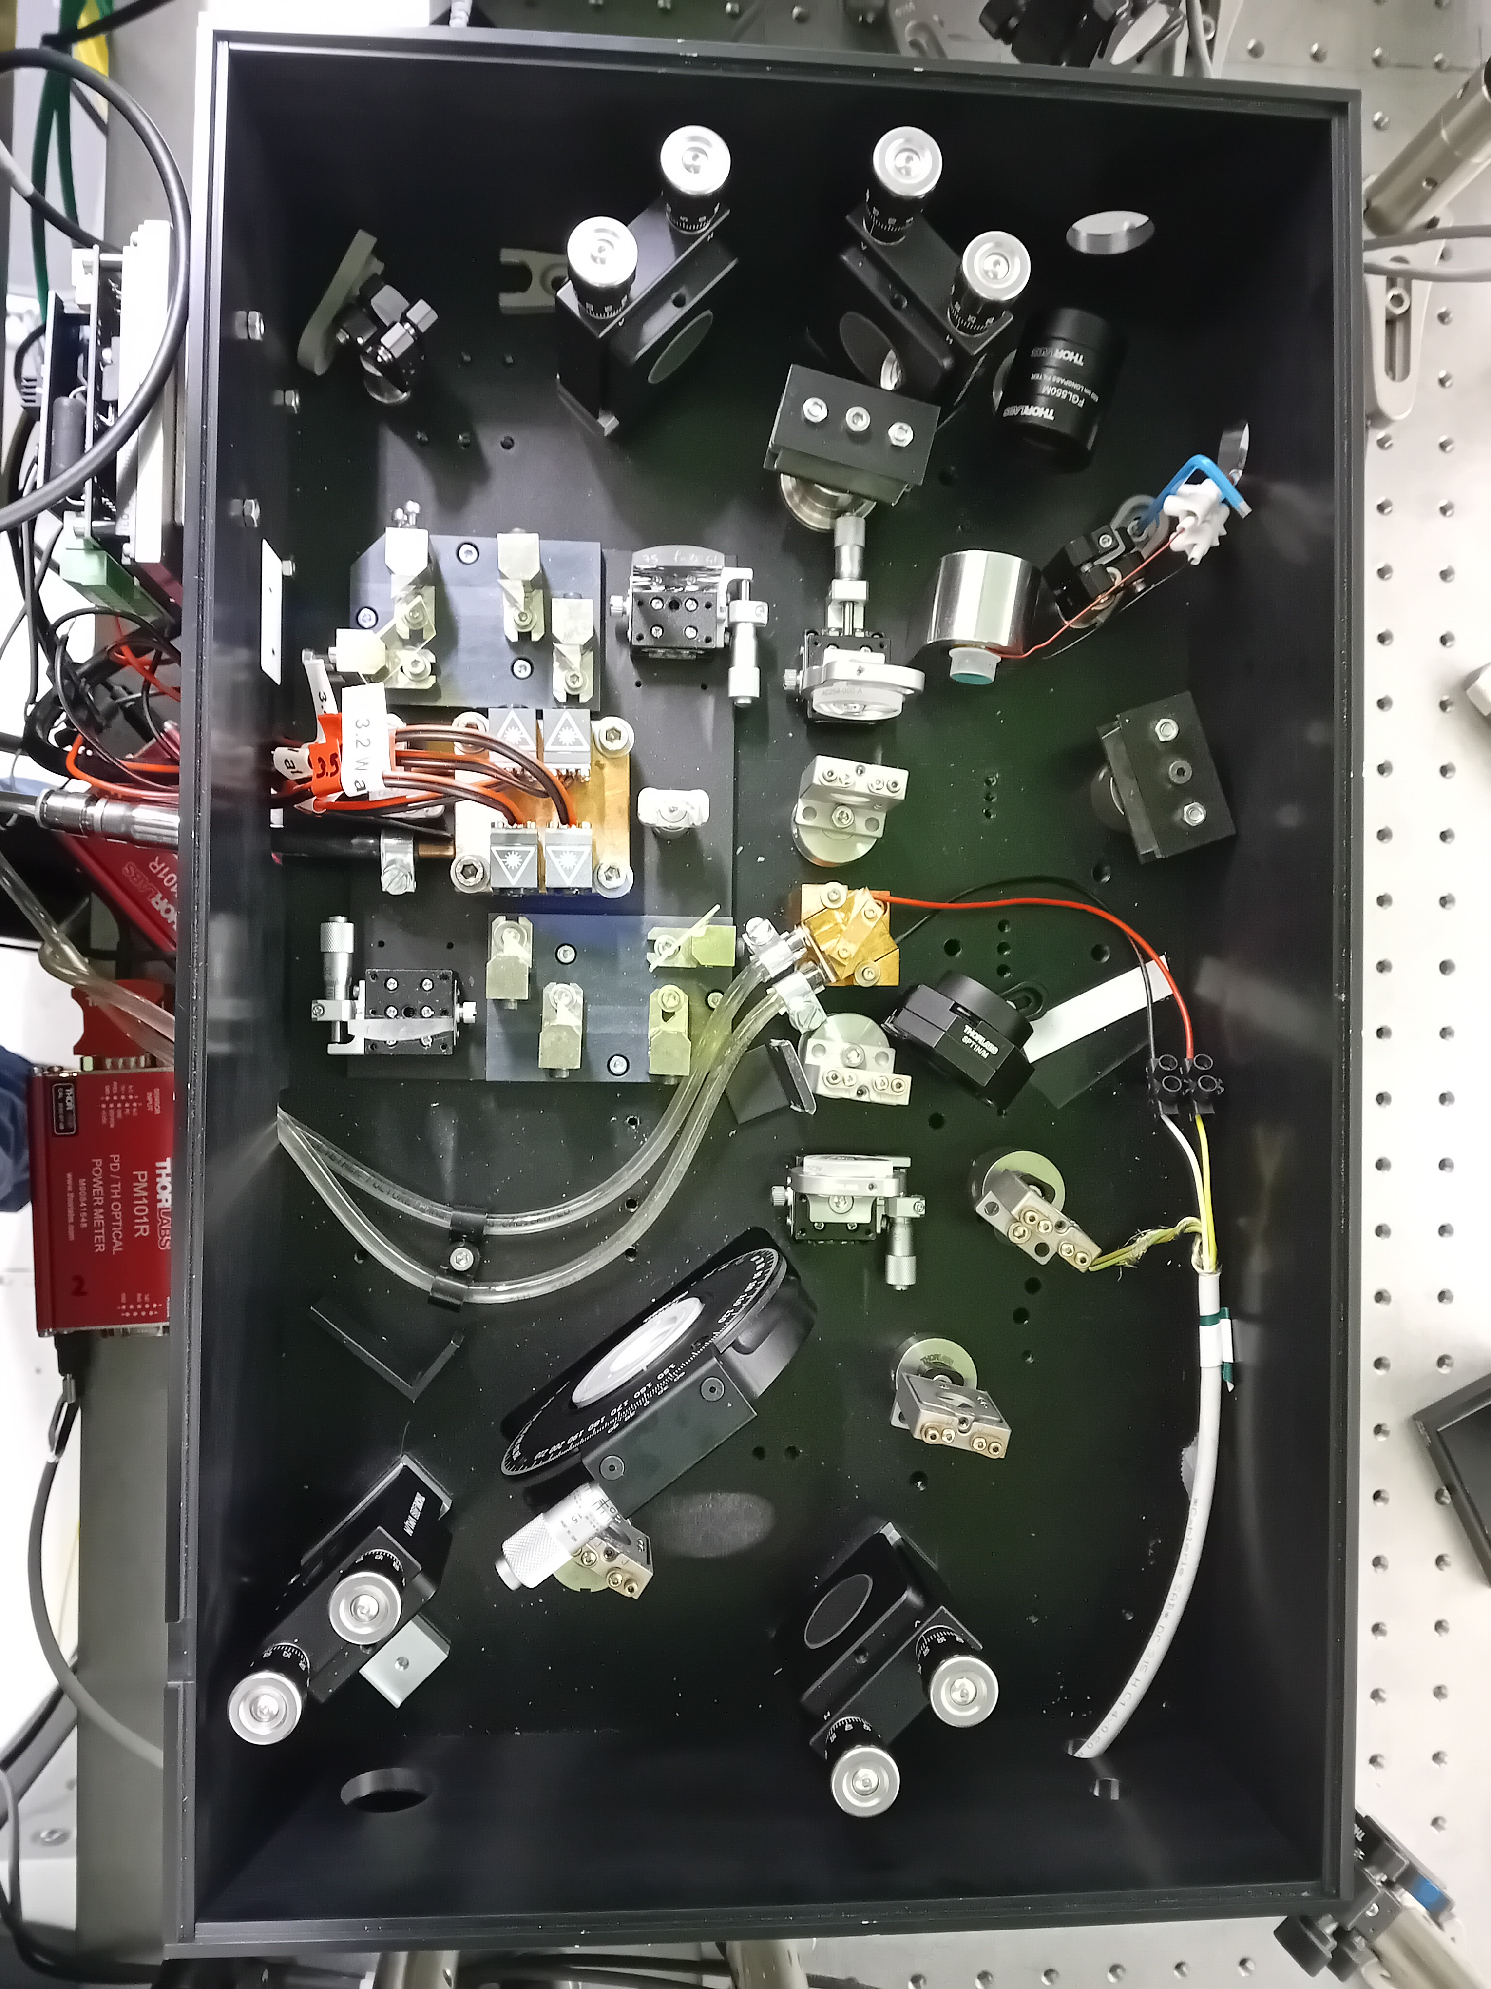
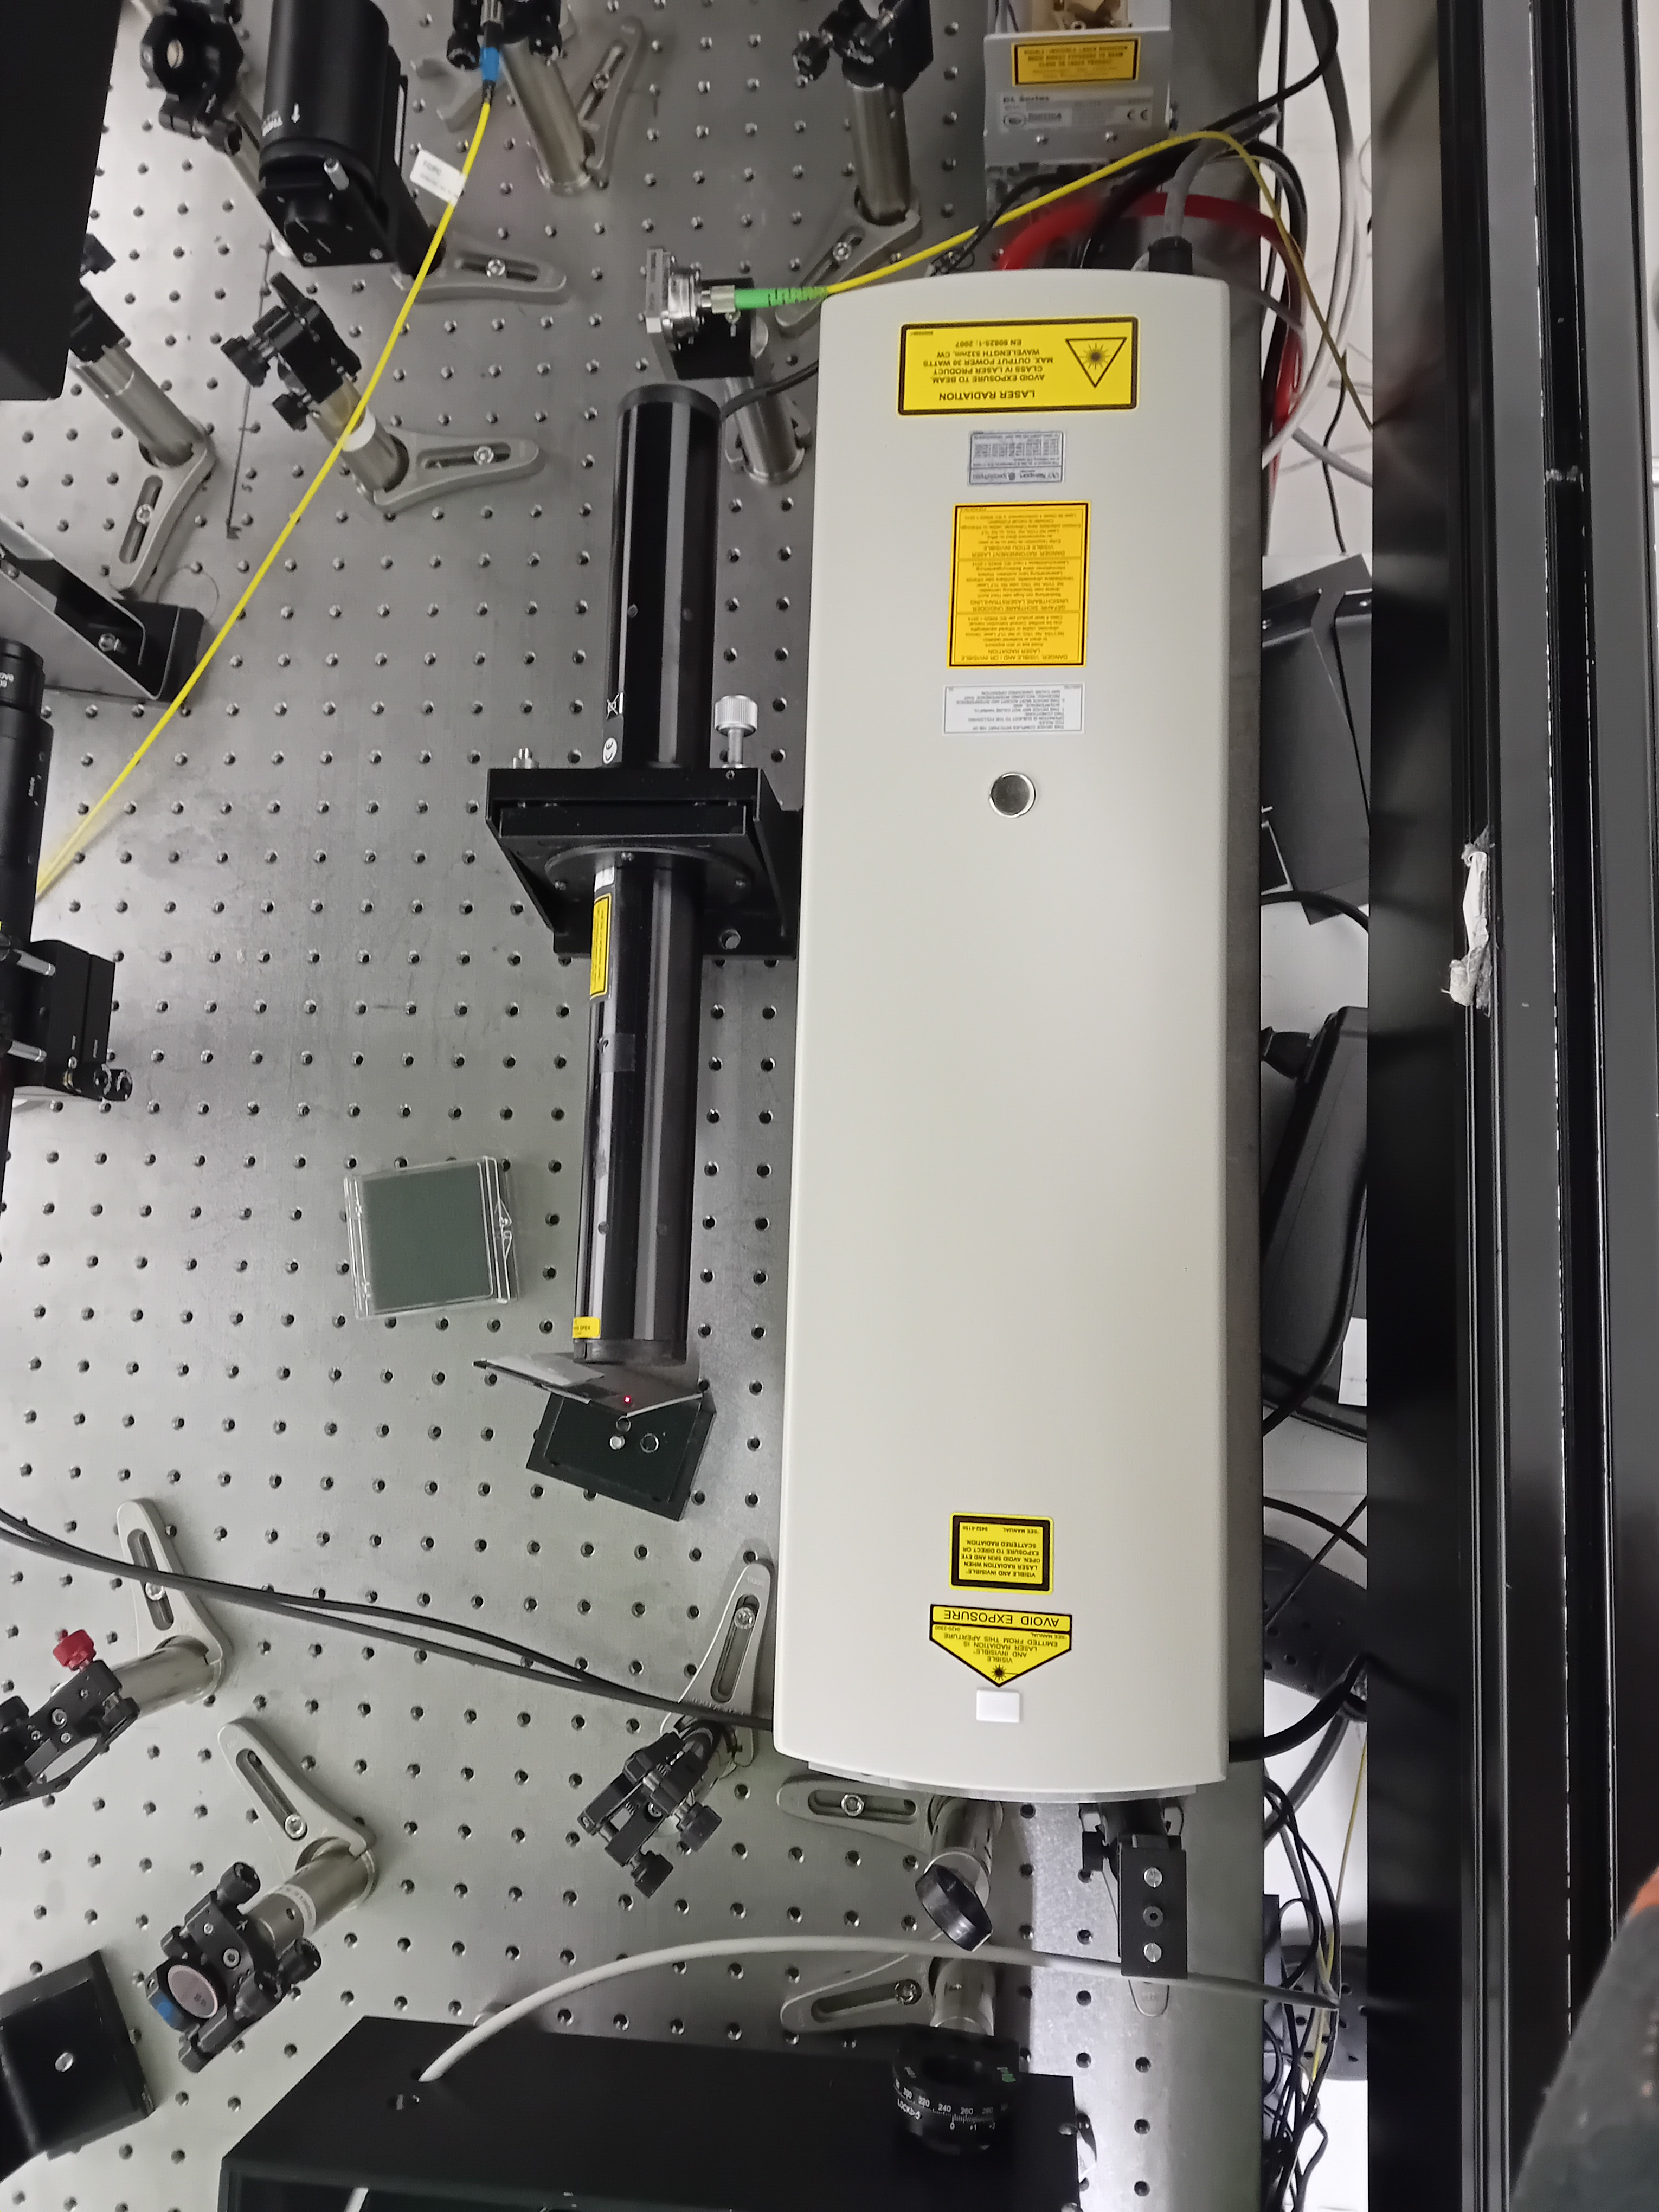
CW Ti:sa : IRL layout
Pump :
  CW Nd:YAG (532 nm)
Optics :
  Wavelength selection :
    BRF
    Air-spaced etalon
    Direction of emission :
      TGG crystal
CW Ti:sa cavity
Millennia eV
pump laser (CW 532 nm)

Slide 27
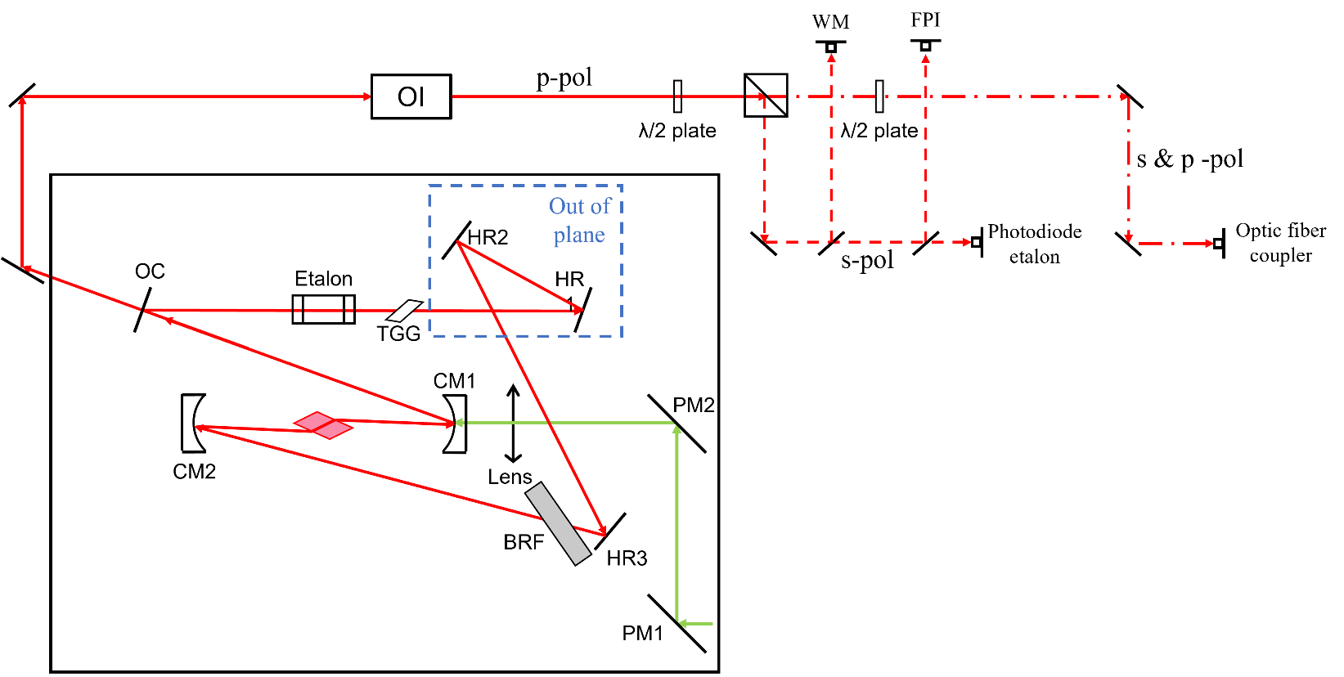
CW Ti:sa : simplified layout
Pump :
  CW Nd:YAG (532 nm)
Optics :
  Wavelength selection :
    BRF
    Air-spaced etalon
    Direction of emission :
      TGG crystal

Slide 28
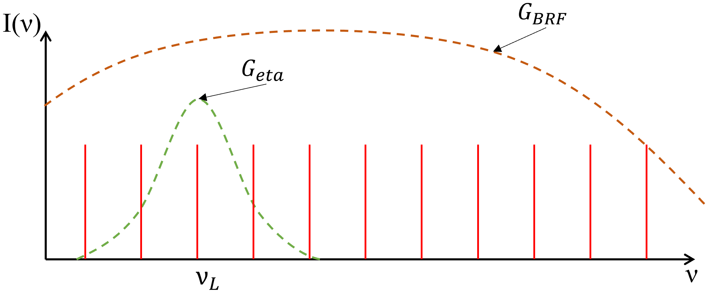
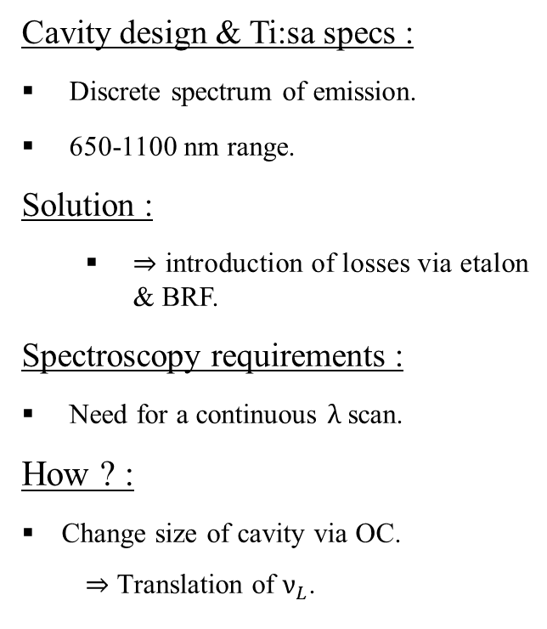
Wavelength selection theory
Cavity design & Ti:sa specs :
Discrete spectrum of emission.
650-1100 nm range.
Solution :
  ⇒ introduction of losses via etalon & BRF.
Spectroscopy requirements :
Need for a continuous $λ$ scan.
How ? :
  Change size of cavity via OC.
    ⇒ Translation of $ν_{L}$.
FSR

Slide 29
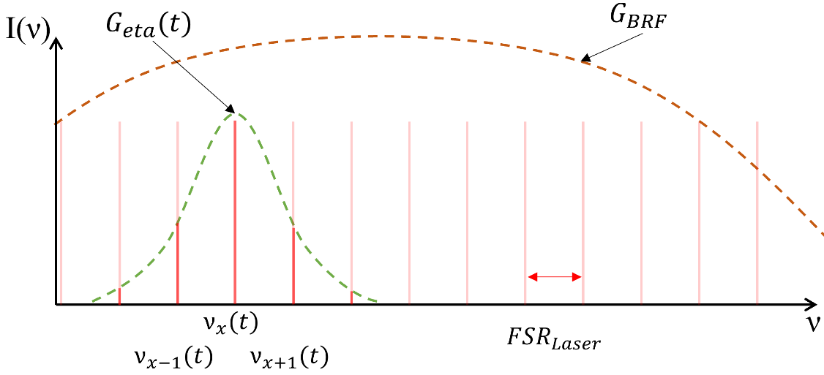
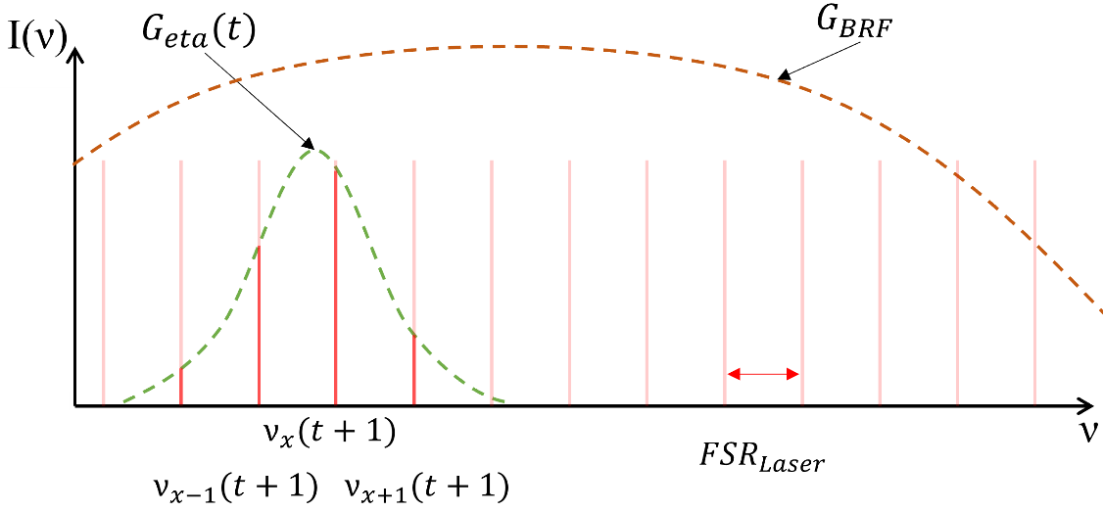
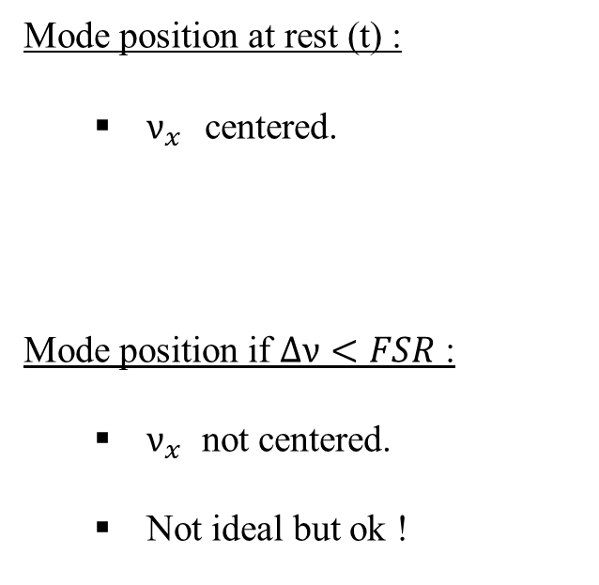
Wavelength selection theory
Mode position at rest (t) :
  $ν_{x}$ centered.
  Mode position if $∆ν<FSR$ :
    $ν_{x}$ not centered.
    Not ideal but ok !

Slide 30
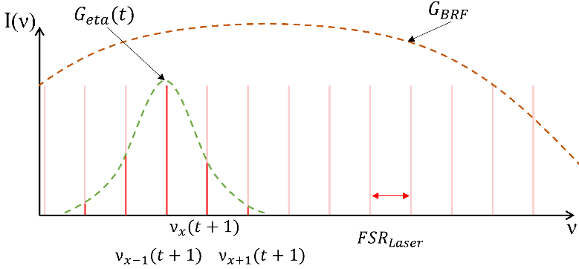
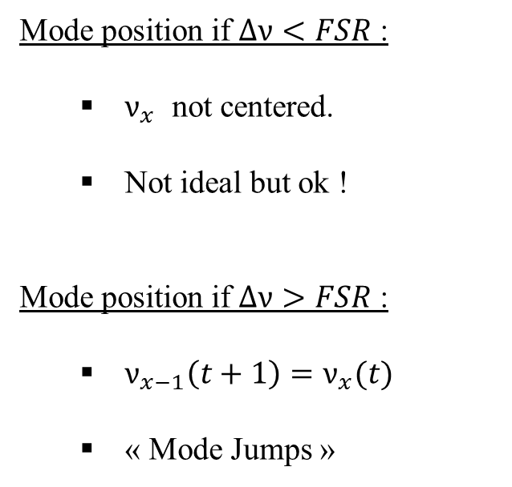
Wavelength selection theory
  Mode position if $∆ν<FSR$ :
    $ν_{x}$ not centered.
    Not ideal but ok !
    Mode position if $∆ν>FSR$ :
      $ν_{x−1}\left(t+1\right)=ν_{x}(t)$
      « Mode Jumps »

Slide 31
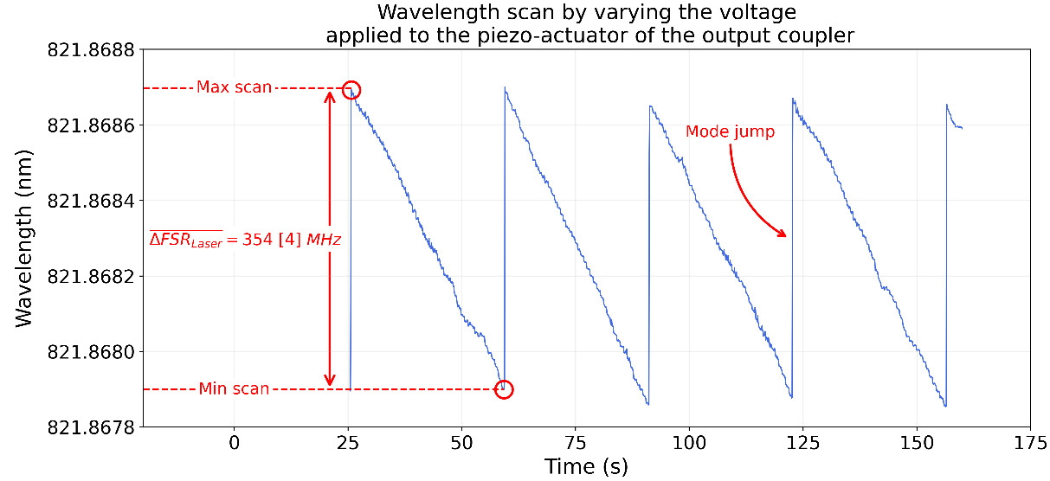
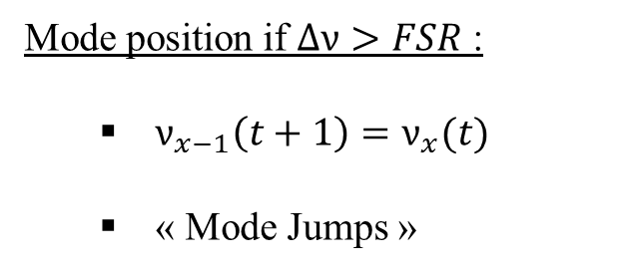
Wavelength selection theory
    Mode position if $∆ν>FSR$ :
      $ν_{x−1}\left(t+1\right)=ν_{x}(t)$
      « Mode Jumps »

Slide 32
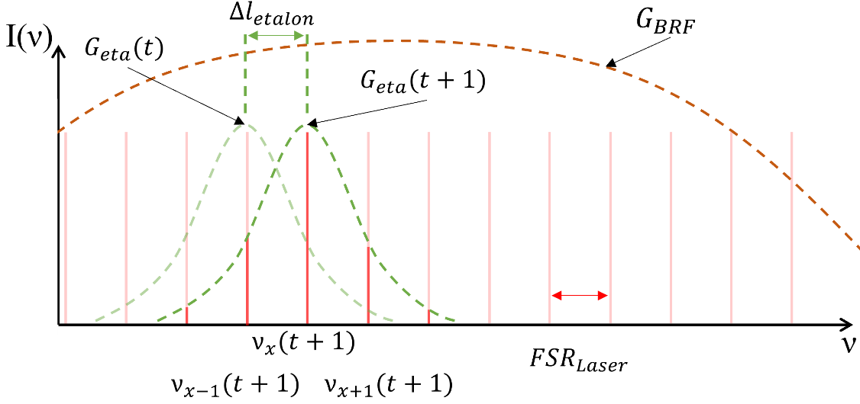
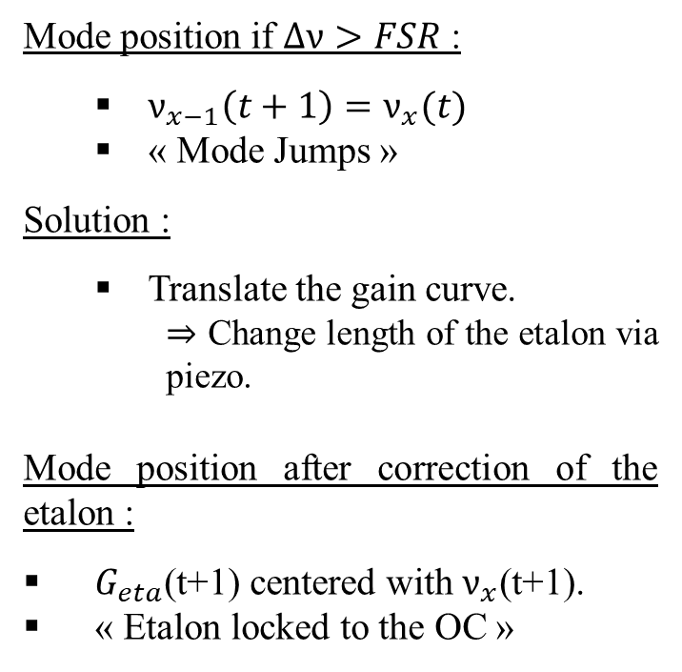
Wavelength selection theory
    Mode position if $∆ν>FSR$ :
      $ν_{x−1}\left(t+1\right)=ν_{x}(t)$
      « Mode Jumps »
      Solution :
        Translate the gain curve.
          ⇒ Change length of the etalon via piezo.
    Mode position after correction of the etalon :
      $G_{eta}$(t+1) centered with $ν_{x}$(t+1).
      « Etalon locked to the OC »

Slide 33
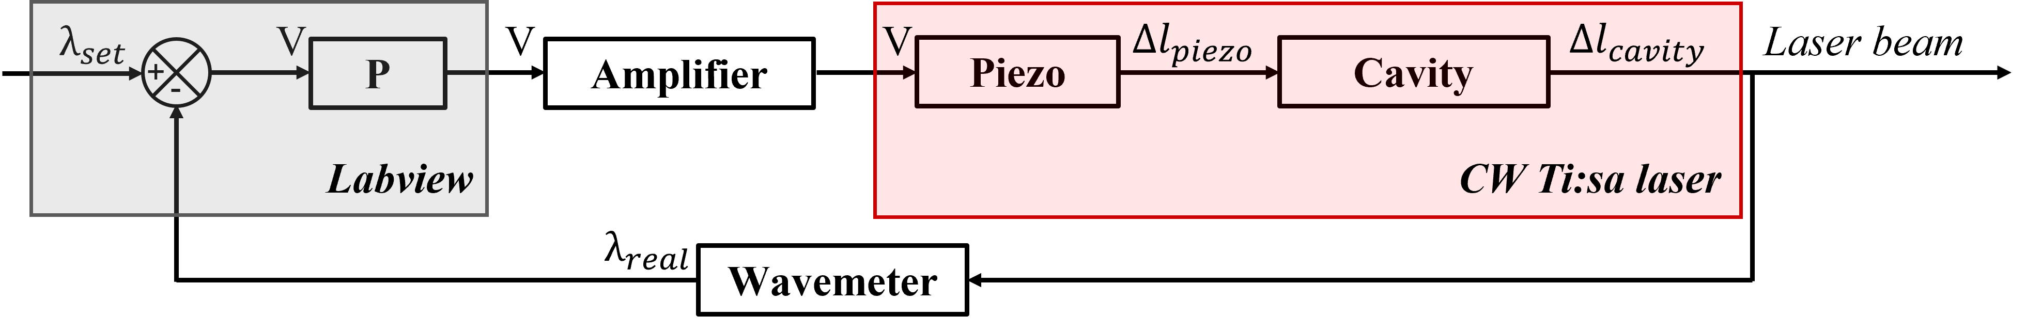
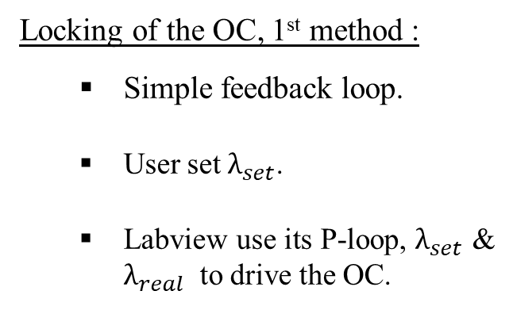
Wavelength selection in practice, 1st step : OC scan
    Locking of the OC, 1st method :
      Simple feedback loop.
      User set $λ_{set}$.
      Labview use its P-loop, $λ_{set}$ & $λ_{real}$ to drive the OC.

Slide 34
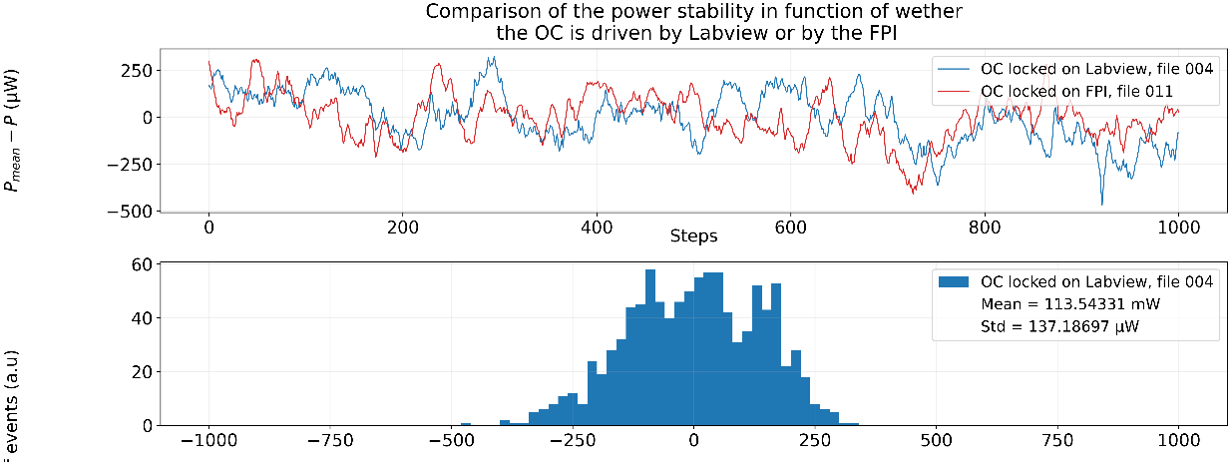
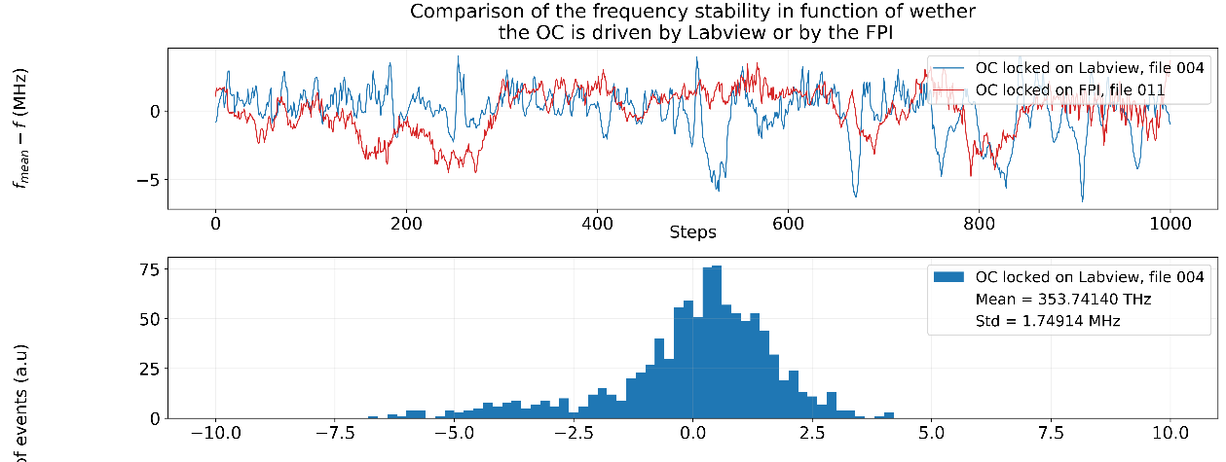
Wavelength selection in practice, 1st step : OC scan
Conclusion :
  Frequency variation below wavemeter relative accuracy (3MHz).
  OC locking works !

Slide 35
Wavelength selection in practice, 2nd step : etalon locking
    Etalon locking :
      Laser sampled by photodiode.
      Use of the Dither-locking technique via LaseLock device.
      LaseLock PID loop drive the etalon piezo to bring the error signal at 0.

Slide 36
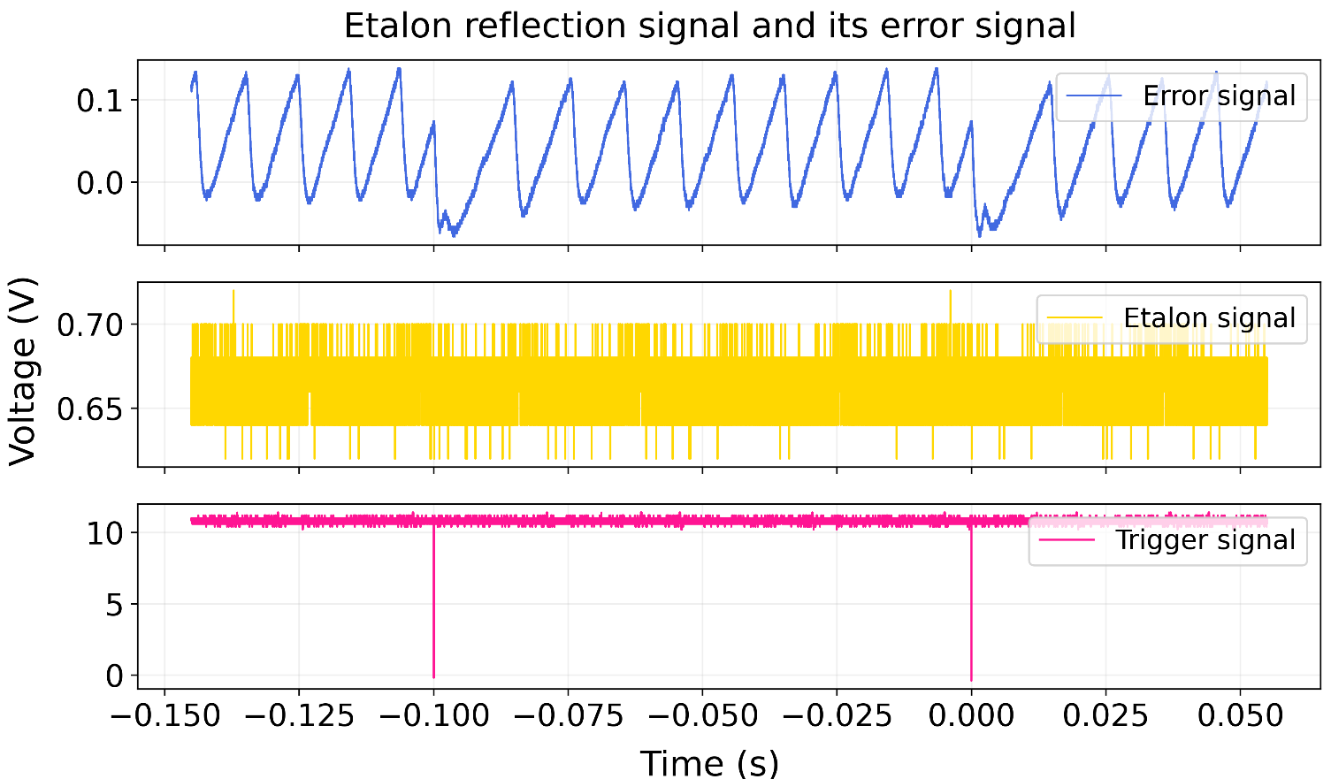
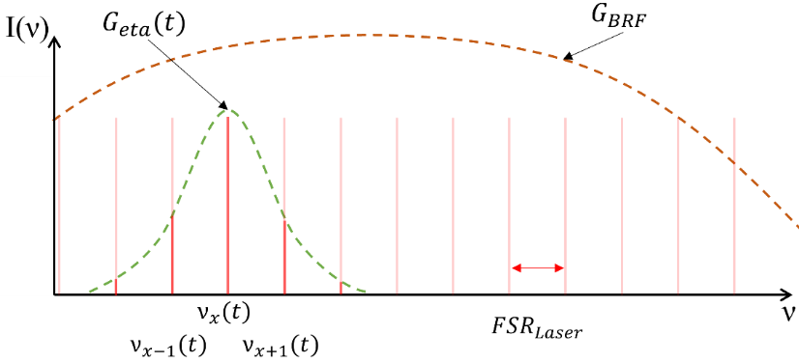
Wavelength selection in practice, 2nd step : etalon locking
    Etalon locking :
      Laser sampled by photodiode.
      Use of the Dither-locking technique via LaseLock device.
      LaseLock PID loop drive the etalon piezo to bring the error signal at 0.

Slide 37
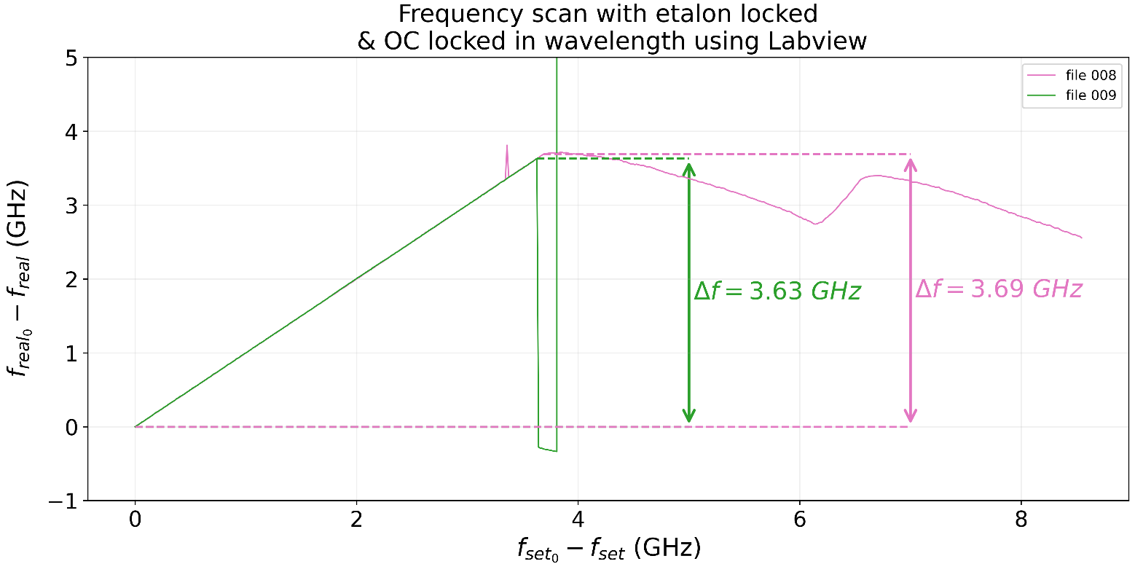
Wavelength scan
    Conclusion :
    Scanning range is relatively low, 5 GHz would be better for laser spectroscopy.
    With frequency doubling, possible to scan for 7 GHz, which make laser spectroscopy possible for low isotope shift.

Slide 38
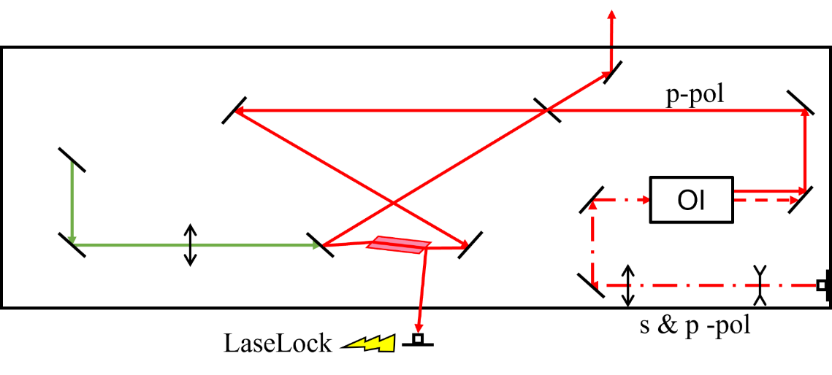
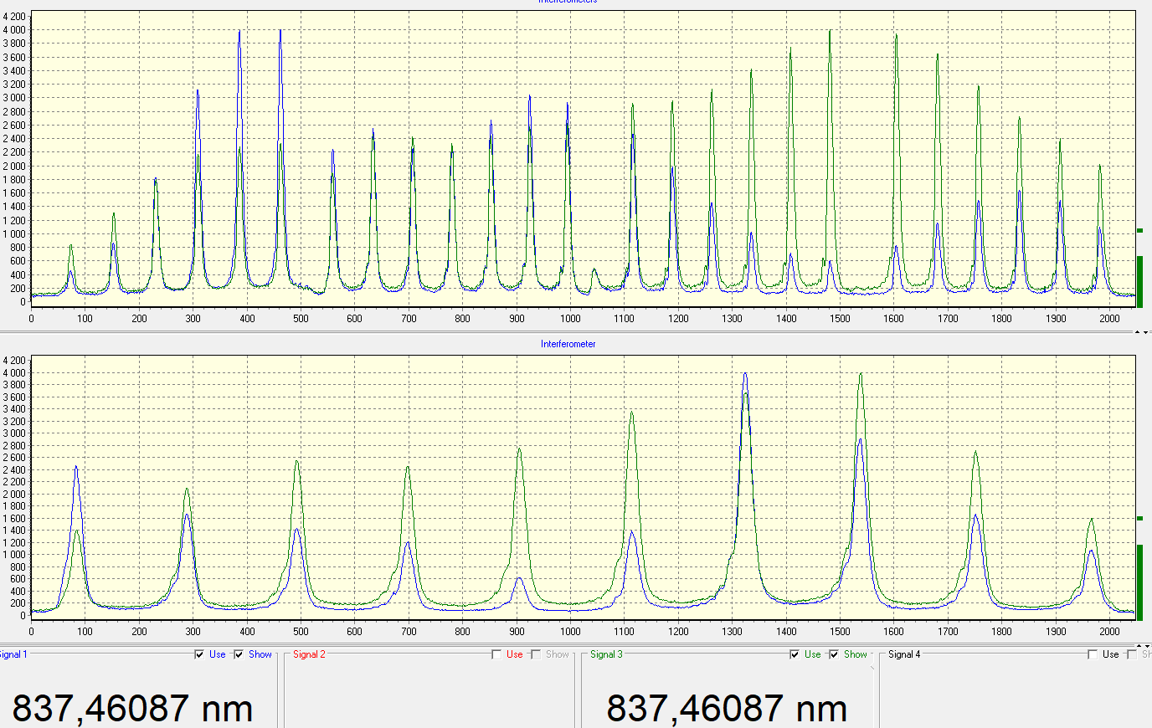

Proof-of concept : Seeding CW Ti:sa
    Injection-Locked Ti:sa Cavity (ILC) :
      Realized that optic fiber generates huge losses via s-polarisation.
      But seeding work perfectly.

Slide 39

Proof-of concept : Stable Dysprosium spectroscopy
48 343,96 cm⁻¹
A.I
47 900,5 cm⁻¹
408,727 nm, 24 466,221 cm⁻¹
23 877,739 cm⁻¹
418,8 nm
0 cm⁻¹

Slide 40

Proof-of concept : Stable Dysprosium spectroscopy
Natural abundances :
156Dy : 0,056 %
158Dy : 0,095 %
160Dy : 2,329 %
161Dy : 18,889 %
162Dy : 25,475 %
163Dy : 24,896 %
164Dy : 28,260 %

Slide 41

Proof-of concept : Stable Dysprosium spectroscopy
Natural abundances :
156Dy : 0,056 %
158Dy : 0,095 %
160Dy : 2,329 %
161Dy : 18,889 %
162Dy : 25,475 %
163Dy : 24,896 %
164Dy : 28,260 %

Slide 42





Proof-of concept : Stable Dysprosium spectroscopy

Slide 43


Proof-of concept : Stable Dysprosium spectroscopy
    Isotope shift :
    $∆ν_{i}^{A^{′},164}=ν_{i}^{A′}−ν_{i}^{164}$
    $\overline{∆ν_{WA}^{A^{′},164}}=σ^{2}\left(∆ν_{WA}^{A^{′},164}\right)\sum_{i}^{n}{\frac{∆ν_{i}^{A^{′},164}}{σ^{2}\left(∆ν_{i}^{A^{′},164}\right)}}$
    Isotope shift in bibliography :
      $∆ν_{418}^{160,164}=−986,3 \left(60\right)$ MHz
      In John S. Ross, J. Opt. Soc. Am. 62, 548-554 (1972)
PRELIMINARY RESULTS

Slide 44


Proof-of concept : Stable Dysprosium spectroscopy
    King-Plot :
    $∆ν^{A^{′},A}=K\left(Z\right)∙Fi∙{∆\left\langle r^{2}\right\rangle }^{A^{′},A}+M_{i}\frac{A^{′}−A}{A^{′}A}$
    $∆ν_{mod,418}^{A^{′},164}=\frac{F_{i}}{F_{ref}}∙∆ν_{mod, 563}^{A^{′},164}+M_{i}−\frac{F_{i}}{F_{ref}}M_{ref}$
    ⇒ $F_{i},M_{i}$ allow to determine ${∆\left\langle r^{2}\right\rangle }^{A^{′},A}$
PRELIMINARY RESULTS

Slide 45


Conclusions
    S³-LEB :
      Installation is finished.
      Commissioning nearing completion.
    FRIENDS³ :
      1st off-line tests soon.
    GISELE :
      New seeding laser for narrowband laser spectroscopy.

Slide 46
Perspectives
    CW Ti:sa :
      Solve scanning & stability problems.
      ⇒ Change OC, eventually study real behaviour
      of etalon/BRF.
    2nd part of my PhD - FRIENDS³ :
      Commissioning of the setup.
      In-gas jet spectroscopy of Dy with CW Ti:sa.
    Spectroscopy :
      Finish analysis for odd-even isotopes.

Slide 47










The S³-LEB collaboration & FRIENDS³ project team
GANIL:
Anjali Ajayakumar; Dieter Ackermann; Alexandre Brizard; Lucia Caceres; Samuel Damoy; Pierre Delahaye; Hemanth Dinesan;
Sai Kumar Chinthakayala; Patrice Gangnant; Sarina Geldhof; Johan Goupil; Nathalie Lecesne; Andrés Lopez;
Thierry Lefrou; Renan Leroy; Franck Lutton; Alejandro Ortiz; Benoit Osmond; Julien Piot;
Blaise-Maël Retailleau; Hervé Savajols; Gilles Sénécal; Tudor Stefan
LPC:
Frédéric Boumard; Maylis Brun; Jean-François Cam; Hugues de Préaumont; Antoine de Roubin;
Philippe Desrues; Xavier Fléchard; Clément Gautier; Pierre Lassegues
Julien Lory ; Yvan Merrer; Skyy Pineda; Christophe Vandamme
IJCLab:
Wenling Dong; Patricia Duchesne; Serge Franchoo; Vladimir Manea; Valentin Marchand;
Elodie Morin; Olivier Pochon; Afonso Vicente
KU Leuven:
Arno Claessens; Ruben de Groote; Rafael Ferrer; Mark Huyse; Fedor Ivandikov; Sandro Kraemer ; Yuri Kudriavtsev;
Jekabs Romans; Simon Sels; Paul Van den Bergh; Piet Van Duppen; Matthias Verlinde ; Elise Verstraelen
JGU:
Sebastian Raeder; Dominik Studer; Klaus Wendt
JYU:
Iain Moore; Michael Reponen; Juha Uusitalo
IPHC:
Emil Traykov
IRFU:
Martial Authier; Olivier Cloué; Antoine Drouard; Thomas Goigoux;
Mathilde Ragot; Emmanuel Rey-Herme; Damien Thisse; Marine Vandebrouck
and the RESIST network in ENSAR2

