Slide 1


Interplay between primordial black holes and dark matter
Mathieu Gross
Dark matter day
06/05/2026

Slide 2
Outline
Introduction
Primordial black holes, Hawking evaporation, and dark matter
PBH hotspot
Conclusion

Slide 3
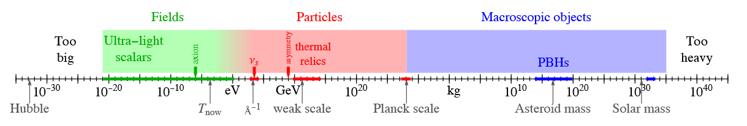
Introduction
Cirelli, M., Strumia, A., & Zupan, J. (2024). Dark Matter. ArXiv. https://arxiv.org/abs/2406.01705

Slide 4
Introduction
Yann’s talk
Cirelli, M., Strumia, A., & Zupan, J. (2024). Dark Matter. ArXiv. https://arxiv.org/abs/2406.01705

Slide 5
Introduction
WIMP/FIMP/UFO/FISC
Yann’s talk
Cirelli, M., Strumia, A., & Zupan, J. (2024). Dark Matter. ArXiv. https://arxiv.org/abs/2406.01705

Slide 6
Introduction
Axions
WIMP/FIMP/UFO/FISC
Yann’s talk
This talk
Cirelli, M., Strumia, A., & Zupan, J. (2024). Dark Matter. ArXiv. https://arxiv.org/abs/2406.01705

Slide 7
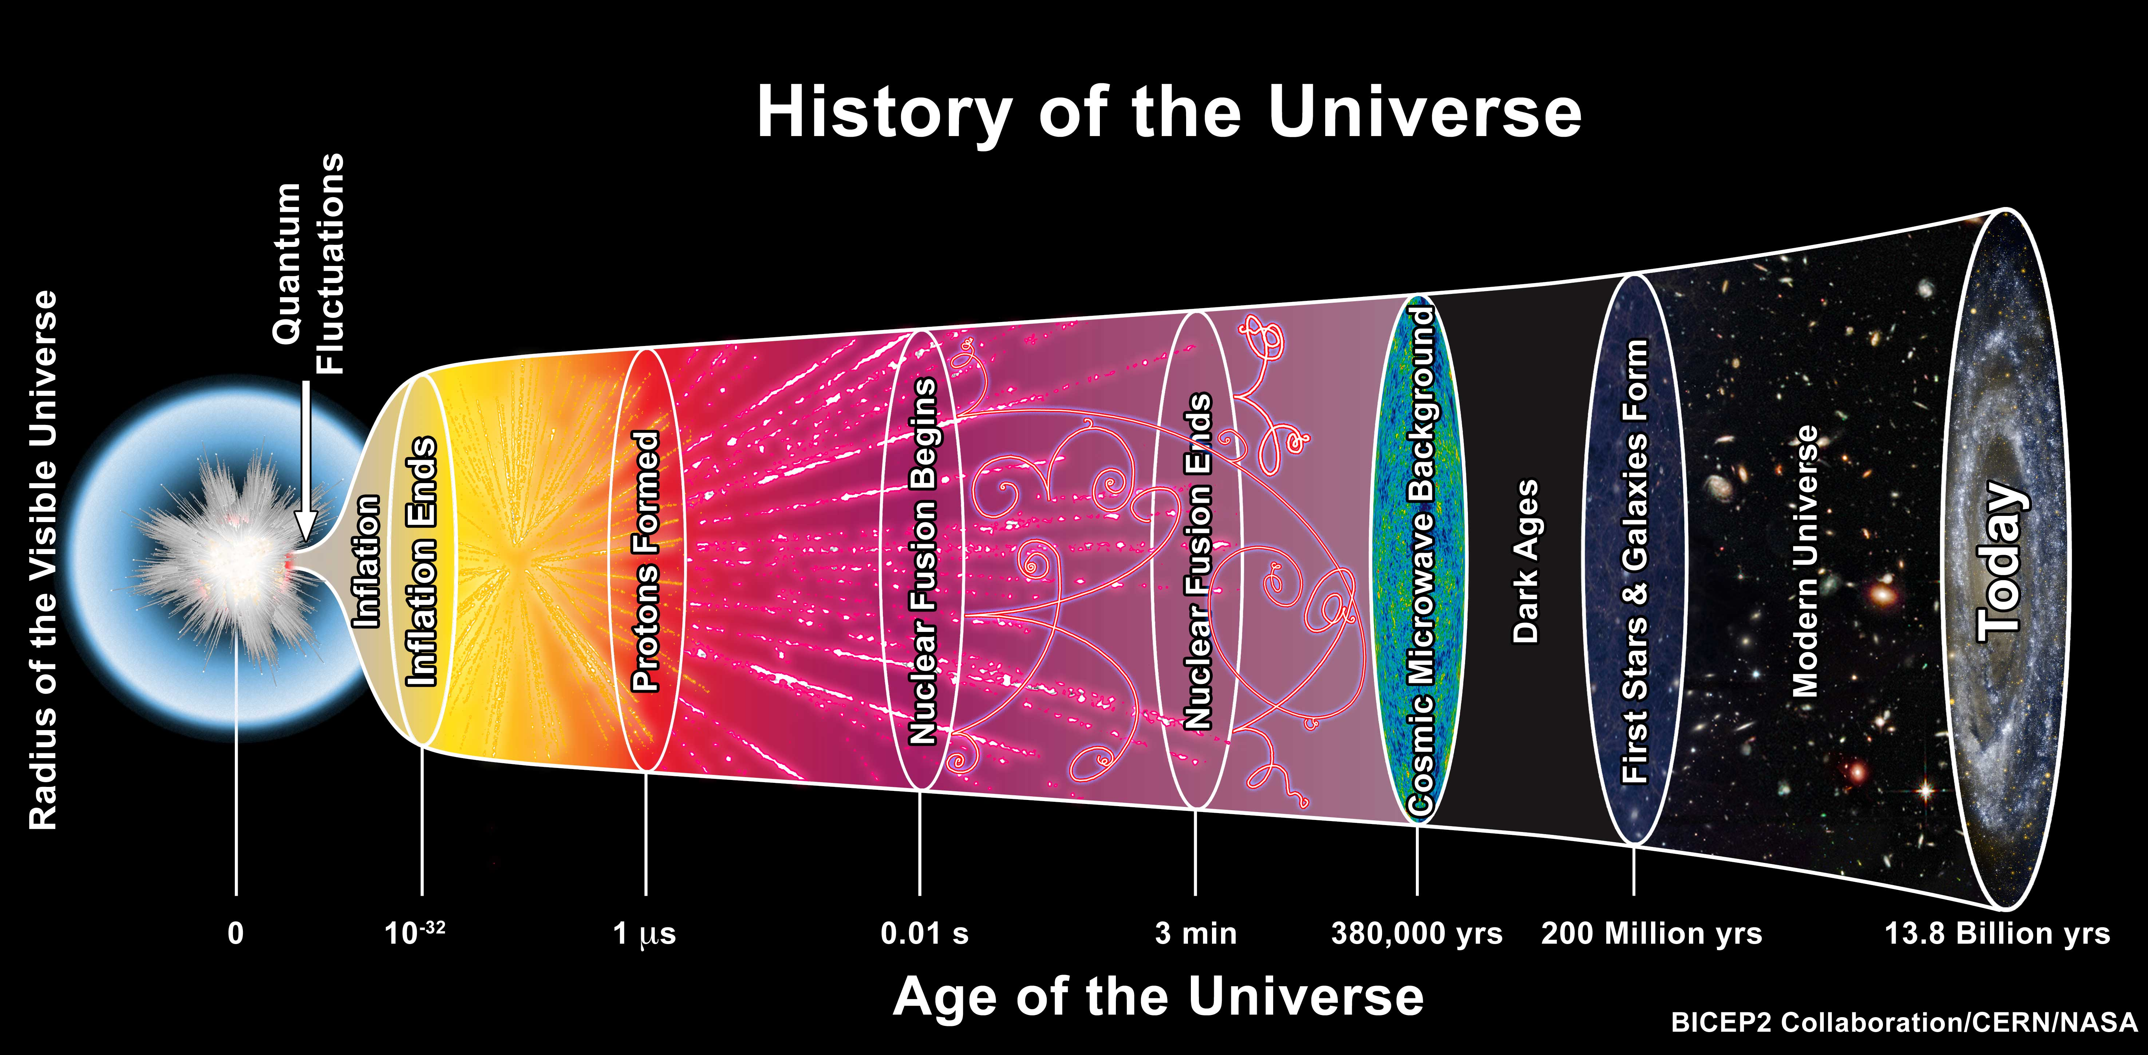
Primordial black holes?

Slide 8
Primordial black holes?

Slide 9
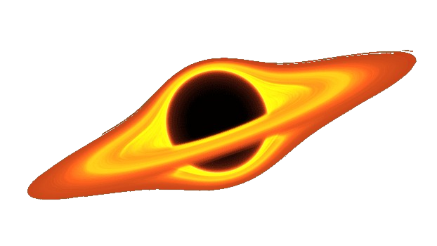
Forming primodial black holes
Primordial inhomogeneities (Yukawa forces, Qballs…)
Inflationary fluctuations collapse
Topological defect collapse (Domain walls, cosmic string ...)
Phase transitions

Slide 10
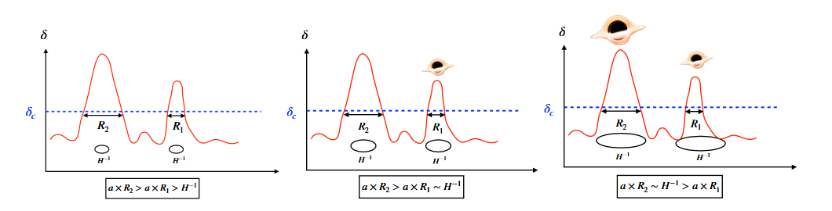
Forming primodial black holes
Primordial inhomogeneities (Yukawa forces, Qballs…)
Inflationary fluctuations collapse
Topological defect collapse (Domain walls, cosmic string ...)
Phase transitions
Yann Mambrini, Particles in the Dark Universe

Slide 11

Forming primodial black holes
Primordial inhomogeneities (Yukawa forces, Qballs…)
Inflationary fluctuations collapse
Topological defect collapse (Domain walls, cosmic string ...)
Phase transitions
Yann Mambrini, Particles in the Dark Universe
Evaporated by now
Stable today

Slide 12
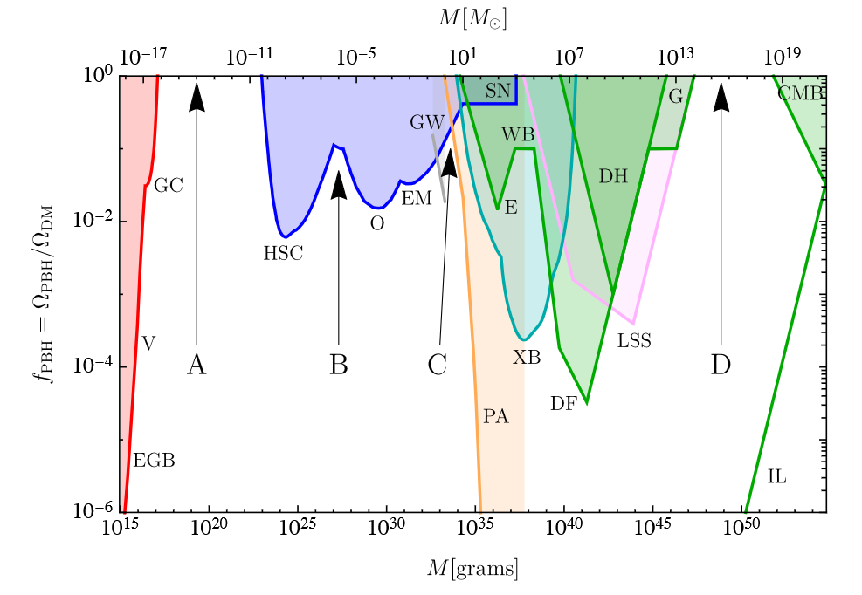
What do we know about PBH
Carr, B., & Kuhnel, F. (2021). Primordial Black Holes as Dark Matter Candidates.

Slide 13
What do we know about PBH
Dynamical effects
Large scale structue
Accretion
Carr, B., & Kuhnel, F. (2021). Primordial Black Holes as Dark Matter Candidates.

Slide 14
What do we know about PBH
Dynamical effects
Lensing
Large scale structue
Evaporation
Accretion
CMB distorsion
Carr, B., & Kuhnel, F. (2021). Primordial Black Holes as Dark Matter Candidates.

Slide 15

Hawking evaporation
Schwarzschild ansatz

Slide 16



Hawking evaporation
Schwarzschild ansatz
Near the horizon
Black hole evaporate!

Slide 17


Hawking evaporation
Schwarzschild ansatz
Near the horizon
Black hole evaporate!

Slide 18
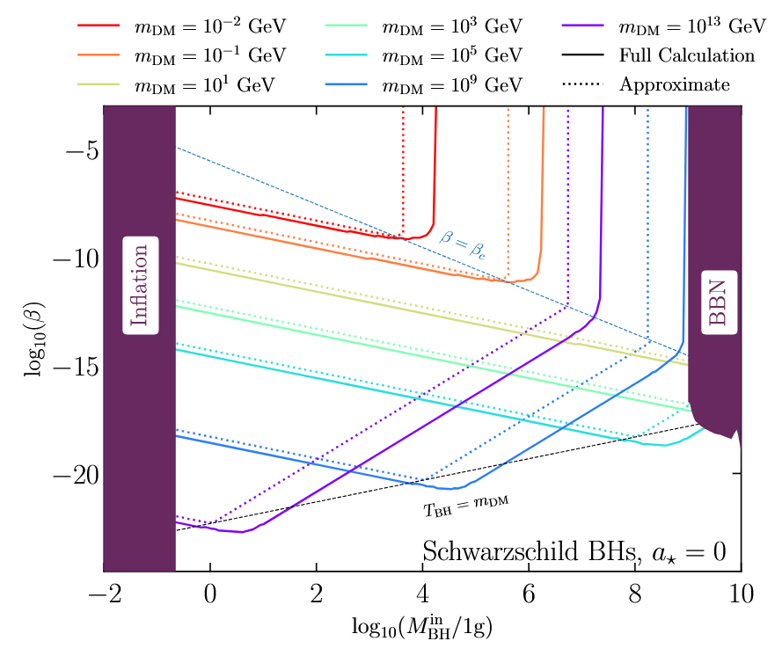

PBH as the only source of dark matter
Dark matter does not interact with the Standard Model
(only coupled to gravity)
Andrew Cheek, Lucien Heurtier, Yuber F. Perez-Gonzalez, and Jessica Turner Phys. Rev. D 105, 015023 (2022)

Slide 19
PBH as the only source of dark matter
Dark matter does not interact with the Standard Model
(only coupled to gravity)
PBH are usually taken as an extra independent source of dark matter
Andrew Cheek, Lucien Heurtier, Yuber F. Perez-Gonzalez, and Jessica Turner Phys. Rev. D 105, 015023 (2022)

Slide 20

PBH as the only source of dark matter
Dark matter does not interact with the Standard Model
(only coupled to gravity)
PBH are usually taken as an extra independent source of dark matter
Andrew Cheek, Lucien Heurtier, Yuber F. Perez-Gonzalez, and Jessica Turner Phys. Rev. D 105, 015023 (2022)

Slide 21

Hotspot and thermal equilibrium dark matter

Slide 22
Hotspot and thermal equilibrium dark matter

Slide 23

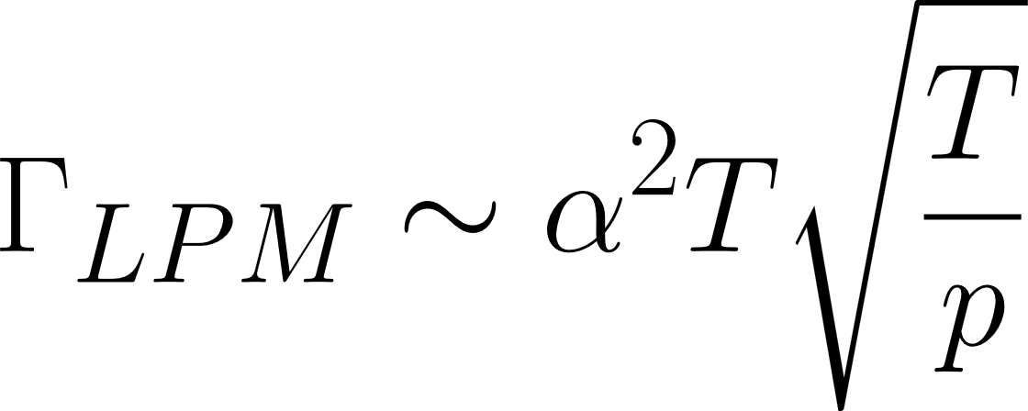
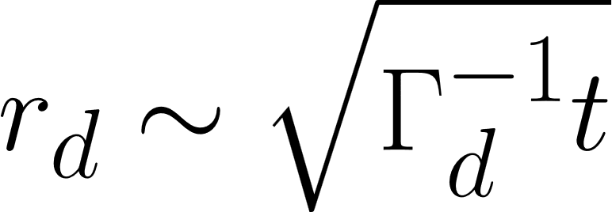
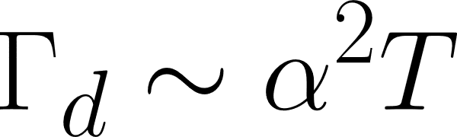


PBH hotspot
Plasma
Energy deposition model:
Plasma
Difusion:
We will take :

Slide 24
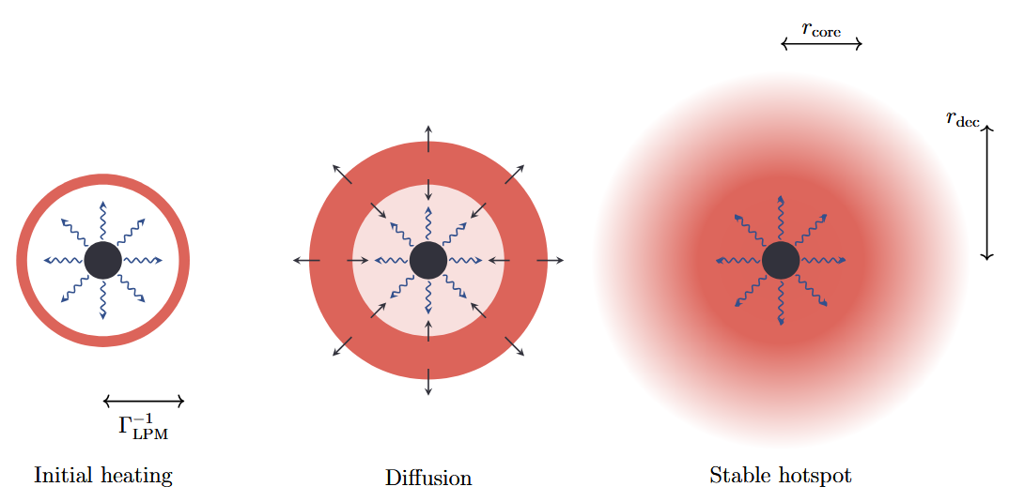
PBH hotspot

Slide 25
PBH hotspot
The hotspot will be sustained until evaporation

Slide 26
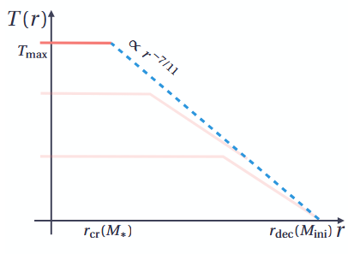

Temperature profile at evaporation
At evaporation the maximal temperature is independant on the PBH mass!

Slide 27
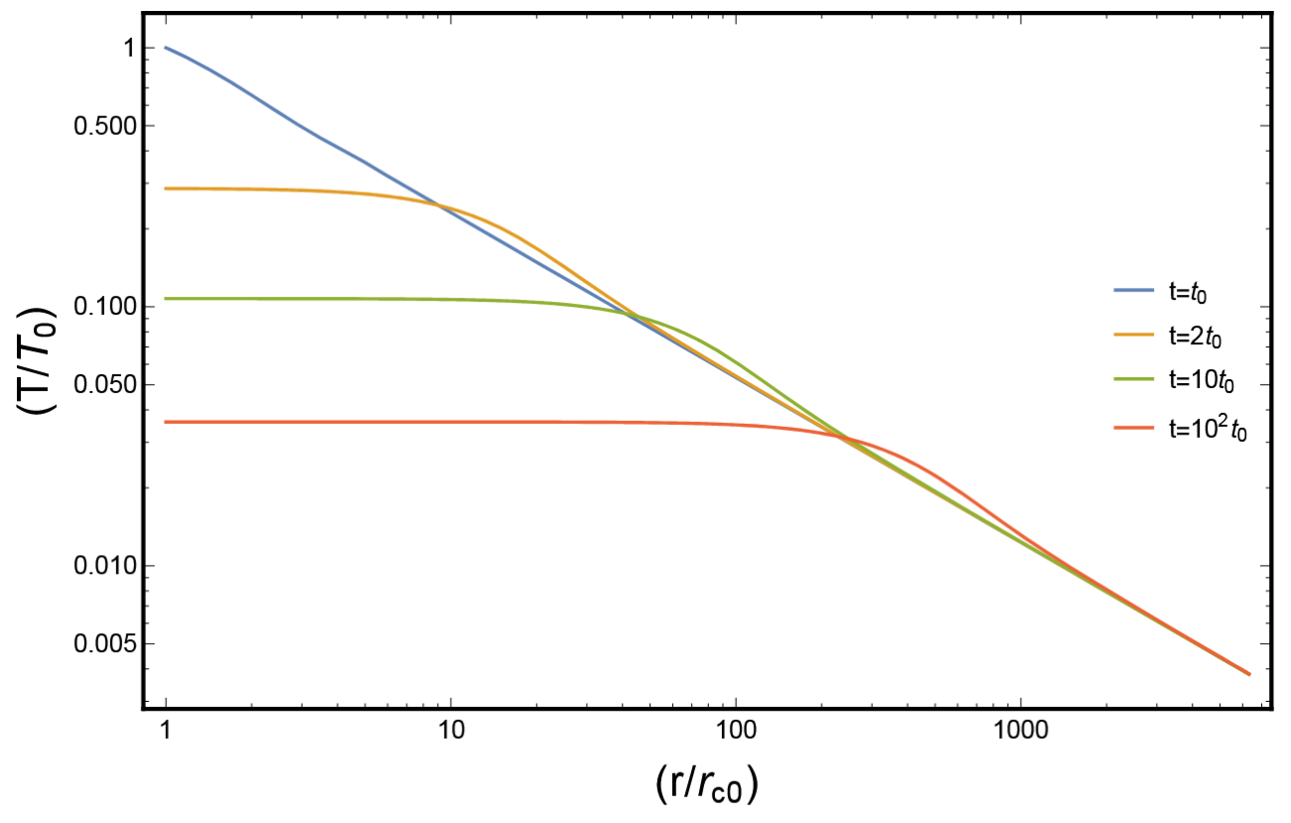


Hotspot cooling
Das, S., Hook, A. J. High Energ. Phys. 2021, 145 (2021)

Slide 28
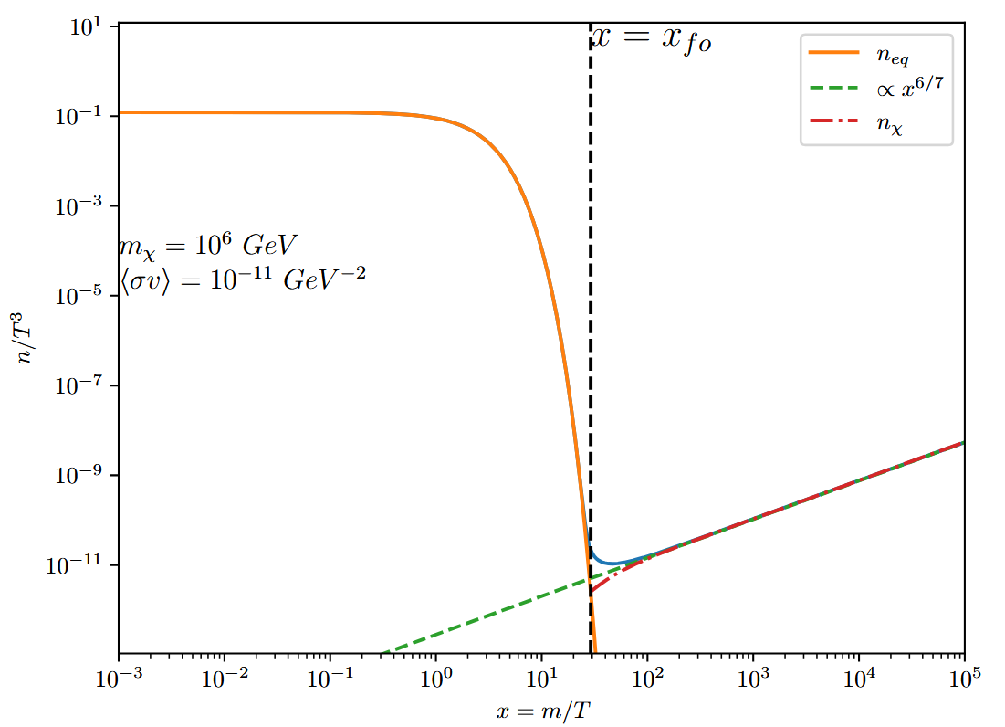
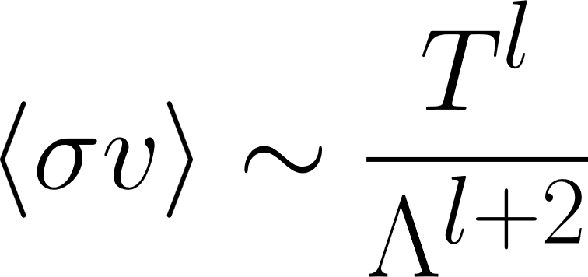

Freeze-out in the hotspot

Slide 29
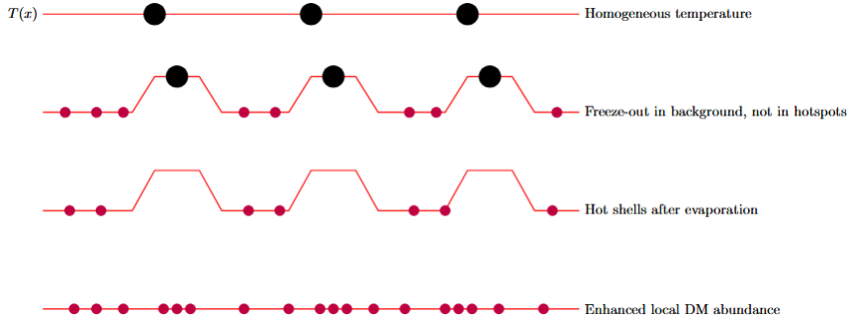
Dark matter timeline

Slide 30
Dark matter timeline

Slide 31
Dark matter timeline

Slide 32
Dark matter timeline

Slide 33
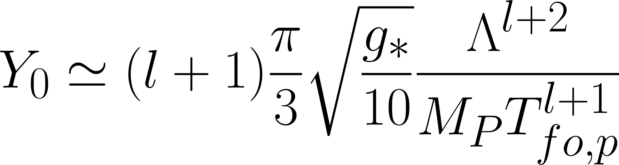
Impact on a preproduced abundance
Dark matter freeze out in the background
Initial dark matter production:

Slide 34
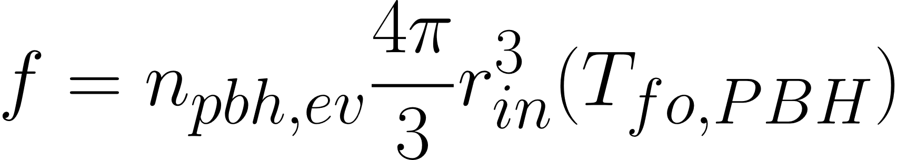

Impact on a preproduced abundance
Dark matter freeze out in the background
Initial dark matter production:
A fraction of the universe is still hot:
Hotspot generates hot region with DM in equilibrium

Slide 35
Impact on a preproduced abundance
Dark matter freeze out in the background
Initial dark matter production:
A fraction of the universe is still hot:
Hotspot generates hot region with DM in equilibrium
In those patch, the dark matter is brought back to thermal equilibrium implying:
A second freeze-out is induced by hotspot cooling

Slide 36
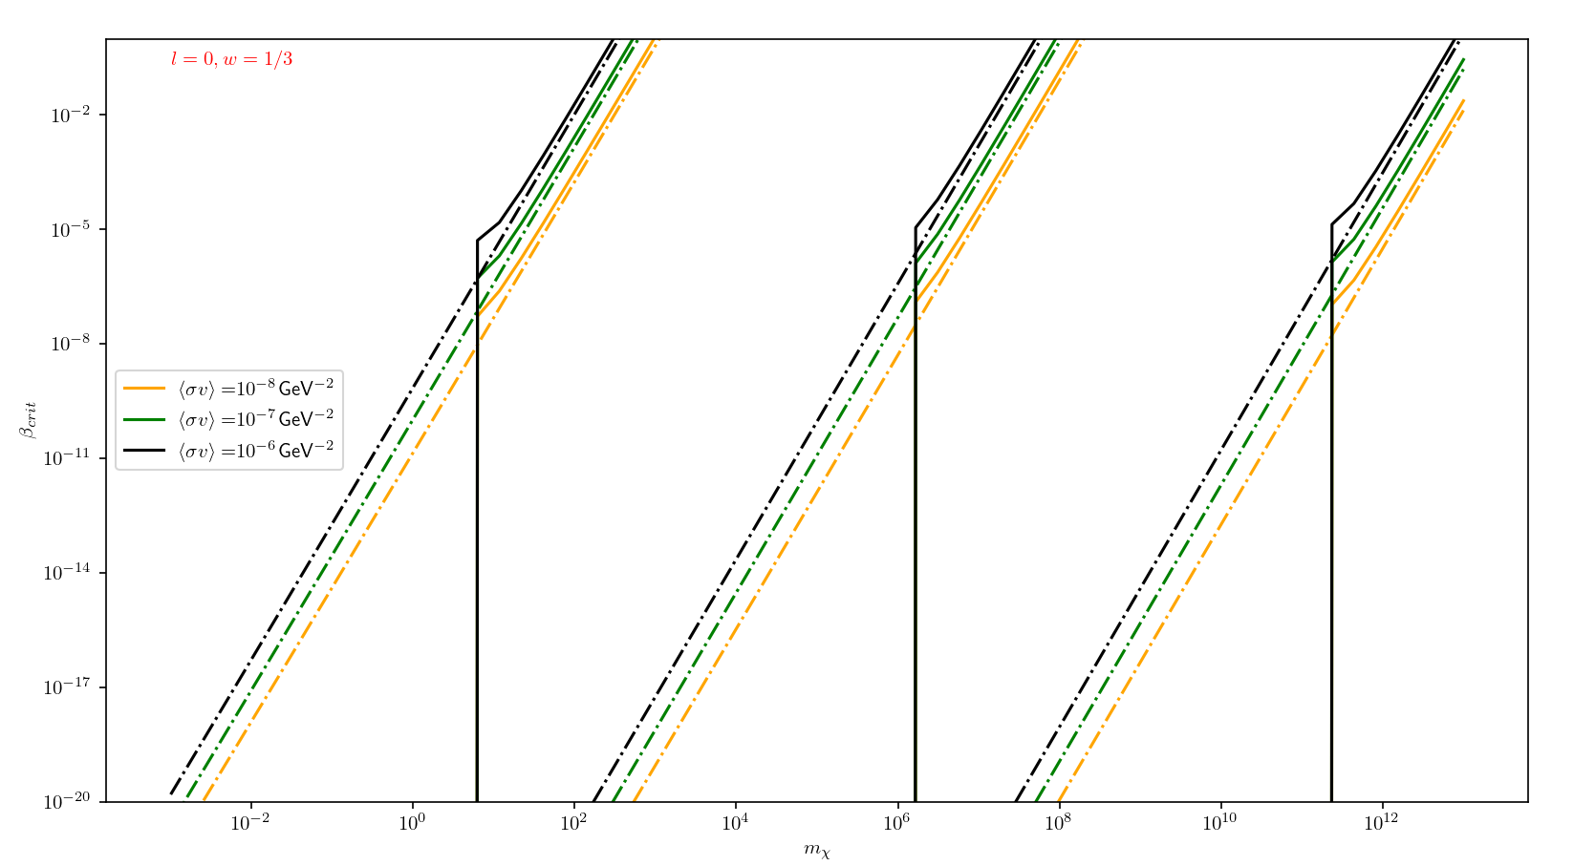



Producing the right relic abundance

Slide 37
Conclusion
1) PBH can be formed in many different scenarios
2) Depending on their mass, they can be (part) of the dark matter or contribute to its sourcing
3) PBH can induce a local hotspot, which enhances DM production (incompatibility with WIMP).

Slide 38
Thank you!

Slide 39
Backup

Slide 40
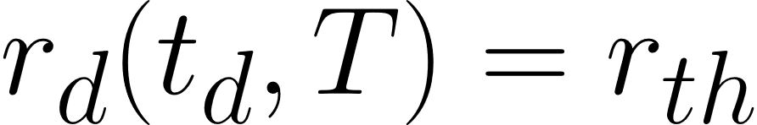
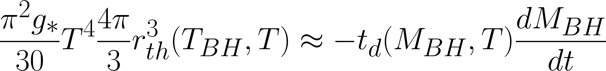
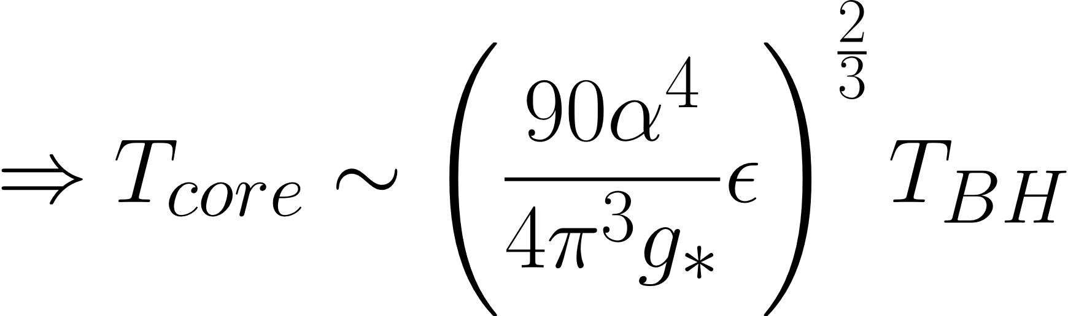
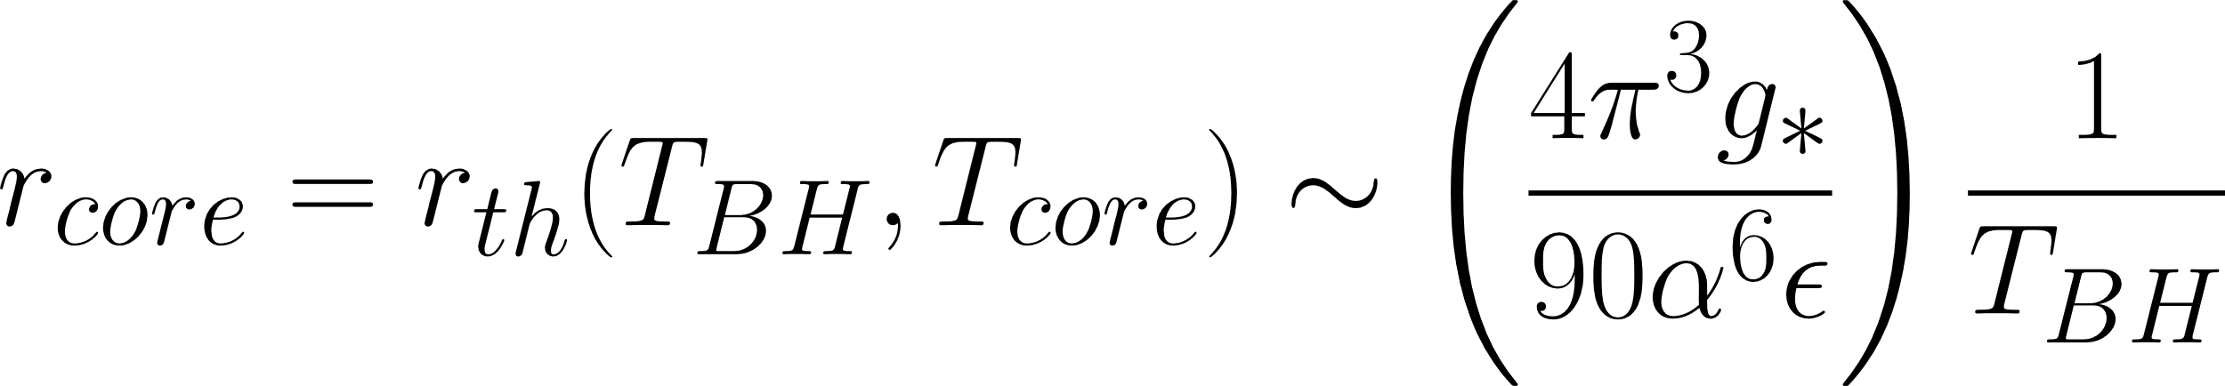
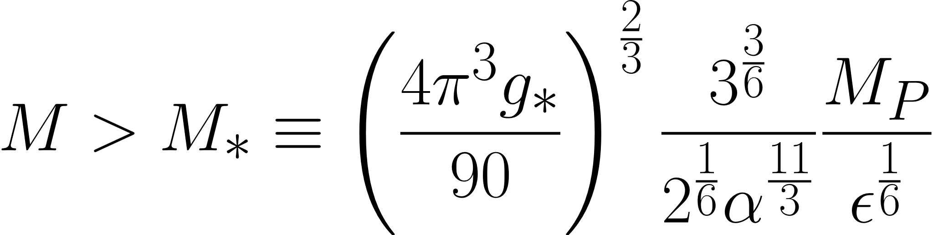
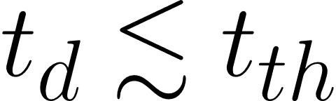
PBH hotspot
Define a difusion time:
For a stable hotspot to form we require :
Size of the central homogeneous patch:
Difusion generates a homogeneous central region until:

Slide 41
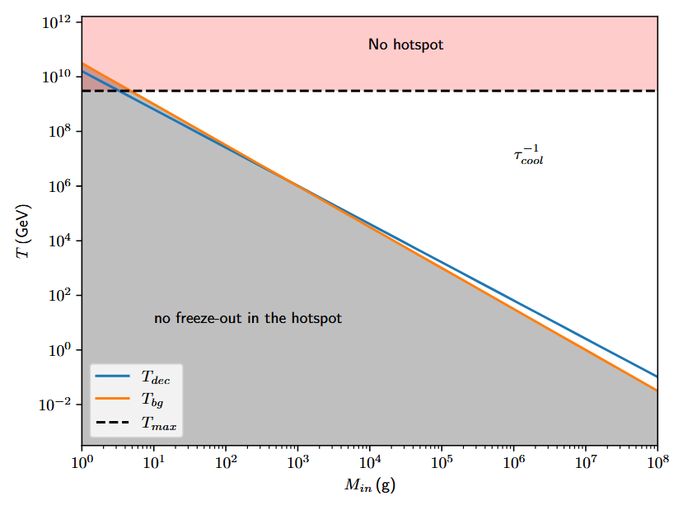
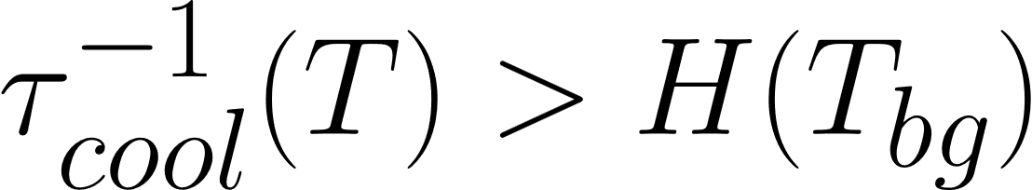
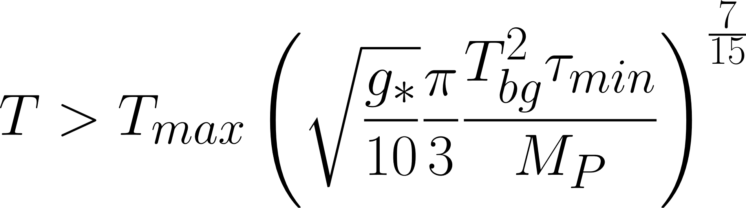

Freeze-out in the hotspot
Hotspot freeze-out imply:

Slide 42
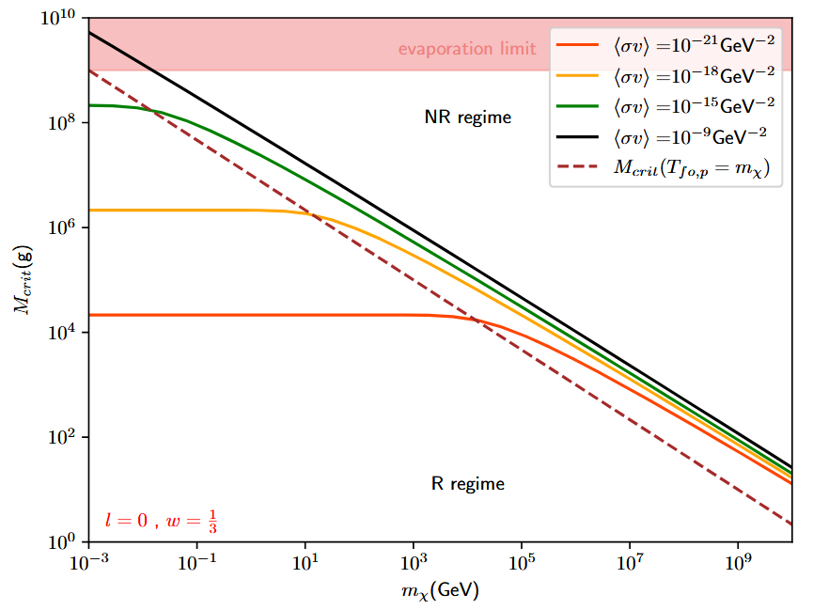
Freeze-out in the hotspot
Can PBH evaporate after background freeze-out?
Relativistic Freeze-out
Non relativistic Freeze-out

