Slide 1
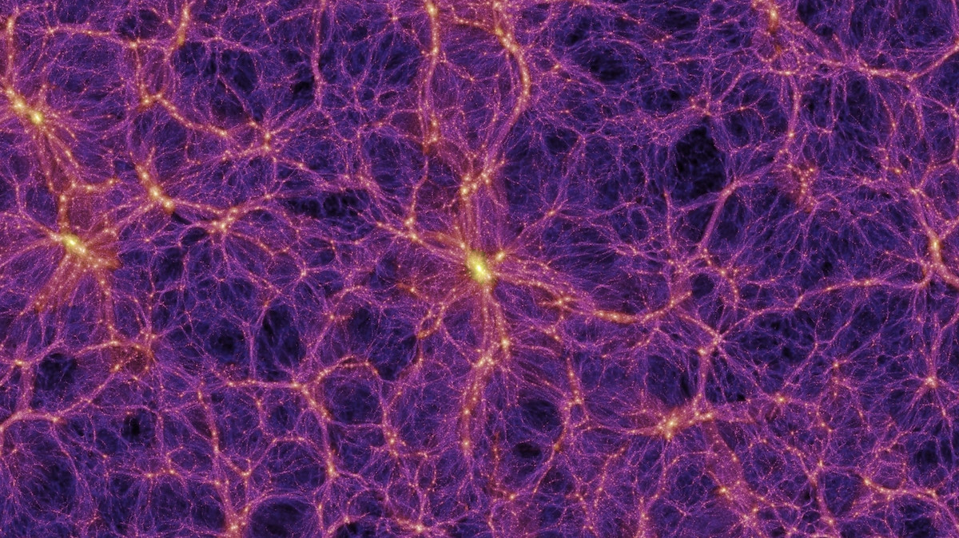



Direct Dark Matter Research :
The Damic-M* experiment
MELLOUKI Issam-Eddine
* DArk Matter In CCDs at Modane

Slide 2
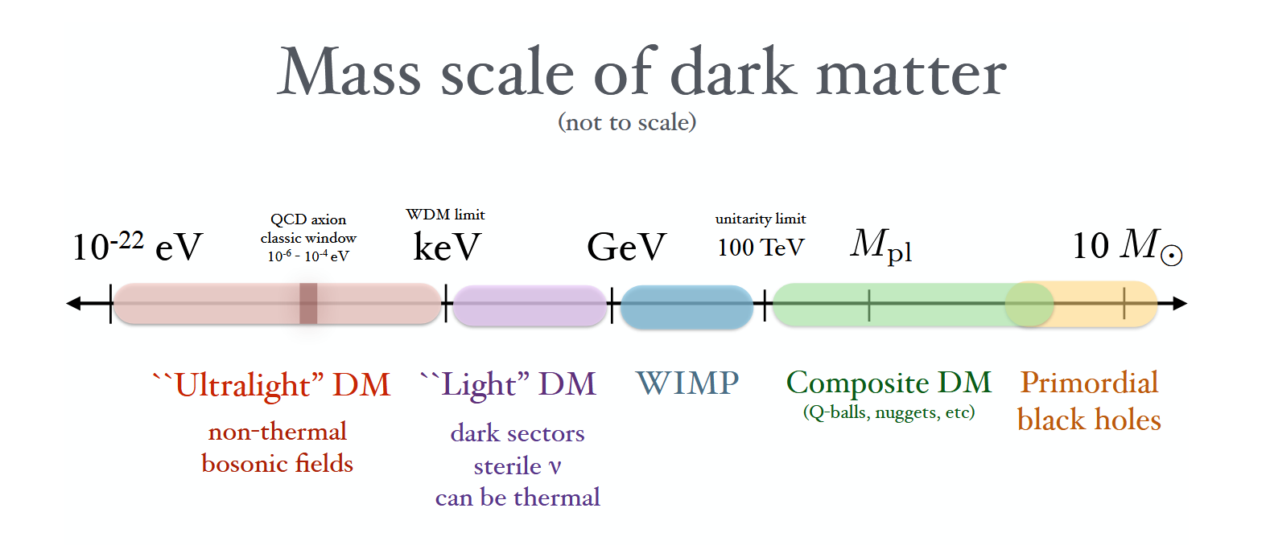
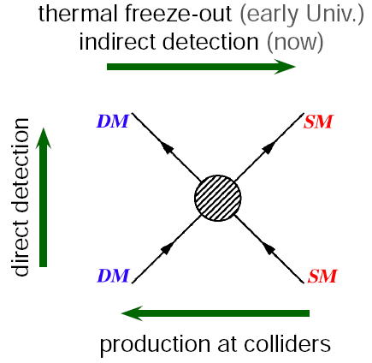
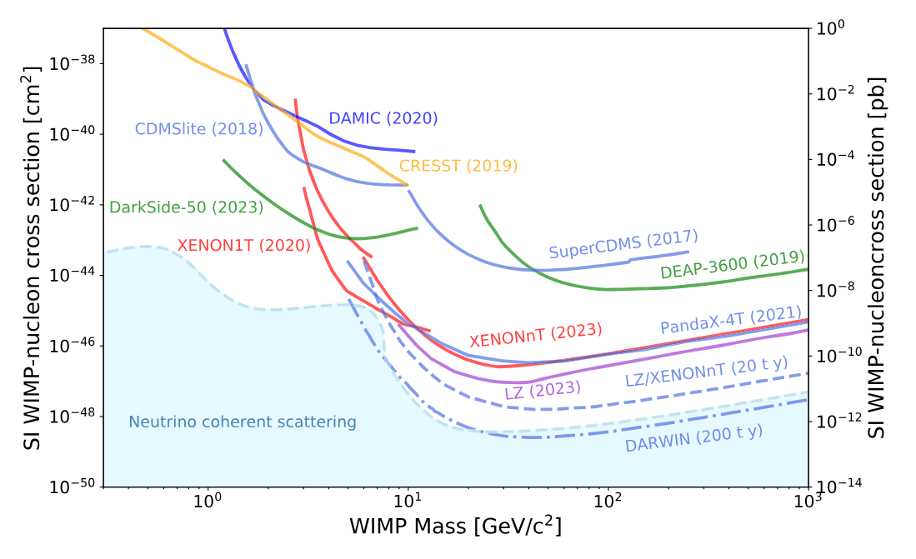
Detection of particles produced by the annihilation of SM particles
T. Lin, arxiv:1904.07915
WIMP Waning, Nearly Excluded
Search for missing transverse energy
Detection of electronic/nuclear recoils

Slide 3
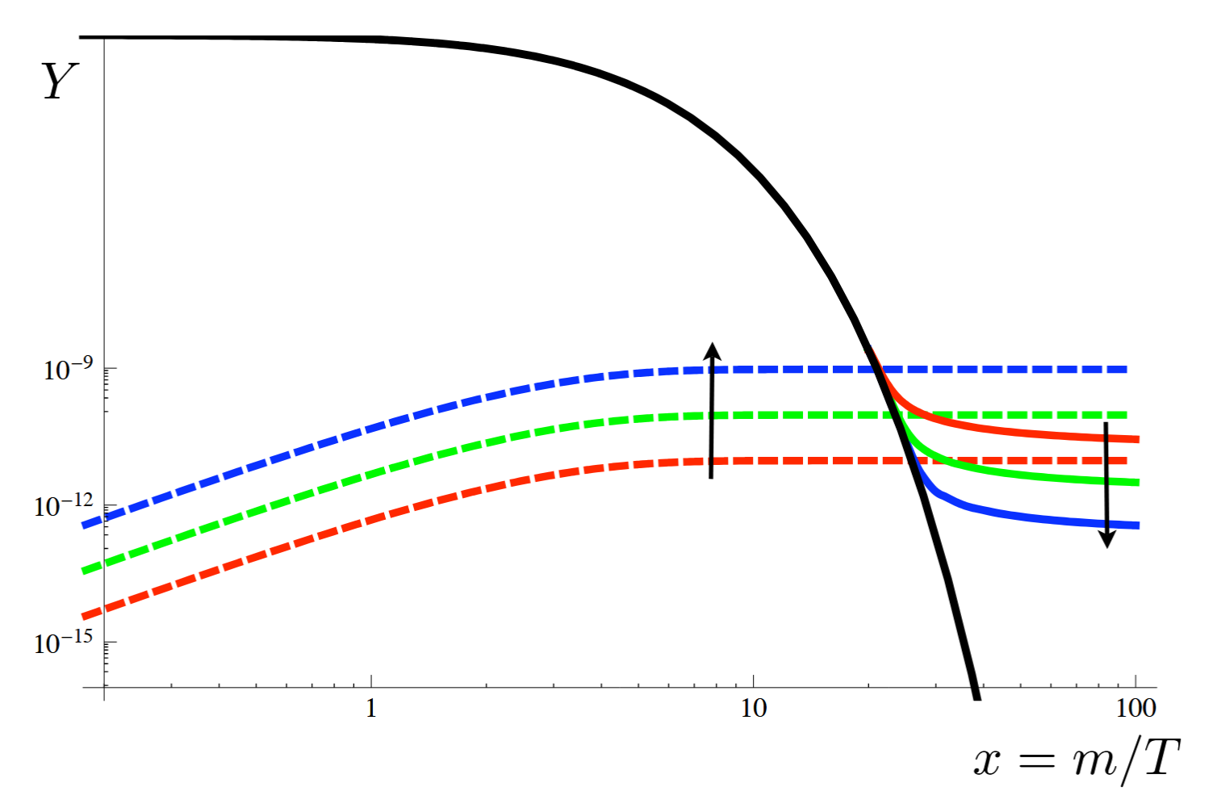
Dark Matter production scenarios
Freeze-out
Freeze-in
Production scenarios :
  Freeze-in/out
  Gravitational
  Etc.
Freeze-out :
  Dark Matter in thermal equilibrium in early universe
Freeze-in assumption :
  No Dark Matter in the primordial plasma
  Production from thermal bath species over time
arXiv:0911.1120

Slide 4
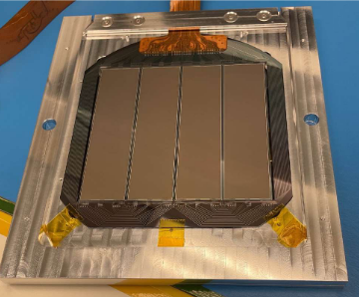
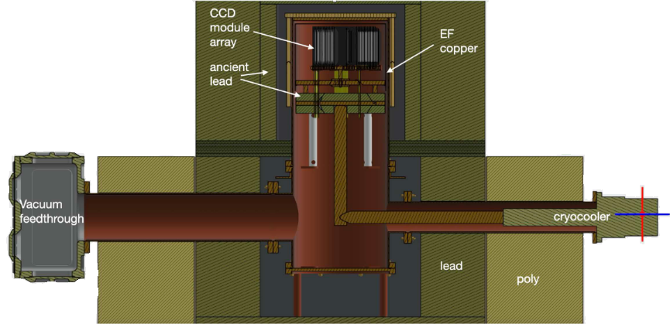
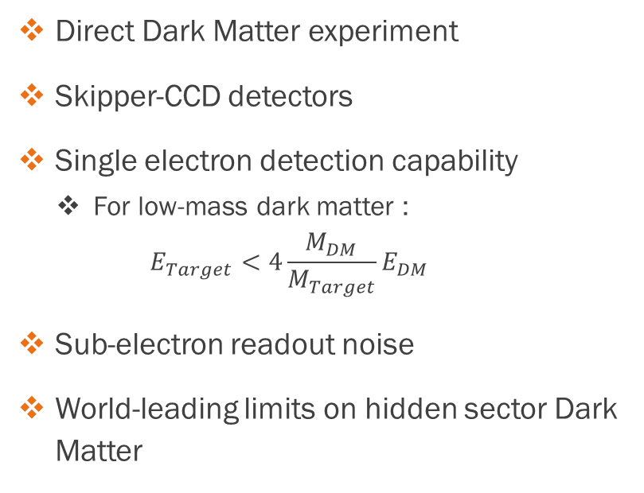
Damic-M in Dark Matter research
Direct Dark Matter experiment
Skipper-CCD detectors
Single electron detection capability
  For low-mass dark matter :
    $$E_{Target}<4\frac{M_{DM}}{M_{Target}}E_{DM}$$
Sub-electron readout noise
World-leading limits on hidden sector Dark Matter
Alvaro E. Chavarria, “The search for dark matterwith DAMIC-M”

Slide 5
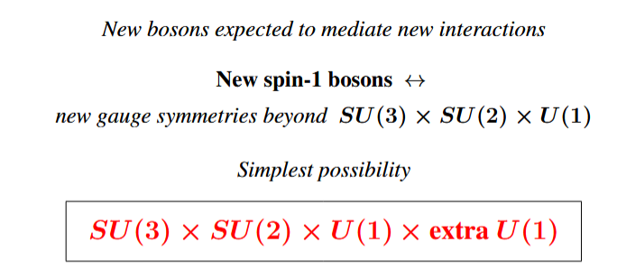
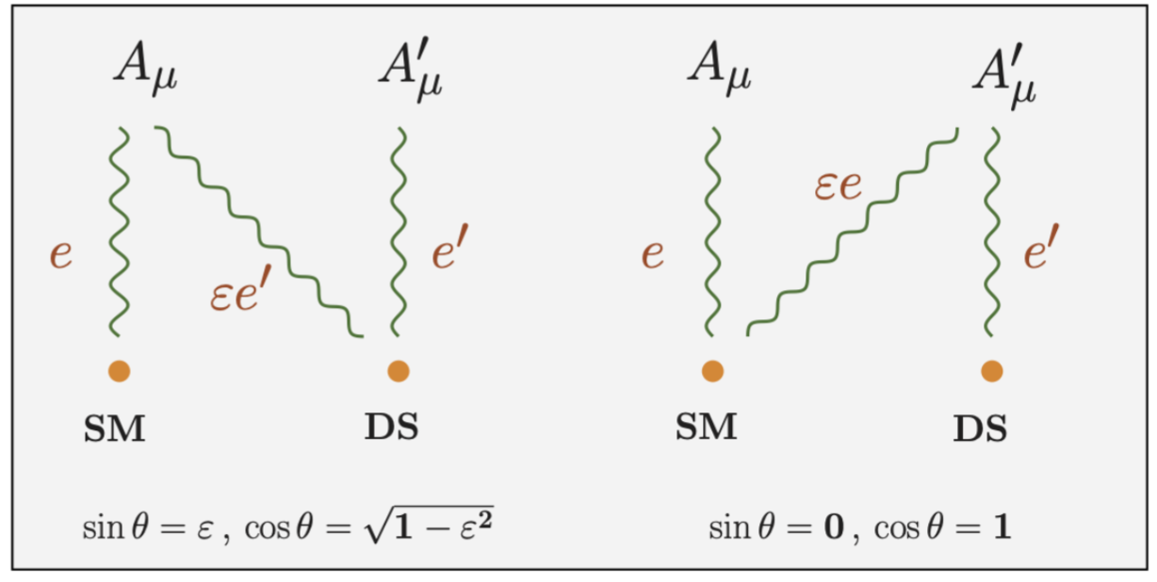
Dark Sector Theory
The SM is not complete (neutrino, dark matter, …)
New Interactions may exist !
Simple natural extension of the Standard Model : new U(1) symmetry
New gauge boson which can be :
  Analogous to the photon
  Analogous to the Z boson with V-A structure
Leads to MeV-scale Dark Matter
Pierre FAYET, “The U BOSON as a generalized DARK PHOTON”
arXiv:2005.01515

Slide 6
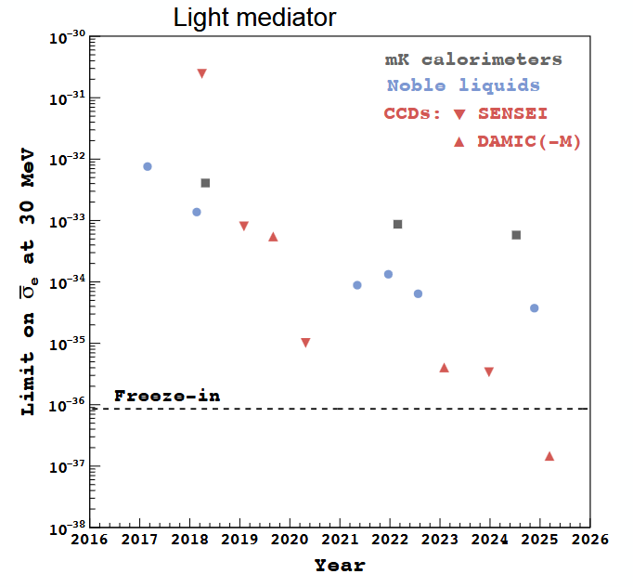
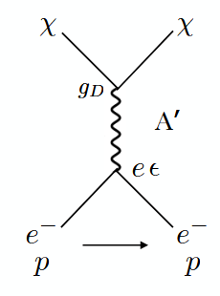
T. Lin, arxiv:1904.07915
MeV
DAMIC-M
Max Planck Institute for Nuclear Physics
Alvaro E. Chavarria, “The search for dark matter with DAMIC-M”

Slide 7
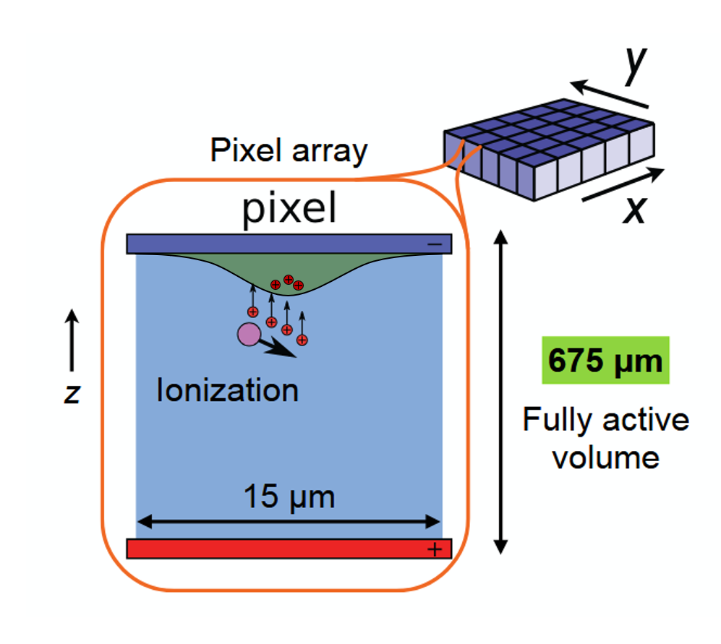
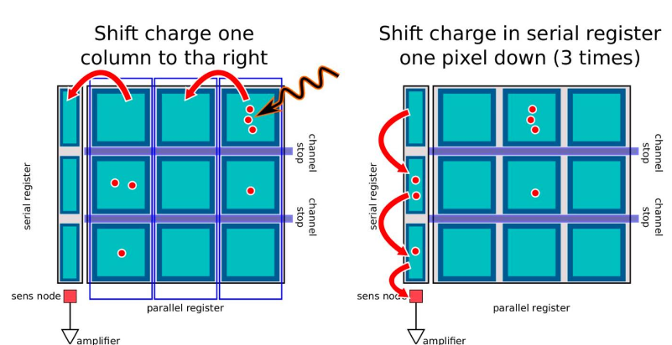
Classical CCDs
interaction ionizes the medium and generates charges
Charges are trapped in potential wells
Then, the charges are moved line by line, pixel by pixel, toward the serial register
Measurment of the charge on each pixel in the sens node

Slide 8
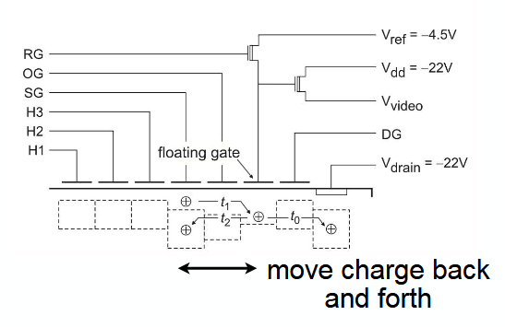
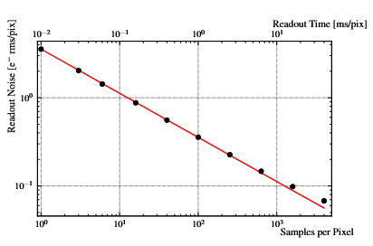
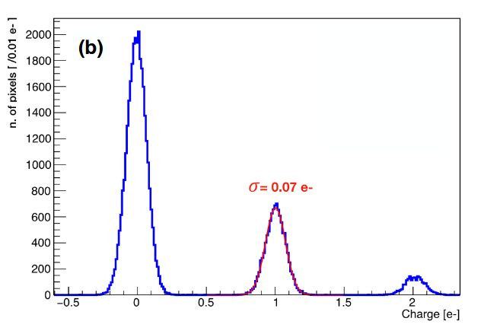

Skipper-CCD
Multiple non-destructive charge measurments
Readout noise divided by $\sqrt{N_{S}}$
  Sub-electron reading noise
Allows us to explore small energy deposits
arxiv:1706.00028

Slide 9
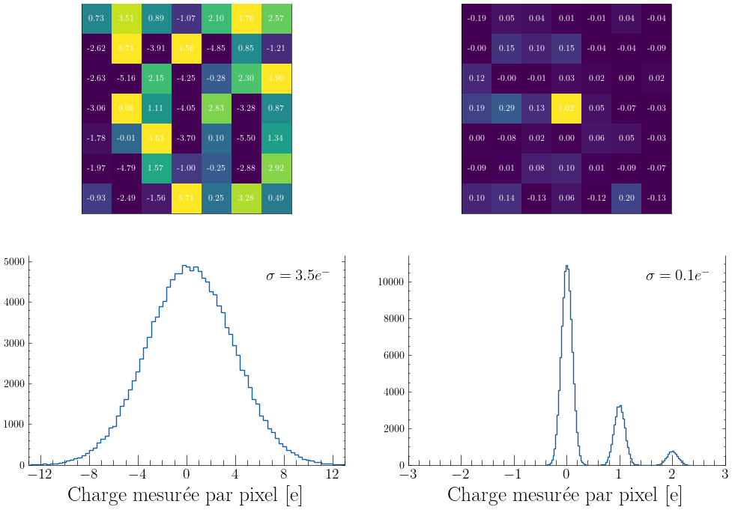

Slide 10
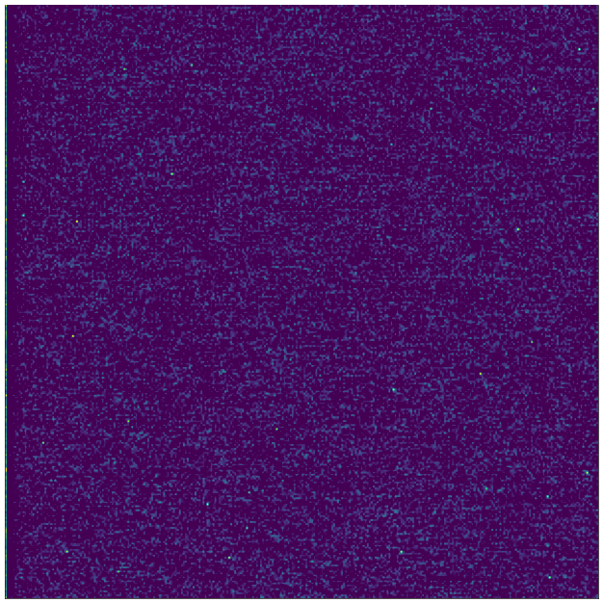
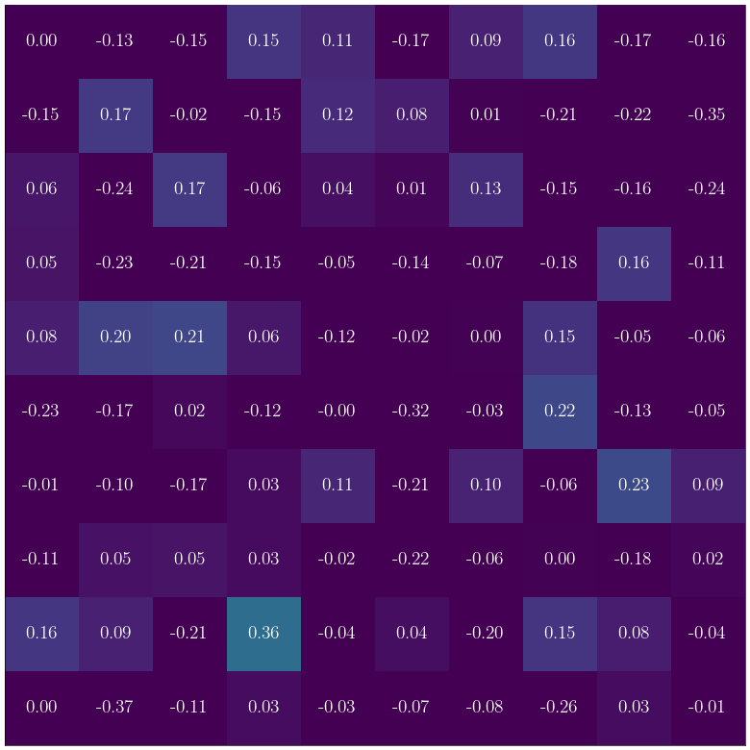
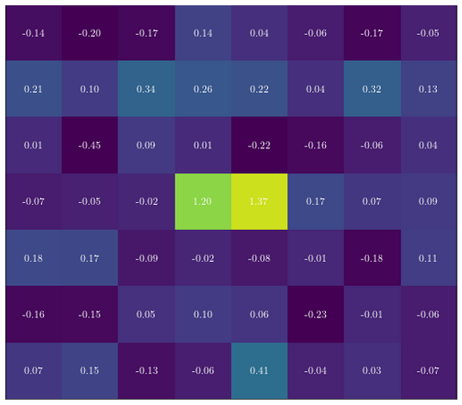

Some informations
CCD mass : ~4g
Images of 6300×1600 pixels taken every 1668 seconds
Pixel size :
  15 μm ×15 μm
  675 μm thick
DAMIC-M readout noise : $σ\sim 0.17e^{−}$
In comparison :
  Euclid space telescope : $σ≤4.5e^{−}$
  3.2-Gigapixel LSST : $σ≤6e^{−}$
DAMIC-M LBC (2025):
  4 CCDs for ~1.3 kg-day exposure
DAMIC-M (2026-202X)
  ~80 CCDs with better bkg/noise

Slide 11
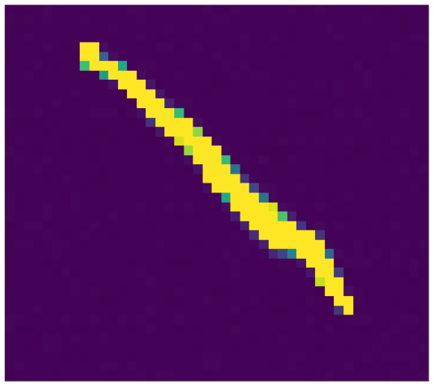

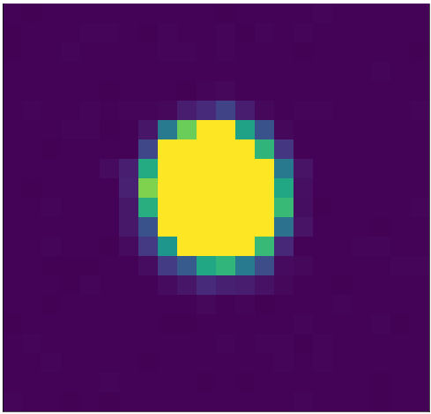
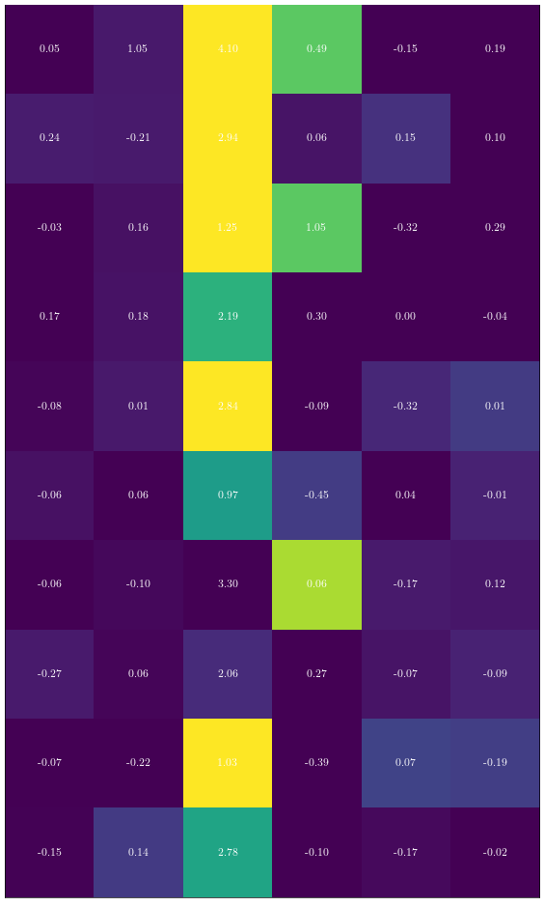

Data Analysis
Contamination sources :
  Astroparticles
  Radioactivity
  Defects generating charges continuously
  Charge transfer inneficiency (CTI)
  Infrared light
  Etc.
Pixel selection :
  Hot region (large $1e^{−}$ rate)
  Clusters of high-charge pixels ($>5e^{−}$ )
  Line/column multiplicity
  Etc.
  ~90% of data are kept

Slide 12
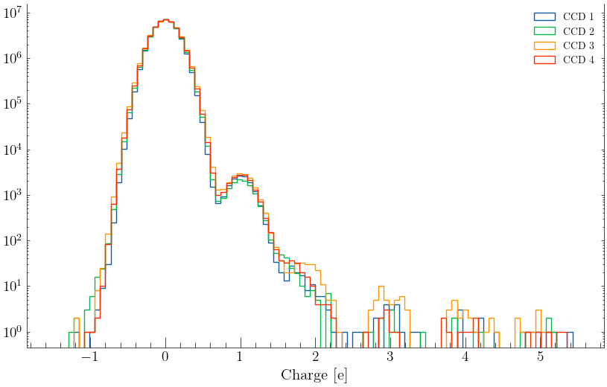
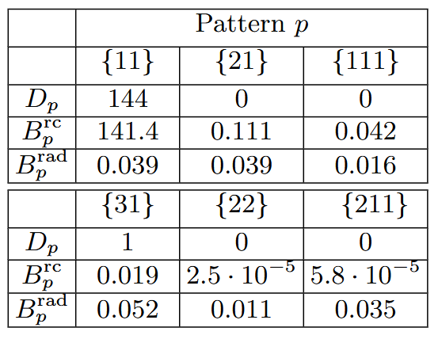




Pattern Event Research: Predictions vs Observations for
DAMIC-M LBC
$$λ=\frac{P(1)}{P(0)}\sim 3.{10}^{−4}$$
$$P\left(k\right)=\frac{λ^{k}}{k!}e^{−λ}$$
The Dark Current (DC) is poissonian
Need to find the $λ$ for the Dark Current to calculate the expected number of events ($B_{p}^{rc}$, $B_{p}^{rad}$)
Comparison with observed events ($D_{p}$):
  Background is compatible with observations
  No evidence for Dark Matter
$$B_{p}^{rc}\left(\left\{11\right\}\right)=N_{pixel, tot}×P\left(1\right)²$$
arXiv:2503.14617

Slide 13
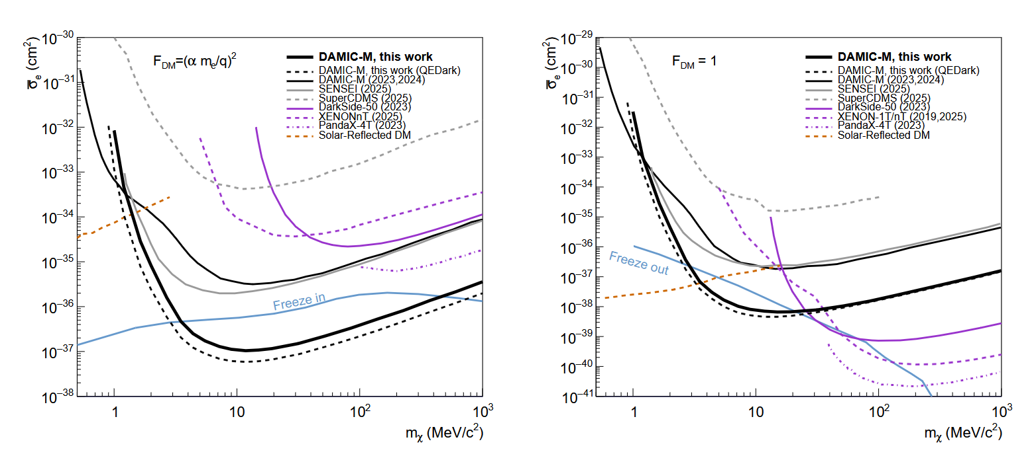
arXiv:2503.14617 : Probing Benchmark Models of Hidden-Sector Dark Matter with DAMIC-M (2025)

Slide 14
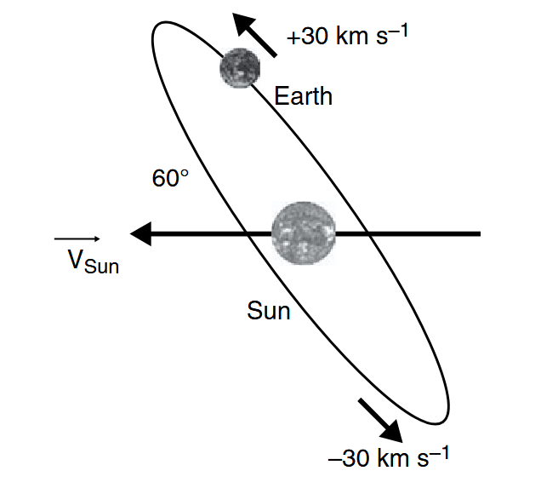
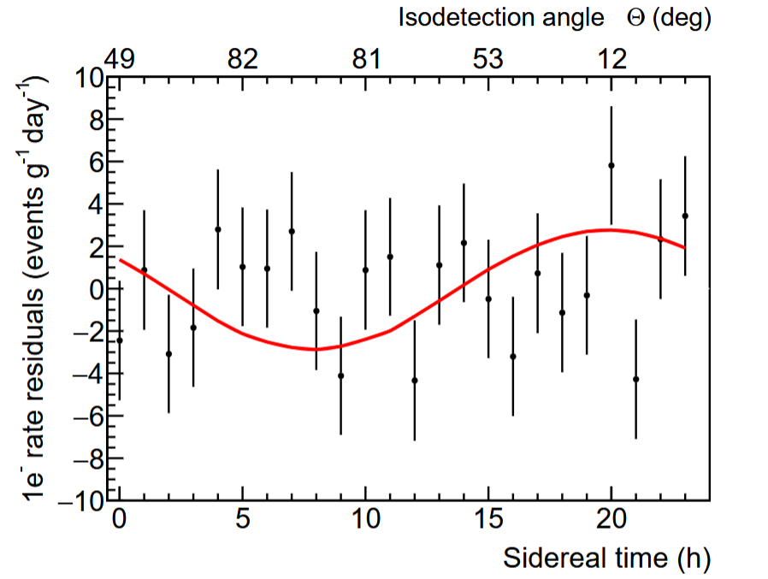
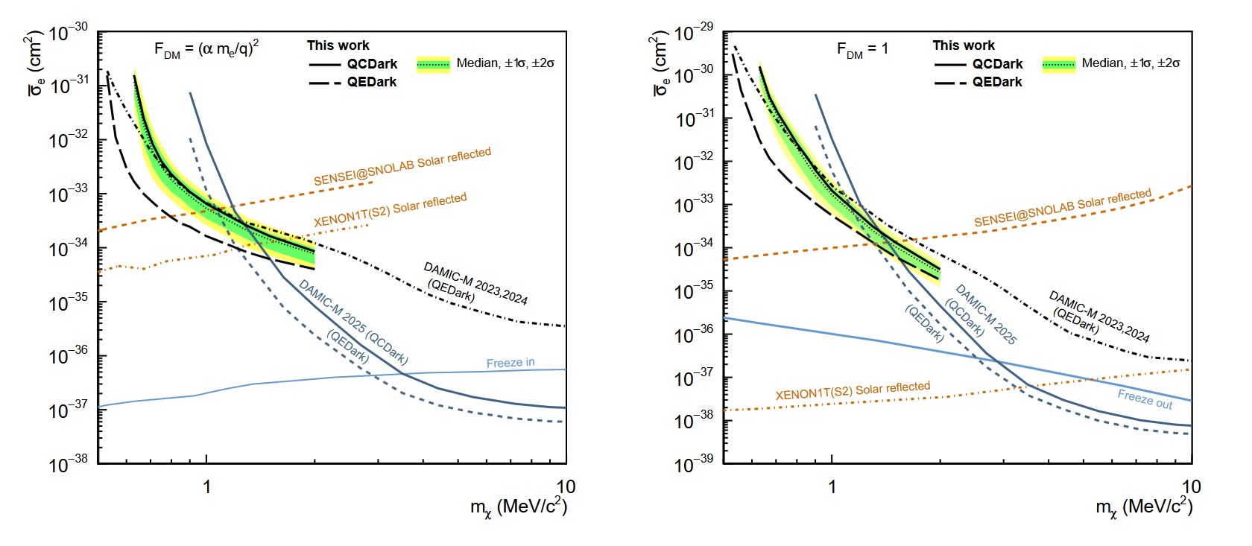
Daily Modulation
Attenuation of the event rate while crossing the Earth
Signal modulated by Earth’s rotation
Can be used to improve the constraints
arXiv:2511.13962

Slide 15

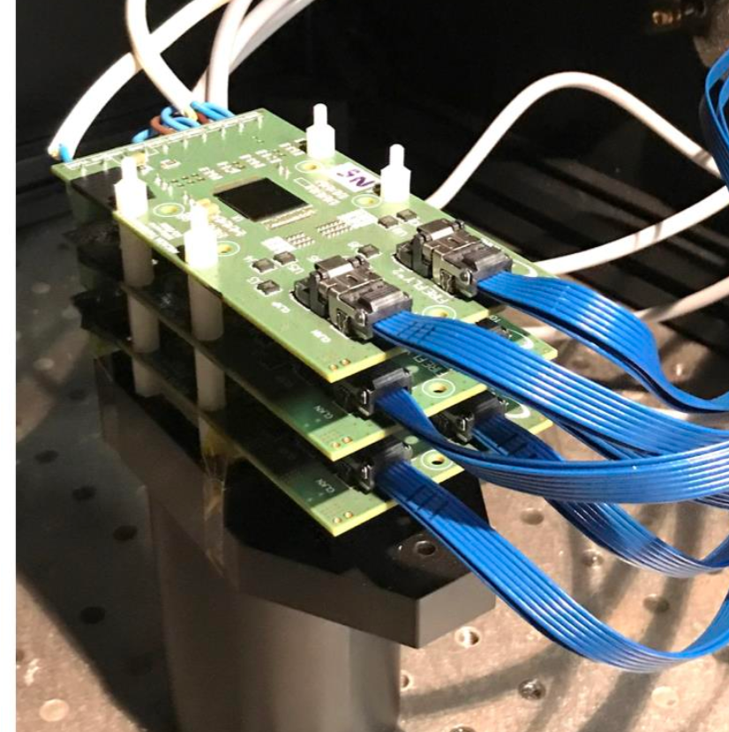
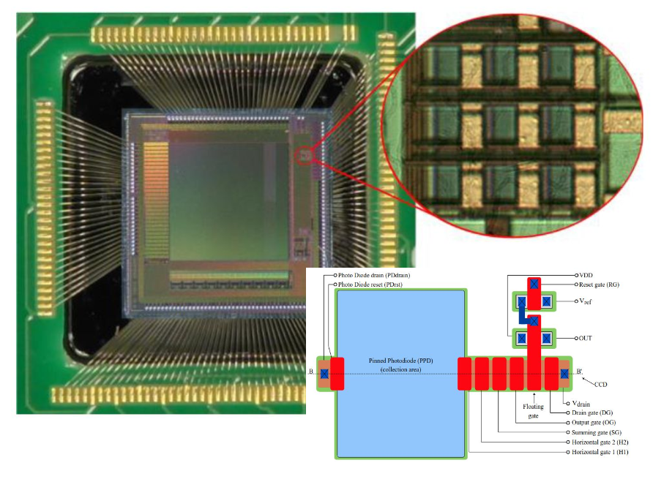
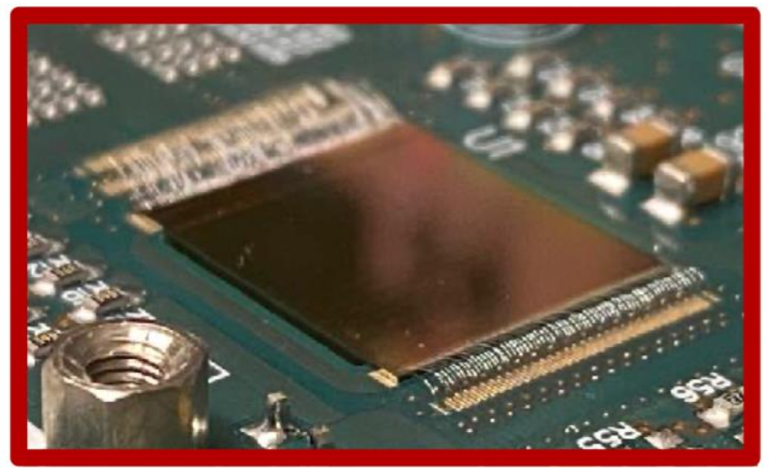

Skipper-CMOS
Taking images with Skipper-CCD can be long
Skipper-CMOS are ${10}^{9}$ times faster !
In developpement here at IJCLab !

Slide 16
Conclusion
The DAMIC-M experiment allows us, for the first time, to probe MeV-scale Dark Matter with remarkable sensitivity
Skipper technology is a powerful tool and may have other interesting applications in physics
Charge-coupled devices are currently among the best detectors for MeV-scale direct Dark Matter searches
Current DAMIC-M LBC limits challenge hidden-sector benchmark models
The upcoming full-scale experiment may achieve the first detection of Dark Matter

Slide 17
Annex

Slide 18
Skipper technology for other fields
A Cosmological examples

Slide 19
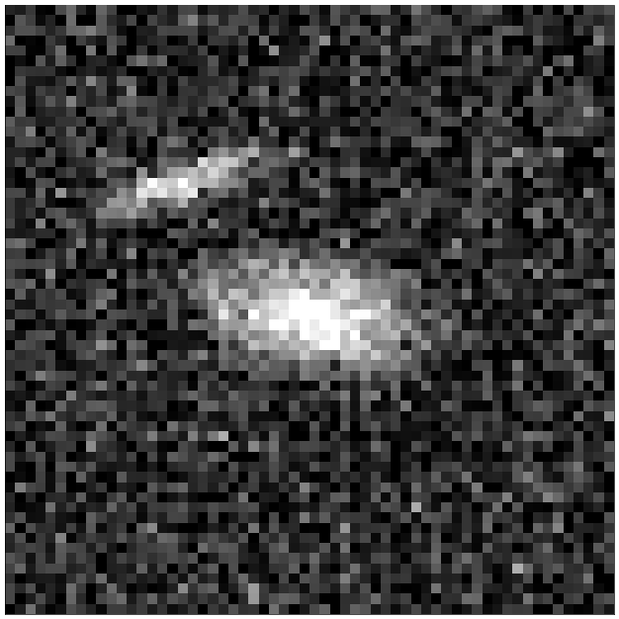

Slide 20
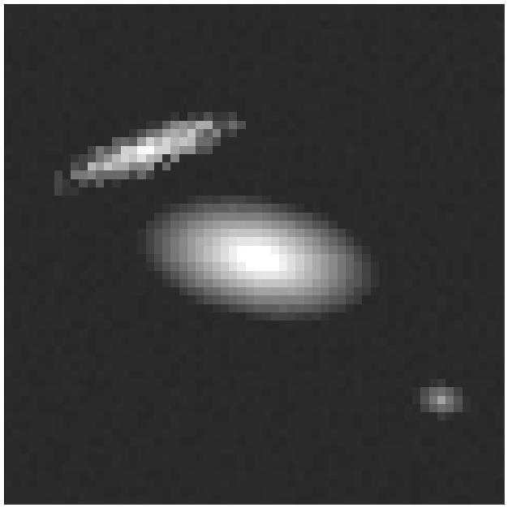

Slide 21
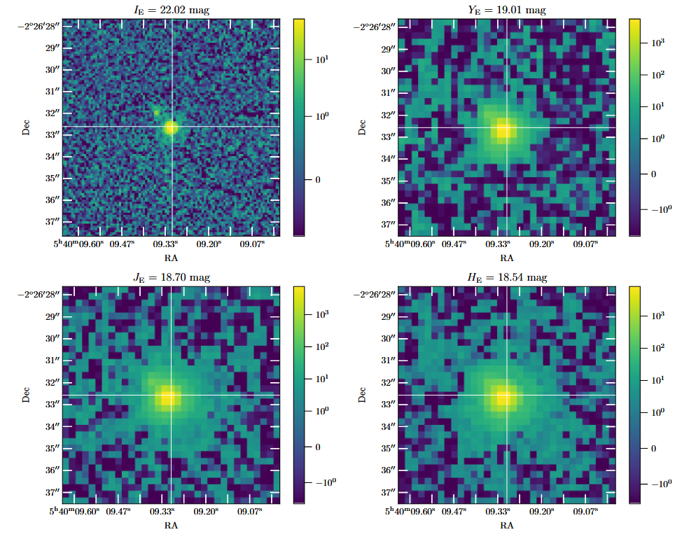
Euclid: Early Release Observations – A glance at free-floating new-born planets in the σ Orionis cluster

Slide 22
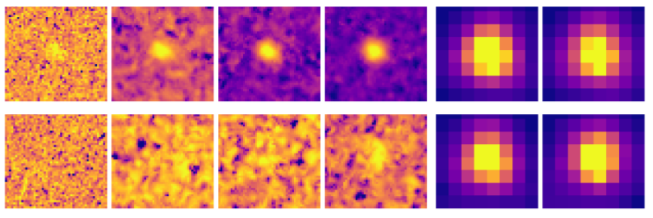
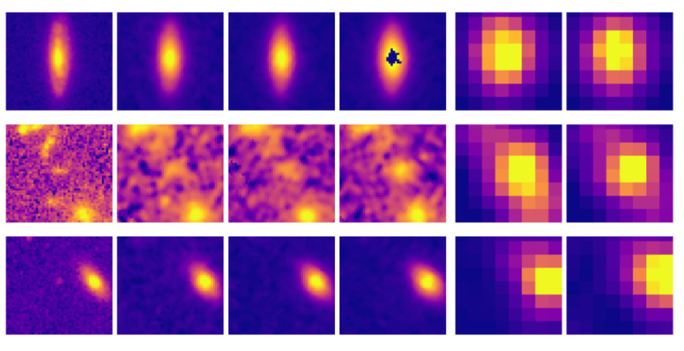
From left to right: IE, YE, JE, HE,
IRAC1, and IRAC2.
Euclid Quick Data Release (Q1) : An investigation of optically faint, red objects in the Euclid Deep Fields (https://arxiv.org/abs/2503.15322)

Slide 23
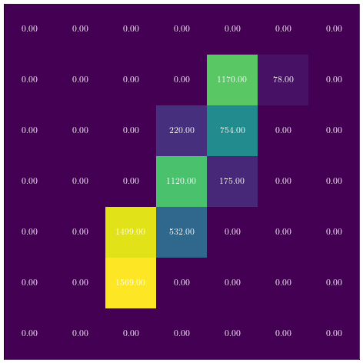
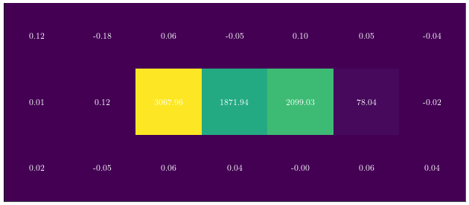

Slide 24
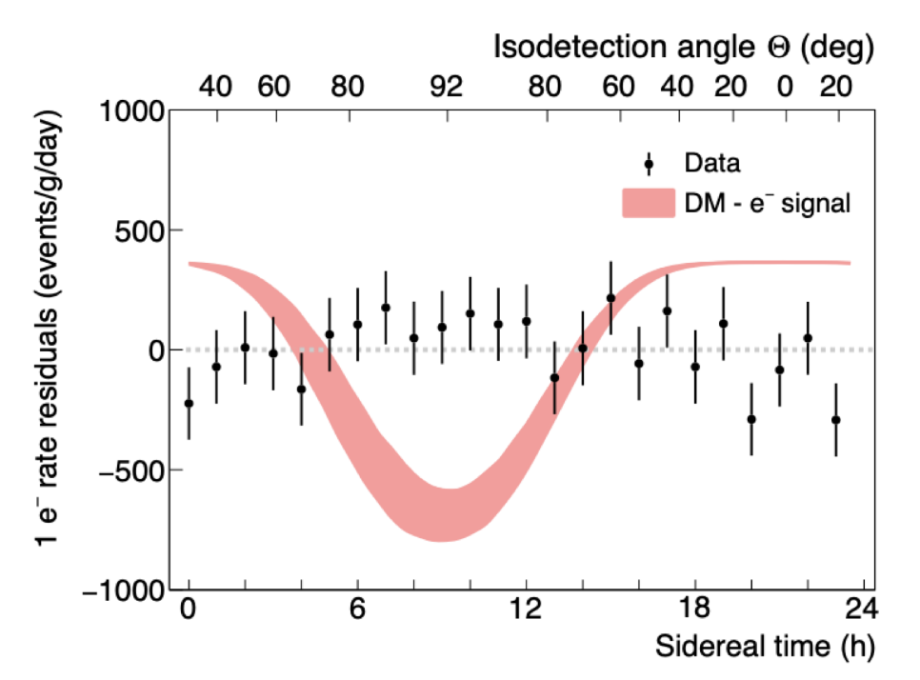
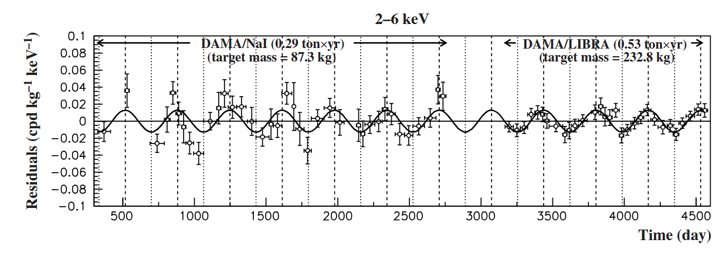

Slide 25
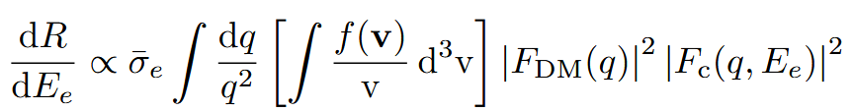
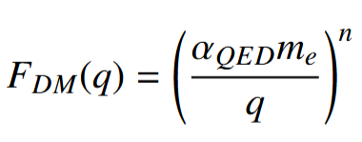
Crystal form factor calculated in QEDark
Dark matter velocity distribution
Differential event rate
Dark matter–electron cross section
Dark matter form factor :

