Slide 1

Dark matter axion search with
CNRS/IN2P3/IJCLab Université Paris-Saclay
Akira Miyazaki, Yoann Kermaidic, Thibaut Houdy on behalf of MADMAX collaboration

Slide 2
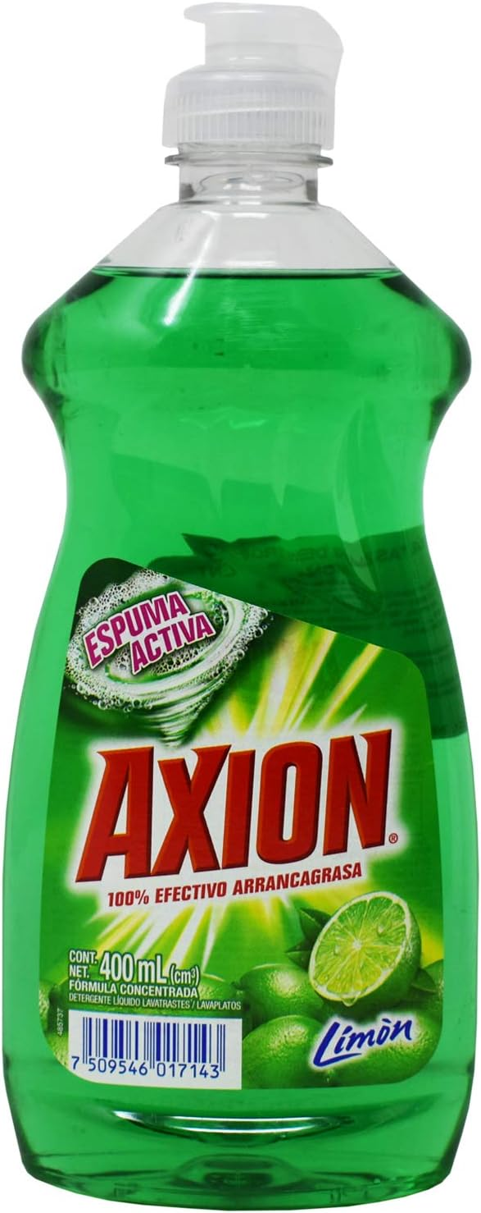
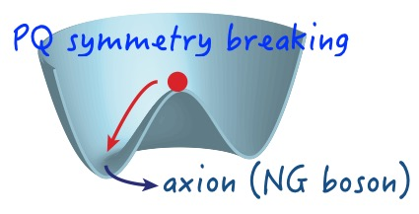
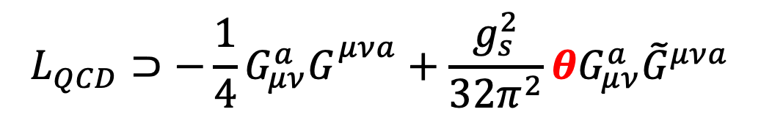
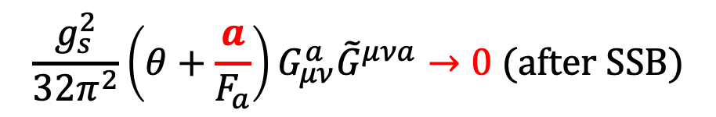
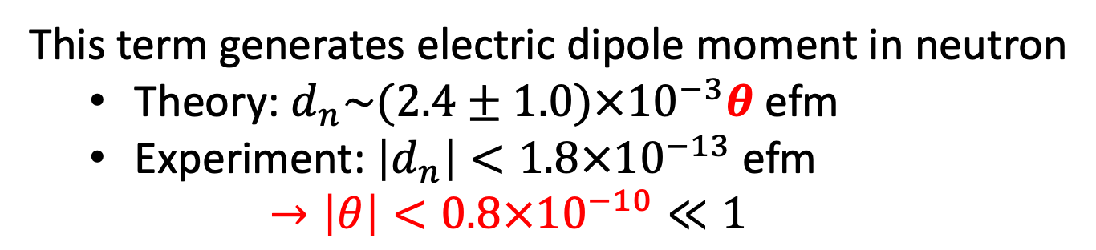
Axions: a byproduct to cancel the strong CP
Quantum Chromodynamics includes
gluons
$$L_{QCD}⊃−\frac{1}{4}G_{μν}^{a}G_{}^{μνa}+\frac{g_{s}^{2}}{32π^{2}}θG_{μν}^{a}{\tilde{G}}^{μνa}$$
This term generates electric dipole moment in neutron
Theory: $d_{n}\sim (2.4±1.0)×{10}^{−3}θ \text{efm}$
Experiment: $\left|d_{n}\right|<1.8×{10}^{−13} \text{efm}$
$$→\left|θ\right|<0.8×{10}^{−10}≪1$$
SciPost Phys. Lect. Notes 45 (2022)
Naturalness problem without anthropic solution
Introduce a new global chiral U(1) (PQ symmetry) field $a$
$$\frac{g_{s}^{2}}{32π^{2}}\left(θ+\frac{a}{F_{a}}\right)G_{μν}^{a}{\tilde{G}}^{μνa}→0 (after SSB)$$
Spontaneous Symmetry Breaking
→ A Nambu-Goldston boson appears as a byproduct = axion

Slide 3
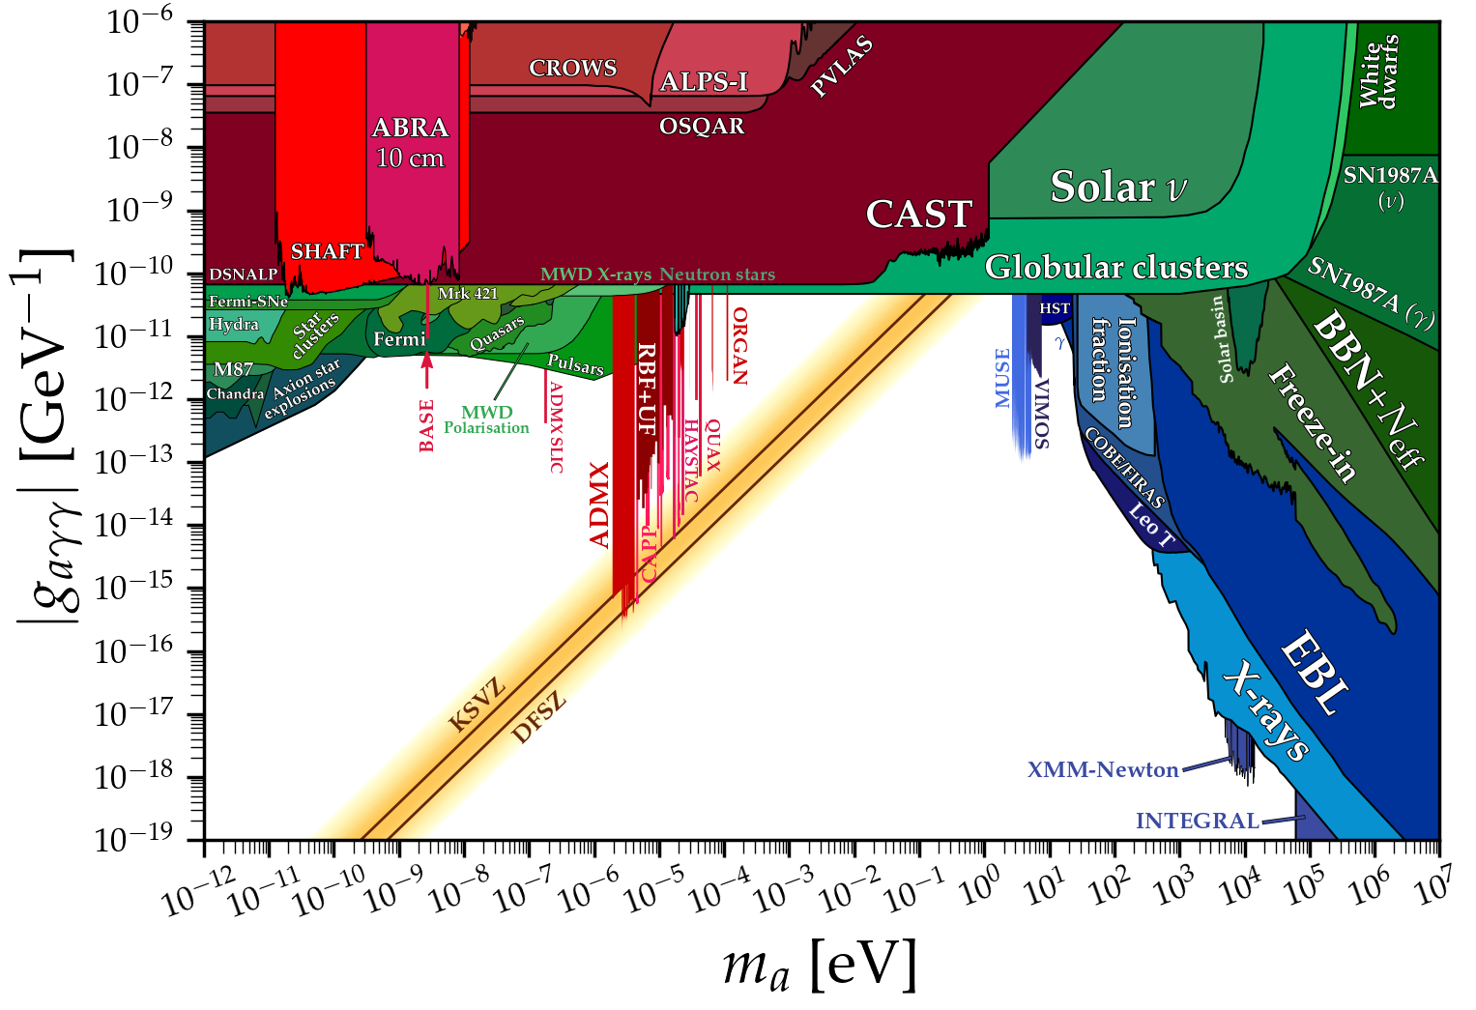
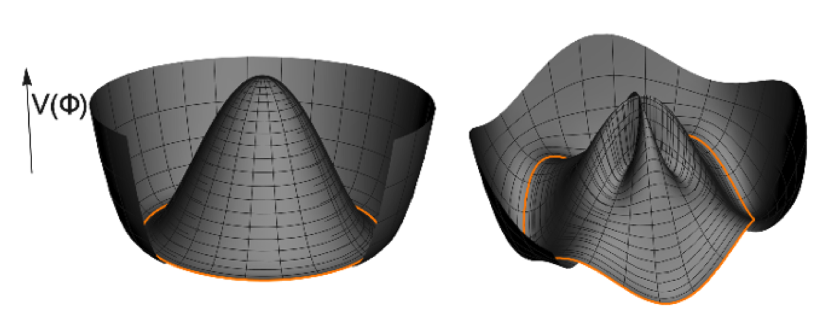
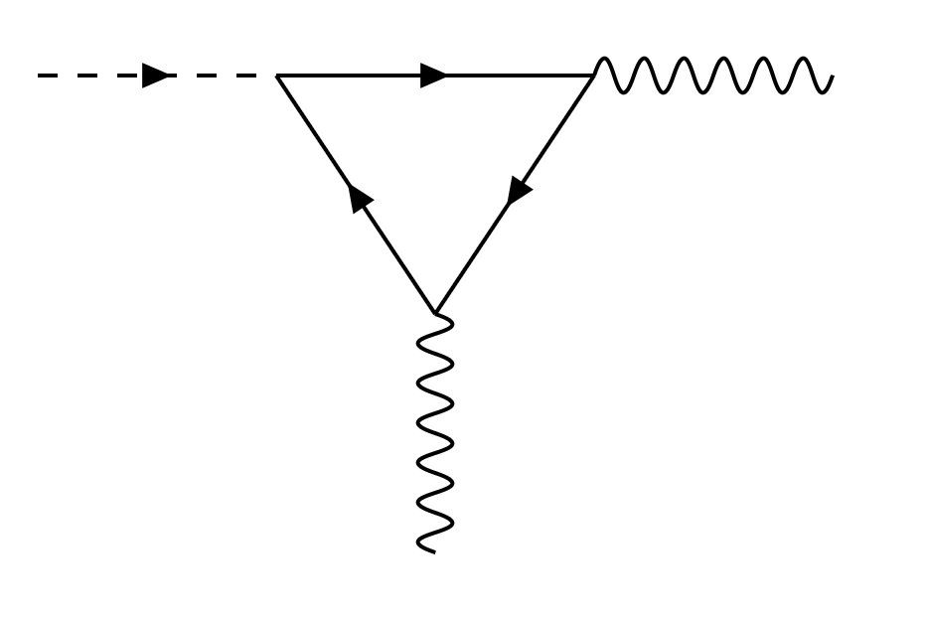
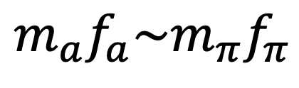
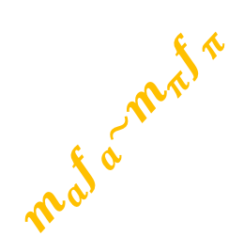
Axion after QCD phase transition
PQ Symmetry is explicitly broken
→ Axion gains (light) mass
F. Chadha-Day, J. Ellis, D. J. E. Marsh, ”Axion Dark Matter: What is it and Why Now?” arXiv:2105.01406
$$m_{a}f_{a}\sim m_{π}f_{π}$$
Axions a mixed with pions
Axion couples to two photons (Primakoff effect)
→ RF/microwaves
$$m_{a}f_{a}\sim m_{π}f_{π}$$
→ Coupling vs mass predictable!

Slide 4
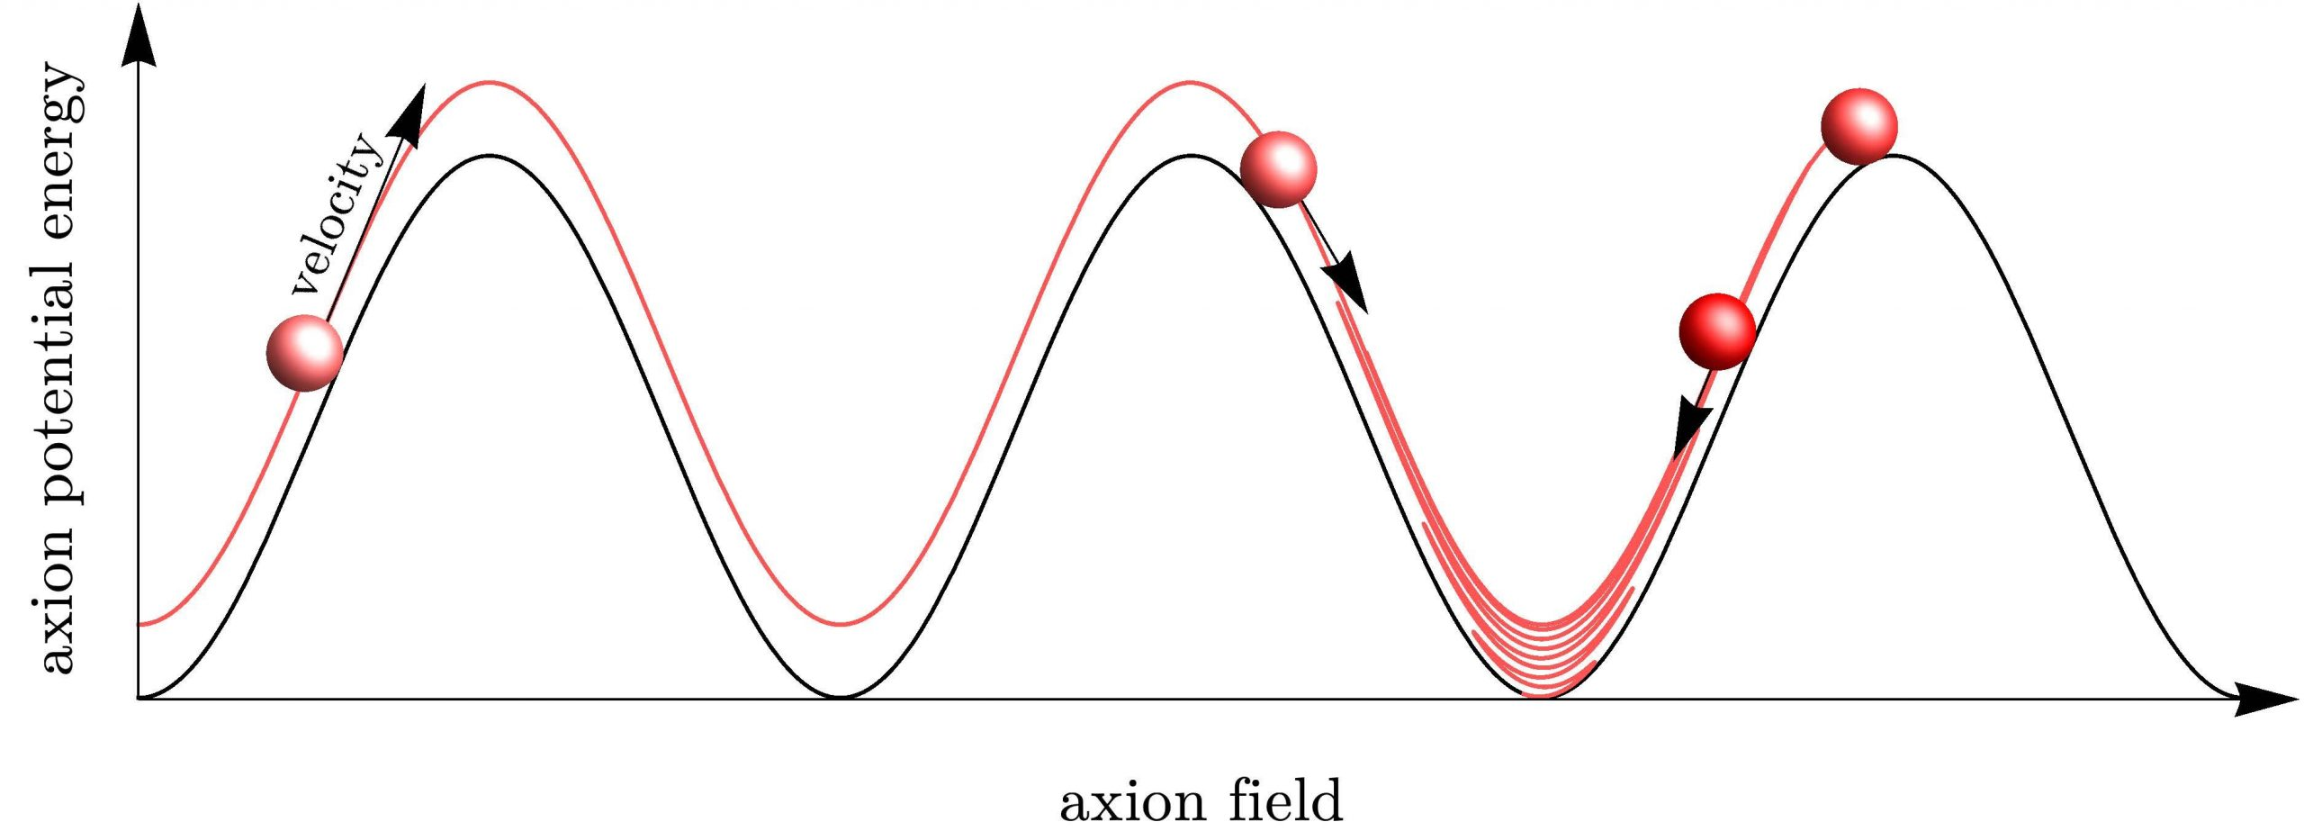
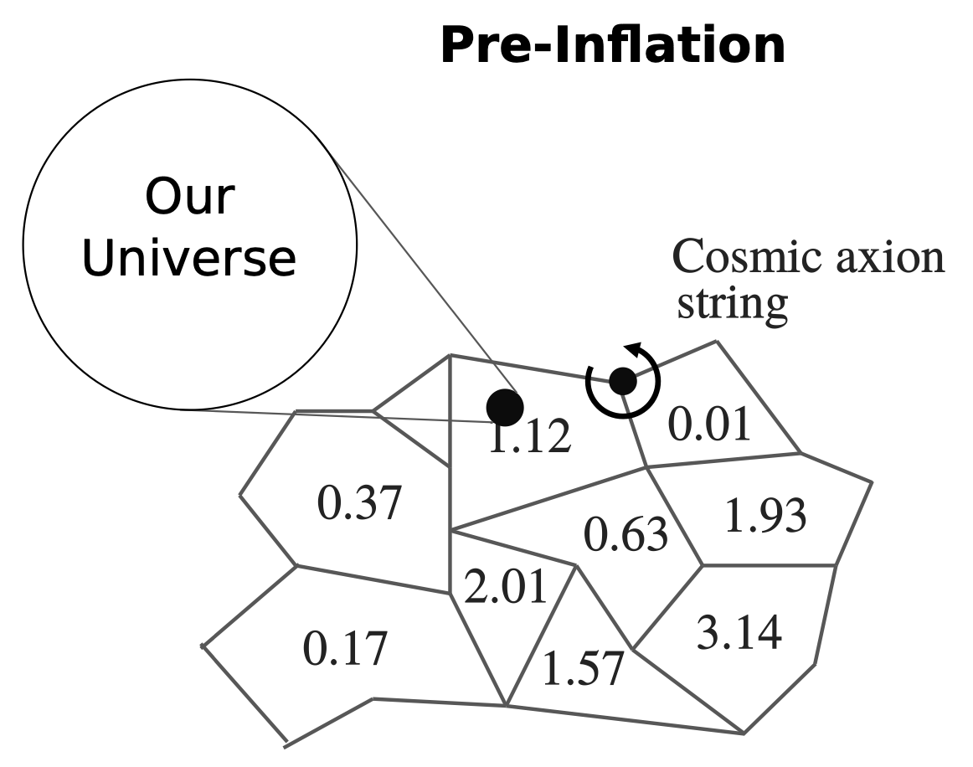
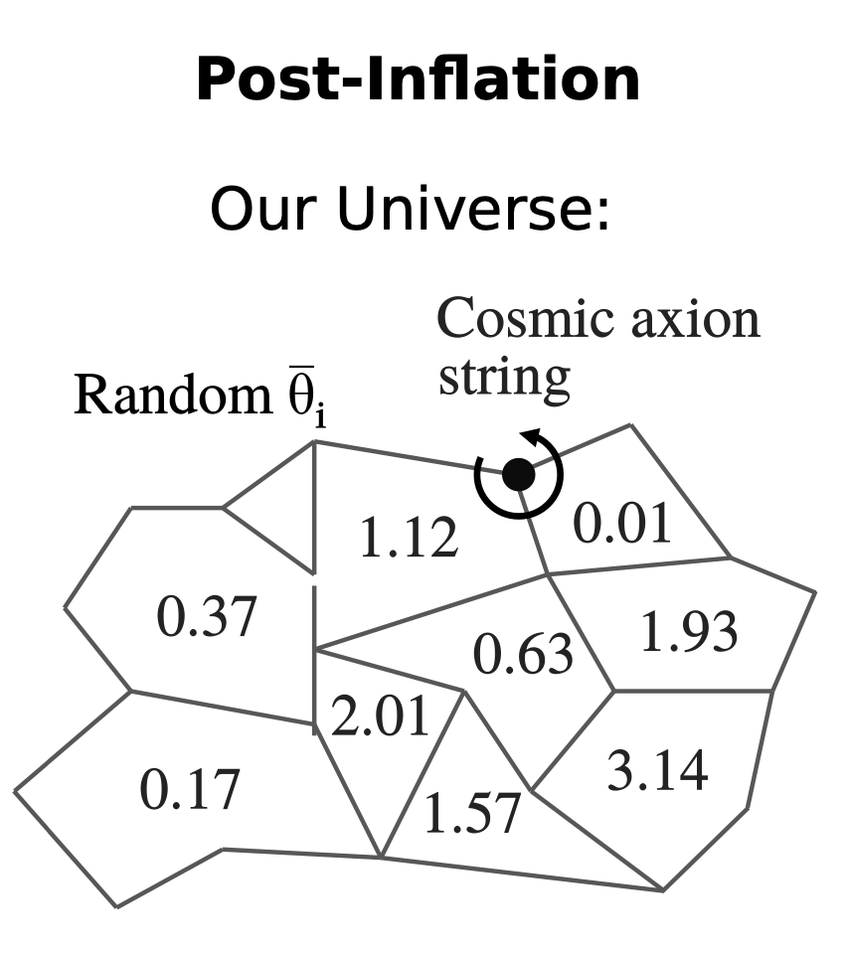


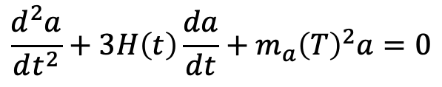
Axion as dark matter
Axion loses kinetic energy non-thermally by coherent oscillation in the PQ potential
Two possible scenarios related to the energy scale of inflation
Misalignment mechanism
$$\frac{d^{2}a}{dt^{2}}+3H\left(t\right)\frac{da}{dt}+m_{a}{\left(T\right)}^{2}a=0$$
Co & Harigaya
$$Λ\left(PQ\right)>Λ(inflation)$$
$$Λ\left(PQ\right)<Λ(inflation)$$
Remaining coherent oscillation = DM
Annihilating axion string = DM
Naturalness problem in DM abundance (initial value dependence)
Natural solution to DM abundance
Stefan Knirck PhD thesis

Slide 5
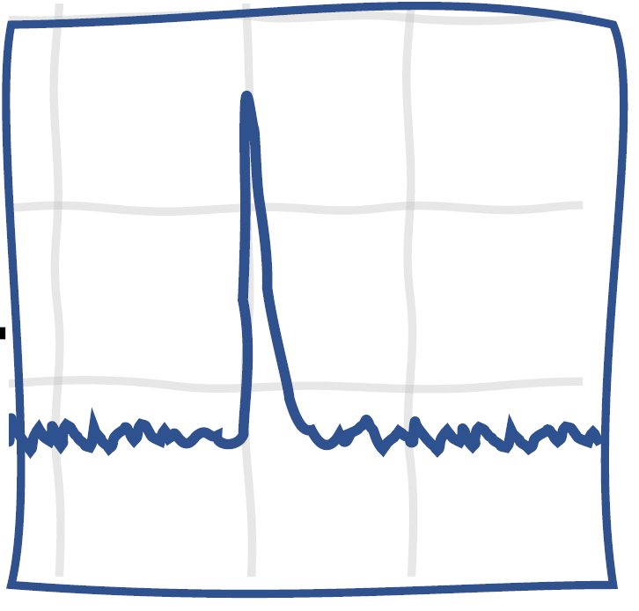
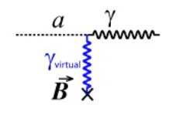
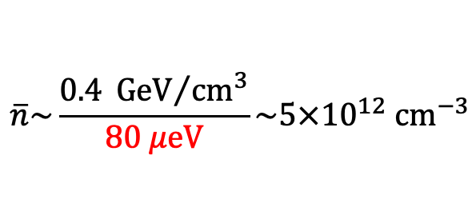



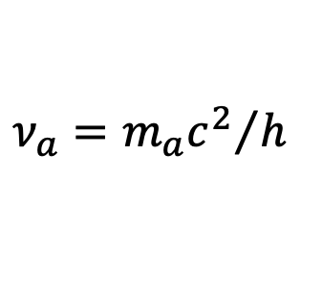
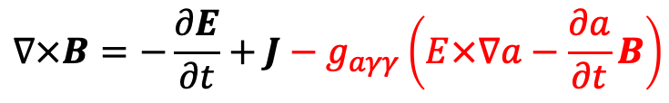

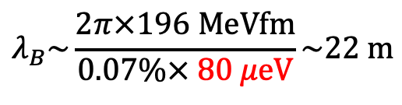
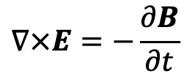
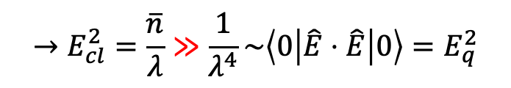

Axions dark matter generates classical microwave under magnetic fields
$$λ_{B}\sim \frac{2π×196 MeVfm}{0.07\%× 80 μeV}\sim 22 m$$
Highly degenerate condensate
Quantum fluctuation negligible
→ Classical fields
$$→E_{cl}^{2}=\frac{\overline{n}}{λ}≫\frac{1}{λ^{4}}\sim \left\langle 0 | \hat{E}⋅\hat{E} | 0\right\rangle =E_{q}^{2}$$
$$\overline{n}\sim \frac{0.4 {GeV}/{cm^{3}}}{80 μeV}\sim {5×10}^{12} {cm}^{−3}$$
$$γ$$
$$γ$$
Axions enter Maxwell equations
$$γ$$
$$∇⋅E=ρ−g_{aγγ}B⋅∇a$$
Power
$$Δν_{a}\sim {10}^{−6}ν_{a}$$
$$∇⋅B=0$$
$$∇×E=−\frac{∂B}{∂t}$$
Effective charge & current
Thermal Noise
$$∇×B=−\frac{∂E}{∂t}+J−g_{aγγ}\left(E×∇a−\frac{∂a}{∂t}B\right)$$
$$ν_{a}={m_{a}c^{2}}/h$$
$ma=80$ μeV generates narrowband $20$GHz MW under a static magnetic field
Frequency

Slide 6
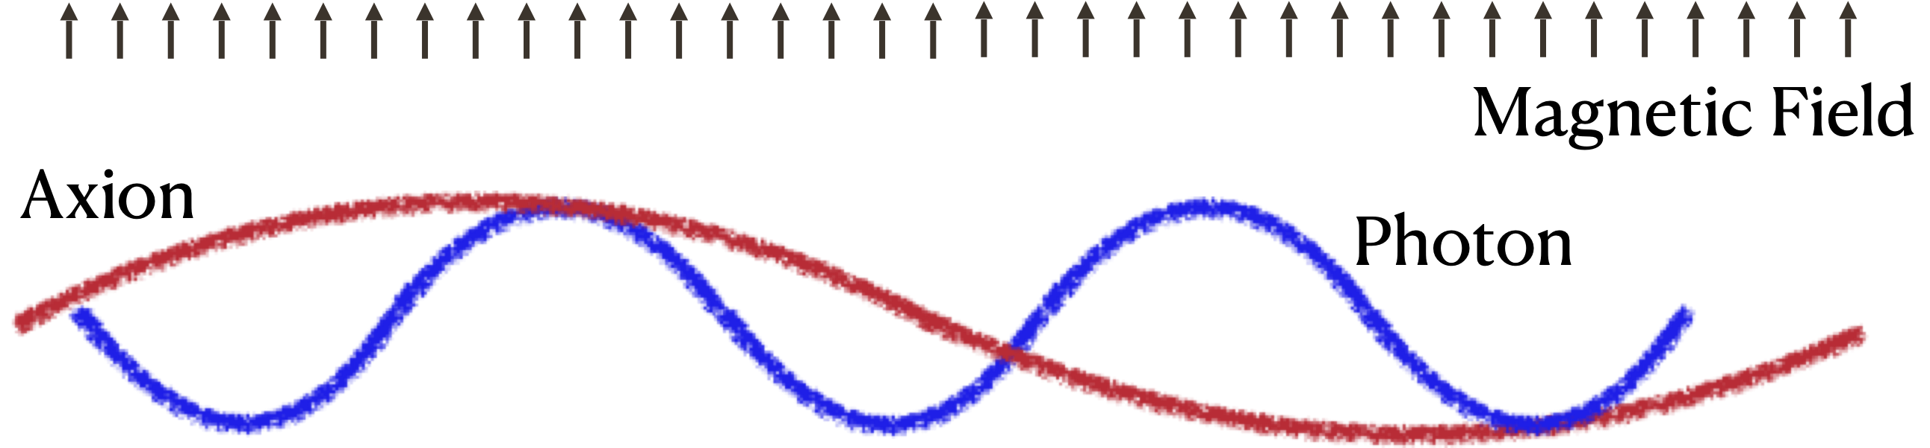
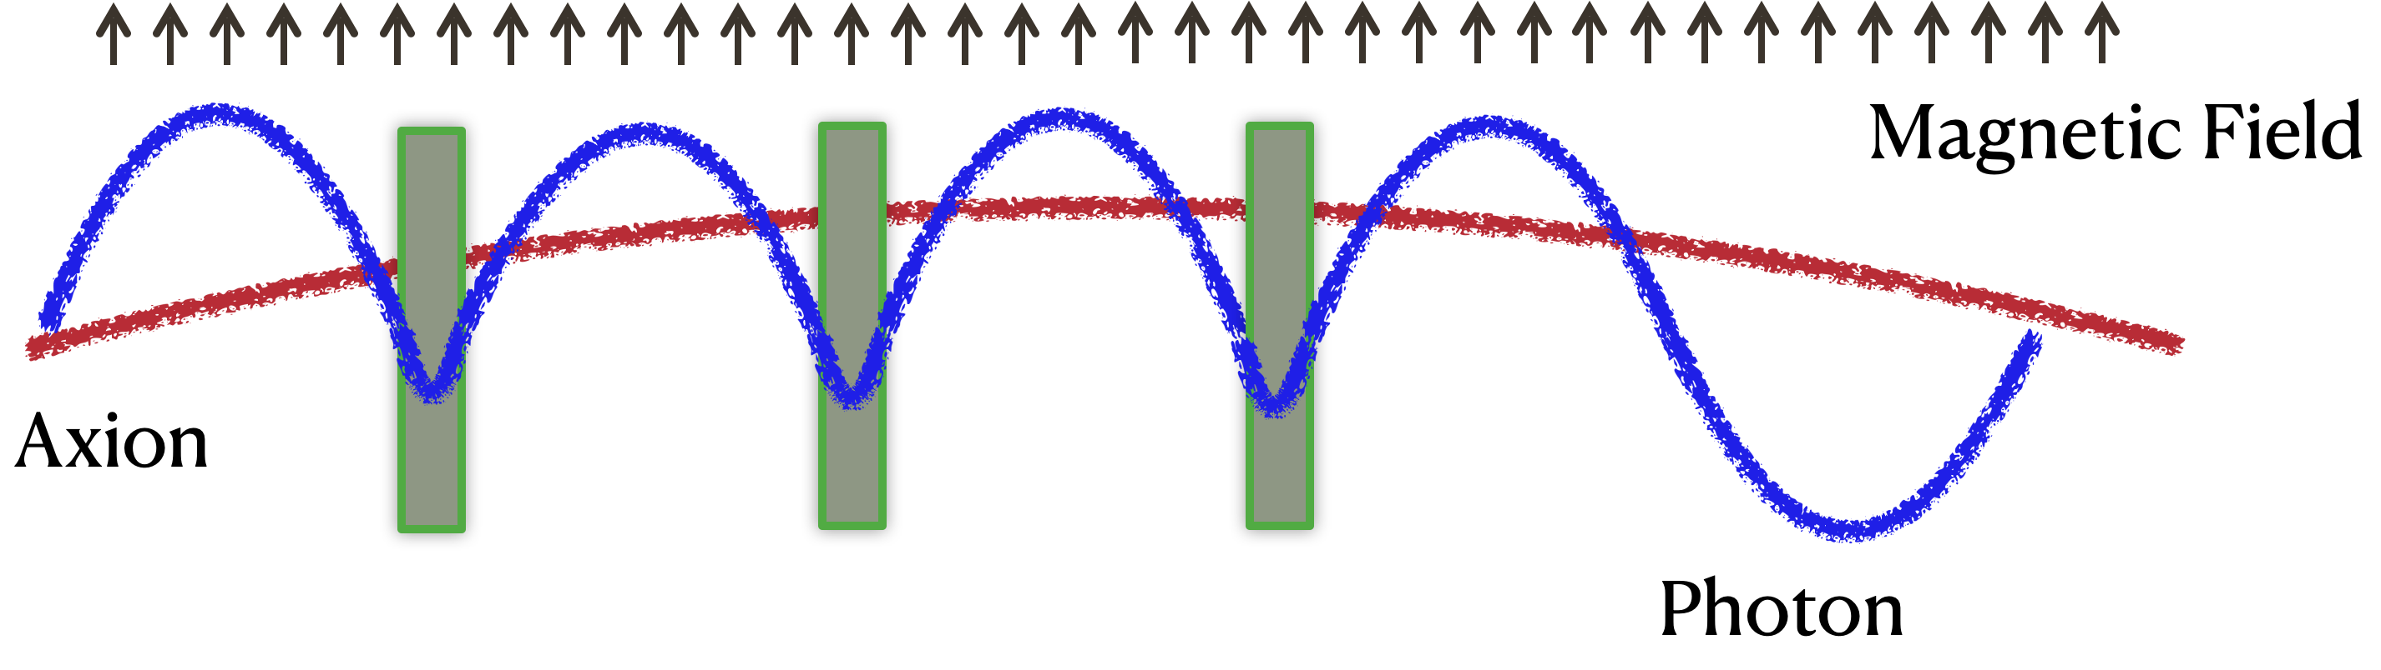

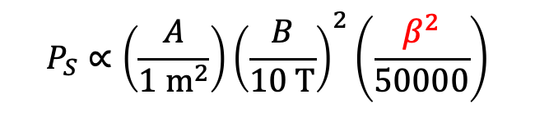
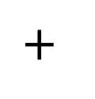
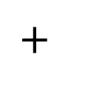
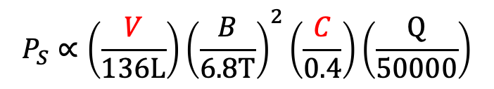
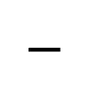
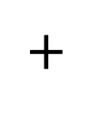
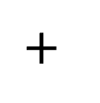
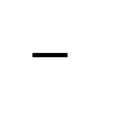
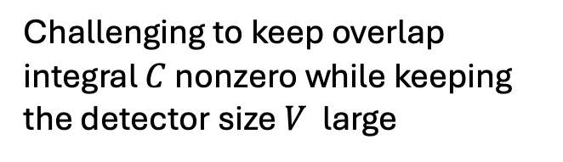
Challenge to address $80 μeV\sim 20 GHz\sim 1.5 cm$
$m_{a}>40 μeV (10 GHz)$ is motivated (post-inflationary scenario, kinetic misalignment, etc) but…
Mismatch in wavelength!
$$→λ_{γ}=1.5 cm≪λ_{B}=22 m$$
$$P_{S}∝\left(\frac{V}{136L}\right){\left(\frac{B}{6.8T}\right)}^{2}\left(\frac{C}{0.4}\right)\left(\frac{Q}{50000}\right)$$
Rev. Sci. Instrum. 92 124502 (2021)
Challenging to keep overlap integral $C$ nonzero while keeping the detector size $V$ large
$$−$$
$$+$$
$$−$$
$$−$$
$$+$$
Insert dielectric disks to cancel the negative overlaps!
Courtesy of Alex Millar Jr.
$$P_{S}∝\left(\frac{A}{1 m^{2}}\right){\left(\frac{B}{10 T}\right)}^{2}\left(\frac{β^{2}}{50000}\right)$$
$$+$$
(Dipole)
$$+$$
$$+$$
$$+$$
Caldwell et al., PRL 118, 091801 (2017)

Slide 7
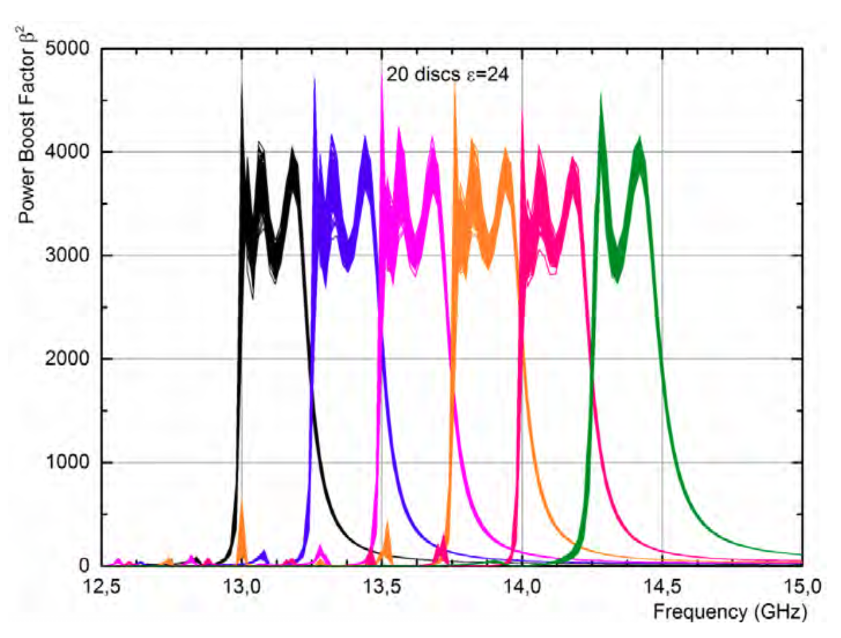
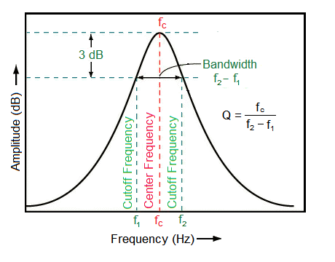
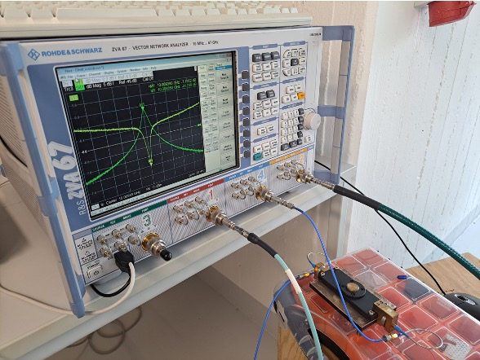
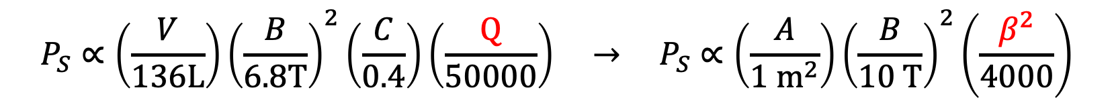
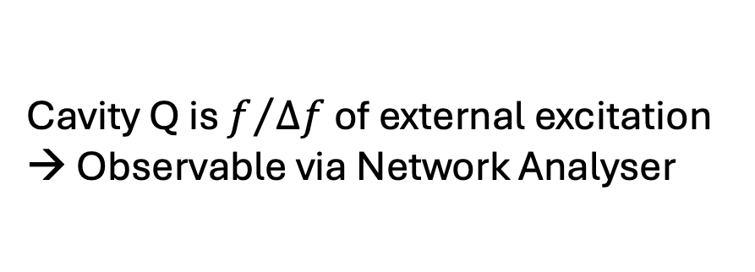
Boost factor ≠ cavity quality factor (Q)
$$P_{S}∝\left(\frac{V}{136L}\right){\left(\frac{B}{6.8T}\right)}^{2}\left(\frac{C}{0.4}\right)\left(\frac{Q}{50000}\right) → P_{S}∝\left(\frac{A}{1 m^{2}}\right){\left(\frac{B}{10 T}\right)}^{2}\left(\frac{β^{2}}{4000}\right)$$
http://lossenderosstudio.com/glossary.php?index=q
Cavity Q is $f/{Δf}$ of external excitation
→ Observable via Network Analyser
Boost factor is for axion-induced signals
→ Virtual concept and not plug & play
→ Calibration & determination of $β^{2}$ has been one of the challenges in MADMAX

Slide 8


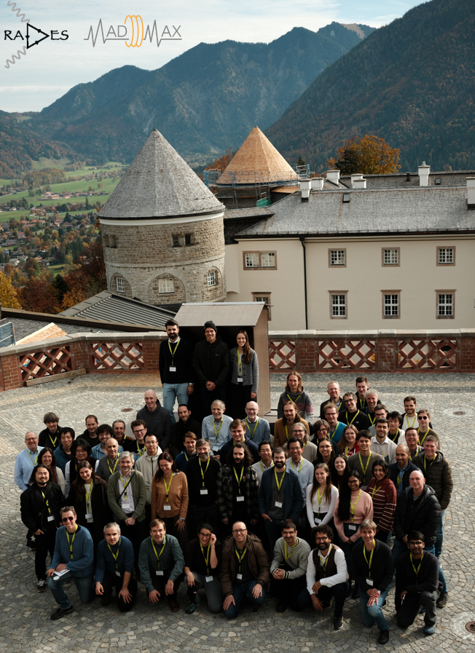











MADMAX collaboration

Slide 9
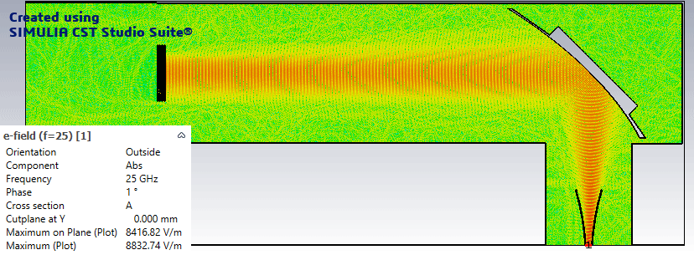
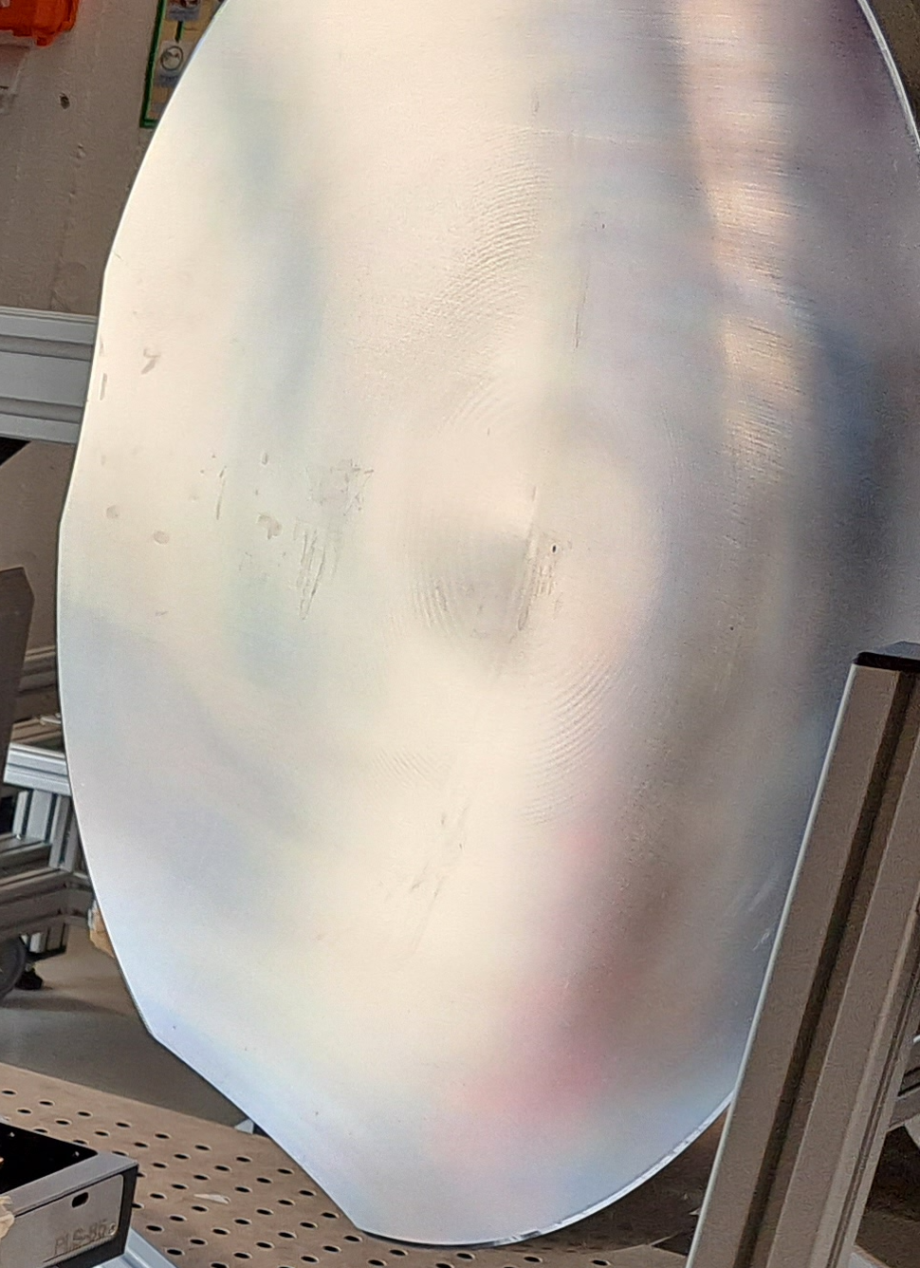
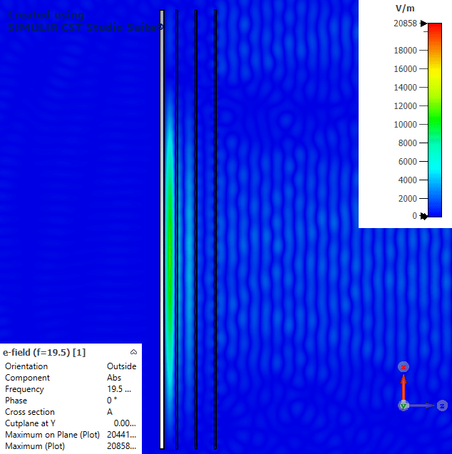
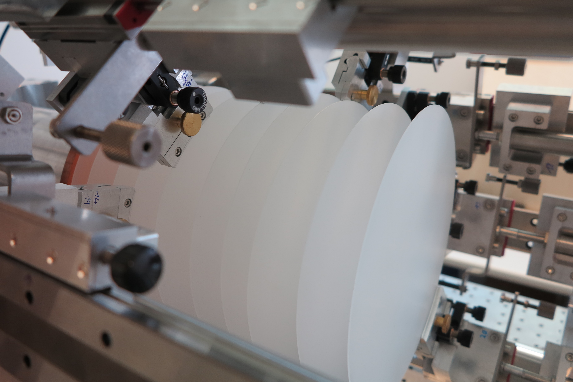
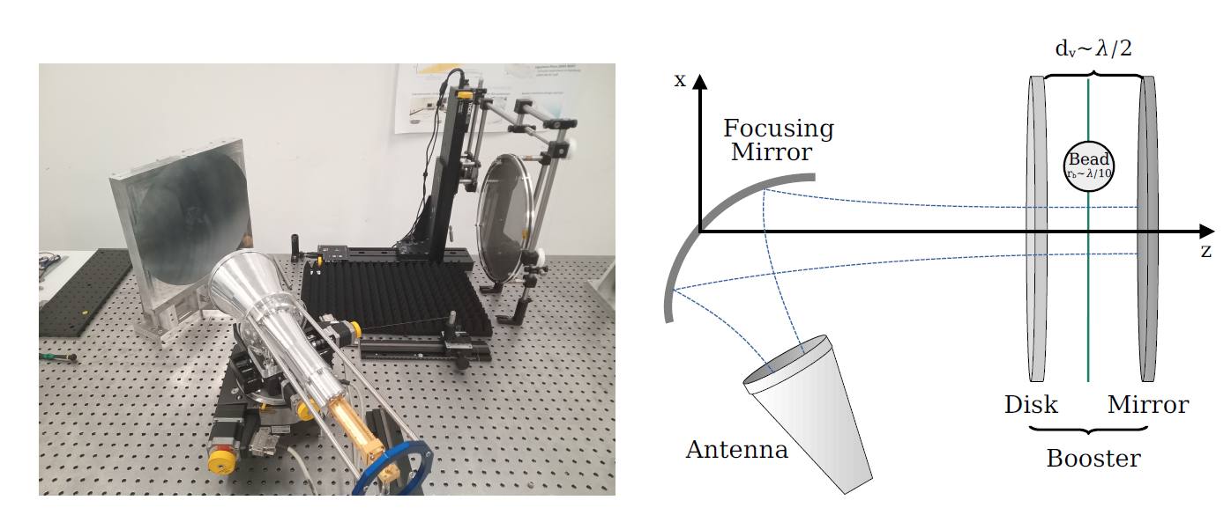
MADMAX overview
Ellipsoidal mirror to focus MW
spacing~15 mm @ 40 µeV
mirror
Horn antenna to collect MW
Sapphire disks (ε=9)
or
Lanthanum aluminate (ε=24)
Resonance inside the dielectric disks

Slide 10
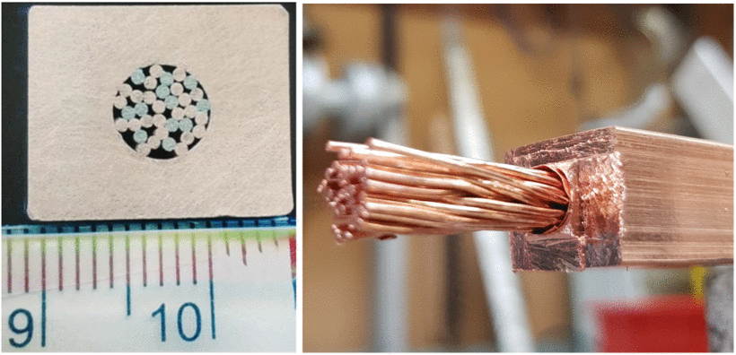
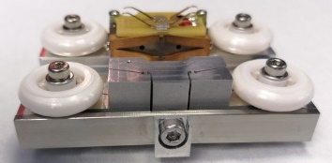

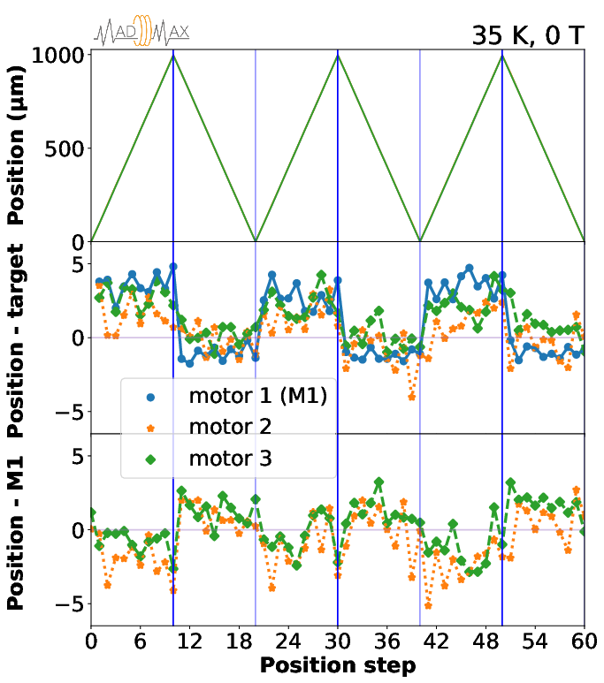
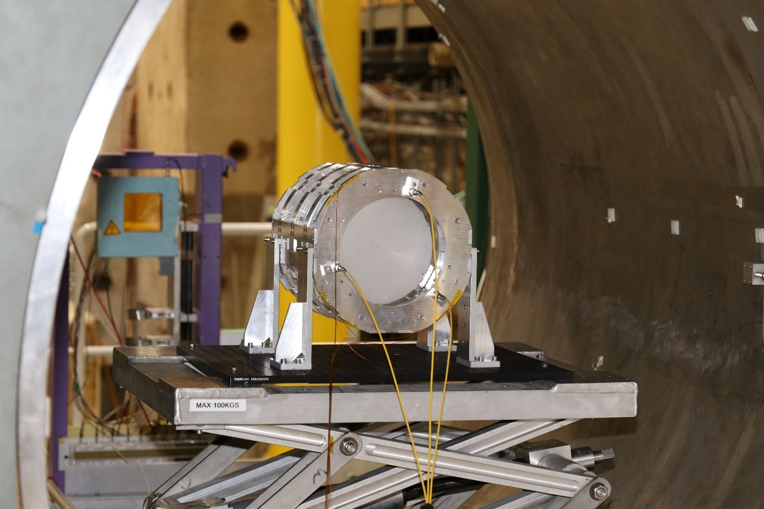
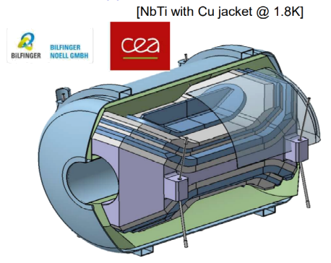
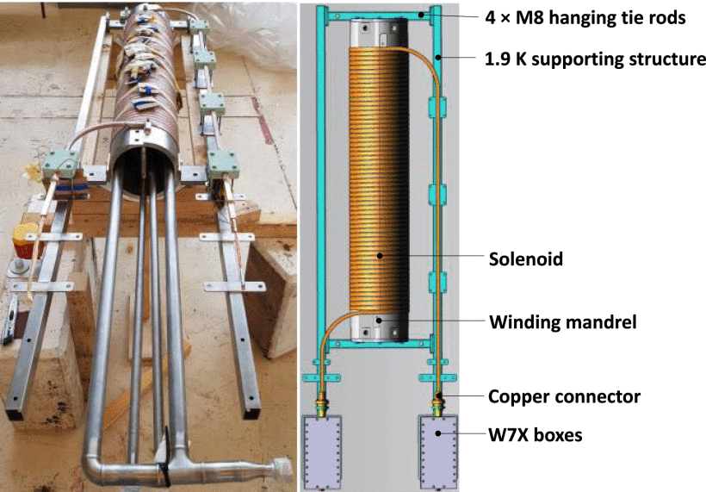
Technical milestones
Piezo worked at 5 K + 5.3 T
Disk motion with piezo-motor was successfully tested at 4K or 1.6 T
Cable-in-Conduit Conductor
MACQU Demo Coil
Dipole feasible!
Fabrication ($$$)
MADMAX collaboration, 2024 JINST 19 T11002
Lorin et al., IEEE TAS 33 (2023) 1
Boost factor $β^{2}$≠ cavity Q → before large scale experiments…small setups!
Boost factor determination & first physics runs without piezo-tuning & existing dipole

Slide 11



Close Booster prototype for axion(-like particle) search
Name | Booster | Disks | Test @CERN
CB200 | Closed | 3, fixed φ = 200 mm | 2024
(room temp., B-field)
Morpurgo magnet at CERN
Booster
(mirror + 3 sapphire disks φ = 20 cm)
CB200
20 cm
8 mm
Cylindrical waveguide
Low Noise Amplifiers (LNA) + filters + spectrum analyzer
Booster peak tuned at 2 frequencies ~18.5 and 19.2 GHz
manual change of disk distances by ~0.3 mm with separation rings
O(10 MHz) variations around these frequencies
manual change of mirror-disk distance by O(10 µm) with tuning rod
15 days of data in Morpurgo magnet at CERN
B=1 to 1.6 T
Why close cylinder setup →waveguide resonant mode (TE₁₁) are clear to model $β^{2}$

Slide 12






$β^{2}$ determination in close booster setup
Model-based approach
Modelling the TE₁₁ booster with free parameters ($ε$, thickness, spacing, mismatch, etc)
1) Fit to determine parameters
2) Calculation with determined parameters
MW measurement data
Reflection data
Noise power resonance
boost factor $β^{2}$
Monte-Carlo approach to propagate the errors in parameters
Limitation of the modelling (3D effect, etc) well included in the uncertainty
In-situ monitoring of the booster resonance during physics run via noise power
→ $β^{2}$ determined with ~15% errors

Slide 13



First physics result of axions(-like particle) search
No excess observed in acquired power spectra [HAYSTACK procedure PRD96 (2017) 1523008]
Limits on axion-photon coupling $|g_{aγγ}|$ [for each 0.9 kHz bin]
Limits better than existing ones by up to x3 with modest system [few small disks, reduced B field]
→ Proving substantial potential of the MADMAX concept
Axion signal for m_{a}=76.75 μeV & |g_{aγ}|=3.5x10⁻¹¹ GeV⁻¹
σ<1 due to noise filter
MADMAX collaboration, PRL 135, 041001 (2025)
First dark matter axion search with the dielectric haloscope!

Slide 14



Work in progress: cryogenic calibration & cryostat & dipole
Small cryostat prototype at CERN
Large prototype cryostat & optics under commissioning
1.6 m
48 cm
MW calibration at cold is challenging
Analysis on-going
D. Kreikemeyer et al. JINST 20 T02005 (2025)
3.5 m
4 K cryostat
Intermediate-scale custom-made dipole (60 cm, 4T) at DESY ~2031

Slide 15







IJCLab’s contributions to MADMAX 1: dielectric disks
Φ300mm t1mm sapphire is deformed
Two solutions proposed by IJCLab
Φ300mm t1.5mm sapphire with a new fabrication technique (KC3) by Kyocera
→ deformation reduced by 1/10
(But more expensive ☹…money…)
@CPPM
High-resistivity silicon by Topsil
→ deformation reduced by 1/10 but max Φ200
Impact: shift and uncertainty in $β^{2}(ω)$
Small prototype @ IJCLab

Slide 16






IJCLab’s contributions to MADMAX 2: MW absorbers → noise mitigation
Qualification of absorbers
Mounting on the support
Installation at UHH

Slide 17


Conclusion and future prospects
Axion searches
Axions are the solution of the strong CP problem and can be an excellent dark matter candidate
Dark matter axions behave as a classical wave
Addressing ~100µeV axions has been challenging due to lacking overlap with microwaves
: dielectric haloscope
Boost the axion signal in periodically placed dielectric disks
Technical milestones (tuning, magnet feasibility, boost factor $β^{2}$)
Two small prototypes
Close booster → mode-based $β^{2}$ determination
Open booster → reciprocity-based $β^{2}$ determination
Successful 1st searches in axions and dark photons!
We are working on the next larger prototype
Cryogenic calibration: analysis on-going
Large cryostat under commissioning & large optics & noise handling
Intermediate magnet to be installed at DESY
Next physics runs are planned during LS3 at CERN
Quantum sensors are under discussions for further upgrade
Caldwell et al., PRL 118, 091801 (2017)
Millar et al., JCAP01(2017)061
MADMAX collaboration, 2024 JINST 19 T11002
Lorin et al., IEEE TAS 33 (2023) 1
Egge , JCAP04(2023)064
Egge et al, JCAP04(2024)005
MADMAX collaboration, PRL 134, 15, 151004 (2025)
MADMAX collaboration, PRL 135, 041001 (2025)
D. Kreikemeyer et al. JINST 20 T02005 (2025)
projections

Slide 18








More pedagogical lectures of mine
90 min x 3 lectures on axions in Nagoya University
https://indico.kmi.nagoya-u.ac.jp/event/15/overview
1-week lectures + hands-on about RF for axions in Hamburg University
https://indico.desy.de/event/50207/
Textbooks (we do not have established textbook for axions ☹):

Slide 19
backup

Slide 20

Open booster prototype for dark photons
Close booster may not be scalable
Open setup is a crucial milestone
The MW reflection data is not as clear as that of close boosters (open boundary)
Model & fitting approach was challenging ☹

Slide 21







$β^{2}$ determination in open booster setup
Lorentz reciprocity approach
$$P_{sig}=\frac{1}{2}Re \int_{S}{\left(E_{a}×H_{a}^{∗}\right)⋅dS}∝{\left|\int_{V}{(E_{R}⋅B_{0})dV}\right|}^{2}$$
Unknown axion fields
Measurement observable!
Boost factor can be determined via electric field of MW excited from outside
$$β^{2}=\frac{P_{sig}}{P_{0}}∝{\left|\int_{V}{E_{R}dV}\right|}^{2}$$
Electric field can be obtained through the beads-pulling method
$$ΔΓ∝E_{R}^{2}$$
JCAP 04 (2023) 064
JCAP 04 (2024) 005
→ $β^{2}$ determined with ~15% errors

Slide 22




First result of dark photons search
No excess observed in acquired power spectra
Limits on kinetic mixing $χ$ between photon and DP for $m_{DP}$ [78.6, 84.0] meV
Limits better than existing ones by up to x1000 with modest system [few small disks]
→ Proving substantial potential of the MADMAX concept
MADMAX collaboration, PRL 134, 15, 151004 (2025)
DP signal for m_{a}=80.56 μeV & $χ=2×{10}^{−13}$
First dark matter DP search with the dielectric haloscope!

Slide 23

DP limits in open and closed boosters
CB200 & OB300 Dark photon dark matter limits complementary
https://arxiv.org/abs/2509.06398
http://vietnam.in2p3.fr/2025/tmex/transparencies/5_friday/morning/DM4/04_Dabhi.pdf

