Slide 1
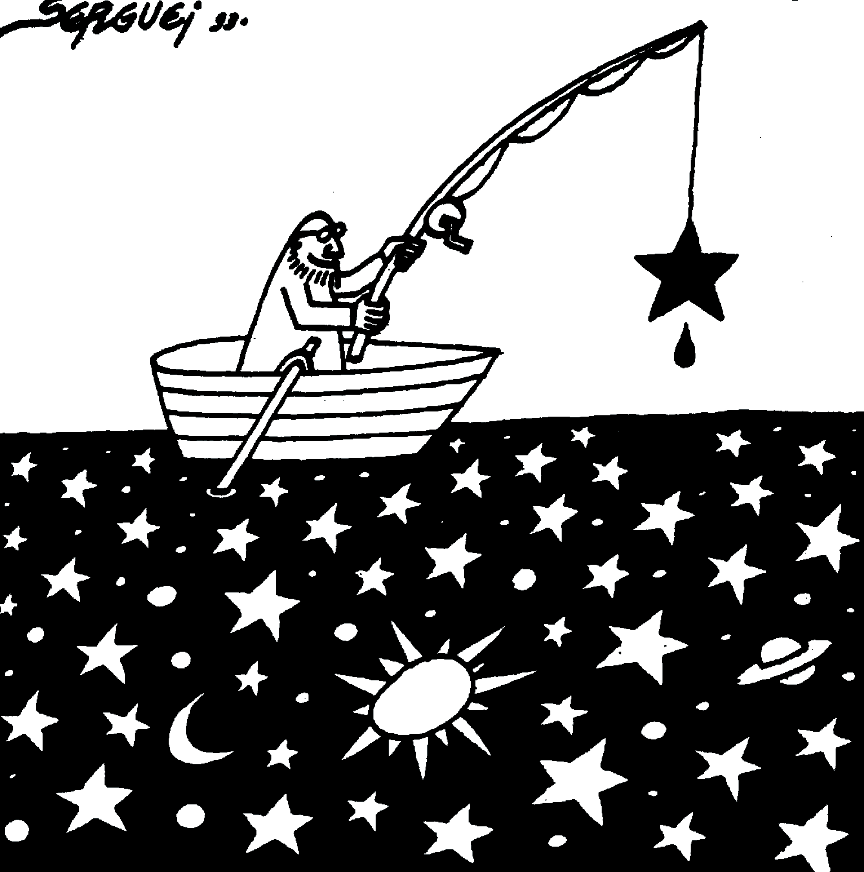
Dark matter as compact objects
microlensing from EROS to LSST
6 may 2026
Marc Moniez IJCLab

Slide 2
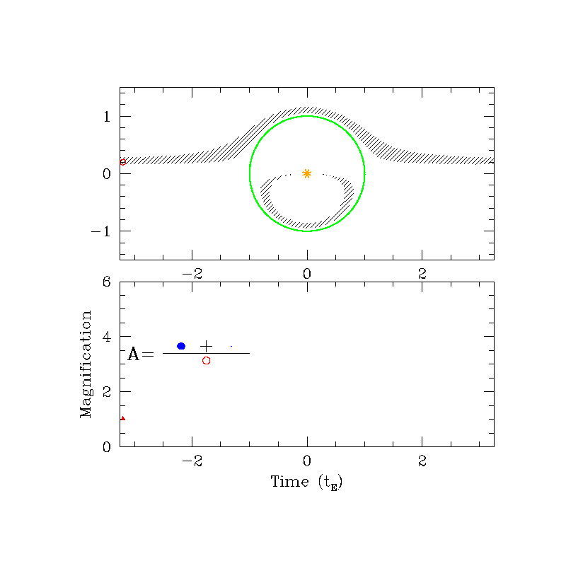
EROS = Expérience de Recherche d’Objets Sombres
Initially designed in 1990
to search for compact hidden objets through microlensing
By a french group lead by particle physicists: CEA, LAL (now IJCLab), IAP, Observatoire de Marseille, Collège de France, OHP
Scott Gaudi’s animation
R_{E} = Einstein radius
t_{E} = Einstein duration
u₀ = impact parameter
t₀ = minimum approach time

Slide 3
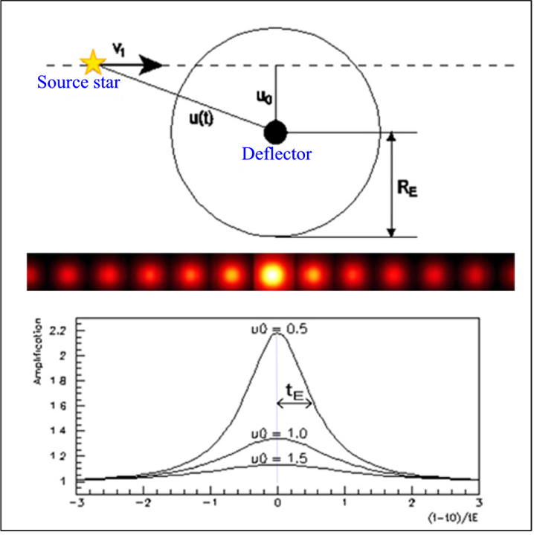
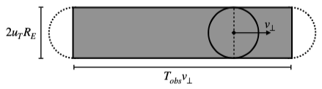
Description of a microlensing event Point-lens, point-source, rectilinear relative motion
The optical depth τ
- probability for a star to be behind an Einstein disk at a given time (Amplification > 1.34)
- disk surface α R_{E}² α M_{lens}
τ α Σ M_{lens}
total mass of the probed structure
The number of events with u₀<R_{E} in T_{obs}
α surface swept by Einstein disks
=> N_{events} α Σ_{lens}R_{E} . V_{T} . N_{star} . T_{obs}
Light curve characteristic:
Symmetric
Achromatic
Singular ( ~1 evt / 10⁶)
Surface covered by a lens during T_{obs}

Slide 4
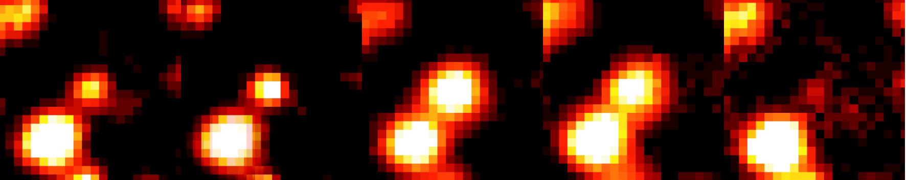
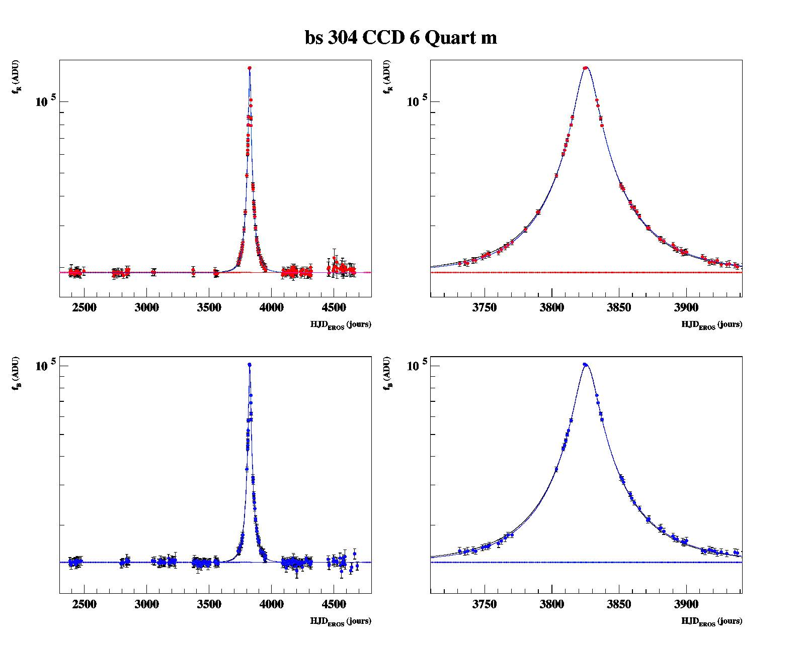
A high S/N candidate
(towards the Galactic center)
…
high S/N

Slide 5
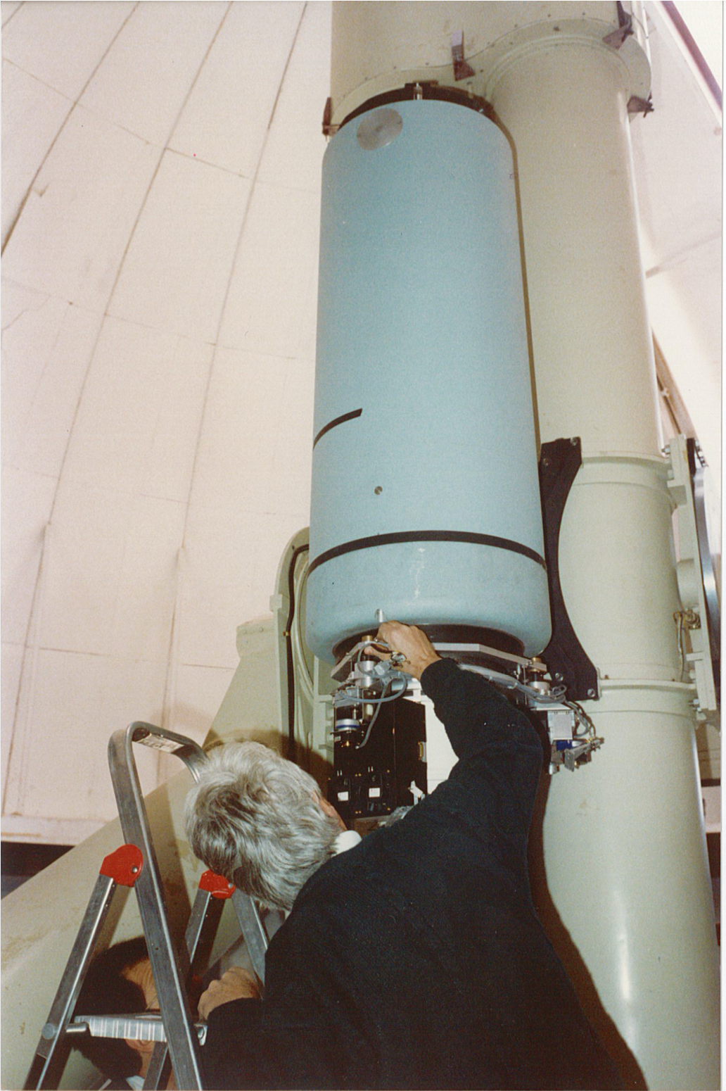
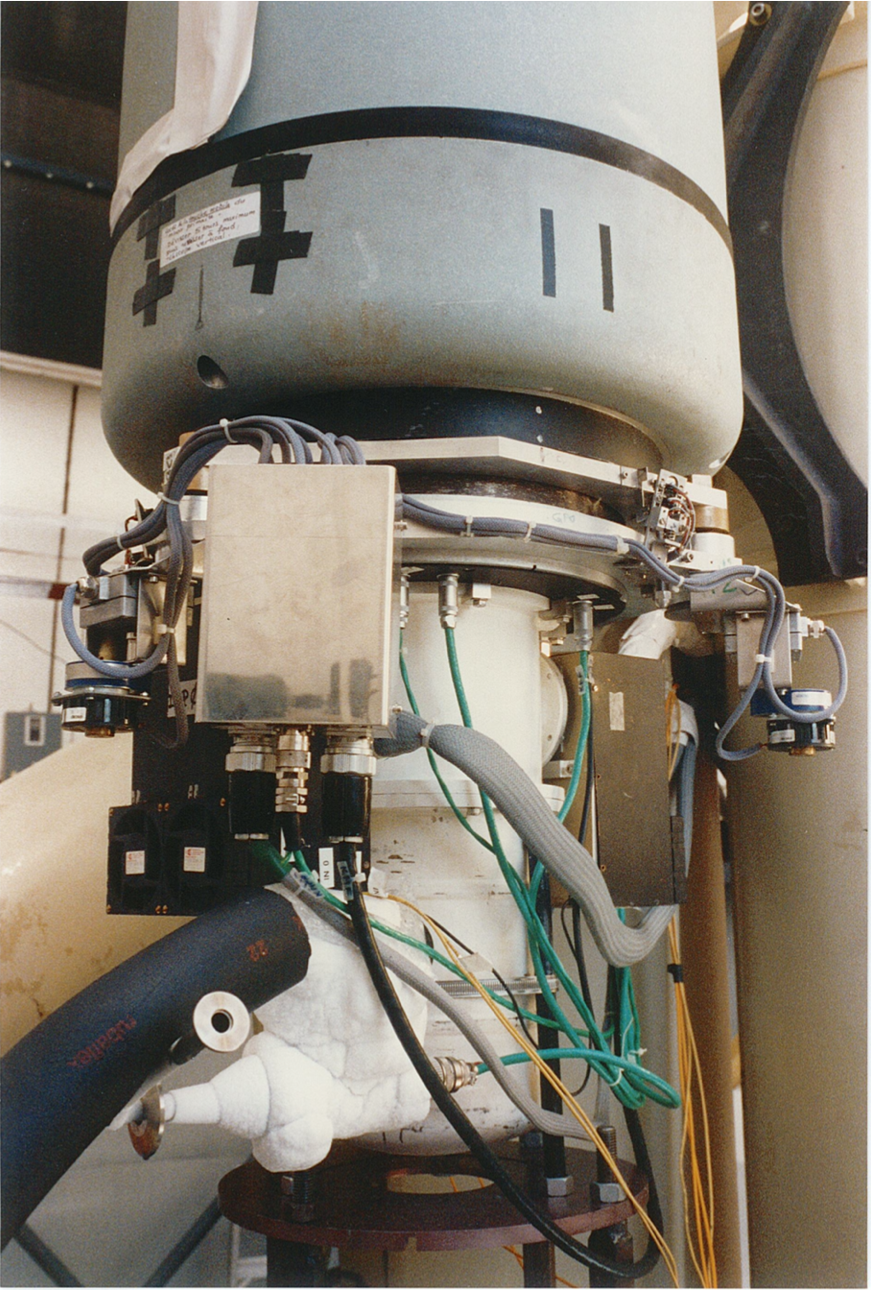
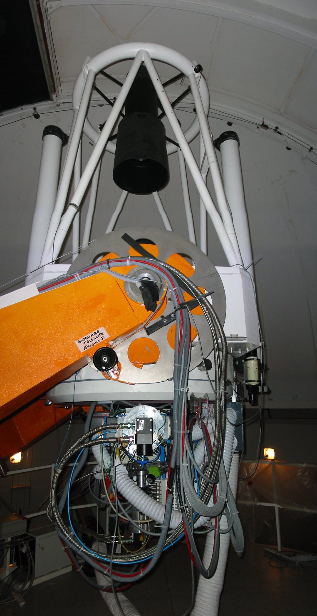
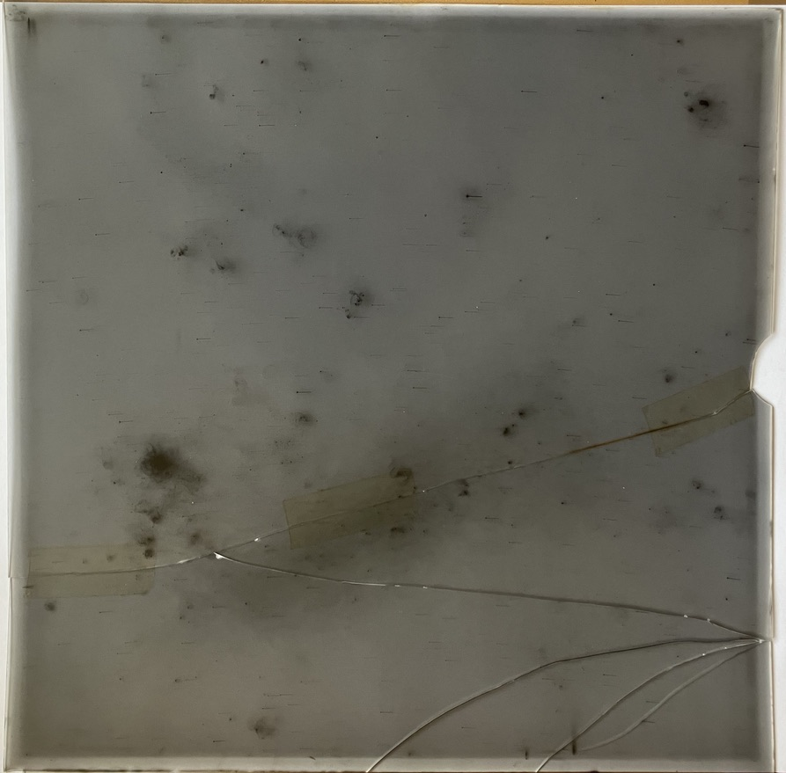
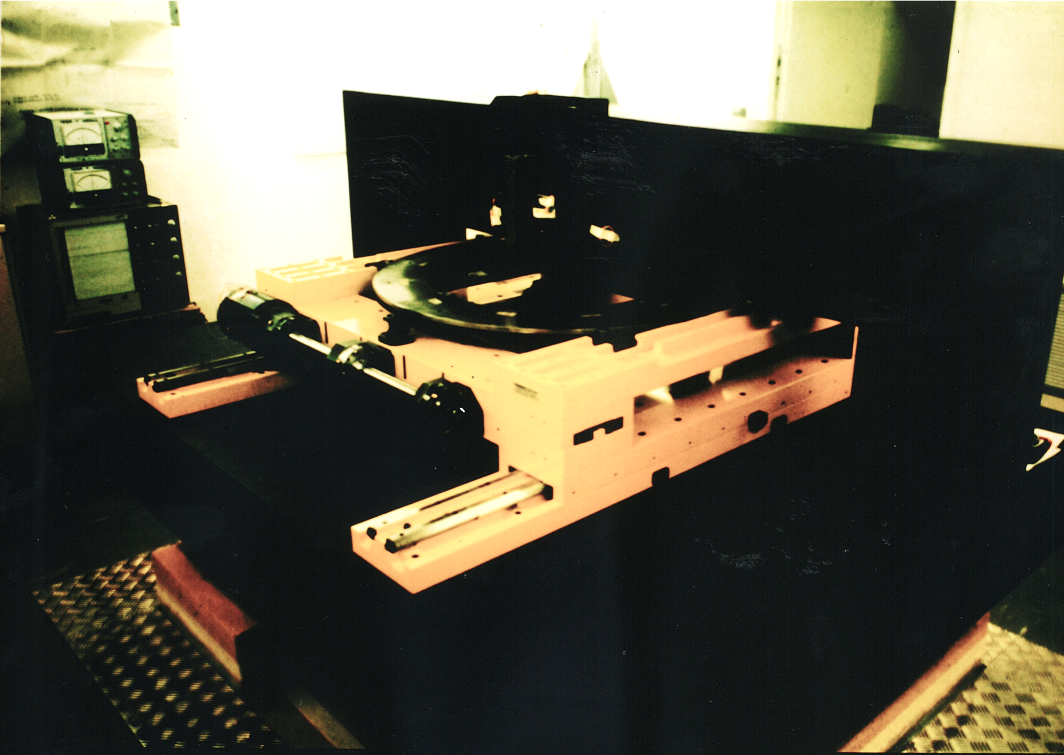
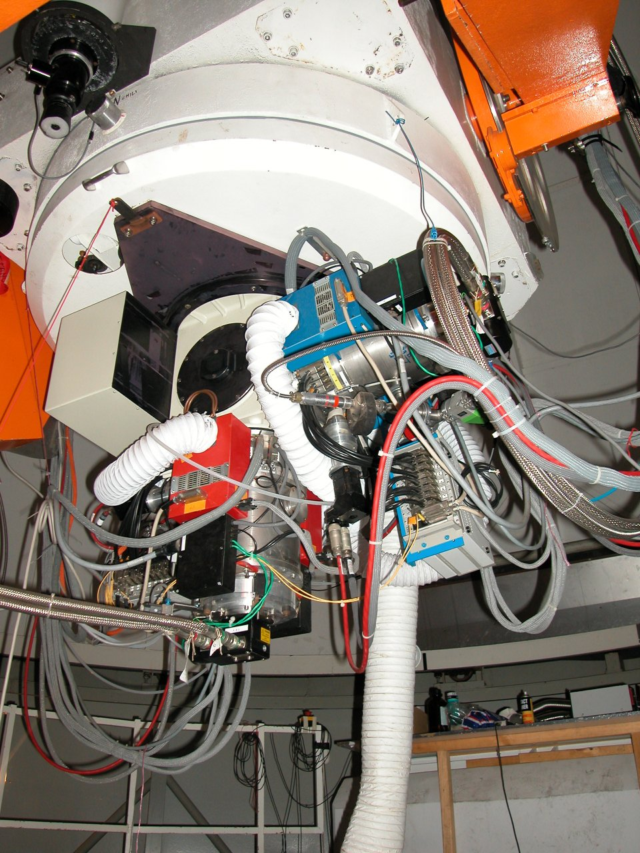
Instruments, detectors
EROS-1: 1990-1994 - 290 photographic plates taken at the 1m Schmidt (ESO), digitized with the MAMA (1Gpixels/plate). 5.10⁶ stars.
- (first) 16 buttable CCD-camera (4M-pixels!) on a 50cm telescope. 19,000 images of the LMC bar. 2.5.10⁵ stars
EROS-2: 1996-2003 - 2 cameras with 32 Mpixels each, on a 1m telescope
- 100,000 exposures in 2 colours

Slide 6
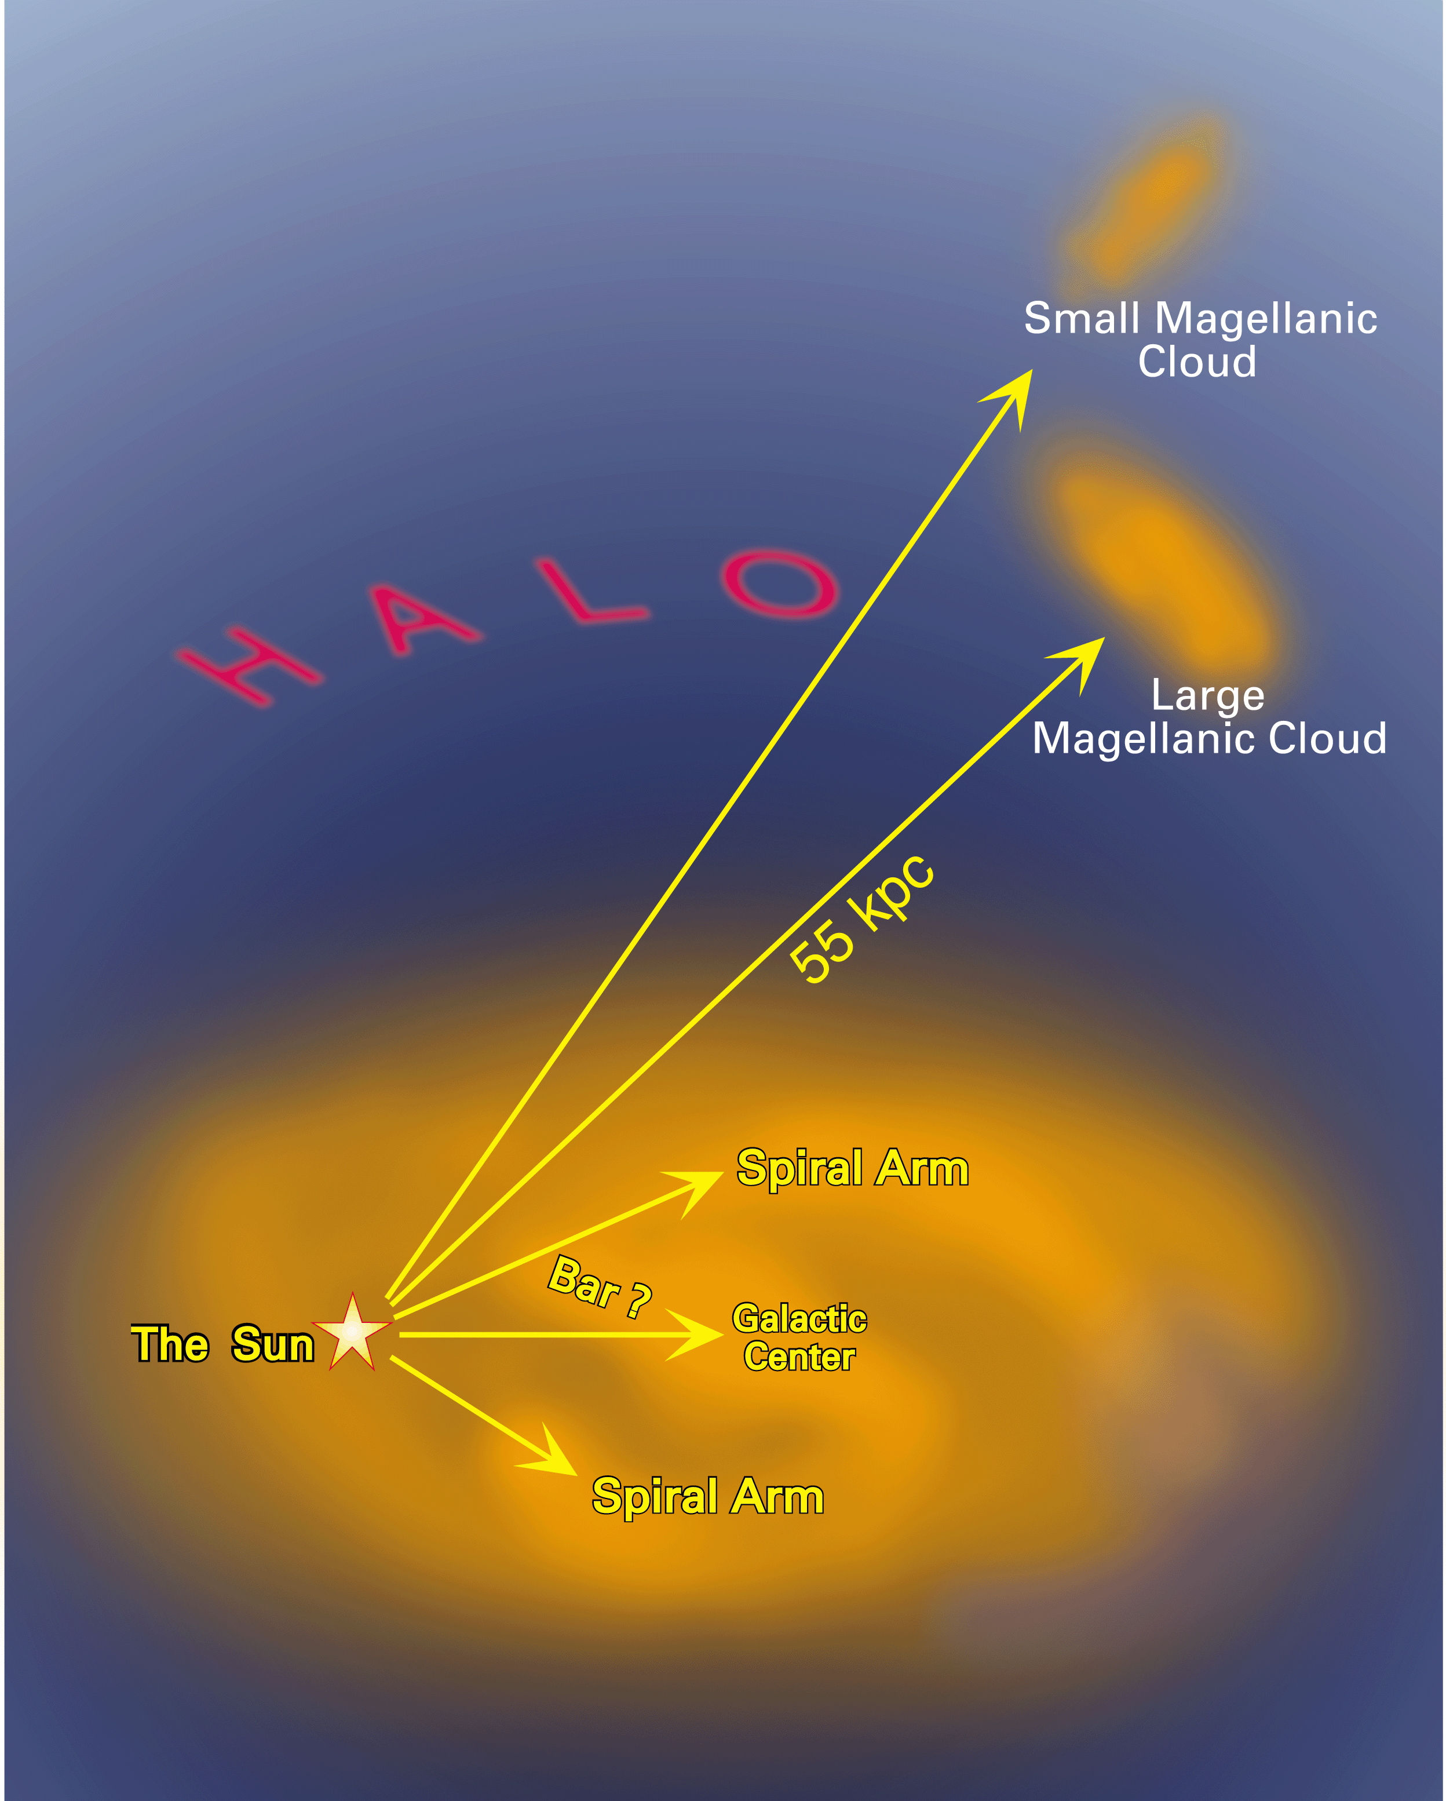
Main targets monitored since 1990’s
Magellanic Clouds => probe hidden matter in halo (τ_{LMC} ~ 4.7x10⁻⁷ expected from hidden matter halo)
Galactic center => probe ordinary stars as lenses in disk/bulge (τ ~ 2.10⁻⁶)
Spiral arms => probe ordinary stars in disk, bar + hidden matter in thick disc (τ ~ 5.10⁻⁷)
50 Terabytes of data
850,000 images processed
~ 77x10⁶ stars measured 300 to 500 times
Notes:
MEGA project? Centre galactique: cusp vs core

Slide 7
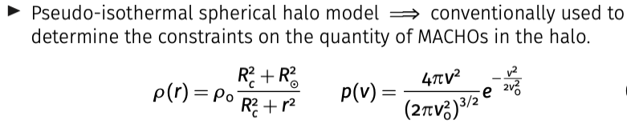
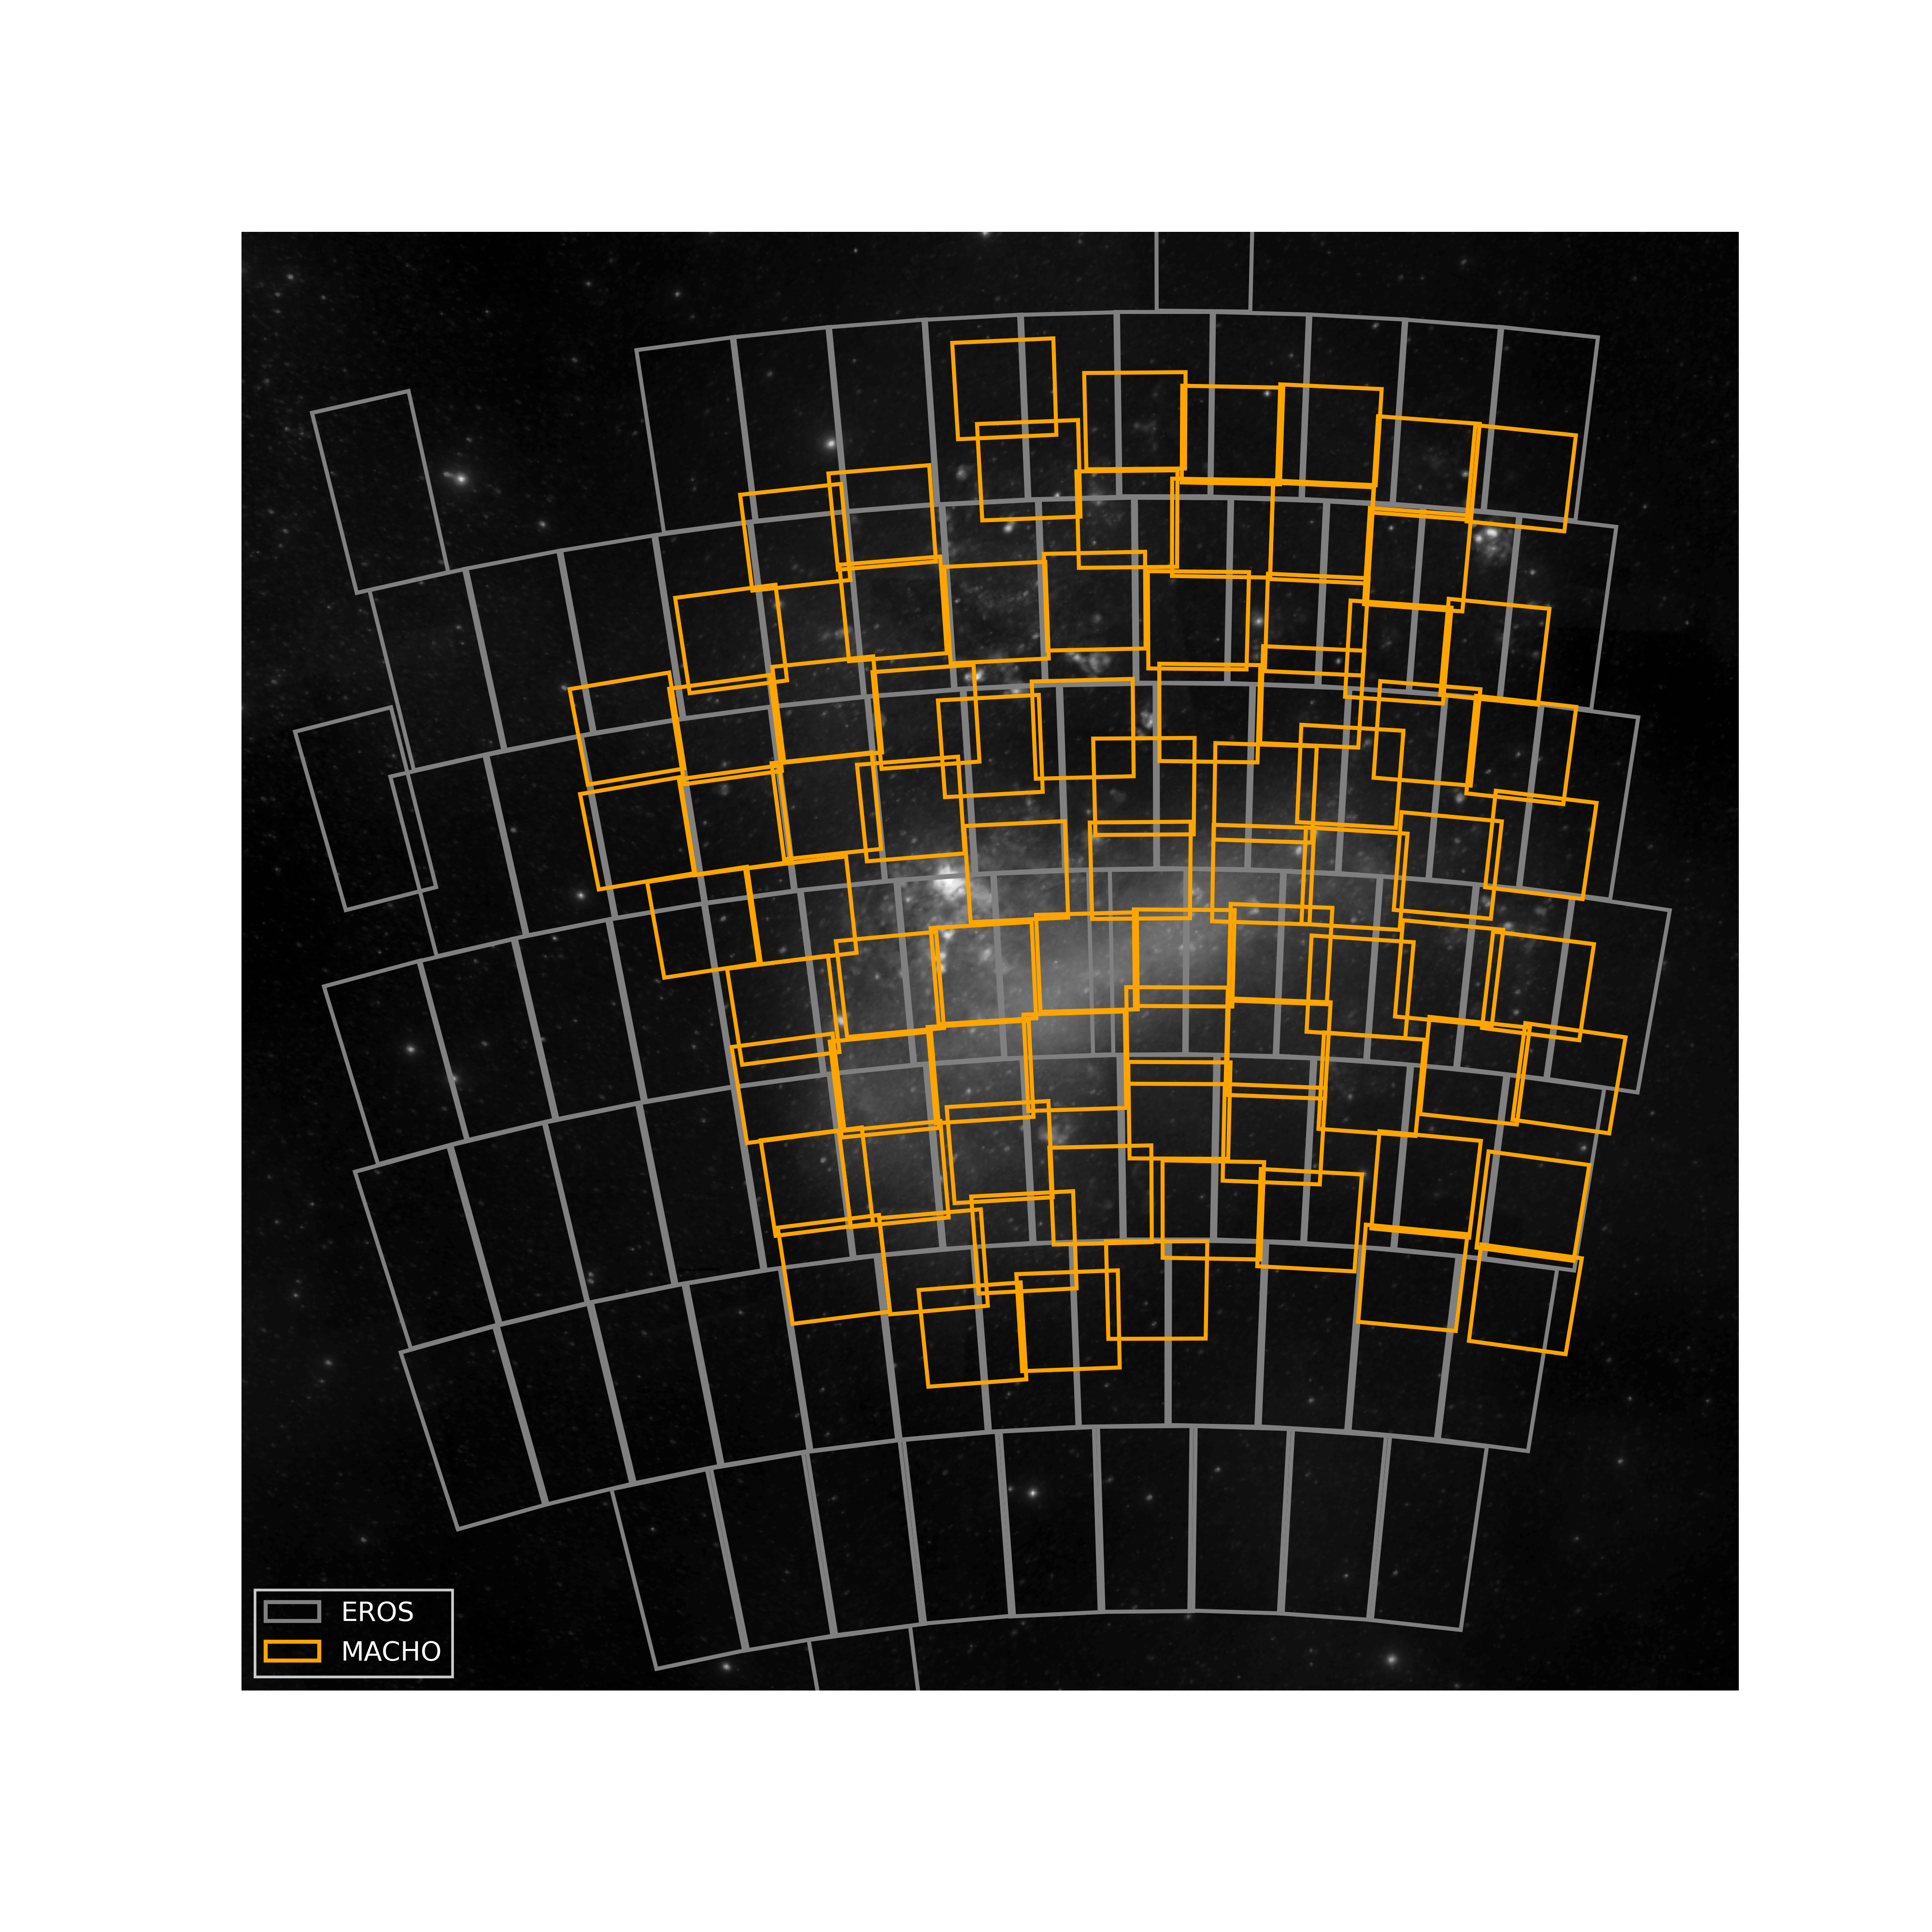
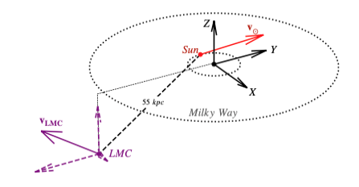
The Large Magellanic Cloud is monitored for microlensing since the 1990s’
u₀
Linked to Amax
t_{E}
t₀
ρ₀ = 0.0078 M☉ /pc²
R_{C} = 5 kpc
R☉ =8.5 kpc
D_{LMC} = 49.5 kpc
v₀ =120 km/s
v☉ , v_{LMC} …
τ ~ 4.7 x 10⁻⁷
<t_{E}> ~ 63days (M_{lens}/M☉)^{1/2}

Slide 8

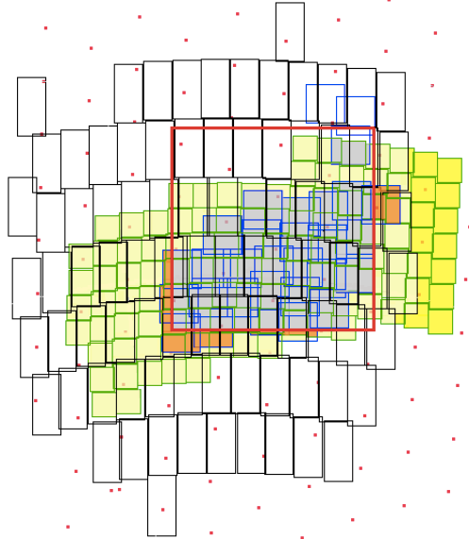
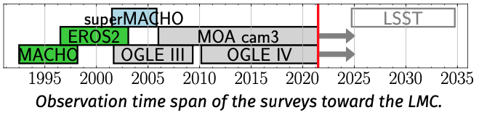
Latest activity: joined data analysis MEMO project (Blaineau et al. A&A, 664, A106 (2022))
Heavy lenses produce long duration events
(~ 2yrs for 100M_{sun} lens)
Detection efficiency of the past surveys vanishes for such durations, because:
Limited duration T_{obs} of each survey (3-8yrs)
Observations/Analysis optimized for light lenses
19 yrs
30 yrs
MoaErosMachOgle combined light-curves provides much more extended light-curves.
Only the combination of EROS2 and MACHO has been performed
24 yrs
28 yrs
Fields monitored within the
Large Magellanic Cloud

Slide 9
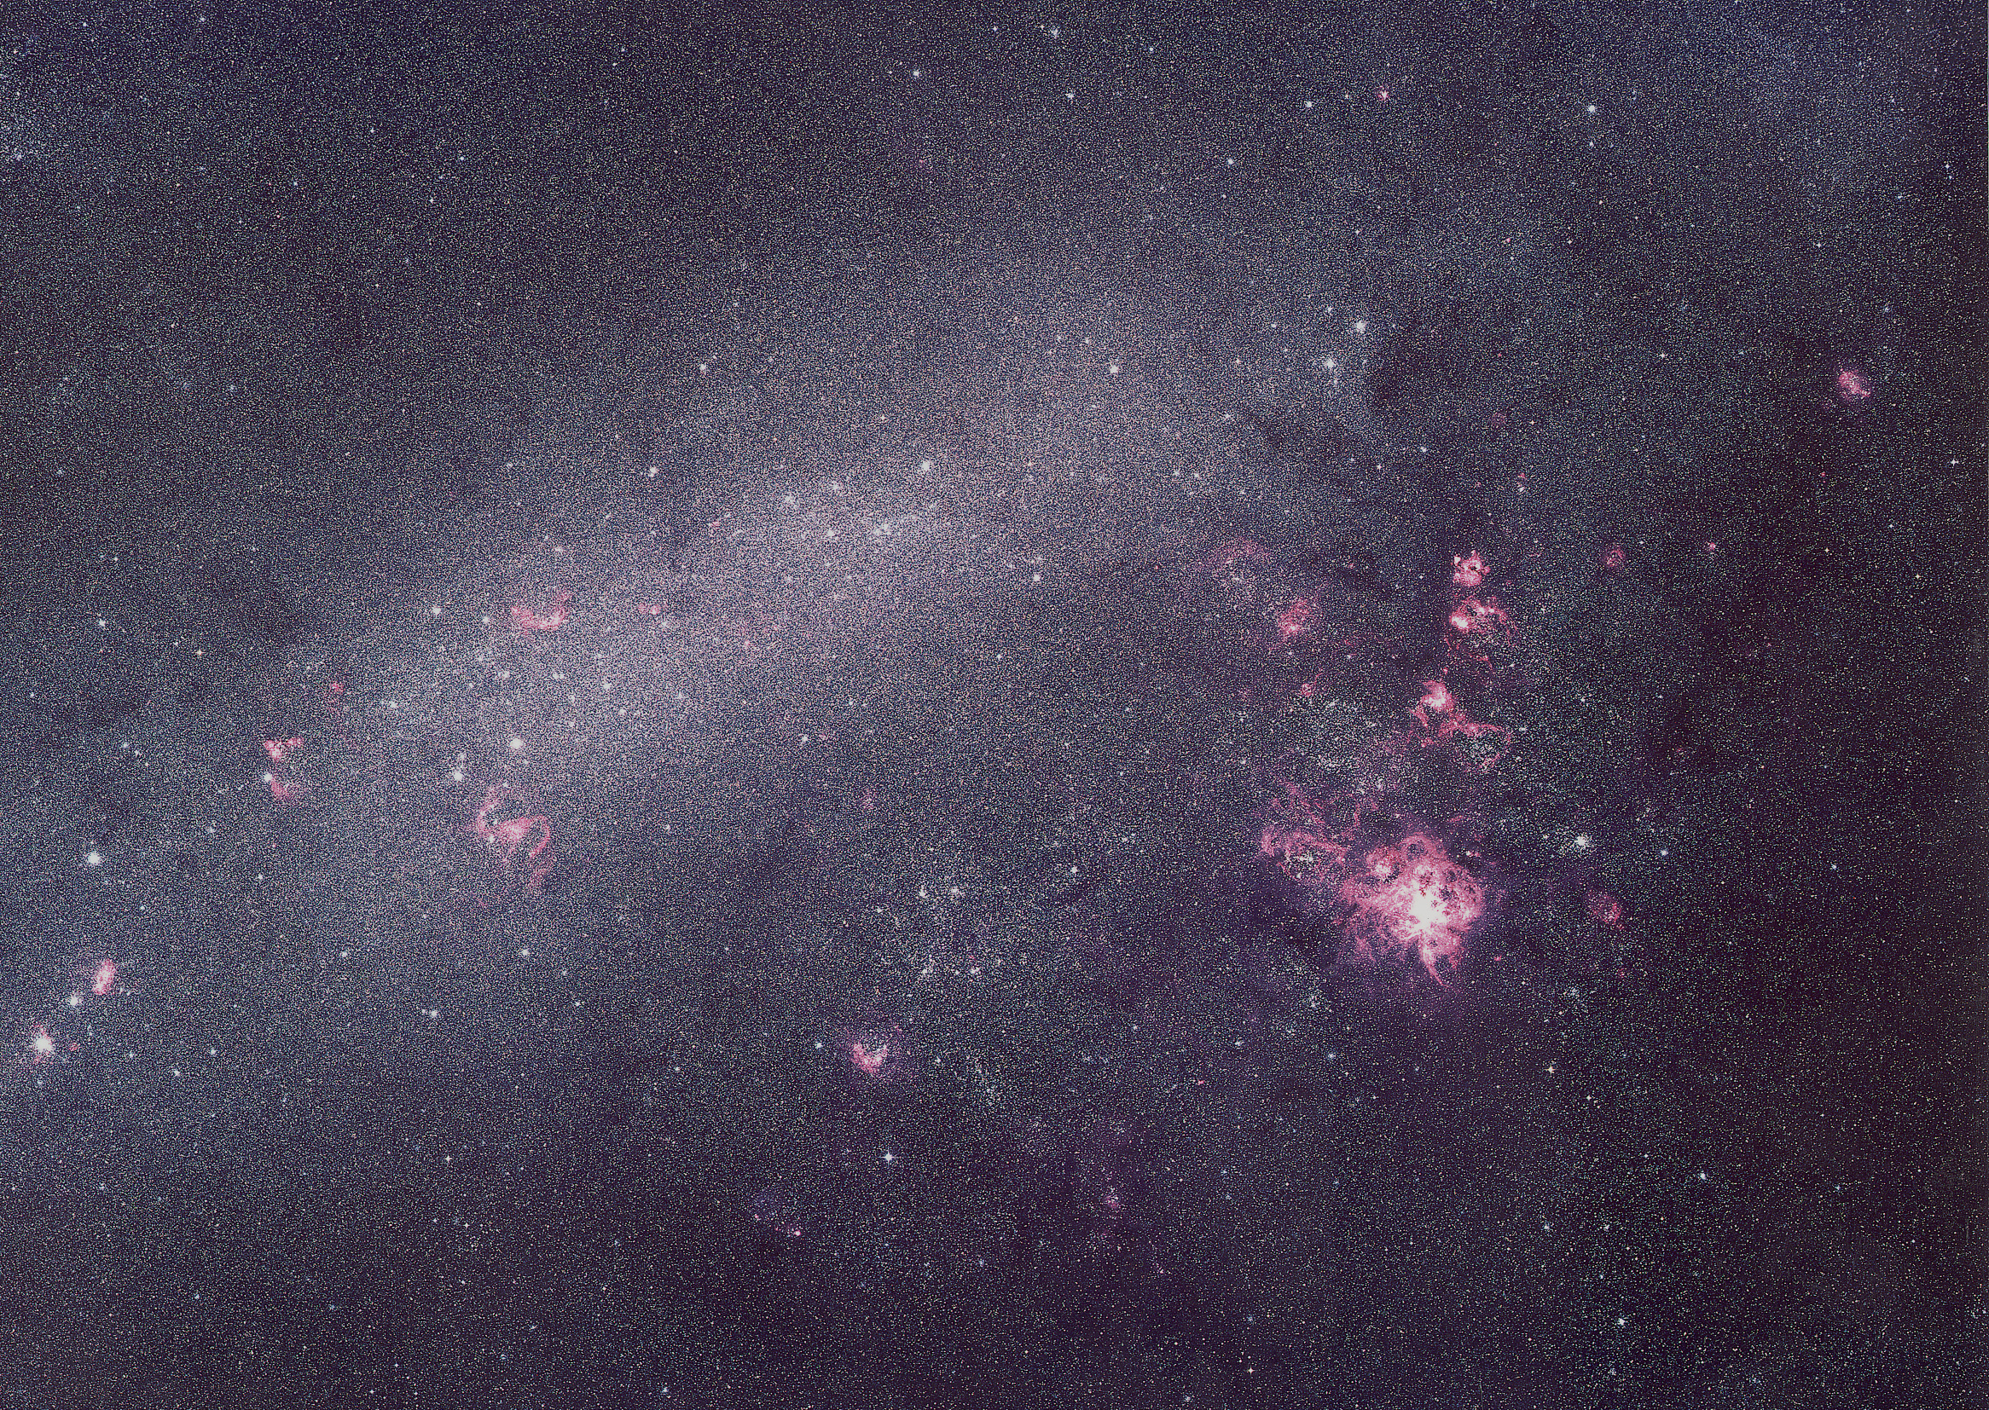
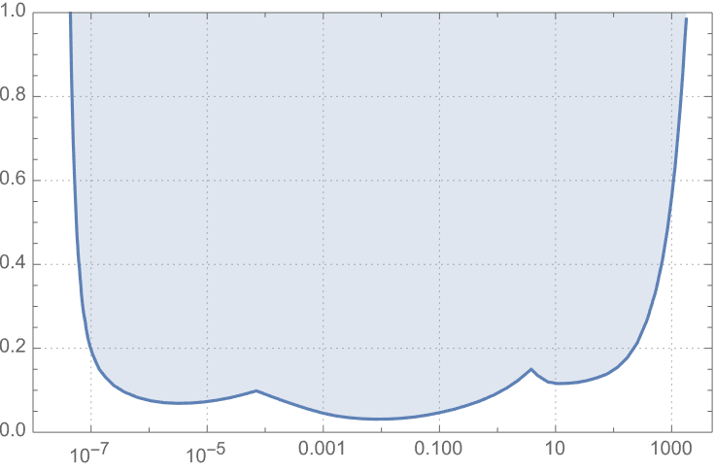
EROS combined results in dark matter (1) Galactic halo: all data + combine EROS+MACHO toward LMC
~ 80 events expected in all surveys if 100% halo @0.4M_{sol}
f = τ / 4.7x10⁻⁷
EROS1 camera + MACHO
20 minutes sampling
Combined
EROS2/MACHO
10.6 year LC
EROS1 plates
+ EROS2 + MACHO
M/M☉

Slide 10
EROS combined results in dark matter (1) Galactic halo: all data + combine EROS+MACHO toward LMC
Compact objects with 10⁻⁷< M < 1000 M☉ not a major component of a standard Galactic Dark Matter halo (@95%CL)
Tisserand et al. A&A 469, 387 (2007)
Moniez, Gen Relativ Gravit 42:2047 (2010)
Blaineau et al. A&A, 664, A106 (2022)
f = τ / 4.7x10⁻⁷
EROS1 camera + MACHO
20 minutes sampling
Combined
EROS2/MACHO
10.6 year LC
EROS1 plates
+ EROS2 + MACHO
M/M☉

Slide 11
EROS combined results in dark matter (1) Galactic halo: all data + combine EROS+MACHO toward LMC
Compact objects with 10⁻⁷< M < 1000 M☉ not a major component of a standard Galactic Dark Matter halo (@95%CL)
Tisserand et al. A&A 469, 387 (2007)
Moniez, Gen Relativ Gravit 42:2047 (2010)
Blaineau et al. A&A, 664, A106 (2022)
f = τ / 4.7x10⁻⁷
EROS1 camera + MACHO
20 minutes sampling
Combined
EROS2/MACHO
10.6 year LC
EROS1 plates
+ EROS2 + MACHO
Objects within this mass range
Contribute for less than 20% of the halo
M/M☉
10⁻⁷M_{sun}
200.M_{sun}

Slide 12
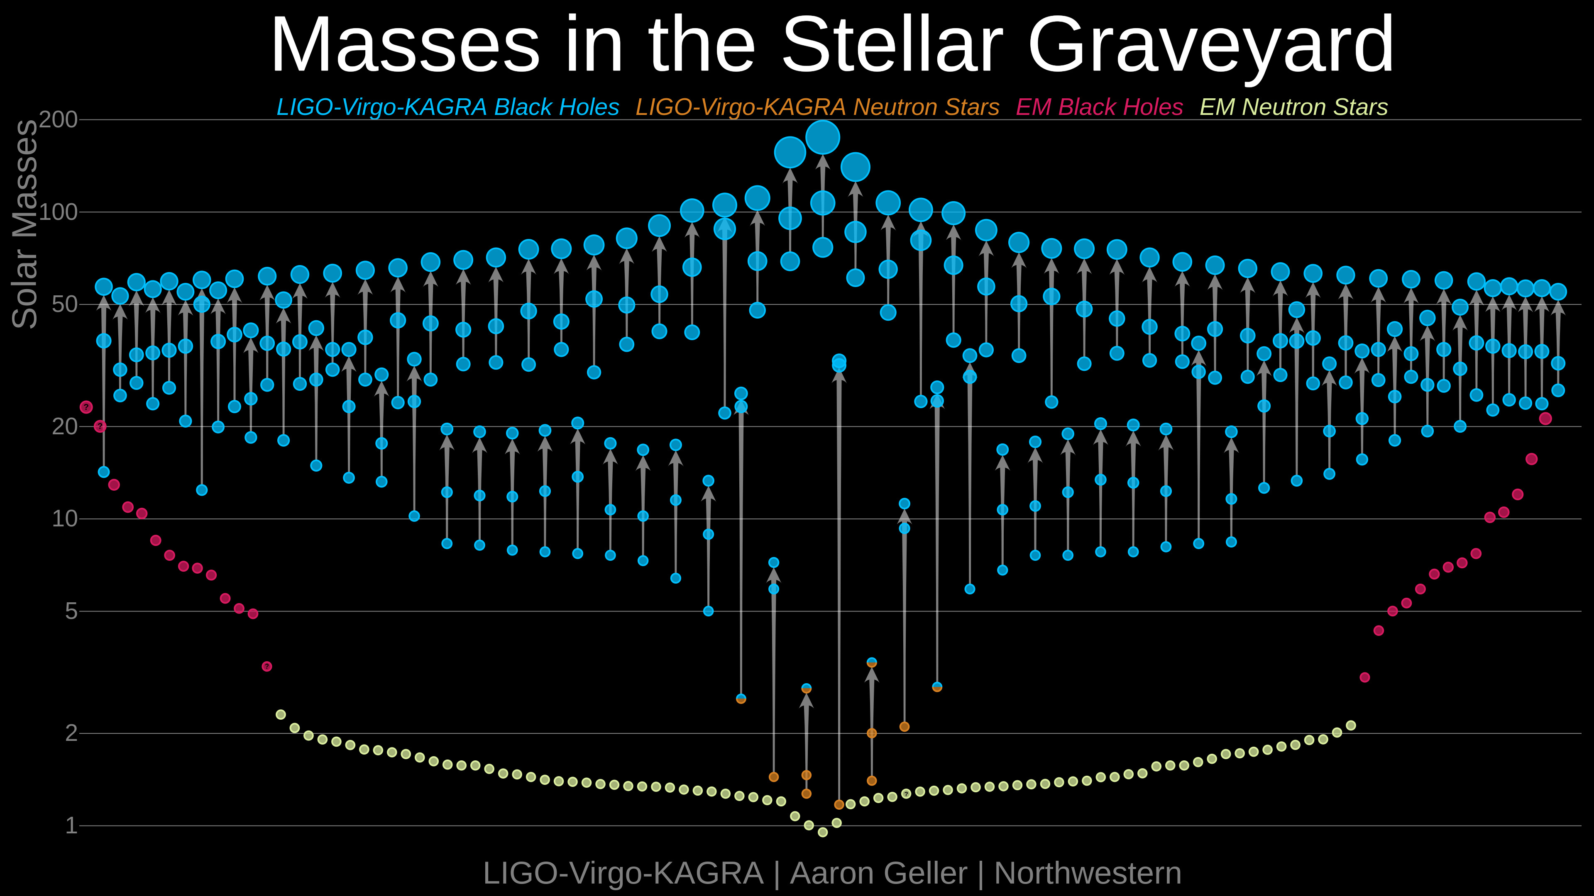
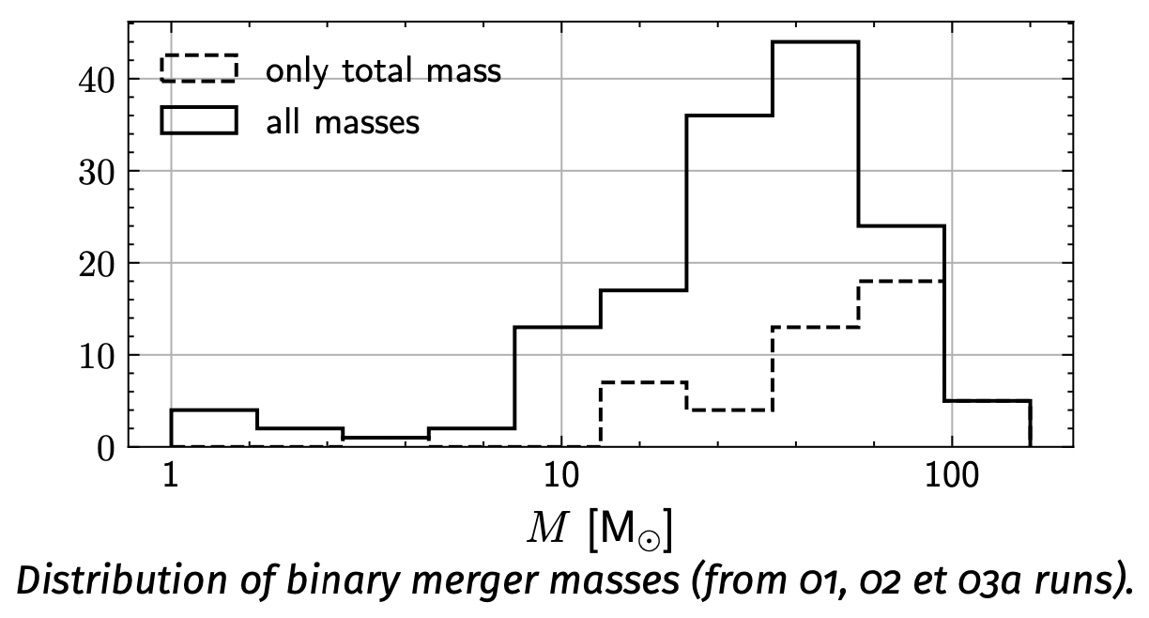
EROS combined results in dark matter (1) Galactic halo: all data + combine EROS+MACHO toward LMC
f = τ / 4.7x10⁻⁷
Objects within this mass range
Contribute for less than 20% of the halo
M/M☉
10⁻⁷M_{sun}
200.M_{sun}

Slide 13
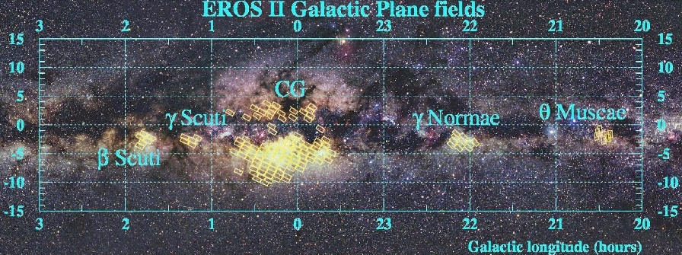
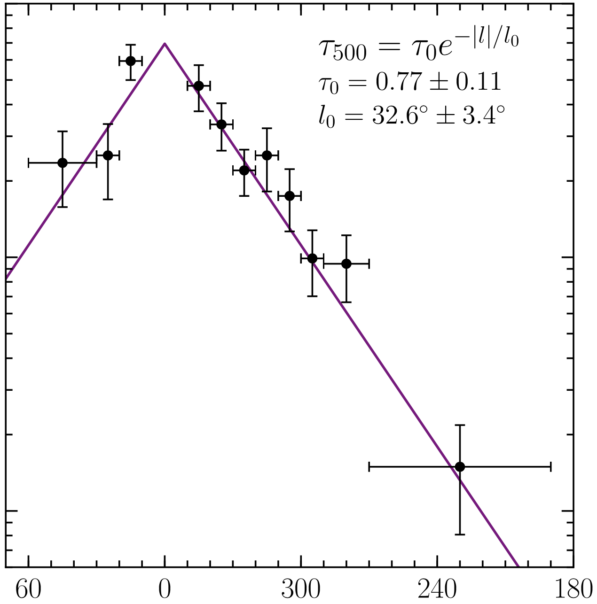
Mapping of τ in galactic longitude ! catalog dependent ! EROS 2 deeper than OGLE => τ_{EROS} larger
EROS results in microlensing (3) Galactic plane : Galactic spiral arms (EROS exlusivity until 2020)
No indication of Compact Objects in a thick disk
Rahal et al. A&A, 500, 1027 (2009)
+ full interpretation (with CMDs) in
Moniez et al. A&A 604, A124 (2017)
Mróz, ApJS249, 16 (2020)

Slide 14
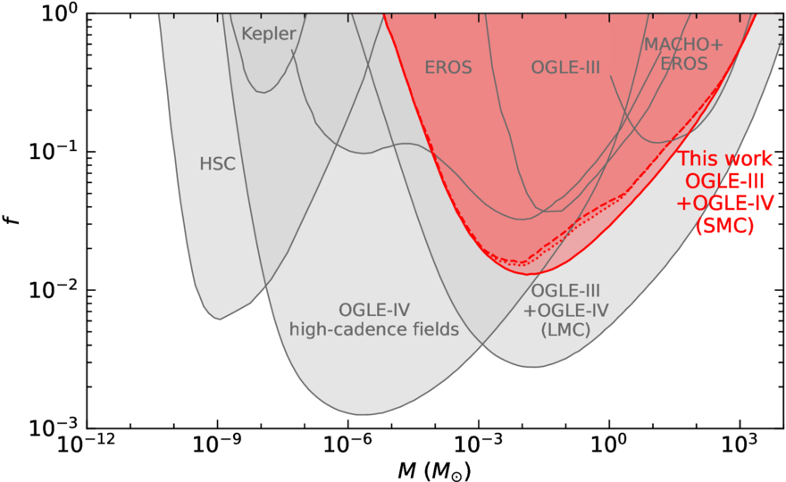
Constraints on compact objects from all microlensing surveys: EROS, MACHO, OGLE

Slide 15
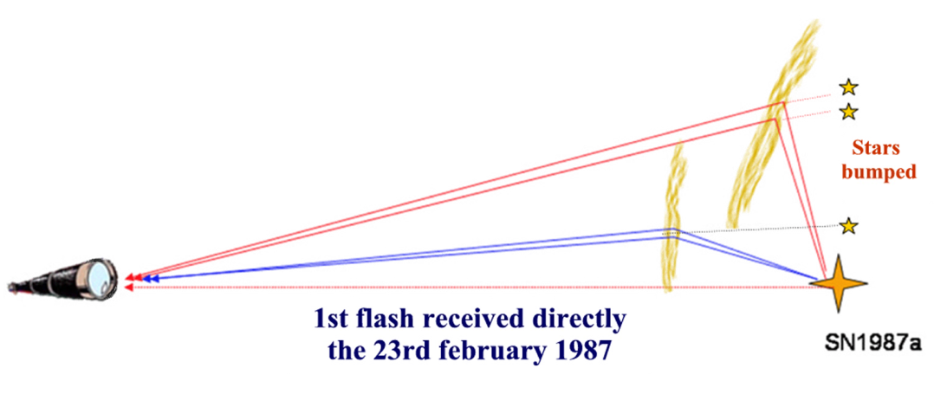
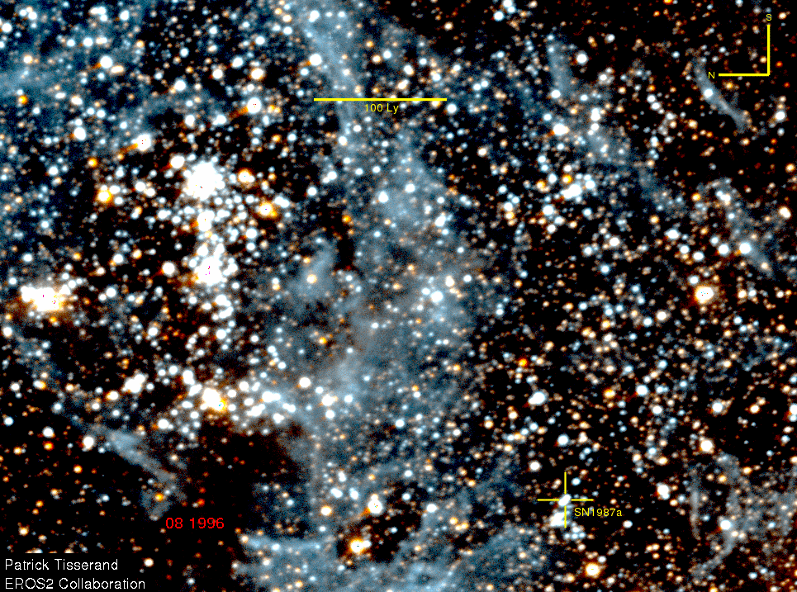
Serendipitious discovery
Residual microlensing background
SN1987A echoes
Diffusion of the light emitted by the SN on interstellar gas
If superimposed on a monitored star -> brightness seems to vary
Unexpected microlensing background…

Slide 16
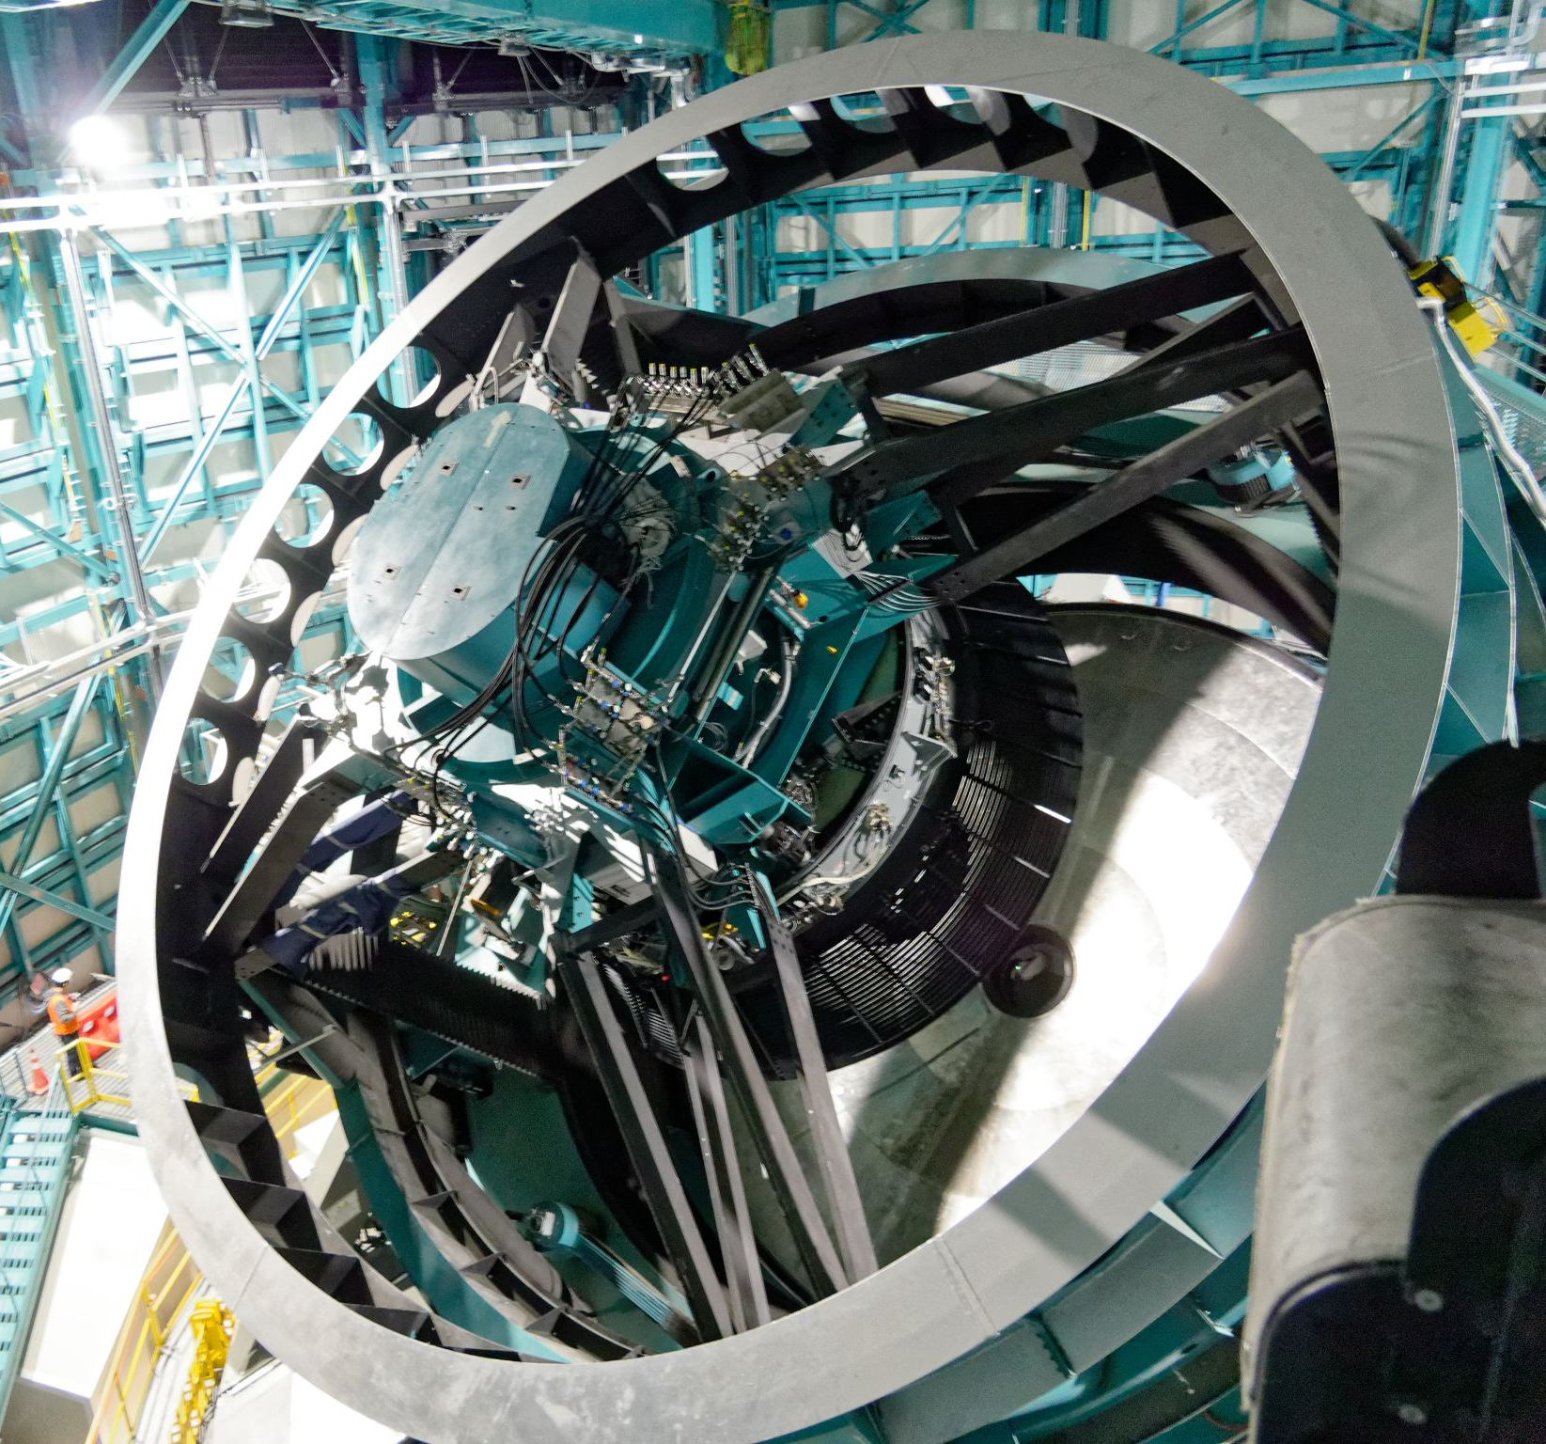

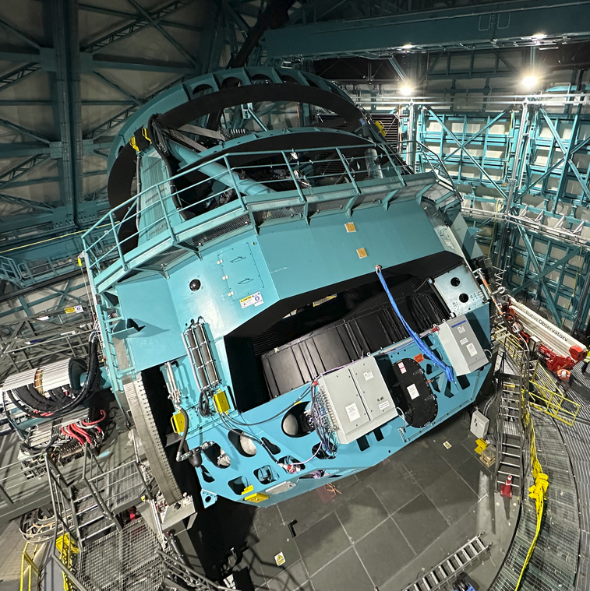
LSST in a few figures
Optical telescope 8.4 m diameter (6.7 m effective aperture)
Wide-field camera : 3.5°, 3.2 Gpixels
6 wide-band filters u g r i z y
Galaxies: r_{lim}=27.5 after 10 year coadd.
Final catalogue: 10¹⁰ galaxies, 10¹⁰ stars
Final database 15 PetaBytes
Weak lensing up to z ~ 3
1,000,000 SNIa up to z ~ 1
Transients with alerts (10⁷/night)
> 2000 scientists in the world (50% US)
USA, Chile & France-IN2P3 (builder since 2005) have privileged access to all data
See LSST science-book http://www.lsst.org

Slide 17
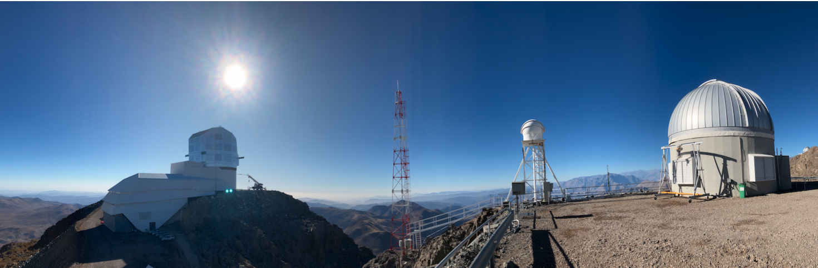
Summary of Science Requirements
Survey Property | Performance
Main Survey Area / duration | 18000 sq. deg. / 10 years
Total visits per sky patch | 825 (1 visit per ~3-4 nights)
Filter set | 6 filters (ugrizy) from 320-1050nm
Single visit | 30 second exposure + 1s shutter + 3s readout)
Single Visit Limiting Magnitude (AB 5σ) | u = 23.9; g = 25.0; r = 24.7; I = 24.0; z = 23.3; y = 22.1
10 year coadd. Limiting Magnitude | u = 26.1; g = 27.4; r = 27.5; I = 26.8; z = 26.1; y = 24.9
Photometric calibration | < 5mmag repeatability & colors, <10mmag absolute
Median delivered image quality | ~ 0.7 arcsec. FWHM
Transient processing latency | 60 sec after last visit exposure
Data release | Full reprocessing of survey data annually
Notes:
Soleil dans le nuage de Magellan: V=23.5

Slide 18
LSST Microlensing perspectives
O(10⁸ stars) monitored with Dm < 5mmag
Towards Milky-Way and LMC/SMC
On average every 4th night during 10 years
10’s of thousands of microlensing events expected, including exotic events
Mapping the Milky-way optical depth and duration distribution
Milky-way kinematical information
Lens IMF
Thick disk, residual fraction of hidden baryonic mass
Detection of exotic events, coupling with follow-up through alert system (Fink)
Binarity, planetary rates
Enriched information
(Dark Matter: don’t expect significant progress)

Slide 19
Microlensing challenges for LSST
Selection criteria
On-line trigger to initiate follow-up (Fink…)
Off-line to search for any exotic events
Exploit the excellent photometric repeatability (<1% for g<21) to search for large impact parameter events and non-standard events
Estimate efficiency <ε(t_{E})>
Use astrometric information
Decrease microlensing degeneracy (D_{os})
Synergies
EUCLID (ground-space parallax, NIR)
On Earth follow-up telescopes

Slide 20
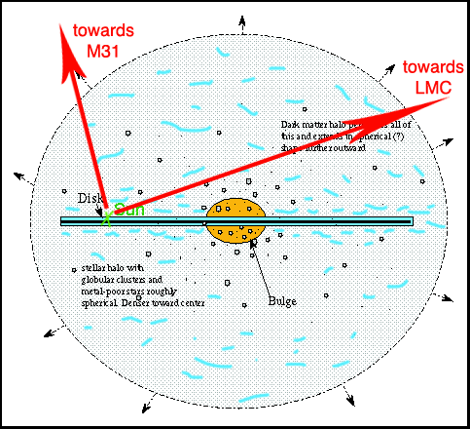
But: where are the hidden baryons?
-> A new technique to measure the last unknown contribution to the baryonic hidden matter: cold H₂ (+He)
Cold (10K) => no emission. Transparent medium.
In the thick disk or/and in the halo (low metallicity)
If it makes 100% of the halo, then average column density toward LMC is
Fractal structure: gas covers ~ 1% of the sky. Clumpuscules ~10 AU (Pfenniger & Combes 1994)
250g/m² <=> column of 3m H₂ on average (normal cond.)
~ 300m H₂ over 1% of the sky

Slide 21
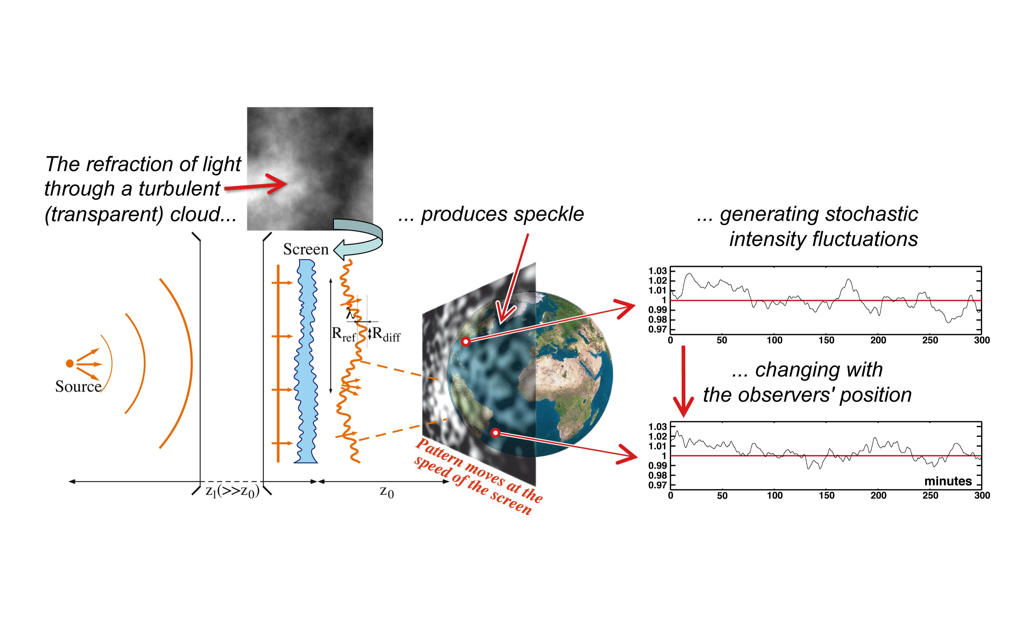
Search for missing H₂ turbulent galactic gas
through scintillation detection (the OSER project)
Light received by telescope varies with
- timescale ~10 min (due to the relative velocity of the gas)
- modulation of a few % (depending on distances / turbulence parameters / source extension)

Slide 22
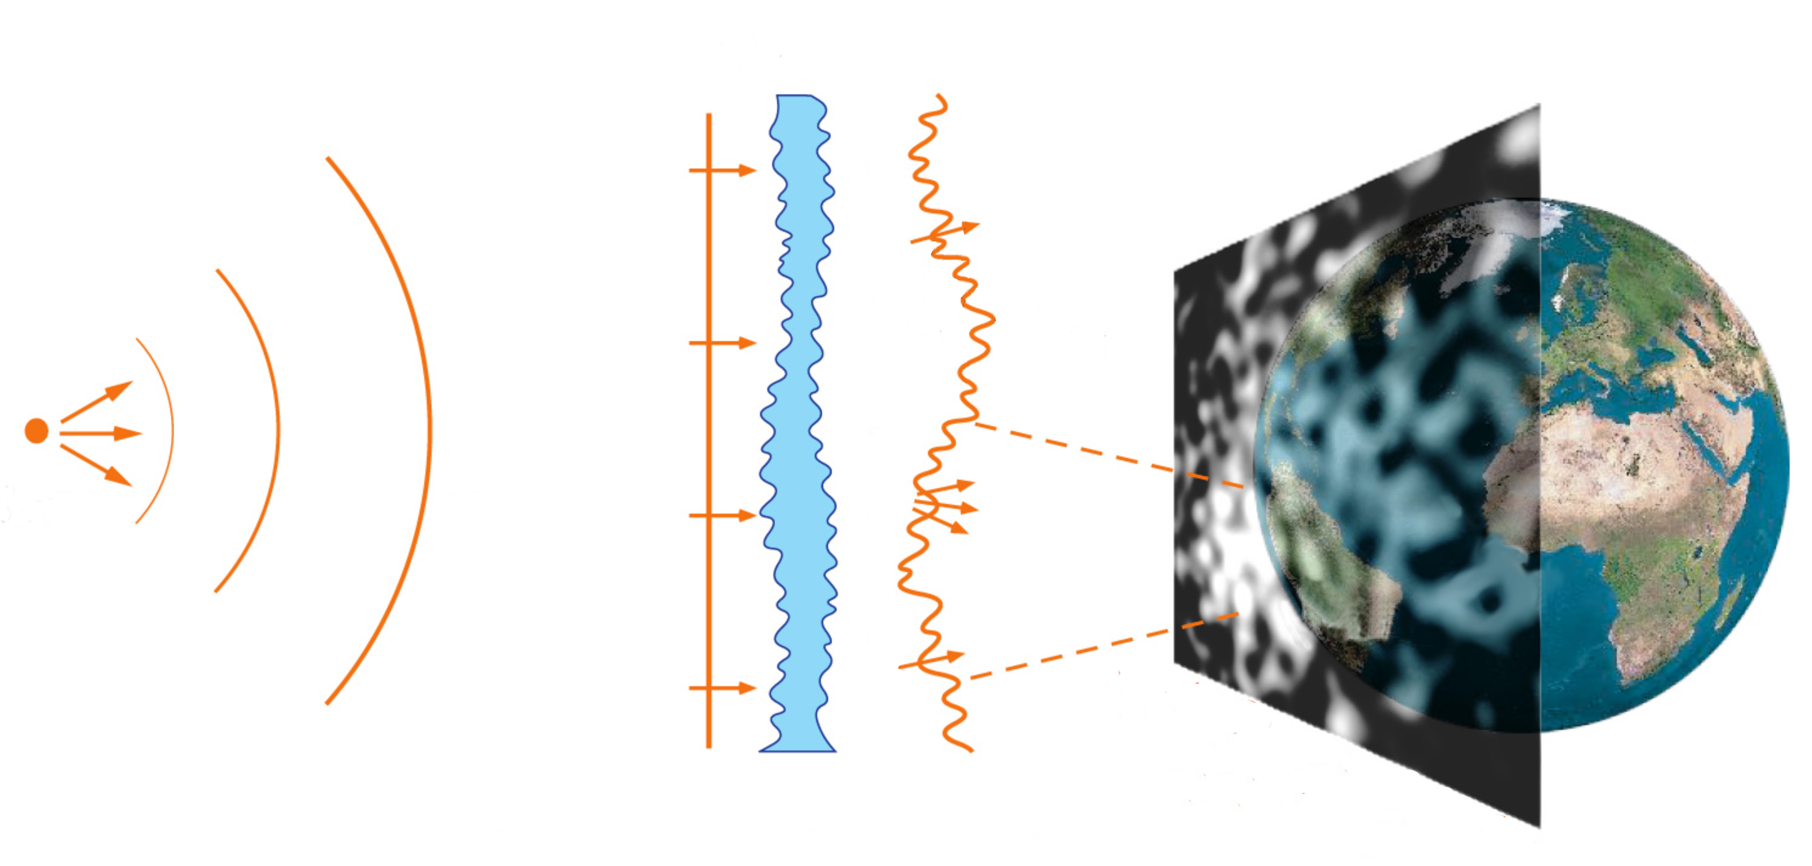
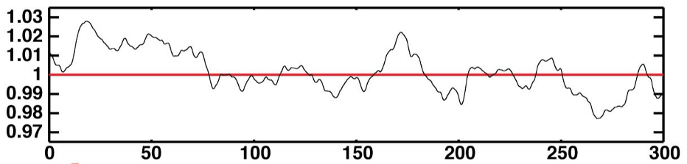
Scintillation with Vera Rubin telescope (15s exposures)
Turbulent gas structures in Galactic halo
Source@55Kpc (LMC) in V
Screen@1Kpc : halo- hidden gas
photometric precision
for T_{exp} = 15s
For a given value of the turbulence parameter R_{diff} ->
modulation m = σ_{I} /<I> decreases with the sources’ magnitude since the apparent stellar radius increases (here MS star)
Scintillation
detectable
with LSST
Typical light-curve with m ~ 1% (simulation)
Turbulence strength
T_{exp} = 15s
V_{source}

Slide 23
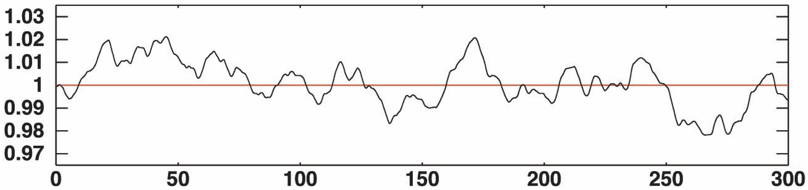
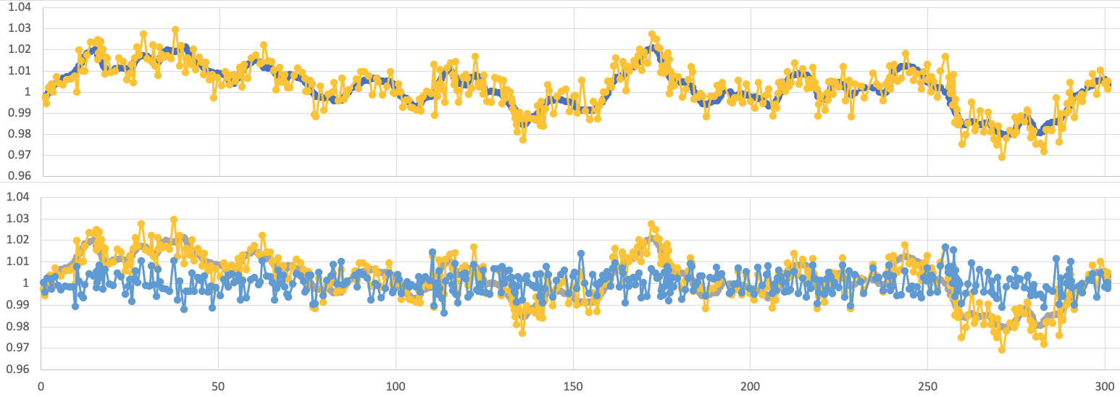
What do we expect with a film of LMC ? Simulation of a highly sampled scintillating light-curve
Theoretical curve (no uncertainty)
minutes
Expected with photometric precision of 5mmag
Same star but no scintillation
If the sampling is high enough (<1min.) -> detect the fine structure of the fluctuations

Slide 24
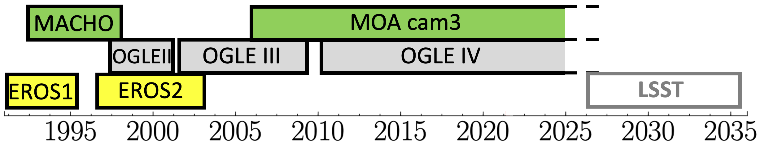
Conclusions, perspectives
Microlensing observations and the Galactic halo @LAL/IJCLab
We have combined EROS2 and MACHO lght-curves towards LMC
Compact objects with M < 1000.M☉ do not dominate a standard* Galactic DM halo (@95%CL) *isotropic and isothermal halo responsible for flat rotation curves (predicts optical depth τ = 4.7x 10⁻⁷)
What about the black holes responsible for the GW?
Do not constitute the standard Galactic DM
Could be in the visible structures of the Milky Way (end-point of IMF)? -> microlensing towards the Galatic Bulge and spiral arms may help
Perspectives: microlensing
EROS database published in 2025 for looking back in the case of emerging events
Long term LSST: combined with the historical surveys => > 40 years coverage
Perspectives: interstellar scintillation to search for H₂ contribution

Slide 25
Complements

Slide 26
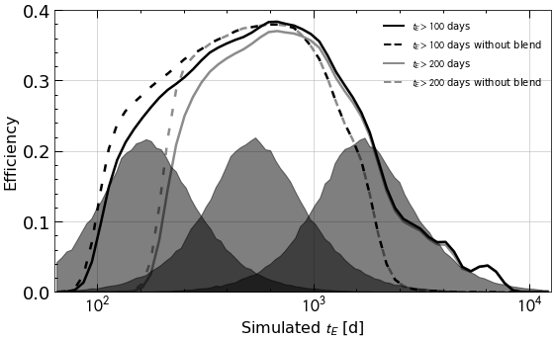
Expected signal
from the standard dark matter halo (S model)
Simulation
Simulated microlensing are applied to real light-curves according to the halo parameters
(incl. complications such as blending)
# events depends on
Halo model for compact objects
Spatial distribution
-> derive optical depth to LMC τ ~ 4.6x10⁻⁷
Velocity distribution
Mass distribution (here δ(Μ))
-> derive t_{E} distribution
Mean detection efficiency
Estimated as a function of t_{E}
# events proportional to
T_{obs}
N_{star in LMC} = 0.95 x N_{star catalog} (< 5% Milky Way stars –from GAIA data)
Final correction: max 10% of events can escape detection because they are exotic (double lens…)
With t_{E} >200 days
Distributions of t_{E} for lenses of fixed mass
10.M_{sol}
100.M_{sol}
1000.M_{sol}
All selected events from simulation
simulated events with u₀ < 1 and t₀ in T_{obs}
ε =

Slide 27
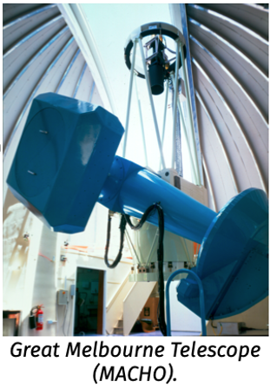
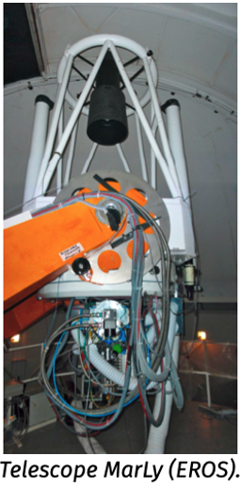
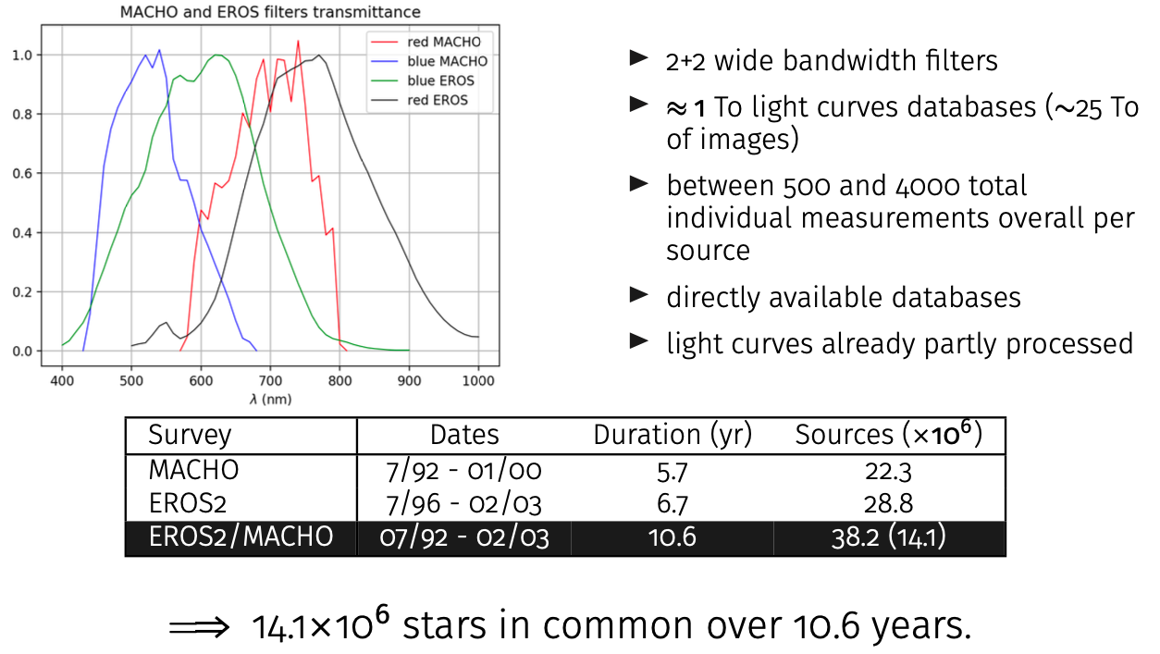
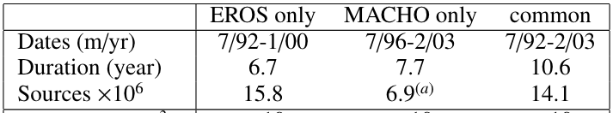
EROS2 and MACHO
Microlensing surveys towards the LMC
MACHO
1.27m telescope in Australia
2 cameras with dichroic
4 CCD 2Kx2K pixels each
Field of view: 0.5 deg²
Monitored 82 fields (39 deg²)
EROS2
1m telescope in Chile
2 cameras with dichroic
8 CCD 2Kx2K pixels each
Field of view: 1 deg²
Monitored 88 fields (88 deg²)
LMC fields
7/96-2/03 7/92-1/00

Slide 28
Alerts…
Sources detected in difference images (images with respect to coadded templates, called DIASources) reported in 60s
Filter a stream of ~ 10 million DIAsources / night
variable stars, SNe, asteroids, and “everything else »
-> Robust filtering + rapid followup
Given a stream of ~ 10,000 DIASources every ~ 40s (per 10 sq.deg. field)
- Asteroids will dominate on the Ecliptic, become insignificant >30°from it.
- Variable stars (~ 1 % of all stars) will dominate in the Galactic plane, always significant (~ 400/field @ Galactic pole)
- Quasars will contribute up to 500/field (but likely several times lower)
SNe will contribute up to about 100/field
Discovery rates will drop fast (factor of ~ 100 after 2 years)
new DIASources will become dominated by cataclysmic variable stars and quasars

Slide 29
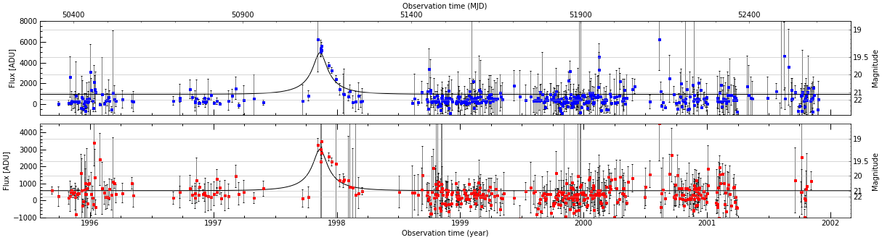
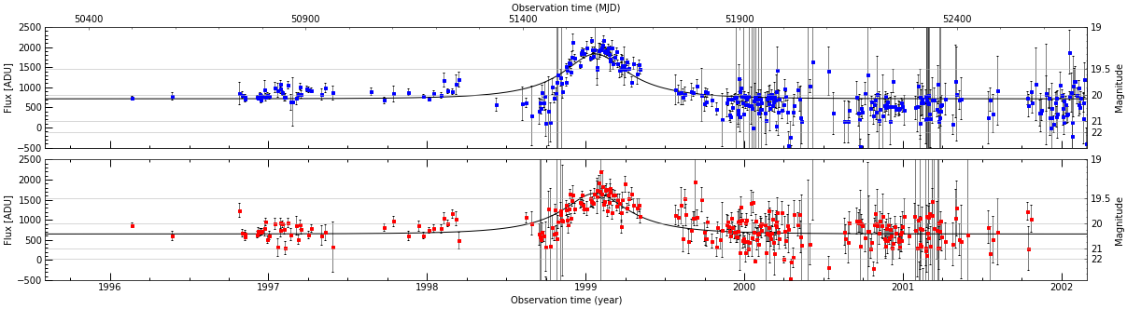
Candidates: only 2
u₀
depends on Amax
t_{E}
t₀
u₀=0.19, t_{E}=106 days.
Asymmetric, high magnification, 0.6’’ shift from min to max. -> probably SNII-L or P
u₀=0.41, t_{E}=183 days.
Suspicious variations outside main peak.
We cannot formally reject these « low quality » candidates without using more criteria (and losing efficiency)
-> We chose to keep them for exclusion limit computation
-> with negligible impact

Slide 30
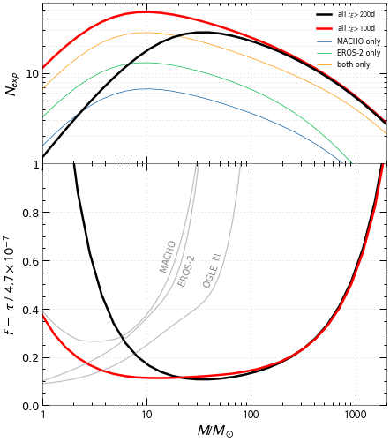
Exclusion limit (T. Blaineau et al. arXiv:2202.13819)
Expected events from the standard halo
This analysis
~ 0.64 events expected from LMC self-lensing+disk (with 100 < t_{E} < 200 days)
2 candidates selected
Likelihood analysis to find 95% CL exclusion limit
If we further require t_{E} > 200 days
0 events expected from self-lensing+disk
0 event selected
Poissonian analysis: 3 events excluded at 95%CL
High mass exclusion unchanged
t_{E} > 100 days
Total
EROS
EROS+MACHO
t_{E} > 200 days
MACHO
Excluded at 95%CL
New limit

Slide 31
IN ONE SLIDE (details follow…)
No microlensing effects towards the Large Magellanic Clouds
Compact objects < 10M_{sun} not a major component of the Milky Way halo
Historical surveys monitored millions of sources for ~ 6-7 years
Merging EROS+MACHO surveys allowed to monitor the same stars for 10.7yrs
Sensitivity to multi-year events significantly improved
New limits are established on heavier objects expected to produce such events
Tristan Blaineau’s PhD thesis

Slide 32
u₀
depends on Amax
The microlensing observables
t_{E}
t₀
Simple events (point-source, point-lens, constant v_{T})
Event by event Einstein radius crossing time t_{E}
Statistical information from a series of events:
optical depth τ and t_{E} distribution
-> Constraints on total (visible + hidden) mass
-> Constraints on lens mass function
-> Constraints on relative obs/lens/source kinematics
Non-standard events
Parallax, Xallarap, extended source, multiple lens/sources… -> extra-information on distance, mass, velocity
Not considered here for statistical studies

Slide 33
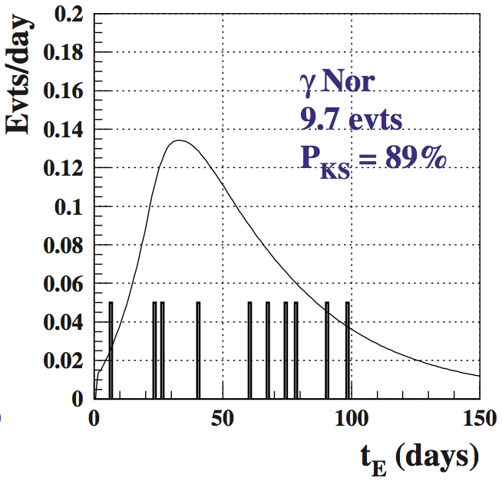
Statistical information from a set of events
- Optical depth τ :
probability for a star to be behind an Einstein disk
Disk surface α R_{E}² α M_{lens}
τ α Σ M_{lens}
Does not depend on the mass distribution
- Einstein ring crossing time t_{E} = R_{E}/V_{t} distribution Use first moments (mean, sigma) or KS-type tests to compare with models
Note: u₀ and t₀ do not provide physical information, but should have a flat prior distribution -> use this to check signal quality

Slide 34
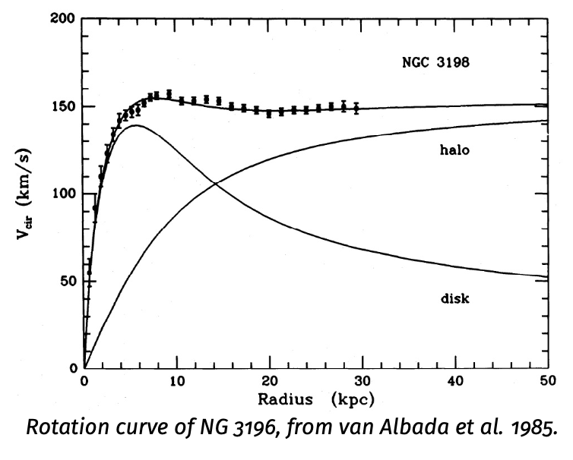
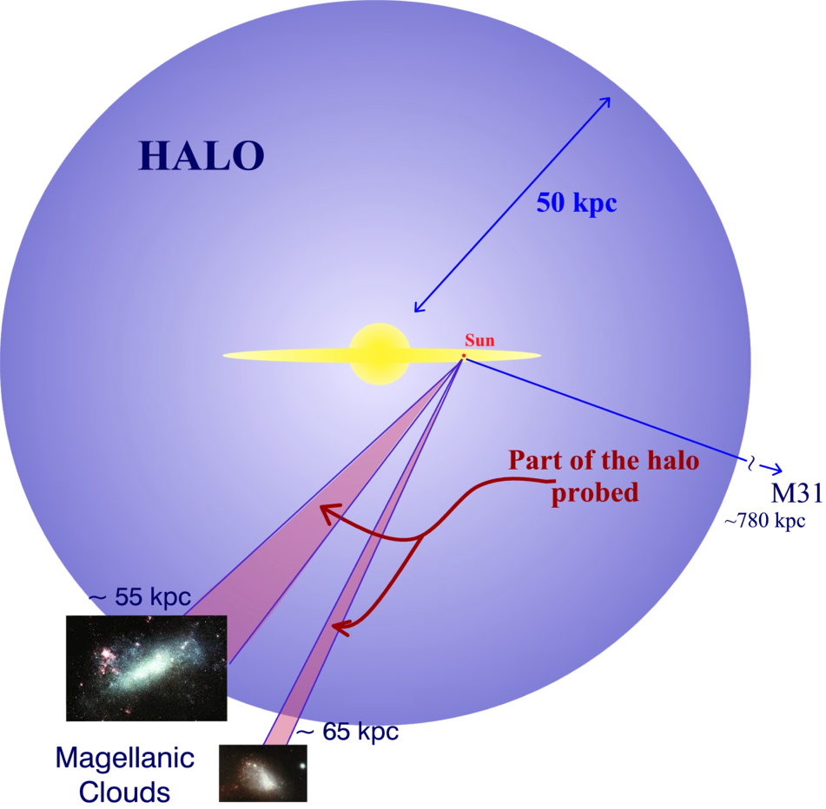
Initial motivation for microlensing searches (90’s): contribution of compact objects to the galactic halo
Sub-stellar mass or invisible stellar mass baryonic objects
Others (accreted particles)
If extended, should be transparent or with occultation radius < R_{E} ~ 1AU to be a lens
Includes black holes and non baryonic massive objects

Slide 35
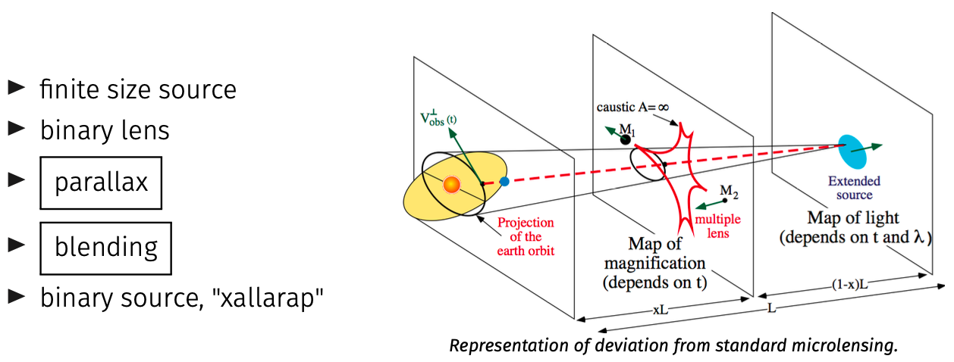
Beyond point source point lens rectilinear microlensing (PSPL)
u₀
depends on Amax
t_{E}
t₀

Slide 36
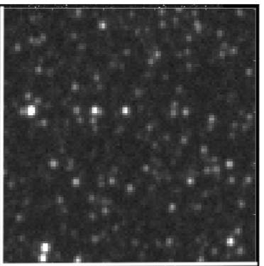




Cleaning low quality images/measurements
Images from MACHO
Good
Bad guiding
defocused
readout
readout
Bad guiding
Condensation (?)
Cleaning: 3% of Macho and 1% of EROS measurements removed

Slide 37

EROS vs HST

Slide 38

EROS vs HST

Slide 39
EROS vs HST

Slide 40



Efficiency
OGLE (2015)
MOA
Averaged on a given source population (RG, all)
Depends on sampling and environment
Averaged on u₀, t₀ -> to obtain a Function of t_{E} only

Slide 41
Several sources of gain
Previous analysis explicitely rejected long events
To have a long enough baseline / reject LPV
Here we use the 2 published catalogs
Cumulate EROS + MACHO statistics and time coverage
22.7 million sources monitored for 6.7 (EROS) or 7.7 (MACHO) years (not in common fields)
14.1 million sources monitored for 10.6 years (in common)
Detection efficiency for these curves is x by ~ 4
Contribute for 72% of the expected detections for a halo made of 1000.M_{sol} lenses

Slide 42


Mapping of τ in galactic longitude
EROS results in microlensing (3) Galactic plane : Galactic spiral arms (only EROS before 2020)
No indication of Compact Objects in a thick disk
Rahal et al. A&A, 500, 1027 (2009)
+ full interpretation (with CMDs) in
Moniez et al. A&A 604, A124 (2017)

Slide 43






Discriminant analysis
u₀
depends on A_{max}
t_{E}
t₀
Based on the comparison of the χ² of a constant fit and a microlensing fit, simultaneous to the 4 light-curves.
- Constant fit (flat) : 4 parameters, 1 mean flux/colour.
Microlensing fit (μ) : 7 parameters, common u₀, t₀, t_{E}, 1 base flux/colour (could be more than 4 when adding OGLE/MOA)
Goodness of μlensing difference (flat – μlensing)
Data
Require long events and well contained
100 days < t_{E} ^{fitted} < T_{obs} /2 ~ 2000 days
T_{start} + 200 days < t₀^{fitted} < T_{end}
Simulation
selection

