Slide 1
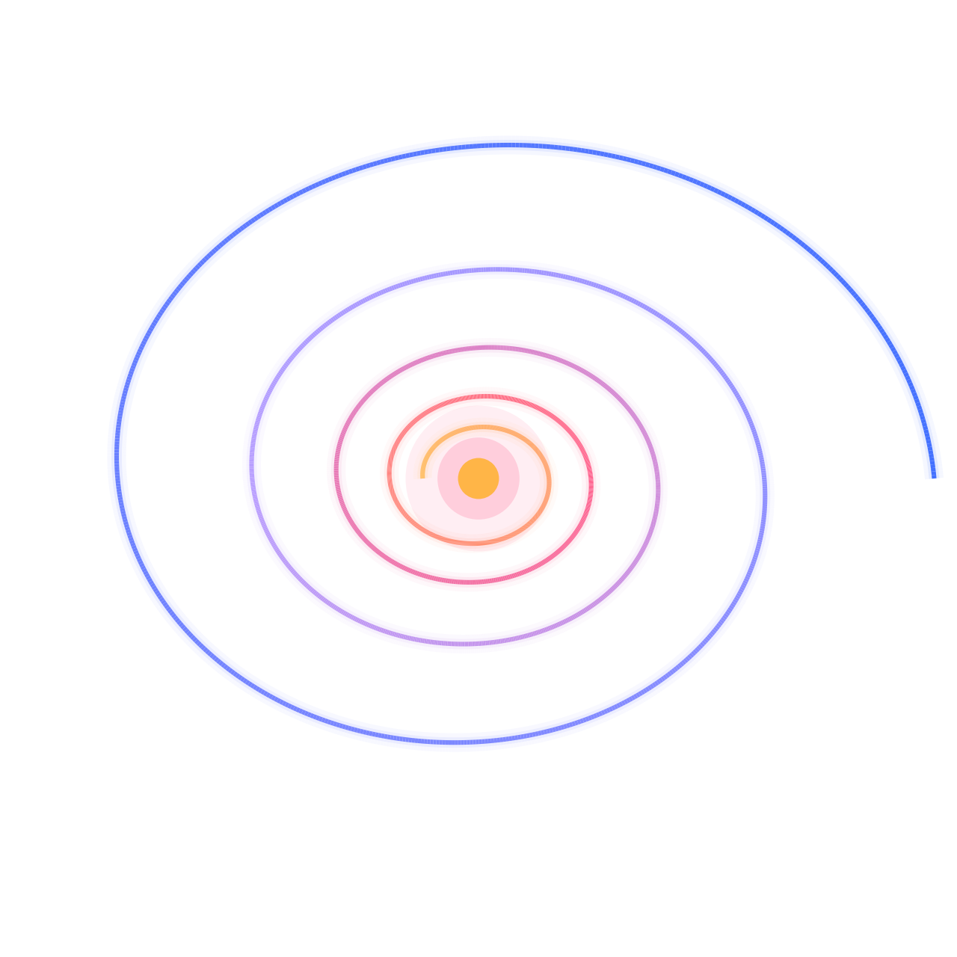



PARIS-SACLAY ASTROPARTICLE SYMPOSIUM 2026
Thermal Damping
of Scalar Fields
How a thermal bath tames overclosure, and erases isocurvature
Sarunas Verner
with Erwin H. Tanin
Notes:
[~0:30] Title. One-line pitch: a light scalar that talks to the primordial plasma feels a friction that depends on its own amplitude. That friction has an attractor, and the attractor fixes both the relic abundance and kills isocurvature. The spiral is literally a damped oscillation in phase space collapsing onto a point.

Slide 2



Dark matter: we know how much, not what
01 · THE DARK SECTOR
≈ 5× more than ordinary matter
Ω_{c}h² ≈ 0.12 (Planck 2018): only interacts gravitationally
27%
Cold and collisionless
Slow enough to cluster on small scales
dark matter
Adiabatic
Its fluctuations track the photons: isocurvature ≲ a few %
● 27% dark matter ● 5% baryons ● 68% dark energy
THIS TALK: a displaced light scalar
CANDIDATE MASSES SPAN ~50 ORDERS OF MAGNITUDE
ultralight bosons: wave-like
particles: sterile ν, WIMPs…
heavy and super-heavy relics
10⁻²² eV
10⁻¹² eV
μeV
eV
keV
GeV
TeV
10¹⁰ GeV
M_{Pl}
Notes:
[~1:00] Planck pins the dark-matter density to a percent, but the candidates span ~50 orders of magnitude in mass. Click: three facts we do know. Stress the third one: DM is adiabatic; that is the constraint that will bite. Click: the mass ladder. Click: this talk lives at the ultralight end: a scalar field displaced from its minimum, i.e. misalignment.

Slide 3




Light scalars and the CMB: it’s complicated
02 · THE PROBLEM, IN ONE CONVERSATION
Planck
SCORECARD
online · staring at the CMB since 2009
ISOCURVATURE
Hi Planck! Can I be all of the dark matter?
δχ ~ H_{inf}/2π, uncorrelated with the curvature perturbation ζ
Sure, as long as your perturbations are adiabatic.
Hmm. I was a light spectator during inflation…
OVERCLOSURE
Huge X_{i} ⇒ far too much dark matter
Then δχ ≈ H_{inf}/2π. That’s isocurvature. β_{iso} < 0.04.
Fine, I’ll start hugely displaced: X_{i} ≫ H_{inf}!
PLOT TWIST?
…and overclose the Universe? Next.
Talking to the plasma changes the story
What if I had friends in the thermal bath?
Light spectators fluctuate. Planck notices.
Notes:
[~0:45] Four clicks; each click sends a message and Planck auto-replies. This is the whole problem in one screen: (1) a light spectator picks up de Sitter fluctuations δχ ≈ H_inf/2π uncorrelated with ζ: isocurvature, β_iso < 0.04; (2) the fix "start with a huge displacement" overcloses the Universe. Last click: the plot twist, coupling to the thermal bath.

Slide 4

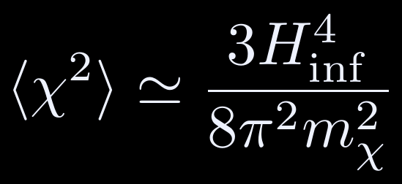



Light scalars face the same problem
03 · GENERIC LIGHT SCALARS
ROAD A
ROAD B
THIS TALK
Sit at the minimum
Start displaced
Stochastic equilibrium: χ is pure fluctuation, so δχ/χ ~ 1 and isocurvature is O(1).
Isocurvature is suppressed by H_{inf}/X_{i}: just make X_{i} huge…
Only safe if heavy: m_{χ} ≳ H_{inf}
…but huge X_{i} ⇒ overclosure
Notes:
[~1:00] Two options for any light spectator. Road A: let it sit at the minimum. Then de Sitter fluctuations build up the Starobinsky–Yokoyama equilibrium ⟨χ²⟩ = 3H⁴/8π²m²: the field IS the fluctuation, O(1) isocurvature. Only fine if the field is heavy, m ≳ H_inf, which suppresses the fluctuations. Click: Road B, start displaced. Isocurvature ∝ H_inf/X_i is small for large X_i, but large X_i means too much dark matter. Click: this talk takes Road B.

Slide 5
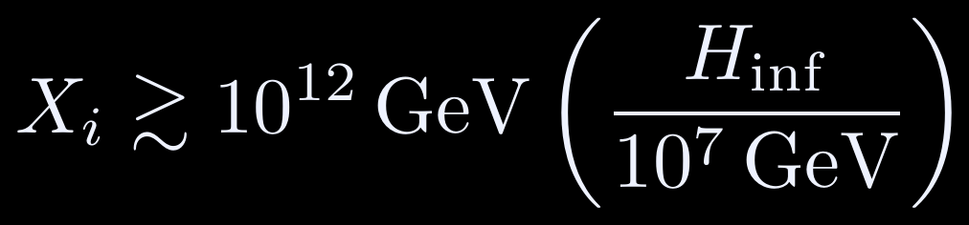


The squeeze: isocurvature vs. overclosure
04 · THE SQUEEZE
10²⁰
overclosure (m_{χ} = 1 eV)
ISOCURVATURE (PLANCK)
high-scale inflation (r ≳ 10⁻³): excluded
10¹⁷
OVERCLOSURE (NO DAMPING)
X_{i} [GeV]
10¹⁴
No room at all if
10¹¹
allowed
isocurvature
Same ~10⁷ GeV ceiling as the axion.
10⁸
Both bounds assume χ evolves in isolation. What if it talks to the plasma?
10⁴
10⁶
10⁸
10¹⁰
10¹²
10¹⁴
H_{inf} [GeV]
Notes:
[~1:00] Plane of initial displacement vs inflationary Hubble rate, schematic for m_χ = 1 eV. Click: isocurvature (Planck, β ≲ 0.04) needs X_i ≳ 10^12 GeV (H_inf/10^7 GeV). Click: overclosure without damping needs X_i ≲ 10^12 GeV (m/eV)^-1/4. Click: what is left is a sliver, gone for H_inf ≳ 10^7 GeV (m/eV)^-1/4: the same ceiling as the axion. (Numbers as in the draft, Sec. IV A.) Click: high-scale inflation sits deep in the excluded region. Teaser: both bounds assume the scalar is isolated.

Slide 6
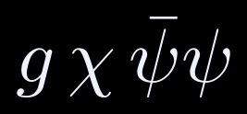






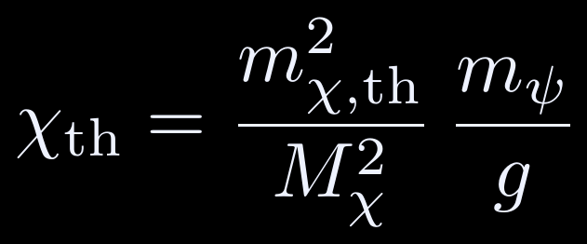

Plot twist: let the scalar talk to the plasma
05 · ENTER THE PLASMA
modulates M_{ψ}
re-equilibrates ψ
n is set by the ψ–SM portal
χ condensate
ψ: thermal fermion
SM plasma
displaced, then oscillating: X cos θ
its mass is modulated: M_{ψ} = |m_{ψ} − gχ|
temperature T, keeps ψ in equilibrium
Thermal mass
Shifted minimum
Thermal damping
equilibrium · c_{m} = 1/√6 (Dirac ψ)
equilibrium · M_{χ}² = m_{χ}² + m_{χ,th}²
out of equilibrium (next slide)
← the bath lags behind χ
Notes:
[~1:00] Minimal model (mostly-minus signature, as in the new draft): χ controls the mass of a Dirac fermion ψ that is in thermal contact with the SM with relaxation rate Γ_th = κ T^n. Click: the chain χ → ψ → plasma. Click: in equilibrium the ψ gas gives a thermal mass m_χ,th = c_m g T (c_m = 1/√6) and shifts the minimum to χ_th = (m_th²/M_χ²) m_ψ/g. Click: the new ingredient: ψ relaxes at a finite rate, so its response lags χ, and the lag is a friction −Υ χ̇.

Slide 7
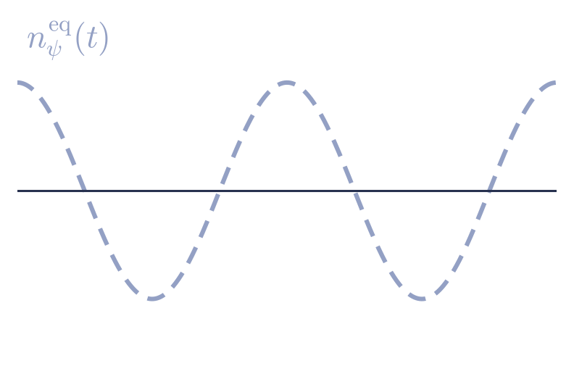
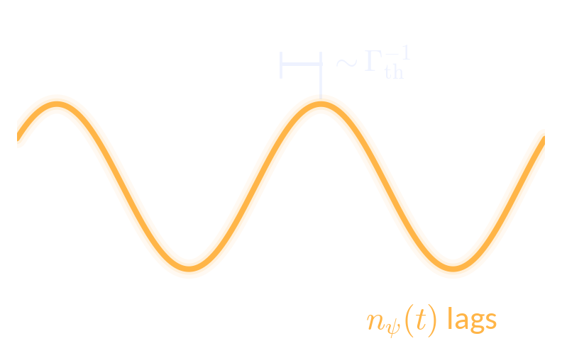
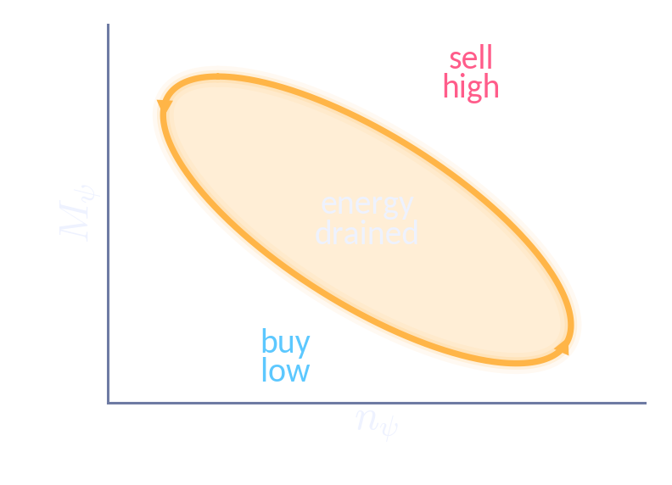
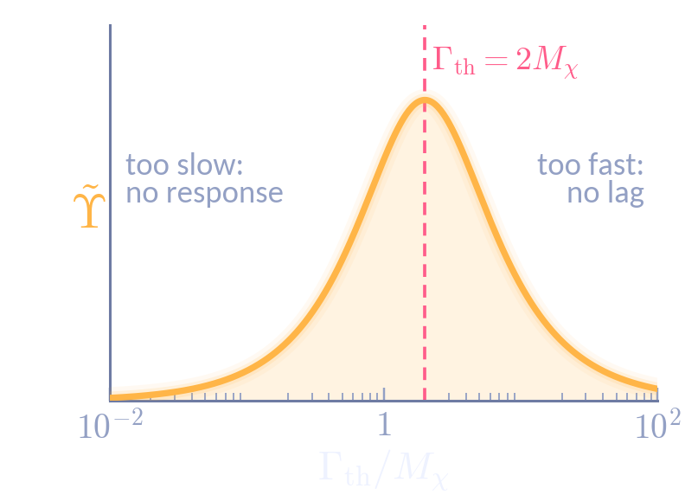
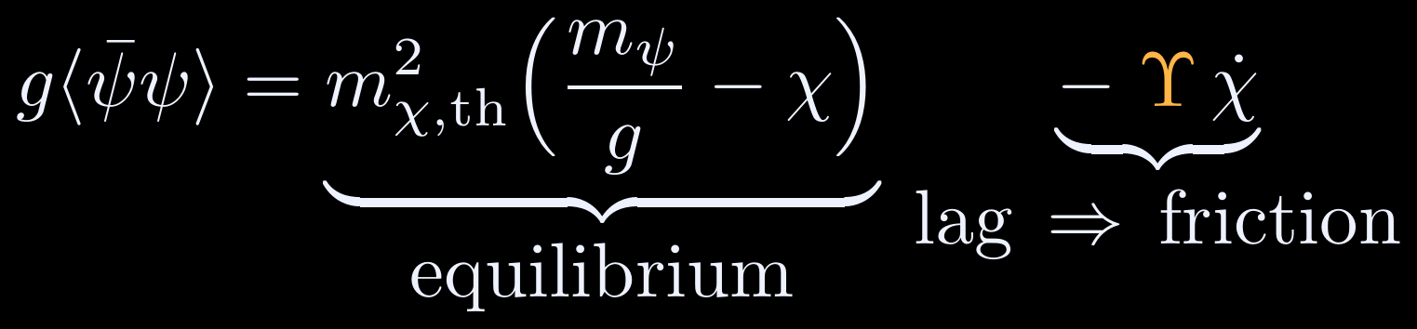
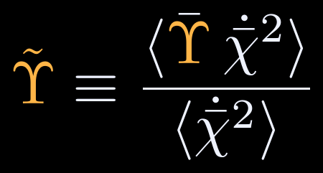
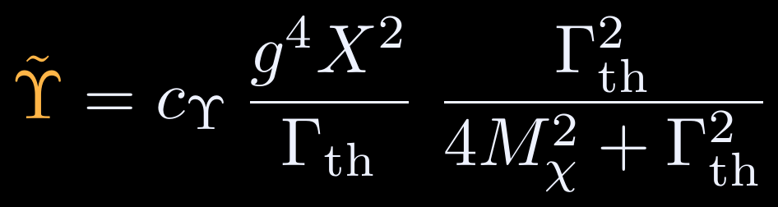
A lagging bath is a frictional bath
06 · WHERE THE FRICTION COMES FROM
1 · The bath lags
2 · Buy low, sell high
3 · Goldilocks response
ψ chases a moving equilibrium, ~1/Γ_{th} behind
ψ is made when light, destroyed when heavy
strongest when the bath relaxes at Γ_{th} ≈ 2M_{χ}
χ drags M_{ψ}, and with it n_{ψ}^{eq}, up and down. ψ relaxes only at rate Γ_{th}, so n_{ψ} always trails behind.
The bath pays M_{ψ} per ψ made and regains M_{ψ} per ψ destroyed. Profit = loop area, paid by χ.
Friction needs a response and a lag. Peak at 2M_{χ} since M_{ψ}² ∝ χ² oscillates twice per period.
THE LAG DEFINES Υ
AVERAGED OVER ONE OSCILLATION (X ≫ m_{ψ}/g)
∝ X²: the bigger the swing, the harder the brake
The equilibrium part gives the thermal mass and the shifted minimum. The part ∝ χ̇ is the friction Υ.
χ̄ = X cos θ: the oscillating background · ⟨…⟩: average over a period · c_{Υ} = 3c_{m}²/2π²
Notes:
[~1:15] Where does the friction come from, and what exactly is Υ? (1) The ψ distribution relaxes toward an equilibrium that χ keeps moving, so it lags by ~1/Γ_th. (2) Buy low, sell high: the bath makes ψ while it is light (cheap) and lets it annihilate while it is heavy (expensive). It pays M_ψ per ψ made and regains M_ψ per ψ destroyed, so each cycle it pockets the loop area ∮M_ψ dn_ψ; by energy conservation that is exactly what χ loses. (3) The response is a Lorentzian in Γ_th: too slow and ψ does not respond, too fast and there is no lag; maximal at Γ_th = 2M_χ (2 because M_ψ² ∝ χ² oscillates at twice the frequency). Click: the definition. The bath response g⟨ψ̄ψ⟩ splits into an equilibrium part (thermal mass, shifted minimum) and a part ∝ χ̇; its coefficient IS the friction Υ. For the oscillating field what matters is the χ̇²-weighted average over a period, Υ̃, which for X ≫ m_ψ/g is c_Υ g⁴X²/Γ_th × Γ_th²/(Γ_th²+4M_χ²) with c_Υ = 3c_m²/2π². Two features carry the rest of the talk: Υ̃ ∝ X², and the Lorentzian peak at Γ_th = 2M_χ (benchmark κ/c_m g ≈ 1.96).7

Slide 8


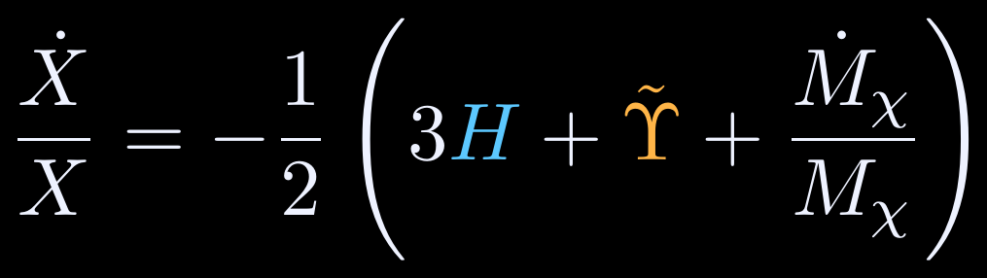
Watch the displacement evolve
07 · THE LIFE OF A DISPLACED SCALAR
Isolated scalar
Coupled to the bath
Hubble friction only: X ∝ a⁻¹
Hubble + thermal friction ∝ X²
locks onto X_{Υ}(T) and tracks it
← frozen while M_{χ} < 3H
← frozen while M_{χ} < 3H
Friction ∝ X²: the bigger the swing, the harder the brake.
Notes:
[~1:15] Same initial displacement, two universes. Before the click both balls are held by Hubble friction (M_χ < 3H). Click: oscillations start. Left: isolated field, the amplitude only redshifts (X ∝ 1/a in the thermal-mass era). Right: with the bath, the friction ∝ X², so the big early swings are crushed within a fraction of a Hubble time, after which the amplitude locks onto a moving target X_Υ(T) (pink label) and decays with it. (Cartoon; real oscillations are ~10^10 times faster than Hubble.) Click: the envelope equation behind it.

Slide 9
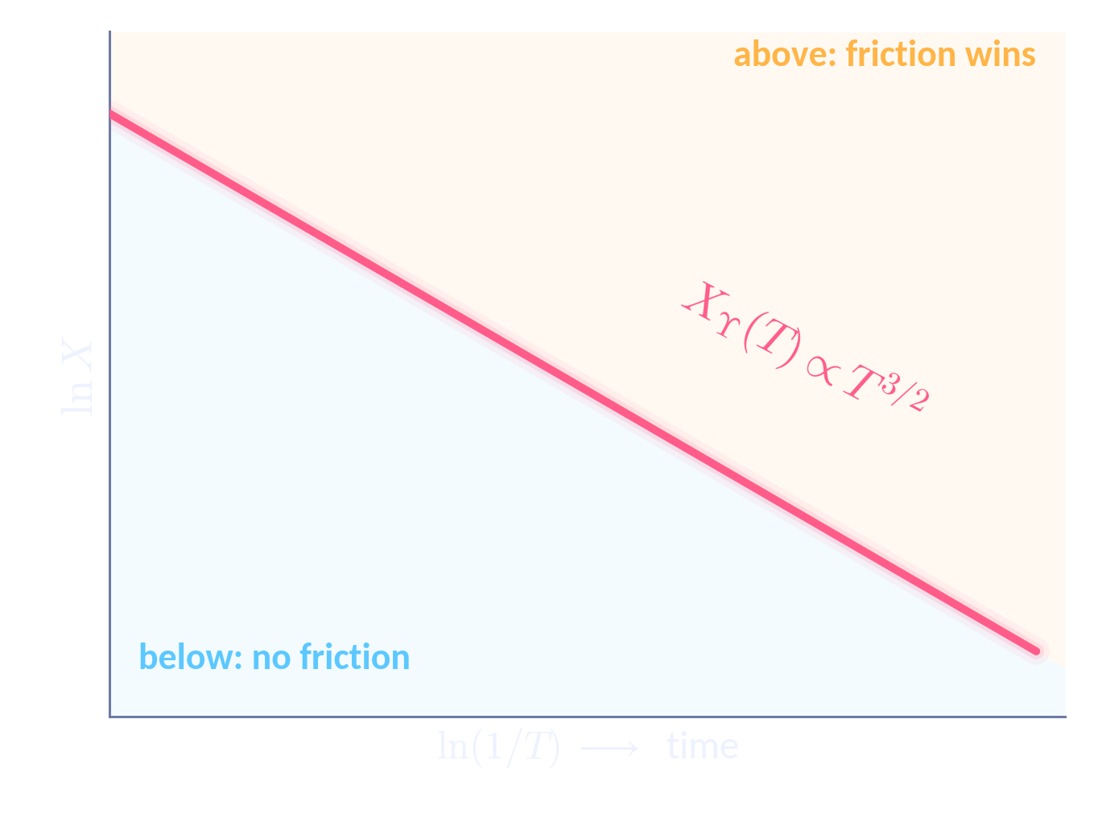
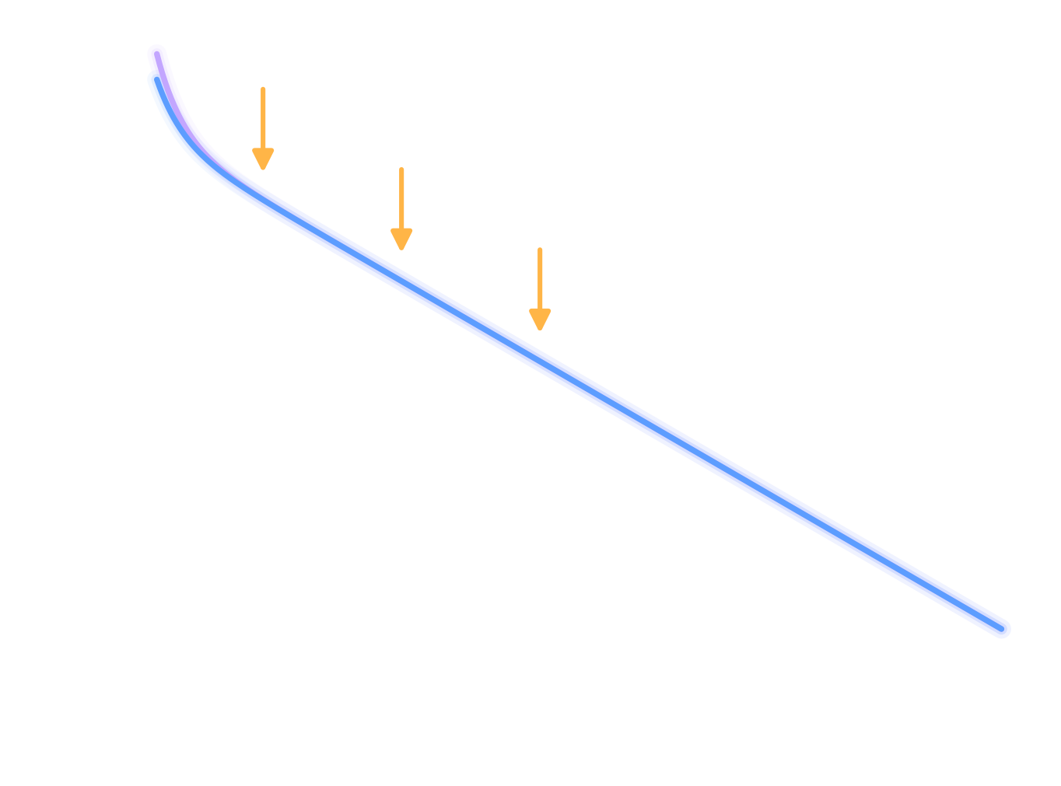
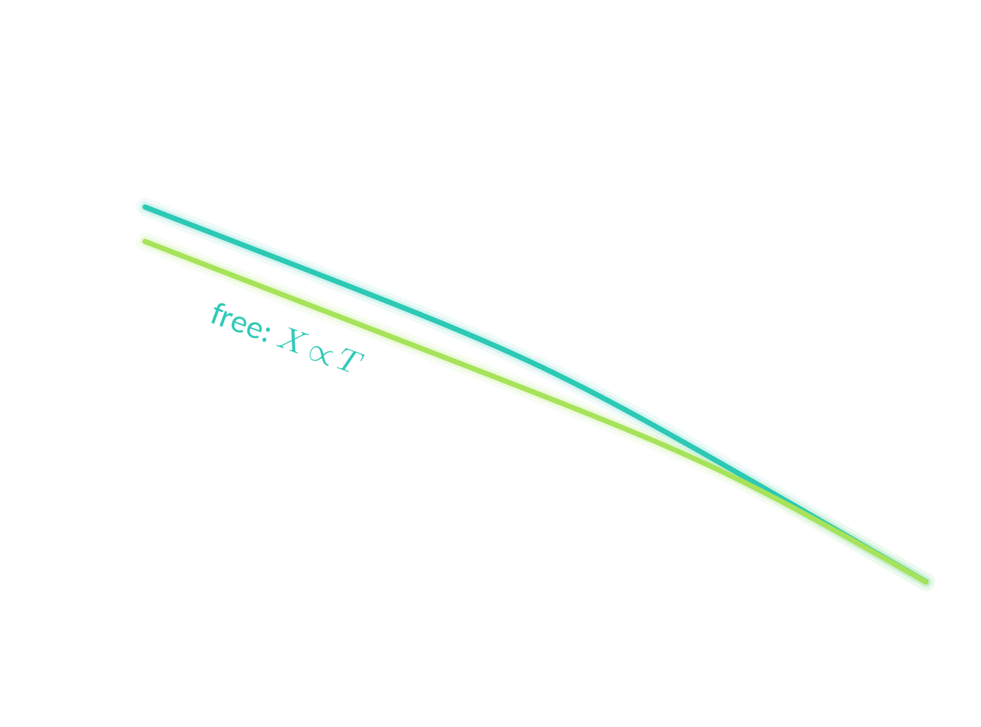

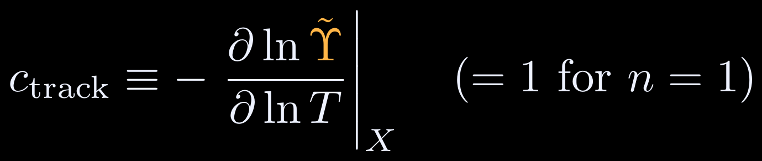
Self-limiting friction locks X onto X_{Υ}(T)
08 · THE THERMAL ATTRACTOR
X_{Υ}(T): WHERE FRICTION MATCHES HUBBLE
Υ̃ ∝ X² picks out one amplitude at each T
ABOVE X_{Υ}
Friction beats Hubble: X is crushed onto X_{Υ} within a fraction of a Hubble time.
BELOW X_{Υ}
Friction is negligible: X ∝ T falls more slowly than X_{Υ} ∝ T^{3/2}, so X_{Υ} comes down to meet it.
ON X_{Υ}
Friction keeps pace with the expansion: X follows X_{Υ}(T) and forgets X_{i}.
Notes:
[~1:15] Because Υ̃ ∝ X², at each temperature there is exactly one amplitude X_Υ(T) where the friction equals (c_track times) Hubble: the pink line. Click: above it the friction beats Hubble and the amplitude is crushed down onto the line within a fraction of a Hubble time. Click: below it the friction is negligible and X just redshifts, X ∝ T, but the line itself falls faster, X_Υ ∝ T^{3/2} for n = 1, so the line comes down to meet the trajectory (after N_approach ≈ (2/c_track) ln(X_Υ/X) e-folds). Click: once on the line, the friction exactly keeps pace with the expansion and X follows X_Υ(T): the initial condition is forgotten. General statement: X_Υ ∝ T^{1+c_track/2}, an attractor iff c_track > 0; for n = 1, c_track = 1.8

Slide 10
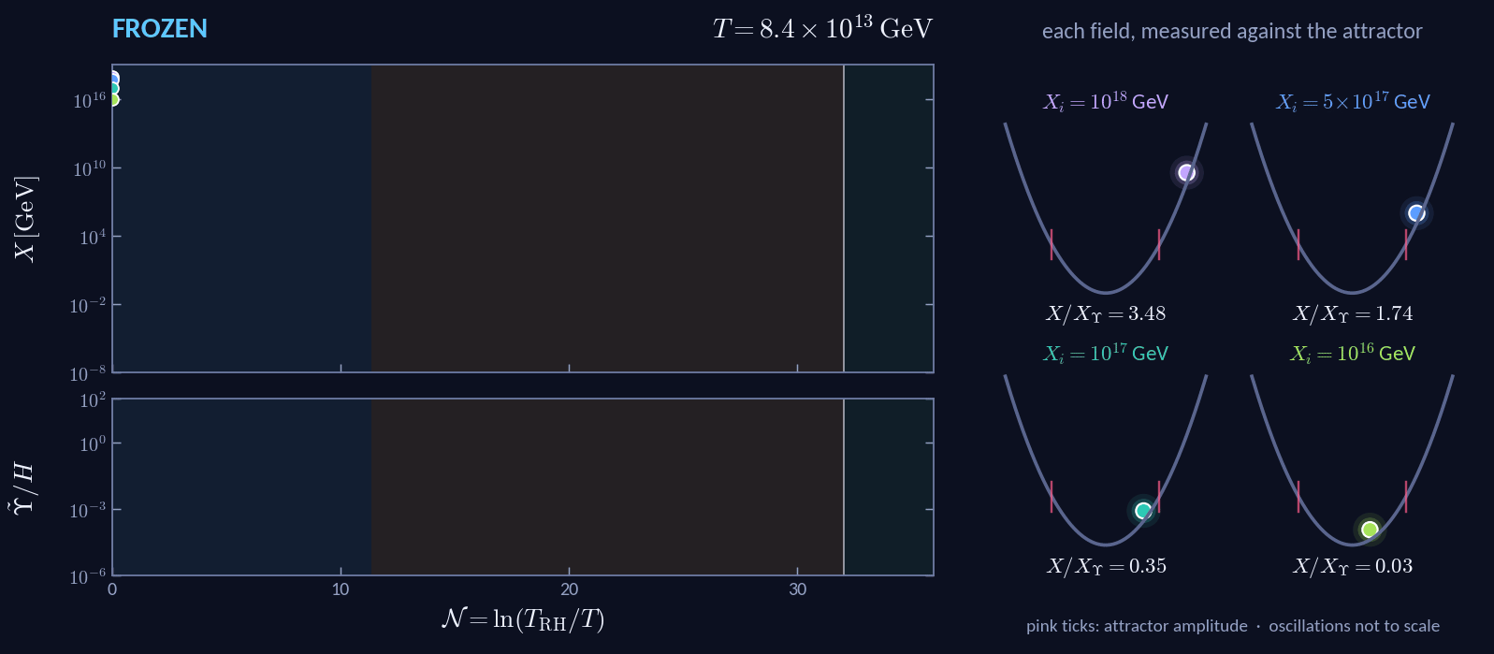
Four initial conditions, one destiny
09 · THE ATTRACTOR IN ACTION
Envelope equation solved numerically · g = 10⁻⁸, κ = 8×10⁻⁹, n = 1, m_{χ} = 10⁻⁷ eV, m_{ψ} = 1 GeV, T_{RH} = 8.4×10¹³ GeV
Notes:
[~0:45] Real solution of the envelope equation (only the pendulum frequency is not to scale). Four initial amplitudes spanning two decades: at onset two start above X_Υ (Υ̃/H = 12 and 3) and two below (0.12 and 10⁻³). Watch the pendulums: X/X_Υ goes to 1 for all four and they swing in sync. At T = m_ψ (N ≈ 32) we switch the damping off, as in the paper, and they continue together; the movie stops at N = 35, the end of the window our analysis covers (Sec. II C). How tracking ends (backup C): it lasts as long as the bath keeps up with the field (c_track > 0) and ends once the bath gets too slow, e.g. when the mediator coupling ψ to the Standard Model becomes heavy, just as neutrino interactions weaken below the electroweak scale. If asked about later times: switching the damping off at T = m_ψ is the conservative choice. Keeping it on (ψ stays light because χ sits near χ_th ≈ m_ψ/g) or letting the thermal mass and the damping decouple together both give a smaller late-time amplitude (2×10⁻⁷ or 4×10⁻¹¹ GeV vs 3×10⁻⁷ GeV at N = 54) and less residual isocurvature, so our suppression is a lower bound. Full-range plot: backup I.

Slide 11
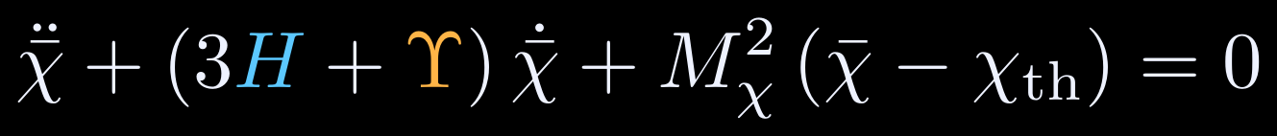
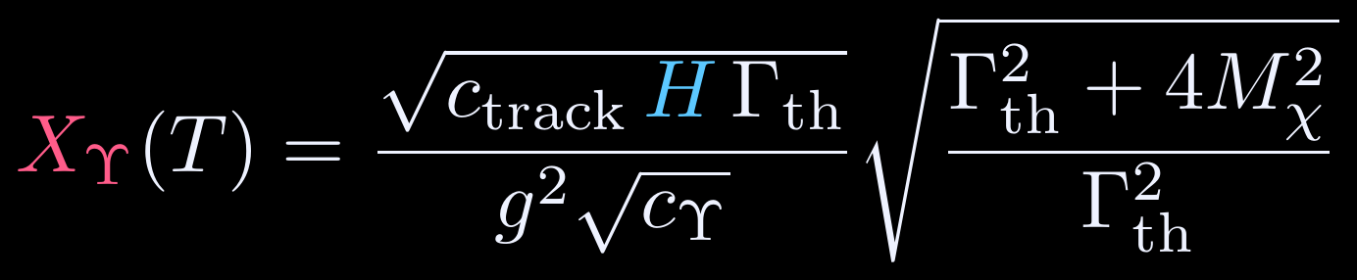
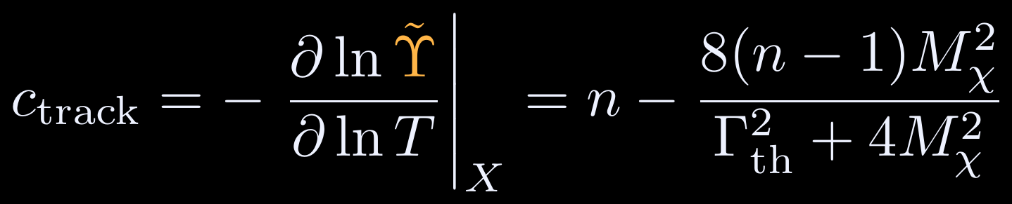
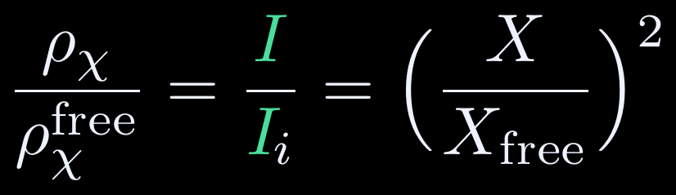
The thermal system in six equations
10 · CHEAT SHEET
1
Background equation of motion
2
Envelope: Hubble + friction + varying mass
3
Damping rate
4
Attractor: friction = c_{track} × Hubble
5
Attractor if c_{track} > 0
6
One factor depletes ρ_{χ} and erases I
X_{free}: amplitude
without damping
Notes:
[~0:45] Everything on one page (from the draft). (1) background EOM with thermal mass M_χ ≈ c_m g T and minimum χ_th ≈ m_ψ/g; (2) oscillation-averaged envelope; (3) damping rate with c_Υ = 3c_m²/2π²; (4) attractor amplitude where Υ̃ = c_track H; (5) c_track from the T-dependence of Υ̃ at fixed X; (6) the headline identity of the new draft: the isocurvature is suppressed by exactly the factor that depletes the scalar, (X/X_free)².

Slide 12
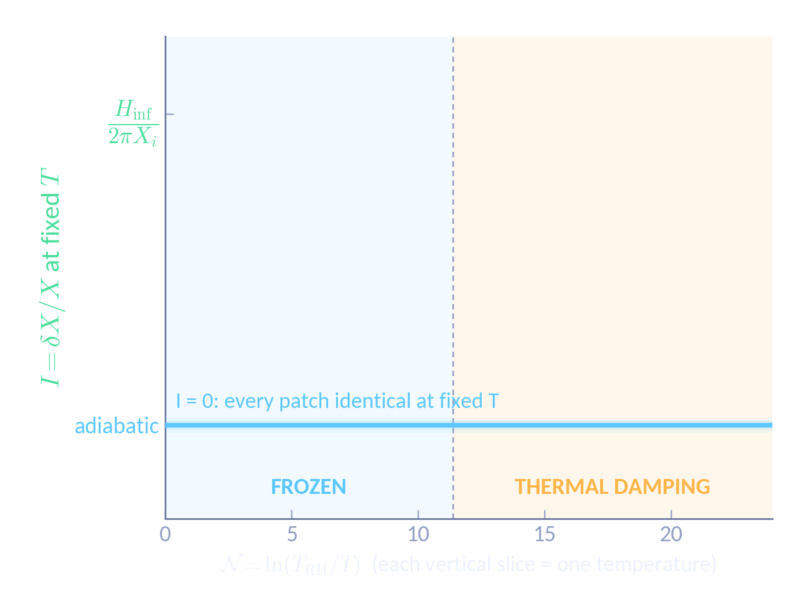


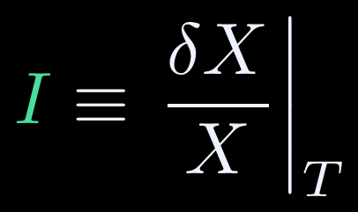
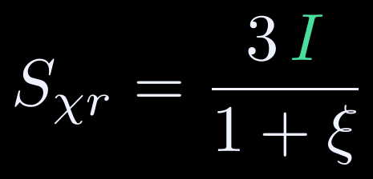
Isocurvature: same temperature, different amplitude
11 · PERTURBATIONS
ADIABATIC: IDENTICAL AT FIXED T
Adiabatic perturbations are only time shifts: read at the same temperature, every patch has the same X.
ISOCURVATURE: A SPREAD AT FIXED T
inflation sets its size, ~H_{inf}/2πX_{i}
in any slicing: I = δX/X − ξ δT/T, with ξ ≡ d ln X̄/d ln T
FRICTION SQUEEZES THE SPREAD
Υ̃ ∝ X²: patches with more χ are damped harder, so every patch converges onto the background and I → 0.
what the CMB constrains: it vanishes with I
Notes:
[~1:00] Each superhorizon patch evolves like a small separate universe, and we compare patches at the same temperature: every vertical slice of this plot is one temperature. Adiabatic perturbations are only time shifts, so read at the same T every patch has the same X: they all sit on I = 0. Click: inflation, however, leaves the spectator with independent kicks, so at the same T different patches have different amplitudes: a spread of size H_inf/2πX_i. That spread is the isocurvature, I ≡ δX/X on a constant-temperature slice (in a general slicing, δX/X − ξ δT/T). While the field is frozen, nothing happens. Click: once it oscillates, the friction Υ̃ ∝ X² damps patches with more χ harder, so every patch converges onto the background and the spread is squeezed to zero. This is the real damping for X_i = 10^17 GeV. The CMB constrains the χ–radiation relative entropy S_χr = 3I/(1+ξ), which vanishes with I. Next slide: the equations and the actual numbers, about 10^-10.

Slide 13
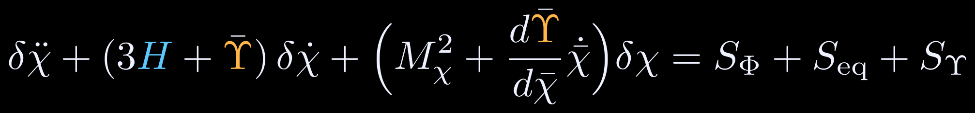
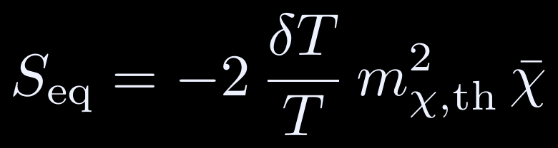
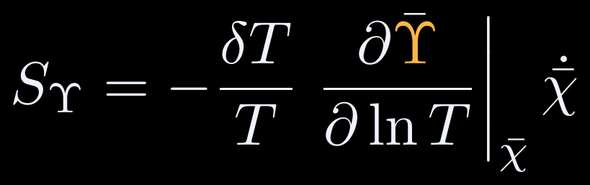
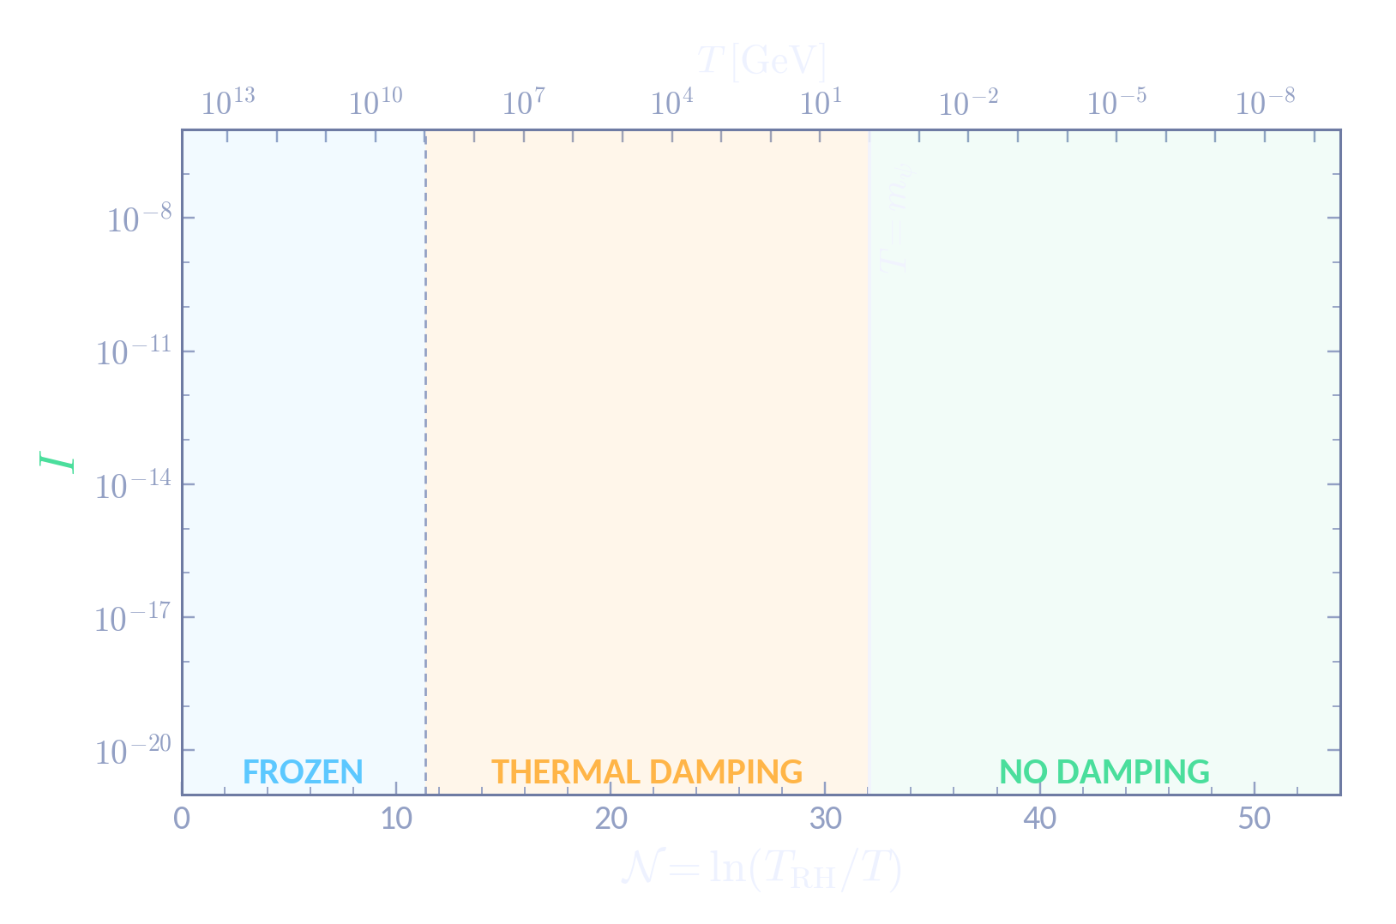
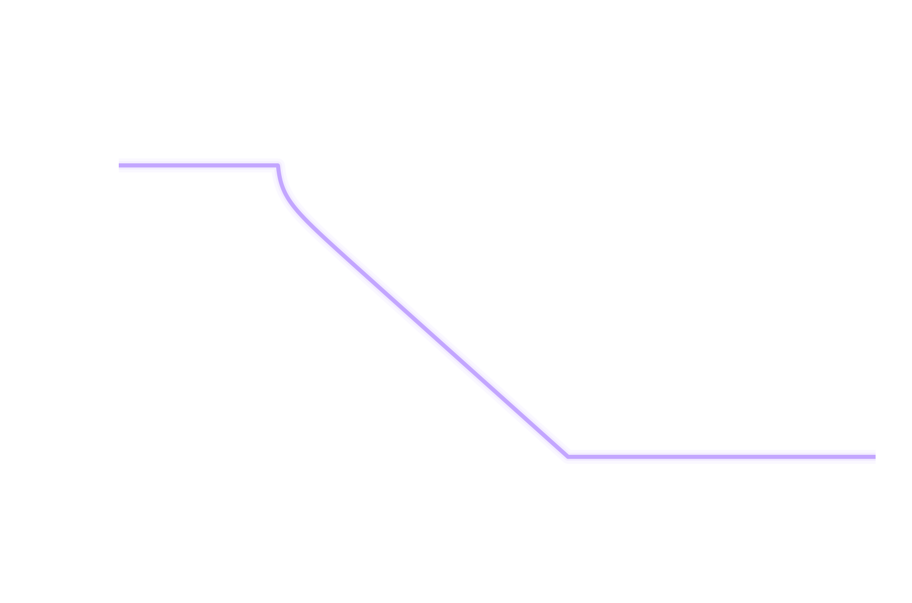
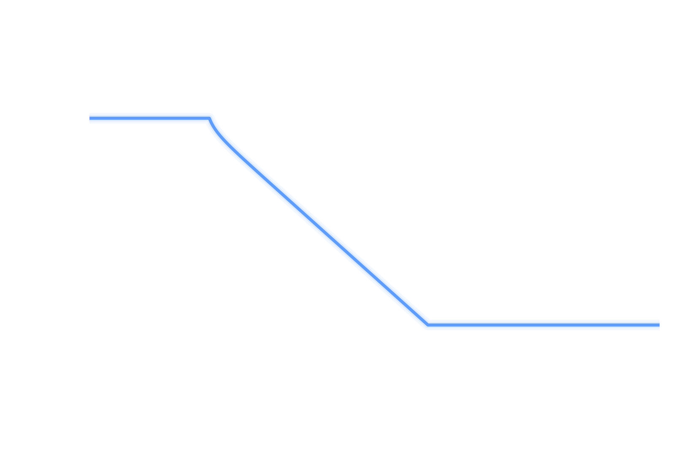
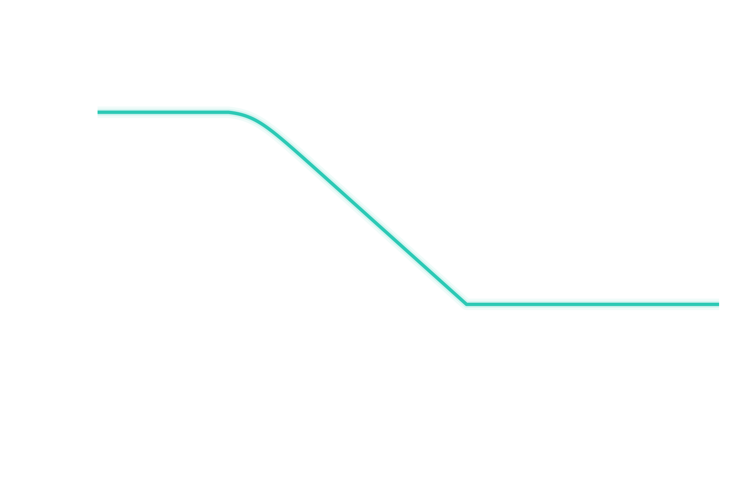
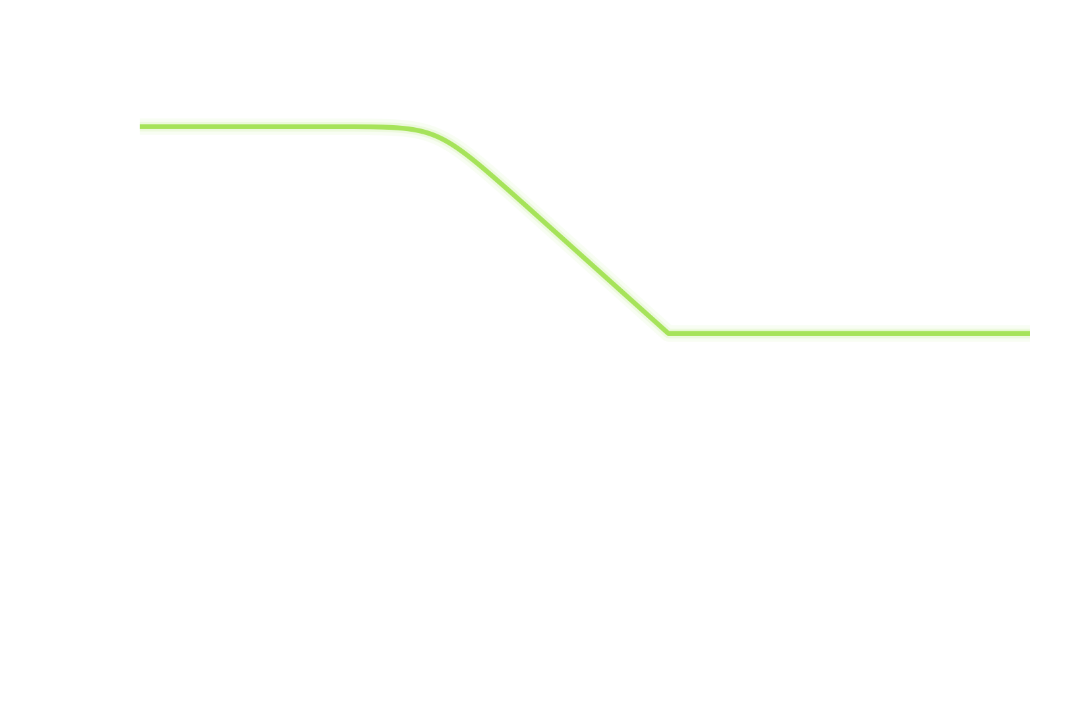
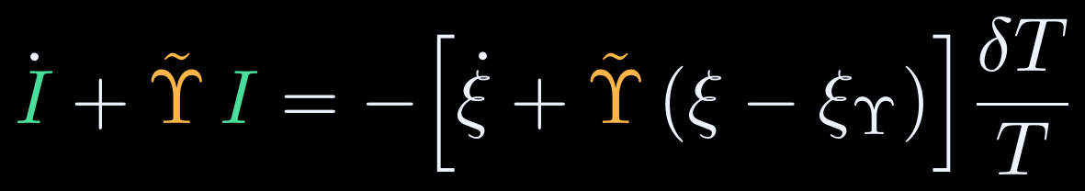
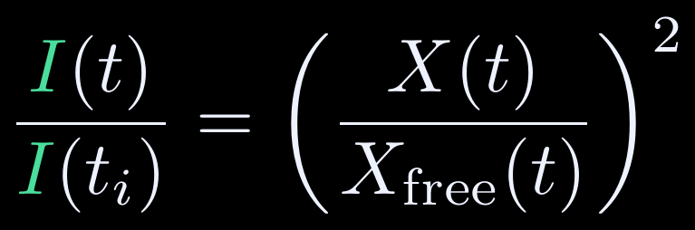
The same friction erases isocurvature
12 · SUPERHORIZON MODES
SUPERHORIZON PERTURBATION (NEWTONIAN GAUGE)
Φ: metric potential (S_{Φ}: backup F) · ξ_{Υ} = d ln X_{Υ}/d ln T = 1 + c_{track}/2 · X_{free}: amplitude without damping
ISOCURVATURE OBEYS
SOURCE VANISHES ON ANY THERMAL-MASS BACKGROUND
…SO I TRACKS THE DEPLETION OF X EXACTLY
Notes:
[~1:15] The superhorizon equation has three sources: metric (S_Φ), the temperature dependence of the thermal potential (S_eq) and of the friction (S_Υ). Time-averaging gives a simple equation for I. Click. Click: the source vanishes identically on any thermal-mass background (it follows from ξ = 1 + Υ̃/2H and ξ_Υ = 1 + c_track/2), so I = I_i exp(−∫Υ̃ dt) during the approach, the tracking and after damping switches off. Watch the plot: the four curves draw in with a dot riding each one. Flat while frozen, falling during tracking, flat again once damping is off; I_end/I_i ≈ 10⁻¹⁰ for X_i = 10¹⁸ GeV. The residual is the standard spectator mode, uncorrelated with ζ, suppressed by the same factor for every superhorizon k. Click: hence the exact identity I/I_i = (X/X_free)²: isocurvature is suppressed by precisely the factor that depletes the scalar (checked numerically to 10⁻¹³).

Slide 14
Back to the squeeze…
13 · PAYOFF
10²⁰
overclosure (m_{χ} = 1 eV)
ISOCURVATURE (PLANCK)
high-scale inflation (r ≳ 10⁻³): excluded
10¹⁷
OVERCLOSURE (NO DAMPING)
X_{i} [GeV]
10¹⁴
No room at all if
10¹¹
allowed
isocurvature
Same ~10⁷ GeV ceiling as the axion.
10⁸
10⁴
10⁶
10⁸
10¹⁰
10¹²
10¹⁴
H_{inf} [GeV]
Notes:
[~0:15] Remember this plot? Advance: it morphs.

Slide 15
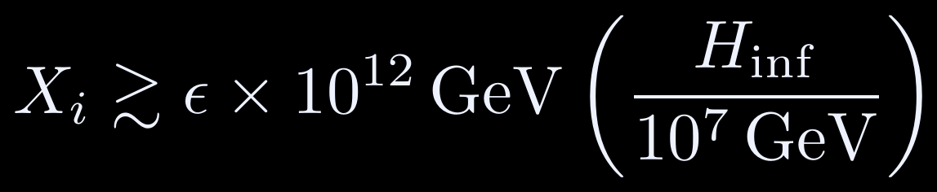
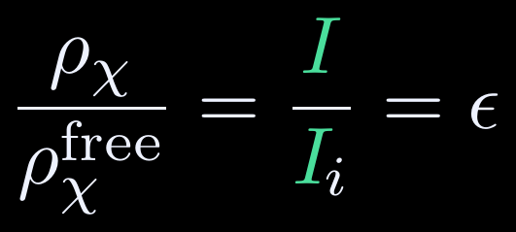
…thermal damping opens the window
13 · PAYOFF
10²⁰
X_{i} > M_{Pl}
ISOCURVATURE, AFTER TRACKING
high-scale inflation (r ≳ 10⁻³): allowed
10¹⁷
OVERCLOSURE: THE SAME FACTOR
allowed with thermal damping
X_{i} [GeV]
10¹⁴
One factor ε depletes the scalar and erases its isocurvature: the tension is gone.
10¹¹
isocurvature × ε, with ε ≈ 10⁻¹⁰
Schematic: n = 1 benchmark, ε ≈ 10⁻¹⁰ for X_{i} = 10¹⁸ GeV; abundance set by where tracking ends.
10⁸
10⁴
10⁶
10⁸
10¹⁰
10¹²
10¹⁴
H_{inf} [GeV]
Notes:
[~0:45] The morph IS the result. By I/I_i = (X/X_free)², the same factor ε suppresses both the isocurvature and the energy density. Isocurvature floor drops to X_i ≳ ε × 10^12 GeV (H_inf/10^7 GeV), ε ≈ 10^-10 in the benchmark, and overclosure no longer constrains X_i: on the attractor the abundance is independent of X_i and H_inf and is set by where tracking ends. The only ceiling left is X_i < M_Pl. High-scale inflation is back. (Schematic; the full parameter scan is in progress.)

Slide 16
Take-home messages
14 · TAKE-HOME
1
The squeeze
Displaced light spectators face overclosure vs. isocurvature: the same ~10⁷ GeV ceiling that haunts axions.
2
Thermal friction
A bath of ψ gives χ a thermal mass and a lagging, amplitude-dependent friction ∝ X².
3
The attractor
Self-limiting friction locks X onto X_{Υ}(T) while c_{track} > 0: the abundance is set by where tracking ends, not by X_{i}.
4
Isocurvature erased
I is damped by exactly the factor that depletes the scalar:
Notes:
[~0:45] Four messages; pause on 3 and 4. Outlook (from the draft's conclusion): realizations in well-studied models: KSVZ (χ = radial mode of the PQ field, ψ = heavy quark Q) or seesaw (χ = radial mode of the L or B−L breaking field σ, ψ = right-handed neutrino N); extending to X ≲ m_ψ/g and to the vacuum-potential era to fix the late-time fate; blue small-scale isocurvature from gradients and thermal noise; scalar-induced GWs in the enlarged parameter space.

Slide 17
Thank you
Questions?
Notes:
Thank you. Backups: damping-rate derivation, validity/endpoints and the benchmark caveat, realizations of Γ_th, the neutrino model, perturbation sources, subleading isocurvature, benchmark numbers.

Slide 18
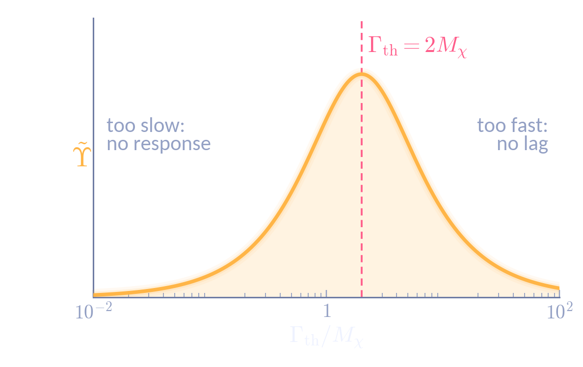

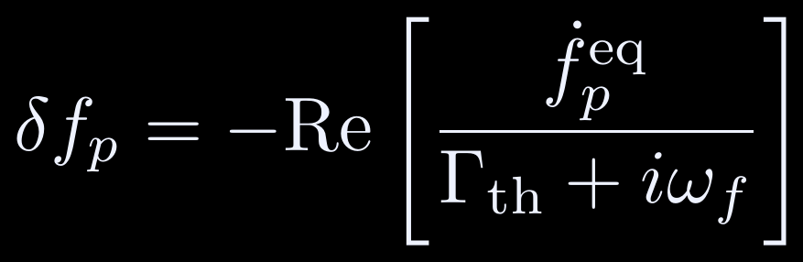
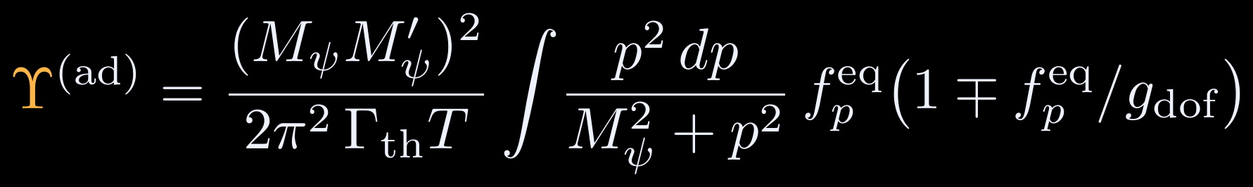
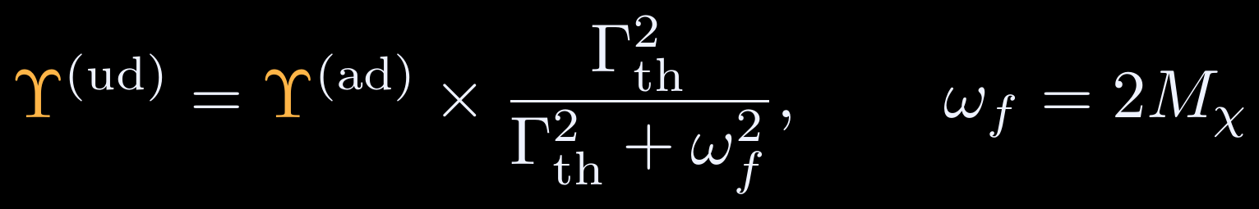
Damping rate: adiabatic vs. underdamped
BACKUP A
RELAXATION-TIME BOLTZMANN EQUATION
STEADY STATE FOR SINUSOIDAL f^{eq} ∝ e^{iω_{f}t}
ADIABATIC LIMIT (Γ_{th} ≫ ω_{f})
Fast bath: Υ ∝ Γ_{th}⁻¹ (tracks too well). Slow bath: Υ ∝ Γ_{th} (barely responds). ω_{f} = 2M_{χ} because M_{ψ}² ∝ χ² oscillates at twice the field frequency (gX ≫ m_{ψ}). From arXiv:2512.05188.
UNDERDAMPED (ANY Γ_{th}/ω_{f})

Slide 19

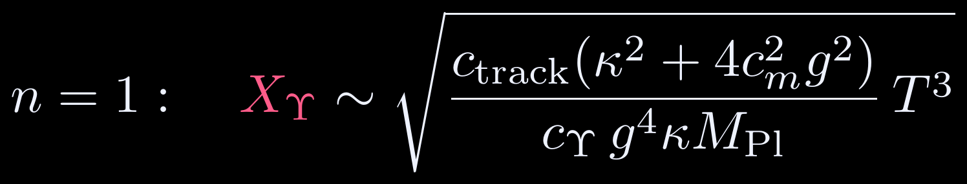
Validity and the end of tracking
BACKUP B
TRACKING REQUIRES
WHAT ACTUALLY ENDS IT
c_{track} > 0 (attractor condition)
ψ thermalized and relativistic: Γ_{th} ≳ H, T ≳ max(m_{ψ}, gX)
Large amplitude X ≫ m_{ψ}/g, thermal mass dominating
Underdamped: friction, H ≪ M_{χ}
Only a sign flip of c_{track}. On X_{Υ}, relativistic ψ is implied by X ≫ m_{ψ}/g; for n > 2, Γ_{th}/H ∝ T^{n−2} falls, but c_{track} turns negative first. For n ≤ 2 tracking ends only where n changes (T*).
APPROACH AND n = 1 ATTRACTOR
BENCHMARK CAVEAT
m_{ψ}/g = 10⁸ GeV is reached at T ≈ 480 GeV (N ≈ 25.9), ~6 e-folds before T = m_{ψ}. Below it the X² scaling of the friction saturates to an X-independent value (it does not vanish); the figures keep the large-amplitude form throughout. Refining this is in progress.

Slide 20
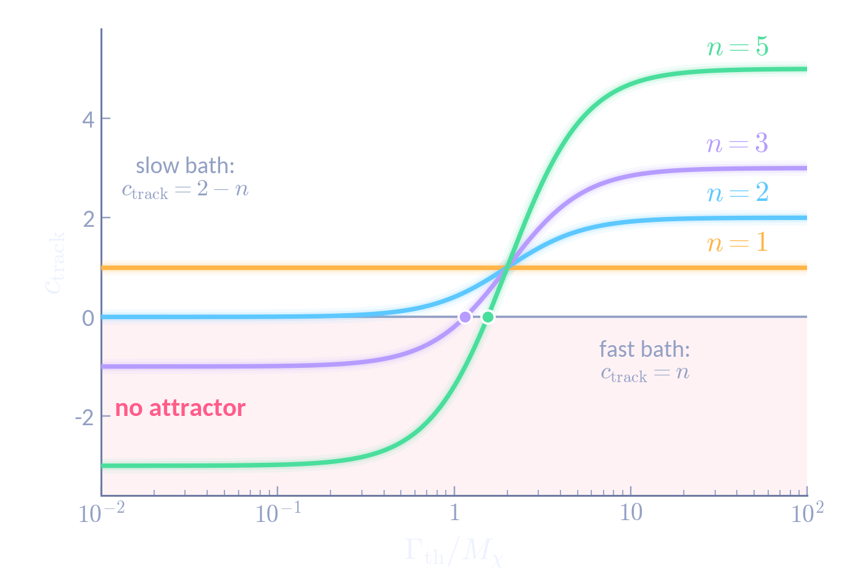
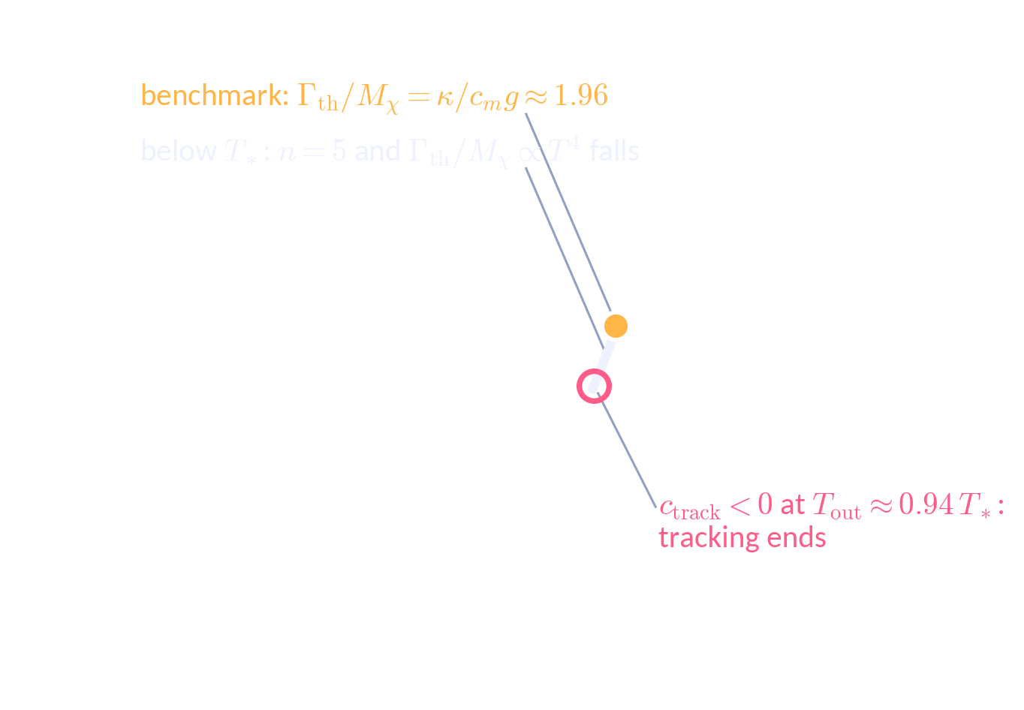

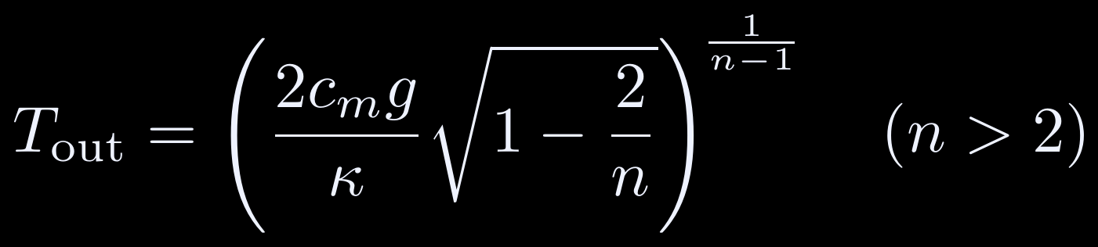


Tracking ends when c_{track} changes sign
BACKUP C
FAST VS. SLOW BATH
⇒ attractor for n > 0 in a fast bath, n < 2 in a slow one
n ≤ 2: NEVER ENDS ON ITS OWN · n > 2: ENDS AT
BENCHMARK: A MEDIATOR WITH m_{V} ∼ T*
Same structure as SM neutrinos: α_{W}²T → G_{F}²T⁵ at the electroweak scale. (The attractor movie and Fig. 1 conservatively switch damping off at T = m_{ψ}.)
Notes:
[~1:00] New in the draft: c_track = −∂lnΥ̃/∂lnT|_X = n − 8(n−1)M²/(Γ²+4M²). Fast bath: c = n; slow bath: c = 2 − n. Nice fact: every curve passes through c_track = 1 at Γ_th = 2M_χ, the Lorentzian peak. Click: limits. Click: for n ≤ 2 tracking never ends on its own (n = 1: Γ/M is constant, c = 1); for n > 2 it ends when c flips sign, T_out = (2c_m g/κ √(1−2/n))^{1/(n−1)}. Click: the draft's benchmark makes n switch 1 → 5 at T_* (a mediator of mass m_V ~ T_*, just like the weak interactions of SM neutrinos). Below T_*, Γ/M ∝ T⁴ slides left along the n = 5 curve and crosses zero at Γ/M ≈ 1.55, i.e. T_out ≈ 0.94 T_* for our κ/(c_m g) ≈ 1.96. N_track ≈ ln(T_osc/T_out).

Slide 21
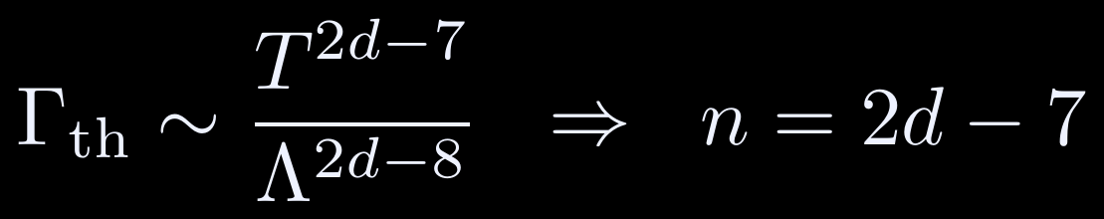
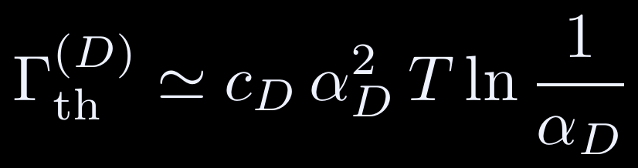
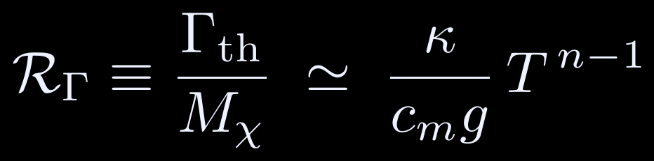
Realizing Γ_{th} = κTⁿ
BACKUP D
Mechanism | Γ_{th} scaling | n
Light mediator (m_{med} ≪ T): scalar or vector portal | ∝ T | 1
Dark U(1) gauge scatterings | c_{D} α_{D}² T ln(1/α_{D}) | 1
Heavy mediator (m_{med} ≫ T) | ∝ T⁵ / m_{med}⁴ | 5
Dimension-d operator, 2 ↔ 2 annihilation | T^{2d−7} / Λ^{2d−8} | 3, 5, 7, …
Decays ψ ↔ SM SM (toy) | constant | 0
n = 1: response ratio constant in the thermal-mass era (benchmark: κ/c_{m}g ≈ 1.96, at the Lorentzian peak).
n > 1: passes from adiabatic to non-adiabatic as T falls.
n > 2: Γ_{th}/H ∝ T^{n−2} falls; the thermal description eventually fails.

Slide 22


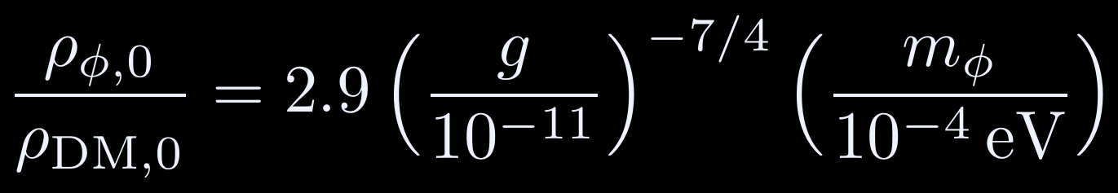

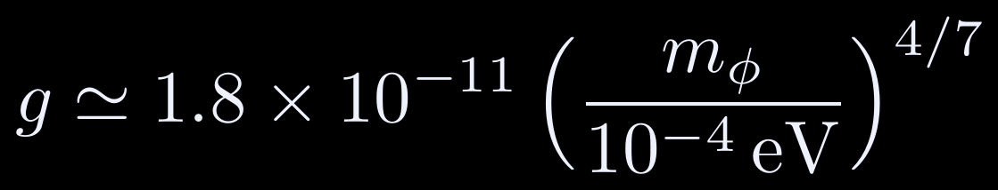
Neutrino-coupled scalar: thermal realignment
BACKUP E
DAMPING BY COSMIC NEUTRINOS (Φ ≫ m_{ν}/g)
ATTRACTOR POINT (V-SHAPED Φ_{Υ}(T))
PREDICTED ABUNDANCE
THERMAL-REALIGNMENT DM LINE
Φ_{Υ} ∝ T^{7/2} above T* and ∝ T^{−1/2} below: initial conditions in the basin converge through Φ* at T*. The target line evades BBN/CMB limits and is approached by the ultimate KamLAND-Zen reach. From arXiv:2509.25308.

Slide 23




Perturbation sources in detail
BACKUP F
PHASE (ADIABATIC) AND AMPLITUDE PIECES, δχ = X(Δ_{X}cos θ − Δ_{θ}sin θ)
ISOCURVATURE SOURCE ON A THERMAL-MASS BACKGROUND
Follows from ξ = 1 + Υ̃/2H and ξ_{Υ} = 1 + c_{track}/2, for Υ̃ ∝ X². An adiabatic perturbation (I = 0) stays adiabatic, as Weinberg’s theorem requires.

Slide 24


Subleading isocurvature: gradients and noise
BACKUP G
GRADIENTS (BEYOND SEPARATE UNIVERSE)
k_{free} = aH at T_{free} ≈ 10⁴ Mpc⁻¹ (T_{free}/MeV): all CMB and LSS modes stay superhorizon throughout the damping epoch, so the correction is beyond reach.
THERMAL NOISE (FLUCTUATION–DISSIPATION)
White noise above the thermal correlation length gives a blue k³ spectrum: negligible on CMB scales, but a target for small-scale probes.
Phase perturbations δθ − M_{χ}δt are not damped, but they do not enter ⟨ρ_{χ}⟩ = M_{χ}²X²/2 at linear order: no energy-density isocurvature.

Slide 25


Every patch is pulled back onto the attractor
BACKUP H
Net suppression:
T_{osc}: onset of oscillations · T_{in} → T_{out}: tracking · same for every k
Notes:
[~0:45] Left: δX/X across Hubble patches at the same temperature, for X_i = 10^18 GeV (colour contrast log-compressed so the fade is visible). Before oscillations start, the offsets are frozen in: a rich pattern. Once tracking starts, the friction damps every offset and the pattern is wiped out; right: I/I_i for the four X_i. Click: the residual is the standard spectator isocurvature mode, uncorrelated with ζ, but suppressed by ε = min[1, (X_Υ/X_i)²|_Tosc] × T_out/T_in (the (X_Υ/X_i)² factor only if X approached the attractor from above; T_out/T_in = e^{−N_track} for c_track = 1). The same suppression applies to every superhorizon k, so the spectral shape is unchanged.

Slide 26







Four decades of X_{i}, one late-time amplitude
BACKUP I
MEMORY ERASED
Every X_{i} from 10¹⁶ to 10¹⁸ GeV locks onto X_{Υ}(T) and tracks it until ψ leaves the bath.
RELIC ABUNDANCE
Set by where tracking ends: independent of X_{i} and H_{inf}, and depleted by the same factor that erases the isocurvature.
BENCHMARK
g = 10⁻⁸, κ = 8×10⁻⁹, n = 1
m_{χ} = 10⁻⁷ eV, m_{ψ} = 1 GeV
H_{inf} = 10¹⁰ GeV, T_{RH} = 8.4×10¹³ GeV
Notes:
[~1:00] Same benchmark as the movie, now the full plot. Click: dash-dotted grey is the isolated field (no bath) for X_i = 10^18 GeV. Click: the four damped trajectories draw in. Lower panel: Υ̃/H spikes or rises to 1 and stays there. Click: the pink dashed line is X_Υ(T); all four sit on it. Click: abundance is set by where tracking ends, so it is independent of X_i and H_inf. As in the draft’s Fig. 1, damping is simply switched off at T = m_ψ; see “How tracking ends” for the physical endpoint. Numbers: N_track ≈ 20.7 e-folds between onset (T ≈ 10^9 GeV) and T = m_ψ.

Slide 27
Benchmark numbers
BACKUP J
Quantity | Value
Reheating temperature T_{RH} | 8.4 × 10¹³ GeV
Onset (M_{χ} = 3H): T_{osc}, N_{osc} | 9.7 × 10⁸ GeV, 11.4
ψ leaves the bath (T = m_{ψ}): N | 32.1
Bare mass takes over (m_{χ,th} = m_{χ}): N | 49.6
Tracking duration N_{track} | 20.7 e-folds
X_{Υ} at onset | 2.9 × 10¹⁷ GeV
Γ_{th} / M_{χ} (= κ / c_{m}g) | 1.96
Γ_{th} / H at T = m_{ψ} | 5.7 × 10⁹
X_{i} [GeV] | X_{i} / X_{Υ} | Friction/H at onset | I_{end} / I_{i}
10¹⁸ | 3.5 | 12 | 8.5 × 10⁻¹¹
5 × 10¹⁷ | 1.7 | 3.0 | 3.4 × 10⁻¹⁰
10¹⁷ | 0.35 | 0.12 | 8.5 × 10⁻⁹
10¹⁶ | 0.035 | 1.2 × 10⁻³ | 8.5 × 10⁻⁷
Check for X_{i} = 10¹⁸ GeV: (X_{Υ}/X_{i})² × e^{−20.7} = 0.083 × 1.0×10⁻⁹ ≈ 8.5×10⁻¹¹, matching the numerical I_{end}/I_{i}. The identity I/I_{i} = (X/X_{free})² holds to 10⁻¹³ for all four X_{i}.

