Slide 1


A unique coupling of the massive spin-2 field to supergravity
“Particle Physics in the Early Universe”,
Paris, sept. 16, 2026
based on 2502.09599 , JHEP 03 (2026) 121
with G. Bossard, G. Casagrande and A. Loty

Slide 2
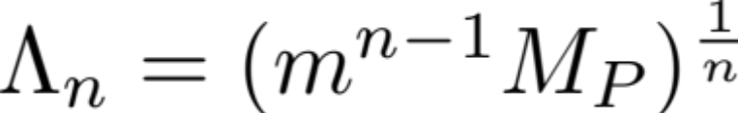
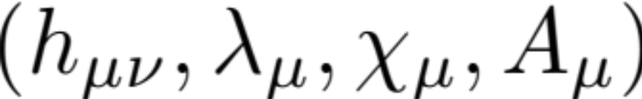
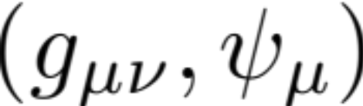
Massive gravity and bigravity theories have cutoffs
The cutoff can be raised for KK theories and string theory: infinite set of massive spin-2 fields
SUSY massive graviton multiplet
: couple it to SUGRA
Usually SUGRA solves problems, ex. causality in gravitino propagation. We find a result superficially
orthogonal to this lore
Is the corresponding action related to a KK truncated action ? Or string theory effective action ?
Until which energy scale it is valid ?

Slide 3




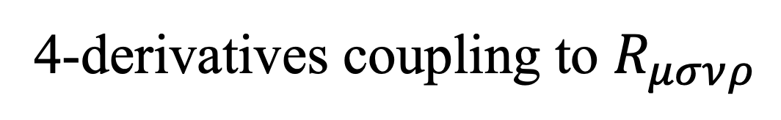

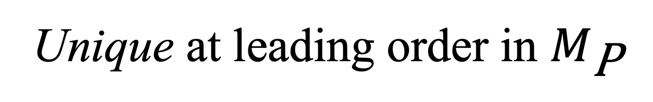
Summary & Outline
massive spin-2 supermultiplet
SUGRA
Unique at leading order in $M_{\text{P}}$
Unique at leading order in $M_{\text{P}}$
consistency with local SUSY
Supercurrent superfield
4-derivatives coupling to $R_{μσνρ}$
Properties of the coupling
connection with string theory
Unitarity and cutoff
Relation to Kaluza–Klein theory*

Slide 4
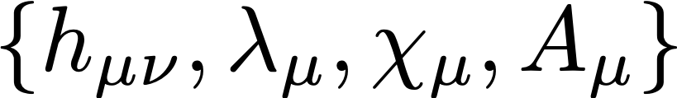
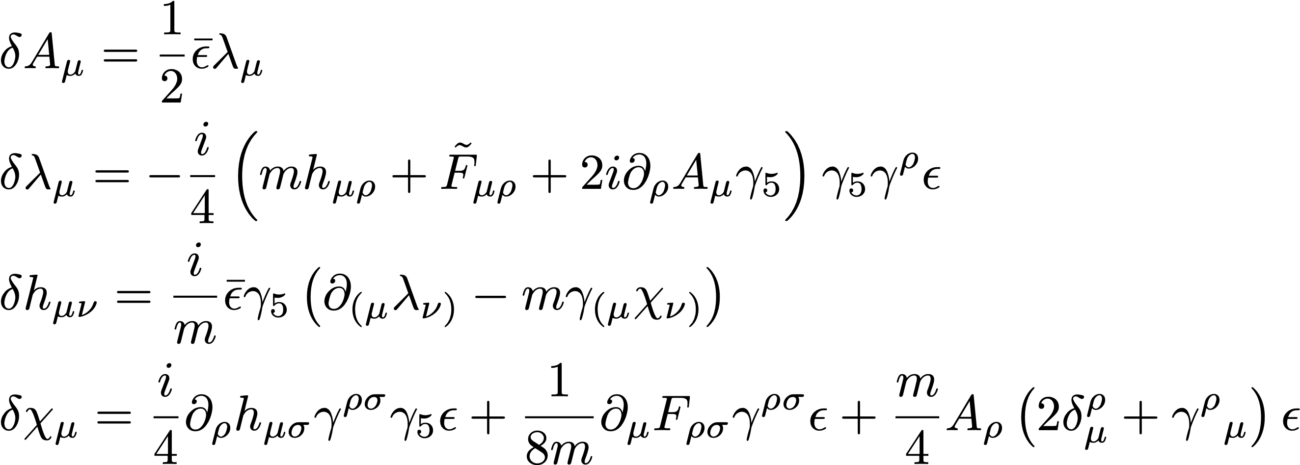
The massive spin-2 multiplet
Massive spin-2 supermultiplet:
[Zinoviev ’02]
[Buchbinder, Gates, Linch, Phillips ’02]

Slide 5
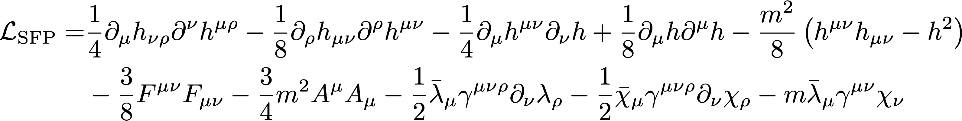
The massive spin-2 multiplet
Massive spin-2 supermultiplet:
[Zinoviev ’02]
[Buchbinder, Gates, Linch, Phillips ’02]
Supersymmetric Fierz–Pauli lagrangian:

Slide 6
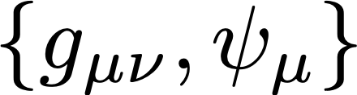






The massive spin-2 multiplet
Massive spin-2 supermultiplet:
[Zinoviev ’02]
[Buchbinder, Gates, Linch, Phillips ’02]
Coupling to supergravity:
Supercurrent superfield

Slide 7
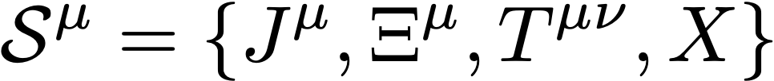

The supercurrent superfield
Multiplets of currents:
[Ferrara, Zumino ’74] [Sohnius, West ’81]
[Komargodski, Seiberg ’10]
linear multiplet
conservation-like equation

Slide 8






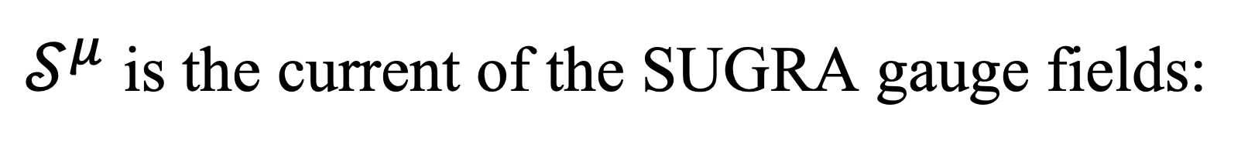
The supercurrent superfield
Multiplets of currents:
[Ferrara, Zumino ’74] [Sohnius, West ’81]
[Komargodski, Seiberg ’10]
Local SUSY
$𝒮^{μ}$ is the current of the SUGRA gauge fields:
off-shell SUGRA
[Ferrara, van Nieuwenhuizen ’78] [Stelle, West ’78] [Siegel, Gates ’79] [Sohnius, West ’81]

Slide 9
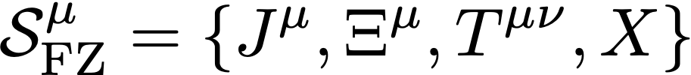



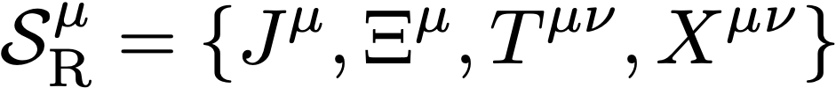


The supercurrent superfield
Currents supermultiplets & off-shell SUGRA formulations:
Ferrara–Zumino multiplet:
old-minimal off-shell SUGRA
[Ferrara, Zumino ’74]
[Ferrara, van Nieuwenhuizen ’78]
[Stelle, West ’78]
complex scalar
R-symmetry multiplet:
new-minimal off-shell SUGRA
[Sohnius, West ’81]
antisymmetric field
[Sohnius, West ’81]

Slide 10
The massive spin-2 supercurrent & the coupling to supergravity

Slide 11
The massive spin-2 supercurrent
Supercurrent for the multiplet :
R-symmetry:

Slide 12


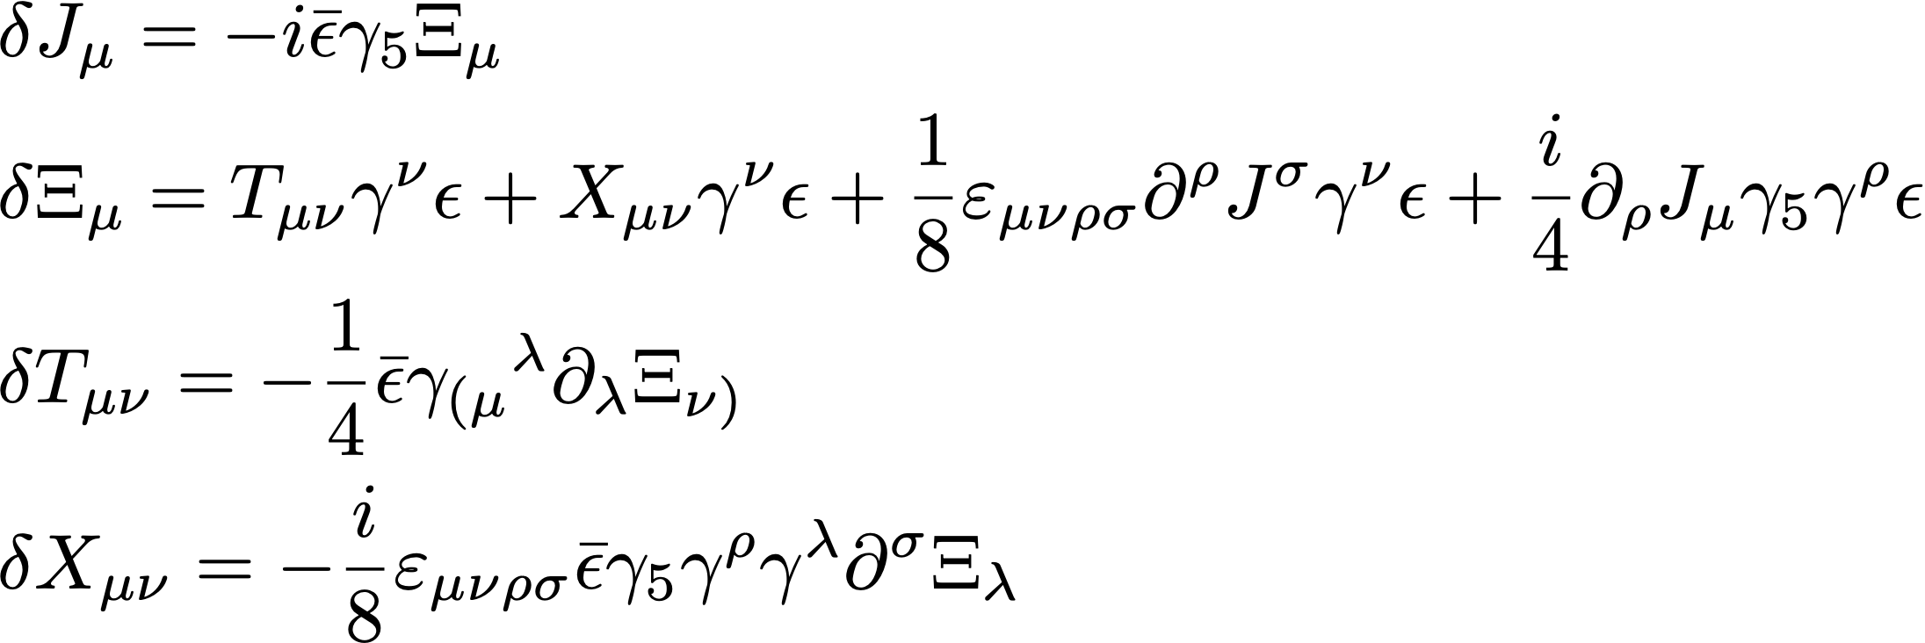
The massive spin-2 supercurrent
Supercurrent for the multiplet :
R-symmetry current:
R-symmetry multiplet:
[Sohnius, West ’81]
new-minimal off-shell SUGRA

Slide 13




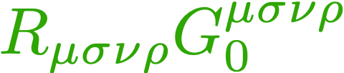
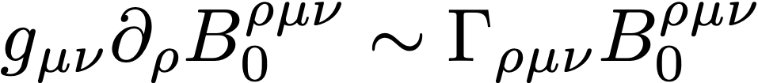
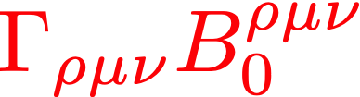


The massive spin-2 supercurrent
Supercurrent for the multiplet :
R-symmetry current:
stress-energy tensor:
improvement terms
[Callan, Coleman, Jackiw ’69]
diff-invariant
non-minimal couplings
not diff-invariant
terms do not define consistent couplings to gravity

Slide 14
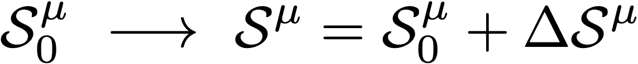



The unique consistent coupling
Improvements to the supercurrent:
[Ferrara, Zumino ’74] [Komargodski, Seiberg ’10]
multiplet of improvements
linear superfield improvement
Parity + linear multiplet + four-derivatives

Slide 15
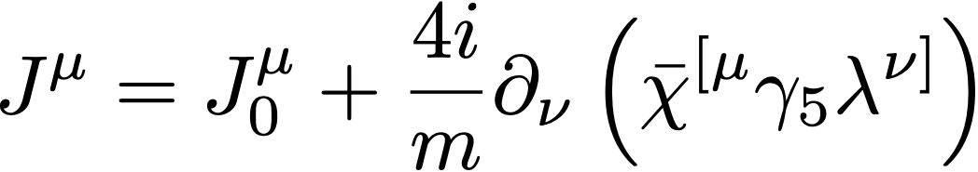
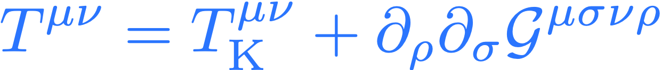


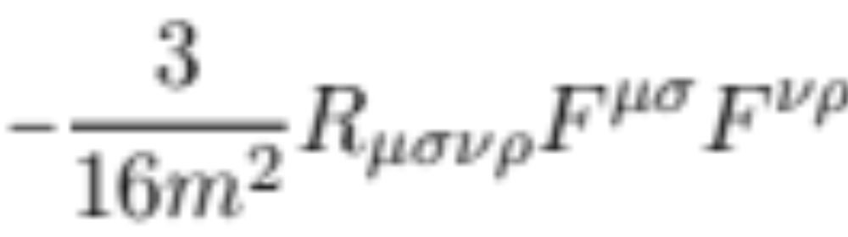
The unique consistent coupling
Unique consistent improvements :
unique coupling to gravity at 4-derivatives
non-trivial coupling to the Riemann tensor

Slide 16
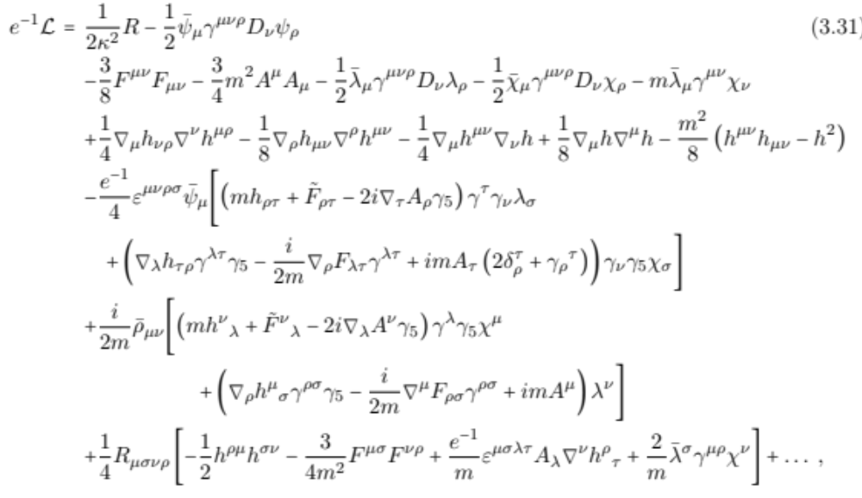
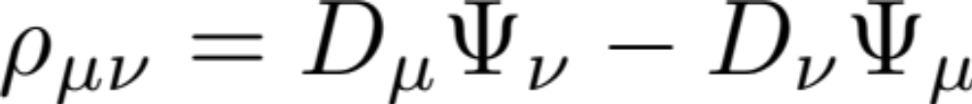
The full action quadratic in massive fields is
where
Higher-derivative terms, potentially dangerous !

Slide 17

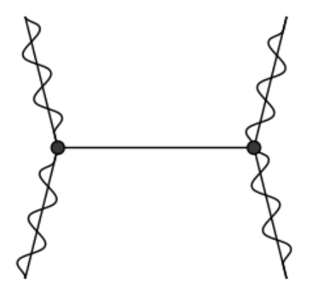
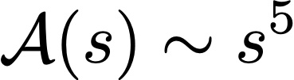
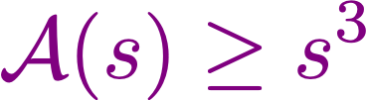

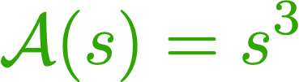


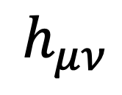
  2 → 2 massive spin-2 scattering amplitude
High-energy limit:
fixed
$$h_{μν}$$
$$h_{μν}$$
&
[Arkani-Hamed, Georgi, Schwartz ’03]
[Bonifacio, Hinterbichler ’18]
[Bonifacio, Hinterbichler, Rosen ’19]
$$h_{μν}$$
$$h_{μν}$$
dRGT massive gravity
&
Hassan-Rosen bigravity
[de Rham, Gabadadze, Tolley ’11]
[Hassan, Rosen ’12]
spin-2, spin-1, spin-0

Slide 18
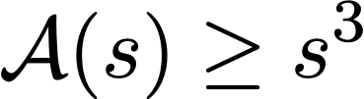

  2 → 2 massive spin-2 scattering amplitude
High-energy limit:
fixed
$$h_{μν}$$
$$h_{μν}$$
&
[Arkani-Hamed, Georgi, Schwartz ’03]
[Bonifacio, Hinterbichler ’18]
[Bonifacio, Hinterbichler, Rosen ’19]
$$h_{μν}$$
$$h_{μν}$$
Regge limit:
fixed
spin-2, spin-1, spin-0
[Kundu, Palti, Quirant ’23]

Slide 19
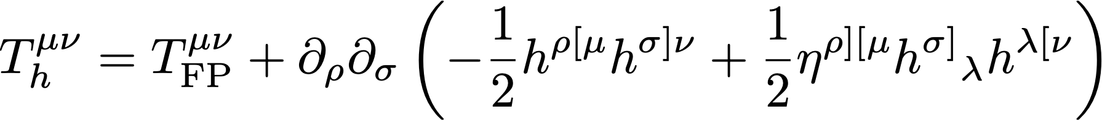

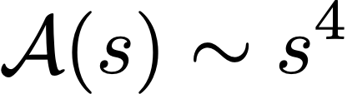




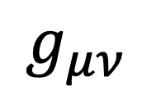
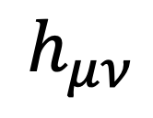
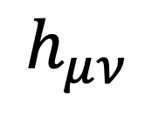
  2 → 2 massive spin-2 scattering amplitude
Massive spin-2 scattering from the unique coupling:
$$h_{μν}$$
$$h_{μν}$$
$$g_{μν}$$
$$h_{μν}$$
$$h_{μν}$$
both high-energy & Regge
agreement with
[Arkani-Hamed, Georgi, Schwartz ’03] [Bonifacio, Hinterbichler ’18] [Bonifacio, Hinterbichler, Rosen ’19] [Kundu, Palti, Quirant ’23]
better behaviour than the generic
non-minimal improvements worsen the amplitude

Slide 20
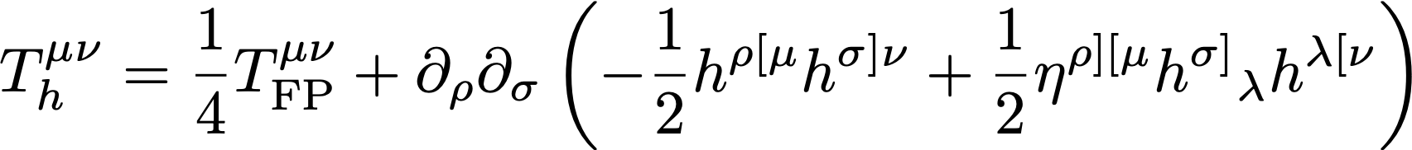






The unique coupling & open string theory
Connection with superstring theory:
(1)
coupling of a massive open string state of mass $m=1/\sqrt{α^{′}}$
[Lüst, Markou, Mazloumi, Stieberger ’21]
(2)
potential violations of causality
tower of higher-spin fields
[Camanho, Edelstein, Maldacena, Zhiboedov ’14]
Evidence for the string lamppost principle for and
[Adams, DeWolfe, Taylor ’10] [Kim, Tarazi, Vafa ’19] [Montero, Vafa ’20] [Bedroya, Hamada, Montero, Vafa ’21]

Slide 21
The Kaluza­­–Klein coupling

Slide 22
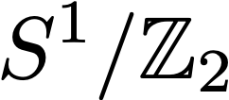
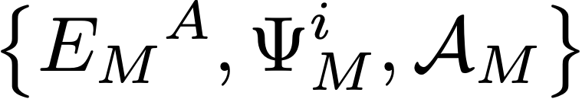
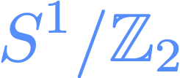

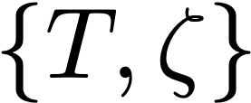
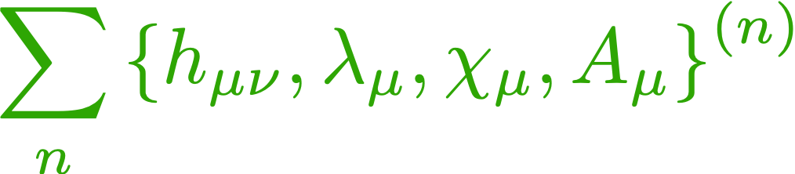
The Kaluza­­–Klein coupling
Kaluza–Klein reduction of 5D pure supergravity on the orbifold :
SUGRA multiplet
chiral multiplet
tower of massive spin-2 supermultiplets

Slide 23


The Kaluza­­–Klein coupling
Kaluza–Klein reduction
Stückelberg organisation of the massive degrees of freedom
5D gauge invariance
unitary gauge:
unitary gauge + massive SUSY
deformation of the massless SUSY
the Kaluza–Klein coupling cannot be captured by the undeformed supercurrent superfield setup

Slide 24




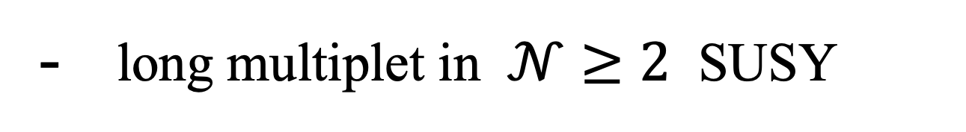
Infinite distance paradigm
String oscillator
Kaluza–Klein mode
long multiplet in $𝒩≥2$ SUSY
1/2-BPS short multiplet in SUSY
unique coupling to gravity
[Bossard, Casagrande, , E.D, Loty ’25]
KK coupling to gravity
deformation expected to be unique
higher-spin tower becoming light for
massive spin-2 tower becoming light for
tensionless limit of the string
decompactification limit
realisation of the infinite distance paradigm of the swampland program
[Ooguri, Vafa ’06] [Grimm, Palti, Valenzuela ’18] [Lee, Lerche, Weigand ’19]

Slide 25



Conclusions & future directions
The coupling of
to undeformed SUGRA is unique
SUGRA is unique.
but it contains higher-derivative terms.
Main (conservative interpretation) result : eliminating causality issues needs higher spins with no mass gap
extension to a fully non-linear lagrangian
propagation of ghosts ?
causality violation?
extend the improvement analysis to higher-derivative orders
prove that the KK is (not) the only deformed coupling.
Massive spin-2 field could be a DM candidate (freeze-in production)

Slide 26
Thank you!

Slide 27
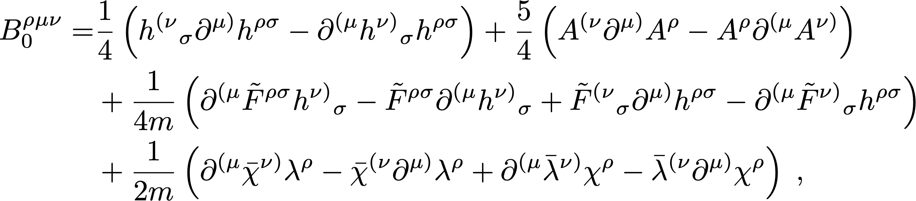
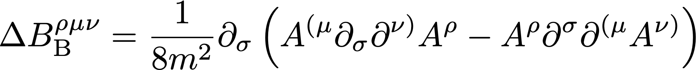
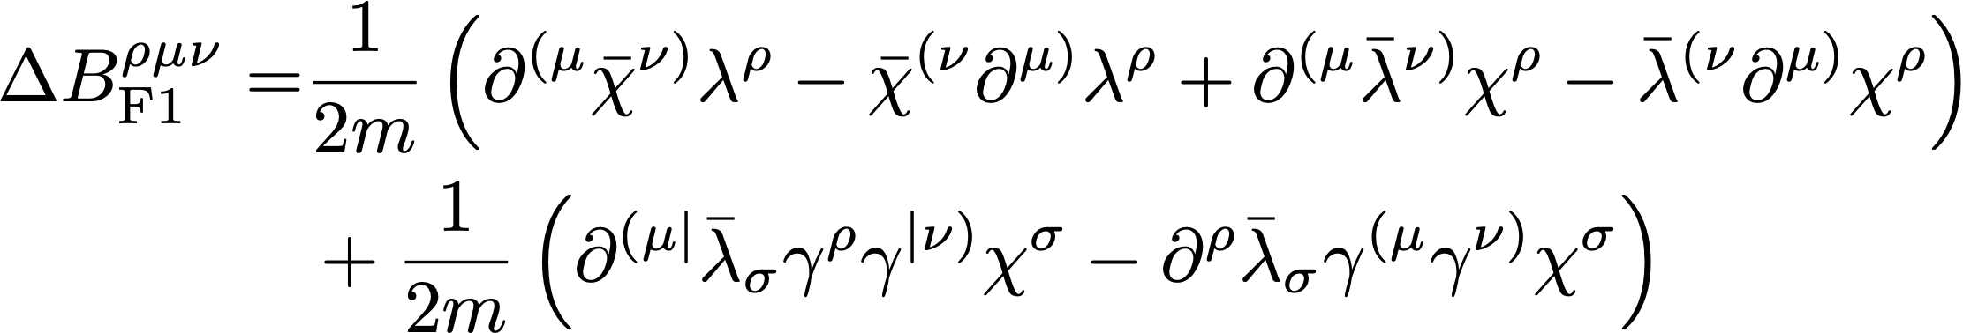
Non diff-invariant improvements

Slide 28
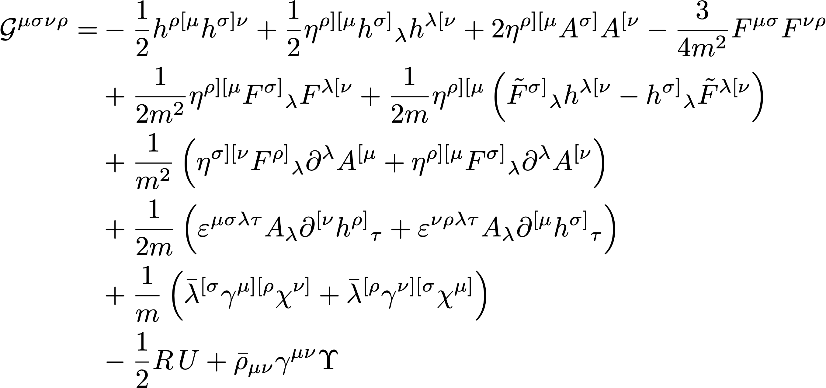
Non-minimal coupling to the Riemann tensor

Slide 29
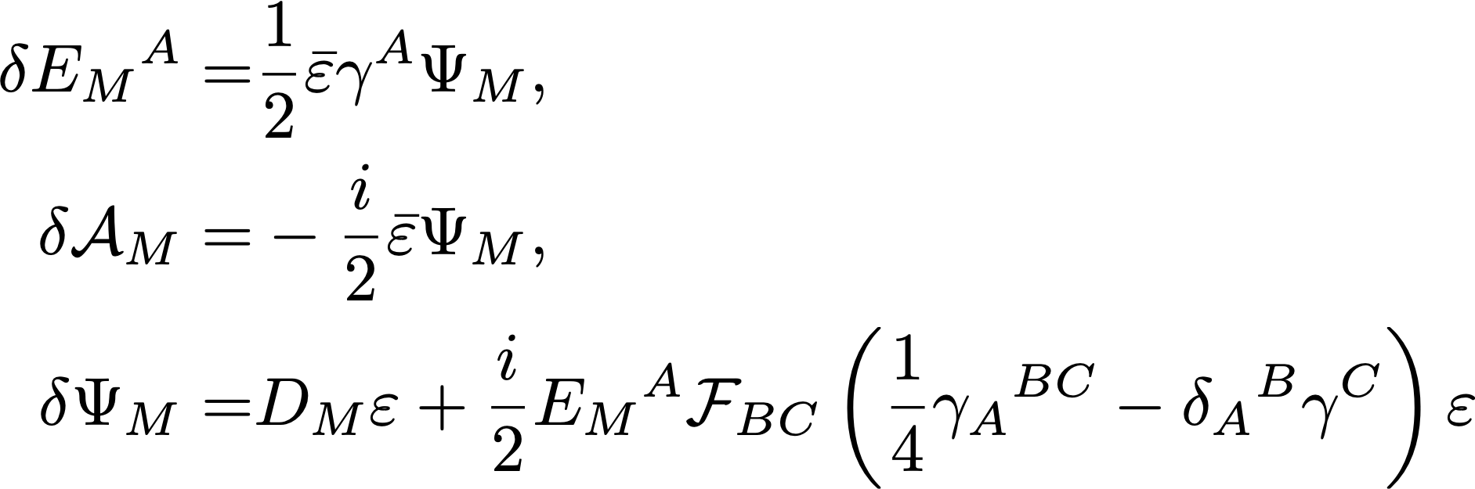
The Kaluza–Klein reduction
5D pure supergravity on the orbifold :
5D supergravity algebra:
[Günaydin, Sierra, Townsend ’83] [Ceresole, Dall’Agata ’00]

Slide 30
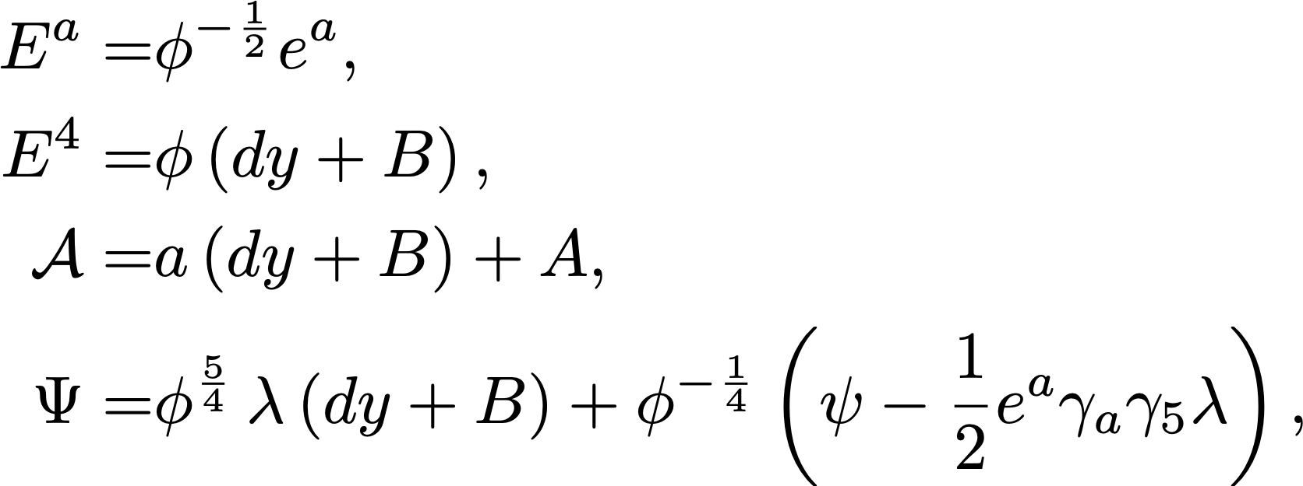
The Kaluza–Klein reduction
5D pure supergravity on the orbifold :
5D supergravity algebra
[Günaydin, Sierra, Townsend ’83] [Ceresole, Dall’Agata ’00]
compactification ansatz:

Slide 31

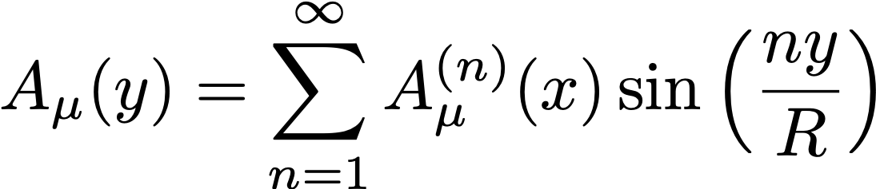
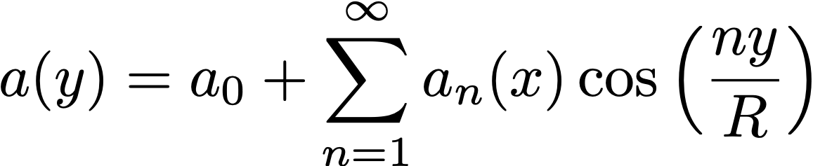
The Kaluza–Klein reduction
5D pure supergravity on the orbifold :
5D supergravity algebra
[Günaydin, Sierra, Townsend ’83] [Ceresole, Dall’Agata ’00]
compactification ansatz
mode decomposition of the fields along. :

Slide 32
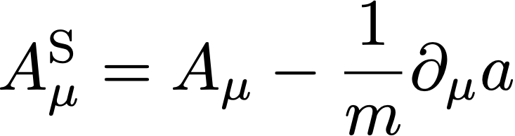



The Kaluza–Klein reduction
5D pure supergravity on the orbifold :
5D supergravity algebra
[Günaydin, Sierra, Townsend ’83] [Ceresole, Dall’Agata ’00]
compactification ansatz
mode decomposition of the fields along S1/Z2
Stückelberg organisation of the massive degrees of freedom:
&

Slide 33

Stückelberg combinations

