Slide 1
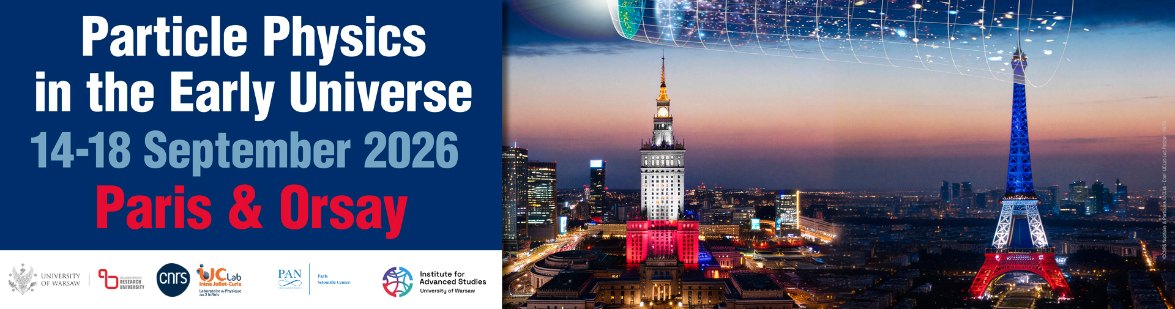






Nonthermal Leptogenesis
Based on arXiv:2605.05304
Tammi Chowdhury
Leah Jenks
Andrew Long
Evan McDonough
Rocky Kolb University of Chicago

Slide 2
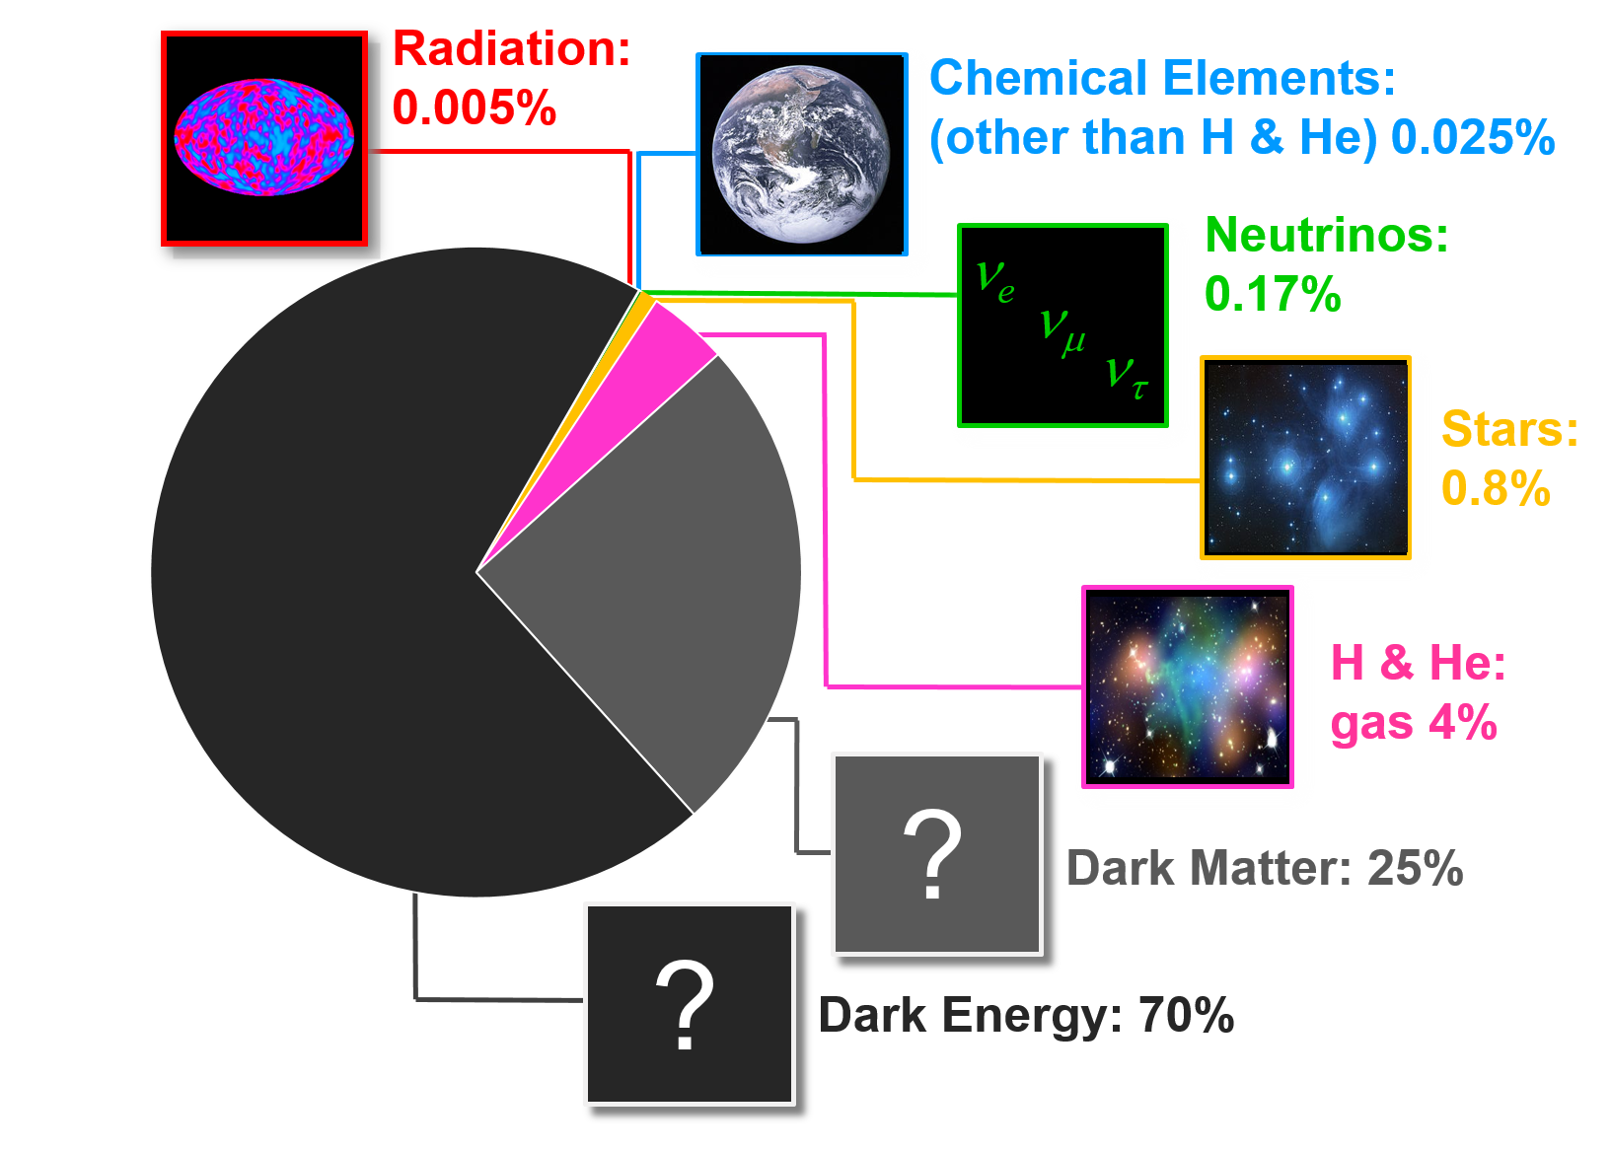
95% of the Mass/Energy of the Universe is a Mystery
Baryon
Asymmetry
Baryon
Asymmetry
Baryon
Asymmetry

Slide 3
99.825% of the Mass/Energy of the Universe
is a Mystery
Baryon
Asymmetry
Baryon
Asymmetry
Baryon
Asymmetry

Slide 4
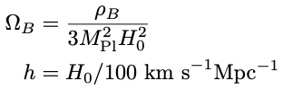
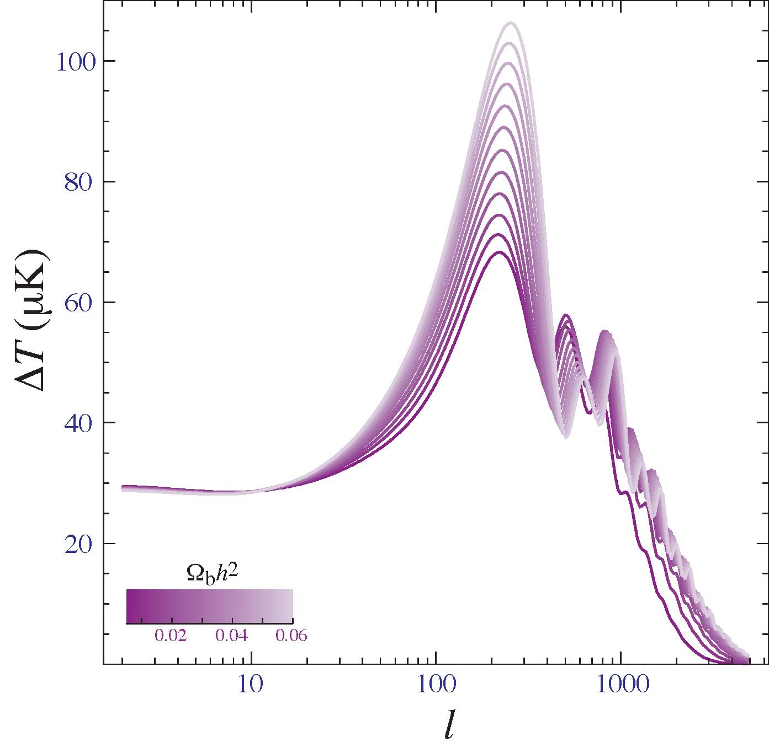
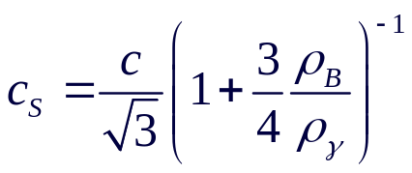
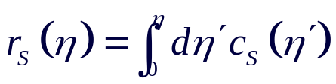

CMB (Planck 2018): Ω_{B}h² = 0.022 ± 0.0001
Increasing baryon component in baryon-photon fluid:
  Reduces sound speed
  Decreases size of sound horizon.
  Peaks moves to smaller angular scales (larger k, larger l).
  Baryon loading increases compression peaks, lowers rarefaction peaks.
Wayne Hu

Slide 5
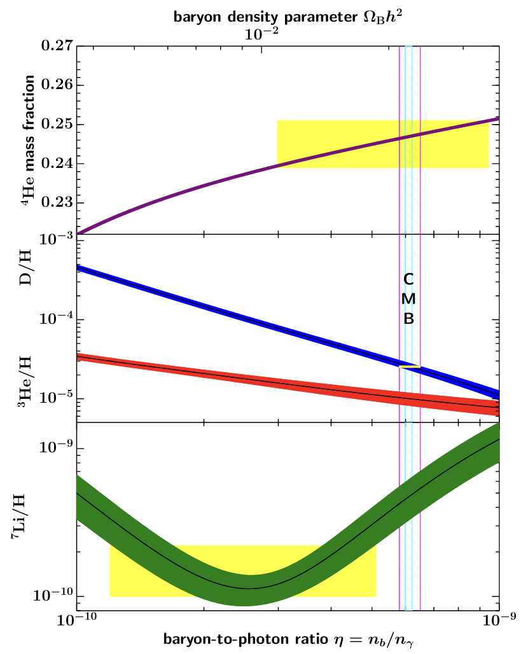
BBN (PDG): 0.021 ≤ Ω_{B} h² ≤ 0.024
PDG 2020
Increasing baryon component in baryon-photon fluid:
  Increases baryon-to-photon ratio η.
  In NSE abundance of species proportional to η ^{A−1}.
  D, ³He, ³H build up slightly earlier leading to more ⁴He.
  Amount of unburnt D, ³He, ³H decreases.
Discrepancy
is fake news

Slide 6
Baryon Asymmetry: n_{B}/s = Y_{B} = (0.879 ± 0.004) × 10 ⁻¹⁰
Why is there an asymmetry between matter and antimatter?
  Initial conditions:
    Requires “acausal” initial conditions.
    Anthropic Principle. (People without ideas can still have principles.)
    Inflation, which evades acausal issue for density perturbations, flatness, etc., dilutes pre-inflation baryon number by an exponential amount.
  The modern perspective is that reheating after inflation produced a symmetric universe (equal abundances of matter & antimatter).
  Asymmetry must develop dynamically after inflation through a process known as “baryogenesis.”
Why is it about 10⁻¹⁰ ?

Slide 7
Inner Space/Outer Space Connection
A complete Standard Model of Particle Physics, arising from laboratory experiments and beautiful theoretical ideas, should be applicable to the universe beyond terrestrial laboratories and (in principle) allow the calculation of cosmological parameters such as the baryon number of the universe.
A failure of today’s Standard Model of Particle Physics to account completely for the observed universe (dark matter, dark energy, inflation, baryogenesis) points to the fact that today’s Standard Model of Particle Physics is not the final Standard Model of Particle Physics.
Cosmological considerations may point to directions for physics beyond today’s Standard Model. The baryon asymmetry is an example of this.

Slide 8
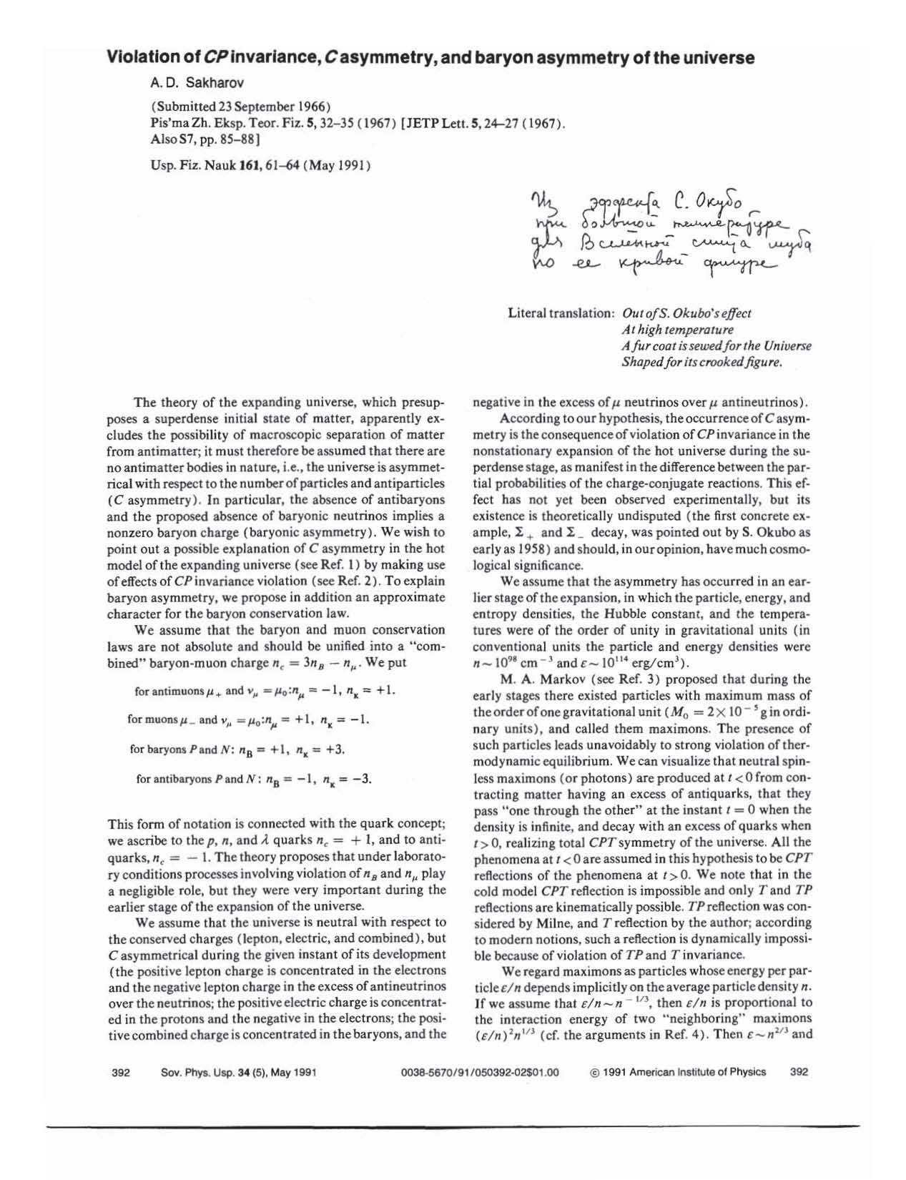
1967
For the universe to evolve from
B = 0 to B ≠ 0, requires:
Baryon number violation
C and CP violation
Departure from thermal equilibrium

Slide 9

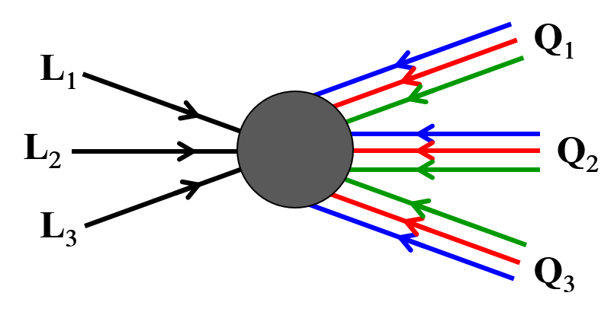







Sakharov Criteria in the Standard Model
Baryon number violating processes:
C and CP violating processes:
Nonequilibrium conditions:
Zero temperature
instantons:
Non-zero temperature
sphalerons:
Yes in SM
(nonperturbatively)
Conserves B – L!
’t Hooft
Klinkhamer & Manton
Yes in SM
Direct CP violation
(CKM)
But Jarlskog invariant very small:
CP ∝ (m_{t}²−m_{c}²) (m_{t}²−m_{u}²) (m_{c}²−m_{u}²) (m_{b}²−m_{s}²) (m_{b}²−m_{d}²) (m_{s}²−m_{d}²) × 2J
J = c₁₂ c₁₃² c₂₃ s₁₂ s₁₃ s₂₃ sinδ
Gavela, Hernandez, Orloff, & Pene
Dimopoulos & Susskind
No in SM and
standard cosmology
CPT conserved ⇒
Notes:
Nine quarks (one of each flavor) and three leptons (one per generation)

Slide 10
Baryon Asymmetry: n_{B}/s = (0.861 ± 0.005) × 10 ⁻¹⁰
Can the standard model of particle physics explain a tiny number in the standard model of cosmology: n_{B}/s = (0.879 ± 0.004) × 10 ⁻¹⁰ ?
No, or at least, not yet!
Can the standard model of particle physics explain an order-unity number in the standard model of cosmology: Dark Matter/Baryons ≈ 5.3?
No, or at least, not yet!
Starting after inflation/reheating with a symmetric universe, how must the SM be augmented to produce an asymmetric universe?

Slide 11

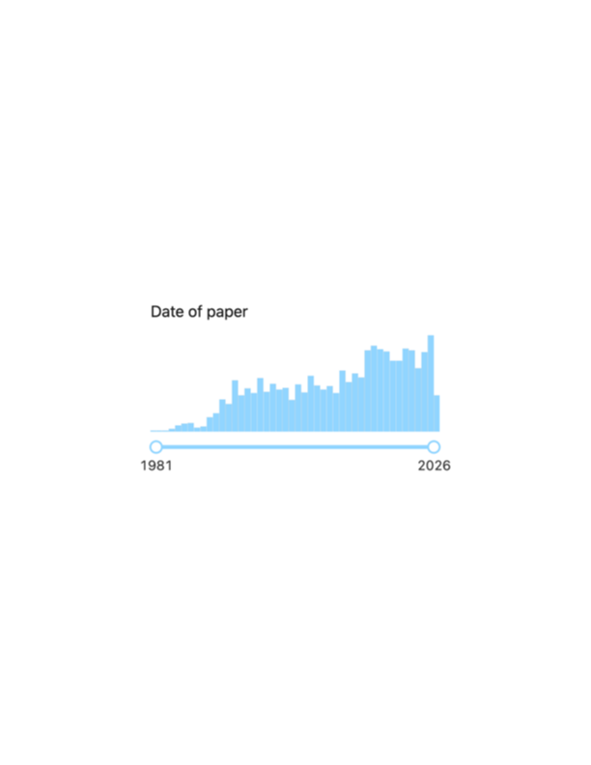

Many, Many Models for Origin of Baryon Asymmetry
To be discussed:
Thermal Leptogenesis
Nonthermal Leptogenesis
Other possibilities:
GUT Baryogenesis (Generation-X bosons)
Electroweak Baryogenesis (Generation-Z bosons)
Baryogenesis from
Primordial Cosmic Strings
  Primordial Magnetic Fields
  Primordial Black Holes
Affleck-Dine Baryogenesis
Dissipative Baryogenesis
Warm Baryogenesis
Cloistered Baryogenesis
Cold Baryogenesis
Planck Baryogenesis
Post-Sphaleron Baryogenesis
WIMPy Baryogenesis
Dirac Leptogenesis
Spontaneous Baryogenesis
Non-Local Electroweak Baryogenesis
Magnetic-Assisted EWK Baryogenesis
Varying Constants Driven Baryogenesis
. . . .
Baryogenesis in title
3054 citations
Leptogenesis in title
2789 citations

Slide 12
Many, Many Models for Origin of Baryon Asymmetry
Model for baryon asymmetry should be well motivated. In my opinion, best motivated models are
  GUT baryogenesis: Grand Unified Theories was (is?) a well-motivated attempt at unification of electroweak and strong interactions. Problems:
        Proton seems stubbornly stable.
        Simplest GUT, SU(5), produces zero B−L … so baryon number erased by sphalerons.
        Reheat temperature after inflation is too low for thermal baryogenesis.
  Electroweak baryogenesis: Standard model has B−L violation (sphalerons) and CP violation and nonequilibrium if phase transition first order. Problems:
        CP violation in SM too small.
        Phase transition in SM not first order unless extend Higgs sector.
  Leptogenesis: Motivated by small neutrino mass and neutrino oscillations (Type I see-saw). Problems:
        Not all parameters directly assessable in experiments.
        In thermal leptogenesis reheat temperature may be too low to populate lightest right-handed neutrino.

Slide 13







Type I See-Saw Model
Extend the SM by adding 3 heavy Majorana neutrinos N_{i} with masses M_{i} on the order M_{i} = $𝒪$(10¹³ GeV).
They interact with the SM Higgs doublet Φ^{b} and the lepton doublets via the Yukawa interaction
where y_{ij} is a 3 × 3 matrix of complex Yukawa couplings.
Mass
ν
After electroweak symmetry breaking, , where
The seesaw relation gives the light neutrino mass scale m_{ν}
in terms of the heavy neutrino mass scale M_{N} .
It’s a see-saw! As M_{N} increases, m_{ν} decreases.
Large M_{N} implies small m_{ν} .
Ν
ordinary
neutrinos
Massive
right-handed neutrinos
Decay channels of N_{i} :
e.g., 10¹⁰ GeV 1 GeV 10⁻¹⁰ GeV
Decays of N₁ violate lepton number!
Decay width

Slide 14

Leptogenesis in the Type I See-Saw Model
Decays of N₁ violate lepton number!
If CP violation in decays of N₁ and
if non-equilibrium conditions exist,
can generate a lepton asymmetry.
Initial lepton asymmetry can be converted to final baryon asymmetry through sphalerons.
N’s originate from thermal bath: Thermal Leptogenesis.
N’s do not originate from thermal bath: Nonthermal Leptogenesis.
Harvey & Turner
Notes:
Type II add SU(2)_L triplet scalar
Type III add 2 SU(2)_L fermion triplets

Slide 15





CP violation in N decay
Require interference between tree amplitude and loop corrections Nanopoulos and Weinberg
Assuming hierarchical model and denoting lightest N_{i} as N and using
y∗_{kj}
+
+
N_{j}
N
N
N_{j}
N
y_{ji}
y_{1i}
y_{1k}
y_{1k}
y∗_{jk}
y_{ij}
Lepton number generated in decay of N’s proportional to CP parameter ε :
Davidson-Ibarra bound

Slide 16
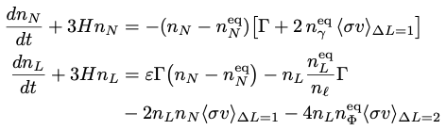
Thermal Leptogenesis—N initial abundance thermal
Boltzmann equation for the evolution of n_{N} and n_{L}
Initial conditions,
  n_{N} = thermal abundance
  n_{L} = 0
For a review: Buchmüller, De Bari, Plümacher, Leptogenesis for pedestrians, Annals of Physics 315 (2005),
N decay products thermalize; if temperature large enough can washout lepton number through processes like:
ΔL = ± 1
ΔL = ± 2
Φ
ΔL = ±1
ΔL = ± 1
ΔL = ± 2
Φ
N
L
N
Φ
N
Φ
Φ
N
L
L
L
N
Φ
Inverse decay, Φ L → N
scattering, N L ↔ f
scattering, L f ↔ N f
scattering,
scattering,
Issues:
  Reheat temperature after inflation must be larger than M_{N}
  Inverse decay and scattering can erase lepton asymmetry
  Challenge of falsifiability.

Slide 17
Nonthermal Leptogenesis: Initial N’s by Other Means
Boltzmann equation for the evolution of n_{N} and n_{L}
Boltzmann equation for the evolution of n_{N} and n_{L}
Initial conditions,
  n_{N} produced via inflaton decay
  (Garcia, Henrich, Ke, Olive),
  nonperturbative reheating,
  other interactions, …
  we will assume CGPP
  n_{L} = 0
We assume initial N abundance result of CGPP
Cosmological Gravitational Particle Production
Particles in our setup:
  Standard Model particles
  + N’s (motivated by neutrino masses and
  oscillations)
  + Inflaton (needed for inflation)
Only nonstandard ingredient:
  Kination phase following inflation rather than matter
  domination phase. (String Theorist friends like this.)

Slide 18
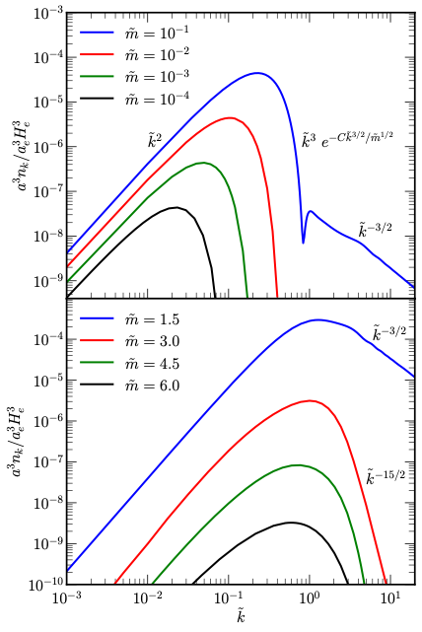





cold
inflaton
condensate
h_{μν}

Slide 19
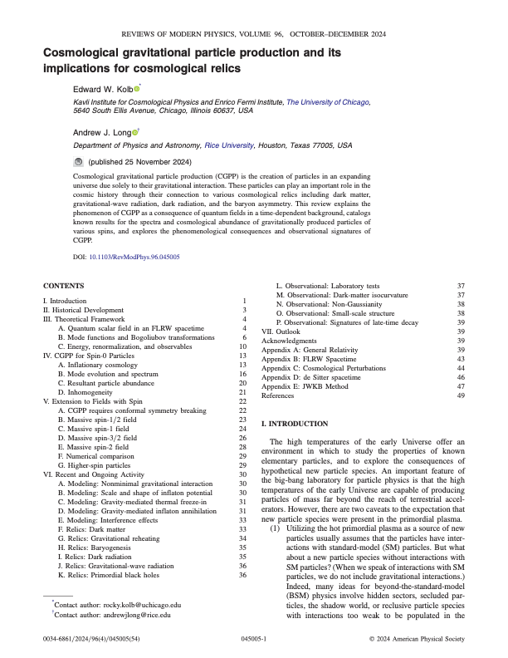
Cosmological Gravitational Particle Production (CGPP)
Original idea traces to a 1939 paper of Schrödinger.
Paper was forgotten for nearly 30 years.
Resurrected in 1960s in the context of quantum field theory by Leonard Parker and collaborators.
Now central to much of early-Universe cosmology: inflationary generation of curvature perturbations and gravitational waves, and perhaps dark matter.

Slide 20
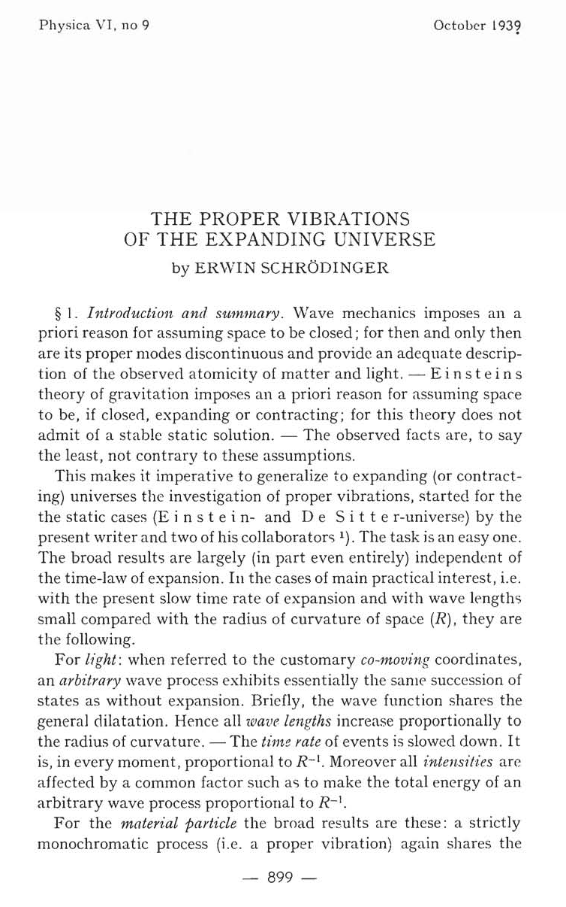
The Proper Vibrations
Of the Expanding Universe
by Erwin Schrödinger
Physica VI, 899 (1939)
Received 21 August 1939; Published October 1939
No author affiliation listed
Cited 397 times (Google Scholar)
Notes:
Published 80 years ago

Slide 21
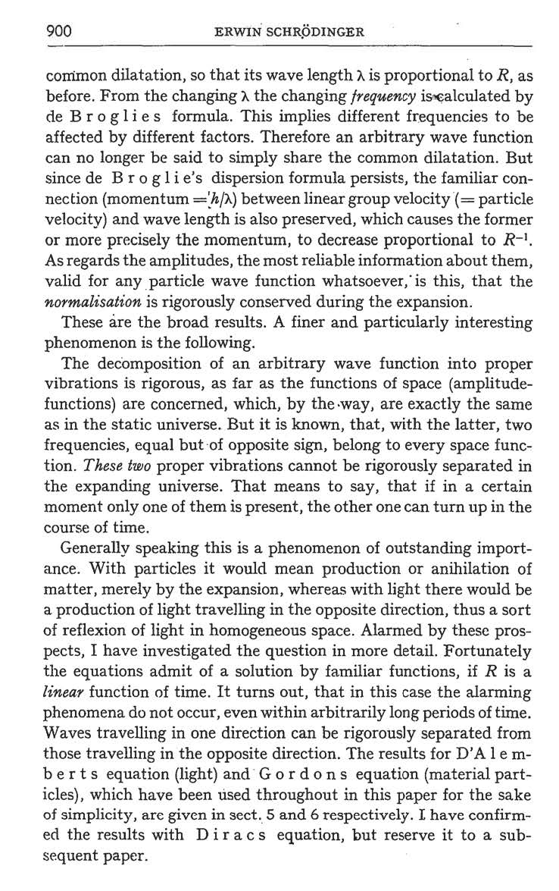
Even in an expanding universe, a particle’s wavefunction can be decomposed into “proper vibrations” (positive & negative frequency modes):
Ψ(t) = e^{−iω t} + e^{+iω t}
If start with pure incoming or outgoing waves, in and out will become mixed.
Outstanding importance. The universe creates particles merely by expansion!
External field (in this case gravitational field) can pull particles from the vacuum.

Slide 22
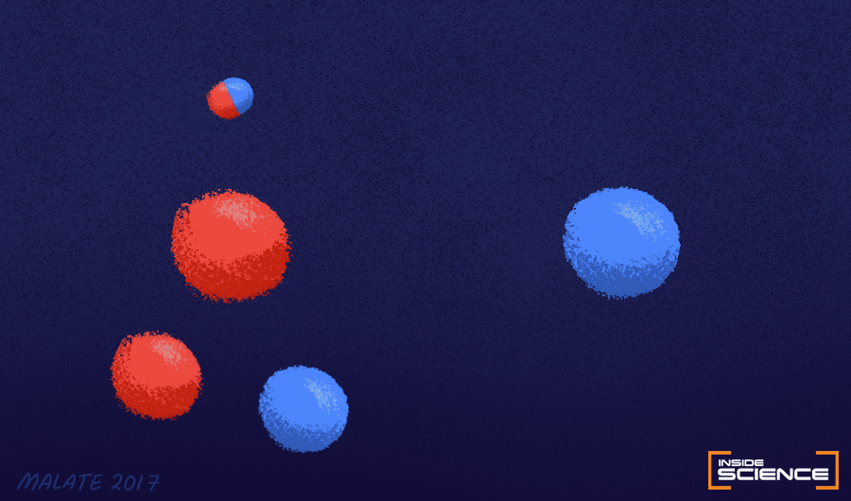



The Schwinger Effect (1951)
Electric field
Particle creation
Δx = Compton wavelength
=
In quantum vacuum
Image: Malate 2017 (AIP)
Particle creation if energy gained in acceleration from electric potential ΔV
over a Compton wavelength Δx exceeds the particle’s rest mass.
Δ (Energy) = e ΔV = mc² ⇒ ΔV = mc² /e , over Δx = λ_{Compton} = ℏ/mc.
Sauter (1931); Heisenberg & Euler (1935); Weisskopf (1936); Schwinger (1951)
Notes:
I = 10^30 W cm^2, B = 5X10^13 G

Slide 23

The Schrödinger Effect (1939)
Expanding space
Particle creation
Δx = Compton wavelength
=
In quantum vacuum
Image: Malate 2017 (AIP)
expansion
of space
Particle creation if energy gained from expansion of space
over a Compton wavelength Δx exceeds the particle’s rest mass.
Hubble’s law: v = H d
c = H ℏ / mc (combines ℏ and h)
Schrödinger (1939); (Parker 1964)

Slide 24


Requirements to pull particles from the vacuum
Schwinger effect
Schrödinger effect
1. Acceleration to relativistic speed
over a Compton wavelength
Particle must feel electric field,
i.e., have electric charge
3. Large spatial gradient of
electric potential V
1. Acceleration to relativistic speed
over a Compton wavelength
Particle must feel expansion,
i.e., break conformal invariance
Large temporal gradient of
particle frequency

Slide 25
Particle creation via the Schrödinger effect
Chung, EWK, Riotto (1998); Kuzmin & Tkachev (1999); earlier work by Ford; Turner & Widrow
My collaborators on completed papers:
  Ivone Albuquerque ⁴
  Edward Basso ²
  Christian Capanelli ⁵
  Tammi Chowdhury ⁵
  Daniel Chung ¹
  Patrick Crotty ¹
  Michael Fedderke ¹
  Gian Giudice ⁴
  Lam Hui ⁶
  Leah Jenks ⁴
  Siyang Ling ³
Ongoing collaborations:
  Mark Kamionkowski ¹ Mikel Martin Anna Negro Glen Starkman Ignacio Vargas Sarunas Verner ⁴
Andrew Long ^{2,4}
Evan McDonough ⁴
Guillaume Payeur ⁵
Toni Riotto ⁴
Rachel Rosen
Leo Senatore
Alexei Starobinski
Keyer Thyme ¹
Igor Tkachev ⁴
Jingyuan Wang ¹
Mark Wyman ⁴
CGPP with spectator fields that are minimally-coupled scalars, conformally-coupled scalars, Dirac fermions, de Broglie-Proca fields, Kalb-Ramond fields, Rarita-Schwinger fields, Fierz-Pauli fields, chiral fields, in one-field inflation models, hilltop-inflation models, rapid-turn inflation models, inflation models with non-canonical kinetic terms, Higgs-inflation models, multi-field inflation models, and impact on dark matter, leptogenesis, CMB, …
¹ Chicago student; ² Student of Chicago student; ³ Student of student of Chicago student; ⁴ Chicago/Fermilab postdoc; ⁵ Student of Chicago/Fermilab postdoc; ⁶ Chicago/Fermilab faculty

Slide 26





Scalar field in FRW background
covariant action
Gravity enters the picture
in a spatially flat FRW background : ds² = a²(η)[dη ² − dx ²] (η is conformal time)
field rescaling for canonically-normalized field:
decompose φ in Fourier modes , which satisfies wave equation
with time-dependent frequency
cosmological expansion ⇒
time-dependent background ⇒
time-dependent Hamiltonian for spectator fields ⇒
particle creation if large temporal gradient in

Slide 27
Using CGPP to produce particles
Classical Background Evolution
After inflation usual assumption is transition to matter-dominated phase with energy density dominated by inflaton oscillations.
In general, after inflation, H/H_{e} = (a/a_{e})^{−3(1+w)/2}
  w = 0: matter dominated, H ∝ a^{−3/2}
  w = 1/3: radiation dominated, H ∝ a⁻²
  w = 1: kination dominated, H ∝ a⁻³
Assume flat FRW
Assume cosmological evolution:
inflation,*
inflation ends,
followed by kination phase (nonstandard),
followed by “reheating” to radiation domination,
followed by matter domination,
followed by dark energy domination*
What we don’t know:
  Hubble rate at end of inflation
  (H_{e} , assumed to be large, about 10¹² GeV)
  Maximum temperature of radiation era
  (T_{RH} , assumed to be around 10⁹ GeV)
  H_{e} and T_{RH} will appear in many expressions
Quantum Spectator Field
Different spins, masses, and properties of particles in the Standard Model plus Right-Handed Neutrino (RHN)
We will assume mass of RHN = H_{e}
CGPP for minimally-coupled scalar (Higgs in SM) dominates
* H (inflation) = 10²³ eV?; H (today) = 10⁻³³ eV. That’s a real Hubble tension!

Slide 28


Using CGPP to produce particles
Bunch of standard QFT stuff (canonical quantization, creation & annihilation operators, Fourier modes…)
Quantize momentum modes
Solve mode equation with frequency
with initial conditions (Bunch-Davies vacuum)
Calculate stress-energy tensor as function of and
From stress tensor find comoving number density a³n of produced particles

Slide 29
Scalar field in FRW background
covariant action
nonminimal coupling term proportional to a “constant” ξ
ξ = 0: “minimal coupling”
ξ = 1/6: “conformal coupling”
in general, ξ should be a free parameter. ξ = 1/6 is an enhanced (classical) conformal symmetry point. Presumably RGE.
ξ = 1/6 useful because in many cases (e.g., fermion) conformal invariance is broken only by mass terms.

Slide 30
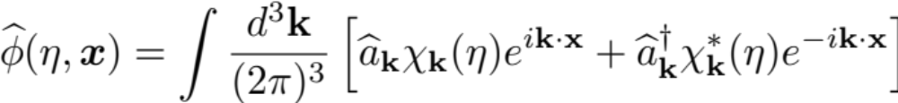



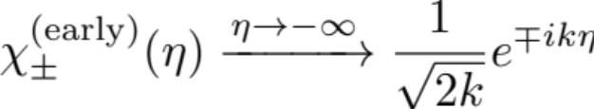
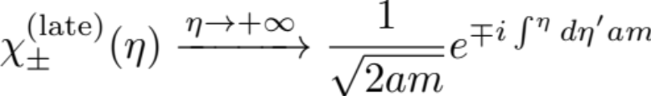
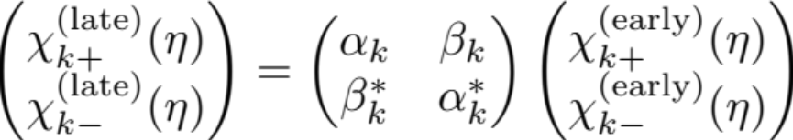
Scalar field in FRW background
Fourier mode decomposition
Comoving number density
mode functions satisfy wave equation
but with a time-dependent dispersion relation
time-dependent Hamiltonian
⇒ mode mixing
⇒ − frequency modes from + frequency modes
⇒ particle creation
+ & − frequency modes
leads to mode mixing

Slide 31
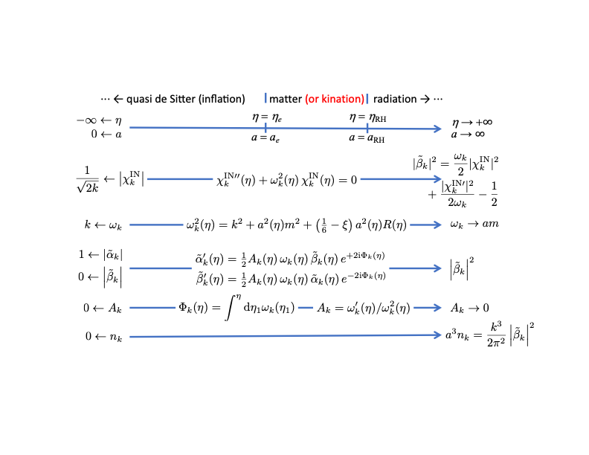

Slide 32
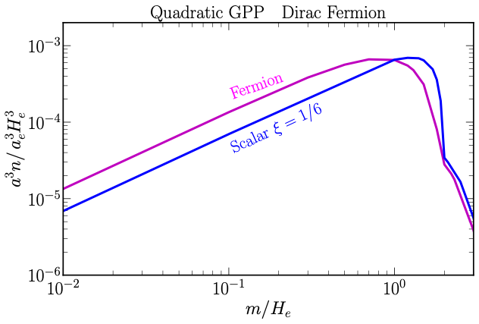

CGPP for fermion & conformally-coupled scalar, ξ = 1/6
This calculation assumes particular inflationary model (quadratic, which is ruled out).
But general picture holds in other models since action occurs around end of inflation.
Peak of about 10⁻³ around m_{χ} / H_{e} ≃ 1 (CGPP produces 10⁻³ particles per Hubble volume at the end of inflation).
Dirac fermions have conformally-coupled kinetic term, so should resemble conformally-coupled scalars.
We will utilize CGPP for Majorana fermion with an inflation model that transitions to kination after inflationary phase.

Slide 33
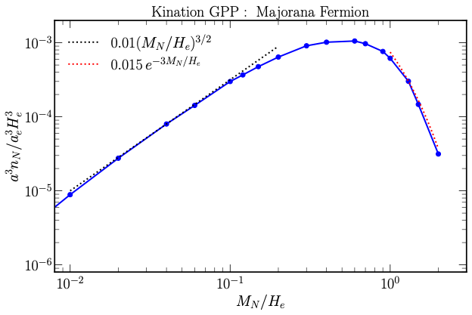
CGPP for Majorana Fermion Transitioning to Kination
M_{N} / H_{e} = 1 ⇒ a³ n_{N} / a_{e}³ H_{e}³ = 6.1 ╳ 10⁻⁴
Motivation for M_{N} / H_{e} = 1:
  H_{e} ≃ m_{inflaton}
  M_{inflaton} signals scale for new physics
  New physics scale includes N
  (actually, could be 10⁻¹ – 2).
mass
all produced via
Schrödinger effect
m_{inflaton}

Slide 34

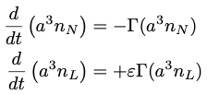

Overview of Our Scenario
Boltzmann equation for the evolution of n_{N} and n_{L}
Boltzmann equation for the evolution of n_{N} and n_{L}
Initial conditions,
n_{N} produced via inflaton decay,
nonperturbative reheating,
other interactions, …
we will assume CGPP
n_{L} = 0
inflation produces
Assume population of N’s present at end of inflation and interact sufficiently weakly that they do not thermalize. Boltzmann equation becomes
A fraction 28/79 of the lepton number later converted to baryon number through sphalerons.
Each N decay produces $ε$ units of lepton number.

Slide 35




Overview of Our Scenario
A fraction 28/79 of the lepton number later converted to baryon number through sphalerons.
Using
  The predicted baryon number is
Customary to quantify baryon number in terms of the baryon-to-entropy ratio:
  N_{RH} = ln(a_{RH}/a_{e}) is duration of reheating
Assuming no entropy injection in radiation-dominated era
  subscript RH denotes beginning of radiation-dominated era

Slide 36
Overview of Our Scenario
Want stiff equation of state and/or large N_{RH}
Assuming M_{N} = H_{e}
w = 1 (kination)
w = 0 (matter)

Slide 37

Kination Phase
Inflaton kinetic energy drives a phase of kination with w ≈ 1
A feature of Quintessential Inflation (Peebles & Vilenkin; Bettroni & Rubio; de Haro & Saló), k-inflation (Armendariz-Picon, Damour, Mukhanov), G-inflation (Kobayashi, Yamaguchi, Yokoyama), and in string-theory context (Apers, Conolon, Copeland, Mosny & Revello).
We model it by using a quadratic potential for φ > 0 and 0 for φ < 0.
Limit to duration of kination (Eröncel, Gouttenoire, Sato & Servant):
  Energy in inflaton field redshifts as a⁻⁶ (t)
  Energy in fluctuations of the relativistic inflaton field redshifts as a⁻⁴ (t)
  Estimate kination cannot last longer than 10 e-folds of expansion
We assume kination ends because inflaton φ has interactions with the SM
e.g., where Φ is the SM Higgs

Slide 38
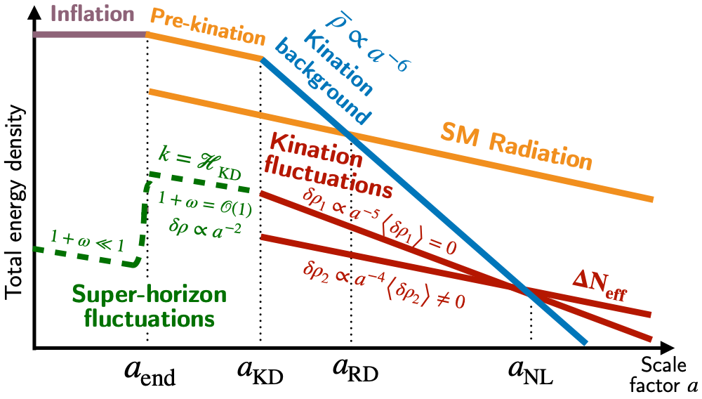
Eröncel, Gouttenoire, Sato & Servant (PRL 2025)

Slide 39
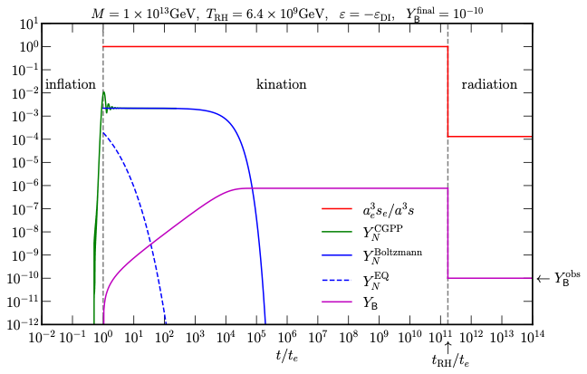

Sample Evolution
[green] Y_{N} (t): produced by CGPP, grows toward the end of inflation.
[solid blue] Y_{N} (t): N decays with neutrino lifetime, t = Γ⁻¹.
[dashed blue] Y_{N}^{EQ}: remains below Y_{N} , signaling thermal production negligible.
[magenta] Y_{B} (t): N decays produce lepton number, later converted to baryon number.
[red] Inverse of comoving entropy density normalized by the amount at the end of inflation. Injection of entropy at t_{RH} dilutes lepton number.

Slide 40
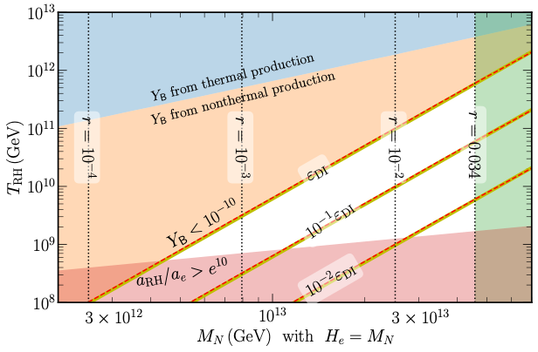
Parameter Space for Nonthermal Leptogenesis
from CGPP
If T_{RH} too large, thermal production dominates nonthermal production (blue region).
CP parameter limited by Davidson-Ibarra bound (orange region).
Limit to duration of kination phase (red region).
Limit on value of H_{e} = M_{N} from CMB (green region).
Our scenario viable in white region.

Slide 41
Baryogenesis Conclusions
Standard Model of Particle Physics alone, Combined with standard Model of Cosmology, cannot explain n_{B}/s = (0.861 ± 0.005) × 10 ⁻¹⁰ , at least so far.
Perhaps answer will come from completely nonstandard cosmology, or from physics way beyond the Standard Model.
Or perhaps cosmology pointing directions BSM.
  Electroweak Baryogenesis: 1st-order phase transition, new scalars coupled to Higgs.
  New sources of .
  GUT baryogenesis: Uses concept of unification of forces.
  Leptogenesis: Exploits BSM physics in neutrino sector.
CP

Slide 42
Leptogenesis
Leptogenesis is BSM, but motivated by observation of neutrino oscillations (and masses). Also, massive right-handed N fermions present in Grand Unified Theories beyond SU(5), e.g., SO(10).
Scenario has all the necessary ingredients: L violation from N decay followed by B violation from sphaleron conversion to B asymmetry; CP violation from complex Yukawa couplings; out-of-equilibrium decay possible for reasonable model parameters.
Experimental proof of Majorana nature of neutrinos would give a boost to scenario.
Inner-Space/Outer-Space connection between Baryon Asymmetry (one number) and the richness of the Type-I see-saw model.

Slide 43
Nonthermal Leptogenesis
Relieves issue of low reheat temperature of thermal leptogenesis to evade washout
Several ideas for origin of right-handed neutrinos
Several implementations of CGPP for origin of right-handed neutrinos
  (Kobayshi, Yamaguchi & Yokoyama; Hashiba & Yokoyama; Bernal & Fong; Co, Mambrino & Olive;
  Fujikara, Hashiba & Yokoyama; Barman, Cléry, Co, Mambrini & Olive; Flores & Perez-Gonzalez)
Our scenario:
  Hierarchical masses: M₁ ≪ M₂ < M₃
  M₁ ≈ H_{e} with 5×10¹² < M₁ < 5×10¹³
  This range of H_{e} accessible to next (future) generation CMB experiments
  N produced by CGPP
  Inflation followed by kination
  Eröncel, et al. limits duration of kination
  During kination N₁ decays out of equilibrium ⇒ no washout
  CP violation in N₁ decay within 10⁻² of Davidson-Ibarra produces lepton asymmetry
  Inflaton energy converted to radiation
  Sphalerons convert lepton asymmetry to baryon asymmetry

Slide 44
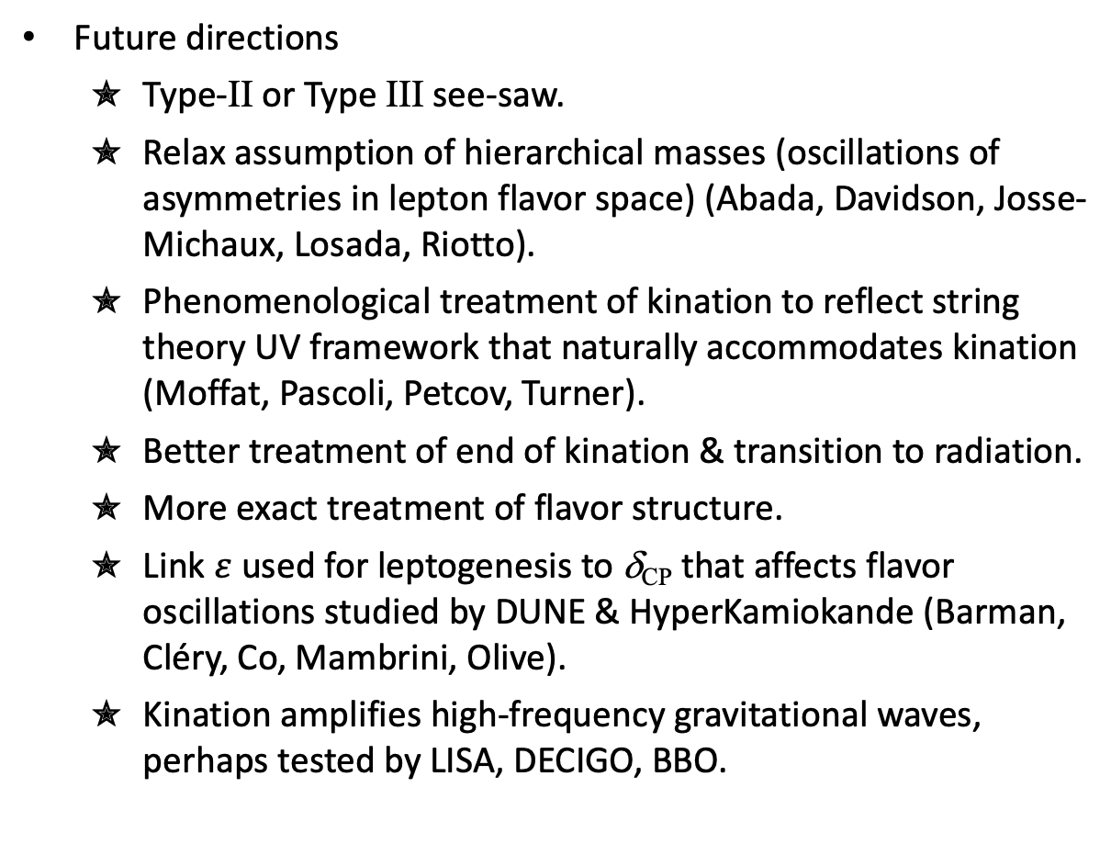
Nonthermal Leptogenesis
Future directions
  Type-II or Type III see-saw.
  Relax assumption of hierarchical masses (oscillations of asymmetries in lepton flavor space) (Abada, Davidson, Josse-Michaux, Losada, Riotto).
  Phenomenological treatment of kination to reflect string theory UV framework that naturally accommodates kination (Moffat, Pascoli, Petcov, Turner).
  Better treatment of end of kination & transition to radiation.
  More exact treatment of flavor structure.
  Link $ε$ used for leptogenesis to δ_{CP} that affects flavor oscillations studied by DUNE & HyperKamiokande (Barman, Cléry, Co, Mambrini, Olive).
  Kination amplifies high-frequency gravitational waves, perhaps tested by LISA, DECIGO, BBO.

Slide 45
Nonthermal Leptogenesis
Based on arXiv:2605.05304
Tammi Chowdhury
Leah Jenks
Andrew Long
Evan McDonough
Rocky Kolb University of Chicago

Slide 46
Backup
Slides

Slide 47

Break conformal invariance
Friedmann-Lemaître-Robertson-Walker (FLRW) metric in terms of conformal time, η
ds² = a²(η) (dη² – dx²) conformal factor a²(η) × Minkowski metric
Conformal transformation of metric: g_{μν} (x) ⟼ e ^{2Ω(x)} g_{μν} (x)
(Conformal transformation with e ^{2Ω} = a⁻²(η) maps FLRW metric to Minkowski metric)
Infinitesimal metric variation δ g_{μν} = 2 δ Ω g_{μν} leads to action variation
If trace of stress tensor of spectator field vanishes, field doesn’t feel expansion!

Slide 48

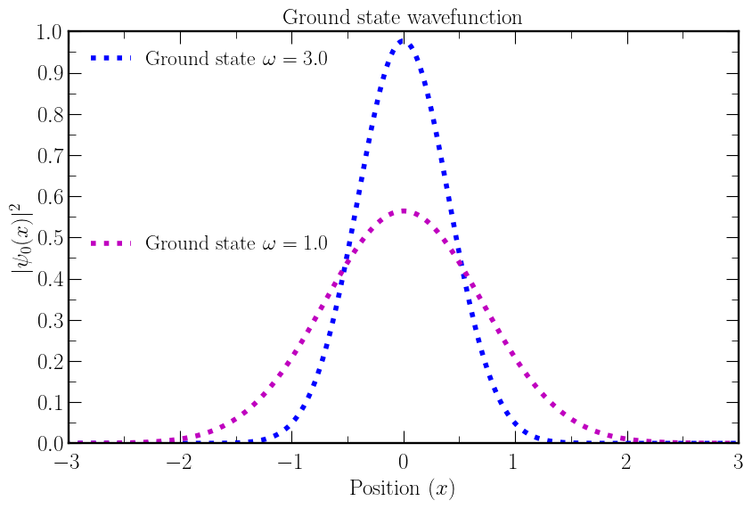

Quantum Harmonic Oscillator with Time-Dependent Frequency
Schrödinger equation:
m = ℏ = 1

Slide 49
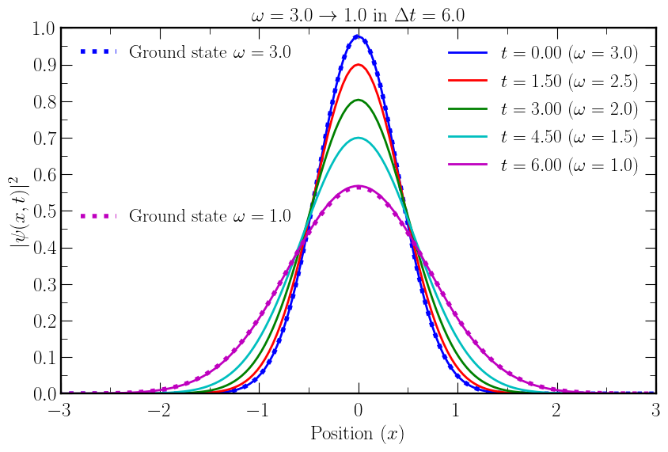
Quantum Harmonic Oscillator with Time-Dependent Frequency
Schrödinger equation:
Slow (adiabatic) evolution

Slide 50
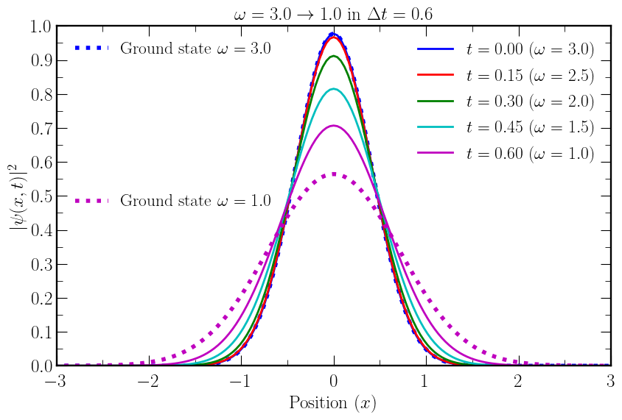
Quantum Harmonic Oscillator with Time-Dependent Frequency
Schrödinger equation:
Fast evolution

Slide 51
Cosmological Gravitational Particle Production (CGPP)
In Minkowskian QFT, a particle is an IR of the Poincaré group.
But, expanding universe not Poincaré invariant.
Notion of a “particle” is approximate.
Schrodinger (1939); Parker (1965, 68); Fulling, Ford, & Hu; Zel’dovich; Starobinski; Grib, Frolov, Mamaev, & Mostepanenko; Mukhanov & Sasaki, Birrell & Davies…
cosmological
expansion
CGPP not optional: can’t hide from gravity
(unless hide behind conformal symmetry)
time-dependent
Hamiltonian
positive and negative
frequency modes mix
particle
production
Notes:
Proper orthochronos homogeneo

