Slide 1
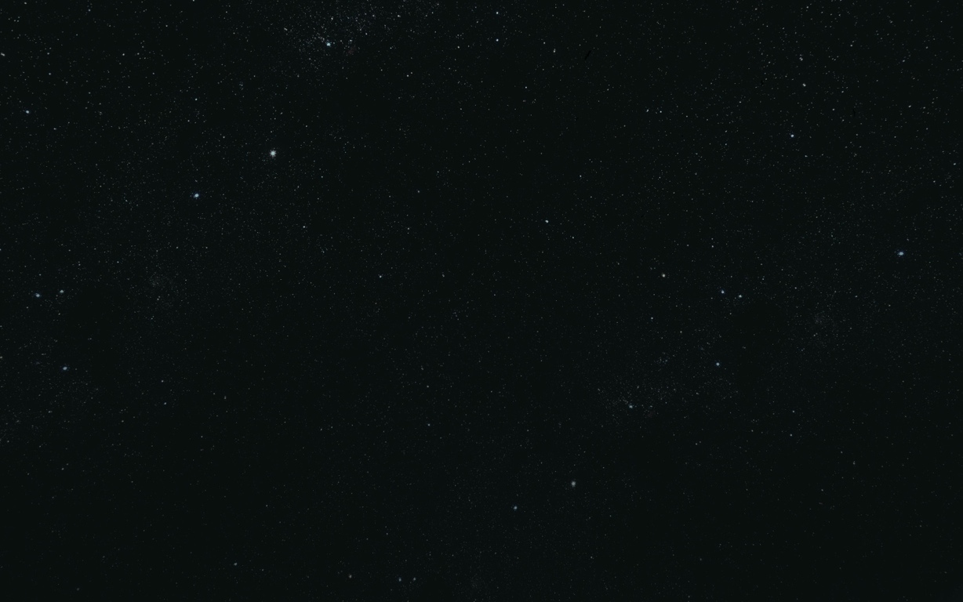



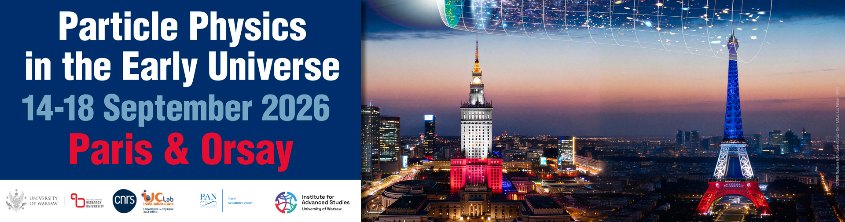
Coupled Dark Energy & Dark Matter for DESI:
An Effective Guide to the Phantom Divide
Can quintessence mimic phantom crossing without a phantom field?
Stefan Antusch (Basel) · *Stephen F. King (Southampton) · Xin Wang (Padova) arXiv:2604.08449 · April 2026
*talk on 15 September 2026, Paris

Slide 2
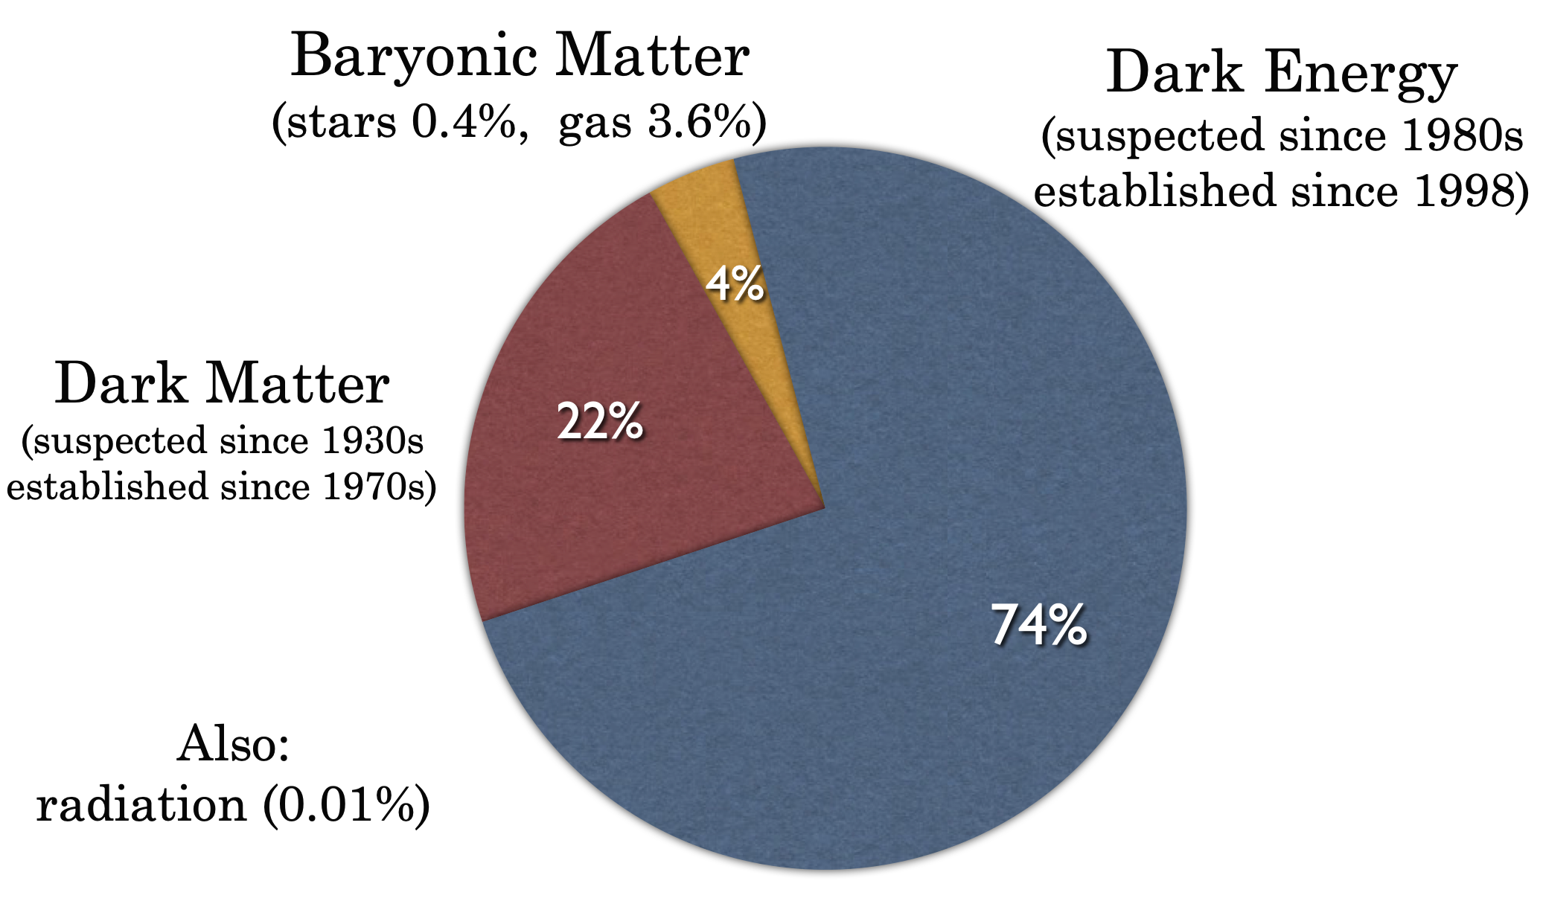
Nature of Dark Energy is unknown
Our focus here

Slide 3
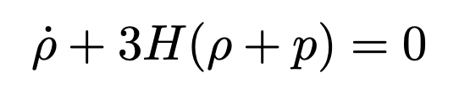

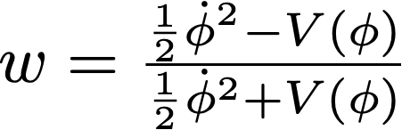
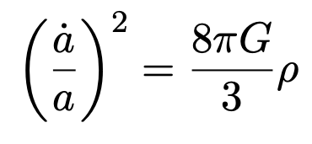
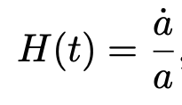
Dark Energy as a “fluid” (quintessence)
Equation of state
($w=-1$ is the cosmological constant)
Scalar field (quintessence) in general time dependent
$$-1≤w$$
Assuming non-negative kinetic term - non-phantom!
Hubble parameter
Expansion history of universe
given by Friedmann equation

Slide 4
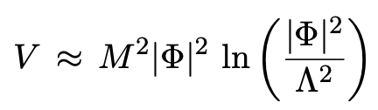


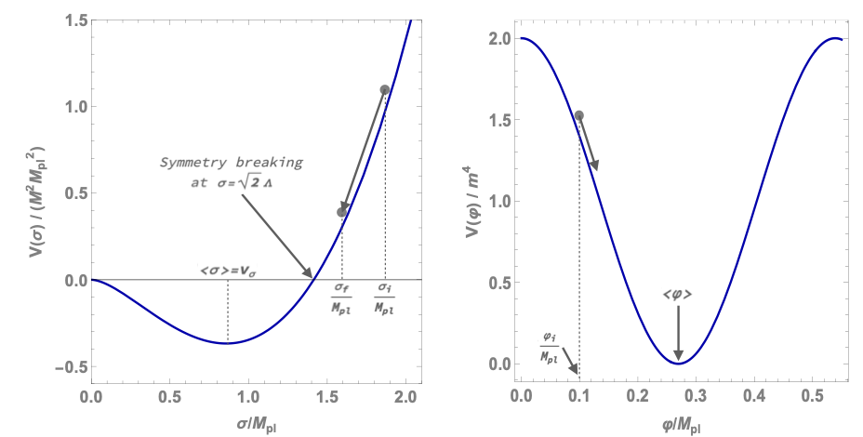

P. Di Bari, SFK, C.Luhn, A.Merle, A.Schmidt-May, 1010.5729, 1404.0009
Venus Keus, SFK, 2511.05799
E.g. Radiative Inflation and Dark Energy (RIDE) model
Unlike chaotic inflation, get SSB and a PNGB—> Quintessence
Inflation
Quintessence
Inflaton
Quintessence

Slide 5
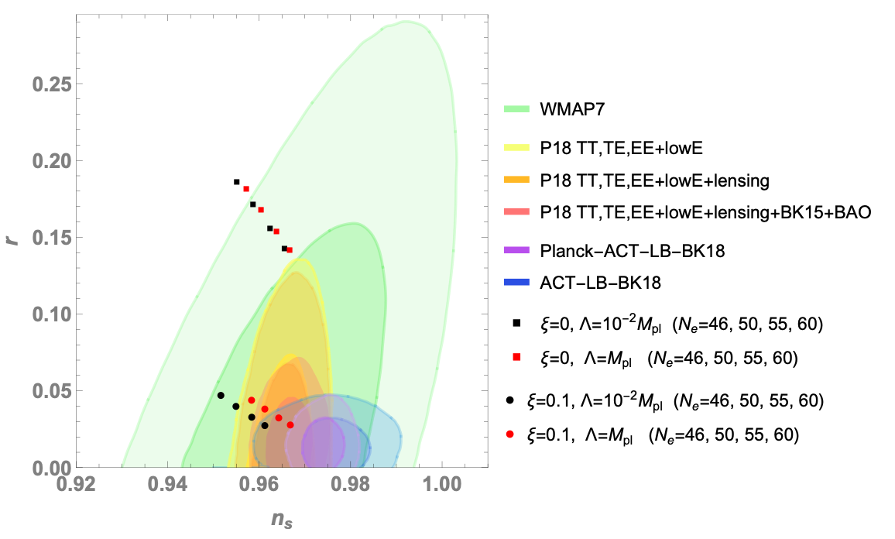


Venus Keus, SFK, 2511.05799
Non-minimal coupling to gravity
Inflation predictions
Venus Keus

Slide 6
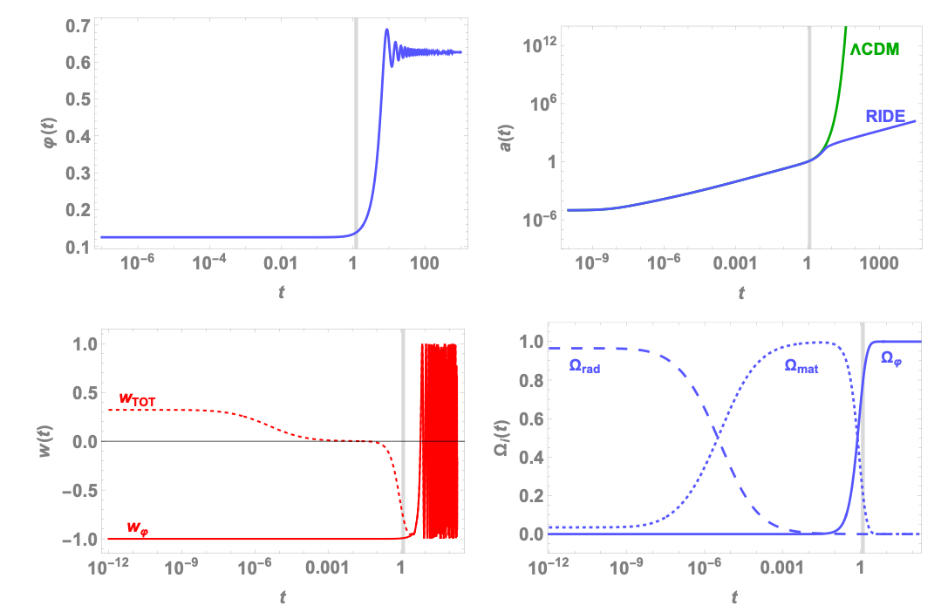
Quintessence predictions
Venus Keus, SFK, 2511.05799
Until recently it was fine to have w=-1
Now there is some evidence for an evolving dynamical DE with w<-1 !
“Phantom DE”?
The evidence comes from BAO data combined with CMB and SNe
Quintessence field
$$w=-1$$

Slide 7
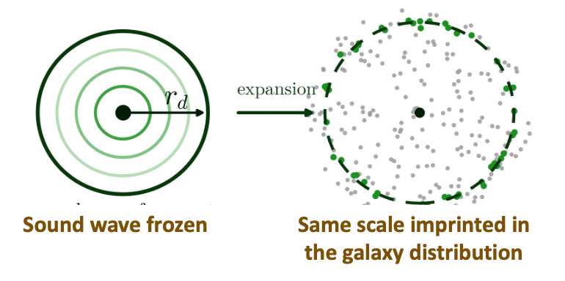
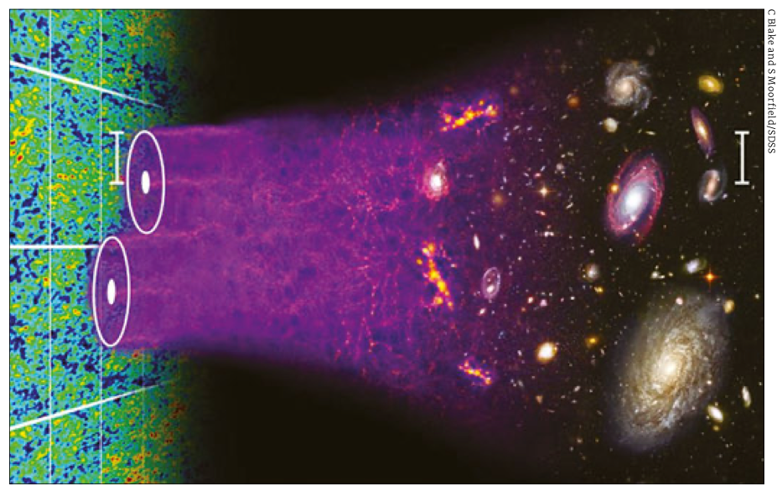
Baryon Acoustic Oscillations: sound horizon of cosmic plasma (distance travelled by sound waves) is imprinted on galaxy separations as a standard ruler.
•Photon–baryon sound waves travel a co-moving distance r_d≃150 Mpc before recombination.
•It is then frozen in at the drag epoch (z_d≃1060).

Slide 8
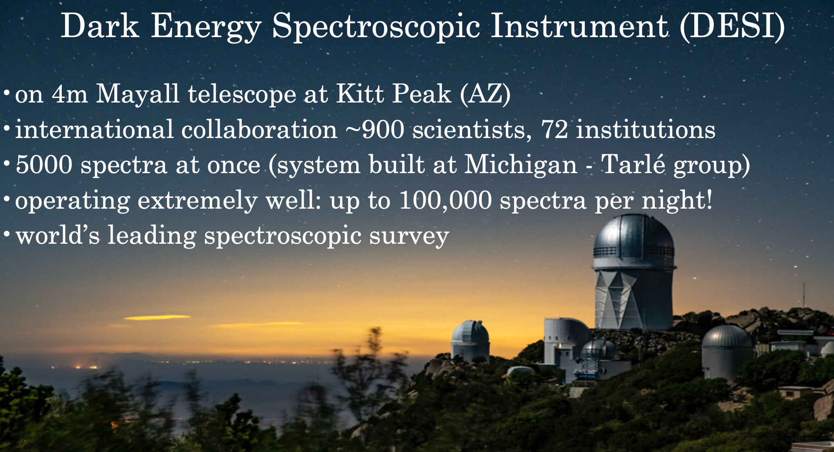

Slide 9
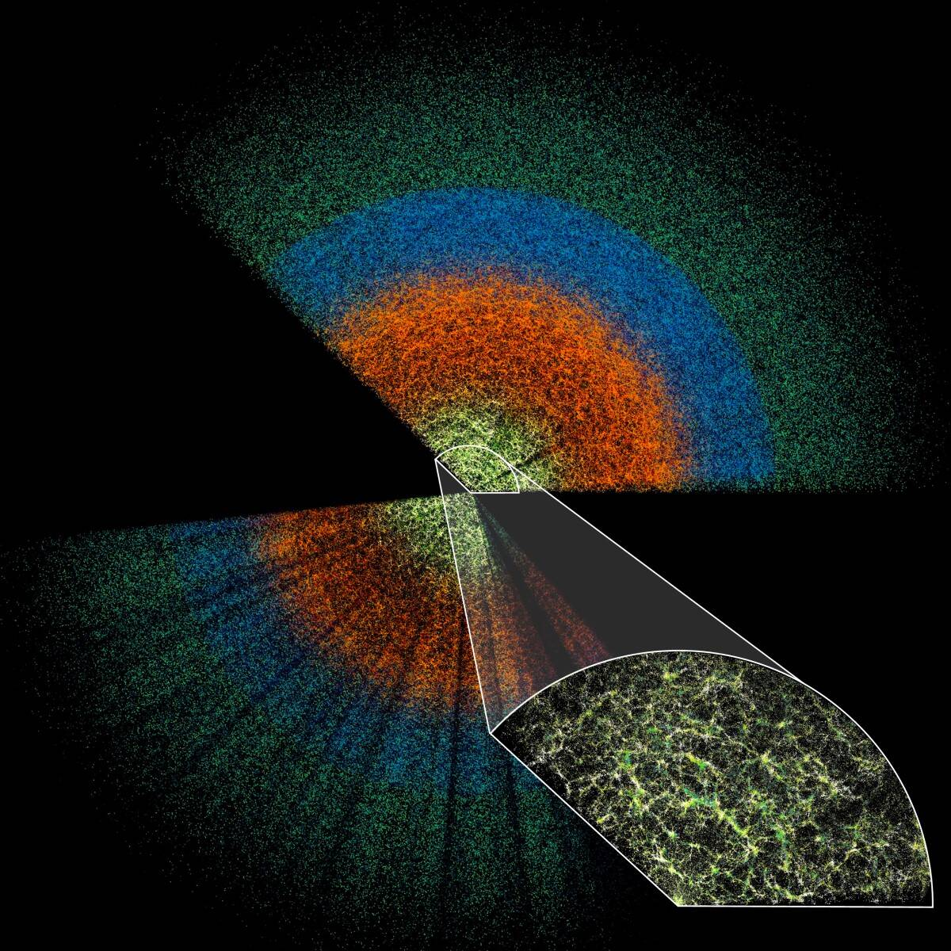
DESI measures redshifts for tens of millions of galaxies and quasars
It reconstructs the BAO feature in galaxy correlation functions and power spectra for both transverse and radial directions
Tracing the BAO ruler from CMB to late times depends on DE and DM, and provides evidence for dynamical DE

Slide 10


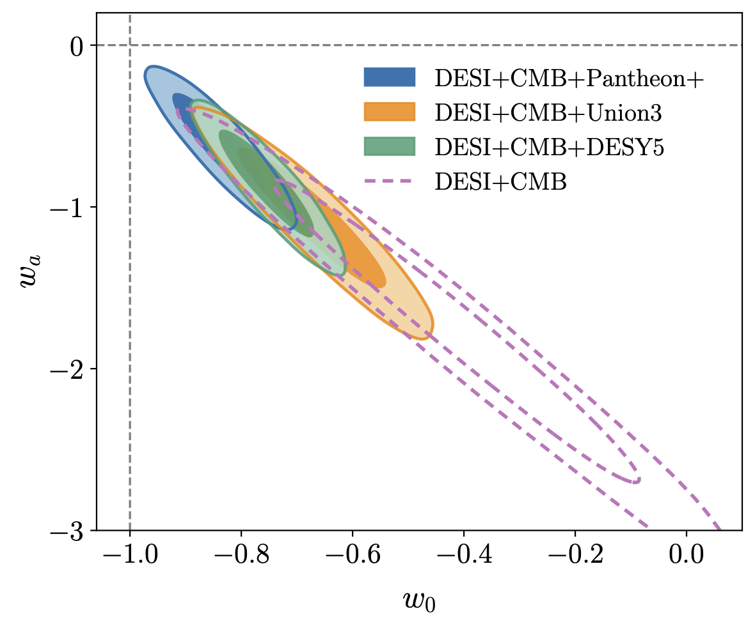
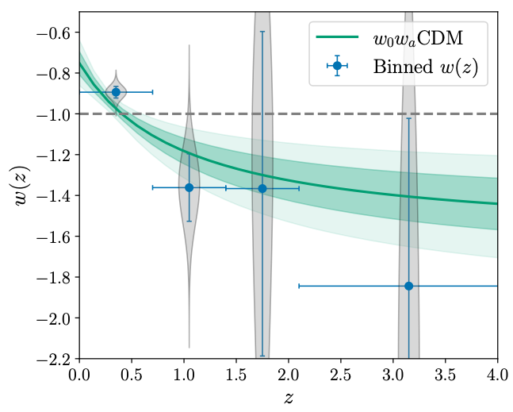

Dynamical Dark Energy
DESI DR2 2503.14738
Assuming CPL parametrisation
Binned data shows w(z) which appears to cross the phantom divide (w=-1)

Slide 11
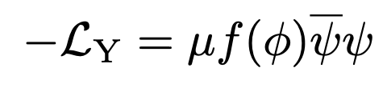
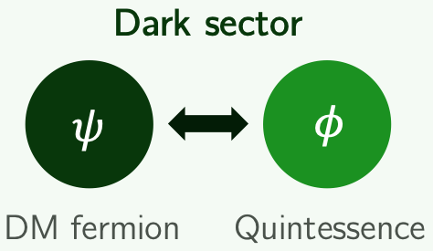
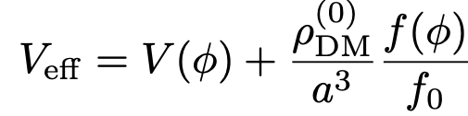
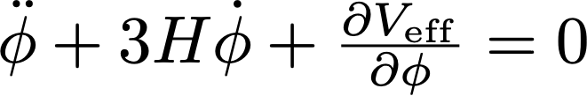
L.Amendola, astro-ph/9908023; Farrar,Peebles, astro-ph/0307316J; Khoury,A.Weltman, astro-ph/0309300
The Model: Quintessence Coupled to Dark Matter
$φ$ is canonical quintessence field
$ψ$ is a fermionic cold dark matter field
$f(φ)$ is dimensionless function (analogous to Higgs Yukawa after SSB)
DM mass depends on the quintessence scalar: $m(φ)=μf(φ)$
In FRW background the scalar evolves in an effective potential V+$ρ$_{DM}

Slide 12
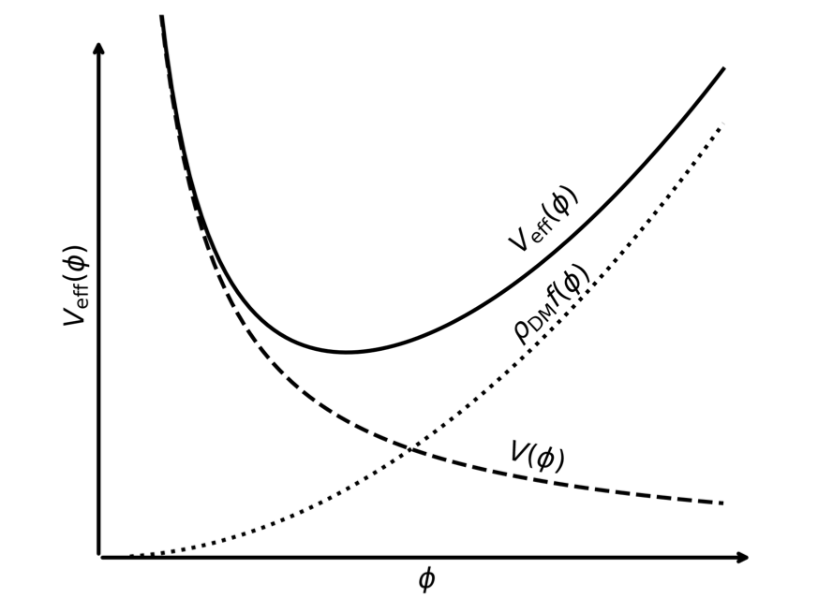
A.Chakraborty, P.K.Chanda, S.Das and K.Dutta, 2503.10806
Crucially: the slopes of V(φ) and f(φ) must be opposite in sign
Dominates in the past
Dominates today

Slide 13
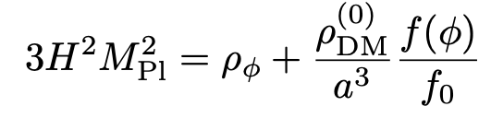
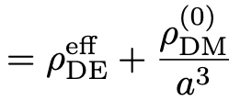
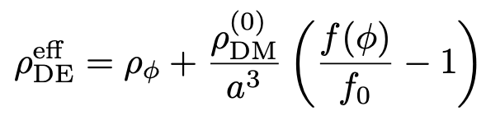
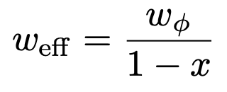
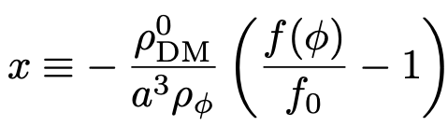
Effective Equation of State
Interpreted as standard DM plus dynamical DE
Friedmann equation
$$p_{DE}^{eff}=ρ_{DE}^{eff}w_{eff}=p_{ϕ}=ρ_{ϕ}w_{ϕ}$$
Pressureless DM
The Key Formula
$w_{φ}$ is the intrinsic scalar field EoS parameter (always ≥ −1 for a canonical field)
A value x > 0 leads to $w_{eff}$ < −1 even when $w_{φ}$ > −1
Hence need f(φ) < f₀ (i.e. DM was lighter in the past)

Slide 14
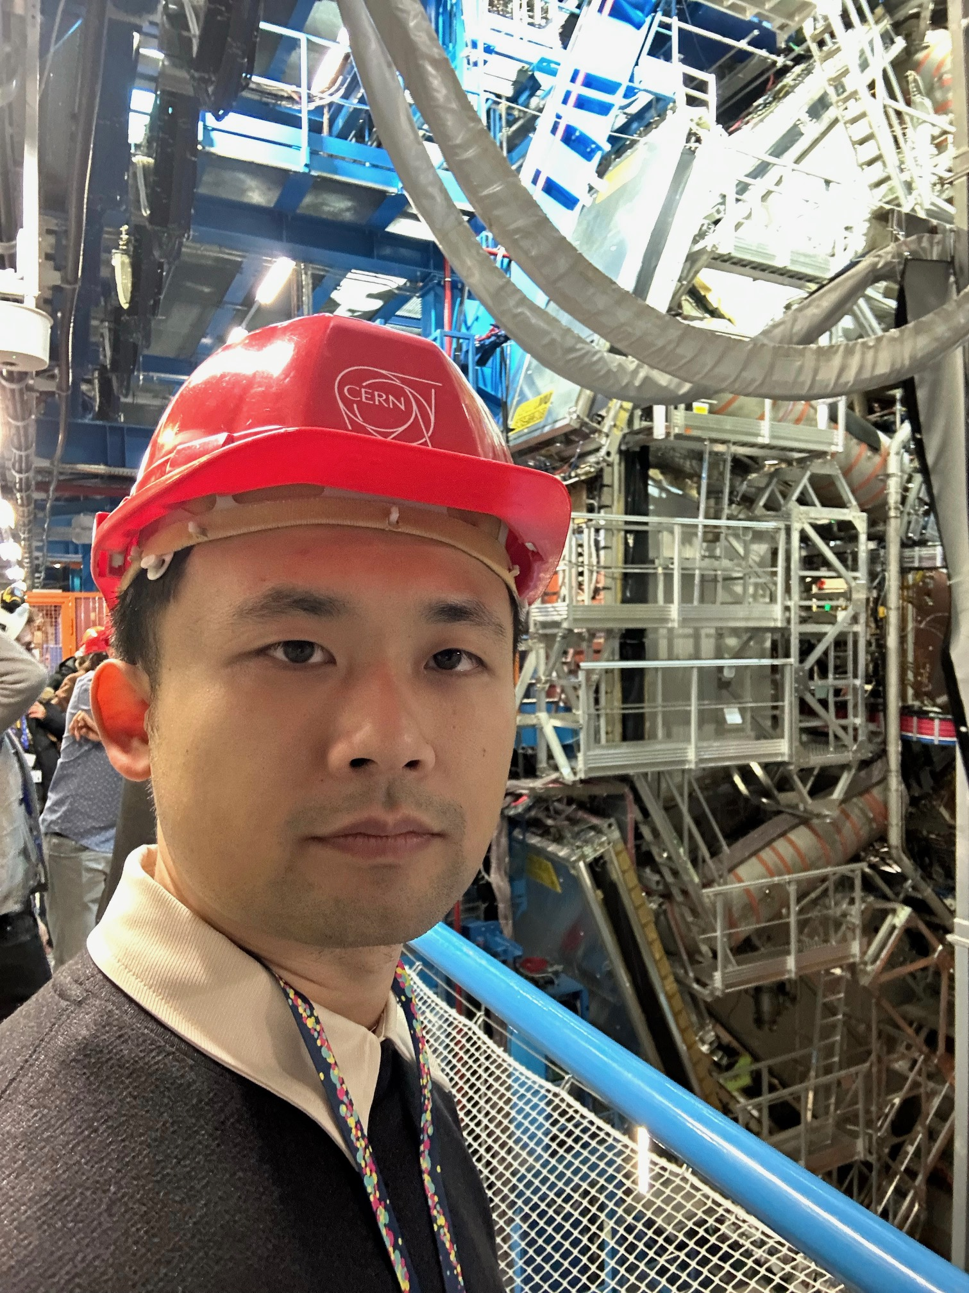

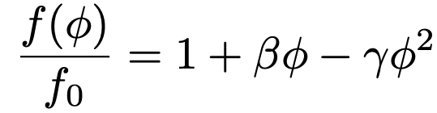
S.Antusch, S.F.King and X.Wang, 2604.08449
Xin Wang
Minimal Phenomenological Realization
Linear bare potential (simplest choice consistent with slow-roll DE today)
Quadratic $−γφ^{2}$ term to suppresses f-slope at large field values (early times), achieving CMB safety (DM mass variation extremely small before recombination)
Four free parameters: α, β, γ plus b.c. $φ_{init}^{′}=0$ at $a_{init}={10}^{−7}$ (stable initial cond.)
V₀ and $φ_{init}$ fixed by shooting: reproduce φ₀ ≈ 0 and $ρ_{φ}(today)≈ρ_{DE}(today)$
Constraint: f(φ) > 0 and f'(φ) > 0 along the full trajectory (no pathological regions)

Slide 15
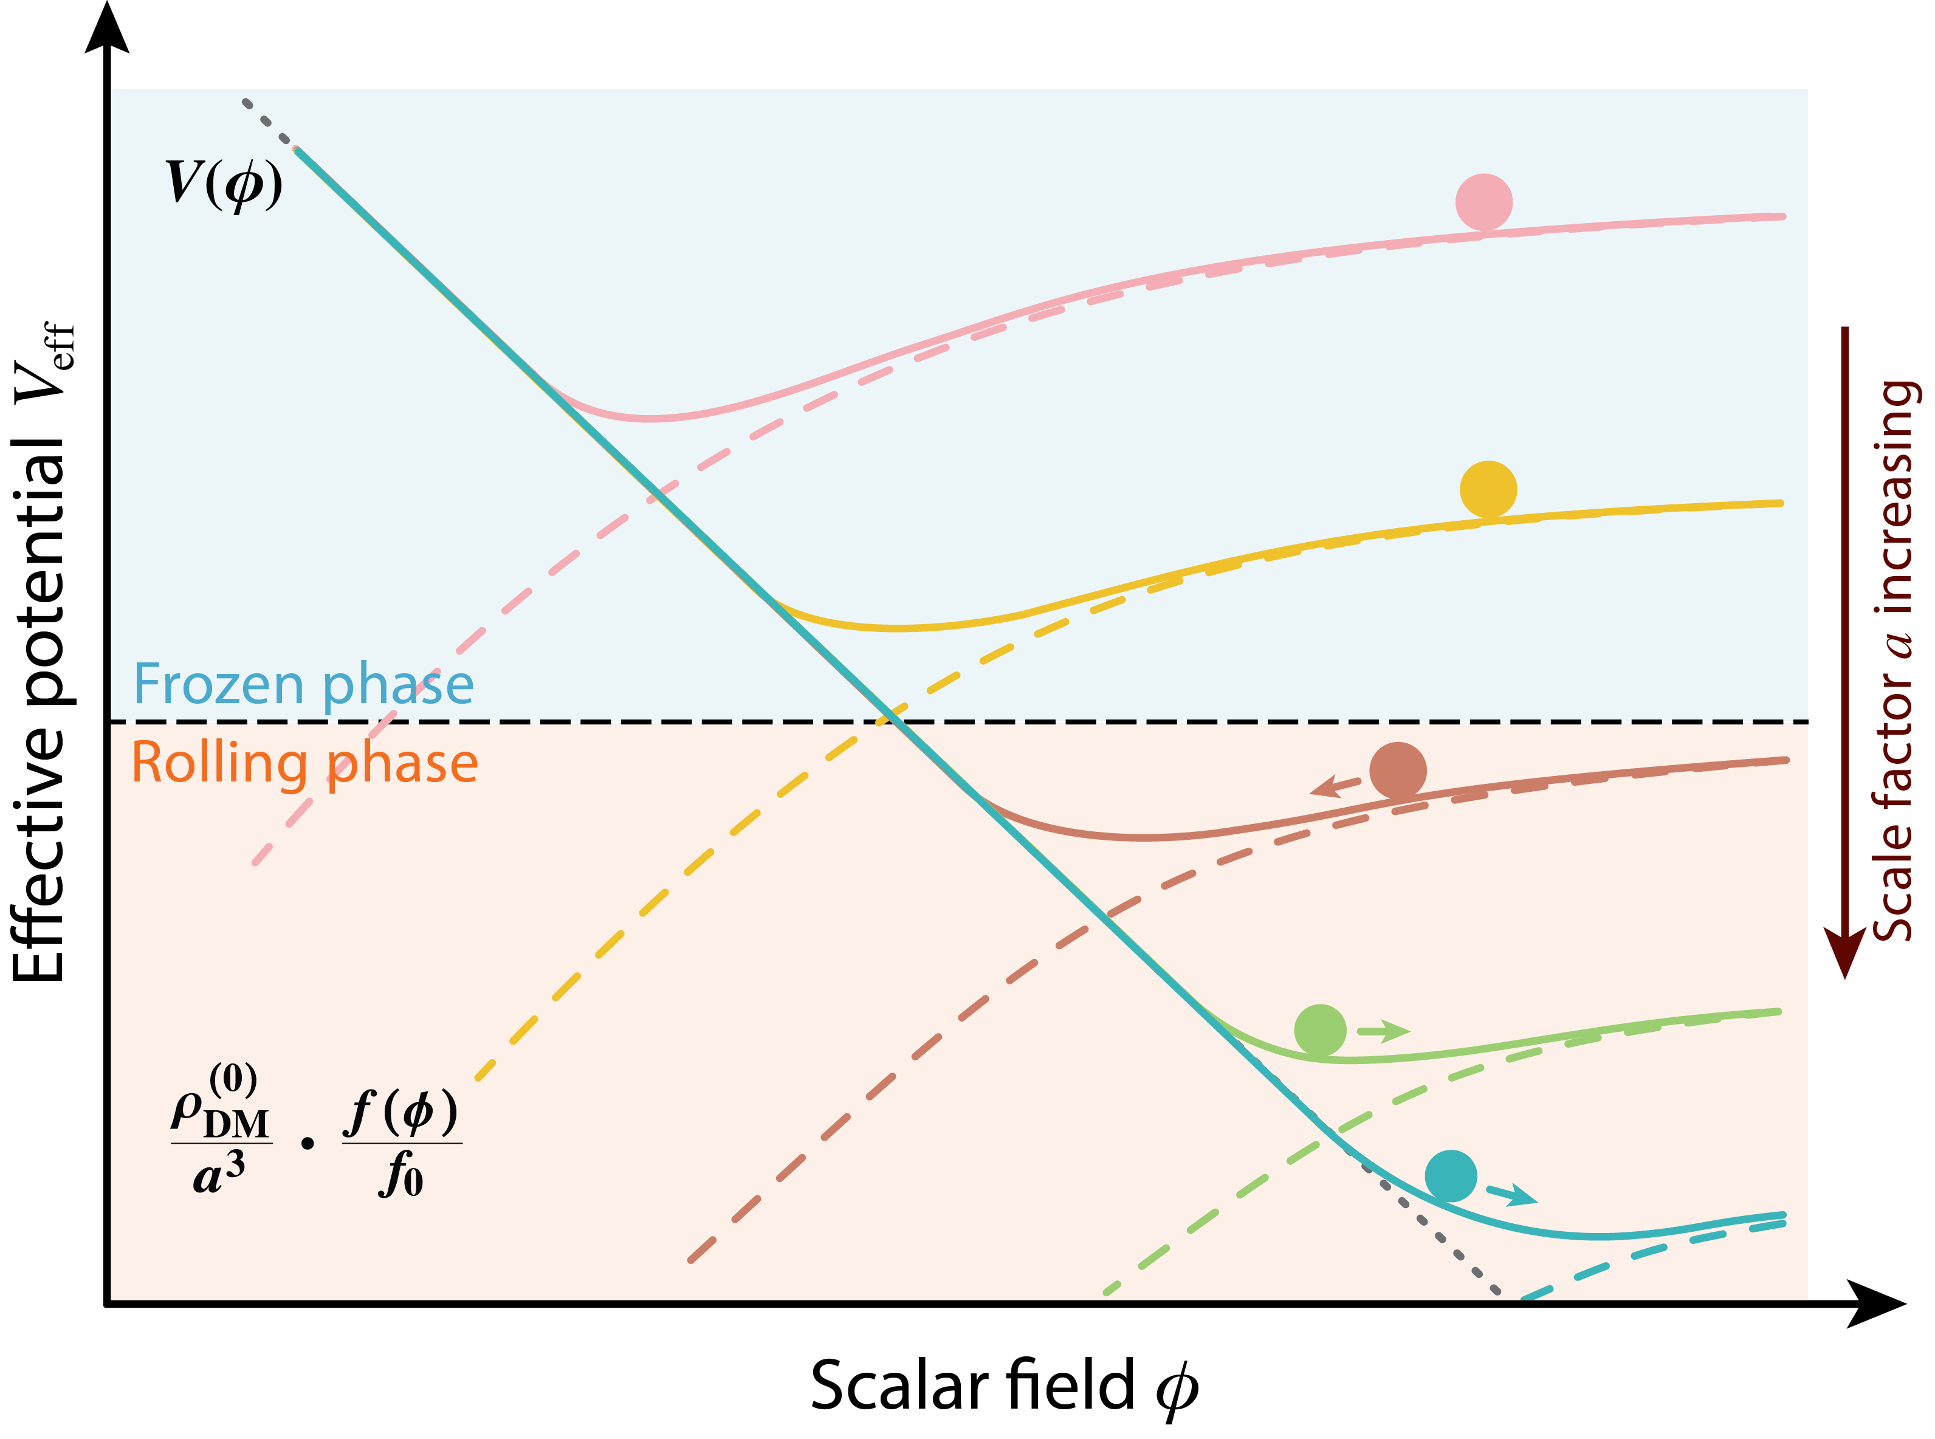
S.Antusch, S.F.King and X.Wang, 2604.08449
Early times$∼1/a^{3}$ term dominates
Field starts from a frozen phase in the early universe (robust initial condition)
Then starts to roll one way, then the other
Late times $V(φ)$ term dominates

Slide 16
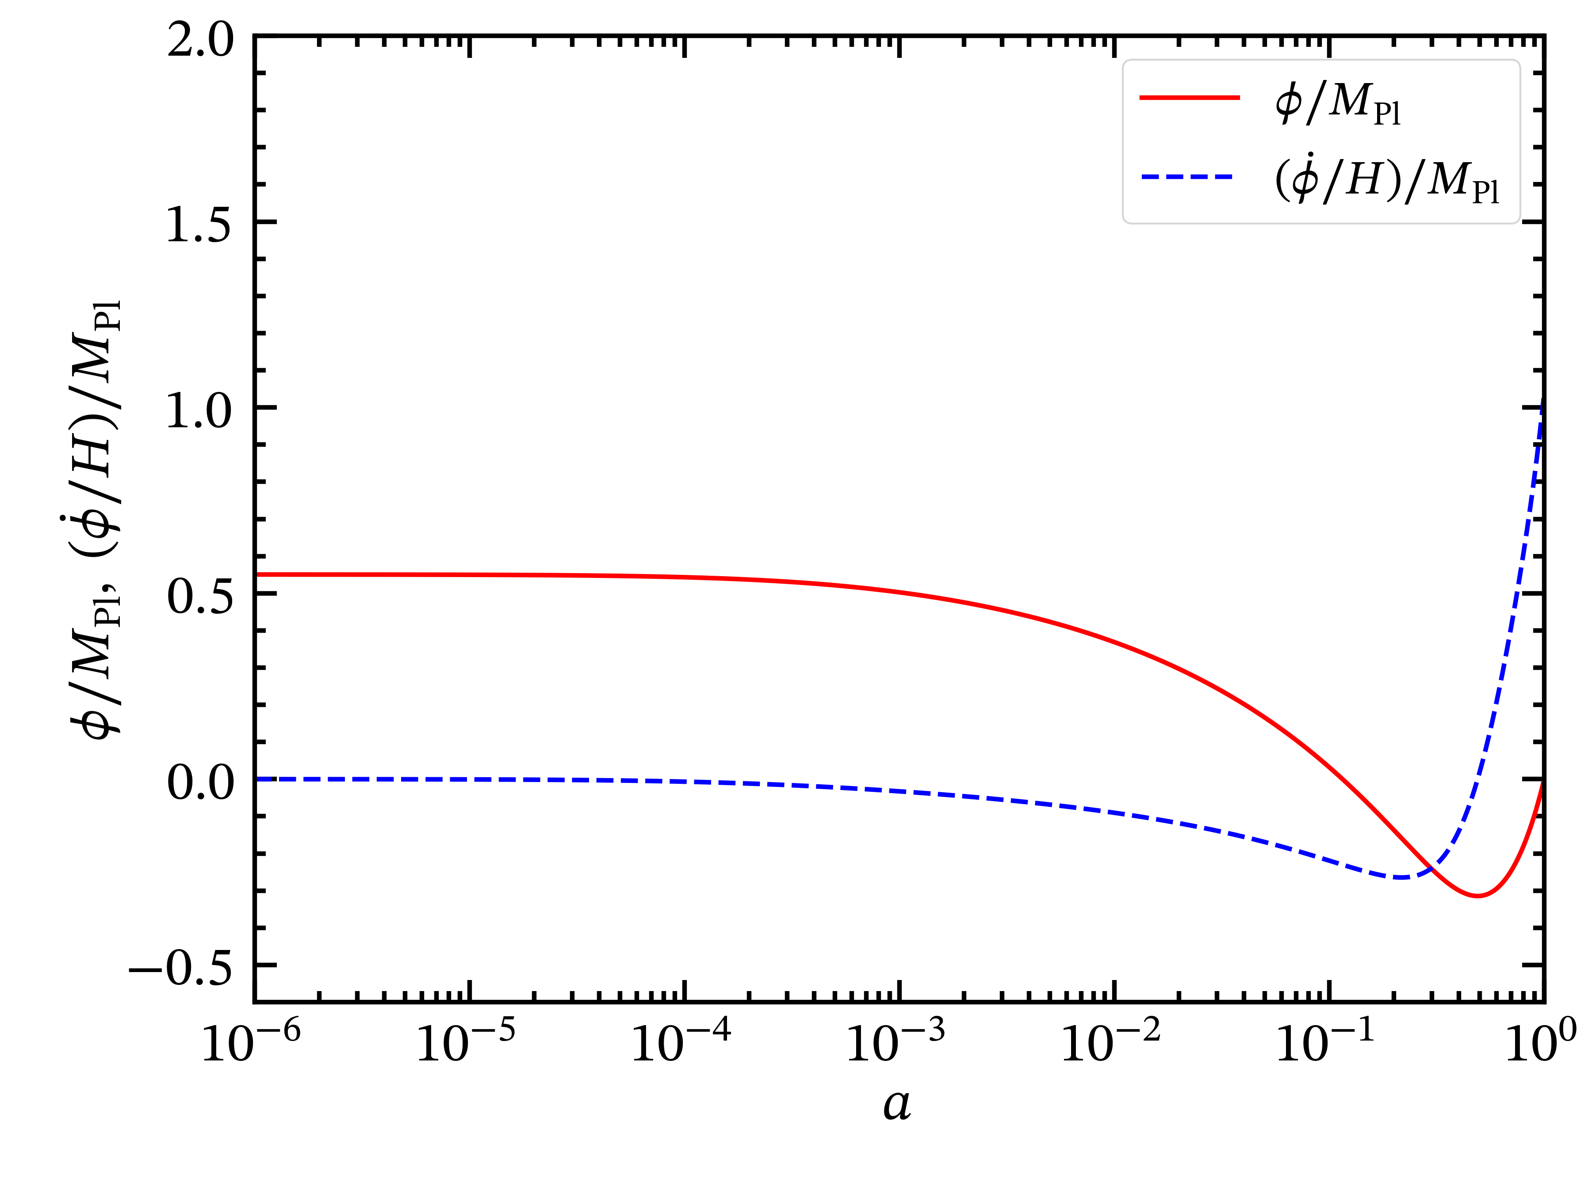



S.Antusch, S.F.King and X.Wang, 2604.08449
$φ_{init}$ fixed by shooting
$$φ_{init}^{′}=0$$
φ₀ = 0 today
Deep radiation era
Now

Slide 17
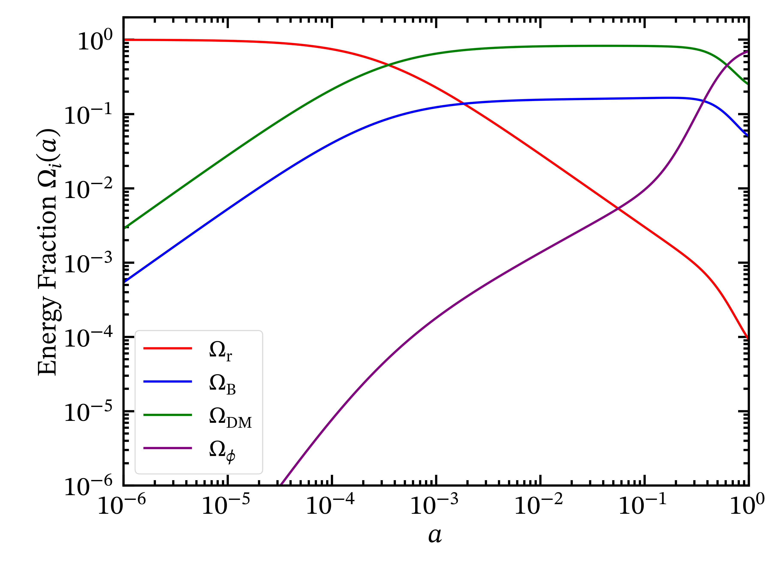
S.Antusch, S.F.King and X.Wang, 2604.08449
Scalar field energy fraction at recombination — well below the 0.0036 Planck bound
Deep radiation era
Now

Slide 18
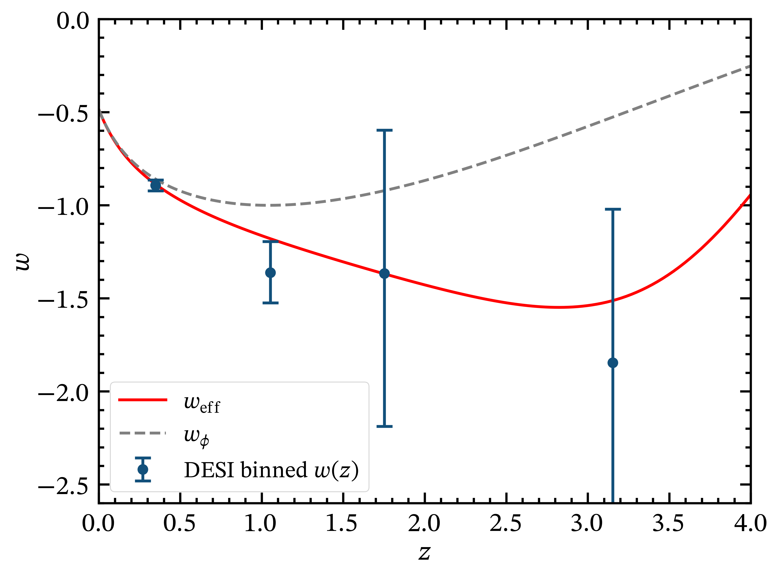
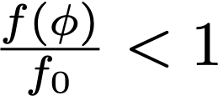
S.Antusch, S.F.King and X.Wang, 2604.08449
All DESI binned w(z) reconstruction bins fitted within 1σ
(DESI+CMB+Union3)
Phantom crossing at z ~0.5 to z~4.0

Slide 19
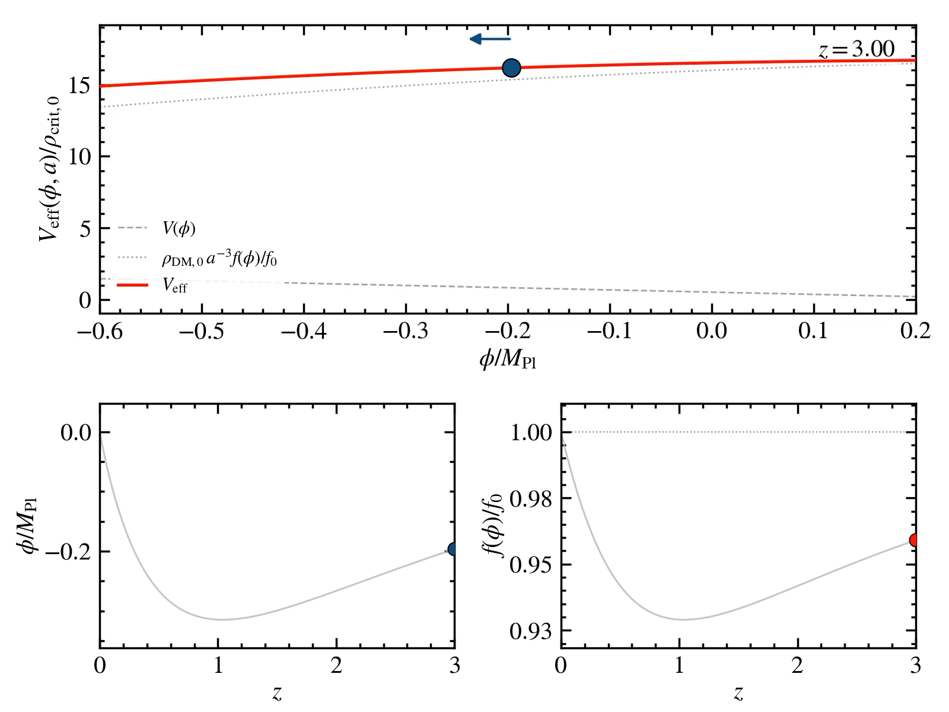
Movie by Xin Wang

Slide 20


CMB Safety: All Constraints Satisfied
Interaction strength at recombination: ε(zrec) ≈ 9.78 × 10⁻⁴ < 0.005 ✓
DM mass drift before recombination: |Δ ln m|rec ≈ 7.01 × 10⁻⁴ < 0.01 ✓
Scalar field energy fraction at recombination: Ωφ(zrec) ≈ 1.62 × 10⁻⁴ < 0.0036 ✓
Accelerated expansion today: deceleration parameter q₀ < 0 ✓
DM mass positive and monotonically varying along trajectory: f(φ) > 0, f'(φ) > 0 ✓
Scalar field remains frozen (|φ'|/MPl ≪ 1) until a ~ 10⁻³, then smoothly activates ✓
Definitions:

Slide 21
Summary & Conclusions
DESI DR2 prefers dynamical dark energy with phantom crossing at z ~ 0.5–1
A canonical quintessence field coupled to cold dark matter via a Yukawa interaction can produce an apparent phantom crossing without any phantom field
The effective equation of state weff = wφ/(1 − x) can dip below −1 when the DM mass was lighter in past
Viable realizations require: (1) frozen initial conditions in the deep radiation era, (2) CMB-safe coupling at recombination, (3) strong coupling active at late times
These three requirements can be simultaneously satisfied with a linear bare potential and quadratic interaction function f(φ) = f₀(1 + βφ − γφ²)
Best-fit weff evolves from ≈ −1.2 at z ≈ 1 to ≈ −0.9 at z ≈ 0.3, fitting all DESI bins within 1σ
This work provides a model-independent guide for building UV-complete dark energy models that safely navigate the phantom divide

Slide 22
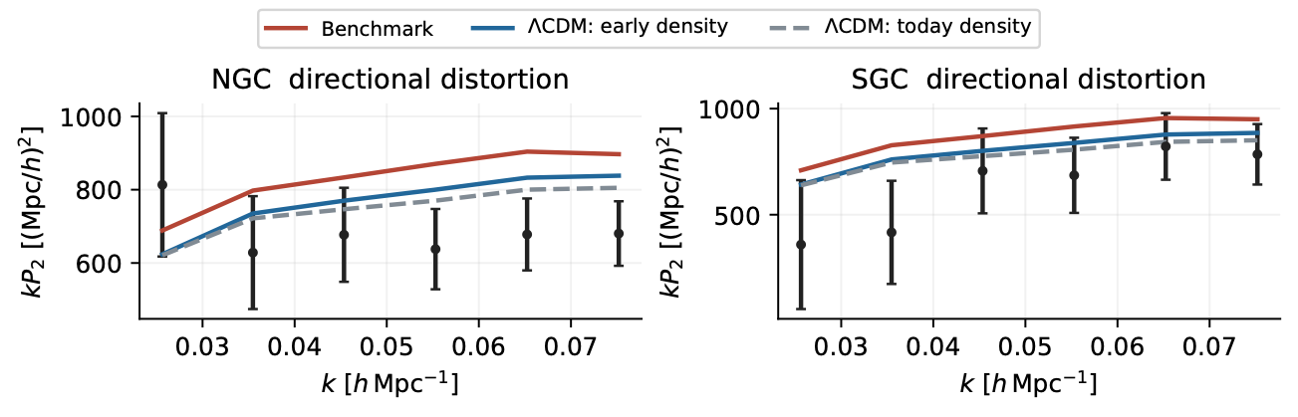
Xin Wang
Backup: Redshift-Space (RSD)
Baryon Oscillation Spectroscopic Survey (BOSS)
Galaxy redshifts contain information about galaxies’ peculiar velocities along the line of sight. When distances are inferred from redshifts, galaxy clustering appears anisotropic.
NGC and SGC mean North and South Galactic Cap.
$$Ω_{DM}=0.25$$
Notes:
BOSS = Baryon Oscillation Spectroscopic Survey, Data Release 12. RSD = redshift-space distortions from galaxy peculiar velocities. NGC and SGC mean North and South Galactic Cap.
The figure shows the quadrupole P2 only, but all chi-square values come from a joint monopole P0 plus quadrupole P2 fit with 24 data points and four nuisance parameters, hence nu=20. The cut is 0.02<k<0.08 h/Mpc and z_eff=0.61. Bias and residual shot noise are fitted independently in the two regions.
Default halo CDM fraction today is 5/6, with theta_h=f_h theta_DM+(1-f_h)theta_B. chi2=27.2824, p=0.1275.
The early-density control gives 17.9805, so Delta chi2=+9.30.

Slide 23
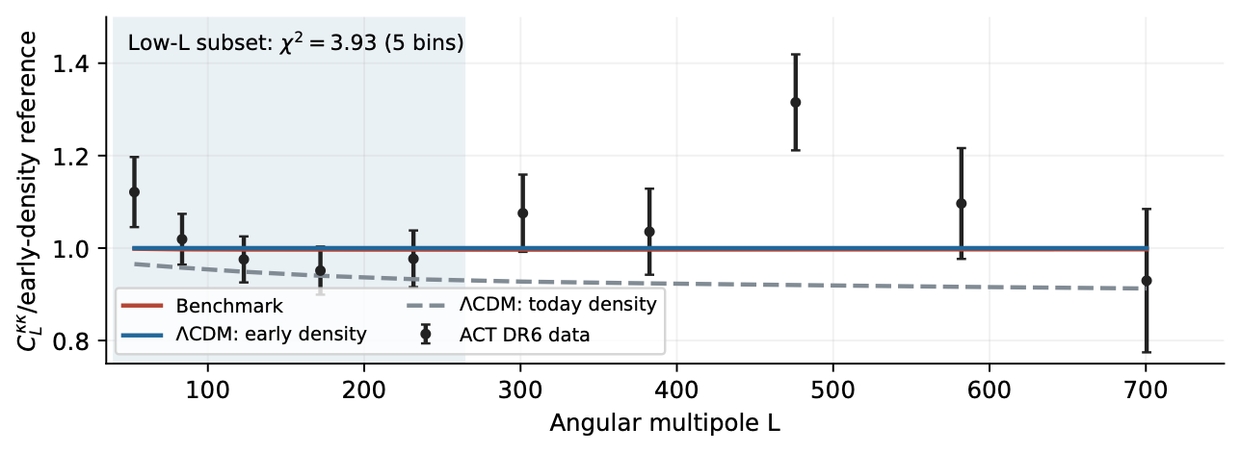
Xin Wang
Backup: Cosmic Microwave Background Lensing
Atacama Cosmology Telescope (ACT), Data Release 6 (DR6)
$$Ω_{DM}=0.25$$
Notes:
L is the angular multipole and kappa the lensing convergence.
All curves and measured band powers are divided by the early-density reference.
The blue low-L region has five bands with window support 40-264. The official lens-only likelihood uses the CMB-marginalized covariance and finite-simulation correction.
At fixed A_s the low-L result is chi2=3.9281 for five degrees of freedom, p=0.560.
Relative to early-density LCDM the predicted power changes by about -0.3% at L=100-500. Relative to today-density LCDM, which instead fixes Omega_DM0=0.250, it increases by 4.6-8.5%.

Slide 24
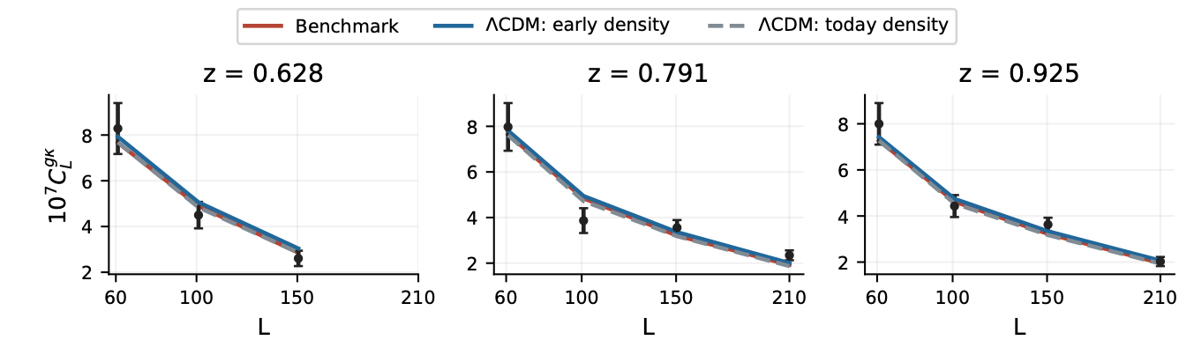
Xin Wang
Backup: Galaxies Correlated with CMB Lensing
DESI luminous red galaxies with ACT lensing at the same redshifts
Use DESI galaxies to tell us where the matter is, and ACT CMB lensing to tell us how much matter lies along the line of sight. Cross-correlating the two measures the growth of cosmic structure.
The luminous red galaxy samples have mean redshifts 0.628, 0.791 and 0.925.
$$Ω_{DM}=0.25$$
$C_{L}^{gκ}$ is the angular cross-power spectrum between galaxies and CMB gravitational lensing.
Notes:
The luminous red galaxy samples have mean redshifts 0.628, 0.791 and 0.925. ACT supplies cosmic microwave background lensing convergence kappa.
The figure displays the cross spectra only. The joint fit includes both galaxy auto spectra and galaxy-lensing cross spectra: 19 bands, with the full covariance across redshift bins and observables.
At fixed cosmology C_L^gg contains two factors of galaxy bias b_g, while C_L^(g kappa) contains one, reducing the freedom to hide a matter-amplitude change in bias. Each sample has a free density bias, a magnification count-slope prior s_i=1+/-0.1 and a relative shot-noise prior N_i/Nbar_i=1+/-0.3. The fixed benchmark has chi2_data=13.3787, chi2_prior=2.1386 and total=15.5173. Allowing a common signal-power amplitude A=A_s/(2.1e-9) gives 1.075+/-0.082 from local curvature.

