Slide 1
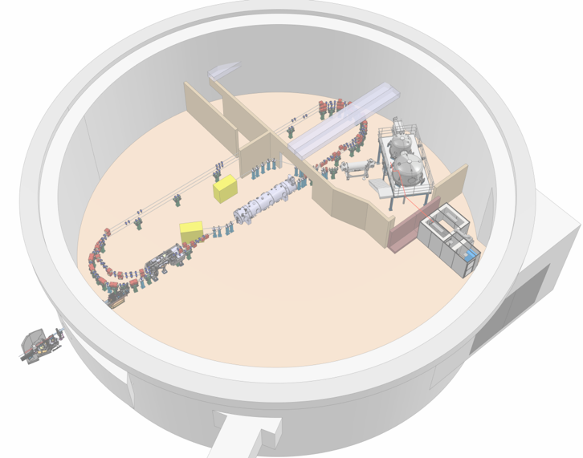

Project Progress Review (PPR) 8-2026
WP- 02
Présenté par: A. Fomin
R. Abukeshek, F. Bouly, A. Cieplak, A. Fomin, J. Issa, J. Michaud, C. Monaghan, L. Perrot, S. Wallon
19 Mars 2026

Slide 2
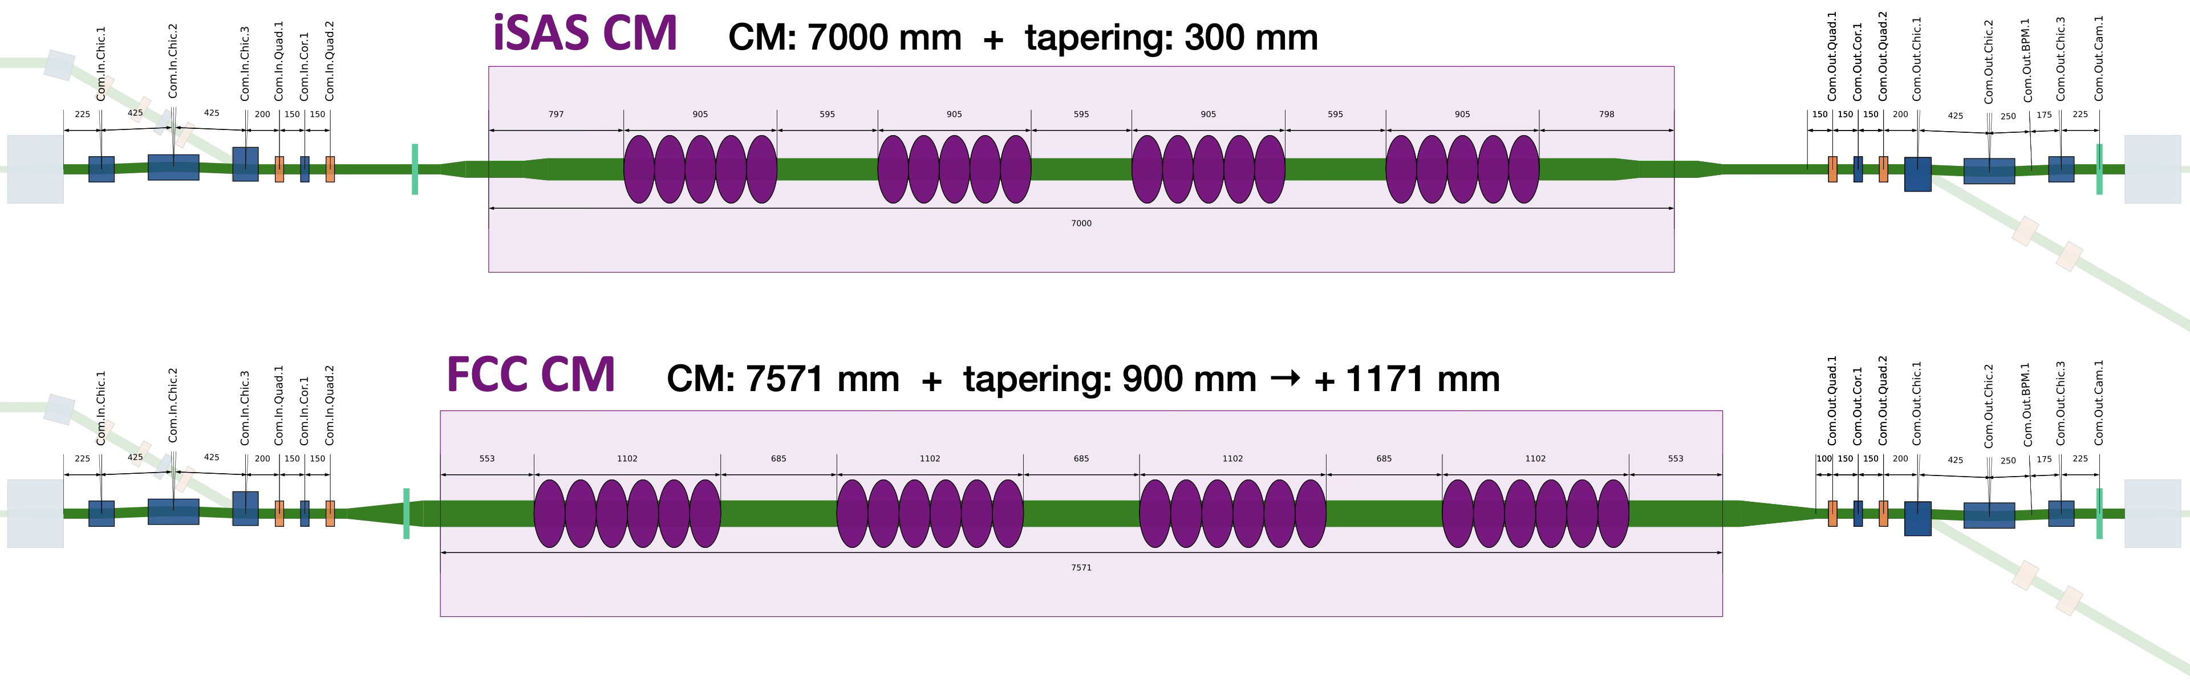
Compatibility with FCC upgrade
FCC upgrade requierments :
Extra space for a longer cryomodule → +571mm of Common Section (between BComs)
Beam pipe diameter is 157mm (iSAS 100mm) → +600mm of extra tapering (preliminary, impedance studies needed)
ICT+BPM+Cam implemented inside tapening area → safe some space

Slide 3
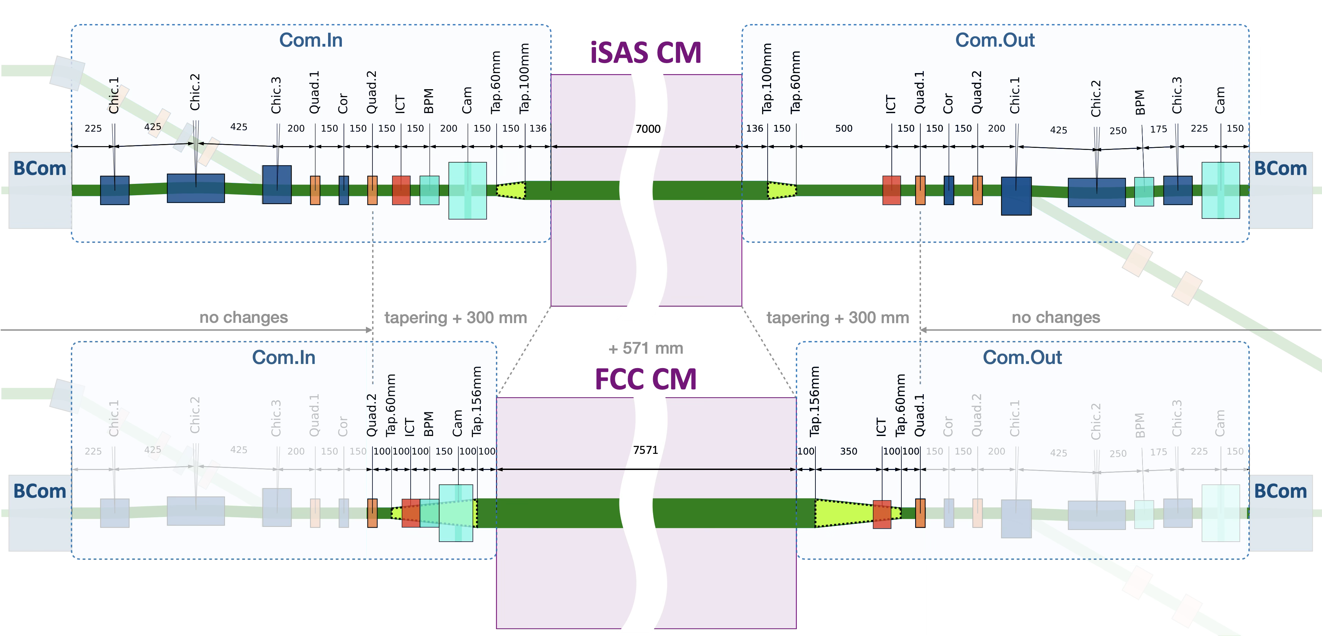
Compatibility with FCC upgrade + diagnostics
FCC upgrade requierments :
Extra space for a longer cryomodule → +571mm of Common Section (between BComs)
Beam pipe diameter is 157mm (iSAS 100mm) → +600mm of extra tapering (preliminary, impedance studies needed)
ICT+BPM+Cam implemented inside tapening area → –600mm
Beam diagnostics :
2 ICTs – transmition in CM
2 (BMP+Camera) in front of CM and Bcom
Q-scan simulated at 7 MeV checked at 89 MeV
FCC upgrade
No changes to the main lattice
Only diag next to CM

Slide 4
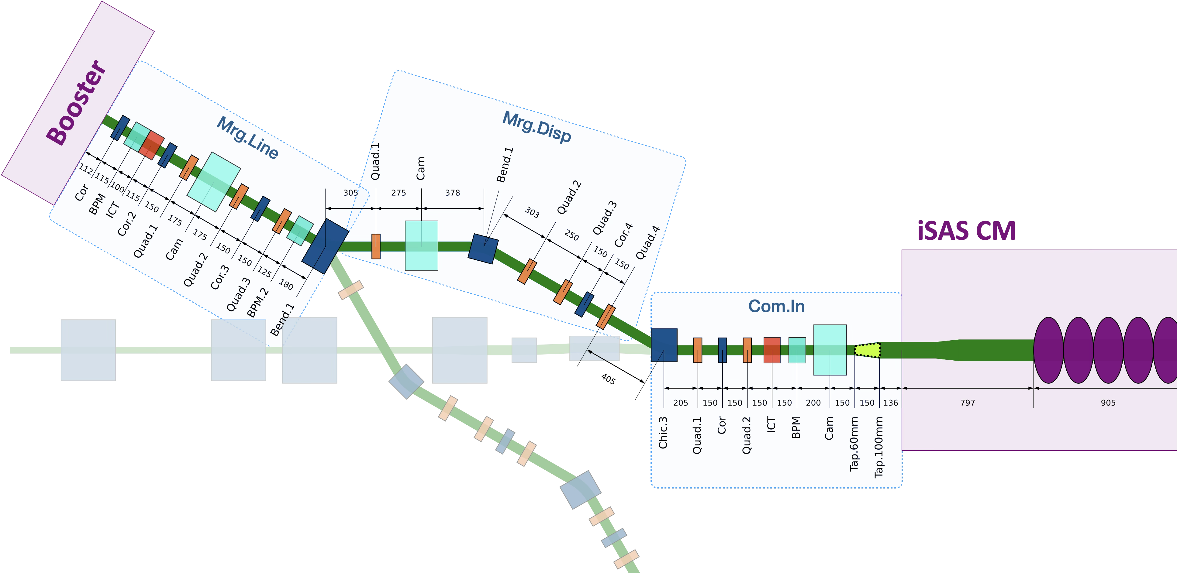
Merger

Slide 5
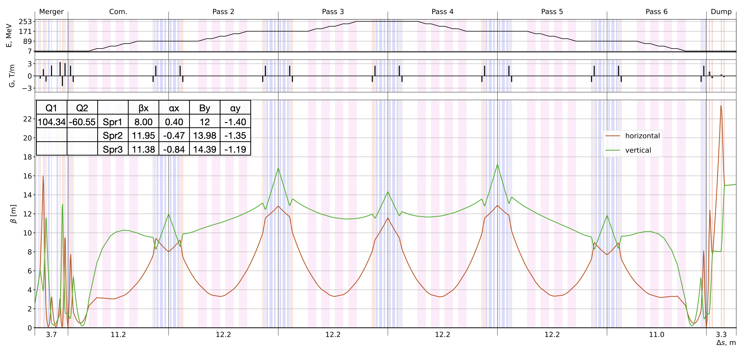
Three Turns Tuning

Slide 6
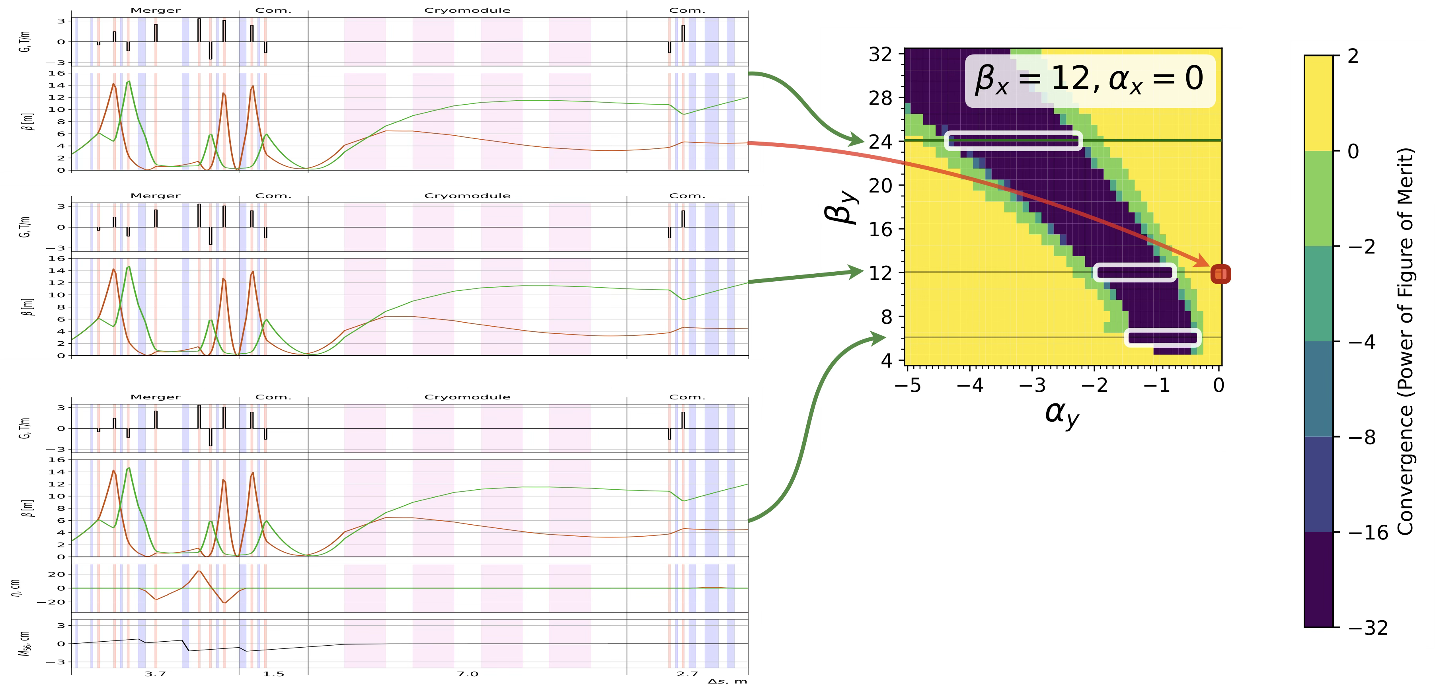
Three Turns Tuning

Slide 7
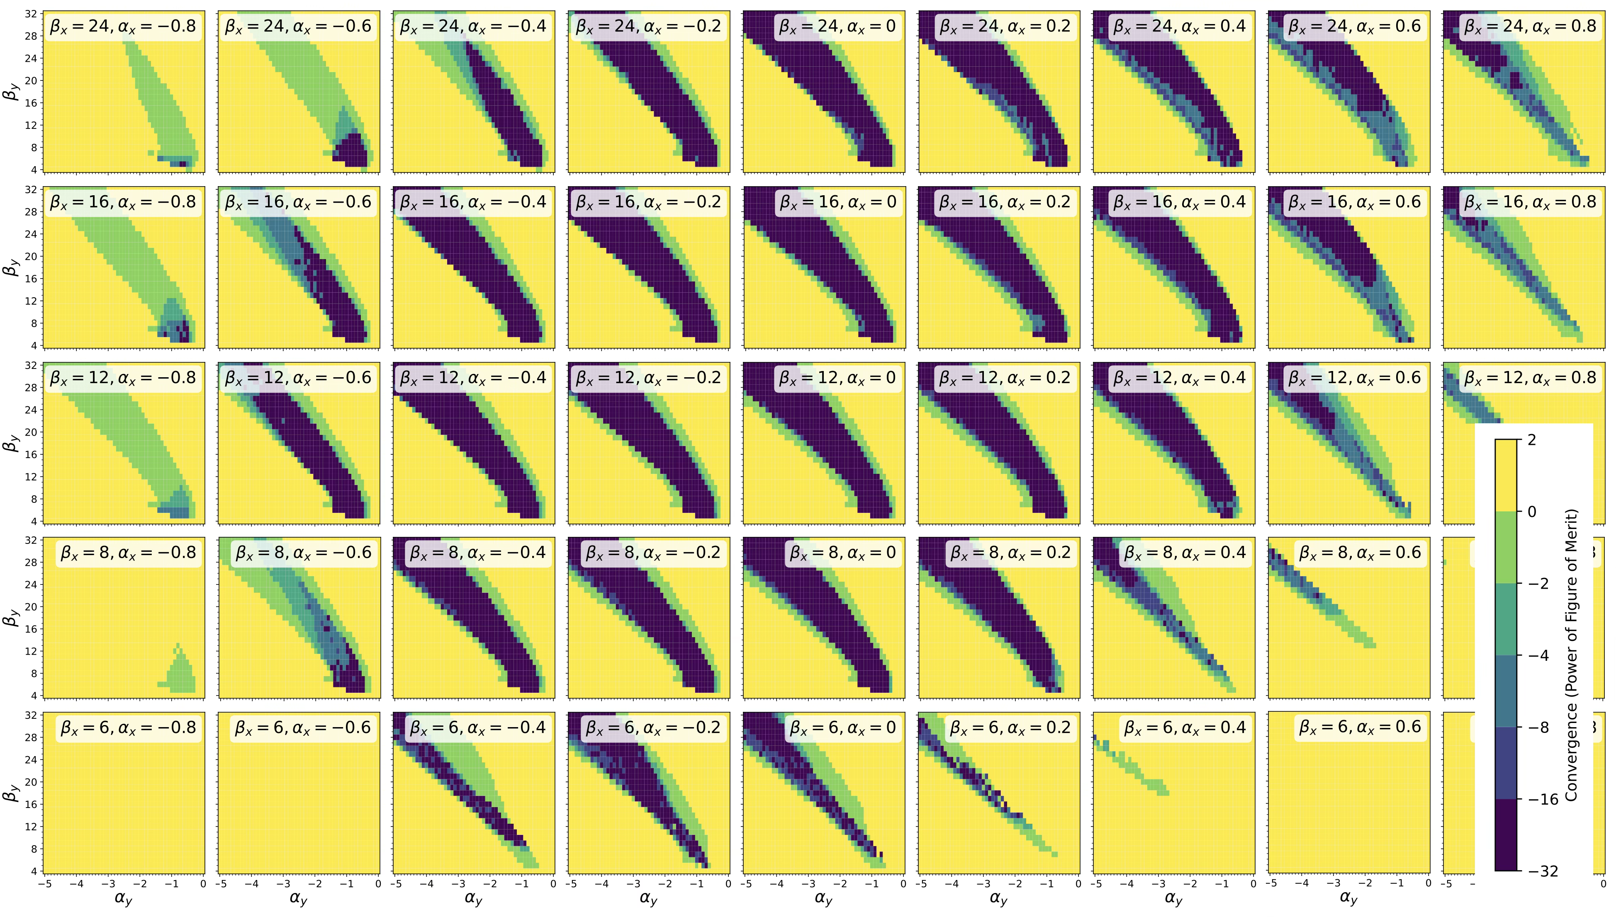
Three Turns Tuning

Slide 8
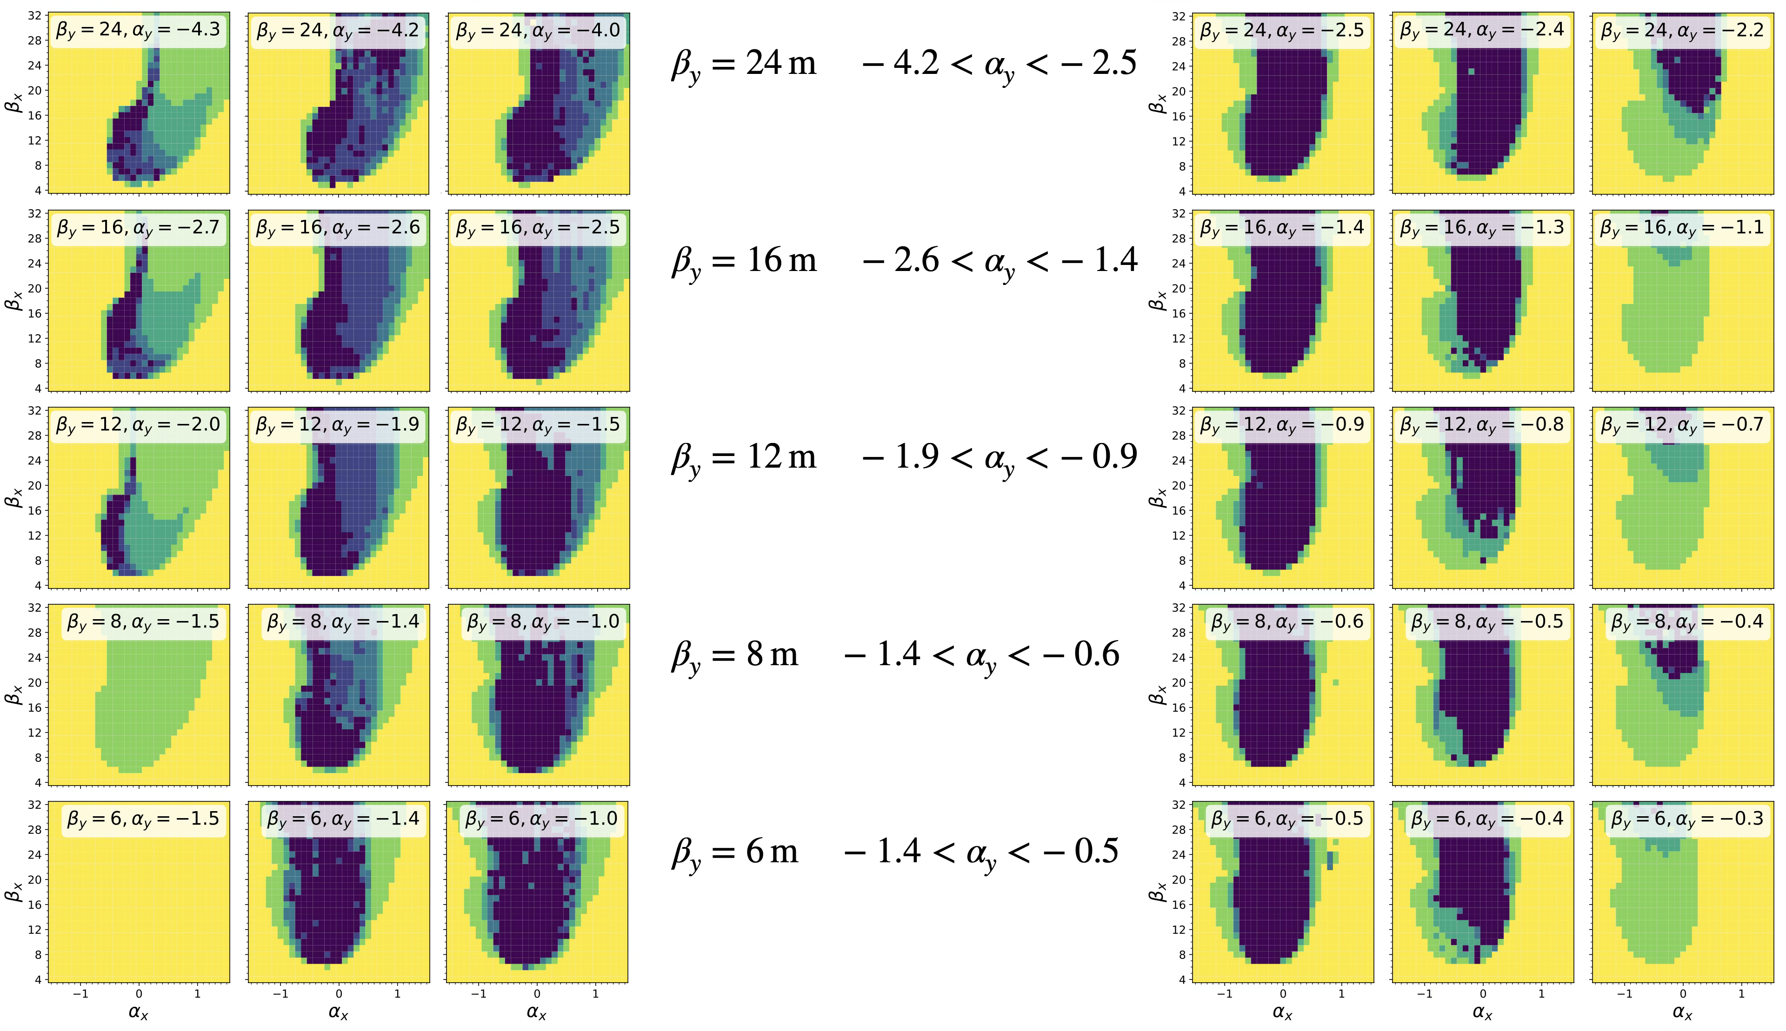
Three Turns Tuning

Slide 9
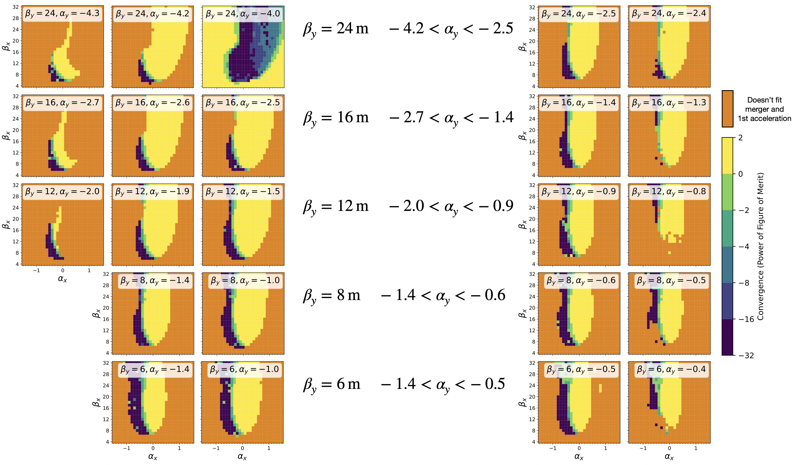
Three Turns Tuning

Slide 10
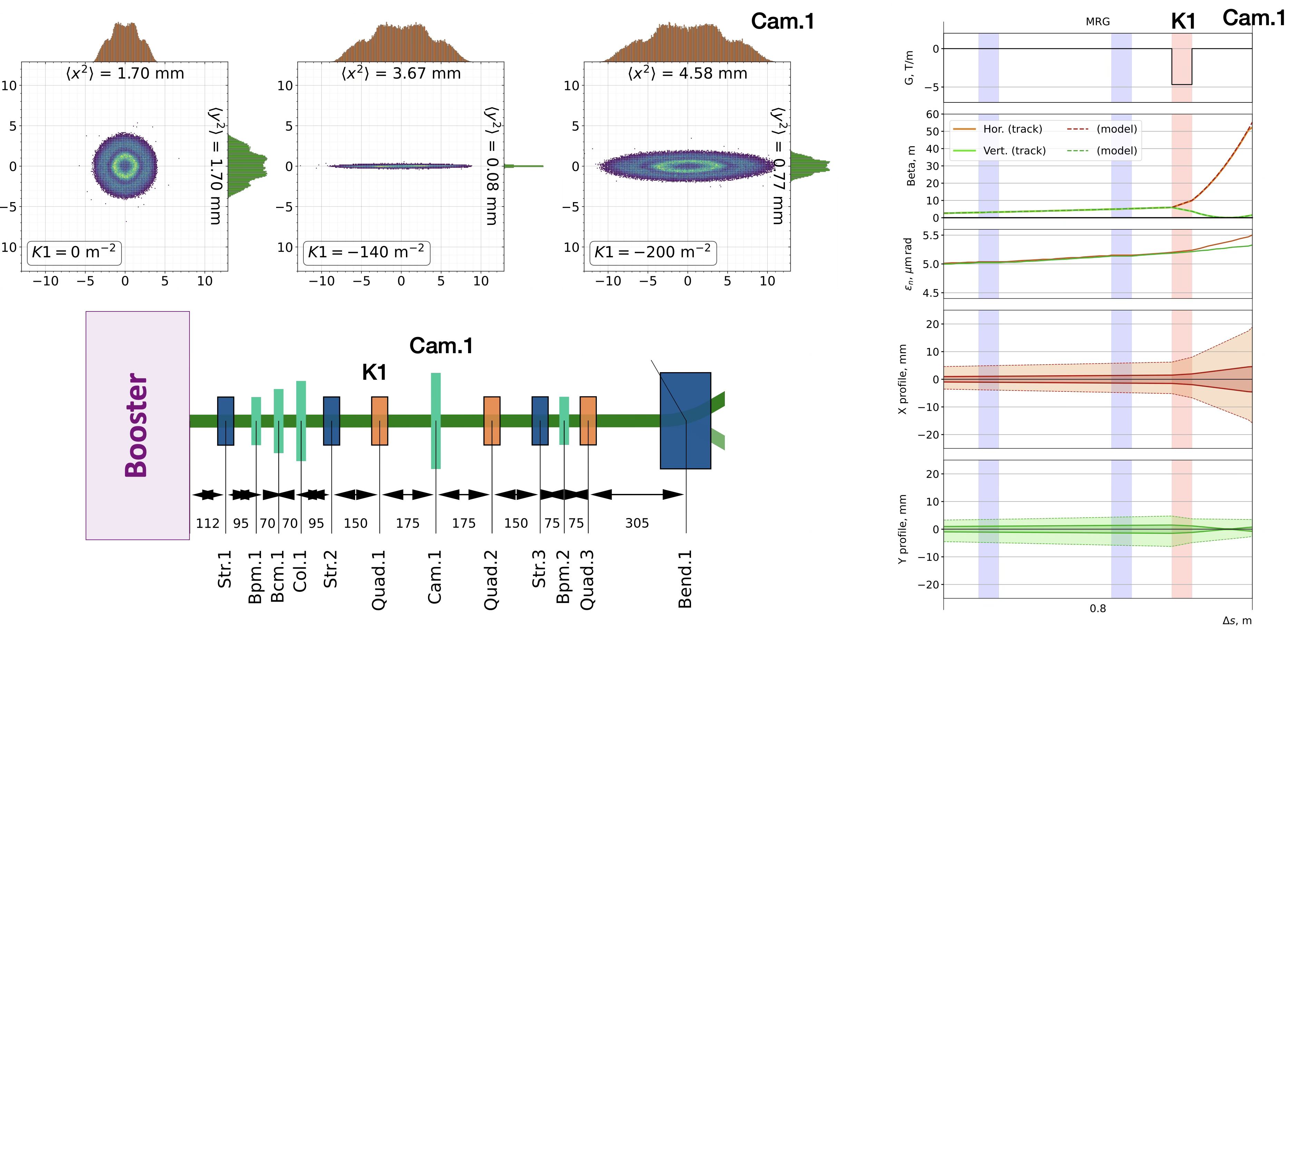
Merger. Q-scan
Purpose :
Measure emittance and twiss functions
Beam alignment
BPM calibration
Requirements :
Distance from Q1 ≳ 175mm
Q1 gradient ~ 6 T/m
Screen size 40mm
Resolution ~ 50 μm
Checked with 50% larger β

Slide 11
Merger. Collimation (studies by Arnaud)
Initial 6D distribution [OPAL] + misalignments in Booster
Collimation limit is 1kW on each collimator (orange)
Collimation with a safety margin: 0.5mm offset of collimator jaw (red)
→ Collimation efficiency as a function of the phase advance
→ Correlation between transverse and longitudinal halo

Slide 12
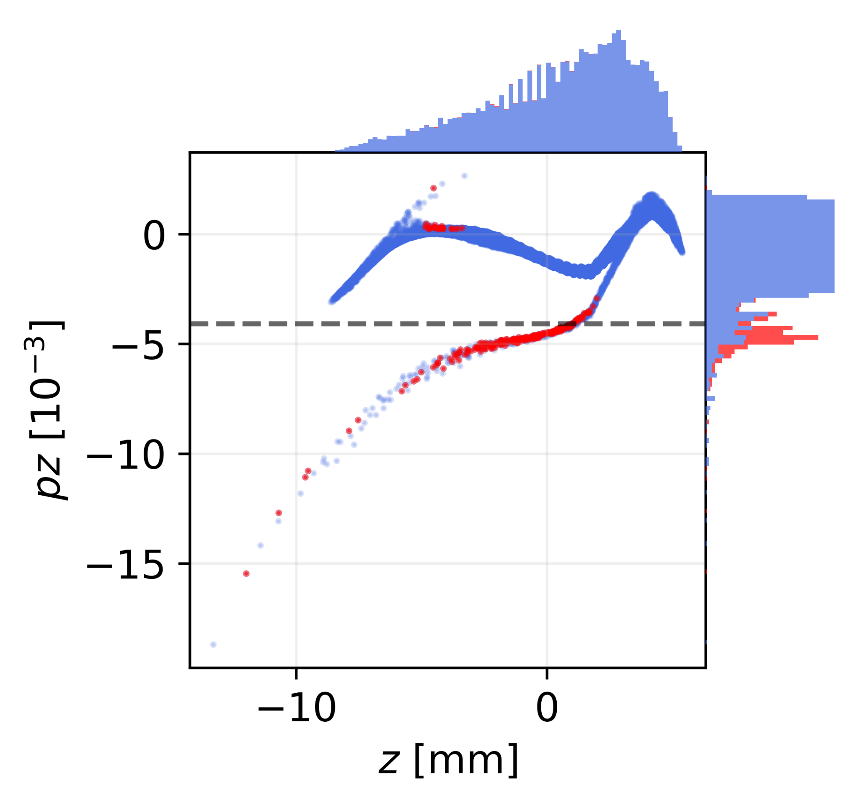
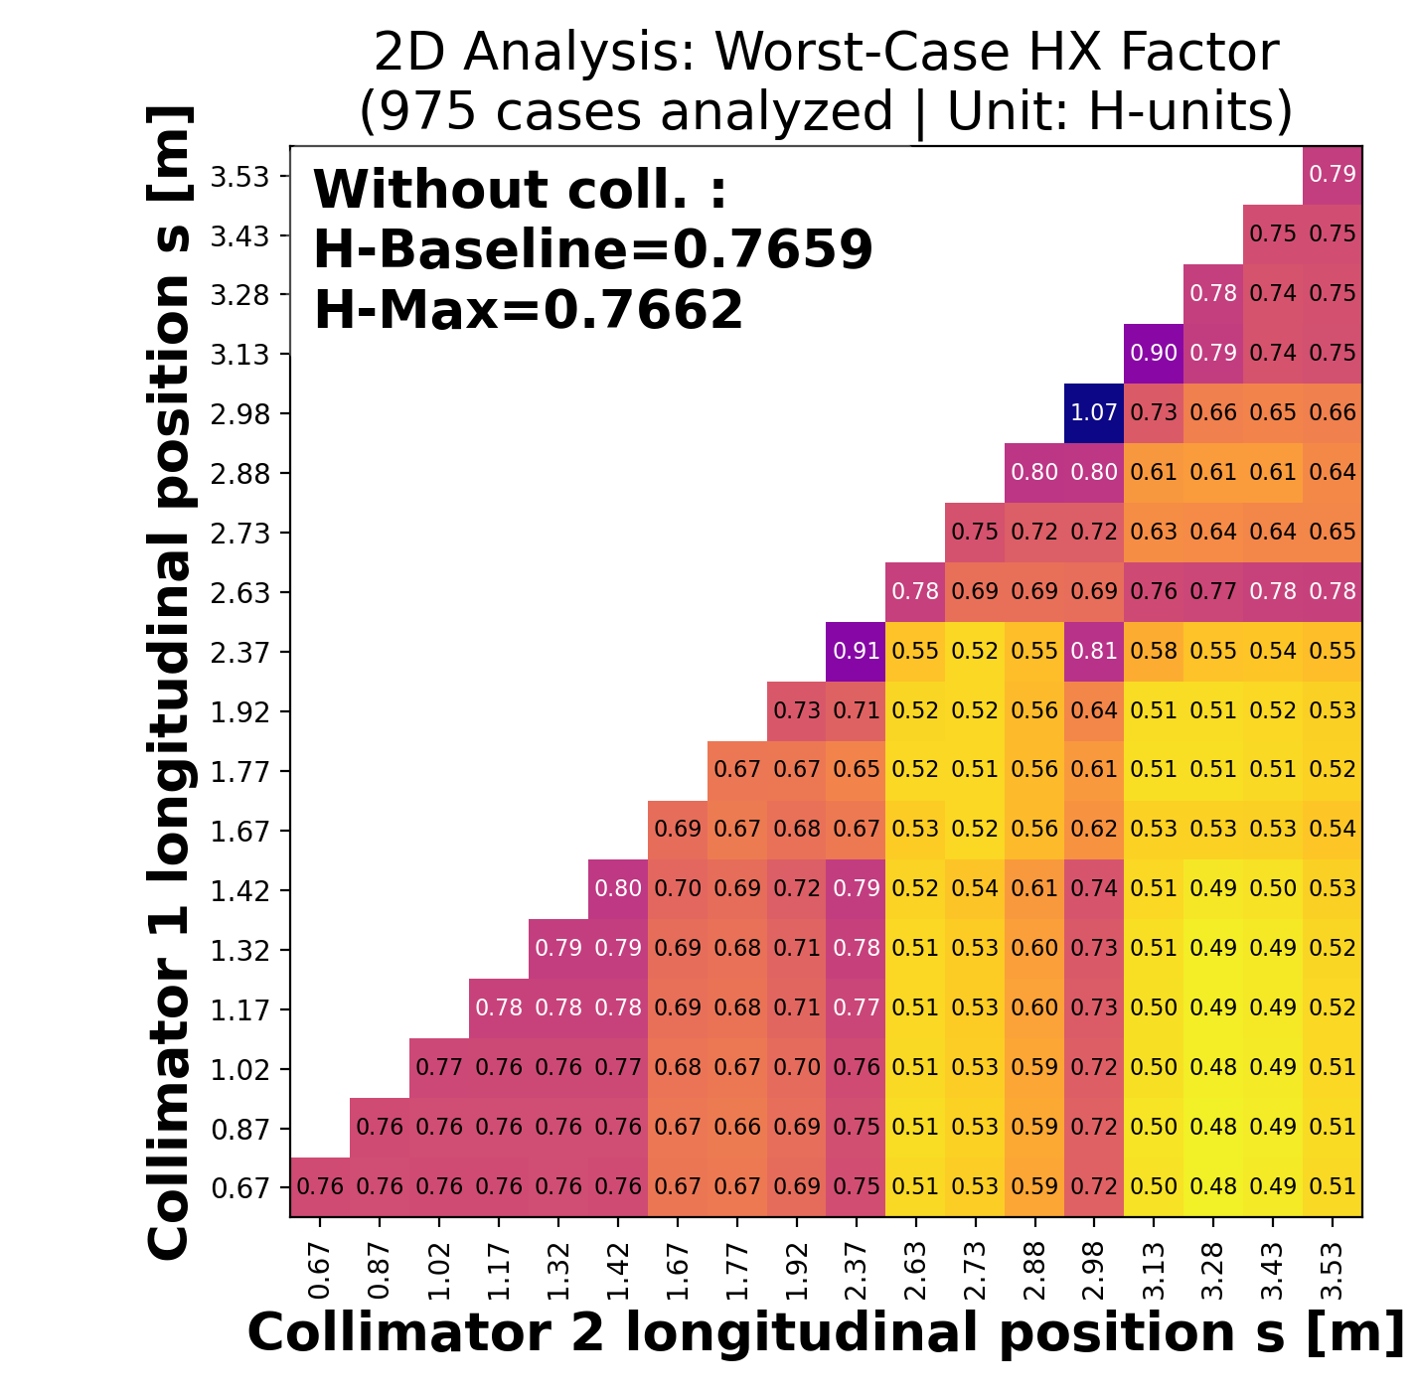
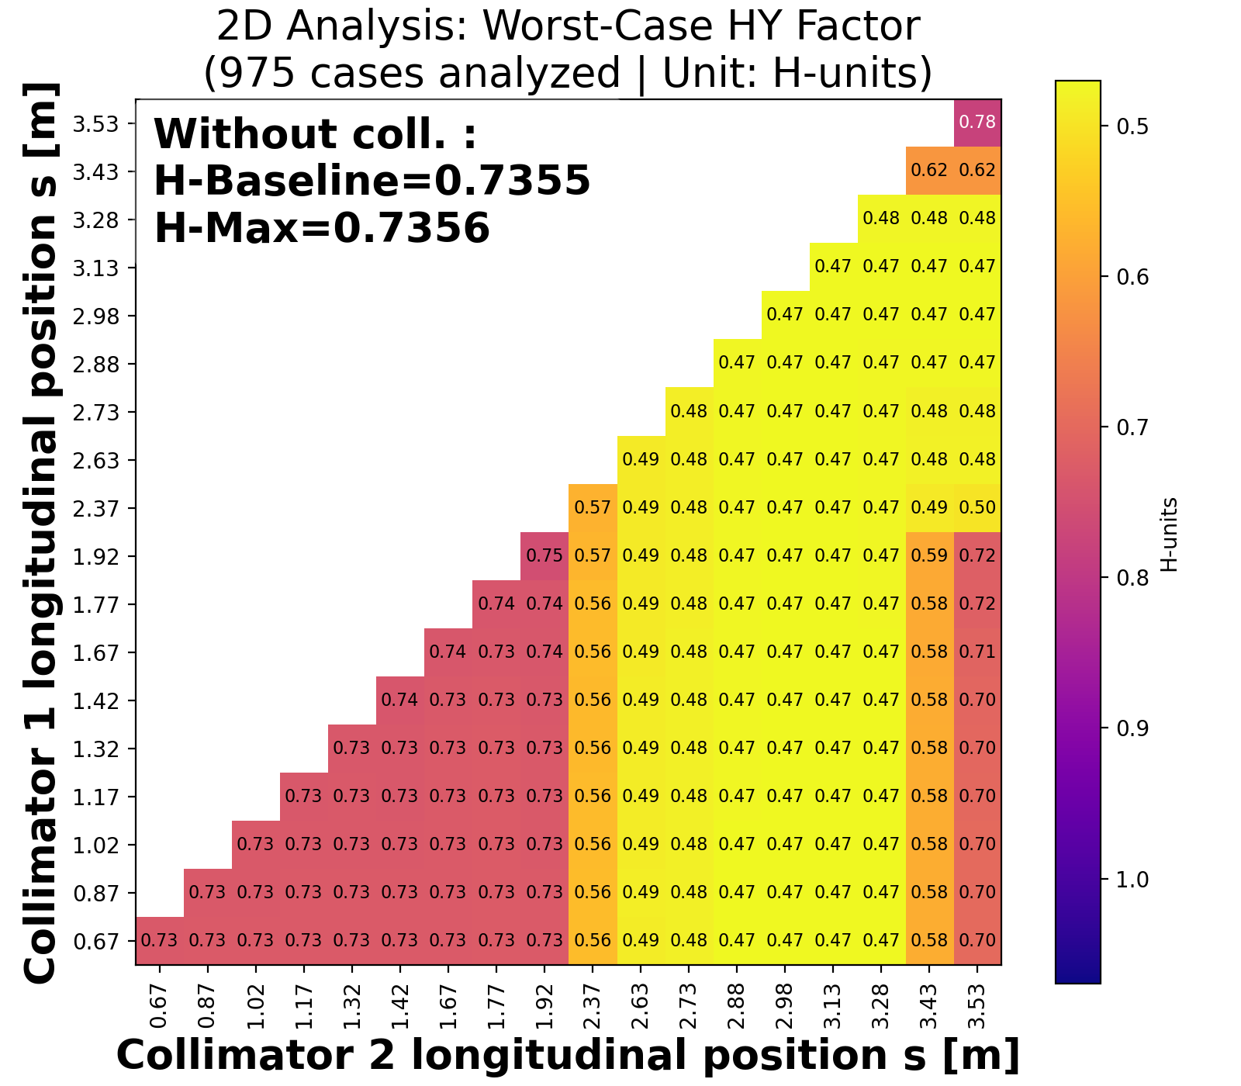
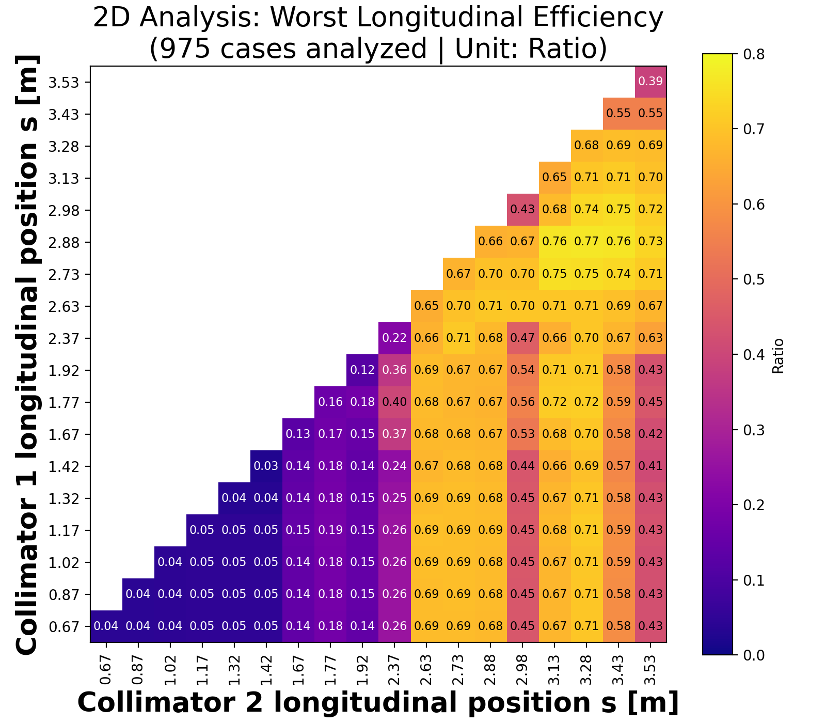
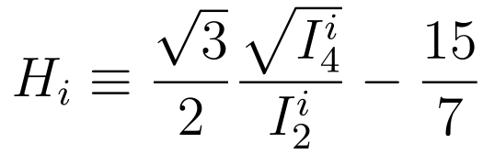
Merger. Collimation
Longitudinal cleaning efficiency
Red/Blue (pz < pz_min)
Halo-factor (hor. plane)
Halo-factor (vert. plane)

Slide 13
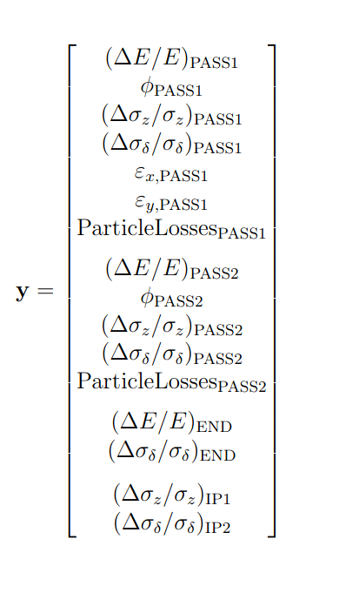

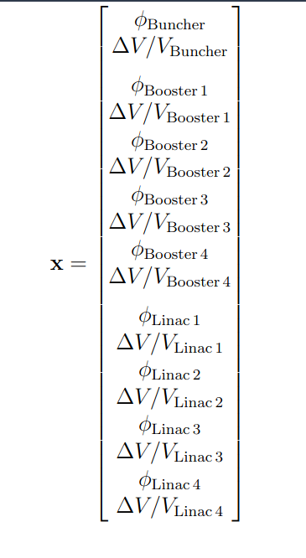
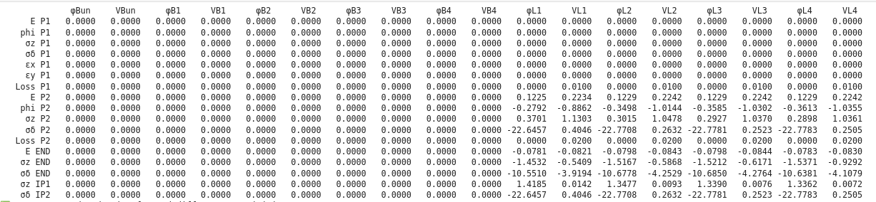
Response Matrix Study (studies by Janine)
Objective: Construct the longitudinal response matrix M of PERLE to RF errors, to understand how RF related perturbations propagate to some beam dynamics parameters:
Pass 1 (P1)
Pass 2 (P2)
Interaction point(s)
End of machine
Sensitivity Matrix
Beam dynamic parameters
RF knobs

Slide 14
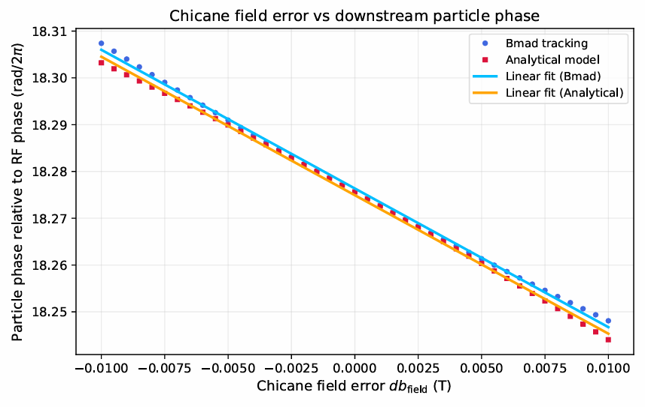
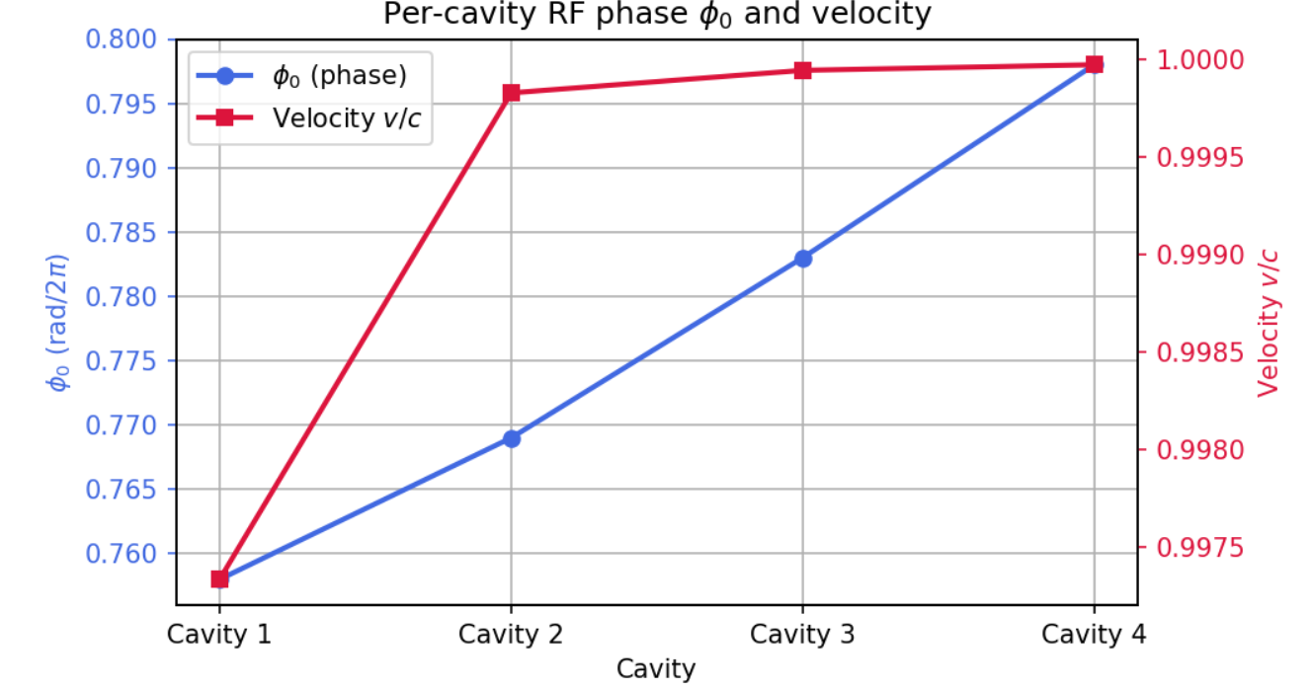
Longitudinal beam dynamics (studies by Janine)
Chicane simulation analytical model vs BMAD tracking
Optimize phases for maximum acceleration (using absolute time tracking in BMAD)

Slide 15
Longitudinal beam dynamics (studies by Janine)
Optmisation of longitudinal beam parameters at DESTIN (Single turn operation)
energy spread minimisation (green)
bunch length minimisation (blue)
Chirped initial distribution from the injector
+ R56 in the merger
+ Chirp in the cavities (compensated later by the chicane) + R56 in the arc and spreader (tuning quadrupoles)
+ minimal losses,
+ stable twiss parameters

Slide 16
Planning et principaux jalons du WP
Review beam dynamics in September
List of invited reviewers
IPAC 2026 :
A number of abstracts - posters
Talk
Introduction cartes de champs pour simulations plus réalistes
RF cavities (more realistic simulation)
For dipoles and quadrupoles (halo studies)
TDR : 30 pages/40
A compléter très bientôt avec les paramètres finaux de la machine 3-tours

