Slide 1

WELCOME
Bienvenu(e)s
A new European Laboratory.
Formed on 2020 by the merging of 5 Laboratories in Orsay-France
CSNSM Centre de Sciences Nucléaires et de Sciences de la Matière
IPN Institut de Physique Nucléaire
IMNC Imagerie et Modélisation en Neurobiologie et Cancérologie
LAL Laboratoire de l’Accélérateur Linéaire
LPT Laboratoire de Physique Théorique

Slide 2
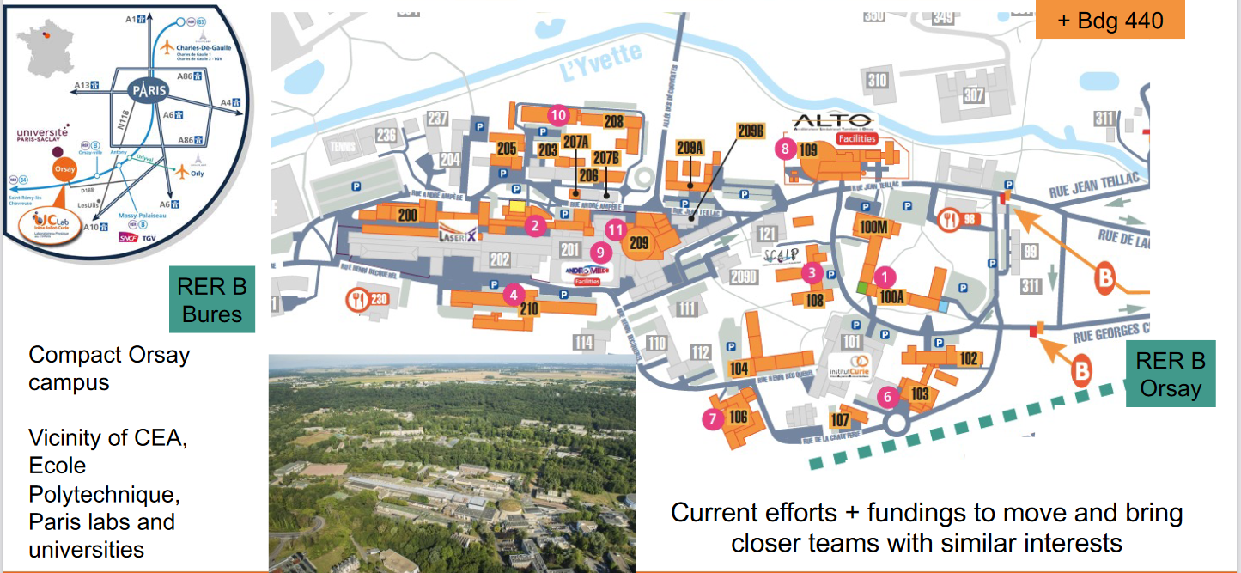
IJCLab : Located in Orsay Campus, 30 Km South-Paris, Campus Paris-Saclay
IJCLab is occupying a large part of the Orsay Campus (~50000m²)
IRFU/CEA in the same Campus
Financial plan (CPER) for renewing buildings and research infrastructures
20,6M€ 2016-2021
9,1M€ 2022-2027

Slide 3
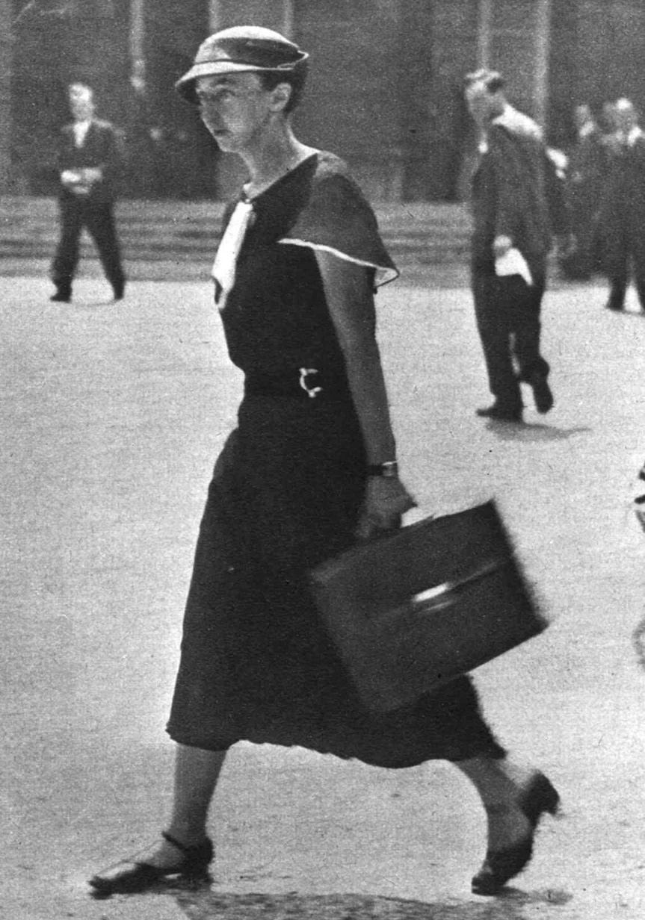
The Orsay Campus
Irène Joliot-Curie.
Her vision was instrumental in the creation of the Orsay campus and the establishment of its first scientific laboratory (in 1955)

Slide 4
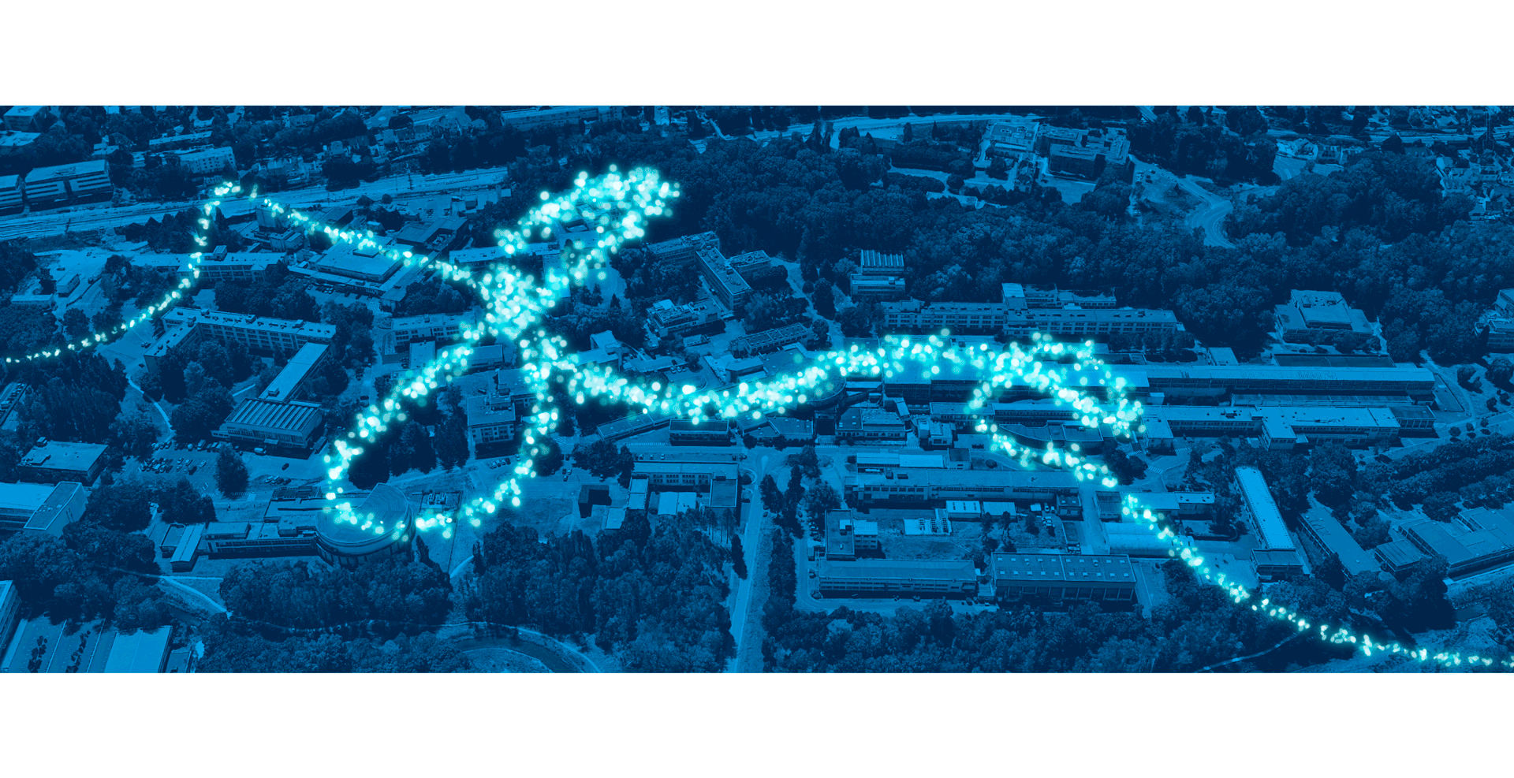

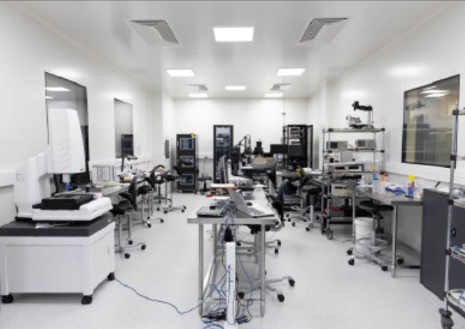
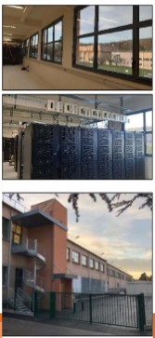
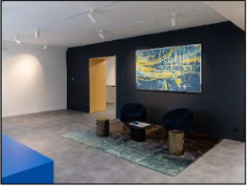
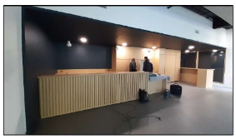

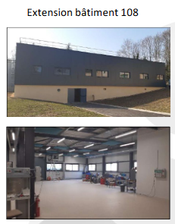
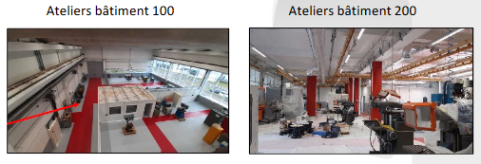
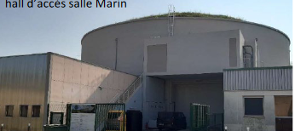
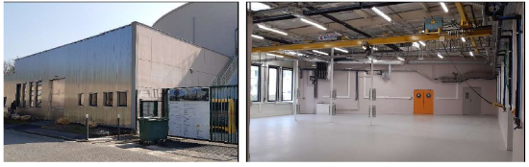
The renovation of the Vallée d'Orsay continues around major scientific instruments!
PSI-Silicon
MOSAIC
Vacuum & Surfaces
ThomX and PERLE
Restructuration du Hall D1-D2, de l’IGLOO, bat 201

Slide 5
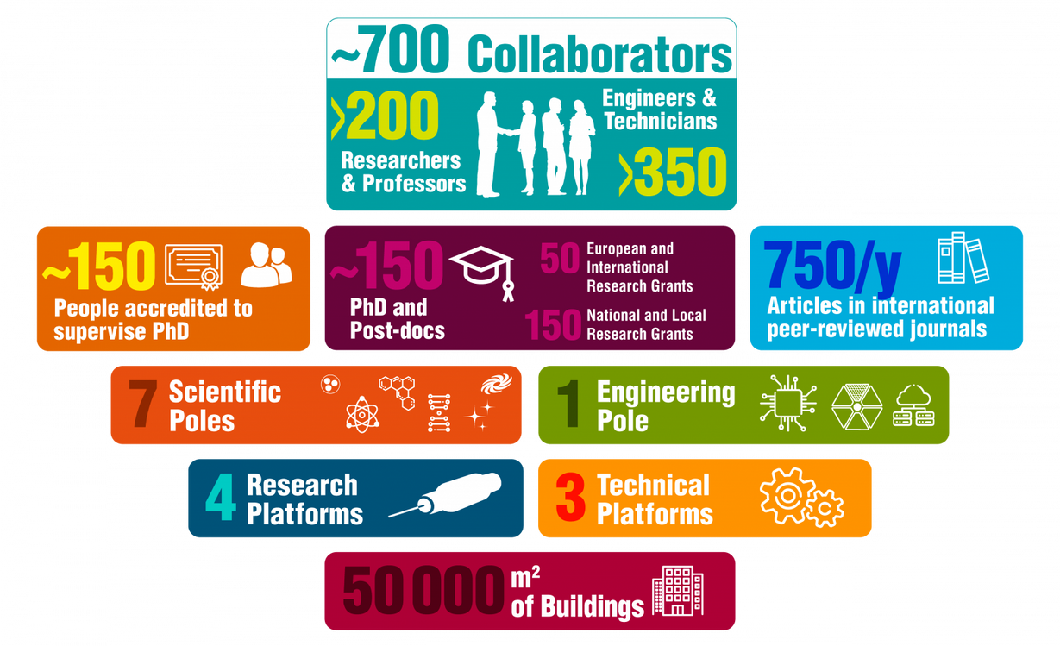
IJClab in a nutshell
One The largest laboratories of the CNRS and Paris Saclay
In the network of the 10 major European laboratories

Slide 6


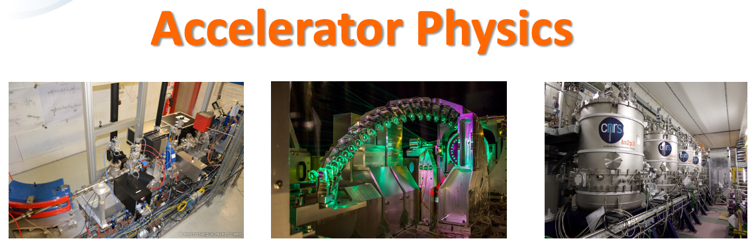

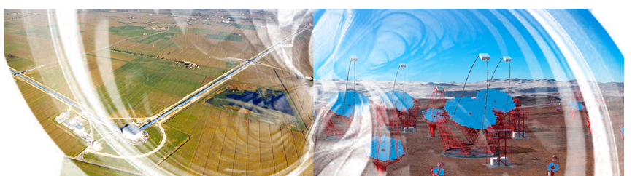
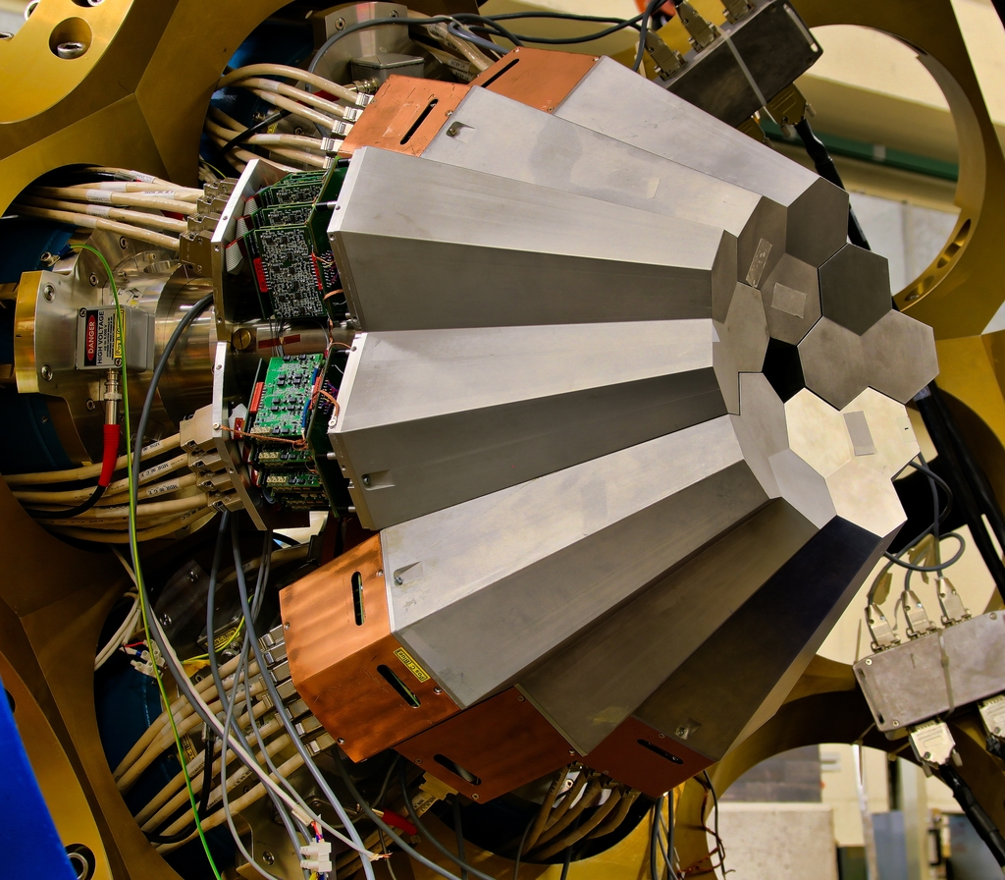
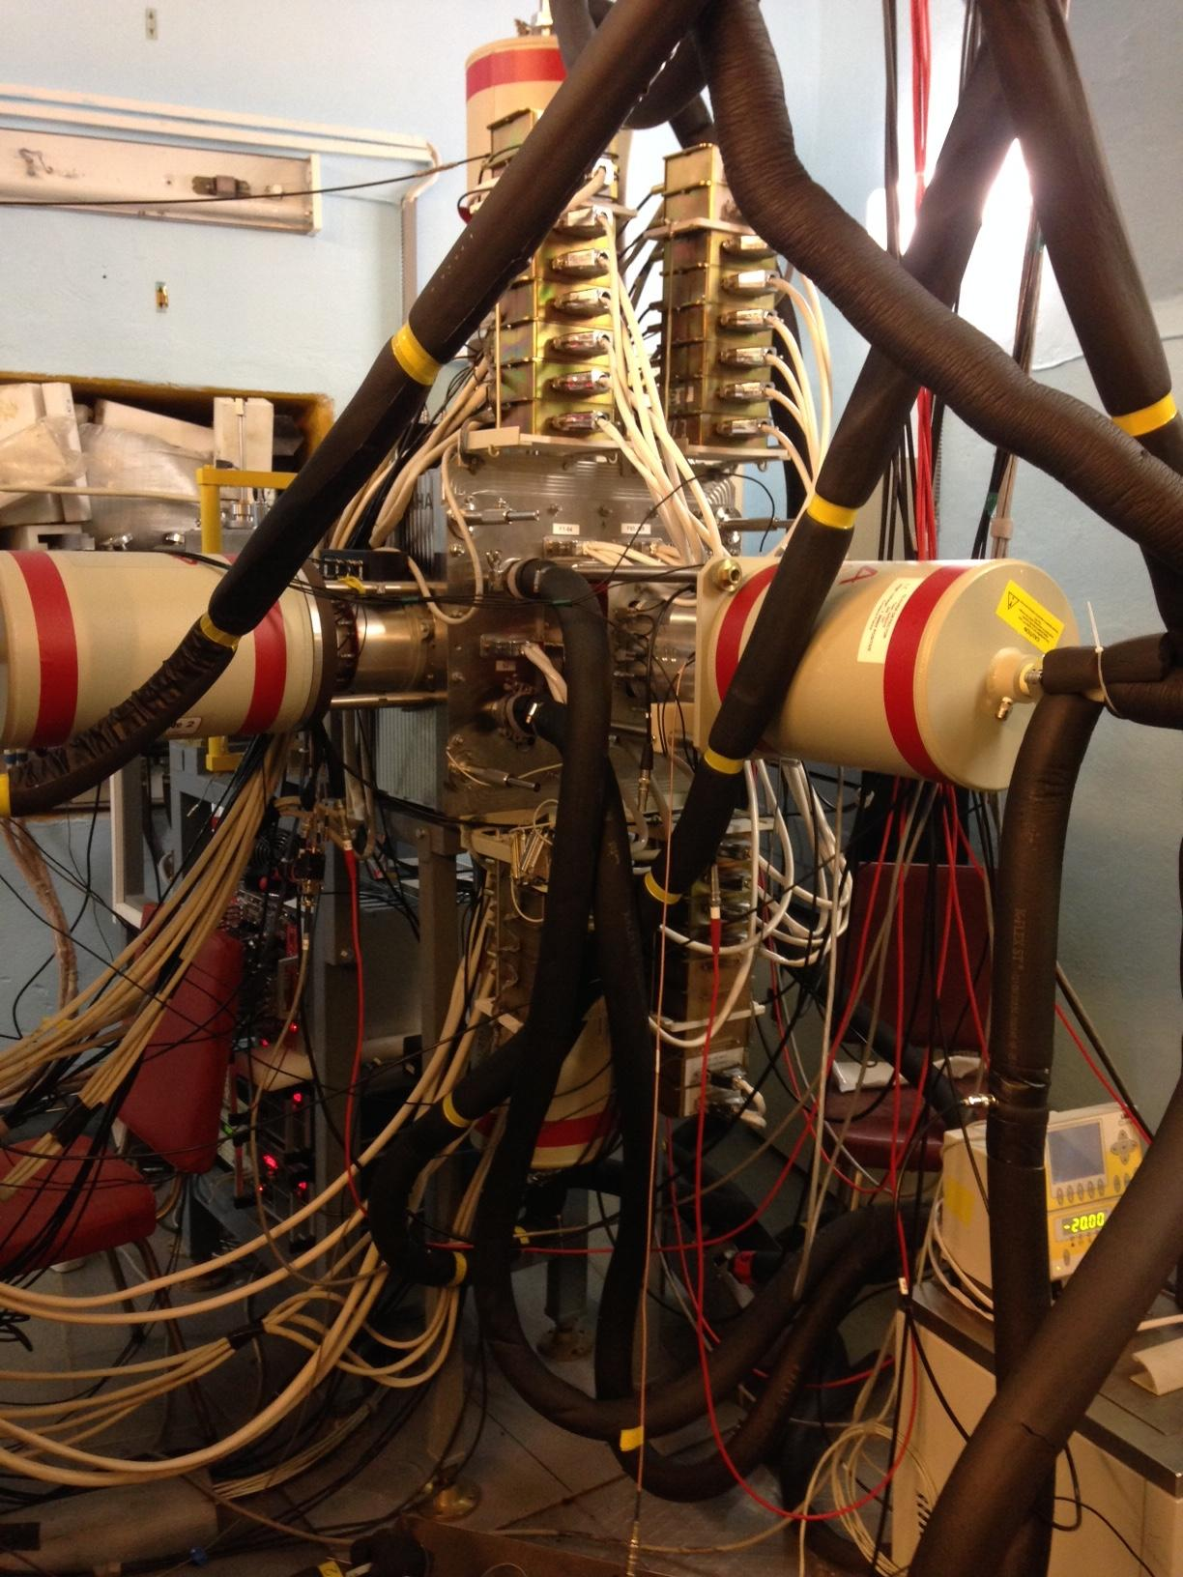
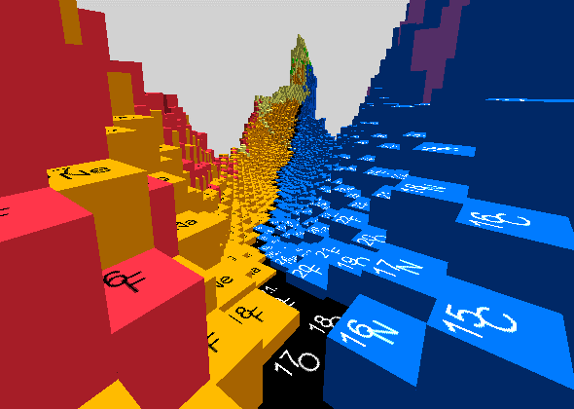
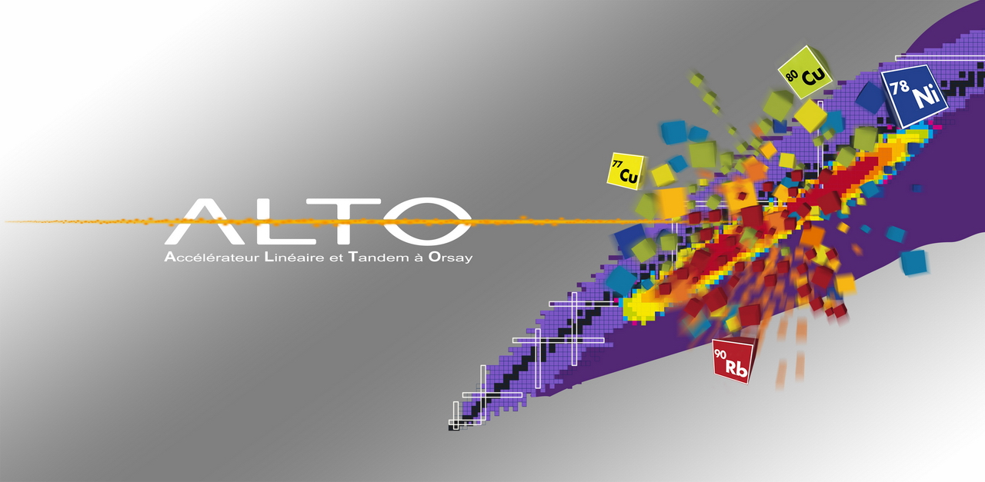
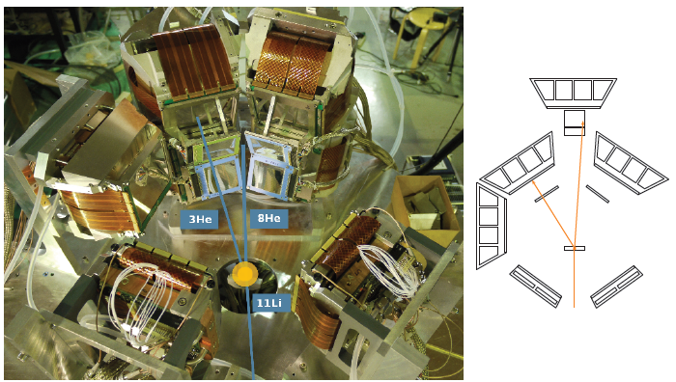
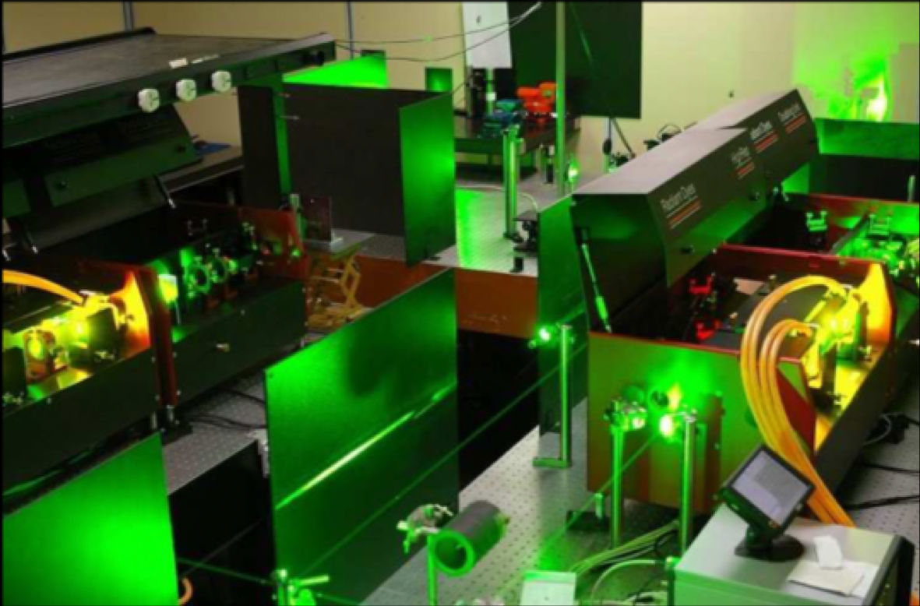
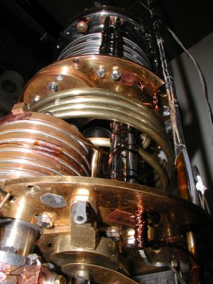

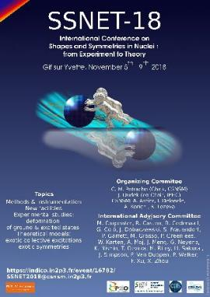
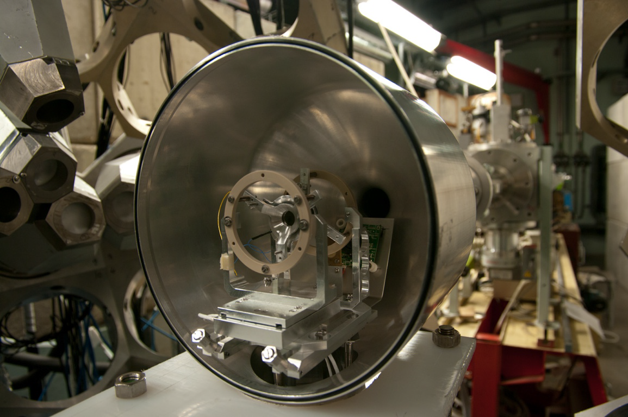



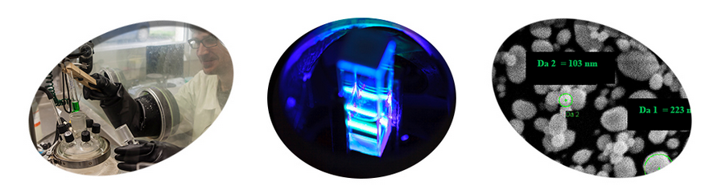
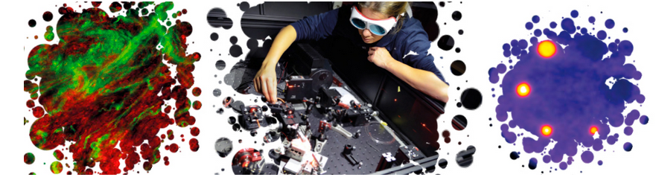
IJClab in a nutshell –scientific themes
All the themes of the "physics of the two infinities" with the presence of strong historical/existing poles, emerging poles and activities at the interfaces.
Including RF and cryogenic services
Theory
Energy and Environnement
Health Physics
~ 107
~ 120 PhD

Slide 7

IJClab in a nutshell : Technical Skills
Services in accelerator Pole
RF
Cryogenics
~30 staff members
~180 staff members
4 Departments :
Electronics / Computing
Instrumentation / Mechanics
with 10 Services
Technical staff with technical skills/expertise
essential pillars for the laboratory to design, draw and build instruments.
Technical services are fuelled by the challenges of research (R&D and projects)
The proximity of technical and research teams (integrated teams)
The ability to combine and make coexist versatility and specialization
Micro-electronics
Front-End electronics
Mechanics
Exploitation
Real Time/
Slow Control
System
CAO – Cabling
Electronics
Developpement Software
Data Acquisition
Computing
Detectors/
Instrumentation
Electrotech./RF
Biology
Mecanical Conception
Cryogenics
Detectors
Laser
Mecanical Worskhops
Vacuum techniques
Accelerators and others specialties
Biology
Materials

Slide 8
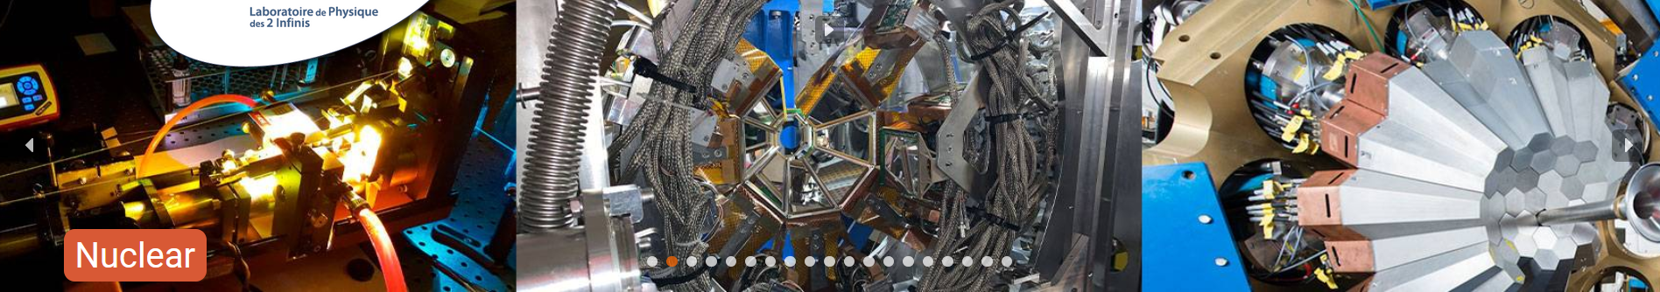

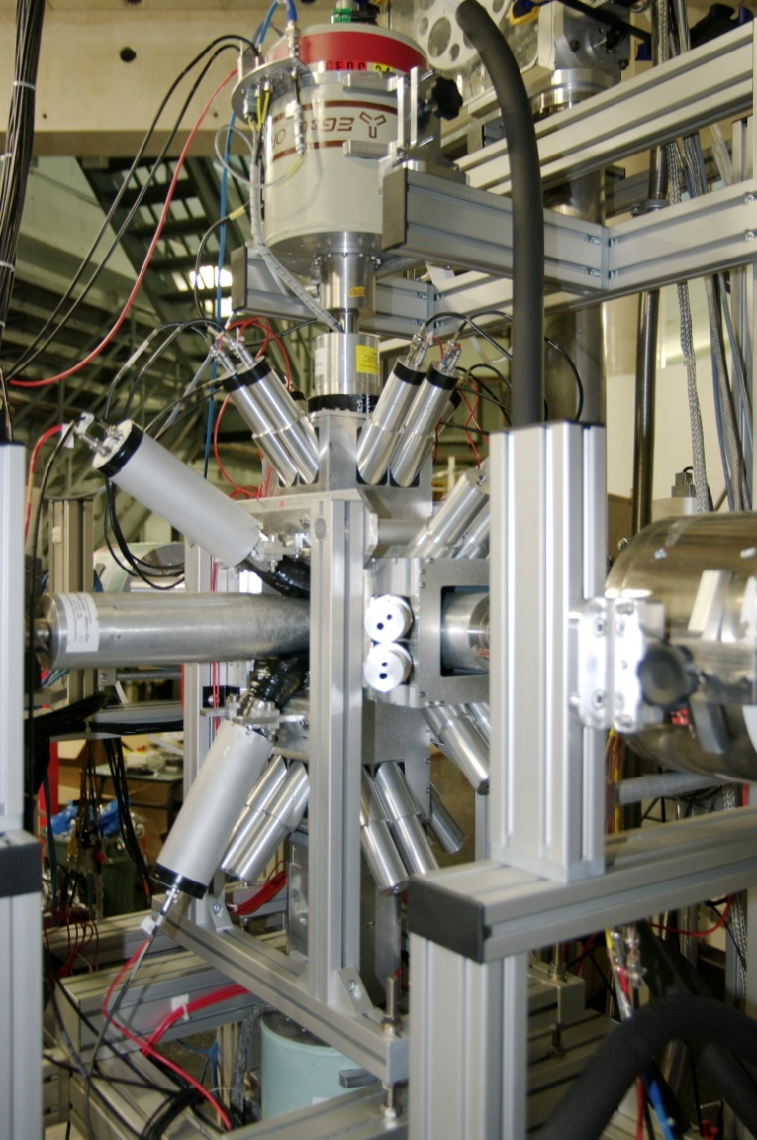
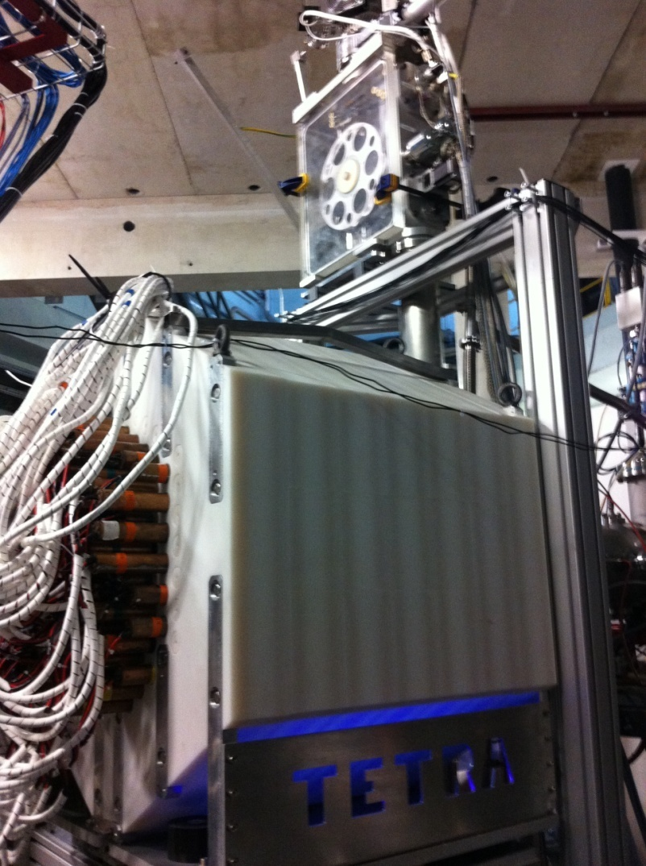
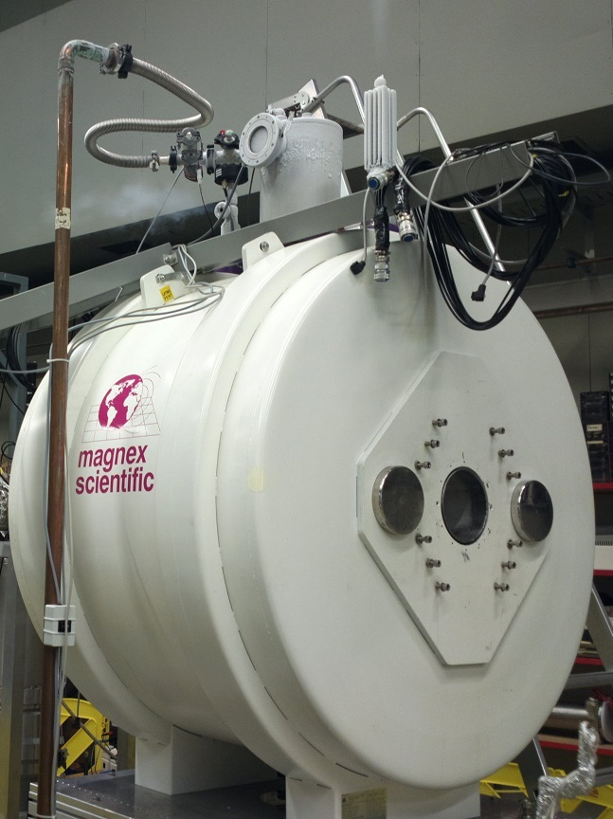
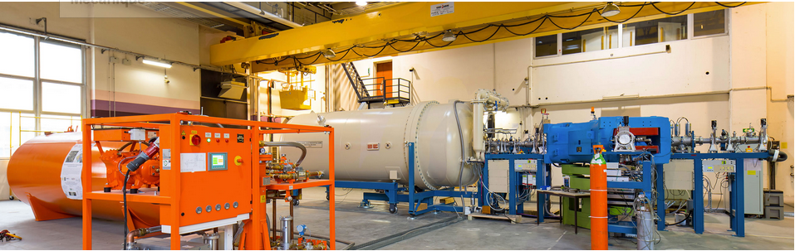

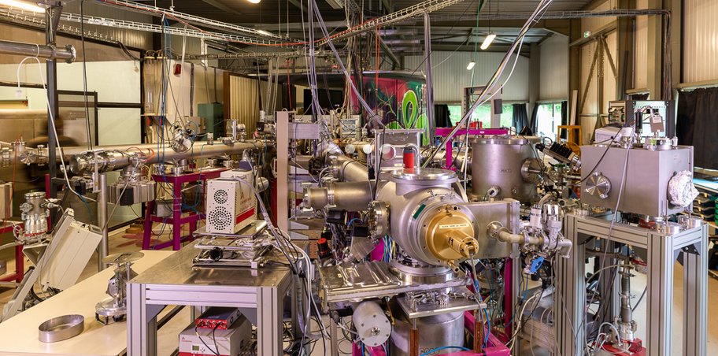

IJClab in a nutshell : The Platforms
15 MV Tandem (from proton to aggregates)
electron linac -> radioactive beams by photofission
Nuclear, Health physics, Irradiation
Opened to external users
Several MeV protons, multicharged atomic ions, gold molecules and nanoparticles
Nuclear/A2C, Health physics, Irradiation
Opened to external users
Ion irradiation / implantation and in situ characterization techniques (TEM, IBA)
Energy, nuclear materials, Health physics, Irradiation physics and chemistry
Opened to external users

Slide 9
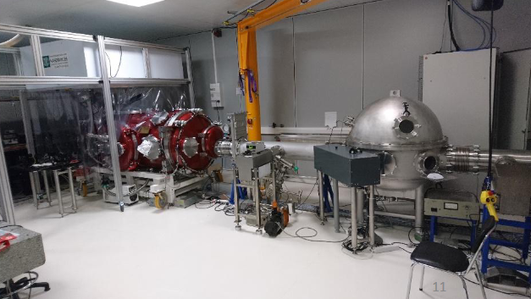
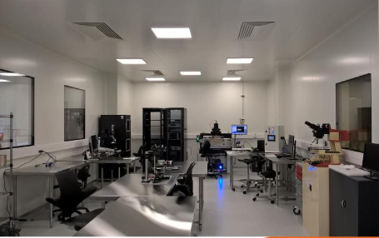
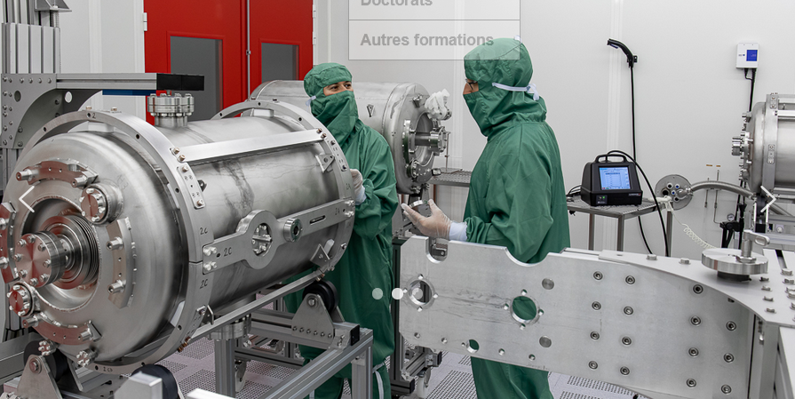
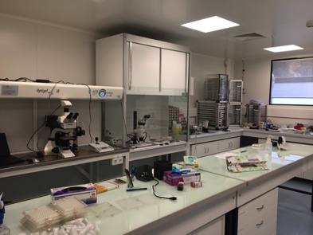
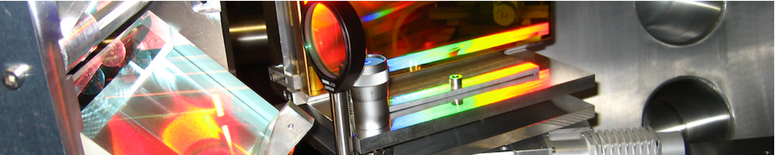
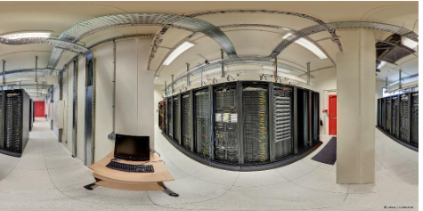

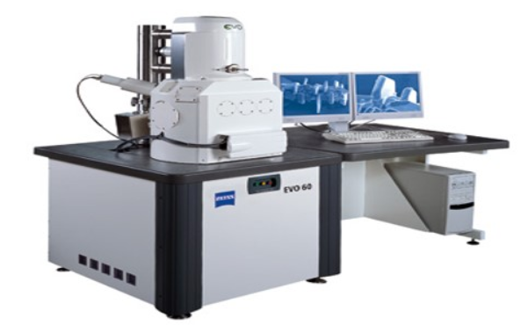
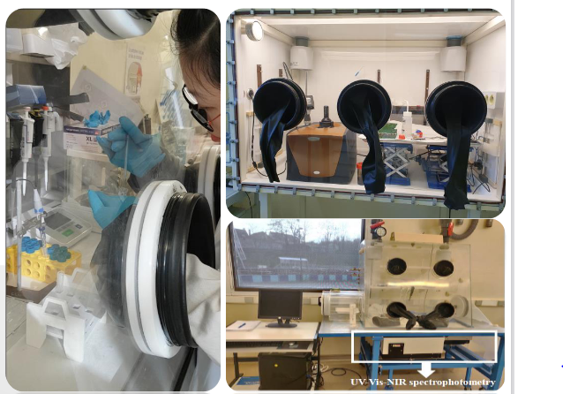

IJClab in a nutshell : The Platforms
Semiconductor Platform : Silicon Detector Characterisation/Production
A2C Research themes
CALVA
Accelerators research themes/technologies
Opening to Materials, atomic physics, detectors
SUPRATECH
R&D on the superconducting cavities (prepare, package, assemble & testof the superconducting RF cavities).
Cavities for the Lock of Adv. Virgo / Squeezing
Cavity locking/Squeezing for VIRGO and ET
VIRTUAL DATA
Advanced computing resources infrastructure
Grid / Cloud
Micrometeorite Preparation/analysis
Myrtho
LaseriX
coherent, intense, brief (50fs to 10 ps) sources in near-infrared (800nm) and EUV (30 to 90 eV)
γ Detectors development / characterization
Radiochemistry laboratory
Actinides - Bat 107
Vide et Surfaces
In construction
Health research themes
non linear optical biphotonique imaging

Slide 10
Forte Participation/Pilotage de la plus part des gros projets mondiaux
Diriger et jouer un rôle majeur dans des projets phares de classe mondiale en physique des hautes énergies, en physique nucléaire, en astroparticules et en cosmologie et accélérateurs en contribuant à tous les niveaux.
Utilisé activités CNES
TGIR
Avec le CNES
Utilisé activités CNES
TGIR
TGIR
Avec le CNES
Avec le CNES
TGIR
TGIR
IR
IR
TGIR
TGIR
MicroM./Myrtho

Slide 11
PhD @ IJCLab
~30 theses defended/year
~slightly more than 30 incoming PHD students per years since IJCLab
~120 PHD student @IJCLab
+ 150 Interships/y
~500 Interships months
From Bachelor→ Master

Slide 12
In conclusions, our Manifesto
Contributing to projects in HEP, A2C and Nuclear Physics at all stages: proposal, design, construction, operation, data analysis, theory
Playing a major role in the conception, design and construction of current and future accelerators.
Developing and operating research infrastructures and technological platforms supporting these research areas as well as original research in health physics and energy
Promoting the development of new technologies for science for the benefit of society and thus supporting national and European industrial competitiveness
Welcoming students that the laboratory trains through and for research in the heart of a world-class academic environment.

Slide 13


