Slide 1


Energy & Environment @ IJCLab
Marc Ernoult
Researcher, Nuclear Reactors and Fuel cycle physics

Slide 2



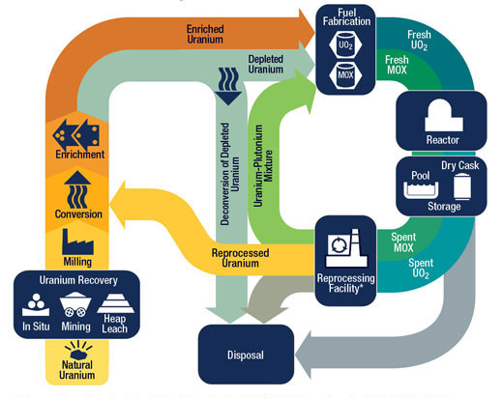
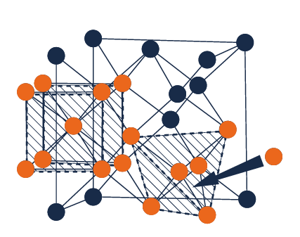

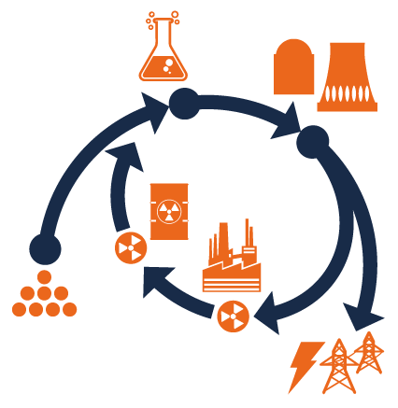
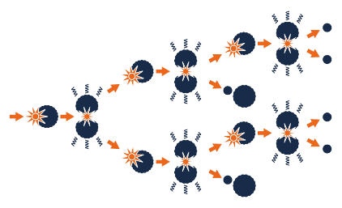


E&E pole at IJCLab
Topics : Present & Future nuclear industry
Nuclear materials
  Radiation damage mechanisms - Understanding of microstructural evolution
  Material behavior at solid/liquid, and liquid/gas interfaces (radiolysis, corrosion, dissolution)
Nuclear reactors and associated nuclear data
  Nuclear data measurement, modelling, evaluation
  Neutronics and thermohydraulics models, sensitivity analysis
  Fuel cycle and interdisciplinary scenarios
Radiochemistry and chemistry of the nuclear fuel cycle
  Physico-chemistry of actinides
  Element Separation
  Molten Salt as fuel
  Interraction Molten Salt - Structures
2
Notes:
The Energy and Environment (E&E) pole of IJCLab consists of chemists and physicists whose research is related to nuclear energy and environment issues. Research projects address fundamental science questions of interest to the development of nuclear energy.
The research projects carried out by the E&E pole combine diversity and complementarity: chemistry and physics for nuclear energy, studies of energy scenarios on a global scale, new reactor concepts and development of new fuels, innovative treatment of nuclear waste and transmutation, recycling of actinides, study of nuclear fission, physicochemical properties of actinides in condensed phases (solids, aqueous solutions, molten salts, ionic liquids, solid / liquid interfaces) and their speciation, chemical behavior of radioactive materials and their interactions with environment, new materials for the electronuclear cycle and fusion (advanced metal alloys, oxide dispersion steels, advanced ceramics for the future of nuclear energy), experimental simulation by ion accelerator of the consequences of the irradiation of solids and associated modeling.

Slide 3
E&E pole at IJCLab
Topics : Present & Future nuclear industry
Nuclear materials
  Radiation damage mechanisms - Understanding of microstructural evolution
  Material behavior at solid/liquid, and liquid/gas interfaces (radiolysis, corrosion, dissolution)
Nuclear reactors and associated nuclear data
  Nuclear data measurement, modelling, evaluation
  Neutronics and thermohydraulics models, sensitivity analysis
  Fuel cycle and interdisciplinary scenarios
Radiochemistry and chemistry of the nuclear fuel cycle
  Physico-chemistry of actinides
  Element Separation
  Molten Salt as fuel
  Interraction Molten Salt - Structures
Behavior and impact of radionuclides (RN) in the environment
  Measuring / mapping radioactivity
  Speciation of radioelements
  Mechanistic description of the behavior of radioelements
3
Notes:
The Energy and Environment (E&E) pole of IJCLab consists of chemists and physicists whose research is related to nuclear energy and environment issues. Research projects address fundamental science questions of interest to the development of nuclear energy.
The research projects carried out by the E&E pole combine diversity and complementarity: chemistry and physics for nuclear energy, studies of energy scenarios on a global scale, new reactor concepts and development of new fuels, innovative treatment of nuclear waste and transmutation, recycling of actinides, study of nuclear fission, physicochemical properties of actinides in condensed phases (solids, aqueous solutions, molten salts, ionic liquids, solid / liquid interfaces) and their speciation, chemical behavior of radioactive materials and their interactions with environment, new materials for the electronuclear cycle and fusion (advanced metal alloys, oxide dispersion steels, advanced ceramics for the future of nuclear energy), experimental simulation by ion accelerator of the consequences of the irradiation of solids and associated modeling.

Slide 4
E&E pole at IJCLab
Topics : Present & Future nuclear industry
Nuclear materials
  Radiation damage mechanisms - Understanding of microstructural evolution
  Material behavior at solid/liquid, and liquid/gas interfaces (radiolysis, corrosion, dissolution)
TWO TEAMS
Nuclear reactors and associated nuclear data
  Nuclear data measurement, modelling, evaluation
  Neutronics and thermohydraulics models, sensitivity analysis
  Fuel cycle and interdisciplinary scenarios
Team CHIMèNE
Team RAPHYNEE
Radiochemistry and chemistry of the nuclear fuel cycle
  Physico-chemistry of actinides
  Element Separation
  Molten Salt as fuel
Behavior and impact of radionuclides (RN) in the environment
  Measuring / mapping radioactivity
  Speciation of radioelements
  Mechanistic description of the behavior of radioelements
4
Notes:
The Energy and Environment (E&E) pole of IJCLab consists of chemists and physicists whose research is related to nuclear energy and environment issues. Research projects address fundamental science questions of interest to the development of nuclear energy.
The research projects carried out by the E&E pole combine diversity and complementarity: chemistry and physics for nuclear energy, studies of energy scenarios on a global scale, new reactor concepts and development of new fuels, innovative treatment of nuclear waste and transmutation, recycling of actinides, study of nuclear fission, physicochemical properties of actinides in condensed phases (solids, aqueous solutions, molten salts, ionic liquids, solid / liquid interfaces) and their speciation, chemical behavior of radioactive materials and their interactions with environment, new materials for the electronuclear cycle and fusion (advanced metal alloys, oxide dispersion steels, advanced ceramics for the future of nuclear energy), experimental simulation by ion accelerator of the consequences of the irradiation of solids and associated modeling.

Slide 5
E&E pole at IJCLab
2 Teams
CHIMèNE Chemistry, Irradiation, Materials, Modelling, Electrochemistry, for Nuclear and Environment
RAPHYNEE RAdiochemistry and PHYsics for Nuclear Energy and Environment
Chemists and physicists
16 Permanent staff: 6 University + 10 CNRS
Total (with Students and CDDs) around 40
https://energie.ijclab.in2p3.fr
5
Notes:
The Energy and Environment (E&E) pole of IJCLab consists of chemists and physicists whose research is related to nuclear energy and environment issues. Research projects address fundamental science questions of interest to the development of nuclear energy.
The research projects carried out by the E&E pole combine diversity and complementarity: chemistry and physics for nuclear energy, studies of energy scenarios on a global scale, new reactor concepts and development of new fuels, innovative treatment of nuclear waste and transmutation, recycling of actinides, study of nuclear fission, physicochemical properties of actinides in condensed phases (solids, aqueous solutions, molten salts, ionic liquids, solid / liquid interfaces) and their speciation, chemical behavior of radioactive materials and their interactions with environment, new materials for the electronuclear cycle and fusion (advanced metal alloys, oxide dispersion steels, advanced ceramics for the future of nuclear energy), experimental simulation by ion accelerator of the consequences of the irradiation of solids and associated modeling.

Slide 6
E&E pole at IJCLab
Strong Relationship with national and international communities
National level
CNRS/ IN2P3 National projects
NEEDS program : fundamental research supported by Industrial
ANR
Bilateral collaboration with : CEA, ASNR, EDF, Orano, Framatome + other nuclear companies
International level
European programs: Euratom, Eurofusion, CONNECT-NM, EURAD2, INNUMAT, Samosafer, Samofar
OCDE/NEA
6

Slide 7
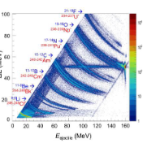
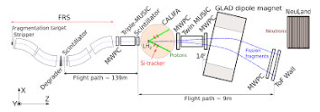
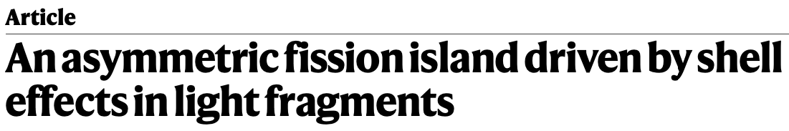

E&E pole at IJCLab
Nuclear fission and nuclear data for reactors
How does excitation energy dampen structure effect and alter the fragments distributions?
Fission program at VAMOS
• Transfer-induced fission on light target
• U but also Th beam
• Goal -> identification of fissioning system and E*
Fission program at FAIR
• (p,2p) fission
• Both fragments identification in the SOFIA setup
• Reconstruction of E* in CALIFA
How does fission barriers and fragment distribution behave very far from stability?
Super-FRS beams : closer to proton/neutron-dripline
• Improved SOFIA setup : revamped IJCLab’s multiwires
Morfouace, P., Taieb, J., Chatillon, A., Audouin, L. et al. Nature 641, 339–344 (2025)
7

Slide 8

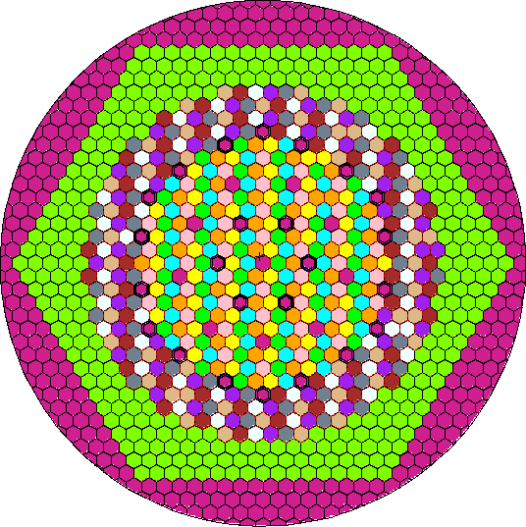
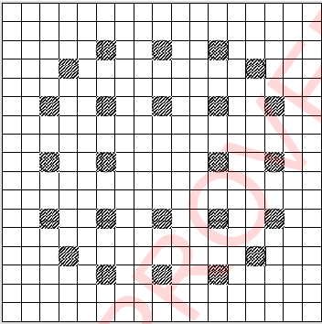
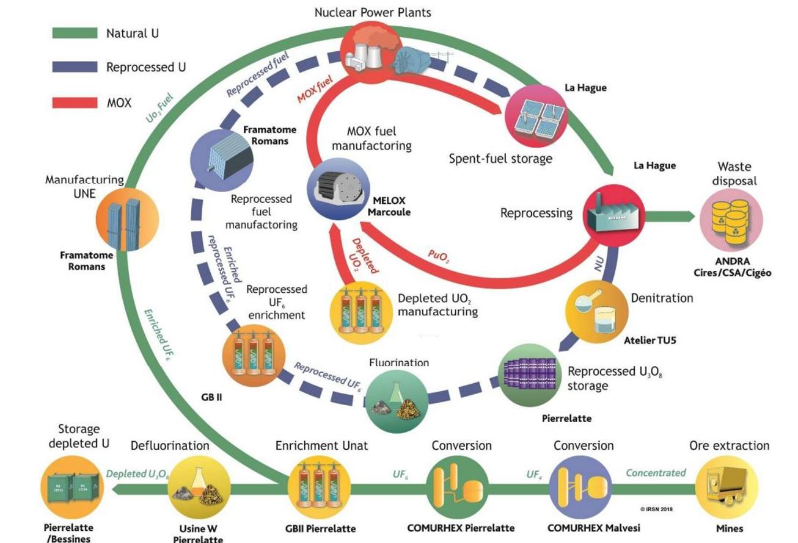
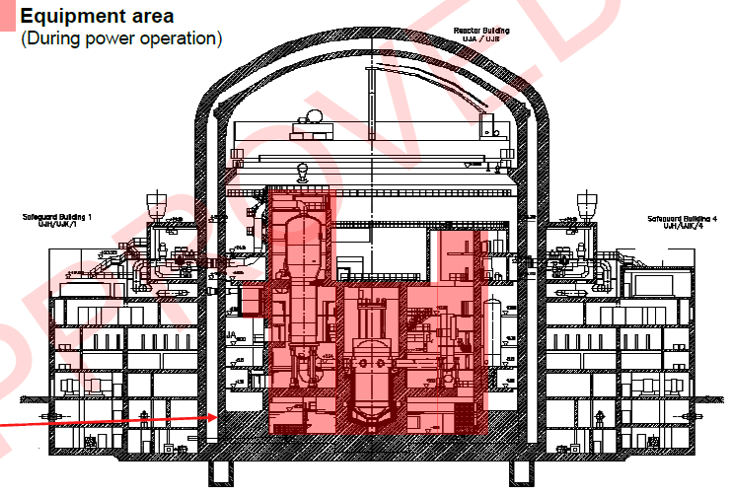
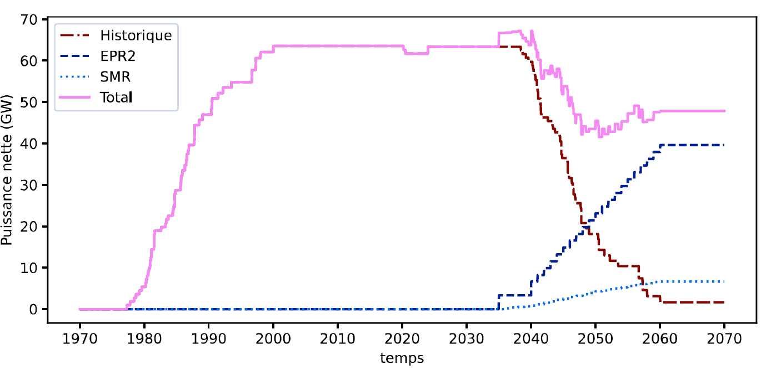
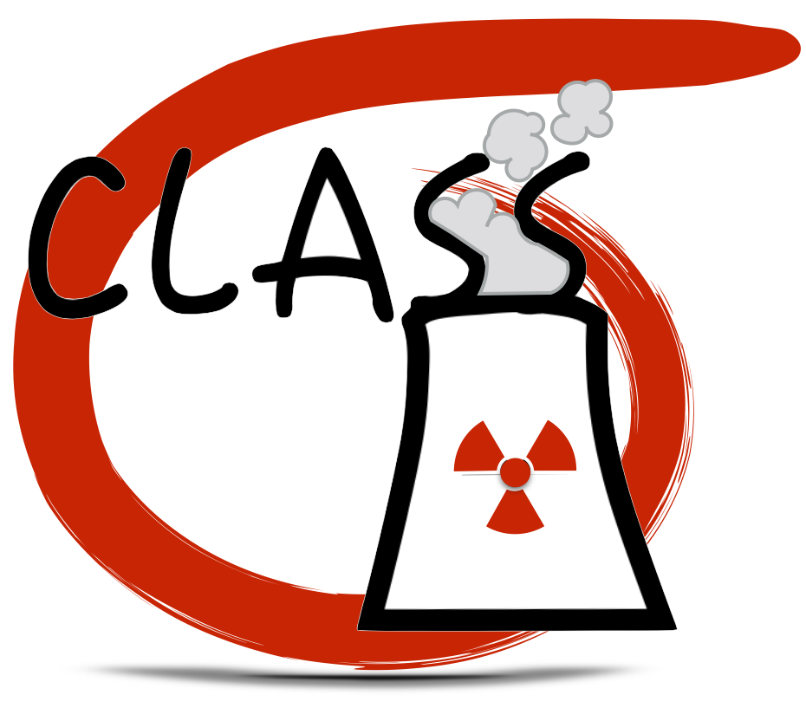
E&E pole at IJCLab
Nuclear reactors and fuel cycle physics
PWR
Gen IV
SFR
Used Mox recycling
SMRs
TRU management
8

Slide 9
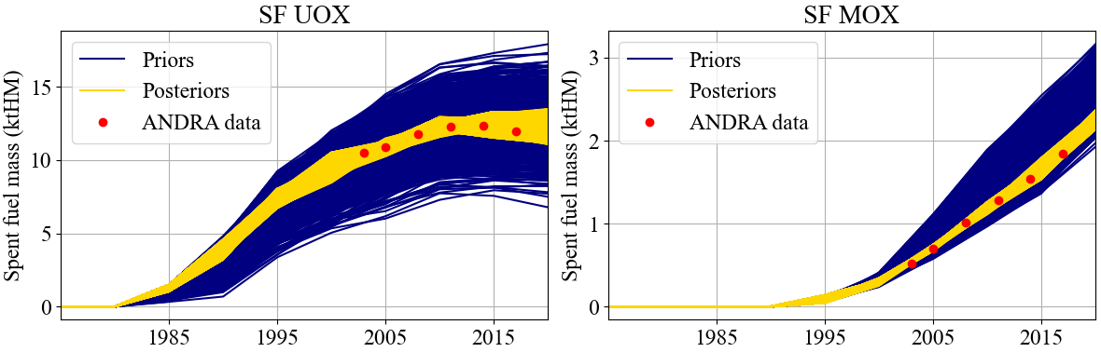
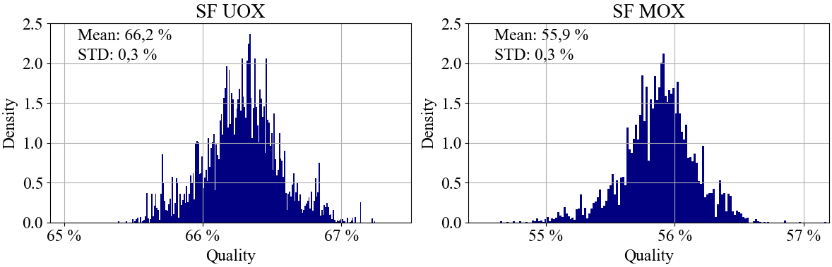
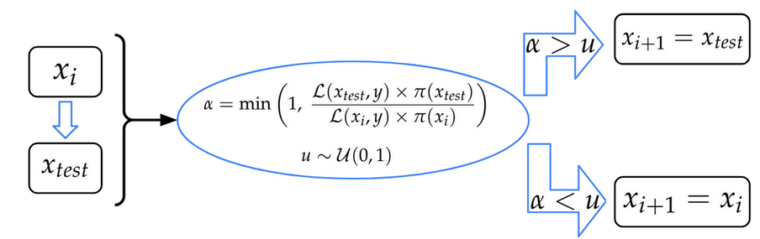
E&E pole at IJCLab
Nuclear reactors and fuel cycle physics
Example Study: PhD of Batiste Durox
2025-2027
9

Slide 10
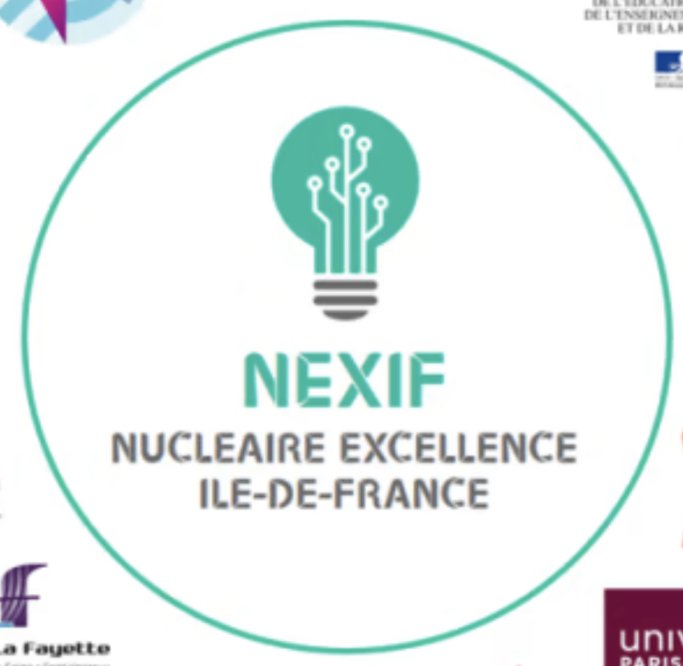
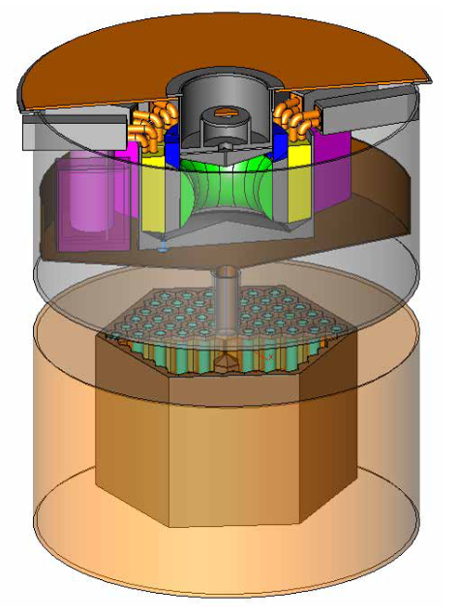

E&E pole at IJCLab
Molten salt chemistry
Molten salt reactor
Projets France 2030 : ISAAC
PEPR DIADEM
European projects
Industrial Collaborations : ORANO, STELLARIA
Scrubber design to trap gazeous FP
Syntheses and analysis of clorine salt with actinides
Pyro-chemistry for spent fuel reprocessing
Other applications
Thick metallic target production (with and for ARRONAX)
Processing of metallic nuclear waste with molten salt (France 2030, ORANO, Projet européen EURAD2 )
10

Slide 11
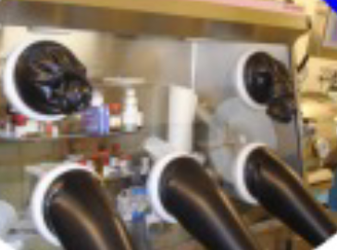
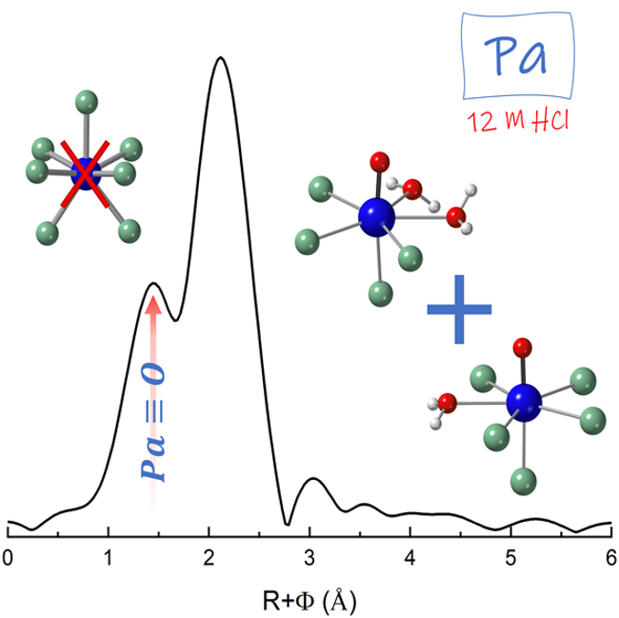
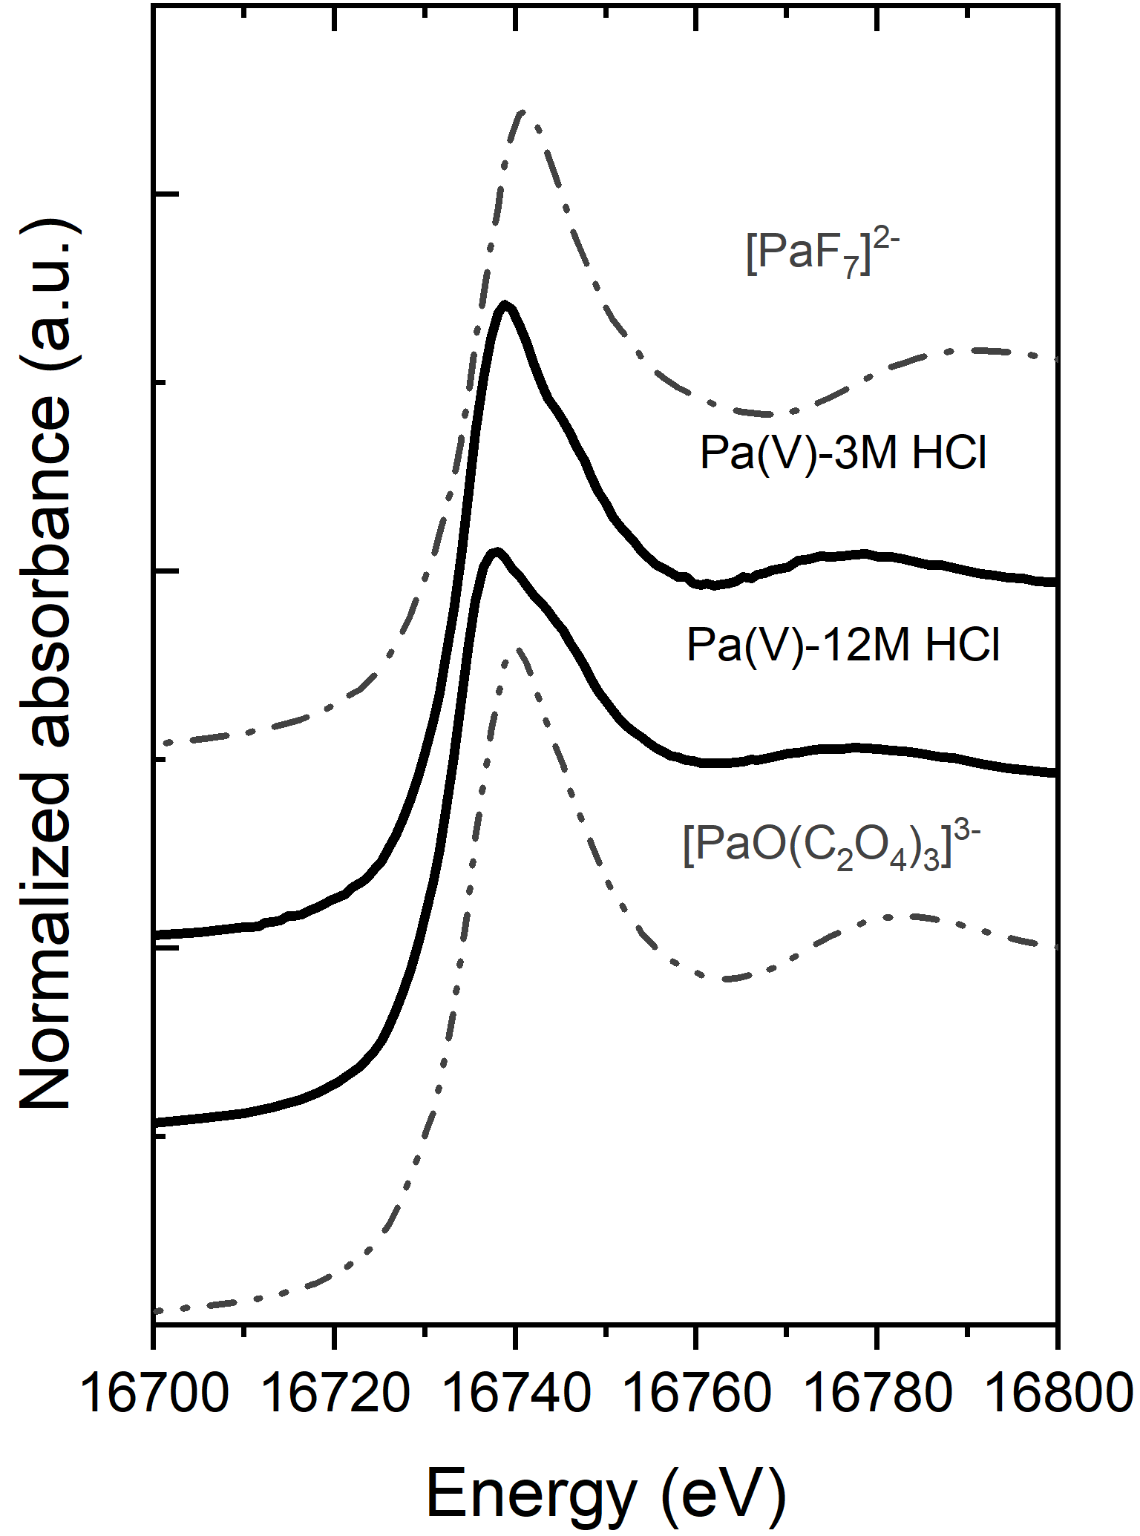

E&E pole at IJCLab
Fuel cycle and environment radiochemistry
Actinides in acqueous solution
Protactinium chemistry, Chemistry, Spectroscopy and Speciation of Pa(IV) and Pa(V)
Complexation of Np(V) and Pa(V) with aromatic acids towards study of complexation with humic matter
Plutonium chemistry (direct of through analogs)
EXAFS + DFT
Maloubier, M., Shaaban, T., et al.
Angew. Chem. Int. Ed. (2025) e18403
Actinides in the biosphere
Localization and speciation of Actinides in mushrooms
Study of mechanisms driving mobility, storage and release of actinides
SLRT, TOF-SIMS, MET….
11

Slide 12
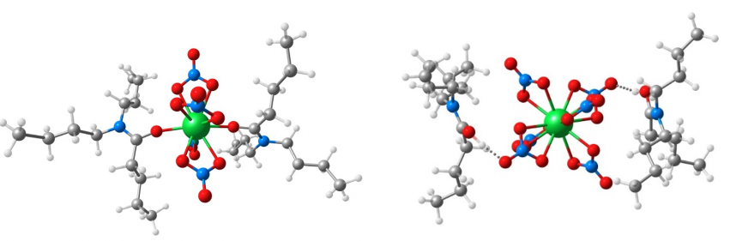
E&E pole at IJCLab
Numerical simulation and modeling in chemistry
Transverse axis, develop theoretical chemistry activities in close collaboration with the pole’s experimentalists
Full DFT Calculation
Complexation of radioelements in solution
Behavior of radioelements at solid/liquid interfaces
Behavior of radioelements and rare gases in solids and at solid/solid interfaces
12

Slide 13
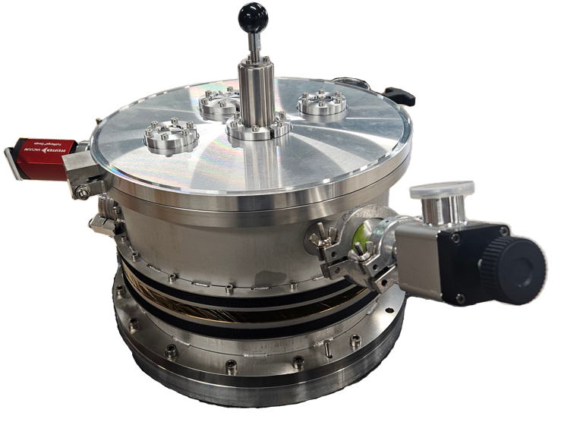
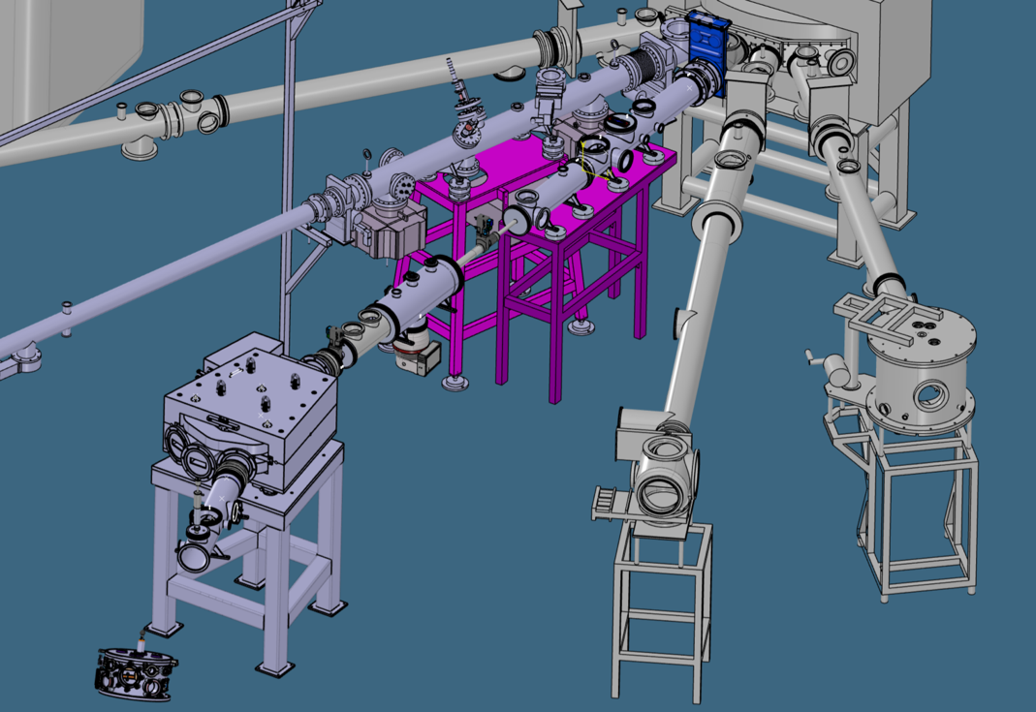
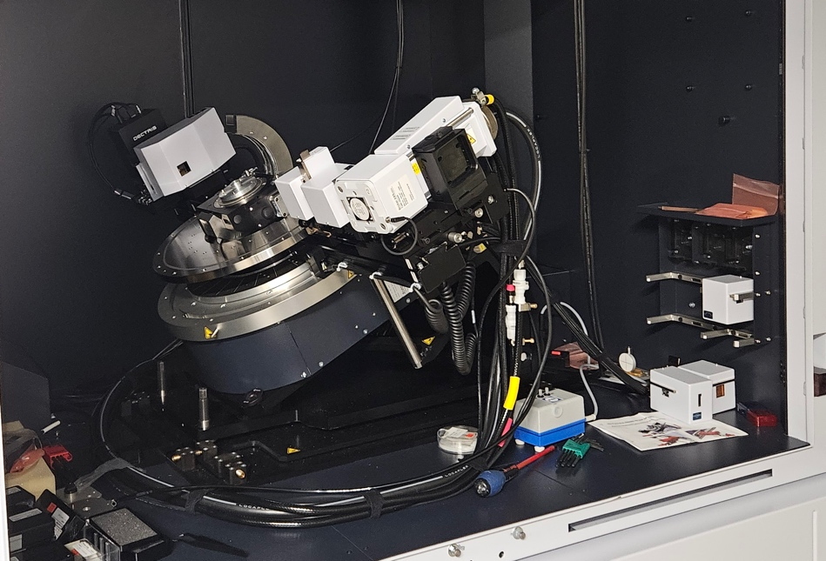

E&E pole at IJCLab
Materials and irradiation
Investigating the microstructural evolution of nuclear fuels under irradiation – Experimental simulation using energetic ion beams
Formation mechanisms of the defect at the fuel periphery (high porosity, small grain size; local increase of the Pu content)
Parametric approach : burnup, T, chemistry of impurities, radiation defects and damage
UO₂ / Steel for cladding / ODS Steel
In situ irradiation/RBS-C or TEM at 773 K
New ion beam line
on ARAMIS accelerator
In situ X-ray
Diffraction
JANNuS-Orsay experimental hall
  (In Situ MEB, Ion Implantation, Surface)
SIDONIE high purity isotope separator
Andromede accelerator
First test of In situ X-ray diffraction for this year
13

Slide 14
E&E pole at IJCLab
Energy Transition Physics Analysis
Development of an analysis tool, based on the modeling of the energy production sector, to quantify the embodied energy needed for the energy transition itself
This physical quantitative analysis requires the development of a validated database and can be coupled with an economic analysis at a later stage.
Calculate the energy required to implement energie production technology
Build a reliable, consolidated database
Analyze different transition scenarios
Bring these data to economists for a better understanding of the role of energy in the economy.
create a public, open, database with easy access to key embodied energy data
14

