Slide 1
Accelerator Physics at IJCLab
Walid Kaabi

Slide 2
Accelerator Physics @ IJCLab: the main drivers
Missions of IJCLab for Particle Accelerators could be summarized in the following points:
To be a major actor in Accelerator Physics research in several key areas, selected for their strategic importance, their development potential and for our ability to have a significant impact and high visibility.
To be an accelerators builders: set a clear strategy to make significant contributions to the international projects and contribute to the roadmaps definitions for major accelerator-based Research Infrastructure, facilitating the positioning of our research teams.
Contribute to IJCLab’s accelerators and technological platforms development: an important point to consolidate and increase our accelerator expertise, our training capacities and ensure strong attractiveness and visibility.
Training young students in accelerator science and technology : Provide courses at different university curriculum level, supervision of doctoral theses, welcoming interns and apprentices, organization of training.
In perfect accordance with IN2P3/CNRS strategy and the European Roadmap, the Projects and research activities of the Accelerator physics pole are conducted within 3 main axis:
  Design and construction of accelerators
  Exploring innovative acceleration technics
  Upstream R&D serving the accelerators

Slide 3
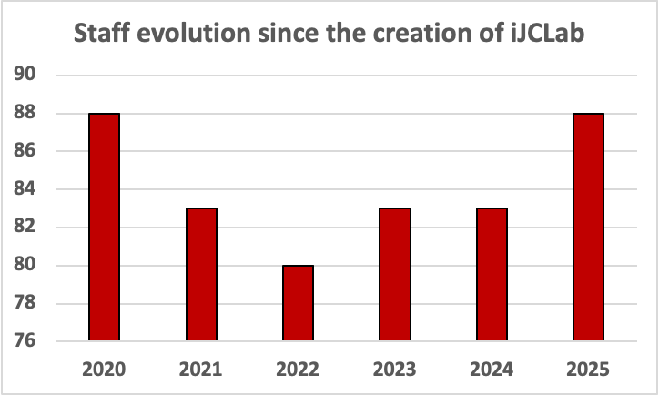
Accelerator Physics Pole Structuration
The Physics Accelerator Pole is structured in:
4 scientific teams
  ALPHA: Laser-plasma acceleration, powerful laser development for applications
  ILE: Compton source development, Polarimetry, Laser Optics
  BIMP: Accelerator design, beam dynamics, beam instrumentations, nano-beams at IP, positrons and electrons sources
  MAVERICS: Vacuum and surface physics, dynamic vacuum in accelerators, Studies of thin films for accelerators (SRF, Getter, anti-multipactor…), photocathodes production
2 specialized services:
  RF technologies: Design, preparation, test and operation of RF acceleration structures and related systems, LLRF, power sources
  Cryogenics: Design and operation of cryogenic systems
1 technological platform
  UHV: Mass spectroscopy, degassing rate measurement, metrology…
  Surface & material characterization: structural (DRX), composition (SIMS, XPS, ED), Topology (MEB, Confocal microscopy)

Slide 4
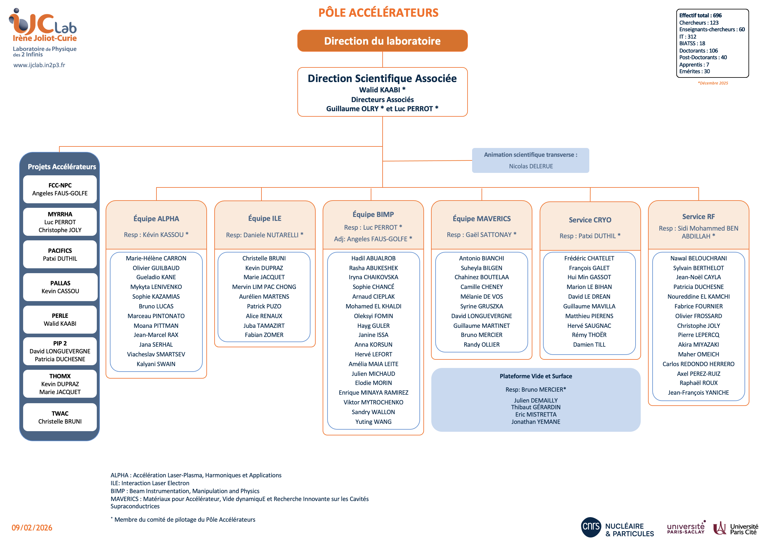
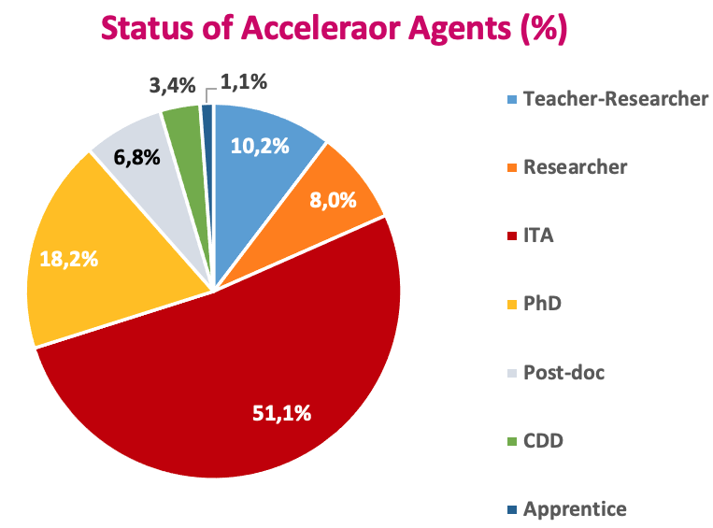
Accelerator Physics Pole Organigramme
Some HRs indicators up to date:
88 agents (including 57 permanent staff)
Gender balance M/F : 64 / 24
7 members with HDR
Average age: 44 Years
Status :
9 Teacher-researchers (5 Pr + 4 MdC)
7 CNRS Researchers (5 CR, 2 DR)
45 Engineers/Technicians (44 CNRS et 3 University)
16 PhD students
3 CDD, 6 Post-doc, 1 apprentice
Affiliation (permanent staff):
46 CNRS
11 Paris-Saclay University

Slide 5
Accelerator Physics Pole Budget
The accelerator physics pole global budget is around 6 M€ (period 2020-2025).
  A multi-annual budget
  The main Contributors (>500 k€): ESS, Myrrha, THOMX, PACIFCS, TWAC, PALLAS, PERLE, iSAS, .
  Funding origins:
    EU projects: iFAST, Eurizon (CREMLIN+), TWAC, Euro-Labs, iSAS, EAJADE, EPITA
    TGIR: ESS In-Kind contribution
    ANR/EQUIPEX: INSPIRER/THOMX, PACIFICS
    Contract: MINERVA
    CNRS/IN2P3: PIP-II, Pallas, PERLE, ERL4ALL (Projet à Risque et Impact (RI2): PERLE Injector), FCC-NPC and many other R&D programs
    SESAME/P2I/P2IO/ ERM: MLLTRAP, LaseriX Upgrade, MAVERICS R&D activities
    International bilateral agreement: FJPPL, FCPPL…

Slide 6
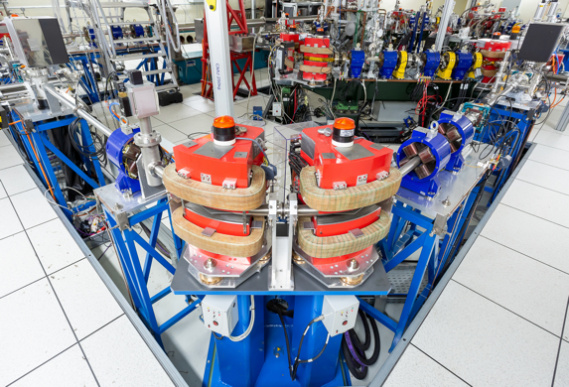
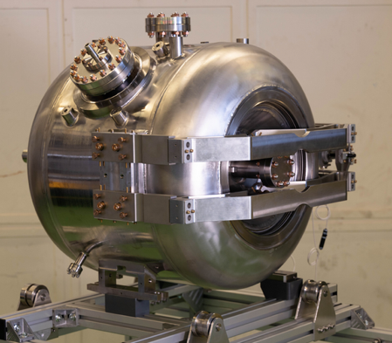
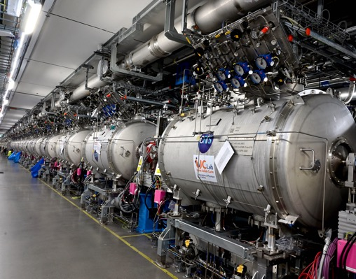
Design and Constructions of accelerators

Slide 7
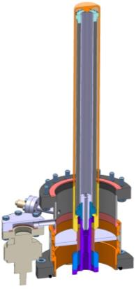
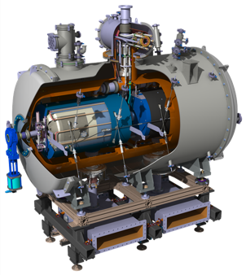
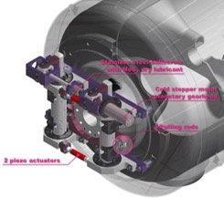
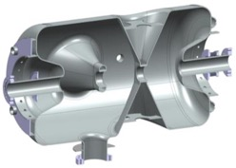
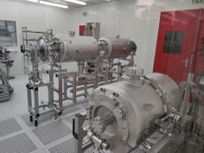
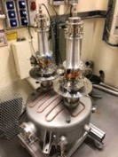
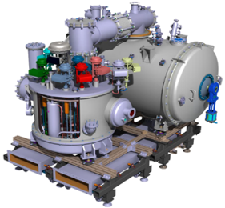
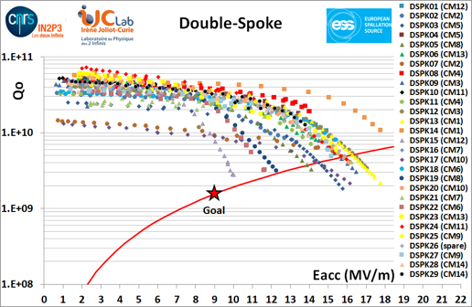
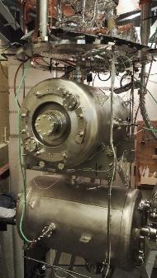
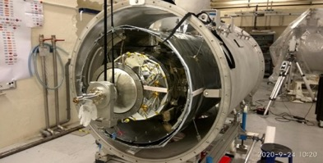
ESS Project:
Warm linac
SCRF linac (T=2K)
Double Spoke SRF Cavities
Power Coupler
Cold Tuning System
13 Spoke cryomodules
Cryogenic distribution of Spoke section: 13 Valve boxes + Cryo distribution lines + « end box »)

Slide 8

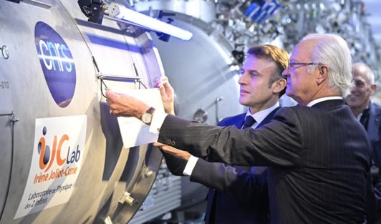
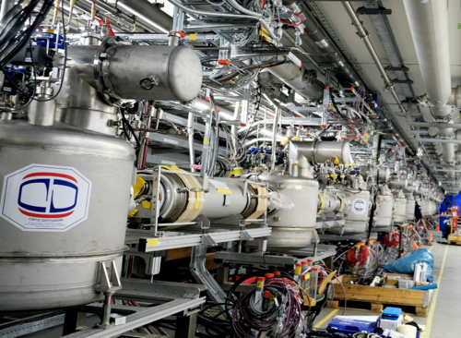
ESS - Main Achievements
20 M€ in-kind contribution to ESS accelerator (Spoke section)
Mid-2020 to end of 2023: preparation, assembly and delivery of 13 (+1 spare) Spoke cryomodules. All tested @ Uppsala within the specifications. All validated!
Delivery & installation of the cryo-distribution system in 2022, first cool-down in February 2023 and fully commissioned end 2023.
→ The Spoke linac section is now fully operational. The year 2023 marks the end of more than 10 years of effort (>100 FTE).
Signed agreement with a French company (CNIM) for the know-how transfer of cryomodule assembly

Slide 9
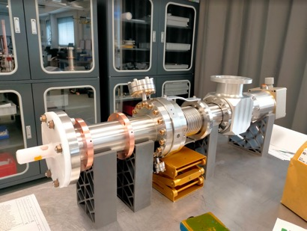
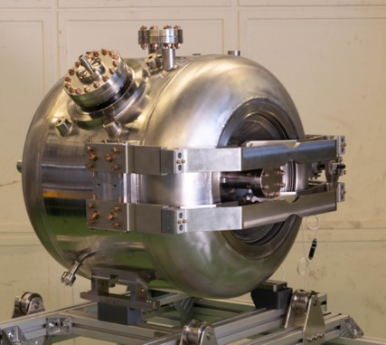
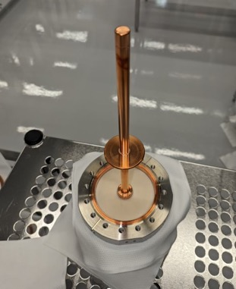
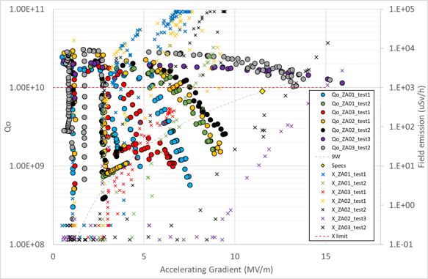
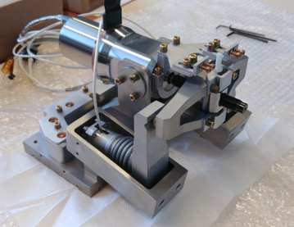
PIP-II - Main Achievements
Prototyping Phase (2018-2024):
4 RF power couplers fabricated in French company (PMB) and shipped to Fermilab.
5 frequency tuner fabricated in French company (PSI), tested and validated with cavities at cryogenic temperature.
6 accelerating cavities fabricated in Italy (Zanon) and tested at cryogenic temperature.
RF power coupler
Tuner motor cartridge
Cavity and tuner
coupler antenna
Summary of all cryogenic tests performed

Slide 10
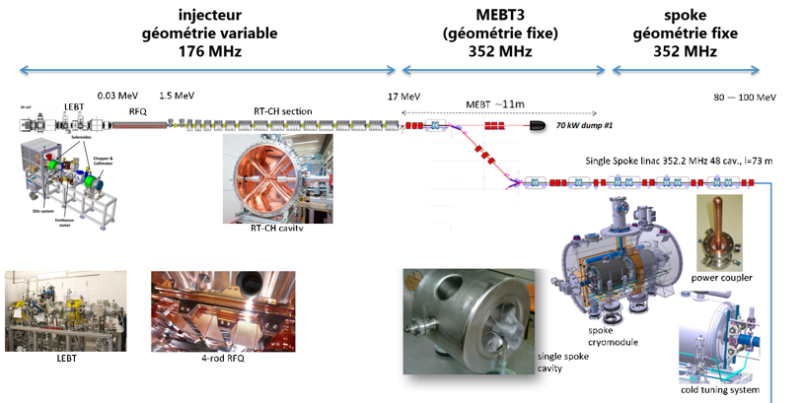
MYRRHA - Main Achievements & Future Plans:
MYRRHA (Multi-purpose hYbrid Research Reactor for High-tech Applications) is the 1st large scale Accelerator Driven System (ADS) worldwide: it consists of a subcritical nuclear reactor driven by a high power linear accelerator. its construction is planned in 3 phases : Linac section up to 100MeV, Linac section up to 600MeV & Construction of the reactor
IJCLab contributes to R&D since nearly 25 years and to series production in the framework of IN2P3 – SCK CEN contracts:
PA2 : Full design assembly & test at cryogenic temperature of the spoke cryomodule => from 2017 up to 2023
PA5 : R&D on beam dynamic of the 100 MeV phase 1 accelerator, BPM prototyping, LLRF design and expertise support from 2020 up to 2024
Future Plans :
PA6 : Tests of (pre-)series components : cavities, power couplers and cold tuning system (from 2023 up to 2027)
PA8 from 2024 up to 2026 : Test of the warm motor solution for the CTS spoke CM.

Slide 11
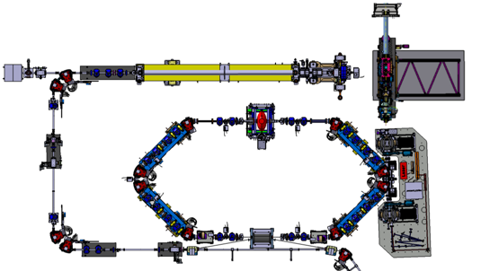
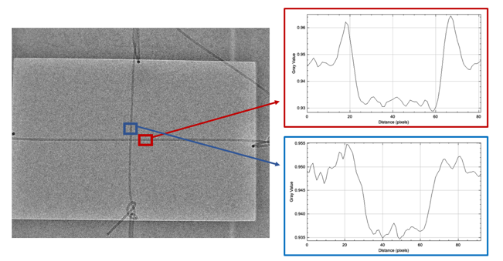
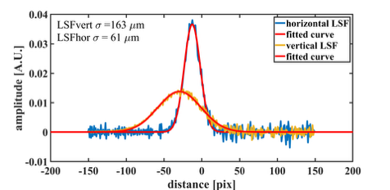
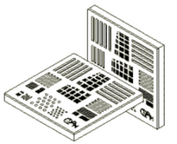
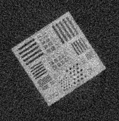
ThomX Project: Main achievements
1st phase contrast 2D image
Source size measurement
A 300 μm wire/fishing line (~ 4,5m Fishing line has only 1-2% absorption).
Slit /edge
Detector plan
source
Blur due to source size
X-ray beam
Flux ~ 3. 10¹⁰ ph/s woth Cu cathode
Increase with Mg → Work in progress
3 operating points:
50, 61, 70 MeV → X-rays 45, 70, 90 keV
Optimization & measurements
(beam sizes, flux, spectrum …)
→ Work in progress
1st phase contrast TOMOGRAPHY
PUBLI:
“Commissioning of ThomX Compton source subsystems and demonstration of 10¹⁰ x-rays/s” PRAB 28, 023401
Bar and point structures
down to a few μm
ThomX
PC TOMO
5 mm

Slide 12
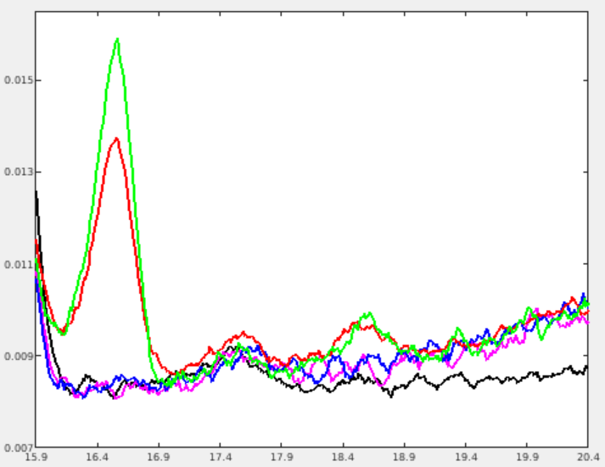
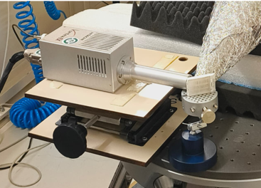
ThomX Project: Main achievements
First experiment of fluorescence spectroscopy
sample 1
sample 2
sample 3
sample 4
Background
Paraffin-embedded prostate
samples from ~ one hundred
individuals living in the Congo.
Some individuals are sick
(we don't know which ones)
4 samples, selected at random,
were analyzed at ThomX.
2 of the 4 samples contain Niobium (samples 3 and 4)
NB: There are many niobium mines in Congo…
Det
(spectro)
Niobium
peak Kα
Sample
Niobium
peak Kβ
ThomX preliminary
X-rays

Slide 13
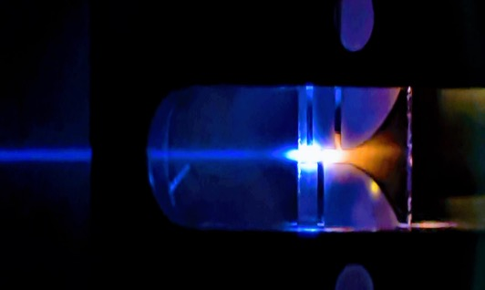
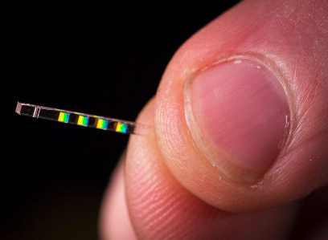
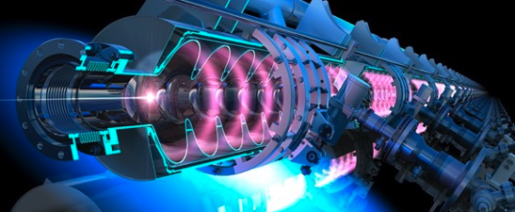
Innovative Acceleration Techniques
injection
laser
e-
acceleration
Plasma lens
Main Achievements & Future Plans

Slide 14
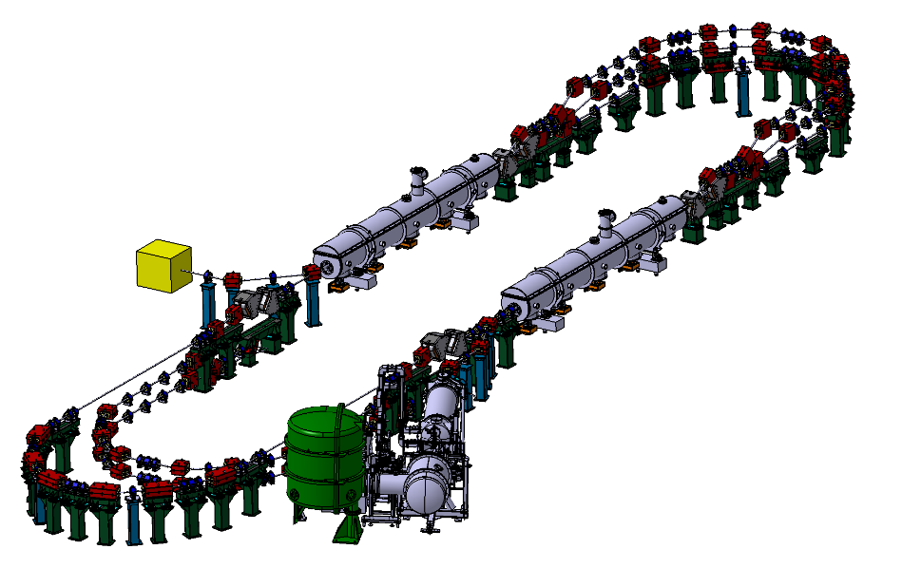
PERLE Project:
PERLE main objectives:
Demonstrate multi-turn and high current operation → access to unexplored power regimes
Validation of important technical choices:
  High-charge electron gun: 500 pC at 40 MHz
  Optimized 800 MHz SRF system: Maximise the efficiency
  Common circulation arcs for accelerated and decelerated beams
  Non-invasive diagnostics
Host experiments of interest for our lab and institute.
Target Parameter | Unit | Value
Injection energy | MeV | 7
Electron beam energy | MeV | 500
Normalised Emittance γε_{x,y} | mm mrad | 6
Average beam current | mA | 20
Bunch charge | pC | 500
Bunch length | mm | 3
Bunch spacing | ns | 25
RF frequency | MHz | 801.58
Duty factor |  | CW
PERLE 500 MeV version

Slide 15
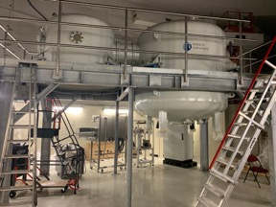
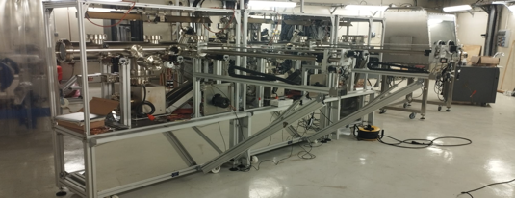
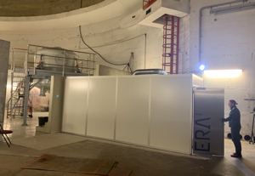
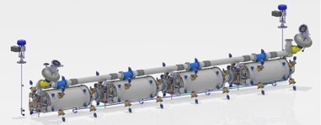
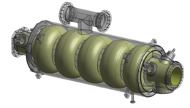


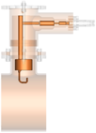
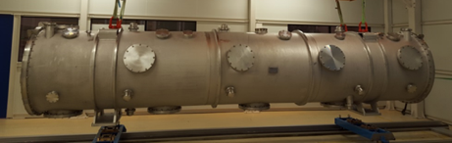
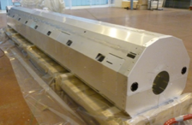
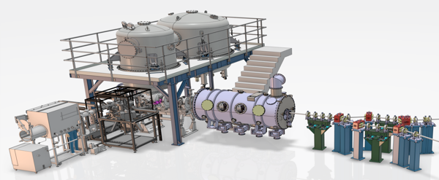
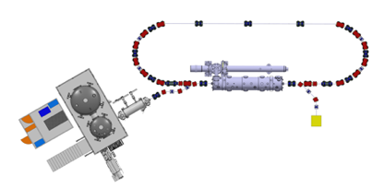
PERLE: Main Achievements & Future Plans
DC-gun + photocathode+ preparation chamber acquired and installation is ongoing in the IGLOO.
DC Gun installation
Photocathode Production Facility (PPF) assembly
Laser room installation
LINAC cryomodule is funded by the UE Program iSAS (+ IN2P3 matching funds + CM vessel from ESS). Components design is ongoing:
Cavity string design
SRF Cavity design
Probe Coupler
Hook Coupler
DQW Coupler
Vacuum vessel
Thermal shield
Funds obtained within RI2 national program (CNRS). it secure the full injection line.
HV system
DC Photogun
Booster
With these 2 funds, we are close to realise PERLE 1 turn
Merger
Buncher
Photocathode Preparation Facility (PPF)
Diagnostics line

Slide 16




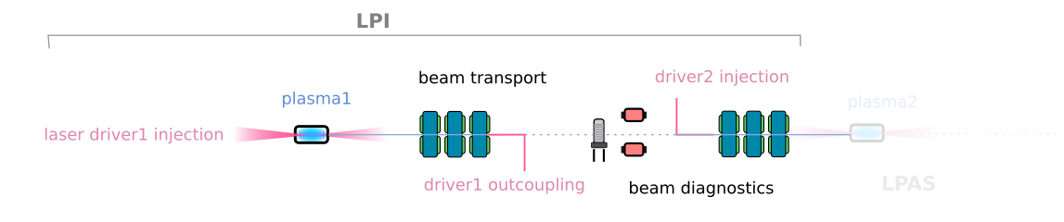
PALLAS project:
Test facility for laser-plasma injector optimisation towards high quality beam, control and reliability
In the context of advanced accelerator high-quality beam laser plasma injector (LPI) for EuPRAXIA [1]
- preparatory technical design phase and future high gradient accelerator R&D at IJClab
- compactness as a sustainable approach
- ultrashort/high peak current beam
- 10 Hz -150-250MeV, 10-100pC, dE<5% LPI test facility to improve quality and stability of e- beam generated by laser-plasma accelerator.
- currently not existing in the world as a day-to-day reliable accelerator [2]
At IJClab, Orsay funded by PIA3-ANR, CNRS-IN2P3, Université Paris Saclay, EuPRAXIA-PP and CPER - almost ~2.3 M€ budget
Advanced laser control (10Hz)
- Spatial and temporal phases control
- Active beam pointing
e- beam compact characterization
Down to 500 keV energy resolution
emittance
multi screen beam profile station
T-ICT
longitudinal phase space
Plasma target development [3]
PIC simulation SMILEI [] – (LLR/LPGP)
testing various gas cell type - (LOA)
Continuous flow and CFD simulation
In-line integration with differential pumping
Density profile tailoring (FLAME/LNF-INFN)
Beam Transport [4]
compact flexible capture ( 4 EM-QP / PMQ 3EM-QP) – (LLR)
active plasma lens capture test (coll. LNF-INFN)
collimator system for energy selection GEANT4 (LP2I-B)
Tracking code used (CODAL, TraceWIN, RFTRACK, wake-T)
[1] : Assmann, R. W. et al. EuPRAXIA Conceptual Design Report. Eur. Phys. J. Spec. Top. 229, 3675–4284 (2020). [2] pallas.ijclab.in2p3.fr [3] Drobniak, P. et al. Random scan optimization of a laser-plasma electron injector based on fast particle-in-cell simulations. Phys. Rev. Accel. Beams 26, 091302 (2023), [4] C. Guyot et al. Benchmarking CODAL beam dynamics code: a laser plasma case study, IPAC 2023 WEPL084 [5]

Slide 17
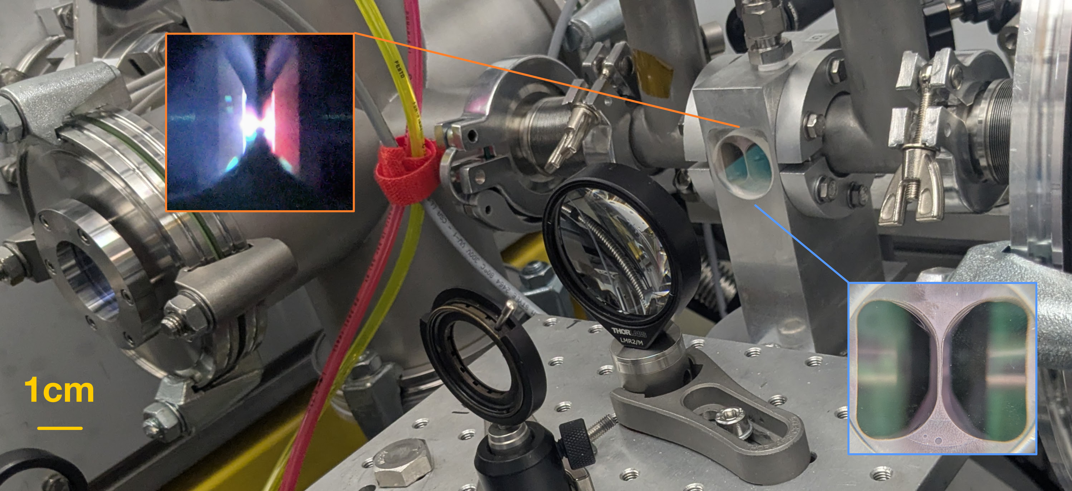
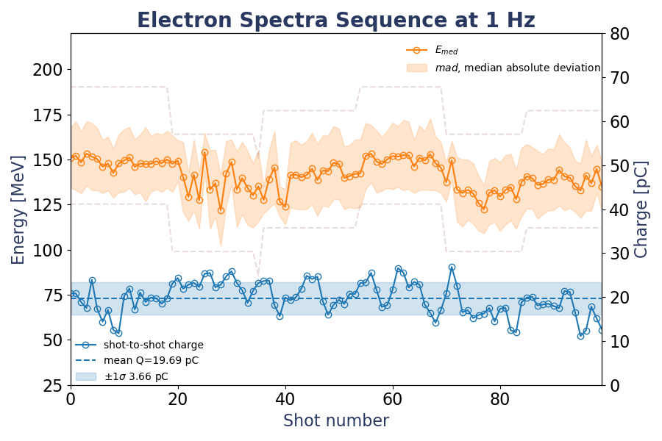
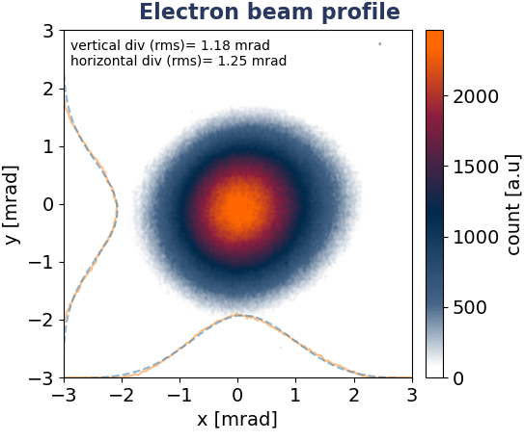
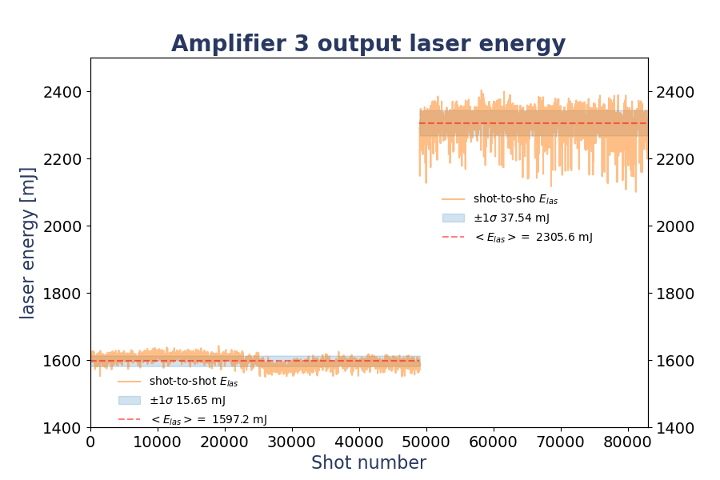

PALLAS commissioning : First electrons beam at 150 MeV
Laser-plasma electrons source commissioning @ 1 Hz
First time fully integrated beamline LPA plasma !
debugging of electron characterisation beamline
No stabilisation active loop on laser or plasma
Parameters | Goal | Achieved
Energy (E_{med}) [MeV] | 150 | 140-160
Energy Spread (𝜎_{E} ) [MeV] | <7.5 | 18-100 ^{(✛)}
Charge (Q) [pC] | 15-30 | 10 -25
Divergence (𝜃) [mrad] | <5 | 0.8 x 1.2
Stability [%] | 5 | 15 -23
LASERIX laser-driver main amplifier upgrade
laserix laser driver amplifier upgrade 1.5 -> 3J
Crystal coating damaged hold back to 2.2-2.5 J
Optical compressor thermal loading studies
Next steps
Restarting laser with repair Ti:Sa crystal, laser beam quality improvement
Electron beam studies optimisation / real-time laser diagnostic development for active laser stabilisation and control
Installation of the electron beam capture and energy selection beamline 03-04/2026
New plasma target development

Slide 18












TWAC - Main Achievements
Dosimetry
Inclusion of CSIC
Dosimeter ready
THz source & zita coupling
THz conversion (simualtion & measured)
Multicycle demonstration
Numerical evaluation of THz coupling
Experimental progress on radial polarisation
Implementation in progress
Advanced diagnostics
Commissioning of ARES accelerator
--> Experimental validation of passive streaking
ZITA
prototype available
Electron bunch
Optimisation in progress
Data acquisition almost ready

Slide 19














-
TWAC : Acceleration THz dans un dielectric
Passage des électrons dans la zita (10-60 pC)
Montage et pilotage de chambre d’interaction en cours
ZITA
e-
ZITA
câblage
Mécanique
Online
Dose mesurée (CSIC) – 1Gy/s
Génération et Transport du THz au point d’interaction
THz
e-
e-
Notes:
Depuis septembre :
Mise en place d’une chambre de test sous vide sur la ligne PHIL. La paquets d’électrons est focalisé dans la zita (2mm de diamètre) et est transmis sans pertes jusqu’à 60 pC (on était limité en charge par le laser) en mode paquets long (laser phil) et en mode paquet court (laserix)
Mesure de la dose du paquet d’électron en bout de la ligne PHIL à l’air avec les détecteur SiC développé par le CSIC (Consuelo Guardialo, Sophie Henrich) 1Gy/s pour 25 pC.de charge.
Montage et test du transport du THz (avec laserix haute énergie – PhLAM, Pecs) au point d’interaction à l’air
Réception de la chambre d’interaction et de la motorisation, montage à blanc mécanique, cablage des interface moteurs, développement du contrôle commande, installation de la chambre sur la poutre phil. Montage et pilotage des moteur sur site en cours
Accueil de Mervin, étudiant en thèse à IJClab, accueil de Anas, étudiant en thèse au PhLAM

Slide 20



Upstream R&D serving the accelerators

Slide 21





Compton polarimetry
Critical accelerator monitoring element required for future colliders and upgrade of existing to:
Optimize polarization of bunches in collisions (ILC, EIC, SuperKEKB)
Accurately calibrate beam energy (FCC-ee)
Compton polarimetry activity focused on innovative developments:
Accurate and real-time monitoring of laser polarization is key to next major future colliders (FCCee, ILC, EIC,…)
24/7 operational polarimetry is essential for these projects, system integration
Overall optimization of laser system and scattered electron/photon detectors is required (small HEP exp.) → huge task
Conceptual implementation for SuperKEKB
Fit of MC for the simulated performance of SuperKEKB detector
Laser injection line
Long term developments (FCC-ee), with significant cross-projects synergies
Collaborations with many international partners: CERN, KEK, U. Victoria
E_{𝛄}

Slide 22







Nanobeam at IRs
Very high peak luminosity needs nanometre transverse IP beam sizes (FCC-ee 30-70 nm, ILC 3-8 nm, CLIC 1-3 nm).
To demagnify the beams, complex IRs and FFS are designed.
IRs studies
Design:
Experimental PoC:
  CLIC/ILC
LCs FFS experiments at ATF2-3
Intensity dependence effects on the IP size
High-order optical aberrations with low and ultra-low β*
Long-term stability emittance measurements
Alternatives IR configurations:
Dual Beam Delivery Scheme (BDS) with two detectors
Energy upgrades scenarios
    Layout of the Dual BDS for CLIC 380 GeV
  FCCee
ATF2 @ KEK
ATF2 beam size story
IR configurations as monochomatization
Performances including Beamsstrahlung (BS)
Optics design to generate antisymmetric D*_{x,y}
Experimental implementation (DAPHNE, SuperKEKB, BEPC)
Realistic IR simulations:
Beam-Beam instabilities studies, including wakefield model and possible experimental studies.
  FCCee experiments at SuperKEKB
Beam-beam instabilities in strong-strong regime including impedance model and code benchmarking with dedicated experiments with a reduced number of bunches varying the collimator settings.
Resonances causing horizontal instabilities after beam-beam interactions with Circulant Matrix Model (CMM) semi-analytical model.
Crossing angle monochromatization scheme featuring IP dispersion of opposite signs.
SuperKEKB @ KEK

Slide 23







High-Intensity Positron Sources for HEP
High-beam intensity and low emittance e⁺ are necessary to achieve high luminosity
(ILC/CLIC 10¹⁴-10¹⁵ e⁺/s, FCC-ee ~10¹³ e+/s while demonstrated @SLC ~6×10¹²e+/s)
→ design, build and operate innovative targets, capture systems and damping rings.
FCC-ee: e⁺ production + Capture System
Investigation of the novel positron production schemes
Feasibility and R&D studies of using the innovative capture systems (superconducting solenoids)
Use of the Artificial Intelligence (AI) for global optimisation of the positron injector parameters
Design studies for the FCC-ee are ongoing and well advanced (FCC FS report 2025)
Crystal-based positron production
Positron capture system R&D
P³ experiment @PSI in 2026/2027
18.2 T @15K@2kA
PSI
KEK
KEK

Slide 24




SRF activity- Future Plans
5 R&Ds pursued in parallel
Start superconducting thin-films activity. Explore NbN by CVD and High-Tc superconductor (FeSe)
Alternative metallographic polishing of Niobium for SRF applications
  RF test of a cavity fabricated from pre-polished disks
Multipacting (electron avalanche in RF systems) mitigation.
  New development of multilayers
Advanced Heat treatment investigation to boost Niobium performances
  Apply successful Mid-T bake treatment for PERLE/FCC cavities
In-situ plasma cleaning of SRF cavities
  Optimization of parameters on PIP-II spoke resonator
  Continue work on plasma parameters measurements by langmuir probe and optical spectroscopy
  Increase plasma cleaning efficiency to other type of pollution (today only carbon contamination)
PERLE
Photocathodes (CsKSb) elaboration for the PERLE photogun

Slide 25





Dynamic vacuum - Achievements
  Dynamic pressure in accelerators : LHC/FCC
NEG coatings
Analysis of data collected in the LHC during the RUN3 (collab CERN)
Simulation of pressure
by the DYVACS code
Comparison between experimental data and calculated pressures

Slide 26



Dynamic Vacuum- Future Plans
4 R&Ds pursued in parallel:
Ultra-thin NEG coatings : measurement of activation temperature and sticking coefficient
Electron stimulated desorption by high energy electrons (with the PHIL photoinjector; experimental data for FCC) : set up development and experiments planned in 2025
Ion stimulated desorption by high energy ions (with the TANCREDE FACILITY) : set up development and experiments planned in 2026
Development of simulation tool (DYVACS) for dynamic pressure in FCC-ee

Slide 27



Vacuum and Surfaces Platform

Slide 28
Thank you for your attention!

Slide 29




PIP-II - Future Plans
Production Phase (2025-2027):
Upgrade of existing cryogenic facilities (Supratech Platform).
Cryogenic test of 33 cavities.
Push R&D on 2 topics to mitigate problem of X-rays emission : advanced cleaning by Cobot and in-situ plasma cleaning (high synergy with SRF activities)
Advanced cleaning by Cobot
Plasma ignition test in cavity
Cavities installed on testing insert

Slide 30

Implications RH aux Projets Accélérateurs en 2025
Notes:
Regrouper PHIL, Acc. THz et TWAC sous TWAC

Slide 31


Projets Accélérateurs depuis la création d’IJCLab
FTE Ch: agents évoluant au sein d’une équipe
FTE IT: agents évoluant dans un service
FTE Pltf: agents évoluant dans une plateforme
Notes:
Regrouper PHIL, Acc. THz et TWAC sous TWAC

Slide 32





Inverse Campton scattering source @ PERLE
X-LINE in X-HUTCH
Fabry-Perot Cavity
X-LINE elements inside bunker

Slide 33



Implementation of DESTIN @ PERLE:
Spectrometer
Ion target location
RIB factory
50 MeV e- Linac

