Slide 1






WP3 Partners
Cristian Pira
WP3 Industrial Reviewer
innovate for Sustainable Accelerating Systems
WP3
Nb₃Sn on Cu films for 4.2K cavity operation
WP3 Meeting 08
20 March 2026

Slide 2
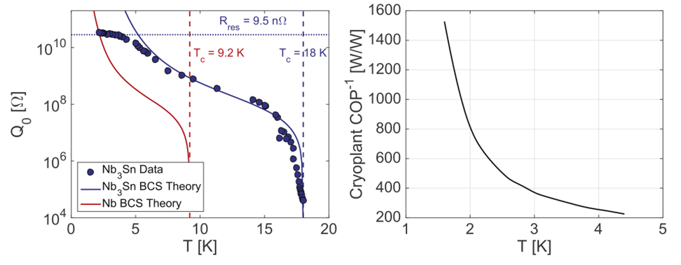
Goal of WP3
Energy saving is mandatory for the next generation accelerators…
…cryogenics is one of the larger energy cost in modern SRF accelerators
Move from bulk Nb @2K to Nb₃Sn @4.5 K
reduces cryogenic power by a factor of 3

Slide 3
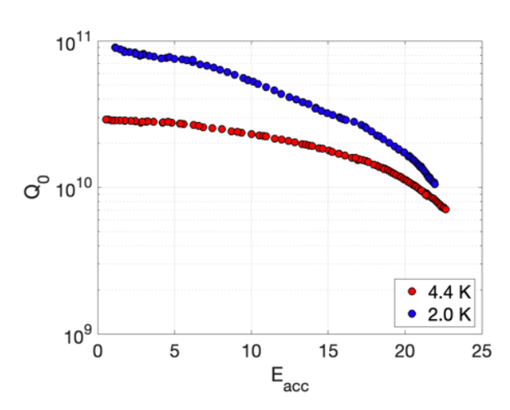
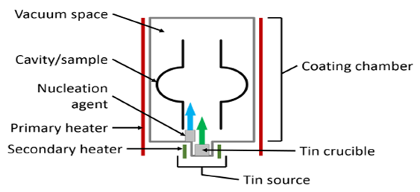
Nb₃Sn state of the art
Vapor Tin Diffusion
Cornell, Fermilab, JLab, KEK, IHEP
1.3 GHz
Nb₃Sn 4.4 K
Nb₃Sn 2 K
Nb bulk 2 K
Nb bulk 4.4 K (Q ∼ 2 * 10⁸)
Technology limitation:
Reproducibility
Substrate cost
S. Posen, SRF 2019 proceedings (elaborated)

Slide 4
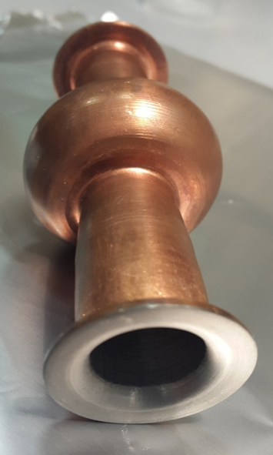
A different approach: Nb₃Sn on Cu
Cu substrate as several advantages:
Cheaper than Nb
Higher thermal conductivity
Higher mechanical stability
PVD technology (Nb on Cu) already used for LEP, LHC, HIE-ISOLDE @ CERN ALPI @ INFN LNL
Interlayer can be added to engineering the surface

Slide 5
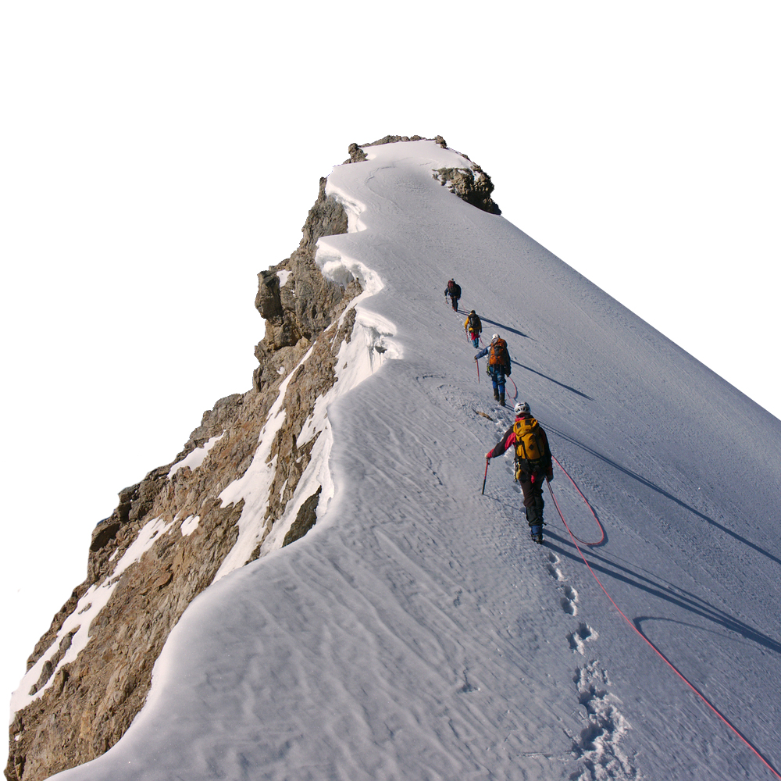
Nb₃Sn on Cu: Multiple challenges
A15 are Brittle materials
Complicate Phase Diagram
Low melting point substrate
Substrate preparation
Interface diffusion
Target Production
Coating Parameters
Trapped Flux
Tuning

Slide 6

Nb₃Sn on Cu: Multiple challenges
A15 are Brittle materials
Complicate Phase Diagram
Low melting point substrate
Substrate preparation
Interface diffusion
Target Production
Coating Parameters
Trapped Flux
Tuning

Slide 7
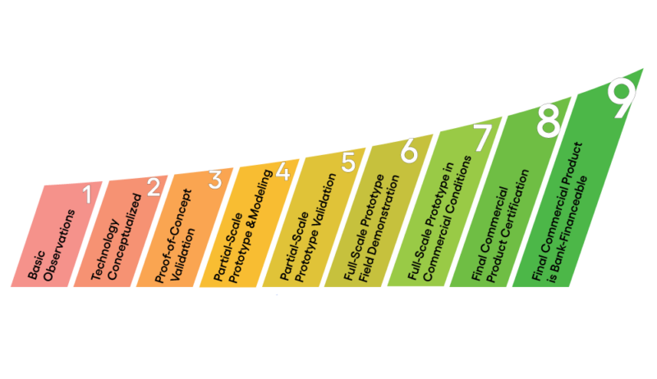
I.FAST Sinergy
MAIN GOAL (2025): Realize a prototype of high performance 1.3 GHz thin film SRF elliptical cavity Q > 1· 10¹⁰ @ 4.5 K
A step forward in TRL
Focus on:
minimizing trapped flux
increasing coating mechanical strength (to allow cavity tunability)

Slide 8
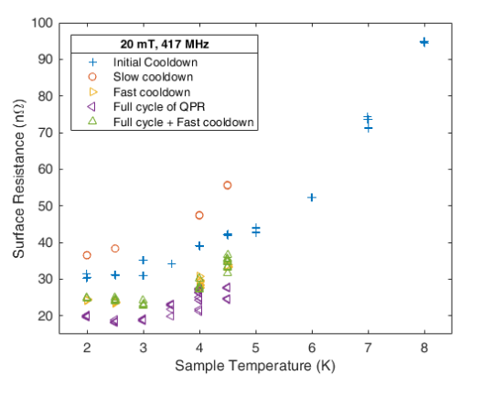
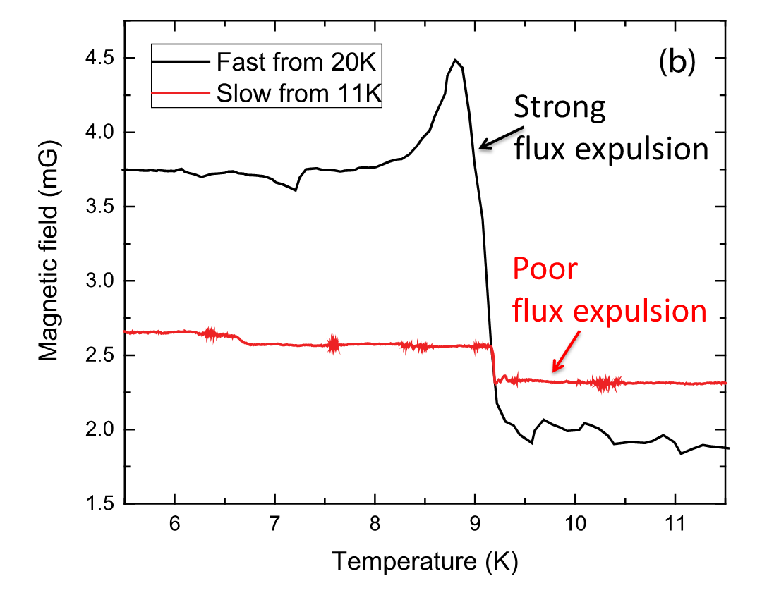
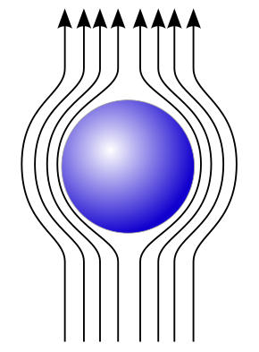
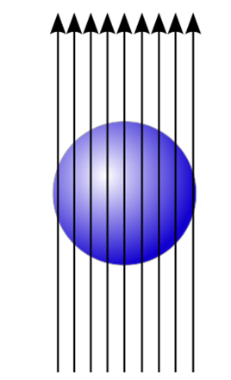

Trapped Flux
First ISAS Results:
$$Q_{0}∝\frac{1}{R_{BCS}+R_{res}+η S B}$$
Slow cooldown
Fast cooldown
Nb₃Sn coating suffer flux trapping
Cooldown procedure influence Rs
A. Romanenko, A. Grassellino, O. Melnychuk, D. A. Sergatskov, J. Appl. Phys. 115, 184903 (2014)

Slide 9
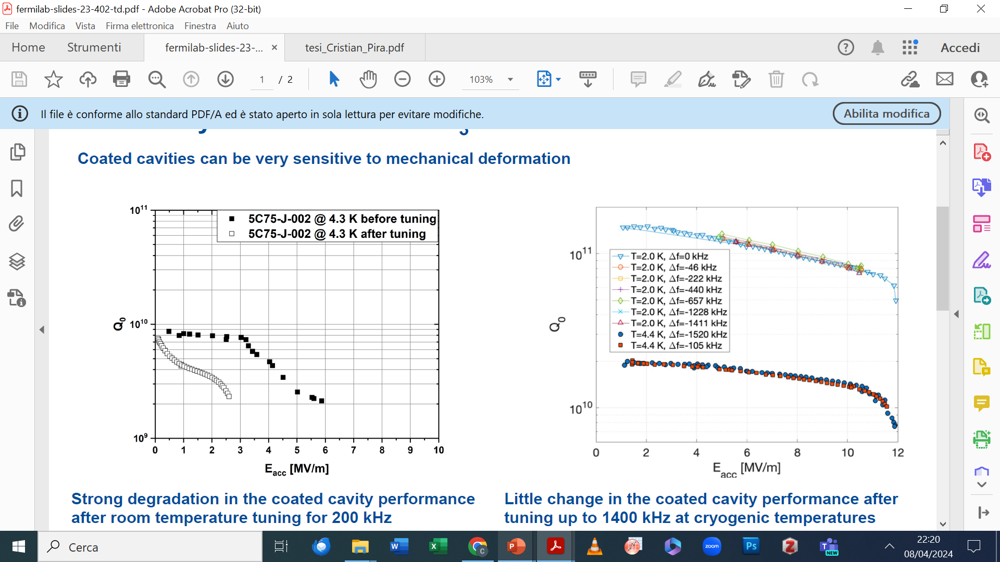
Cavity Tunability
Nb₃Sn is extremally brittle
Eremeev, G. (2023). Tunability/robustness of Nb3Sn (No. FERMILAB-SLIDES-23-402-TD). Fermi National Accelerator Laboratory (FNAL), Batavia, IL (United States).
Strong performance degradation after room temperature tuning for 200 kHz
Little change in the coated cavity performance after tuning up to 1400 kHz at cryogenic temperatures
Vapor Tin Diffusion Nb₃Sn on Nb cavities can be tuned only at cryogenic T
An interlayer in Nb₃Sn on Cu coatings can be added to enhance film mechanical stability and tunability

Slide 10
WP3 Partners

Slide 11
Main activities in ISAS
Partner
Nb₃Sn coatings by PVD, coating characterizations, WP coordination
Nb₃Sn coatings by PVD, coating characterizations, RF test on small resonators, trapped flux characterizations
Interlayer coatings by ALD, coating characterizations, mechanical strenght test
RF test on 1,3 GHz cavity and QPR, trapped flux characterizations, tunabilty test

Slide 12
WP3 Structure

Slide 13
WP3 Structure
Task 3.1: Coordination of R&D on SC cavities
Task 3.2: Flux trapping
Task 3.3: RF Tunability
Task 3.4: Adaptative layers
Task 3.5: Working Cavity @4.2 K

Slide 14
WP3 Tasks 3.1 Coordination of R&D on SC cavities – M1-M48 (INFN, CEA, HZB, UKRI) – Cristian Pira
Periodic meeting (in person and online) every 2-3 months (possibly in collaboration with I.FAST → EPITA)
Milestone 39 Impact Risk Analysis WP3 – INFN – Presentation/report M24
Completed in time

Slide 15
WP3 Tasks 3.2 Flux Trapping – M1-M32 (INFN, CEA, HZB, UKRI) – Oleg Malyshev
Objectives
Explore new coating parameters for planar samples and small resonators to minimize flux trapping in SC A15 films.
Upgrade the STFC choke cavity and the HZB QPR to support detailed flux trapping analyses of coated superconducting films.
Characterize trapped flux, flux viscosity and the interaction with the RF field with SC A15 films in small resonators and samples with the upgraded systems.
On track
Deliverable 3.2 Flux trapping Report on flux dynamics study in Nb3Sn on Cu samples - HZB - Report M30
Completed in time
Milestone 3.1 Modification of choke cavity for flux trapping study - Engineering report M12

Slide 16
WP3 Tasks 3.3 RF Tunability – M1-M32 (INFN, CEA, HZB, UKRI) – Oliver Kugeler
Objectives
Explore new coating parameters on planar samples and small resonators to enhance the mechanical strength in SC A15 films.
Mechanical film-stability tests with planar samples.
Build cavity tuning system and perform vertical cryo-tests of coated cavities to explore RF performance limits and acceptable tuning without incurring film damage.
Devise cavity tuning schemes for Nb3Sn cavities fulfilling the required tuning parameters while taking into account the constraints of Nb3Sn. The implementation of FE-FRT to assist will be considered.
Completed (3 weeks delay)
Deliverable 3.1 Cavity tuning Report on implementation of cavity Q vs F tuning tool - HZB - Report M24
Not started yet
Milestone 3.3 Report on mechanical strength test of SC coatings - Test report M30

Slide 17
WP3 Tasks 3.4 Adaptive Layers – M1-M40 (INFN, CEA, HZB, UKRI) – Thomas Proslier
Objectives
Develop adaptative layers by atomic layer deposition on Cu that are stable up to 650 °C.
Compare performance Nb3Sn on Cu with and without adaptive layers on planar samples and QPR.
On track
Deliverable 3.3 Adapt. Layer Report on QPR study of Nb3Sn on Cu & adaptive layers - CEA - Report M38
Completed in time
Milestone 3.2 Developed ALD adaptive layers on Cu - Test report M24

Slide 18
WP3 Tasks 3.5 Working Cavity – M1-M48 (INFN, CEA, HZB, UKRI) – Reza Valizadeh
Objectives
Improve I.FAST 1.3-GHz superconducting coating recipe based on Tasks 3.2-3.4 results.
Prepare 1.3-GHz thin film cavities with an optimized coating recipe.
Perform full cavity characterization @4.2 K (Q vs E, Q vs F, and flux trapping in the VTS@SupraLab vertical test stand).
Deliverable 3.4 4.5-K Cavity Report on 4.5-K Cavity performance & tunability tests - INFN - Report M46
On track
Milestone 3.4 Characterization of Nb₃Sn reference cavity - Test report M34
On track but discussion needed

Slide 19
WP3 Timeline
M3.1 Modification of choke cavity for flux trapping study - Engineering report M12
M3.2 Developed ALD adaptive layers on Cu - Engineering report M24
M39 Impact risk analysis WP3 – Presentation/report M24
M3.3 Report on mechanical strength test of SC coatings - Test report M30
M3.4 Characterization of Nb₃Sn reference cavity - Test report M34
D3.1 Cavity tuning Report on implementation of cavity Q vs F tuning tool - Report M24 - HZB
D3.2 Flux trapping Report on flux dynamics study in Nb3Sn on Cu samples - Report M30 - HZB
D3.3 Adapt. Layer Report on QPR study of Nb₃Sn on Cu & adaptive layers - Report M38 - CEA
D3.4 4.5-K Cavity Report on 4.5-K Cavity performance & tunability tests - Report M46 - INFN
M39
TODAY
M3.1
M3.2
M3.3
M3.4
D3.3
D3.4
Y0
Y1
D3.1
Y2
D3.2
Y3
Y4
2024 | 2025 | 2026 | 2027 | 2028
M | A | M | J | J | A | S | O | N | D | J | F | M | A | M | J | J | A | S | O | N | D | J | F | M | A | M | J | J | A | S | O | N | D | J | F | M | A | M | J | J | A | S | O | N | D | J | F
Task 3.1 - Coordination
Task 3.2 – Flux Trapping
Task 3.3 – RF Tunability
Task 3.4 – Adaptive Layers
Task 3.5 – Working Cavity @4.2K

Slide 20
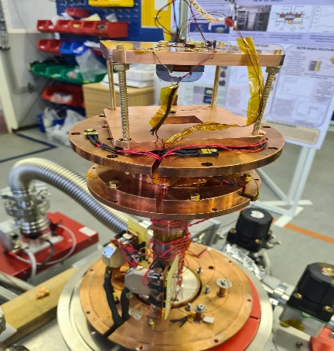
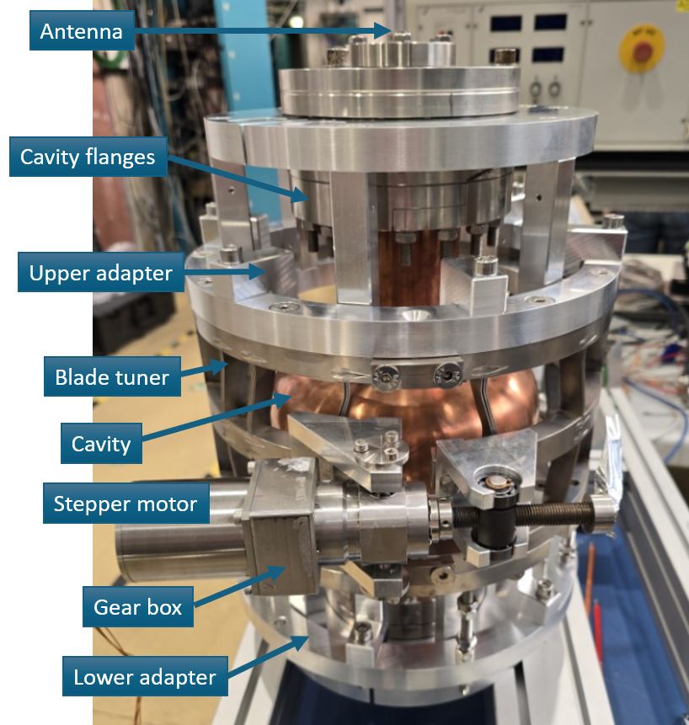
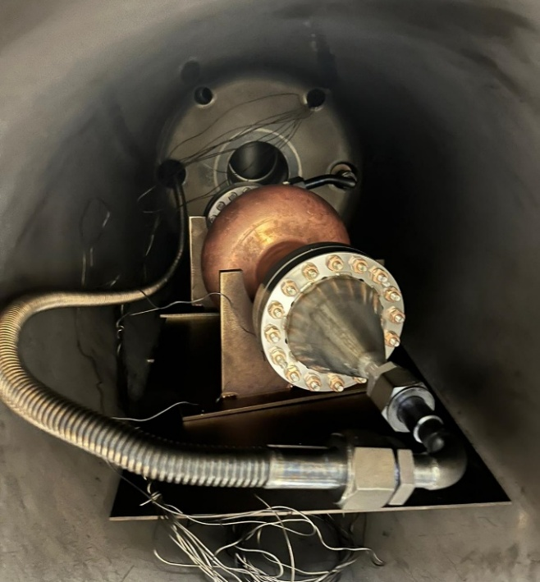

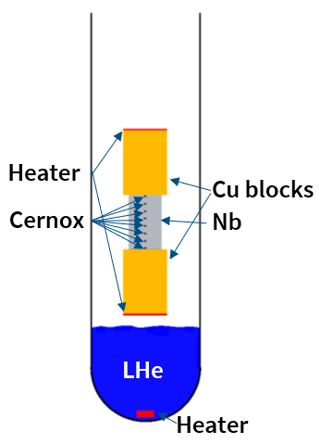
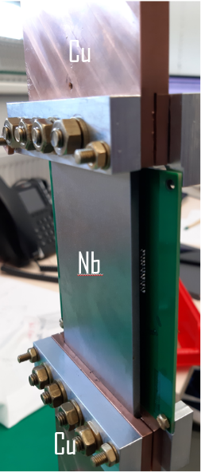


WP3 Key Outcomes (1)
Advanced characterization facilities (task 3.2 and 3.3)
Adaptive layers (task 3.4)
Flux trapping
Tunability
Al₂O₃, ZrO₂ and AlZrO_{x} oxides successfully coated by ALD and stable up to 750 °C
Mitigation of thermo-electric currents proved on Nb
Choke cavity and field penetration facility upgrade done
ZrO₂ (20 nm) / Al₂O₃ (5 nm) / Cu
Milestone 3.1 completed
TraMaFlu Facility built and tested
Blade Tuner built and tested
Milestone 3.2 completed
Deliverable 3.1 completed

Slide 21


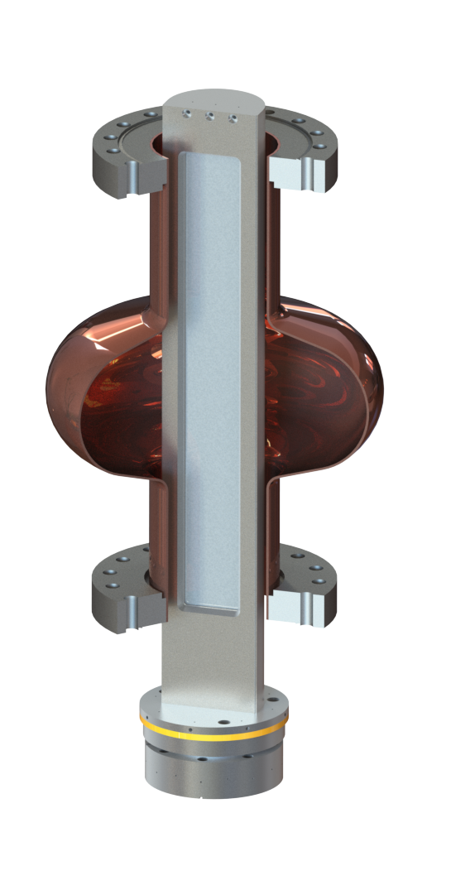
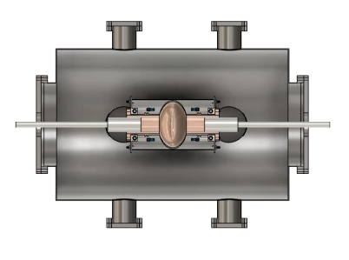
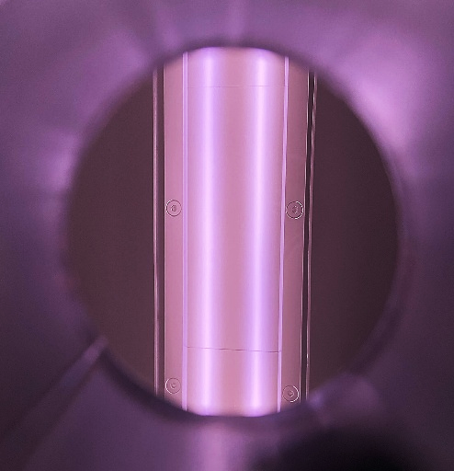
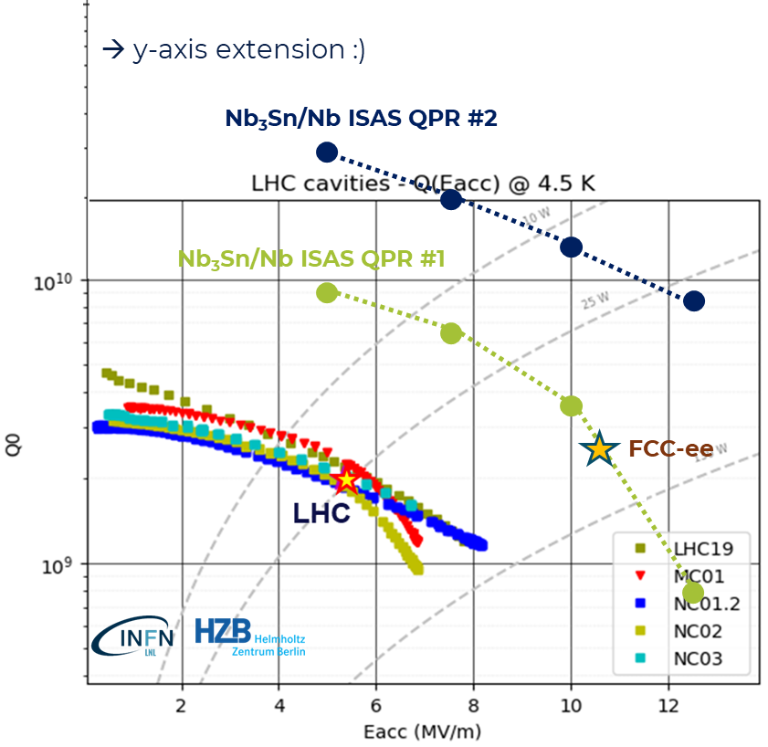
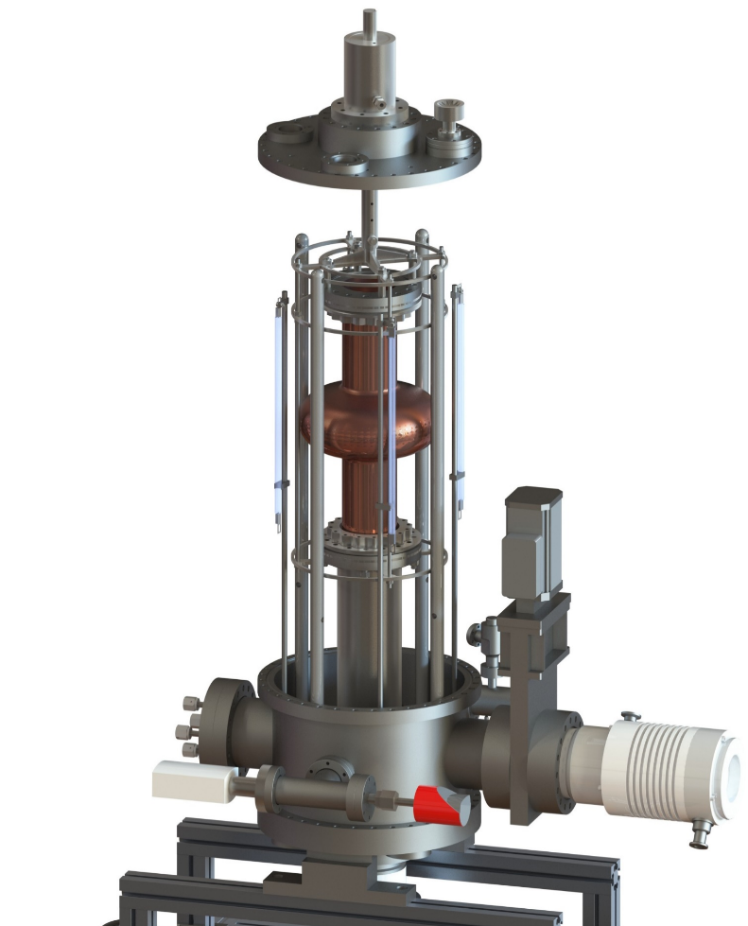
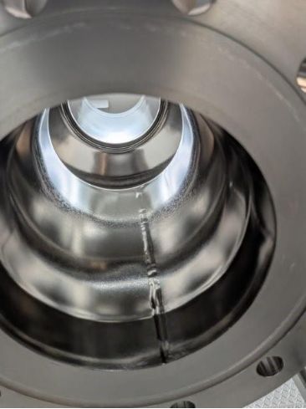
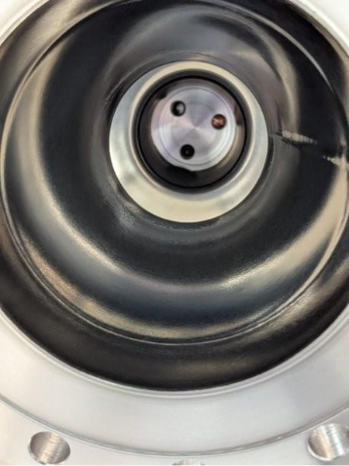
WP3 Key Outcomes (2) - Nb₃Sn coating R&D
(task 3.5)
Coating recipe optimized and validated on small planar resonator (QPR)
2 Different 1.3 GHz coating system ready (testing phase)
Rectangular magnetron Rotating Cavity
Double movable magnetrons Fixed cavity
Q value 10 times > LHC!
ignited plasma
before coating
after coating
D. Fonnesu et al., Recipe optimization and SRF test of Cu-compatible Nb3Sn films by DC magnetron sputtering from a stoichiometric target. Sci Rep 16, 3539 (2026)
M. Lazzari et al., "Development of a new system for Nb₃Sn thin film deposition on 1.3 GHz cavities", in Proc. SRF2025, Tokyo, doi:10.18429/JACoW-SRF2025-TUP31
N. Leicester et al., "Development of a 1.3 GHz longitudinally split RF research cavity for use in testing of superconducting thin films", in Proc. SRF2025, Tokyo, doi:10.18429/JACoW-SRF2025-TUP19

Slide 22
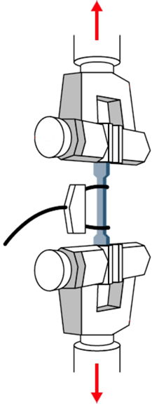
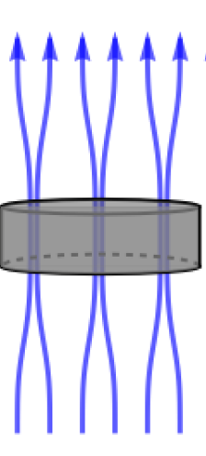
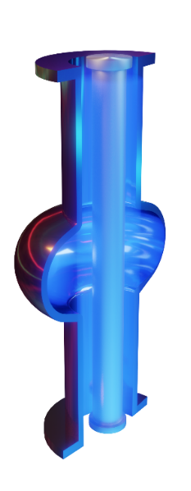
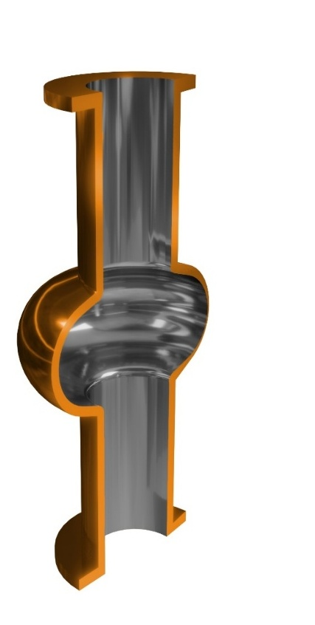

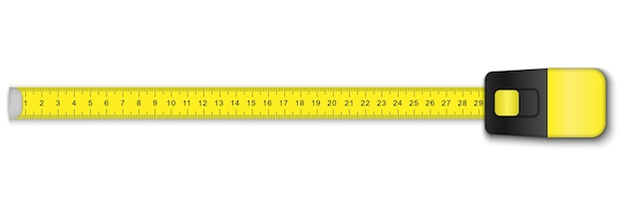
WP3 Next Steps
Insert Adaptive Layer between Nb₃Sn coating and Cu substrate
Test mechanical strenght and flux trapping on planar samples
Nb₃Sn
Al₂O₃
Coat a 1.3 GHz cavity with optimized recipe
Cu
4.2 K SRF vertical test of Nb₃Sn on Cu optimized cavity (ISAS WP3 final goal)

Slide 23
Thank You!

Slide 24
WP3 Tasks 3.2 Flux Trapping – M1-M32 (INFN, CEA, HZB, UKRI) – Oleg Malyshev
Description of work
This task aims to study how trapped magnetic flux may affect the superconducting properties of the thin film and its RF surface resistance. Initially, copper samples coated with A15 superconductors by PVD techniques will be provided by the INFN and UKRI. Three facilities will be used to characterize the samples: the choke cavity test facility at UKRI and the HZB QPR@SupraLab as well as the magnetometric mapping system at HZB. The facility at UKRI will be upgraded with a magnetic shield and Hall probes, allowing it to study magnetic flux trapping in 100-mm planar samples. At HZB the impact of flux trapping will first be investigated in the QPR equipped with an excitation coil and a fluxgate probe which allows one to correlate flux trapping with the RF performance of the SC film, as well as the study of flux viscosity. In a later step, the existing magnetometric mapping system for 1.3 GHz cavities at HZB will be used to investigate cavities from Task 3.5. The results will feed back on the cavity coating procedures.

Slide 25
WP3 Tasks 3.3 Tunability – M1-M32 (INFN, CEA, HZB, UKRI) – Oliver Kugeler
Description of work
This task aims to study and improve mechanical properties of SC thin films to assess the impact of future cavity tuning during normal 4.2 K operation. Initially, the study concentrates on small planar strips coated at INFN and UKRI and tested at CEA. Elongation and compression tests will be carried out at room temperature and at cryogenic temperature by applying a deformation typically incurred during cavity tuning. In parallel, HZB will design and build a cavity tuner system for vertical RF tests in SupraLab with coated 1.3-GHz cavities. The device should be capable of reproducing both of slow and fast tuning conditions, as needed for microphonics compensation. Length changes in the μm and sub-μm ranges, equivalent to frequency spans in the MHz and kHz ranges, respectively will be studied. Combined with the findings in Task 1.1 regarding the FE-FRT, a tuning scheme for Nb3Sn cavities will be devised.

Slide 26
WP3 Tasks 3.4 Adaptive Layers – M1-M40 (INFN, CEA, HZB, UKRI) – Thomas Proslier
Description of work
This task aims at developing suitable adaptative layers synthesized by ALD on Cu for subsequent Nb₃Sn deposition by PVD to reduce the detrimental effect of mechanical deformation on the superconducting properties of Nb₃Sn. In addition, these layers can also be used as diffusion barriers for Sn diffusion into Cu. The first step will be to find the layer composition and structure to make them stable on Cu up 650 °C. The second step will be to ensure no detrimental cross contamination between the layers and the Nb₃Sn occurs. Initially, we will conduct experiments on flat Cu coupons to optimize the first two steps prior to scaling up to QPR samples. A comparative study of Nb₃Sn on Cu with and without adaptive layers will be carried out systematically. The results of this task will be then applied for coating a 1.3 GHz cavity for Task 3.5.

Slide 27
WP3 Tasks 3.5 Working Cavity – M1-M48 (INFN, CEA, HZB, UKRI) – Reza Valizadeh
Description of work
This task comprises the main deliverable of the WP3: optimize the SC coating procedure of 1.3 GHz cavities and demonstrate suitability for 4.2 K operation. Substrate preparation will be done at INFN on Cu cavities originally produced for I.FAST. CEA will grow an adaptive layer via ALD according to the results obtained in Task 3.4. SC coating R&D and cavity deposition will be carried out in different PVD facilities at INFN and UKRI in order to test multiple deposition parameters, employing experience and knowledge from Tasks 3.2-3.4. Coated cavities will be shipped to HZB for a full characterization at 4.2 K (Q vs E, Q vs tuning, and flux trapping) on the new vertical stand system developed in Task 3.3. A complete characterization of the prototype cavity coated in I.FAST will be performed for reference.

