Slide 1


Cristian Pira
LNL Status
innovate for Sustainable Accelerating Systems
WP3
Nb₃Sn on Cu films for 4.2K cavity operation
WP3 Meeting 08
20 March 2026

Slide 2
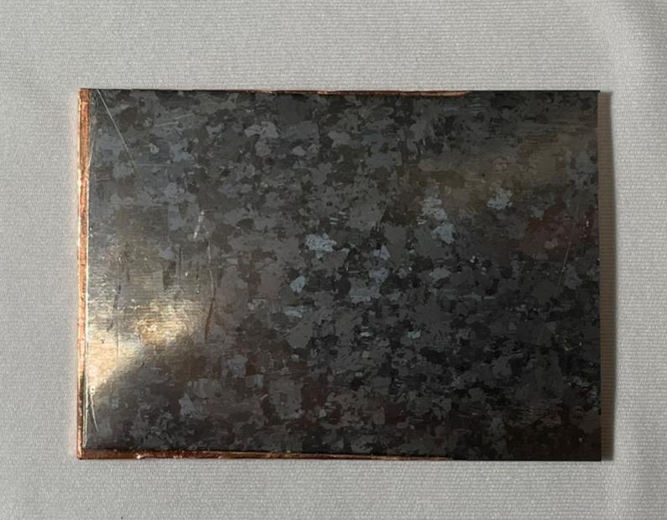
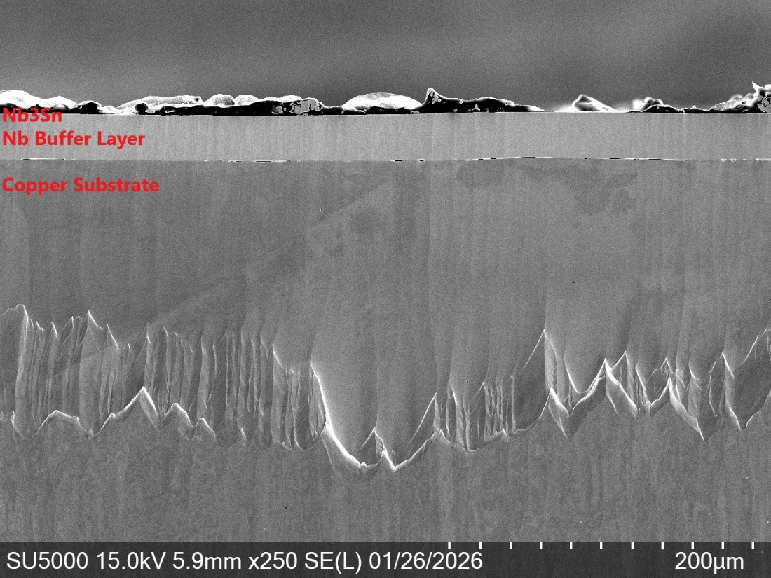
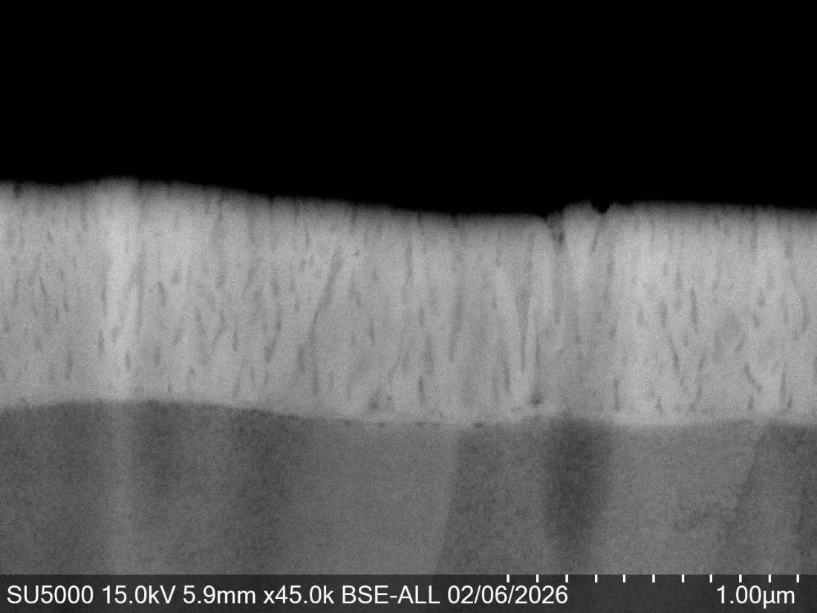
Task 3.2 Flux Trapping
Nb₃Sn Coating for large Cu slab for trapped flux measurements at HZB
Strong flux trapping, low Tc → poor dense film
Reasons?

Slide 3
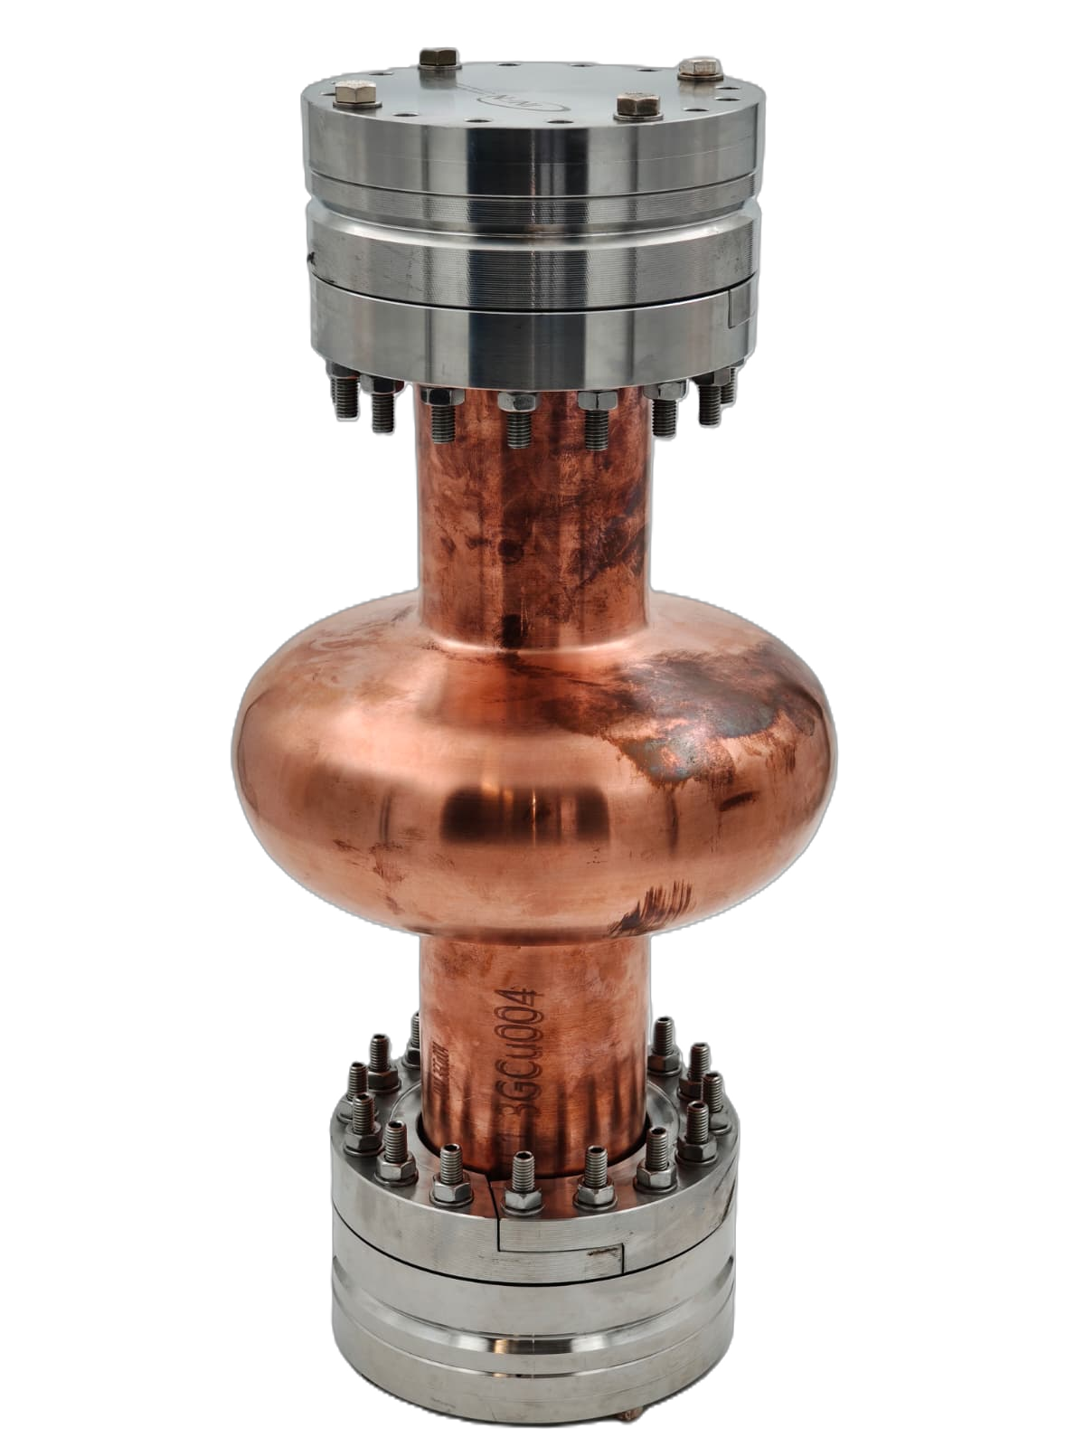
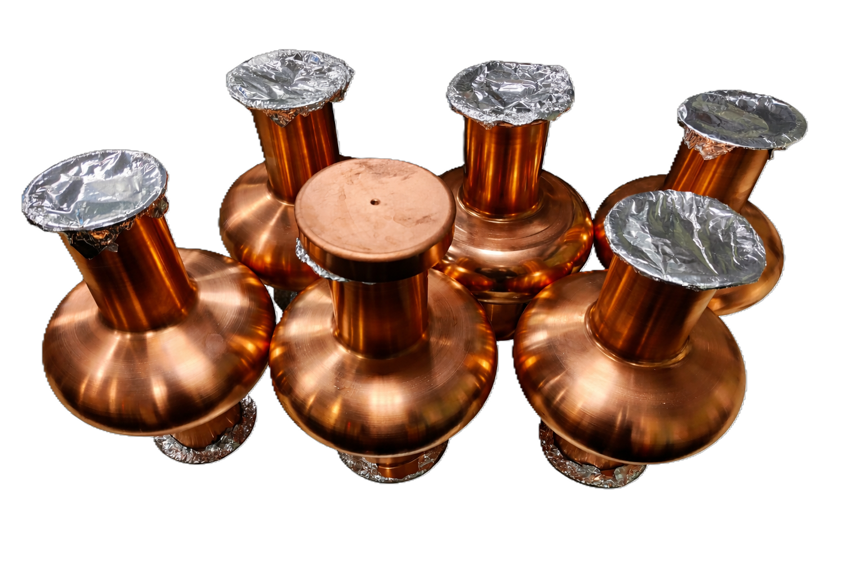
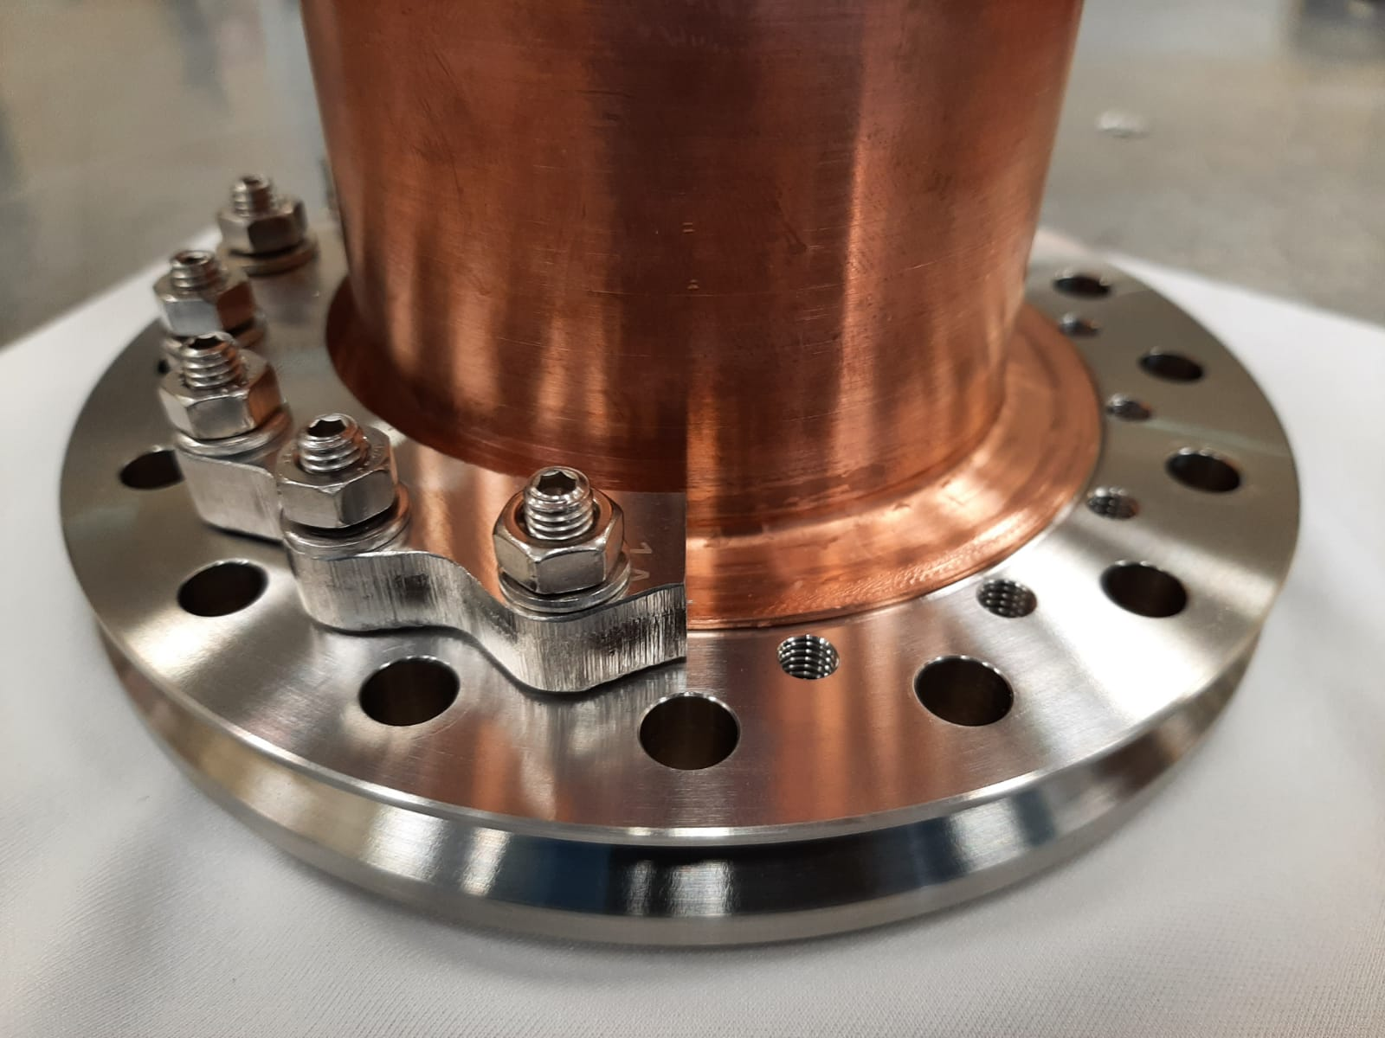
Task 3.3 RF Tunability
Developed a new fully seamless design for 1.3 GHz elliptical cavities
Cavity sent to HZB for testing the new Tuning System (Milestone 3.1)
Leak of 10-10 mbar*L/s on one of the two flanges. → Heat treatment necessary to release cold working
Further analysis required
→Master Student thesis project will start on April

Slide 4
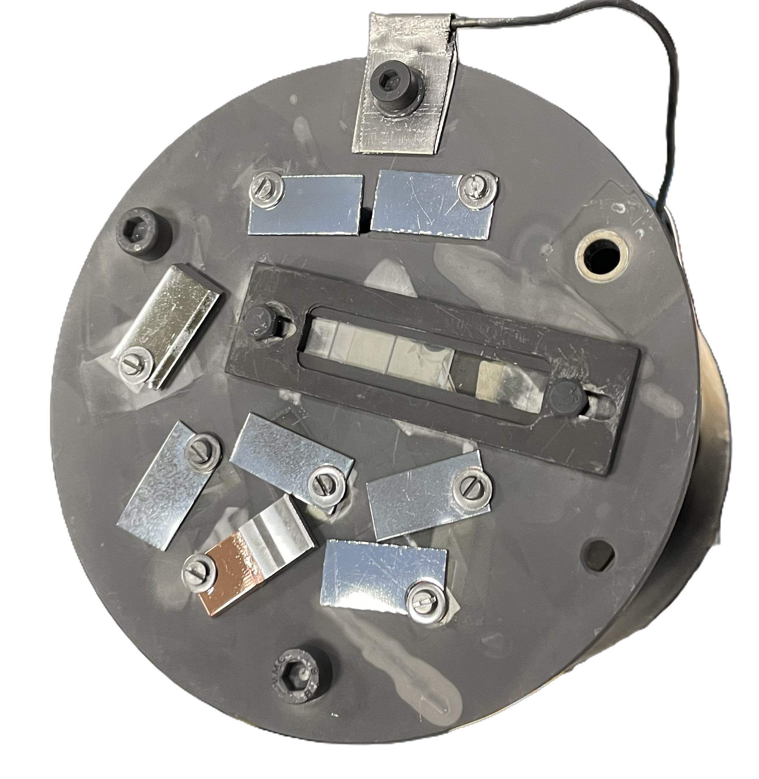
Task 3.4 Adaptive Layer
Test CEA Adaptive Layer between Nb buffer layer and Cu substrate
Nb₃Sn (1 μm)
Nb (30 μm)
ALD
Cu
Buffer Layer | T_{c} | ΔT_{c}
No buffer layer | 13.8 K | 0.3 K
16 μm Nb | 16.5 K | 0.6 K
30 μm Nb | 16.7 K | 0.5 K
30 μm Nb + 18 nm Al₂O₃ | 16.3 K | 0.5 K
30 μm Nb + 25 nm AlZrO_{x} | 16.9 K | 0.2 K
30 μm Nb + 5 nm Al₂O₃ + 22 nm ZrO₂ | 16.8 K | 0.2 K
Slightly enhancement of Tc
Further analysis required
→Master Student thesis project will start on April

Slide 5
Tasks 3.5 Working Cavity
Objectives
Improve I.FAST 1.3-GHz superconducting coating recipe based on Tasks 3.2-3.4 results.
Prepare 1.3-GHz thin film cavities with an optimized coating recipe.
Perform full cavity characterization @4.2 K (Q vs E, Q vs F, and flux trapping in the VTS@SupraLab vertical test stand).
Deliverable 3.4 4.5-K Cavity Report on 4.5-K Cavity performance & tunability tests - INFN - Report M46
Milestone 3.4 Characterization of Nb₃Sn reference cavity - Test report M34

Slide 6
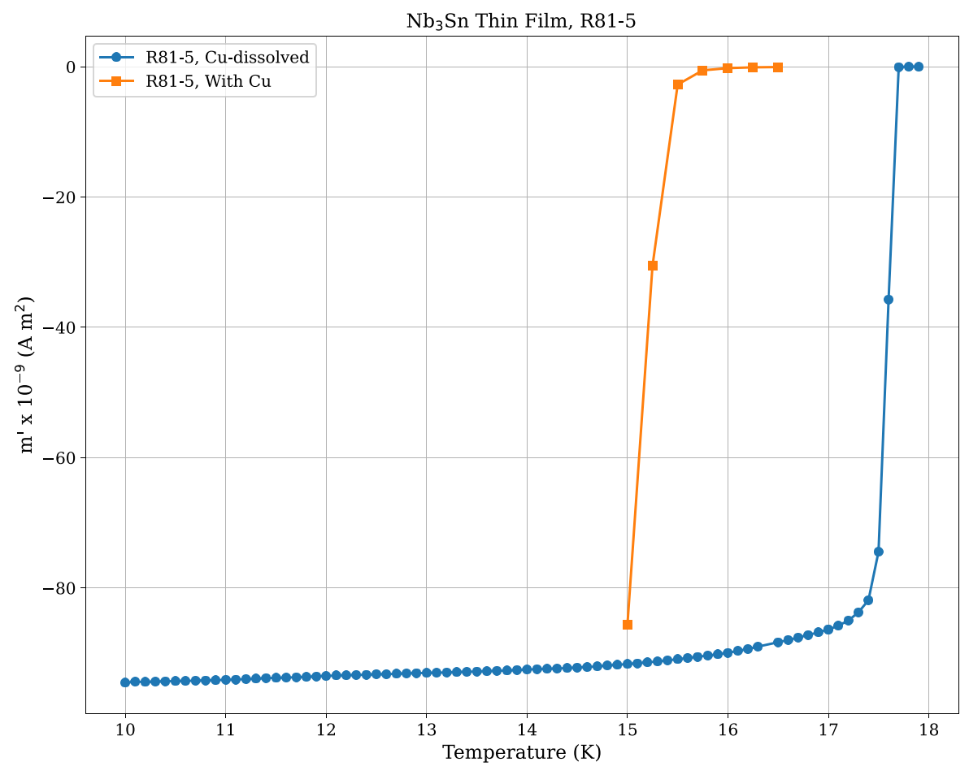
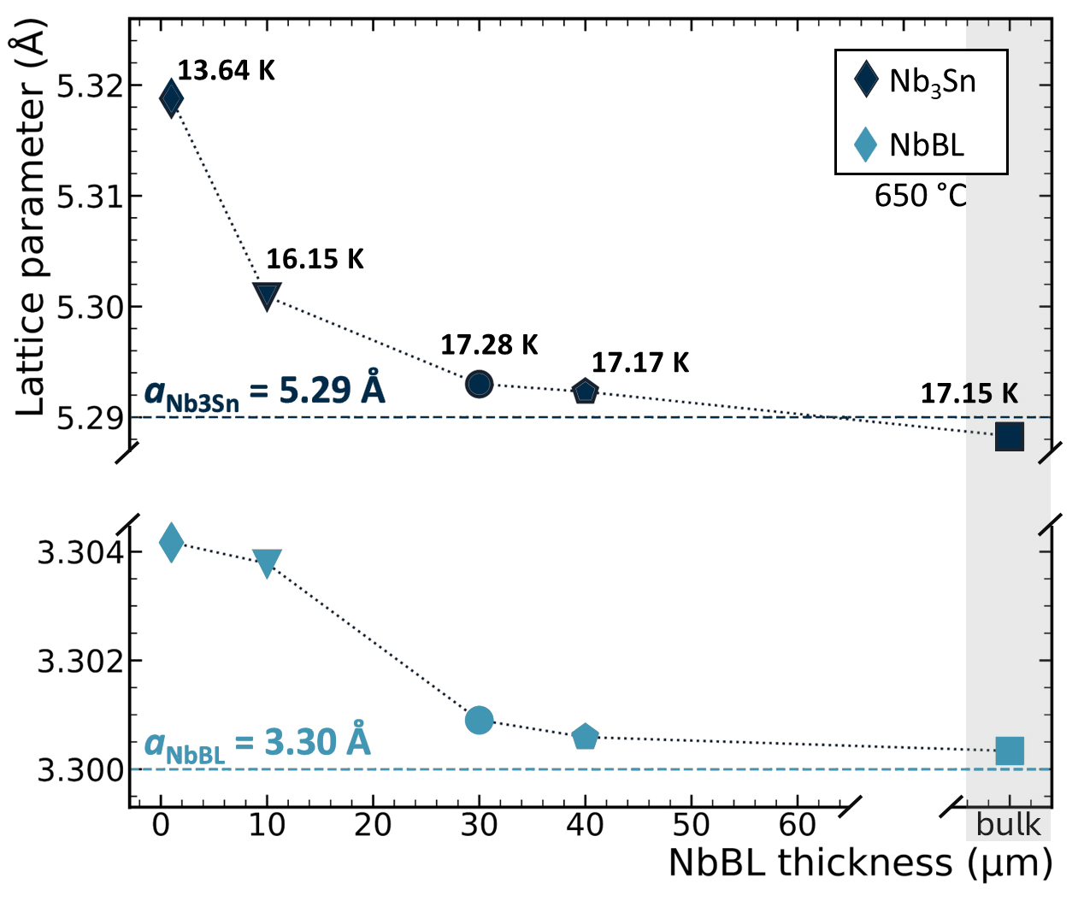

Optimized coating parameters
Barrier Layer against Sn and Cu diffusion
Accomodation layer (release thermal stress)
1. Low cathode Power ≤ 250 mW/cm² +
2. High deposition Pressure: 2 x 10⁻² mbar +
3. Deposition Temperature: 600 ºC – 650 ºC +
4. No post Annealing +
5. Nb buffer layer ≥ 30 µm
G. Rosaz, FCC week 2025
Cu dissolved
Nb₃Sn on Cu
Substrate’s Thermal Expansion coefficient drives the residual stress → Tc
Tc > 17 K
D. Fonnesu et al., Recipe optimization and SRF test of Cu-compatible Nb3Sn films by DC magnetron sputtering from a stoichiometric target. Sci Rep 16, 3539 (2026)

Slide 7
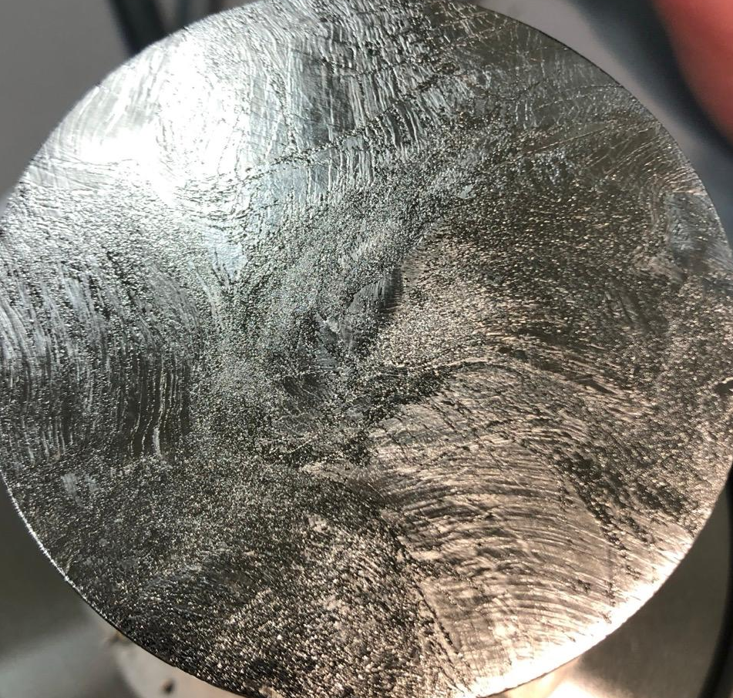
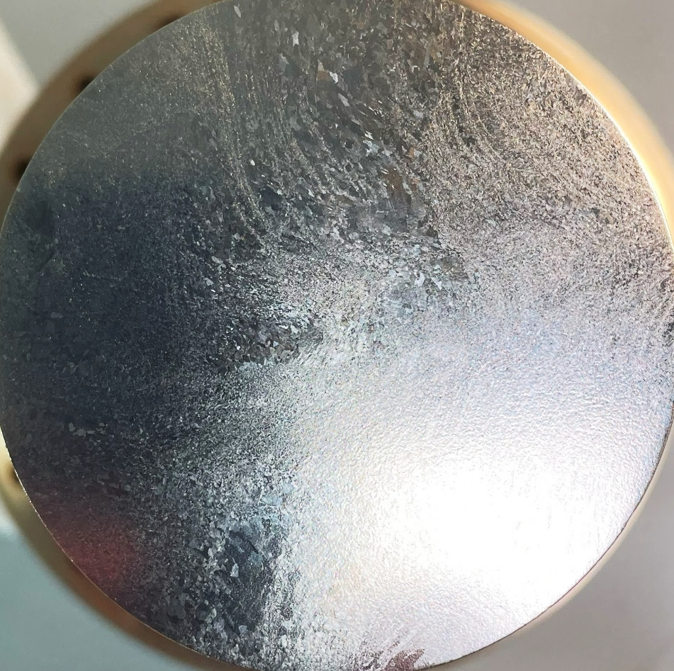
QPR sample comparison
Nb₃Sn/bulk Nb
Sample #1 (just seen)
Nb₃Sn/bulk Nb
Sample #2
Surface preparation:
Metallographic polishing + EP
Surface preparation:
BCP
Rz > 6µm

Slide 8
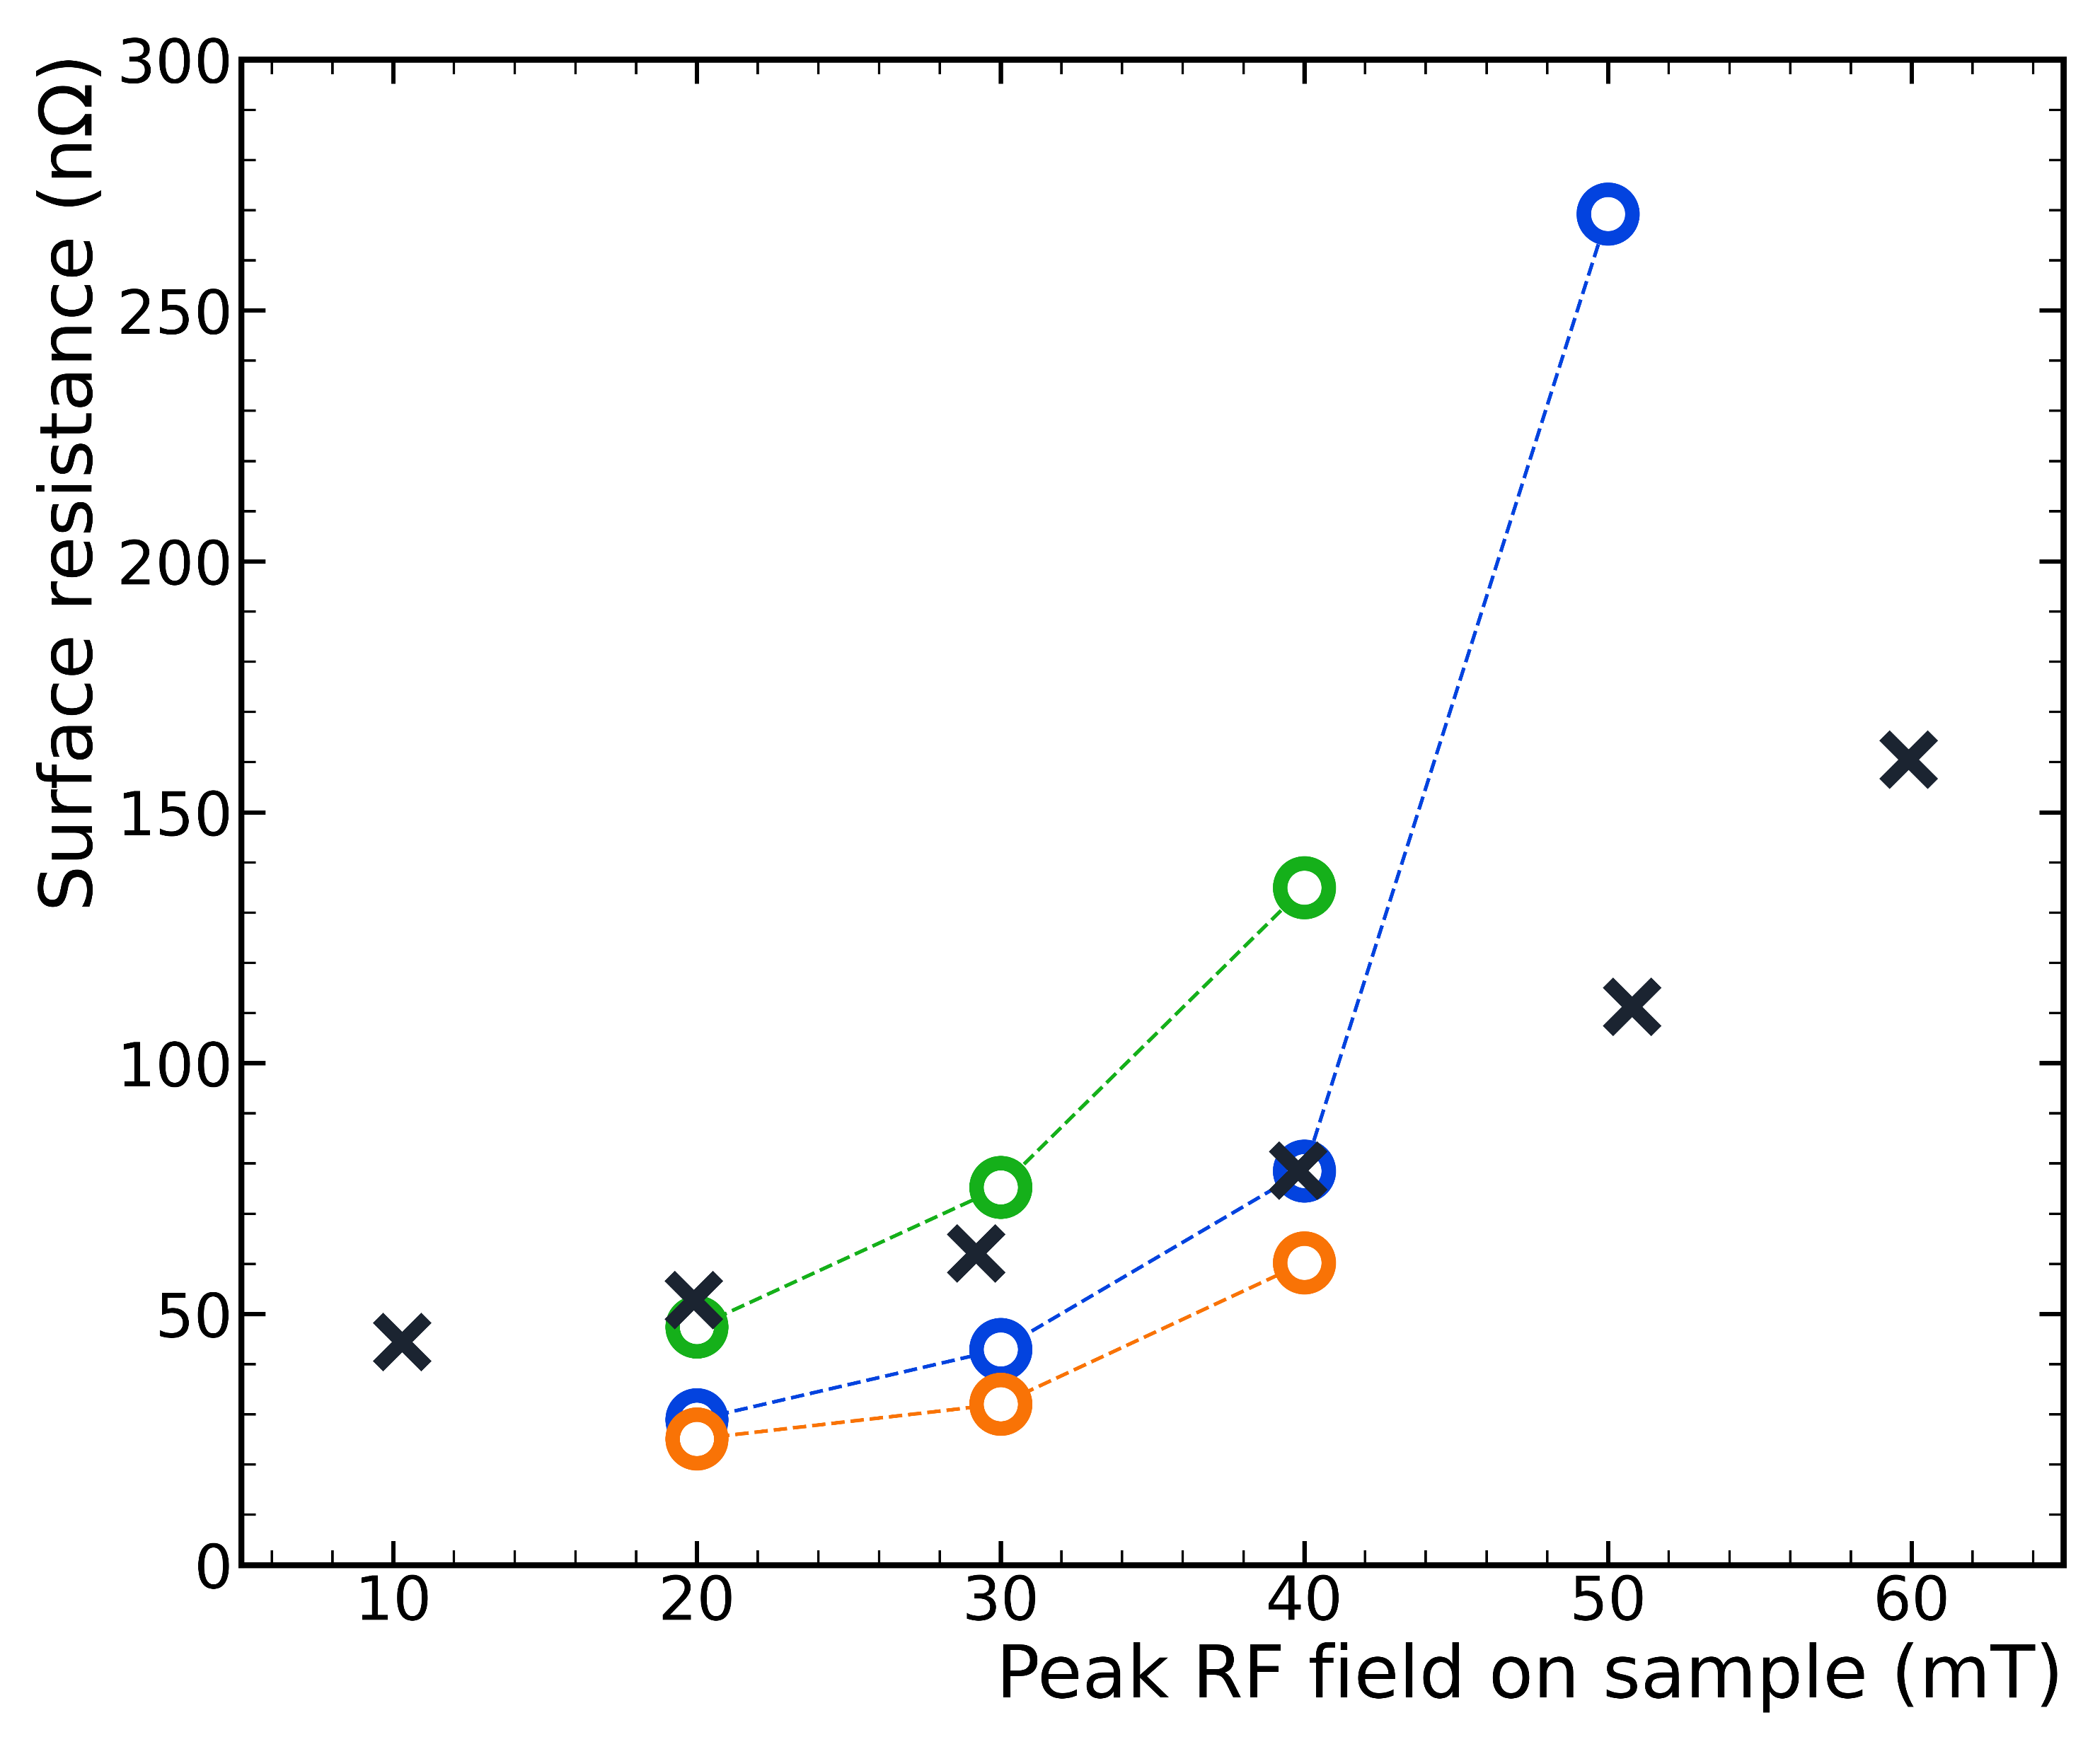
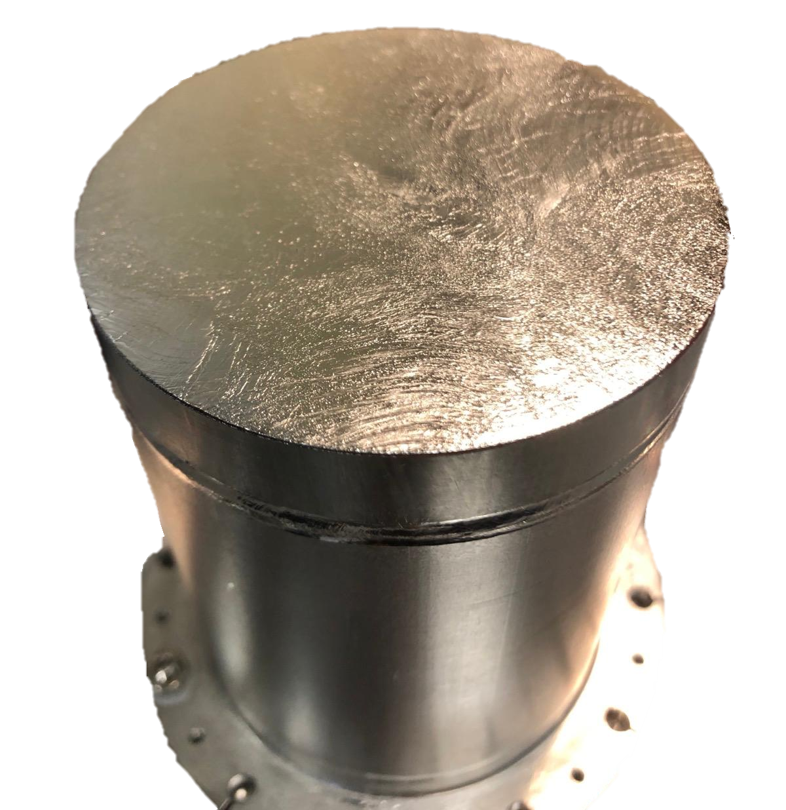

Surface resistance #1
Bulk Nb QPR sample coated with Nb₃Sn film
4 K, 400 MHz
T_{c} = 17.2 K
Quench > 70 mT extrapolated @ 0 K
R_{s} ~ 25 nΩ @ 4 K, 20 mT
Comparable to (slightly better) than VTD sample up to 40 mT
slow cooldown #1
fast cooldown #1
full thermal cycle #1
Cornell VTD sample Keckert, S. et al., Supercond. Sci. Technol. 32, 2019
→ Slow cool down data
suggest flux trapping
Steep rise > 40 mT likely due to thermal dissipation
10 cm
Courtesy of O. Kugeler, S. Keckert

Slide 9
Surface resistance #2
Bulk Nb QPR sample coated with Nb₃Sn film
4 K, 400 MHz
T_{c} = 17.45 K
Quench > 85 mT extrapolated @ 0 K
R_{s} < 9 nΩ @ 4 K, 20 mT
Better than VTD sample up to 50 mT
slow cooldown #1
fast cooldown #1
full thermal cycle #1
Cornell VTD sample Keckert, S. et al., Supercond. Sci. Technol. 32, 2019
full thermal cycle #2
PRELIMINARY
Low field R_{s} improved by more than a factor 2
High field rise mitigated
10 cm
Substrate matters!
Courtesy of O. Kugeler, S. Keckert

Slide 10
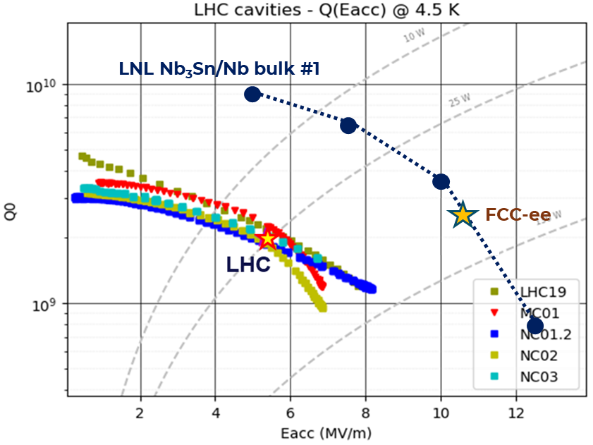
Surface resistance #2
Bulk Nb QPR sample coated with Nb₃Sn film
T_{c} = 17.45 K
Quench > 85 mT extrapolated @ 0 K
R_{s} < 9 nΩ @ 4 K, 20 mT
Better than VTD sample up to 50 mT
Low field R_{s} improved by more than a factor 2
High field rise mitigated
10 cm
Substrate matters!

Slide 11
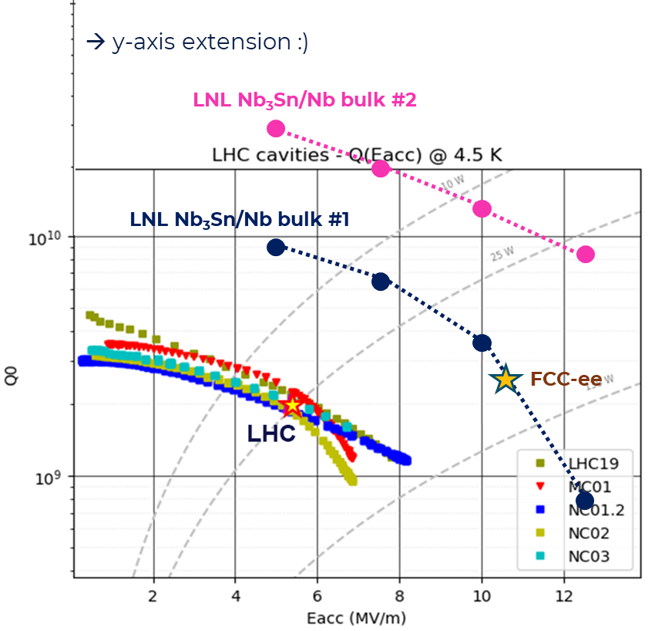
Surface resistance #2
Bulk Nb QPR sample coated with Nb₃Sn film
T_{c} = 17.45 K
Quench > 85 mT extrapolated @ 0 K
R_{s} < 9 nΩ @ 4 K, 20 mT
Better than VTD sample up to 50 mT
Low field R_{s} improved by more than a factor 2
High field rise mitigated
10 cm
Substrate matters!

Slide 12
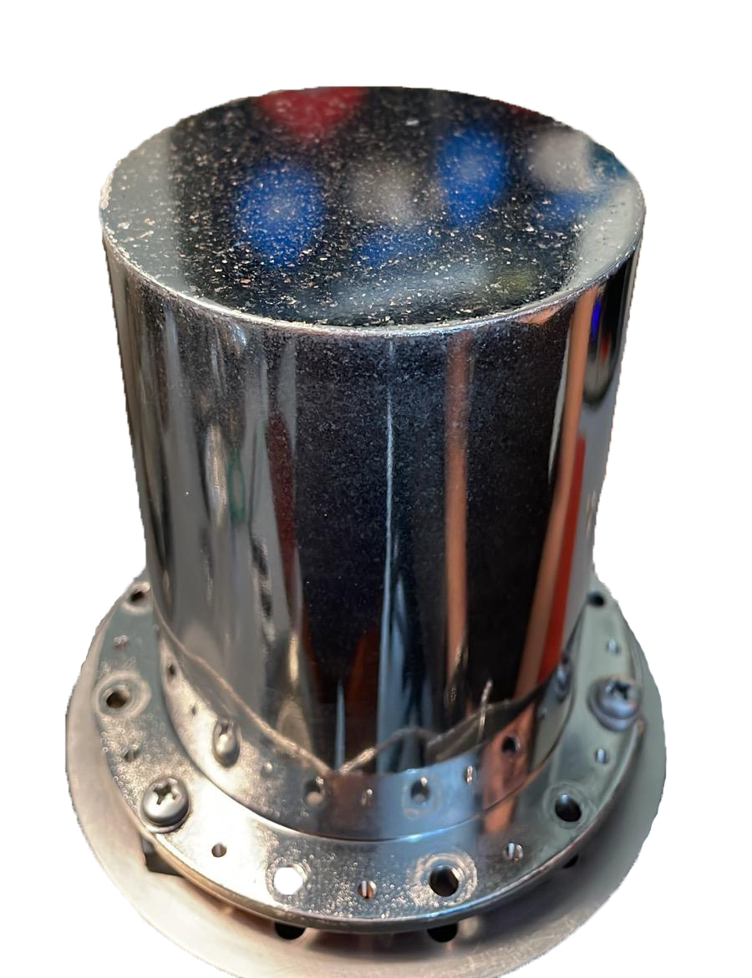
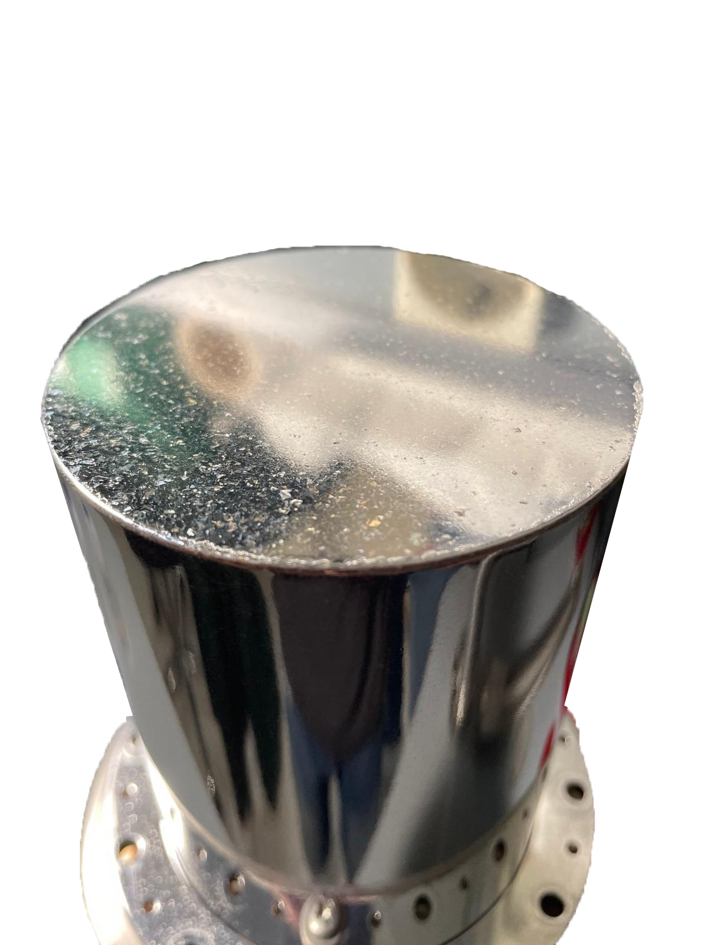
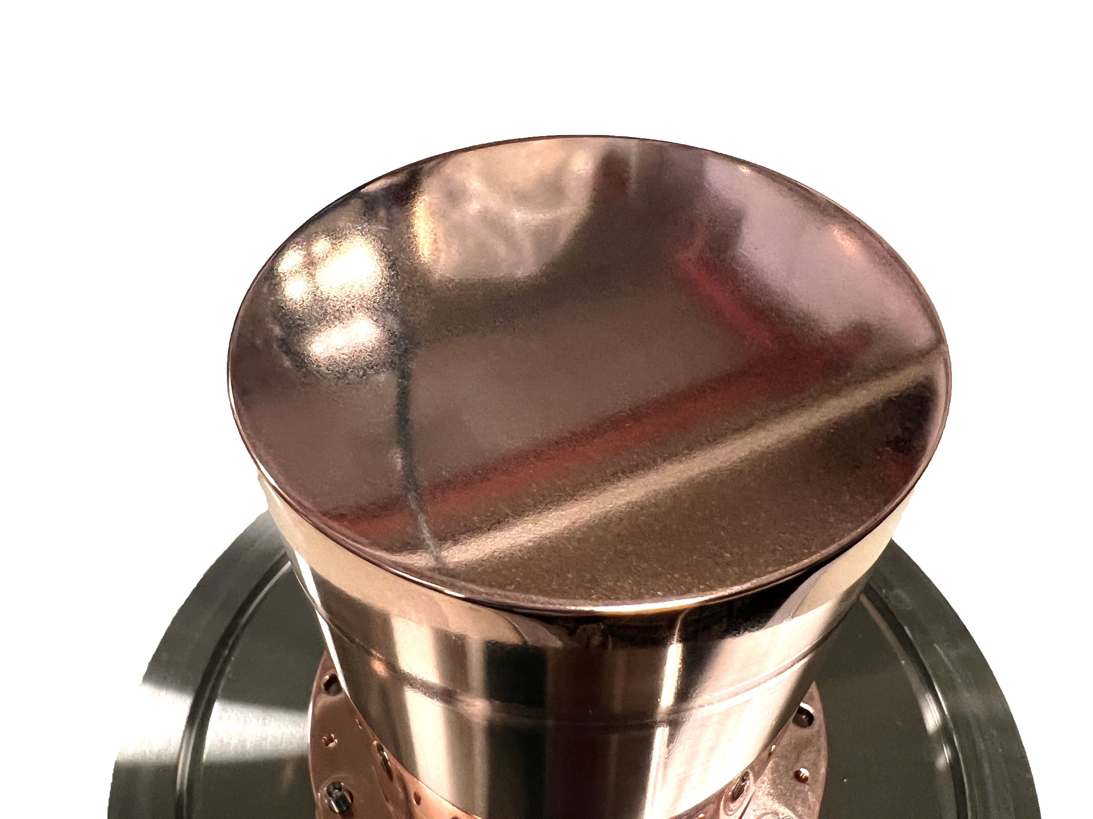
Surface resistance #3
Full Cu QPR sample / NbBL30/ Nb₃Sn film
Nb-BL30
Cu
Nb₃Sn

Slide 13
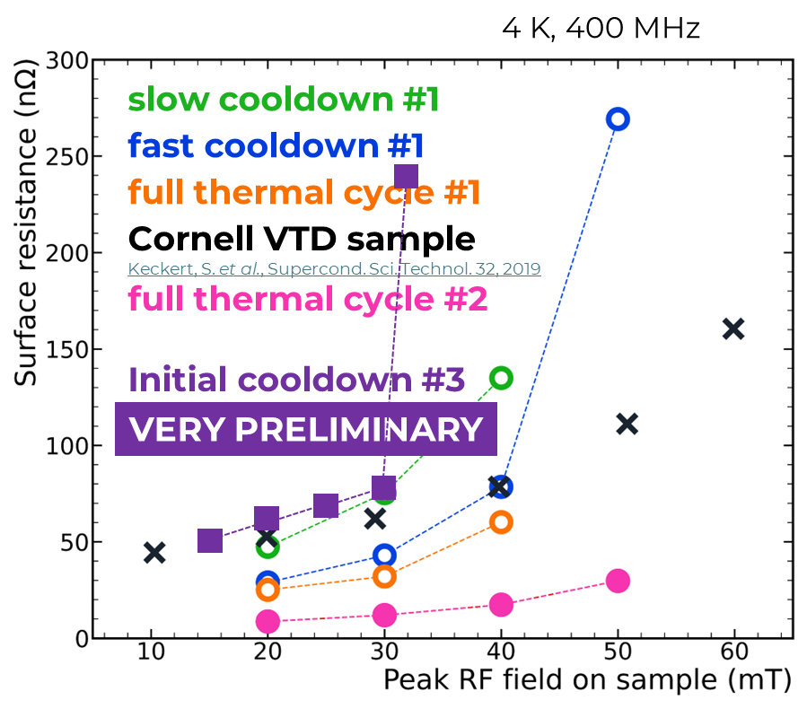
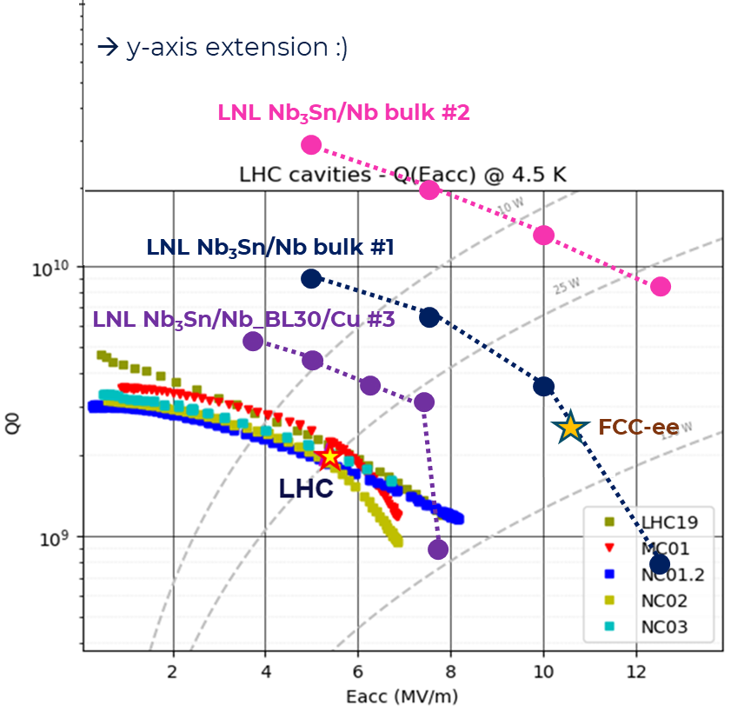
Surface resistance #3
Full Cu QPR sample / NbBL30/ Nb₃Sn film
VERY PRELIMINARY

Slide 14
Surface resistance #3
Full Cu QPR sample / NbBL30/ Nb₃Sn film
Nb-BL30
“Pinkles” on the surface
Cu
Nb₃Sn

Slide 15
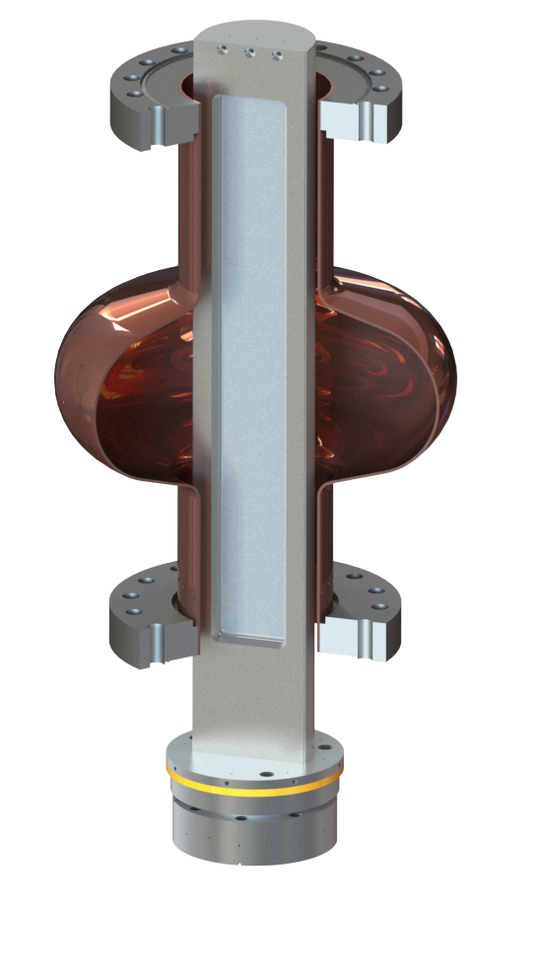
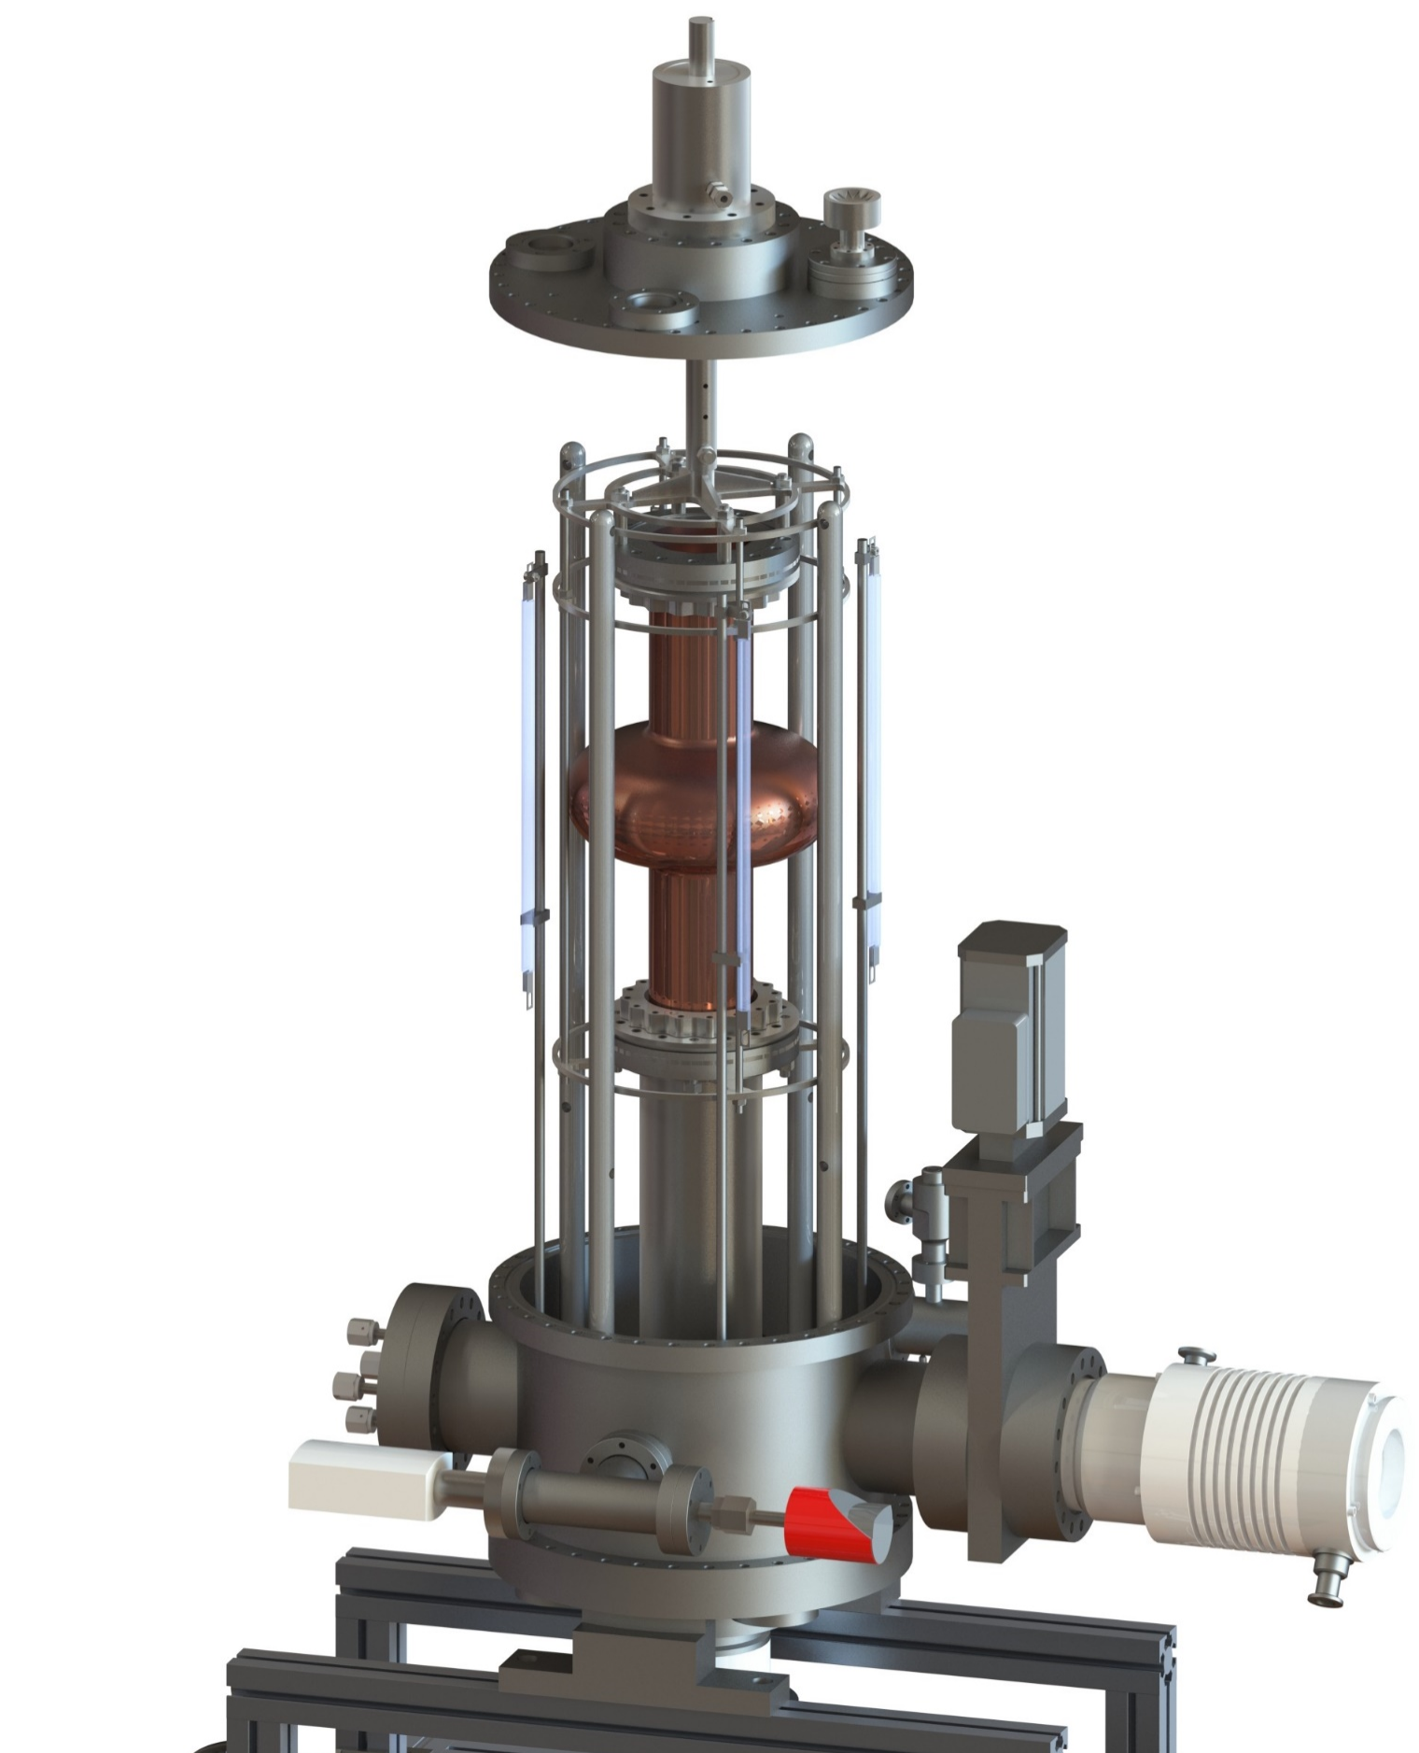
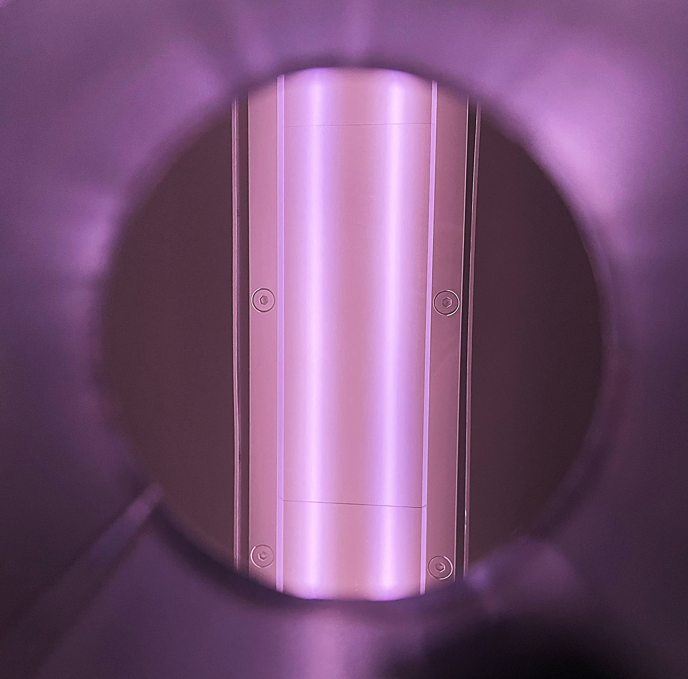
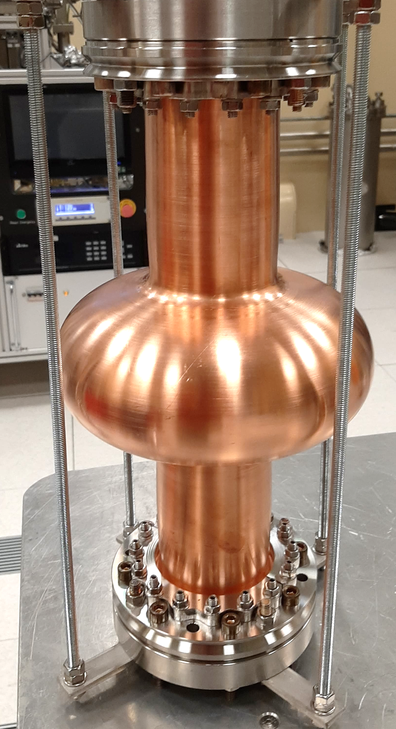
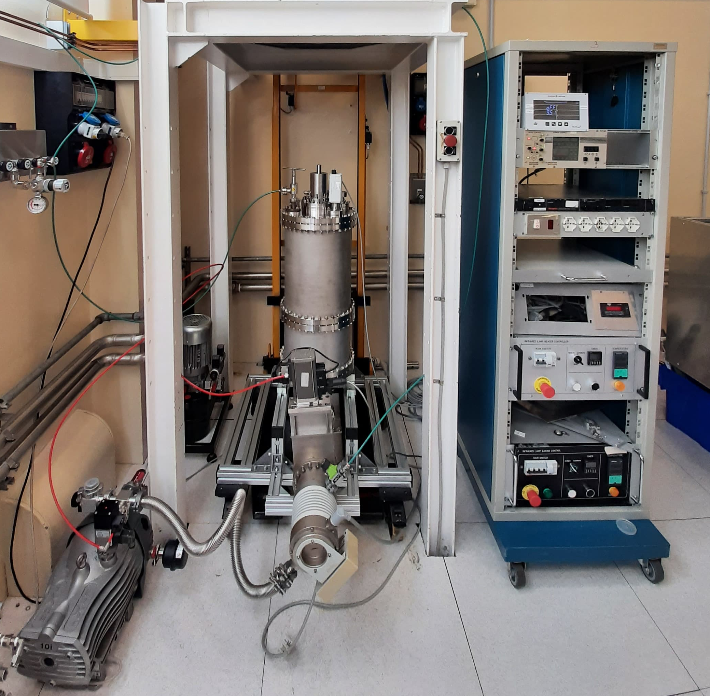

1.3 GHz coating system
Custom fixed rectangular planar magnetron with rotating cavity system
Current Status:
vacuum system assembled and tested
heating system completed and tested
magnetron test with first Nb target ignition completed
first Nb cavity coating planned for 2026
Coating on Cu cavity planned for 2027
1.3 GHz rotating cavity
fixed rectangular magnetron
ignited plasma

Slide 16
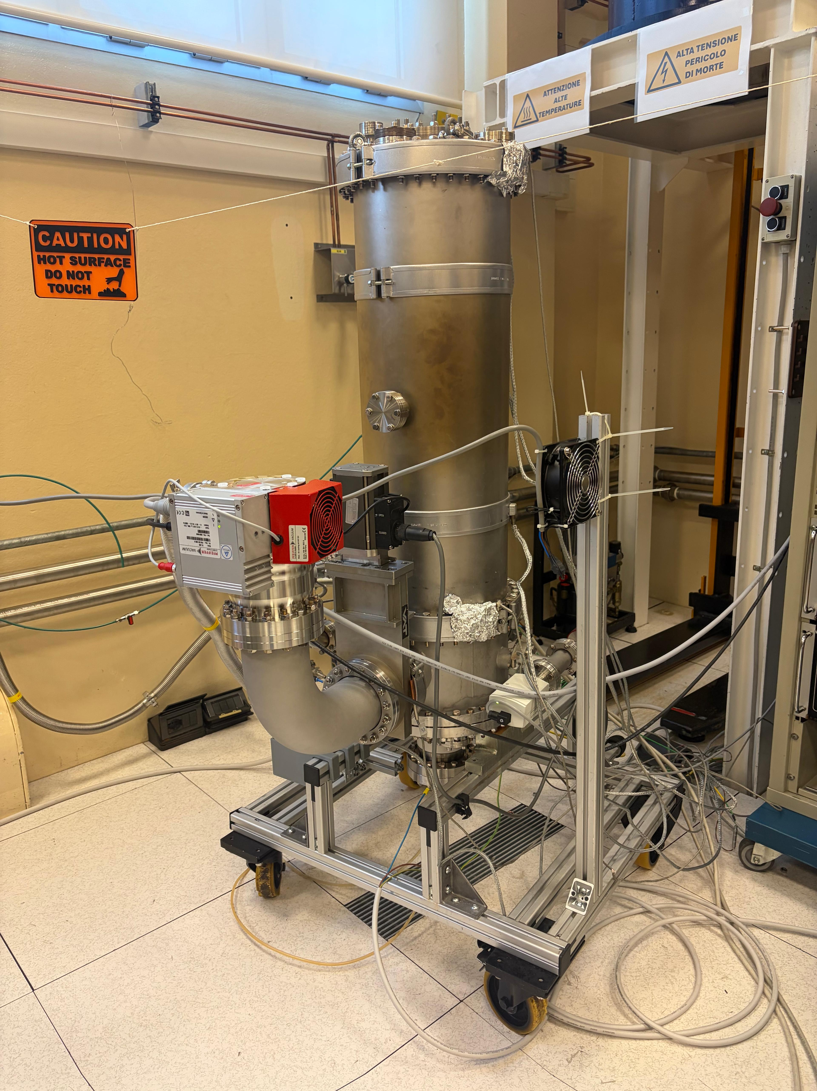
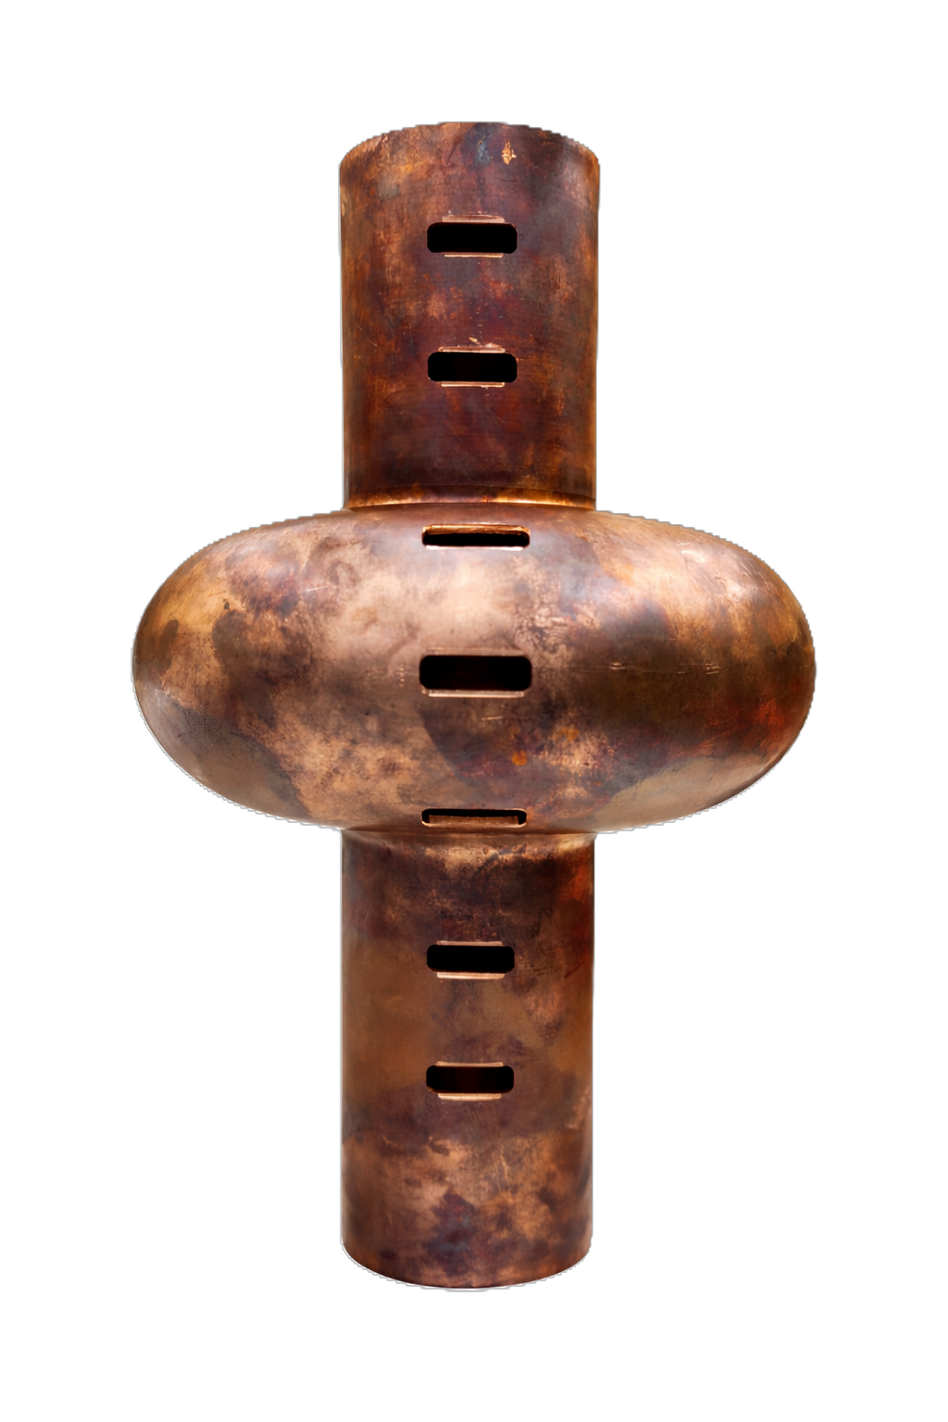
1.3 GHz coating system
Status and ongoing activity
Vacuum System
All metal system
New Turbo Pump
Ultimate Vacuum: 5*10⁻⁹ mbar, leak rate <10⁻¹² mbar*L/s
Mock up cavity designed and commisioned
7 window (3 samples each for a total of 21 samples for each run) to monitor morphology, deposition rate, Tc, composition

Slide 17
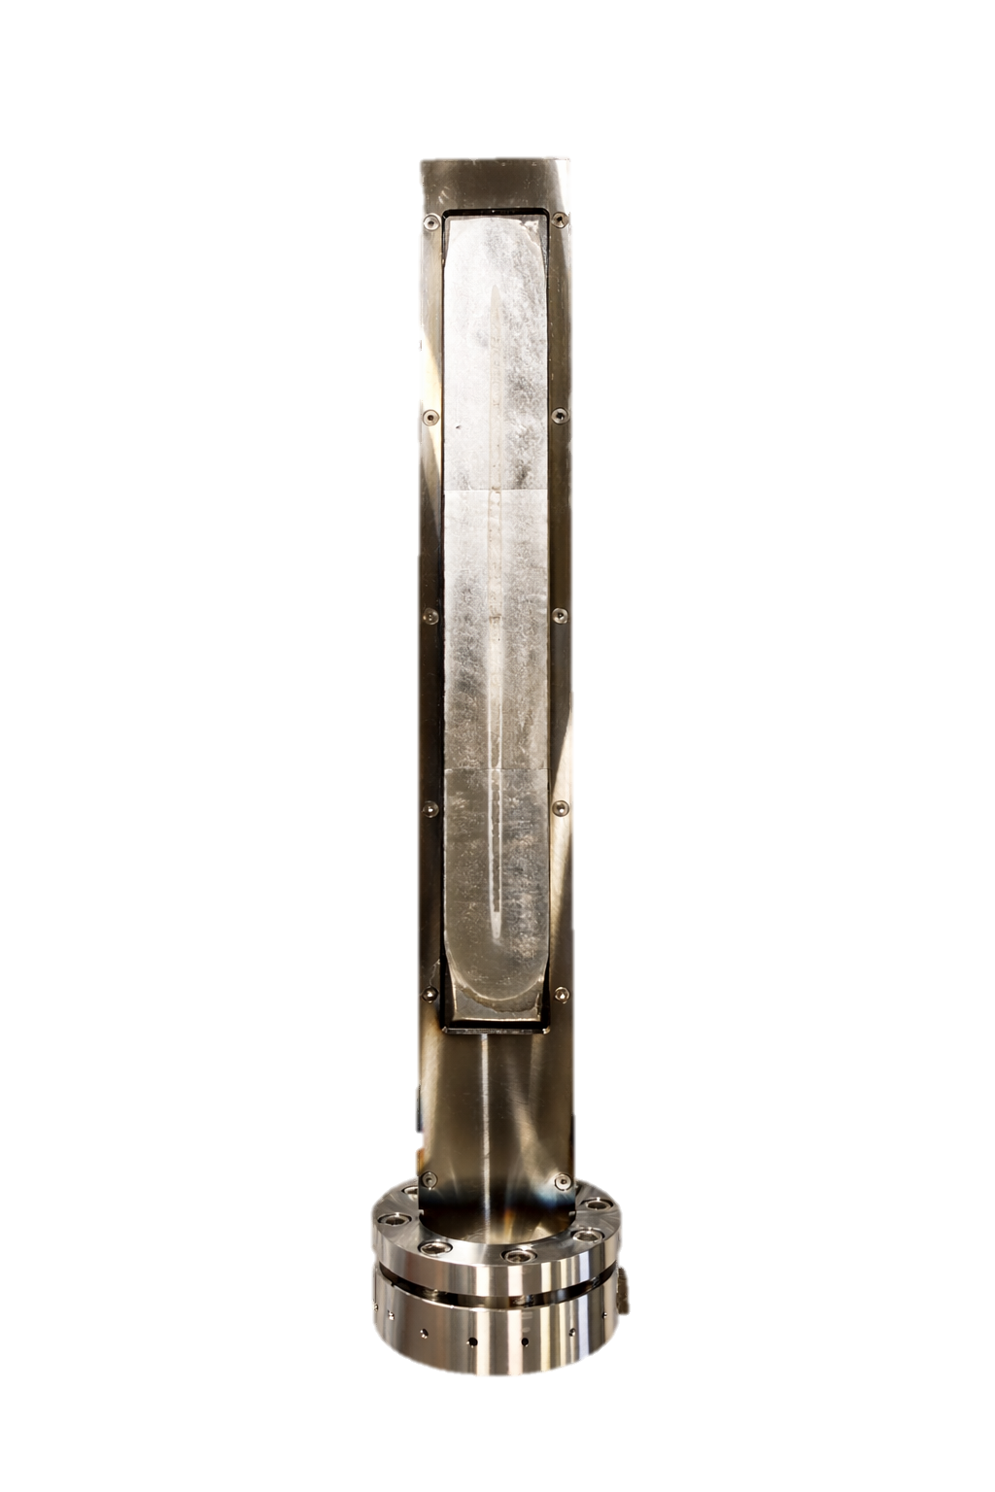
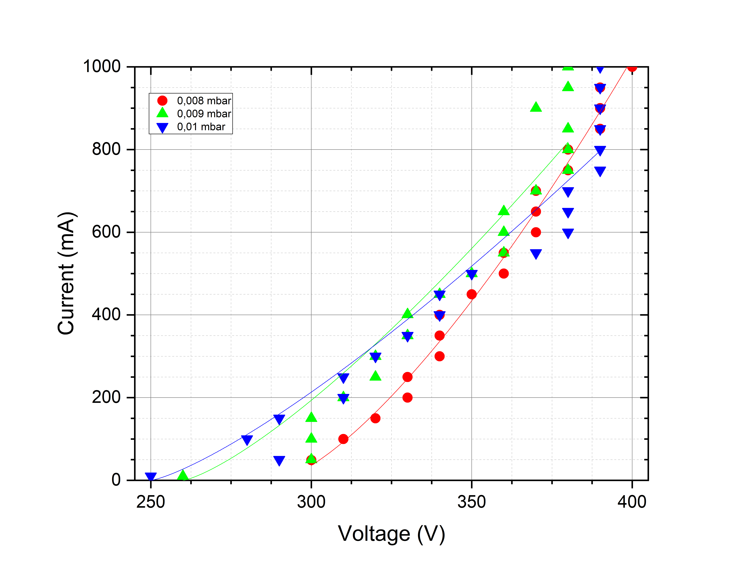
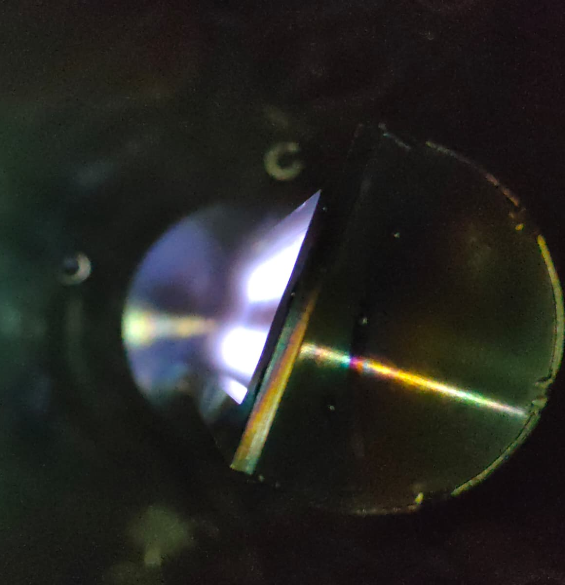
1.3 GHz coating system
Status and ongoing activity
Rectangular Magnetron
3 sets of magnets to be tested (0.68 T, 0.92 T, 1.02 T)
Tested 0,92T configuration up to 1 A → classical power law obtained;
The race track seems open at the bottom
Shortcut at T>200 °C due to expansion of ground screen (solved)
Deposition rate Cut-off = 10 x Deposition rate at Equator/Iris position

Slide 18
1.3 GHz coating system
Activity Plan:
Optimize magnetron magnetic configuration (~ 2 weeks)
Optimize coating parameters in static position (~ 1 month)
Optimize coating parameters with rotating cavity (~ 2 months)
Coat the first Nb cavity (second half of 2026)

Slide 19
Thank You!

