Slide 1



Ashutosh Singh
Journée Nouveaux Entrants, IJCLab
13/05/2026

Slide 2
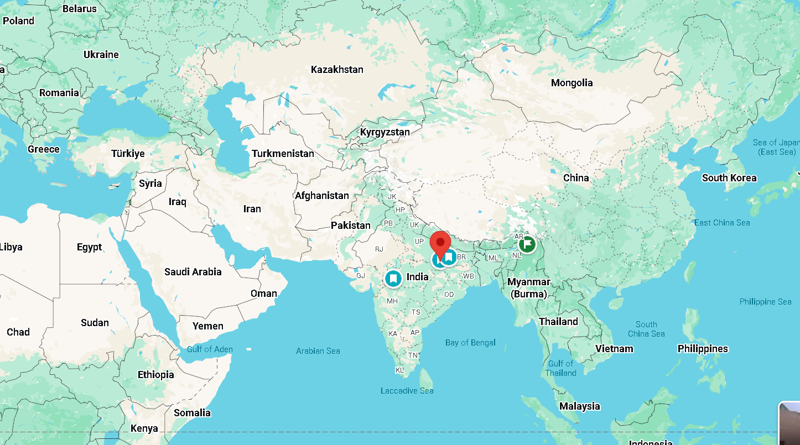
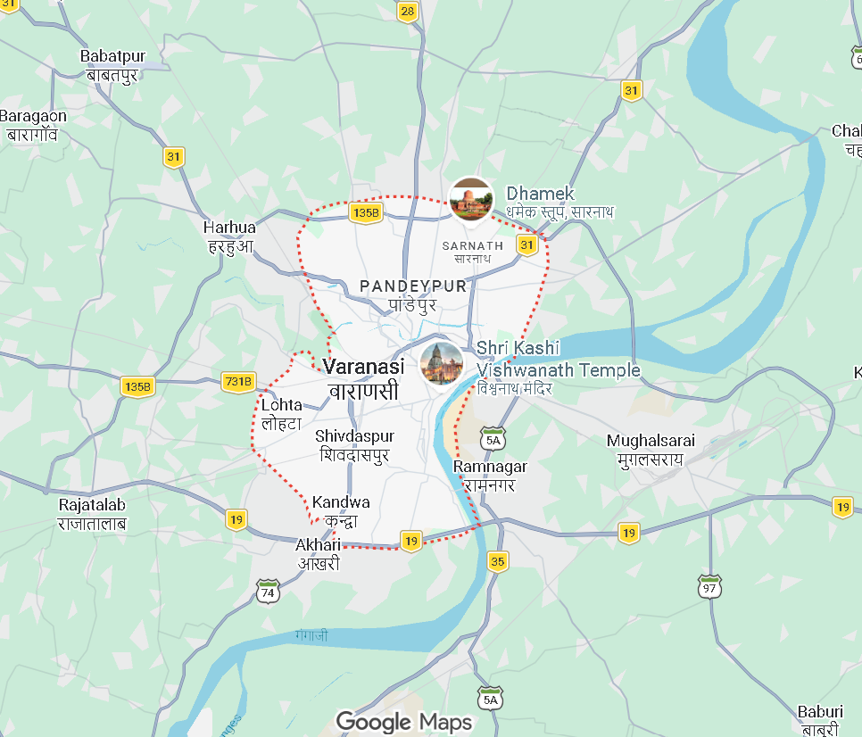
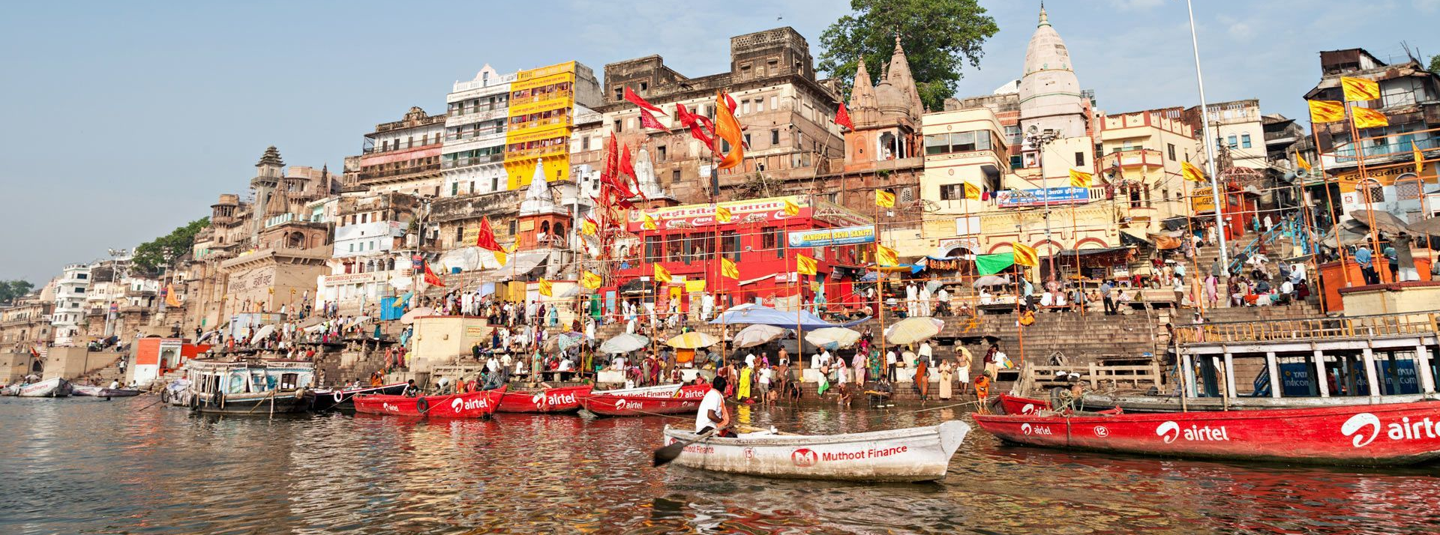
I come from Varanasi, Uttar Pradesh, India

Slide 3
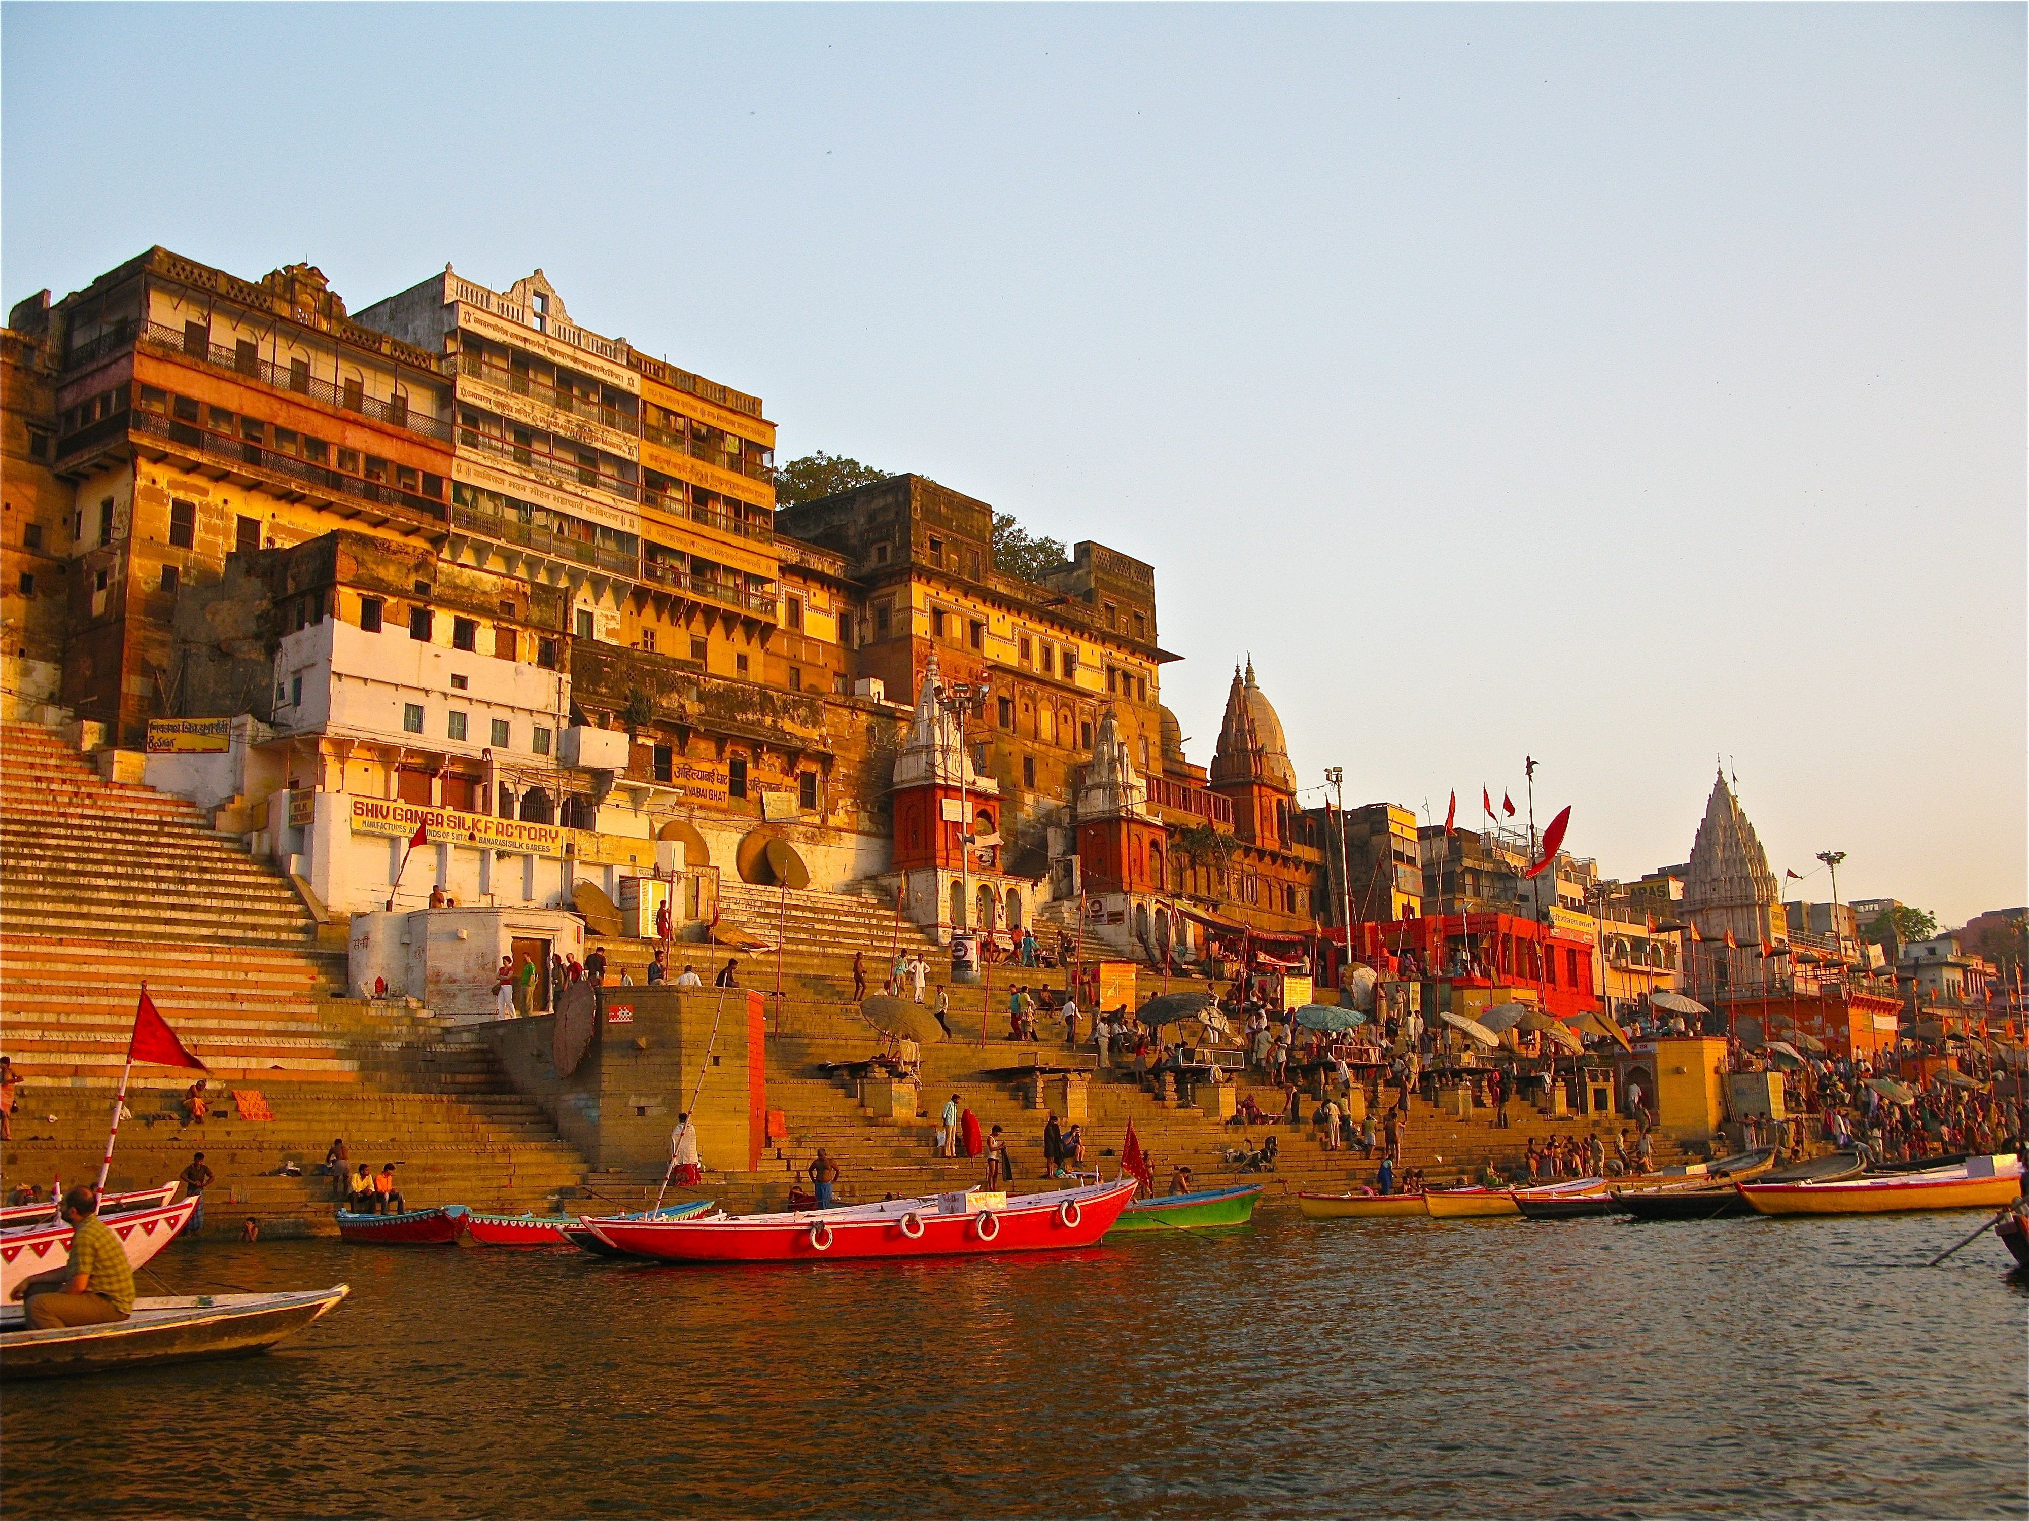
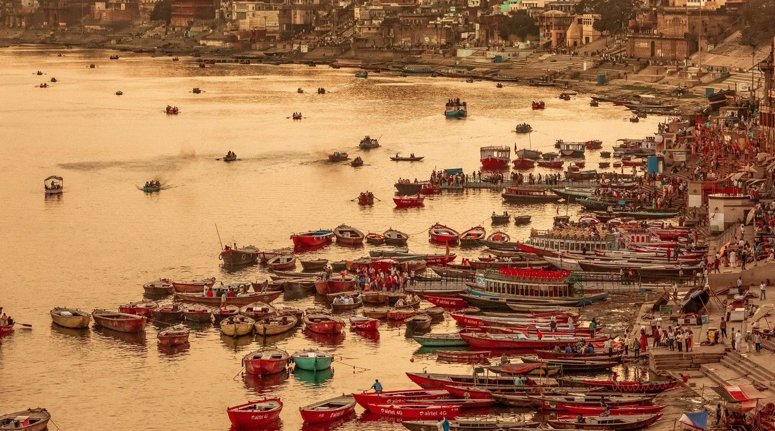
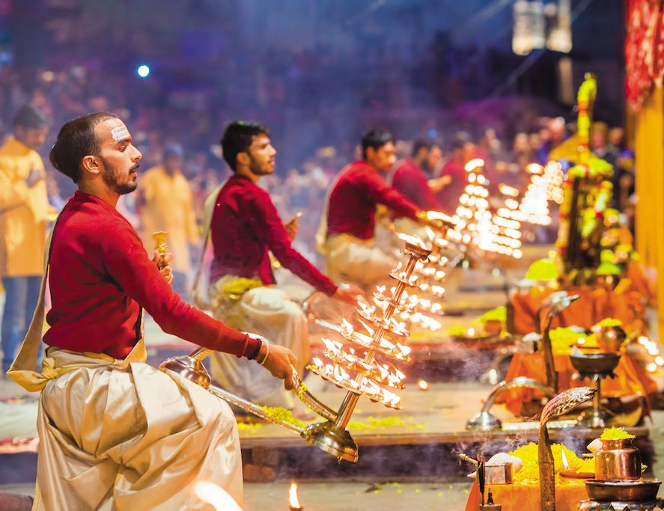

Slide 4
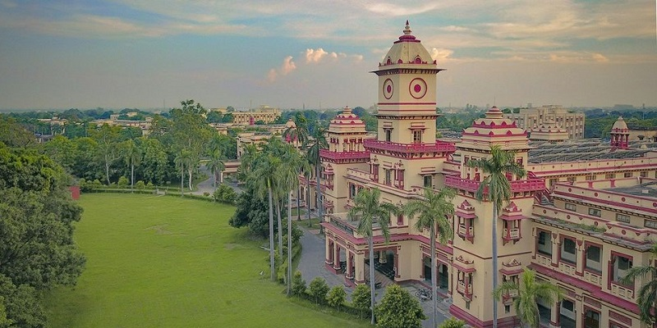
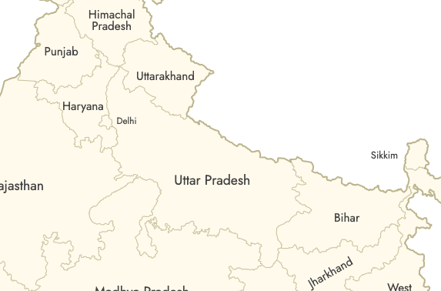

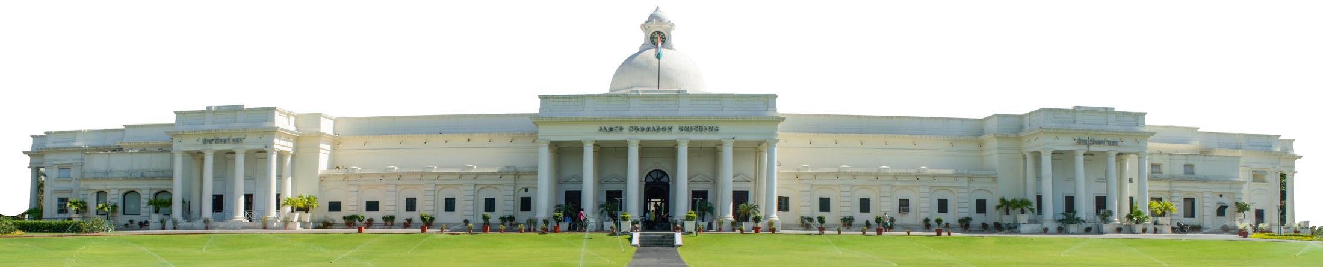
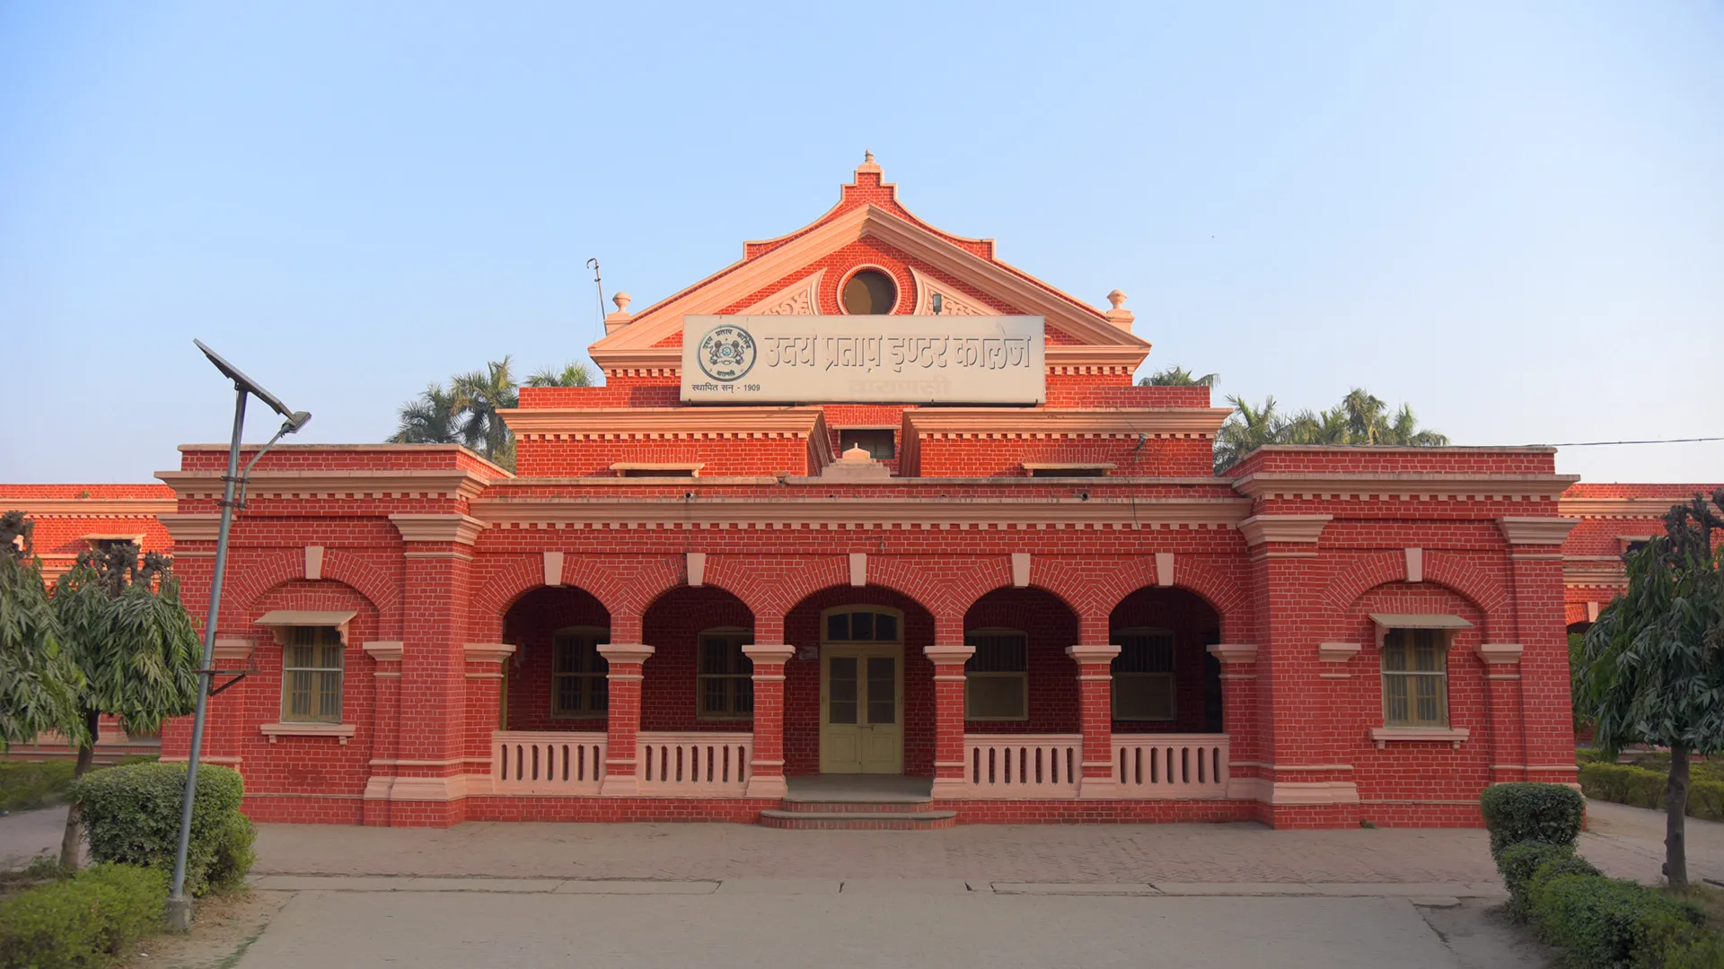

IIT Roorke

Slide 5
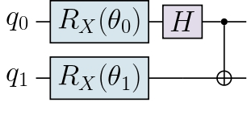

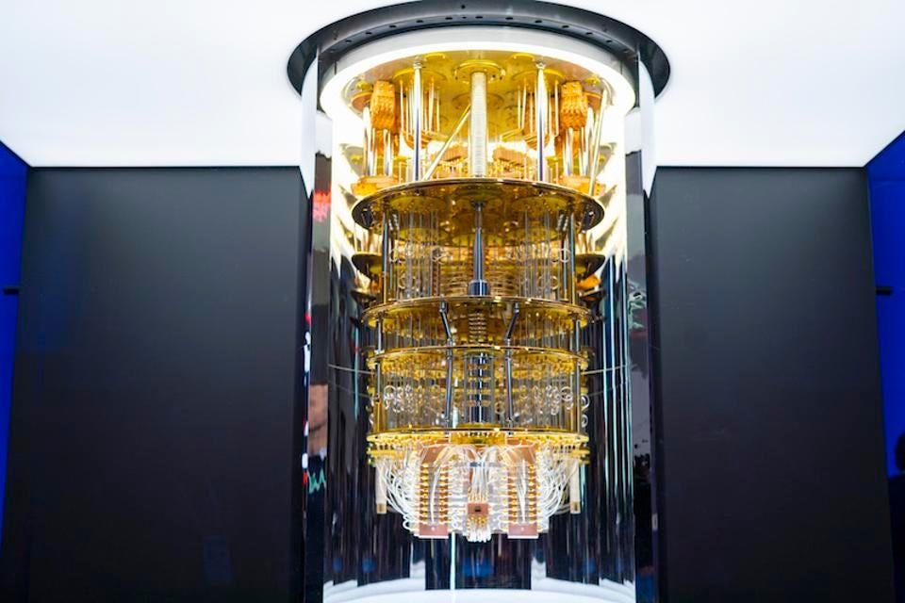
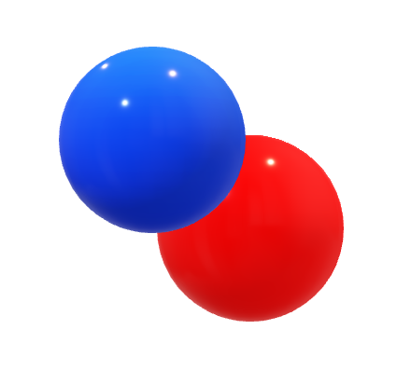
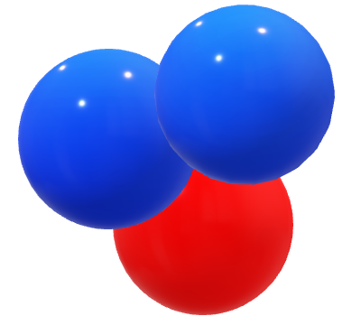
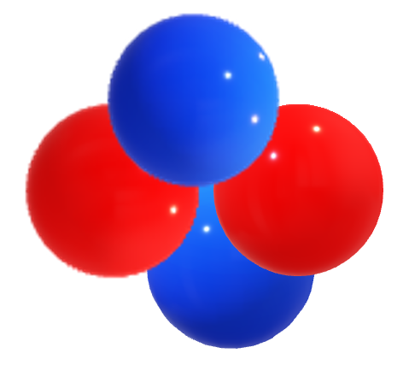
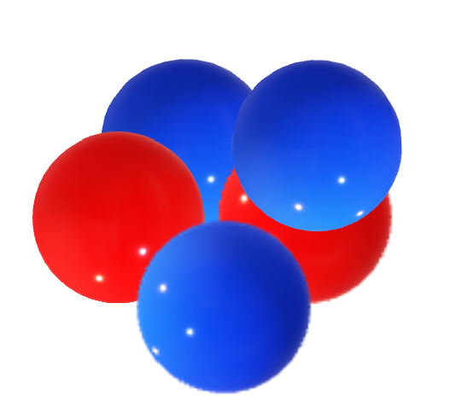
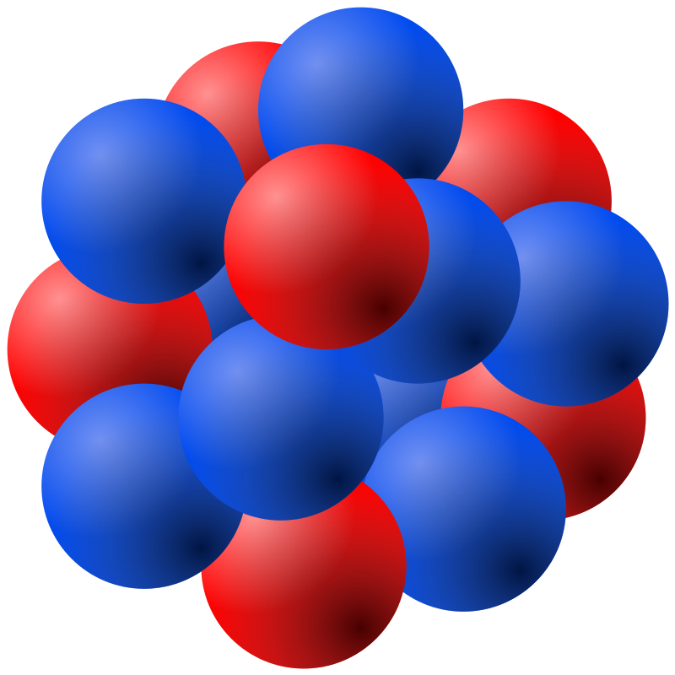
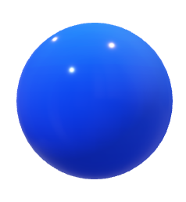
PhD thesis: Quantum Entanglement and Quantum Simulation Involving Atomic Nuclei
Classical Computer
Beyond humanly feasible limit
Quantum Computing Speedup
Computational
time
Quantum Computer
Humanly feasible time
System size

Slide 6
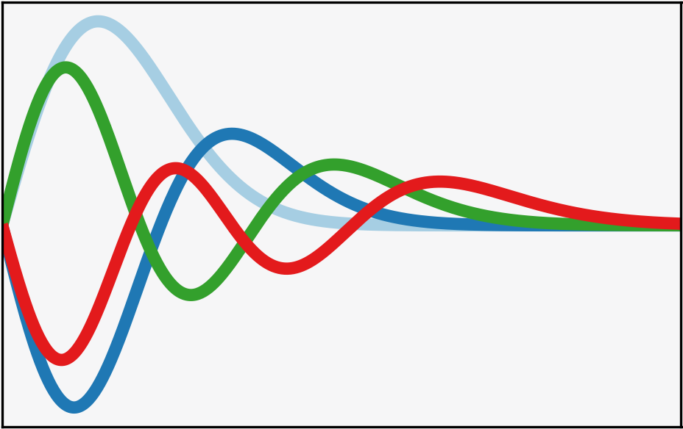

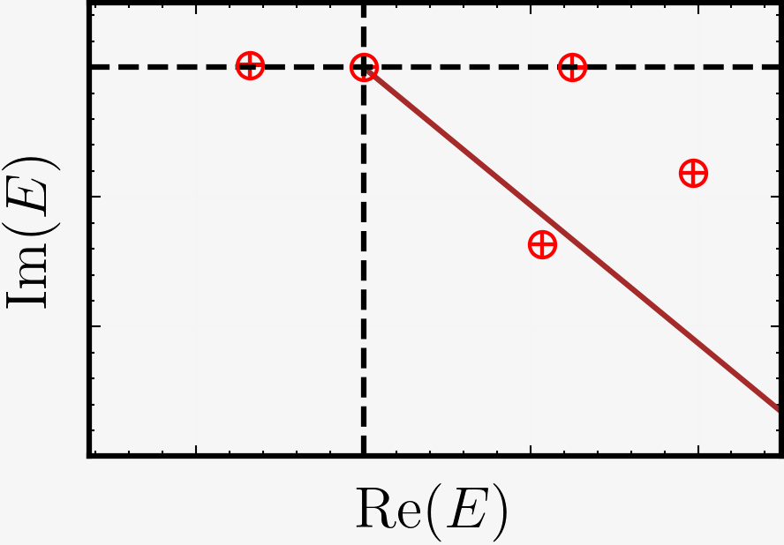

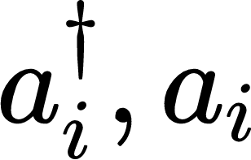
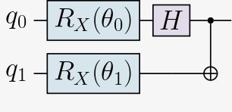
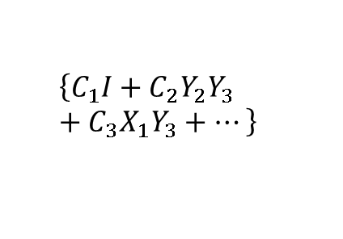
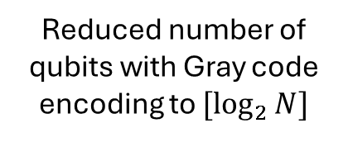
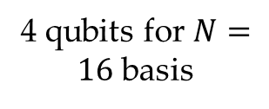
Quantum simulations of nuclear resonances with variational methods
4 qubits for $N=16$ basis
$$\left\{C_{1}I+C_{2}Y_{2}Y_{3}+{C_{3}X}_{1}Y_{3}+⋯\right\}$$
Reduced number of qubits with Gray code encoding to $[\log_{2}{N}]$
Suspected Resonances
Classical Simulation
Efficient Mapping
Quantum Simulation
Figure : Schematic workflow for simulating many-body nuclear systems and extracting resonance states using quantum computing.

Slide 7
This is my first postdoc in the nuclear theory group at IJCLab
My research at IJCLab focuses on Scalable Quantum Computation of Nuclear system.
The development of quantum simulation using variational techniques, such as the Variational Quantum Eigensolver and its adaptive variant, to obtain the energies of many-body systems.
Possibility of exploring non-variational techniques, such as imaginary-time approaches.
The development of quantum simulations on a lattice. One direction that will be pursued is the possibility of applying Effective Field Theory techniques with application to atomic nuclei using modern interactions.

Slide 8
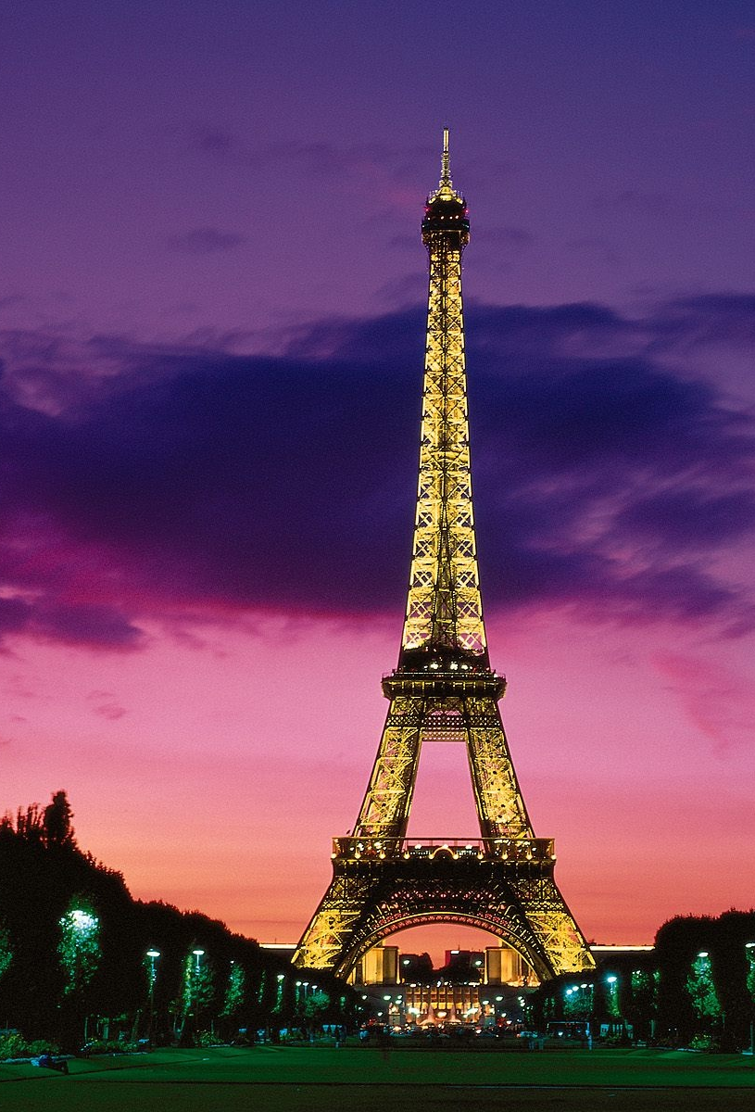
Thank You!

