Slide 1


WP5: Integration into a new LINAC Cryomodule In-person meeting, Jan 28, 2026 WP Leader: Nuno Elias (ESS) WP Deputy: Vittorio Parma (CERN)
All information contained in this presentation and any accompanying documents is for iSAS project only, and must be treated as strictly confidential.
Any dissemination, distribution or other use of this information without the consent of its owner is prohibited.
Funded by the European Union. Views and opinions expressed are however those of the authors only and do not necessarily reflect those of the European Union or the European Commission. Neither the European Union nor the granting authority can be held responsible for them.

Slide 2
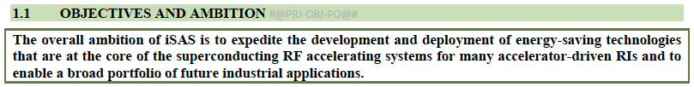
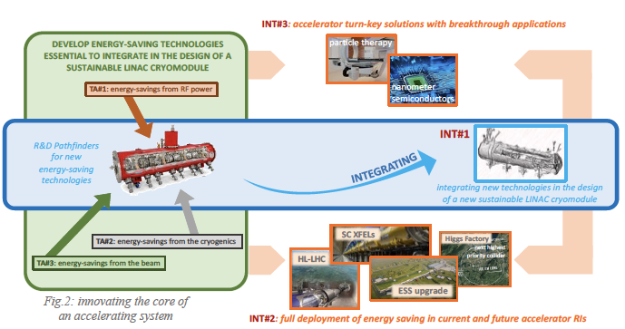
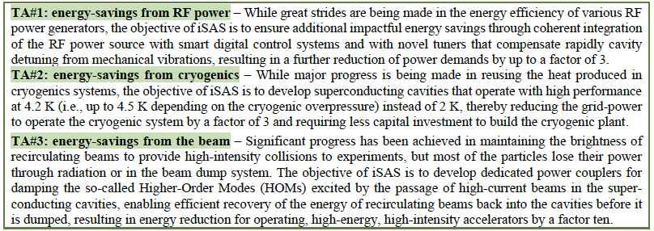
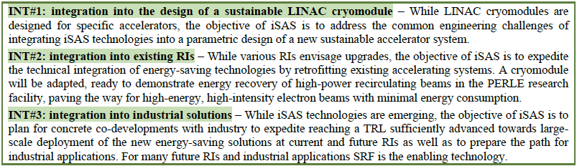
iSAS Project
iSAS proposal: Mar-2023
iSAS accepted: Jul-2023
iSAS start: Mar-2024

Slide 3
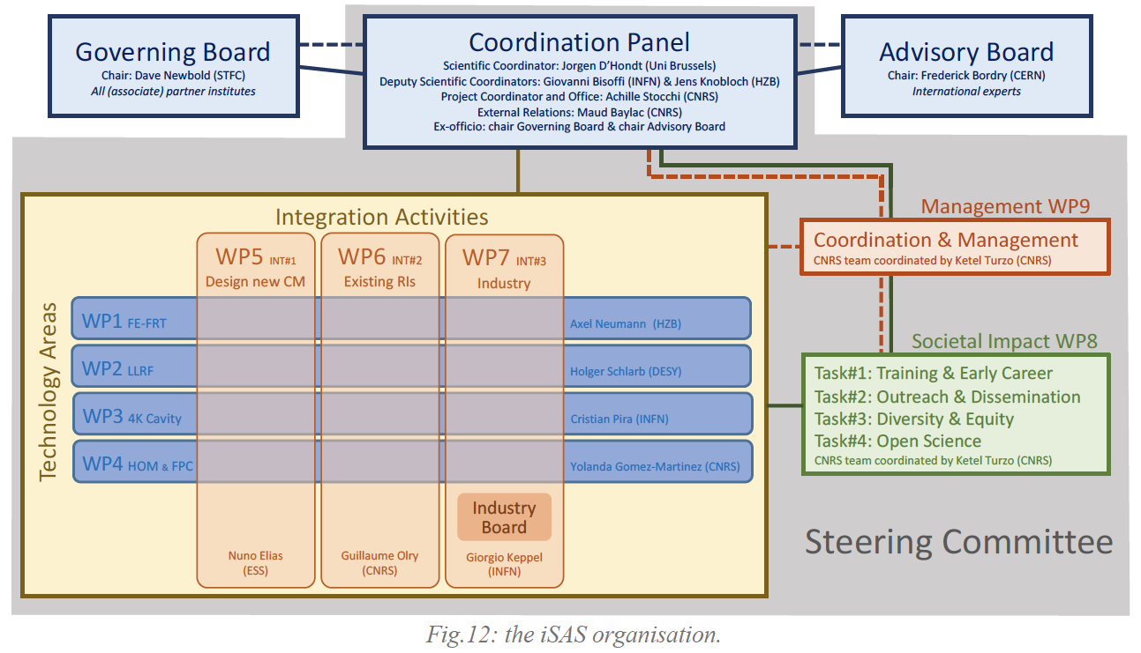
iSAS Organization

Slide 4
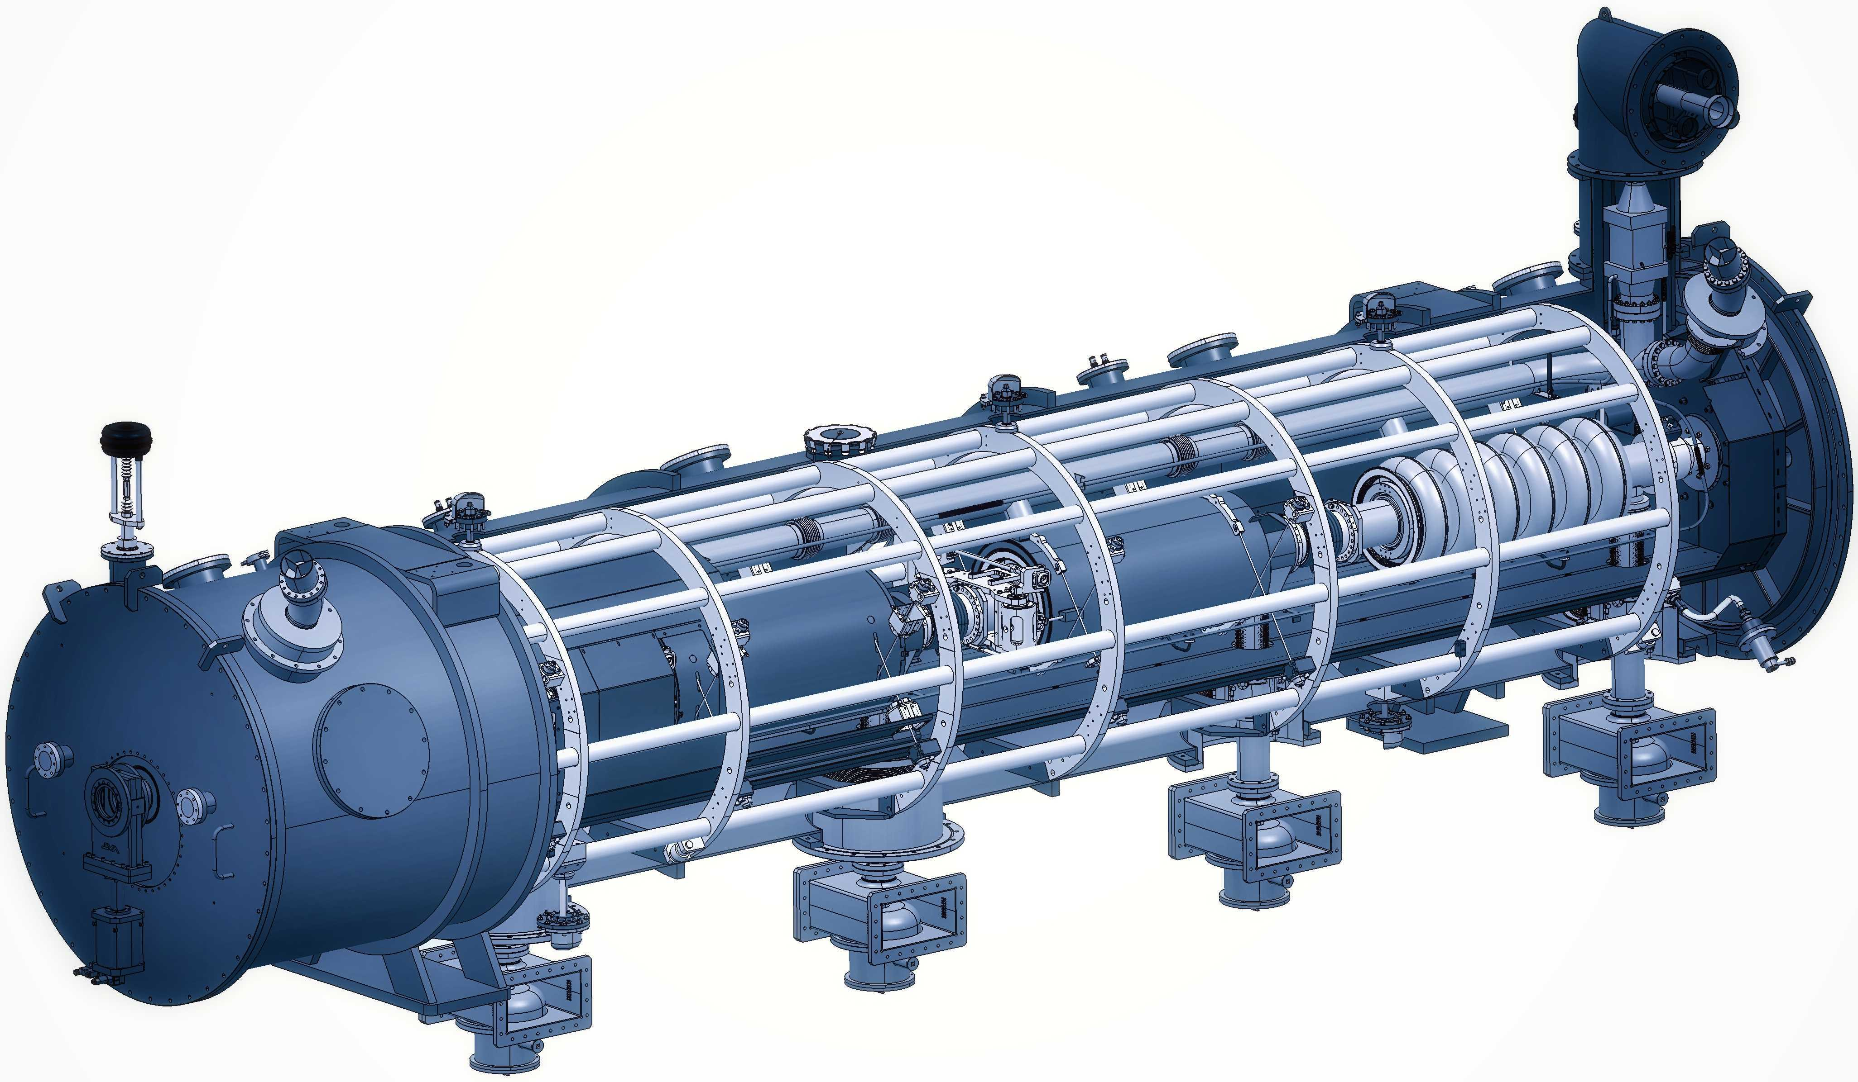
WP5: Integration into a new LINAC Cryomodule
ESS | CNRS | CERN | EPFL
Convener: Nuno Elias (ESS)
Main contacts with other partners: G. Olry (CNRS), V. Parma. CERN); M. Siedel (EPFL)
The design of any LINAC cryomodule is optimised to meet the specific research objectives of the accelerator facility, while addressing common challenges such as high-power electric fields, ultra-low temperatures, ultra-high vacuum, precise alignment, etc.
WP5's main goal is to tackle the common engineering challenges of integrating iSAS technologies into a parametric design of a new cryomodule, building on developments made with ESS cryomodules whilst benchmarking against other facilities.
In addition, to unlock the full energy-saving capability of this cryomodule, the objective of WP5 is to also address the challenging beam dynamics requirements when operating the new cryomodule in Energy Recovery Linacs with recirculating beams.

Slide 5
WP5: Integration into a new LINAC Cryomodule
ESS | CNRS | CERN | EPFL
Convener: Nuno Elias (ESS)
Main contacts with other partners: G. Olry (CNRS), V. Parma. CERN); M. Siedel (EPFL)
Task 5.1: Coordination on cryomodule design activities– M1-M48
• General coordination by ESS as described above.
Task 5.2: ESS cryomodules experience and benchmarking with other recent facilities– M1-M36
• Compile the lesson learned from the ESS CM testing activities, technical commissioning, and initial operation.
• Benchmarking with projects in the implementation phase (worldwide).
• Develop a roadmap to develop a new, sustainable CM design.
Task 5.3: Sustainable criteria for LINAC cryomodule design– M24-M48
• Integrate findings from the other iSAS WPs into a generic CM design.
• Explore the sustainability criteria for the design.
Task 5.4: Beam Dynamics for ERL-based accelerators with energy-efficient cryomodules – M1-M48
• Simulate the beam dynamics of ERL-based accelerators when the energy efficient CM is included.
• Study the lattice design to optimize the beam and energy saving performances.

Slide 6
WP5: Integration into a new LINAC Cryomodule
ESS | CNRS | CERN | EPFL
Work Plan

Slide 7
WP5 – Coordination: status/evolution of Task 5.1
Task 5.1: Coordination on cryomodule design activities– M1-M48
• General coordination by ESS as described above.
Milestone 5.1 : In-person WP kick-off meeting at ESS (Due date: M3 or Jun-2024)
Milestone 5.1 : Impact Risk analysis (Due date: M24 or Feb-2026
Deliverable 5.1 : Compilation of ESS CM lessons learned & benchmarks (Due date: M24 or Feb-2026)
Deliverable 5.2 : Roadmap for the CM design (Due date: M36 or Feb-2027)
Deliverable 5.3 : Parametric design for a sustainable CM with iSAS tech. (Due date: M46 or Dec-2027)
Deliverable 5.4 : Report on beam dynamics study for ERL with iSAS CM (Due date: M43 or Sep-2027)
M5.1
D5.1
D5.2
D5.3
Y0
Y1
Y2
Y3
D5.4
Y4
Task 5.1
Task 5.1
M
M
Task 5.2
Task 5.2
D
D
D
D
D
Task 5.3
Task 5.3
D
D
Task 5.4
Task 5.4
D
D
D
D
D
Mar
2024
Mar
2025
Mar
2026
Mar
2027
Feb
2028

Slide 8
WP5 – Experience/Benchmark CMs: status of Task 5.2
Task 5.2: ESS cryomodules experience and benchmarking with other recent facilities – M1-M36
• Compile lesson learned from the ESS CM testing activities, technical commissioning, initial operation.
• Benchmarking with projects in the implementation phase (worldwide).
• Develop a roadmap to develop a new, sustainable CM design.
Past developments
Discussions with relevant people: ESS CM lifecycle
Gathering of relevant high-level information
Preliminary table-of-contents for ESS CM lessons learned report
Current developments
Developing of on the ‘ESS CM lessons learned’ report structure
Alignment with CM ‘benchmarking template’
New member in place, report used as a good tool for training
• Compile lesson learned from the ESS CM testing activities, technical commissioning, initial operation.
Deliverable 5.1 : Compilation of ESS CM lessons learned & benchmarks (Due date: M24 or Feb-2026)
Deliverable 5.2 : Roadmap for the CM design (Due date: M36 or Feb-2027)

Slide 9
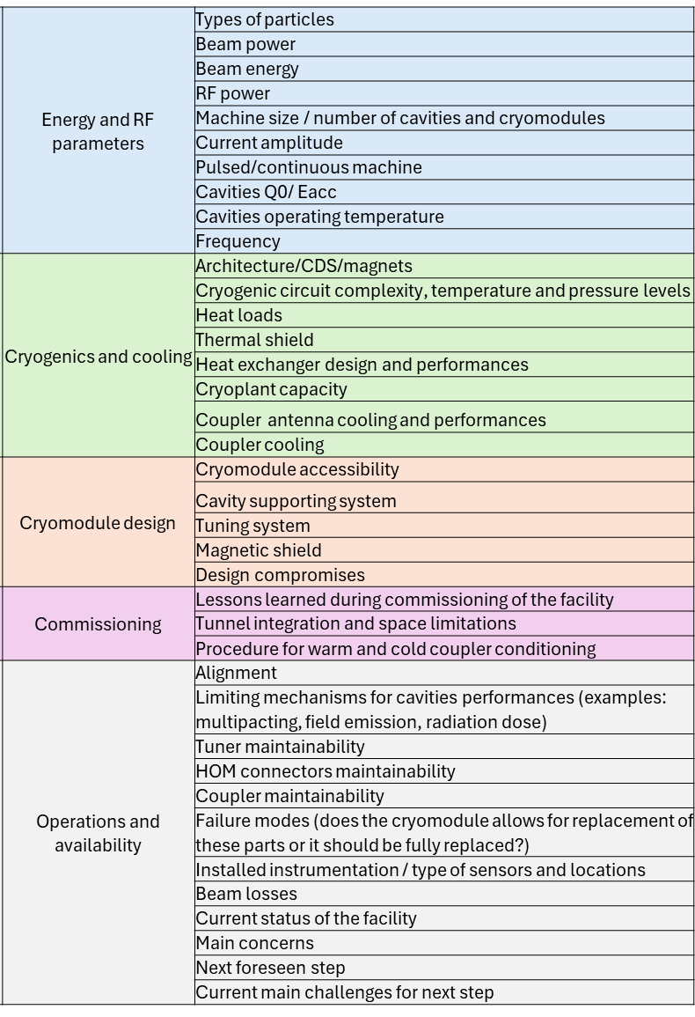
WP5 – Experience/Benchmark CMs: status of Task 5.2
Task 5.2: ESS cryomodules experience and benchmarking with other recent facilities – M1-M36
• Benchmarking with projects in the implementation phase (worldwide).
Past developments
Benchmarking parameters defined in the previous point (5.2.1)
Benchmarking facilities: SNS, LHC, PIP-II, XFEL, LCLSII
Definition of a questionnaire to receive a uniform response from the facilities
Identification of the contact people in the different facilities
Bibliographic search completed to propose a suggestion to every answer (reviewing can be easier than completing a blank questionnaire)
Draft of the Questionnaire (pre-filled for all labs LHC and ESS)

Slide 10
WP5 – Design new CM: status/evolution of Task 5.3
Task 5.3: Sustainable criteria for LINAC cryomodule design – M24-M48
• Integrate findings from the other iSAS WPs into a generic CM design.
• Explore the sustainability criteria for the design.
Deliverable 5.3 : Parametric design for a sustainable CM with iSAS tech. (Due date: M48 or Feb-2028)
“Integrating these iSAS technologies or instruments into a LINAC cryomodule is a delicate engineering challenge.
The design of a LINAC cryomodule is in general adapted to the specific research objectives of the accelerator facility but will always have to mitigate the challenges related to operation in the extreme environments of high-power electric fields, extremely low cryogenic temperatures and with the
ultimate mechanical precision.”

Slide 11
WP5 – Design new CM: status/evolution of Task 5.3
Task 5.3: Sustainable criteria for LINAC cryomodule design – M24-M48
• Integrate findings from the other iSAS WPs into a generic CM design.
• Explore the sustainability criteria for the design.
Deliverable 5.3 : Parametric design for a sustainable CM with iSAS tech. (Due date: M48 or Feb-2028)
“Synergies for the development of LINAC cryomodules appear across accelerators. The ambition of iSAS is to pave the way by developing common solutions for the engineering and industrial challenges to expedite the implementation of energy saving solutions.”

Slide 12
WP5 – Design new CM: status/evolution of Task 5.3
Task 5.3: Sustainable criteria for LINAC cryomodule design – M24-M48
• Integrate findings from the other iSAS WPs into a generic CM design.
• Explore the sustainability criteria for the design.
Deliverable 5.3 : Parametric design for a sustainable CM with iSAS tech. (Due date: M48 or Feb-2028)
“Leveraging the developments in the ESS cryomodules, a new parametric design of a LINAC cryomodule will be developed to address the engineering challenges of integrating each of the new technologies. In addition, the aim is to develop for the first time a fully integrated parametric design that incorporates the entire portfolio of iSAS energy-saving technologies to achieve the largest possible energy savings for new accelerating systems.”

Slide 13
WP5 – Design new CM: status/evolution of Task 5.3
Task 5.3: Sustainable criteria for LINAC cryomodule design – M24-M48
• Integrate findings from the other iSAS WPs into a generic CM design.
• Explore the sustainability criteria for the design.
Deliverable 5.3 : Parametric design for a sustainable CM with iSAS tech. (Due date: M48 or Feb-2028)
“To maximise the impact, the parametric design of the LINAC cryomodule will embrace concrete guidelines as a toolbox for engineers to expedite the integration of iSAS technologies in the widest variety of current and future accelerator-driven facilities and realize energy savings without delay.”

Slide 14
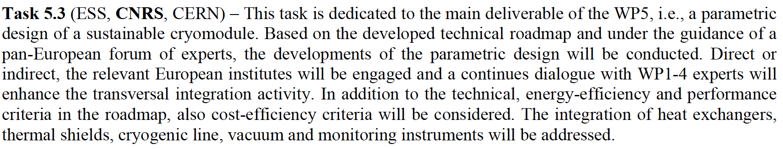
WP5 – Design new CM: status/evolution of Task 5.3
Task 5.3: Sustainable criteria for LINAC cryomodule design – M24-M48
• Integrate findings from the other iSAS WPs into a generic CM design.
• Explore the sustainability criteria for the design.
Deliverable 5.3 : Parametric design for a sustainable CM with iSAS tech. (Due date: M48 or Feb-2028)

Slide 15
WP5 – Design new CM: status/evolution of Task 5.3
Task 5.3: Sustainable criteria for LINAC cryomodule design – M24-M48
• Integrate findings from the other iSAS WPs into a generic CM design.
• Explore the sustainability criteria for the design.
Deliverable 5.3 : Parametric design for a sustainable CM with iSAS tech. (Due date: M48 or Feb-2028)
Parametric
Design
Sustainable
CM
iSAS

Slide 16
WP5 – Design new CM: status/evolution of Task 5.3
Task 5.3: Sustainable criteria for LINAC cryomodule design – M24-M48
• Integrate findings from the other iSAS WPs into a generic CM design.
• Explore the sustainability criteria for the design.
Deliverable 5.3 : Parametric design for a sustainable CM with iSAS tech. (Due date: M48 or Feb-2028)
Parametric
Design
Sustainable
CM
iSAS
: Which are relevant
: degree of complexity
: Systems Engineering
: Requirements + Constraints + Uncertainty
:Best Practices
: Availability/ Maintainability/ Repairability
: Industrialisation
: Lifecycle
: Main Functions/ Components
: Main Design Dilemmas
: Technologies
: Looking into the future
: Quantification of gains

Slide 17
WP5 – Design new CM: status/evolution of Task 5.3
Task 5.3: Sustainable criteria for LINAC cryomodule design – M24-M48
• Integrate findings from the other iSAS WPs into a generic CM design.
• Explore the sustainability criteria for the design.
Past developments
This task is set to start on M24 (Mar26)
Current developments
Attention to Sustainability criteria strategies applied to “Technology Areas”.
Attention to implementation of performance criteria of technology areas and its integration.
Breakdown of CM sub-systems (<- input from benchmarking)
Discussions on KPI associated with each sub-system.
Brainstorming of ideas initiated in Oct
Plan in-person meeting at IJCLAB in 28-Jan-2026, to prepare for a smooth start, meeting focus mostly on task 5.3.prepare with parametric design (create a team)
Deliverable 5.3 : Parametric design for a sustainable CM with iSAS tech. (Due date: M48 or Feb-2028)

Slide 18
Thank you

